Slide 1
Summary of PSD13 Conference, Oxford, 4-8 Sept 2023
Chris Damerell
RAL
11 October 2023
PSD = Position Sensitive Detectors. UK-based series with international participants, held every 3 years since 1987 (first was at UCL, triggered by the novelty of position-sensitive silicon detectors, after decades of photographic film in astronomy and particle physics – including bubble chambers and nuclear emulsions)
Please look through the slides in areas of interest to yourself: https://indico.cern.ch/event/1230837/
16 categories (each with an excellent keynote speaker):
• X-ray and Gamma Ray Detectors
• Applications in Life Sciences, Biology & Medicine
• Applications in Planetary & Space Science
• Applications in Security & Environmental Imaging
• Applications in Nuclear Physics
• Applications in Particle Physics
• Applications in Astrophysics & Astroparticle Physics
• Novel Photon Detection Systems
• Detectors for Synchrotrons, FELS & other Advanced Light Sources
• Detectors for Neutron Facilities
• Detectors for High Radiation & Extreme Environments
• Advances in Pixel Detectors & Integration Technologies
• Gas-based Detection Methods
• Position Sensitive Fast Timing Detectors
• Applications in Condensed Matter
• Quantum Detectors
Total ~125 talks and posters, so I can only cover some that caught my eye.
Introductory words, an apology, and an invitation

Slide 2
My selection (with humble apologies for many omissions):
Those 16 categories obscure advances which are common to most application areas, such as in the technology of silicon detectors, so I consider those first. In my opinion, the most significant advance here is in stacked CMOS image sensors, brilliantly led by SONY for optical imaging - reminiscent of the evolution of monolithic pixel devices, invented in the form of CCDs in 1970. (Physics Nobel Prize to Willard Boyle and George Smith, 2009)
Particle physics
Smart pixels
High speed pixels, notably LGADs
Some thoughts on risk management
LCLS-II at SLAC - brilliant startup on 18th September. A huge challenge for PSDs
The advance to Ultrafast MeV-scale electron microscopy, including an initiative in the UK, and the link to attosecond laser pulses (Physics Nobel Prize to Pierre Agostini, Ferenc Krausz and Anne L’Huillier, 2023)
VHE gamma ray astronomy
Dark Matter – could it (even now) be entirely due to Primordial Black Holes?
The DM distribution of the Milky Way Galaxy (or was it a joke?)

Slide 3
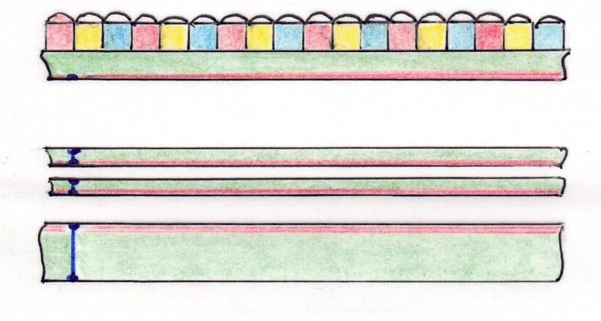
Stacked CMOS image sensors (layered chiplets of sensors, analog and digital signal processing, memory, ASICs, opto drivers, etc)
For optical image stacks, use back illumination, usually but not always prefer full depletion
Visible light and X-rays can be fully absorbed in the imaging layer, giving the stack maximum radiation hardness, while MIPs traverse the whole stack and can damage all layers
For the simplest stack, use just 2 wafers assembled face-to-face. That’s how SONY started 3 years ago …
Technology is now moving far beyond – additional layers from different design groups, even chiplets from from different foundries working to agreed standards. Excellent crosstalk suppression – see side panel
Intelligent in-module data processing for automotive and other real-time applications, such as signal extraction for X-ray diffraction imaging at high speed light sources such as LCLS II, or EMERGENCY BRAKE to vehicles.
Don’t usually need stitching, but may need 4-side buttable modules, for adequate area coverage. These are easily provided, given routine use of TSVs
Stacked CMOS image sensor
(exploded view)
N
3
2
1
Active CMOS
circuitry
Electically isolated TSVs
Active circuitry is on top of layer 1, and on underside of all subsequent layers
This circuitry may receive additional metal shielding, to ensure robust crosstalk suppression to the adjacent substrate after stacking (electrically clean by comparison with a complex monolithic chip)
Note the ancient art of ‘damascening’ to achieve perfect planarisation for every processing step of every layer, even with many metal layers
Once the complete module is assembled, it may be sufficiently robust mechanically for layer 1 to be further back-thinned, to minimise module thickness

Slide 4
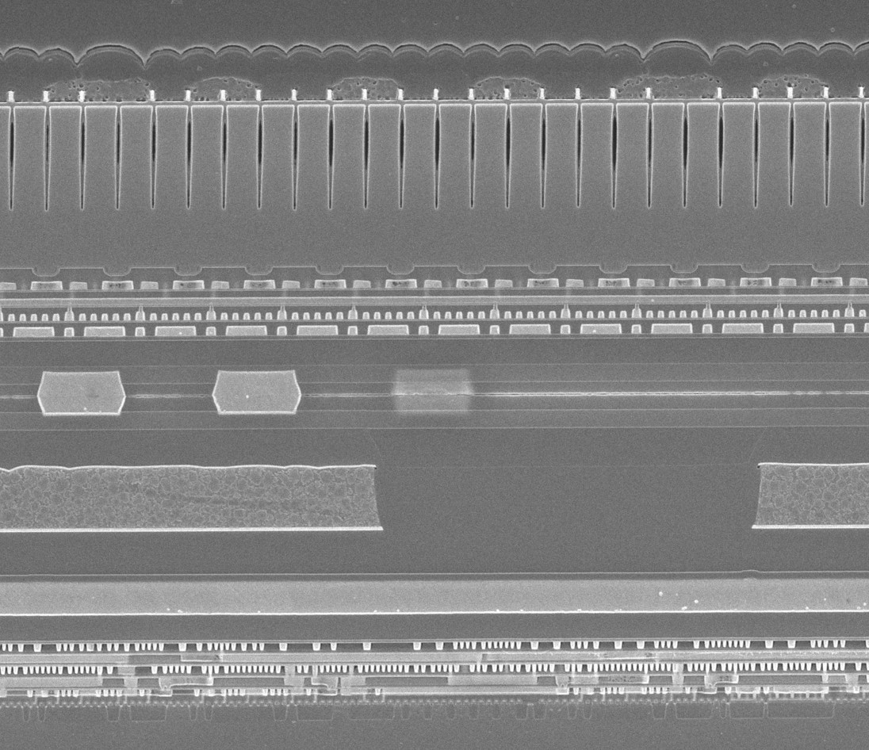
micro-lenses
colour filters
DTI
Imaging Tier – pixels + front-end transistors
channel stops
7.8 μm
Numerous metal layers
copper-copper bonds Note the wafer-to-wafer alignment! – 2 yrs
Wafer-to-wafer bond
Digital Signal Processing Tier
Note metal ground plane for inter-layer shielding (avoiding substrate currents which often induce crosstalk in monolithic devices)
Tech Insights image, via Albert Theuwissen
numerous metal layers
transistors
SEM view of a slice through the imaging region of a 2-tier SONY CMOS image sensor, or CIS, with single pixel layer (CERN Courier, 2021)

Slide 5
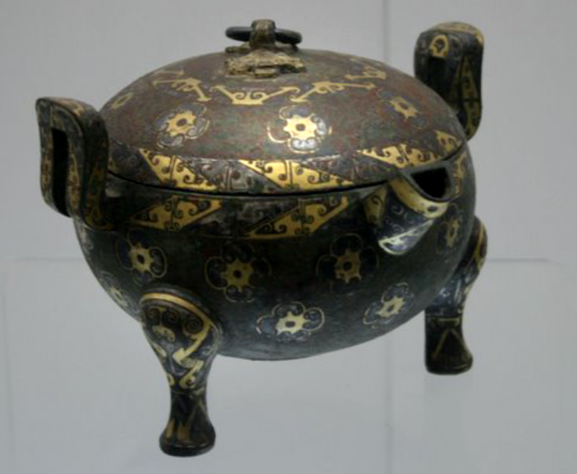
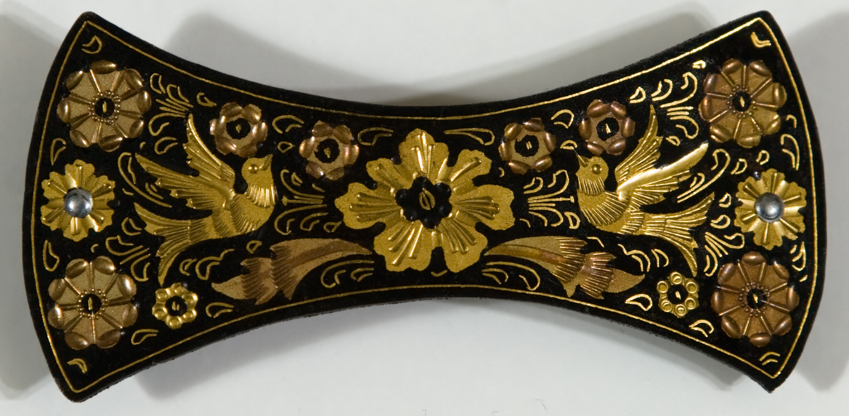
Damascening
China, Warring States Period, circa 300 BC
Bronze vessel with gold and silver inlay
Toledo, Spain, 18th C
Gold inlaid in oxidized steel

Slide 6
Impressive developments over past 2 years:
Taku Umebayashi of SONY has received the Japan Prime Minister’s Award for his pioneering of stacked image sensors. He started in 2008 and 15 years later runs a group developing next-generation memory technology for these devices
In 2022, SONY announced the first stacked CIS with 2-layer imaging tier, comprising sense diodes and front-end transistors, which doubles saturation signal level, widens dynamic range and reduces noise (next slide)
There are currently 19 camera models in the world using these frontier systems, marketed by SONY, Canon and OM System. They have the fastest frame rate and highest sensitivity for visible light. They are used for many frontier applications, such as night vision systems for defence purposes
90% of SONY camera output now uses stacked sensors
Mike Campbell reported 4-side buttable Timepix4 chips, enabled by TSVs from Fraunhofer Institute instead of wire bonds.
Walter Snoeys, who is developing stitched devices for ALICE with great success, knows of a company offering a foundry service for multi-chip systems which combine stitched and stacked devices for image sensors. This will open many doors, including for particle tracking.
No news at PSD13 from Grzegorz Deptuch (BNL), or Takaki Hatsui (RIKEN, who is working with SONY), in terms of stacked devices for X-ray systems, but they are advancing. There’s potentially a very large market here, most urgently (I think) for LCLS II.
Quote: SONY’s work ethic

Slide 7
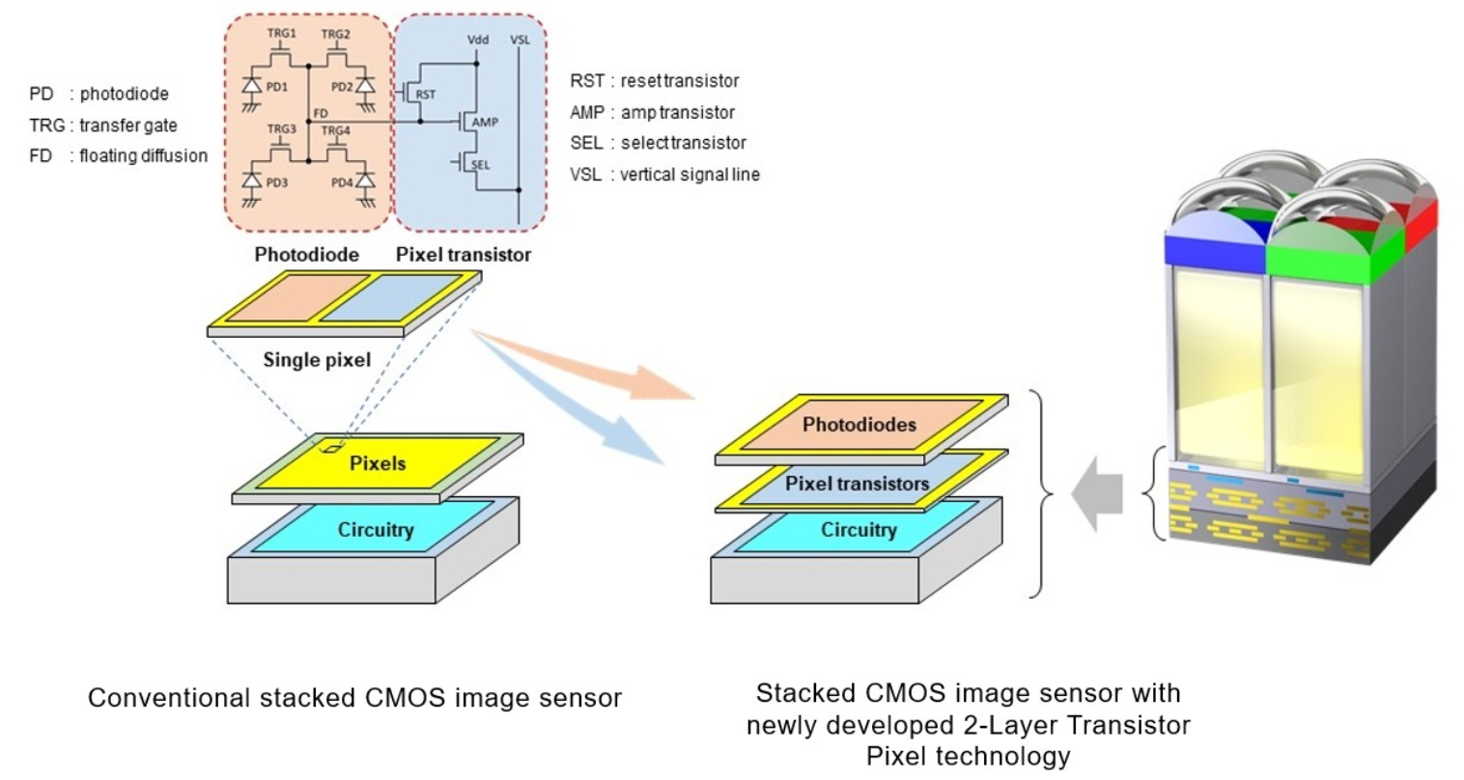
Even here, presence of in-pixel circuitry reduces photodetection efficiency below that of a CCD – which is still the winner for astronomical and other applications where optical quality is paramount, and readout speed isn’t an issue
Deep Trench Isolation

Slide 8
SYNOPSYS Panel discussion: Accelerating Mainstream Adoption of Multi-Die Systems
https://www.synopsys.com/multi-die-system/accelerating-mainstream-adoption-of-multi-die-systems.html
AKA stacked CMOS modules
Experts in discussion from Synopsys (chair), ANSYS, Bosch, Intel, Samsung
Example application areas: mobile devices, automotive, defence
Functional systems: high performance computers, massive memory modules, intelligent imaging systems
Scale of activity: 3 times more in 2023 than last year, SYNOPSYS currently tracking 100 multi-die projects world-wide
Key challenge for the industry:
Need to drive standards
Happening within foundries (eg Samsung: 3d tools, 3d codes, validating processes and procedures
Co-operating foundries starting to define wider standards, eg UCIe:
Universal Chiplet Interconnect Express is an open specification for a die-to-die interconnect and serial bus between chiplets. It is co-developed by AMD, Arm, ASE Group, Google Cloud, Intel, Meta, Microsoft, Qualcomm, Samsung, and TSMC.
In China, they have recently agreed standards between many companies within their automotive eco-system
General enthusiasm for moving from a chip-centric to a system-centric view - it’s just beginning.

Slide 9
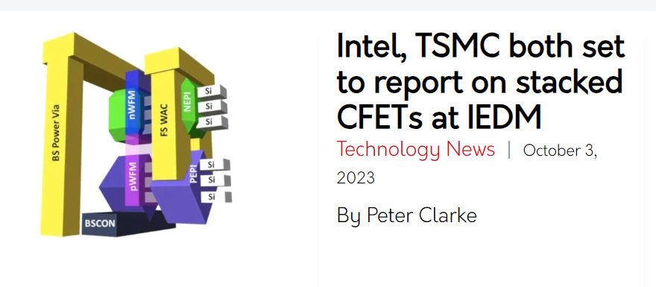
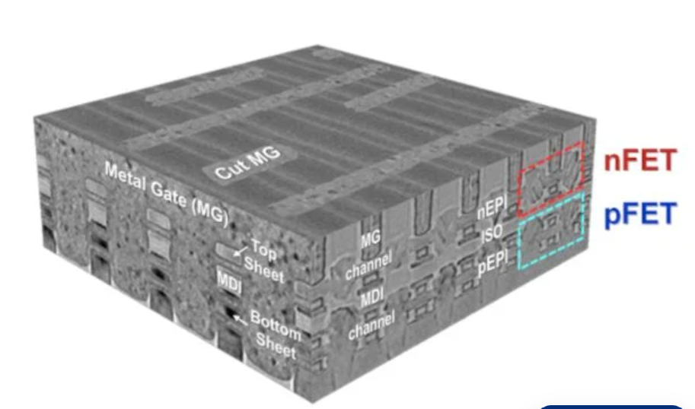
9-13 Dec, 2023
Complementary field-effect transistor (CFET) is a future transistor type with a high potential to be used beyond 3-nm technology nodes
On-state current and subthreshold leakage:
on/off current ratio = 10⁶
Middle Dielectric Isolation (MD)

Slide 10
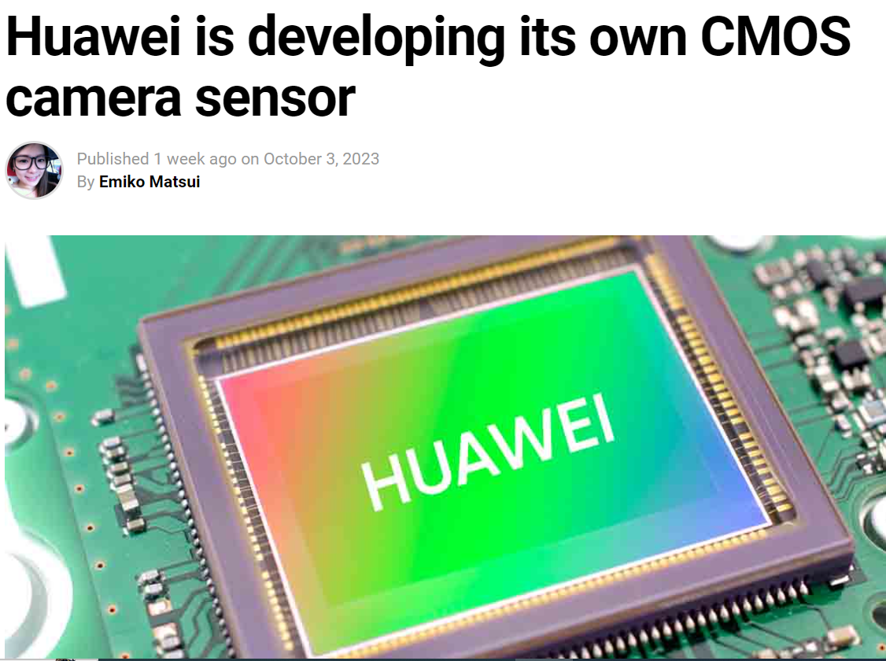
Huawei and Sony:
Sony and Huawei have been working together on camera sensor technology for a long time. After US sanctions, Sony received permission to supply image sensors to Huawei. However, the Chinese techmaker is now working more on itself rather than relying on Sony for its mobile camera requirements.
According to the report, the sensor will be one inch across, and could feature 36:1 pixel binning. That could mean unimaginably good low light performance, with 36 pixels doing the job that would previously have been done by one.

Slide 11
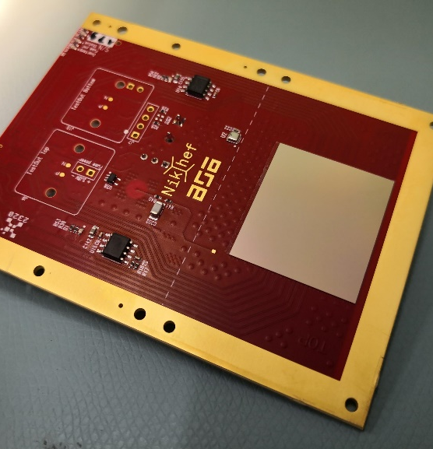
TSV-processed successfully mounted
Michael Campbell
Chip behaves identically to a wire bonded version. But the TSV version is 4-side buttable

Slide 12
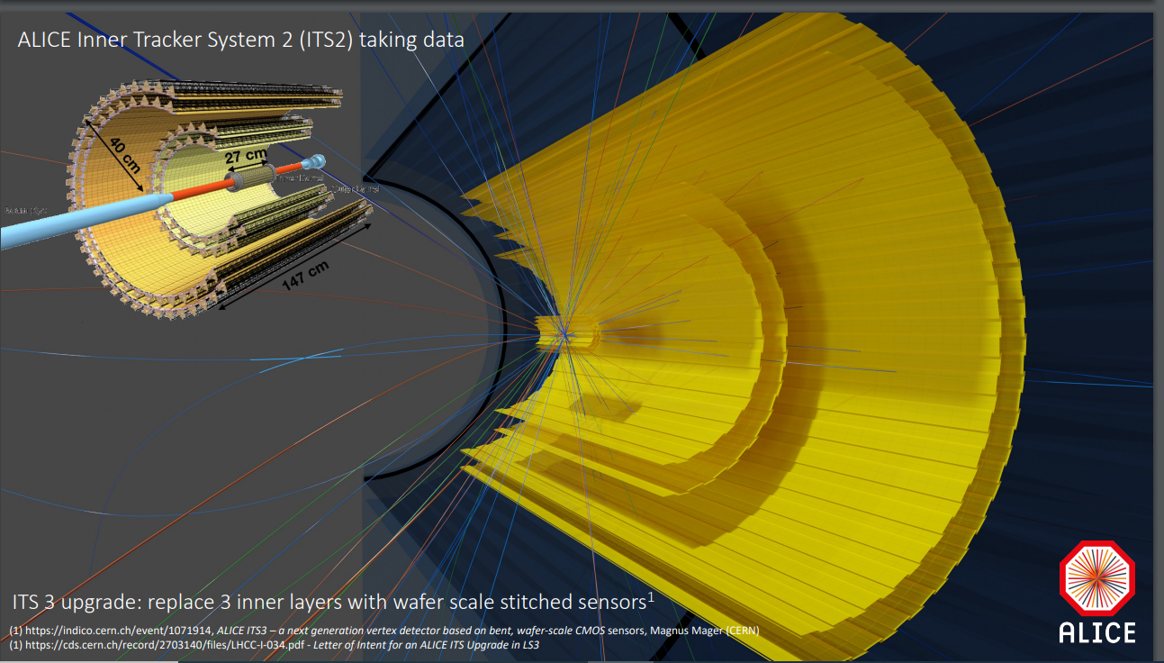
12.5 Gpixels
≈30×30 µm pixels, ALPIDE MAPS sensors
Outer barrel 1.48 m long
Total 10 m² silicon
Walter Snoeys

Slide 13
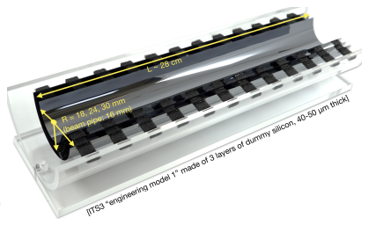
ITS3. Curved wafer scale stitched CMOS sensors, huge pioneering effort of ALICE Collaboration.
Sensors use TPSCo 65 nm process, Collaboration led by CERN Microelectronics (Walter Snoeys)
12” (300 mm) diameter wafers suffice for these half-cylinders. 65 nm is sufficient: far below state-of-art in wafer processing, which is pushing 2 nm effective feature size, measured by transistor density

Slide 14
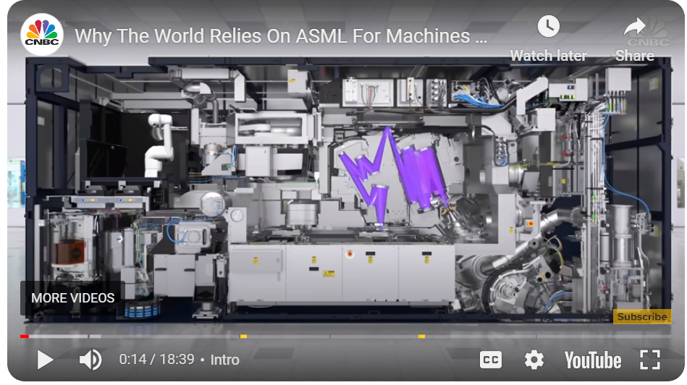
Excellent YouTube - EUV wafer processing machine from ASML in Netherlands (outgrowth from Philips)
λ = 13.5 nm, beyond DUV, λ = 193 nm
EUV needed for effective feature size below 14 nm, down to 2 nm (measured by density transistors)
30 component machines gathered together from ASML subsidiary companies world-wide
Assembled and commissioned in Netherlands, then disassembled and shipped to the customer
20 trucks, 3 Boeing 747 transport planes, at cost of $200M
ASML expect to complete delivery of 30 units during 2023
Export to China is currently blocked. So …
https://www.youtube.com/watch?v=iSVHp6CAyQ8
Size of a large truck

Slide 15
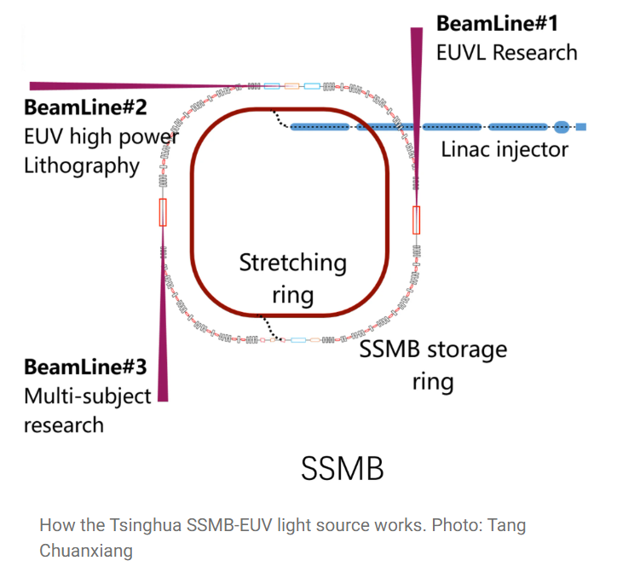
Article in South China Morning Post
https://www.scmp.com/news/china/science/article/3235419/china-plans-build-giant-chip-factory-driven-particle-accelerator
Prof Tang Chuanxiang
Of Tsinghua U
‘Many lithography machines’
SSMB – Steady State Microbunching storage ring, proposed by Prof Zhao Wu and then-student Daniel Ratner, SLAC 2010. Circumference ~100 m. Each undulator will produce SR light down to the EUV range, just short of X-rays
‘Compared with current ASML EUV technology, SSMB will be a more ideal light source. It will have a higher average power and higher chip production output with lower unit cost.’
100 W to 1 kW on wafer, compared to 5 W ASML

Slide 16
Petra Merkel’s Keynote talk – Particle Physics
Links to a presentation of Jennet Dickinson at Fermilab.
Assumes 28 nm CMOS, and a stacked architecture could possibly enable even more challenging applications than HL-LHC, notably FCC-hh

Slide 17
For HL-LHC, ATLAS (High Granularity Timing Detector - below) introduce large pairs of LGAD disks between the barrel tracker and ECAL, for pileup suppression by point measurements on all seen tracks, with 1.5 mm square pixels, 30-50 ps timing precision
Carbon enrichment enhances the rad hardness
SEB – Single Event Burnout is a nasty problem – avoided by restricting the operating voltage
3 Chinese companies will provide the full system of LGADs. Start full production next year
Readout with 130 nm CMOS ASICs from TSMC, bump-bonded

Slide 18
‘Everyone makes mistakes’ – Risk Analysis and Risk Management Procedures
‘Incidents’ are generally resolved, but are sometimes accompanied by a reluctance to talk about them in public, so important lessons may not be shared. Some projects are simply abandoned, as happened with UA1 after the ‘room temperature calorimetry’ disaster
A few examples:
The first attempt to get min-I signals from silicon pixel detectors (CCDs) in the t6 beam at the CERN PS, 1979
The failure of LHC splice joints during commissioning
The failure of the first production CCDs for LSST (eventually 3.2 Gpixels of highest quality)
The ‘vacuum incident’ with the LHCb RF box (this conference)
Lessons learned:
Rigorous procedures that were followed for 20 years at CERN, RAL and SLAC, with no further incidents of that type
Rigorous procedures under the guidance of an enlightened Director
Switch to a balanced investigative procedure for both design and production
Not discussed at PSD13 – just ‘replace the box’, but presumably robust procedures in future. Is there a report on this?

Slide 19
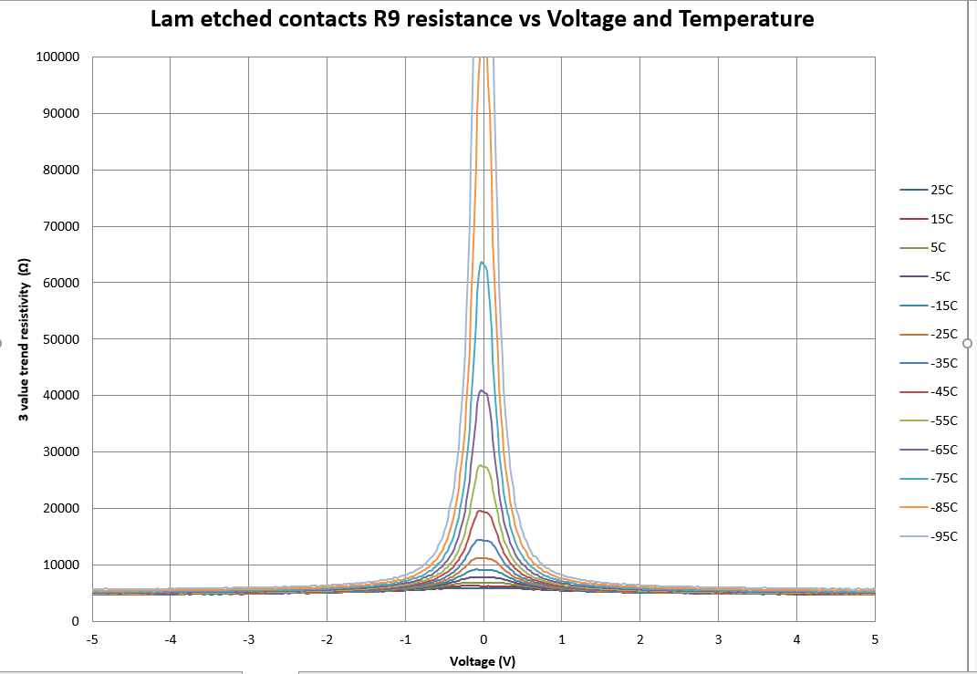
LSST CCD prototyping went smoothly from ~2010, but in 2014 production was held back for a year due to a DOE funding freeze. Then in 2015, e2V were unable to produce working devices.
Weekly crisis meetings focused on possible ‘design improvements’. Why only that?
Al
SiO₂
Si

Slide 20
U of Science and Technology, Cracow

Slide 21
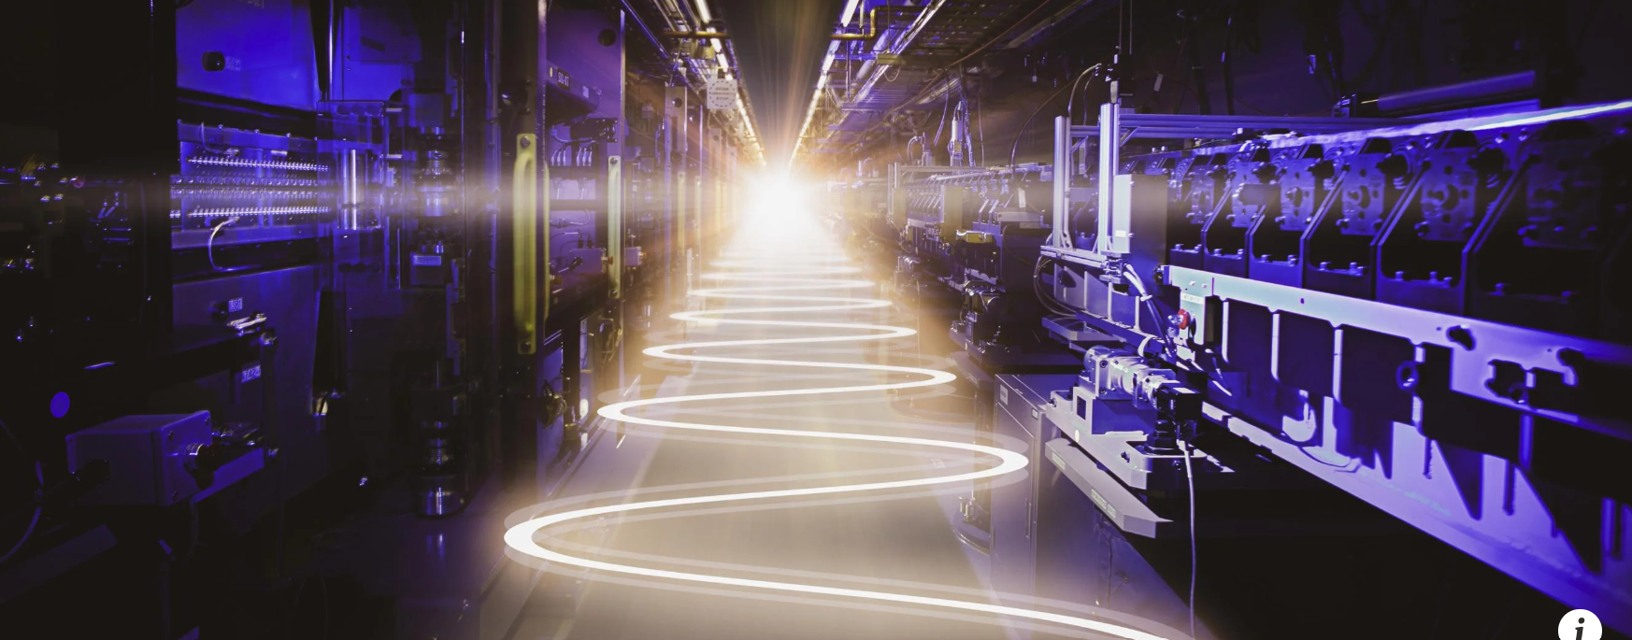
Celebrating the startup of LCLS-II, 18th Sept 2023. Collaboration between SLAC, Fermilab, Jlab, …
https://www6.slac.stanford.edu/news/2023-09-18-slac-fires-worlds-most-powerful-x-ray-laser-lcls-ii-ushers-new-era-science
LCLS operates with an X-ray bunch frequency of 120 Hz. Comparable to the EUXFEL average, but far below the needs of science
LCLS-II operates continuously at 1 MHz. Wonderful for science, but a huge challenge for the detectors

Slide 22
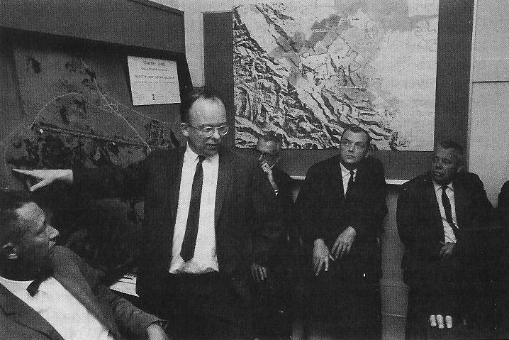
Pief Panofsky, Stanford U 1962, convincing the trustees to go for the 2-mile monster. Expected lifetime? …

Slide 23
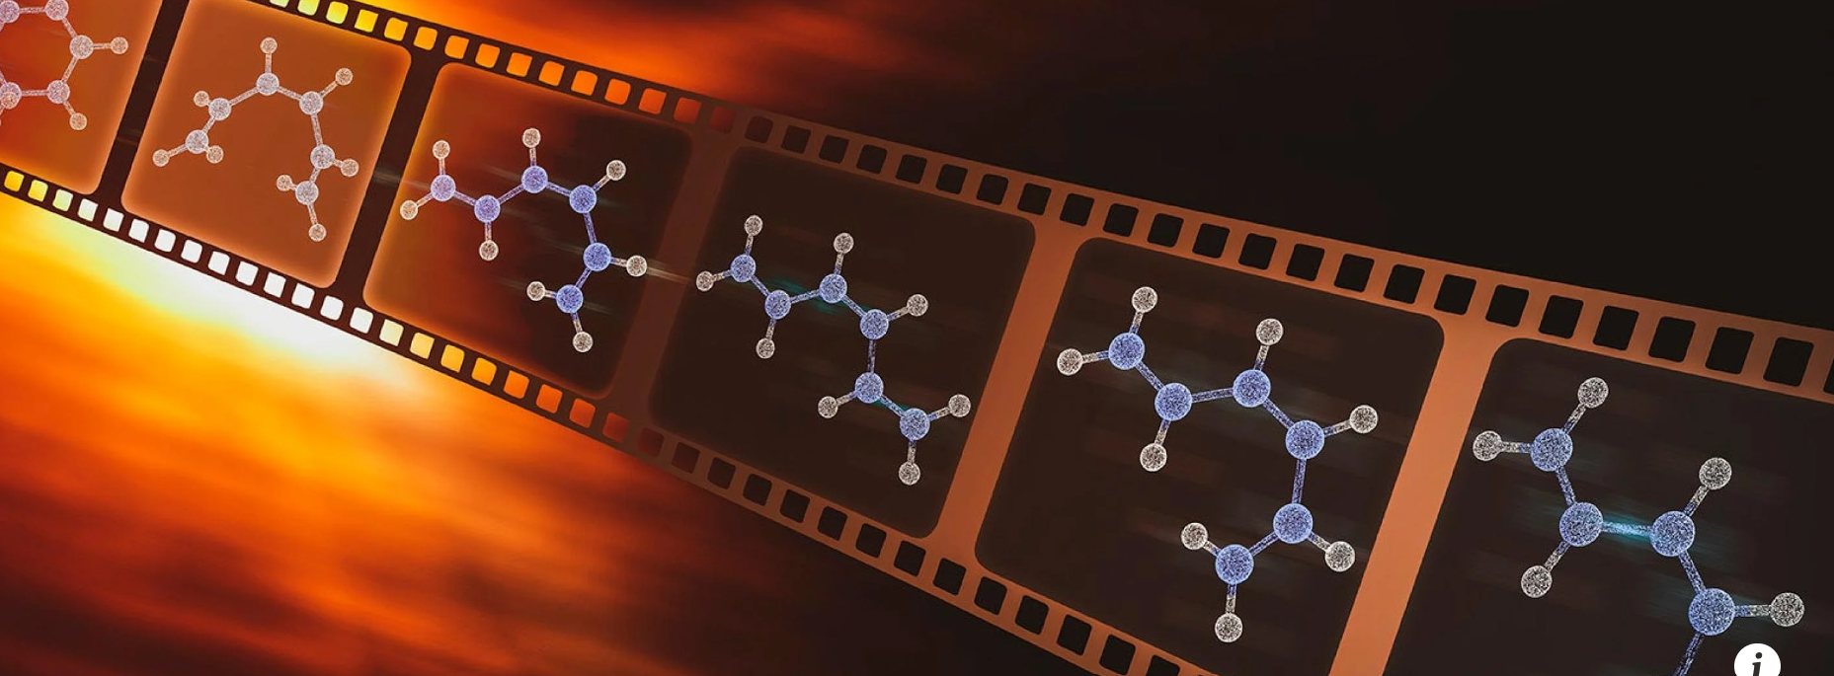
Beautiful simulations of ‘molecular movies’, which will enable breakthroughs in vast areas of science including photosynthesis and retinal functions, by observing molecules responding to optical stimulation, femtosecond by femtosecond, pumped with short flashes of light (this year’s Nobel Prize for physics) and probed by short bursts of X-rays from LCLS-II
Huge challenge for experiments and detectors, aiming eventually for studies with single molecules (spi – single particle imaging). ‘Diffraction before destruction’

Slide 24
Angelo Dragone

Slide 25
Looks like a natural area for stacked modules – with layers of ASICs for triggering and data sparsification
Large area detectors – 4-side buttable a must
Timescale? Expect surprises from SONY and their collaborators? Any news from next month’s CPAD conference?
Coordinating Panel for Advanced Detectors (CPAD) Workshop November 2023, SLAC National Accelerator Laboratory
https://indico.slac.stanford.edu/e/cpad2023
[Very good talk last year from Ron Lipton]

Slide 26
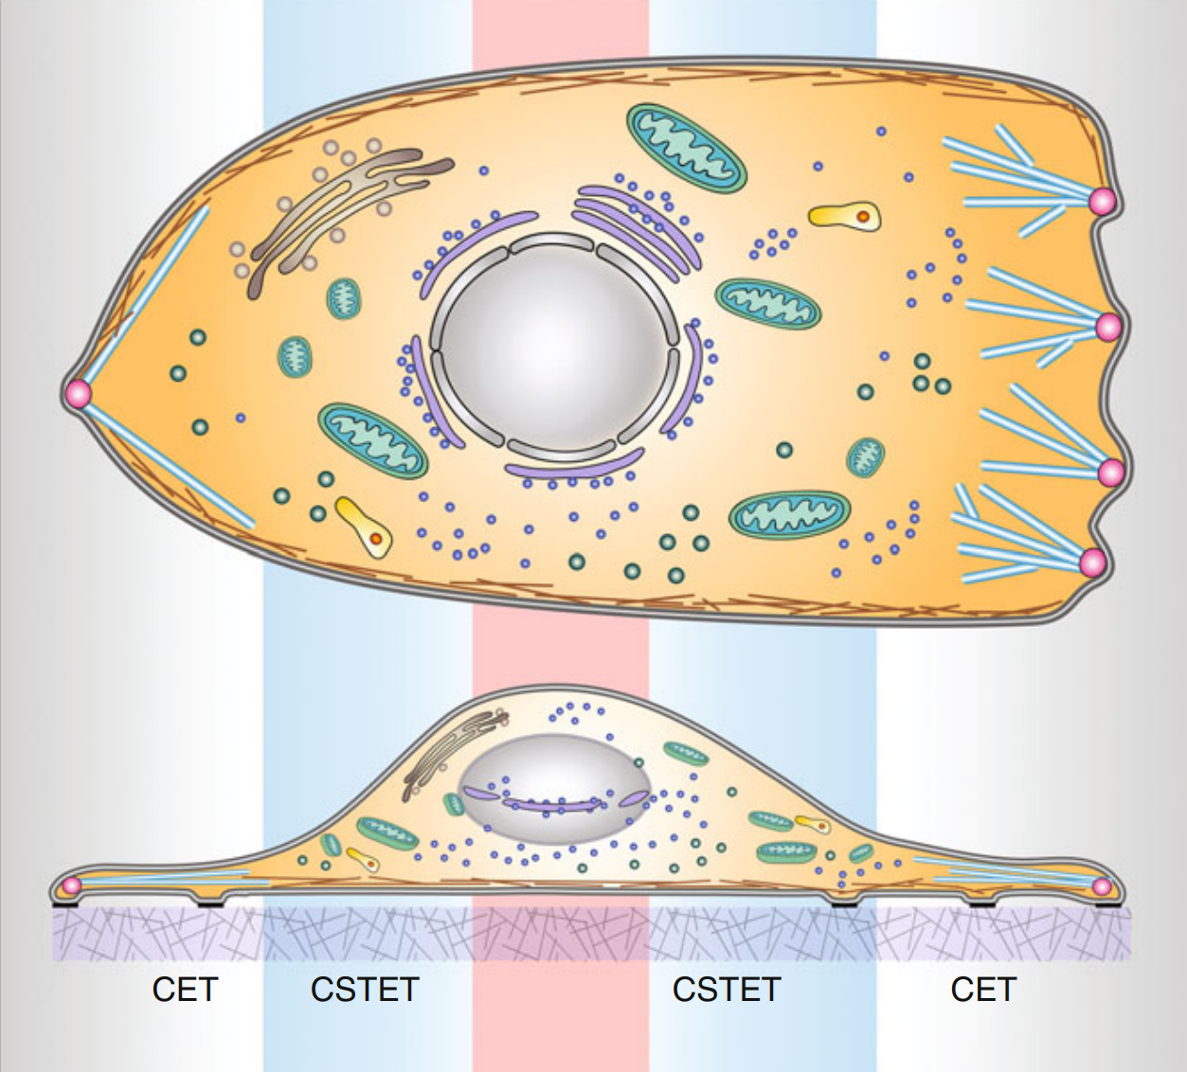
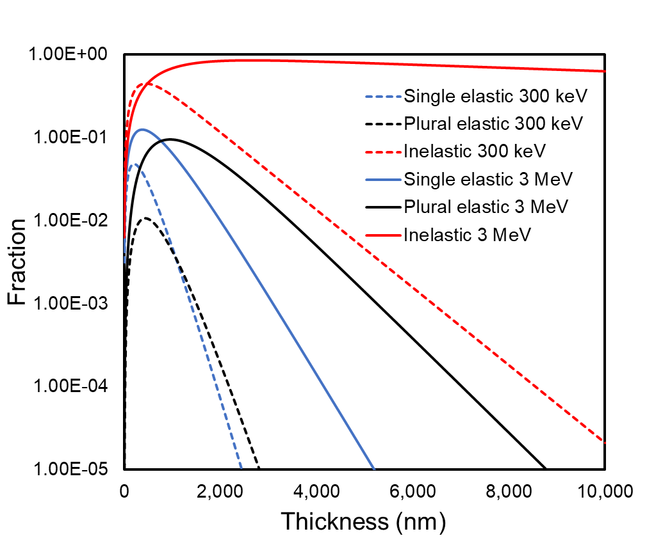
Promise of MeV Microscopy
Xi Yang BNL UEM Team
C-cubed wkshop, Cornell U
Benefit of increasing electron energy to MeV
Life science application: 3D image intact thick bio-samples
No need of cryo-FIB (focused ion beam) slicing thick cells
Limit to 10-20 lamellae/day, “blindly” select target
Speed up discovery
I
Why MeV? Phase contrast (TEM) & amplitude contrast (STEM)
300 keV
Single-elastic drop <1% after 1-µm ice layer
Inelastic drop <1% after 4-µm
3 MeV
Single-elastic drop <1% after 2-µm ice layer
Inelastic stays 63% after 10-μm
3 MeV STEM/UEM
Signal for 3 MeV-STEM
300 keV-STEM
Signal for 3 MeV-UEM
300 keV-UEM
Nucleus
Diameter ~ 50 μm
Thickness ~ 10 μm
cryo-electron tomograph
cryo-scanning transmission e- tomograph
300 keV
Top and side views of a eukaryotic cell.
STEM Scanning Transmission Electron Microscopy
S.G. Wolf, et al., Cellular Imaging, Springer

Slide 27
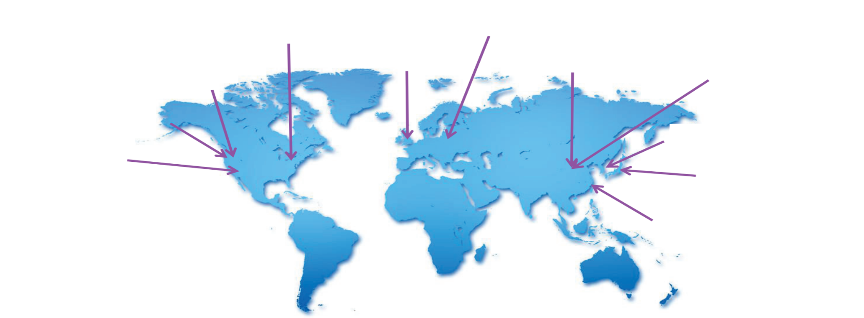
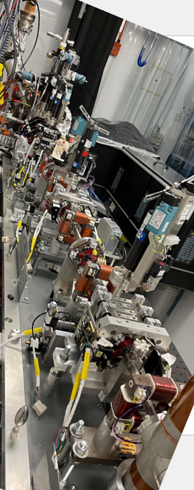
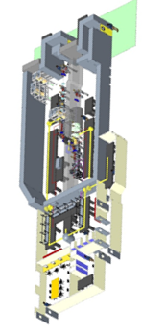
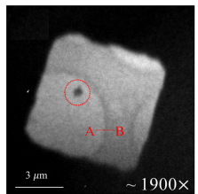
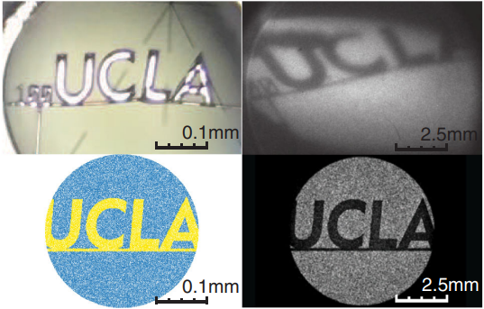
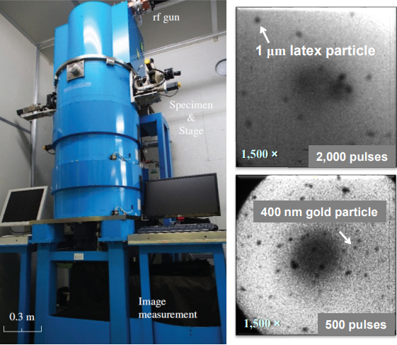
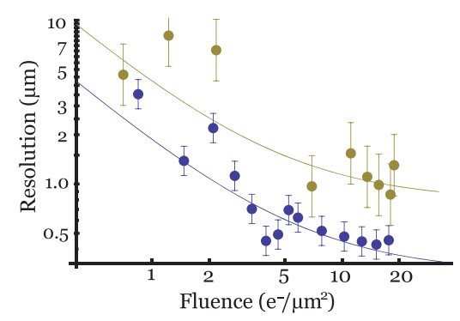
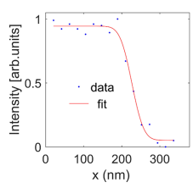
State of art MeV UEM/UED: world-wide efforts
A UK Facility for Relativistic Ultrafast Electron Diffraction & Imaging (RUEDI)
DESY
‘Beam’ could be 1 cell of a C-cubed structure
BNL
Diamond
PKU
THU
LBNL
RUEDI
SLAC
KAERI
BNL
UCLA
OSAKA
RUEDI
SJTU
SJTU
Nano-particle
UCLA
OSAKA
Beam
Single shot
Spatial resolution ~50 nm
$$E=3MeV, \frac{∆E}{E}=5∙{10}^{−4}$$
proposed UK National User Facility
halfway through design stage
Temporal resolution 180 fs
Wait for beam testing
PRL 118, 154802 (2017)
Microscopy 67, 291 (2018)
Appl. Phys. Lett. 112, 113102 (2018)

Slide 28
Jon Lapington, Leicester U
Light, gamma rays and neutrinos point back to the source. Charged particle cosmic rays are curved by magnetic fields
Very High Energy gamma rays must have interesting origins
Need large effective area, so not possible from space. Natural detector, the earth’s atmosphere

Slide 29
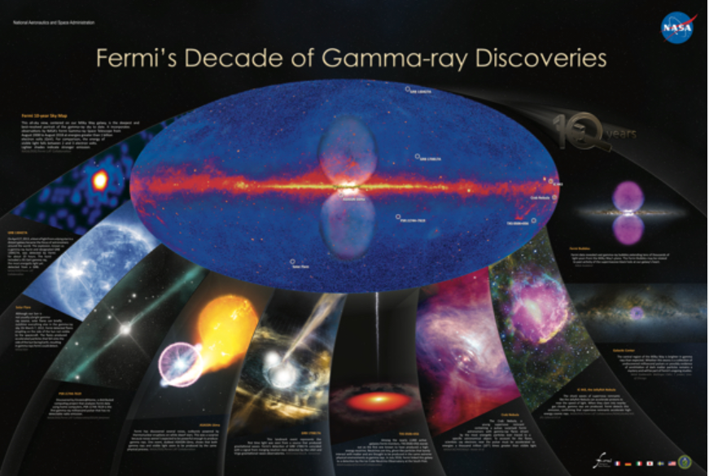
Formerly GLAST, renamed Fermi Gamma Ray Space Telescope
Operating since 2008
γ-ray energies 8 keV to 300 GeV, above which statistics is minimal and energy measurement is partial
Fermi bubbles and many major discoveries related to neutron stars, black holes and other scenes of violent jets
Broadly international, but not UK

Slide 30
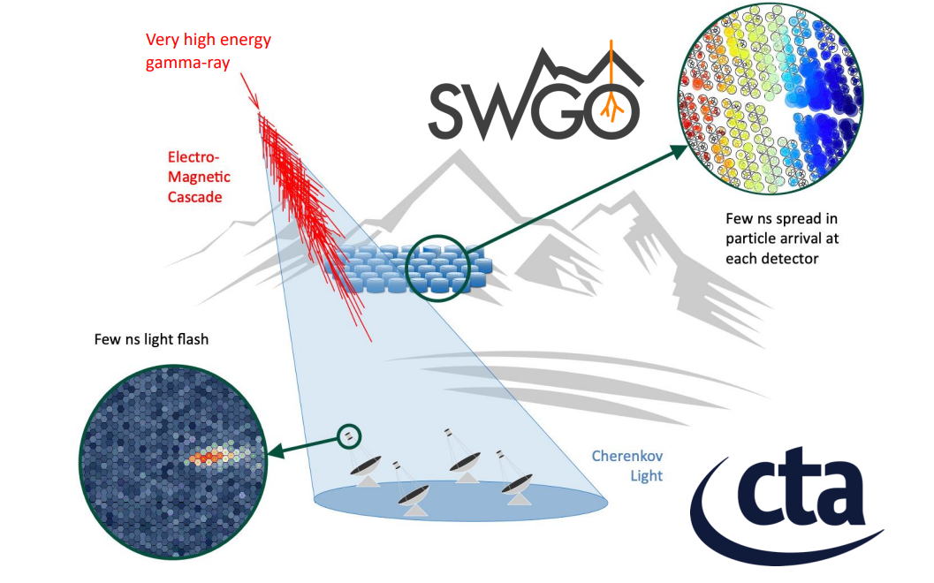
2 big ones on the way, the Southern Wide-Field Gamma Ray Observatory, and the Cerenkov Telescope Array Observatory (North and South)
Key features are:
high altitude. Shower max is at ~10 km altitude
large area coverage, to accumulate good event samples up to PeV range
Both will deliver a factor more than 10 increase in high energy events over the total from existing telescopes
SWGO must be at an altitude (>4.4 km) at which the shower electrons penetrate the walls of the water tanks, then generate Cerenkov light.
Operable 24 hrs/day, as with Auger.
CTAO can be lower, and observes the Cerenkov light generated in the atmosphere, so it can operate only at night, like optical telescopes.
CTAO (S) at Paranal, Chile
CTAO (N) at La Palma, Canary Isles
SWGO in S America, site to be selected soon
STFC not yet convinced about UK participation

Slide 31
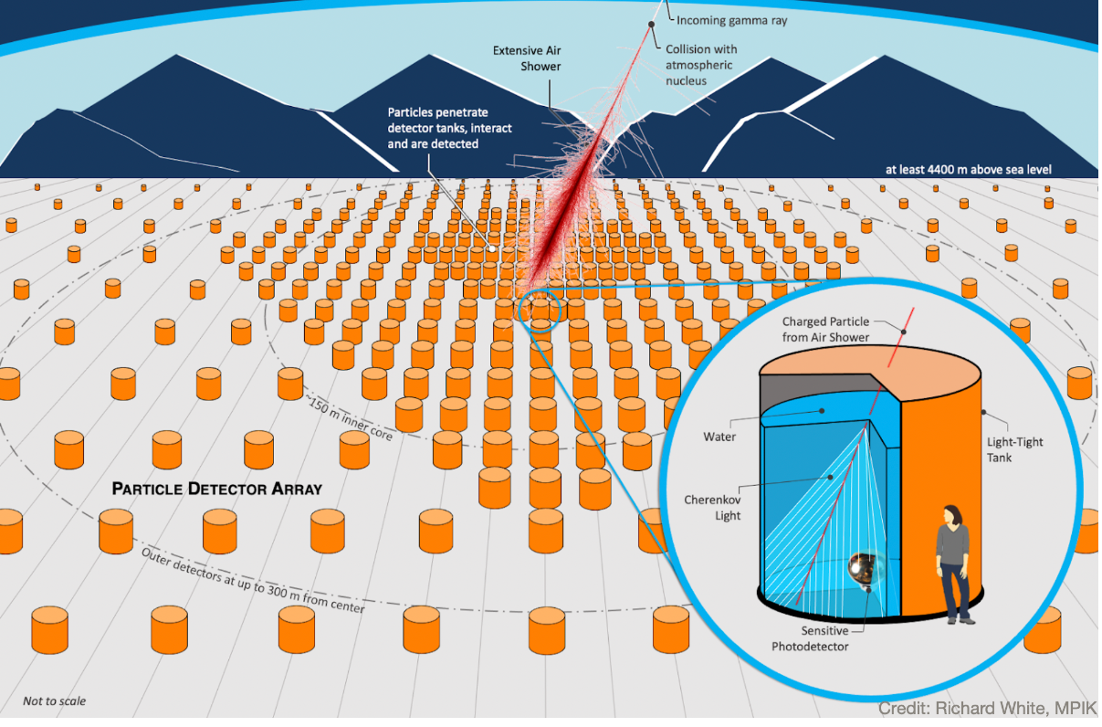
SWGO layout of water tanks

Slide 32
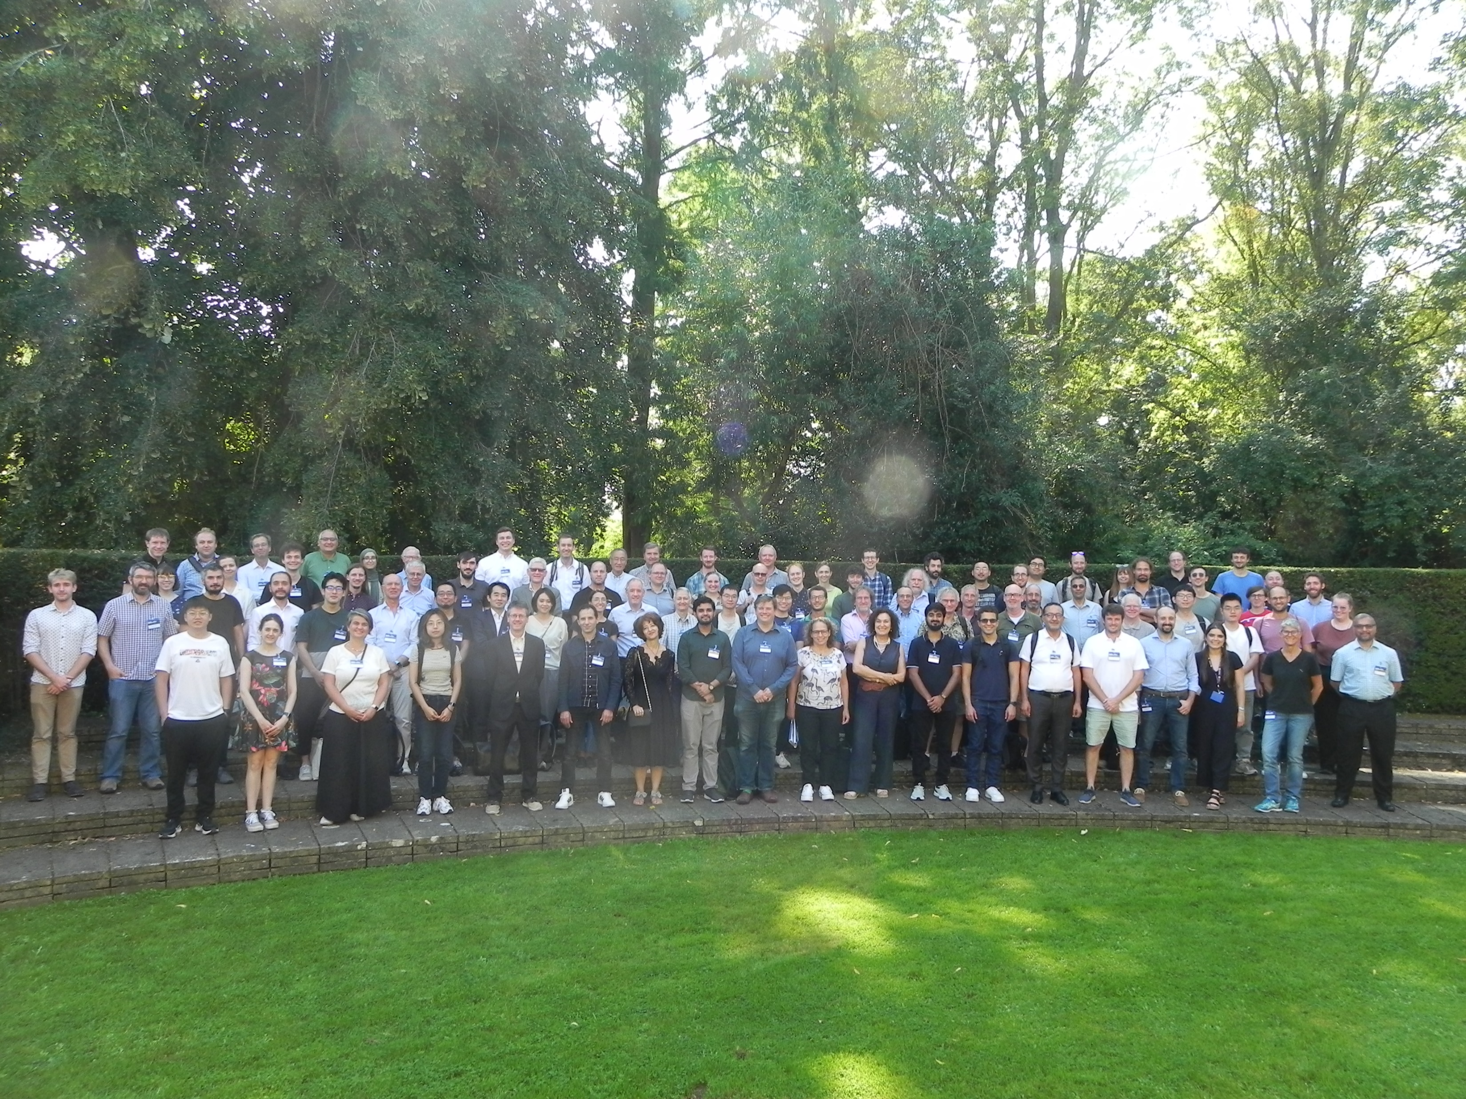
Apologies for all the wonderful work I omitted.

Slide 34
M(sun) = 2.0 x 10^33 g
M(earth) = 5.9 x10^27 g
M(Everest) = 1.6x10^17 g
Ed Copeland (Nottingham U)

Slide 35
Largest 3D space catalogue ever, and highest angular precision
Lagrange Point L2. By parallax, determine distance and proper motion of every object
Amazing CCDs from Te2V
10^9 MW stars (mostly). Each observed 70 times over 5 years
Wide band – near UV to near IR
Nominally 2014-2019, but exceeding design lifetime – extended to 2025
Wyn Evans, Cambridge

Slide 36
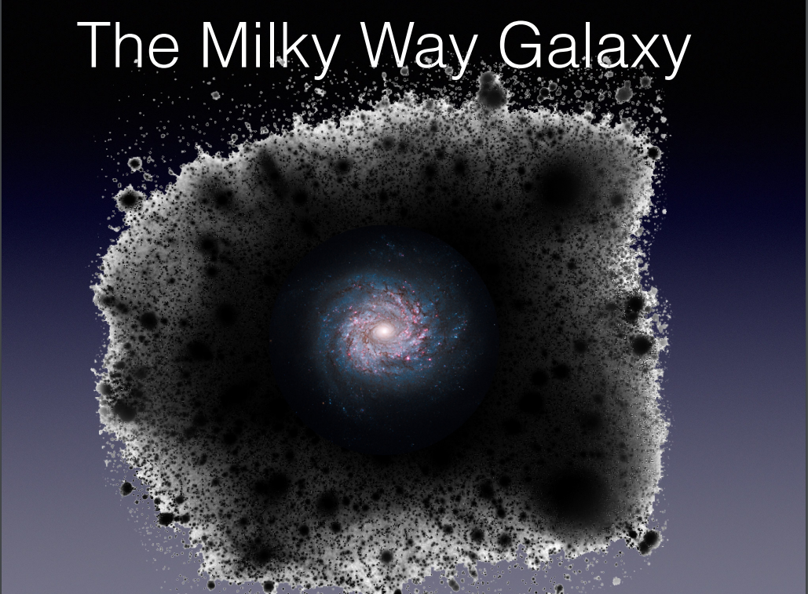
Has this anything to do with GAIA? No reply from Evans
Dark matter hurricanes, cyclones and downbursts
Wyn Evans, Cambridge

Slide 37
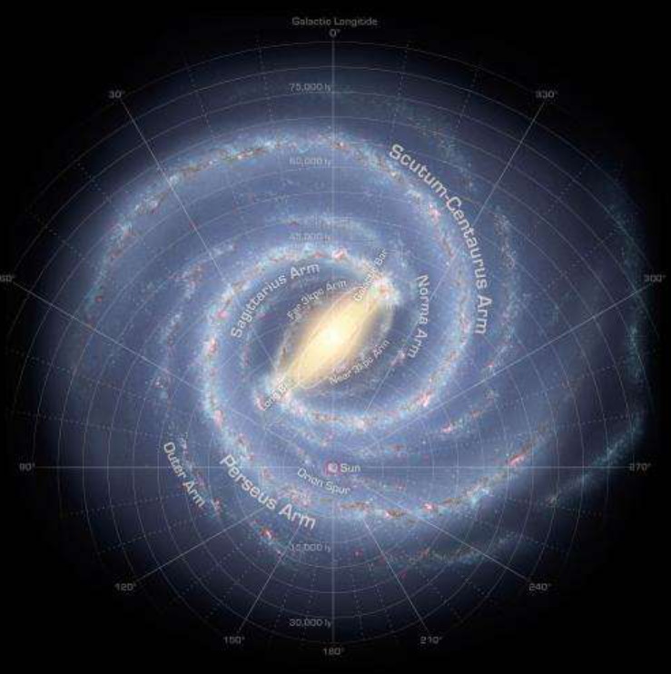
Rotation period of Milky Way Galaxy is 225 million years.
Last time our Solar System was in this location,
dinosaurs were starting to arise

Slide 38
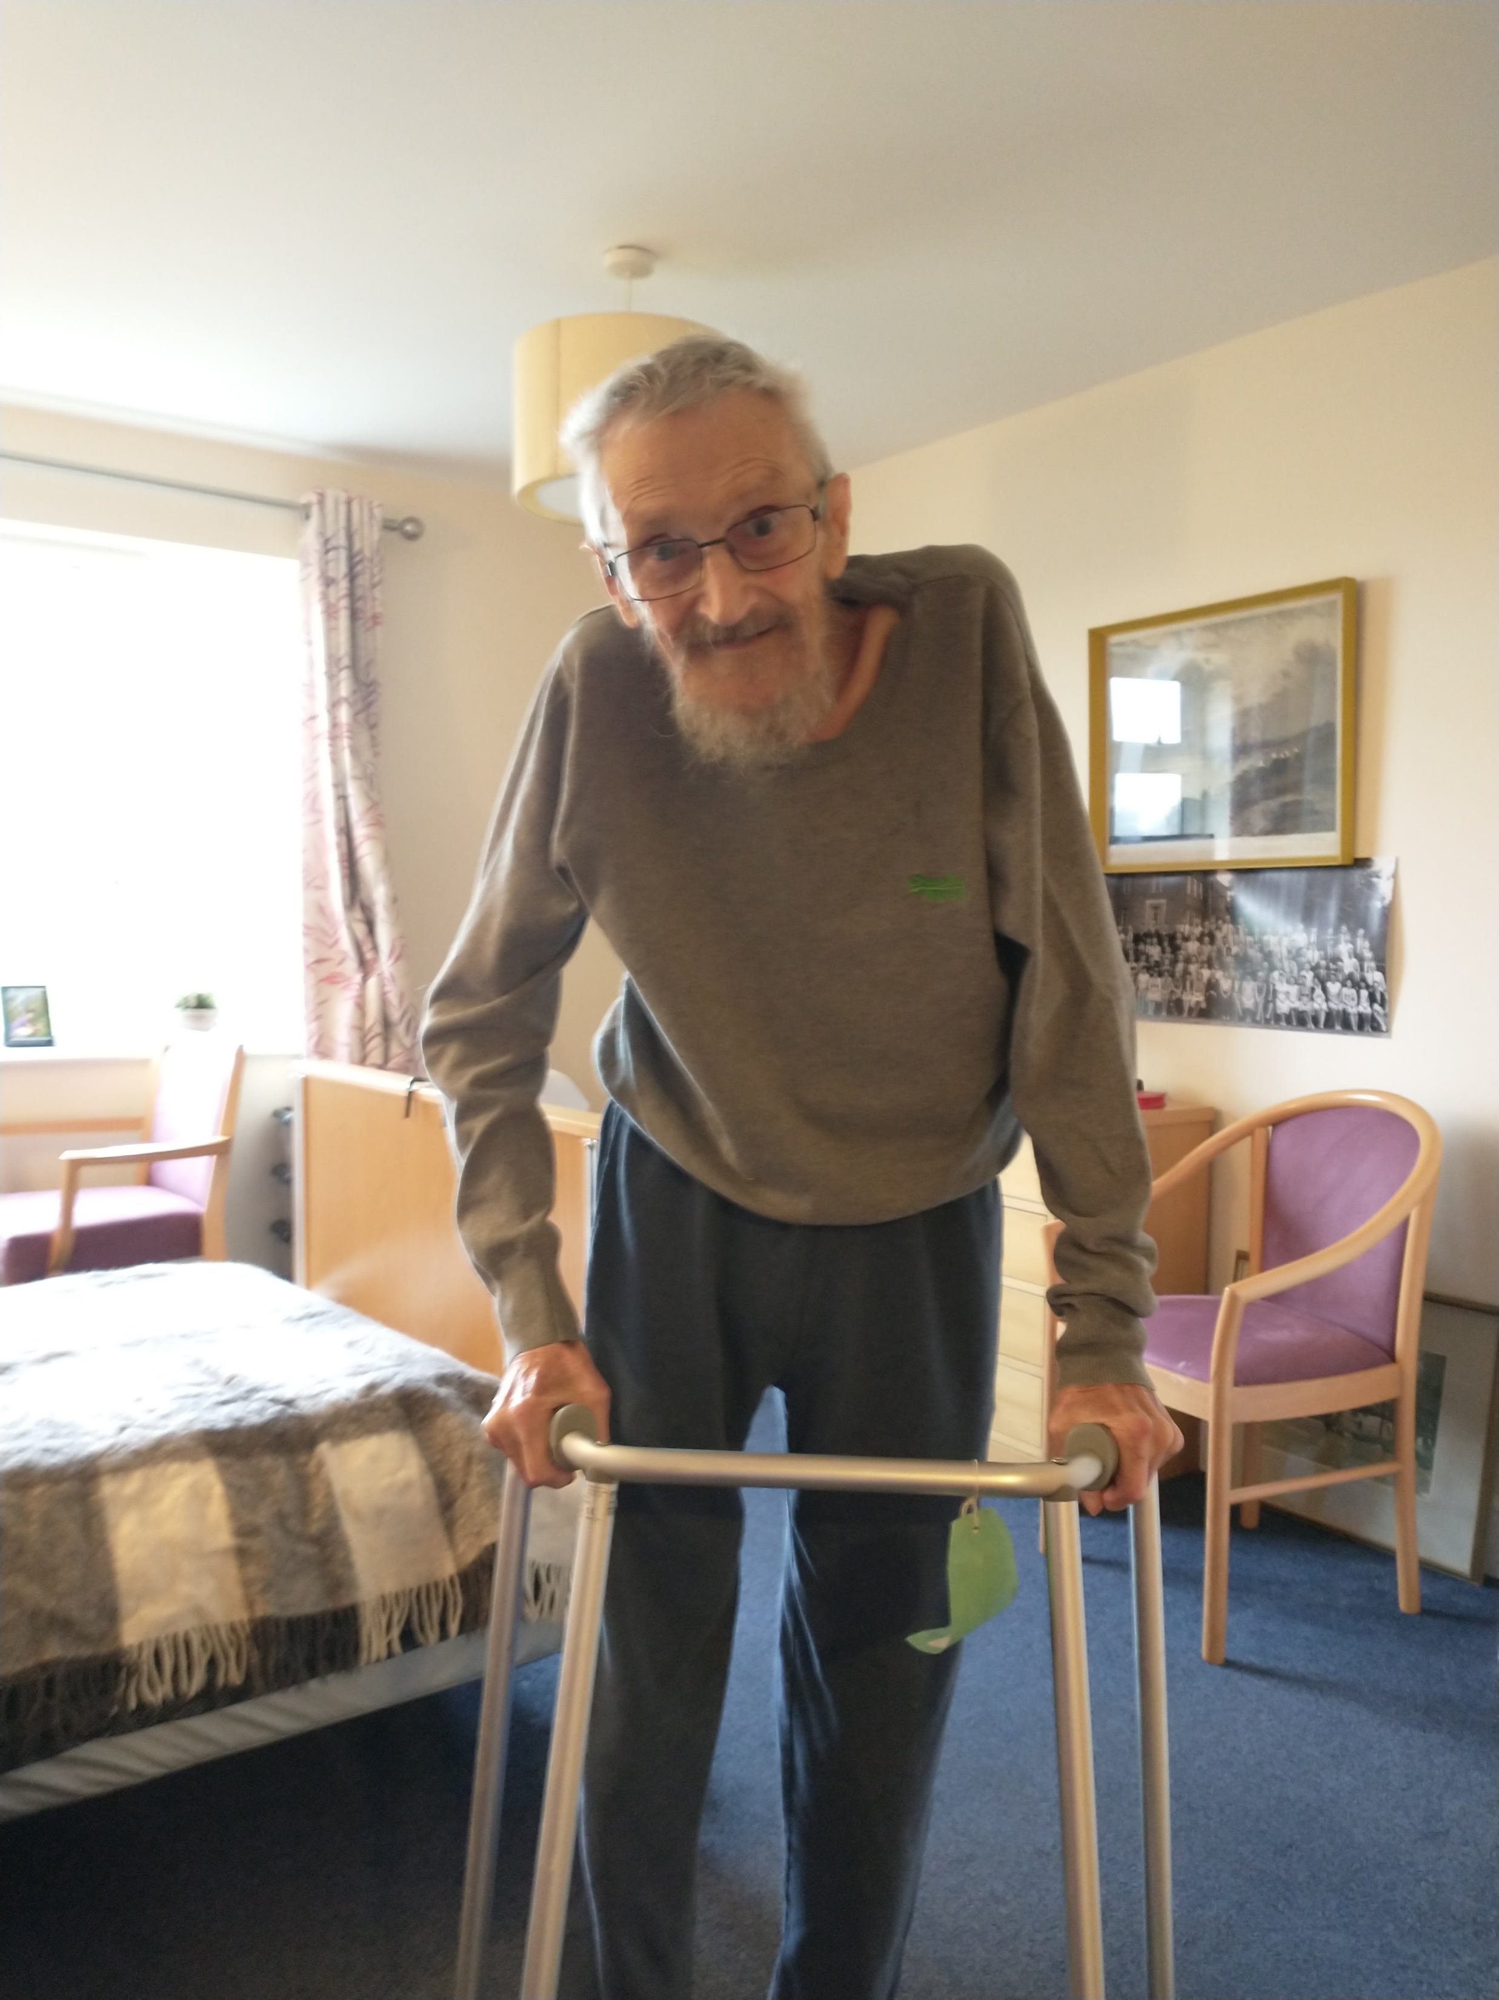
Subir’s punchline from his 3-day Fest:
‘It’s wonderful to have a job where every day, you can get out of bed hoping to prove that everything that went before is completely wrong’
Equally wonderful I think, that a variant of this can be shared by everybody – from an 11 month-old baby determined to start walking today, to an equally determined 92-year old patient in a care home

