Slide 1
Student mental health
Prof Graeme Burt
Engineering Dept

Slide 2
What percentage of mental health problems are established by the age of 25?
20%
45%
75%
80%

Slide 3
What percentage of mental health problems are established by the age of 25?
20%
45%
75% of mental health problems are established by the age of 25 (EPI, 2018)
80%

Slide 4
What percentage of students experience clinical levels of stress?
2.9%
9.2%
29%
58%

Slide 5
What percentage of students experience clinical levels of stress?
2.9%
9.2%
29%
58%

Slide 6
Facts about mental health
29% of university students experience clinical levels of stress, its very common.
Only 3.5% will disclose this to the University but 75% will disclose to a friend.
The university will take any information provided about your health as confidential and will not disclose to anyone (even internally) without your permission unless we believe there is a risk of serious harm to yourself or others
No information about you or your attendance at any sessions will go on your University student record.
The University can try to put measures in place to help support students experiencing mental health challenges if we know about it

Slide 7
Why students don’t disclose
There are many reasons students don’t disclose mental health challenges
https://www.studentminds.org.uk/uploads/3/7/8/4/3784584/grand_challenges_report_for_public.pdf

Slide 8
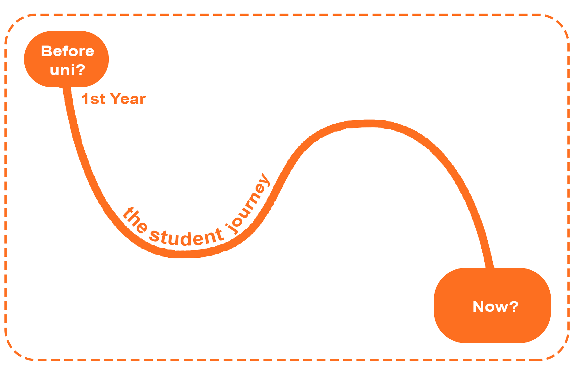
What challenges do PhD students face at Cockcroft?
8

Slide 9
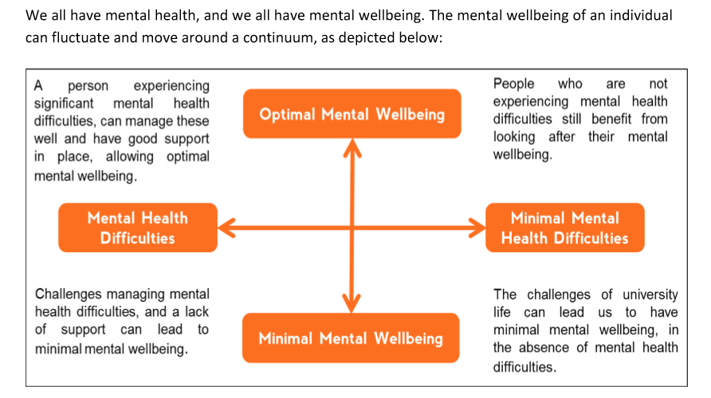
The Mental Health Continuum
Video here
https://www.youtube.com/watch?v=_FZ7ikpzBwc&feature=youtu.be
9

Slide 10
Thinking happy
You had a really bad day, you get home and are exhausted, and feel sad and anxious about your workload.
You had agreed to go to the cinema with your friends, it’s a real struggle to get yourself there.
Once there, you start chatting to your friends who are cheerful, and without realising it your low mood starts to slip away.
You didn’t think yourself happy, but instead you changed your behaviours to give yourself the opportunity to feel better.
Actions and behaviours have a big impact on our mental health.
10
Notes:
We know from the challenges you have mentioned that university can be difficult at times. When these times arise, it would be ideal for us to have a positive attitude all of the time. However, ‘thinking ourselves happy’ is far harder than it sounds - if you have ever tried to ‘think’ yourself happy you will know how frustrating it can be. You all have strategies in place that help you look after your mental wellbeing, and often what we do has a big impact on how we feel.
[Refer to the slide]
For example: Have you ever had a really bad day, you get home and you are exhausted, you are feeling sad and anxious about your workload. But you had agreed to go to the cinema with your friends and it is a real struggle to get yourself there… but once you are there you start chatting to your friends who are cheerful and without realising it, your low mood starts to slip away.
You didn’t think yourself happy, but changed your behaviours to give yourself the opportunity to feel better.
10

Slide 11

Possible stressors
Appraisals and thesis
Project deadlines
Self-learning, self-motivating
Impostor syndrome
Relationship problems
Family problems
Living away from home
Isolation and Loneliness
Financial Issues
Drink or Drugs problems
Students have a life outside of the University and these can add additional stress.

Slide 12
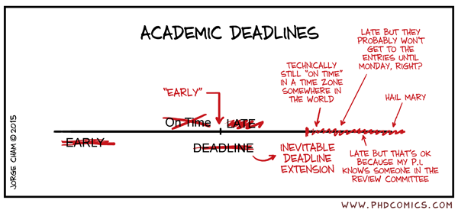
Possible stressors
Appraisals and thesis
Project deadlines
Self-learning, self-motivating
Impostor syndrome
Relationship problems
Family problems
Living away from home
Isolation and Loneliness
Financial Issues
Drink or Drugs problems
Students have a life outside of the University and these can add additional stress.

Slide 13
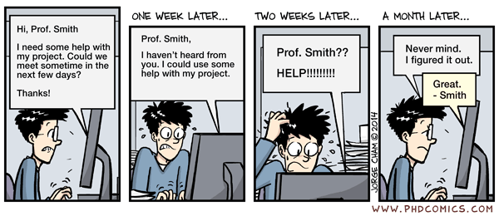
Possible stressors
Appraisals and thesis
Project deadlines
Self-learning, self-motivating
Impostor syndrome
Relationship problems
Family problems
Living away from home
Isolation and Loneliness
Financial Issues
Drink or Drugs problems
Students have a life outside of the University and these can add additional stress.

Slide 14
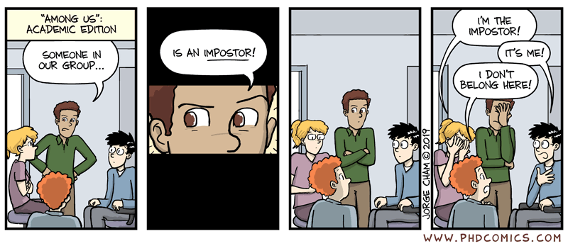
Possible stressors
Appraisals and thesis
Project deadlines
Self-learning, self-motivating
Impostor syndrome
Relationship problems
Family problems
Living away from home
Isolation and Loneliness
Financial Issues
Drink or Drugs problems
Students have a life outside of the University and these can add additional stress.

Slide 15
What you should look out for in friends

Slide 16
What you should look out for in friends
Have they become more withdrawn?
Have they been avoiding social interactions?
Are they crying a lot?
Significant changes in eating habits
Not been taking care of themselves
Lethargic or preoccupied
Changes in how they speak (rapidly, incoherently or slowly) or what they are saying

Slide 17
Liverpool
The first place to check is the general student support service:
https://www.liverpool.ac.uk/studentsupport/
For support the counselling service is available:
https://www.liverpool.ac.uk/studentsupport/counselling/
Mental health advisory service:
https://www.liverpool.ac.uk/studentsupport/mentalhealthadvisoryservice/
Wellbeing Advice:
https://www.liverpool.ac.uk/studentsupport/advice/
GP practice:
https://www.liverpool.ac.uk/study/undergraduate/welcome-to-liverpool/campus/health/
Additionally, there is a Disability Support Team who deal with students with longer term physical or mental health support needs:
https://www.liverpool.ac.uk/studentsupport/disability/

Slide 18
Manchester
Postgraduates at Manchester can use the following services: Disability and Advisory Support Service; Wellbeing service, Counselling Service, and Student Support
The single launch point for students to access support at Manchester is here:
https://www.manchester.ac.uk/study/experience/student-life/university/student-support/
But there are separate portals for each (not all of which are accessible publicly - they require a log-on and/or VPN):
https://my.manchester.ac.uk/uPortal/f/mywellbeing/normal/render.uP
http://www.dso.manchester.ac.uk/
http://www.counsellingservice.manchester.ac.uk/
http://manchester.nightline.ac.uk/contact-us/
Physics students can also email physics.support@manchester.ac.uk

Slide 19
Lancaster
https://www.lancaster.ac.uk/student-and-education-services/counselling-and-mental-health-service/
Wellbeing Service: For general welfare advice, please contact the wellbeing officer for your college: Students can contact their CAT at any point for support or someone to talk to about any aspect of life at Lancaster, such as homesickness, wellbeing, money worries, personal problems, or any other issues
Bowland bowlandwelfare@lancaster.ac.uk
Cartmel cartmelcat@lancaster.ac.uk
County countywelfare@lancaster.ac.uk
Furness furnesscat@lancaster.ac.uk
Fylde fyldecat@lancaster.ac.uk
Graduate gradwellbeing@lancaster.ac.uk
Grizedale grizedalecat@lancaster.ac.uk
Lonsdale lonsdalewelfare@lancaster.ac.uk
Pendle pendlecat@lancaster.ac.uk
One-off easy access appointments during term-time throughout the week, no need for self-referral.
Just call us on 01524 592690 after 10am (or email counselling@lancaster.ac.uk).
Out of Hours support
College Porters – Available 24 hours a day, 7 days a week during term-time. Bowland Porters can be reached on 01524 592 348, or visit the Porters Lodge.
Medical Attention (non-emergency) - 111
Medical Emergencies including mental health crisis – College Porters or Main Security 01524 594541. Our trained staff can provide first aid and will contact the emergency services if needed.
Lancashire Care Wellbeing and Mental Health - Call free 0800 915 4640. Available Monday to Friday 7pm-11pm, Saturday to Sunday 12 noon-12 midnight.
Samaritans – Call free 116 123, confidential 24/7 advice and support.
Papyrus - Call free 0800 0684141. Trained staff are on-hand to listen. Available Monday to Friday 10am-10pm, Saturday to Sunday 2pm
Nightline - Lancaster Nightline is a peer to peer listening and information service run by Lancaster students, providing a night-time contact point, free information or just somebody to listen. All calls are anonymous and confidential, and you can contact Nightline by telephone on 01524 594444. Alternatively, you can email Nightline, instant message Nightline or Skype Nightline.
Lancaster students who are currently based offsite can access self-help resources and are able to use Silvercloud. SilverCloud is an online self-help programme, which uses evidence based techniques to help individuals learn to manage common mental health difficulties as effectively as possible.

Slide 20
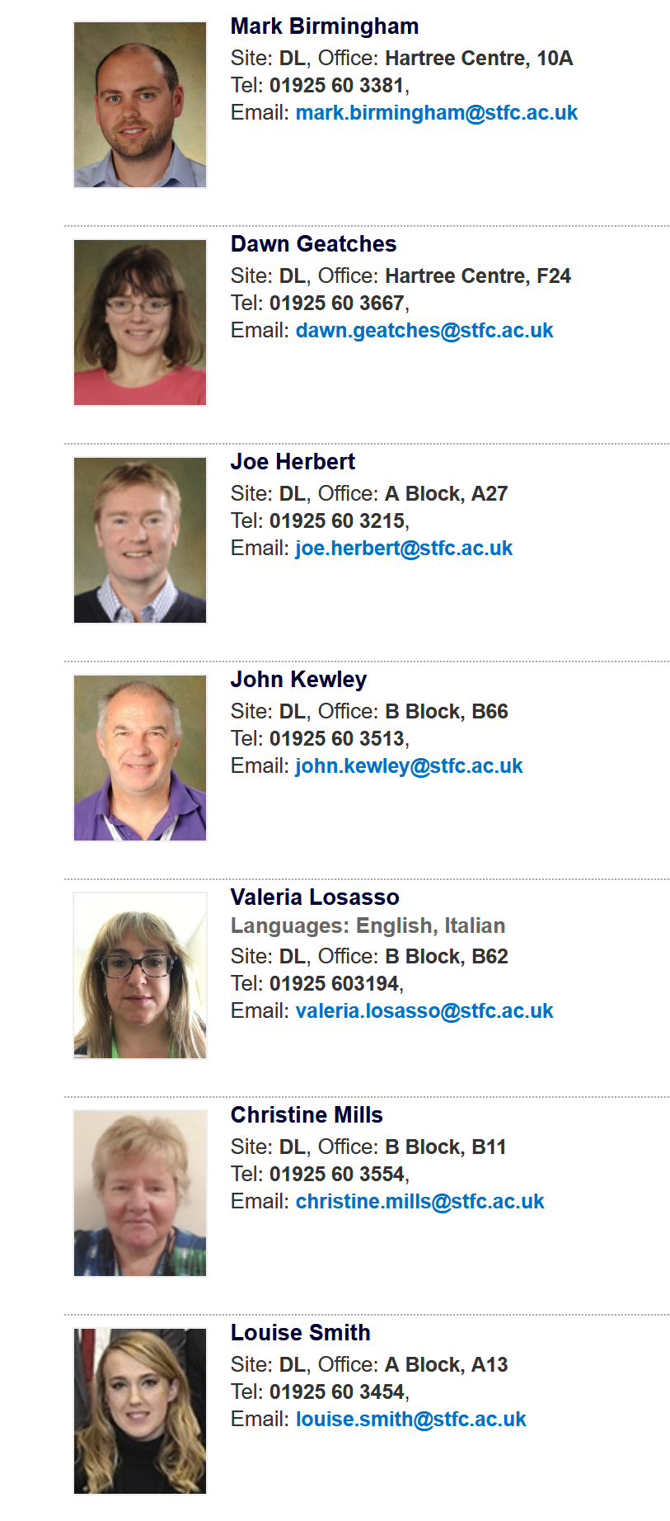
STFC
https://staff.stfc.ac.uk/people/wellbeing/Pages/default.aspx
In an emergency please call the DL Site Security team on 3333. Security will determine what support is required and deploy Mental Health First Aiders if necessary.​
STFC Mental Health First Aiders (MHFAs) and Suicide First Aiders (SFAs) are able to help someone who is experiencing a mental health problem, before professional help is available or can be obtained.
​MHFAs are trained to deal with some frequently seen problems like anxiety or depression, through to more urgent situations, such as a person feeling suicidal, deliberately self-harming, having a panic attack and being acutely psychotic. SFAs are trained to help those in crisis, who are at risk of/are planning to take their own lives, or who are currently in the middle of doing so.
Staff can contact any MHFA or SFA they wish - they do not need to be based at the same site or within the same department.
https://www.mentalhealthatwork.org.uk/

Slide 21
Strathclyde
Disability and Wellbeing service delivery
delivered remotely via Zoom, telephone and email. Operates from Mondays to Thursdays with counselling and disability appointments being offered. Students can refer themselves to any of our services by emailing disability-wellbeing@strath.ac.uk or calling 0141-5483402.
We have a new Early Intervention Counselling Team in place. We are aiming to offer same day triage appointments to all students who refer before 4pm each working day. Students can refer directly by emailing disability-wellbeing@strath.ac.uk .
Disability & Wellbeing faculty contacts: Science- Gillian Mutch, Disability Adviser and Sean McCann, Early Intervention Counselling Team Leader
Helping students in distress guide and other resources
There is a range of resources, e-learning packages and bookable training programmes on webpages
The Rape Crisis service for students of all genders who have experienced sexual violence at any time in their lives will continue to be offered for this academic year. Further information is available here.
Covid-19 health and wellbeing advice for students
Our Health & Wellbeing Adviser can assist with specific coronavirus related health enquiries and can be contacted via studenthealthenquiries@strath.ac.uk.
Staff: The following resources are available to staff to help support and maintain positive mental health and wellbeing:
Silvercloud, our online e-learning platform offers immediate access to online CBT (Cognitive Behavoural Therapy) programmes tailored to the individual’s needs. This programme is available to staff and students.
The University’s Employee Assistance Programme (EAP) offers 24/7 confidential independent help, information, and guidance which is accessed by telephone.
The EAP is now complemented by an in-house, confidential staff counselling service where staff can access up to six sessions of therapy via Zoom.

Slide 22
Student Space - Coronavirus resource and support from UK charity Student Minds
Student Space has been developed by UK student mental health charity Student Minds, and is here for you through coronavirus. How ever you’re feeling, they have help and guidance available. Explore a range of trusted information, services and tools to help you with the challenges of student life.
There are three ways that Student Space is here to help:
Access dedicated support services for students, by phone or text.
Information and tools to help you through the challenges of coronavirus.
Helping you find what support is available at your place of study.
Student Space phone line
Call FREE on 0808 189 5260.
Access a dedicated freephone number which is open from 4pm to 11pm, offering listening support, information and onward signposting for students.
www.studentspace.org.uk/support-services/phone-support
Student Space text suppport
To start a conversation, text ‘STUDENT’ to 85258.
Get 24/7 support from a trained volunteer. It’s free, confidential and anonymous. Whether you’re experiencing suicidal thoughts, depression, anxiety, loneliness or relationship issues, we’re here to listen and support you.
www.studentspace.org.uk/support-services/text-support
Social Media
Instagram: @StudentMindsOrg
Facebook: Student minds
Twitter: @StudentMindsOrg
LinkedIn: Student Minds

Slide 23
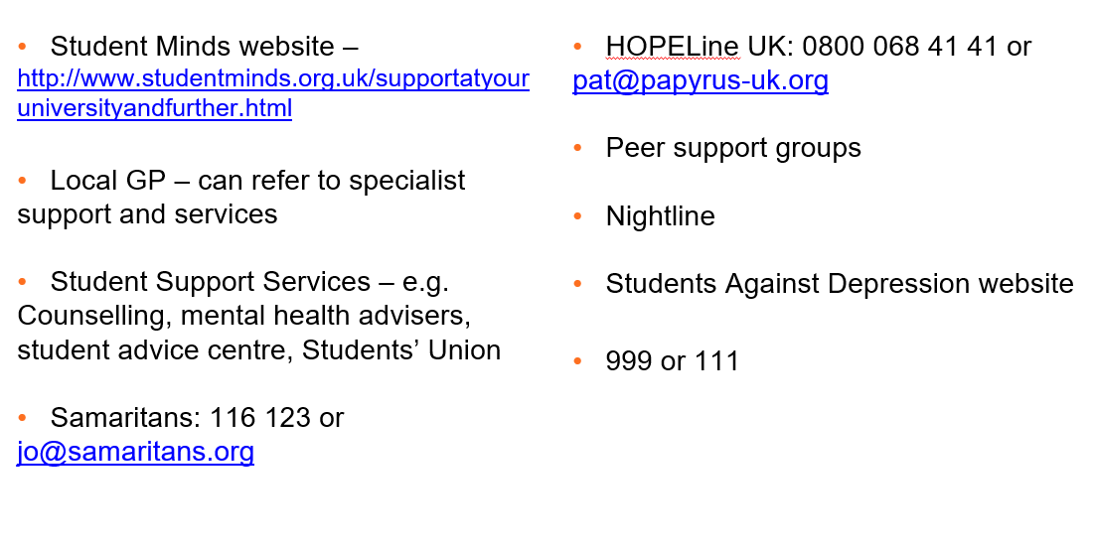
Other support

