Slide 1

Atom Interferometry Long-baseline Systematics and Environmental Noise
Jeremiah Mitchell
13 November 2023
RAL GW Meeting

Slide 2
Overview
Noise in atom interferometers
  How?
Characterization
  Where?
Mitigation
  What?

Slide 3
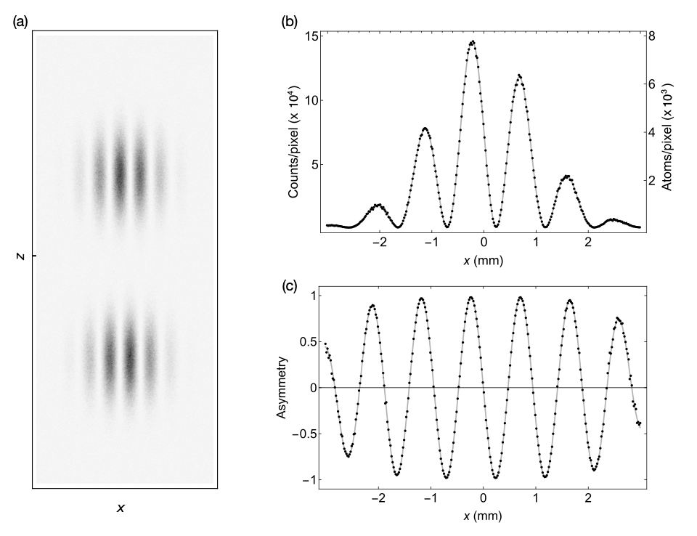
Noise in atom interferometers
Measurement relies on two key components
  Phase shift between quantum states (energy levels)
  Contrast
Simulation (MAGIS-100)
M. Abe et al, Quantum Sci. Technol. 6 044003 (2021)

Slide 4
Phase noise
Phase Shift
Leading order phase shift

Slide 5
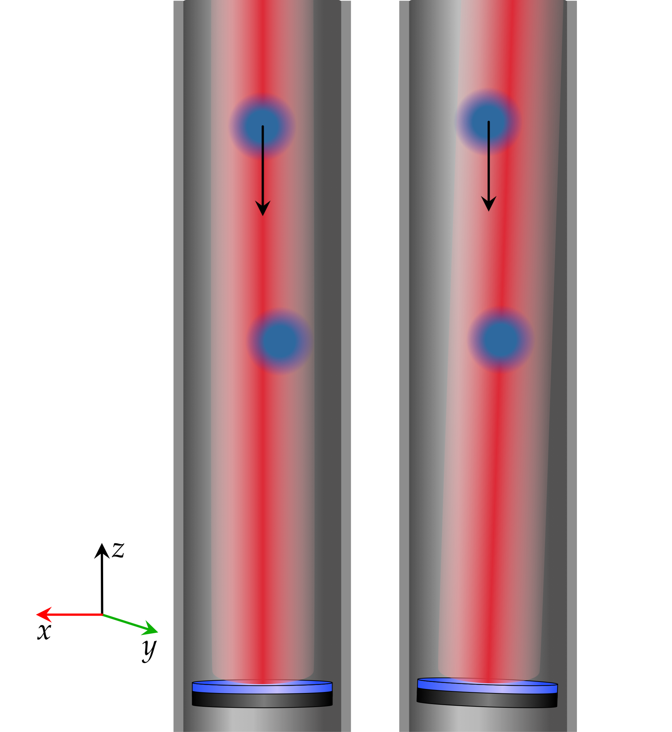
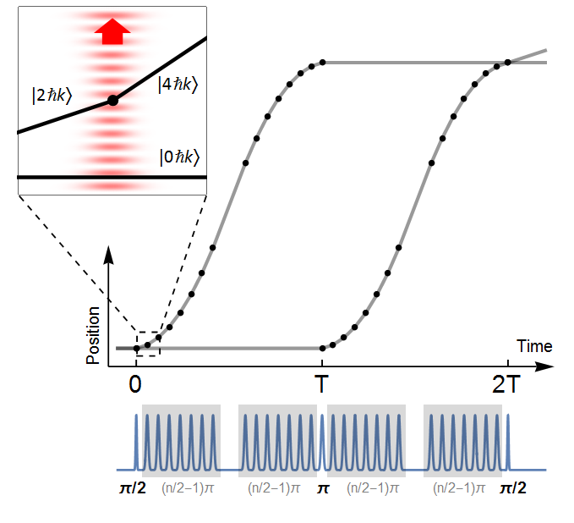
Contrast noise
Loss of atom interaction during interferometry sequence
Effective loss of atom number
Coriolis effect example of contrast loss
Laser-atom interaction efficiency (large momentum transfer)
TK, P. Asenbaum, C. Overstreet, C. Donnelly, S. Dickerson, A. Sugarbaker, J. Hogan, and M. Kasevich, Nature 2015
P. Asenbaum, C. Overstreet, TK, D. Brown, J. Hogan, and M. Kasevich, PRL 2017

Slide 6
Characterizing noise
Multi system instrument → many sources of noise
Light for atom interaction
Production of ultracold atom clouds
Interferometry sequence and readout
Interfaces between subsystems

Slide 7
Where?
Atom number/flux
Initial kinematics
Temperature, vacuum
Sources galore!
Laser light
Magnetic fields
Gravitational fields
M. Abe et al, Quantum Sci. Technol. 6 044003 (2021)
J. Mitchell, T. Kovachy et al, J. Inst. 17, E02001 (2022).

Slide 8
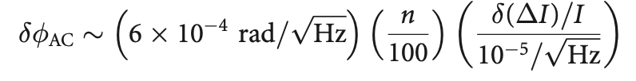
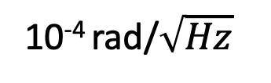
Estimates and parameter dependence
Laser effects
10⁻⁴ rad/$\sqrt{Hz}$

Slide 9
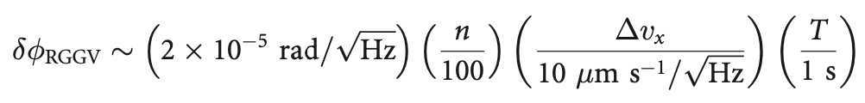
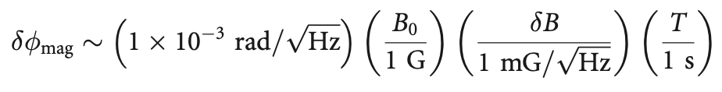
More estimates
Vibrations and Magnetic fields

Slide 10
Long-baseline atom interferometers
Some effects are amplified along the baseline
Laser wavefront aberrations
Environmental gravity field fluctuations

Slide 11
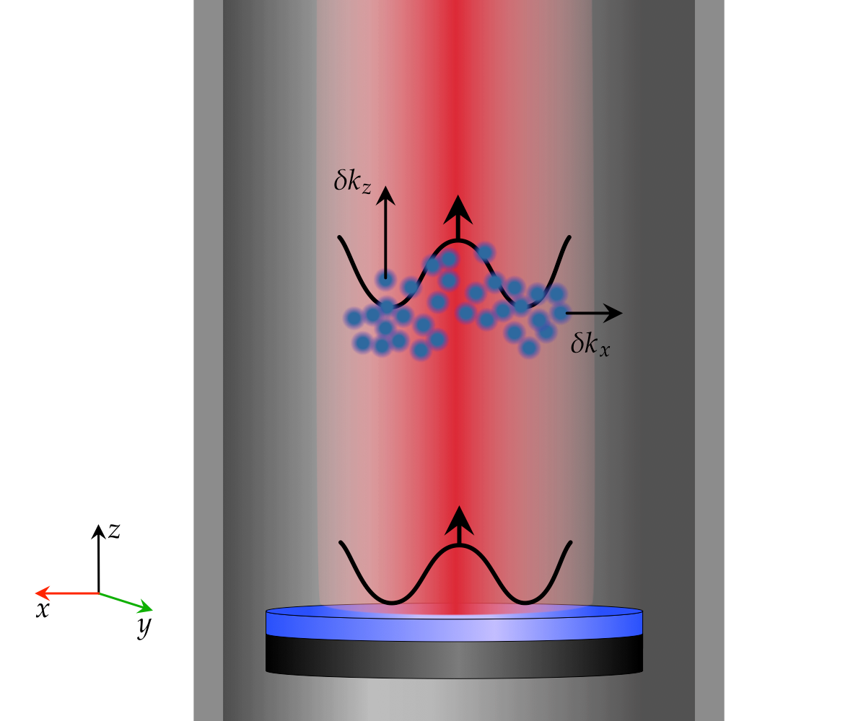
Laser wavefront aberration
Effective transverse momentum
Effective longitudinal momentum

Slide 12
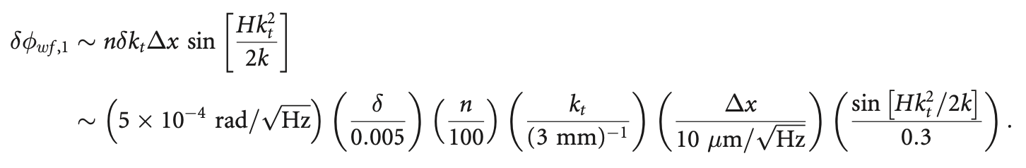
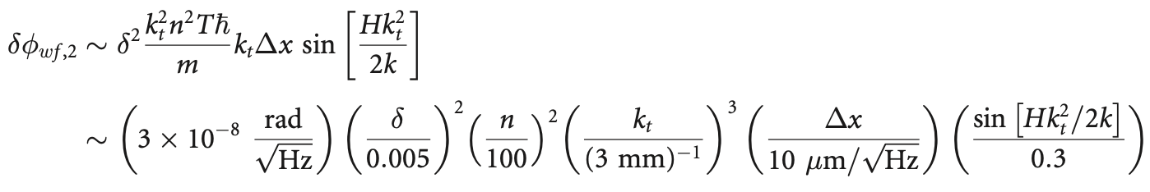
Laser wavefront aberration estimates

Slide 13
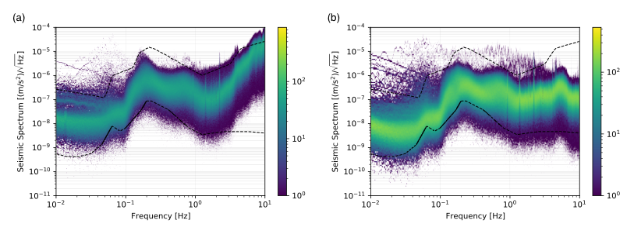
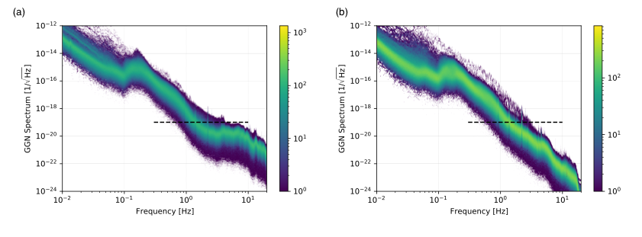
Gravity gradient noise
Seismic and atmospheric
2022 JINST 17 P01007

Slide 14
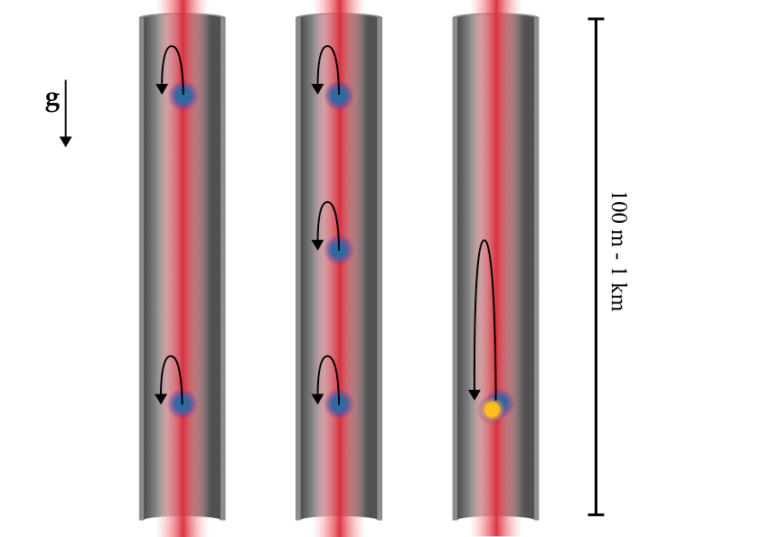
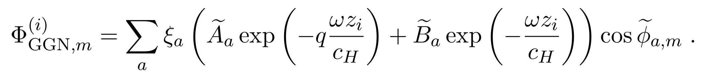
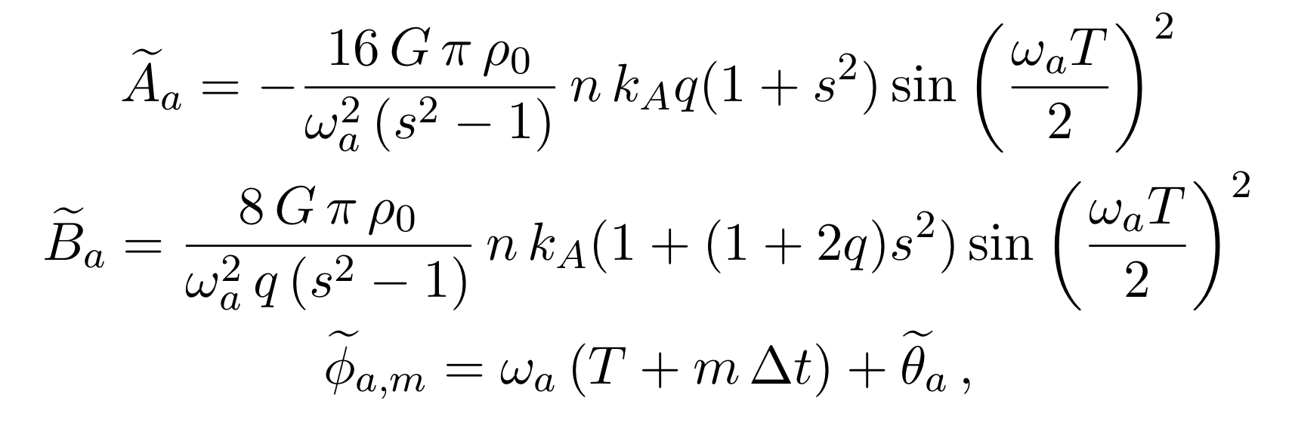
GGN simulations
Badurina, et al. Phys. Rev. D 107, 055002

Slide 15
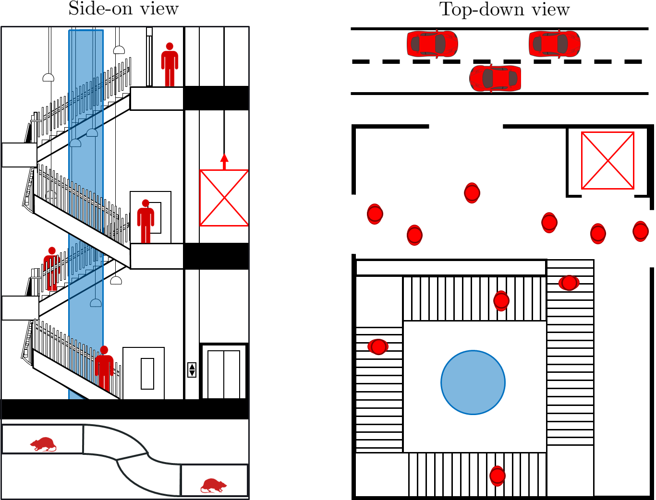
Anthropogenic and synanthropic
Many potential sources of noise surround the detector:
Large anthropogenic sources
People walking on the stairs/in the foyer
Traffic on the road outside
Lift moving next to the tower
Small synanthropic sources
Random animal transients (RATs)
J. Carlton and C. McCabe, arXiv:2308.10731.

Slide 16
Ongoing works
Other works
  Numerical simulators and data analysis tools
  Networked detection
  Bayesian inference for atom interferometers
Atmospheric gravity gradient noise
  Infrasound sourced
  Temperature gradients
  Turbulent flows
Site measurements and instrumentation
Environmental monitoring systems
  Seismometer arrays
  Infrasound sensor arrays/microphones
  Vertical seismic profiling
Val Gibson, Noam Mouelle, Yu Zhi
@ University of Cambridge

Slide 17
Mitigation plans
Passive
Active
Ultra high vacuum
Temperature control and isolation
Magnetic shielding
Vibration isolation
Site selection
Laser locking
Tip-tilt mirror control
Bias magnetic field control
Vibration stabilization and feedback control
Environmental monitoring arrays for filtering/feedback

Slide 18
Final thoughts
Systematics are a demanding area of study and crucial to reaching science and sensitivity goals
Massive overlap with work LIGO and the gravitational wave community do
Space for collaboration and detector networking and understanding global systematics
Thanks!
- Isaac Newton Trust

Slide 19
Backups

Slide 20
Investigations
Research into Newtonian Noise strongly initiated by laser interferometry gravitational wave community
First investigations for atom interferometry advanced by MIGA also being investigated by MAGIS and VLBAI
Saulson. Phys. Rev. D 30,4, (August 1984)
Hughes, Thorne. Phys. Rev. D 58, 122002 (1998)
Teviet Creighton. 2008 Class. Quantum Grav. 25 125011
Harms. Living Reviews in Relativity Volume 22, Article number: 6 (2019)
MIGA. Proc. SPIE 9900, Quantum Optics, 990008 (29 April 2016)
Mitchell et al. 2022 JINST 17 P01007

