Slide 1



Adaptive algorithms for Newtonian noise cancellation at Virgo gravitational-wave detector
Soumen Koley, Jan Harms et al.

Slide 2

Scientific relevance of gravitational-wave physics
Multi-messenger astronomy started: a broad community is relying on gravitational wave science
Scientific programs are limited by LVC instruments over the entire frequency band 10 – 10000 Hz
Fundamental physics
Access to dynamic strong field regime; new tests of General Relativity
Black holes: inspiral, merger, ringdown, quasi-normal modes, echo’s
Lorentz invariance, equivalence principle, parity violation, polarization
Astrophysics
Detection of binary neutron stars – relation to sGRB
Kilonova evidence, element formation
Astronomy
Gravitational-wave astronomy, population studies, remnant studies
Cosmology
Use of binary neutron stars as “standard-sirens”
Dark matter and dark energy
Nuclear physics
Tidal interactions between neutron stars get imprinted on gravitational waves
Equation of state

Slide 3
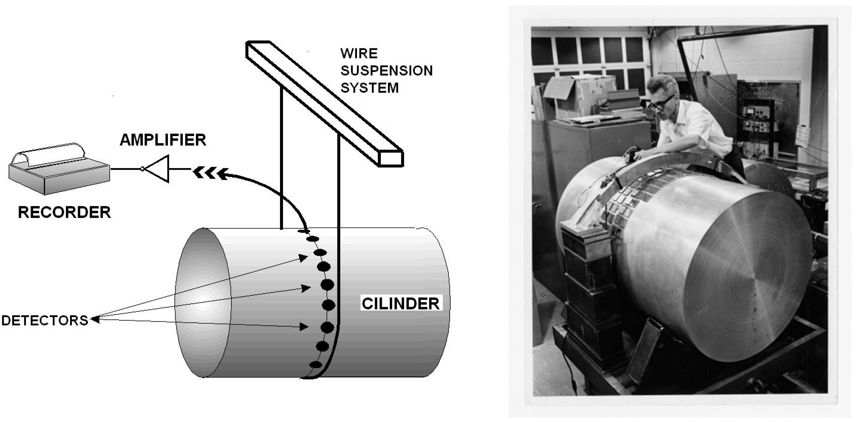
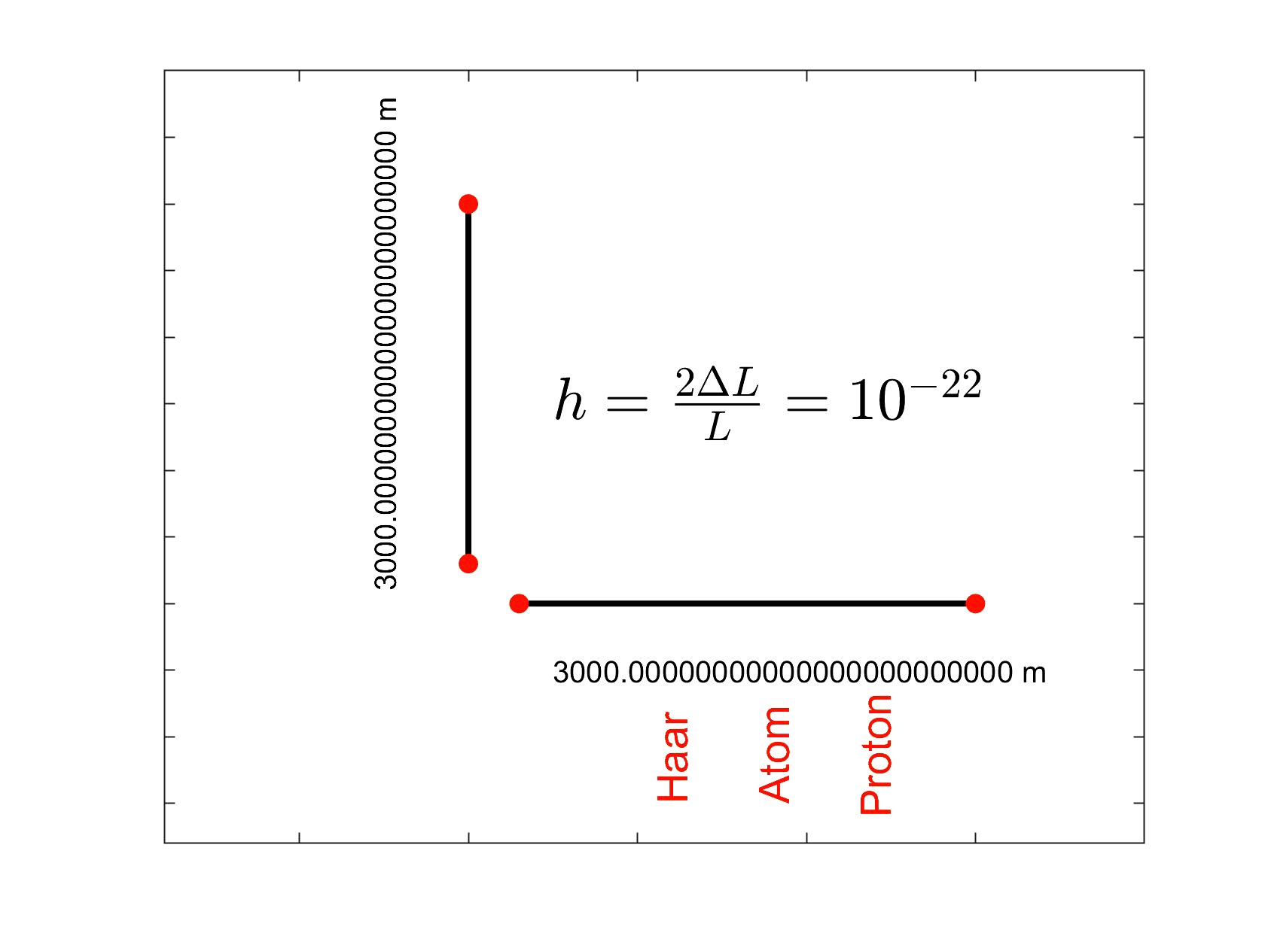
Gravitational waves can be measured with an ITF
The year following the meeting at Chapel Hill, Joseph Weber began to speculate how he could detect gravitational waves.
He proposed the detection of gravitational waves by measuring vibrations induced in a mechanical system.
In 1969 he published results announcing the detection of waves
By 1971 Forward reported the design of the first interferometer prototype (which he called a “Transducer Laser”)
Also in the 1970s, Weiss independently conceived the idea of building a Laser Interferometer, inspired by an article written by Felix Pirani
Weiss also held talks with Phillip Chapman, who had glimpsed, independently, the same scheme

Slide 4
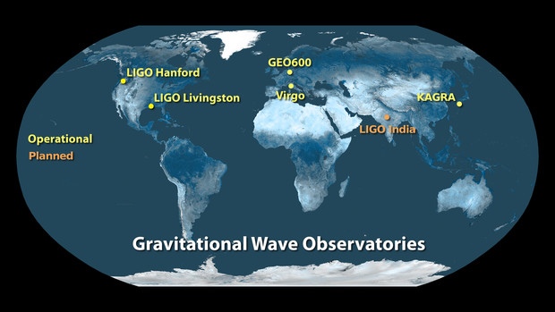
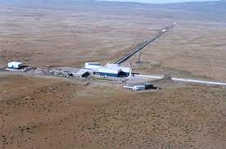
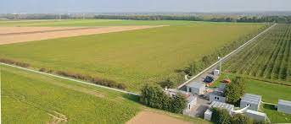
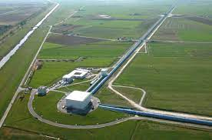
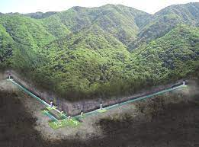
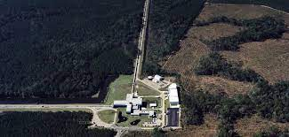
Current and planned 2nd generation GW detectors
Observe together as a network of GW detectors with integrated data-analysis
LIGO-Virgo started their first science run in 2007
Advanced Virgo joined Advanced LIGO in 2017
KAGRA joined in 2020
IGWN: International Gravitational Wave Network

Slide 5
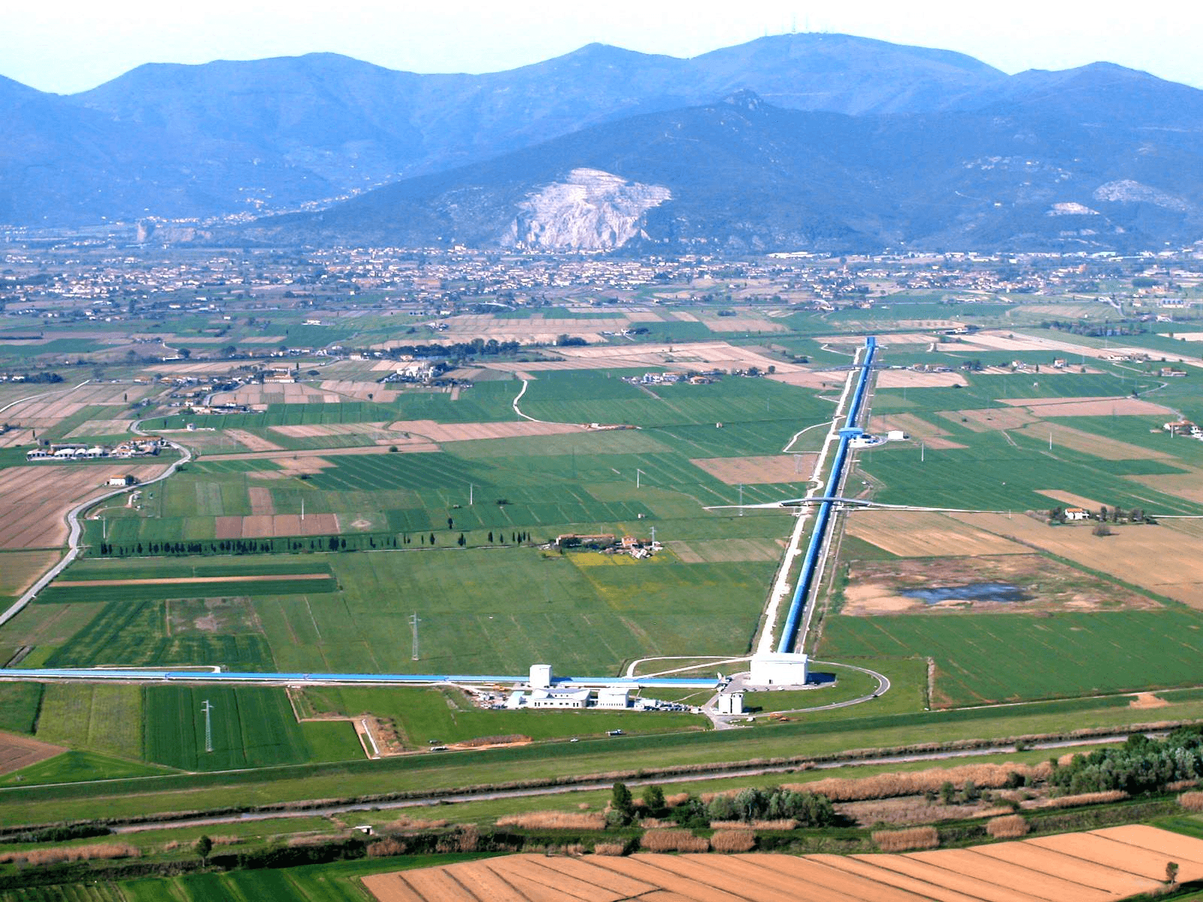
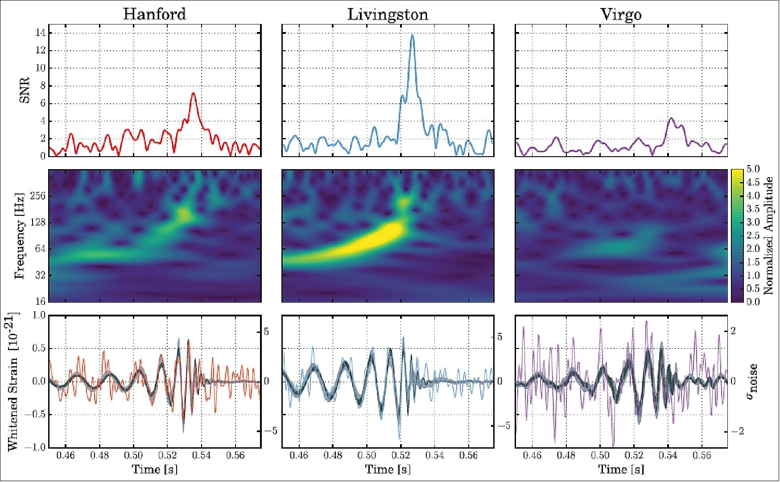
First three network detection – GW170814
Einstein’s General Theory of Relativity predicts to two polarizations. General metric theories of gravity allow six polarization. GW170814 proves Einstein’s prediction
Test of GW polarization
LIGO and Virgo have different antenna patterns
Our tests suggest a tensor structure over a vector or scalar structure

Slide 6
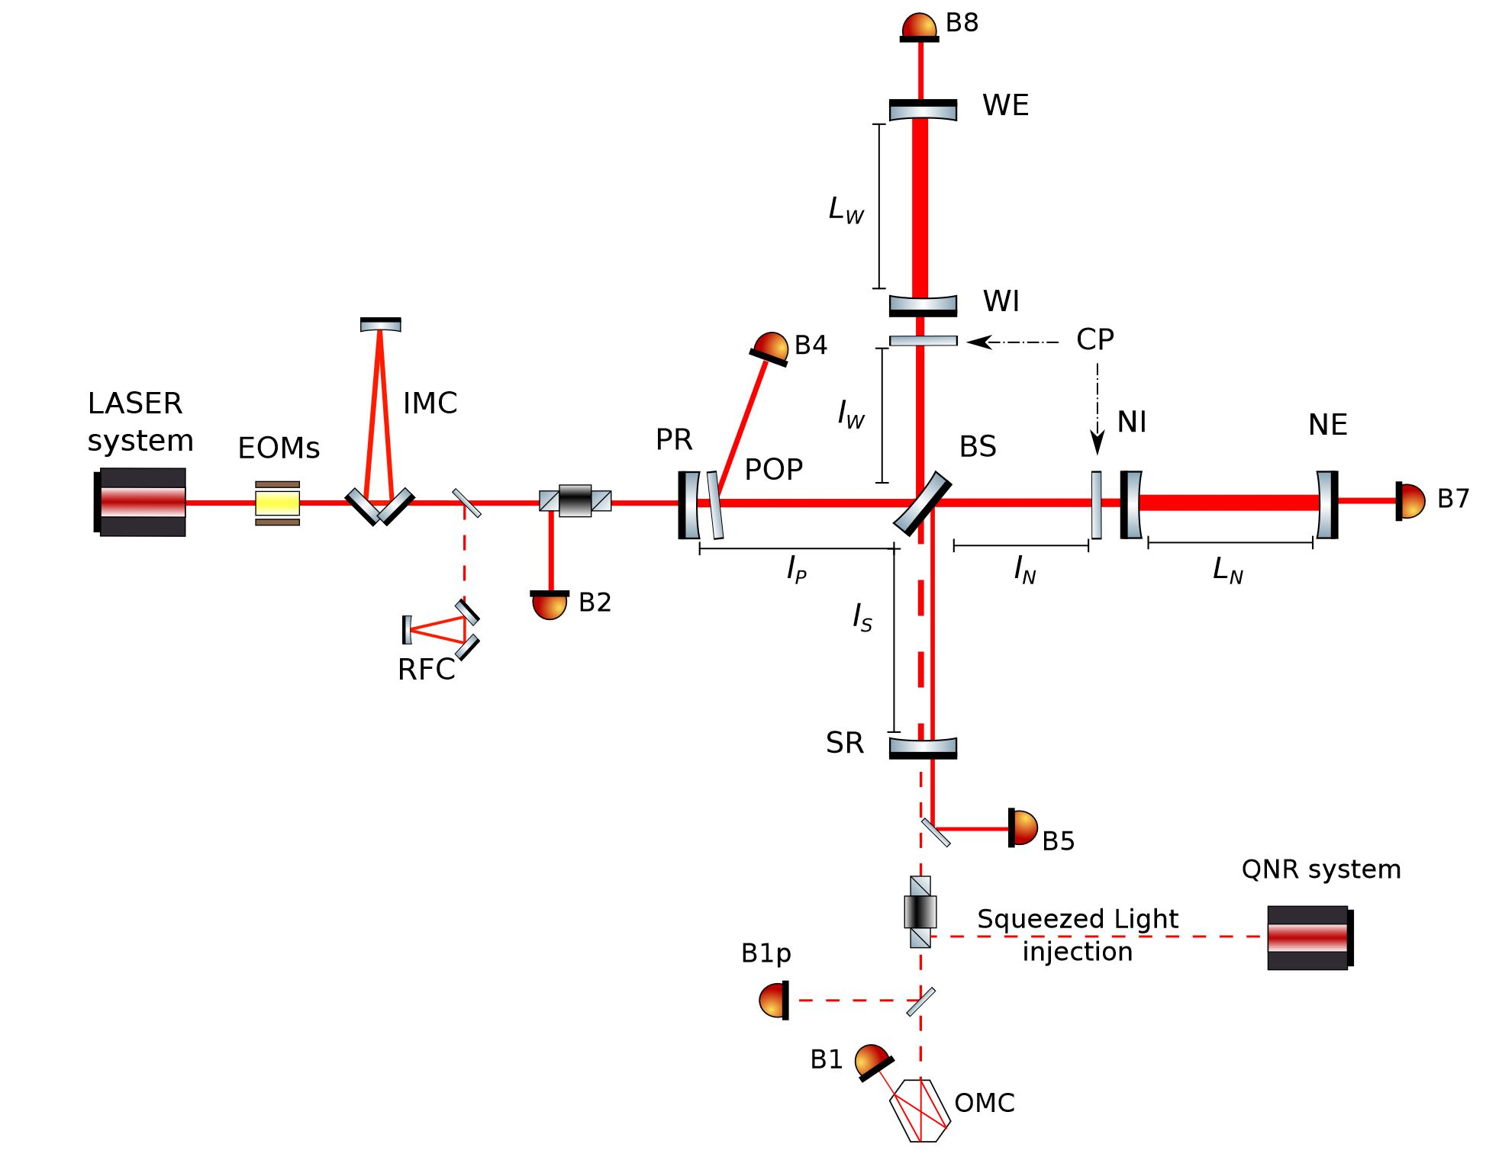
Advanced Virgo+ - A dual recycled Fabry-Perot interferometer
LIGO and Virgo are dual recycled Michelson interferometers equipped with Fabry-Perot cavities and input/output mode cleaners

Slide 7
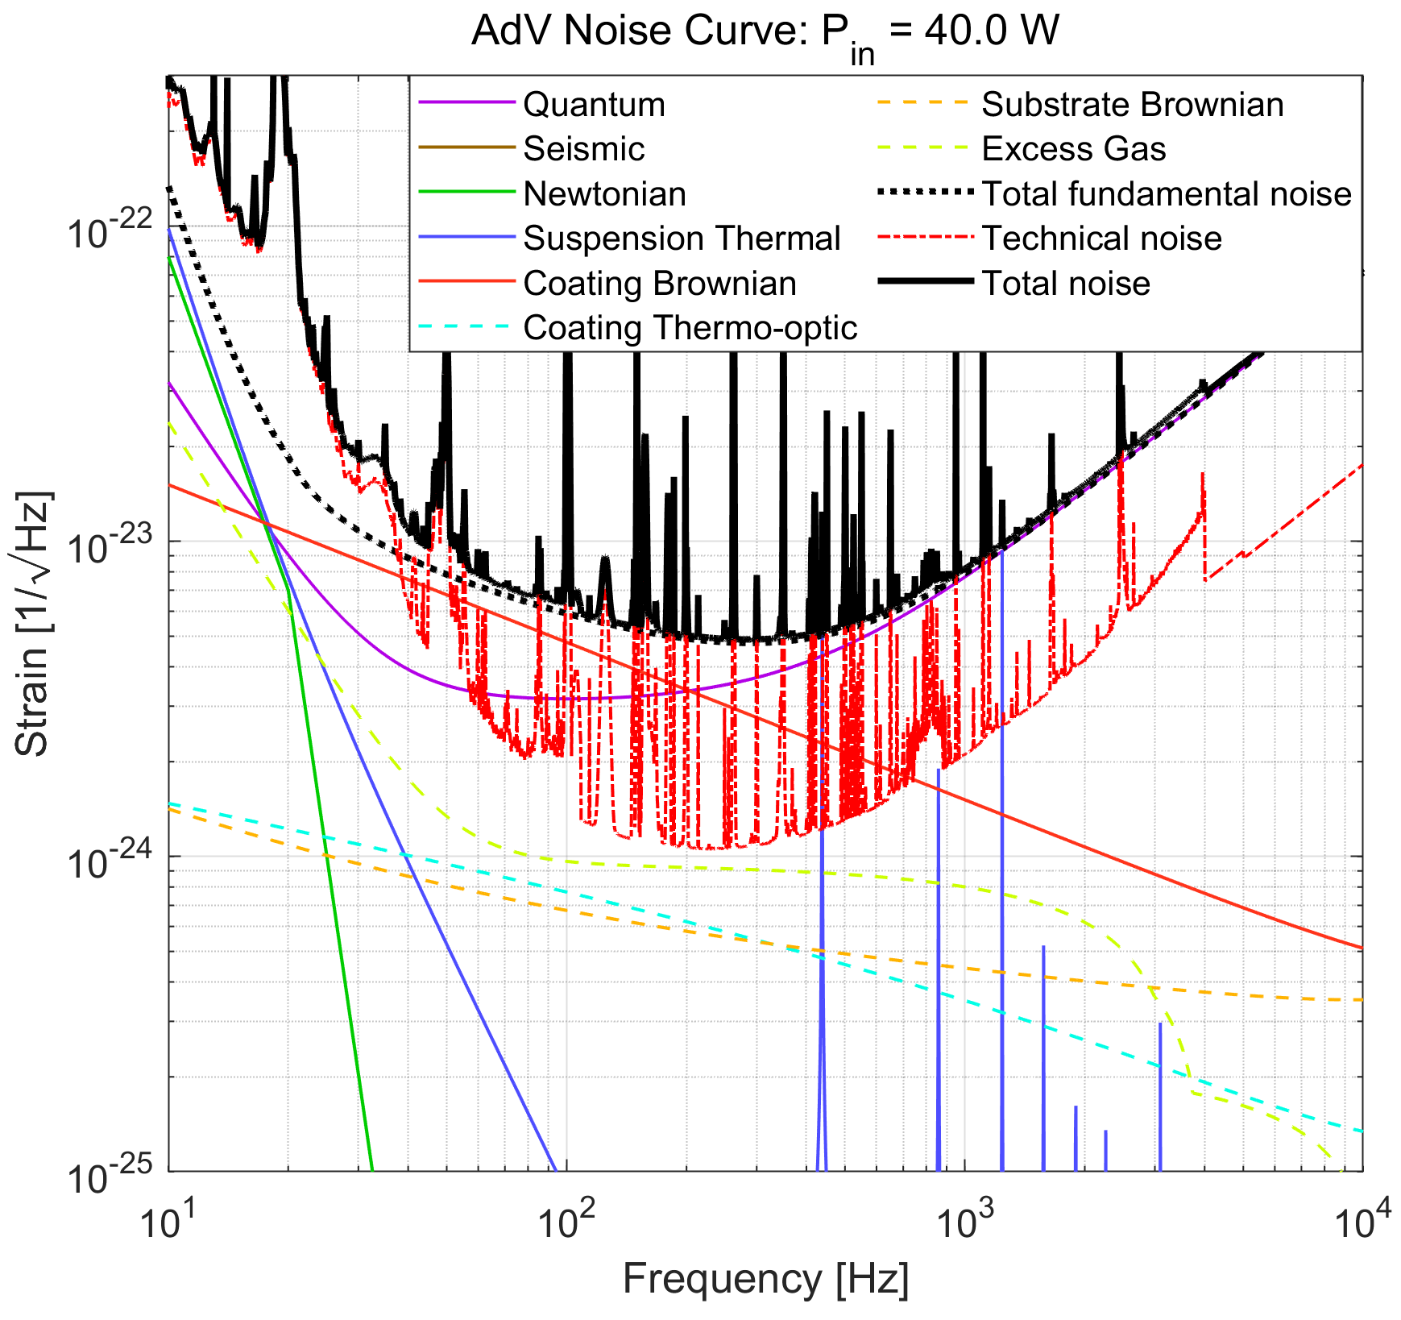
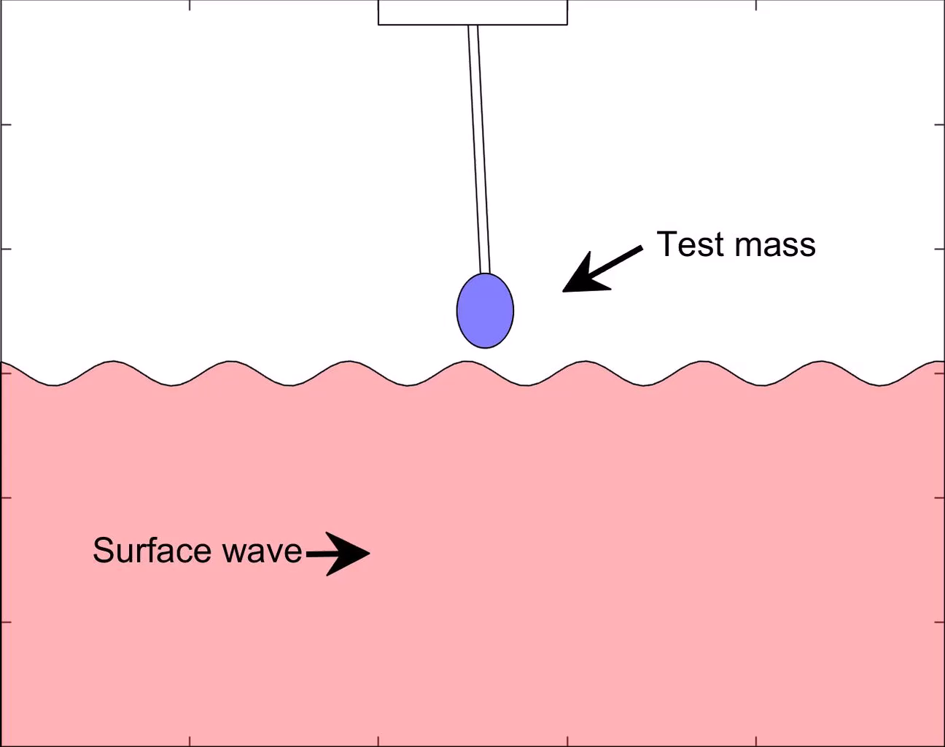
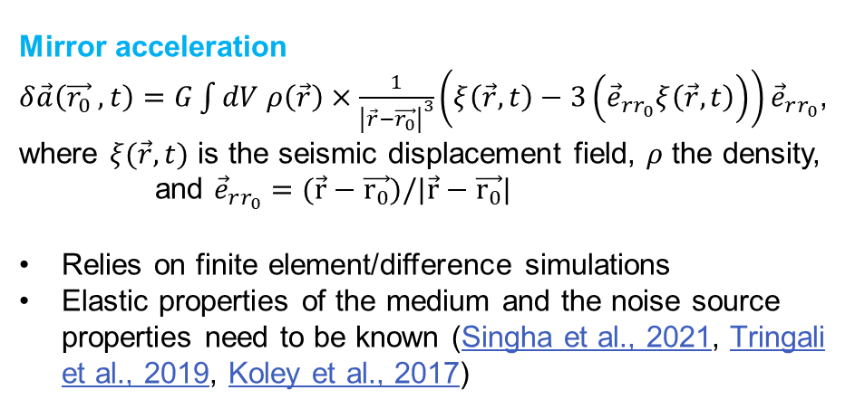
Fundamental and Technical noise at AdV+
Newtonian and suspension-thermal noise are expected to be the two main contributors to the low-frequency noise at AdV+
Mirror acceleration
$δ\vec{a}\left(\vec{r_{0}} ,t\right)=G\int{dV ρ\left(\vec{r}\right)×\frac{1}{{\left|\vec{r}−\vec{r_{0}}\right|}^{3}}}\left(ξ\left(\vec{r},t\right)−3\left({\vec{e}}_{rr_{0}}ξ\left(\vec{r},t\right)\right)\right){\vec{e}}_{rr_{0}}$,
where $ξ(\vec{r},t)$ is the seismic displacement field, $ρ$ the density,
and ${\vec{e}}_{rr_{0}}=(\vec{r}−\vec{r_{0}})/|\vec{r}−\vec{r_{0}}|$
Relies on finite element/difference simulations
Elastic properties of the medium and the noise source properties need to be known (Singha et al., 2021, Tringali et al., 2019, Koley et al., 2017)

Slide 8
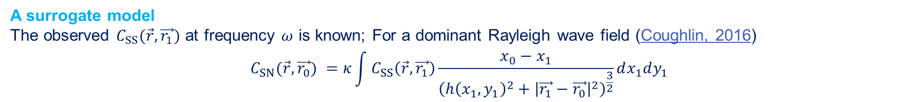
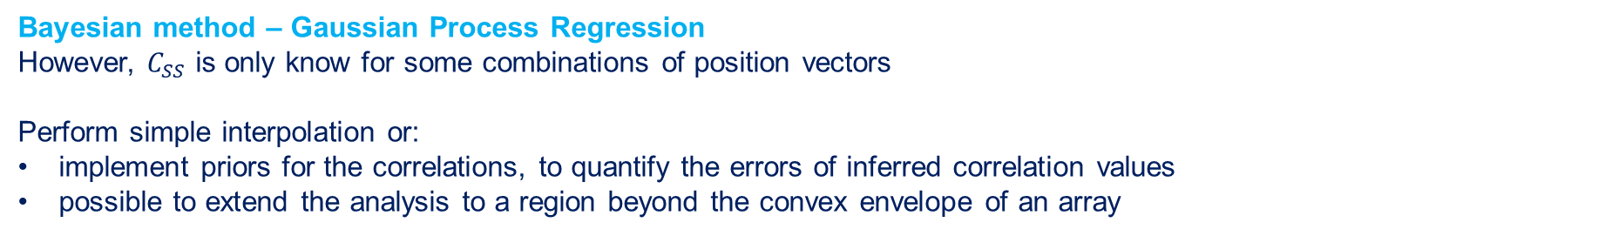
Newtonian noise cancellation – Array optimization
NN cancellation system based on observed two-point spatial correlations between seismometers deployed in an array. The solution takes the form of a surrogate Wiener filter with seismometers as input channels (Badaracco & Harms, 2020)
Wiener formulation
$δ\hat{a}\left(ω\right)=\vec{W}\left(ω\right)\vec{ξ}\left(ω\right),$ where $δ\vec{a}$ is the mirror acceleration and $\vec{ξ}$ is the seismic displacement
$$⇒W\left(ω\right)= \left\langle {\vec{ξ}}^{T}δa\right\rangle .{\left\langle \vec{ξ} {\vec{ξ}}^{T}\right\rangle }^{−1}$$
Wiener residual (Cella, 2000)
$$R\left(ω\right)=1− \frac{{\vec{C}}_{SN}^{T}\left(ω\right)C_{SS}^{−1}\left(ω\right){\vec{C}}_{SN}(ω)}{C_{NN}(ω)}$$
A surrogate model
The observed $C_{SS}(\vec{r},\vec{r_{1}})$ at frequency $ω$ is known; For a dominant Rayleigh wave field (Coughlin, 2016)
$$C_{SN}(\vec{r},\vec{r_{0}}) =κ\int{C_{SS}\left(\vec{r},\vec{r_{1}}\right)\frac{x_{0}−x_{1}}{{\left(h{\left(x_{1},y_{1}\right)}^{2}+{\left|\vec{r_{1}}−\vec{r_{0}}\right|}^{2}\right)}^{\frac{3}{2}}}dx_{1}dy_{1}}$$
Bayesian method – Gaussian Process Regression
However, $C_{SS}$ is only know for some combinations of position vectors
Perform simple interpolation or:
implement priors for the correlations, to quantify the errors of inferred correlation values
possible to extend the analysis to a region beyond the convex envelope of an array

Slide 9
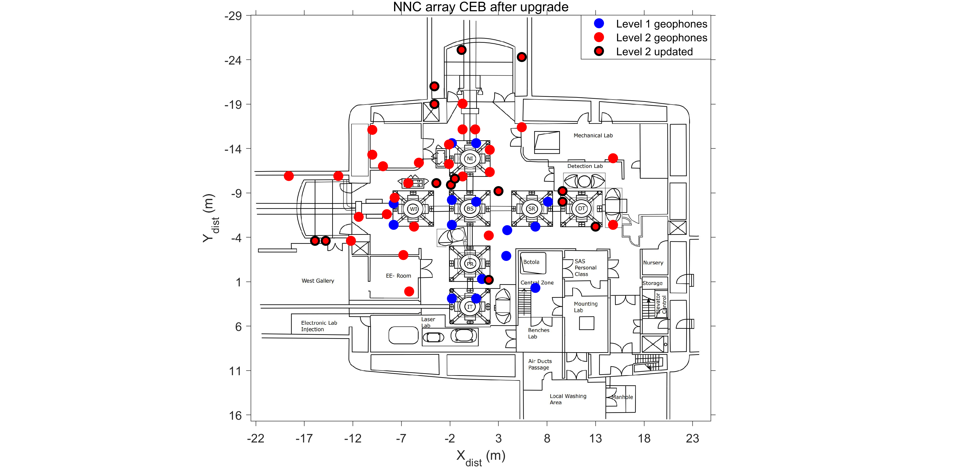
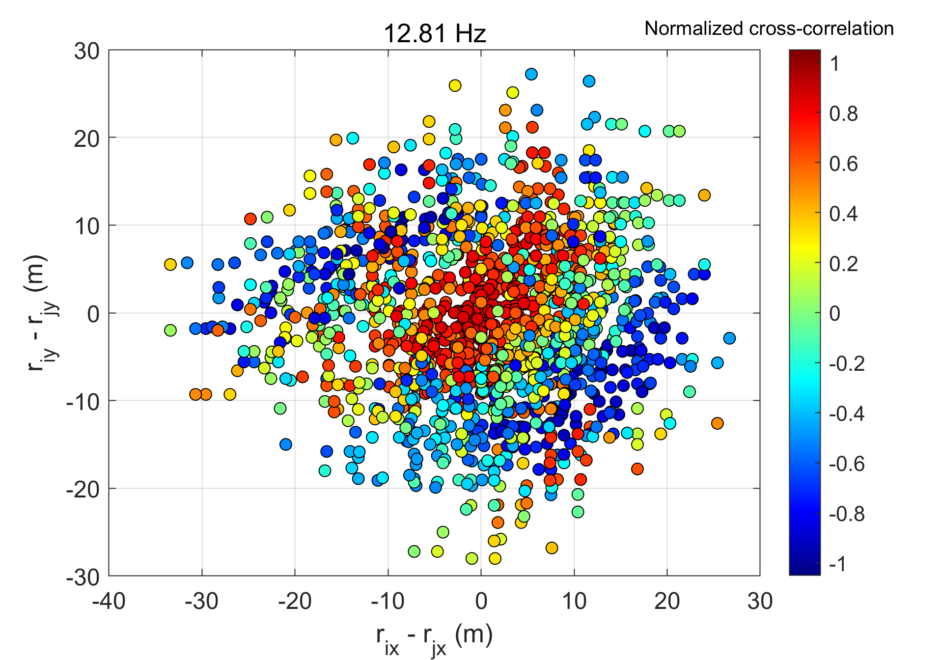
Newtonian noise cancellation – Array optimization
For broadband optimization we use global optimizers like Particle Swarm Optimizer to minimize the cost function $max\left(R\left(ω\right)\right), ∀ ω_{i}∈(ω_{min},ω_{max})$
Some examples of $C_{SS}({\vec{r}}_{1},\vec{r_{2}})$

Slide 10
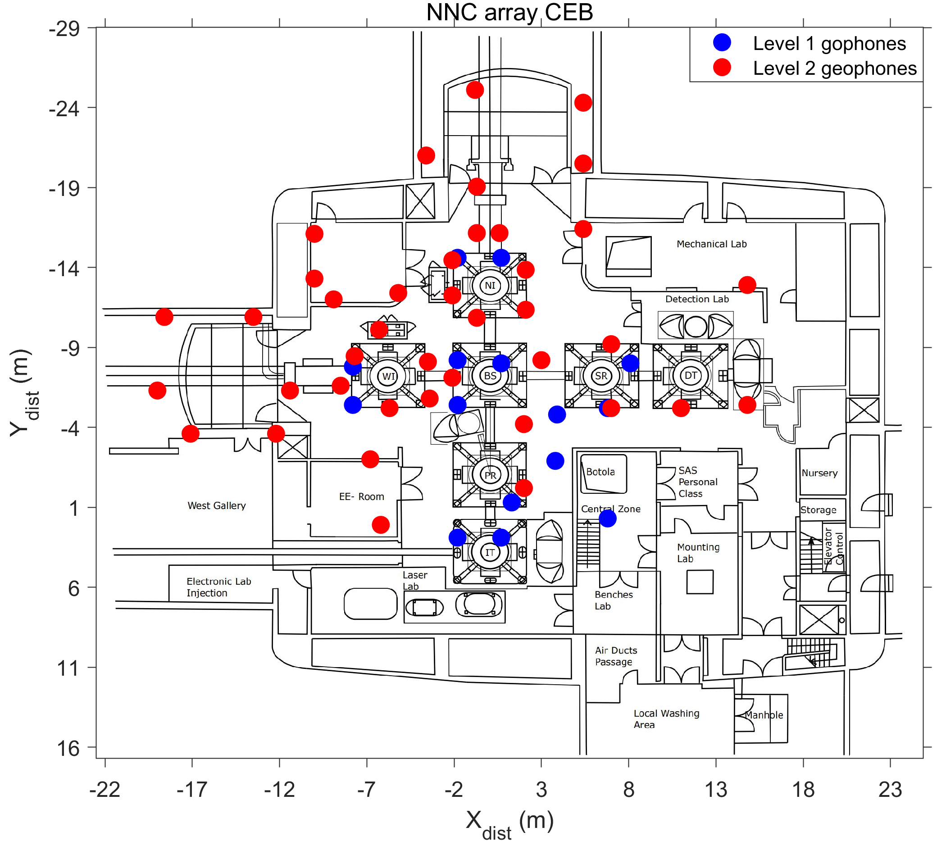
Newtonian noise cancellation – Central Building Array layout
A total of 55, 5 Hz geophones deployed in the central building (CEB)
  15 geophones level 1
  40 geophones level 2
Station positions were updated in May 2022 for optimal Newtonian noise cancellation
  Data acquired continuously at 500 sps and integrated with Virgo DAQ

Slide 11
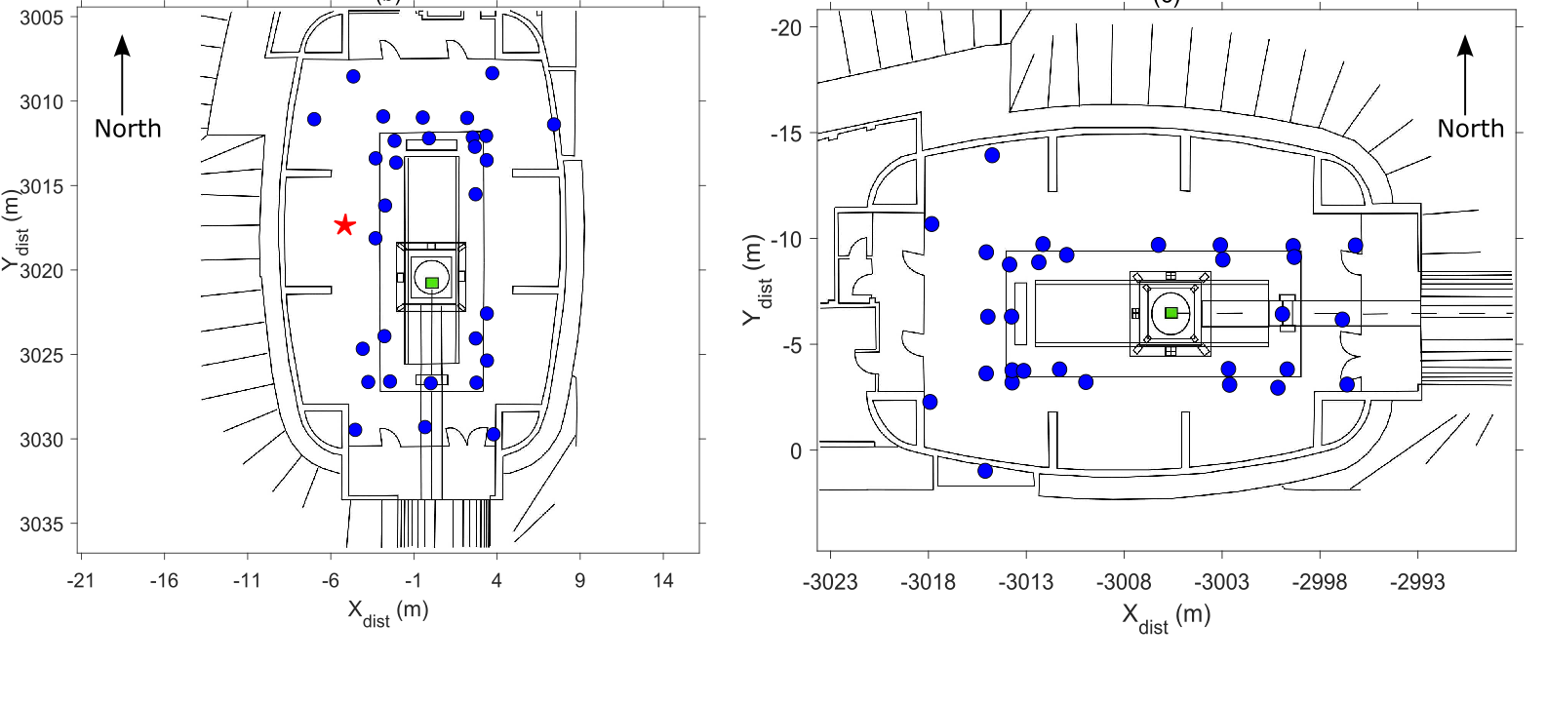
Newtonian noise cancellation – End Buildings Array layout
A total of 28, 5 Hz geophones deployed in the North End Building (NEB)
Red star shows the location of tiltmeter at NEB
A total of 30, 5 Hz geophones deployed in the West End Building (WEB)

Slide 12
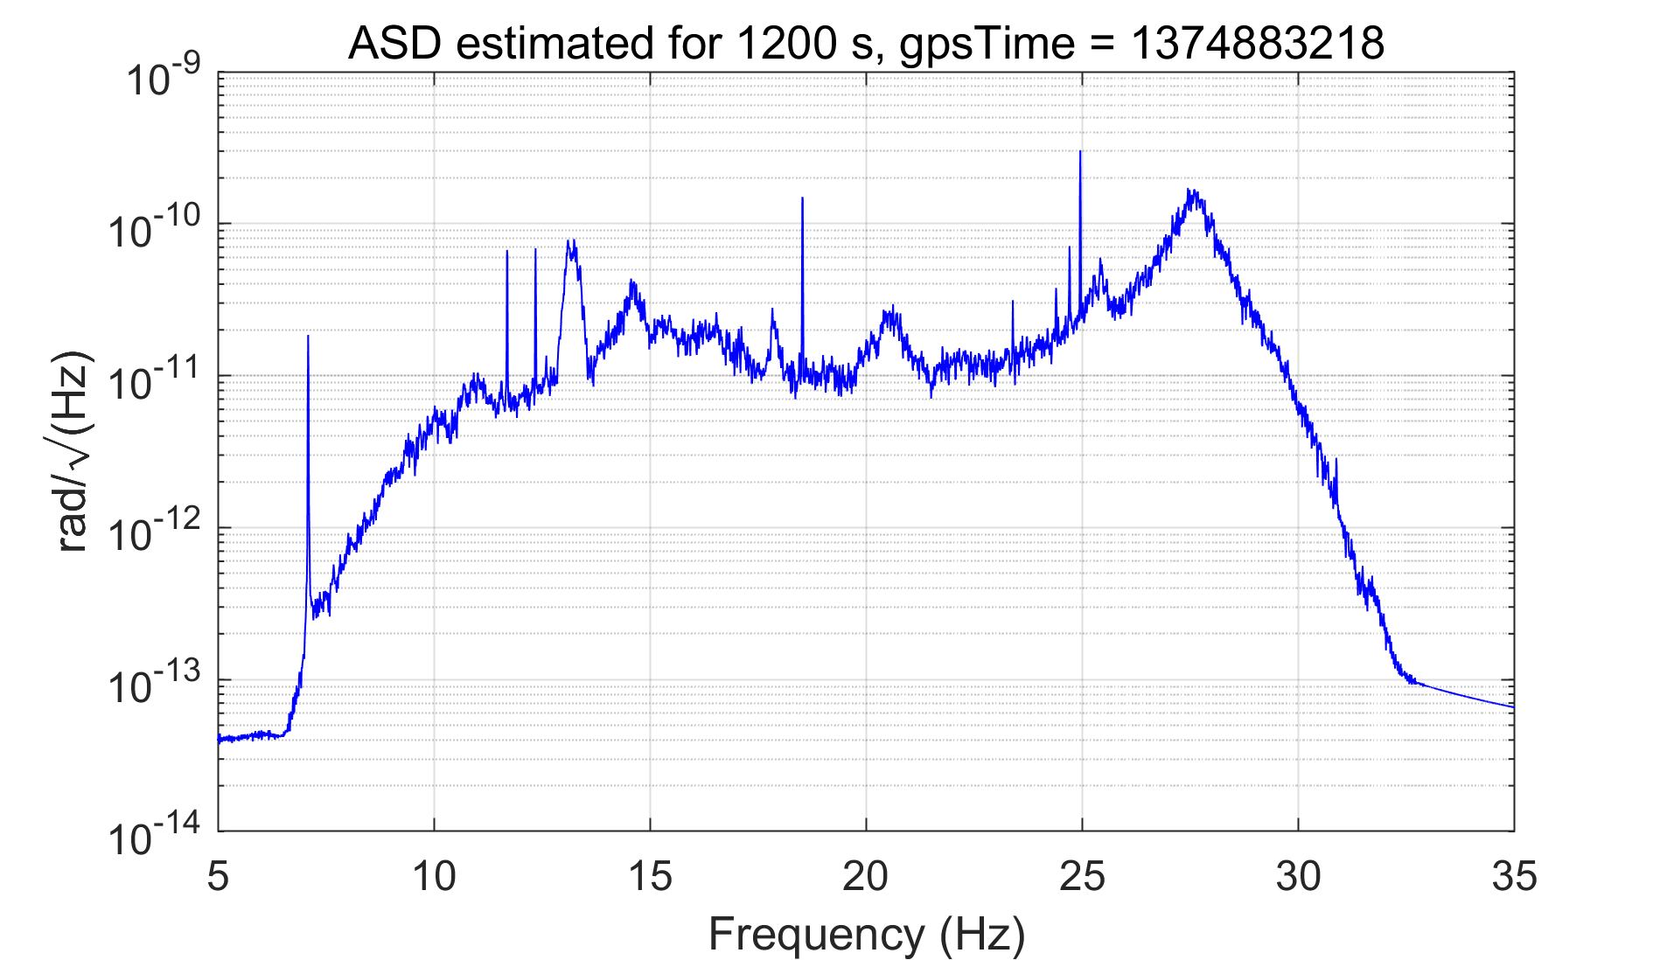
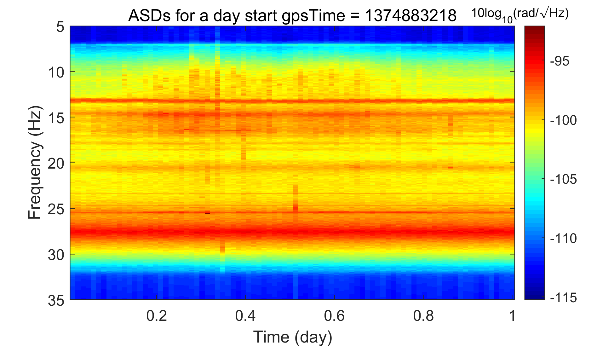
Spectral characteristics of target signal (tiltmeter)
Selection of output channel for cancellation – Seismic / Tiltmeter / GW strain channel
ASDs estimated every 1200 s, day = Aug 01, 2023
Several noise peaks visible in the seismic noise channels also visible in the tiltmeter
We aim for both sharp and broadband noise cancellation

Slide 13
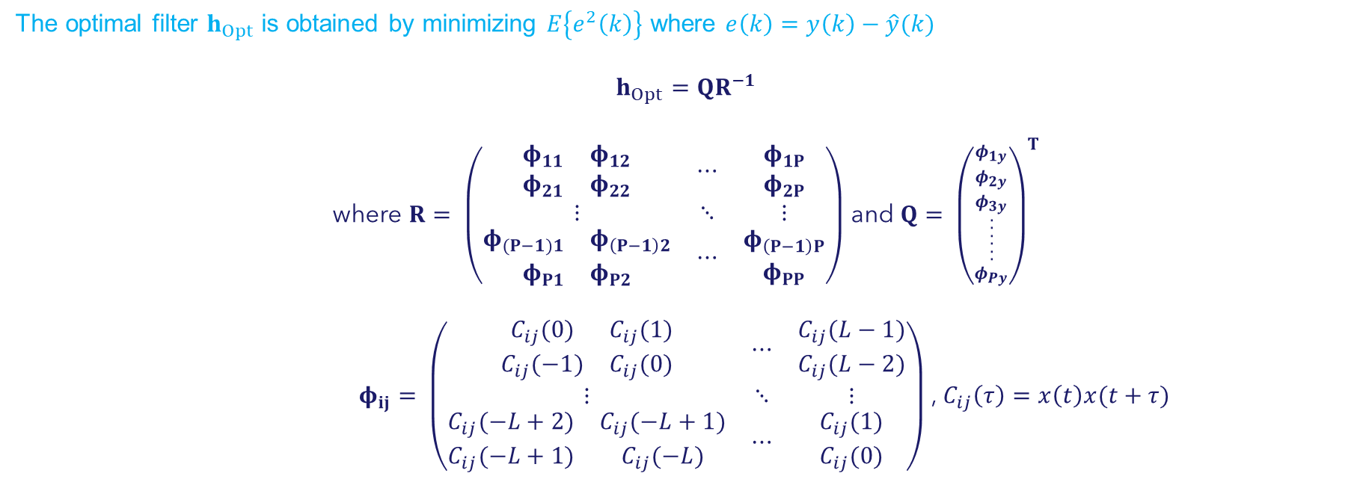
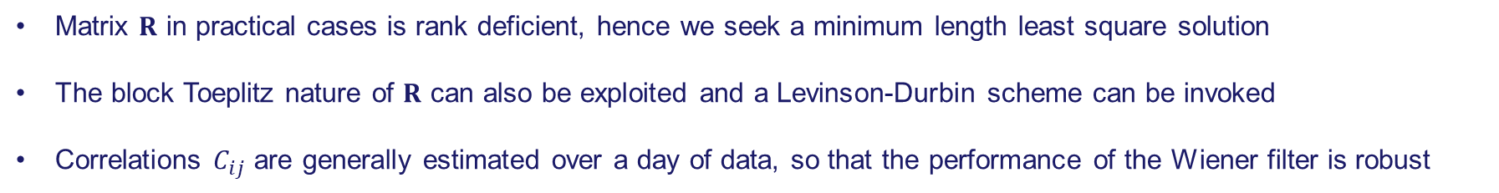
A static noise canceller – Wiener filter
The optimal filter $h_{Opt}$ is obtained by minimizing $E\left\{e^{2}\left(k\right)\right\}$ where $e\left(k\right)=y\left(k\right)−\hat{y}(k)$
$$h_{Opt}=QR^{−1}$$
where $R= \left(\begin{matrix}\begin{matrix}\begin{matrix}φ_{11} \\ φ_{21}\end{matrix} & \begin{matrix}φ_{12} \\ φ_{22}\end{matrix}\end{matrix} & ⋯ & \begin{matrix}φ_{1P} \\ φ_{2P}\end{matrix} \\ ⋮ & ⋱ & ⋮ \\ \begin{matrix}\begin{matrix}φ_{(P−1)1} & φ_{\left(P−1\right)2}\end{matrix} \\ \begin{matrix}φ_{P1} & φ_{P2}\end{matrix}\end{matrix} & ⋯ & \begin{matrix}φ_{\left(P−1\right)P} \\ φ_{PP}\end{matrix}\end{matrix}\right)$ and $Q= {\left({\begin{matrix}φ_{1y} \\ φ_{2y} \\ φ_{3y}\end{matrix} \atop \begin{aligned}. \\ . \\ . \\ . \\ . \\ . \\ φ_{Py}\end{aligned}}\right)}^{T}$
$φ_{ij}= \left(\begin{matrix}\begin{matrix}C_{ij}(0) & C_{ij}(1) \\ C_{ij}(−1) & C_{ij}(0)\end{matrix} & ⋯ & \begin{matrix}C_{ij}(L−1) \\ C_{ij}(L−2)\end{matrix} \\ ⋮ & ⋱ & ⋮ \\ \begin{matrix}C_{ij}(−L+2) & C_{ij}(−L+1) \\ C_{ij}(−L+1) & C_{ij}(−L)\end{matrix} & ⋯ & \begin{matrix}C_{ij}(1) \\ C_{ij}(0)\end{matrix}\end{matrix}\right)$ , $C_{ij}\left(τ\right)=x\left(t\right)x(t+τ)$
Matrix $R$ in practical cases is rank deficient, hence we seek a minimum length least square solution
The block Toeplitz nature of $R$ can also be exploited and a Levinson-Durbin scheme can be invoked
Correlations $C_{ij}$ are generally estimated over a day of data, so that the performance of the Wiener filter is robust

Slide 14
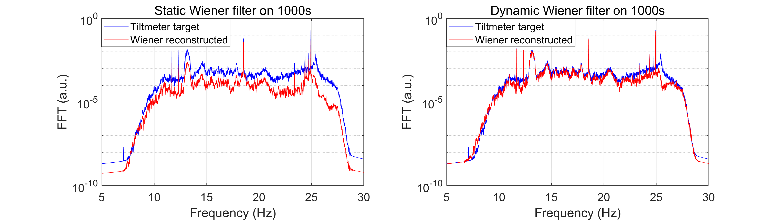
Wiener filter performance – spectral reconstruction
Noise cancellation in $dB$ is expressed in frequency band $f_{1}−f_{2}$ as $20\log_{10}\left(\frac{\sum_{f=f_{1}}^{f_{2}}{ℱ}(e\left(k\right))}{\sum_{f=f_{1}}^{f_{2}}{ℱ}(y\left(k\right))}\right)$
Errors are computed by doing a FFT of the error and target signal every 10 s
Case 1 – Wiener filter estimated using a day of data on July 31, 2023 and applied to the data on Aug 01, 2023
Case 2 – Wiener filter estimated every 1000 s and applied to the same data segment

Slide 15
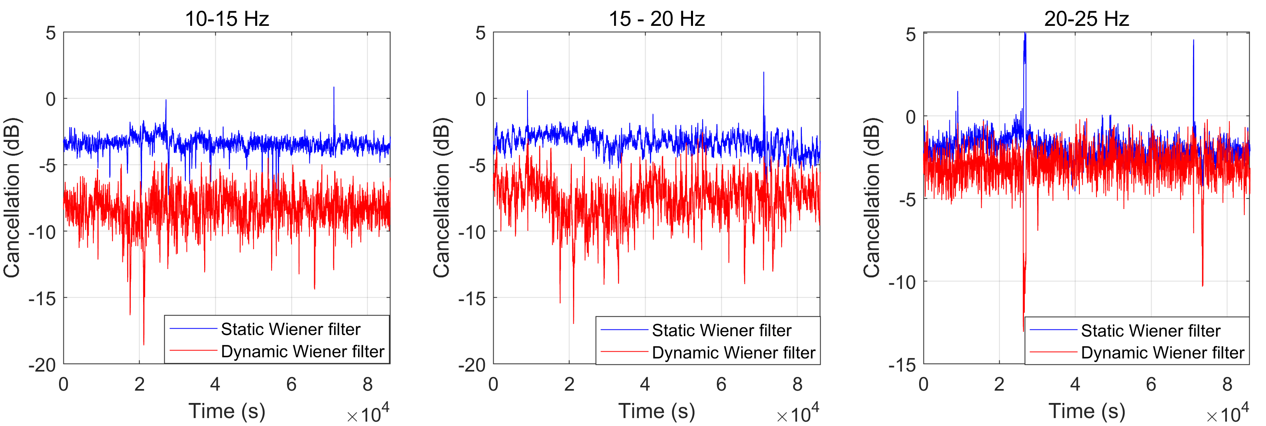
Wiener filter performance – subtraction in frequency bands
Noise cancellation in $dB$ is expressed in frequency band $f_{1}−f_{2}$ as $20\log_{10}\left(\frac{\sum_{f=f_{1}}^{f_{2}}{ℱ}(e\left(k\right))}{\sum_{f=f_{1}}^{f_{2}}{ℱ}(y\left(k\right))}\right)$
Errors are computed by doing a FFT of the error and target signal every 10 s
Case 1 – Wiener filter estimated using a day of data on July 31, 2023 and applied to the data on Aug 01, 2023
Case 2 – Wiener filter estimated every 1000 s and applied to the same data segment

Slide 16
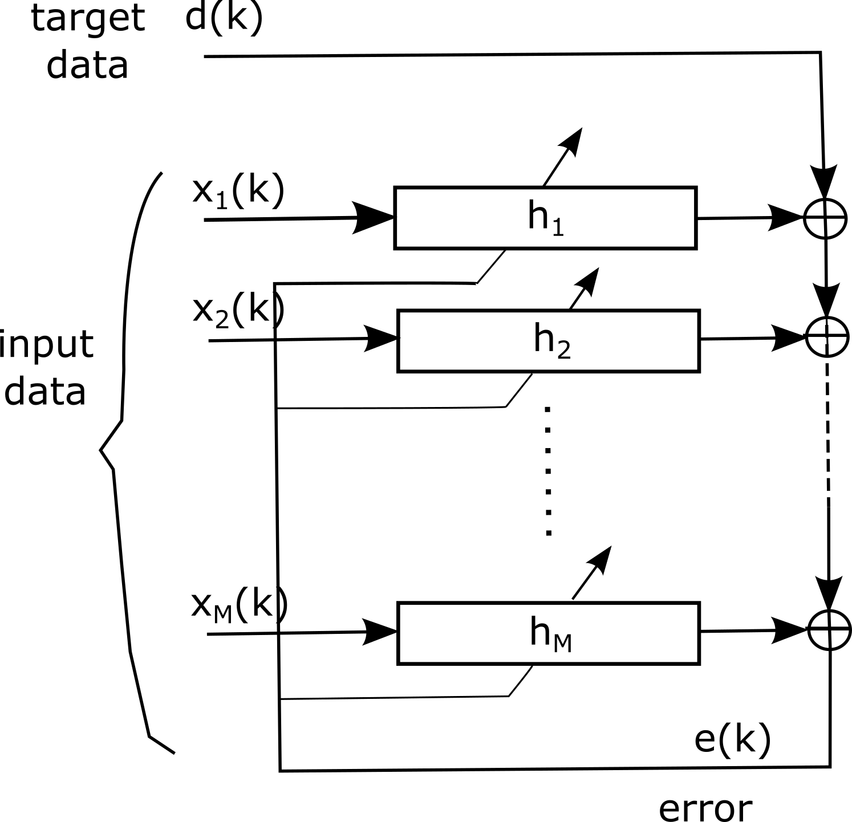
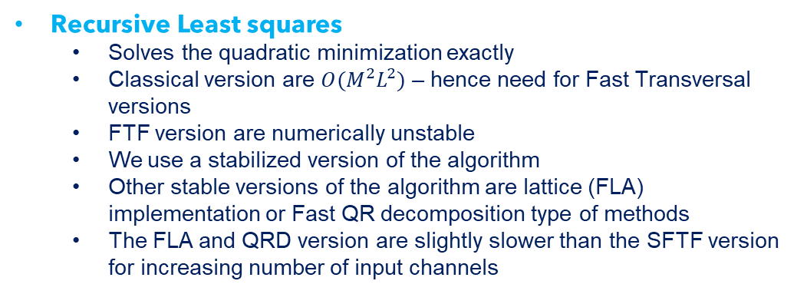
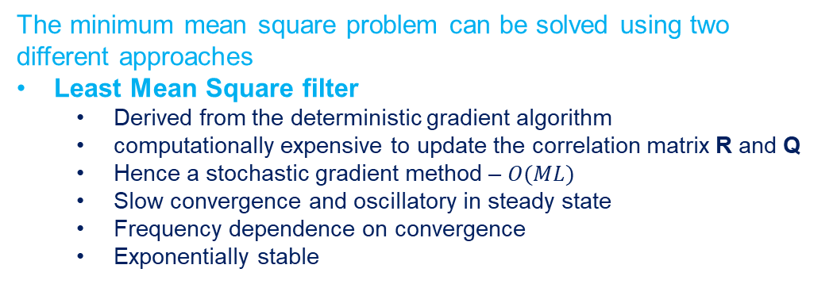
Adaptive filters
Since the static Wiener filter does not match the performance of the dynamic Wiener filter – Need for Adaptive filters (S. Koley et al., 2023)
The minimum mean square problem can be solved using two different approaches
Least Mean Square filter
  Derived from the deterministic gradient algorithm
  computationally expensive to update the correlation matrix R and Q
  Hence a stochastic gradient method – $O(ML)$
  Slow convergence and oscillatory in steady state
  Frequency dependence on convergence
  Exponentially stable
Recursive Least squares
  Solves the quadratic minimization exactly
  Classical version are $O(M^{2}L^{2})$ – hence need for Fast Transversal versions
  FTF version are numerically unstable
  We use a stabilized version of the algorithm
  Other stable versions of the algorithm are lattice (FLA) implementation or Fast QR decomposition type of methods
  The FLA and QRD version are slightly slower than the SFTF version for increasing number of input channels

Slide 17
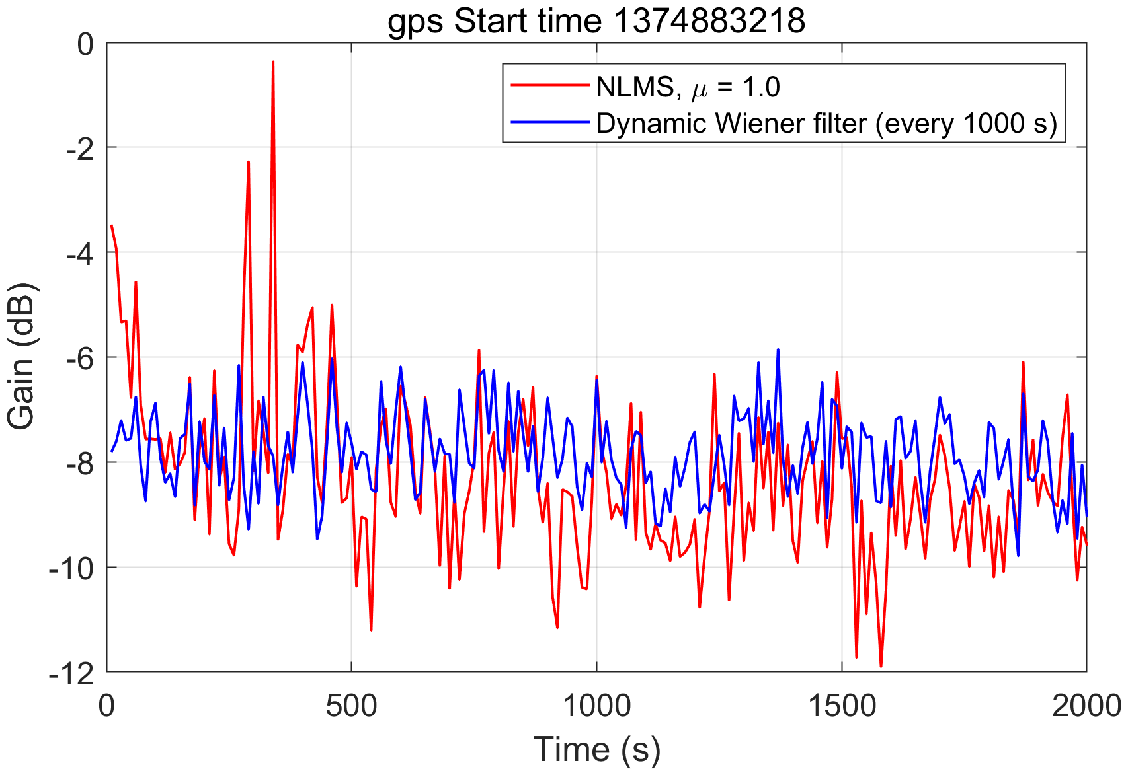
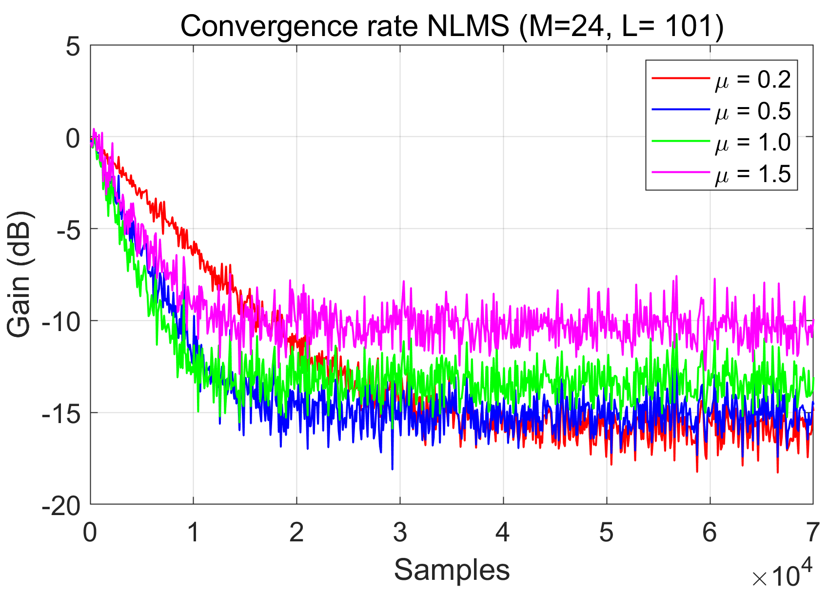
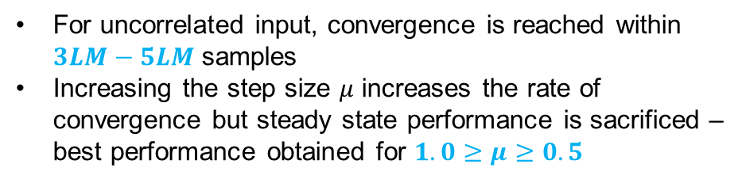
Adaptive filters – Normalized Least Mean Square
The NLMS filter adapts stochastically to every new sample; normalized step length of 0.5 works best
The filter coefficients at $k^{th}$ time step are updated using the coefficients at the ${\left(k−1\right)}^{th}$ time step as
$h\left(k\right)=h\left(k−1\right)+μ(k)x\left(k−1\right)e\left(k\right)$,
where $μ(n)= \frac{α}{x\left(n\right)x^{T}\left(n\right)+δ}$, $0<α<2$, $δ≈0$
For uncorrelated input, convergence is reached within $3LM−5LM$ samples
Increasing the step size $μ$ increases the rate of convergence but steady state performance is sacrificed – best performance obtained for $1.0≥μ≥0.5$
NLMS convergence when applied to the tiltmeter signal

Slide 18
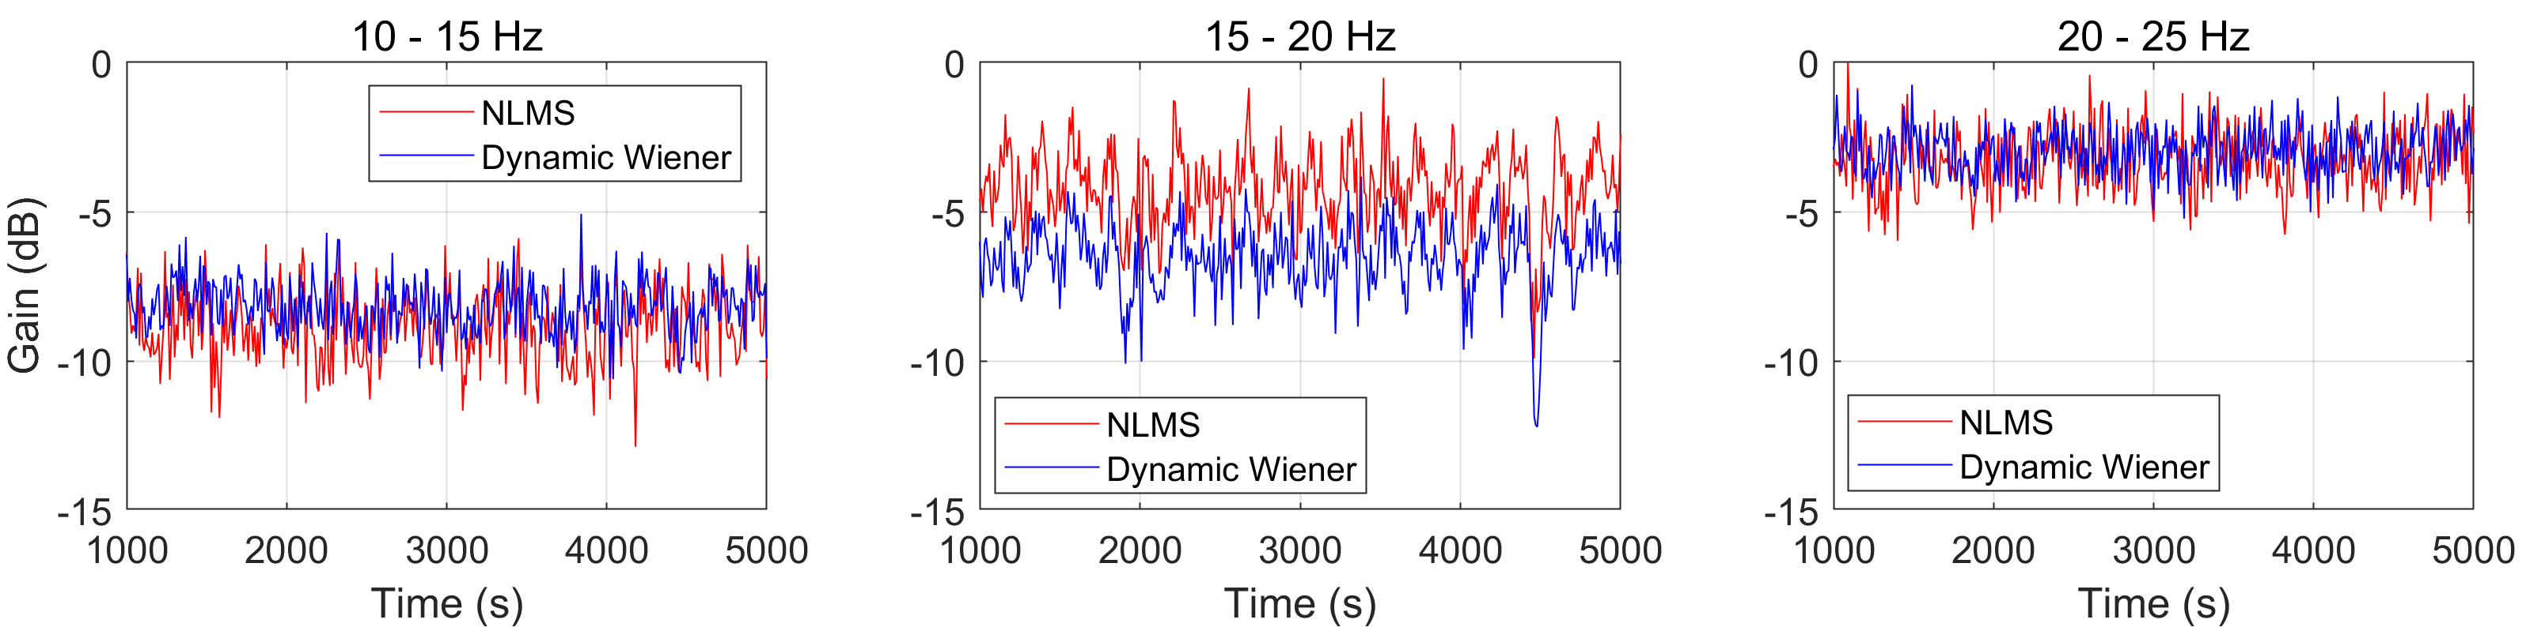
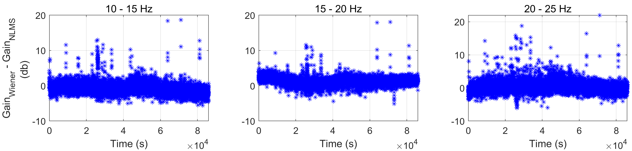
Adaptive filters – Normalized Least Mean Square
The NLMS algorithm suffers from spectral bias and suffers from sub-optimal performance in 15-20 Hz band
Difference between the gain obtained from dynamic Wiener filter and that from the NLMS can be used to assess the performance of the adaptive filter

Slide 19
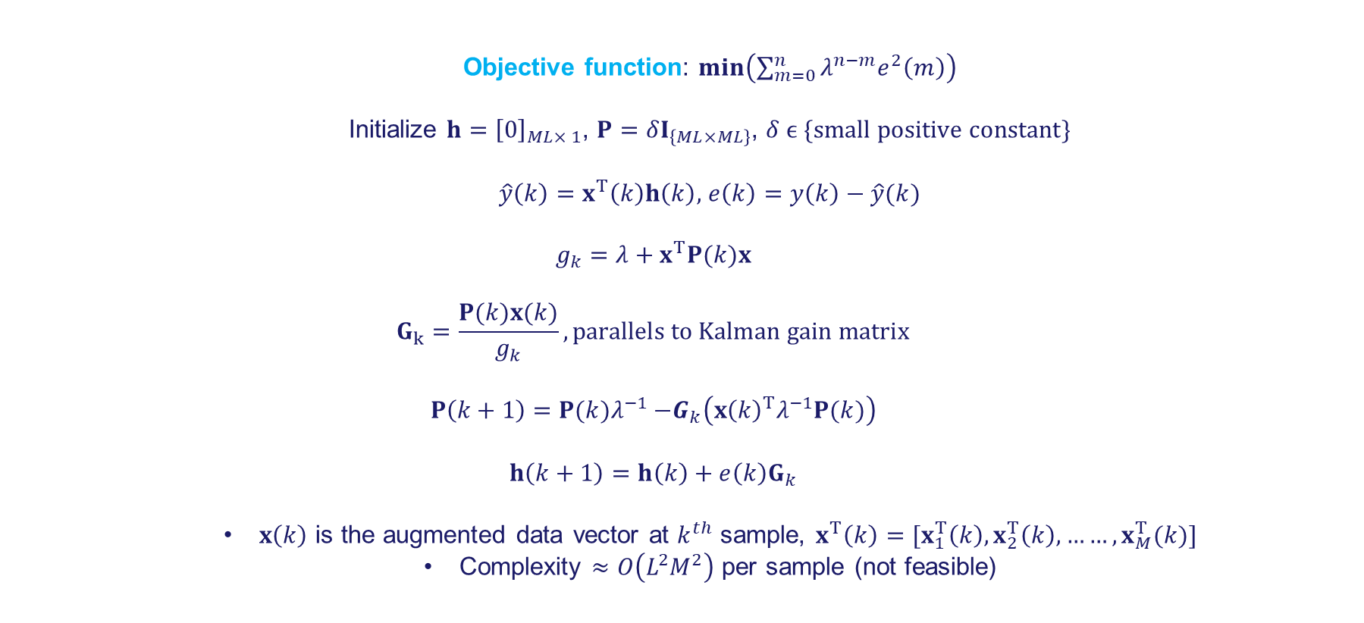
Adaptive filters – Recursive Least Square (classical RLS)
The algorithm minimizes a weighted sum of squares of the error by making use of forgetting factor $λ, λ≈1.0$, but $≠1.0$
  Objective function: $\min\left(\sum_{m=0}^{n}{λ^{n−m}e^{2}\left(m\right)}\right)$
  Initialize $h={\left[0\right]}_{ML× 1}$, $P=δI_{\left\{ML×ML\right\}}$, $δ ϵ \{small positive constant\}$
  $\hat{y}\left(k\right)=x^{T}\left(k\right)h\left(k\right),$ $e\left(k\right)=y\left(k\right)−\hat{y}(k)$
  $$g_{k}=λ+x^{T}P(k)x$$
  $$G_{k}=\frac{P(k)x(k)}{g_{k}}, parallels to Kalman gain matrix$$
  $$P\left(k+1\right)=P{(k)λ}^{−1} −G_{k}\left({x\left(k\right)}^{T}λ^{−1}P(k)\right)$$
  $$h\left(k+1\right)=h\left(k\right)+e\left(k\right)G_{k}$$
  $x\left(k\right)$ is the augmented data vector at $k^{th}$ sample, $x^{T}\left(k\right)=[x_{1}^{T}\left(k\right), x_{2}^{T}\left(k\right),……,x_{M}^{T}(k)]$
  Complexity $≈O\left(L^{2}M^{2}\right)$ per sample (not feasible)

Slide 20
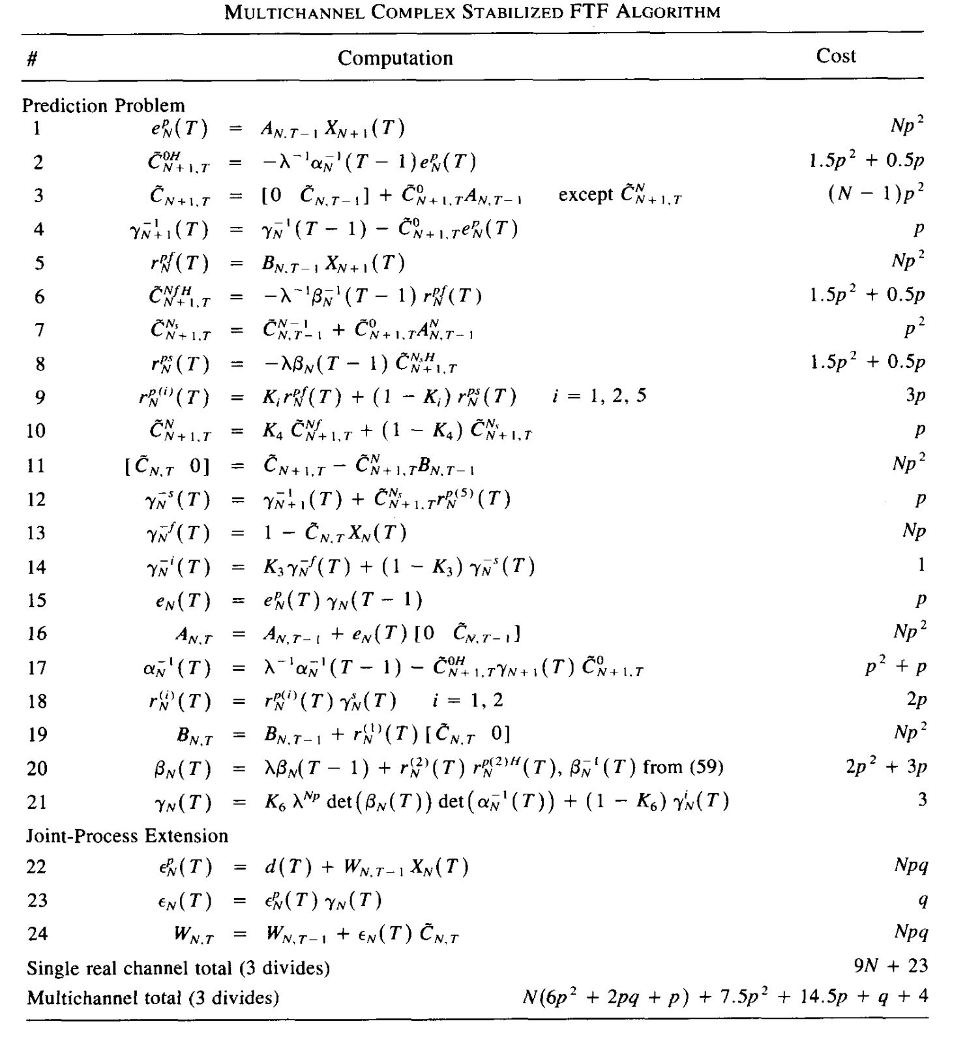

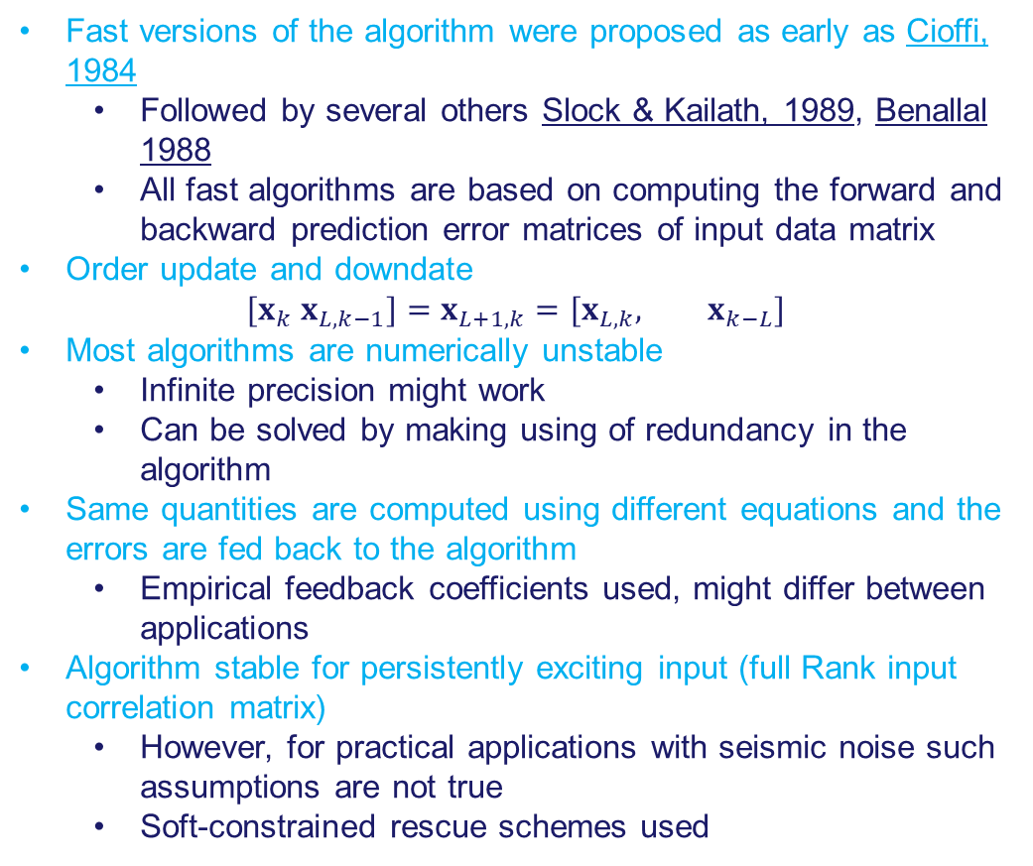
Adaptive filters – Numerically stabilized fast RLS (Slock & Kailath, 1991)
Fast versions of the algorithm were proposed as early as Cioffi, 1984
  Followed by several others Slock & Kailath, 1989, Benallal 1988
  All fast algorithms are based on computing the forward and backward prediction error matrices of input data matrix
Order update and downdate
$${[x}_{k} x_{L,k−1}]=x_{L+1,k}=[x_{L,k}, x_{k−L}]$$
Most algorithms are numerically unstable
  Infinite precision might work
  Can be solved by making using of redundancy in the algorithm
Same quantities are computed using different equations and the errors are fed back to the algorithm
  Empirical feedback coefficients used, might differ between applications
Algorithm stable for persistently exciting input (full Rank input correlation matrix)
  However, for practical applications with seismic noise such assumptions are not true
  Soft-constrained rescue schemes used

Slide 21
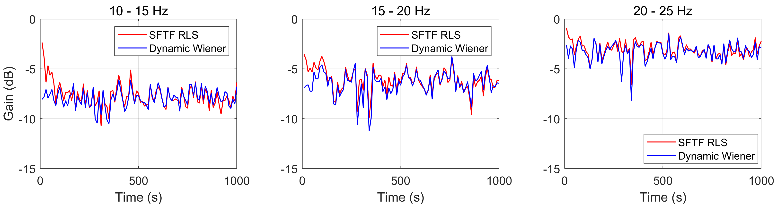
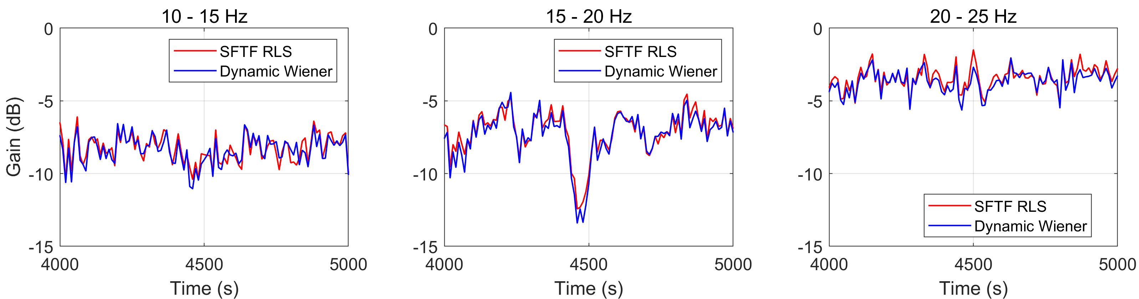
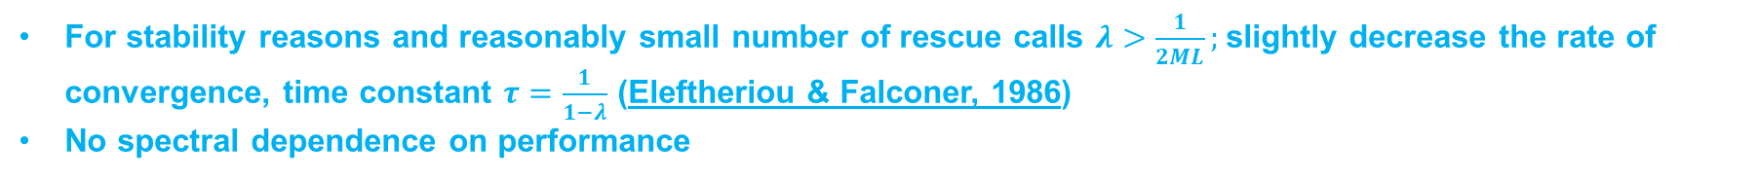
Adaptive filters – SFTF RLS implementation
For stability reasons and reasonably small number of rescue calls $λ>\frac{1}{2ML};$slightly decrease the rate of convergence, time constant $τ=\frac{1}{1−λ}$ (Eleftheriou & Falconer, 1986)
No spectral dependence on performance
Initial convergence
Steady state

Slide 22
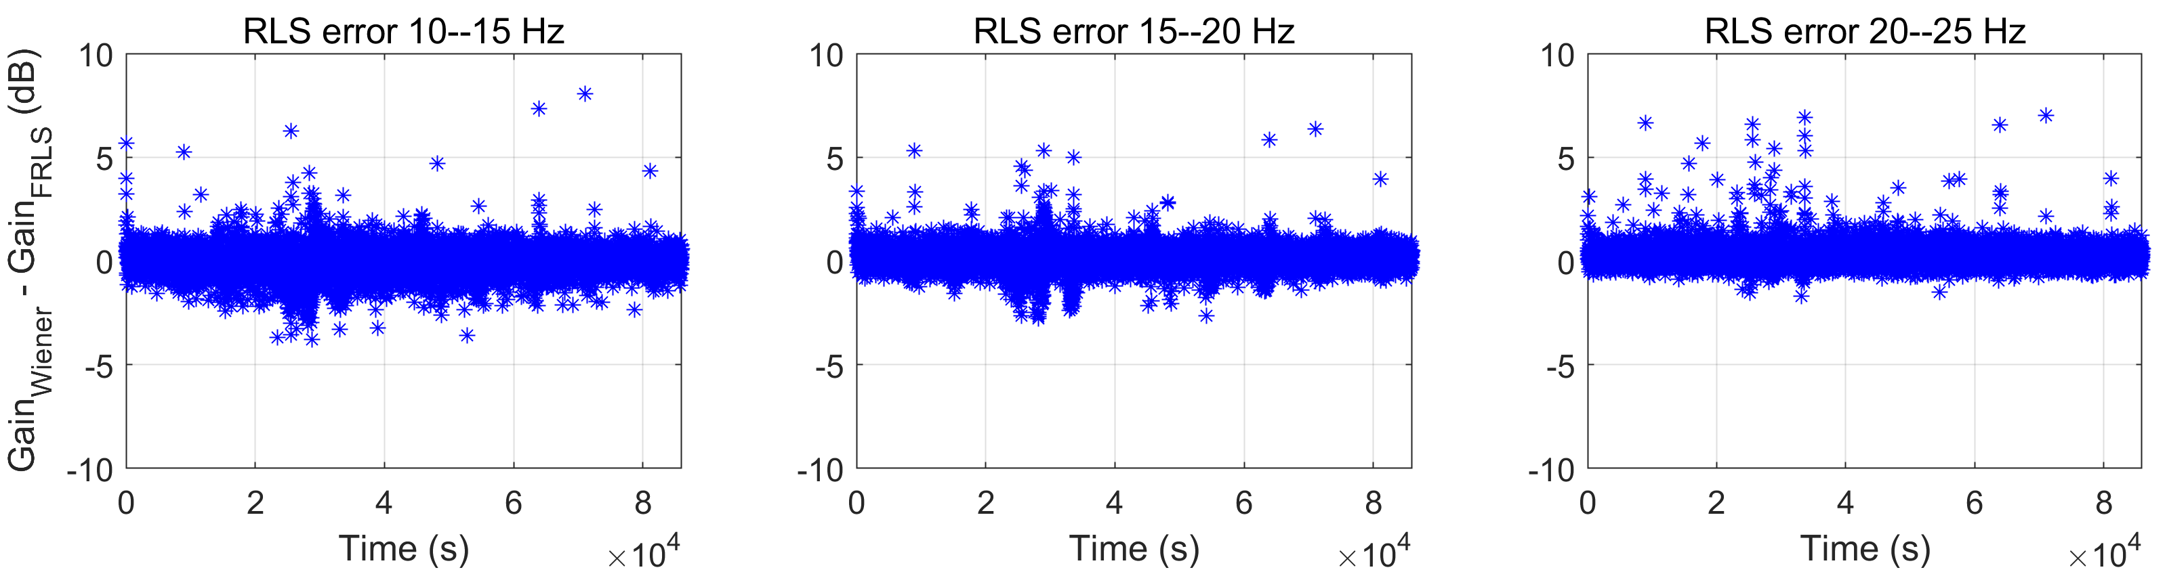
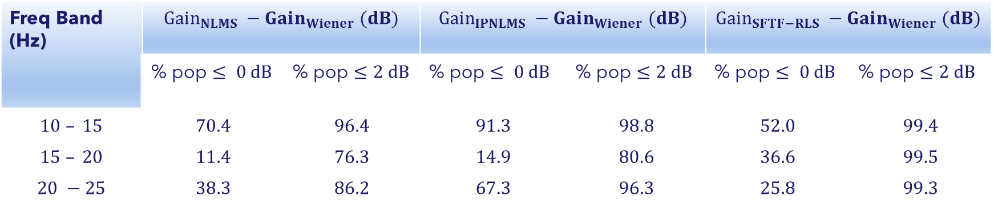
Adaptive filters – SFTF-RLS comparison with Dynamic Wiener
Difference between the gain obtained from dynamic Wiener filter and that from SFTF RLS can be used to assess the performance of the adaptive filter
Freq Band (Hz) | $$Gain_{NLMS} −Gain_{Wiener} (dB)$$ |  | $$Gain_{IPNLMS} −Gain_{Wiener} (dB)$$ |  | $$Gain_{SFTF−RLS} −Gain_{Wiener} (dB)$$
 | % pop $≤ 0 dB$ | % pop $≤2 dB$ | % pop $≤ 0 dB$ | % pop $≤2 dB$ | % pop $≤ 0 dB$ | % pop $≤2 dB$
$$10 – 15$$ | $$70.4$$ | $$96.4$$ | $$91.3$$ | $$98.8$$ | $$52.0$$ | $$99.4$$
$$15 – 20$$ | $$11.4$$ | $$76.3$$ | $$14.9$$ | $$80.6$$ | $$36.6$$ | $$99.5$$
$$20 −25$$ | $$38.3$$ | $$86.2$$ | $$67.3$$ | $$96.3$$ | $$25.8$$ | $$99.3$$

Slide 23
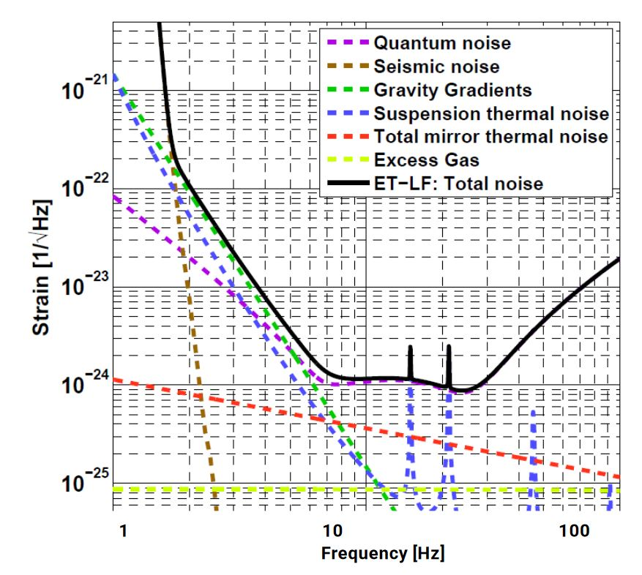
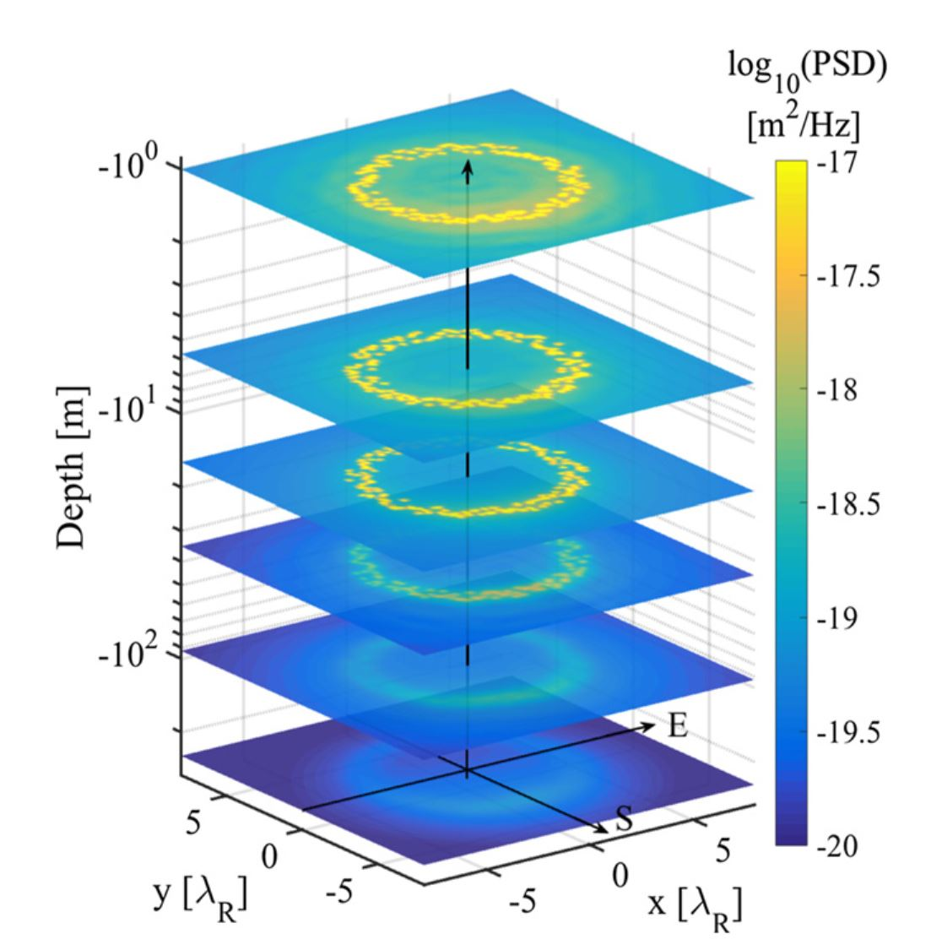
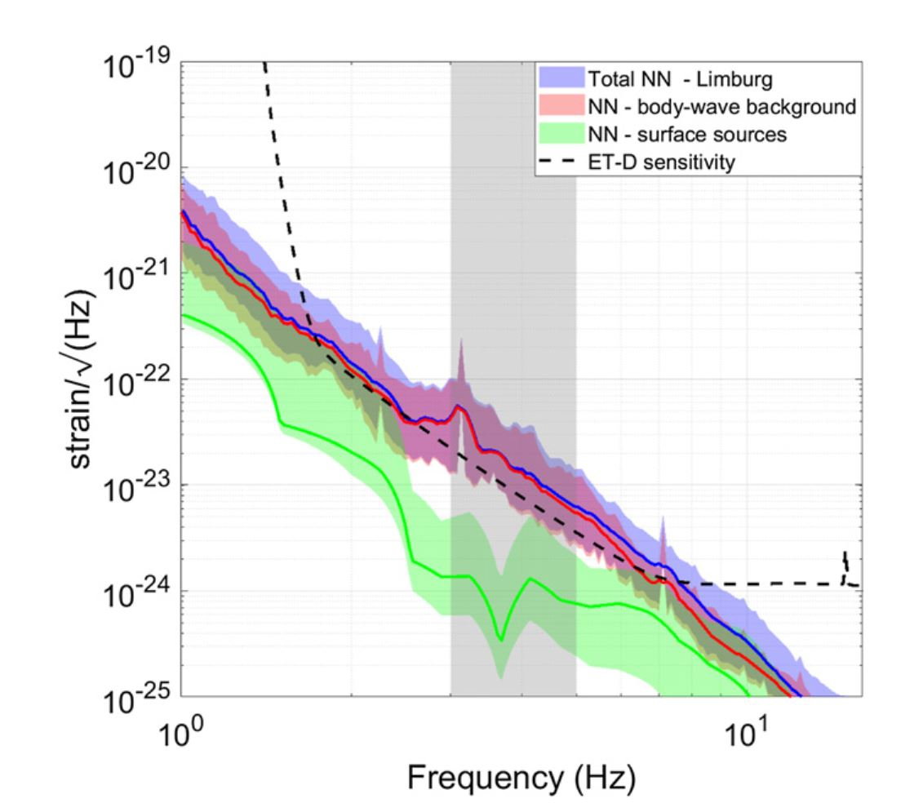
Outlook – Towards Einstein Telescope
Einstein Telescope is a planned underground GW detector that aims two order of magnitude sensitivity improvement over AdV+ at 10 Hz and achieve strain sensitivity of ${10}^{−22}/√Hz$ at 2 Hz – Newtonian noise is a severe limitation
Numerical simulations of NN (M.Bader et al 2022, S.Koley et al 2022)
Elastodynamic simulations – based on geology and noise source distribution at the site
Body wave background – plane waves

Slide 24
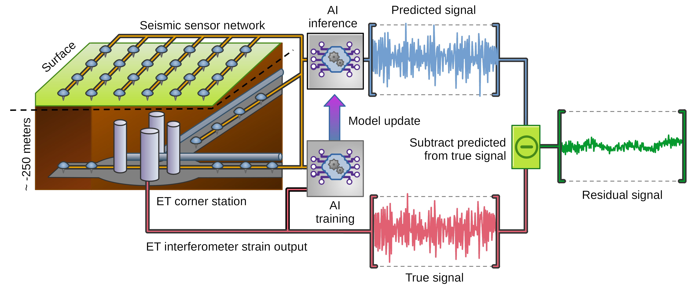
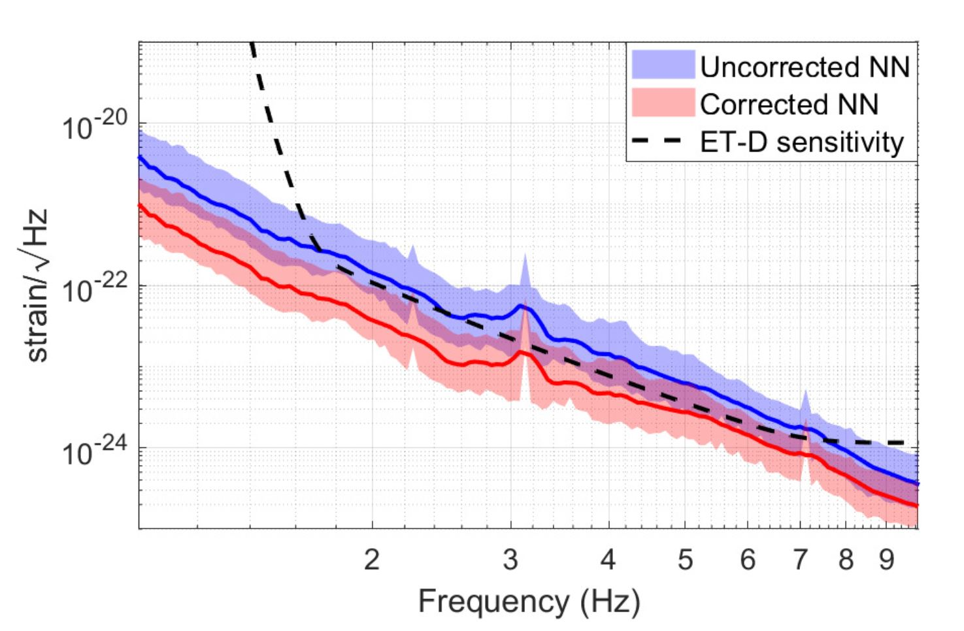
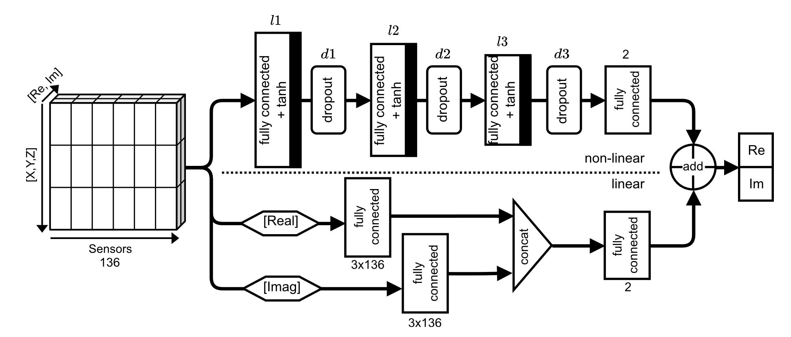
Outlook – Deep Neural Network for Newtonian noise subtraction
Up to a factor 4 reduction in strain could be achieved in the frequency band 3-10 Hz (V. Beveren et al, 2023)
Network architecture
Newtonian noise subtraction performance

Slide 25
Recap
Wiener filter (static and dynamic) and adaptive filters were applied to cancel the tilt signal by using seismic noise data acquired by an array of 24 geophones surrounding the tiltmeter
Tilt cancellation was performed in the frequency band 10 - 25 Hz
Dynamic Wiener filter (estimated every 1000 s) achieved a subtraction of about 10 dB in the frequency band 10 -20 Hz- almost double than that of the static Wiener filter
Several adaptive noise filtering schemes were explored – NLMS, IPNLMS, RLS, FTF-RLS – QRD-RLS FLA-RLS not feasible
The NLMS algorithm performed better than the dynamic filter in the 10 – 15 Hz band and performance degrades at higher frequencies
IPNLMS performed better than NLMS but performance in the 15 – 20 Hz was worse than the dynamic Wiener filter
Stabilized FTF versions of the RLS algorithm was found suitable for real time applications – O(N)
Performance as good as the dynamic filter in the entire frequency band of interest – 10 – 25 Hz

Slide 26

Thank you!
Questions

