Slide 1
Science targets in the decihertz frequency band
Christopher Berry • cplberry.com • @cplberry
Gravitational Waves: Noise sources and mitigation strategies • 13 November 2023
LIGO/Caltech/MIT/Sonoma State/Aurore Simonnet

Slide 2
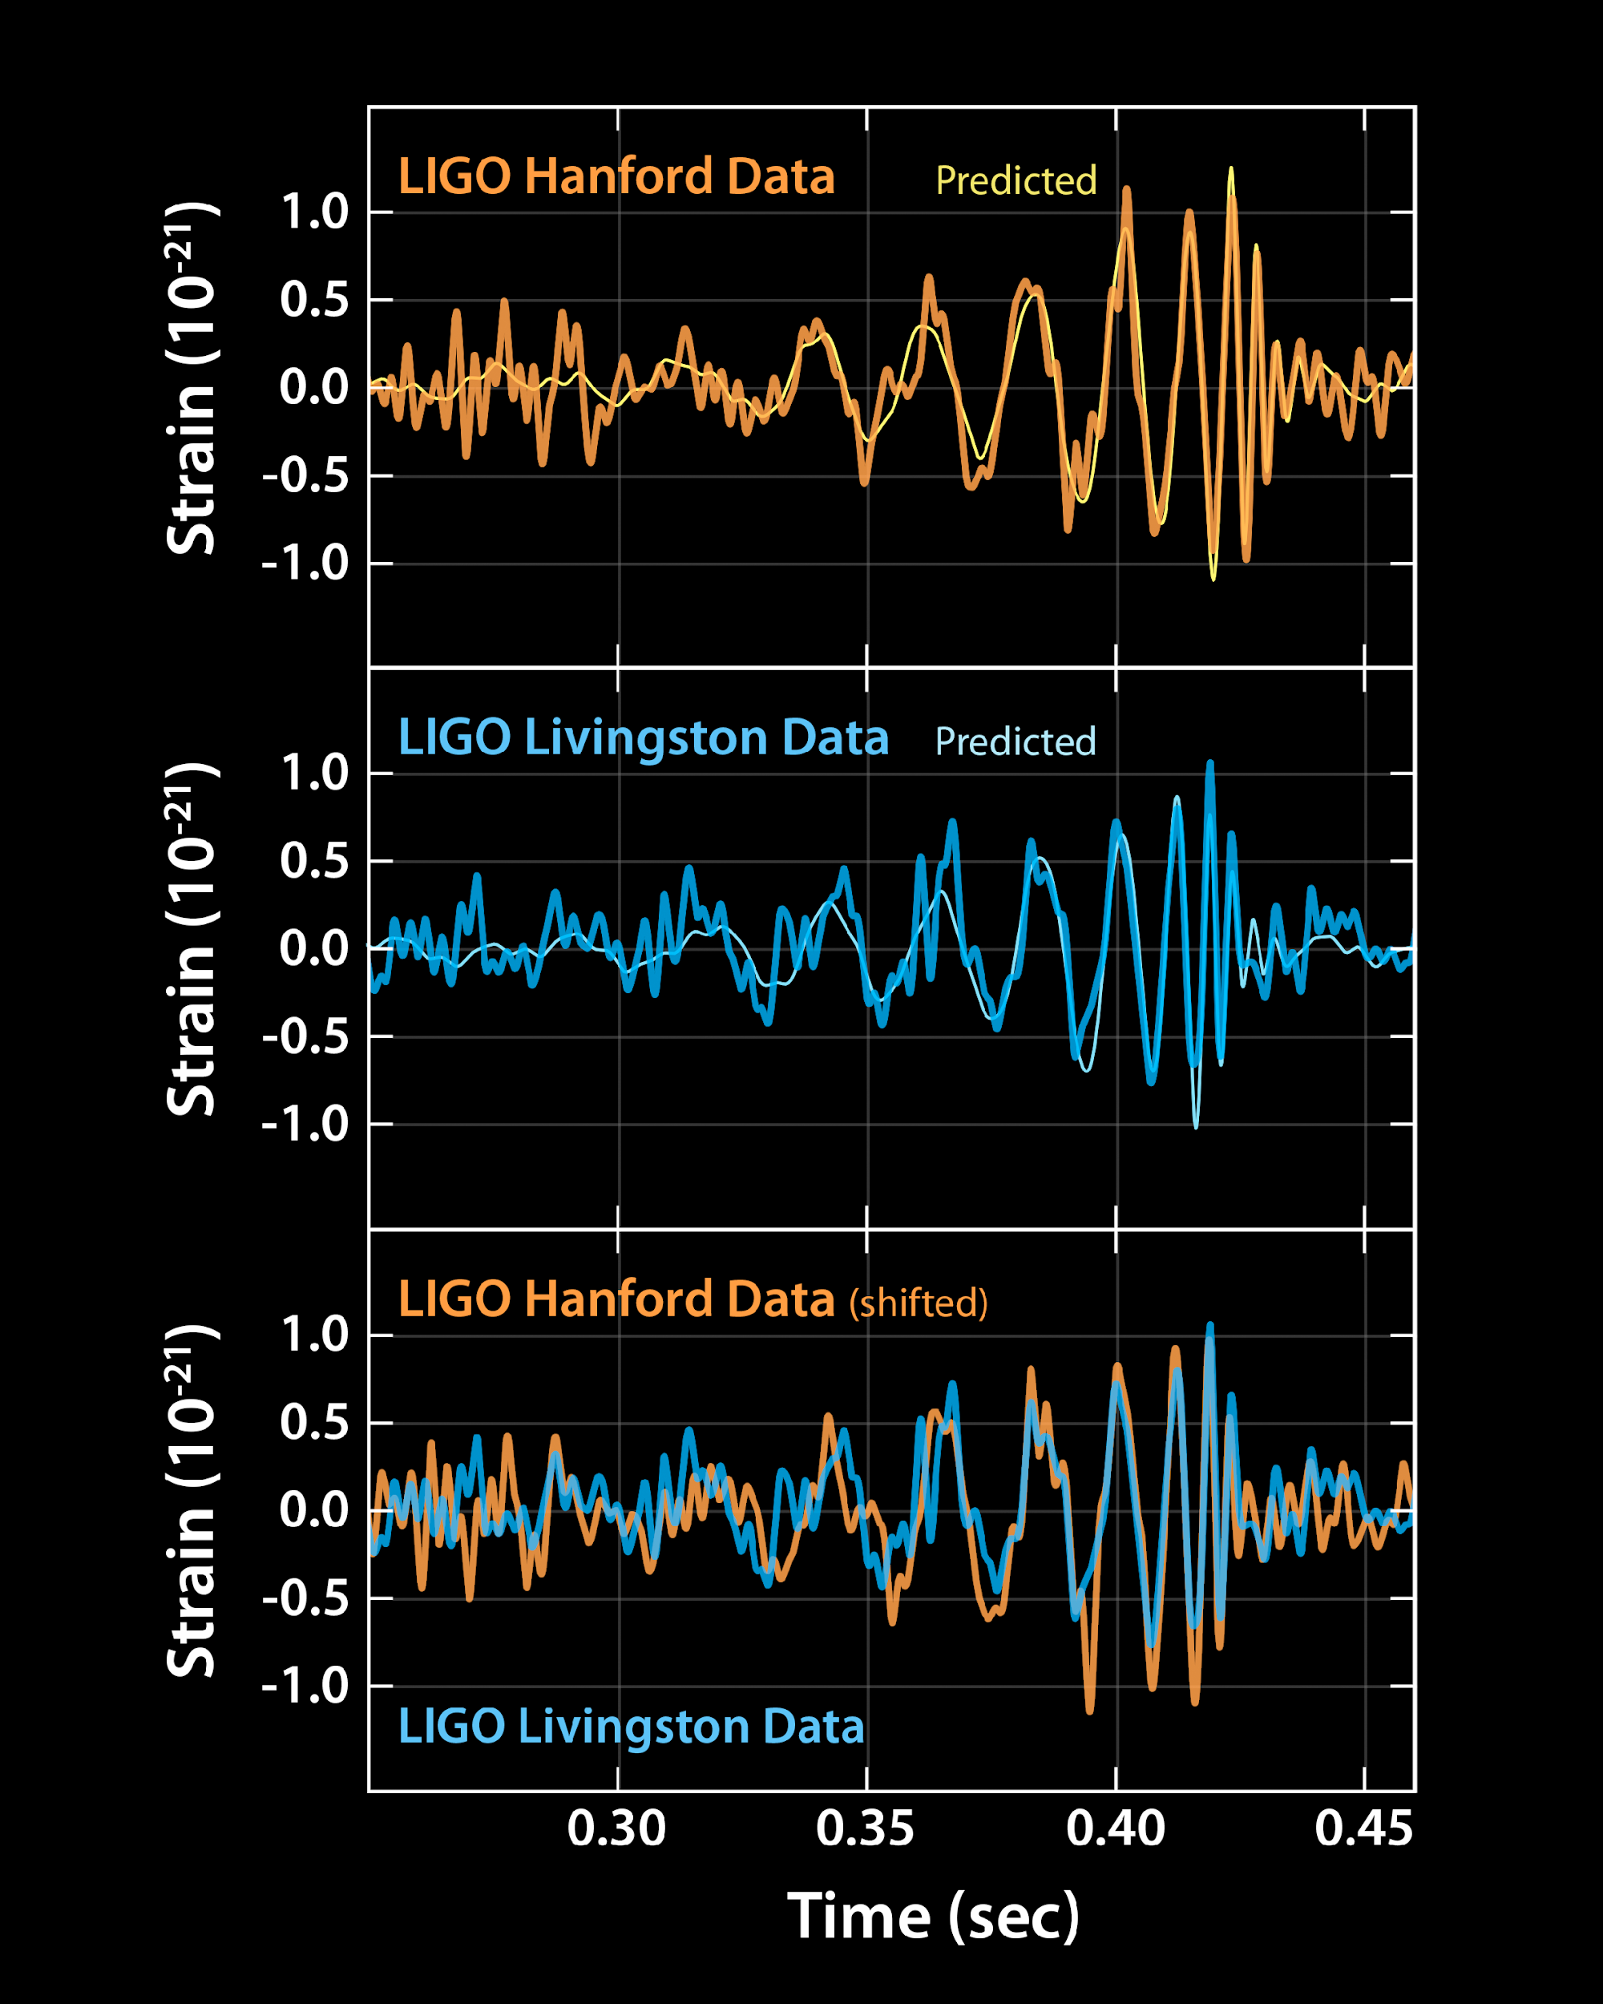
GW150914
Signals encode information about their sources
GW150914 parameter estimation arXiv:1602.03840
GW150914 astrophysical implications arXiv:1602.03846
14 September 2015 we observed gravitational waves
The signal came from the coalescence of a binary black hole
LIGO

Slide 3
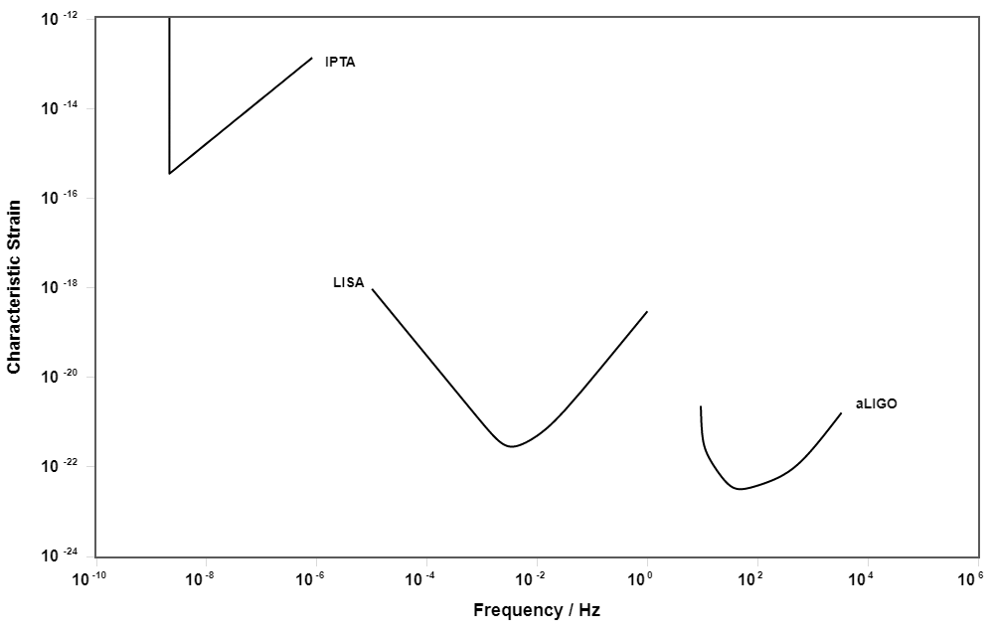
Gravitational-wave spectrum
Different technologies used for different frequency ranges
Currently, LIGO, Virgo and KAGRA observe at highest frequencies
LISA is due for launch in 2030s
Pulsar timing arrays observe at lowest frequencies
Pulsar timing arrays
Space-borne detectors
Ground- based detectors
Moore, Cole & CPLB arXiv:1408.0740

Slide 4
Gravitational-wave spectrum
Not to scale
Different sources wait in each part of the spectrum
Pulsar timing arrays
Space-borne detectors
Ground- based detectors
Moore, Cole & CPLB arXiv:1408.0740
Black holes: ButterflyLove1

Slide 5
Gravitational-wave spectrum
ALIA Bender, Begelman & Gair 2013 TianQin Luo et al. arXiv:1512.02076 Taiji Ruan et al. arXiv:1807.09495 DECIGO Kawamura et al. arXiv:2006.13545 TianGO Kuns et al. arXiv:1908.06004 GADFLI McWillians arXiv:1111.3708 gLISA Tinto et al. arXiv:1410.1813 SAGE Lacour et al. arXiv:1811.04743 MAGIS Graham et al. arXiv:1711.02225 AEDGE Abou El-Neaj et al. arXiv:1908.00802 Big Bang Observer Crowder & Cornish arXiv:gr-qc/0506015 DO-Conservative & DO-Optimal Arca Sedda, CPLB et al. arXiv:1908.11375
dHz
Moore, Cole & CPLB arXiv:1408.0740

Slide 6
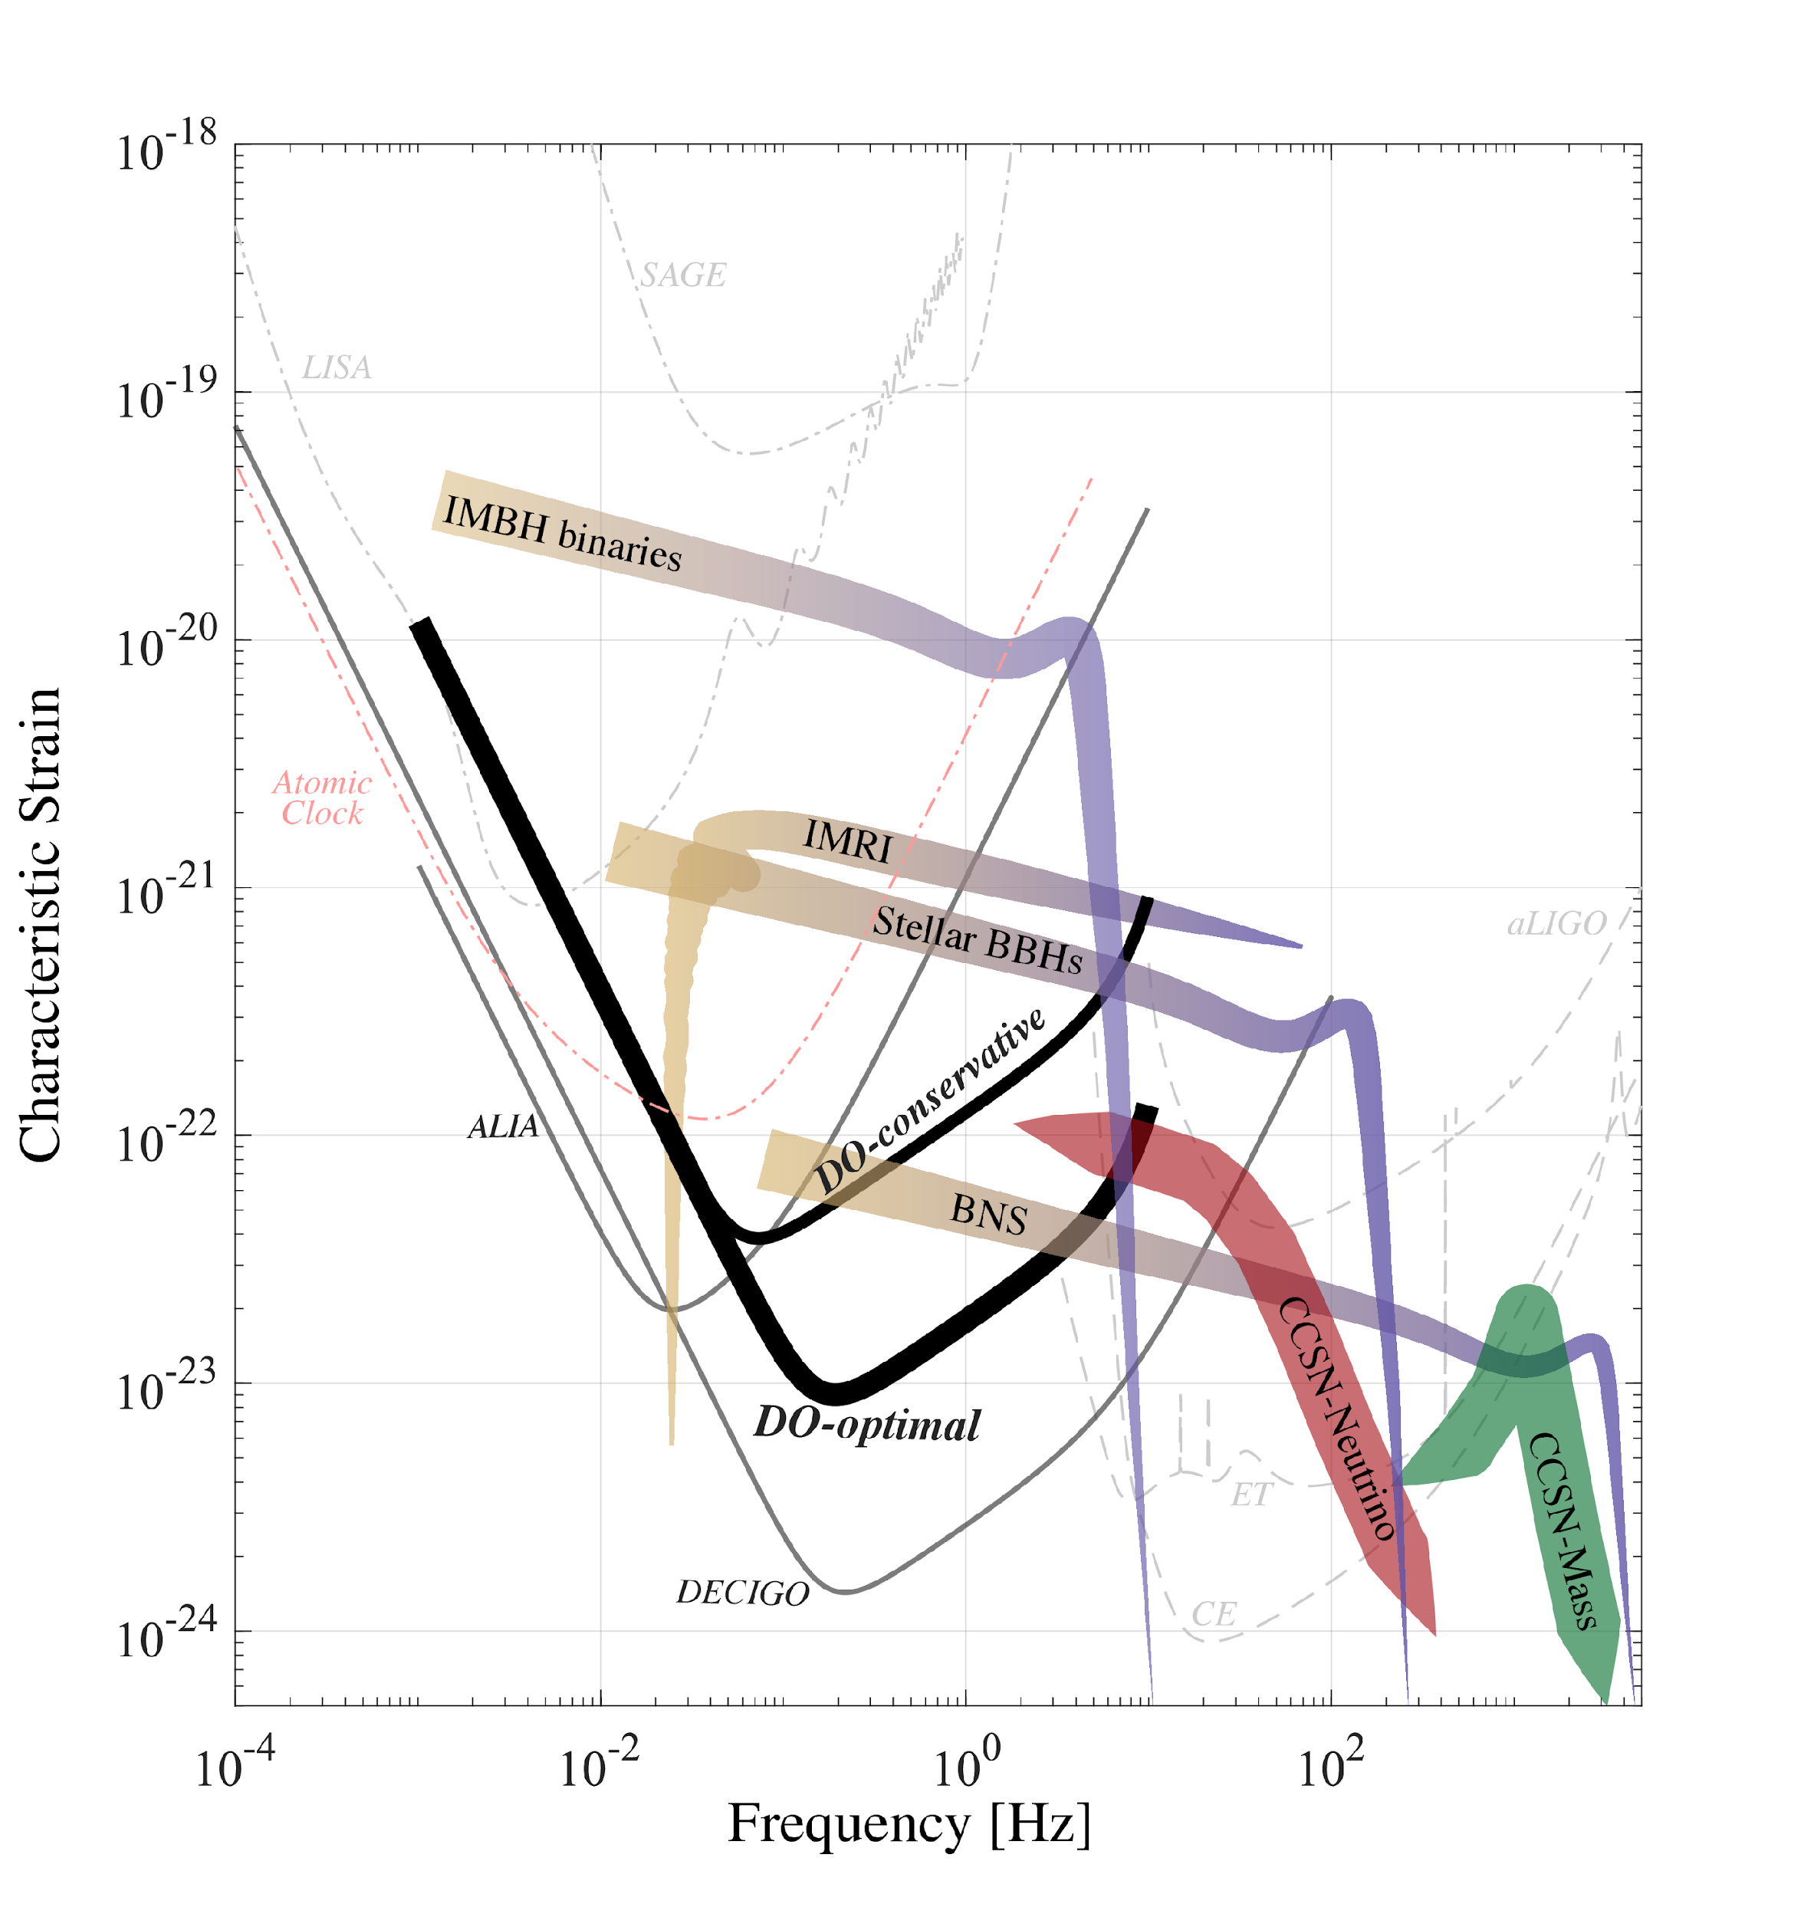
Decihertz
New insights into the properties of stellar-mass binaries
Completing observations of the black hole mass spectrum
Multiband observations
New tests of fundamental physics
Arca Sedda, CPLB et al. arXiv:1908.11375

Slide 7
Stellar-mass binaries

Slide 8
GW150914
Signals encode information about their sources
GW150914 parameter estimation arXiv:1602.03840
GW150914 astrophysical implications arXiv:1602.03846
14 September 2015 we observed gravitational waves
The signal came from the coalescence of a binary black hole
LIGO

Slide 9
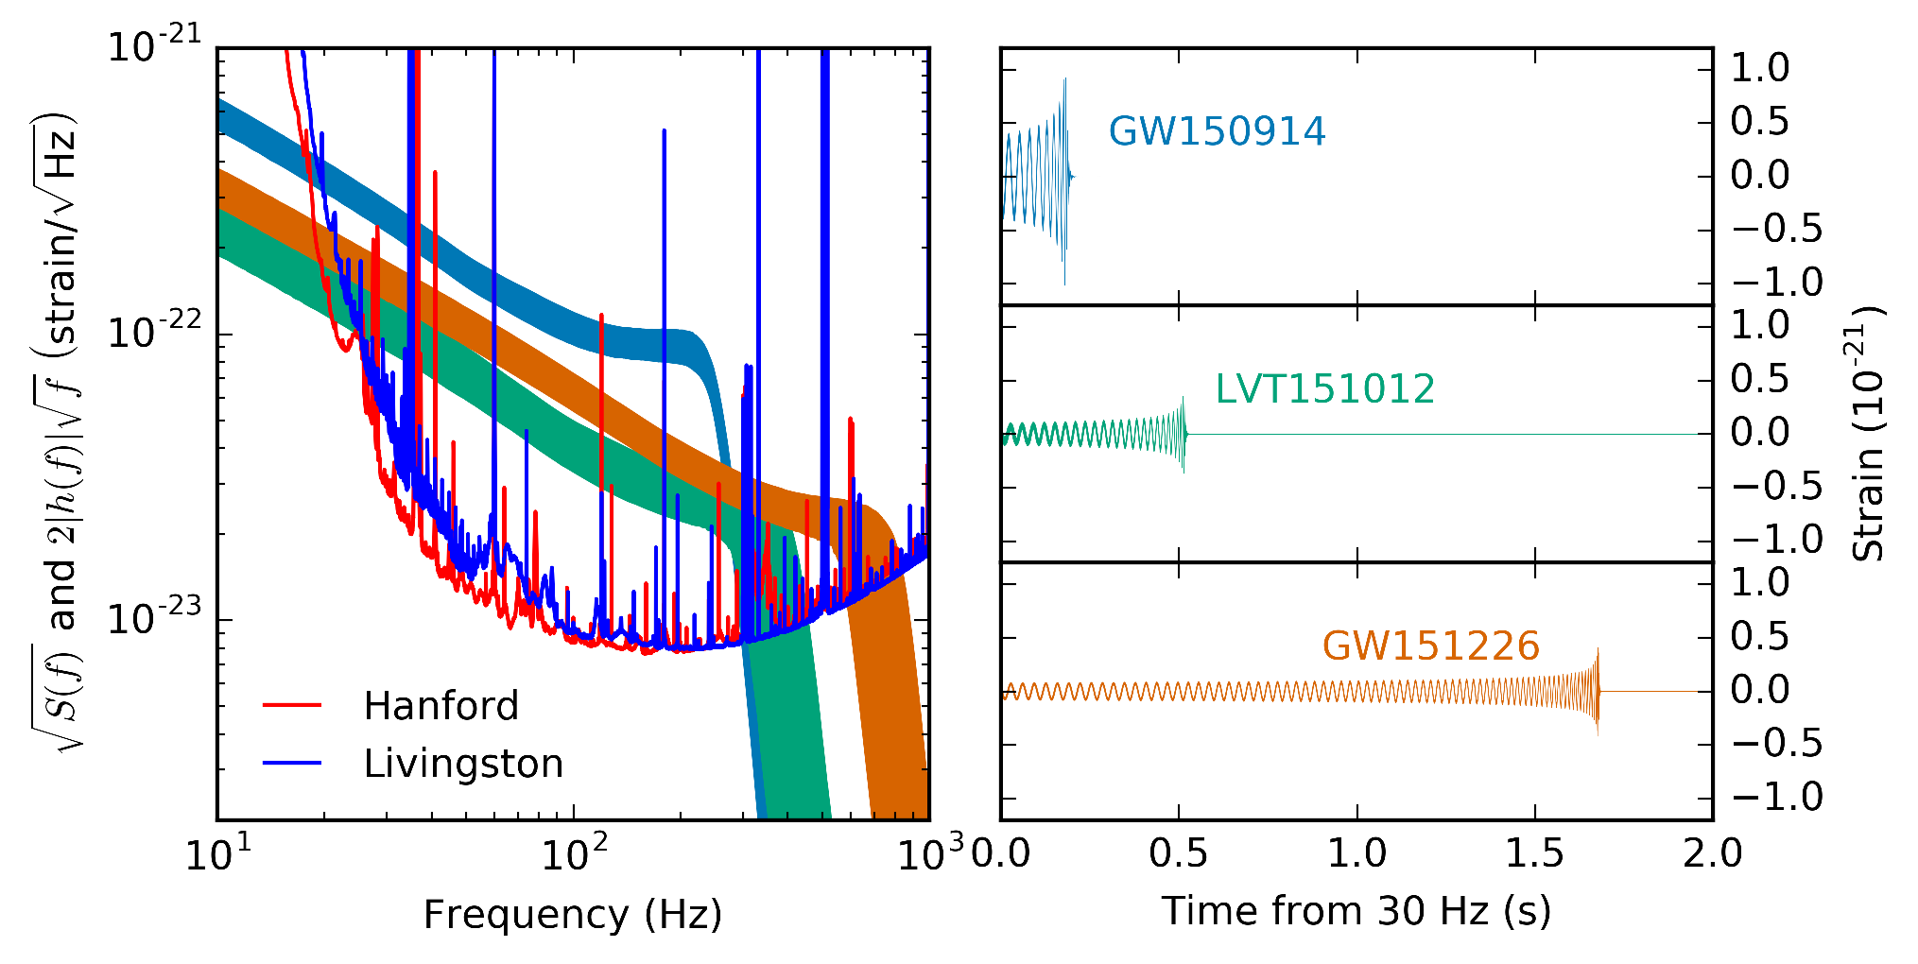
Signals
Detection papers GW150914 arXiv:1602.03837 GW151012 arXiv:1602.03839 GW151226 arXiv:1606.04855
For a waveform explainer: Farr, CPLB & Kijbunchoo LIGO Magazine 8:6
LVC arXiv:1606.04856

Slide 10
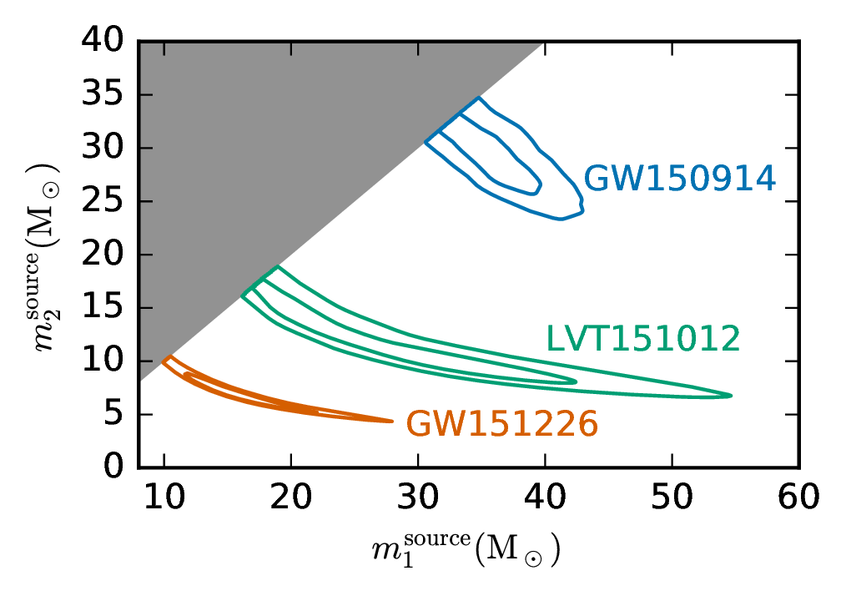
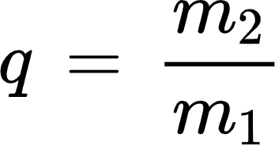
Chirp mass determines to leading order determines the rate of inspiral
Total mass sets properties of merger and ringdown:
Mass ratio q is ratio of secondary to primary mass:
LVC arXiv:1606.04856

Slide 11
Compact object masses
Ground-based detectors have observed a population of stellar-mass compact objects

Slide 12
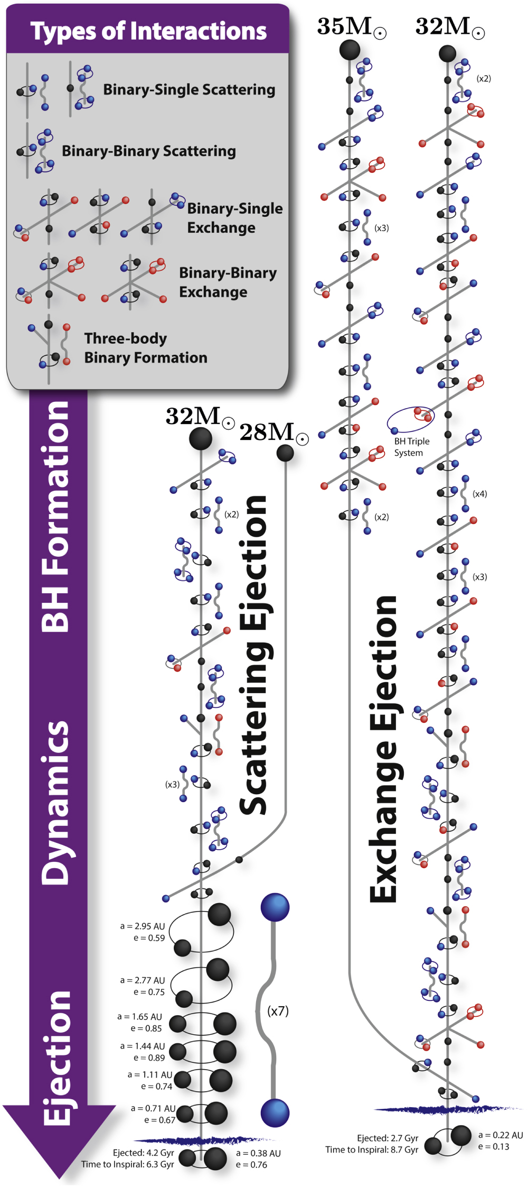
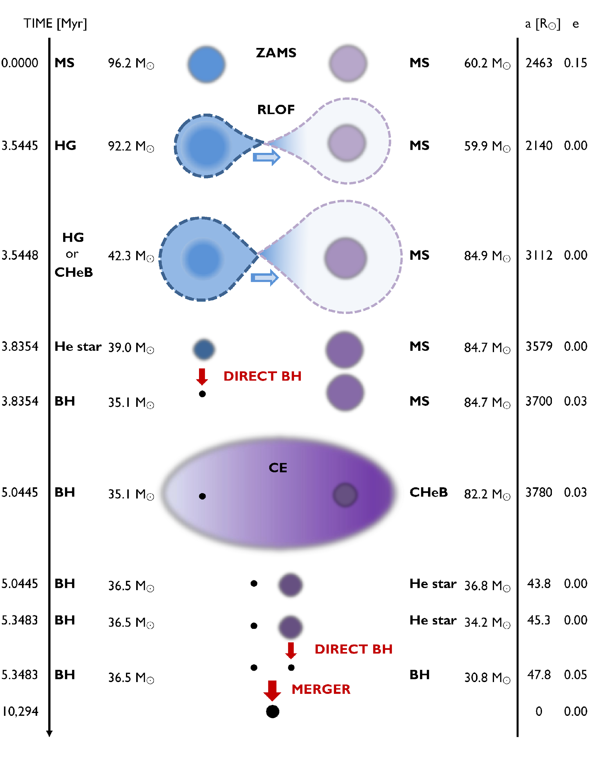
Binary evolution
Belczynski et al. arXiv:1602.04531
Black holes must be close enough to merge due to gravitational wave emission
Rodriguez et al. arXiv:1604.04254

Slide 13
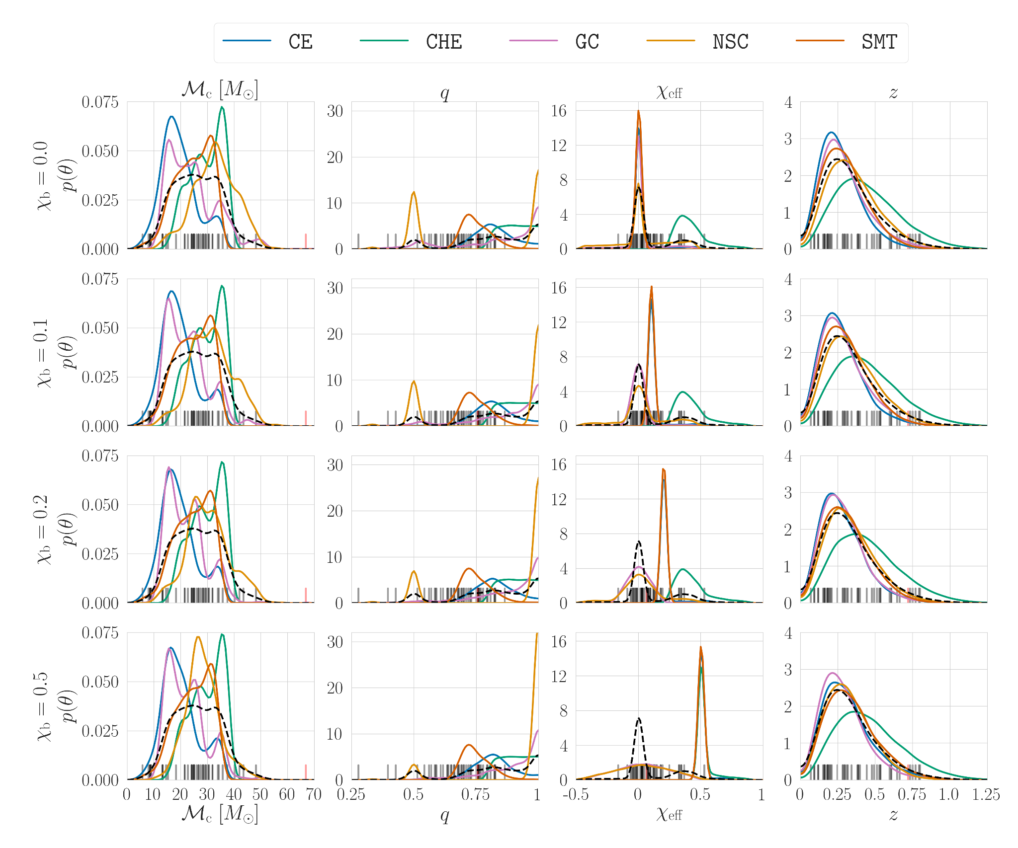
Formation channels
CE = common envelope CHE = chemically homogeneous evolution GC = globular cluster NSC = nuclear star cluster SMT = stable mass transfer
Model data release DOI:10.5281/zenodo.4277619
Zevin, Bavera, CPLB et al. arXiv:2011.10057

Slide 14
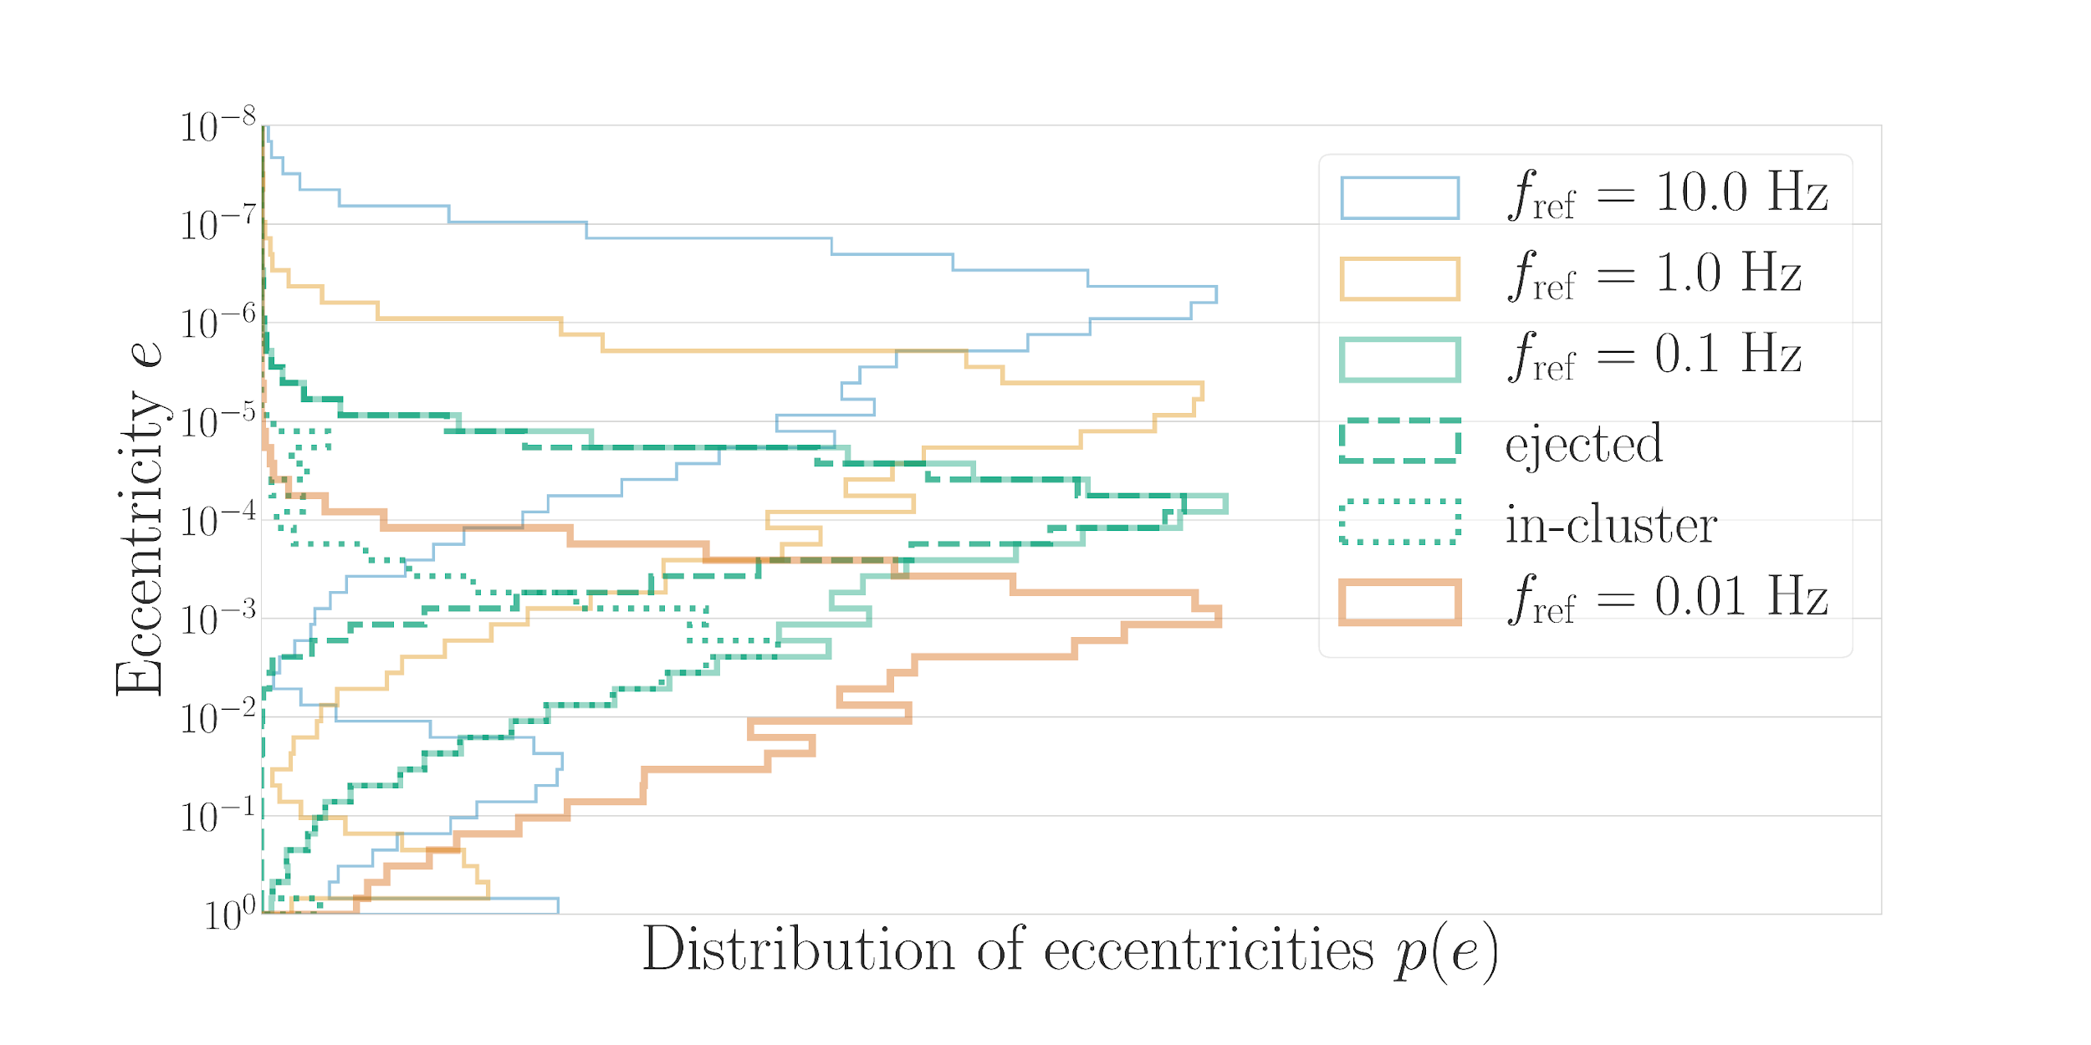
Eccentricity
Eccentricity is a key tracer of formation mechanism
Arca Sedda, CPLB et al. arXiv:1908.11375

Slide 15
Intermediate-mass black holes

Slide 16
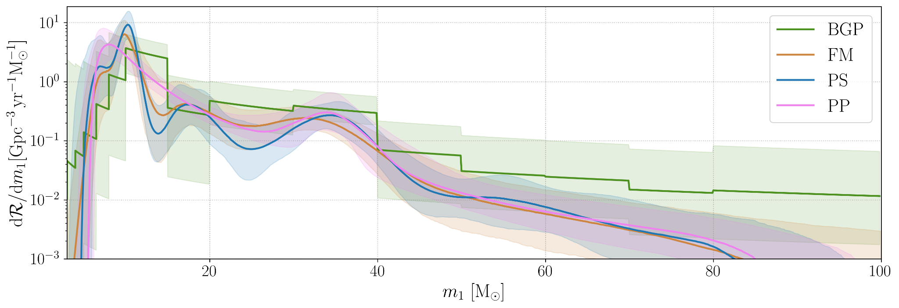
Astrophysical distribution
BGP = binned Gaussian process
FM = flexible mixtures Gaussian kernels
PS = power-law plus spline
PP = power-law plus (Gaussian) peak
LVK arXiv:2111.03634

Slide 17
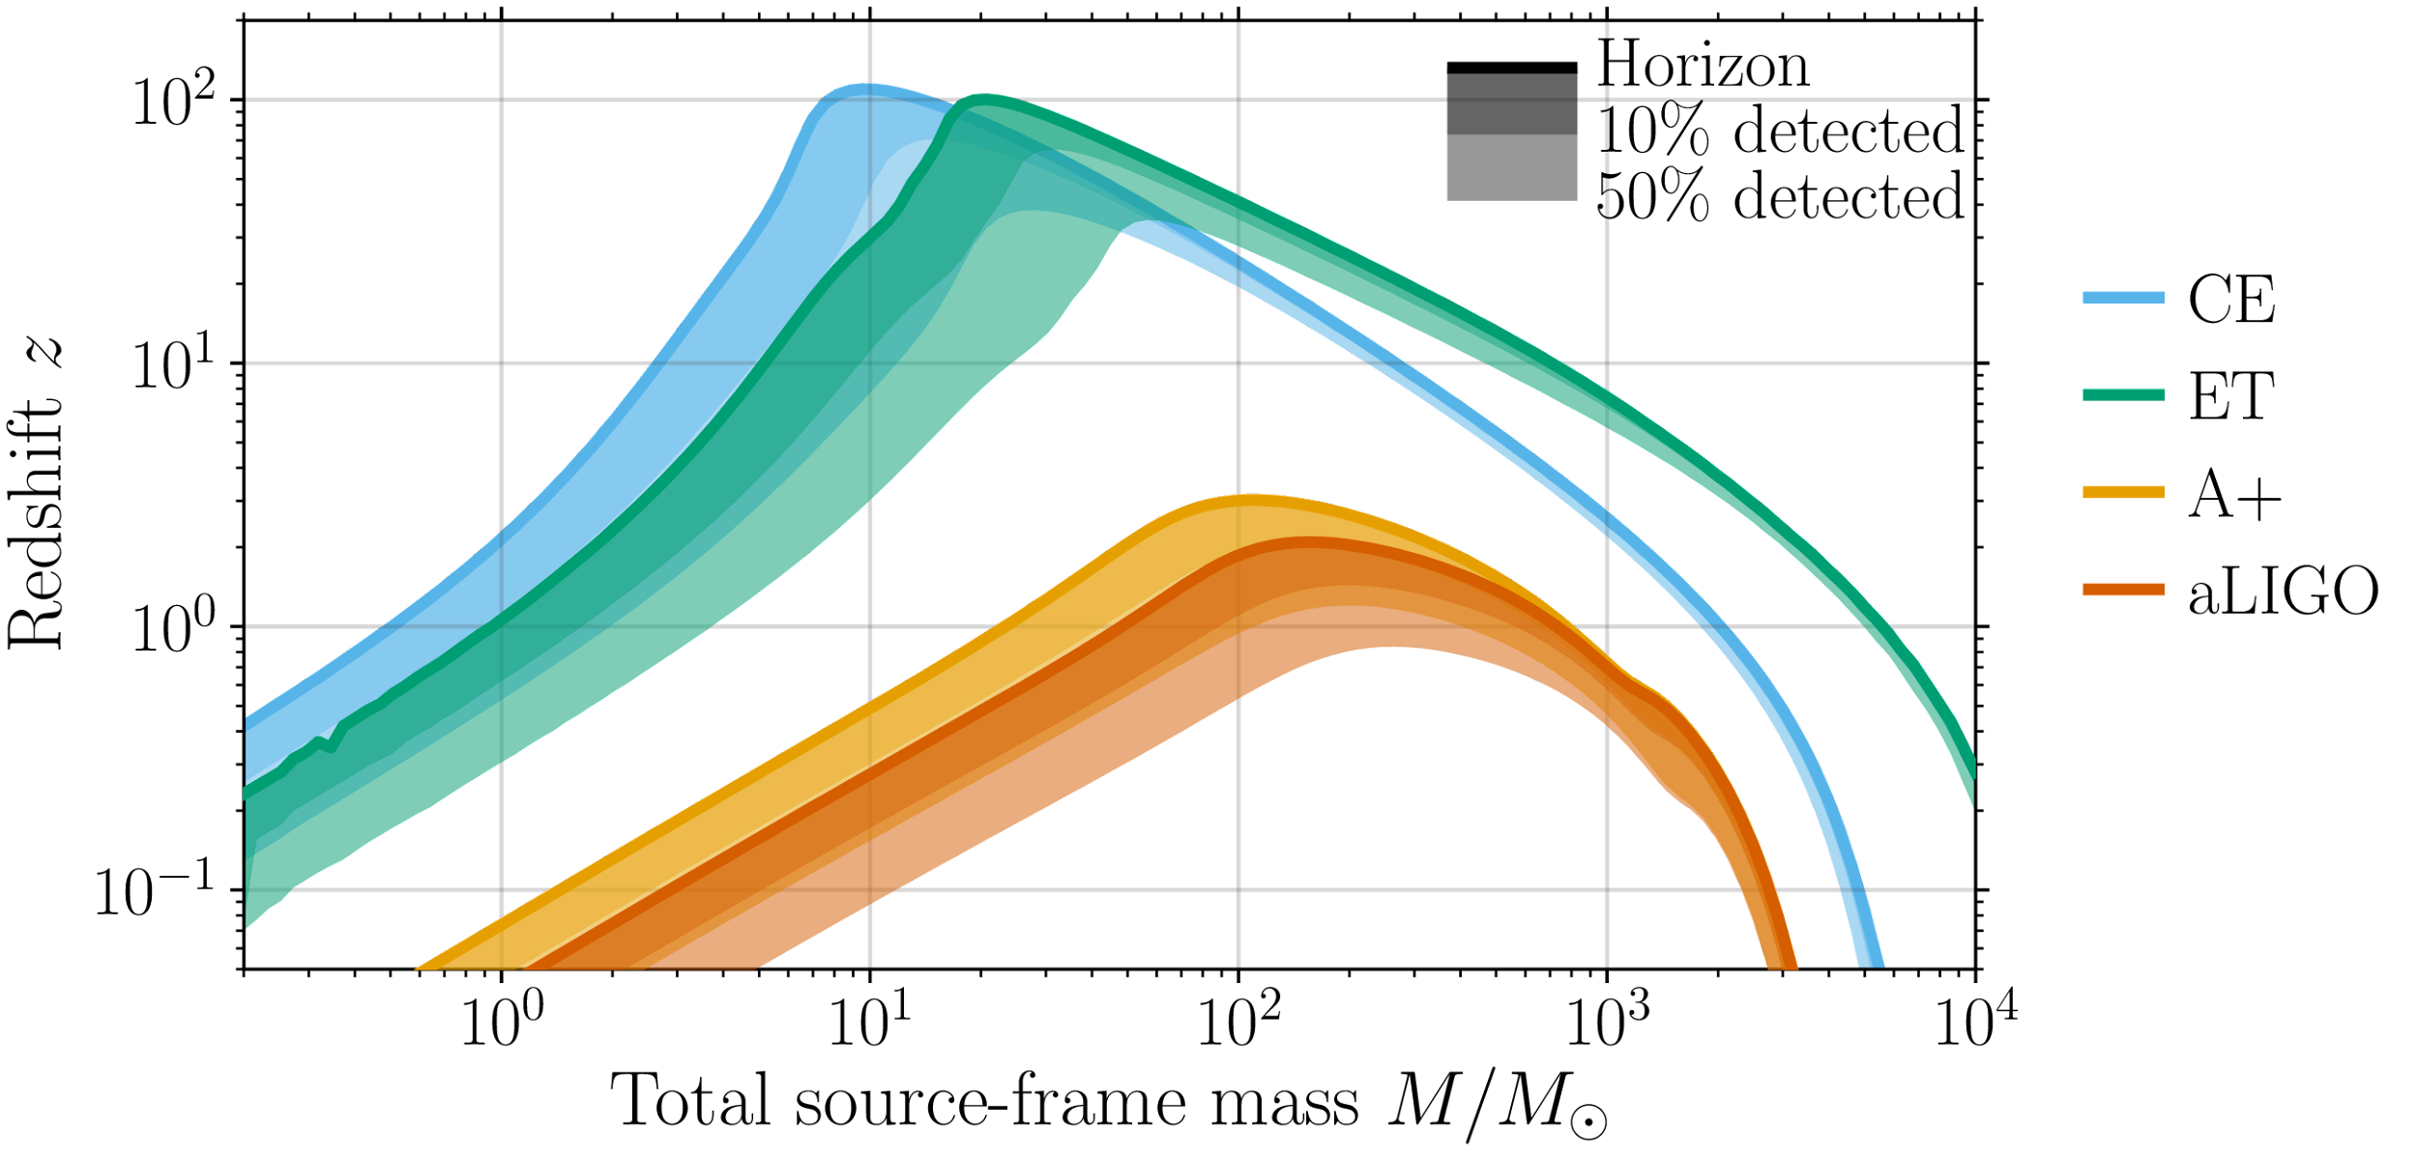
Next-generation detectors
Next-generation detectors will see further and have a wider mass range
The 3G Science Book Kalogera, …, CPLB et al. arXiv:2111.06990
Adapted from Hall & Evans arXiv:1902.09485

Slide 18
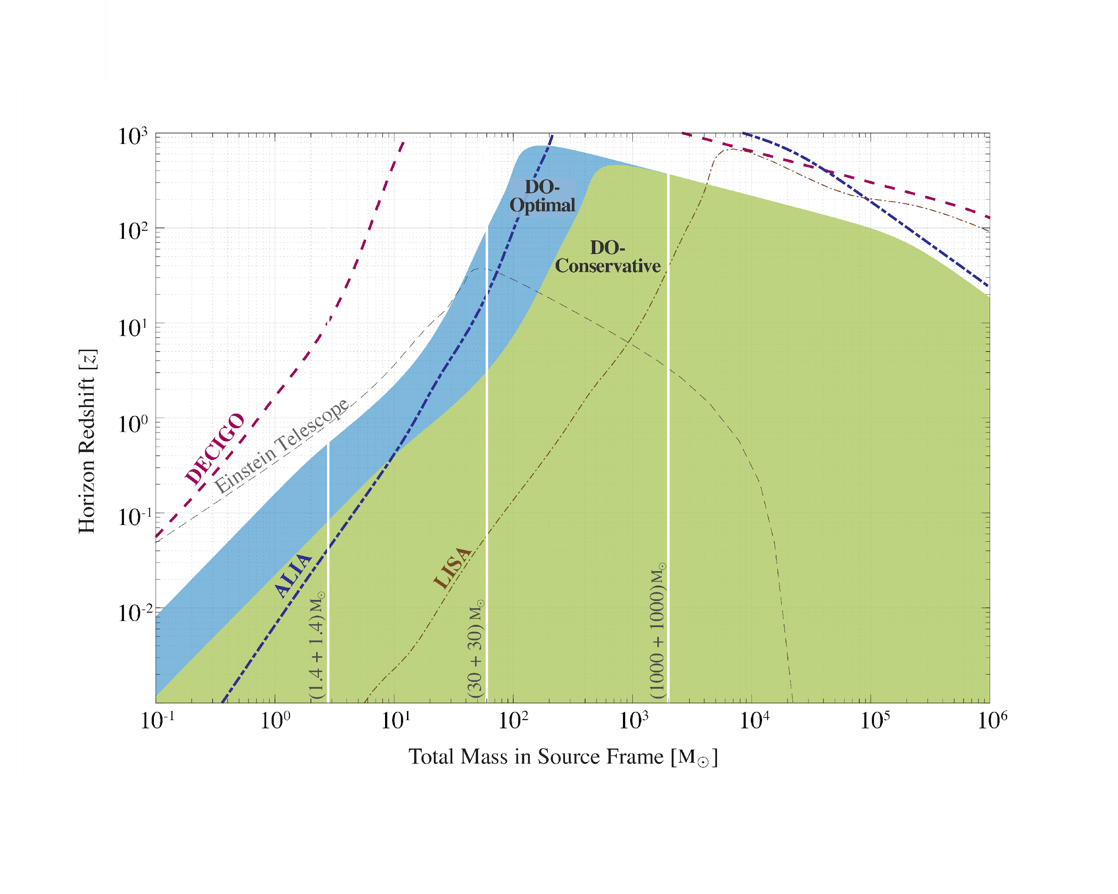
Intermediate-mass black holes
Is there a missing link between stellar-mass and massive black holes?
Arca Sedda, CPLB et al. arXiv:1908.11375

Slide 19
Multiband observations

Slide 20
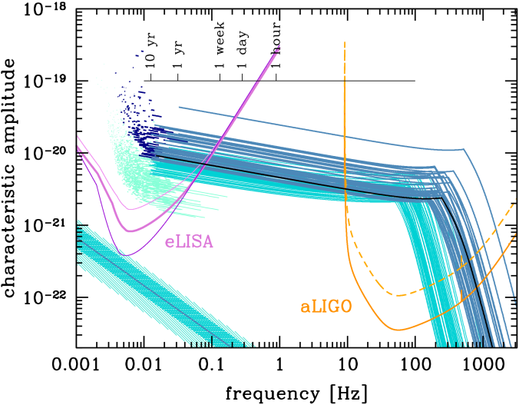
Early warning
Multiband observations allow precise measurements, tests of general relativity and early warning
For more with LISA, see Nishizawa et al. arXiv:1606.09295 Breivik et al. arXiv:1606.09558 Vitale arXiv:1605.01037
Sesana arXiv:1602.06951

Slide 21
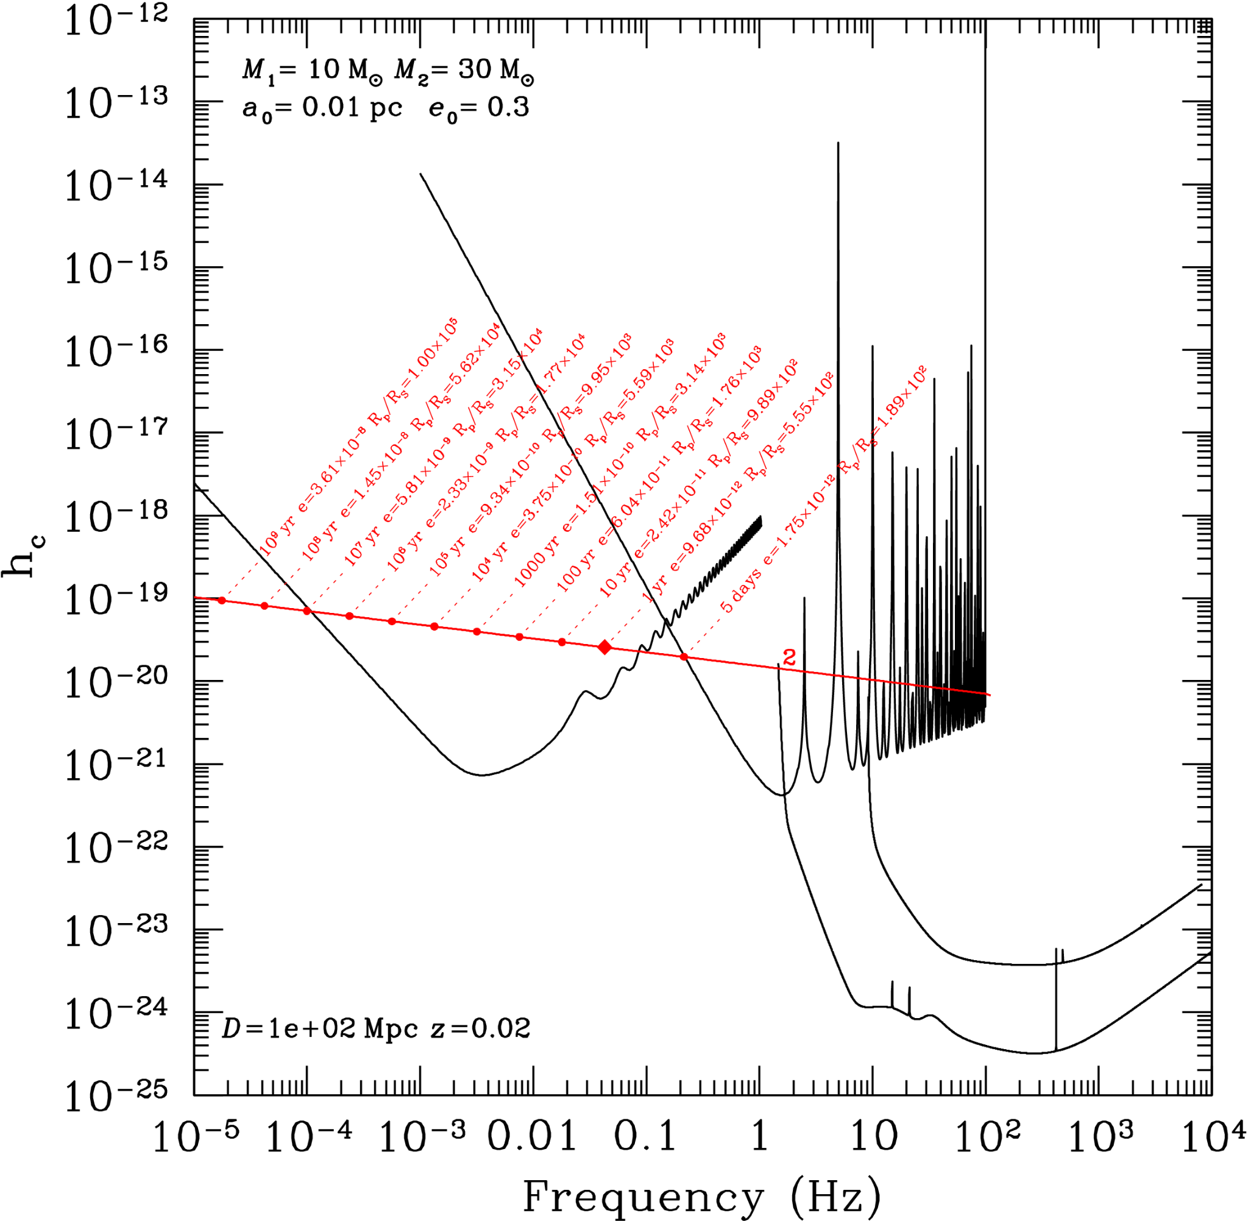
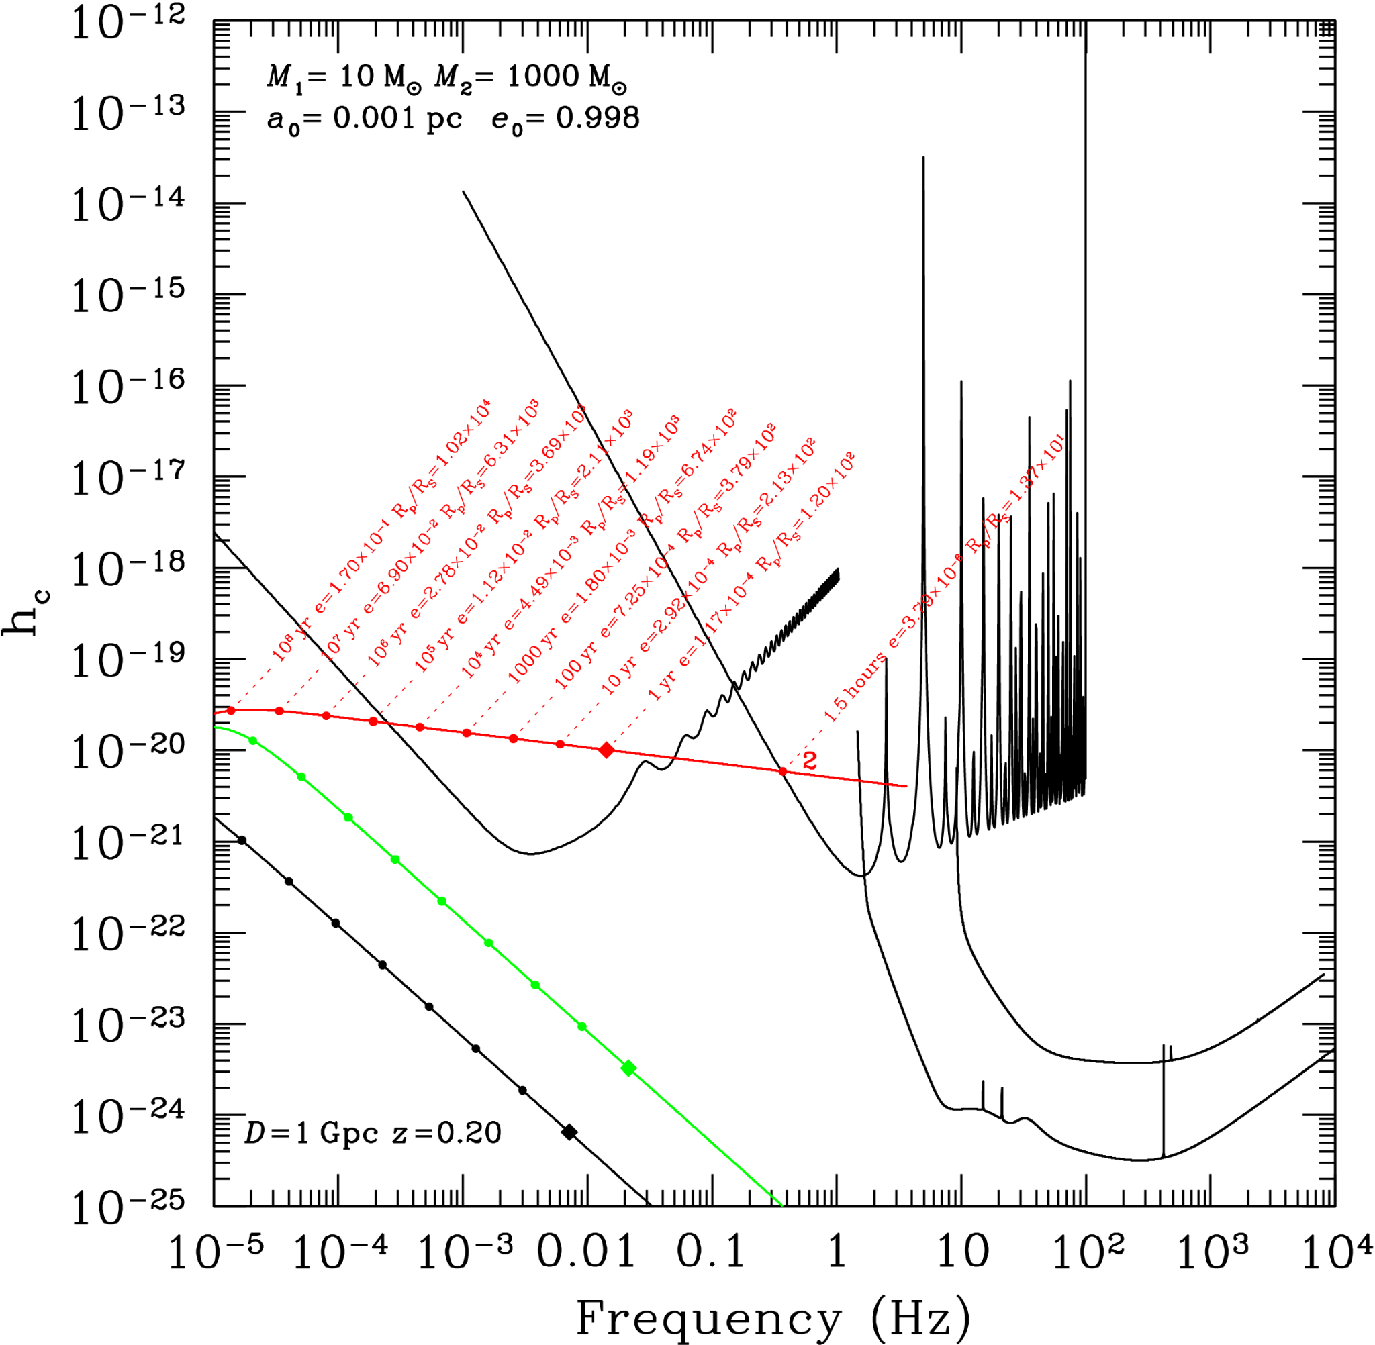
Multiband observations
Decihertz observatories enable multiband observations of both stellar-mass and intermediate-mass binaries
Canuel et al. arXiv:1911.03701

Slide 22
Fundamental physics

Slide 23
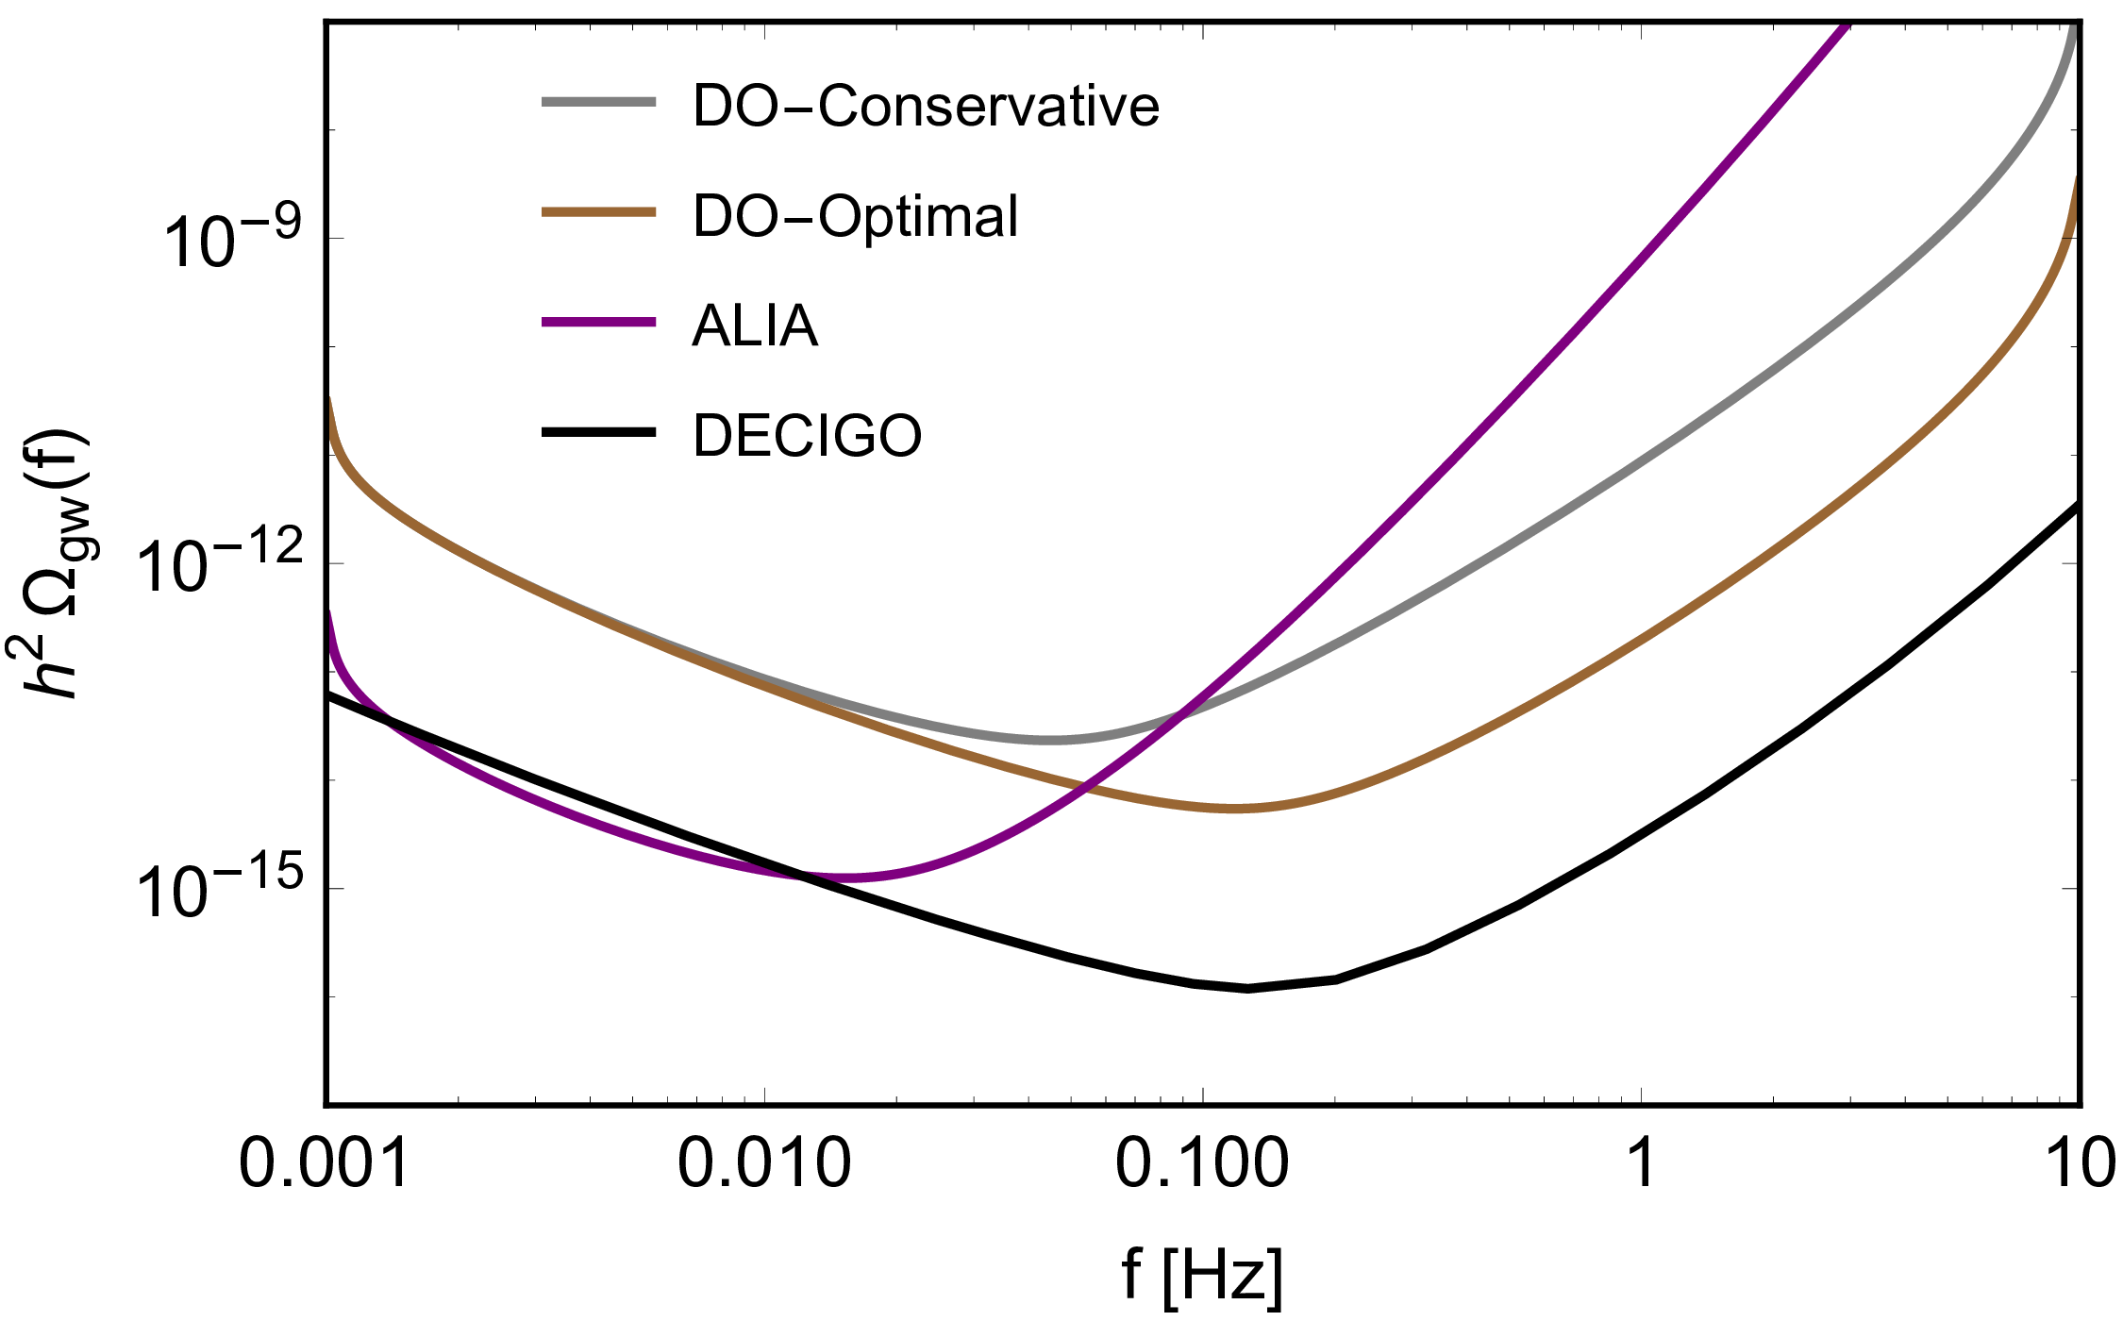
Stochastic backgrounds
Probe phase transitions at ~10–10³ GeV and cosmic string tensions Gµ ∼ 10−19
Arca Sedda, CPLB et al. arXiv:1908.11375

Slide 24
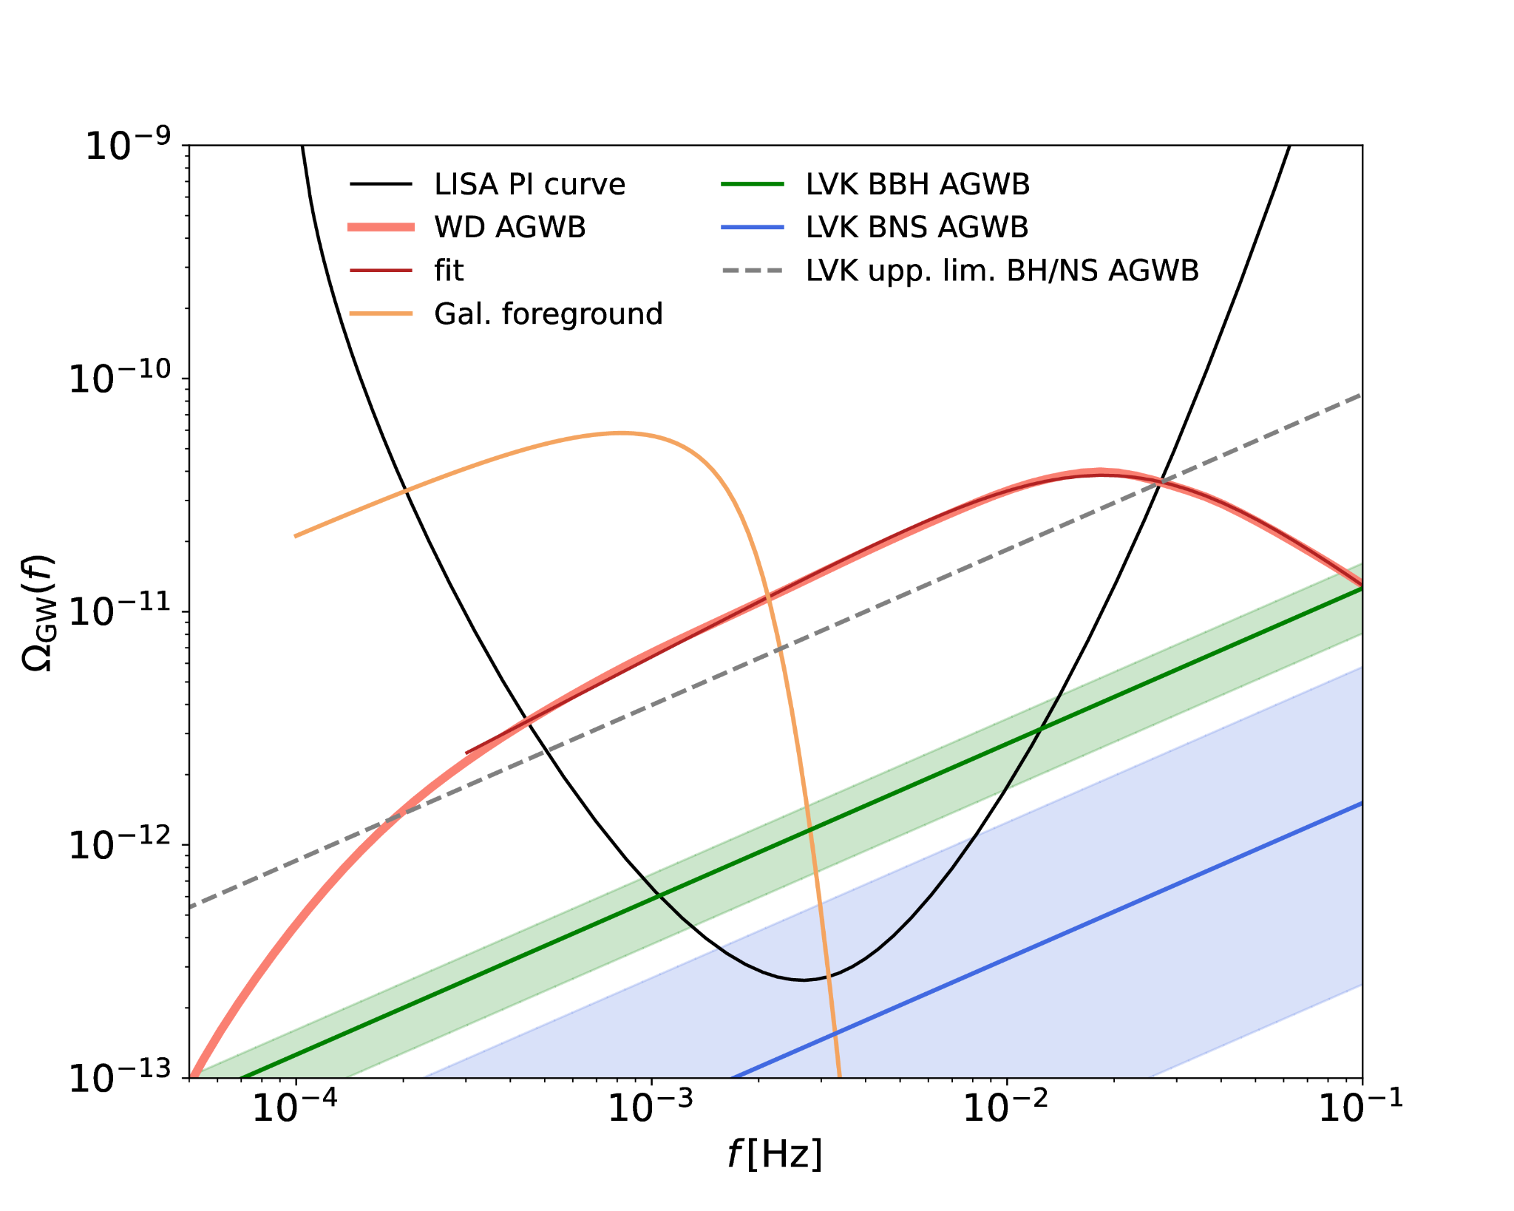
White dwarfs
The astrophysical foreground contains useful information about sources
The foreground masks stochastic backgrounds
White dwarfs merge in the decihertz range
Staelens & Nelemans arXiv:2310.19448

Slide 25
Eccentricity is a key tracer of compact binary formation
Intermediate-mass black holes may hold the key to massive black hole formation
Multiband observations give unique measurements and warning for multimessenger discoveries
A new regime for tests of fundamental physics
ButterflyLove1

Slide 26
Thank you cplberry.com • @cplberry
CPLB & Kijbunchoo LIGO Magazine 7:32

Slide 27
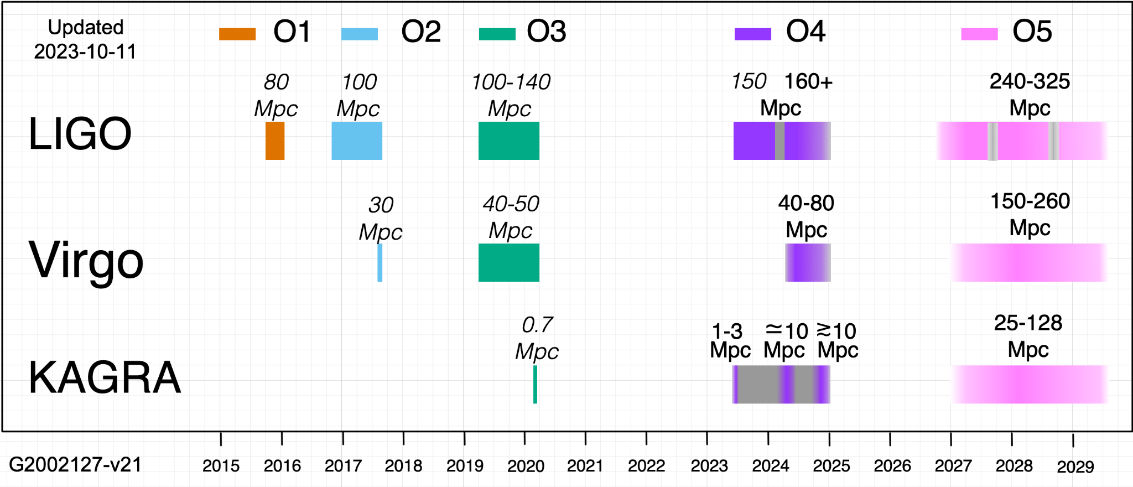
Observing plans
O4 is planned for 18 months of observing starting 24 May
Observing may be interleaved with month-long maintenance periods
O5 start dates, duration and sensitivities will be adjusted closer to the time
LVK observing.docs.ligo.org/plan/

Slide 28
Operating detectors and calibrating data
Searching for candidates
The astrophysical population properties
Data collection
Data quality
Detection
Parameter estimation
Population inference
Characterising detector performance
Inferring source properties

Slide 29
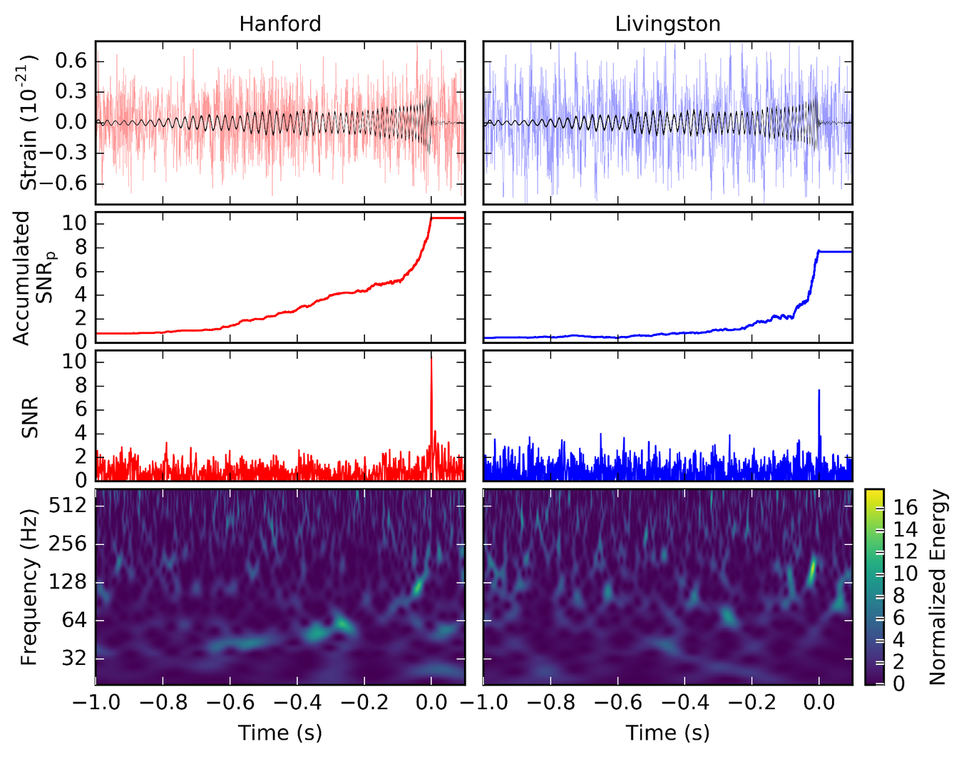
LVC arXiv:1606.04855
Matched filtering searches for signals using templates
For more on how gravitational-wave data is analysed, see LVC arXiv:1908.11170
For a nice derivation of the noise-weighted inner product, see Finn arXiv:gr-qc/9209010
So far, only compact binary coalescences detected

Slide 30
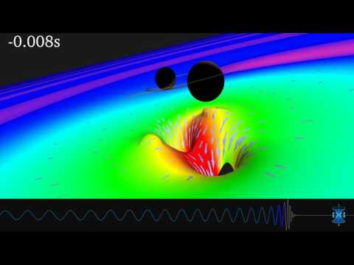

Slide 31
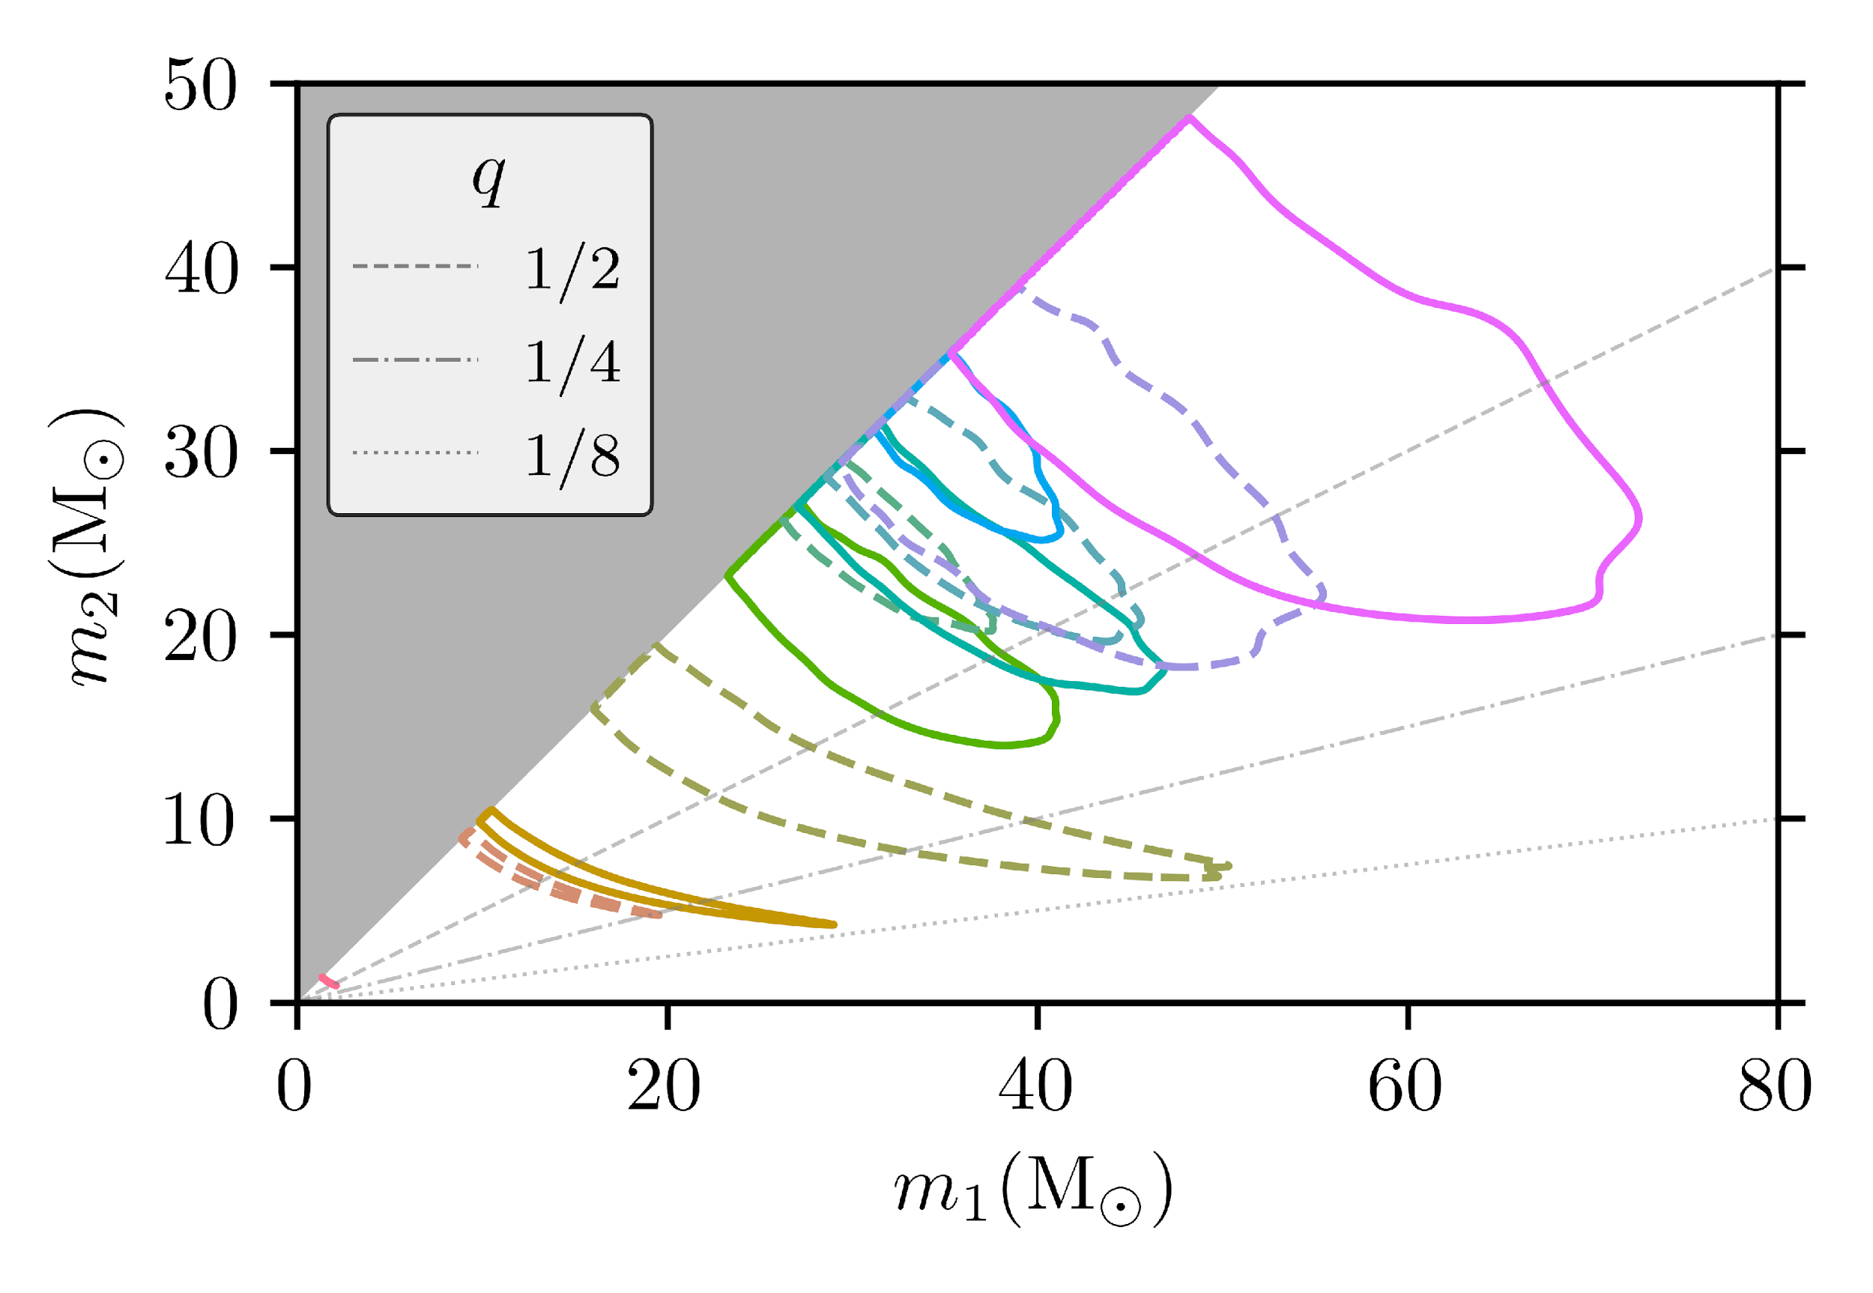
Source masses: GWTC-1
LVK gravitational-wave catalogues:
GWTC-1 (O1+O2) arXiv:1811.12907
GWTC-2 (O3a) arXiv:2010.14527 youtu.be/nJD3DAaEkxs GWTC-2.1 (O3a) arXiv:2108.01045 youtu.be/tD36nX_rzic
GWTC-3 (O3b) arXiv:2111.03606 youtu.be/MUyOVX1HqB8
LVC arXiv:1811.12907

Slide 32
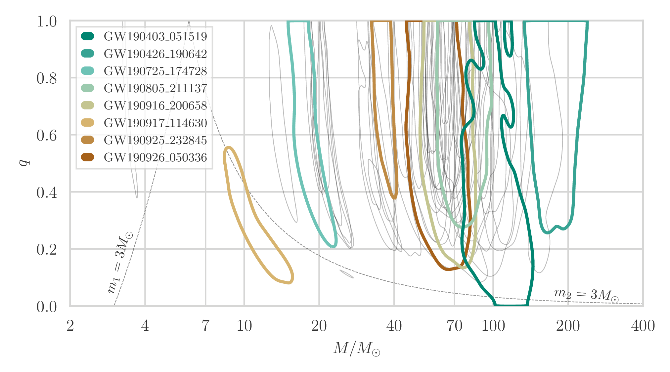
Source masses: GWTC-2.1
GW190425 is a second binary neutron star after GW170817
GW190814 has a well-measured secondary mass that could correspond either to a neutron star or a black hole
LVK arXiv:2108.01045

Slide 33
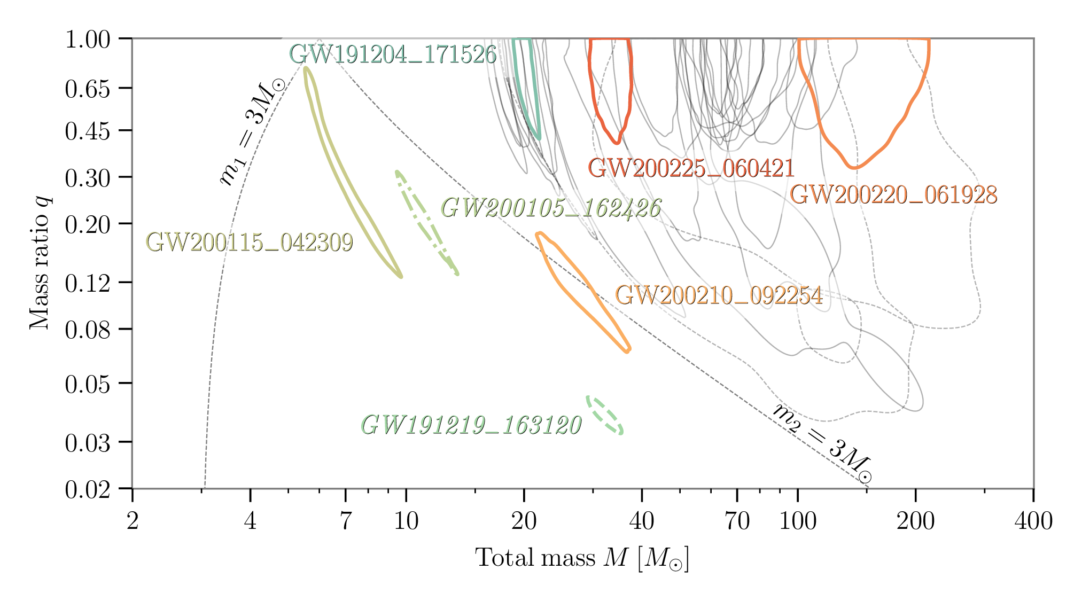
Source masses: O3b
No tidal information so must identify neutron stars by component masses
GWTC-2.1 release DOI:10.5281/zenodo.5117702
GWTC-3 release DOI:10.5281/zenodo.5546662
LVK arXiv:2111.03606

Slide 34
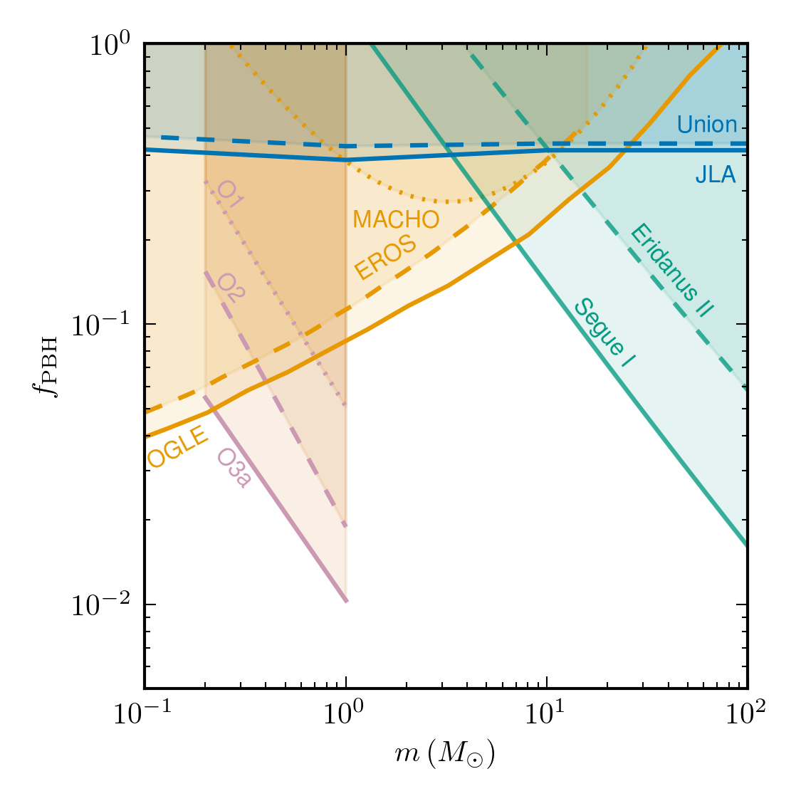
Subsolar-mass search has yet to make any detections, so we can place upper limits on merger rates
Assuming a monochromatic mass distribution, these can be used to place limits on dark matter fractions for primordial black holes
LVC arXiv:2109.12197 LVK arXiv:2212.01477

Slide 35
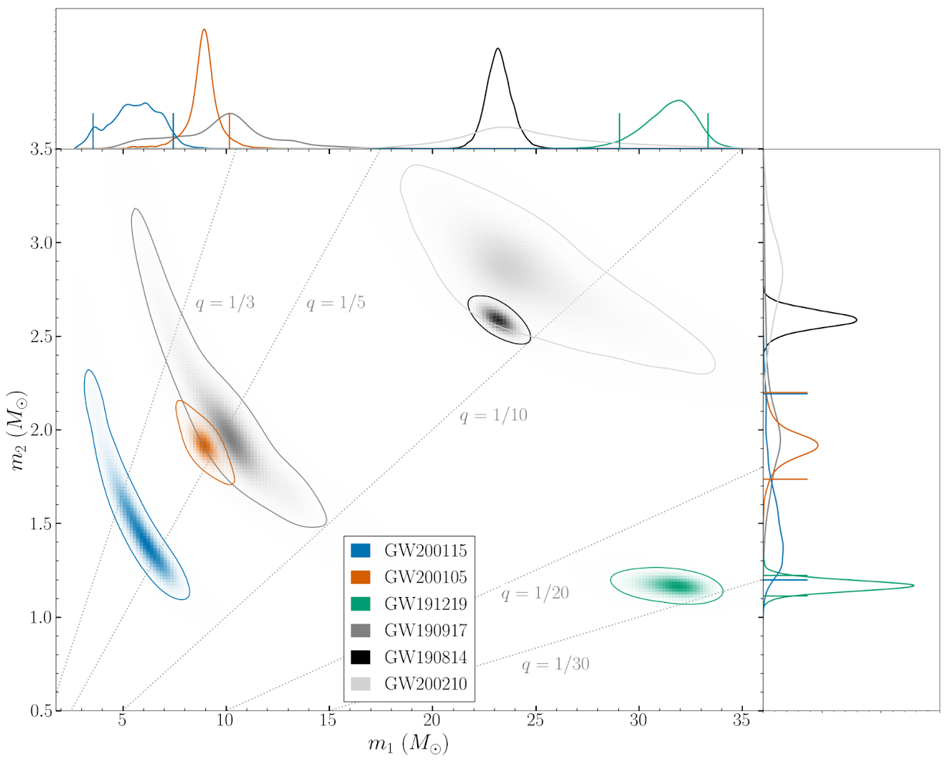
The maximum neutron star mass is uncertain, so there are several potential neutron star–black hole binaries
Coloured contours in this plot are confident neutron star–black hole pairs
Grey contours in this plot are ambiguous, with secondary that may be a black hole or a neutron star
LVC arXiv:2010.14527 LVC arXiv:2108.01045 LVK arXiv:2111.03606

Slide 36
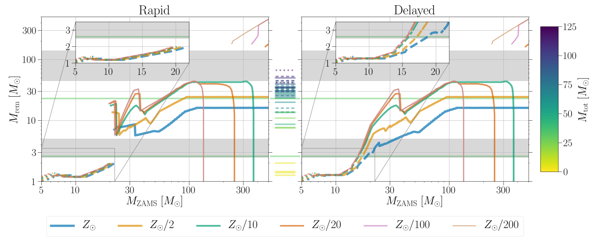
Single star remnant masses
Lower mass gap due to core-collapse supernovae
Upper mass gap due to (pulational) pair-instability supernovae
For more on massive stellar evolution, see Woosley, Heger, & Weaver (2002)
Zevin, Spera, CPLB & Kalogera arXiv:2006.14573

Slide 37
Astrophysical distribution
BGP = binned Gaussian process
FM = flexible mixtures Gaussian kernels
PS = power-law plus spline
PP = power-law plus (Gaussian) peak
LVK arXiv:2111.03634

Slide 38
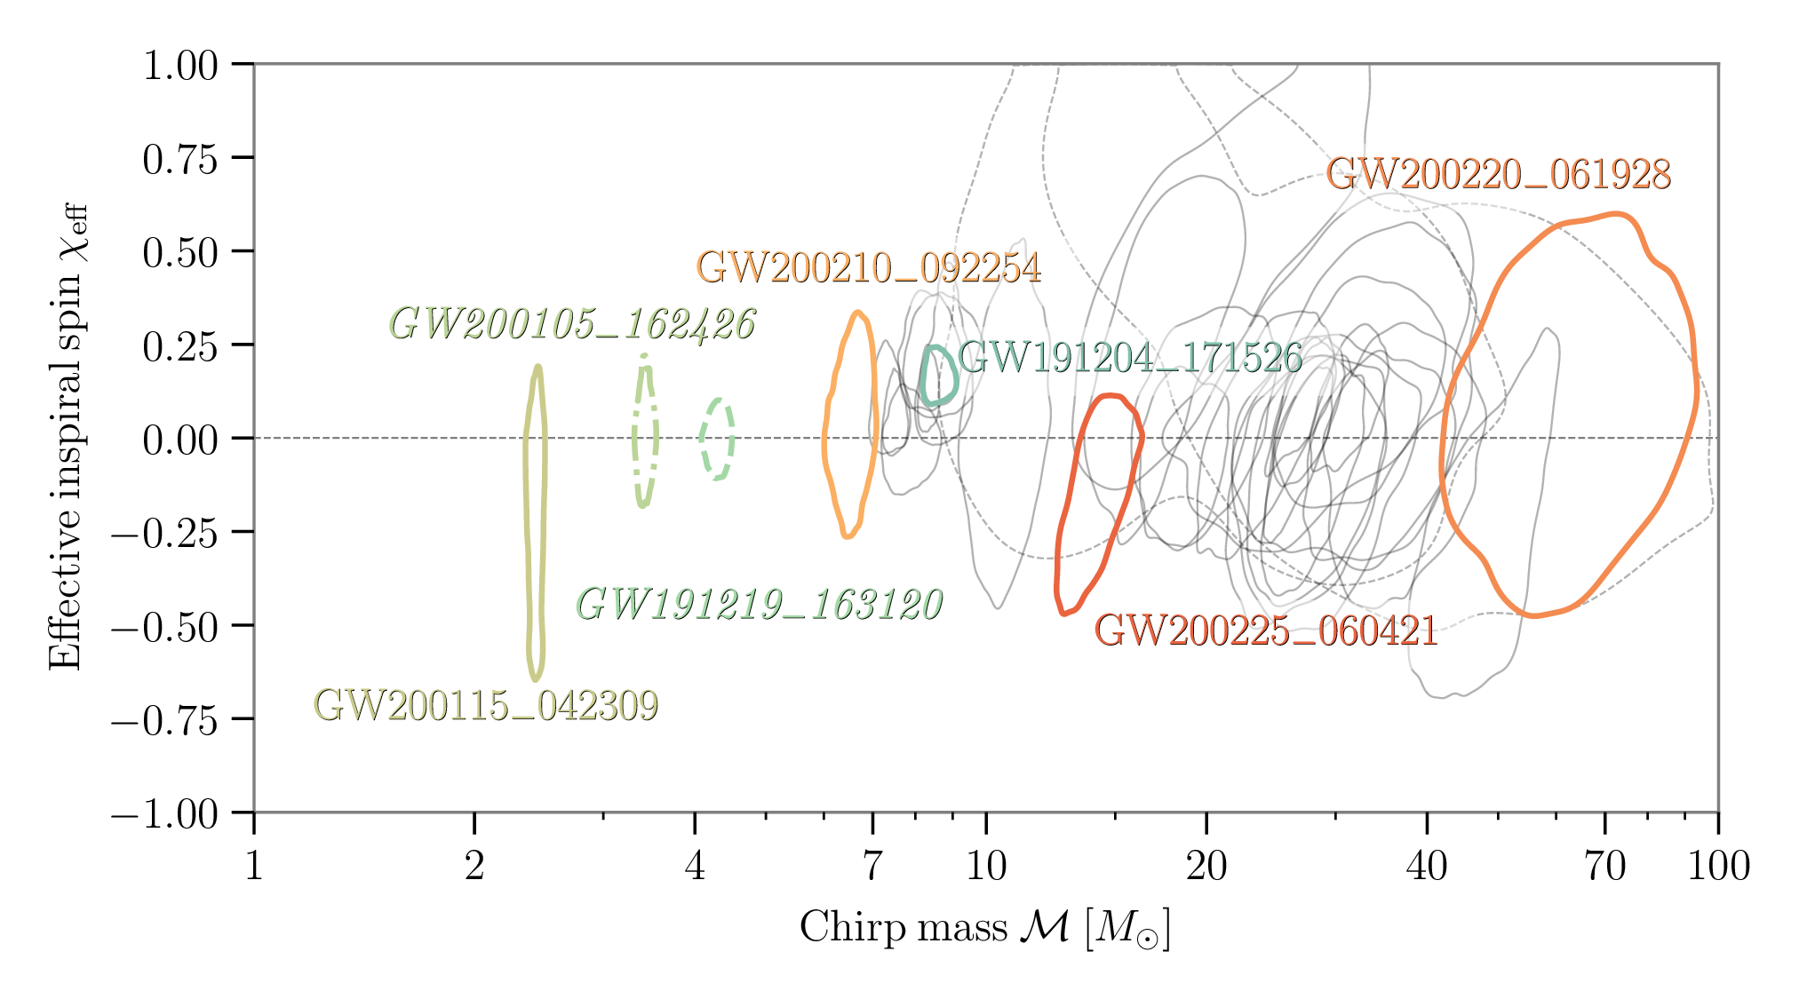
Effective inspiral spin
Mass-weighted combination of spins parallel to orbital angular momentum
Multiple events with non-zero values
More candidates with positive values than negative
GW191109 and GW200225 have significant support for negative values
LVK arXiv:2111.03606

Slide 39
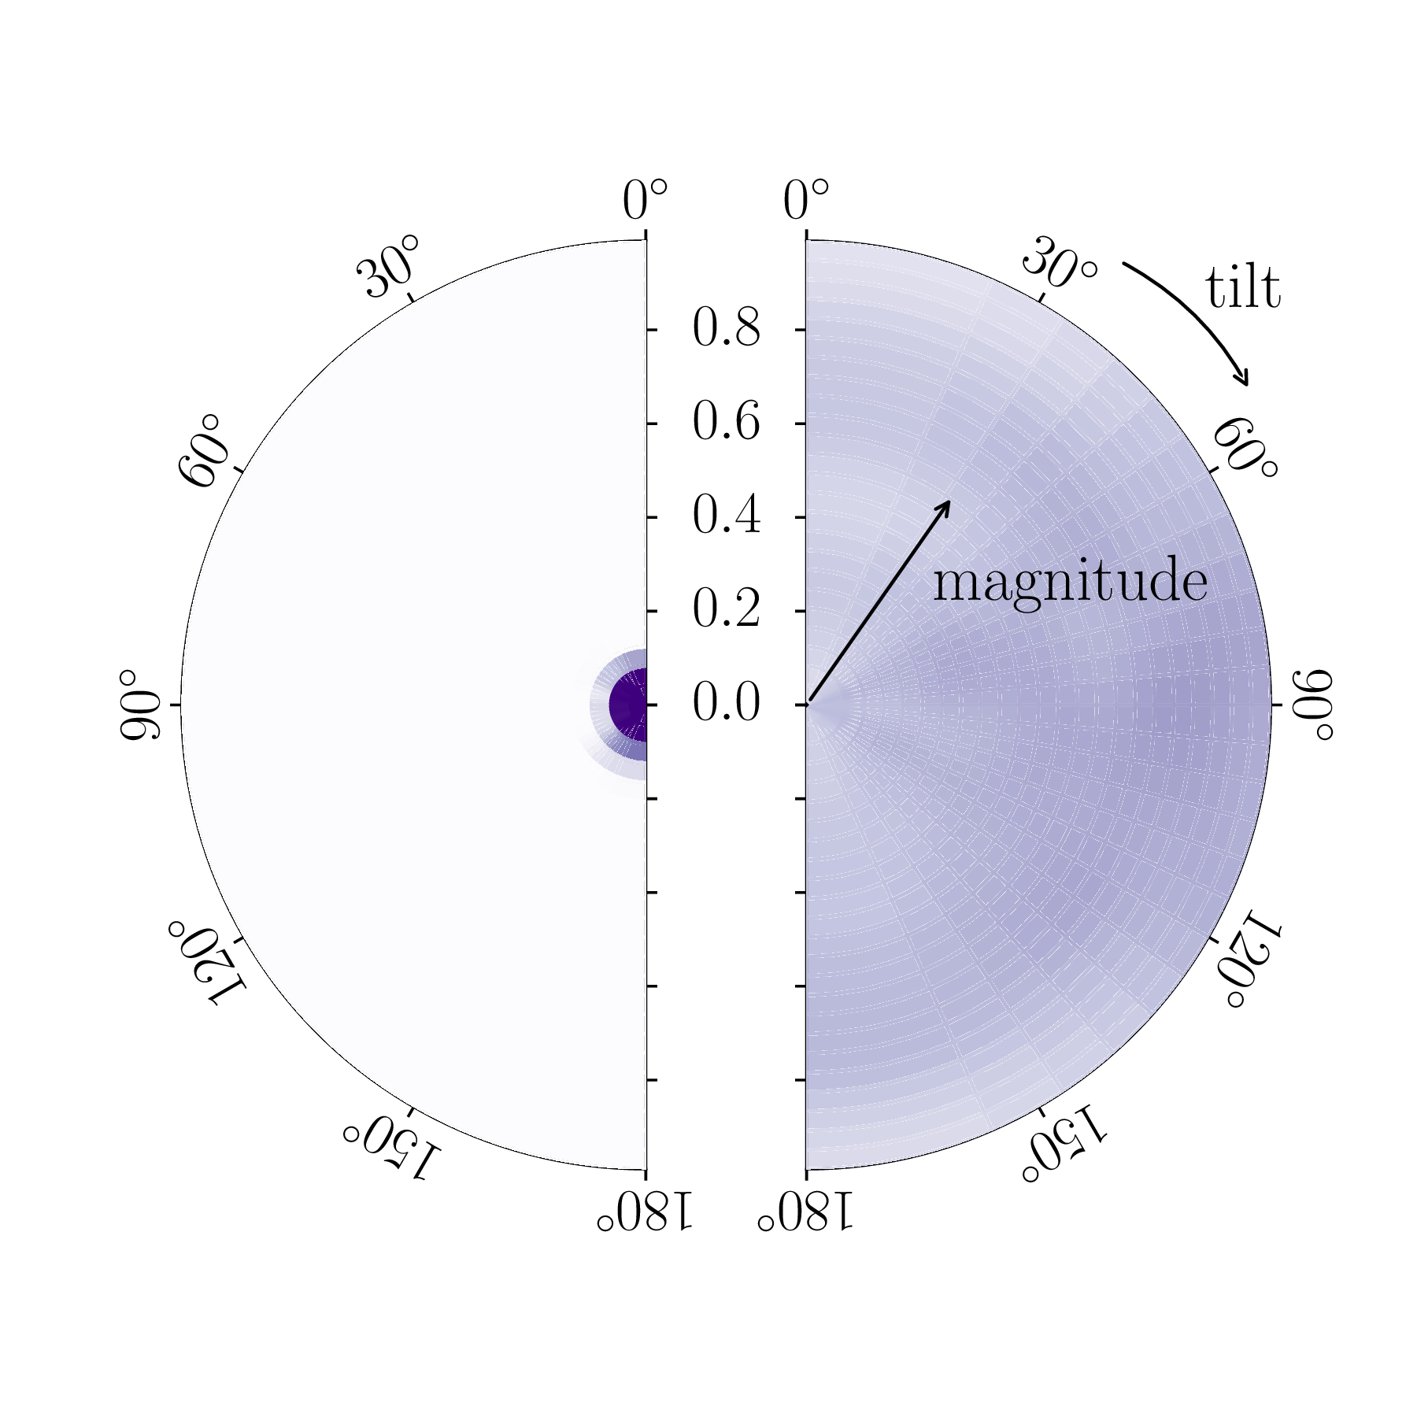
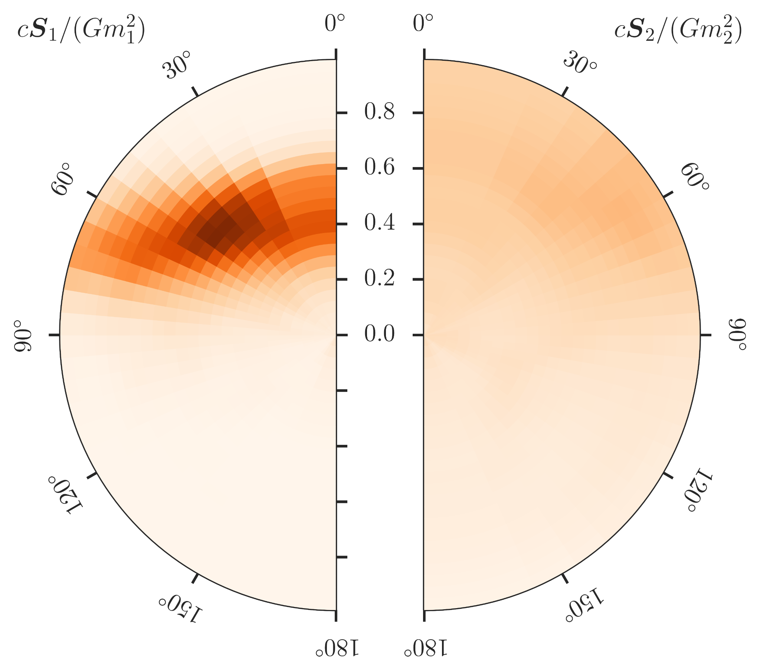
Spins
Gravitational-wave measurements of spins can be a tracer of formation mechanism, e.g., Stevenson, CPLB & Mandel arXiv:1703.06873
GW151226 had first evidence for non-zero spin and positive effective inspiral spin
GW190814 has tightest constraints on primary spin and precession
LVC arXiv:1606.04855 LVC arXiv:2006.12611

Slide 40
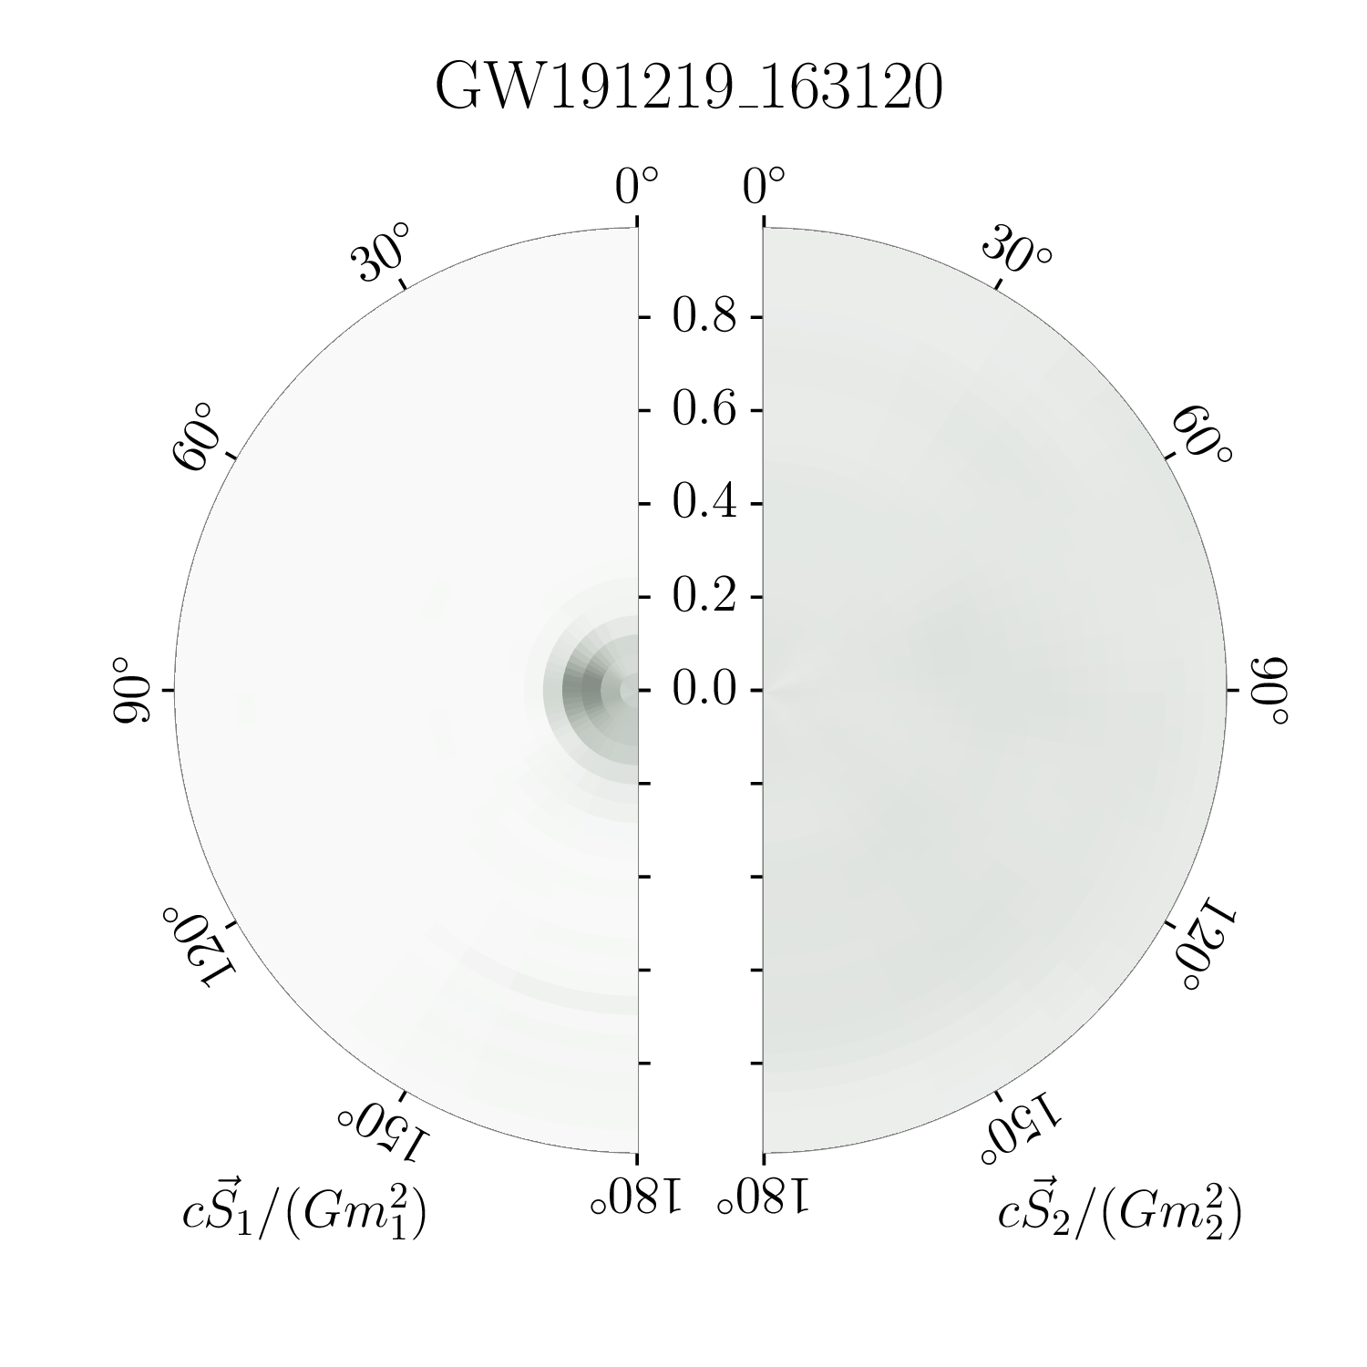
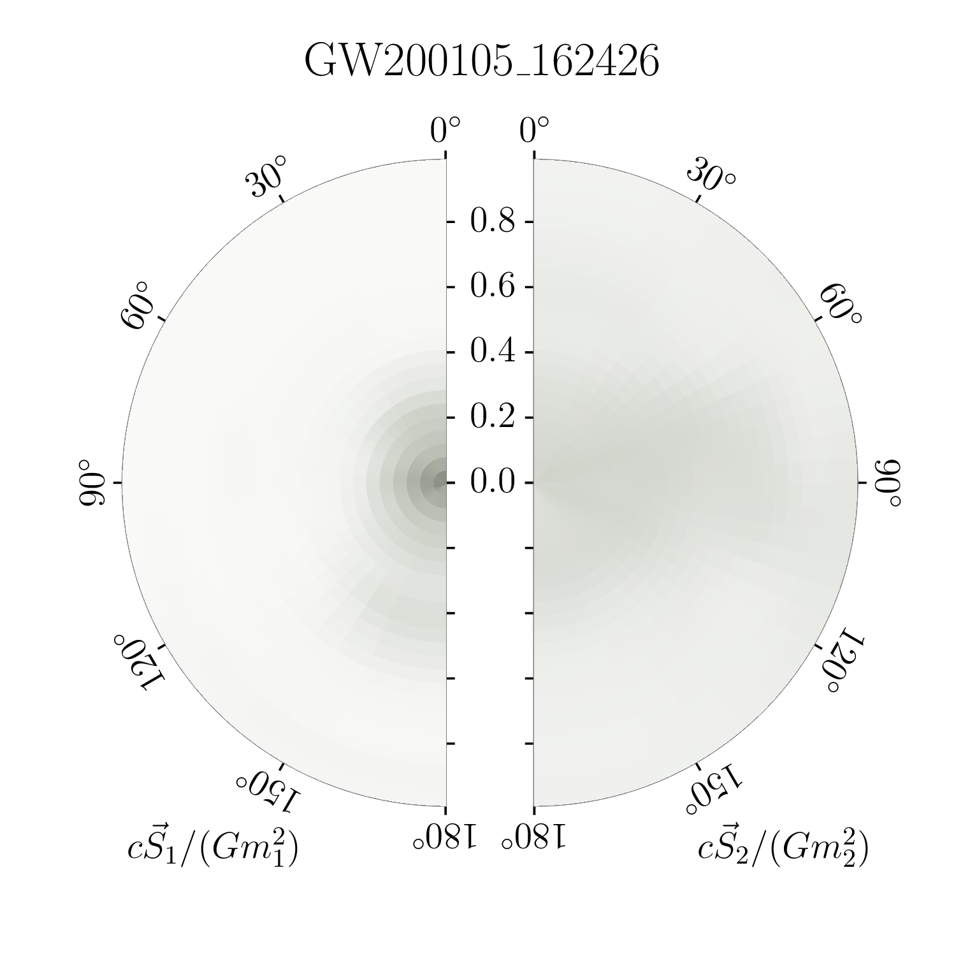
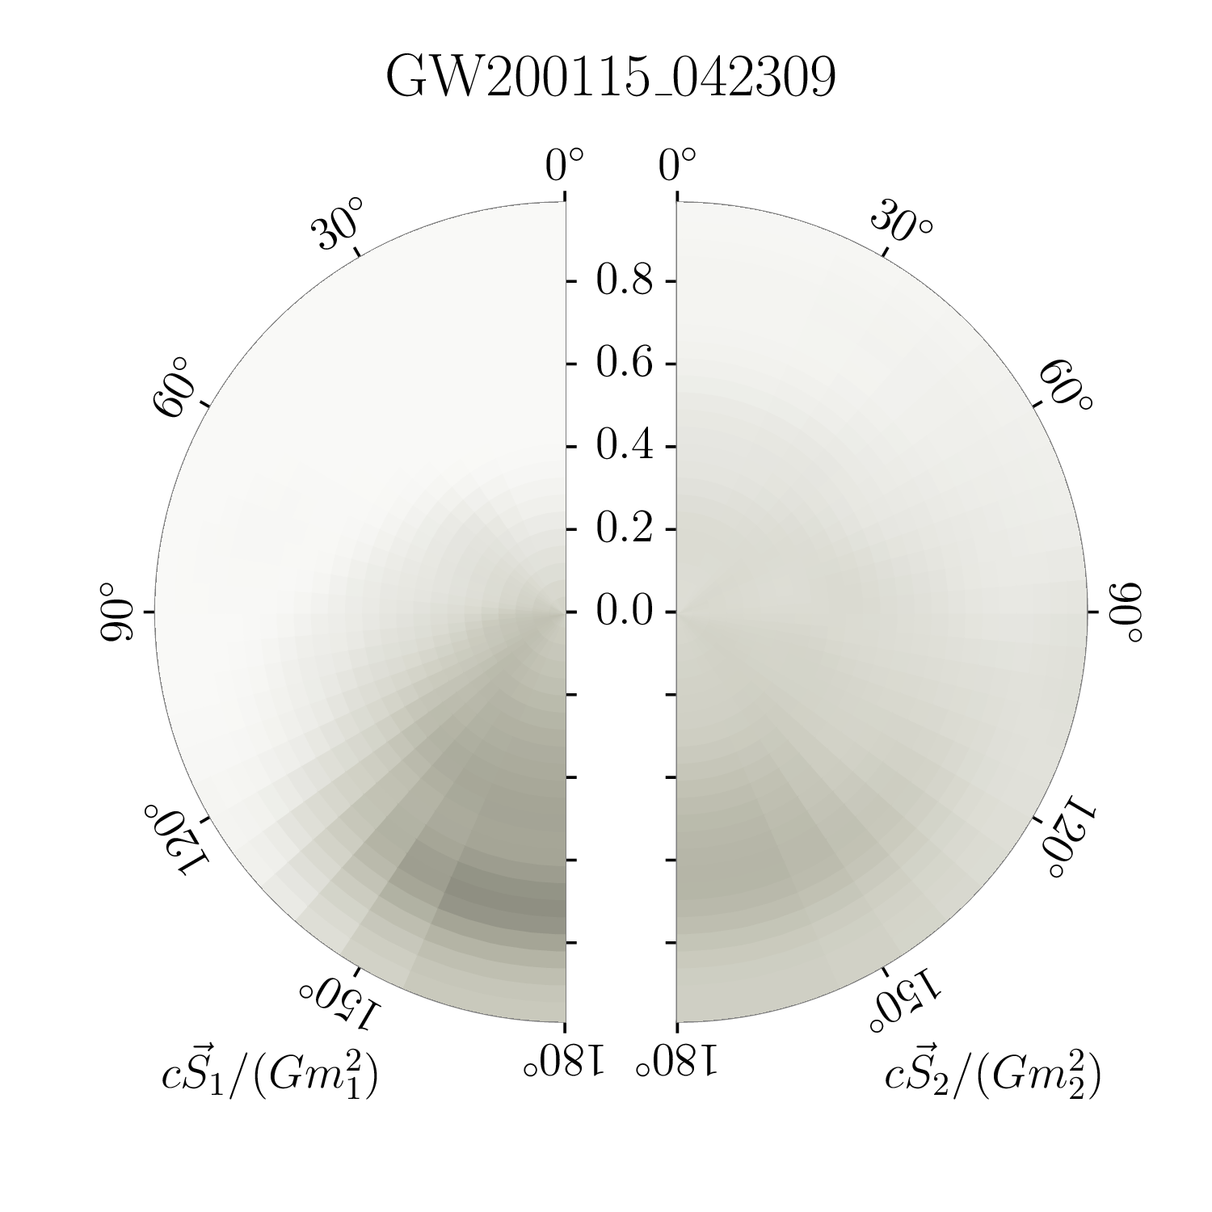
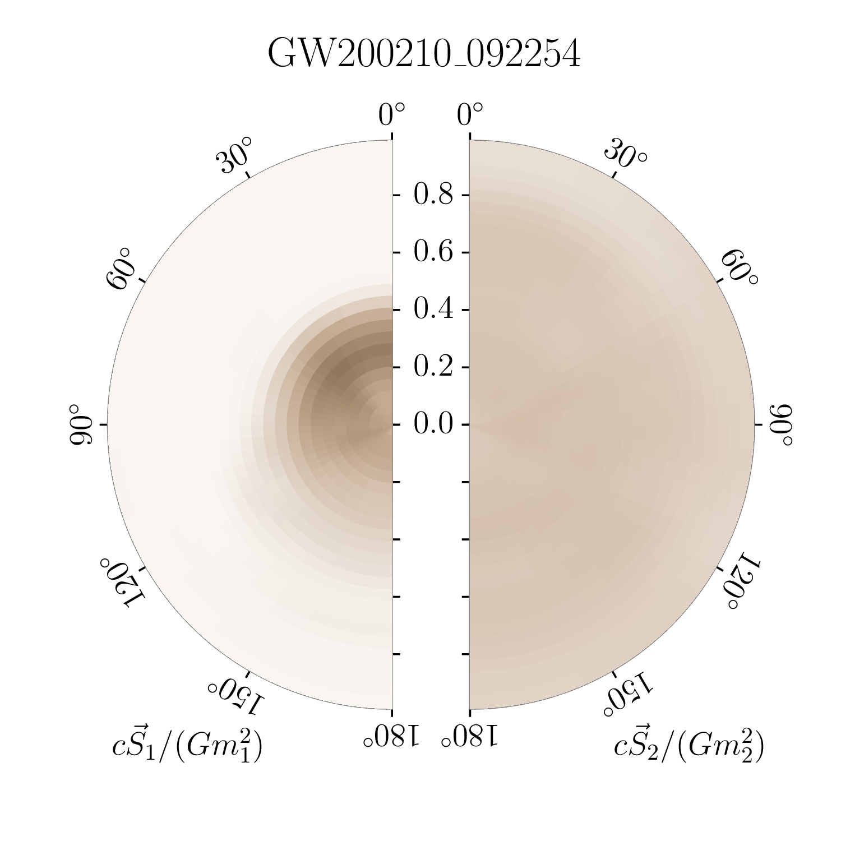
Spins: neutron star–black holes
Primary spin better measured as more important for dynamics
Spin components in the orbital plane better measured for more extreme mass ratios
LVK arXiv:2111.03606

Slide 41
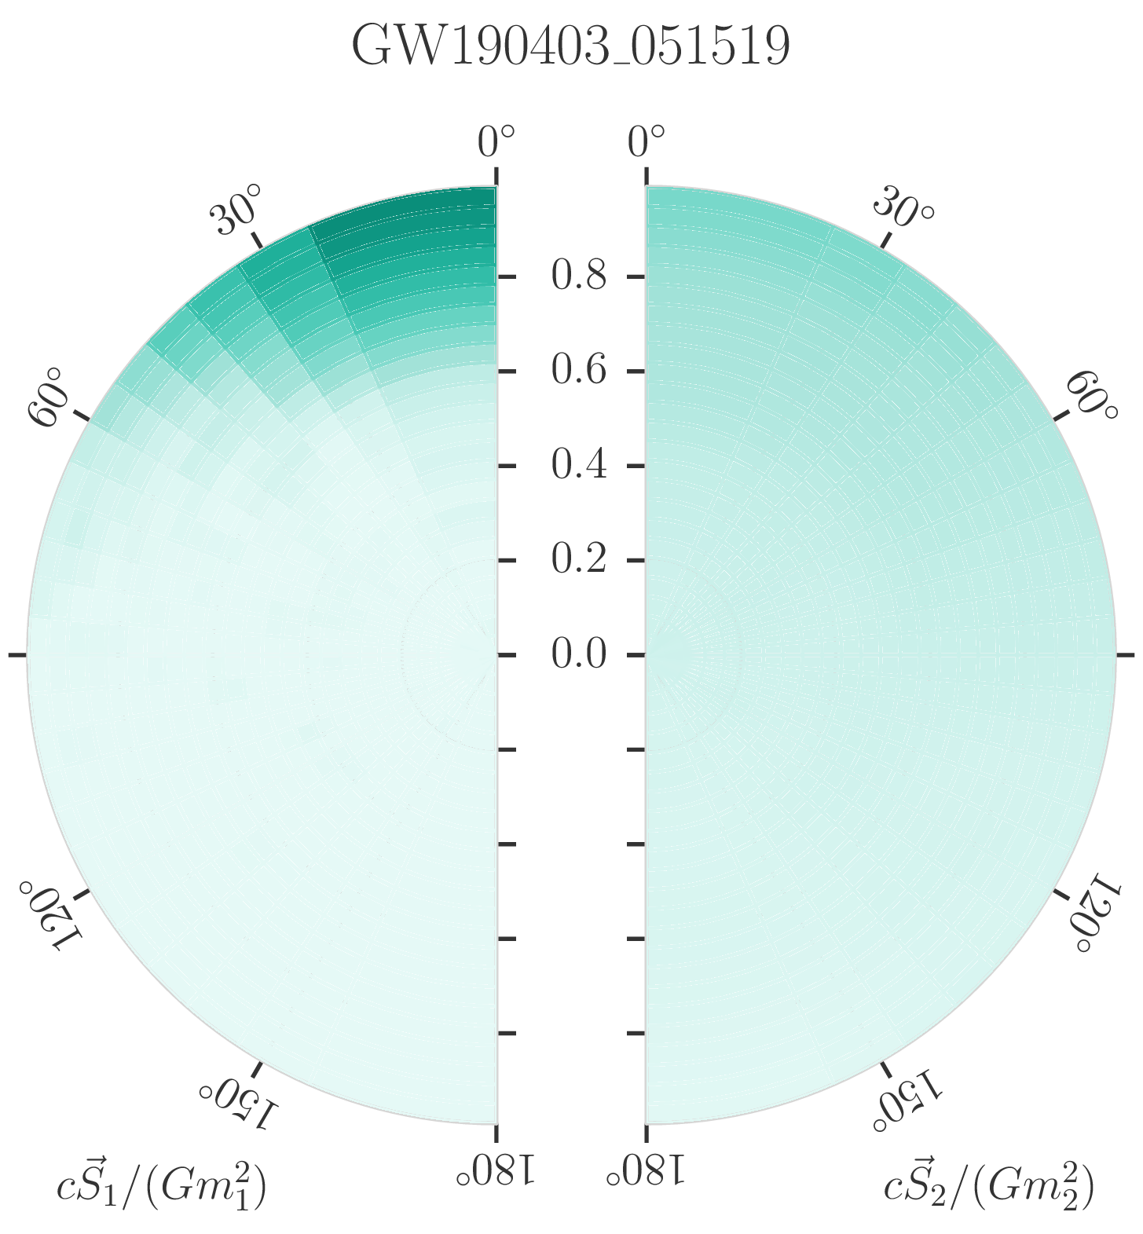
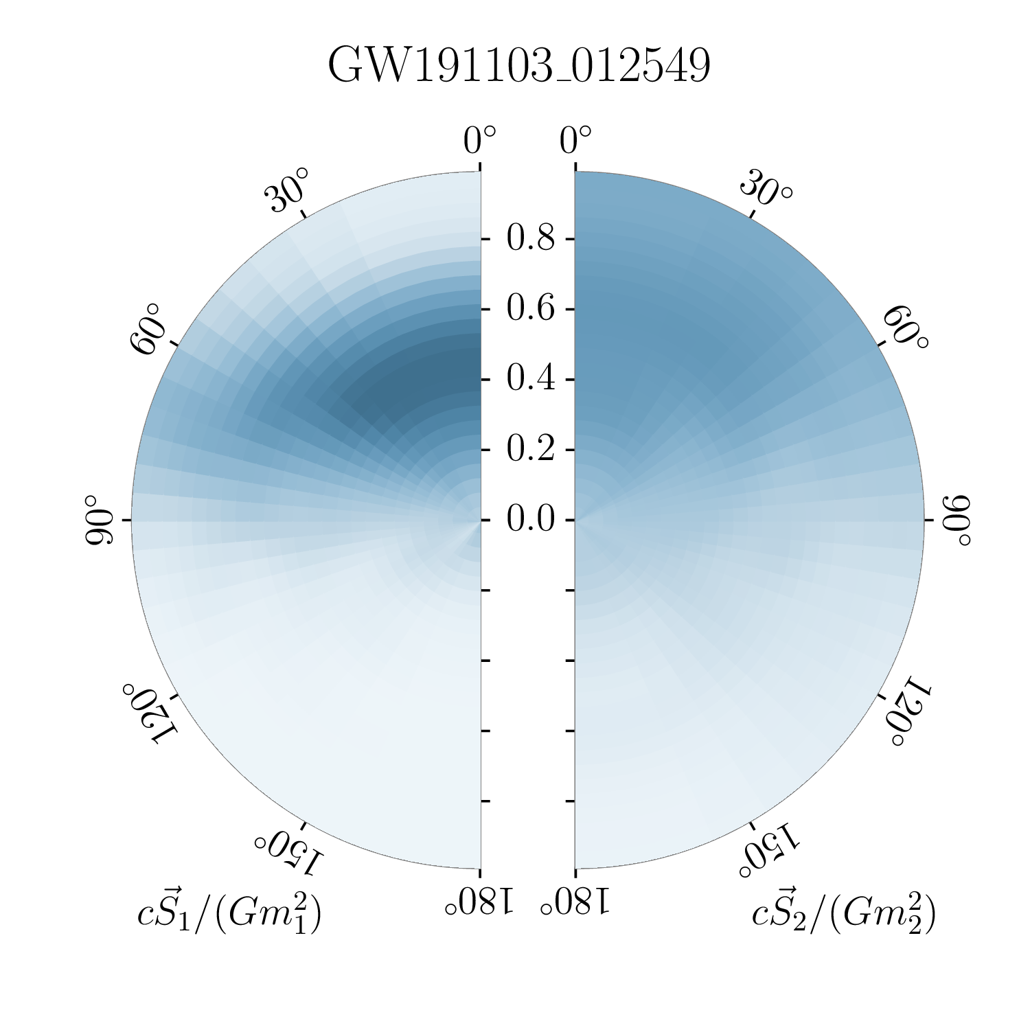
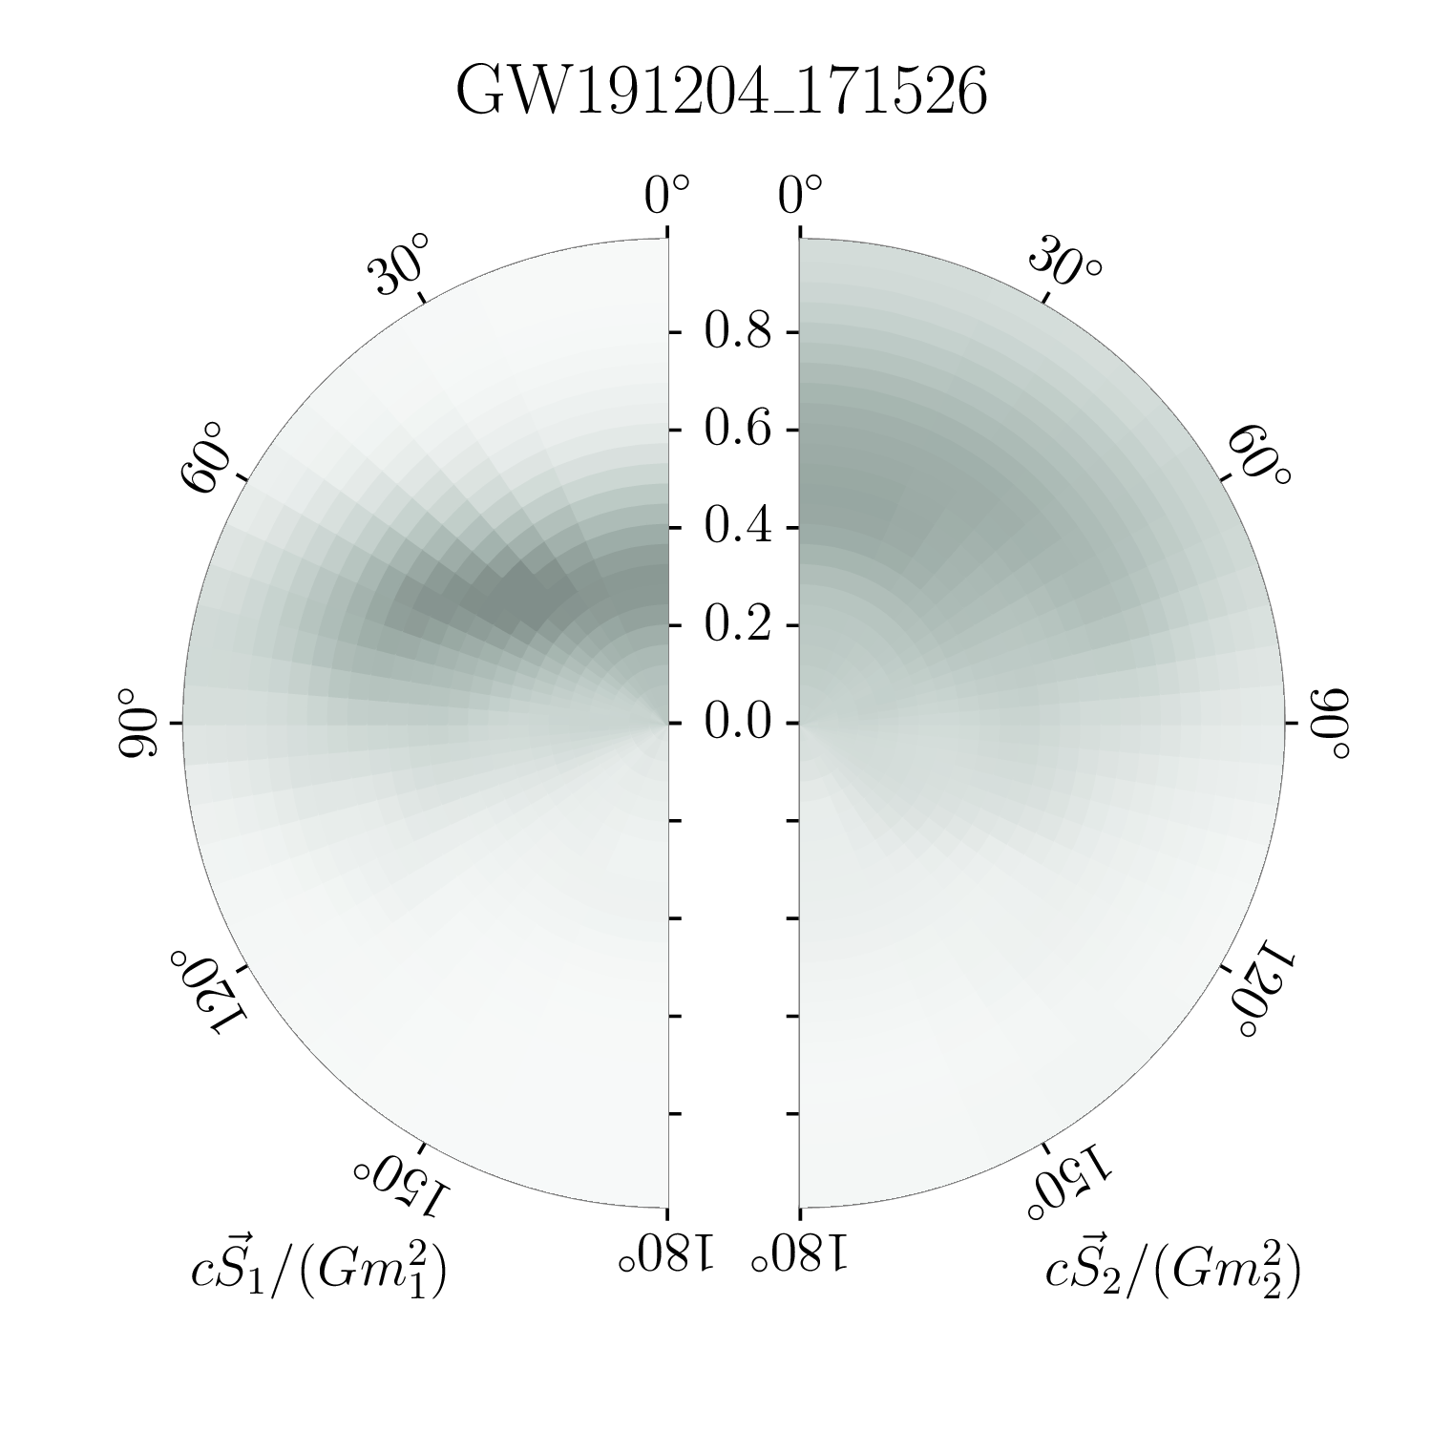
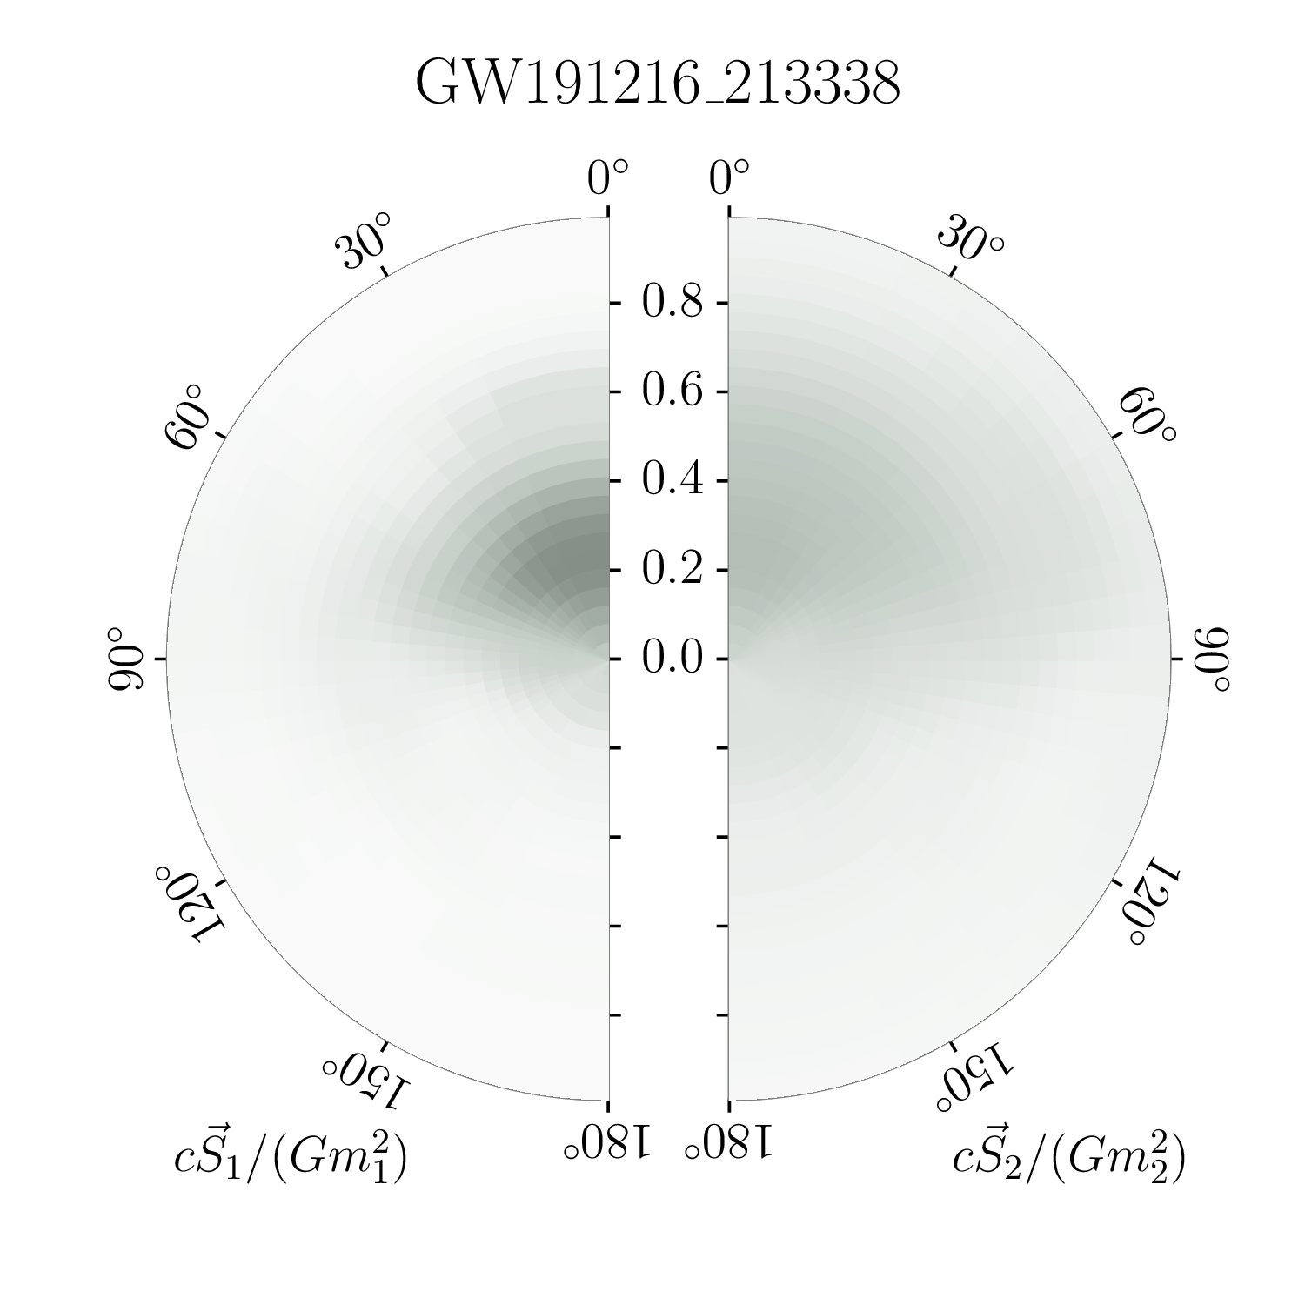
Spins: non-zero spins
GW190403 has support for near maximal spins
Spins in X-ray binaries extend close to the Kerr limit of 1
LVC arXiv:2108.01045 LVK arXiv:2111.03606

Slide 42
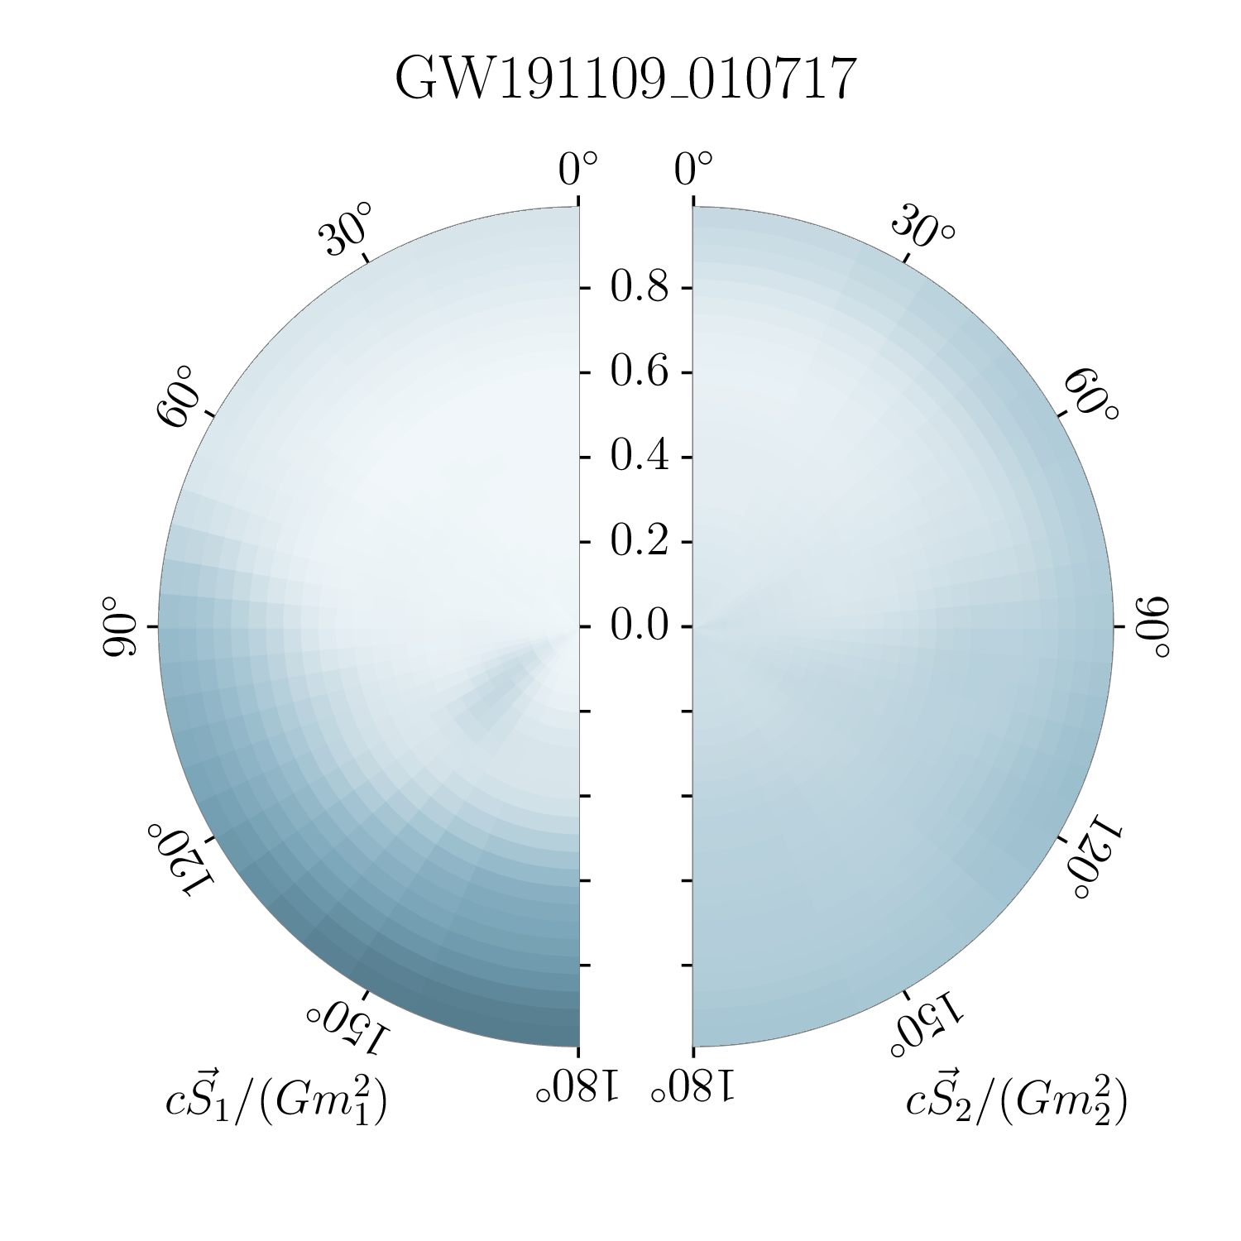
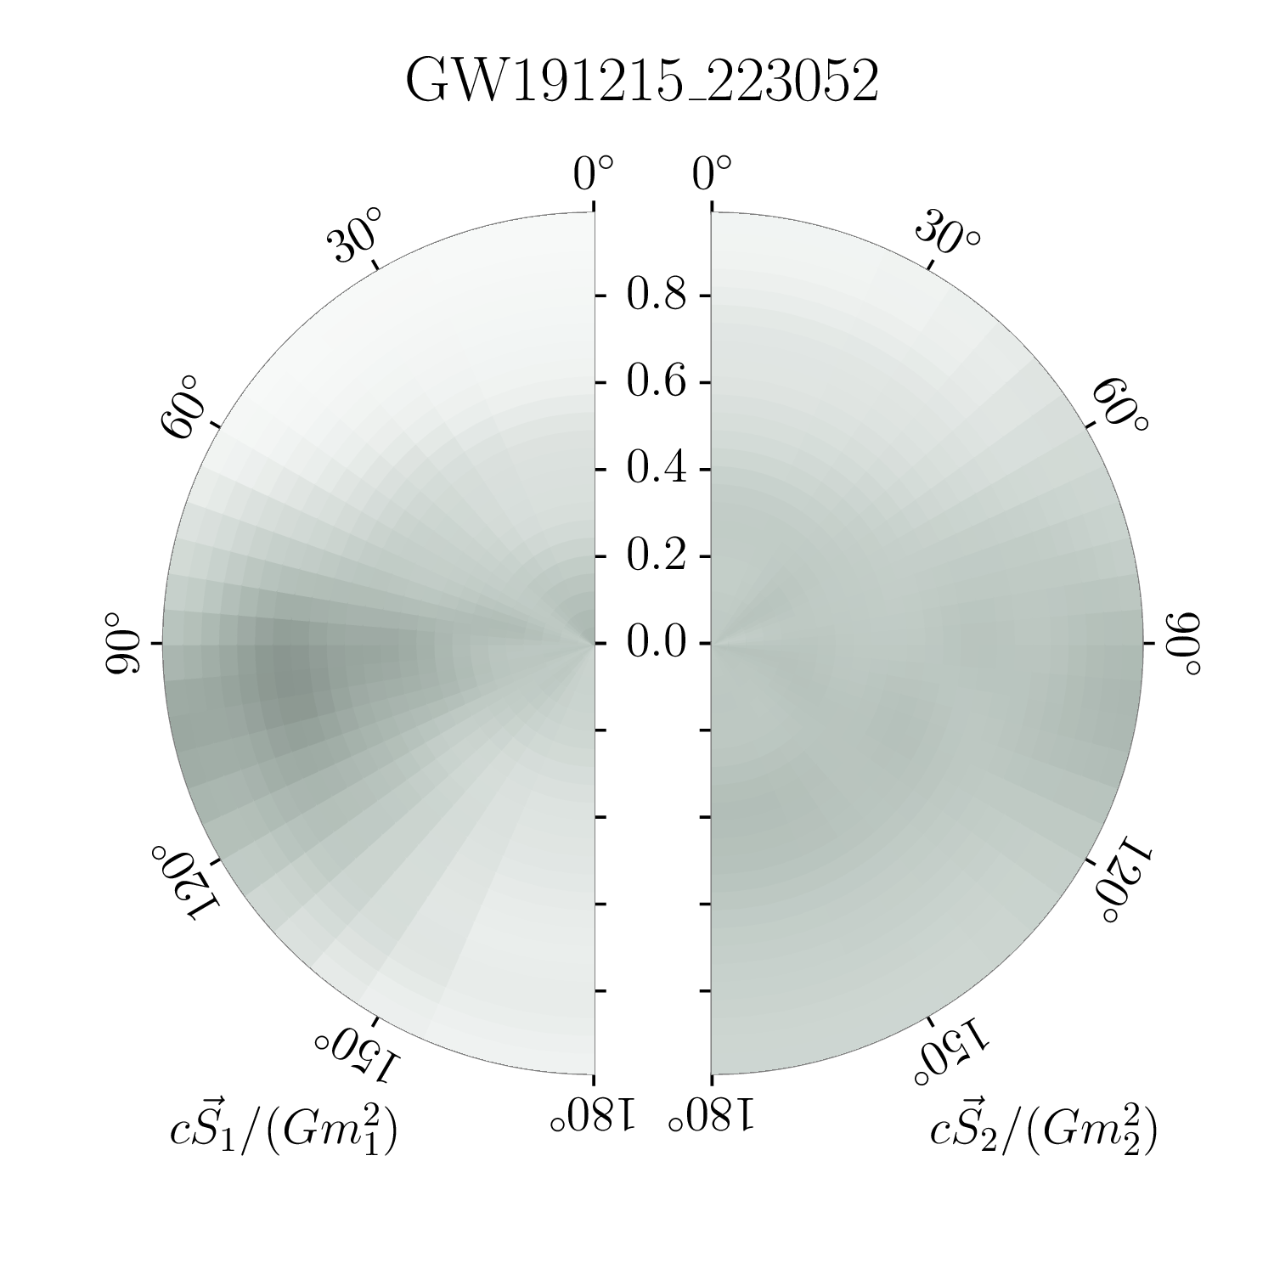
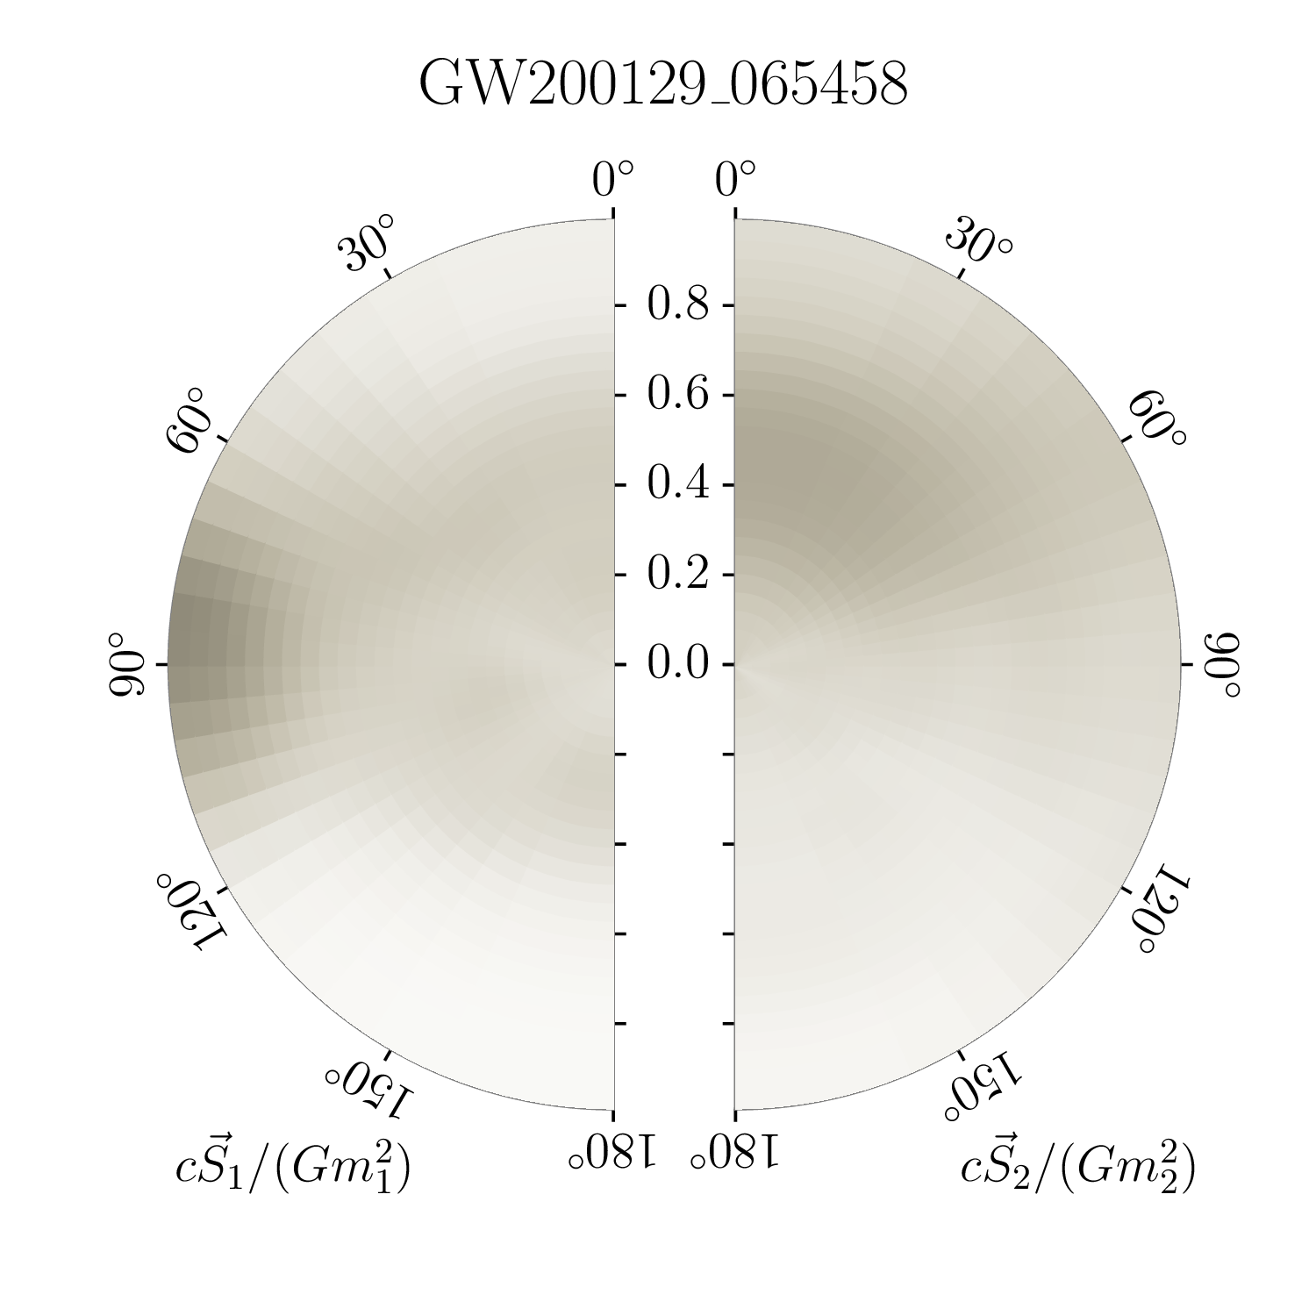
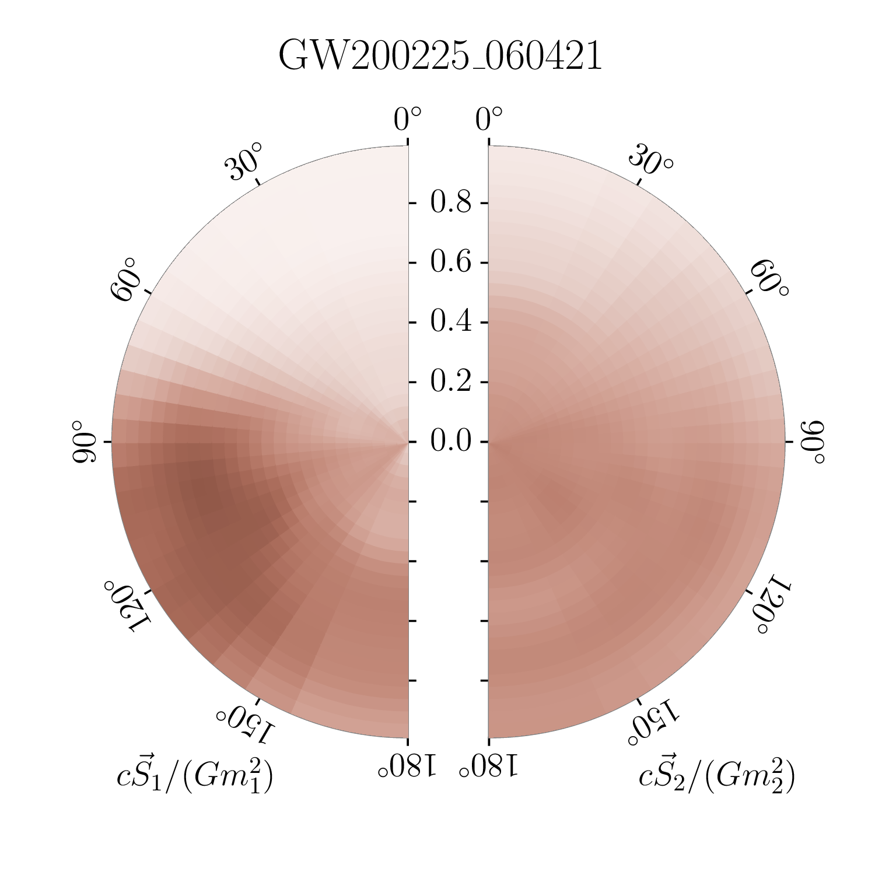
Spins: misaligned spins
GW200129 shows best evidence for precession, but differences between waveform models
GW200129 is the second highest signal-to-noise ratio ever observed, but is also impacted by data-quality issues
LVK arXiv:2111.03606

Slide 43
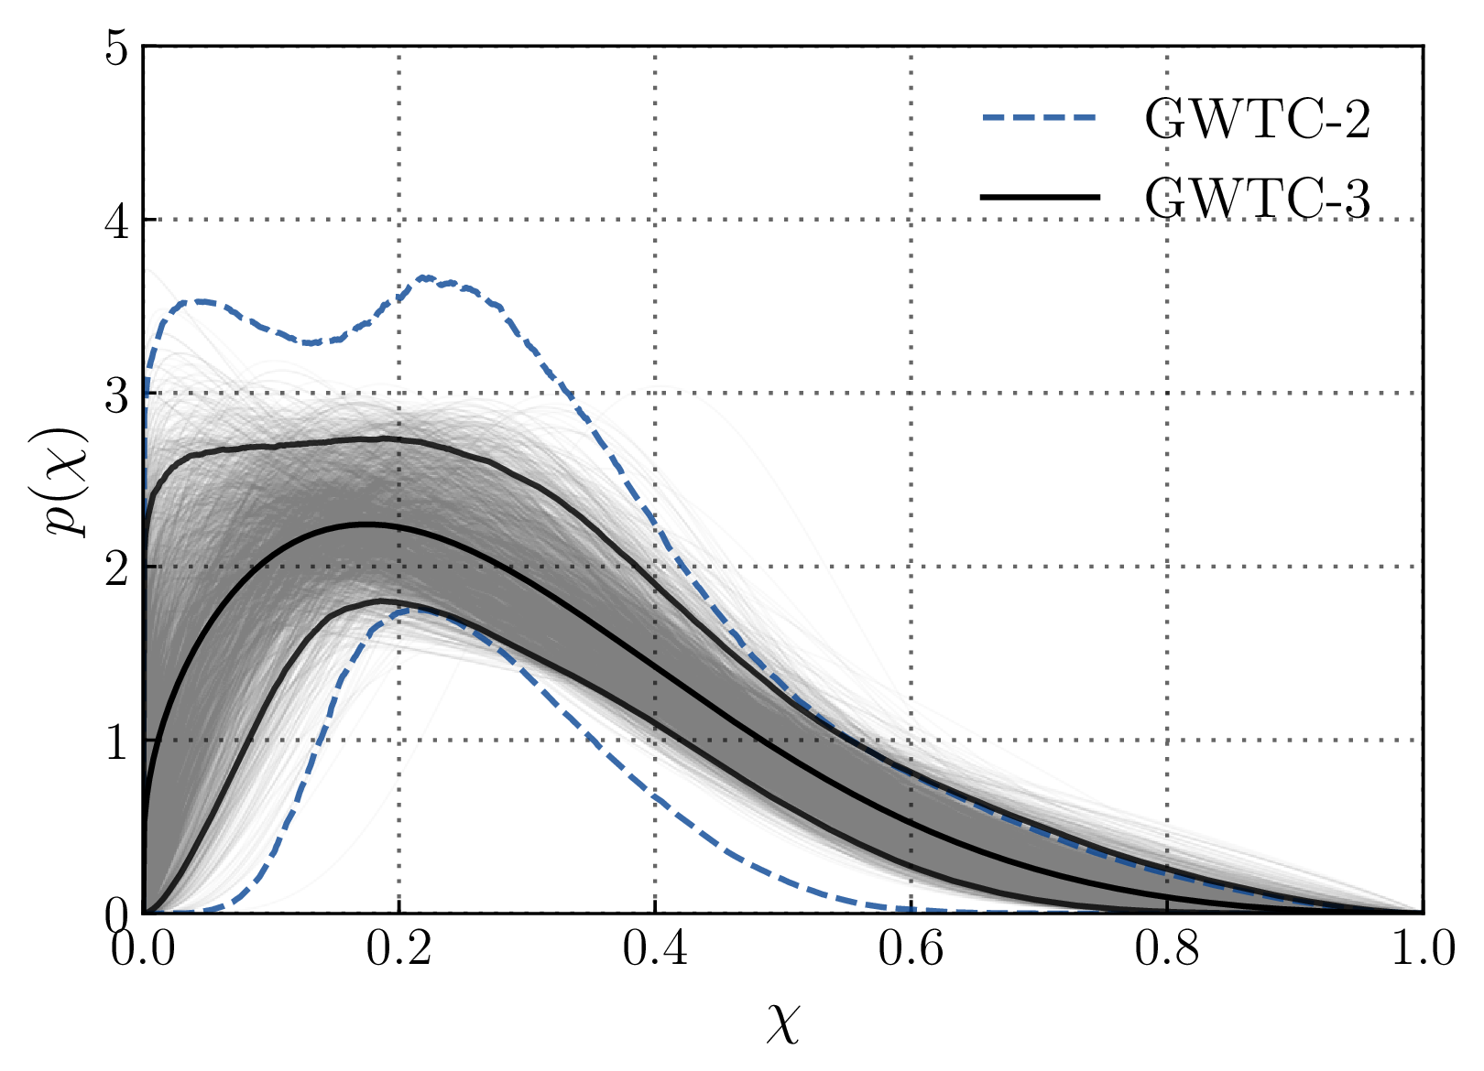
Spin distribution
Most spin magnitudes are small
The same spin distribution is assumed for primary and secondary spins
LVK arXiv:2111.03634

Slide 44
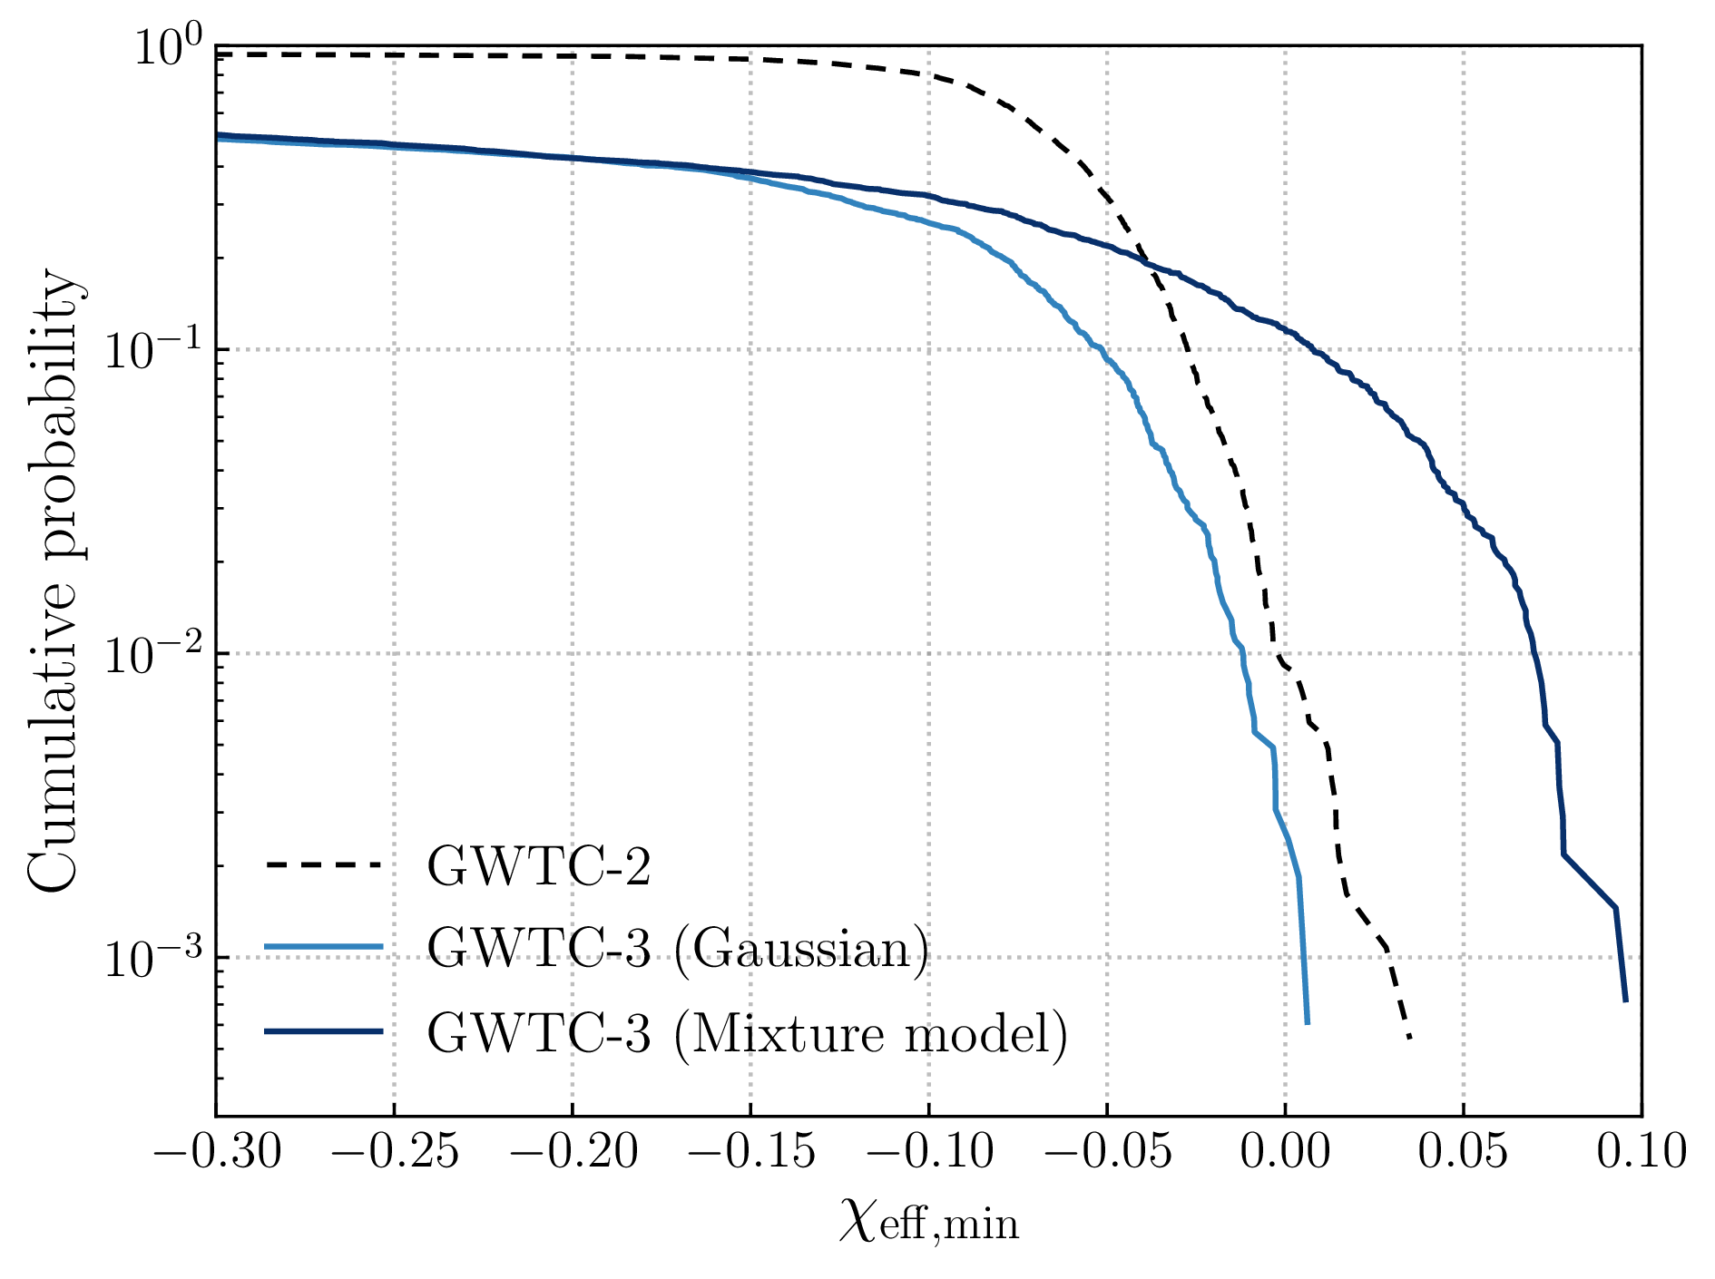
Spin distribution
Evidence for negative effective inspiral spin implies at least some misalignment of spins
Effective precession spin distribution also favours some spin misalignment
LVK arXiv:2111.03634

Slide 45
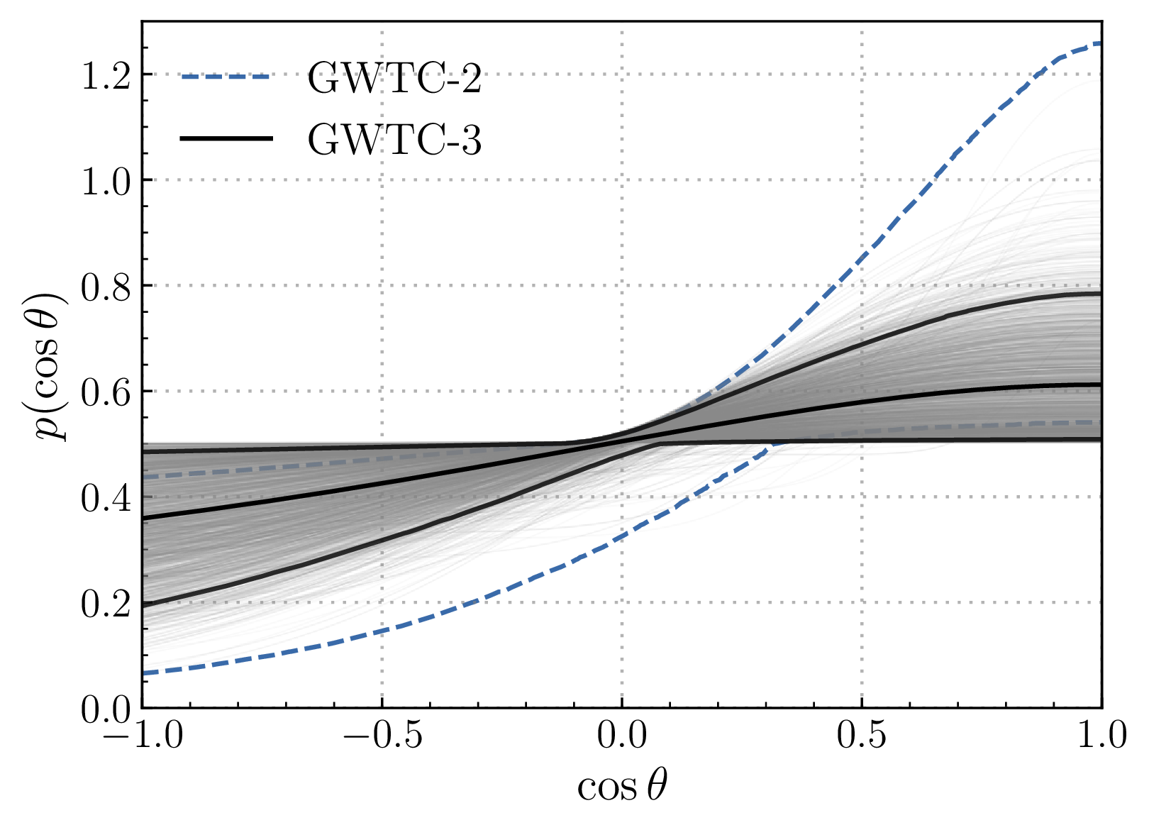
Spin distribution
More support for aligned spins
Still consistent with an isotropic distribution of spins
Measurements of spins can be a tracer of formation mechanism, for more, see Stevenson, CPLB & Mandel arXiv:1703.06873
LVK arXiv:2111.03634

Slide 46
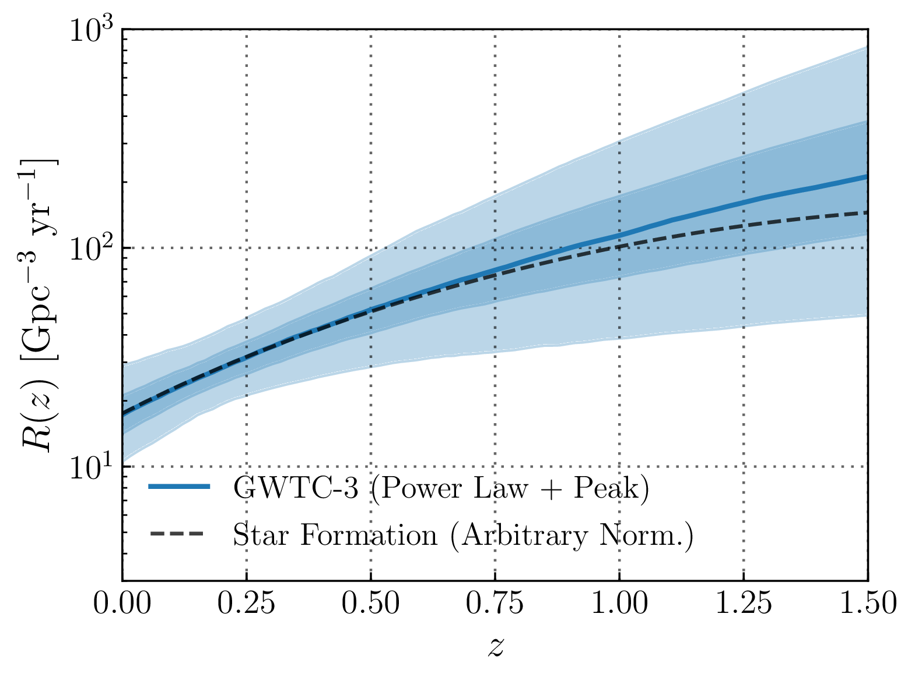
Redshift distribution
Range of current detectors is limited, so uncertainty increases at higher redshifts
Information from (lack of) observations of lensing and the stochastic background can constrain higher redshifts
For more on lensing, see LVC arXiv:2105.06384
LVK arXiv:2111.03634

Slide 47
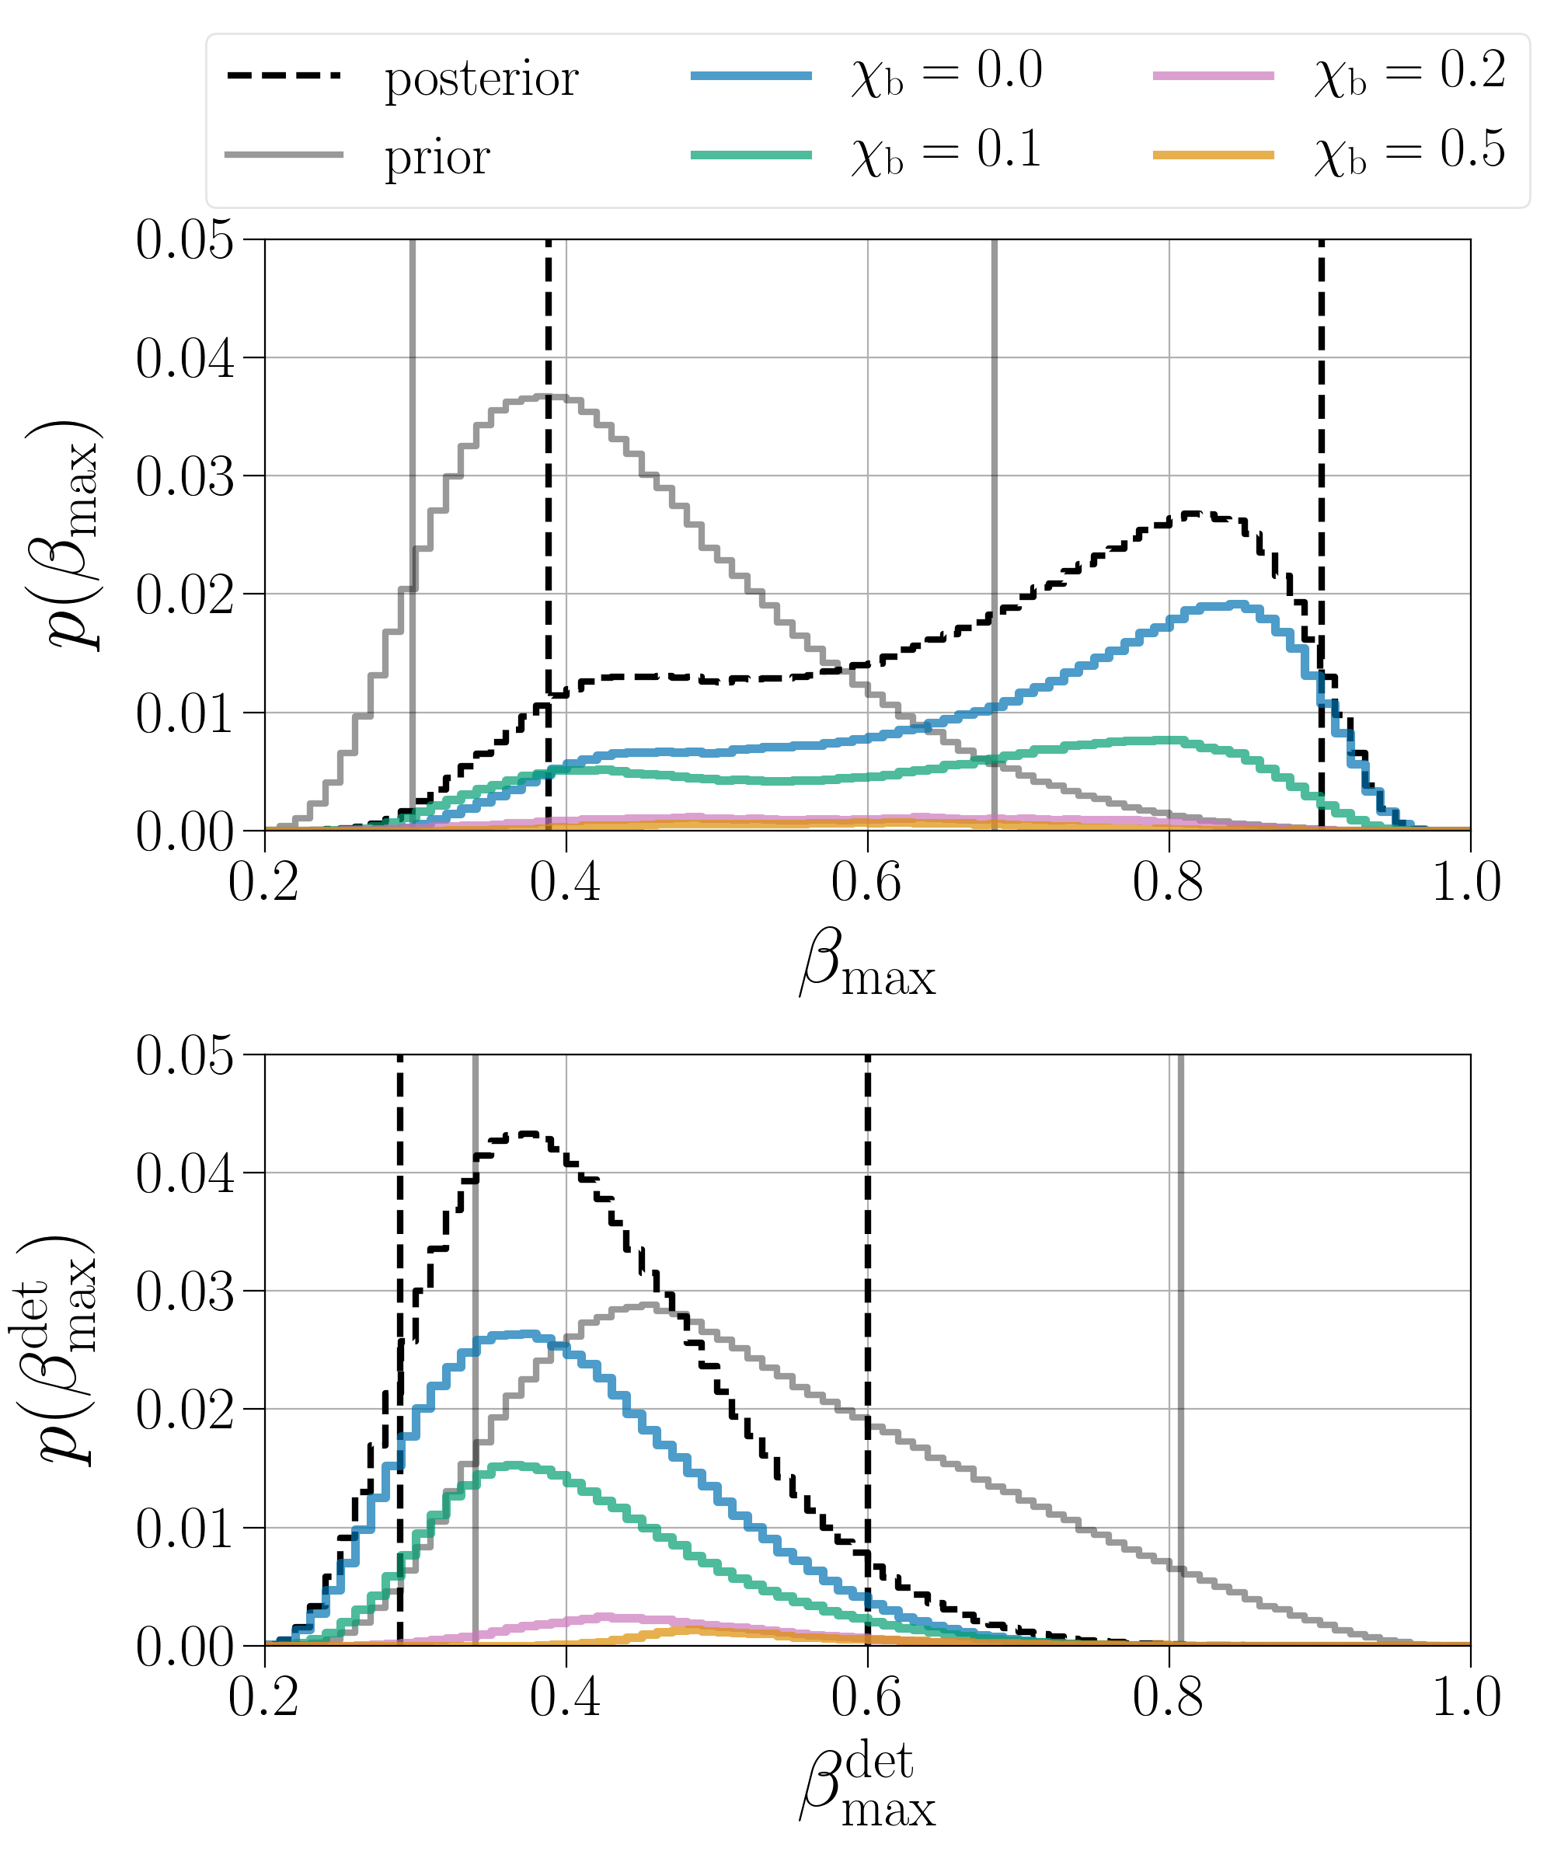
Mixing
Probably a mix of different channels
For a discussing of primordial black holes, see Franciolini et al. arXiv:2105.03349
Zevin, Bavera, CPLB et al. arXiv:2011.10057

Slide 48
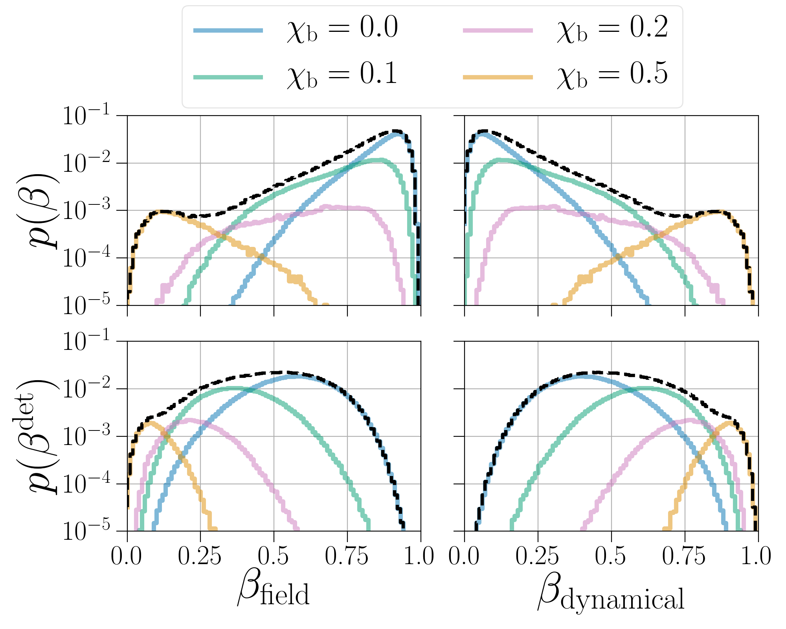
Branching ratios
Varying the birth spin of black holes
Zevin, Bavera, CPLB et al. arXiv:2011.10057

Slide 49
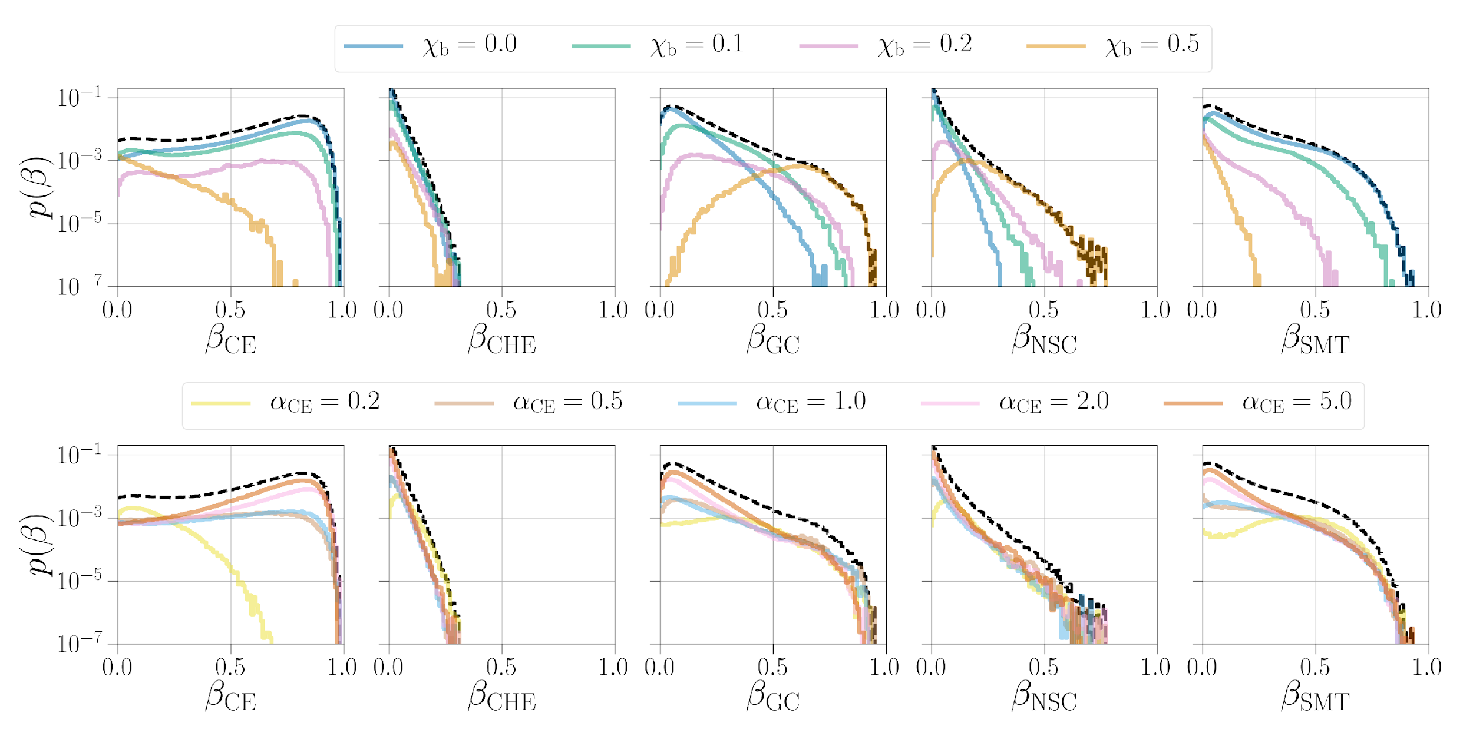
The astrophysical mix
Common envelope efficiency only influences the CE channel, but there are correlations between channels
Probably a mix of different channels
Model data release DOI:10.5281/zenodo.4277619
Zevin, Bavera, CPLB et al. arXiv:2011.10057

Slide 50
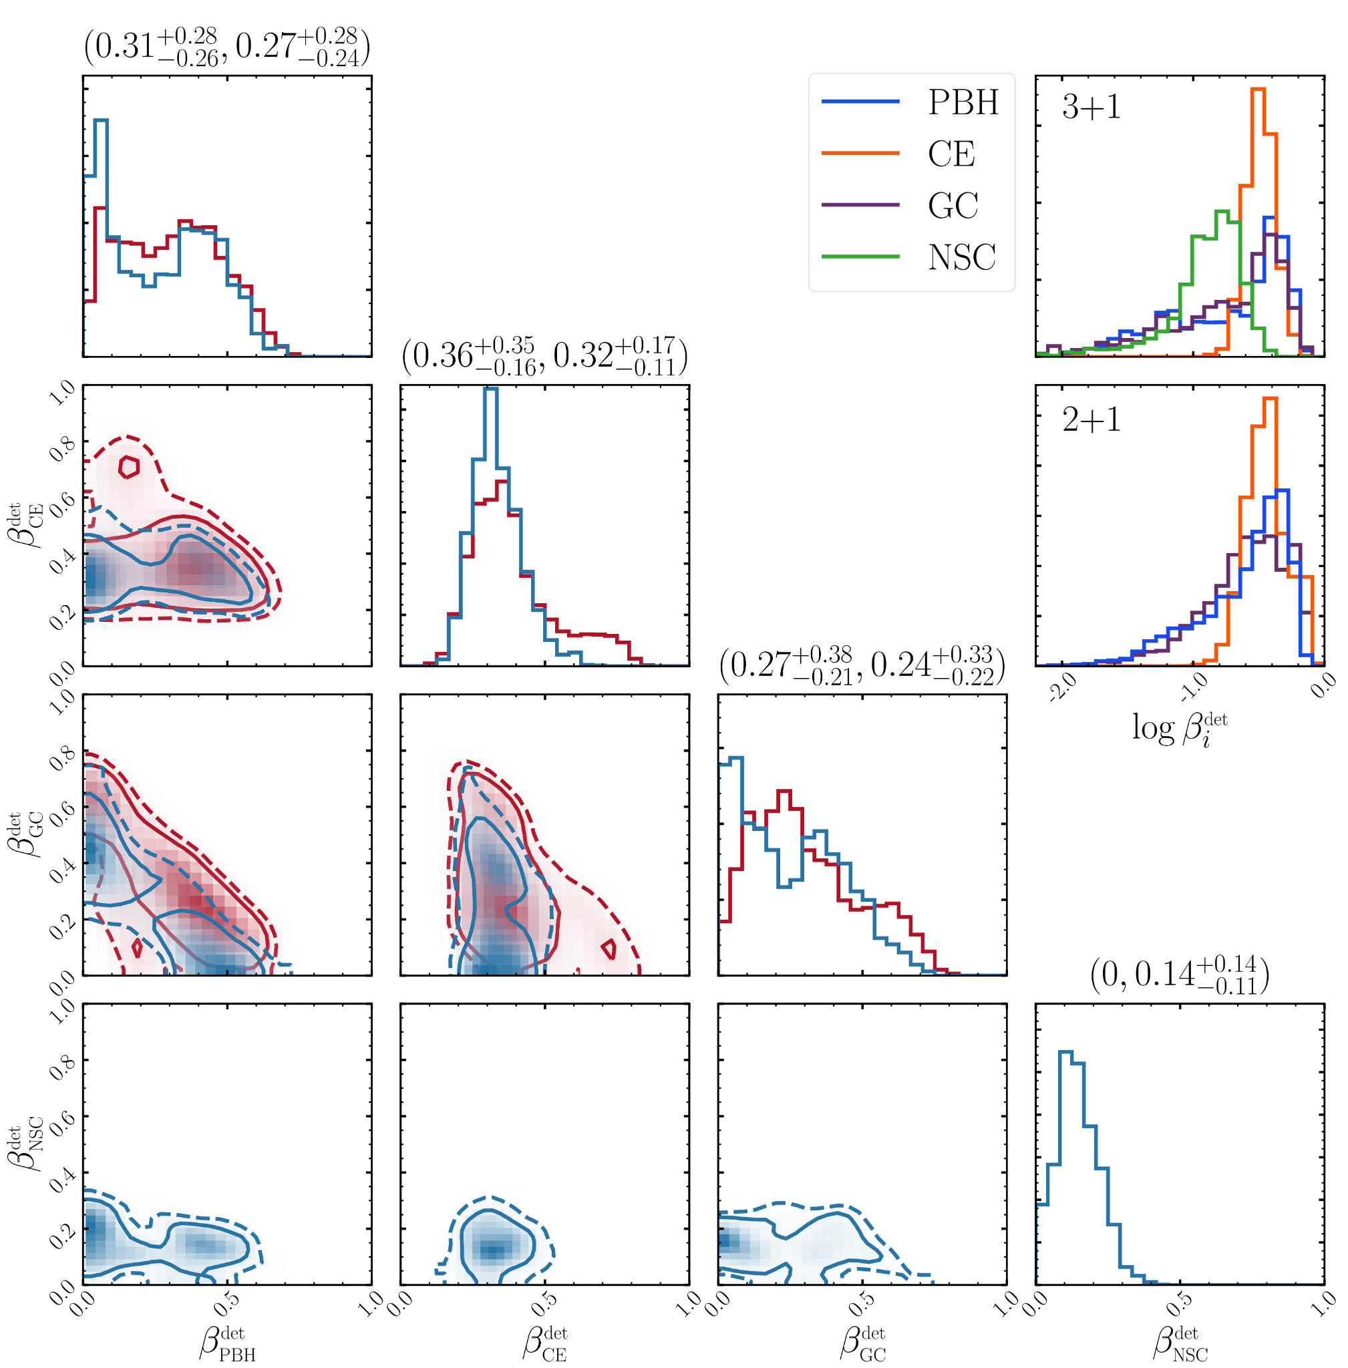
Primordial
Including others channels
PBH = primordial black holes
Franciolini et al. arXiv:2105.03349

Slide 51
Future
Including incorrect physics in models or excluding channels will lead to biased results
O4 should yield hundreds of candidates
For a review of merger rates: Mandel & Broekgaarden arXiv:2107.14239
Zevin, Bavera, CPLB et al. arXiv:2011.10057

Slide 52
Precision astrophysics
After 1000 detections of binaries from isolated evolution channels
Systematic modelling uncertainty will become dominant over statistical uncertainty
Barrett, …, CPLB et al. arXiv:1711.06287

Slide 53
Hierarchical mergers
Merger products (2G) have higher masses and characteristic spins
Hierarchical merger rates depend upon recoil kicks and hence spins
Inference methods Kimball, Talbot, CPLB et al. arXiv:2005.00023
Kimball, Talbot, CPLB et al. arXiv:2011.05332

Slide 54
Example cluster
For a cluster with an escape velocity of ~300 km s⁻¹
Assumes that all coalescences come from dynamical mergers in a single type of cluster
From GWTC-2, GW190521 and GW190519 have the best odds of being hierarchical
Kimball, Talbot, CPLB et al. arXiv:2011.05332

Slide 55
Rates
Rates encode information about formation
Rate density evolves with redshift
Multiple channels likely contribute: can only rule out models that over predict
For predictions of rates prior to the first detection, see LVC arXiv:1003.2480
Mandel & Broekgaarden arXiv:2107.14239

Slide 56
Cosmology
Hubble constant characterises the expansion of the Universe
Most information comes from GW170817
Different mass distributions yield different results
LVK arXiv:2111.03604

Slide 57
Correlation
Power law plus peak model
LVK arXiv:2111.03604

Slide 58
Selection effects
Mass and spin distributions differ from X-ray observations
There are differences in evolutionary channel and observational selection effects between X-rays and gravitational waves
Gravitational wave sources are mostly formed at lower metallicity
Liotine, Zevin, CPLB, Doctor & Kalogera arXiv:2210.01825

Slide 59
Improving simulations
Tracking stellar structure and mass transfer self-consistently, stars expand less
Avoiding significant dust driven and luminous blue variable winds reduces mass loss
Possible to form 30 solar mass black holes at solar metallicity
Bavera, …, CPLB et al. arXiv:2212.10924

Slide 60
Next-generation detectors
Boost relative to LIGO A+ sensitivity
Einstein Telescope and Cosmic Explorer designs are equivalent to a boost factor > 10
The 3G Science Book Kalogera, …, CPLB et al. arXiv:2111.06990
Kalogera, CPLB et al. arXiv:1903.09220

Slide 61
Next-generation detectors
Boost relative to LIGO A+ sensitivity
Einstein Telescope and Cosmic Explorer designs are equivalent to a boost factor > 10
The 3G Science Book Kalogera, …, CPLB et al. arXiv:2111.06990
Kalogera, CPLB et al. arXiv:1903.09220

Slide 62
White dwarfs
Galactic binaries are a prime target for LISA
For more on LISA astrophysics, see Amaro Seoane et al. arXiv:2203.06016
Korol, Rossi & Barausse arXiv:1810.03938

Slide 63
White dwarfs
White dwarfs merge in the decihertz range
The astrophysical foreground contains useful information about sources
The foreground masks stochastic backgrounds unless they can be removed
Staelens & Nelemans arXiv:2310.19448

Slide 64
Eccentricity is a key tracer of compact binary formation
Intermediate-mass black holes may gold the key to massive black hole formation
Multiband observations give unique measurements and warning for multimessenger discoveries
A new regime for tests of fundamental physics
Arca Sedda, CPLB et al. arXiv:1908.11375

