Slide 1
WG6 LLRF-ML-AI progress (concrete)
Zheqiao Geng
22.09.2023

Slide 2
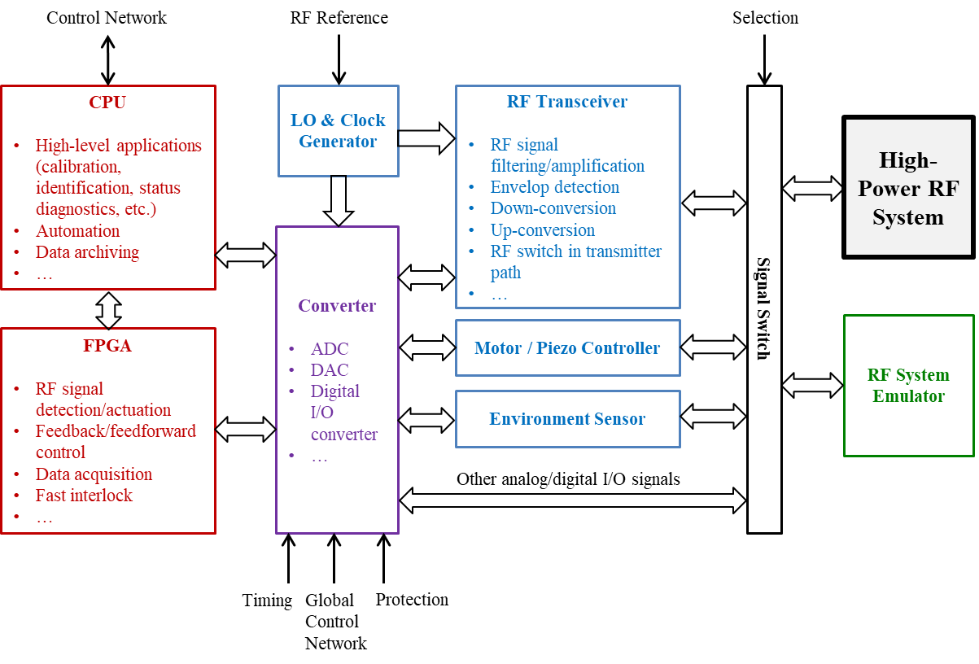
Functional Architecture of a LLRF System

Slide 3
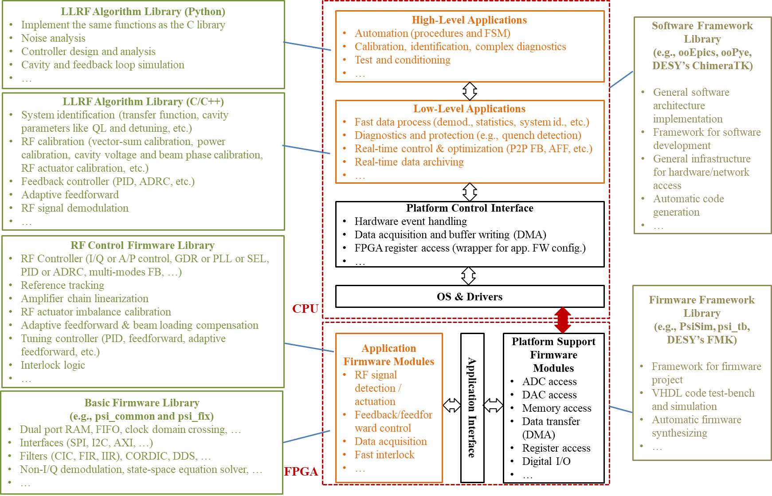
Functional Architecture of LLRF Firmware & Software
Firmware Libraries
Firmware Framework Library
Construct the firmware project structure
Simulate the firmware code
Automate the firmware synthesize
Access common components (e.g., ADC, DAC, etc.)
Basic Firmware Library
Collect firmware build components common for different applications
RF Control Firmware Library
Implement high-level LLRF control modules
Can be assembled and configured for fast prototyping of LLRF controllers

Slide 4
Functional Architecture of LLRF Firmware & Software (cont.)
Software Libraries
Software Framework Library
Define a common software architecture
Implement infrastructures for multi-threading, hardware access, and network access
LLRF Algorithm Library (C/C++)
Implement RF control domain algorithms
Support soft-real-time applications
LLRF Algorithm Library (Python)
Implement same algorithms as the C/C++ library
Also implement features like noise analysis, feedback controller design, and system simulation
For high-level applications and automation

Slide 5
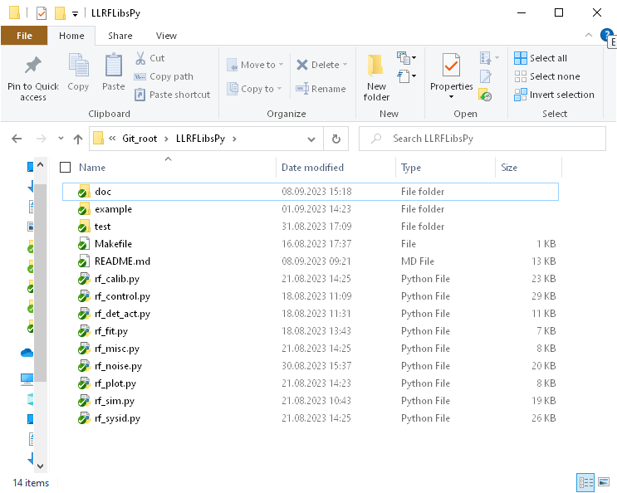
Contents of LLRFLibsPy
Python modules in LLRFLibsPy
Files in the Git repository

Slide 6
Contents of LLRFLibsPy (cont.)
Description of Modules
rf_sim | Simulate the cavity response; determine the operation parameters
rf_control | Design and analyze RF feedback/feedforward controllers
rf_det_act | Measure RF amplitude and phase from ADC samples
rf_noise | Noise analysis, generation, and filtering
rf_calib | RF calibrations like virtual probe, RF actuator offset/imbalance, forward and reflected, and power calibrations
rf_sysid | Identify the system transfer function and characteristic parameters (e.g., cavity QL and detuning)
rf_fit | Fit data to sine/cosine, circle, ellipse or Gaussian functions
rf_misc | Misc. functions like saving data to files and reading data from files
rf_plot | Plot functions for internal usage
Note: the library relies on “numpy” and “scipy”, “matplotlib” is also loaded if any plot function is enabled.

Slide 7
Thank you for attention!

