Slide 1
NC RF STRUCTURES
SURVEY
David Alesini and Walter Wuensch
RF Coordination Panel meeting, September 22, 2023

Slide 2
CONTACTED RESEARCHERS/LABORATORIES
european
26 Laboratories/Universities
Launched survey on week 18-22/9/23
6/26 received answers up to now
Non european

Slide 3
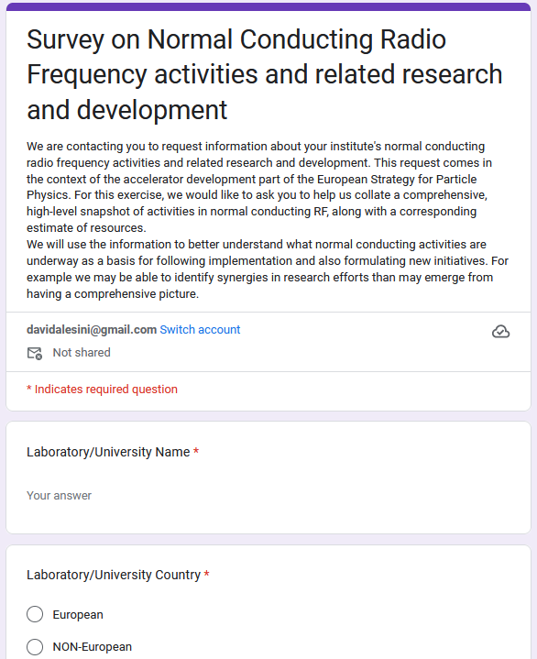
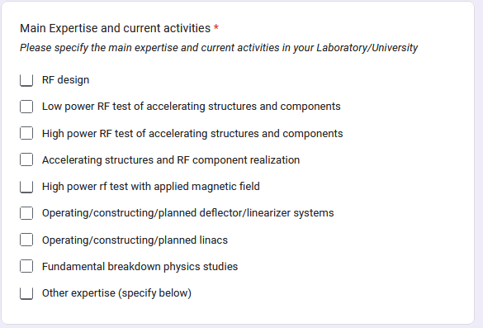
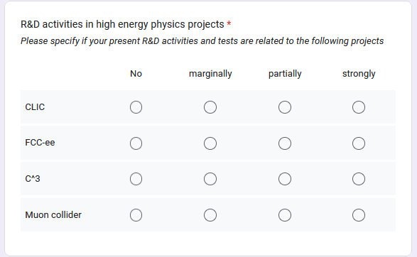
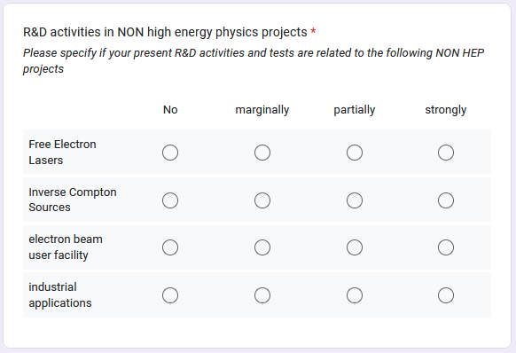
SURVEY ON NC RF STRUCTURES
https://forms.gle/jCoVuYR3pzZ3DGuB7
Google form

Slide 4
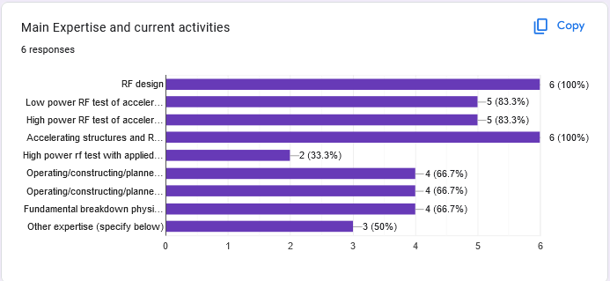
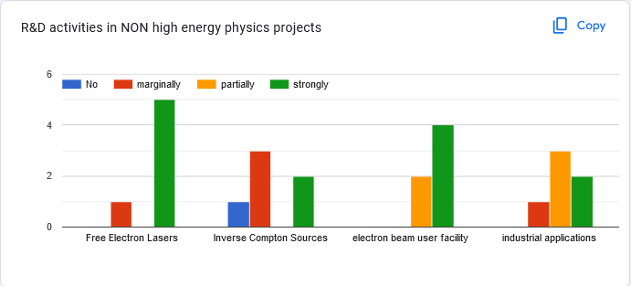
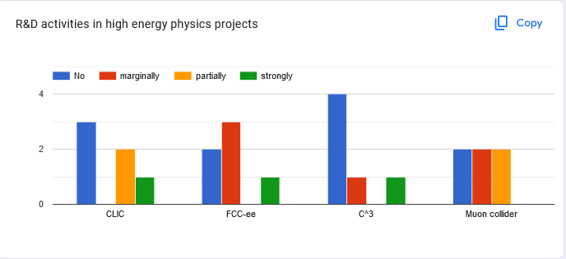
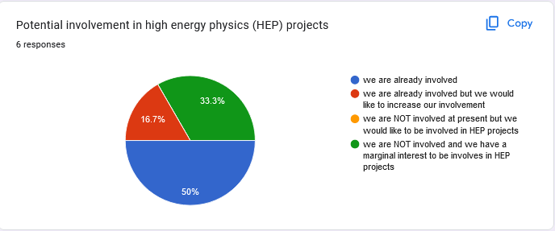
ELABORATION OF THE SURVEY RESULTS

Slide 5
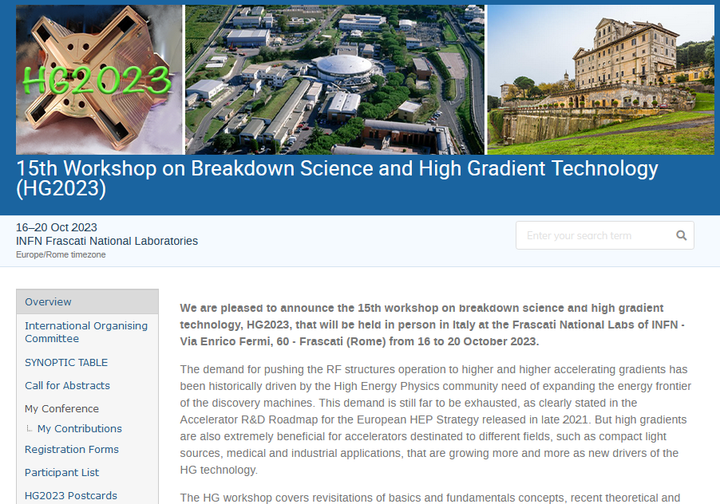
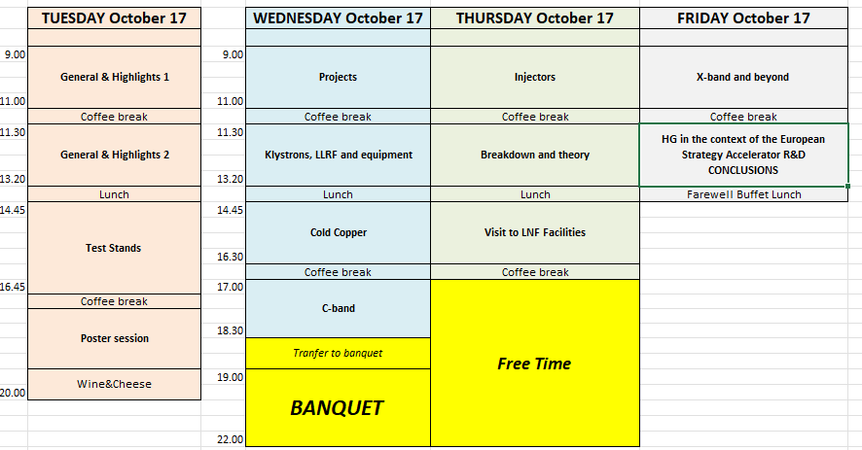
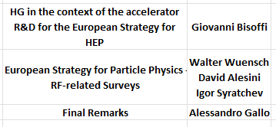
WHEN DISCUSS WITH THE RF NC COMMUNITY

