Slide 1

CI-Mag-106 - Conventional Magnets for Accelerators
Lecture 1
Dr Alex Bainbridge
Magnetics and Radiation Sources Group
ASTeC
Daresbury Laboratory
alex.bainbridge@stfc.ac.uk

Slide 2
Course Purpose
This course is an overview of magnet technology commonly found in particle accelerators here at Daresbury and around the world, including emerging technologies.
We will be focusing on the magnets themselves, not the dynamics of the beam through them!
Lecture 1: Will cover some basic theory, purpose and design of various types of DC electromagnets and field generation through coil design.
Lecture 2: Will cover advanced magnetic theory, pole tip design, basic concepts of permanent magnets, practical magnet design and engineering.
Lecture 3: Will cover AC magnets and the challenges they pose for surrounding systems.
Lecture 4: Will cover magnetic measurement techniques.
Not covered: Superconducting magnets, insertion devices, shielding.

Slide 3
Useful resources
Materials for this lecture series come from a variety of sources
-Previous CI Mag 106 lectures by Ben Shepherd, in turn adapted from lectures by Neil Marks
-CERN Accelerator School on Magnets, Bruges, Belgium; June 2009
https://arxiv.org/html/1105.5069v1
-United States Particle Accelerator School Magnet and RF Cavity Design, January 2016,http://uspas.fnal.gov/materials/16Austin/austin-magnets.shtml
-J.D. Jackson, Classical Electrodynamics
-J.T. Tanabe, Iron Dominated Electromagnets - https://www.slac.stanford.edu/pubs/slacreports/reports16/slac-r-754.pdf
CI book: https://www.taylorfrancis.com/books/oa-mono/10.1201/9781351007962/science-technology-particle-accelerators-graeme-burt-rob-appleby-james-clarke-hywel-owen

Slide 4
Contents – Lecture 1
Introduction to common DC magnets
  Nomenclature
  Dipole, quadrupole and sextupole magnets
  ‘Higher order’ magnets
Electromagnetic excitation
  Fields from currents
  Dipole, quadrupole and sextupole excitation
  Introducing efficiency and fields in materials
Practical coils
The magnetic circuit
  Magnet geometries
  Yoke optimisation

Slide 5
Introduction –
Common DC Magnets

Slide 6
Some useful terms
Variable | SI Unit | Notes / other units
Force, F | Newton (N) | Dyne – very rarely used
Charge, q | Coulomb (C) | Consists of 6.24 x 10¹⁸ electrons, or 1 electron = 1.6 x 10⁻¹⁹ C.
Magnetic field, H (magnetomotive force produced by electric currents) | Amp/metre (A/m) | American units Oersted (Oe) 1 Oe = 79.577 A/m
Magnetic Flux, Φ | Weber (Wb) | Maxwell (Mx) 1 Wb=10⁸ Mx Surface integral of normal component of field
Flux density, B (commonly referred to as ‘field’) | Tesla (T) | Gauss (G), 1 T = 10,000 G 1Tesla = 1 Wb/m^2
Current, I | Ampere (A) | 1 Amp = 1 Coulomb/second
Energy, E | Joule (J) | Use eV for particles, 1eV = 1.6 x 10⁻¹⁹ J
B and H related by B=µH, where µ=“Magnetic Permeability” of material
Permeability of free space, µ₀ = 4π x 10⁻⁷ Tm/A

Slide 7
Magnetic Flux Densities
Value | Item
0.1 - 1.0 pT | human brain magnetic field
24 µT | strength of magnetic tape near tape head
31-58 µT | strength of Earth's magnetic field at 0° latitude (on the equator)
0.5 mT | the suggested exposure limit for cardiac pacemakers by American Conference of Governmental Industrial Hygienists (ACGIH)
5 mT | the strength of a typical refrigerator magnet
0.15 T | the magnetic field strength of a sunspot
1 T to 2.4 T | coil gap of a typical loudspeaker magnet
1.25 T | strength of a modern neodymium-iron-boron (Nd₂Fe₁₄B) rare earth magnet.
1.5 T to 3 T | strength of medical magnetic resonance imaging systems in practice, experimentally up to 8 T
9.4 T | modern high resolution research magnetic resonance imaging system
11.7 T | field strength of a 500 MHz NMR spectrometer
16 T | strength used to levitate a frog
36.2 T | strongest continuous magnetic field produced by non-superconductive resistive magnet
45 T | strongest continuous magnetic field yet produced in a laboratory (Florida State University's National High Magnetic Field Laboratory in Tallahassee, USA)
100.75 T | strongest (pulsed) magnetic field yet obtained non-destructively in a laboratory (National High Magnetic Field Laboratory, Los Alamos National Laboratory, USA)
730 T | strongest pulsed magnetic field yet obtained in a laboratory, destroying the used equipment, but not the laboratory itself (Institute for Solid State Physics, Tokyo)
2.8 kT | strongest (pulsed) magnetic field ever obtained (with explosives) in a laboratory (VNIIEF in Sarov, Russia, 1998)
1 to 100 MT | strength of a neutron star
0.1 to 100 GT | strength of a magnetar

Slide 8
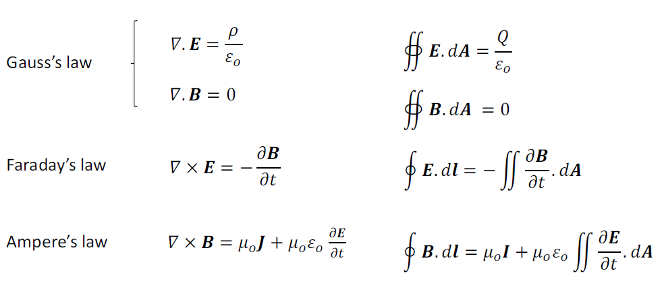
Maxwell’s equations
In free space magnetic and electric fields obey the 4 Maxwell equations:
These are Maxwell’s equations for fields in vacuum. They modify slightly for fields in materials.

Slide 9
The Maxwell equations
In free space magnetic and electric fields obey the 4 Maxwell equations:
These are Maxwell’s equations for fields in vacuum. They change slightly for fields in materials.
Electric fields diverge away from sources
Magnetic fields cannot diverge away from sources, what comes out one end has to go back in the other!
A changing magnetic field (or an electric charge moving through a field) will produce a force at right angles to the field and motion!
Moving electric charges produce a magnetic field that curls around the direction of motion.

Slide 10
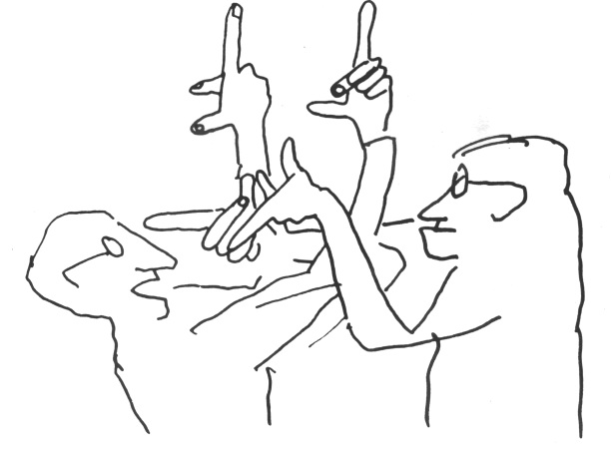
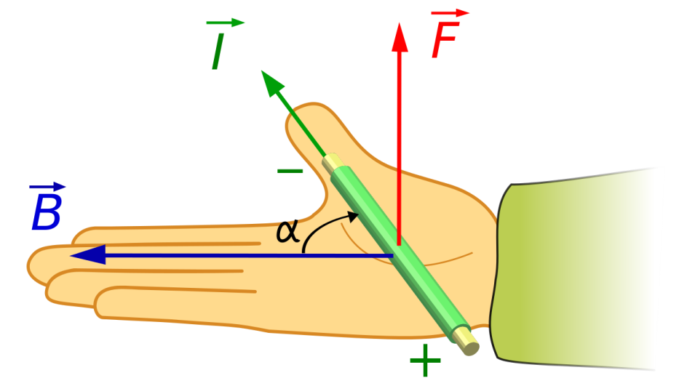
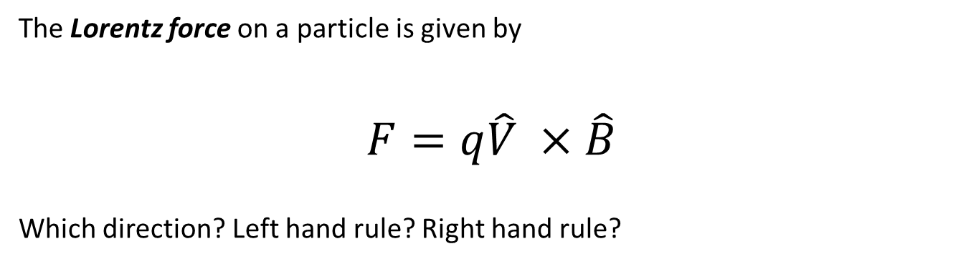

Magnets on particles
The Lorentz force on a particle is given by
$$F=q\hat{V} ×\hat{B}$$
Which direction? Left hand rule? Right hand rule?
Bruno Touschek
Classically: $F=qVB=\frac{mV^{2}}{r}$
$$→rqB=mV$$

Slide 11
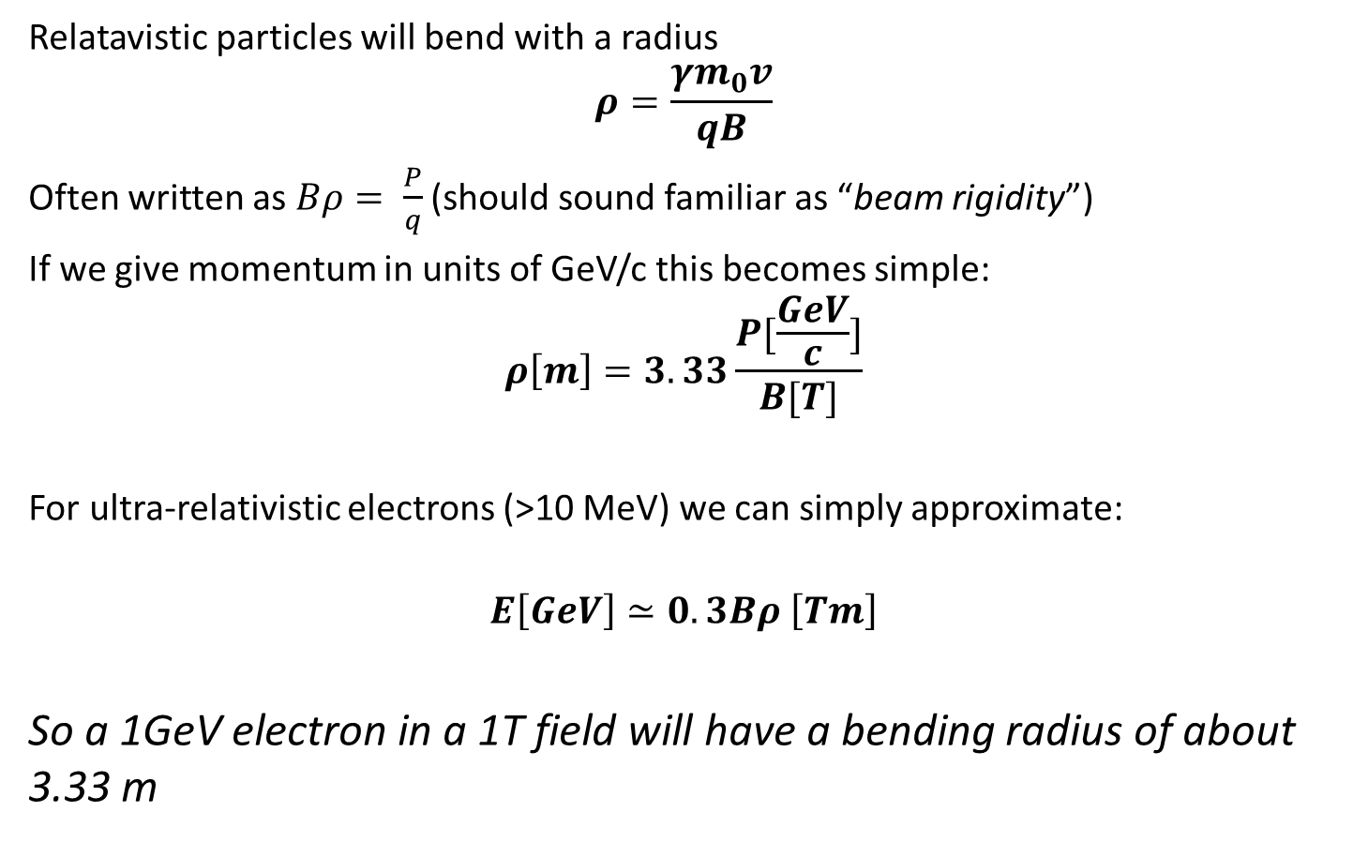
Relativistic particle motion
Relatavistic particles will bend with a radius
$$ρ=\frac{γm_{0}v}{qB}$$
Often written as $Bρ= \frac{P}{q}$ (should sound familiar as “beam rigidity”)
If we give momentum in units of GeV/c this becomes simple:
$$ρ\left[m\right]=3.33\frac{P[\frac{GeV}{c}]}{B[T]}$$
For ultra-relativistic electrons (>10 MeV) we can simply approximate:
$$E\left[GeV\right]≃0.3Bρ \left[Tm\right]$$
So a 1GeV electron in a 1T field will have a bending radius of about 3.33 m

Slide 12
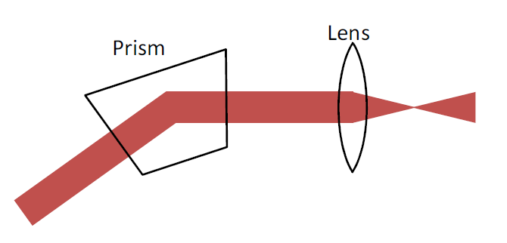
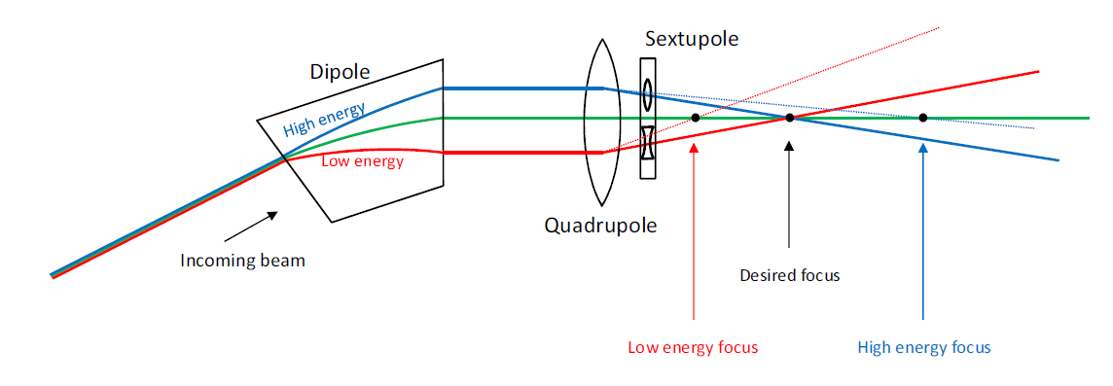
Magnets vs Optics
Magnets are like optics for charged particles.
The physics is different but the end results are very similar.

Slide 13
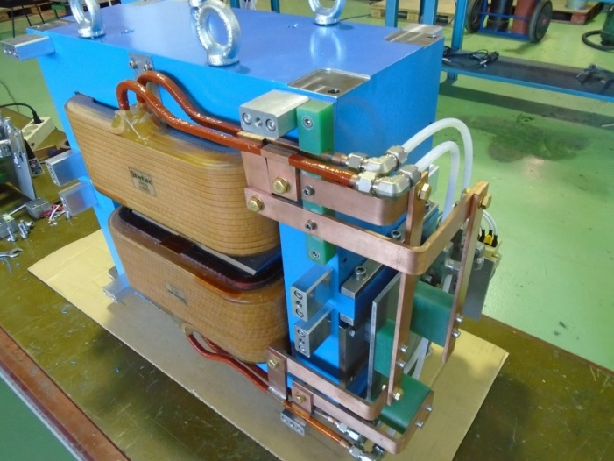
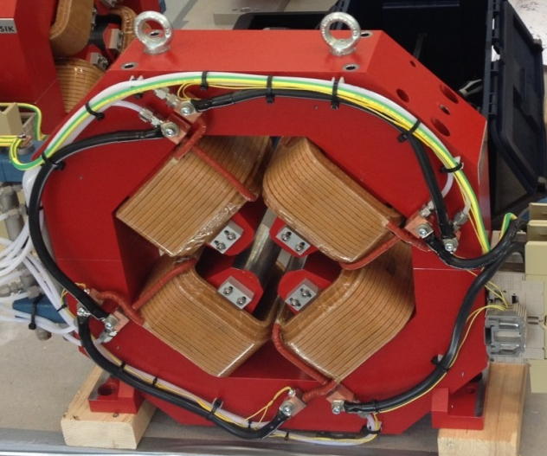
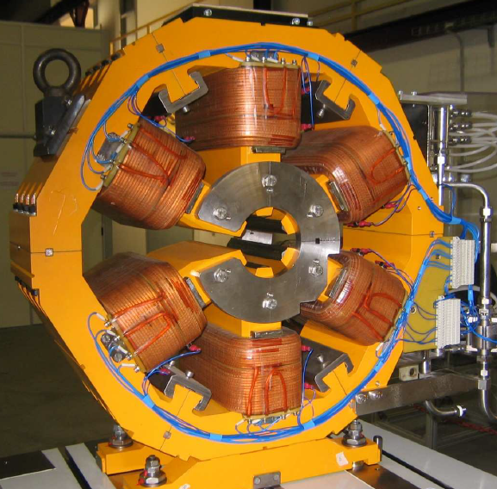
Magnet Effects
Magnetic fields exert a Lorentz Force F=q(V x B) on a particle. Force is always perpendicular to field vector and particle motion – circular motion
Dipoles bend the beam
Quadrupoles focus it
Sextupoles correct chromaticity
Higher order magnets are also common, most circular machines have octupoles

Slide 14
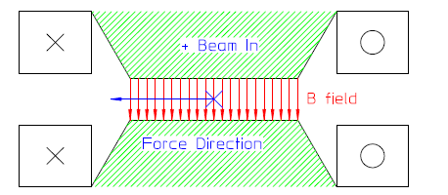
Dipoles
Dipoles have 2 poles, a constant field across the gap and steers a particle beam left or right depending on charge and field direction.
To bend the beam uniformly, dipoles need to produce a field that is constant across the aperture. Field homogeneity is one of the most important aspects of dipole design. A non homogenous field will result in unwanted horizontal focussing or defocussing.

Slide 15
Dipoles
End design also has an effect on unwanted focussing in dipoles.
Sector dipoles focus horizontally
The 2 most common types of dipole. Curvature saves material costs.
Sector dipole
Parallel-ended dipole
Parallel ended dipoles cause some vertical focussing. There is a field component normal to the beam direction off the vertical axis.
B

Slide 16
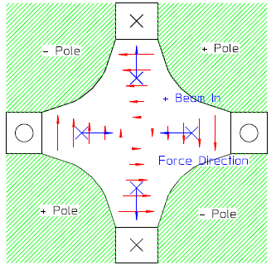
Quadrupoles
Quadrupoles have 4 poles, the field varies linearly with distance from the magnet axis. B at axis is typically 0 so on-axis beam is not affected.
This is a “normal” or “upright” quadrupole. It focusses the beam in one plane whilst defocussing in the other. F (focussing) type focusses in horizontal plane, D (defocussing) types focus in vertical plane.

Slide 17
Skew Quadrupoles
Skew quadrupoles change coupling between horizontal and vertical beam oscillations
Beam that has horizontal displacement (but not vertical) is deflected vertically. Horizontally centred beam with vertical displacement is deflected horizontally.

Slide 18
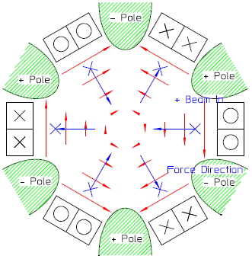
Sextupoles
Sextupoles (or Hexapoles) have 6-poles, the field varies quadratically with distance from the central axis.
F sextupoles steer high momentum particles towards ring center. Note that sextupoles may also steer along 60 and 120 degree lines.
Off-momentum particles are incorrectly focussed in quadrupoles (high momentum particles are under-focussed), so transverse oscillation frequencies are modified – chromaticity.
But off momentum particles circulate with a horizontal displacement (high momentum particles at larger x)
So sextupole field corrects this effect – can reduce chromaticity to 0.

Slide 19
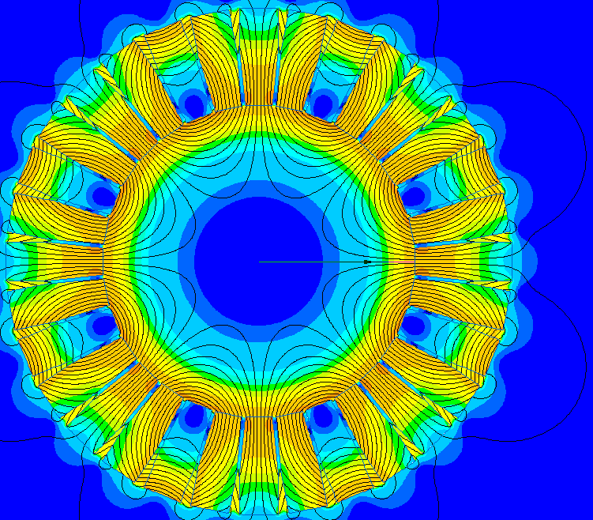

Higher order magnets
e.g. Octupoles, often needed in rings.
Effect?
$B_{y}∝x^{3}$
Octupole field induces Landau damping:
Introduces tune-spread as a function of oscillation amplitude
De-coheres the oscillations
Reduces coupling
Higher order magnets e.g. decapoles exist but are rarely needed

Slide 20
Electromagnetic excitation

Slide 21
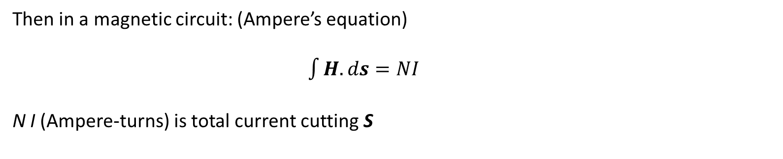
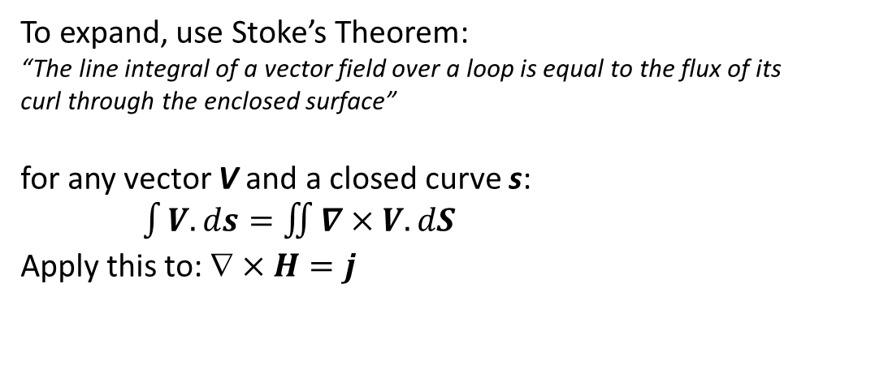
Introducing currents
F$or j  0$, $×H=j$
To expand, use Stoke’s Theorem:
“The line integral of a vector field over a loop is equal to the flux of its curl through the enclosed surface”
for any vector V and a closed curve s:
$\int{V.ds}=\iint{∇×V.dS}$
Apply this to: $×H=j$
Then in a magnetic circuit: (Ampere’s equation)
$\int{H.ds}=NI$
N I (Ampere-turns) is total current cutting S

Slide 22
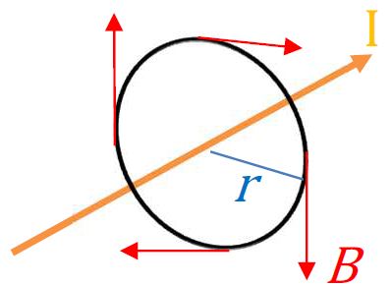
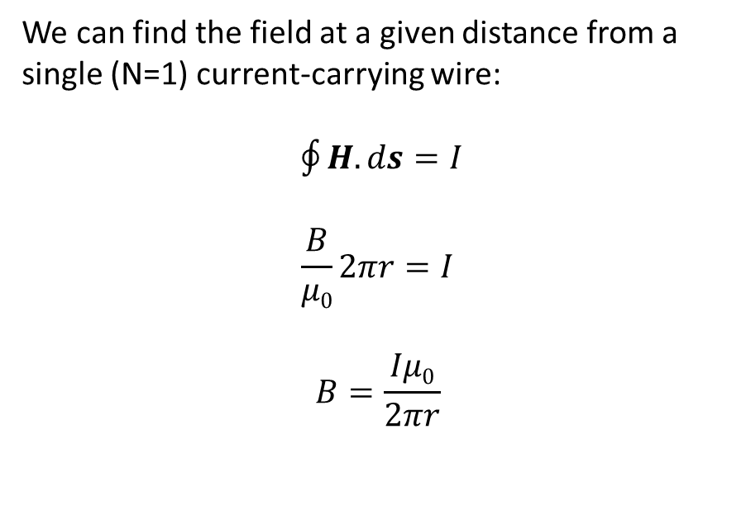
Biot-Savart Law
$×H=j$ implies that the a field curls around a flowing current
We can find the field at a given distance from a single (N=1) current-carrying wire:
$\oint{H.ds}=I$
$$\frac{B}{μ0}2πr=I$$
$$B=\frac{Iμ0}{2πr}$$

Slide 23
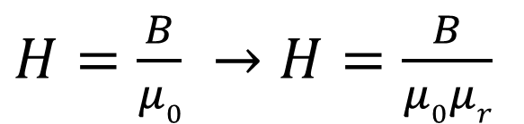
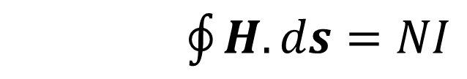
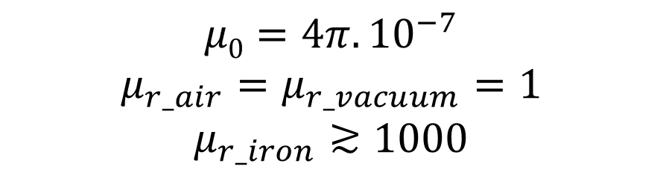
Fields in materials
In materials the magnetic permeability of free space (µ₀) is no longer applicable.
Instead the material has a relative permeability (µ_{r}) modified by material properties. It is typically not constant!!!
In most materials µ_{r} is a function of local field strength in the material and may vary throughout the material as the composition and grain direction changes.
$\oint{H.ds}=NI$
$$μ0=4π.{10}^{−7}$$
$$μ_{r_air}=μ_{r_vacuum}=1$$
$$μ_{r_iron}≳1000$$
$H=\frac{B}{μ0} →H=\frac{B}{μ0μr}$

Slide 24
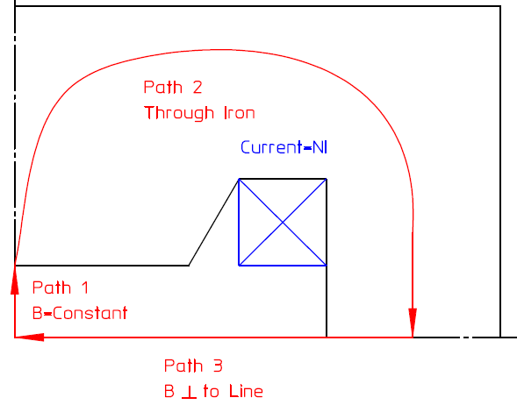
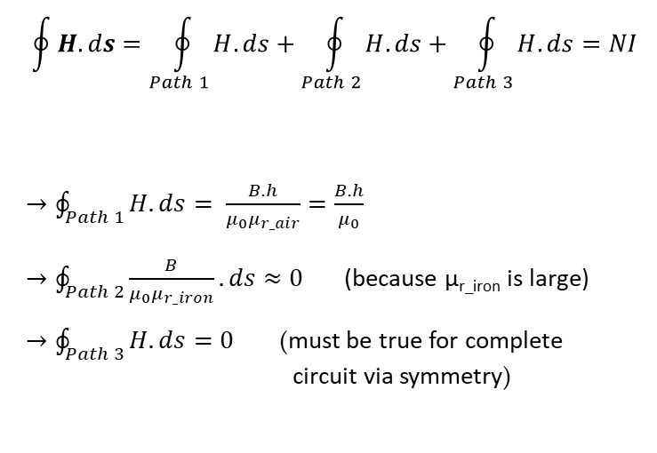
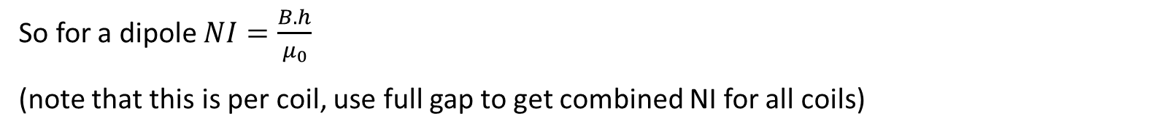
Dipole excitation
Picture the path of the field through a dipole – in this case a H-dipole with full symmetry. The path has 3 sections:
$$\oint{H.ds}=\oint_{Path 1}^{ }{H.ds}+\oint_{Path 2}^{ }{H.ds}+\oint_{Path 3}^{ }{H.ds}=NI$$
$→\oint_{Path 1}^{ }{H.ds}= \frac{B.h}{μ_{0}μ_{r_air}}=\frac{B.h}{μ_{0}}$
$→\oint_{Path 2}^{ }{\frac{B}{μ_{0}μ_{r_iron}}.ds}≈0$ (because µ_{r_iron} is large)
$→\oint_{Path 3}^{ }{H.ds}=0$ (must be true for complete circuit via symmetry)
= h (half gap)
So for a dipole $NI=\frac{B.h}{μ_{0}}$
(note that this is per coil, use full gap to get combined NI for all coils)

Slide 25
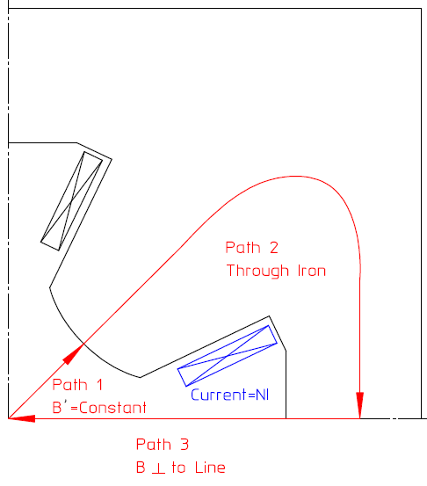
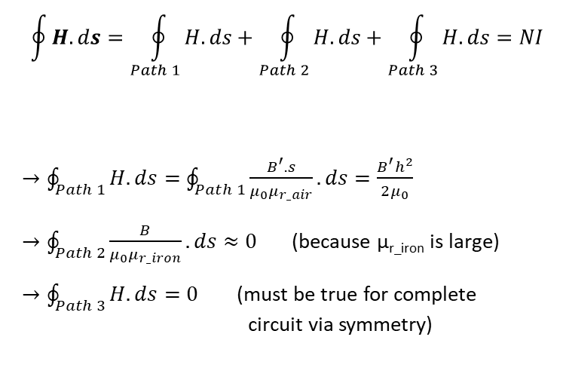

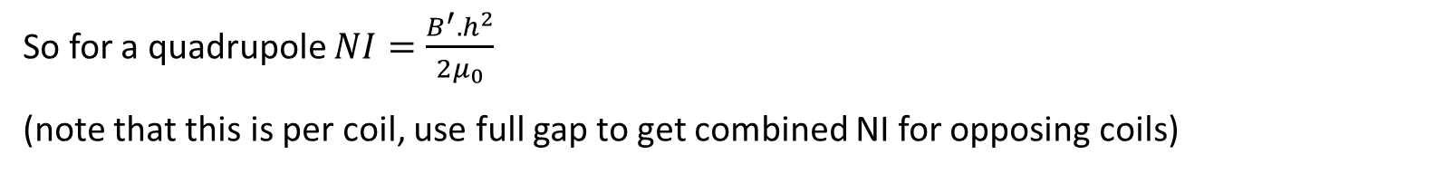
Quadrupole excitation
Picture the path of the field through a quadrupole – in this case with 4-fold symmetry. The path has 3 sections:
$$\oint{H.ds}=\oint_{Path 1}^{ }{H.ds}+\oint_{Path 2}^{ }{H.ds}+\oint_{Path 3}^{ }{H.ds}=NI$$
$→\oint_{Path 1}^{ }{H.ds}=\oint_{Path 1}^{ }{\frac{B^{′}.s}{μ_{0}μ_{r_air}}}.ds=\frac{B^{′}h^{2}}{2μ_{0}}$
$→\oint_{Path 2}^{ }{\frac{B}{μ_{0}μ_{r_iron}}.ds}≈0$ (because µ_{r_iron} is large)
$→\oint_{Path 3}^{ }{H.ds}=0$ (must be true for complete circuit via symmetry)
“half gap” for a quadrupole is also known as “inscribed radius”
$$B\left(s\right)=\int{B^{′}.ds}$$
= h (half gap)
So for a quadrupole $NI=\frac{B^{′}.h^{2}}{{2μ}_{0}}$
(note that this is per coil, use full gap to get combined NI for opposing coils)

Slide 26
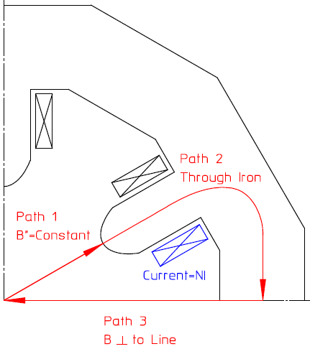
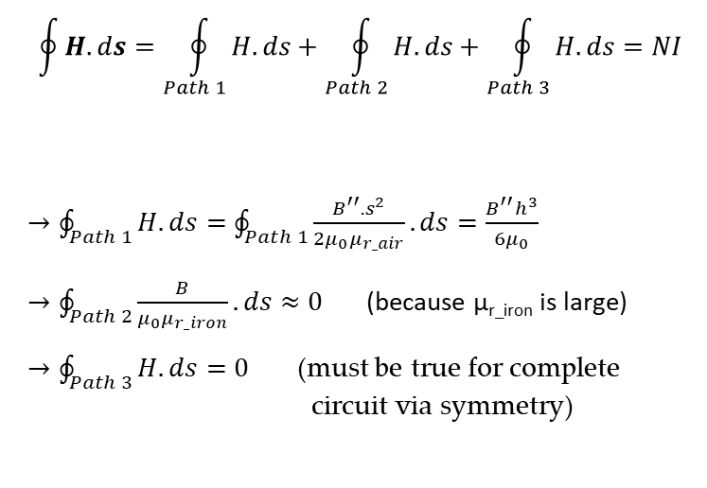
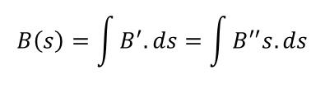
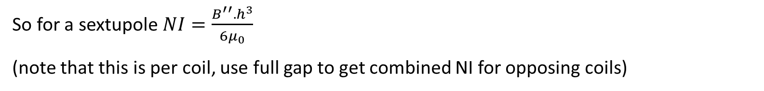
Sextupole excitation
Picture the path of the field through a sextupole – in this case with 4-fold symmetry. The path has 3 sections:
$$\oint{H.ds}=\oint_{Path 1}^{ }{H.ds}+\oint_{Path 2}^{ }{H.ds}+\oint_{Path 3}^{ }{H.ds}=NI$$
$→\oint_{Path 1}^{ }{H.ds}=\oint_{Path 1}^{ }{\frac{B^{′′}.s^{2}}{{2μ}_{0}μ_{r_air}}}.ds=\frac{B^{′′}h^{3}}{6μ_{0}}$
$→\oint_{Path 2}^{ }{\frac{B}{μ_{0}μ_{r_iron}}.ds}≈0$ (because µ_{r_iron} is large)
$→\oint_{Path 3}^{ }{H.ds}=0$ (must be true for complete circuit via symmetry)
$$B\left(s\right)=\int{B^{′}.ds}=\int{B^{′′}s.ds}$$
= h (half gap)
So for a sextupole $NI=\frac{B^{′′}.h^{3}}{{6μ}_{0}}$
(note that this is per coil, use full gap to get combined NI for opposing coils)

Slide 27
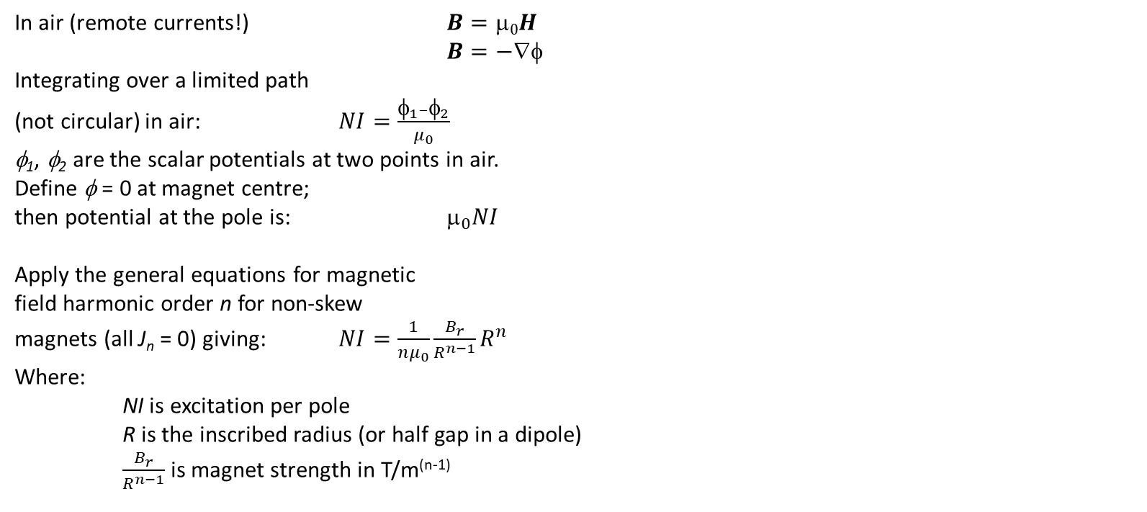
General soluton
This will probably make more sense after lecture 2, but fits better here….
In air (remote currents!) $B=0H$
$B=−$
Integrating over a limited path
(not circular) in air: $NI=\frac{φ_{1}–φ_{2}}{μ_{0}}$
φ₁, φ₂ are the scalar potentials at two points in air.
Define φ = 0 at magnet centre;
then potential at the pole is: $_{0}NI$
Apply the general equations for magnetic
field harmonic order n for non-skew
magnets (all J_{n} = 0) giving: $NI=\frac{1}{{nμ}_{0}}\frac{B_{r}}{R^{n−1}}R^{n}$
Where:
NI is excitation per pole
R is the inscribed radius (or half gap in a dipole)
$\frac{B_{r}}{R^{n−1}}$ is magnet strength in T/m^{(n-1)}
φ = μ₀ NI
φ = 0

Slide 28
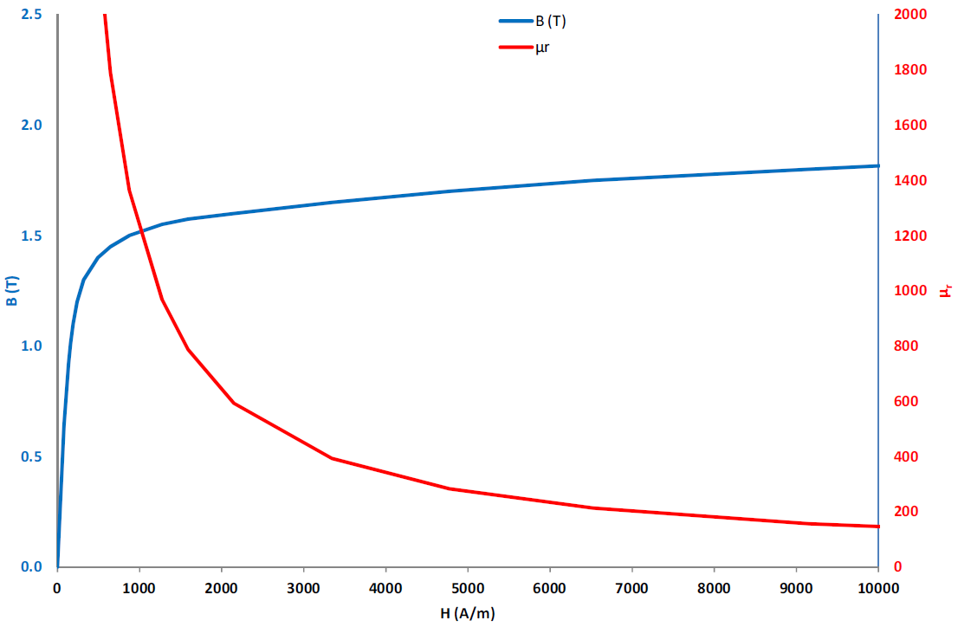
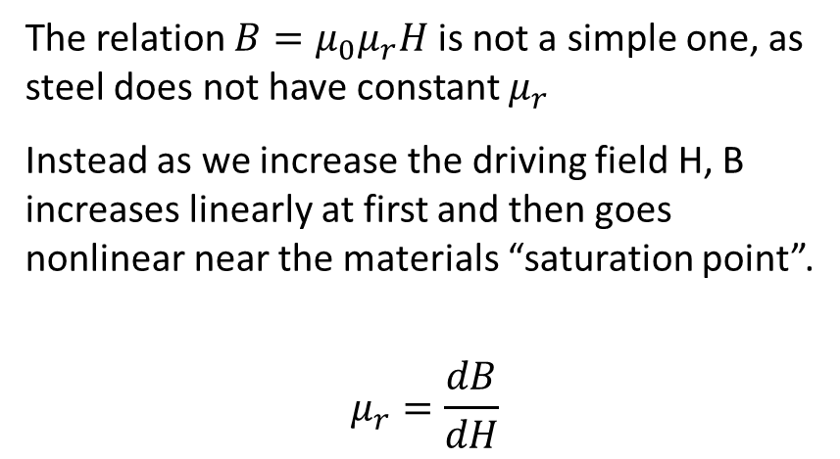
Metallic BH Curves
We have assumed in the above derivation that the steel/iron has an essentially infinite permeability. This is not always the case.
The relation $B=μ_{0}μ_{r}H$ is not a simple one, as steel does not have constant $μ_{r}$
Instead as we increase the driving field H, B increases linearly at first and then goes nonlinear near the materials “saturation point”.
$$μ_{r}=\frac{dB}{dH}$$
The exact BH curve is a unique property of the material!

Slide 29
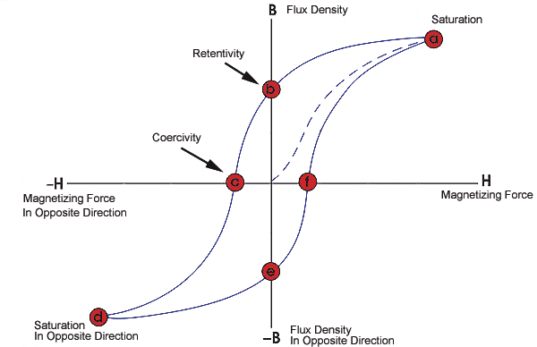
Ferromagnet BH Curve
If a material has a BH curve that does not go through (0,0) it is ferromagnetic
Permeability is the gradient of the BH curve, it defines how easily field flows through a material but does not define whether it produces its own field.
The B value at H=0 is known as Br, remanent field, remanence or retentivity.
The H value at B=0 is known as Hc, or Coercivity.
These parameters together define the flux generation capacity of a ferromagnet.
Remanance/

Slide 30
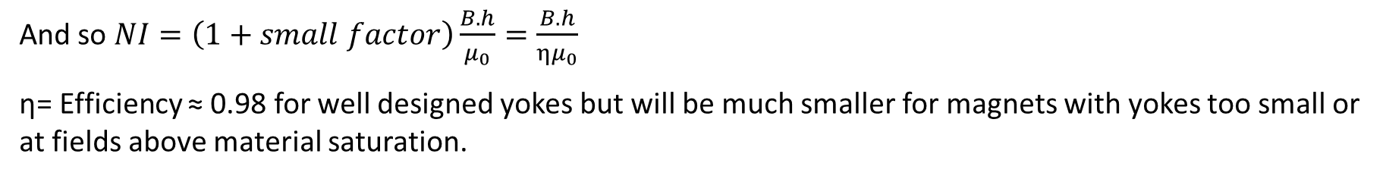
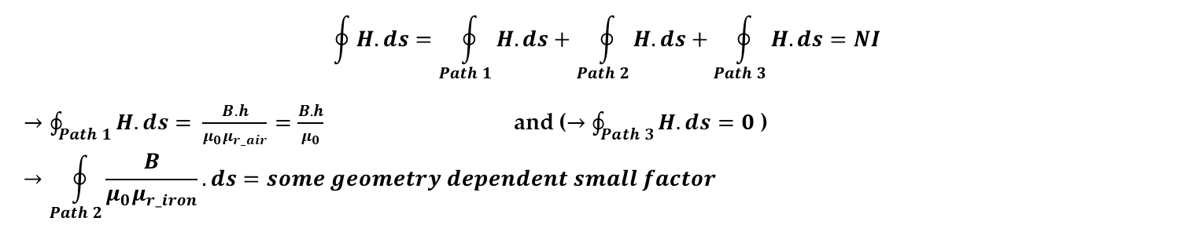
Efficiency
The introduction of a BH curve tells us that iron/steel is not a perfect magnetic conductor and there will be some losses.
Using dipole excitation as an example:
$$\oint{H.ds}=\oint_{Path 1}^{ }{H.ds}+\oint_{Path 2}^{ }{H.ds}+\oint_{Path 3}^{ }{H.ds}=NI$$
$→\oint_{Path 1}^{ }{H.ds}= \frac{B.h}{μ_{0}μ_{r_air}}=\frac{B.h}{μ_{0}}$ and ($→\oint_{Path 3}^{ }{H.ds}=0$)
$$→\oint_{Path 2}^{ }{\frac{B}{μ_{0}μ_{r_iron}}.ds}=some geometry dependent small factor$$
And so $NI=\left(1+small factor\right)\frac{B.h}{μ_{0}}=\frac{B.h}{{ημ}_{0}}$
η= Efficiency ≈ 0.98 for well designed yokes but will be much smaller for magnets with yokes too small or at fields above material saturation.

Slide 31
Practical coil design

Slide 32
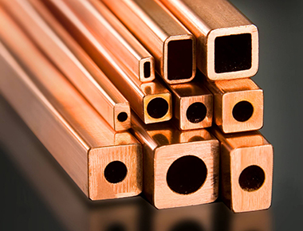
Current density
The coil cross section must take into account several factors, the most important of which is current density. This determines magnet power dissipation.
Magnet power dissipation is key in facility planning– affects the cost and type of power supplies, cables, installation, cooling system, operating costs e.t.c.
As a general rule solid conductors can handle up to 2-2.5 Amm⁻² (higher in single layer).
Water cooled hollow conductors are much more efficient and stable, able to handle 10 Amm⁻² in short sections and 3-5 Amm⁻² in sections hundreds of meters long.

Slide 33
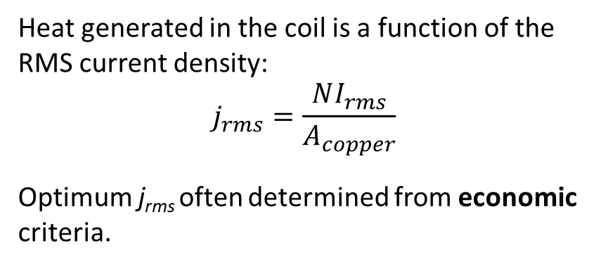
Coil geometry
Most common designs are square or rectangular copper (or aluminium) conductor, with cooling water channel. Insulation is glass cloth and epoxy resin.
Amp-turns (NI) are pre-determined by excitation requirements, but total copper area (A_{copper}) and number of turns (N) are two degrees of freedom and need to be decided.
Also should consider space efficiency i.e. packing factor – how much of coil cross section is useable copper?
Heat generated in the coil is a function of the RMS current density:
$$j_{rms}=\frac{NI_{rms}}{A_{copper}}$$
Optimum j_{rms} often determined from economic criteria.

Slide 34
Optimisation
Advantages of low j_{rms}:
lower power loss – power bill is decreased
Often lower current – smaller/cheaper PSU
less heat into temperature sensitive areas
Advantages of high j_{rms}:
smaller coils
lower capital cost
smaller magnets
Chosen value of j_{rms} is an optimisation of
magnet capital against power costs,
modified by other considerations e.g.
Cable sizes and runs, building capacity….

Slide 35
Number of turns
The value of number of turns (N) is often chosen to match power supply and interconnection impedances, or fit space requirements.
Factors determining choice of N:
Large N (low current) | Small N (high current)
Small, neat terminals | Large, bulky terminals
Thin interconnections- low cost and flexible | Thick, expensive connections
More insulation in coil; larger coil volume; increased assembly costs | High percentage of copper in coil; more efficient use of available space
Total coil length means higher voltage – safety problems | High current power supply – greater losses

Slide 36
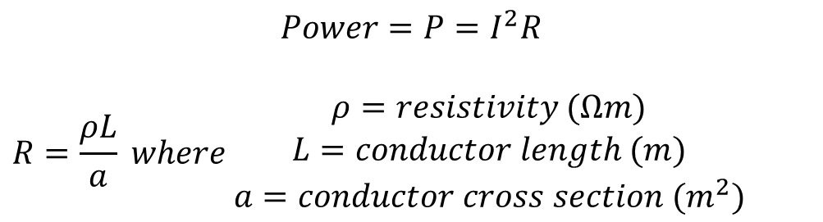
Coil parameters
The minimum loop length of the wire is determined by the magnet pole.
Coil cross section area a
Inside length slightly longer than magnet pole
Inside width slightly wider than magnet pole
Average loop length (xN gives L)
$$Power=P=I^{2}R$$
$$R=\frac{ρL}{a} where \begin{matrix}ρ=resistivity (Ωm) \\ L=conductor length (m) \\ a=conductor cross section (m^{2})\end{matrix}$$

Slide 37
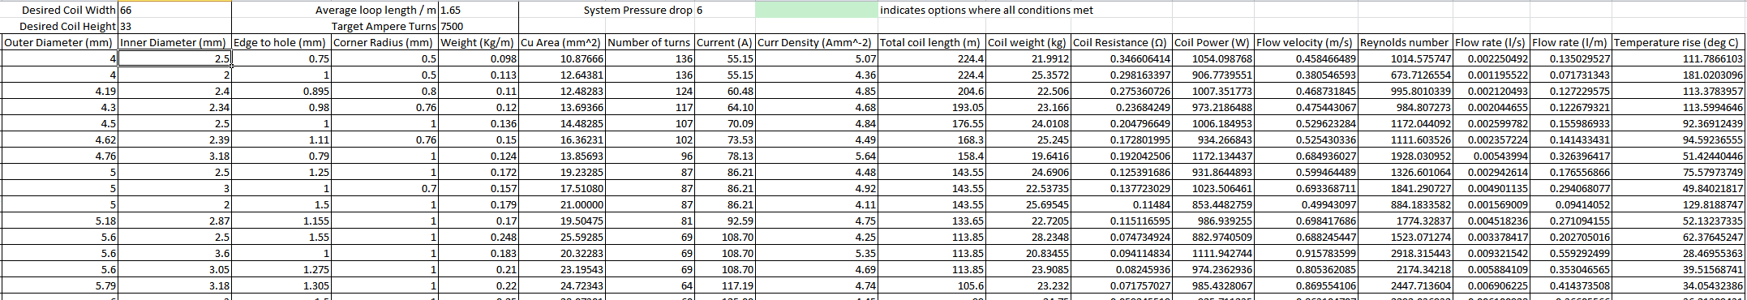
Coil Balance
Coil design is a balance of many parameters – do we go for compact with high I, low N and keep it short at cost of higher power? or do we go for small I large N, making coil bulkier/longer and so higher resistance?
It is possible to assess viable coil options based on calculating the temperature rise of the output cooling water, but we have many degrees of freedom and multiple solutions always exist…

Slide 38
Coil Balance
One way is to use a spreadsheet
Desired Coil Width |  | 96 | Average loop length / m |  | 2.64 | System Pressure drop |  | 6
Desired Coil Height |  | 48 | Target Ampere Turns |  | 9000
Luvata Product | Outer Diameter (mm) | Inner Diameter (mm) | Edge to hole (mm) | Corner Radius (mm) | Weight (Kg/m) | Cu Area (mm^2) | Number of turns | Current (A) | Curr Density (Amm^-2)
6844 | 4 | 2.5 | 0.75 | 0.5 | 0.098 | 10.87666 | 288 | 31.25 | 2.87
8529 | 4 | 2 | 1 | 0.5 | 0.113 | 12.64381 | 288 | 31.25 | 2.47
8350 | 4.19 | 2.4 | 0.895 | 0.8 | 0.11 | 12.48283 | 262 | 34.35 | 2.75
8301 | 4.3 | 2.34 | 0.98 | 0.76 | 0.12 | 13.69366 | 249 | 36.14 | 2.64
8153 | 4.5 | 2.5 | 1 | 1 | 0.136 | 14.48285 | 227 | 39.65 | 2.74
8206 | 4.62 | 2.39 | 1.11 | 0.76 | 0.15 | 16.36231 | 215 | 41.86 | 2.56
8150 | 4.76 | 3.18 | 0.79 | 1 | 0.124 | 13.85693 | 203 | 44.33 | 3.20
8128 | 8 | 6 | 1 | 1 | 0.31 | 34.86726 | 72 | 125.00 | 3.59
Total coil length (m) | Coil weight (kg) | Coil Resistance (Ω) | Coil Power (W) | Flow velocity (m/s) | Reynolds number | Flow rate (l/s) | Flow rate (l/m) | Temperature rise (deg C)
760.32 | 74.51136 | 1.174384087 | 1146.85946 | 0.21723503 | 480.7361024 | 0.00106635 | 0.063980998 | 256.682595
760.32 | 85.91616 | 1.010247745 | 986.5700631 | 0.178132709 | 315.3628562 | 0.00055962 | 0.033577225 | 420.7463565
691.68 | 76.0848 | 0.930896907 | 1098.459435 | 0.222327704 | 472.325829 | 0.001005787 | 0.06034721 | 260.6537955
657.36 | 78.8832 | 0.806479044 | 1053.608854 | 0.224453363 | 464.9206598 | 0.000965268 | 0.057916054 | 260.5059672
599.28 | 81.50208 | 0.695160216 | 1092.743454 | 0.251752531 | 557.1225344 | 0.001235787 | 0.074147241 | 211.0378952
567.6 | 85.14 | 0.5827832 | 1021.21015 | 0.250426671 | 529.8041454 | 0.001123482 | 0.067408942 | 216.9376027
535.92 | 66.45408 | 0.649743812 | 1277.129967 | 0.330287729 | 929.7291122 | 0.002623231 | 0.157393869 | 116.1942166
190.08 | 58.9248 | 0.091585749 | 1431.027324 | 1.001209655 | 5317.569205 | 0.028308536 | 1.698512164 | 12.06469902

Slide 39
Magnetic circuit design

Slide 40
Magnet geometry
The magnetic circuit for an iron dominated electromagnet has 4 components
  A field source, either a coil/set of coils or a permanent magnet
  An air gap, in which we desire a particular field strength and shape
  A permeable yoke which eases the path of the field outside the gap
  Pole tips, parts of the yoke on the edge of the gap which determine the field shape
Iron dominated electromagnetic dipoles can be ‘C core’, ‘H core’, or ‘Window frame’.
Quads and sextupoles also have a few geometric types mostly concerning angle from yoke into poles.
All yoke dimensions and shapes are degrees of freedom to be considered.

Slide 41
C-core dipole
The C-core is a classic design used in many rings.
'C' Core:
Advantages:
Easy access to beam pipe
Classic well defined design
Very easy to install and remove
Disadvantages:
Pole shims needed
Asymmetric (small)
Less rigid
The ‘shim’ is a small, additional piece of pole material added on each side of the two poles – it compensates for the finite cut-off of the pole, and is optimised to reduce the 6-, 10-, 14-… pole error harmonics and enhance field homogeneity.

Slide 42
A typical ‘C’ cored Dipole
Cross-section of the Diamond storage ring dipole
Curvature into pole reduces field saturation at sharp corners, pole is wide enough that shims are not needed

Slide 43
H-core dipole
A common design where wide good field region is needed.
‘H' Core:
Advantages:
Symmetric
Very rigid
Good field homogeneity
Disadvantages:
Pole shims still needed
Access problems
Hard to install
Like the C-core, the H-core will have small shims at the edges of the pole to ensure homogeneity

Slide 44
Window dipole
A common design where lower fields are needed, provides very good homogeneity over a wide region.
‘Window frame’:
Advantages:
Symmetric
Rigid
V. Good field homogeneity
No shims
Disadvantages:
Access problems
Hard to install
Coil insulation
Bedstead coils
Each coil block actually contains top and bottom coils that split at ends to allow beam pipe entry

Slide 45


Quadrupole examples
Quadrupole yoke design is driven by practical matters such as machining, angles into pole tips , need to build in correctors e.t.c.
Simple, saves material, not suitable for stronger fields
Uses more material, more expensive, can handle higher fields and has space for correctors

Slide 46
An open sided quadrupole
Diamond storage ring quadrupole
The yoke support pieces in the horizontal plane need to provide space for beamlines and are not ferromagnetic.
Error harmonics include n = 4 (octupole), a finite permeability error.

Slide 47
Yoke design
When designing the yoke we must take into account the permeability of the material and its saturation value. This may include non-trivial material properties like rolling direction.
Rolling direction will be discussed further in lecture 3 and is important in AC magnets!
‘saturation’ region:
µ drops off

Slide 48
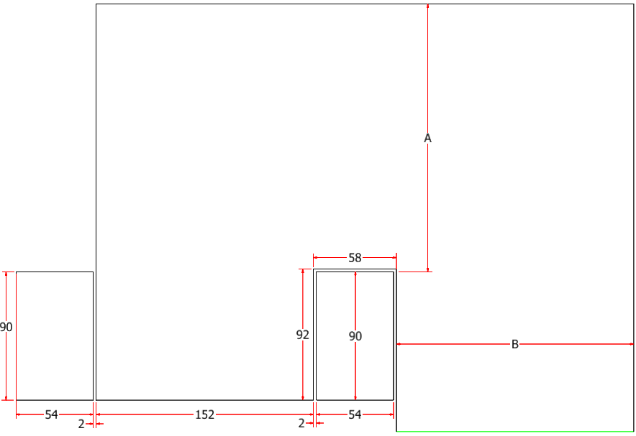
Yoke design
Some dimensions e.g. pole width may be defined by field requirements, but in other dimensions we may have degrees of freedom
e.g. A proposed C dipole.
Dimensions A and B are not fixed
They need to be optimised to find the balance
Being big enough to avoid saturation and reducing efficiency
Without being too big that they waste material and money.

Slide 49
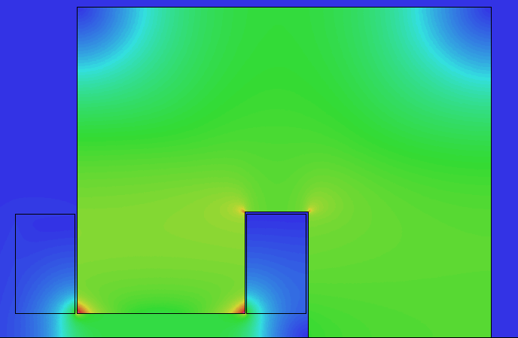
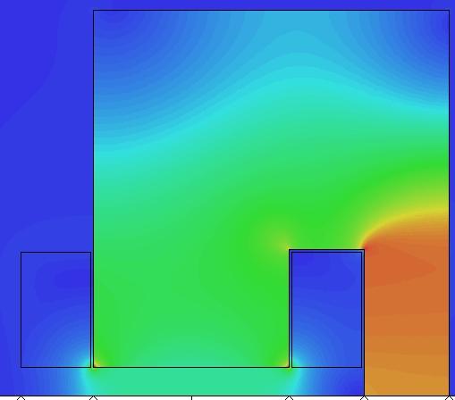
Yoke design
2 models of same dipole with different dimension B, same materials, colour scale and driving currents. Not that if yoke is too narrow saturation results in efficiency drop, dramatically lowering central magnetic field
1.128 T 0.793 T

Slide 50
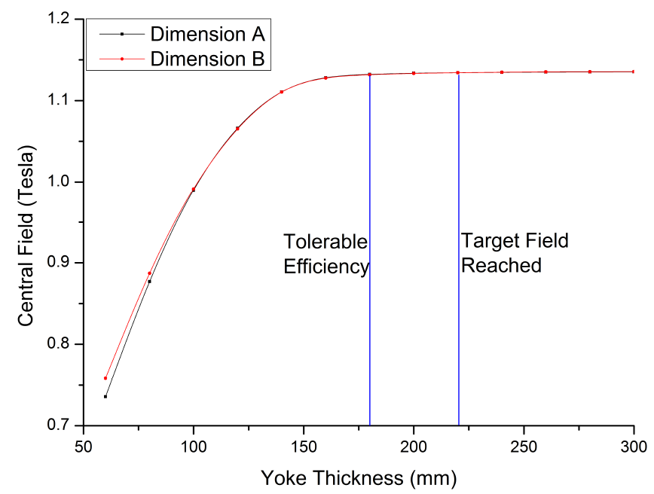
Yoke design
The relevant dimensions can be independently optimised or together.
When dimensions are too small flux is compressed into higher density – bigger B results in smaller µ_{r}
When big enough, move into linear region of BH curve

