Slide 1
Digital Research infrastructure Programme
Digital Research Infrastructure and Cybersecurity
Notes:
To edit the background image, select ‘Format’ from the PowerPoint menu and ‘Slide Backgound’ from the drop-down menu. Within the new list of options that appears on the right of the screen, select the ‘File’ button under ‘Insert picture from’ and select your image from your file browser.

Slide 4
UKRI Digital Infrastructure Phase 2 Portfolio
National Computational Research Services
Software for future Large-scale compute
Federated Data Services
To deliver aspects of the DRI strategy relating to data infrastructure and implementation of FAIR.
Ensuring the UK has the compute services to facilitate the ambitions of our R&I community.
Creation of a mission-led software programme for large-scale accelerated computing.
Total for this SR
Indicative forward profile
Total for this SR
Indicative forward profile
Total for this SR
Indicative forward profile
£38.1M
£31.6M
£23M
£16M
£8.5M
£13.5M
Supporting DRI Professionals
Software, Networks, Security and Net Zero
Ensuring the UK has the skills base to deliver effective world-leading research and innovation.
Secure access and connectivity, and software as an infrastructure and UKRI net zero ambitions.
Total for this SR
Indicative forward profile
Total for this SR
Indicative forward profile
£12.2M
£21.5M
£11M
£18.2M
Notes:
Federated Data Services
Overview: The objective is to deliver aspects of the DRI strategy relating to data infrastructure and implementation of FAIR. We aim to provide consistent, appropriate and secure data services to UKRI’s communities; improve connectivity and collaboration across data services; and improve data stewardship, discovery and reuse of data.
Option: These investments will enable UKRI to build upon and/or implement the outcomes of scoping from current investments in federated data services.
-------
National Computational Research Services
Overview: This workstream is focussed on ensuring the UK has the compute services to facilitate the ambitions of our R&I community. In doing so, we will implement relevant recommendations of the Future of Compute review, expand the user base of UKRI’s compute services and increase RTP & RSE support.
Option: These investments will see the establishment of several National Computational Research Services with Hardware, Service Provision, Research Software Engineer (RSE) costs all included
-------
Software for future Large-scale compute
Overview: This workstream involves the creation of a mission-led software programme for large-scale accelerated computing. It will ensure that the UK software is ready to deploy the next generation of technologies in our DRI to support a heterogeneous computing landscape. It is key to enabling an expanded user base for computational services and building skills and RTP/RSE capacity
Option: The investments will see the establishment of a mission led Large Scale Accelerated compute programme which will build on the successful ExCALIBUR Programme.
--------
Supporting DRI Professionals
Overview: This workstream focuses on skills and careers, ensuring that the UK has the skills base it needs to deliver effective world-leading research and innovation in the future. We will achieve this by addressing skills shortages, increase retention of skills and build capacity.
Option: Investments include:
Support for networking, led by new Digital RTP Champions which will build new and enhanced communities of DRI professionals
An open call for RTP Pools/Platforms as an indication of UKRI’s intent to drive new models of working with digital RTPs across the UK R&I community.
--------
Software, Networks, Security and Net Zero
Overview: The Enabling Software, Networks, Security workstream underpins all other DRI workstreams and will support them in achieving their outcomes. UKRI net zero ambitions are also incorporated into this theme.
The focus of this area is on secure access and connectivity, and software as an infrastructure.
Option: The core elements of this workstream include:
AAAI (ii) Cybersecurity
(iii) Software Sustainability Institute (SSI) Phase 4
(iv) Mapping critical software that is required to deliver the UKRI DRI
(v) Competitive Funding – to enable the community to develop and deploy Net Zero solutions.

Slide 5
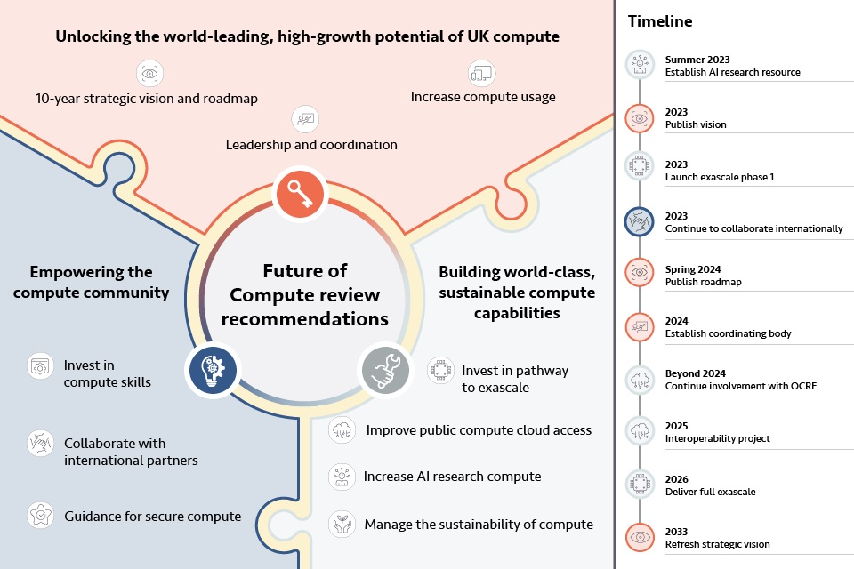
Future of Compute Review
Notes:
List of recommendations
A. Unlock the world-leading, high-growth potential of UK compute
Recommendation 1: Inaugurate a strategic vision and roadmap for compute, for the next decade and beyond.
Recommendation 2: Increase leadership and national coordination to support users and ensure the UK’s vision for compute is delivered.
Recommendation 3: Enable increased and broader use of compute by all users, both existing and potential, through the creation of a diverse, healthy and integrated compute ecosystem.
B. Build world-class, sustainable compute capabilities
Recommendation 4: Make immediate investments in the pathway to public exascale capability.
Recommendation 5: Improve access to public compute via the cloud through improved interoperability and better procurement.
Recommendation 6: Immediately and significantly increase compute capacity significantly for AI research.
Recommendation 7: Manage the sustainability of building and using compute through planning, procurement and innovation.
C. Empower the compute community
Recommendation 8: Invest in attracting and retaining world-class researchers and technical talent through targeted investment into domestic and international compute skills programmes.
Recommendation 9: Provide guidance and support for appropriately secure compute.
Recommendation 10: Collaborate with international partners to strengthen the UK’s domestic compute ecosystem and increase its international influence in science and technology.

Slide 6
Building blocks
Growing portfolio of resources for Digital Research
Increasing dependence on digital resources for innovation
Processing capacity
Access to curated data
Investment required to build and maintain relevant infrastructures

Slide 7
Priorities for collective investment
1
2
3
4
5
Theme
Data Infrastructure
LSC
Sensitive data
Skills
Foundational tools
Councils' highest priorities for collective investment in Phase 2 (2023-2025)
Ranked by Council vote, >3 votes included
Priorities don’t always map neatly on to strategic themes!
Coordination/ overarching network
Federation
Data standards/ management/ curation
Data policy and governance
Mapping data infrastructures
Access to LSC (e.g., for new communities)
Move towards a national system/ scoping future requirements
Maximising current investments
Priorities for this theme tended to be included in 'Data Infrastructure' more broadly
Training
Knowledge exchange/ community building
Technical 'pools'/ 'ambassadors' to work with researchers
Career pathways
Software activities (software as infrastructure, and development of future software)
Note: General agreement with skills working group here
Cross-cutting: Net zero, interdisciplinary working

Slide 8
Security and interoperability
Beyond islands: interoperability and federation of systems may lead to challenges in security (up/down/side-to-side)
Command-and-control will not work!
Requires coordinated cybersecurity strategies
Complex risk environments
Compute – cloud compute – storage
Trusted Research Environments
Shared user communities

Slide 9
@UKRI_news
UK Research and Innovation
UK Research and Innovation
Notes:
The abstract pattern can be removed or repositioned if required. Be careful to ‘Send to Back’ so that it does not obscure any important information.

