Slide 1
ITRF - LhARA
General Facility Infrastructure and Integration
ITRF WP2 & LhARA WP1.6
12 Month Design Review (Summary of Progress & Status)
20th September 2023
Andy Goulden, Clive Hill, UKRI-STFC-Daresbury Laboratory, On behalf of the team
Notes:
The abstract pattern can be removed or repositioned if required. Be careful to ‘Send to Back’ so that it does not obscure any important information.

Slide 2
Progress since the 6 month design review
Mechanical engineering design and Finite Element Analysis of a Fixed Field Accelerator vacuum chamber to inform the combined function magnet gap, document RFS-1055-meng-fea-0001-v2.0-FETS-FFA-Vacuum-Chamber-2023-09-08.
Update to the Building concept in this report. Figures 1-7 and facility room sized Tables 2 & 3.
Update to the low energy line engineering concept in this report. Figure 8.
Update to the Vacuum design. Amended section 1.7 in this report.
Update to the Controls design. Amended section 1.8 in this report.
Update to the Electrical Engineering design based on the electrical power consumption. Amended section 1.9 in this report.
Cooling System design concept based on the electrical power consumption added. New section 1.10 in this report.
Compressed Air and Air Conditioning section 1.11 and 1.12 added to this report.

Slide 3
Progress since the 6 month design review - continued
Sustainability contributing to Net Zero by 2040, section 1.1 added.
Estimate of the ITRF power consumption, document 1272-pa1-pm-est-0001-v2.0-power-consumption-est-2023-09-07.
Estimate of the Full Infrastructure cost for UKRI IF preliminary activity 2 proposal, document 1272-pa2-pm-fin-0002-v2.0-ITRF-construction-cost-model-2023-09-08.
Update to the Facility Schematic, document 1272-pa1-pm-sch-0001-v3.0-ITRF schematic. Figure 10 in this report.
New draft ITRF vacuum flow diagram, document 1272-pa1-vac-vfd-0001-v0.1
Mechanical design concept for the laser target chamber for a proton beam tape drive configuration, document 1272-pa1-meng-prs-0009-v1.0-target-chamber-2023-08-22. Update to Figure 9 in this report.
Target chamber vacuum simulations, document 1272-pa1-vac-prs-0001-v1.0-nozzle-gas-trans-prob-2023-08-15

Slide 4
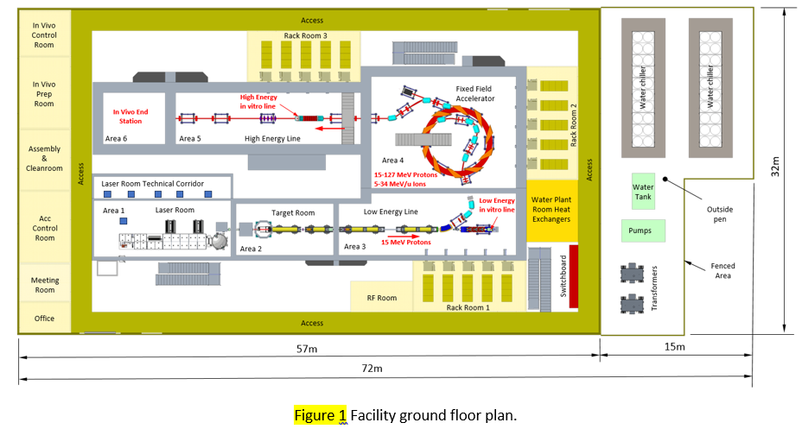
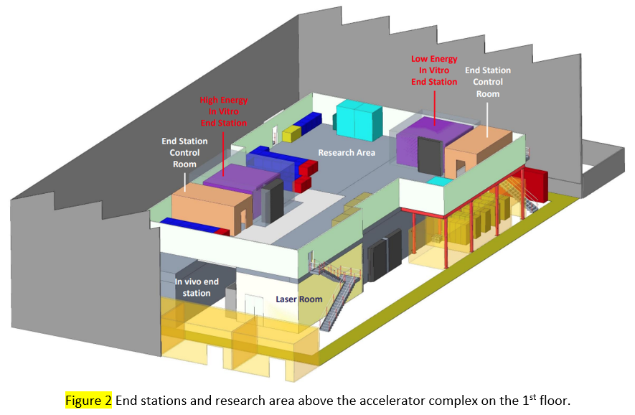
Building & Technical Services
General introduction describing the design concept for the building and technical services
Current ideas that will need developing
Updates will be required when the accelerator design provides enough information on the Magnets and RF requirements to develop the overall power and cooling requirements.
Rational for the location of the technical services equipment & rooms described
Size/number of transformers, switchboard, racks and cooling plant will change when we have the numbers
No equipment yet shown in the end stations
Novel end station consultation with peer-group in progress

Slide 5
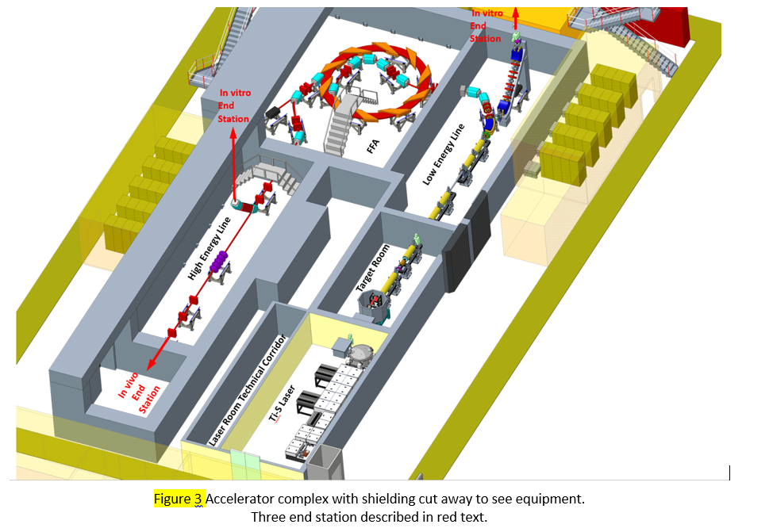
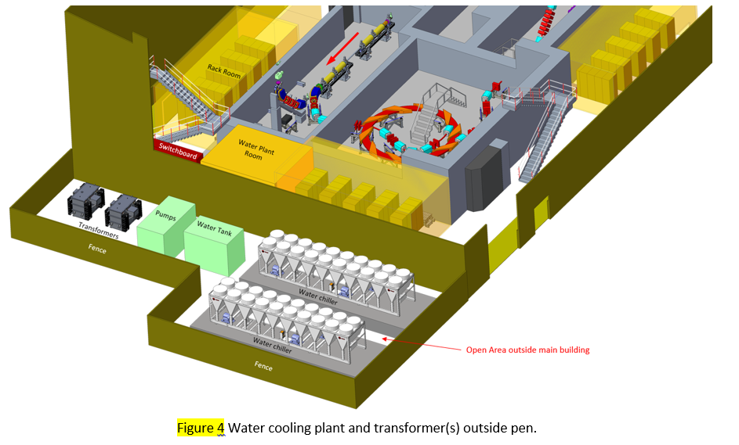
Building & Technical Services
The facility includes an open area shown in figure 4
Radiation safety section includes with generic description of requirements without any numbers yet
The plan is that a a specialist company will perform a Radiation Study & concrete sustainability from November 2023 and contain the following activities:
A high level shielding design basis report that creates a point of reference for all the shielding protection calculations.
Radiological classification of areas
Preliminary bulk shielding requirements
Concrete sustainability appraisal
Some ideas for composite radiation shielding block included
Some ideas already for composite radiation shielding block

Slide 6
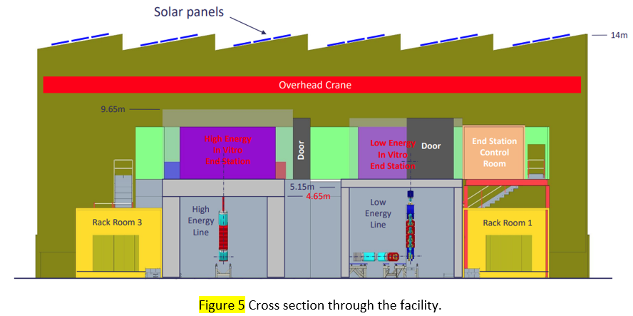
Building & Technical Services
Overall height is estimated as 14m that allows the implementation of an overhead crane to install and decommission the facility
Lifting solutions will also be required inside the radiation enclosures for installation, maintenance and decommissioning.
Saw-tooth roof construction is proposed comprising of a series of ridges with dual pitches either side. The steeper surfaces at ~70° to have double glazed windows to admit natural light. The shallower surfaces at ~35° are proposed for the installation of solar panels facing south to receive the most direct sunlight and energy gain.

Slide 7
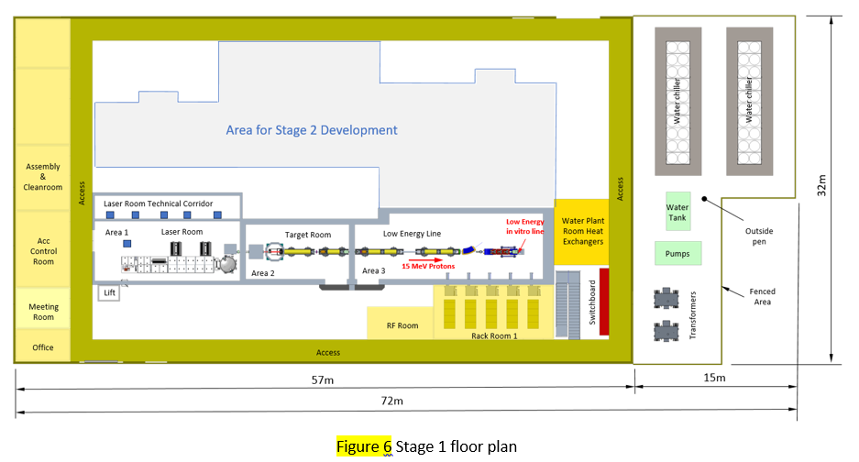
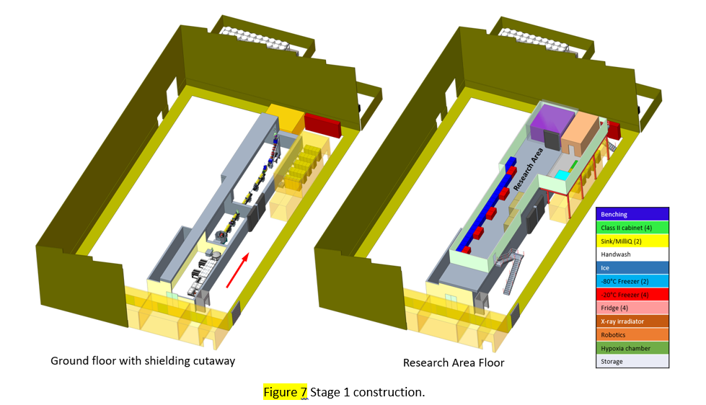
Building & Technical Services
Stage 1 construction proposed is the full building envelope and outside pen to house the laser, target, low energy line, low energy in vitro end station, control rooms and research area.
Stage 2 development would add the FFA, high energy beamline, high energy in vitro end station, in vivo end station and upgrade to the technical services and research areas
More breakdown detail of the above descriptions in the review report.

Slide 8
Key Installation Milestones
Stage 1
First demonstration of the capture of a laser-driven ion beam using a Gabor lens system;
Demonstration of the energy selection capabilities of a Gabor lens system;
Irradiation of cells with a laser-driven ion beam.
Stage 2
Injection line to the FFA;
Fixed Field Accelerator;
Extraction line from the FFA and the transfer line to the in vivo end station;
High energy in vitro arc;
High energy in vitro end station;
In vivo end station.

Slide 9
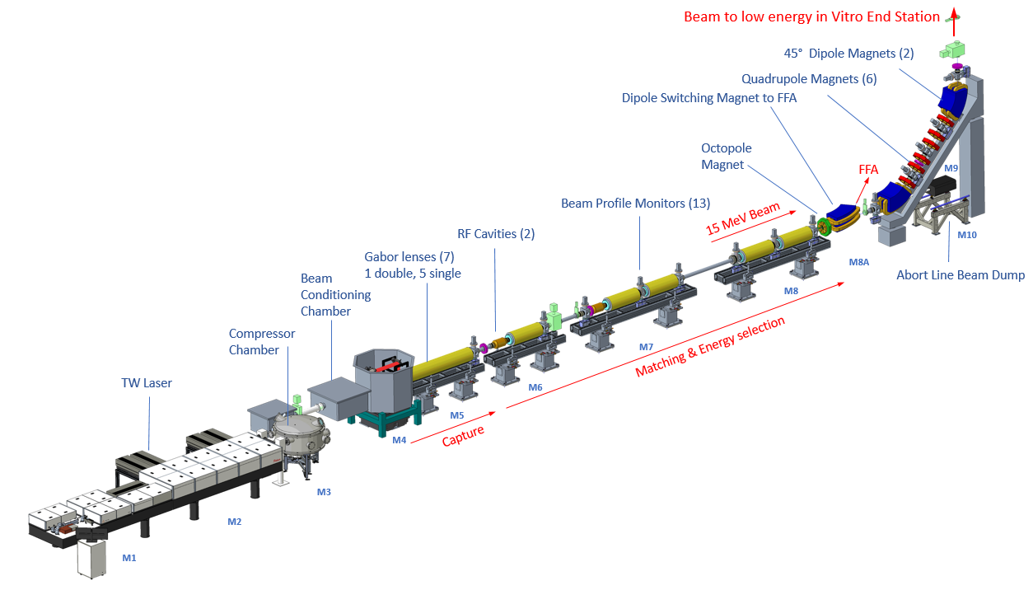
LhARA Stage 1 Conceptual Design

Slide 10
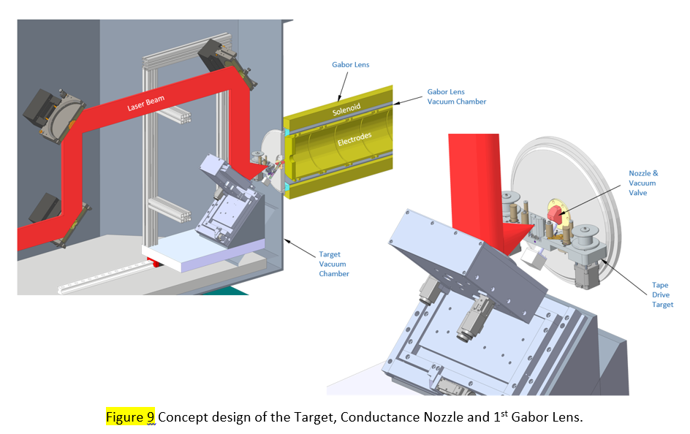
Laser Target, Nozzle, Gabor Lens Concept Design
Solenoid
Laser beam

Slide 11
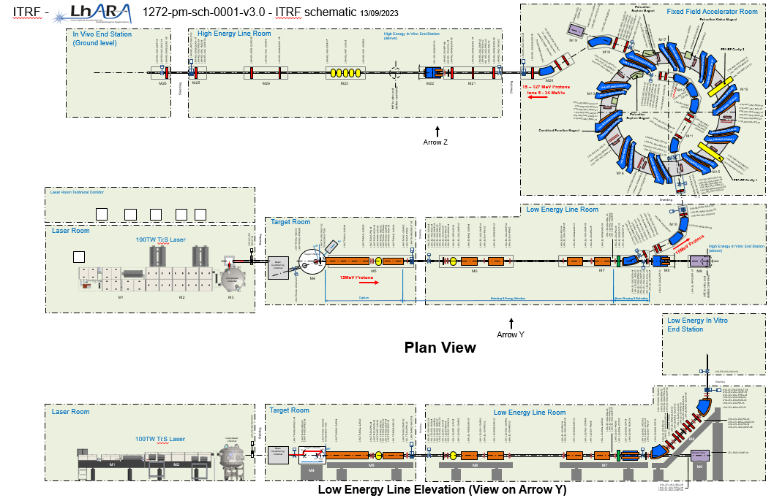
LhARA Schematic
Document: 1272-pa1-pm-sch-0001-v3.0-ITRF schematic https://stfc365.sharepoint.com/sites/ITRF
The intention is to capture all the required equipment in the schematic
The diagram is available at large format
A device naming convention has been adopted to;
Each device with a unique name.
The function of a device can be derived from its name
Names can be adopted by the LhARA Control System.

Slide 12
Vacuum Systems & Controls
Review Report document describes;
General Vacuum Systems Design Objectives
How the facility is broken down to several vacuum regions
Provisional working pressures in the various vacuum regions
Vacuum Design Principles
Vacuum Pumping
Pressure Measurement
Vacuum Values
Bakeout considerations

Slide 13
Summary
Infrastructure plan is well established
Low energy line is well defined
Need to ramp up the engineering design of the FFA
Obtain a better understanding of the:
Magnet definition for the high energy line
Diagnostics
End stations
Update the schematic diagram, vacuum flow sheet & CAD model as the design evolves.
Providing an understanding to inform the Planning and Cost Model

