Slide 1




WP1.6: Design & Integration:
Stage 1 Design
William Shields
(william.shields@rhul.ac.uk)
LhARA Collaboration Meeting #4
20th September 2023

Slide 2

Outline
Beam and baseline design performance review
7 Gabor lens configuration
Optimised optics & spot size flexibility
Beam uniformity
Dose delivery validation

Slide 3
Re-simulated Beam Parameters
 | Pre-CDR Beam | Smilei Sampled Beam | SCAPA Beam (6 month report) | SCAPA Beam (updated)
Mean RMS emittance [m] | 3.26x10⁻⁷ | 1.43x10⁻⁸ | 7.98x10⁻⁸ | 8.25x10⁻⁸
Mean beta [m] | 4.89 | 141.34 | 21.62 | 20.24
Mean alpha | -50.22 | -1418.43 | -222.23 | -204.99
GPT simulation artefact discovered, artificial emittance growth
Target housing beam transport remodelled
Beam transport simulation drafted into technical note.

Slide 4
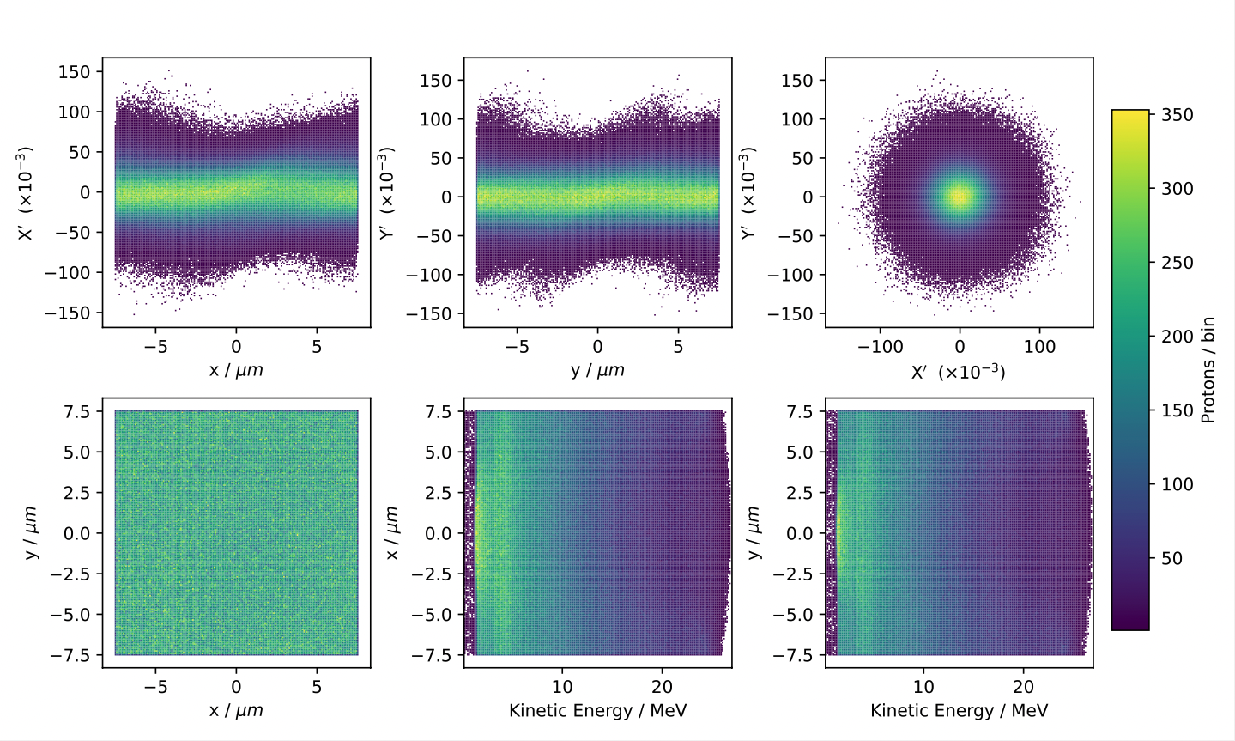
SCAPA Beam: Full Spectrum
15 MeV ± 100 % beam
Excess at ~ 4 MeV
Constant bandwidth across transverse spatial distribution
  Suspected simulation artefact
Negligible impact on 15 MeV ± 2% region

Slide 5
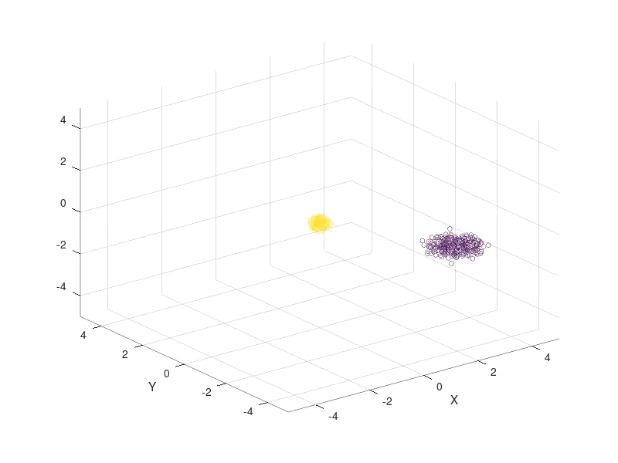
Co-propagating Beam Modelling
RF-Track: modelling composite beams with space charge forces
RF track example: 1000 protons & 1000 electrons (all macroparticles)
Aim: model LhARA proton & electron co-propagation in the target housing
Simulated electron data needed

Slide 6
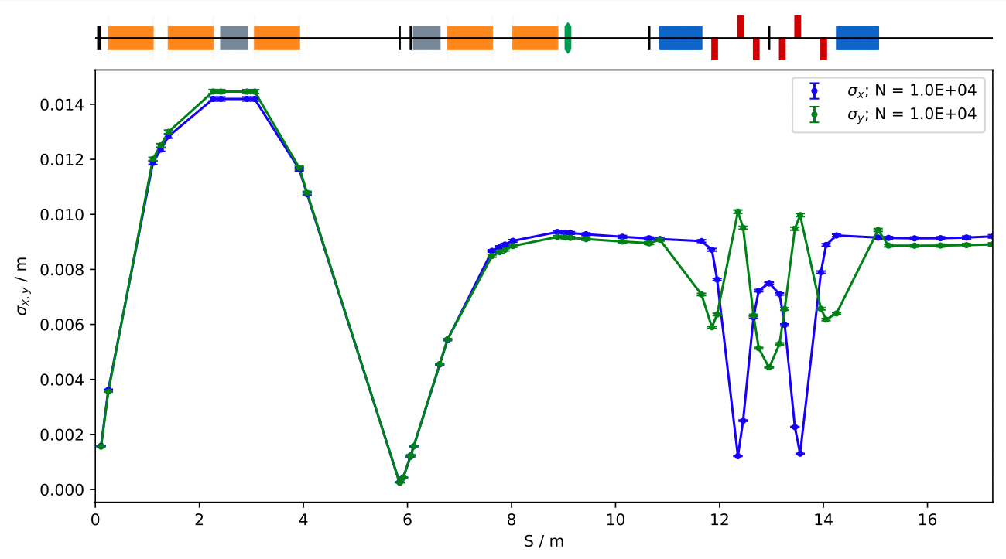
Baseline Design Performance
Optimised solutions for 3.6 cm and 3.2 cm beam. Smaller beams challenging.
No solutions for FFA injection line conditions.

Slide 7
7 Gabor Lens Configuration
Investigation of 7 Gabor lens / solenoids configuration
Single energy collimator
Geometry modifications:
  Extra 0.2m between GL4 & GL5
  2.5m long drift after GL5
  GL6 & GL7 added in same configuration as GL4 & GL5
Matched solutions for 5 spot sizes (no space charge):
  3.0, 2.5, 2.0, 1.5, 1.0 cm (2 sigma diameter)
Baseline design update technical note drafted.

Slide 8
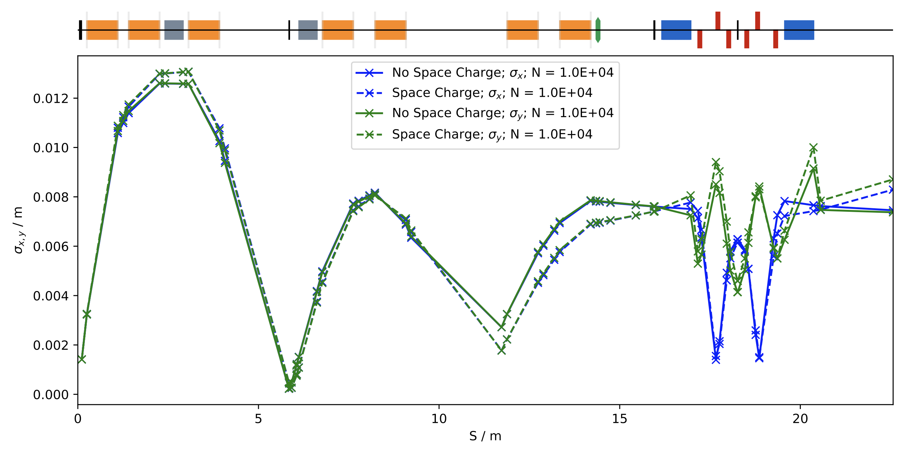
Model Validation & Performance
Space charge impacting performance

Slide 9
Capture Section Optimisation
GL1
GL2
GL3
Machine length flexibility between GL2 & GL3 achieved
  ~ 2.5 m
 | Original |  | Optimized
 | KS | B [T] | KS | B [T]
Gabor Lens 1 | 2.491764 | 1.4 | 2.491764 | 1.4
Gabor Lens 2 | 1.018776 | 0.572400 | 1.045545 | 0.587440
Gabor Lens 3 | 1.448605 | 0.813900 | 1.449852 | 0.814601

Slide 10
Spot-size Optimisation
Optimised solutions found for 3.0, 2.5, and 2.0 cm spot sizes
Trending to divergent beam, focus after GL7.
Spot Size [cm] | Solenoid Equivalent Field [T]
 | Gabor Lens 4 | Gabor Lens 5 | Gabor Lens 6 | Gabor Lens 7
3.0 | 1.072940 | 0.807211 | 0.001191 | 0.787153
2.5 | 0.996313 | 0.832585 | 0.000871 | 0.858701
2.0 | 0.995976 | 0.823955 | 0.749300 | 0.836557

Slide 11
Optimised Optics: Beam Profile
Similar end station profile and phase space to pre-CDR beam.

Slide 12
2.0cm Spot Size: Arc Optimisation
Arc quadrupoles varied, improved solution for 2.0 cm spot size beam.
  Quad gradient constrained to ± 22.4 T/m (pole tip field = 0.82 T, 3.65cm radius)
Solutions for smaller spot sizes remains challenging.

Slide 13
2.0cm Spot Size: Beam Profile
No major impact on end station beam profile.

Slide 14
Matched Solution for FFA Injection Line
 | Optimized Solenoid Strength
 | KS | B [T]
Gabor Lens 4 | 1.82756 | 1.02682
Gabor Lens 7 | 0. 55688 | 0.31288
Beam Parameter | Value
Mean RMS Emittance [m rad] | 2.959 x 10⁻⁶
Mean Beta [m] | 49.92
Mean Alpha | 0. 075

Slide 15
Preliminary Octupole Simulations
No octupole strength found producing sufficient uniformity over the spot size area.
Arbitrary K3 values shown.

Slide 16
Repositioned Octupole: Arc End
Moving the octupole to the end of the vertical arc improves uniformity significantly.
Octupole strength to be optimised.

Slide 17
Octupole Position Sensitivity
Artificial shift of mean vertical position entering the arc improved uniformity asymmetry.
Uniformity sensitive to beam position – correctors likely needed

Slide 18
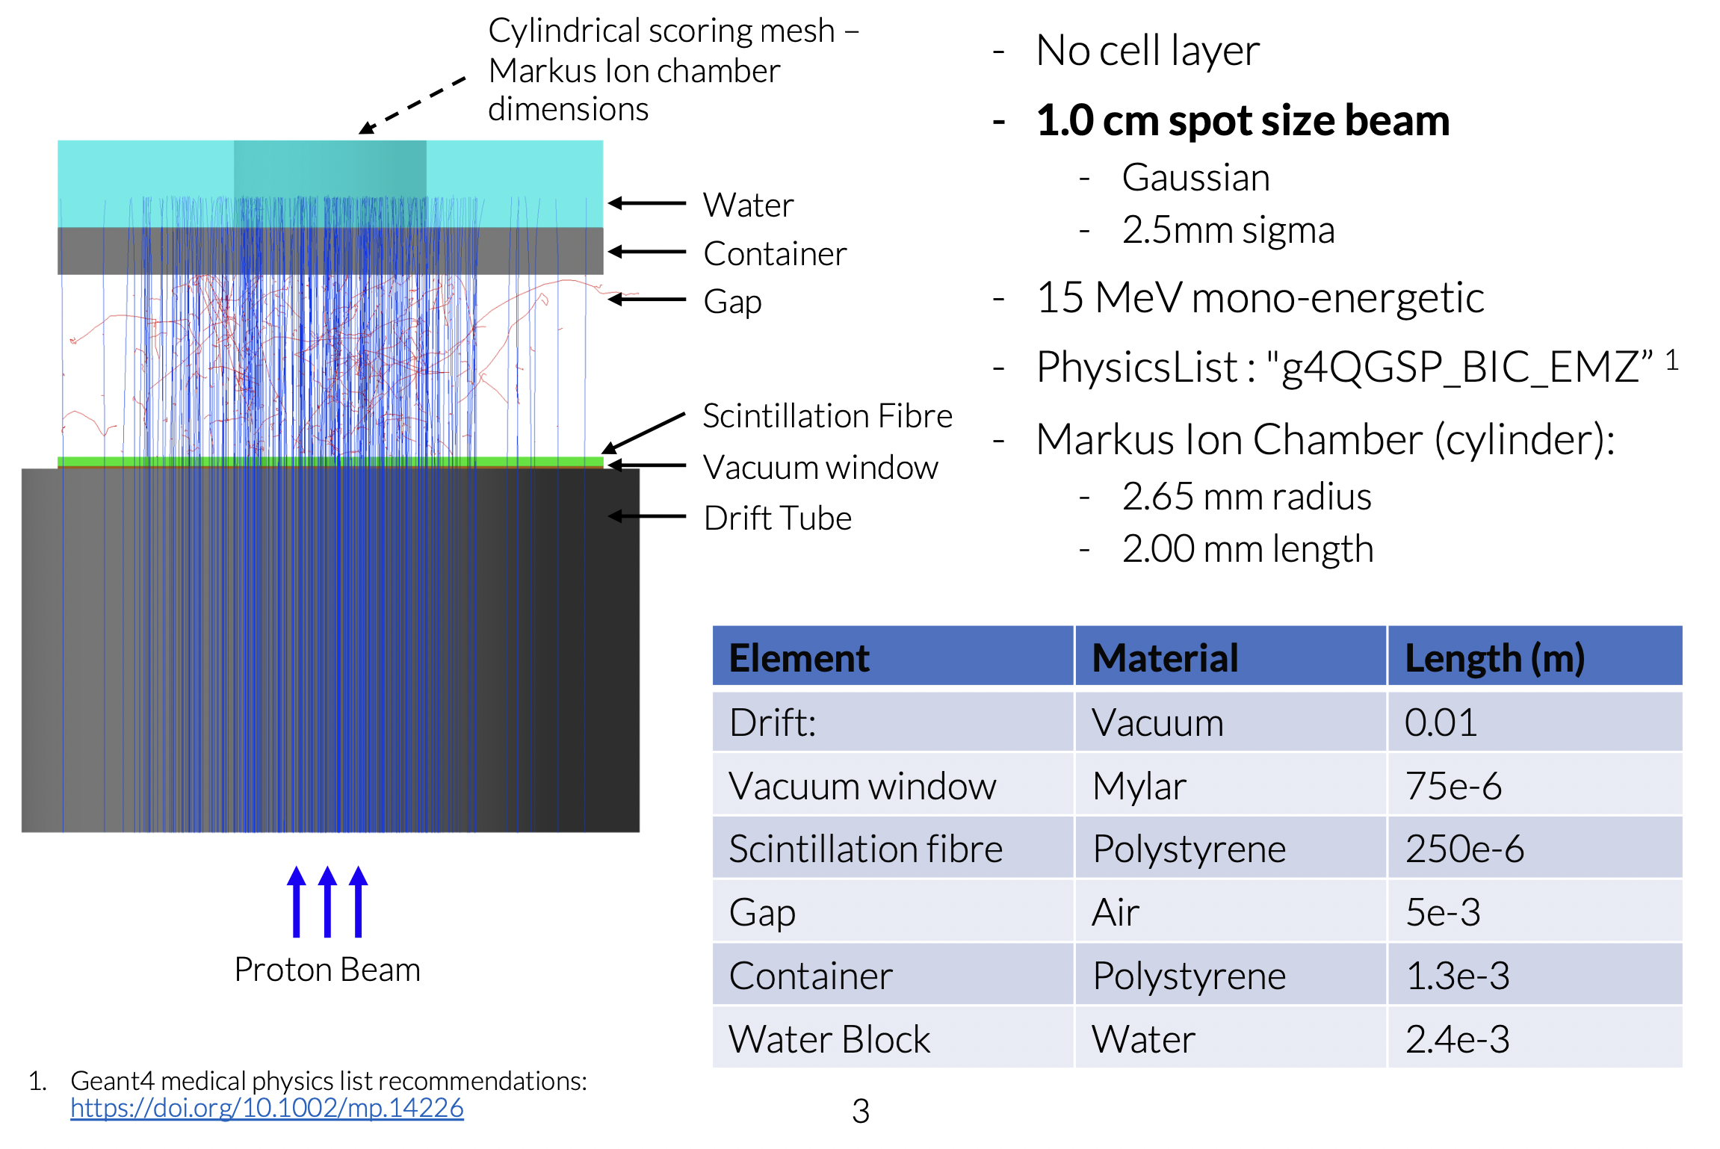
Dose Rate Check: End Station Model

Slide 19
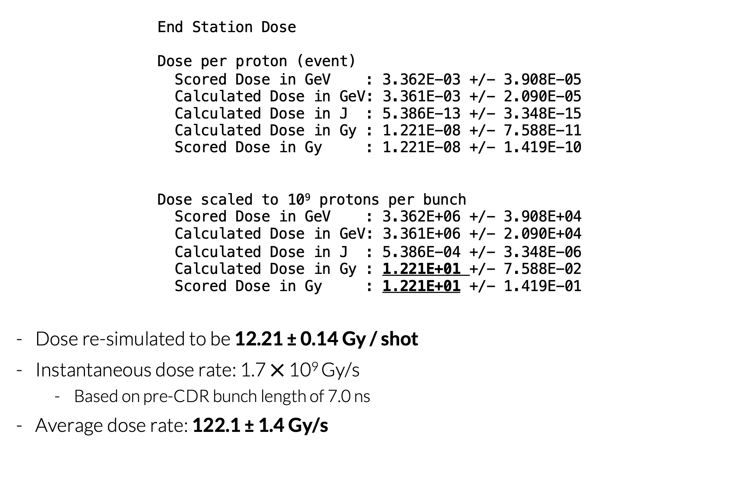
End Station Dose Rate

Slide 20
Summary
Demonstrated flexibility of 7 Gabor lens configuration
Optimised solutions for spot sizes & FFA injection line
Re-established octupole feasibility
Validated end station dose calculations

Slide 21


Thank you
William Shields
william.shields@rhul.ac.uk

