Slide 1
PoP beam modelling
KL, R. Razak, R. Pullan, M. Maxouti

Slide 2
Development of radiation biology programme:
  At existing facilities:
    Novel (e.g. laser driven)
    Conventional
Josie, Jason, Yolanda taking steps …
LhARA proof-of-principle experiment:
  CW: “… include as many of key LhARA elements as possible …”
Focus of today’s discussion

Slide 3
Laser-driven beams for rbio: example 1
On Draco @ HZDR
DOI: 10.1038/s41598-020-65775-7
Draco:
  Petawatt laser
    E = 13 J, τ = 30 fs, 3 μm FWHM
Beam line:
  Target Normal Sheath Acceleration (TNSA)
  Pulsed solenoid focusing
    19.5T, 2 or 3 pulses/min.
    S1, S2: 40 mm bore
    Half angle acceptance 14º
  Measured transmission
  (18.6 MeV p)
    50.6% (dual solenoid)
    28.6% (single solenoid)

Slide 4
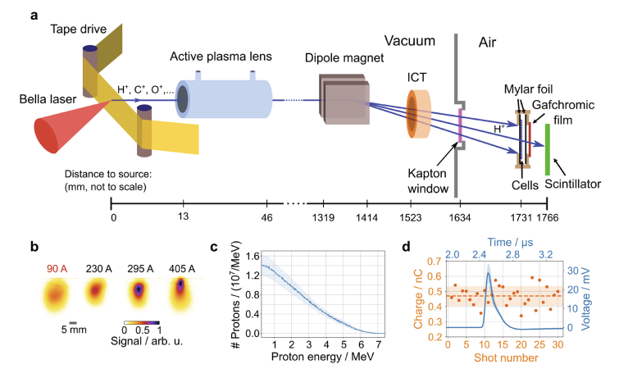
Laser-driven beams for rbio: example 2
On BELLA @ Berkeley
DOI 10.1038/s41598-022-05181-3
Berkeley Lab Laser Accelerator (BELLA):
  Petawatt laser
    E = 35 J, τ = 35 fs, 52 μm FWHM
Beam line:
  Target Normal Sheath Acceleration (TNSA)
  Active plasma lens focusing
    1 mm diameter Ar gas filled capillary
    33 mm length
    13 mm behind the tape drive target
    ~0.2% transport efficiency for protons with E > 1.5 MeV

Slide 5
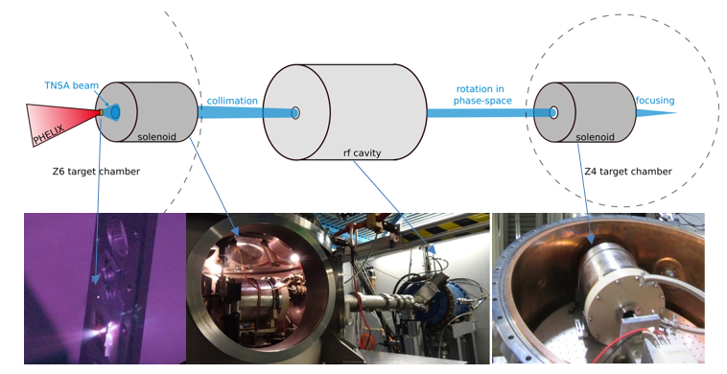
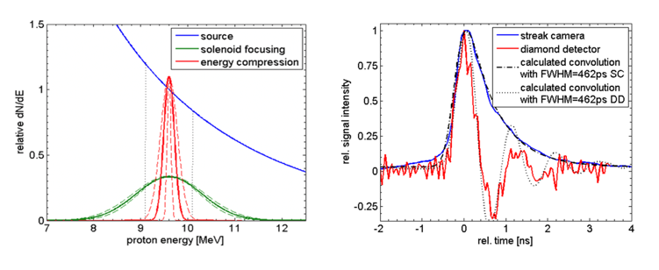
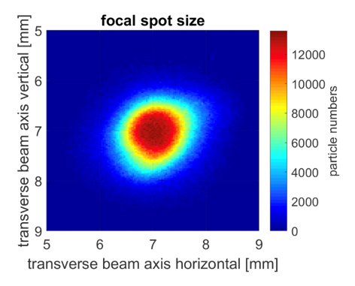
Capture
Variety of initiatives; some key examples
On PHELIX @ GSI
LIGHT – Laser Ion Generation, Handling and Transport
DOI: 10.1063/1.3299391
DOI: 10.1103/PhysRevSTAB.14.121301
DOI: 10.1103/PhysRevSTAB.16.101302
DOI: 10.1103/PhysRevSTAB.17.031302
NIMA 909 (2018) 173–176
PHELIX:
  Petawatt High-Energy Laser for Heavy Ion EXperiments
    E < 25 J, τ = 500 fs, I > 10¹⁹ J/cm2
LIGHT:
  Target Normal Sheath Acceleration (TNSA)
  Ion beam is collimated by a pulsed high-field solenoid
  Phase rotation in RF cavity
  Final focus with a second pulsed high-field solenoid
https://www.gsi.de/work/forschung/appamml/plasmaphysikphelix/experimente/light

Slide 6
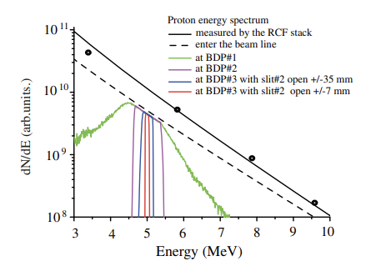
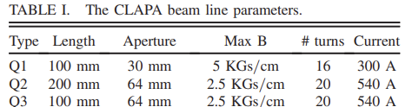
Capture
Variety of initiatives; some key examples
On CLAPA @ Peking University
DOI: 10.1103/PhysRevAccelBeams.22.061302
DOI: 10.1103/PhysRevAccelBeams.23.121304
Compact Laser Plasma Accelerator (CLAPA):
  Petawatt laser
    E = 1.3 J, τ = 30 fs, 5 μm FWHM
Beam line:
  Target Normal Sheath Acceleration (TNSA)
  Quadrupole triplet focusing
  Measured transmission:
    88% transmission through triplet
    ±50 mrad collection angle @ 5 MeV

Slide 7
ELIMAIA-ELIMED
Quantum Beam Sci. 2018, 2, 8; doi:10.3390/qubs2020008
Frontiers in Phys. Med. Phys. & Imag. – doi: 10.3389/fphy.2020.564907
Extreme Light Infrastructure, Prague, Czech Republic:
ELI Multidisciplinary Applications of laser-Ion Acceleration (ELIMAIA)
  ELI MEDical and multidisciplinary applications (ELIMED)
    ELIMAIA section dedicated to ion focusing, selection, characterization, and irradiation
  Proton energies from 5 to 250 MeV transported to in-air section

Slide 8
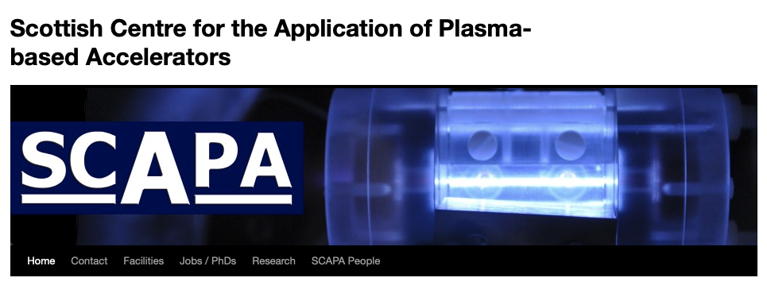
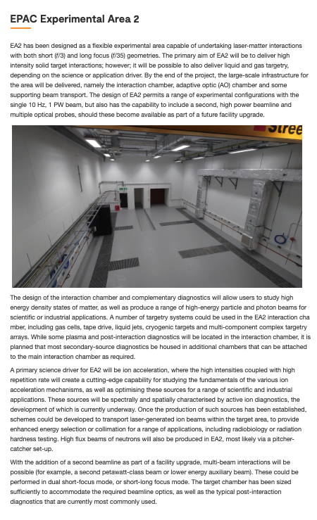
Prepare for discussion of PoP experiment in September
We are generating interest!
  Natural hosts: SCAPA, perhaps EPAC/EA2
    But also, perhaps, European labs?
Biological programme
  Complementarity of different sources?

Slide 9
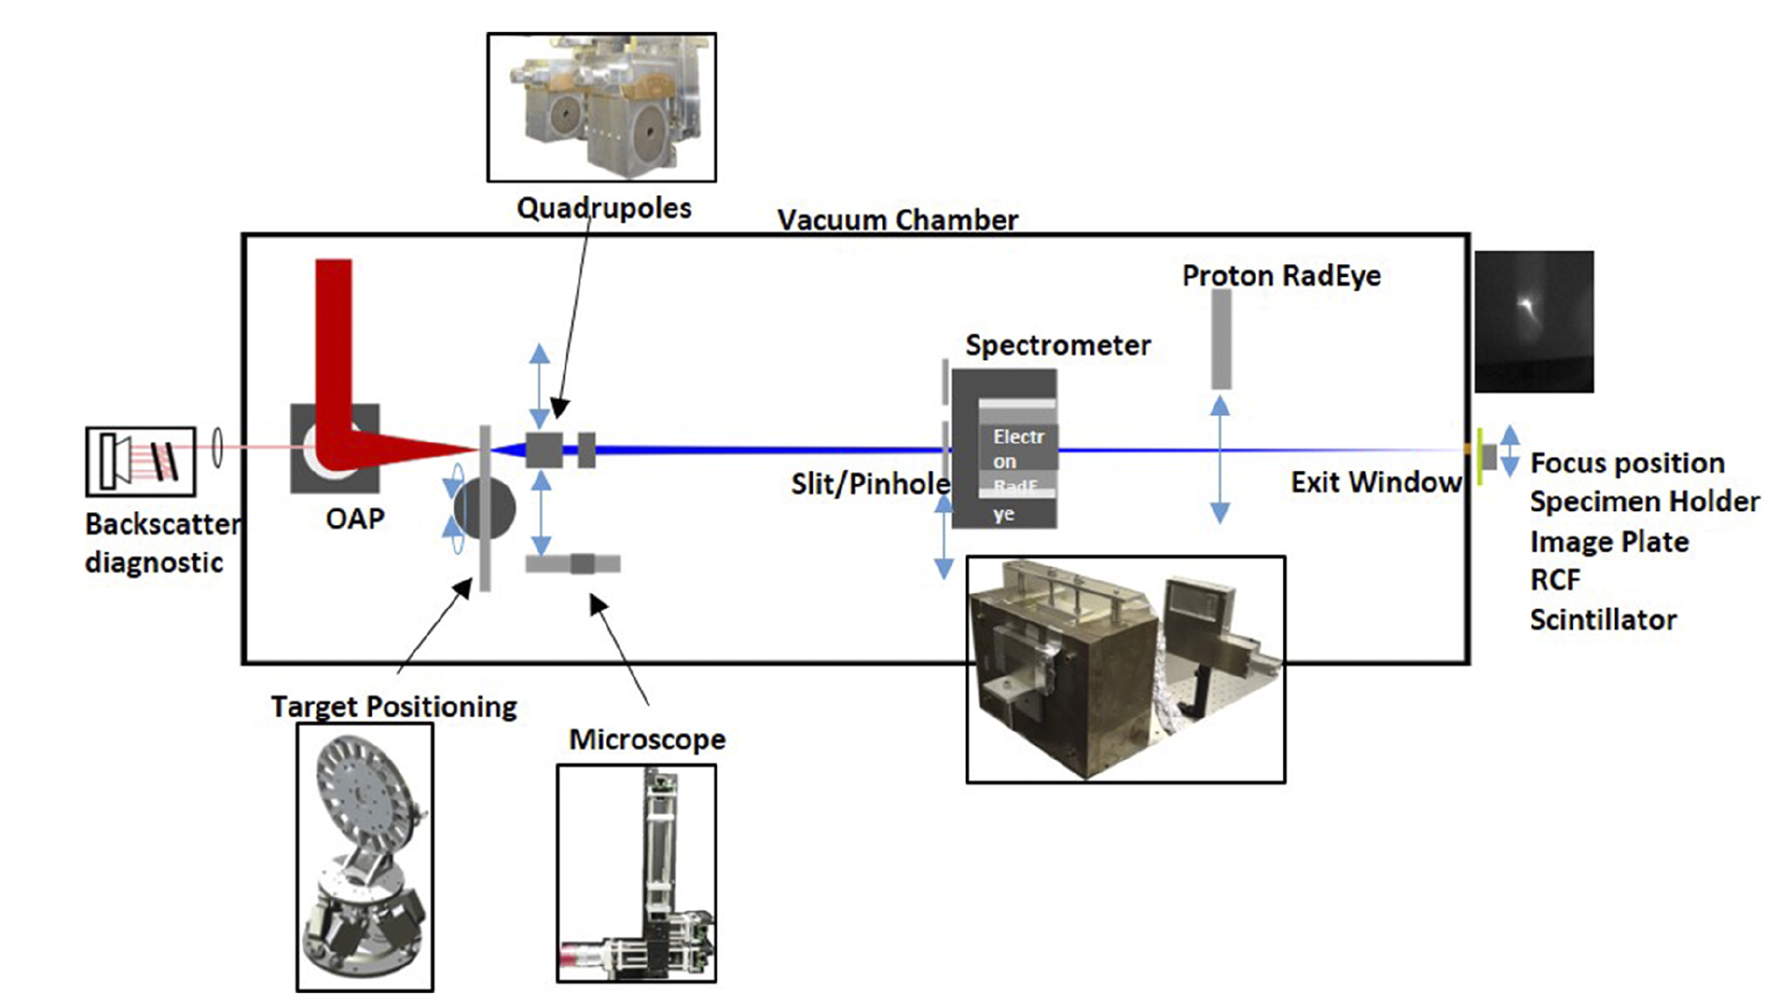
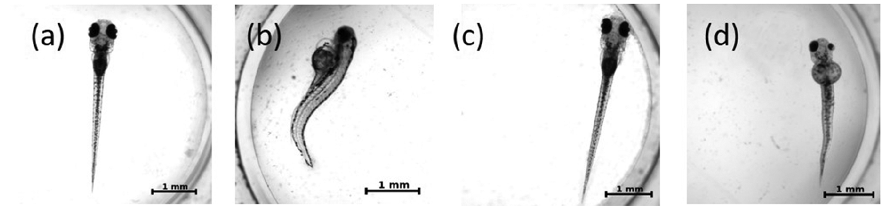
Example Set Ups
A feasibility study of zebrafish embryo irradiation with laser- accelerated protons. doi: 10.1063/5.0008512
ATLAS 300 Laser at the LION Beamline
Comparison of Irradiated versus Control Embryos

Slide 10
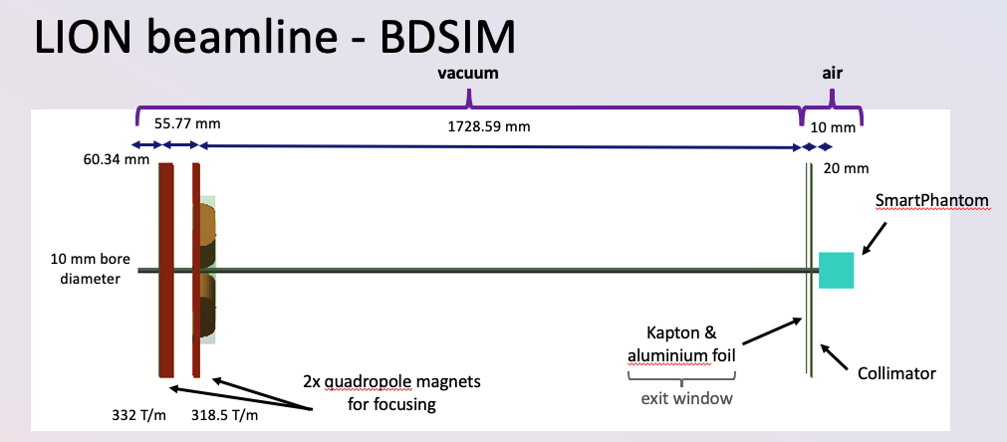
From Maria
Source:
exponential
Capture
Delivery

Slide 12
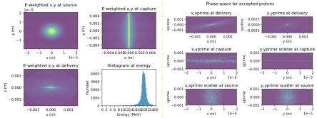

Slide 13
Some parameters from Maria’s figure, some from papers.

Slide 14
r at delivery vs energy
(x, y) = (0, 0)
[x’, y’]
at source

Slide 15
(x,y) position and energy distribution
at delivery

Slide 16
Next steps
Move on to model existing beam lines:
  DRACO, BELLA, Gemini, …
Work with CLF on EA2 beam line:
  Possibly also with ASTeC
Following today’s discussion:
  Focus on “LhARA PoP” – on SCAPA?
  Evaluate parallel streams at existing facilities w\ beam lines

