Slide 1
Characterisation of Silicon Photomultipliers for LHCb Upgrade 2 RICH
Lukasz Domanski
16/08/2023

Slide 2
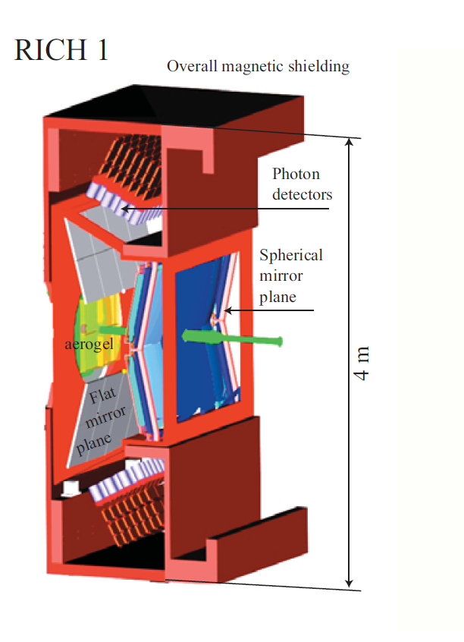
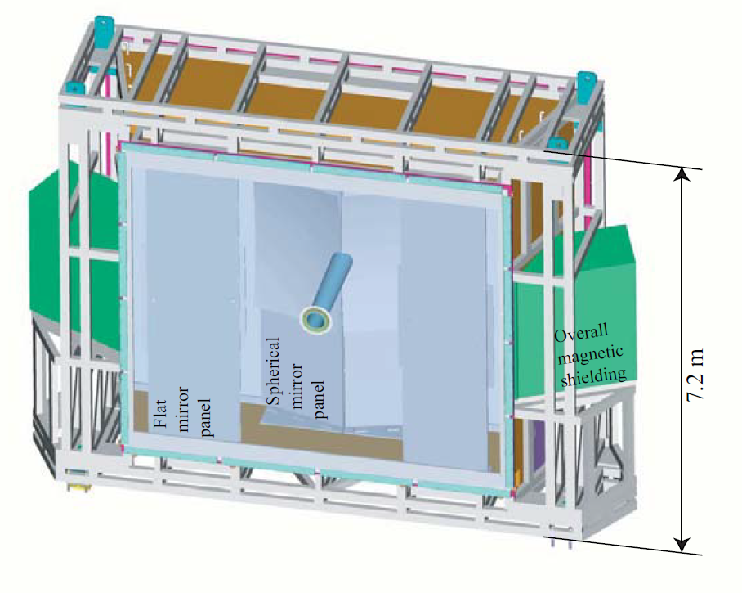
A little background

Slide 3
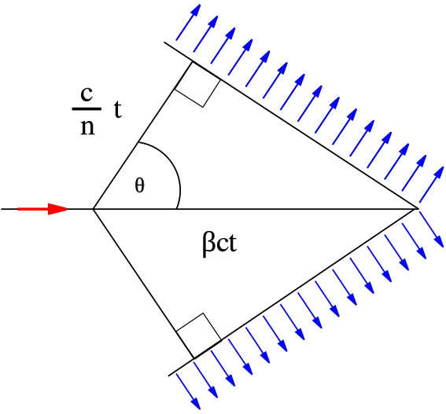
What is RICH?
RICH stands for Ring imaging Cherenkov detector.
Cherenkov radiation: charged particles passing through a medium emit light if their speed is higher than the speed of light in the medium.
The light is emitted in a cone with opening angle given by:
$cosθ= \frac{1}{nβ}$
By measuring the cone’s opening angle, you can
obtain particle’s velocity. Then, if you know particle’s
momentum, measured in the tracker, you can identify
it by calculating its mass.
Source: https://commons.wikimedia.org/wiki/File:Cherenkov.svg
Copyright under CC by Arpad Horwath 2006

Slide 4
Why do we need to upgrade them?
Current maximum instantaneous luminosity: $2∙{10}^{33} {cm}^{−2}s^{−1}$
Projected maximum instantaneous luminosity after the LHCb upgrade 2 (planned for 2032): $1.5∙{10}^{34} {cm}^{−2}s^{−1}$
Current photodetectors (multi-anode photomultiplier tubes) do not have required spatial and temporal resolution to handle this increase.

Slide 5
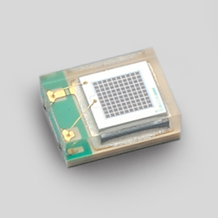
What is a silicon photomultiplier (SiPM)
A single-photon sensitive light detector consisting of an array of single photon avalanche diodes.
Operated at a reverse bias above its breakdown voltage.
Single photon gets absorbed and creates an electron-hole pair by exciting an electron above the band gap. The charge carriers get accelerated by the voltage and produce more charge carriers by ionisation of Si lattice – avalanche.
The signal gets quenched by the quenching resistor.
Source: https://hep.hamamatsu.com/eu/en/products/S13360-1350PE.html

Slide 6
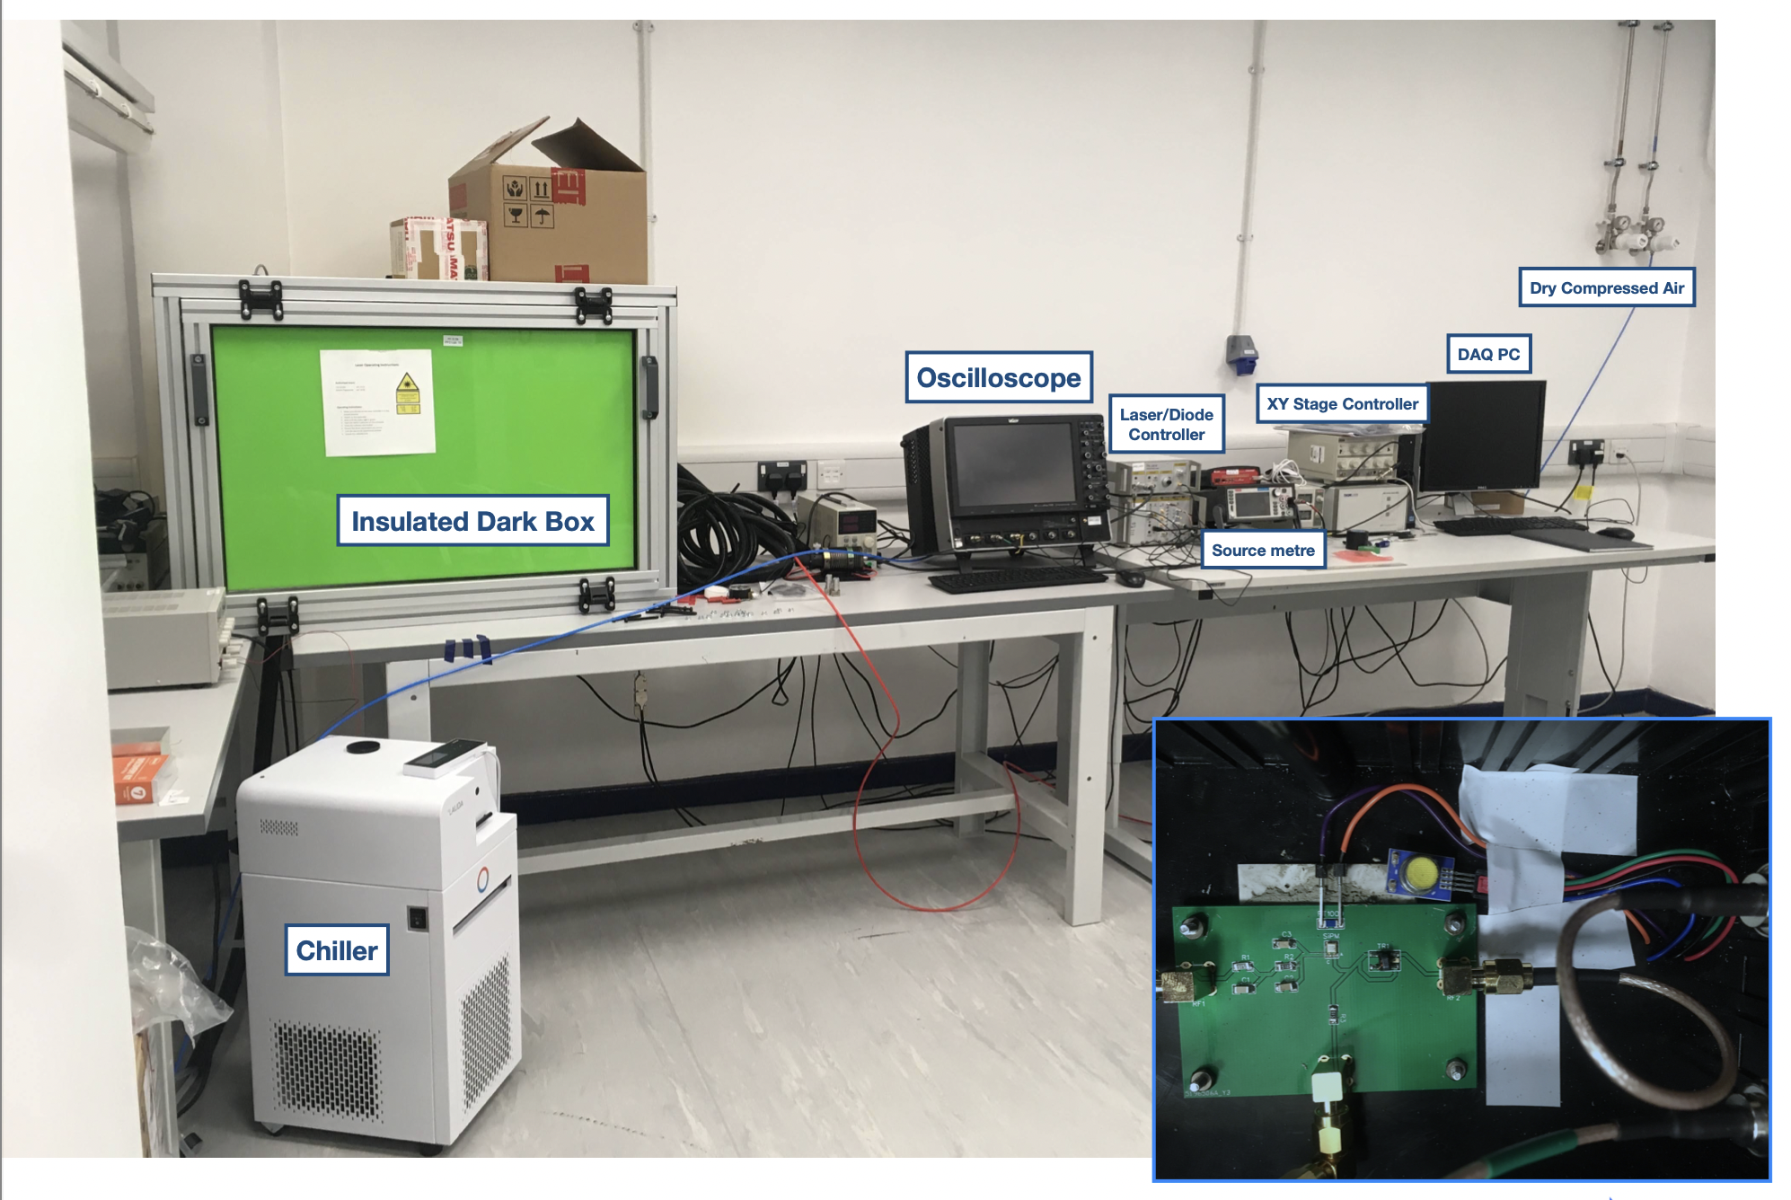
My work – measurement of SiPM parameters

Slide 7
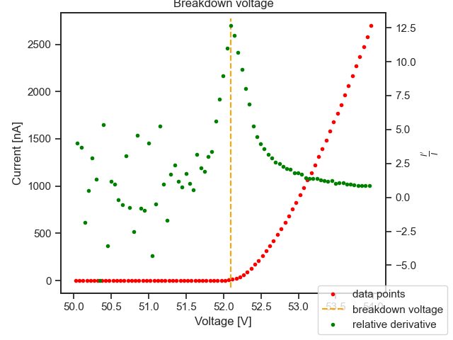
Breakdown voltage
SiPMs start detecting single photons when biased at the breakdown voltage of its constituent diodes.
Experimental truth: the breakdown voltage corresponds to the local maximum of a $\frac{\frac{dI}{dV}}{I}$ curve.
Typical operating point: $V_{BR}$ + 3-4 V.
Increasing voltage increases the probability
of photon detection, but also increases
noise in the system.
Typically, breakdown voltage
decreases linearly with temperature.

Slide 8
Main source of noise – dark counts
Thermal excitation of electrons can also cause avalanche in a diode – a dark count.
Dark current (current due to dark counts) increases with overvoltage and depends exponentially on temperature.
Cooling the system down is the principal way of dealing with it.

Slide 9
Forward bias – quenching resistance
As forward bias increases, voltage drop across the diode becomes negligible compared to the resistor.
Slope of the linear part of a forward IV curve is given by $\frac{1}{R_{||}}$, where $R_{||}$ is the total parallel resistance.
Knowing the total no. of cells, individual quenching resistance can be calculated.

Slide 10
Outlook: neutron irradiation
SiPMs are expected to receive ${10}^{14} {cm}^{−2}$1-MeV-equivalent neutron fluence during the operation of RICH after upgrade 2.
Main problem: collisions between neutrons and Si atoms create vacancies and interstitial defects.
The defects give rise to energy levels inside the band gap.
These energy levels facilitate thermal excitation of electrons, increasing drastically the dark current.
How much do you need to cool the device to counter this?

Slide 11
Thanks for listening!

