Slide 1
Using Machine Learning to Speed up ATLAS Tracking
VIKTORIA eRDI-kRAUSZ
15/08/23

Slide 2
Agenda
Background
ATLAS and ITk
FastTrackFinder
Project
Aims and Overview
Introduction to Machine Learning
Data Exploration
Model Development
Results
Implementations and Next Steps
15/08/2023
Viktoria Erdi-Krausz

Slide 3
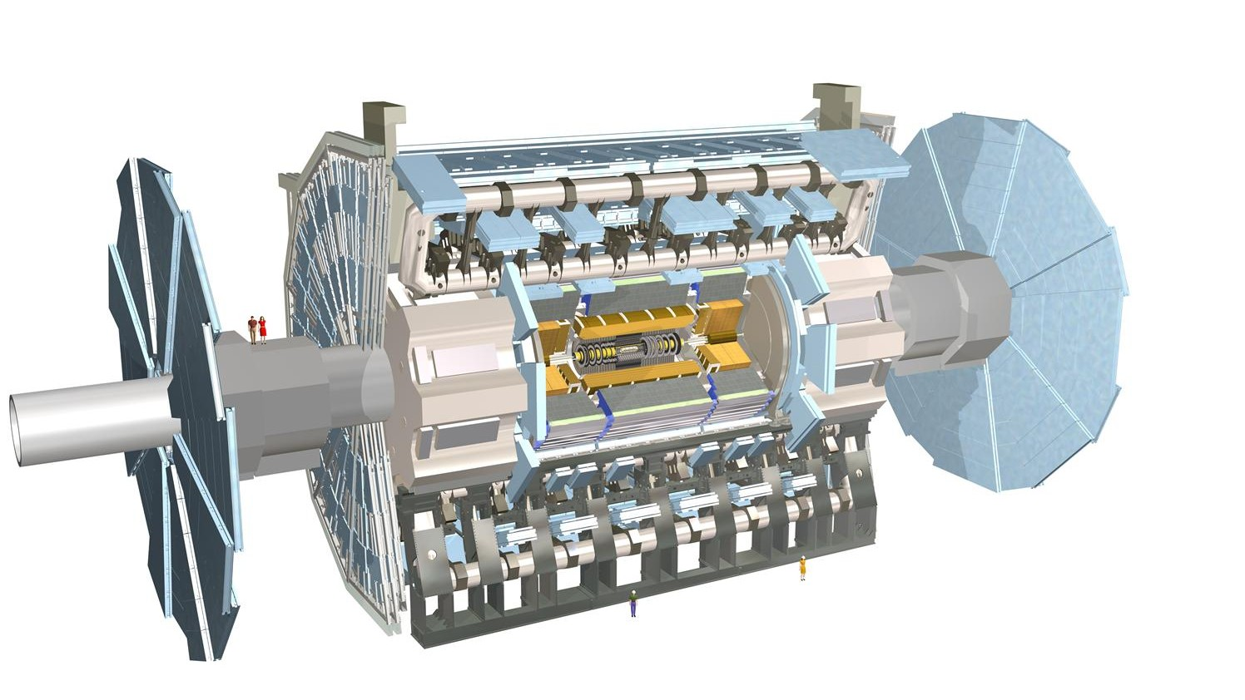
Background
ATLAS inner tracker replaced by all silicon ITk detector.
Inclined disks
More forward coverage
Collisions occur at origin and where particles hit the detectors are connected to create tracks.
Tracking starts in pixel detector, later extended to strip detector.
We only focus on doublets in the pixel detector.
ITk Pixel Detector
Red: Pixel detectors
Blue: Strip detectors
15/08/2023
Viktoria Erdi-Krausz
1/10

Slide 4
Background
15/08/2023
Viktoria Erdi-Krausz
2/10

Slide 5
Project Overview
Aims
Create machine learning model to speed up tracking.
Overview
Use track angle and cluster width to reduce number of possible doublets.
Random Forrest
Type of machine learning model which uses a number of decision trees to identify trends in dataset.
15/08/2023
Viktoria Erdi-Krausz
3/10

Slide 6
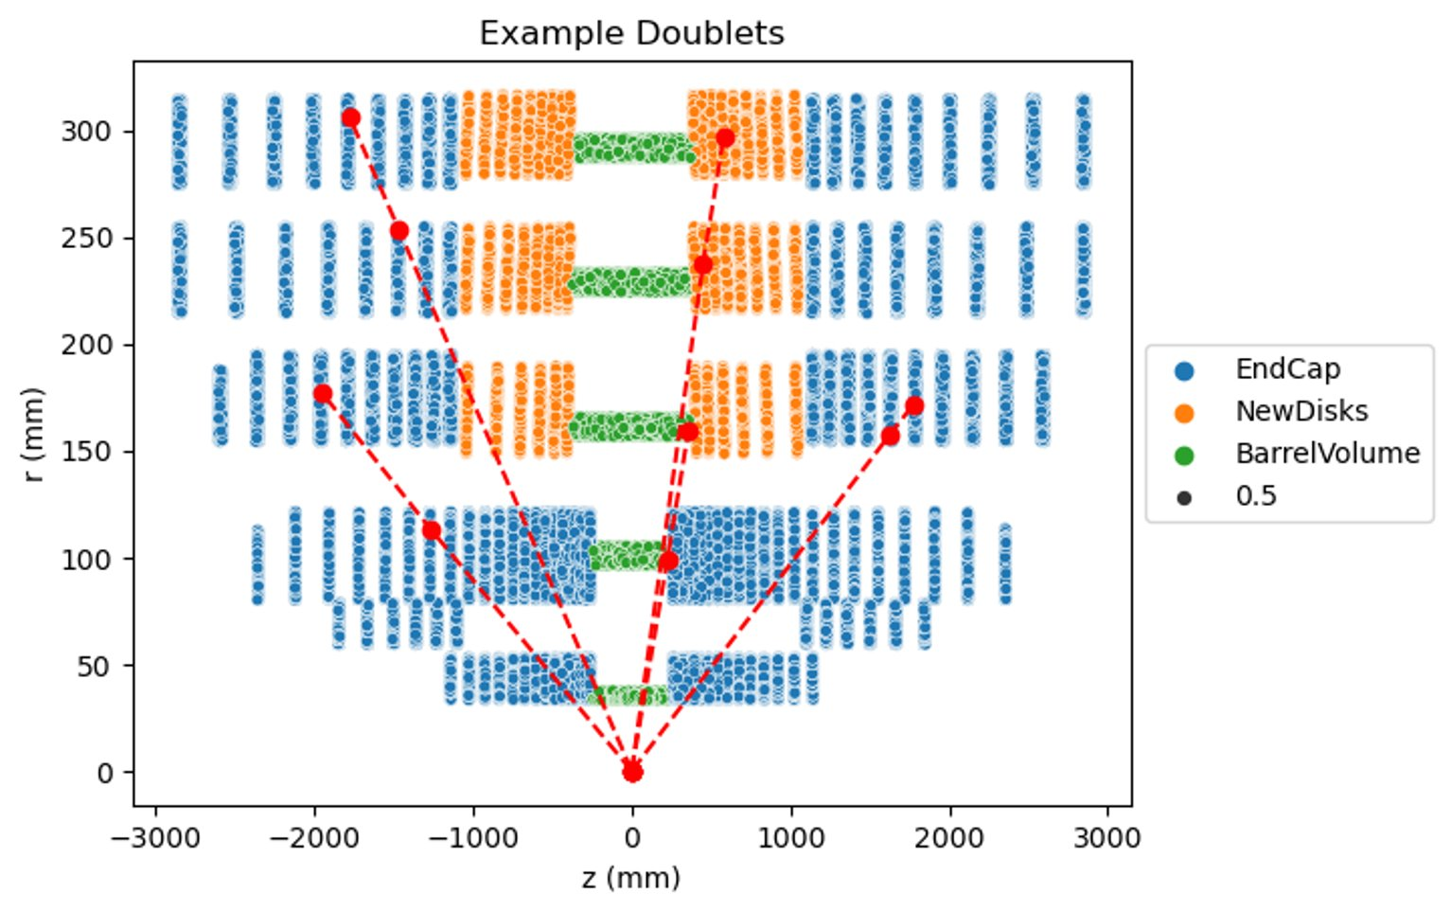
Data Exploration
Data used: TT bar with 200 pileup
Signal: any particle produced from the physics interaction.
Background: Low momentum tracks.
Issues with large data quantity – for 1 event:
2380 signals
10,091,380 background
Data must be reduced to workable volume whilst staying representative of each region.
Data extracted for 55 events and down sampling was implemented leaving:
375,034 signals
750,068 background
Different trends observed in each part of the detector i.e. barrel, endcap, inclined.
15/08/2023
Viktoria Erdi-Krausz
4/10

Slide 7
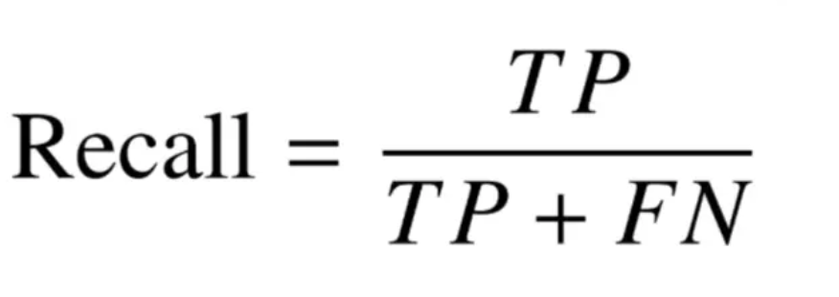
Model Development
Model was trained to maximise efficiency, not purity.
Efficiency (/recall) is the number of points correctly classified:
Signal recall is the number of signals correctly identified (i.e. (PREDICTED signal and IS signal) / ((PREDICTED signal and IS signal)&(PREDICTED background and IS signal)) )
Background recall is the number of background correctly identified (i.e. (PREDICTED background and IS background ) / ((PREDICTED background and IS background )&(PREDICTED signal and IS background )) )
All three models must achieve a minimum efficiency of 95%.
Existing ML model for current detector has a background recall of ~40%.
15/08/2023
Viktoria Erdi-Krausz
5/10

Slide 8
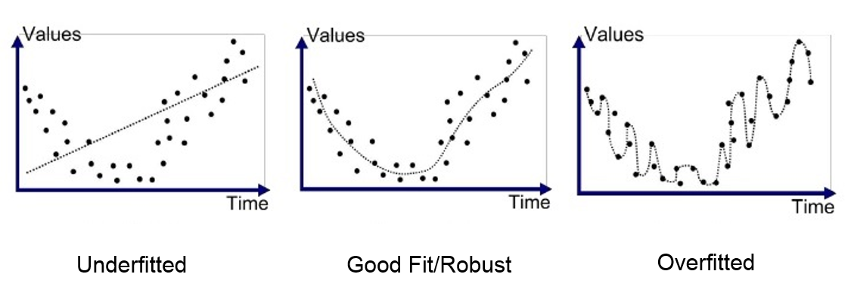
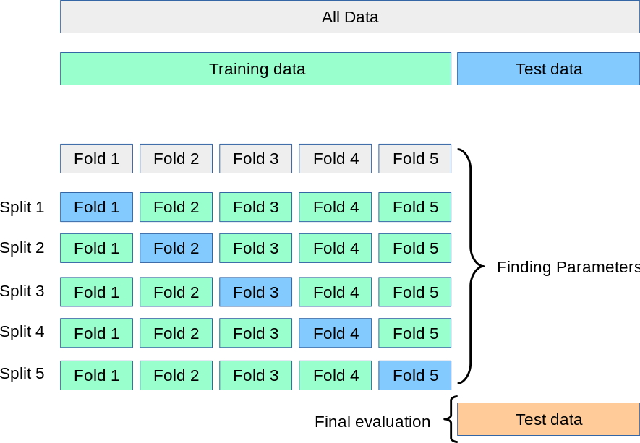
Model Development - Tuning
Tuning a model ensures the model fits the true trend of the provided data to improve chosen metric.
A too simple model is defined as underfitted.
Overfitted model fits to the noise in the data set.
Cross validation can be used to reduce the chance of overfitting.
Split train and test data with 70-30 split.
5 fold cross validation performed on training, large variation in performances suggests overfitting.
15/08/2023
Viktoria Erdi-Krausz
6/10

Slide 9
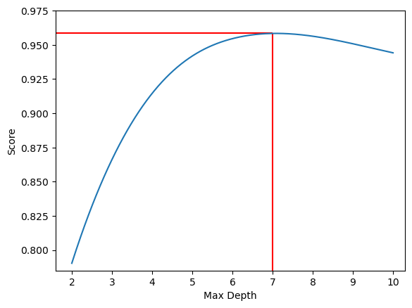
Model Development - Tuning
Tuning works by running model using range of hyperparameters and finding the optimum values (where the efficiency is the highest).
Example using max_depth:
Max_depth is the number of branches in each tree of a random forest.
Increases max_depth increases complexity and therefore increase in accuracy.
Increasing too far causes overfitting and therefore a drop in accuracy.
Optimum value identified as max_depth = 7
15/08/2023
Viktoria Erdi-Krausz
7/10

Slide 10
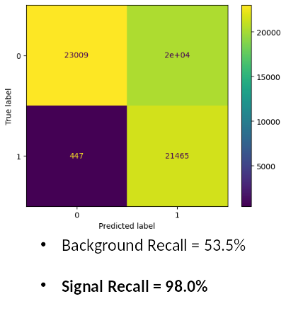
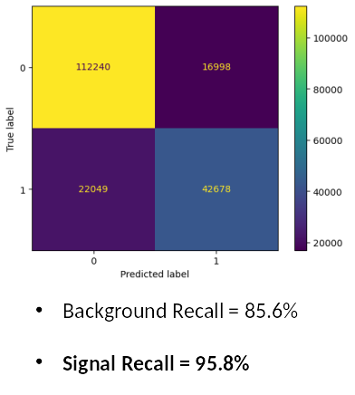
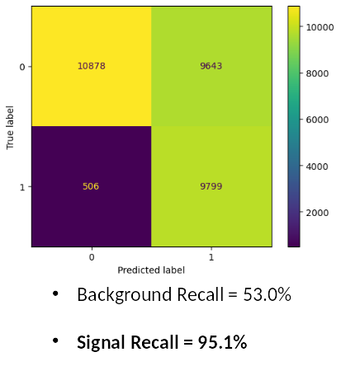
Results
Achieved the desired >95% efficiency for all 3 models whilst keep accuracy high enough to reject significant amount of background.
Barrel Predictions
Endcap Predictions
Inclined Disks Predictions
15/08/2023
Viktoria Erdi-Krausz
8/10

Slide 11
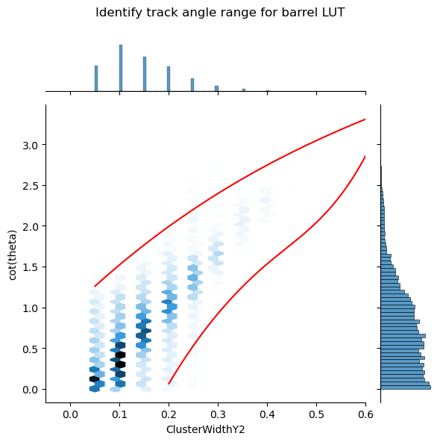
Implementation and Next Steps
Using the models' predictions data is grouped with respect to cluster width and range of track angles identified where data is most probable to be signal.
Create LUT.
Causes some loss in accuracy.
LUT can be implemented into C++.
FTF should be run implementing LUT to assess the performance and how speed of program is affected.
15/08/2023
Viktoria Erdi-Krausz
9/10

Slide 12
THANK YOU!
VIKTORIA eRDI-kRAUSZ
11/08/23

