Slide 1
Rutherford Scattering Outreach Project
Chloe Rey and Lizzie Bloomfield

Slide 2
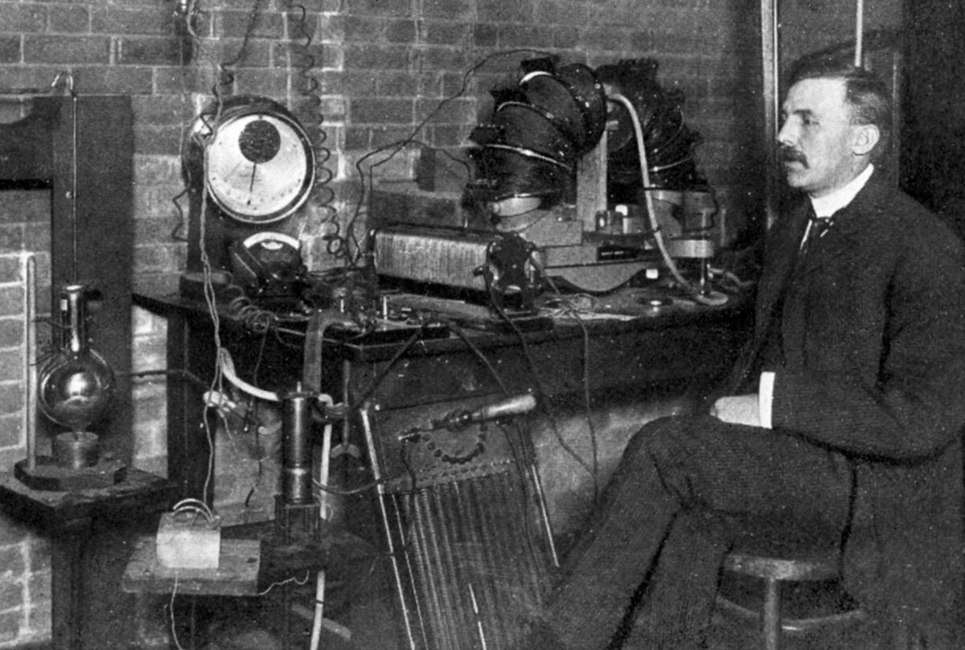
The Project
Reconstruction of the Rutherford Experiment from 1909
Update the setup with modern detector technology
Final product is a multi-detector array that can display a historical experiment and different iterations of modern particle physics detectors

Slide 3
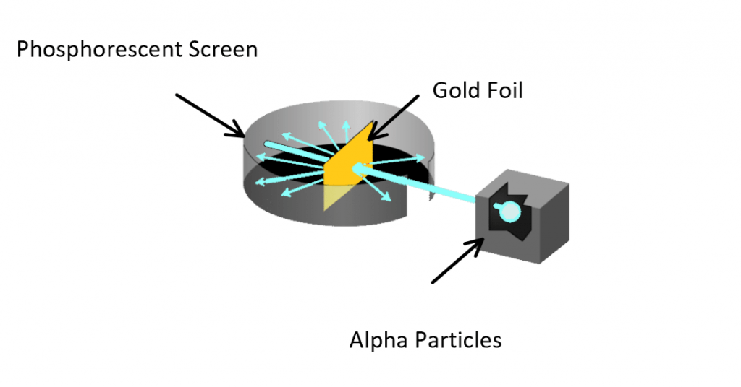
The Experiment
A setup of alpha particles, shot into a sheet of gold foil.
The scattered alpha particles were then detected by a phosphorescent scene
The experiment proved Thompson's model of the atom to be incorrect and concluded that the atom was in fact mostly empty space with a dense, positive nucleus.

Slide 4
The Updated Hardware
Use three types of detectors to replace the zinc sulphide phosphorescent screen.
All three are silicon based and originally used for other purposes such as muon detection.
In this experiment, they will be set up in an array and calibrated to produce three coherent data sets.

Slide 5
Cosmic Watch
Originally made to detect cosmic rays and muons
Its silicon sensor is light dependent and therefore uses a scintillator to detect alpha hits
The necessary code is uploaded to the Arduino nano attached and a python code on the RPi collects and collates all the data
The data we're interested in the voltage of the silicon sensor which tells us if there is a hit or no hit

Slide 6
SPM Micro Sensors 'John'
With a silicon sensor we can read changes in voltage depending on how much light is incident on the sensor
This sensor gives an analog output which therefore needs to be translated through an Arduino to digital to be read by the Raspberry Pi
A python script then reads this and tells us if there is a hit or no hit depending on the change in voltage

Slide 7
ITk Pixel Sensor and RD53A chip
The second sensor is an ITk pixel sensor, with an RD53A chip
Unlike the other two sensors, this one needs to be prompted to supply data as it's originally designed for LHC readout
To get around this, we have written a bash script to prompt the sensor to run a noise scan, convert the .json file to text file and then push the data to Prometheus.

Slide 8
The Software
This setup uses two main pieces of software, Prometheus and Grafana.
These are used to process and display the data of all of the detectors on an external monitor.
We will quickly go into what both of these applications do.

Slide 9
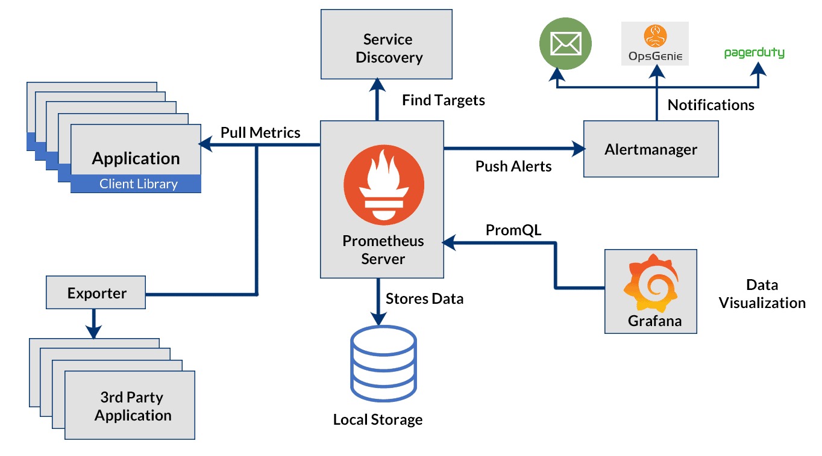
Prometheus
Prometheus is a software application used for event monitoring and in this experimental setup, it monitors the hit/no-hit rate of alpha particles.
In this experiment, Prometheus collates data from all three sensors and allows us to send them to Grafana to display them.

Slide 10
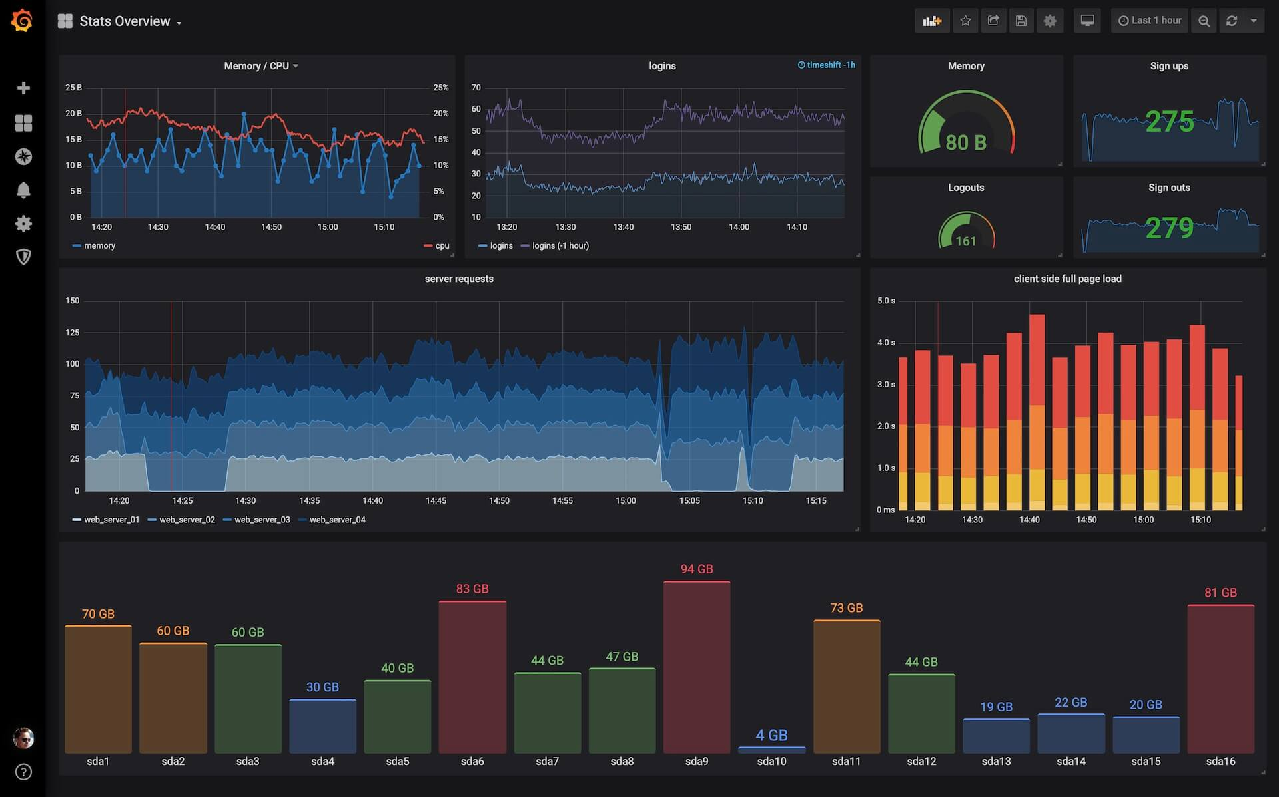
Grafana
Grafana works in tandem with Prometheus and is an open-source analytics and interactive visualization web application that allows us to display the real time hits of alpha particles during the experiment.
We used the gauge metric and a bar gauge to show the hits in real time from each detector.

Slide 11
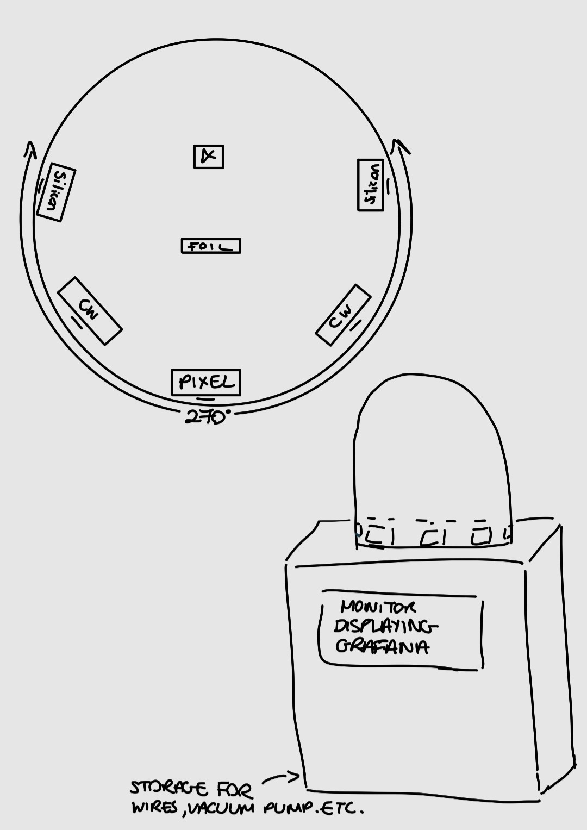
Outreach Aims Overall
To Demonstrate:
How the Rutherford scattering experiment works
Why it is an important experiment in particle physics
Different types of silicon-based detectors and how they work

Slide 12
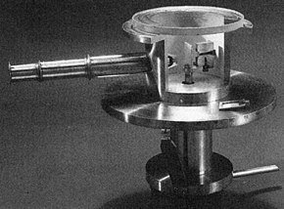
Thank you for listening

