Slide 1
Science and Technology Impact of XFELs and Opportunities with a Next Generation Facility
UK XFEL SCIENCE TEAM
Introduction to impact of XFELs on Science and Technology
2.1 Physics and X-ray Photonics
2.2 Chemical Sciences
2.3 Life Sciences
2.4 Condensed Matter, Quantum and Nanomaterials
2.5 Matter at Extreme Conditions
2.6 Industrial Applications
3. Future Directions

Slide 2
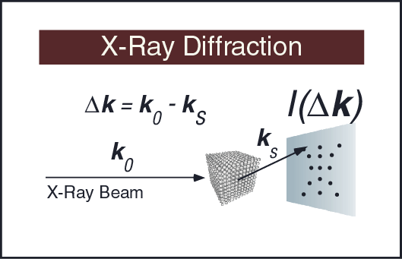
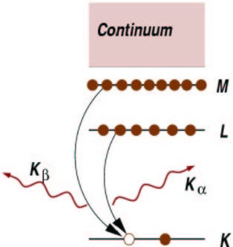
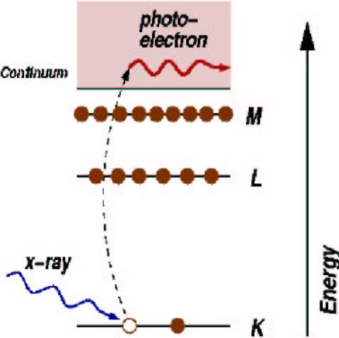
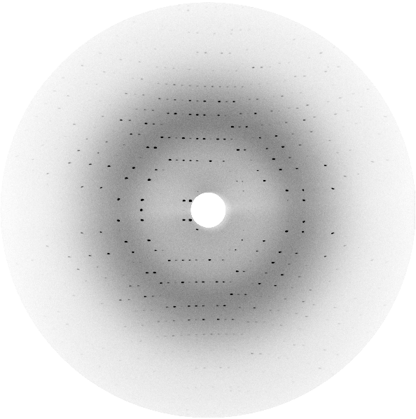

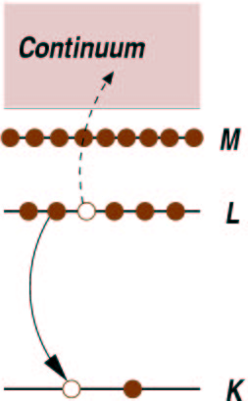
1. X-ray probing of the nanoscale structure of matter
X-ray Spectroscopy
X-ray Fluorescence
X-ray Absorption
I₀
SAMPLE
I_{T}
Auger decay
d
inner shell – valence or free state transitions
X-ray scattering/diffraction: provides atomic structure of materials and molecules
X-ray spectroscopy: core-valence transitions
gives electronic states with atomic specificity

Slide 3
1. XFEL Self-Amplified Spontaneous Emission (SASE)
Input
Low emittance, narrow energy spread,
relativisitic electron bunch
4 – 15 GeV accelerated in 100 m - > 1 km electron linear accelerators (LINACS)
(relativistic electrons are the gain medium with a Lorentz factor ϒ ~ 2000)
Undulator (period λ_{u} ~0.01 m)
Output
Self-Amplified Spontaneous Emission (SASE)
high brightness,
short pulse of coherent
soft to hard X-rays
XFEL radiation wavelength
λ_{r} ~ λ_{u} ϒ⁻²
X-rays from 10 eV to > 10 keV photon energies (100 nm to < 0.1 nm wavelength)
Pulses 0.3 fs – 100 fs duration
Exceptional brightness
Enable time resolved x-ray scattering and x-ray spectroscopy measurements

Slide 4
Science driver for XFELs is real-time access to the characteristic processes and fluctuations in matter down to the quantum scale
Electron-ion coupling timescales in conductors/ thermalisation in hot dense plasma
Material damage spallation, melting etc
Primary photoexcitation event
Lattice dynamics, exciton dynamics, magnon dynamics etc.
Nuclear processes
Vibronic coupling timescales (chemical reaction)
Secondary/tertiary structure dynamics in biomolecules timescales
Valence electron dynamics
Ro-vibronic coupling timescales (structural fluctuation)
Inner shell electron dynamics
Timescales of excited modes at thermal equilibrium (T = 10K)
Timescales of excited modes at thermal equilibrium (T = 300 K)
10⁻¹⁷
10⁻¹⁶
10⁻¹⁵
10⁻¹⁴
10⁻¹³
10⁻¹²
10⁻¹¹
10⁻¹⁰
10⁻⁹
10⁻⁸
10⁻⁷
Time s
Synchrotron
XFEL
(future)
(current)

Slide 5
1. XFELs Enable: Time-resolved X-ray measurements by the pump-probe methodology
Probe
τ
Pump
In a pump-probe measurement the sample is excited/activated by a pump pulse and probed after a controllable delay τ through observation of a suitable observable. As τ is varied the dynamics can be mapped
Sample
X-ray
observable
Pump (X-ray to THz) – activates the sample:
e.g. Sudden heating, injection of hot electrons, electronic state photoexcitation/photoionisation, excitation of vibrational/phonon or rotational modes etc.
Probe (X-ray) – interrogates the sample after delay time τ by generating a suitable observable:
e.g. X-ray scattering/diffraction, resonant inelastic X-ray scattering (RIXS), X-ray spectroscopy (absorption (XAS) and emission (XES), X-ray photoelectron spectroscopy (XPS) etc.)

Slide 6
1. XFELs Enable: Time-resolved X-ray measurements by high data volume sampling with short pulses
In physical, chemical and biological systems critical processes can proceed through brief rare events (e.g. barrier crossings) arising from intrinsic fluctuations. Scattering from “identical” single systems with a large number of shots, coupled to advanced analysis methods, is enabling mapping of conformational dynamics
Conformational landscape of a virus by single-particle X-ray scattering
Abbas Ourmazd group Nature Methods, 14, 877 (2017)
But far more opportunities at high ( > 100 kHz – MHz) rep-rate

Slide 7

1. XFELs Enable: high brightness scattering can outrun destruction
With conventional X-ray sources non-crystal samples (or small crystals) destroyed before signal enough to determine structure. As well as ultrafast temporal resolution the > 9 orders of magnitude higher brightness of XFELs enable new concepts in imaging.
“Diffract before Destroy” possible with the very short and very bright pulses from an XFEL !
Non-crystal sample can be imaged before destroyed:
Damage free structures and single object images
Chapman et al, Nature 470, 73 (2011)

Slide 8
1. Expert Science Team – Addressing Major Research Themes
Matter in extreme conditions: Andy Higginbotham (York), Andy Comley (AWE), Emma McBride (QUB), Sam Vinko (Ox), Marco Borghesi (QUB), Malcolm McMahon (Edinburgh), Justin Wark (Ox)
Nano/Quantum materials: Anna Regoutz (UCL), Marcus Newton (Soton), Ian Robinson (UCL/Brookhaven), Mark Dean (Brookhaven), Awan Shakil* (Plymouth), Paolo Raedelli (Oxford), Simon Wall (Aarhus), Sarnjeet Dhesi (Diamond),
Engineering/Materials/Applications : David Rugg (RR), Sven Schroeder (Leeds), David Dye (IC) Dan Eakins (Oxford), Mike Fitzpatrick (Coventry) +*
Life sciences: Allen Orville* (Diamond), Jasper van Thor (IC), Xiaodong Zhang (IC), Shakil Awan (Plymouth), Adrian Mancuso# (Diamond), Tian Geng (Heptares)
Chemical sciences: Julia Weinstein (Sheffield), Russell Minns (Soton), Sofia Diaz-Moreno* (Diamond), Andrew Burnett (Leeds), Tom Penfold (Newcastle), Rebecca Ingle (UCL), Mark Brouard (Oxford), Claire Vallance (Oxford), Alex Baidak (Manchester)
Physical sciences: Amelle Zair (KCL), Adam Kirrander (Edinburgh), Jason Greenwood (QUB), Jon Marangos (IC), Elaine Seddon (Cockcroft), + #
+ around 100 additional experts from around the world contributing to Science Case
UK XFEL Science Case available at xfel.ac.uk

Slide 9



UK XFEL
An exciting opportunity for science and innovation
Key next-generation capabilities identified in the UK XFEL Science Case:
- Transform limited operation across entire X-ray range
- High efficiency facility with a step-change in the simultaneous operation of multiple end stations
- Evenly spaced, high-rep rate pulses to match samples & detectors
- Improved synchronisation/timing data with external lasers to < 1 fs
- Multiple colour X-rays at one end-station
- Full array of synchronised sources:
XUV-THz, e-beams, high power & high energy lasers at high rep-rate
UK XFEL Science Case available at xfel.ac.uk
Notes:
To replace photo with one of your own. 1) Send the geometric shape overlay to the back – Right-Click > Send to Back > Send to Back. 2) Replace image – use the guides provided to correctly position it. 3) Send your image to the back so that the geometric overlay re-appears over the image. Please remove or amend the image credit if you are using a different image to the one provided.

Slide 10
2.1 FELs enable new Physics and X-ray Photonics
High Intensities
10¹⁸-10²² W/cm²
Attosecond X-rays (1as= 10⁻¹⁸ s)
Ultrafast Imaging
X-ray NLO/ Coherent Control/ Electronic Dynamics
Fundamental Physics
Exotic Polarization
Circular, OAM, chiral/vector fields
High Pulse Rates
(MHz)
Physical sciences: Amelle Zair (KCL), Adam Kirrander, (Oxford), Jason Greenwood (QUB), Jon Marangos (IC), Elaine Seddon (Manchester)

Slide 11
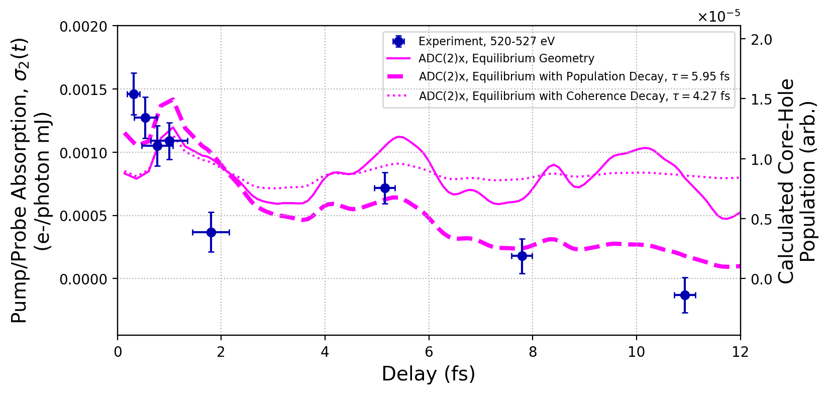
Attosecond electron dynamics
New opportunities in physics
Charge migration damping in aminophenol
Resonant x-ray excitation of nuclear clock isomer ⁴⁵ Sc
Charge migration and electron-nuclear coupling in glycine Science Advances 8 eabn6848 (2022)
Isolated attosecond pulses Nature Photonics 14 30 (2020)
Impulsive stimulated x-ray Raman scattering PRL 99 073203 (2020)
Core electronic wavepacket dynamics Science 375 285 (2022)
Nature 622 471 (2023)
New tools to reveal electron dynamics, electron-phonon and photon-electron coupling in molecules, metals, semiconductors, dielectrics, 2D materials, liquids and amorphous systems
Future opportunities to explore fundamental physics eg: strong field QED, CP violations, axions, dark matter
Notes:
Probing the hole following x-ray ionisation of glycine we observe both oscillatory charge migration and evidence of vibronic coupling. A near transform limited 3 fs pulse enabled the temporal and energy resolution needed for this measurement.

Slide 12
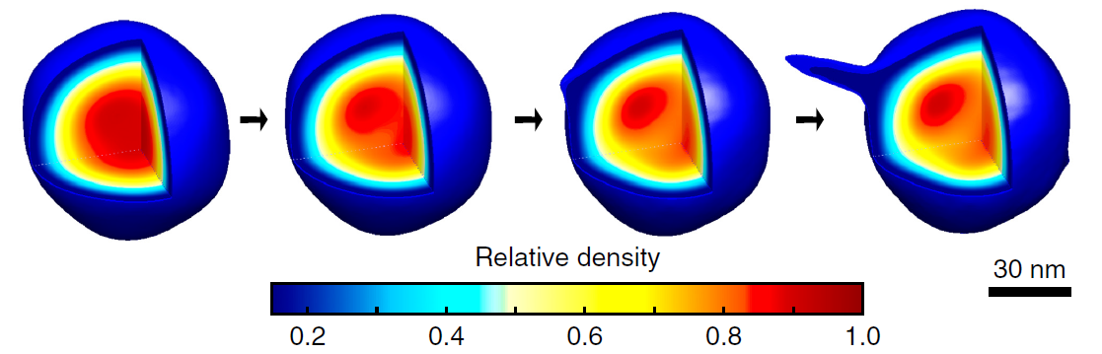
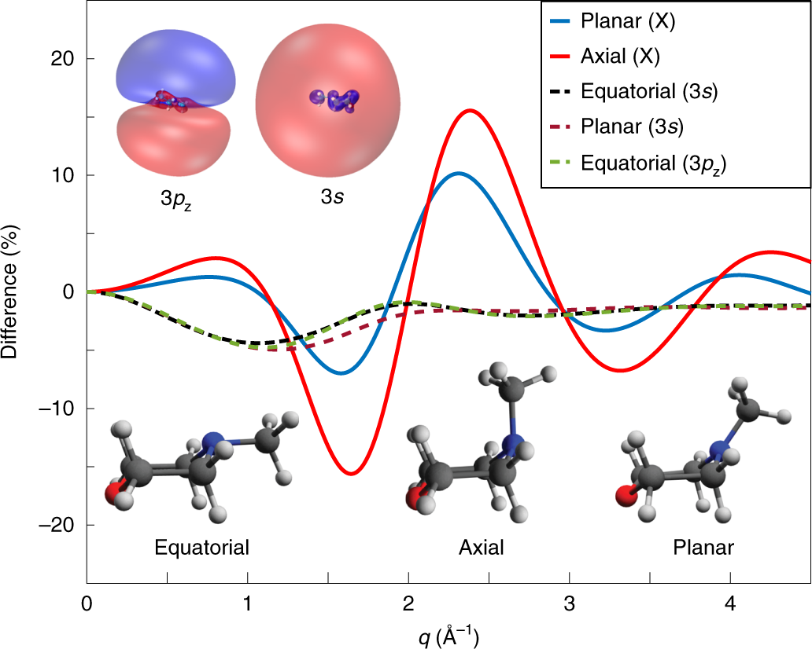
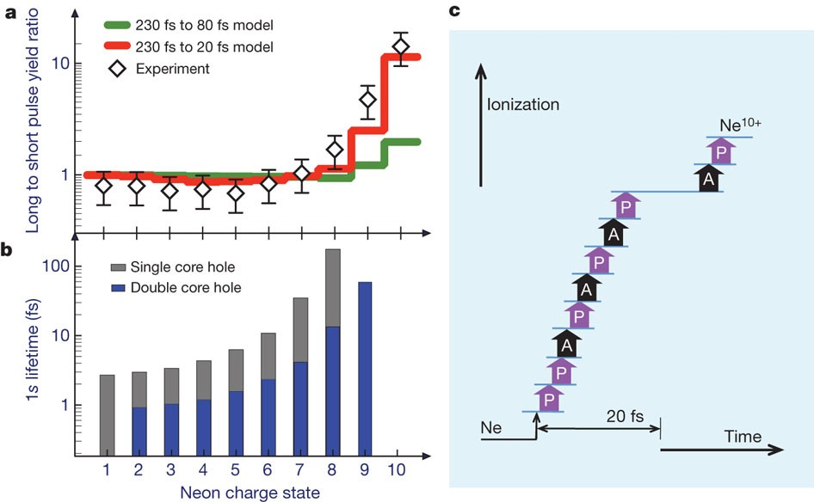
X-ray - matter interaction
New directions in x-ray scattering
Future XFEL Science Highlights for Physical sciences:
X-RAY NON-LINEAR REGIME
Conformational dynamics from data driven approaches
Nature Methods 14 877 (2017)
Ultrafast coherent dynamics in isolated molecules
Nature Chemistry 11 716 (2019)
Response to ultra-intense X-rays –
Nature 466 56 (2010)
Interaction with liquids Nature Physics 12 966 (2016)
Ultrafast radiolysis Science 367 179 (2020)

Slide 13
2.1 Future Opportunities for Physical Sciences
Future XFEL Science Highlights in Physics and X-ray Photonics
New linear and non-linear x-ray spectroscopies
  Probe dynamics, charge, and energy transfer in matter
    (intense, high rep-rate, attosecond pulses, soft to hard x-rays, multi-colour x-rays)
Sensing chirality and tracking chiral dynamics
(ultrafast pulses, polarisation control, high rep-rate, soft x-rays)
Biomolecular and nanosystems
  Conformational dynamics across wide spatial and temporal scales
  (high rep rate, hard x-rays)
Extreme x-ray interaction with matter and vacuum
  X-ray nanoscale high fields, formation virtual electron-positron pairs
    (high rep-rate/high intensity/hard x-rays)
Material processing
  New opportunities with atomic scale resolution/atomic specificity (nanofocusing, high rep-rate, short pulses)

Slide 14
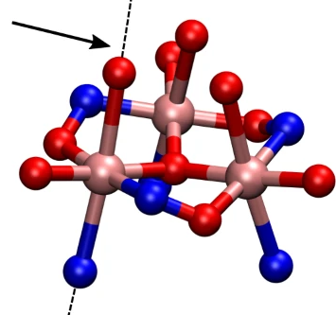
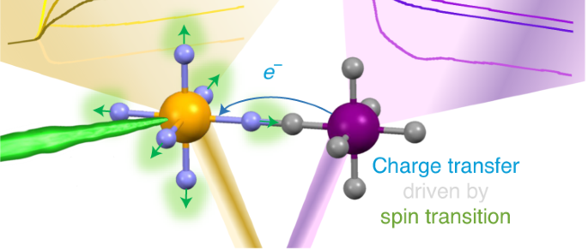
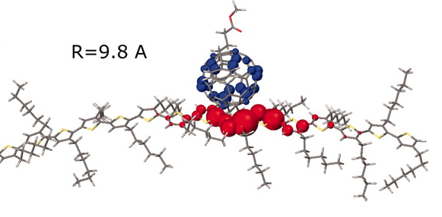
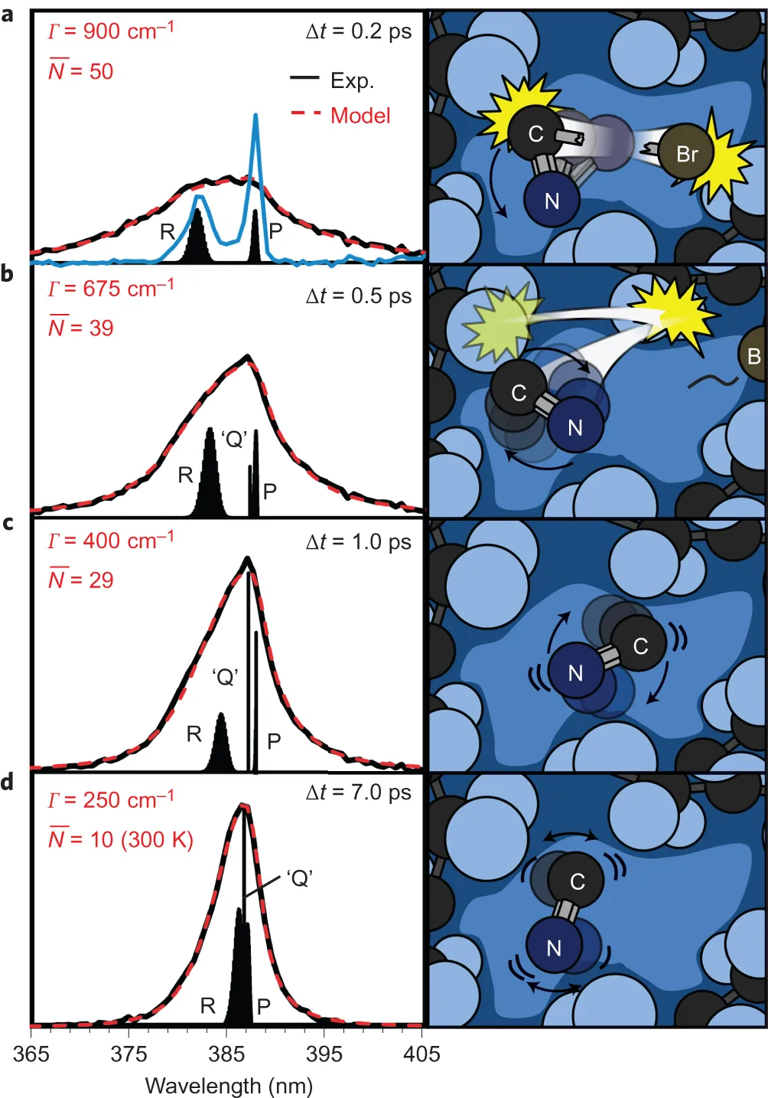
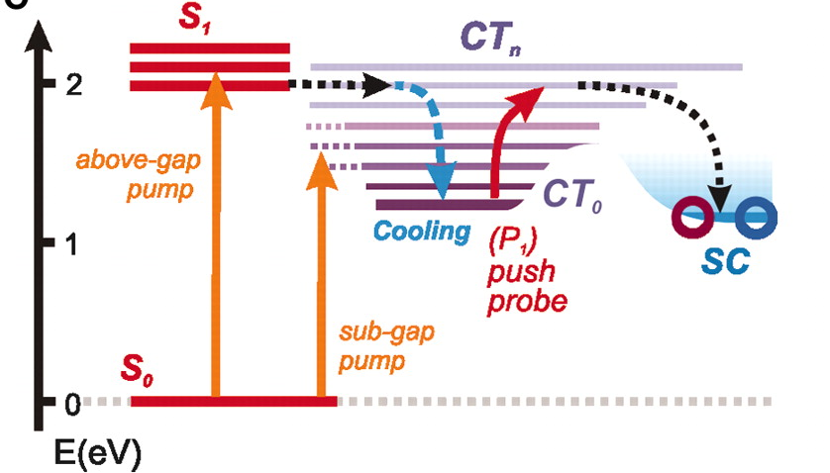
2.2 Chemical Sciences, Catalysis, Energy
Dynamics of transient electronic coherence (e.g. attosecond X-Ray Raman)
Spin dynamics
Charge-transfer dynamics
Charge transfer driven by
ultrafast spin transition
in a CoFe Prussian blue analogue. Nature Chem 2021, 10.
Vibrational coherence in
single-molecule magnets, «Mn₃»
Nature Chem. 2020, 452
Phys Rev Lett 2015, 115, 19003
Solvent-Solute interactions dynamics
Exciton Dynamics
The science question:
Fundamentals of reaction dynamics, the interplay of spin, charge, structure.
Science 2012, 335, 1340
Nature Chem.2016, 242

Slide 15
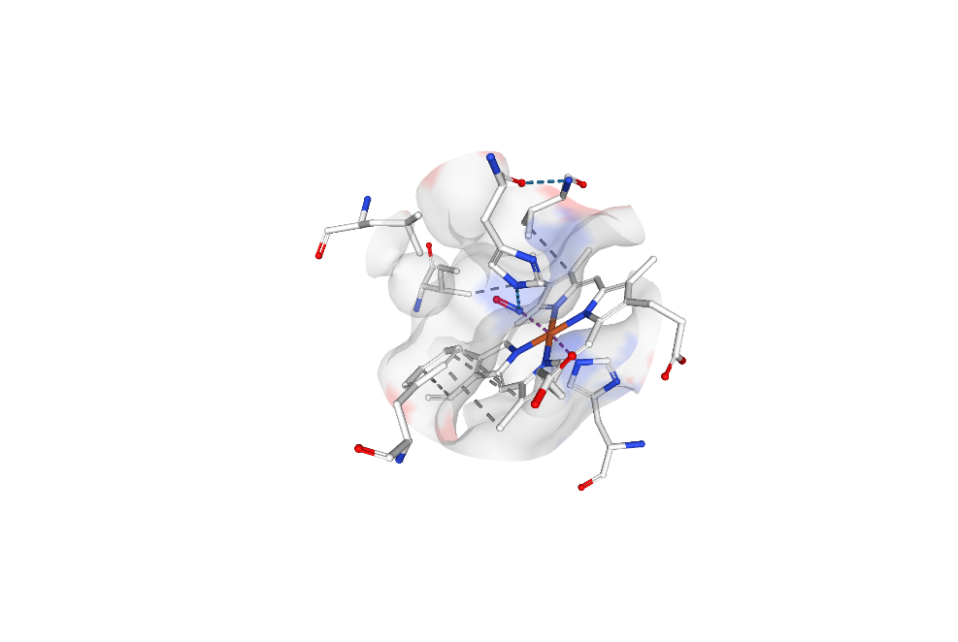
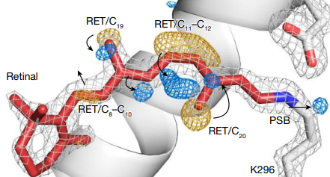
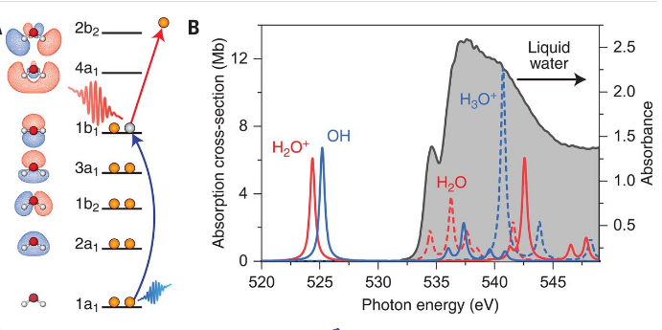
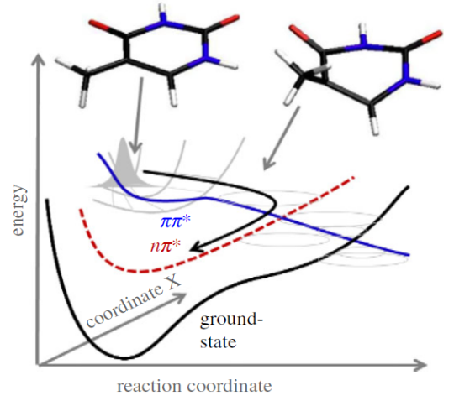
Recent work (1): Towards molecular movie in chemistry and biochemistry
Correlated spin & structural dynamics
Observation of the fastest chemical processes in the radiolysis of water
Ultrafast structural changes direct the first molecular events of vision
The dissociation / recombination of NO to Fe-centre in Myoglobin
[Nat. Comm. 11, 4145 (2020)].
Photochemistry of DNA
TR-AES and TR-NEXAFS reveal relaxation
paths of
UV-populated excited states
Time-resolved Serial Femtosecond Crystallography reveals:
retinal has isomerized <1 ps after rhodopsin photoactivation
[Nature, 615, 939 (2023)].
Ultrafast x-ray pulses established compelling evidence for the formation of H₂O⁺ and its decay to an OH-radical by a proton transfer mechanism
[Science, 367, 179 (2020)].
[Nat. Comm. 8, 29, (2017)]

Slide 16
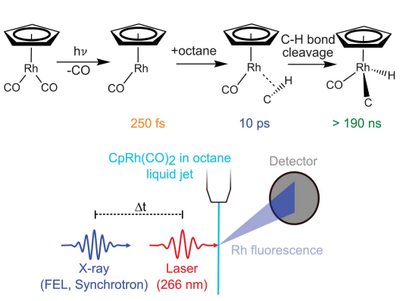
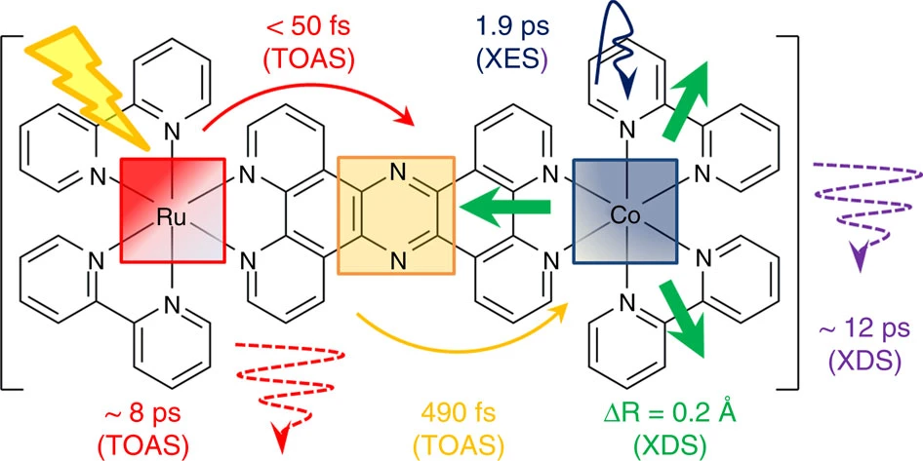
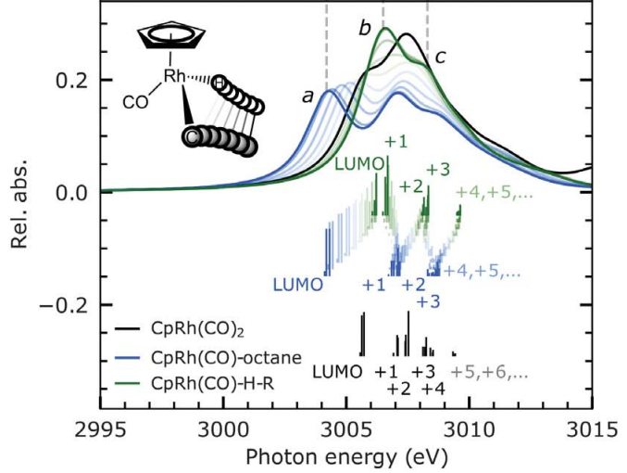
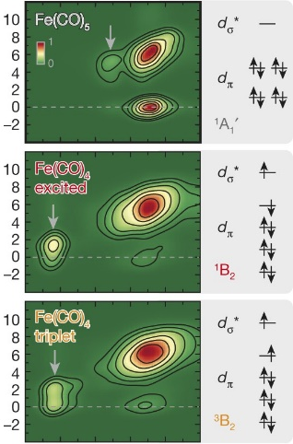
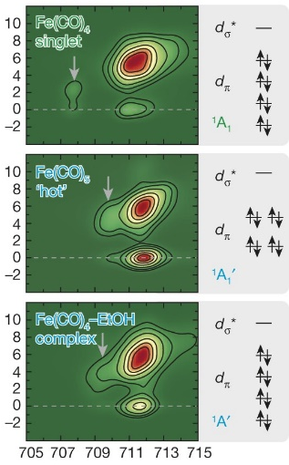
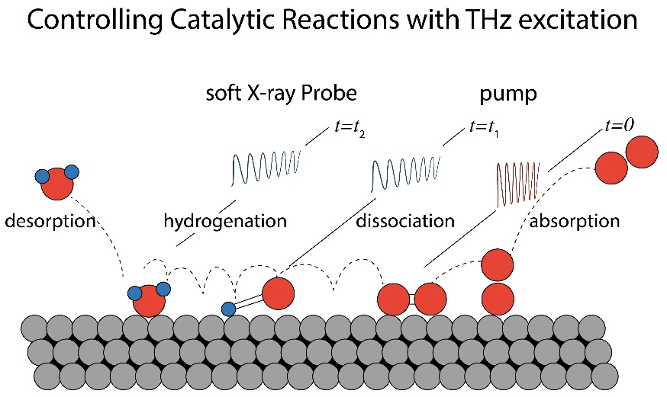
Recent work (2): Fundamentals of reaction dynamics:
Coupling between nuclear, electronic and spin degrees of freedom
Spin Dynamics & Magnetism
Photocatalysis, Enzyme catalysis
Homogeneous catalysis
Vibrational coherence in single-molecule magnets
[Nature Chem. 452 (2020)]
UV, IR, THz, e-beam
Element- and site-specific probing:
Time-resolved RIXS at the Fe L₃ edge, Fe(CO)₅
Energy transfer, eV
Controlling catalytic reactions with THz excitation
Incident energy, eV
Tracking C–H activation with orbital resolution provides opportunities for manipulating C–H reactivity in transition metals [Science 380, 955 (2023)]
Orbital-specific mapping of the ligand exchange dynamics of Fe(CO)₅ in solution [Nature 520, 78 (2015)]
[Chem Phys Lett 675, 145 (2017)]

Slide 17

2.2 OUTLOOK: Chemical Sciences and Energy with XFELs: fs, <0.01 Å, real-time “movie”
Chemistry: all states of matter, decades of time-scale and energies,
and dimensions from atomic to protein to whole organisms.
detector
pump
pump
t, fs
pump
detector
detector
probe
probe
probe
probe
Predict and control photochemical reactions
Fundamentals of reaction dynamics: nuclei, electrons and spin
Exploring complex energy landscapes through chemical activation
Energy materials and devices
(Photo)(electro)catalysis in operando
Environment: aerosols, space, combustion, corrosion
Photodynamics in biomolecules, therapies, diagnostics
Game-changing opportunity:
Combine X-rays with
e-beam, VUV, UV, Vis, IR, THz excitation and detections:
mix-and-match, multicolour, multi-parameter space,
multidimensional methods

Slide 18
2.3 Opportunities for Life Sciences
Major Life Science use case include:
Atomic resolution structures of biomolecules w/o X-ray dependent artifacts via serial femtosecond crystallography (SFX) methods using nano- to microcrystal slurries.
Obtaining deep functional insights through time-resolved crystallography, scattering, and/or imaging of biomolecules in crystalline and/or solution states that can also be correlated with spectroscopy derived from the same sample and X-ray pulse.
The Era of Dynamic Structural Biology (at XFELs & synchrotrons)
NEW SCIENCE
NEW CAPABILITY
IMPACT
Time-Resolved SFX / SSX
General and Widespread
High Temporal (fs) and Spatial (~ 1 Å) Resolutions
Correlated with one/more Spectroscopies (tr-XES …)
High rep. rate detectors → more time points / Rxn
Spatially Resolved Anomalous Dispersion → status of intermediates
SASE -vs- Seeded → tr-SFX ± tr-XES ± ΔE across metal(s) absorption edge(s)
Stop-motion movies of functional systems
Detailed mechanistic insights, less ambiguity
New drugs, therapies
New catalysts for global energy challenges

Slide 19
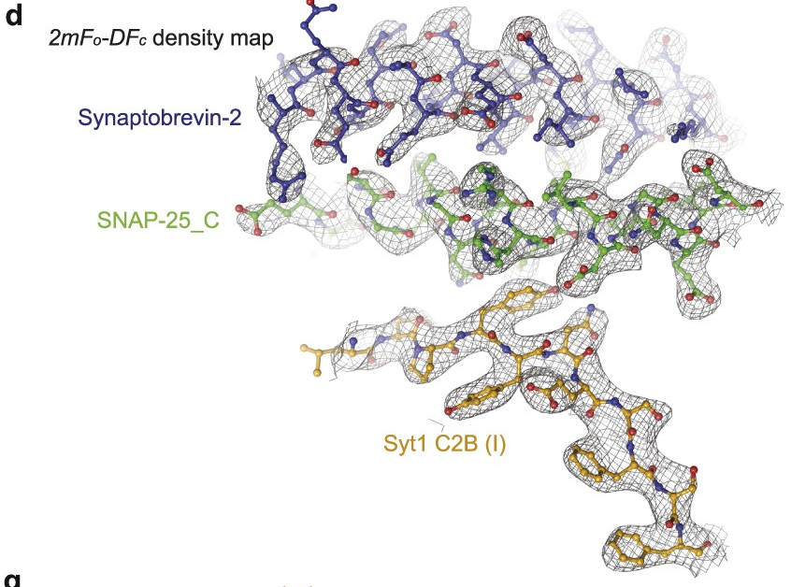
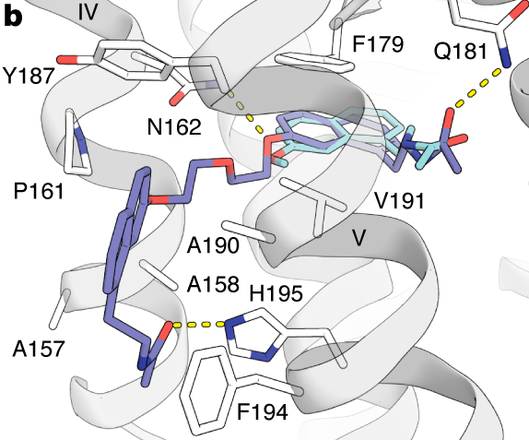
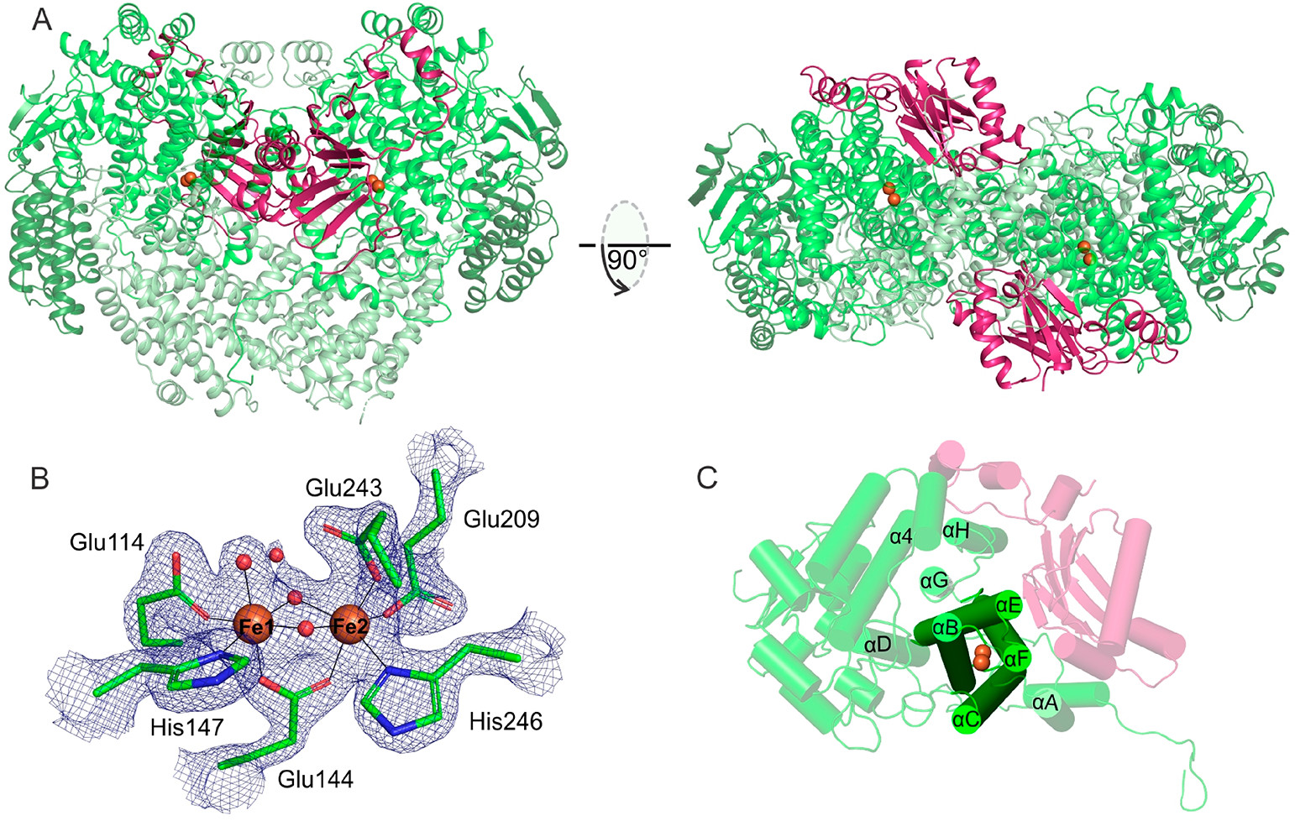
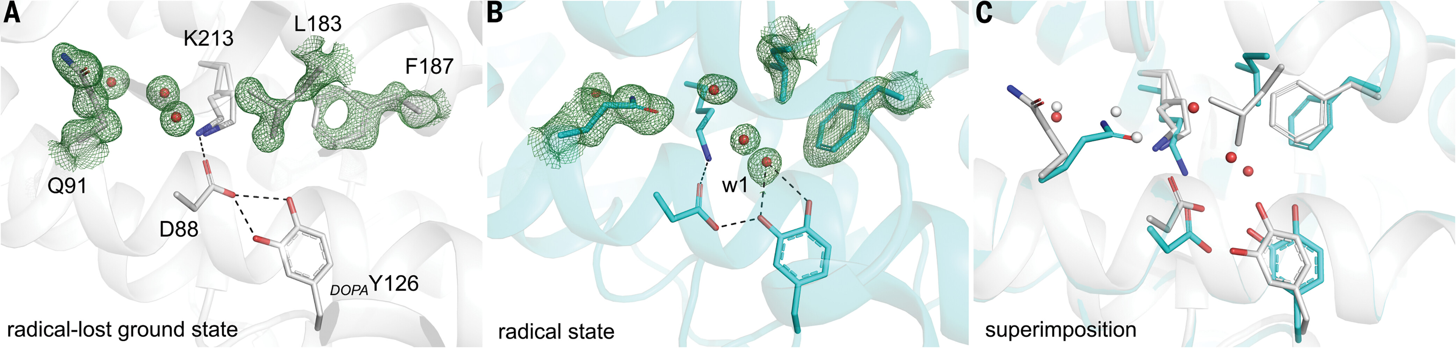
Atomic resolution structures w/o artifacts
Stauch et al (2019) Nature 569, 284-288
Structural basis of ligand recognition at the human MT1 melatonin receptor
Architecture of the synaptotagnmin-
SNARE machinery for neuronal exocytosis
Structure of methane monooxygenase
Zhou et al (2015) Nature 525, 62-67
Structure of a ribonucleotide reductase R2 protein radical
Srinivas et al (2020) J Am Chem Soc 142, 14249-14266
Lebrette et al. (2023) Science 382, 109-113
Notes:
Lebrette, H. et al. Structure of a ribonucleotide reductase R2 protein radical. Science 382, 109-113, doi:10.1126/science.adh8160 (2023).
Srinivas, V. et al. High-Resolution XFEL Structure of the Soluble Methane Monooxygenase Hydroxylase Complex with its Regulatory Component at Ambient Temperature in Two Oxidation States. J Am Chem Soc 142, 14249-14266, doi:10.1021/jacs.0c05613 (2020).
Stauch, B. et al. Structural basis of ligand recognition at the human MT1 melatonin receptor. Nature 569, 284-288, doi:10.1038/s41586-019-1141-3 (2019).
Zhou, Q. et al. Architecture of the synaptotagmin-SNARE machinery for neuronal exocytosis. Nature 525, 62-67, doi:10.1038/nature14975 (2015).
d–f, Representative 2mF_{o} − DF_{c} electron density maps of the Ca²⁺-bound Syt1–SNARE complex in the long unit cell crystal form using diffraction data collected at the LCLS XFEL.
Ishigami, I. et al. Detection of a Geminate Photoproduct of Bovine Cytochrome c Oxidase by Time-Resolved Serial Femtosecond Crystallography. J Am Chem Soc 145, 22305-22309, doi:10.1021/jacs.3c07803 (2023).

Slide 20
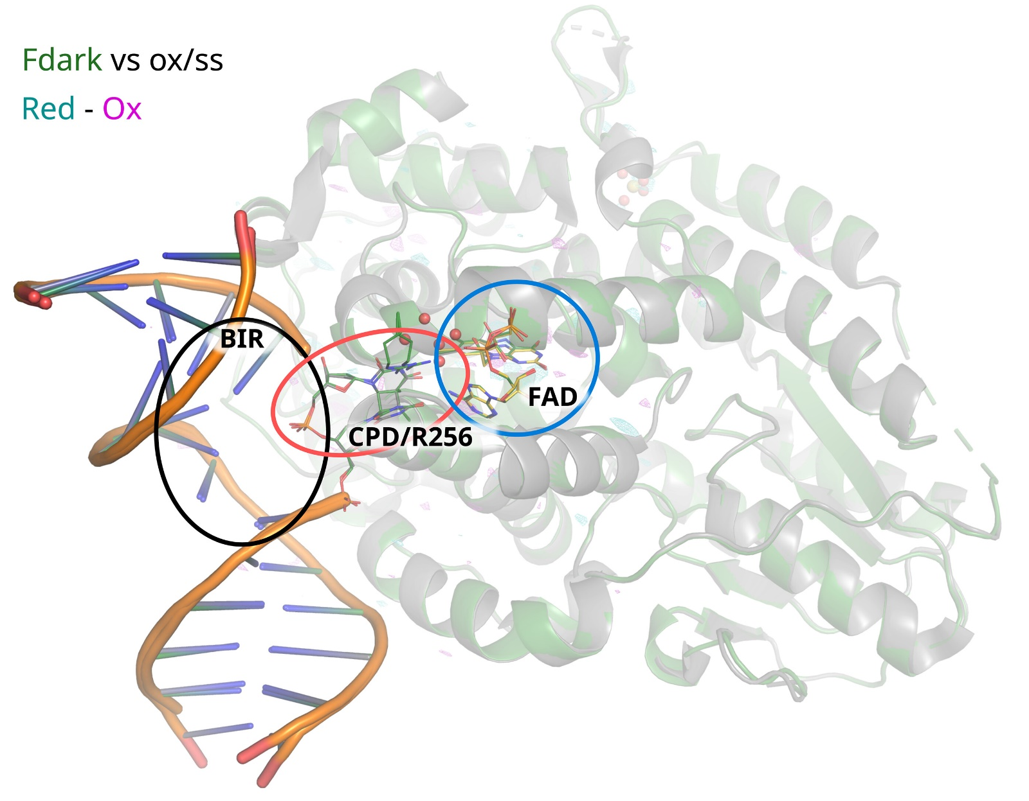
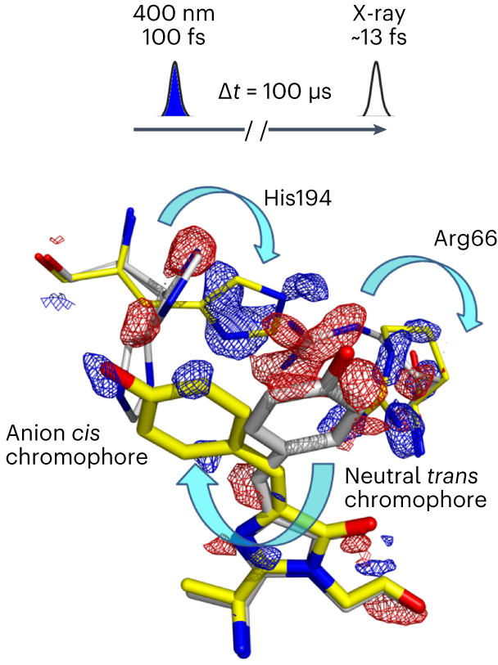
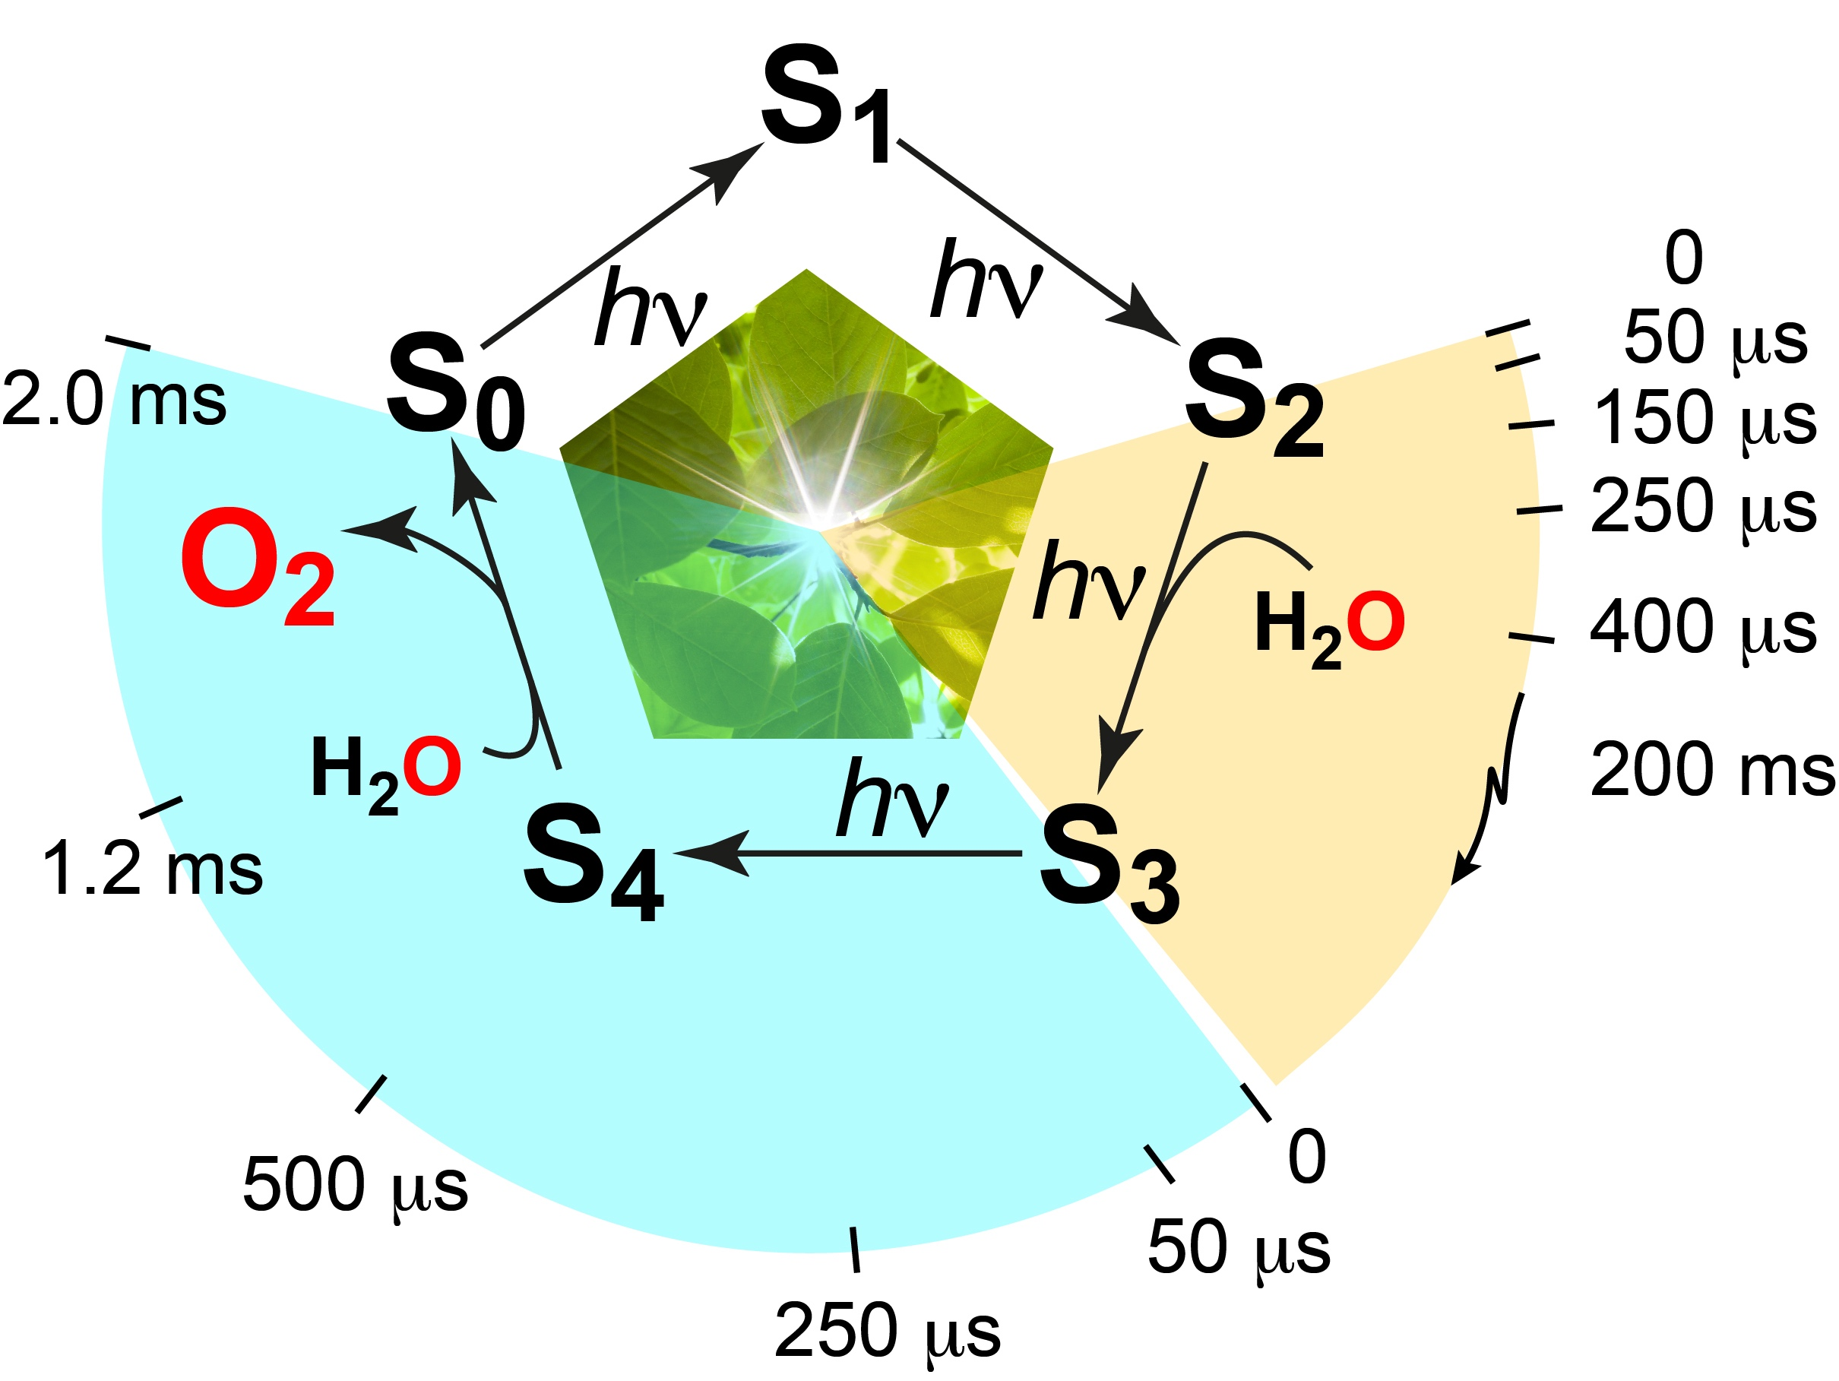
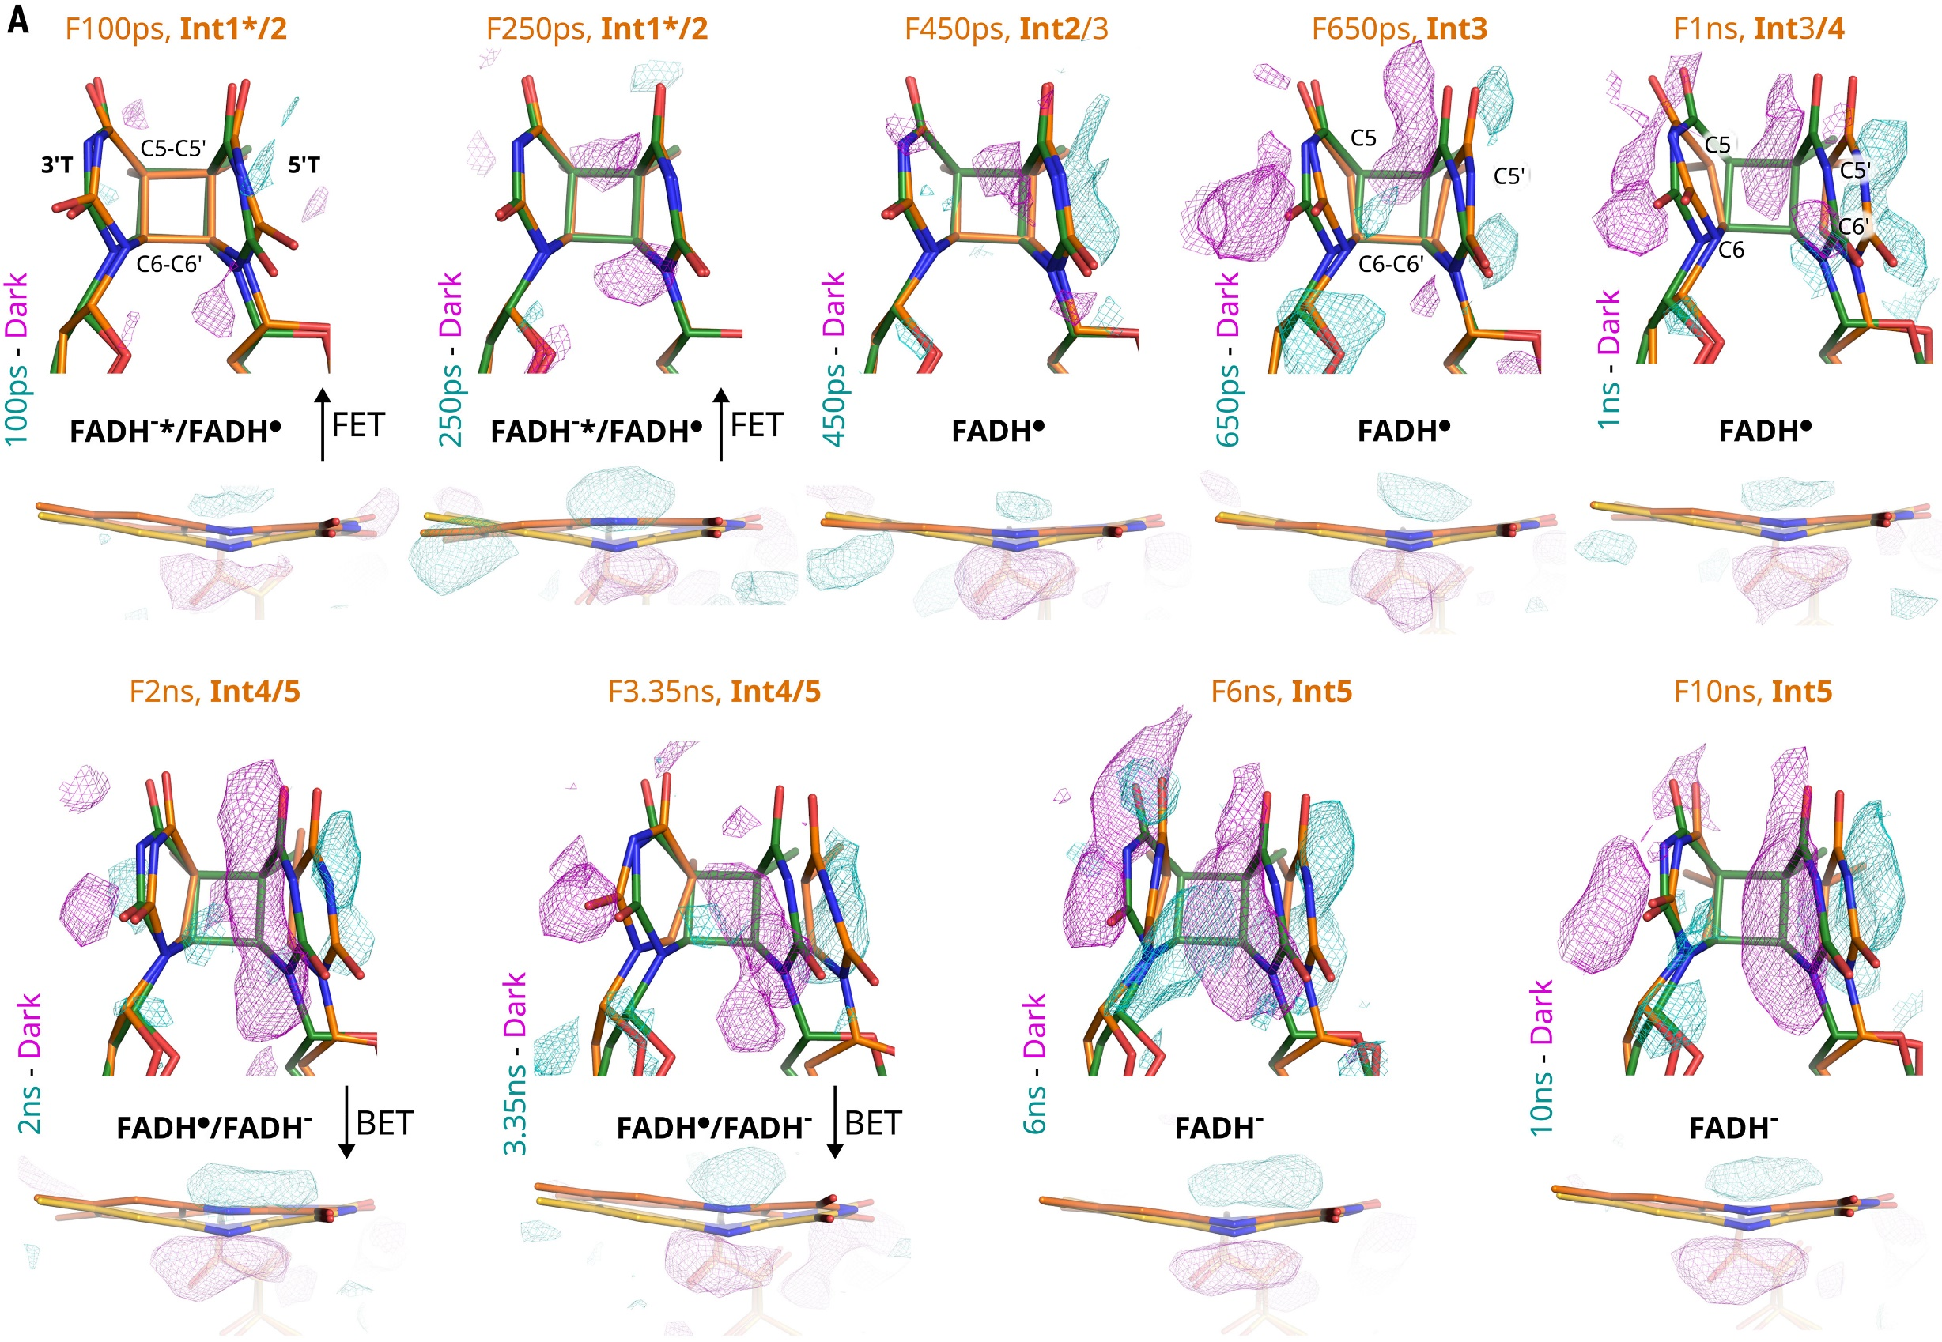
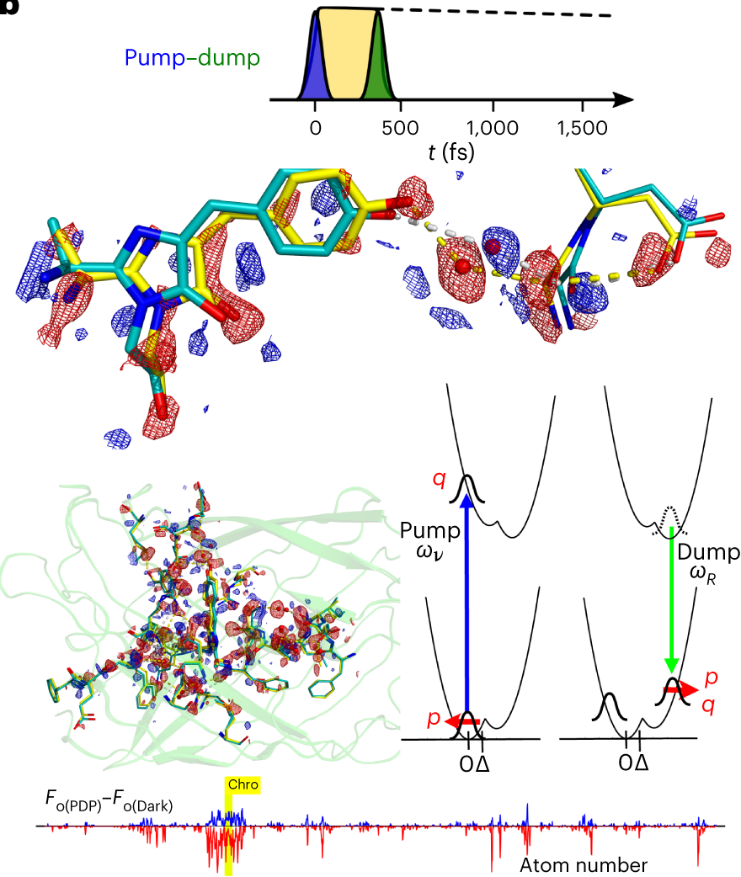
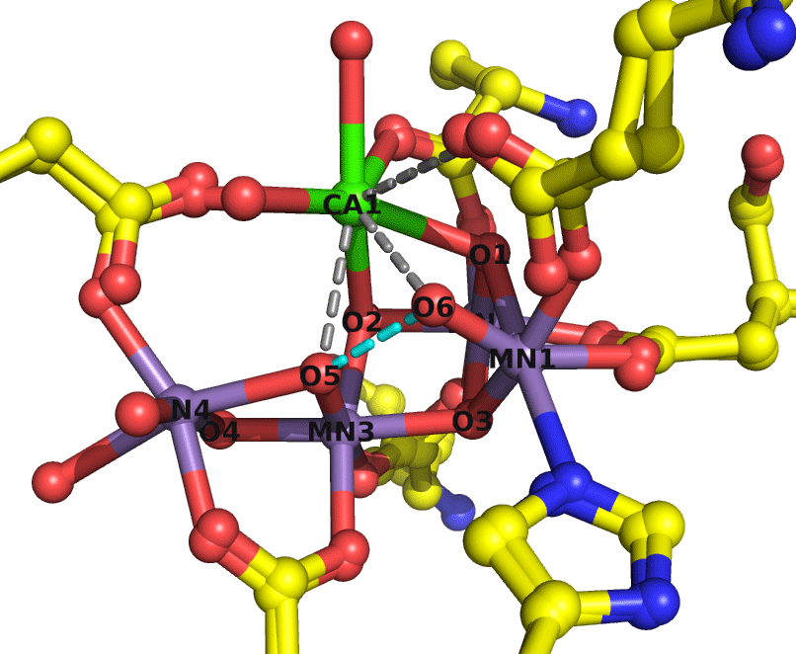
Dynamic structural biology
Optical control of ultrafast structural dynamics in a fluorescent protein.
Pump
Visualizing the DNA repair process at atomic resolution
Structural evidence for intermediates during O₂ formation in photosystem II
Pump - Dump
S₃
Hutchison et al
(2023)
Nature Chem.
12, 1607
Maestre-Reyna et al (2023) Science 382, eadd7795
Kern et al (2018) Nature 563:421
Bhowmick et al (2023) Nature 617:629
Notes:
Time-resolved crystallography measurement of trans–cis photoisomerization of the off state
Hutchison, C. D. M. et al. Optical control of ultrafast structural dynamics in a fluorescent protein. Nat Chem, doi:10.1038/s41557-023-01275-1 (2023).
Maestre-Reyna, M. et al. Visualizing the DNA repair process by a photolyase at atomic resolution. Science 382, eadd7795, doi:10.1126/science.add7795 (2023).

Slide 21
2.3 Future Opportunities for Life Sciences
Future XFEL Science Highlights in Physics and X-ray Photonics
High throughput SFX enabling new structures for life-sciences and pharma
    (high rep-rate x-rays, matched rep-rate of detectors and sample deliver
High data volume CDI and tomographic XRD
(average x-ray flux orders of magnitude higher than DLS II, nanofocusing)
Conformational dynamics in viruses and sub-cellular assemblies
  (high rep rate, hard x-rays)
Mapping drug activity in real time
    (high rep-rate/high intensity/hard x-rays)
Dynamic structural biology capturing dynamics across many timescales
(high rep-rate x-rays, samples and detectors, synchronised laser and activation sources)
Radiation biology and medicine
(hard x-rays synchronised to soft x-rays, electron, proton and ion pulses)
“… all things are made of atoms; everything that living things do, can be understood in terms of the jigglings and wigglings of atoms.”
Richard P. Feynman
Lectures on Physics Vol 1, Chapter 3, © 1963
New XFELs enable three transformations:
From overwhelming data to useful information;
From static “structures” to dynamic objects;
From jiggling objects to purposeful function.
Abbas Ourmazd (16 Jan 2023)

Slide 22
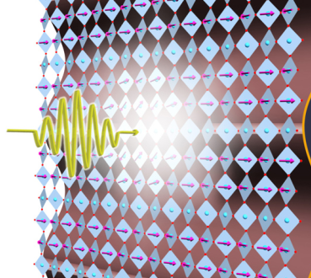
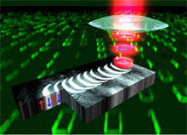
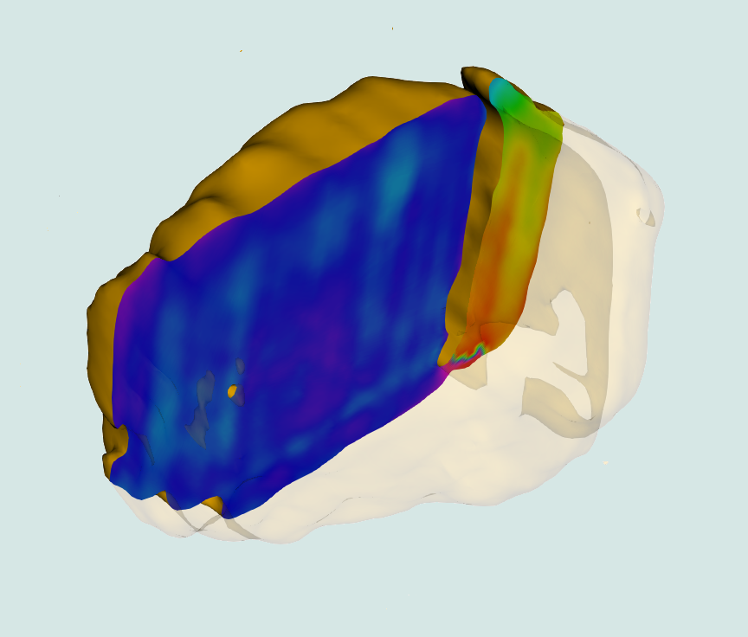
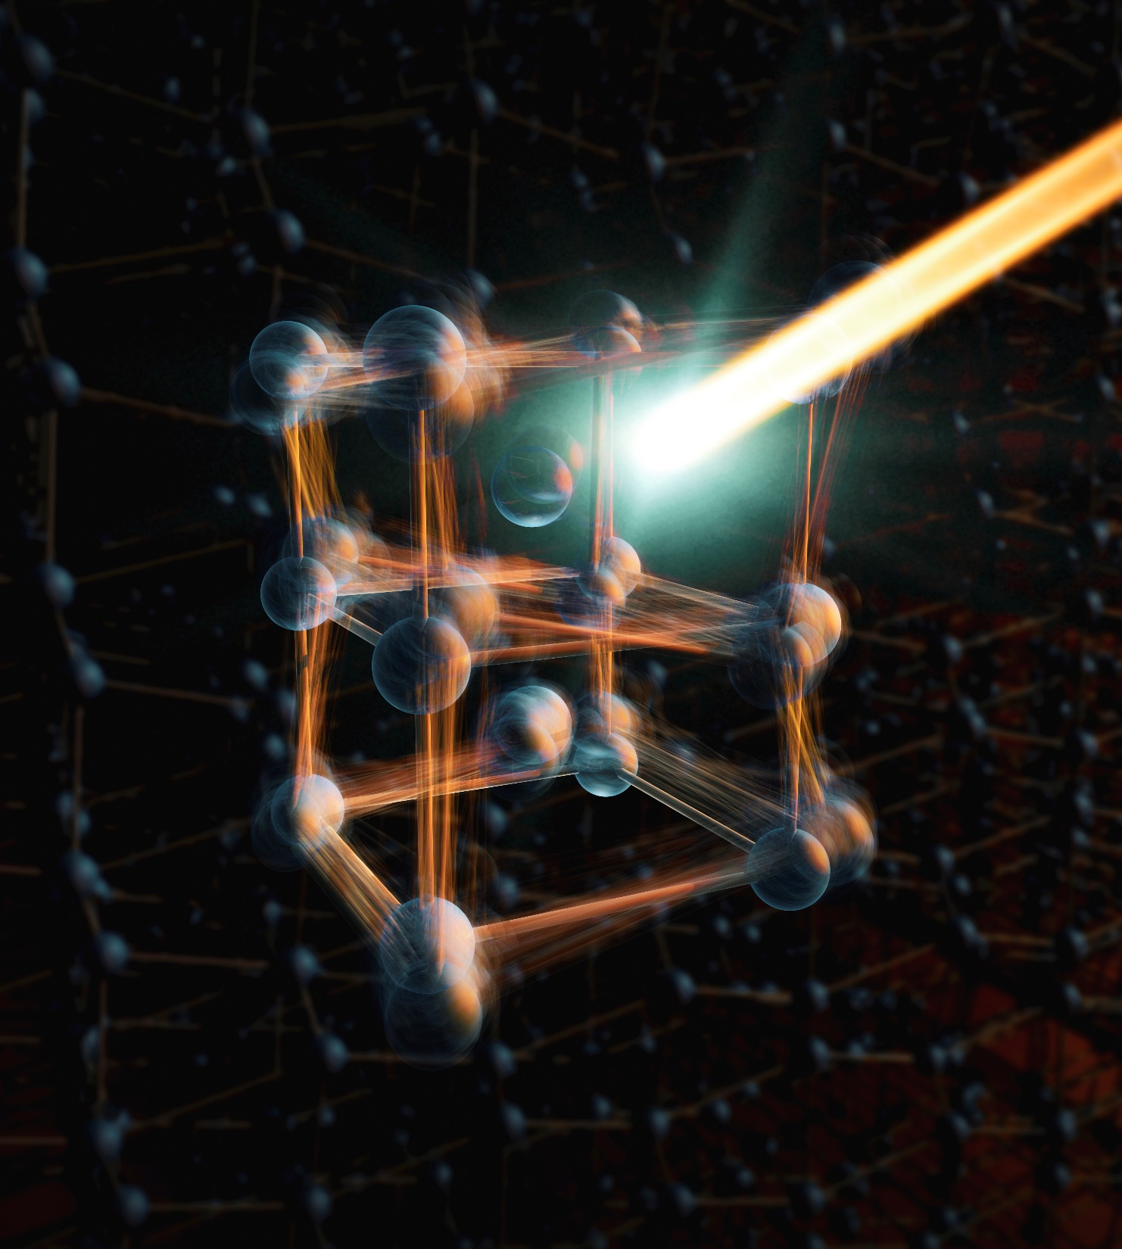
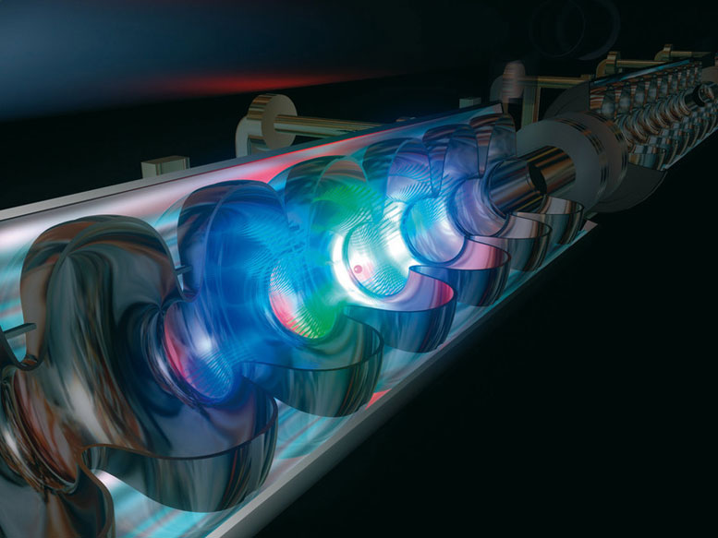
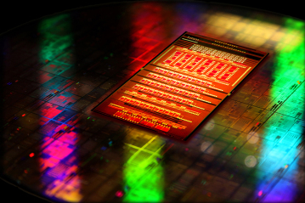

2.4 Condensed Phase, Quantum Materials and Nanotechnology :
Dynamics in
2D Materials
Ultra-fast
Magnetism
Dynamics in
Nanomaterials
Light-induced
Phases
XFEL
Ultra-low
power storage
All Optical
Computing
Notes:
Overview slide indicating the main challenges in the area that XFELs are addressing.
Ultrafast Magnetism:
Excited & transient states. Order-disorder interplay. Hidden phases.
Time-varying characteristics of magnetic domains: size domain wall migration, etc.
Structural Dynamics & Light-induced Phases in Quantum Materials:
How light mediates subtle pm changes atomic displacements.
Origin, ubiquity of CDW instabilities.
Charge and lattice fluctuations in high temperature superconductors.
Dynamics in Nanomaterials in 3D:
Image structural phase transitions (SPTs) in 3D.
Transient phonon behaviour in 3D.
Electronic Dynamics in Quantum Materials:
Probing momentum-space electronic structure.
Disorder in Quantum Materials:
Orbital degeneracy lifting by probing local order (Tr-PDF)

Slide 23
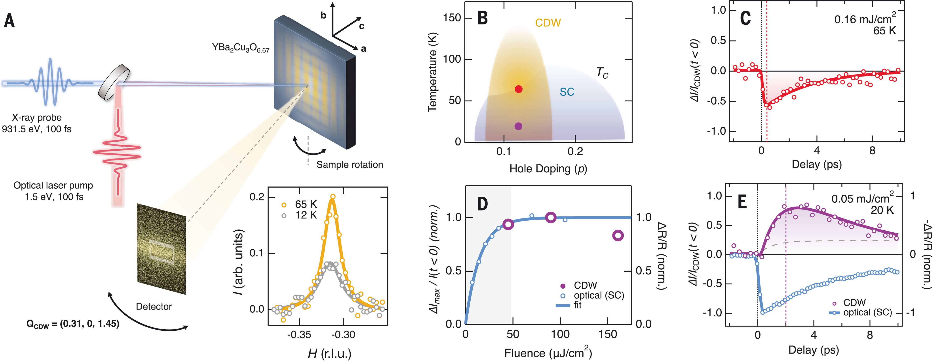
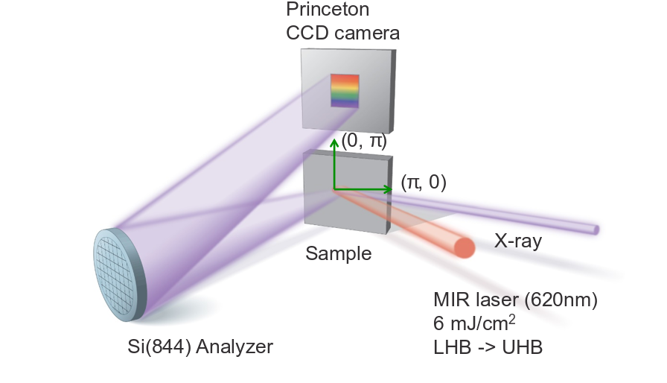
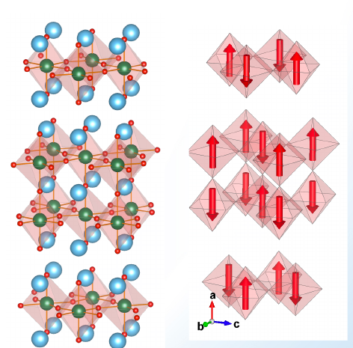
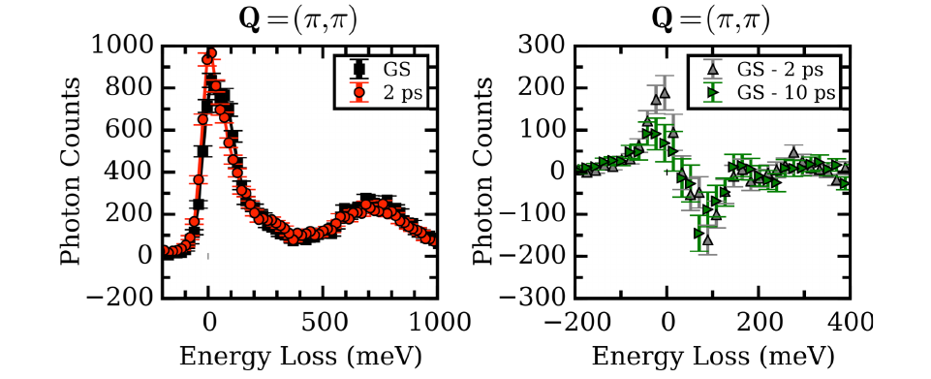
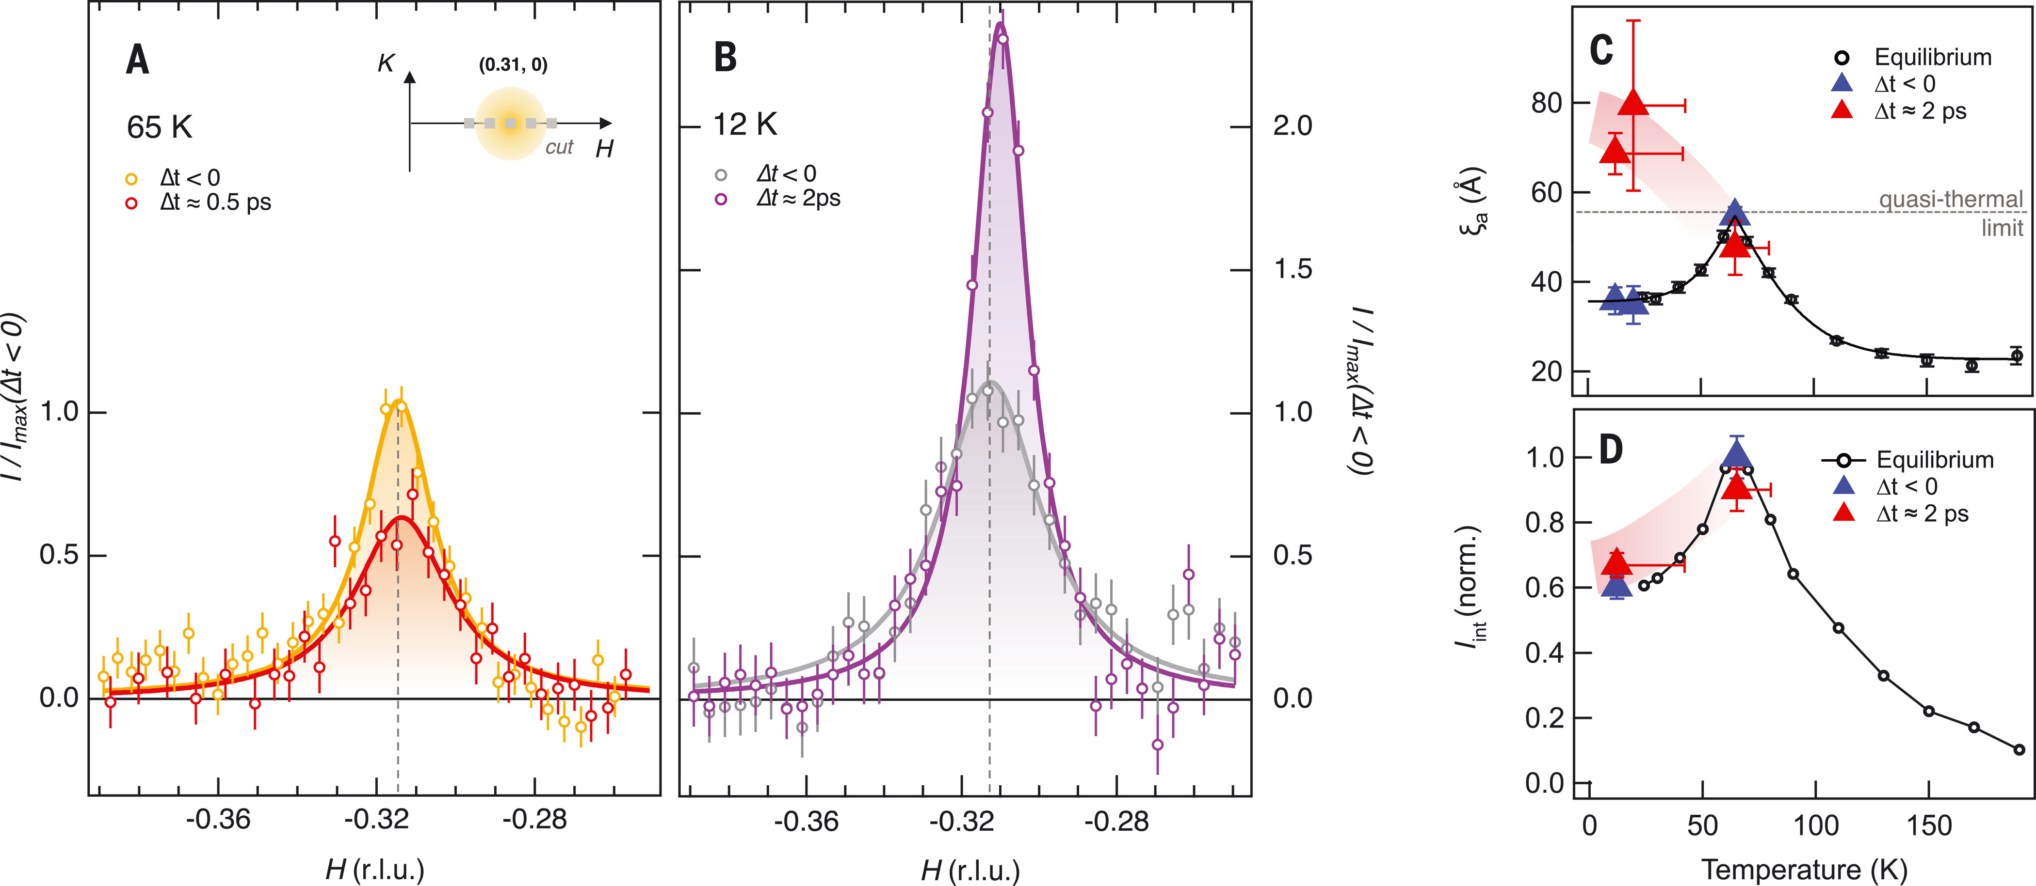
Recent work (1):
Time-resolved Resonant Inelastic X-ray Scattering (Tr-RIXS)
Laser pump, X-ray probe of Superconductivity and CDW Interactions
Tr-RIXS resolves spin, orbit charge contributions in magnetic materials out of equilibrium.
Superconductivity stabilises CDW topological defects that are removed by suppressing superconductivity.
R. Mankowsky et al. Nature 516, 71-73 (2014)
S. Wandel et al., Science 376, 860 (2022)
M. P. M. Dean et al., Nature Materials 15, 601–605 (2016)
Notes:
Examples of prominent recent work (1).
1) Tr- RIXS
- Tune to magnetic (L) edge of Material (Strontium Irridate)
- Perform a grazing incidence asymmetric scattering experiment to capture inelastic scattering.
- Resolves spin, orbit charge contributions in magnetic materials out of equilibrium.
- Would like to see higher energy resolution.
2) CDW & Superconductivity
- Simultaneously measure both CDWs and superconductivity on the same sample under similar excitation conditions
- Ultrafast laser pulses enable selective quenching of orders, thereby inducing an enhancement of the competing orders.
- Result indicate that superconductivity stabilizes CDW topological defects that are removed by suppressing superconductivity.

Slide 24
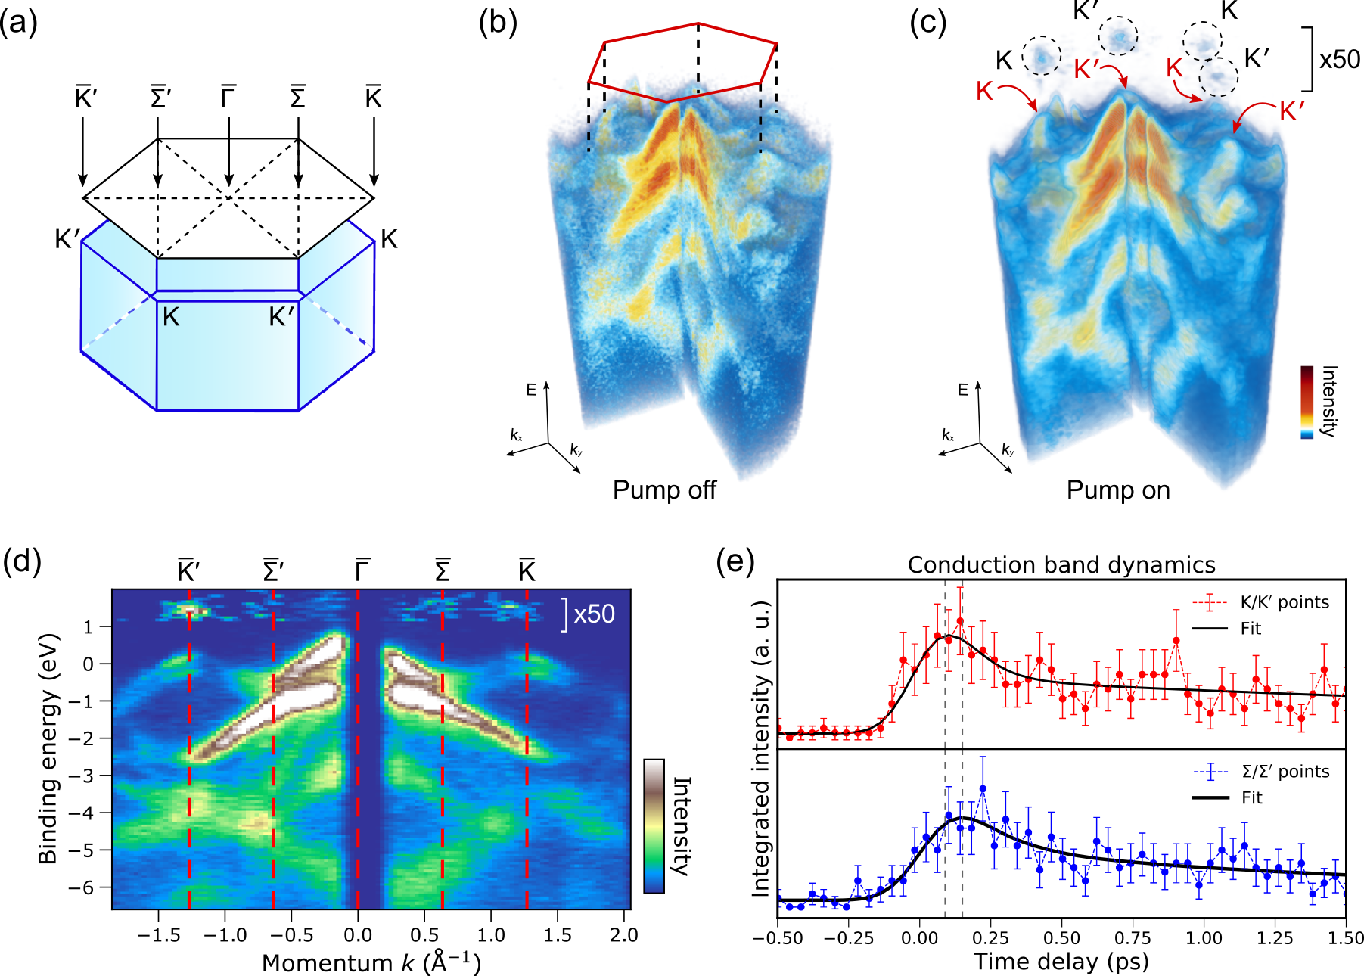
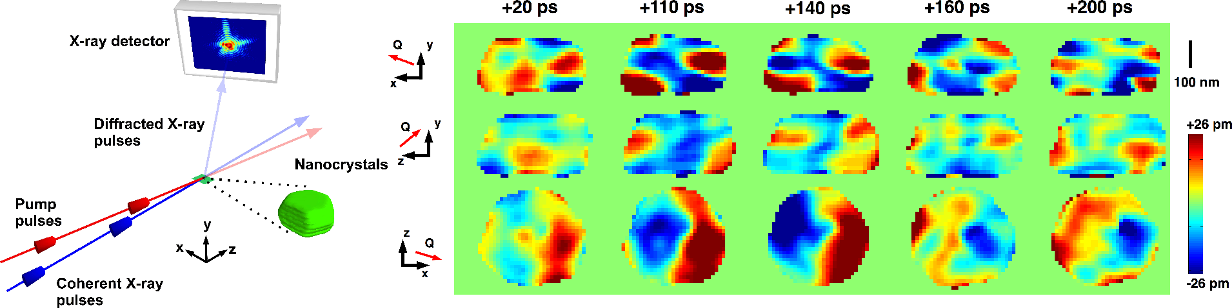
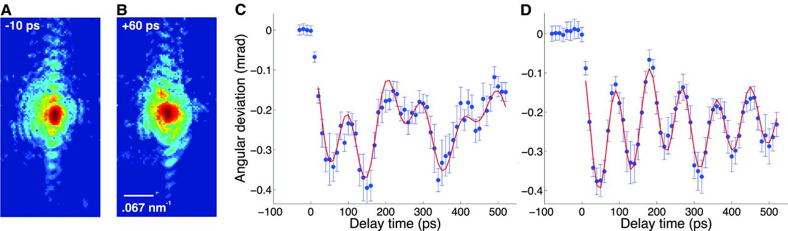
Recent work (2):
Time-resolved Bragg Coherent Diffraction Imaging (Tr-BCDI)
Photoelectron Momentum Microscopy of 2D Material
3D images of acoustic phonons in a nanocrystal. Orthogonal cut planes through the nanocrystal showing the projected displacement as a function of delay time.
Combining valence-band and core-level spectroscopy with photoelectron diffraction for electronic, chemical, and structural analysis.
J.N. Clark et al. Science 341, 56–59 (2013)
D. Kutnyakhov, et al., Rev. Sci. Instrum. 91 (1): 013109 (2020)
Notes:
Examples of prominent recent work (2).
- Tr-BCDI:
3D imaging technique providing atomic displacement information with angstrom sensitivity.
3D images of acoustic phonons in a nanocrystal. Orthogonal cut planes through the nanocrystal showing the projected displacement as a function of delay time.
- Photoemission Momentum Microscopy:
(a) Brillouin zone of WSe2. [(b) and (c)] Volumetric rendering of the band-mapping measurement outcome before (b) and after (c) optical excitation with 775 nm pulses. The
data from one quadrant are cut out to reveal the dispersive electronic bands on the inside. (d) A momentum path sampled through the volumetric data along the K′–Γ–K
momentum path labeled in (a). The vertical cut-out around 0 Å−1 in (d) removes the influence from the edges of the quadrant detector. (e) Temporal evolution of the excited
state signal integrated over a region around the K/K′ and Σ/Σ′ points in the first conduction band.

Slide 25
2.4 Outlook
Ultrafast Magnetism:
  Femto/atto second pump-probe scheme in THz/mid-IR to couple to phonon modes.
Imaging Dynamics in Nanomaterials:
  Femto/atto second time-resolution to unambiguously probe each stage during a structural phase transition in three-dimensions.
Electronic Dynamics in Quantum Materials:
  Access to electronic dynamics in the time-domain with atto second time resolution.
Disorder in Quantum Materials:
  Probing disorder in broad range of materials with femto/atto second
  time resolution.
  Utility of high energy x-rays, for time-resolved pair distribution function (tr-PDF) measurements upto 50 keV.
Notes:
Outlook slide predicting where a next generation XFEL will have further impact.

Slide 26
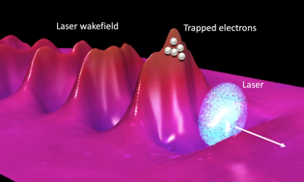
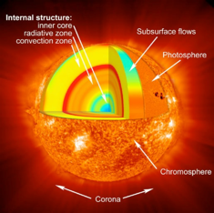

2.5 Matter at Extreme Conditions
Shocked materials and matter at extremes
Interactions with energetic electron and ion beams
Quantum plasmas: warm and hot dense matter
Even more extreme conditions at a spherical compression facility

Slide 27



Shocked materials and matter at extremes
At extreme pressures matter undergoes complex low-symmetry phase transformations including melting. Understanding this behaviour is important for many different scientific fields
Melting at extreme pressures
Understanding planetary interiors
Novel material synthesis
Shock-induced melting in tin
Partial dissociation of C-H in Neptune and formation of diamond
Observation of metastable phase in bismuth
Briggs et al., APL, 115, 264101 (2019)
Kraus et al. Nat. Ast. 1, 606 (2017)
Gorman et al., APL 114 120601 (2019)
Dynamic strength of materials
High strain rate phenomena
Twinning in dynamically compressed tantalum
Response of silicon to uniaxial compression
Wehenberg, et al. Nature, 550, 496 (2017)
McBride et al. Nat. Phys 15, 89 (2019)

Slide 28




Quantum plasmas: warm and hot dense matter
XFEL beams are not just exquisite probes of extreme matter, they can also generate solid density plasmas in the warm to hot dense matter regime
Al solid density plasma at ~150 eV
Inelastic X-ray scattering in warm dense matter
Vinko et al., Nature 482, 59 (2012)
Fletcher et al., Nature Phot. 9, 274 (2015)
Higher X-ray pulse energies and nanofocusing will achieve even more extreme states
X-ray pump probe schemes will allow many X-ray techniques to explore volumetrically heated matter

Slide 29



2.5 Future Directions afforded by a UK XFEL
Interactions with laser accelerated electrons
Even more extremes at a spherical compression facility
High intensity lasers can be used to produce beams of energetic electrons
Creating and studying matter at stellar core and burning plasma conditions will lead to advances in fusion energy and our understanding of the universe.
Laser generated proton and ion beams can be used for in situ damage studies, as well as isochoric heating
The UK has a wealth of expertise in creating diode pumped high rep. rate high intensity lasers and combining these drivers with hard X-rays to investigate matter at extremes

Slide 30
2.6 Initial Science Drivers for Applied and Industrial Research
Key technology challenges that we uniquely address with XFELs include:
Advanced manufacturing technologies – structural dynamics over multiple timescales down to the quantum scale
Catalysis, green chemistry, energy – unravelling photophysical, photochemical and catalytic cycles
Characterising the functional dynamics in new materials – from quantum technology to data storage to energy transmission
Properties of shocked materials for engineering and defence – real-time insight into lattice dynamics and phase transitions
Nucleation, solidification and crystallisation in soft matter – unravelling the dynamics of elementary steps and the trajectories of self-organisation on the potential energy surface
Medicines – nanoscale dynamics of drug-biomolecule interactions, drug-release from formulated medicines and drug interactions enabling effective formulation
UK XFEL Science Case available at xfel.ac.uk
Notes:
1274-WP0-prs-0025-v1.0-UKXFEL Community Slides Extended

Slide 31


Applications to Laser Processing, Energy Materials, Manufacturing
Melt-front dynamics in laser processing
Sci. Advances 6, eaax2445 (2020)
In situ x-ray imaging of additive manufacturing
Nat. Comm. 9, 1533 (2018)
Mix-and-extrude crystallisation dynamics with 3D printed nozzles
J. Appl Cryst 56, 1038 (2023)
Organic photovoltaics
Nat.Comm. 12, 1196 (2021), Nat.Comm. 13, 3414, (2022)
Plasmonic photocatalysis Angew. Chem. 54, 5413 (2015)

Slide 32





Application to Understanding Shocked Materials
SAXS at CXI, LCLS of Laser Shocked Cu foil.
Coakley et al, Sci. Adv., 6(51):eabb4434, 2020.

Slide 33
2.6 Future Impact Includes
xfel.ac.uk
New biomedical technology
Spatiotemporal structure dynamics in biologically relevant and complex systems; for example, peptide and protein (mis)folding
(hard x-rays, high rep-rate, solution scattering and spectroscopy)
Advances in industrial processing
Developing detailed understanding of advanced processes to optimise manufacturing outcomes with the minimum number of empirical trials
(from XUV for gas phase processing & photolithography to hard X-rays, at high rep-rate, and coupled to compact process replicators)
Advancing understanding of nucleation, solidification and crystallization in soft-matter
Spatiotemporal dynamics of phase behaviour and reactions: molecular - mesoscale – macroscopic, capturing rare events, non-crystalline phases, nucleation, liquids.
(0.2 keV to > 40 keV high rep-rate, compact process replication)
Radiation damage mitigation in space and nuclear industry
(high rep-rate x-rays, synchronised to ultrafast lasers, electron, proton and ion beams)
UK XFEL Science Case available at xfel.ac.uk
Notes:
1274-WP0-prs-0025-v1.0-UKXFEL Community Slides Extended

Slide 34
3. Satisfying Future Scientific Research Needs
Transform limited operation across entire X-ray range
Fully resolving dynamics at the combined limits of temporal and energy resolution
High efficiency facility with a step-change in the simultaneous operation of multiple end stations
Expanding access by providing scope for many hundreds of unique experiments every year
Evenly spaced, high-rep rate pulses to match samples & detectors
Enabling the most advanced measurement methodologies whilst supporting high throughput measurements with standard capabilities
Improved synchronisation/timing data with external lasers to < 1 fs
Realising the full temporal resolution to see dynamics unfold across multiple timescales from sub-femtosecond electronic dynamics to nanosecond thermal relaxation and larger scale structural changes
Multiple colour X-rays at one end-station and full array of synchronised sources:
To interrogate specific electronic, vibronic, excitonic etc. modes to completely uncover the complex dynamical pathways and couplings in matter

Slide 35
3. Drivers for Applied and Industrial Research
Contributes to generic national strategic themes
Advancing Technology – through understanding quantum scale structural dynamics
Healthcare – through advancing dynamical structural biology
Frontiers of Knowledge – through access to brightest ultrafast X-ray pulses
Net Zero Growth – through unravelling photo-chemical/catalytic cycles
Economic Strengths – through skills and research outcomes maintaining competitiveness with China, USA and Europe
XFEL based probes of structural dynamics will have transformative impact e.g. in:
Advanced Manufacturing Technologies
Developing & Characterising New Energy Materials for Generation, Transmission & Storage
Catalysis
Properties of Shocked Materials for Engineering and Defence
Developing & Characterising New Materials for Quantum and Information Technology
Nucleation, Solidification and Crystallisation in Soft Matter, Medicines Manufacturing
UK XFEL Science Case available at xfel.ac.uk
Notes:
1274-WP0-prs-0025-v1.0-UKXFEL Community Slides Extended

Slide 36


A Next Generation XFEL
https://www.xfel.ac.uk
Over the next 3 years we will:
Map out how best to deliver the advanced XFEL capabilities identified in the Science Case.
Explore a Conceptual Design for a unique new machine that can fulfil all required capabilities and more.
Examine other investment options in existing XFELs
Update Science Case to inform process and future decisions & we will hold Townhall Meetings around UK
The collaborative effort will be led by a team at STFC Daresbury Laboratory with strong engagement from those looking at the developing science opportunities to inform the design.
Project Sponsor: John Collier
Science Lead: Jon Marangos
Technical Lead: Jim Clarke
Project Manager : Paul Aden

