Slide 1




UK XFEL
Plymouth Townhall
Fundamental Physics,
Quantum Computing and AI
Talks resume 13:30
xfel.ac.uk
Notes:
1274-WP0-prs-0025-v1.0-UKXFEL Community Slides Extended

Slide 2
UK XFEL
An exciting opportunity for
science and innovation
Paul Aden¹, Jon Marangos², Dave Dunning¹
¹STFC Daresbury Laboratory
²Imperial College London
xfel.ac.uk
Notes:
1274-WP0-prs-0025-v1.0-UKXFEL Community Slides Extended

Slide 3


What is an XFEL?
Notes:
1274-WP0-prs-0025-v1.0-UKXFEL Community Slides Extended

Slide 4
X-ray free-electron lasers are effectively large microscopes, which allow scientists to spot the tiny movements of molecules capturing their motion in snapshots then stringing these individual images into videos with attosecond frame rates.
Notes:
1274-WP0-prs-0025-v1.0-UKXFEL Community Slides Extended

Slide 5
Why are we here?
Notes:
1274-WP0-prs-0025-v1.0-UKXFEL Community Slides Extended

Slide 6



2016
2018
2020
FELs
Strategic Review
Not a facility design but highlighted a SwissFEL-like option + increased international engagement
Eu-XFEL + UK
UK becomes a member of Eu-XFEL
UK XFEL
Science Case
Soft x-rays @ 1 MHz
Hard x-rays @ 1 kHz to 1 MHz

Slide 7


The Science Case for UK XFEL 2019-2020
xfel.ac.uk
In the last decade XFELs have had an impressive scientific impact, but there is clearly scope to do much, much more.
Taking a long view we looked at what kind of science we will do with an advanced XFEL operating from mid 2030’s. Extrapolating current technology advances to frame what will be possible.
Science Case Objectives:
To demonstrate scientific need
To define a next generation XFEL capability
To inform the technology that must be developed
Authored by an expert Science Team
Published in 2020 – available online at xfel.ac.uk
xfel.ac.uk
Notes:
1274-WP0-prs-0025-v1.0-UKXFEL Community Slides Extended

Slide 8
UK XFEL Conceptual Design and Options Analysis (CDOA) Project

Slide 9
Proposal and Aims
How best to deliver access to a Next Generation XFEL?
Evaluate five different options
including their feasibility, costs, benefits, risks and sustainability.
UK Facility in the UK
UK Facility in the UK with International partnerships
Invest in an International facility within Europe
Invest in an International facility internationally
No further investment
The science case will also undergo a refresh during this period along with research and development into new technologies required to deliver a sustainable next generation XFEL.
£3.2 million over the next three years, Project timescale Oct 2022 to Oct 2025.
Notes:
The conceptual design and options to build a UK XFEL will be investigated during this CDOA, along with other options, including investigation into investments in overseas XFELs to enhance their​ current capabilities as part of a strategic development to create a next generation XFEL.

Slide 10
Objectives
By October 2025 we will have:
mapped out how best to deliver advanced XFEL capabilities identified in the Science Case
explored a Conceptual Design for a unique new machine that can fulfil all required capabilities
examined other investment options and collaborations in existing XFELs
updated the Science Case to feed into the process and inform future decisions
held multiple Townhall Meetings around UK engaging with the user community (like this one)
investigated the socioeconomic impact of a next generation XFEL

Slide 11
Who are we?
Notes:
1274-WP0-prs-0025-v1.0-UKXFEL Community Slides Extended

Slide 12
WP0 - Management
The Design Team
Science Lead
- Jon Marangos
Technical Led
- Jim Clarke
Sponsor
– John Collier
Project Manager – Paul Aden
Chief Engineer – Barry Fell
Champion lead – Jim Clarke
International
– Ed Snedden
UK-XFEL
– Dave Dunning
European
– Deepa Angal-Kalinin
Machine Design team:
WP13 -Socioeconomic
WP3. Low Energy Beam - Boris Militsyn
WP4. High Energy Beam - Peter Williams
WP5. FELs & Undulators - Neil Thompson
WP6. Photon Beams - Mark Roper
WP7. Data & ML - Storm Mathisen
WP8. Synchronous Sources - Dave Walsh
WP9. End Stations - James Green
WP10. Synchronization - James Henderson
WP11. Project Delivery - Barry Fell
WP12. Detector Systems - Matt Wilson
Notes:
Two main work streams.

Slide 13

Expert Science Team
Matter in extreme conditions
Andy Higginbotham (York), Andy Comley (AWE), Emma McBride (QUB), Sam Vinko (Oxford),
Marco Borghesi (QUB), Malcolm McMahon (Edinburgh), Justin Wark (Oxford)
Nano/Quantum materials
Anna Regoutz (UCL), Marcus Newton (Soton), Ian Robinson (UCL/Brookhaven), Mark Dean (Brookhaven),
Awan Shakil* (Plymouth), Paolo Raedelli (Oxford), Simon Wall (Aarhus), Sarnjeet Dhesi (Diamond),
Engineering/Materials/Applications
David Rugg (RR), Sven Schroeder (Leeds), David Dye (IC) Dan Eakins (Oxford), Mike Fitzpatrick (Coventry) +*
Life sciences:
Allen Orville* (Diamond), Jasper van Thor (IC), Xiaodong Zhang (IC), Shakil Awan (Plymouth),
Adrian Mancuso# (Diamond), Tian Geng (Heptares)
Chemical sciences:
Julia Weinstein (Sheffield), Russell Minns (Soton), Sofia Diaz-Moreno* (Diamond), Alex Baidak (Manchester),
Andrew Burnett (Leeds), Tom Penfold (Newcastle), Rebecca Ingle (UCL), Mark Brouard, Claire Vallance (Oxford)
Physical sciences:
Amelle Zair (KCL), Adam Kirrander (Edinburgh), Jason Greenwood (QUB), Jon Marangos (IC),
Elaine Seddon (Cockcroft) + #
+ around 100 additional experts from around the world contributing to Science Case

Slide 14
Progress so far

Slide 15
Five Options
UK Facility in the UK
UK Facility in the UK with Iinternational partnerships
Invest in an International facility within Europe
Invest in an International facility internationally
No further investment

Slide 16
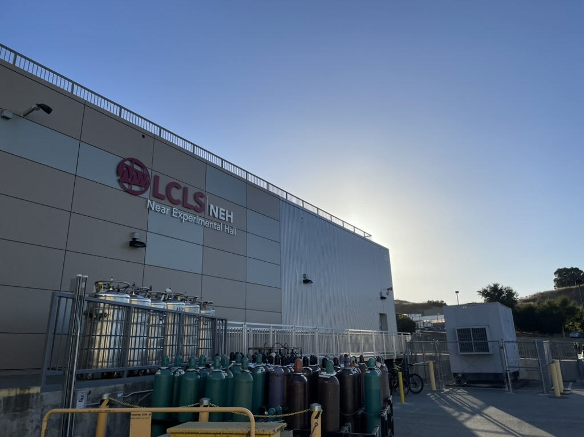
LCLS

Slide 17
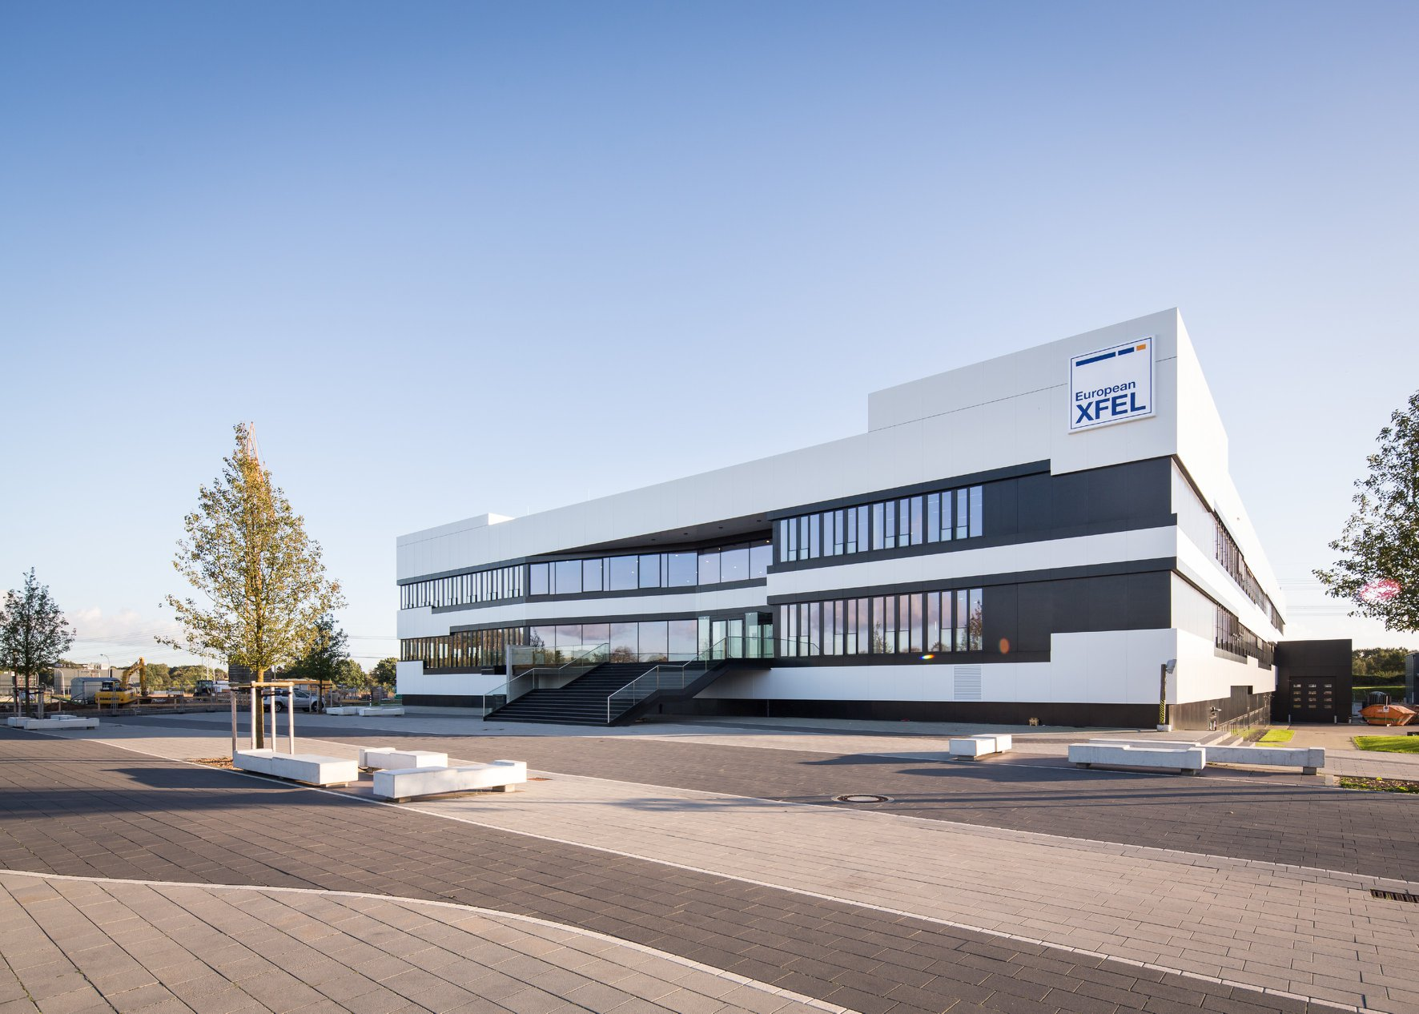
Eu-XFEL

Slide 18
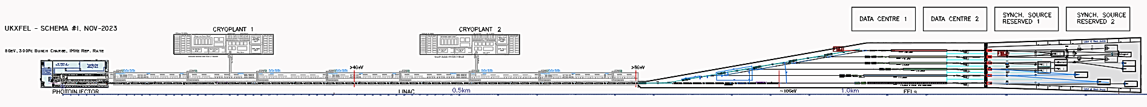
Design Philosophy
Options analysis mean this is a sliding scale from £0 to £Xbn.
Designing for the top end and scaling down to fit in the other options.
Cryoplant x2 (or . . . X3) for 2-3GeV extra boost – or move further downstream
Data Centre footprint
other synch sources
~1.8km
LINAC 8GeV ~950m
FELs ~350 - 400m
8GeV can be achieved with x46 TESLA/Fermi type cryomodules
Could be reduced to <250m with smarter configurations
Notes:
Supercoducting etc.
Green field site

Slide 19
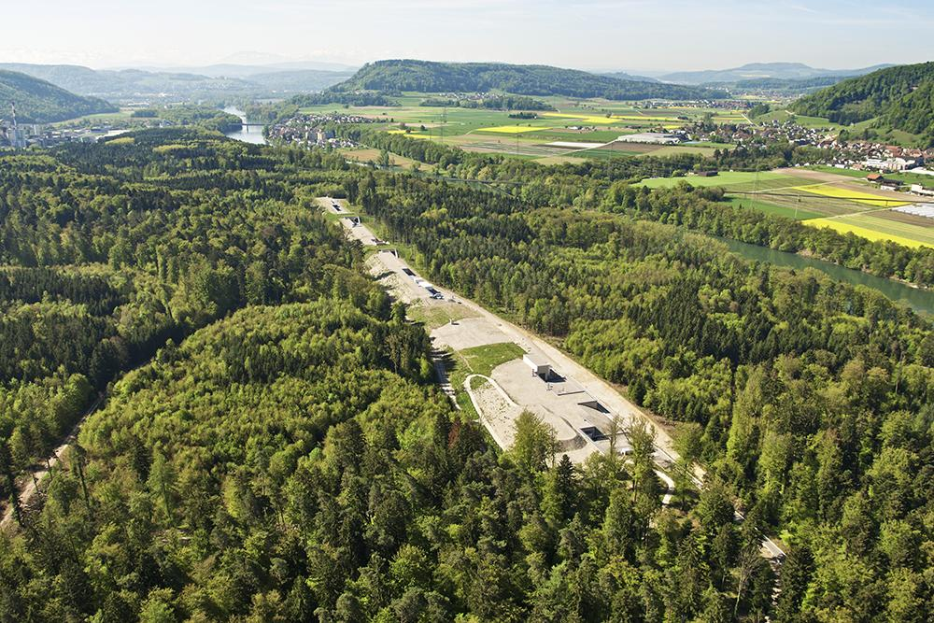
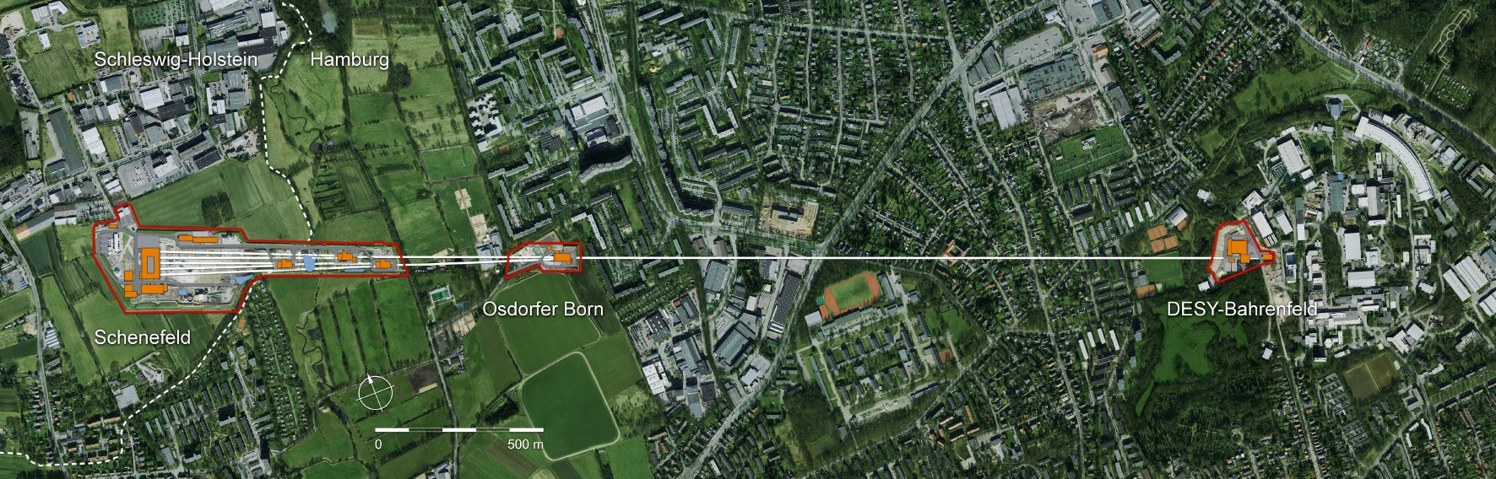
Cost and Location
For the UK based option the CDOA project will not take any account of the possible facility location. The conceptual design will assume a green field site.
For an idea of the scale of the facility cost and physical layout we can refer to existing XFELs:
  SwissFEL cost ~275 MCHF (2013) and is ~750m long and ~15m wide
  European XFEL cost ~1220 Meuro (2005) and is ~3.4km long
SwissFEL, PSI
European XFEL
https://www.psi.ch/en/media/our-research/hollywood-in-the-wuerenlingen-woods
https://www.xfel.eu/facility/overview/facts_amp_figures/index_eng.html

Slide 20
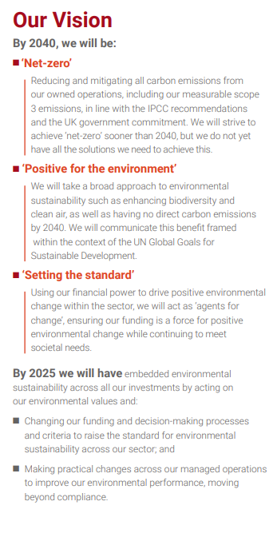
Sustainability
https://www.ukri.org/wp-content/uploads/2020/10/UKRI-050920-SustainabilityStrategy.pdf10
Notes:
Data canter

Slide 21
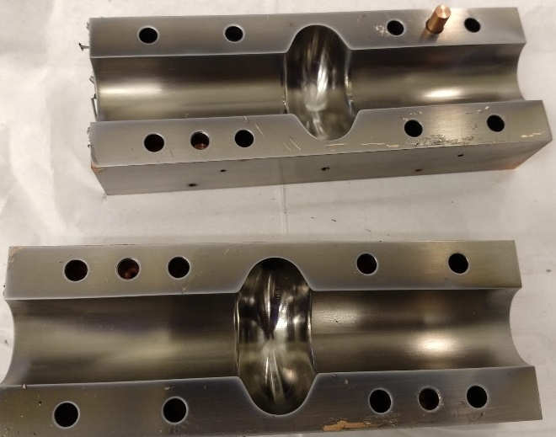
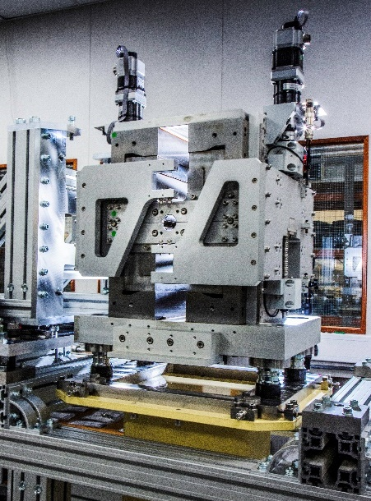

Sustainability
The UK accelerator community is already very active in developing more sustainable technologies, Using permanent magnets instead of electromagnets.
  Making use of different superconducting materials and coatings for RF cavities so that they can operate at 4K instead of 2K.
  Developing more efficient RF power sources and much faster RF cavity tuners.
In addition we are assessing accelerators more broadly in terms of carbon footprint throughout the full project life cycles. This analysis will continue and feed directly into the CDOA project.
Notes:
It is essential that we assess, and optimise where possible, all of the options from a sustainability perspective.
many of which would have a significant positive impact on the power requirements of a new XFEL facility

Slide 22
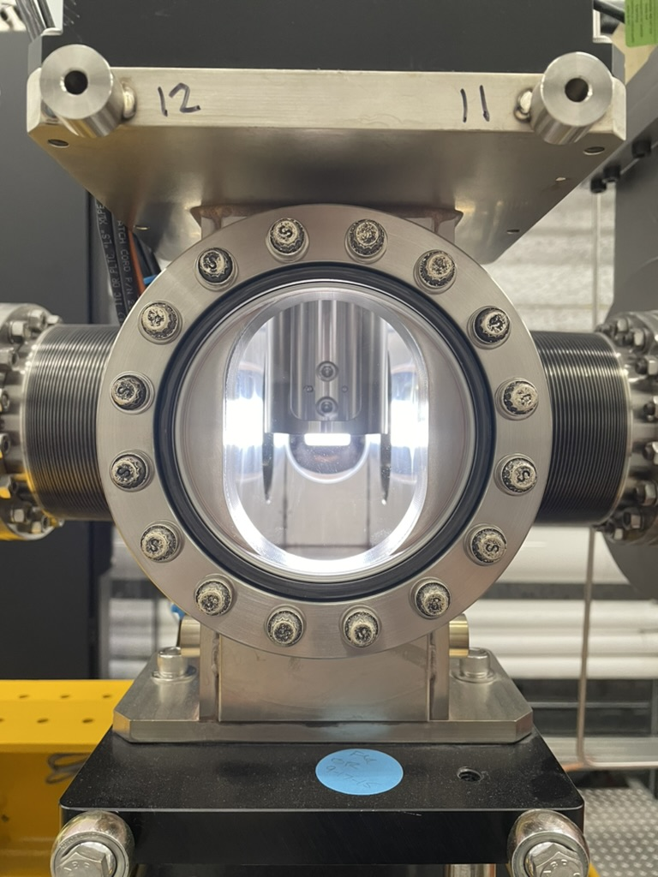
Engagement
Town hall events
Focused work shops
User Surveys
Close engagement with the Science team
Oversight
International Advisory Board
Internal Oversight Commitee

Slide 23
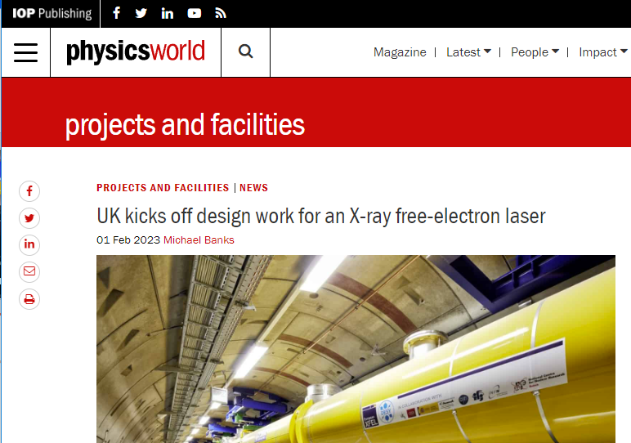

Launch Event
The UK XFEL project was successfully launched at the Royal Society on 30th January 2023
Over 150 in-person attendees from a range of institutions, with another 150 attending virtually.
The event attracted positive attention on society media from the research community, including articles from leading research outlets:
  Physics World, including podcast including interview with John Collier, Chemistry World
Presentations from the meeting are now available on the UK XFEL website: https://xfel.ac.uk/

Slide 24

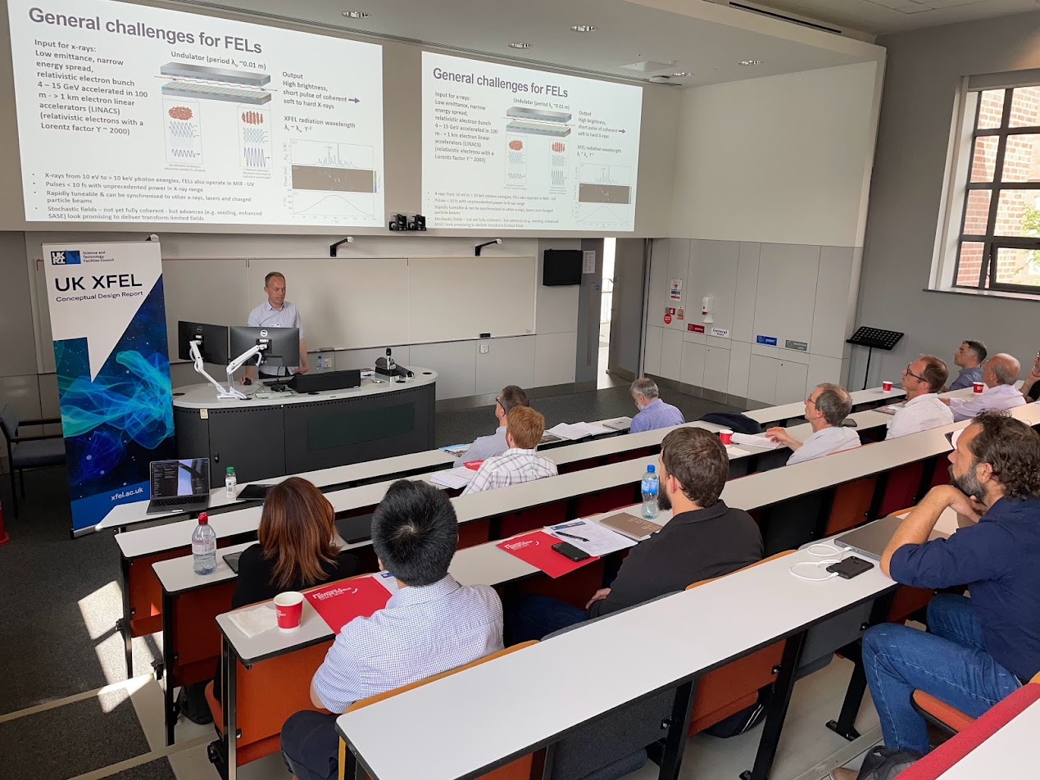
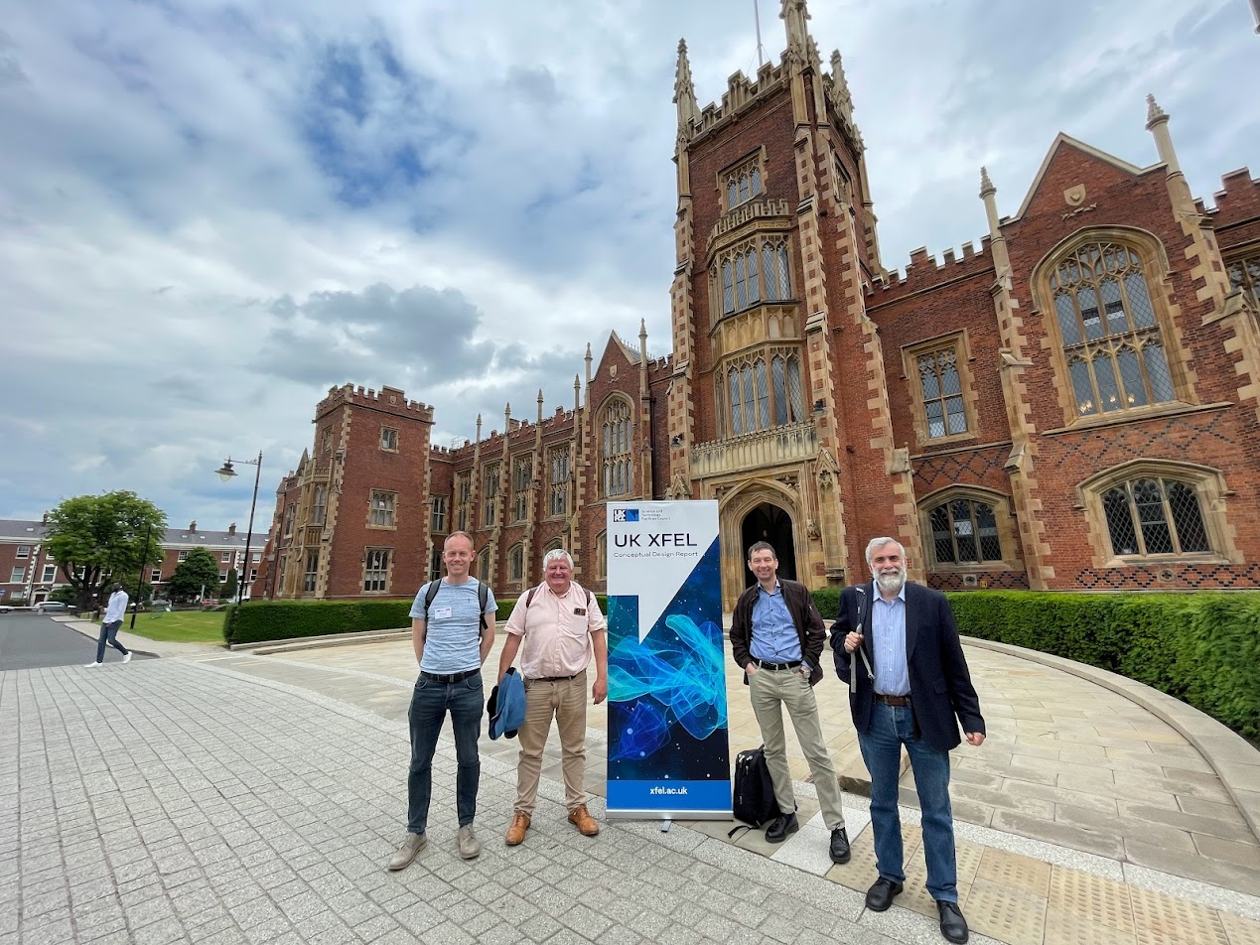
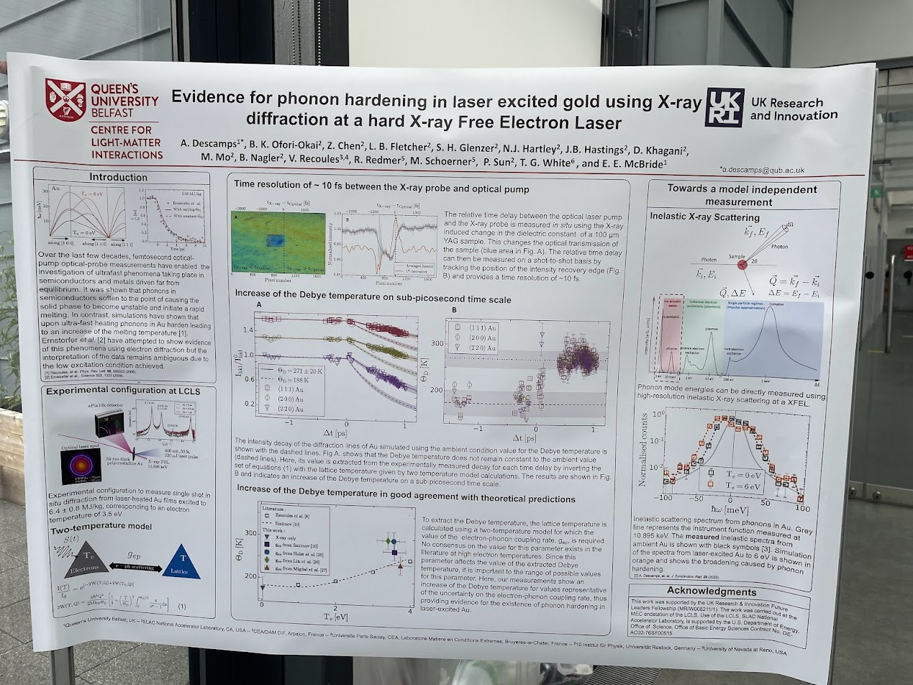
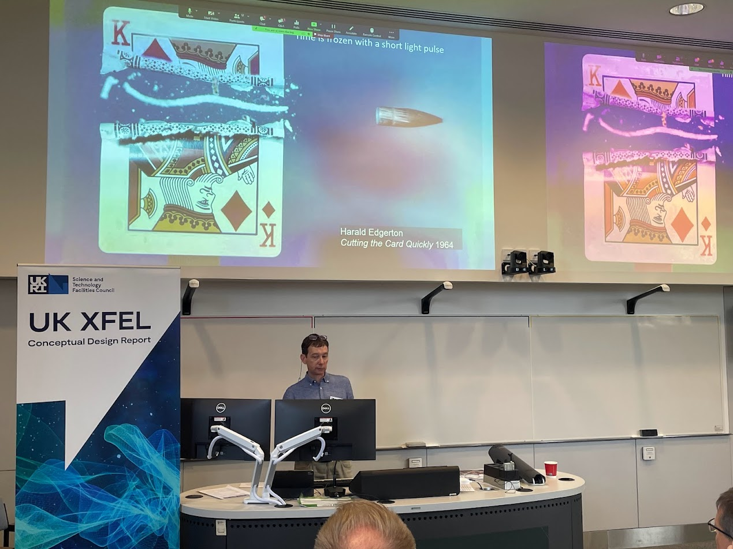
Frontiers of Measurement Technology
2 Day event
> 30 people in the room
15 People Online
16 Speakers
10 Posters

Slide 25
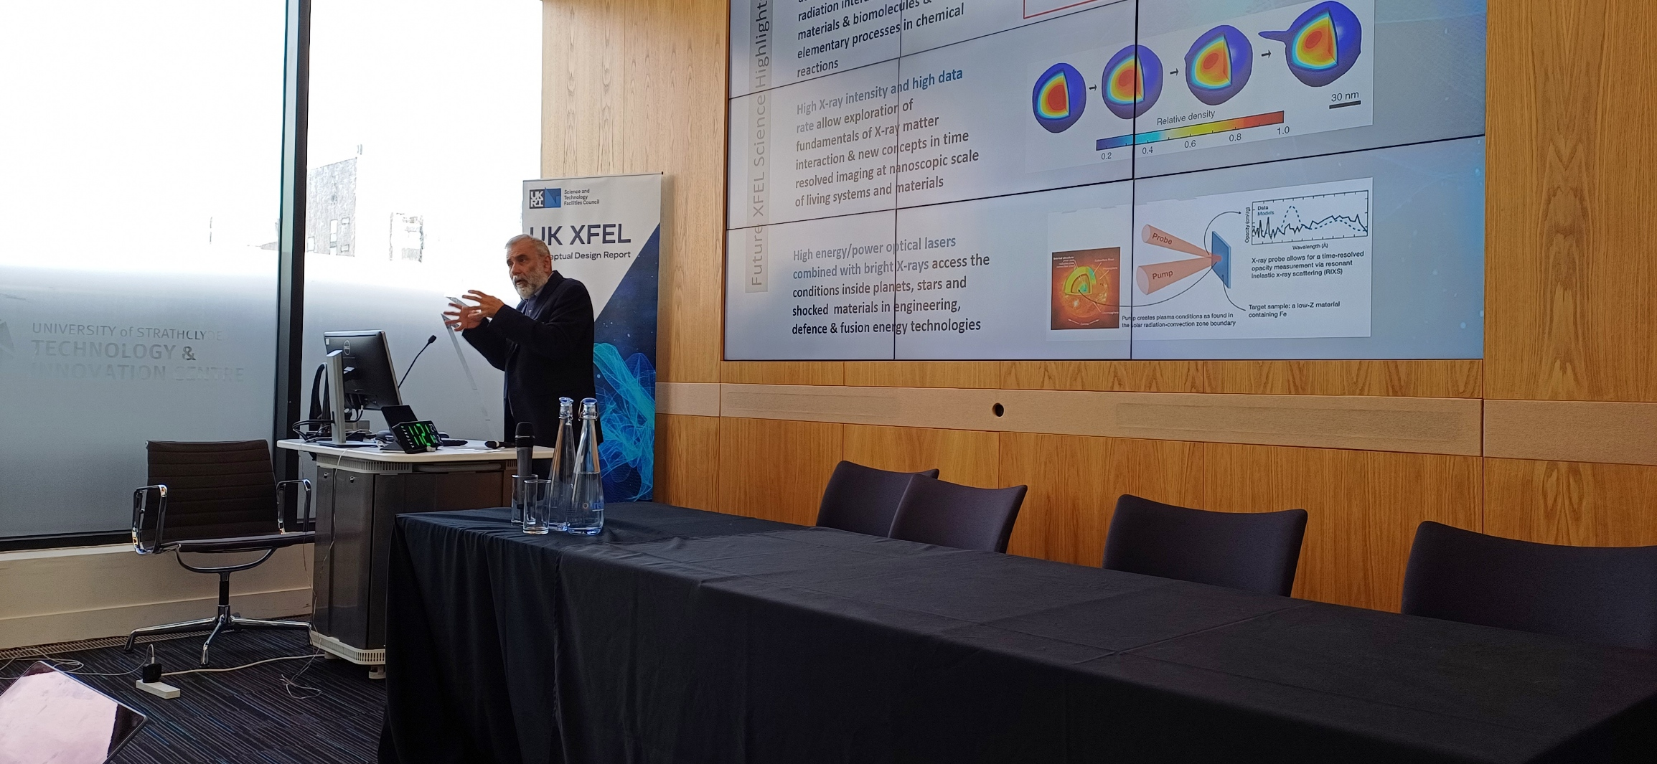

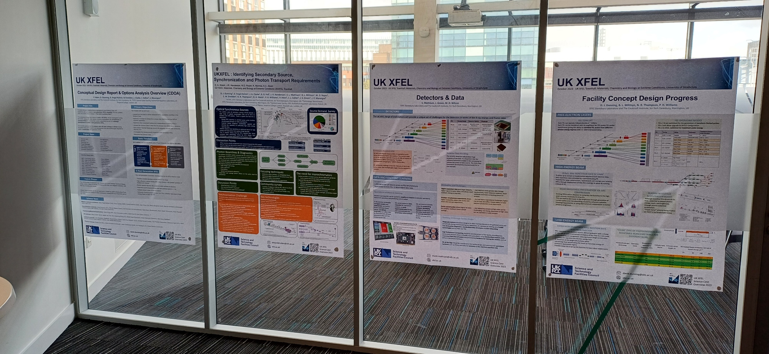
Scotland Townhall
Materials, Chemistry, and Biology at extreme conditions
2 Day event
~40 people in the room
~40 People Online

Slide 26
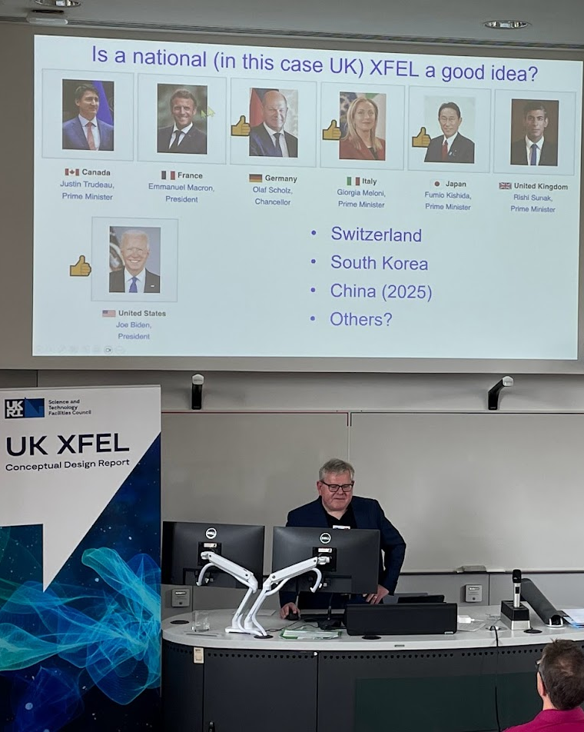
Belfast Town Hall
Excellent quality of talks and discussions
Great local organisation
Good opportunity to advertise the project in the community and we received a lot of enthusiasm
Branding at the event was good.
Discussion session was very useful
Convinced that during 2024 Science Team should devote some attention to planning the end stations.
Image © STFC John Dawson

Slide 27
Belfast bullet points
Across all wave functions of the hard X-ray people like Henry and Rebecca made the point about reconstructions from many, many shots, using machine learning.
Evenly spaced pulses important, 100Khz is a reasonable number
However, in some cases evenly spaced pulses at 100 KHz might mean the separation forces is too large.
Photon energy upto 20KeV – might not cover everything. MEC – 100KeV as example
Transform limited pulses and attosecond pulses talked about
Also longer pulses with narrower band width
Pulse energy route to 10’s of millijoule
Multi colours – 3 or 4 and phase relation between pulses.
Polarization as standard
Diagnostics diagnostics diagnostics.
Time – dedicated end stations
Foot print – RIXs as an example

Slide 28
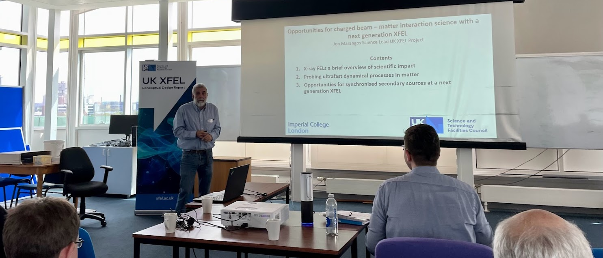
Ion-Beams workshop at
The University of Manchester

Slide 29
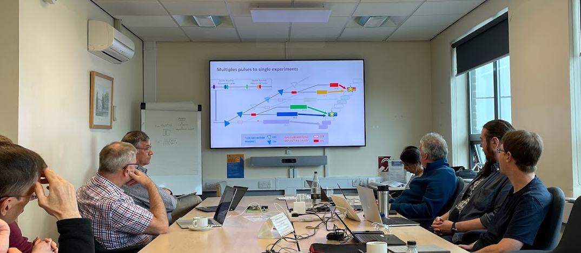
Eu-XFEL at STFC
Notes:
WP3,4 and 5 have also produced a second iteration of the facility layout, and have started investigating the possibility of a fixed electron beam serving multiple FEL lines each with their own purpose, which then has the possibility to have some of these lines converging at the same end stations

Slide 30
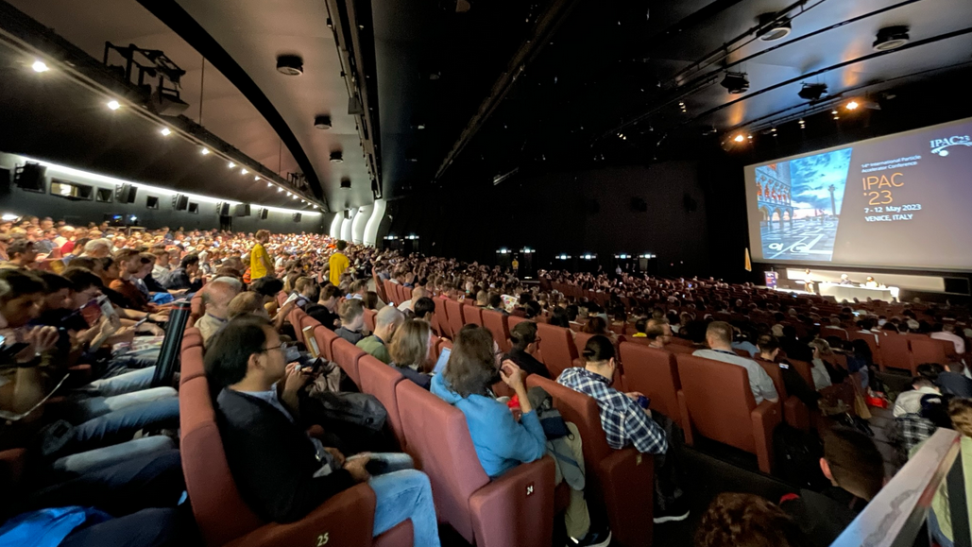
IPAC ‘23
Amongst our own presentations there was also a large number of other FEL based presentations and posters. It is clear that FEL technology is still rapidly advancing and that there is significant interest in these machines.

Slide 31
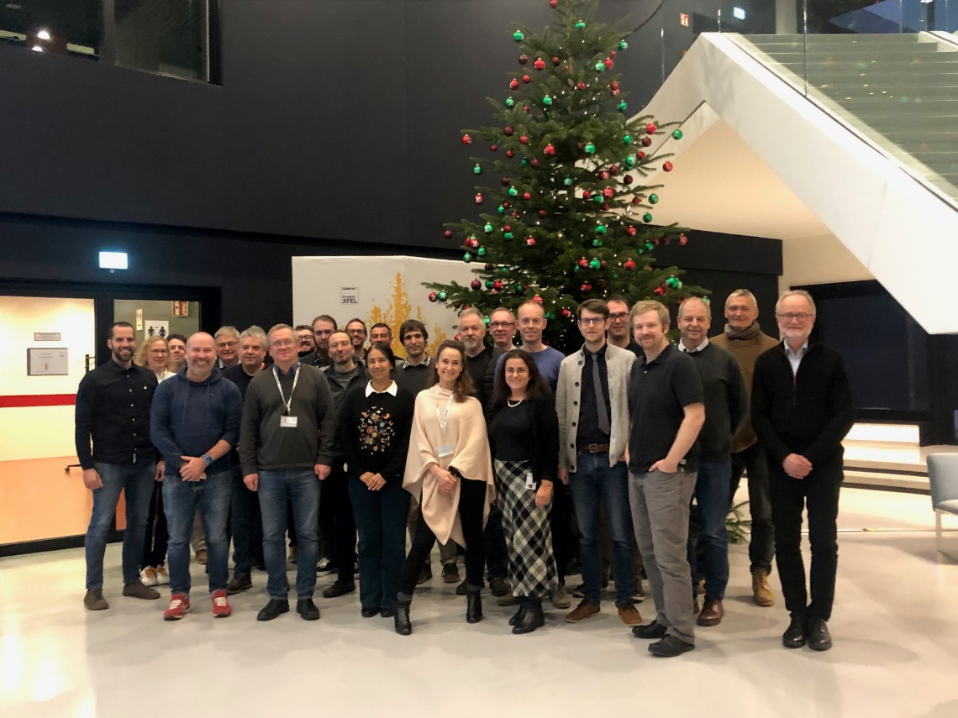
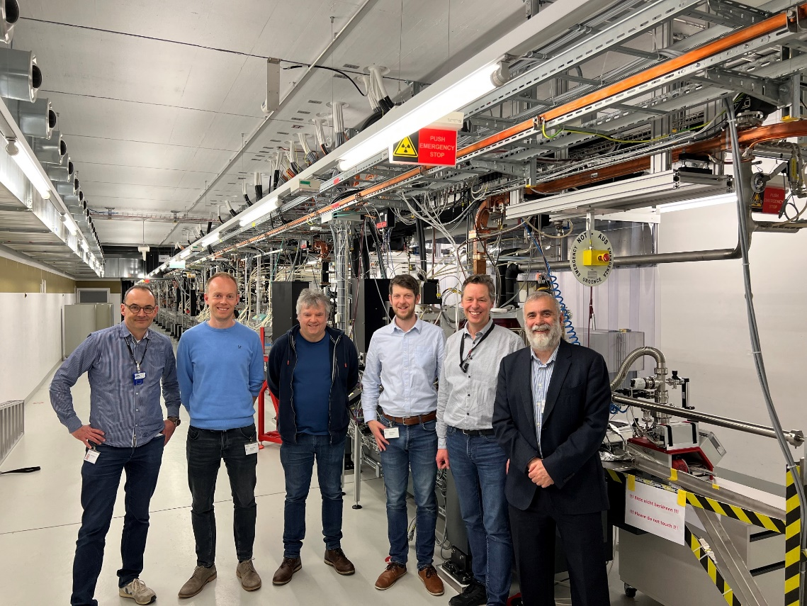

Progress so far
  Stakeholder Engagement
  Regular Eu-XFEL seminars
  Continued SwissFEL Engagement
  SHINE Visit expected in April 24
  Multiple Conferences attended
  Science team now meets monthly
    Facility Design Team presents updates at this meeting
  International Advisory Board – Dec 23
  Communications
  Website now live, and updated – xfel.ac.uk
  Community slides produced for use by anyone
  Social media presence via twitter and linkedin

Slide 32
Overview
xfel.ac.uk
We are presently 8 months into the project. The Year 1 activities below are largely complete – the focus is on developing the conceptual design and making progress towards the Year 2 activities.
Year 1
Project launch event January 2023
Initial conceptual design and layout
Preliminary engagement with overseas XFEL facilities
Survey of the science team, workshops and town halls meetings begin
Year 2
R&D targeting gaps in key physics and technology areas
Collaborative activities and working groups with overseas XFEL facilities
Workshops and town hall meetings continue
Year 3
Summary of R&D activities
Preferred options identified, socio-economic analysis
Revision to science case published
CDOA phase completed September 2025

Slide 33
Expected timelines
Evaluate
  2019 to 2020 Science Case – Completed
  Oct 2022 to Oct 2025 Conceptual Design and Options Analysis
  Oct 2025 to ~2029 Technical Design Review
  ~2029 onwards Civil Construction work
  ~2030 onwards Accelerator Construction work
Design
Currently here
Construction
Funding Bids would need to be approved before the start dates suggested.

Slide 34
Future Phases
The CDOA phase is expected to be followed by a more detailed Technical Design phase, which is likely to include prototyping and other risk mitigation activities, and then by a Construction phase.
Clearly future phases are not yet approved or funded by UKRI Infrastructure Fund and planning and costing for these subsequent phases will be an important part of our work.
The costs and timescales associated with these later phases depends very much on which option is adopted and approved by UKRI.

Slide 35
UK XFEL
A next generation XFEL
Key next-generation capabilities identified in the UK XFEL Science Case:
- Transform limited operation across entire X-ray range
- High efficiency facility, with a step-change in the simultaneous operation of multiple end stations
- Evenly spaced, high-rep rate pulses to match samples & detectors
- Improved synchronisation/timing data with external lasers to < 1 fs
- Widely separated multiple colour X-rays to least one end-station
- Full array of synchronised sources:
XUV-THz, e-beams, high power & high energy lasers at high rep-rate
UK XFEL Science Case available at xfel.ac.uk

Slide 36
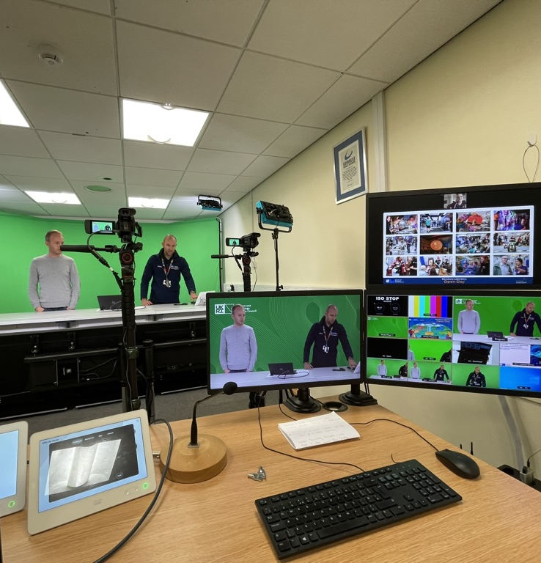
Communications
  Website now live, and updated – xfel.ac.uk
  Community slides produced for use by anyone
  Social media presence via twitter and linkedin
  Video in production
  Industry Flyer in production
  Possible Podcasts with science team under investigation
  Mailing list now over 360 people
  Open meetings continue
  SharePoint has improved front page
  Project Plan moved to project online for ease of access

Slide 37


The UK XFEL Conceptual Design and Options Analysis Project: Science Case For A Next Generation X-ray FEL
Jon Marangos, Imperial College & Science Lead, UK XFEL CDOA
Contents
Development of the Science Case
Distillation of a Next Generation Capability from Science Case
Next steps in Science Case development and community engagement

Slide 38
Expert Science Team – Addressing Major Research Themes
Matter in extreme conditions: Andy Higginbotham (York), Andy Comley (AWE), Emma McBride (QUB), Sam Vinko (Ox), Marco Borghesi (QUB), Malcolm McMahon (Edinburgh), Justin Wark (Ox)
Nano/Quantum materials: Anna Regoutz (UCL), Marcus Newton (Soton), Ian Robinson (UCL/Brookhaven), Mark Dean (Brookhaven), Awan Shakil* (Plymouth), Paolo Raedelli (Oxford), Simon Wall (Aarhus), Sarnjeet Dhesi (Diamond),
Engineering/Materials/Applications : David Rugg (RR), Sven Schroeder (Leeds), David Dye (IC) Dan Eakins (Oxford), +*
Life sciences: Allen Orville* (DLS), Jasper van Thor (IC), Xiaodong Zhang (IC), Shakil Awan (Plymouth), Adrian Mancuso# (Diamond), Tian Geng (Heptares)
Chemical sciences: Julia Weinstein (Sheffield), Russell Minns (Soton), Sofia Diaz-Moreno* (DLS), Andrew Burnett (Leeds), Tom Penfold (Newcastle), Rebecca Ingle (UCL), Mark Brouard (Oxford), Claire Vallance (Oxford), Alex Baidak (Manchester)
Physical sciences: Amelle Zair (KCL), Adam Kirrander (Edinburgh), Jason Greenwood (QUB), Jon Marangos (IC), Elaine Seddon (Cockcroft), + #
* + around 100 additional experts from around the world contributing to Science Case

Slide 39
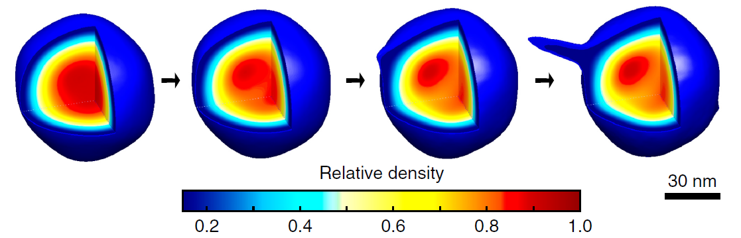
Ultrafast X-rays to probe attosecond electron dynamics, radiation interaction with materials & biomolecules & elementary processes in chemical reactions
High X-ray intensity and high data rate allow exploration of fundamentals of X-ray matter interaction & new concepts in time resolved imaging at nanoscopic scale of living systems and materials
Future XFEL Science Highlights
High energy/power optical lasers combined with bright X-rays access the conditions inside planets, stars and shocked materials in engineering, defence & fusion energy technologies

Slide 40
Transform limited X-rays and high data rates enable probing and optimisation of photochemical technologies, quantum materials, ultrafast magnetisation, & nanotechnologies
Future XFEL Science Highlights
X-rays synchronized to ultrafast lasers, THz and electrons uncover the fundamentals of chemical dynamics in the environment, space, engineering & energy materials
High rep-rate multi-colour ultrafast X-rays provide powerful approaches to systematic advances in e.g. catalysis, MEC, biochemistry & structural materials

Slide 41


UK XFEL: An exciting opportunity for science and innovation
Key next-generation capabilities identified from the UK XFEL Science Case:
Transform limited operation across entire X-ray range
High efficiency science facility with a step-change in the parallel operation of multiple end stations
Evenly spaced high-rep rate pulses to match samples & detectors
Improved synchronisation/timing data with external lasers to < 1 fs
Multiple colour X-rays at one end-station
Full array of synchronised sources: XUV-THz, e-beams, high power & high energy lasers at high rep-rate
Read the UK XFEL Science Case, visit
https://www.xfel.ac.uk
Notes:
To replace photo with one of your own. 1) Send the geometric shape overlay to the back – Right-Click > Send to Back > Send to Back. 2) Replace image – use the guides provided to correctly position it. 3) Send your image to the back so that the geometric overlay re-appears over the image. Please remove or amend the image credit if you are using a different image to the one provided.

Slide 42
OTHER ESSENTIAL CAPABILITIES
X-ray photon energy range ( < 200 eV to > 20,000 keV)
X-ray pulse energy (multi-mJ range in some modes)
Range of X-ray polarisation states (including OAM modes)
High speed of photon energy tuning and changing polarisation
Small transverse spot size (possibility to nanofocus)
Multiplexing of end-station use (multiple users simultaneously)
Full range of end-stations and instruments with state-of-the-art sample delivery, detectors and data systems
Upgrade path to expand instruments and capabilities over time

Slide 43
Developing Science & Technology Case and Community Engagement
1. Northern Ireland Townhall (hosted by: Queens Belfast) June 20th & 21st 2023
Focus discussion topic: Frontiers of measurement technology
2. Scotland Townhall (hosted in Glasgow at Strathclyde) Oct 2 & 3rd 2023
Focus discussion topic: Materials, chemistry and biology at extreme conditions
3. Southwest England Townhall (hosted by Plymouth) 18th & 19th Jan 2024
Focus discussion topic: AI, Quantum Computing and Fundamental Physics
Wales Townhall (in Cardiff ~ September 2024)
Focus discussion topic: Advanced materials and manufacturing
North-East England Townhall (hosted by Sheffield 4th and 5th June 2024)
Focus discussion topic: Energy, environmental and climate technologies
North-West England Townhall (hosted by Royce Institute, 8th and 9th August 2024)
Focus discussion topic: Electronics, photonics and quantum technologies
Central England Townhall (hosted by Diamond, 1st and 2nd May 2024)
Focus discussion topic: Lifesciences and biomedicine
Physics, Life Sciences, Chemistry, Engineering, Quantum Materials
Physics, Astrophysics, Materials, Defence, Chemistry, Life Sciences
All areas – an advanced technology& fundamental science focus
Engineering, Defence, Materials, Physics, Chemistry, Life Sciences
Chemistry, Quantum Materials, Engineering, Materials, Physics
Quantum Materials, Physics & Photonics, Materials
Life Sciences, Engineering, Chemistry, Physics and Photonics

Slide 44
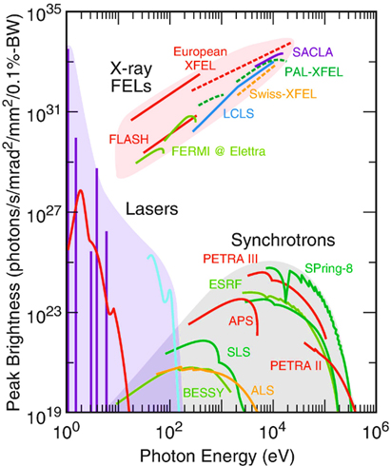
Introduction to XFELs
XFEL = X-ray Free-Electron Laser
“free-electron” means the electrons are not bound in atoms but ‘freely’ propagating in a particle accelerator
Undulator (period λ_{u} ~0.01 m)
Output
High brightness,
short pulse of coherent
soft to hard X-rays
XFEL radiation wavelength
λ_{r} ~ λ_{u} ϒ⁻²
Electron source
~ 1km of linear accelerator
~100 m
(see next slide)
~ 4 – 15 GeV, Lorentz factor ϒ ~ several thousand
Lasing
(exponential amplification)
Electron energy modulation
Electron micro-bunching
Radiation emission

Slide 45
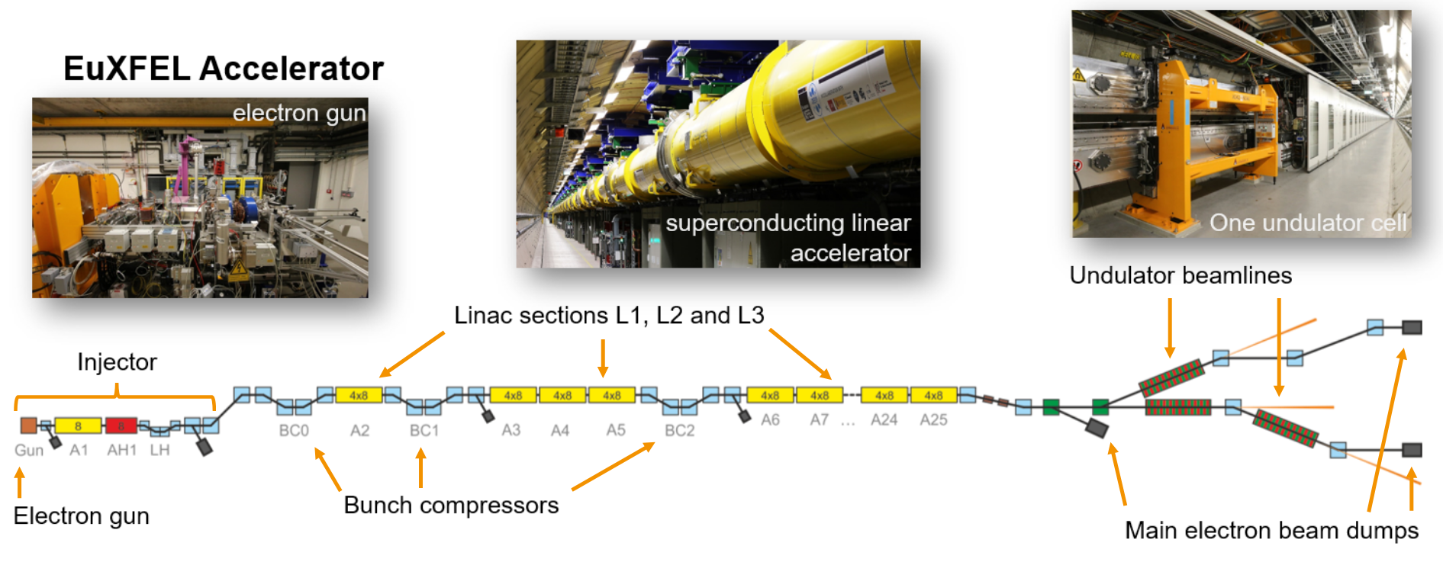
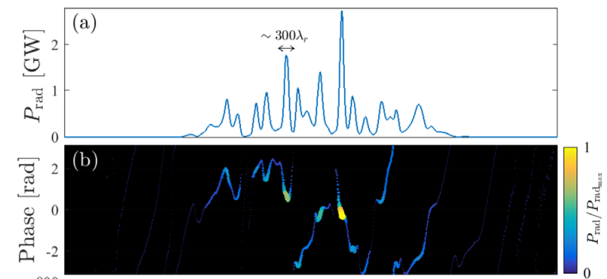
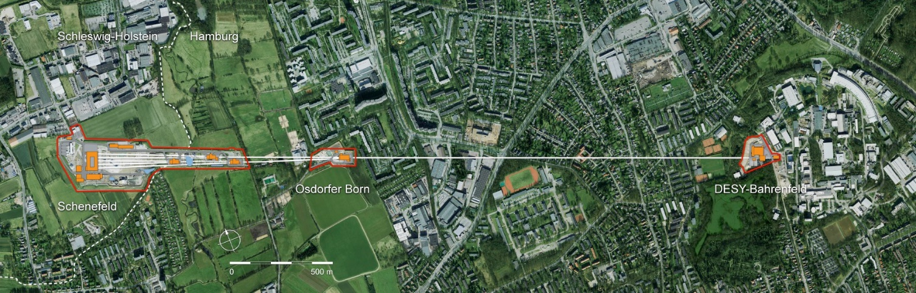
General XFEL challenges/opportunities
The electron bunch must be exceptionally bright for lasing to occur – and the lasing process spoils the bunch quality – i.e. can’t re-use the bunch
  Based on linear accelerators + it is challenging to serve many experiments
The X-ray pulses are naturally far from transform limited
  But there are several demonstrated or emerging techniques for transform limited pulses
Increasing capacity and capability go hand in hand
t
In the default SASE mode, there is an intrinsic coherence length of ~hundreds of wavelengths (hundreds of attoseconds at X-ray)

Slide 46
UK XFEL conceptual design process
Understanding/ Defining the Specification
Specific Technical Solutions
Compelling Facility Concepts
Understanding the specification
  Not one spec. but several interlinked sets
  Continuing to incorporate new ideas
Developing specific technical solutions
  e.g. science area requires X then the best possible solution is Y
Developing compelling facility proposals
  UK-based and international investment options
  Compatibility of technical features
  Scope, international context
  Sustainability, socioeconomic factors

Slide 47
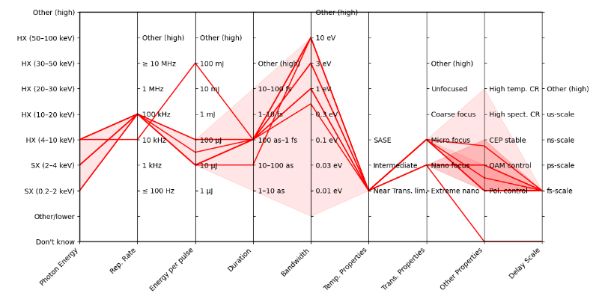
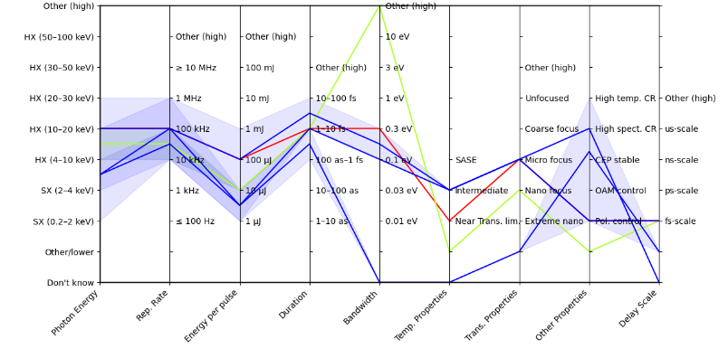
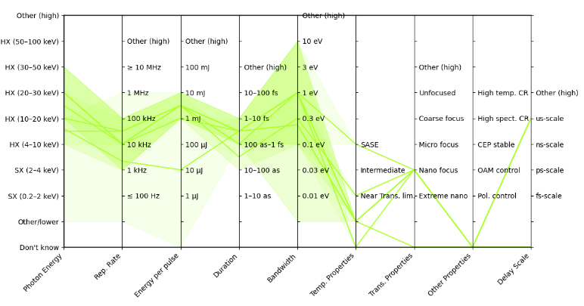
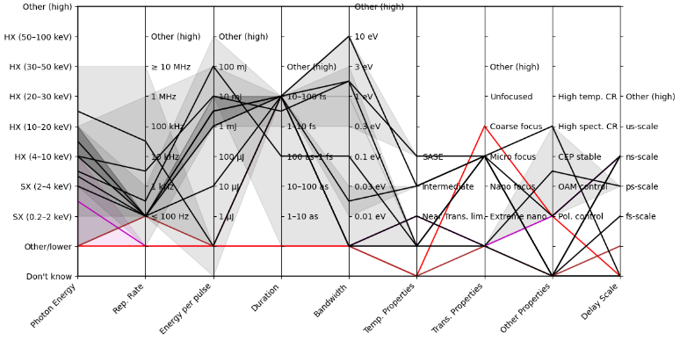
Defining the specification: User survey
One of the first major activities of this phase was a detailed survey to capture requirements
Physical sciences
~70 case studies: ‘tick box’ parameters help define top-level choices
Experiment descriptions informing end station development
Still open for input
e.g. Cluster 1: mainly Chemical sciences
Life sciences
MEC

Slide 48
Key next-generation capabilities identified in the UK XFEL Science Case
Our focus to date has been on some of the most challenging and fundamental features
- Transform limited operation across entire X-ray range (approx. 100 as – 100 fs and 50 eV to 20 keV)
- High efficiency facility with a step change in the simultaneous operation of multiple end stations
- Evenly spaced, high-rep rate pulses to match samples & detectors (~ 100 kHz per FEL, with flexibility)
- Improved synchronisation/timing data with external lasers to < 1 fs
- Widely separated multiple colour X-rays to at least one end-station (e.g. SXR+ HXR)
Full array of synchronised sources:
XUV-THz, e-beams, high power & high energy lasers at high rep-rate
Minimise the carbon footprint and energy consumption for both operation and build.
Also significant interest in:
High pulse energy (>>1 mJ)
High photon energy (> 20 keV)
In some cases with less demand for high rep rate

Slide 49
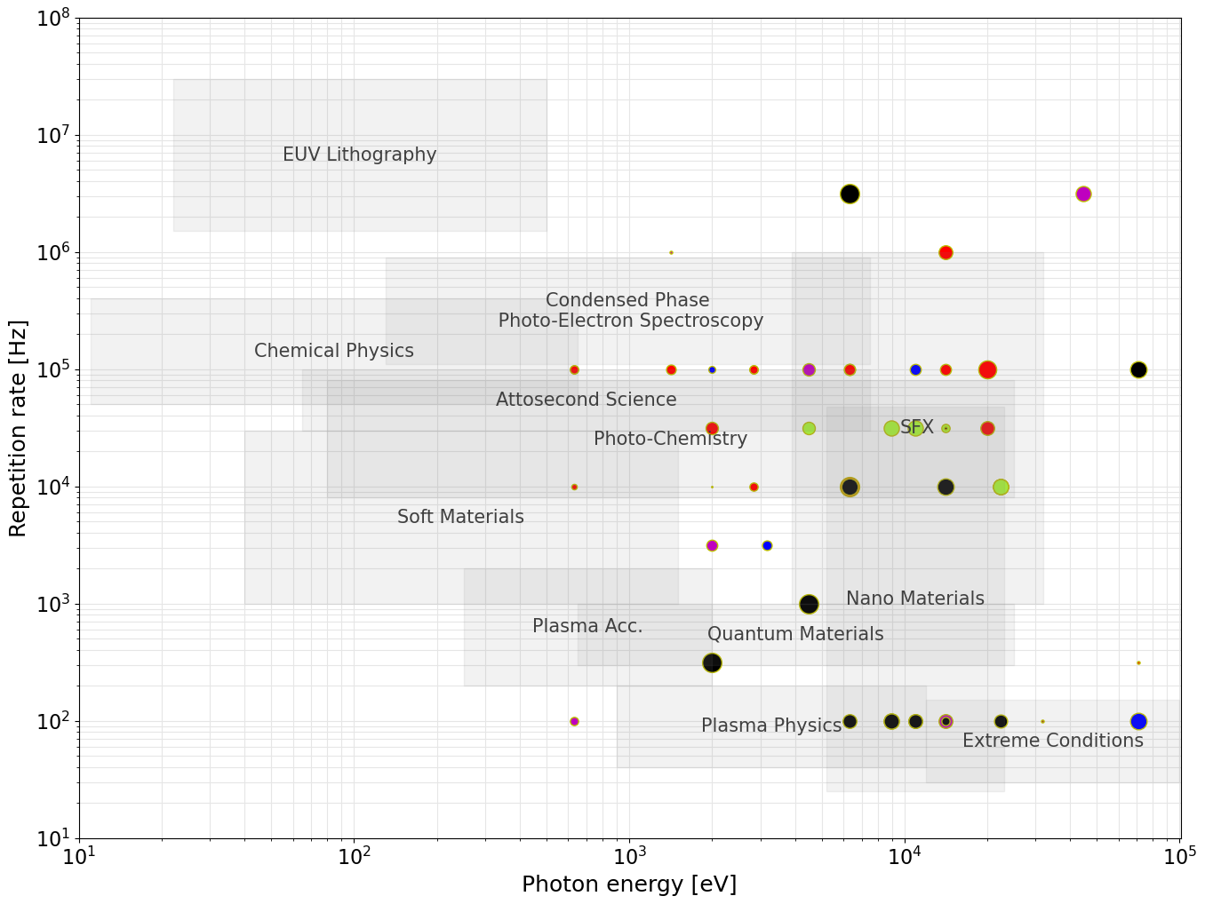

Acceleration Technology:
Evenly spaced, high-rep rate pulses
User Requirements from the Science Case & Survey
ERLs
SRF
(CW)
Preliminary focus for
UK-based option:
~8 GeV SRF CW
Max. photon energy strongly influences the required electron beam energy
Repetition rate largely dictates the type of acceleration technology
Requirements suggest
~8 GeV superconducting RF linac
SRF
(Pulsed)
HRR NC
NC
Electron Beam Energy:
~1-1.5 GeV
~2-3 GeV
~6-8 GeV
≥10 GeV

Slide 50
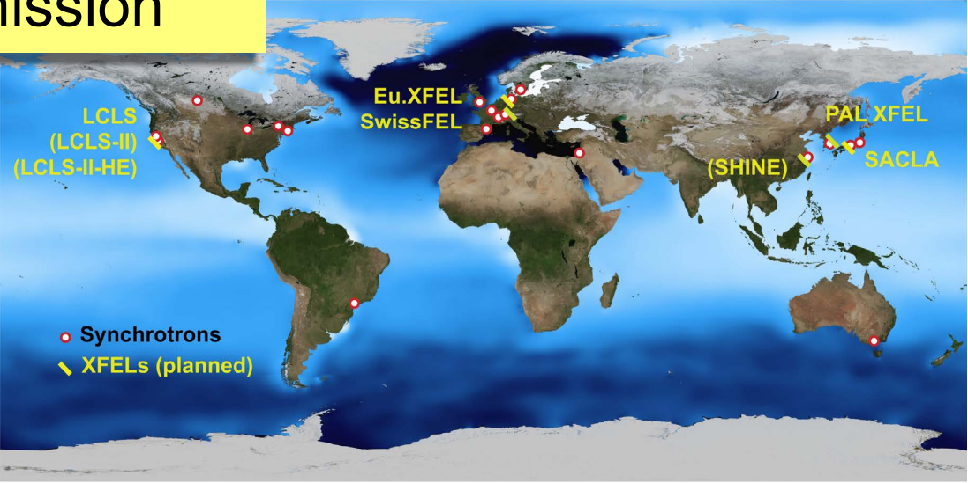
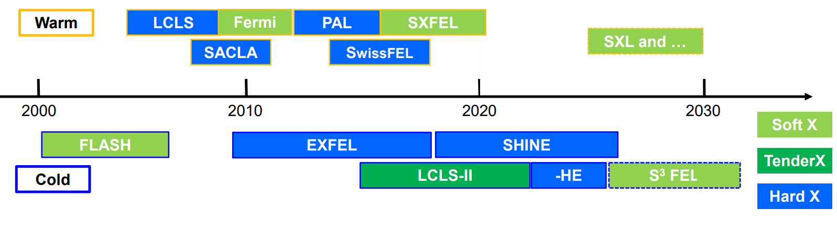
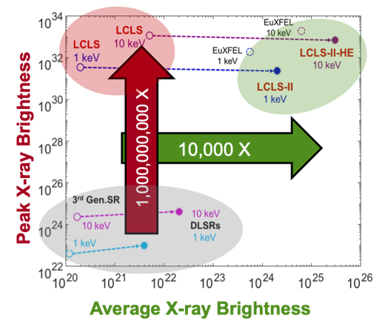


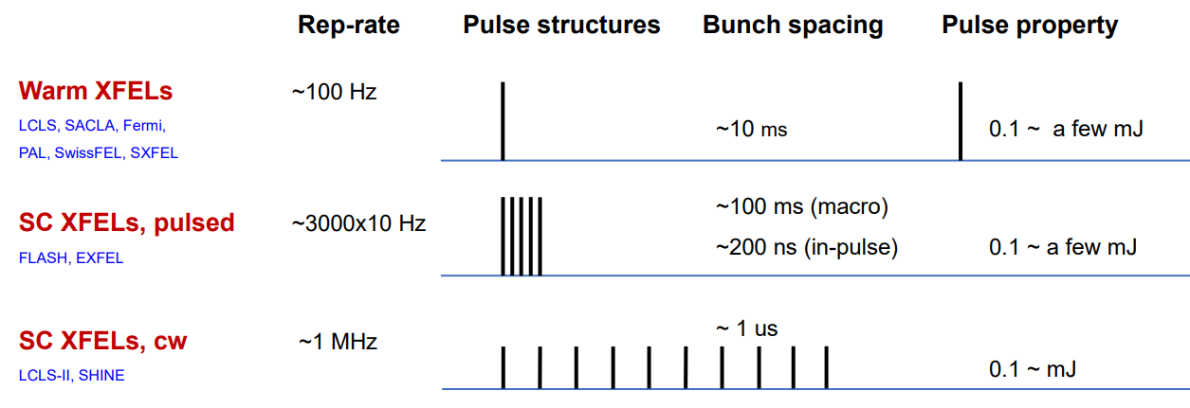
Evenly spaced, high rep rate pulses
Hard X-ray FELs
Allen Orville, Diamond, UK XFEL Town Hall Meeting
https://www.clf.stfc.ac.uk/Pages/final_AMOrville_RS-TownMeeting_16July2019-b2.pdf
Outlook to Future XFELs, Dong Wang
Shanghai Advanced Research Institute, Chinese Academy of Sciences and SHINE IPAC23, Venice, May 12, 2023
https://accelconf.web.cern.ch/ipac2023/pdf/FRXD2_talk.pdf
Mike Dunne, SLAC, Future Developments at LCLS, UK XFEL Launch Event 2023 https://youtu.be/sxipwNyXMhg

Slide 51
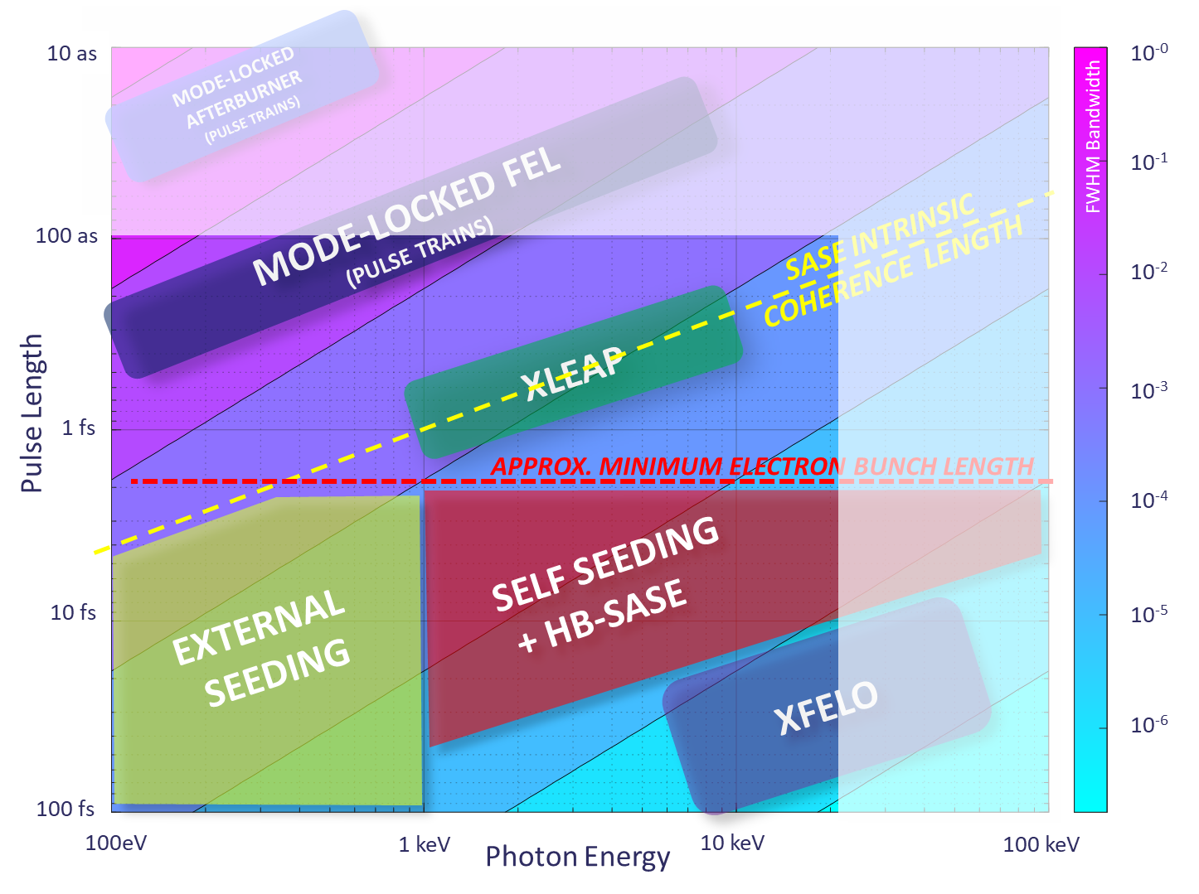

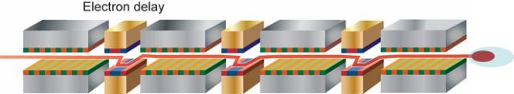
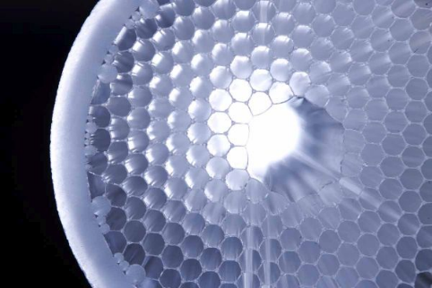
Transform-limited pulses
Transform-limited pulses across a wide range of energies and pulse lengths requires a wide range of techniques.
Attosecond pulses tightly synchronised to external sources (e.g. XLEAP)
HB-SASE-2.0 for 25 keV, 2.5 fs duration, TW peak power, >mJ pulse energy, 8 × 10⁻⁵ FWHM BW, at any e-beam repetition rate
XLEAP
HB-SASE schematic
Advances in high rep-rate lasers (e.g. Kagome fibres) for ≤ 1MHz UV seeding + harmonic FEL conversion to ≤ 2 keV
Enhanced self-seeding for few-GW 30 fs stable coherent SXR pulses
Cavity XFELs: RAFEL, XFELO for narrowest bandwidth
Notes:
Single-cycle undulator light with carrier-envelope phase control

Slide 52
Facility concept: a step change in the simultaneous operation of multiple end stations
Potential for e-beam experimental areas
FELs independently tuneable in terms of photon energy, pulse duration etc.
Kicker magnets to split MHz bunches at ~100 kHz.
Electron bunch properties tailored per FEL after kicker
FEL-6
FEL-5
FEL-4
Multiple end stations per FEL
FEL-3
FEL-2
FEL-1
Fixed accelerator:
~ 8 GeV electron bunches at ~1 MHz
Possible energy boost for higher photon energy in FEL-1
~ 100 kHz Kicker Magnet

Slide 53
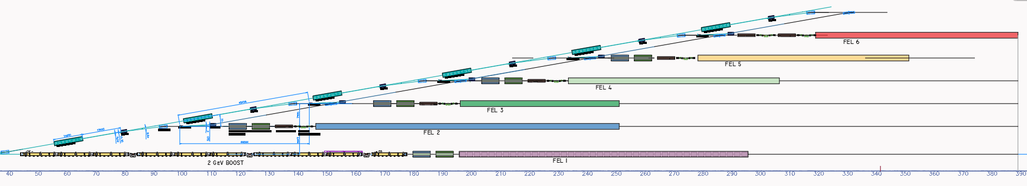
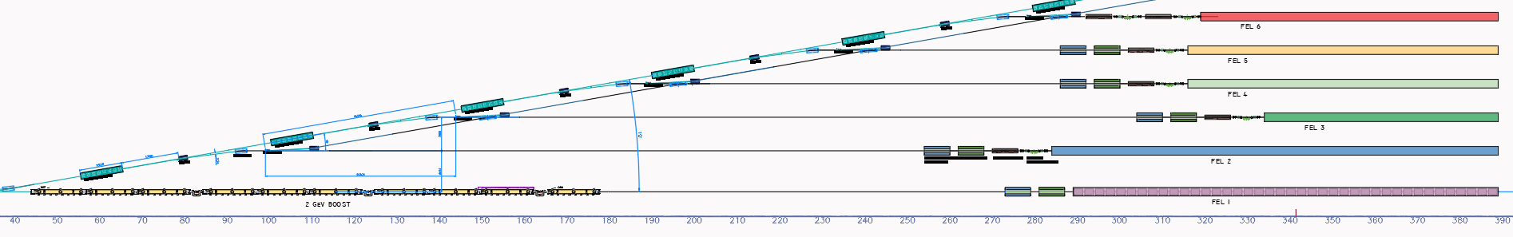
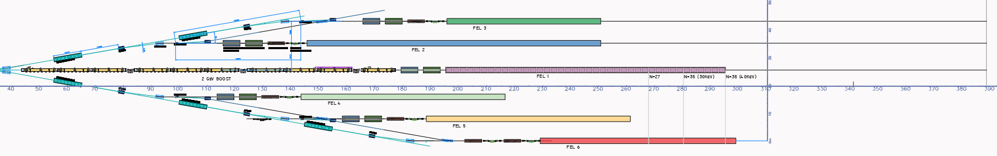
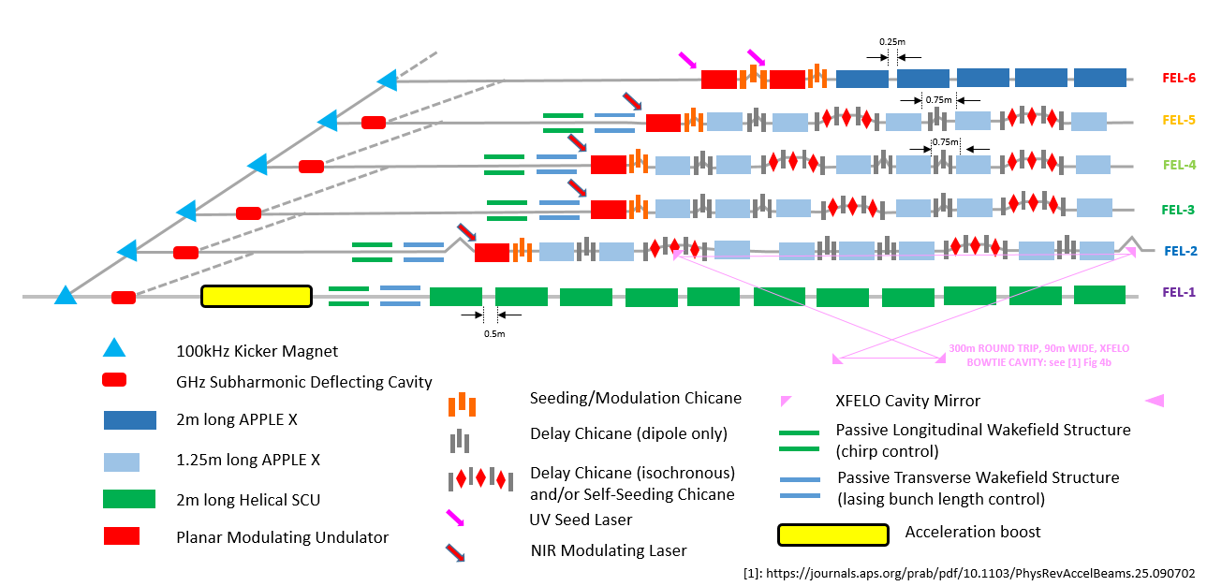
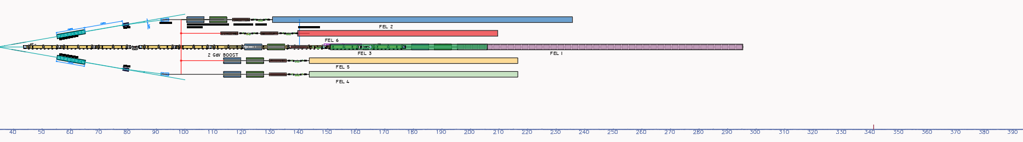
Early draft FEL section layouts
1
Planar
Default – added FELs in positions and lengths shown as per schematic sequentially with no spaced out considerations to synchronise at end of FELs
~80m
~140m
2
Planar – end synch
As used in drawing layouts – note synchronised at end of FELs – but observe very large drift spaces
~80m
~140m
Planar – mirror
By making use of bi-polar capability of LCLS kicker – if we position FEL1 at centre and mirror half of each FELs around it, lengths & widths are significantly reduced, and staggering improved.
3
~50m
~80m
~90m saved
4
3D layout
In this arrangement a ‘gun barrel’ with vertical and horizontal clustering via multi-axis kicker enables much tighter compaction and length reductions.
Note though the extra 130m+ of the the 2GeV boost section still pushes out FEL1 well beyond any other FEL line. What to do?
!
2GeV Boost
!
Looking on-axis
!

Slide 54
FEL tuning ranges
Assuming a fixed electron beam energy from the spreader of 8 GeV. To cover photon energy range from ~50 eV – 20 keV with some overlap: best covered by ~6 FELs (at least). The tuning ranges have been developed in co-ordination with the science team.
SXR: 0.2 – 4 keV
TXR: 2 – 7 keV
Tuning
0.05 – 1.0 keV
0.25 – 3.0 keV
1.0 – 5.0 keV
3.0 – 13.0 keV
5.0 – 20.0 keV
9 – 20 keV
13 – 30keV
20 – 40 keV
HXR: 4 – 100 keV
Tuning
0.05 – 1.0 keV
0.25 – 3.0 keV
1.0 – 5.0 keV
3.0 – 13.0 keV
5.0 – 20.0 keV
9 – 20 keV
13 – 30keV
20 – 40 keV
FEL-6
FEL-5
FEL-4
FEL-3
FEL-2
FEL-1
FEL-1: ≈ 10 GeV
FEL-1: ≈ 11.5 GeV
0.05
0.25
1
3
5
9
13
20
30
40
keV
Potential booster in FEL-1 line
Potential booster in FEL-1 line

Slide 55
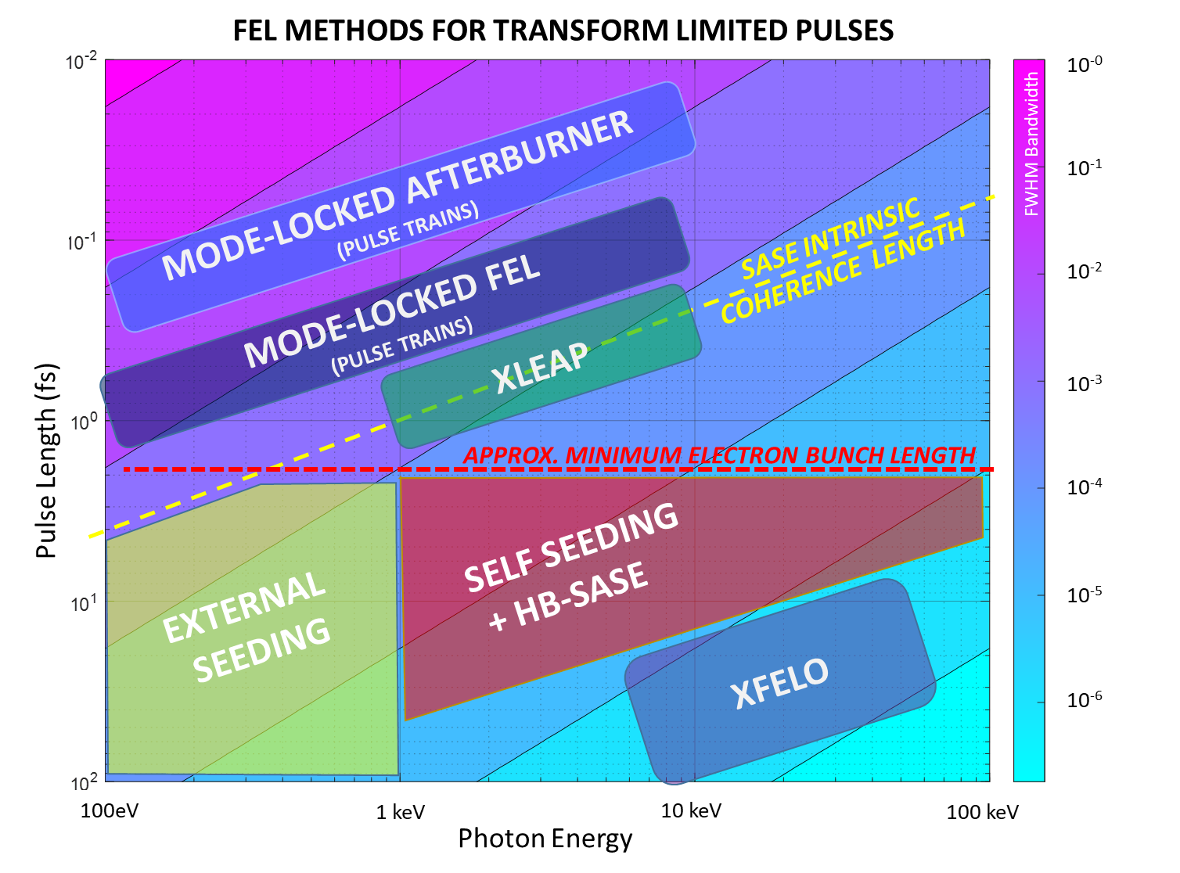
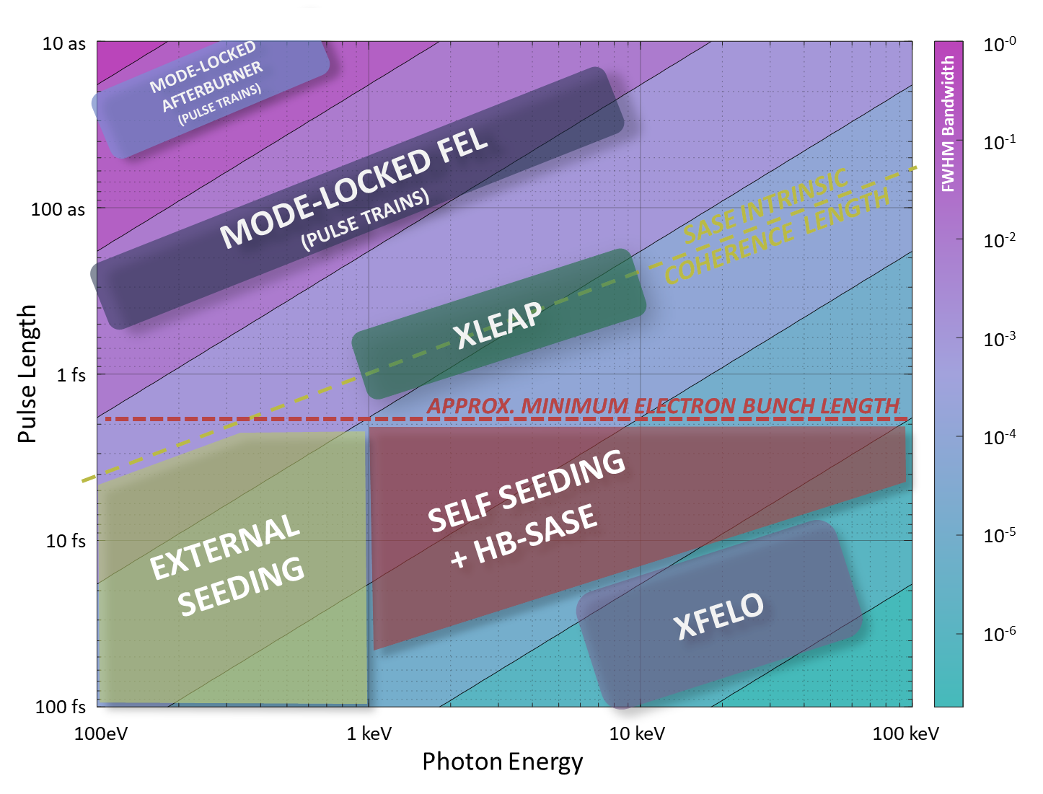
Each FEL has 1-3 primary operating modes, covering both short and long pulse options
Proposed FEL modes
FEL | Tuning | Mode | Technique | Transform Limited Pulse Duration
FEL-6 | 0.05 – 1.0 keV | Seeded | EEHG | 5 – 100 fs
FEL-5 | 0.25 – 3.0 keV | Long pulse | EEHG/HB | 100 fs – 20 fs
 |  | Short Pulse | XLEAP | 2 fs – 350 as
FEL-4 | 3.0 – 13.0 keV | Long Pulse | HB-SASE | 20 fs – 10 fs
 |  | Short Pulse | XLEAP | 400 as – 200 as
FEL-3 | 1.0 – 5.0 keV | Long Pulse | HB-SASE | 40fs – 15fs
 |  | Short Pulse | XLEAP | 800 as – 275 as
FEL-2 | 5.0 – 20.0 keV | Long Pulse | HB-SASE | 16 fs - 12 fs
 |  | Short Pulse | XLEAP | 300 as – 200 as
 |  | Cavity | XFELO | ~ 100 fs
FEL-1 | 9 – 20 keV | High Power | SASE | ~ 60 fs (not TL)
 | 13 – 30keV* | High Energy
 | 20 – 40keV* | High Energy
100 eV – 20 keV
100 as to 100 fs
Short Pulse Modes
FEL-3
FEL-4
FEL-2
FEL-5
FEL-6
Seeded
Long Pulse Modes
FEL-1
High Energy
Cavity
Pulse durations estimated from simulations/scaling, intermediates between short and long pulse modes also accessible.
Non-sequential order of FEL photon energies is to enable wider separation of two-colour pulses from adjacent lines.
*via booster, possibly at lower rep. rate
*+ work planned e.g. to compare HB-SASE/self-seeding
Notes:
Single-cycle undulator light with carrier-envelope phase control

Slide 56
Widely separated multiple colour X-rays to at least one end-station
Two-colour FEL pulses: independently tuneable in photon energy, pulse duration etc.
The concept is also designed to allow FEL pulse combinations between any neighbouring lines
E.g. FEL-1+2 and FEL-5+6
Which combinations are most important?
FEL-6
FEL-5
FEL-4
Modification of incoming bunch train, e.g:
FEL-3
FEL-2
FEL-1
100kHz Kicker Magnet
GHz Subharmonic Deflecting Cavity

Slide 57
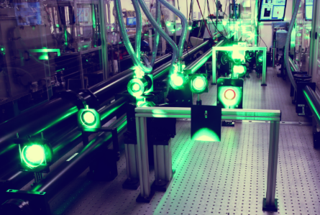
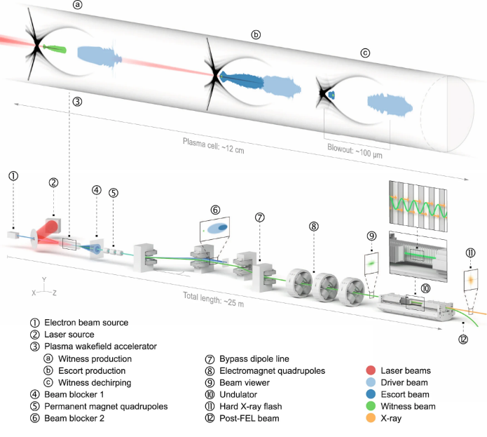
Other key aspects
Synchronous sources
A laser facility as well as an XFEL facility:
High rep. rate femtosecond pumping from 10 nm - 10 µm, as per UK Artemis and Ultra facilities
A high power (multi-PW, >1022 Wcm-2)
and high energy (kJ-class) laser facility as large as budget allows
  Scalable and tunable diode-pumped laser technology (e.g. CLF DiPOLE)
  High repetition-rate (> 10 Hz)
Very high pulse energy (~10s-100s mJ)
  To consider: an additional feature of UK XFEL, or delivered at another facility?
    Transform-limited pulses not necessary.
    Potentially low repetition rate, matched to high power lasers
    What photon energy? High pulse energy more readily accessible <<20 keV
  After NIR/ Visible lasers, terahertz is the most requested synchronous source. Requests for protons, ions and gamma sources need further exploration with Science Team
Central Laser Facility's Gemini facility
Very high photon energy
(>20 keV, to 50-100 keV)
  To consider: an additional feature of UK XFEL, or delivered at another facility?
    Transform-limited pulses not necessary.
    Low repetition rate, matched to high power lasers (for some applications)
    Considering a booster section in FEL-1 line (conventional or plasma)
Next-gen XFELs are expected to be some of the biggest data machines on the planet
Focus is on the following areas:
Data handling
Applications of Machine Learning at an XFEL
Conceptual designs and frameworks to enable Machine Learning
Collaborations with relevant expertise within the UK

Slide 58
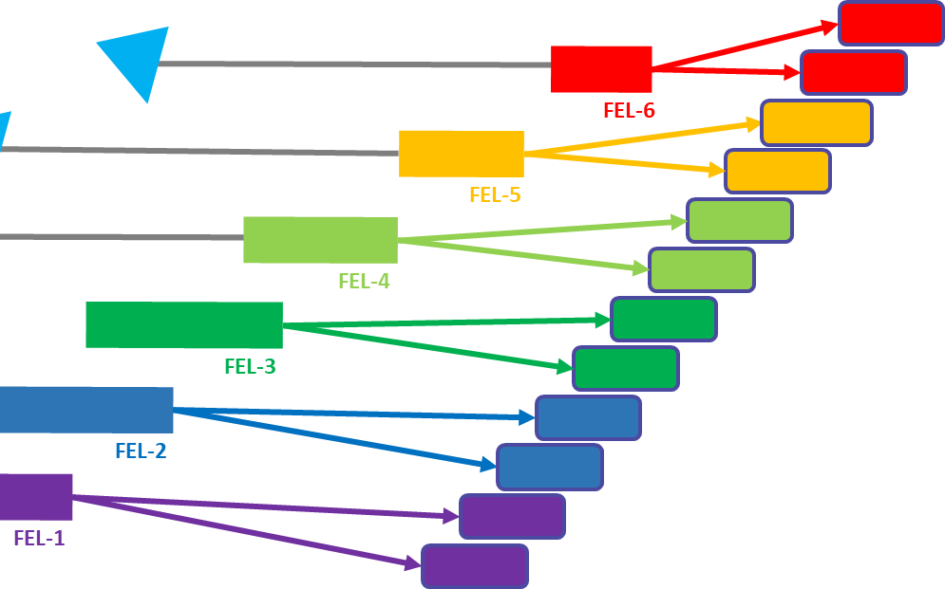

Post-FEL design process
The design process so far has focused on tailoring the key FEL parameters and layout to meet the needs of case studies from the Science Team survey, guided by ongoing iteration with the science sub-teams
We have recently started to focus this process around the experimental instruments:
  Compiled a set of essential end stations from existing XFELs (recognizing that capabilities may evolve significantly or have no present equivalent – several may remain undefined in this phase)
  Identifying expert users from the Science Team and beyond to help draw up specifications
  Work towards matching up provisional end stations with the proposed FEL design (+ expect iteration)

Slide 59

Summary
Just over one year into the conceptual design and options analysis
phase, we’ve made significant progress in producing a
concept to deliver:
  Transform-limited pulses
  A step change in the simultaneous
  operation of multiple end stations
  Evenly spaced, high-rep rate pulses
  Widely separated multiple colour X-rays
Work is progressing in many technical areas (see posters) in collaboration with existing XFELs, with performance and sustainability as key criteria
We’re aiming to identify high impact examples in each science area that really exploit the unique capabilities of the proposed next generation XFEL

Slide 60
Opportunities to engage
Science workshops – every ~3 months, around the UK
Facility design events (plasma acceleration workshop being planned)
How to join the team – contact paul.aden@stfc.ac.uk or direct contact to relevant team members
Website + mailing list: https://xfel.ac.uk/
Central England Townhall (hosted by Diamond, 1st and 2nd May 2024)
Focus discussion topic: Engineering biology, genomics and healthcare
North-East England Townhall (hosted by Sheffield 4th and 5th June 2024)
Focus discussion topic: Energy, environmental and climate technologies
North-West England Townhall (hosted by Royce Institute, 8th and 9th August 2024)
Focus discussion topic: Electronics, photonics and quantum technologies
Wales Townhall (in Cardiff ~ September 2024)
Focus discussion topic: Advanced materials and manufacturing

Slide 61

Thank you
xfel.ac.uk
@STFC_Matters @UKXFEL

Slide 62
UK XFEL:
Townhall on AI, Quantum Computing and Fundamental Physics
18th & 19th January 2024
xfel.ac.uk
Notes:
1274-WP0-prs-0025-v1.0-UKXFEL Community Slides Extended

Slide 63
xfel.ac.uk
@STFC_Matters @UKXFEL

Slide 64
xfel.ac.uk
@STFC_Matters @UKXFEL

Slide 65
xfel.ac.uk
@STFC_Matters @UKXFEL

Slide 66


