Slide 1
Physics using XFELs and high intensity lasers
Stuart Mangles
stuart.mangles@imperial.ac.uk
UK XFEL Townhall - Fundamental Physics, Quantum Computing and AI

Slide 2


What do I mean by “high intensity”?
Laser power 0.1 – 10 PW
  Pulse energy: 1 – 100 J
  Pulse duration: ≈ 40 fs
  Focused intensities up to 10 PW.µm⁻² = 10²⁴ W.cm⁻²
Sunlight on Earth: 1400 W.m⁻²
  Focus to 10 µm
  10 PW.µm⁻² would need 30 km diameter lens!

Slide 3
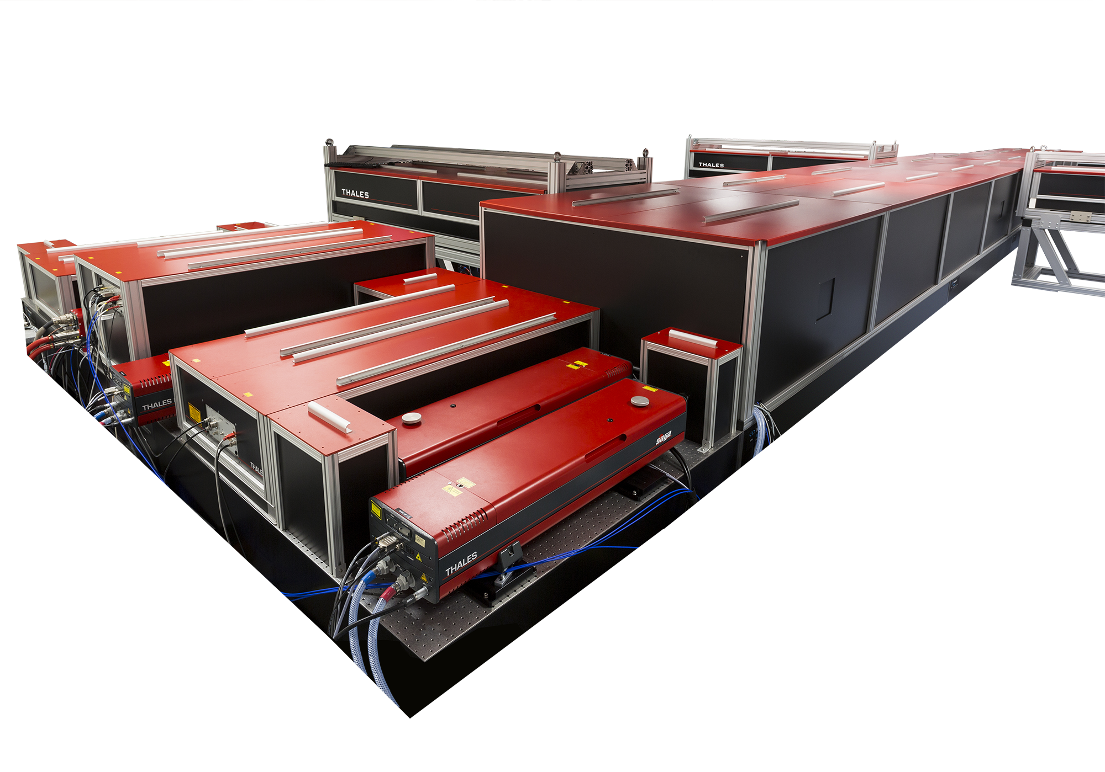
What do I mean by “high intensity”?
Laser power 0.1 – 10 PW
  Pulse energy: 1 – 100 J
  Pulse duration: ≈ 40 fs
  Focused intensities up to 10 PW.µm⁻² = 10²⁴ W.cm⁻²
Some existing and upcoming lasers
  Gemini @ RAL: 0.3 PW
  ELI-NP @ RAL: 10 PW
  ZEUS @ UMich: 3 PW
  ReLaX @ EuXFEL: 0.3 PW
  MEC-U @ LCLS: 1 PW
  EPAC @ RAL: 1 PW (2025)
Thales PW laser system*
*other PW laser suppliers are available

Slide 4
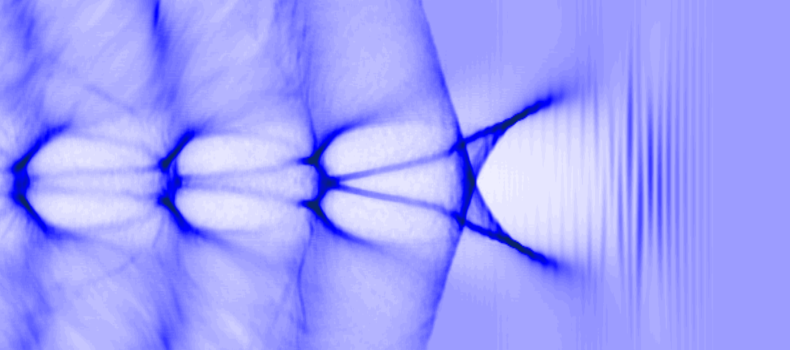
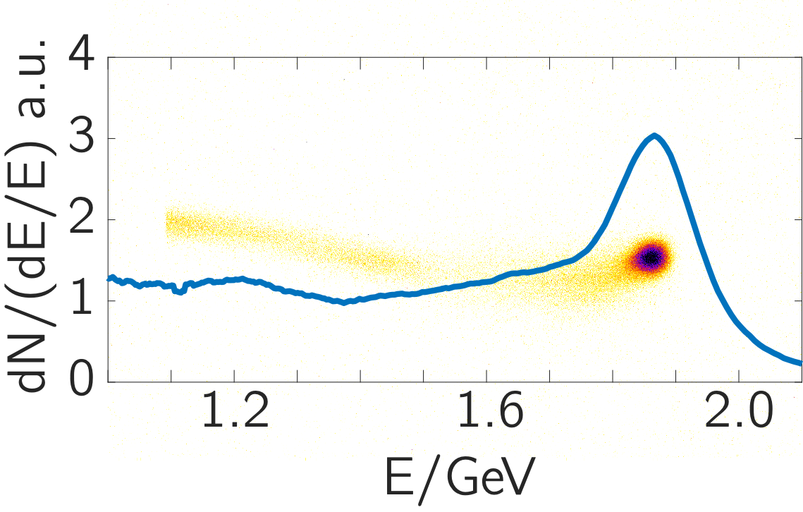
Applications of High intensity lasers
Laser wakefield accelerators
  gigaelectronvolt energy electrons
  micrometre size; femtosecond duration

Slide 5
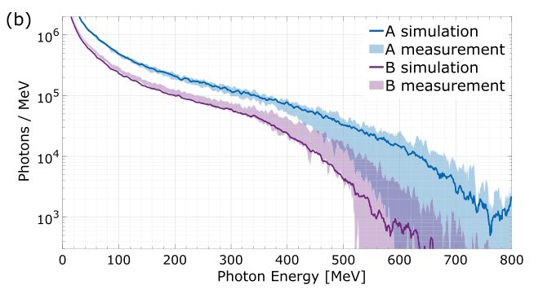
Applications of High intensity lasers
electron beam
gamma-rays
metal target
Kettle NJP 2021
Laser wakefield accelerators
  Secondary radiation
    Bremsstrahlung: collision of e-beam with solid target
    Broadband bright gamma-rays

Slide 6
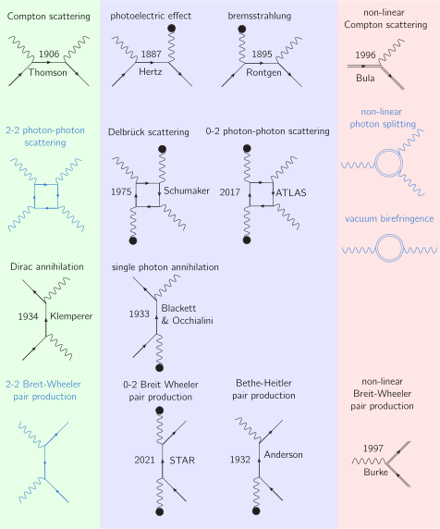
Photon-Photon Physics
Key processes not yet observed
Collisions between two real photons
  Inelastic scattering: Breit Wheeler pair production
  Elastic Scattering: light-by-light scattering
Leptons and photons in strong background fields
  Vacuum birefringence
  Photon splitting

Slide 7
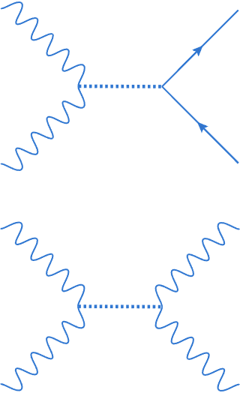
Photon-Photon Physics
Key processes not yet observed
Collisions between two real photons
  Inelastic scattering: Breit Wheeler pair production
  Elastic Scattering: light-by-light scattering
  Possible route to constrain Beyond Standard Model physics,
    e.g. axions, mini charged particles...
“axion Breit Wheeler”
“axion photon-photon scattering”

Slide 8


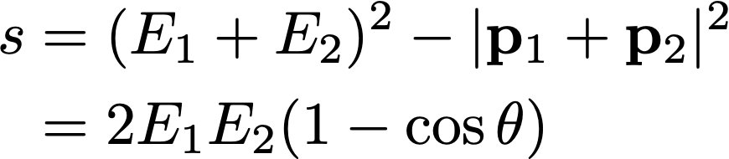



Photon-Photon Physics
Invariant mass of collision
photons with energy E₁, E₂ and momenta p₁, p₂
to create particle-antiparticle pair

Slide 9
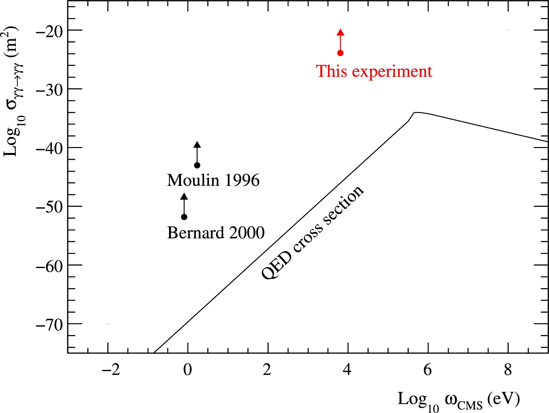

Photon-Photon Physics with XFELs
Collisions at SACLA measured bound √s = 13 keV
Bound is factor of 10²⁰ above QED prediction of cross section
Photon 1 | Photon 2 | (θ = π/2)
9.2 keV | 9.2 keV | 0.013 MeV
Inada Phys Lett B 2014, Yamaji Phys Lett B 2016

Slide 10
Photon Photon Physics with LWFAs
Collide Gamma rays from LWFA
  up to E₁ = 600 MeV
With X-rays from a laser heated plasma
  ML band in Ge E₂ ≈ 1.4 keV
Photon 1 | Photon 2 | (θ = π/2)
9.2 keV | 9.2 keV | 0.013 MeV
1.4 keV | 375 MeV | 1.02 MeV
Inada Phys Lett B 2014, Yamaji Phys Lett B 2016

Slide 11
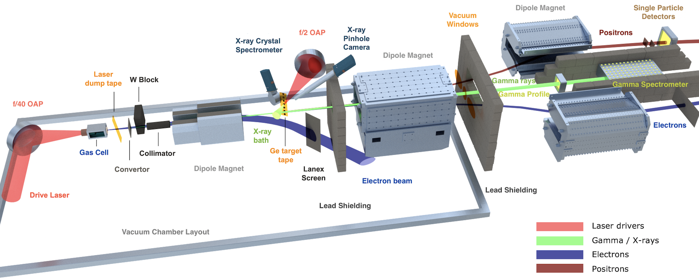
Photon Photon Physics with LWFAs
Kettle NJP 2021
Gamma rays from LWFA up to E₁ = 600 MeV
X-rays from a laser heated Ge plasma interaction E₂ ≈ 1.4 keV

Slide 12
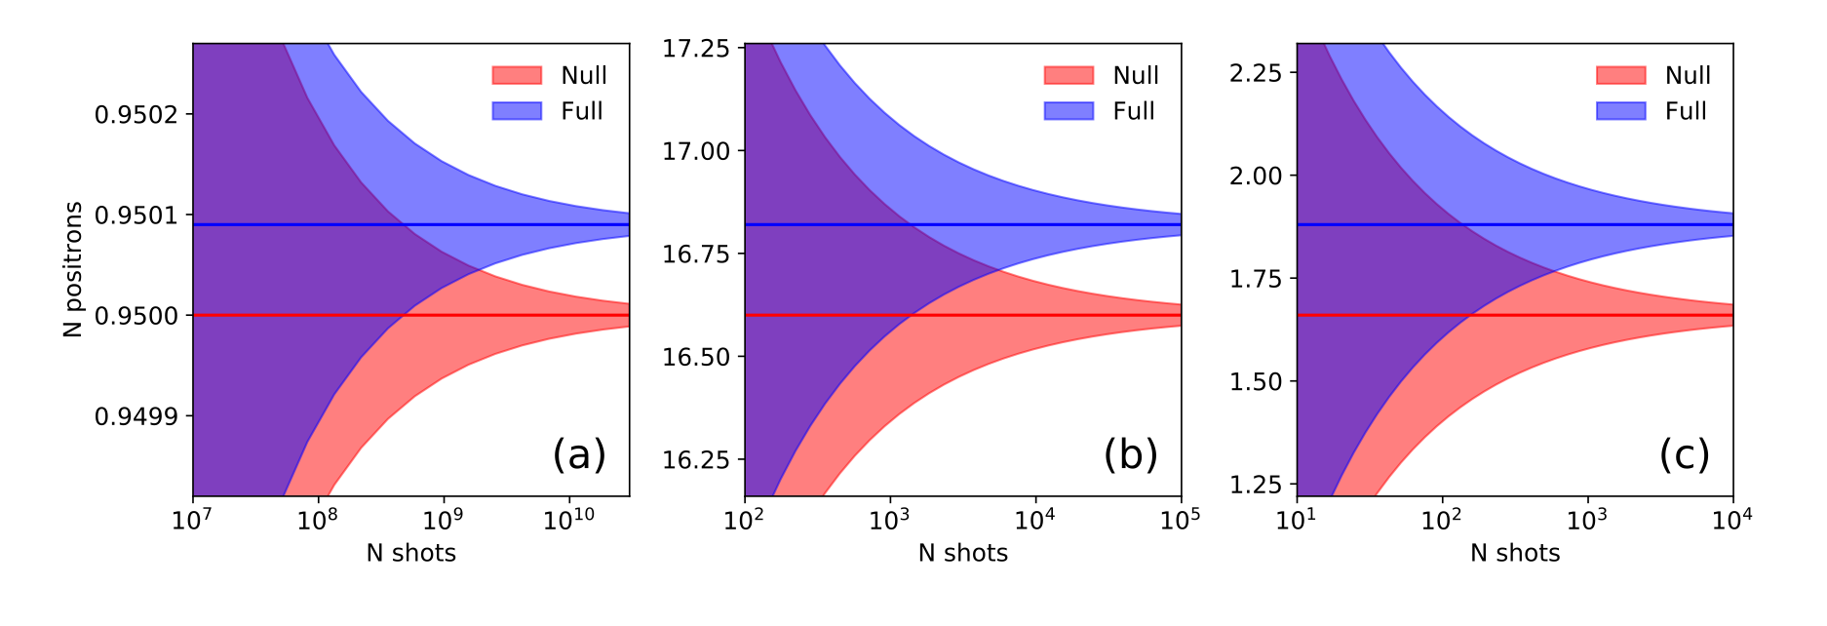
Photon Photon Physics with LWFAs
Breit Wheeler
Kettle NJP 2021
Photon flux too low to see signal in 2018 Gemini run (10⁹ shots would have been needed!)
  1000 shots would be required with optimum gamma beam and improvements to background

Slide 13
Photon Photon Physics with LWFAs
Light-by-Light Scattering
We can use the fact that we don’t observe effect of scattering on gamma spectrum to bound the elastic scattering cross section to bound the cross section at √s ≈ 2 MeV
  “only” factor 10¹⁵ above QED prediction
R Watt in preparation

Slide 14
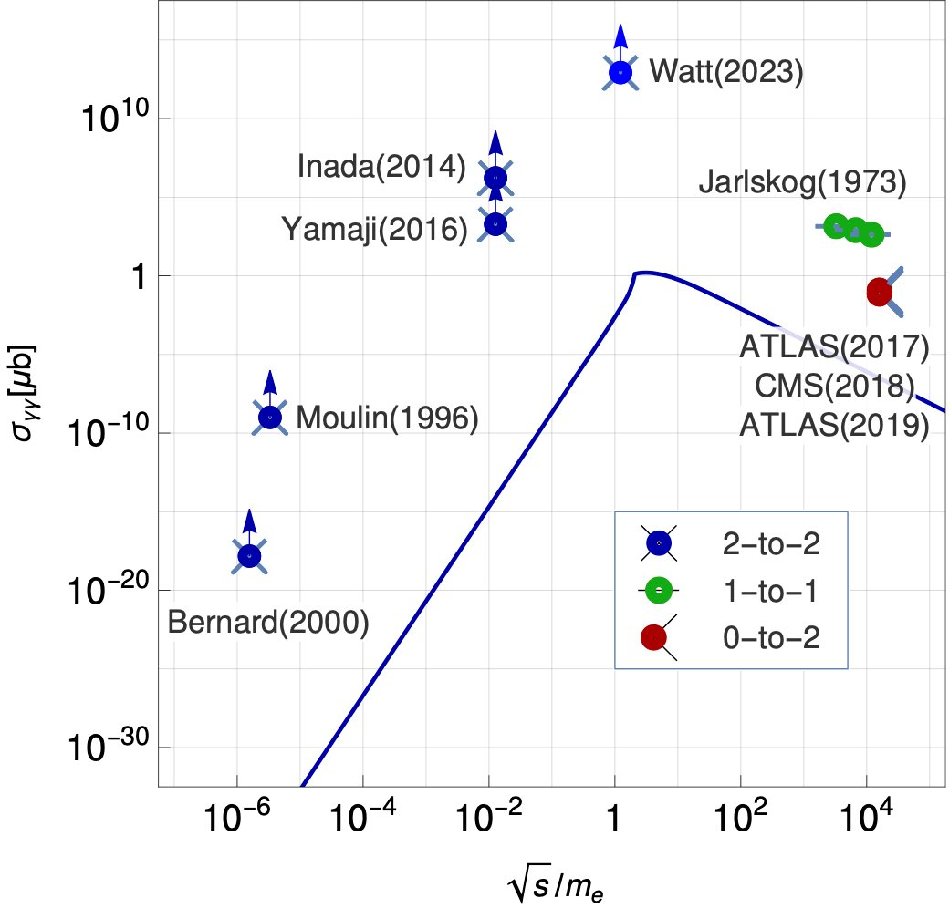
Photon Photon Physics with LWFAs
Light-by-Light Scattering
We can use the fact that we don’t observe effect of scattering on gamma spectrum to bound the elastic scattering cross section to bound the cross section at √s ≈ 2 MeV
  “only” factor 10¹⁵ above QED prediction
R Watt in preparation

Slide 15
Photon Photon Physics with LWFAs
Light-by-Light Scattering
We can use the fact that we don’t observe effect of scattering on gamma spectrum to bound the elastic scattering cross section to bound the cross section at √s ≈ 2 MeV
“only” factor 10¹⁵ above QED prediction
Watt in preparation

Slide 16
Photon Photon Physics with LWFAs + XFEL
More X-ray photons per shot
  by at least a factor of two (based on 10¹² photons per shot)
Higher X-ray energy
  access pair production at lower gamma energy
  more gamma photons
Collision at larger angle
  access pair production at lower gamma energy
  more gamma photons
Photon 1 | Photon 2 |  | θ
9.2 keV | 9.2 keV | 0.013 MeV | π/2
1.4 keV | 375 MeV | 1.02 MeV | π/2
8 keV | 35 MeV | 1.02 MeV | π

Slide 17
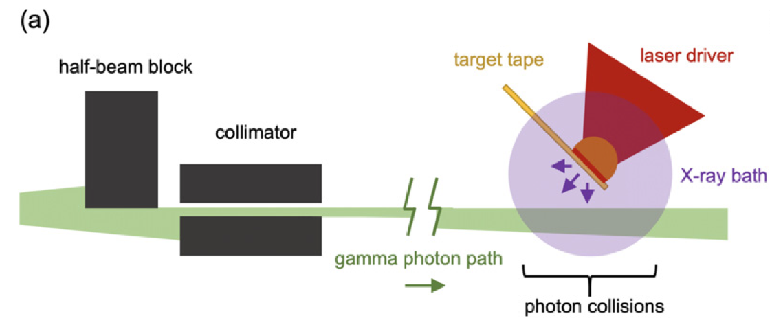
Photon Photon Physics with LWFAs + XFEL
No material near the collision
  Much lower background: better signal to noise ratio
  Less need for collimators: more gamma photons
  No solid target tape drive: more shots
gamma photons
XFEL x-rays
LWFA + Laser plasma set up
LWFA + XFEL set up

Slide 18
Photon photon physics with LWFAs + XFEL
Observation of 2 photon BW pair production
  Number highly dependent on LWFA and XFEL parameters so I won’t speculate…
  ... but everything is going in the right direction. It is highly feasible
Observation of 2-2 photon-photon scattering
  As photons energies are more similar, scattered photons are now detectable….
LWFA + Laser plasma set up
LWFA + XFEL set up

Slide 19
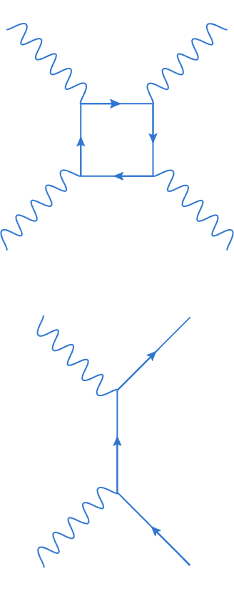
Conclusion
Laser wakefield accelerator + XFEL beam would be a unique platform for photon-photon physics
  First observation of 2 photon BW
  First observation of 2-2 photon-photon scattering
    Capable of probing physics beyond standard model
Requires PW laser beam for LWFA
  PW laser would also be suitable for strong-field QED (see Tom Blackburn’s talk)
  LWFA driver can also produce bright X-rays for probing extreme conditions (but that’s another story)
  XFELs can probe intense laser-plasma interactions

