Slide 1




Real-time observation of conical intersections in biomolecules using XFELS
Giulio Cerullo
Dipartimento di Fisica- Politecnico di Milano
giulio.cerullo@polimi.it
UK XFEL Townhall – fundamental physics, quantum computing and AI

Slide 2
Outline of the presentation
INTRODUCTION TO CONICAL INTERSECTIONS
ULTRAFAST DYNAMICS OF THE PRIMARY EVENT OF VISION
ULTRAFAST PHOTOPROTECTION MECHANISMS IN DNA
OPPORTUNITIES TO STUDY CONICAL INTERSECTIONS WITH XFELS

Slide 3
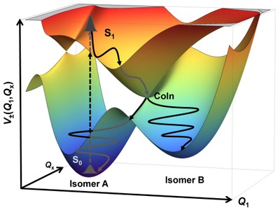
Introduction to conical intersections

Slide 4
Adiabatic molecular dynamics
To describe molecular dynamics one typically adopts the Born-Oppenheimer approximation, separating the electronic and the nuclear coordinates in the wavefunction.
This approximation solves the Schrödinger equation for the electrons at given fixed nuclear positions and obtains the electronic energies as a function of those fixed nuclear coordinates, the so-called potential energy surfaces (PES).

Slide 5
Non-adiabatic molecular dynamics
There are regions of the potential energy landscape where the electronic and nuclear degrees of freedom become strongly mixed and the Born-Oppenheimer (adiabatic) approximation breaks down.
Such conical intersections are “doorways” through which the photoexcited wavepacket is efficiently funneled to a lower energy electronic state, thus accounting for efficient non-radiative relaxation.
Yarkony, Rev. Mod. Phys. 68, 985–1013 (1996).
Levine and Martinez, Annu. Rev. Phys. Chem. 58, 613–634 (2007).

Slide 6
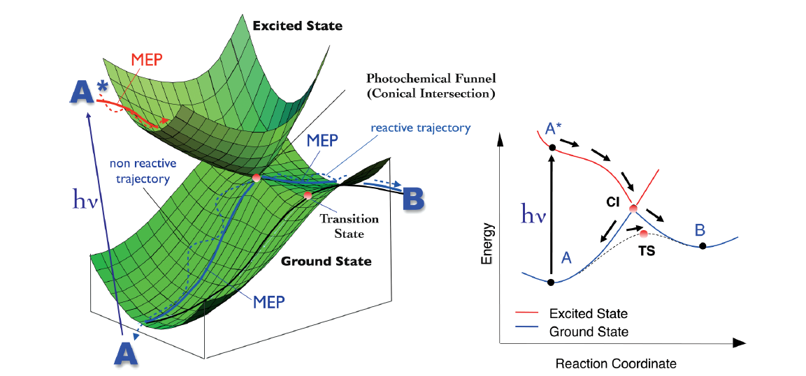
Conical intersections
Collections of molecular geometries in which two (or more) electronic states are isoenergetic, which form a high-dimensional ‘seam’, any point of which can serve as a doorway through which molecules may pass to reach the ground electronic state.
I .Schapiro et al., Photochem. Photobiol. Sci., 2011, 10, 867

Slide 7
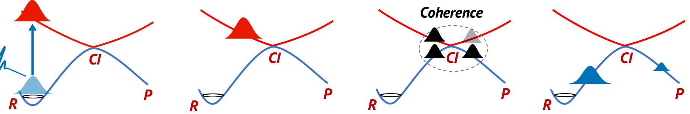
Conical intersection: a quantum beam splitter
When the wave packet approaches a conical intersection, non-adiabatic couplings lead to the creation of a coherence between the interacting electronic states.
Upon crossing the conical intersection, the wave packet enters a pure electronic-nuclear quantum regime and acquires a quantum mechanical topological phase, known as the geometric or Pancharatnam-Berry phase, which determines the interference between the interacting electronic states and its evolution.

Slide 8
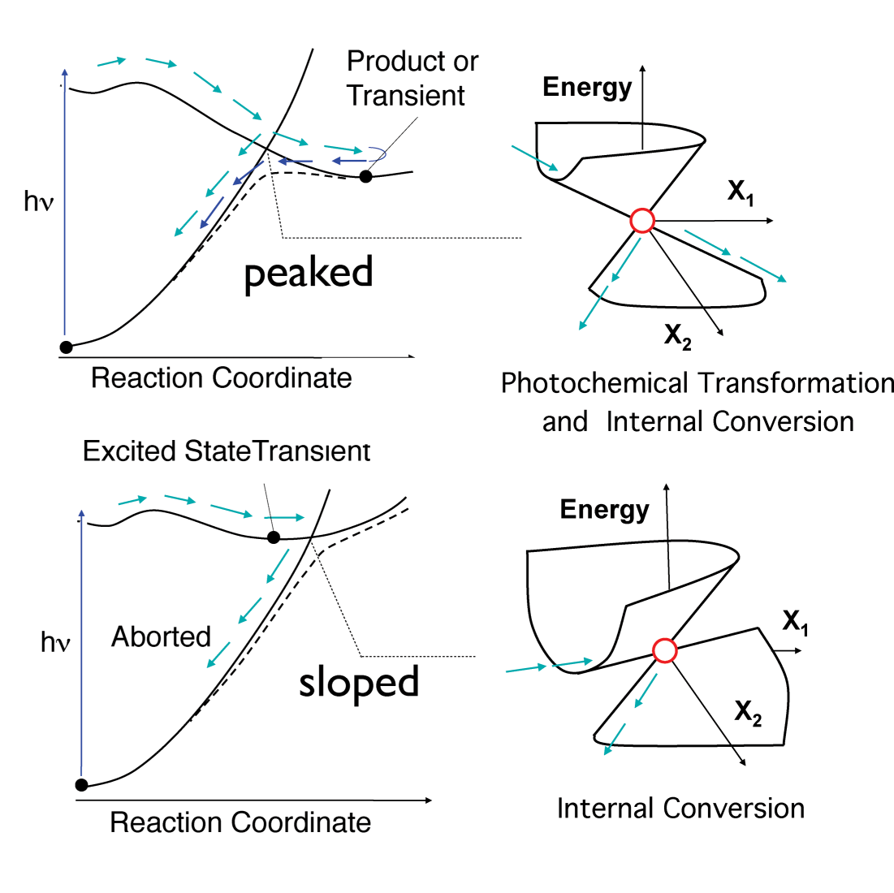
Peaked and sloped conical intersections
T. Martinez, Nature 467, 412 (2010).

Slide 9
Prototypical photochemical reaction paths
TS
FC
FC
FC
Energy
CI
CI
CI
P
P
R
R
R
Reaction Coordinate
Reaction Coordinate
Reaction Coordinate
Photochemistry
Ultrafast
Radiationless
Photochemistry
Decay
Peaked CI (rhodopsin)
Sloped CI (DNA)
G. Cerullo and M. Garavelli, PNAS 117, 26553 (2020).

Slide 10
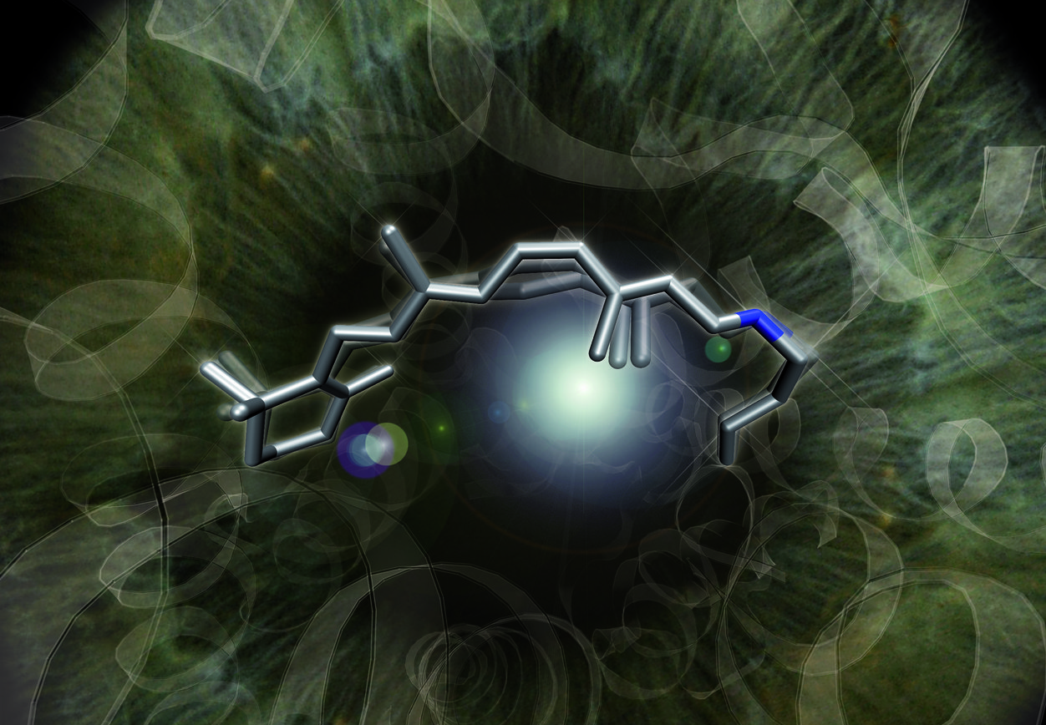
Ultrafast dynamics of the primary event of vision

Slide 11
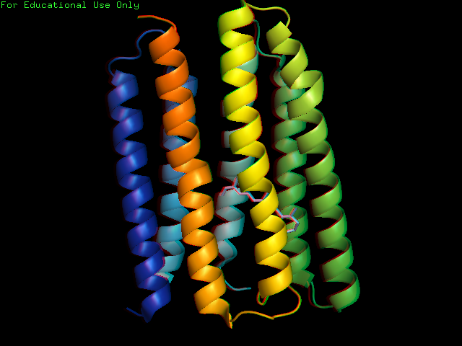
Retinal Proteins – Building Blocks in all domains of living organisms
Retinal Proteins – Structure:
Trans-membrane proteins, consist of seven α-helices.
An internal pocket in which the chromophore Retinal (vitamin-A aldehyde) is bound.
Retinal is attached through a Schiff base linkage to a Lysine residue in the seventh helix.

Slide 12
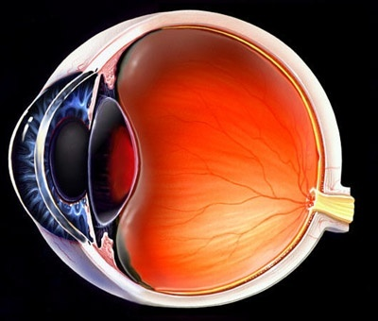
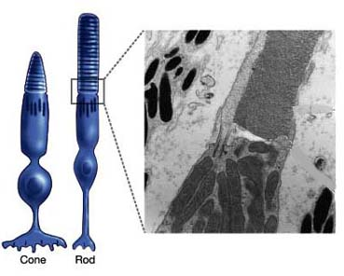
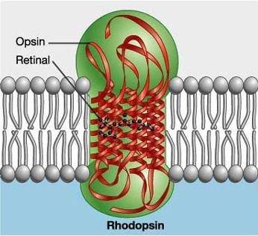
Rhodopsin: the Visual Pigment in the Retina
The photoreceptors in the retina are contained
in the cones (colour vision) and in the rods (night vision)
The rhodopsin molecule consists of a protein pocket (opsin)
containing a light-sensing chromophore (retinal)

Slide 13
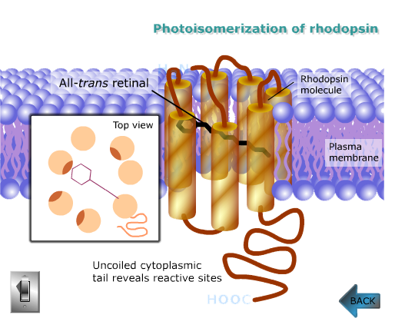
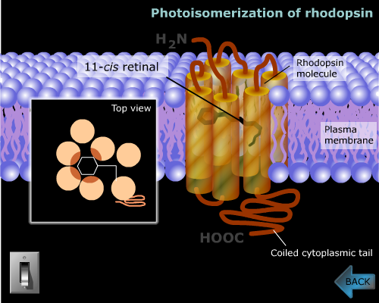
Ultrafast isomerization initiates vision

Slide 14
Following Rhodopsin isomerization in real time
11-cis Rhodopsin
All-trans photoproduct
11
11
12
12
Photoinduced
Absorption (PA)
S₁
Energy
S₀
Pump 500 nm
Sub-20-fs pulses
Very broad tunability
Stimulated
Emission (SE)
Isomerization coordinate

Slide 15
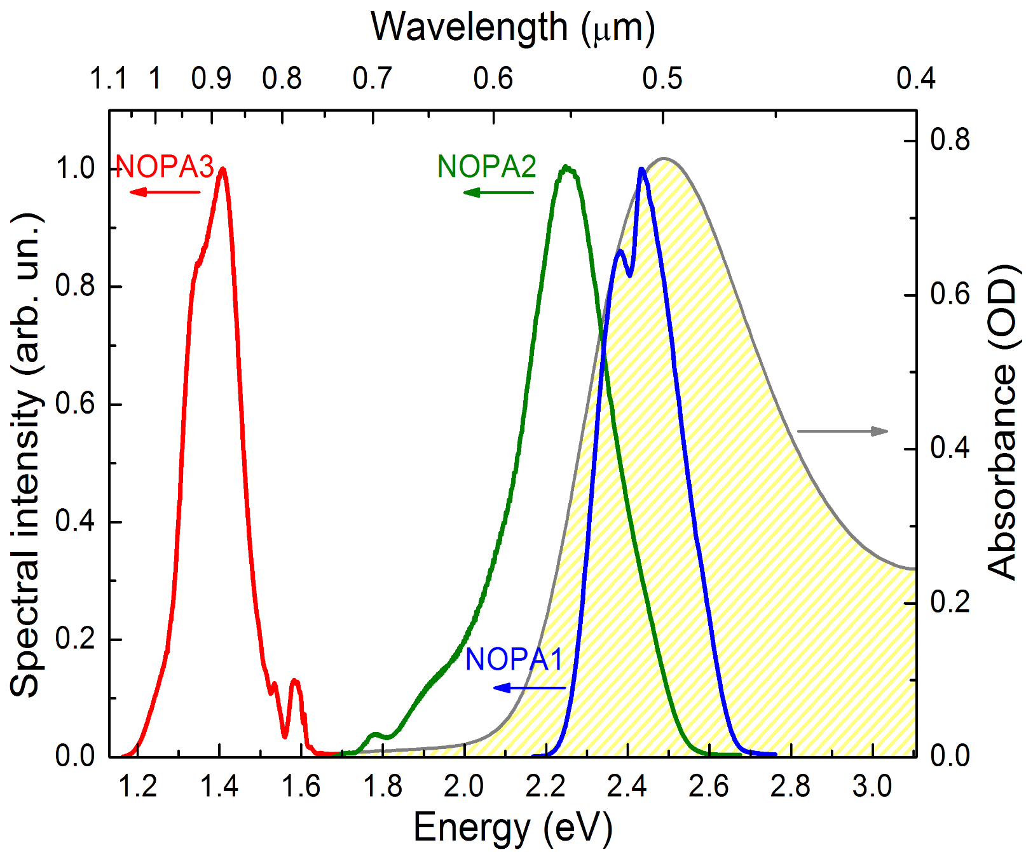
Ultrafast spectroscopy of rhodopsin
D. Polli, L. Lüer & G. Cerullo, Rev. Sci. Instrum. 78, 103108 (2007)
13 fs PROBE
7 fs PROBE
10 fs PUMP

Slide 16
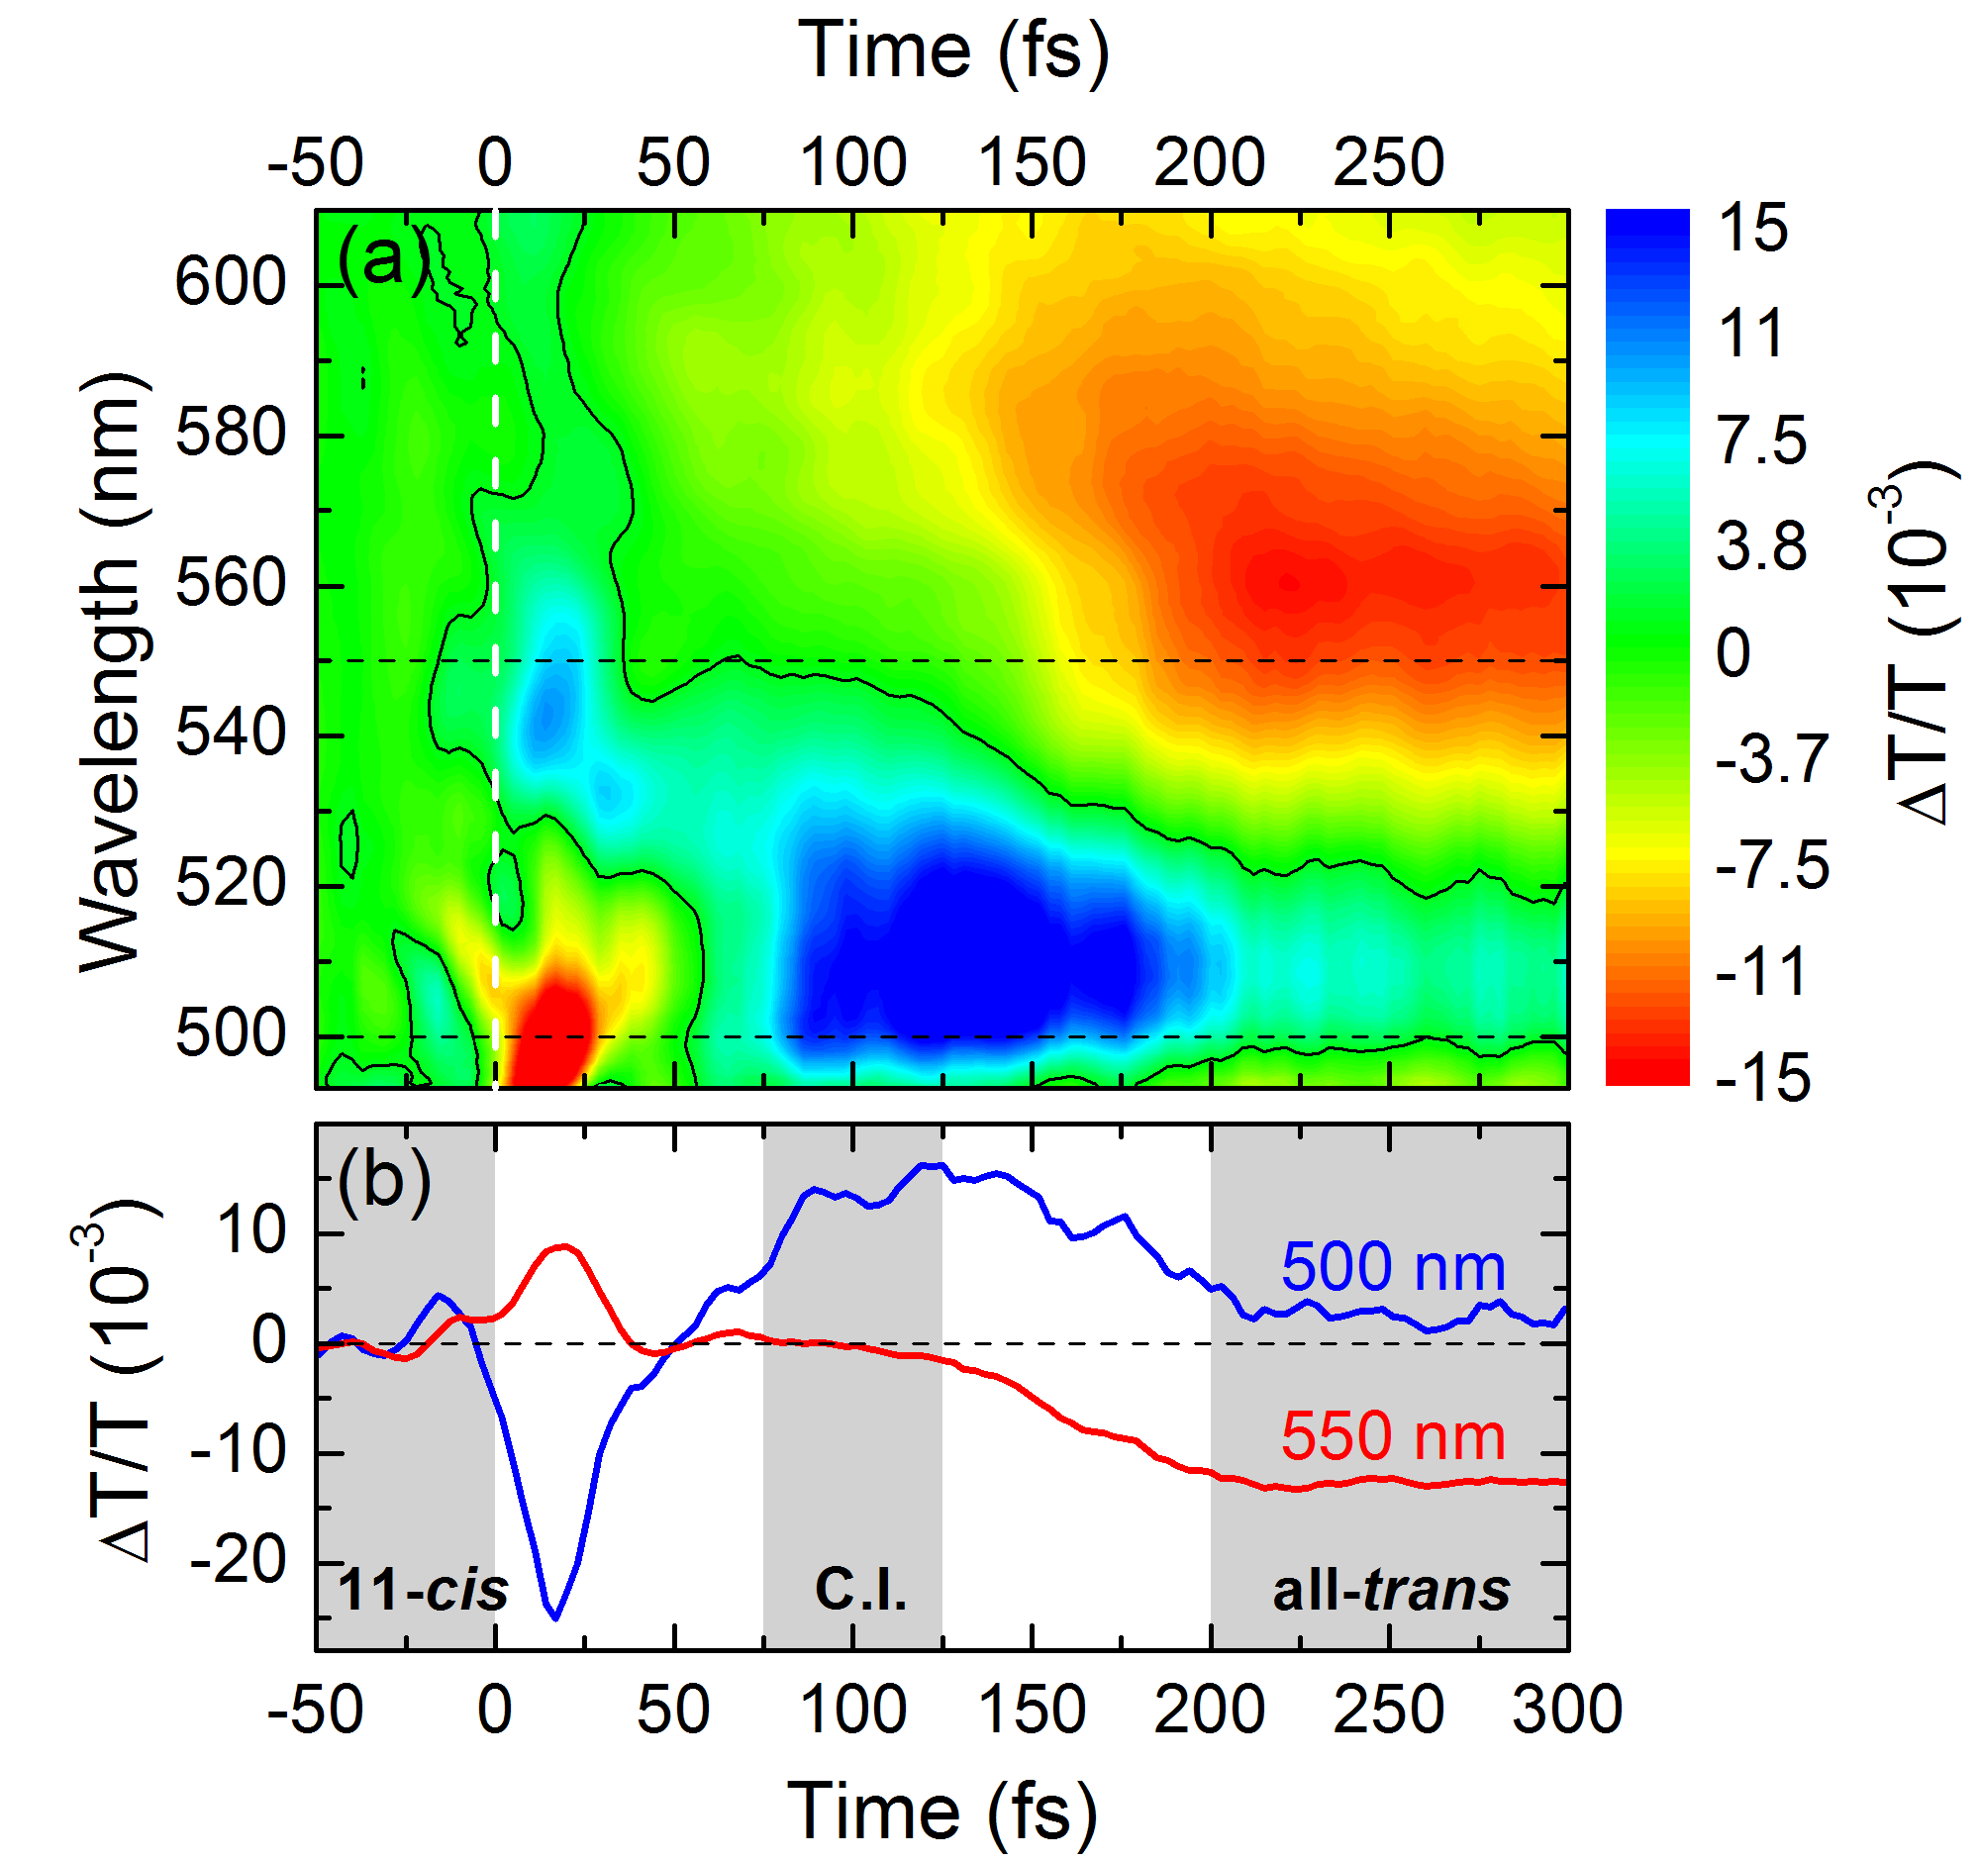
Watching the Isomerization of Rhodopsin
Build-up of the photoproduct photoinduced absorption with 200 fs delay
PA
11
12
11
12
PA

Slide 17
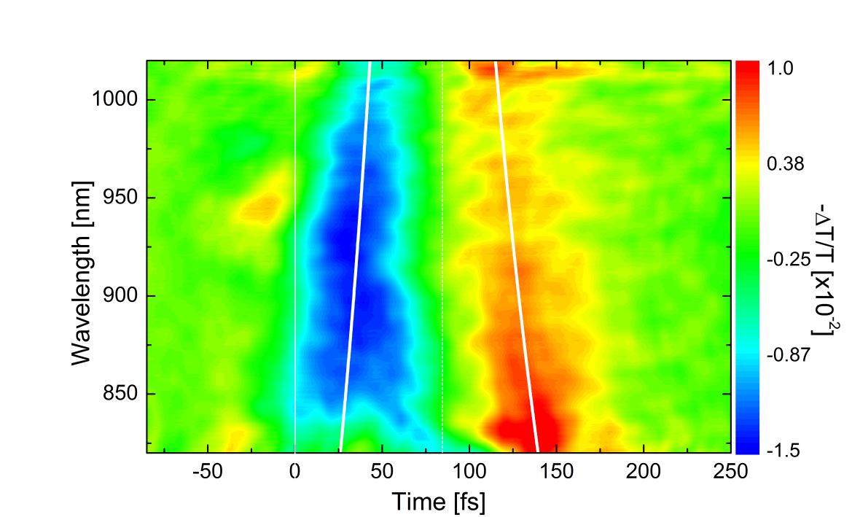

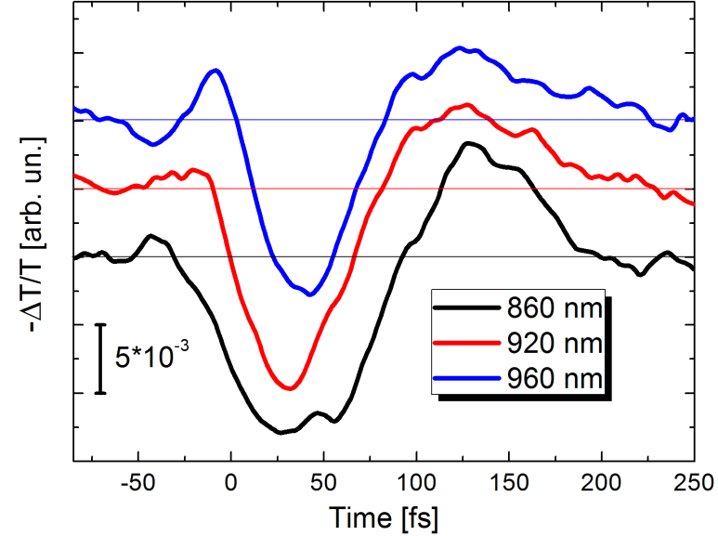
Probing the Rhodopsin in the Near-Infrared
D.Polli et al., Nature 467, 440 (2010)
SE
PA
Red shift
PA
SE
SE
PA
Blue shift
Notes:
17

Slide 18
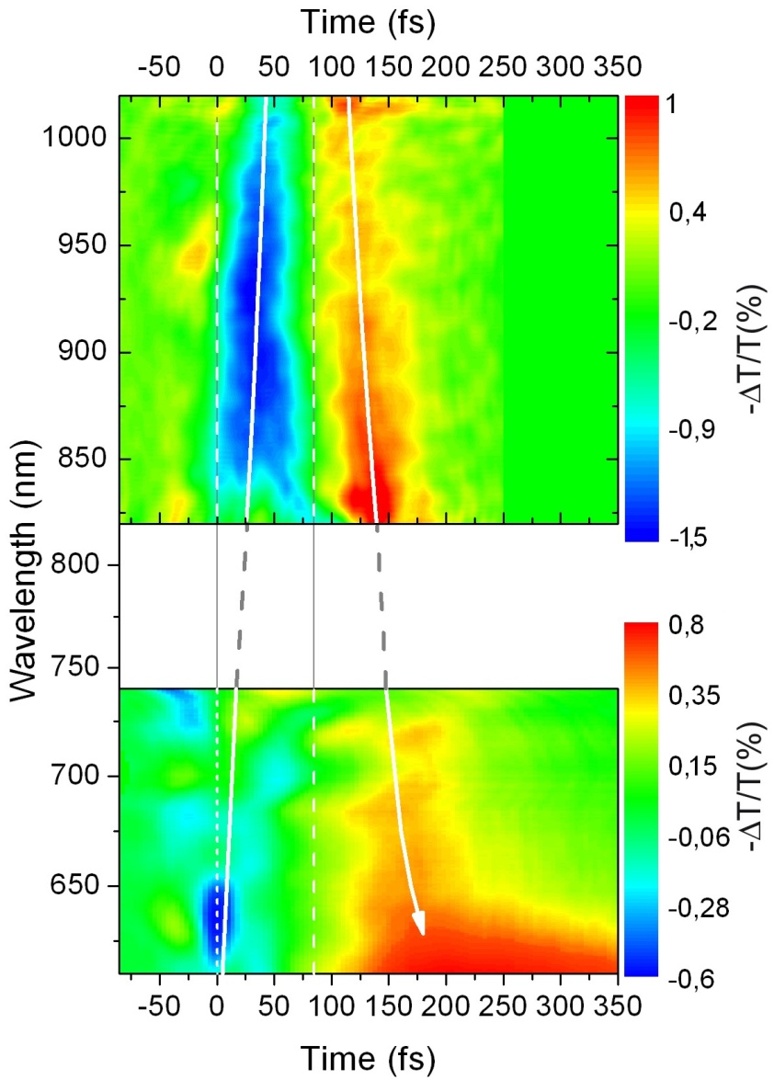
Combined Visible-Infrared Measurements
D.Polli et al., Nature 467, 440 (2010)
SE
PA
PA
SE
Notes:
18

Slide 19


Numerical simulations: QM&MM approach
MM
QM
MM
QM
Molecular region where atoms are directly involved in the breaking
and forming of chemical bonds described at the QM level
(usually a rather small portion of the molecular system)
Remaining atoms (protein environment and/or solvent molecules) described at the MM level (MM region is usually very large and can include many thousands of atoms)

Slide 20
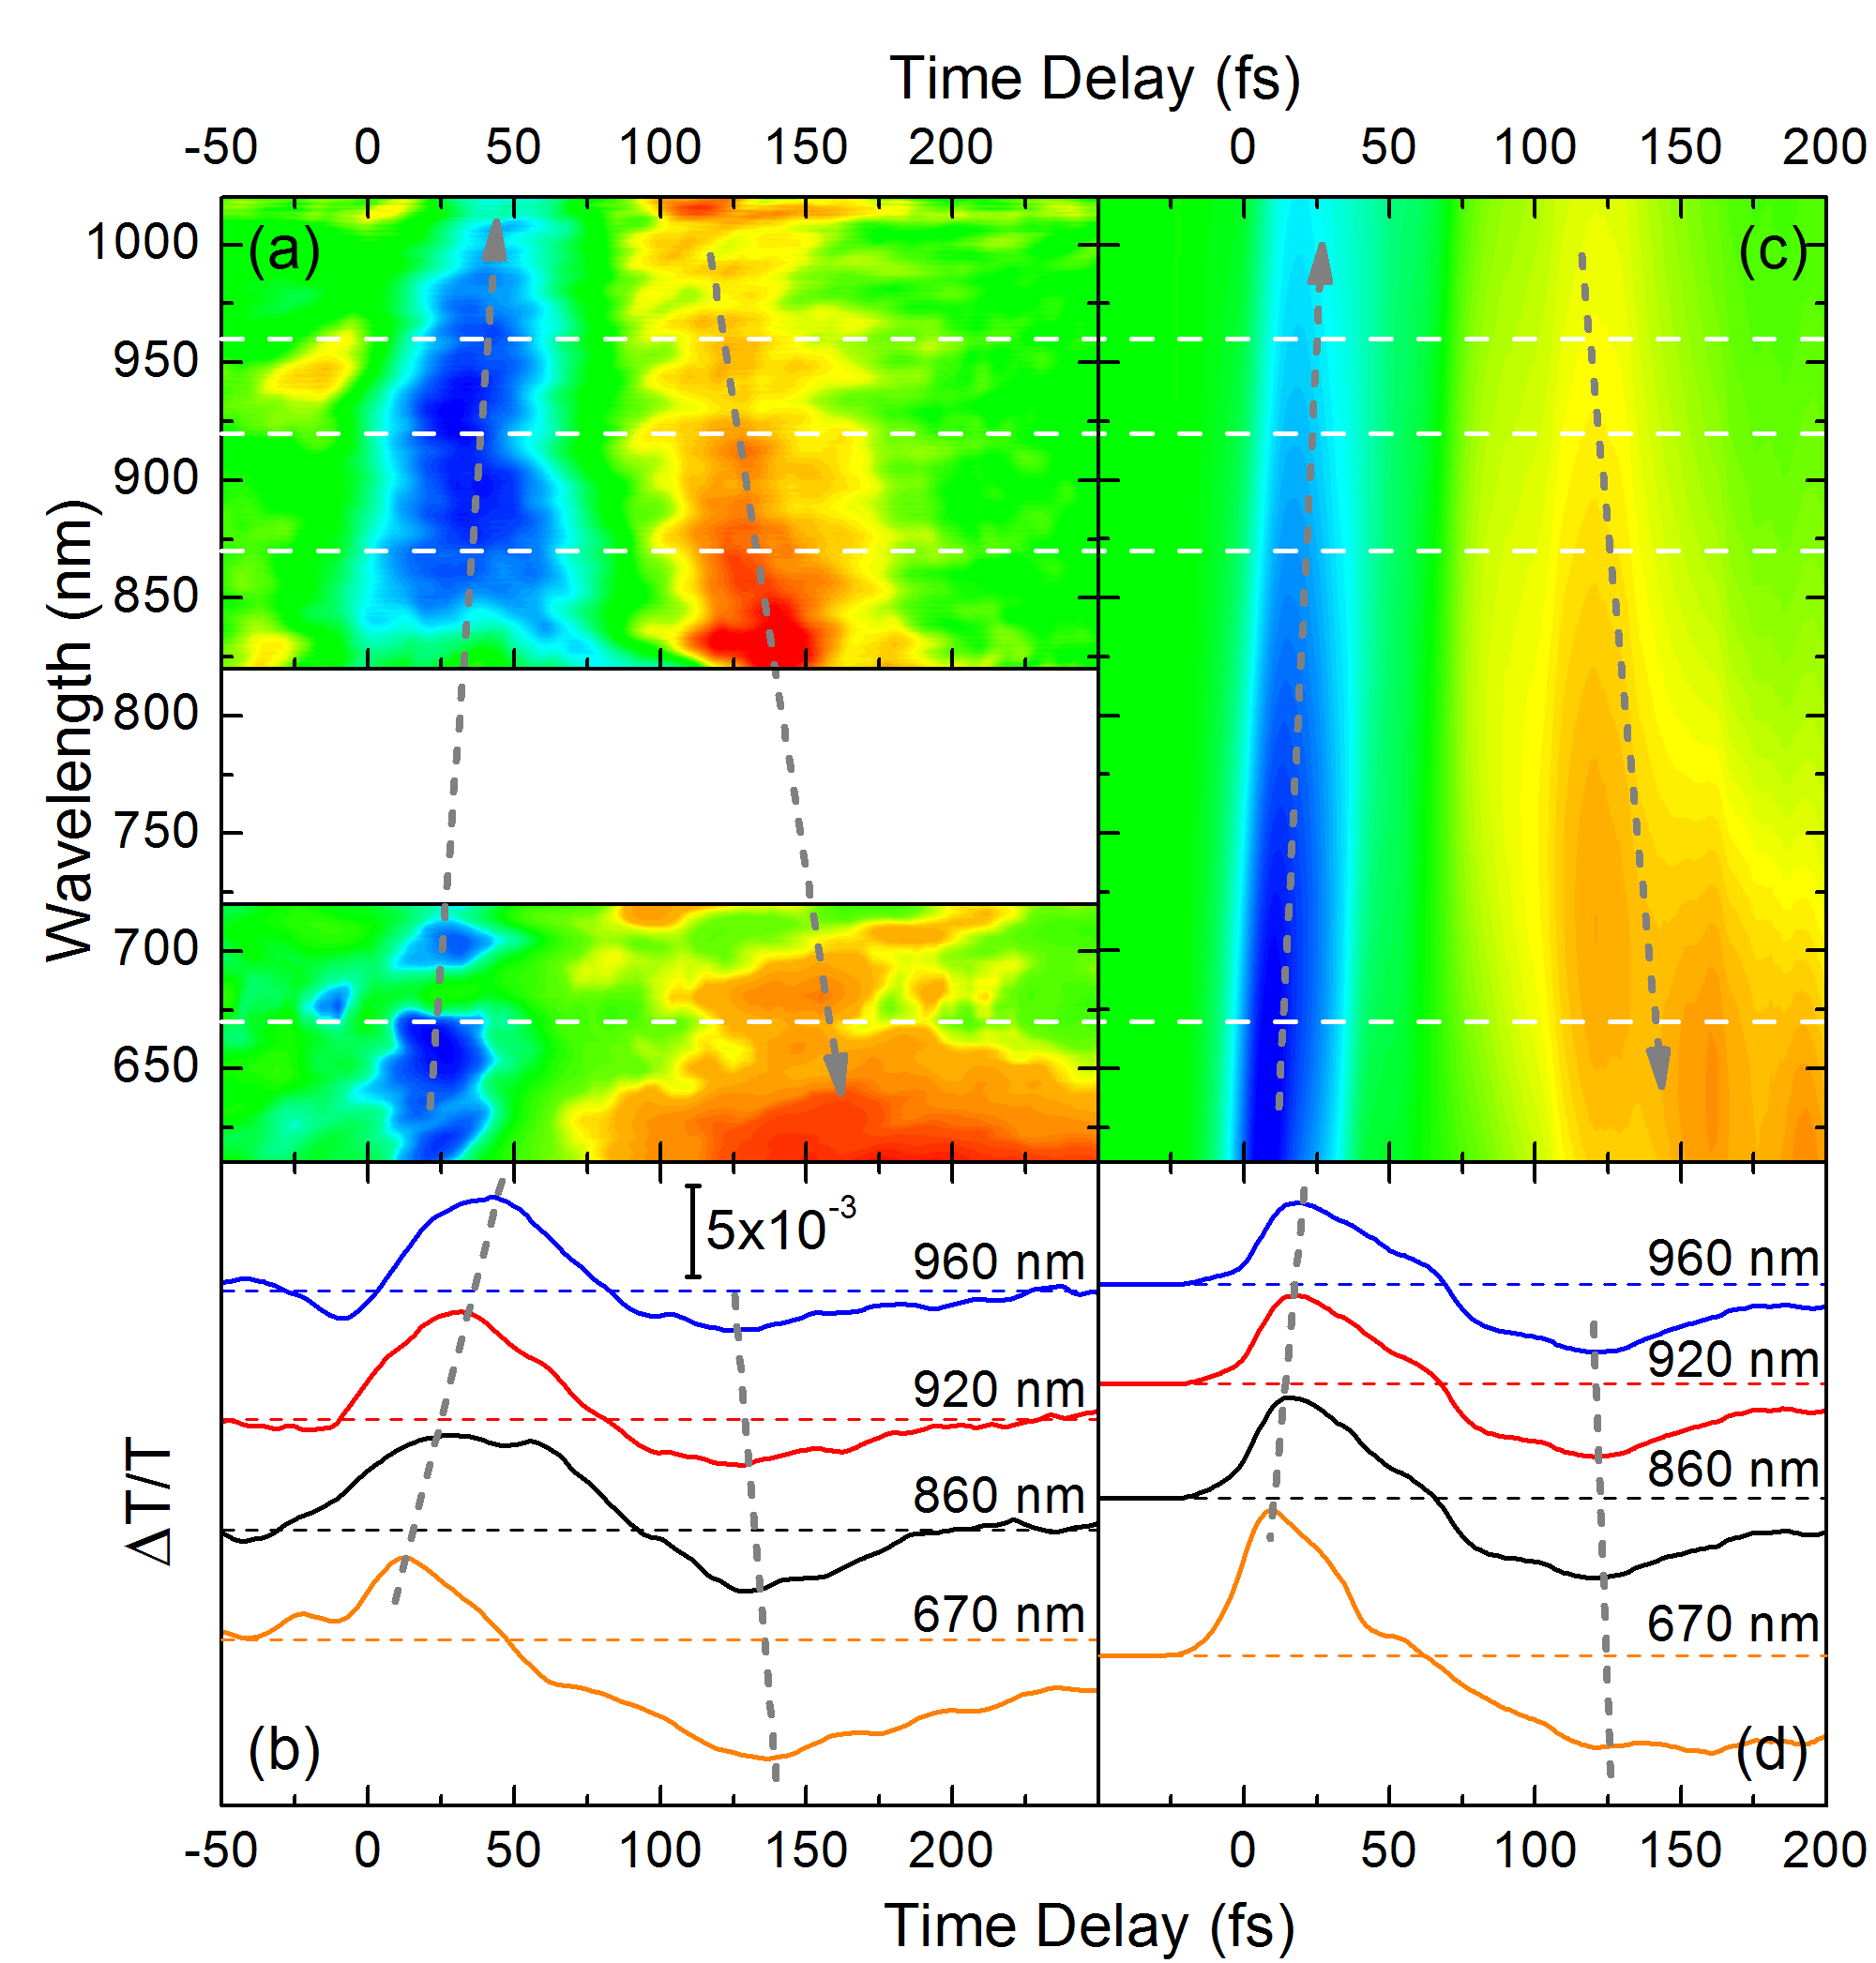
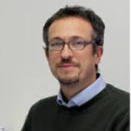
Comparison with Numerical Simulations
Experiments
Theory
D.Polli et al., Nature 467, 440 (2010)
Notes:
20

Slide 21
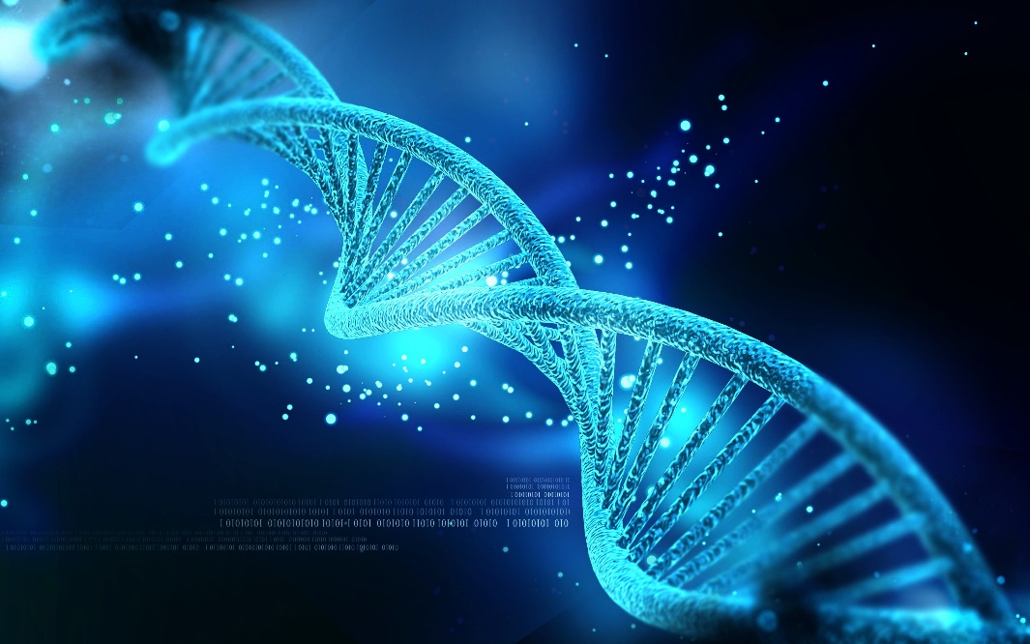
Ultrafast photoprotection mechanisms in DNA

Slide 22
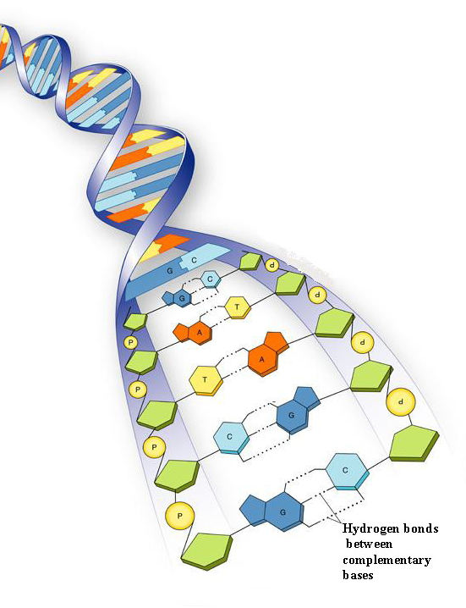
Nucleic acids
Nucleoside
nucleobase
sugar (deoxyribose or ribose)
Nucleotide
nucleobase
sugar (deoxyribose or ribose)
phosphate group
22

Slide 23
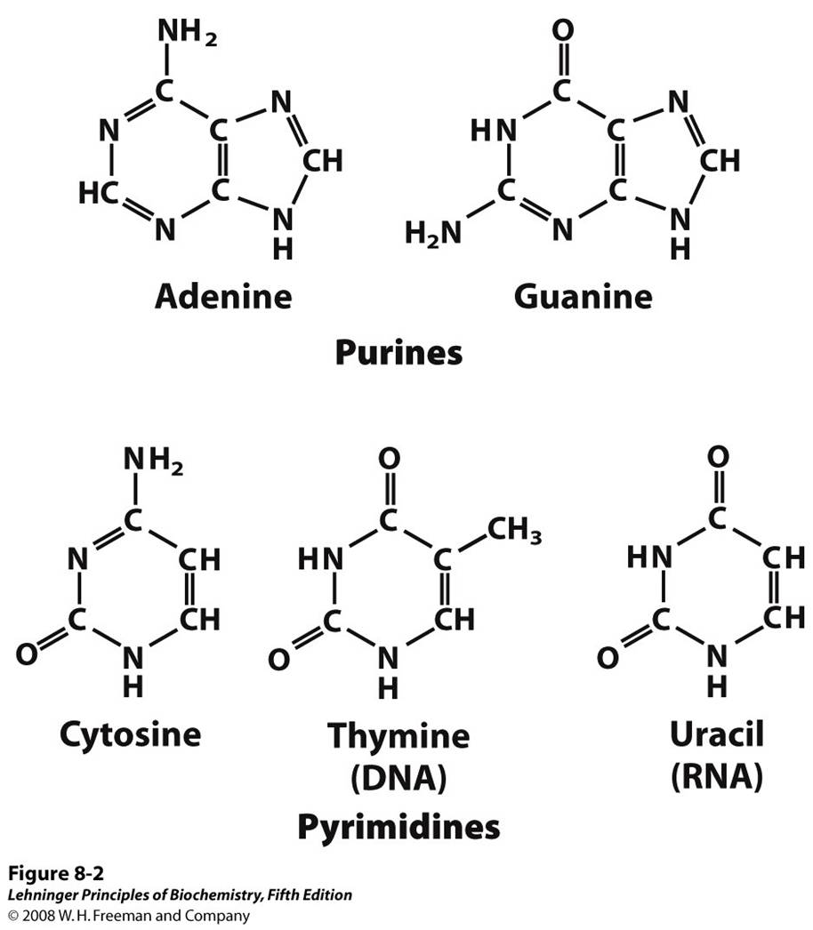
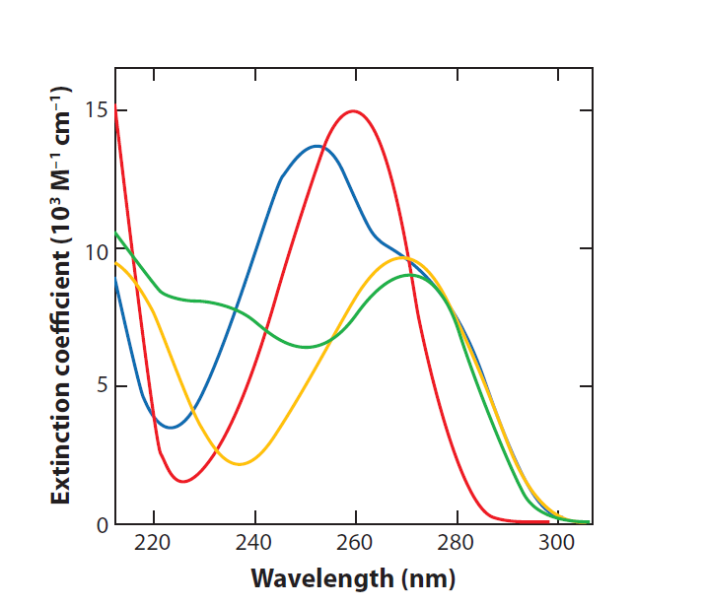
Nucleobases
Strong absorption in the UV range
Gua
Cyt
Ade
Thy
C. Middleton et al., Annu. Rev. Phys. Chem. 60, 217 (2009)
C. Crespo-Hernández et al., Nature 436, 1141 (2005)
C. Crespo-Hernández et al., Chem. Rev. 104, 1977 (2004)
23

Slide 24
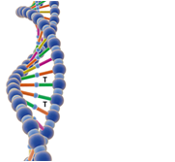
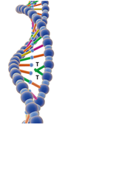
Nucleic acids and UV light
UV light absorption might cause damages (formation of pyrimidine dimers, disruption in the strand, error during the copy and genomic lesions…)
UV light
Canonical nucleobases have photoprotective mechanisms to prevent photochemical reactions: more than 99.9% of the photons are converted in a harmless way on the ultrafast timescale
Aim: understand ultrafast relaxation dynamics in DNA
24

Slide 25
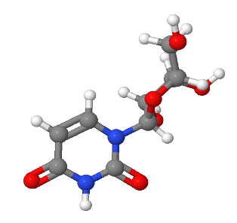
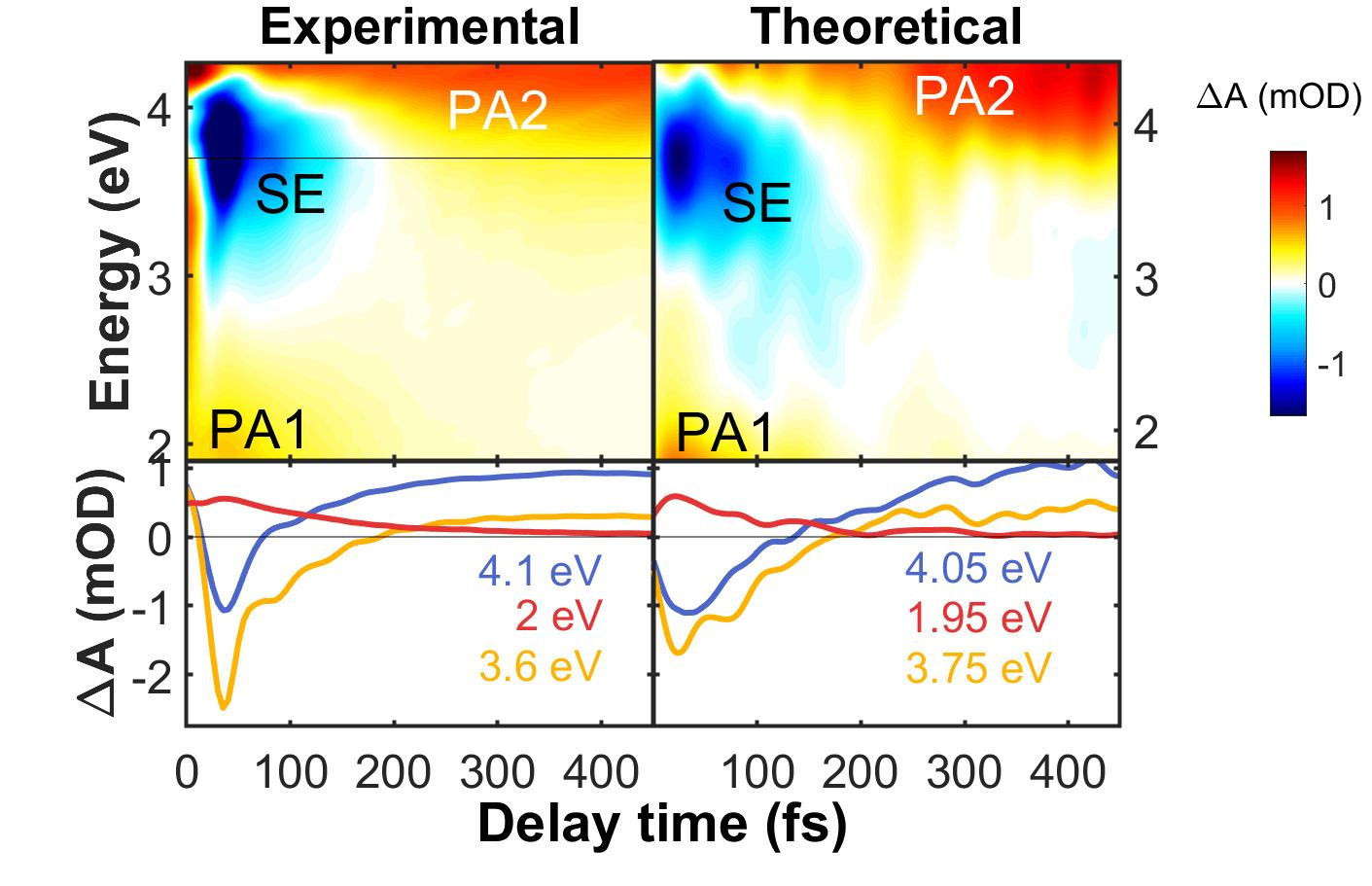

Transient absorption of uridine
In uridine we observe short-lived SE and PA signals, which disappear in ≈ 100 fs and give way to a long-lived PA signal
R. Borrego-Varillas et al., Nat. Commun. 12, 7285 (2021).
Notes:
25

Slide 26





Transient absorption of uridine
S₁
S₂
PA1
PA2
SE
S₀
We observe a ballistic wavepacket motion to the conical intersection with the ground state, which is reached in ≈ 100 fs
The decay is promoted by the puckering mode of the aromatic ring
Notes:
26

Slide 27
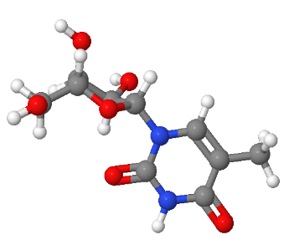
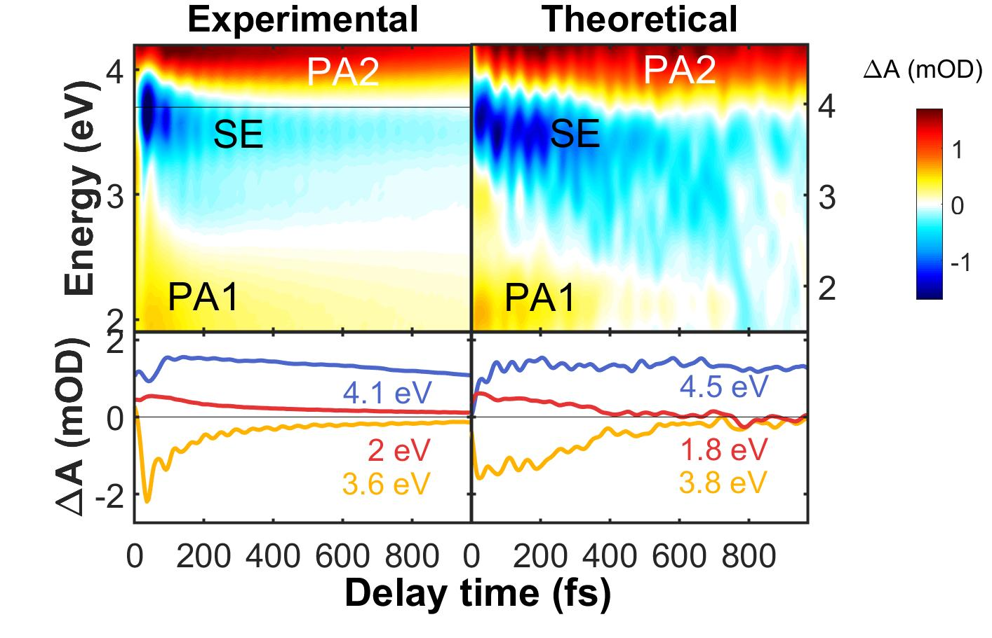
Transient absorption of thymidine
In thymidine the excited state takes much longer (≈ 1 ps) to reach the conical intersection with the ground state
The longer lifetime is explained by the larger inertia of the methyl group in the puckering motion of the ring
R. Borrego-Varillas et al., Nat. Commun. 12, 7285 (2021).
Notes:
27

Slide 28
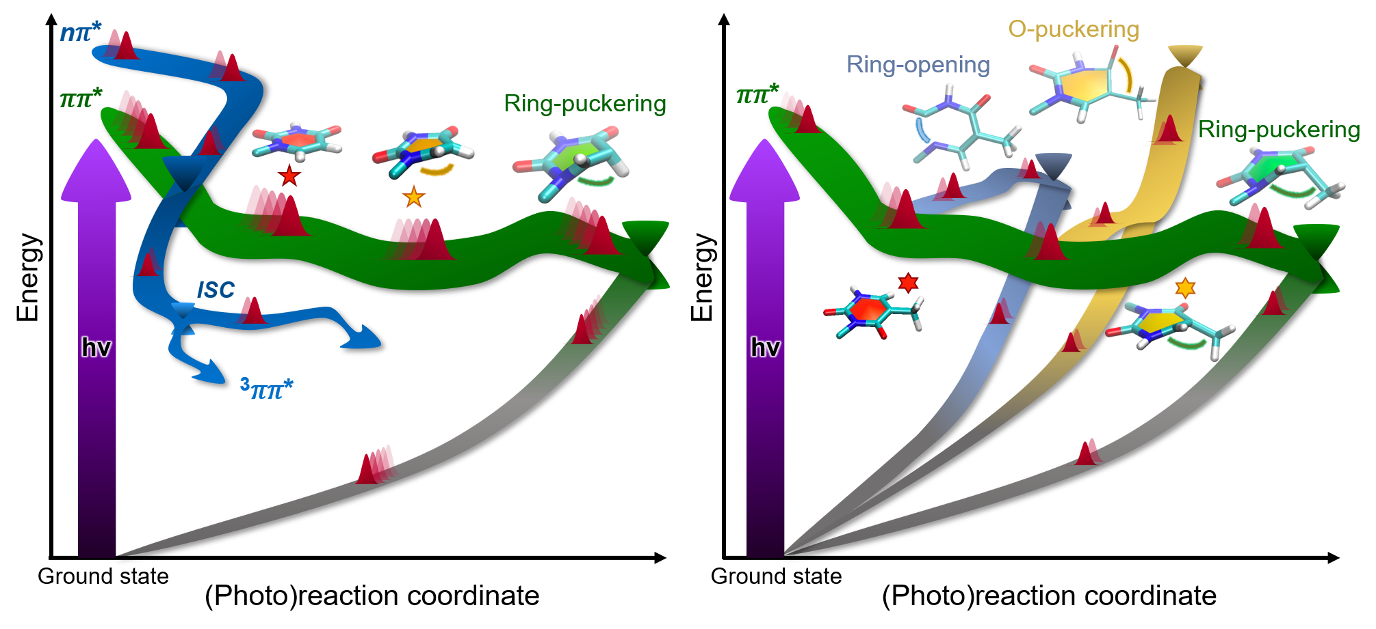
Energy landscape and deactivation pathways
Uridine
Thymidine
Due to its longer excited state lifetime, thymidine has the opportunity to explore more deactivation pathways, and is more prone to damaging photochemical reactions.
R. Borrego-Varillas et al., Nat. Commun. 12, 7285 (2021).
Notes:
28

Slide 29
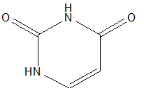
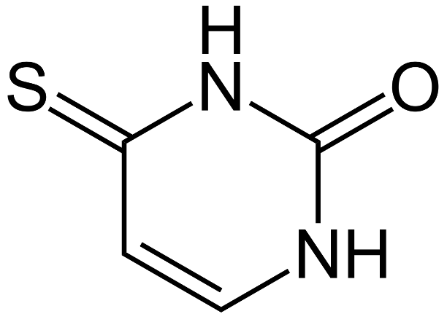
From nucleobases to thiobases
uracil
4-thiouracil
Thiobases are non-canonical nucleobases obtained by replacing oxygen with sulphur atoms. This substitution dramatically changes the photophysics.
In thiobases long-lived triplet states are formed via ultrafast intersystem crossing.
Due to the high transfer efficiency to the triplet states and the high rate of singlet oxygen formation, thiobases are used as photosensitizers in photodynamic therapy
Notes:
29

Slide 30
Ultrafast intersysterm crossing in 4-thiouracil
We observe a clear mismatch between the time scales for the decay of the SE from the bright ππ* state (76±16 fs)and the buildup of the PA of the triplet state (225 ± 30 fs).
R. Borrego-Varillas et al., J. Am. Chem. Soc. 140, 16087 (2018).
Notes:
30

Slide 31
Ultrafast intersysterm crossing in 4-thiouracil
Theory predicts that a dark nπ∗ state mediates the ISC from the bright ππ∗ state to the triplet.
This dark state is however not observed in visible spectroscopy.
R. Borrego-Varillas et al., J. Am. Chem. Soc. 140, 16087 (2018).
Notes:
31

Slide 32
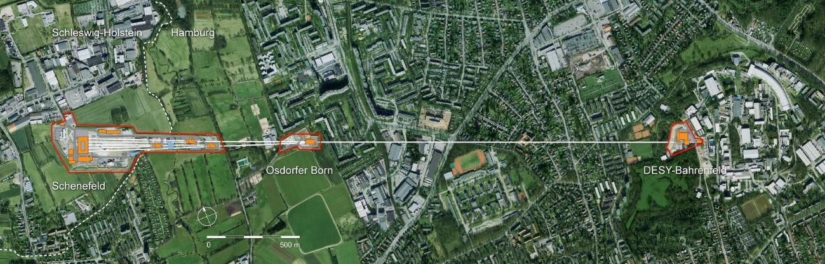
Opportunities to study conical intersections with XFELs

Slide 33
Novel spectroscopic windows on conical intersections
Ultrafast soft X-ray pulses (100-500 eV) allow probing element specific transitions from core levels
Attar et al., Science 356, 54–59 (2017)
Kobayashi et al., Science 365, 79–83 (2019)
Direct information on structural dynamics («the molecular movie») can be obtained from:
ultrafast X-ray diffraction
ultrafast electron diffraction
Pande et al., Science 346, 1242-1246 (2018)
Nogly et al., Science 361, eaat0094 (2018)
Yang et al., Science 361, 64–67 (2018)
Yang et al., Science 368, 885–889 (2020)
Notes:
33

Slide 34
UV-visible versus X-ray excitations
UV-visible excitations X-ray excitations
X-ray excitations involve transitions from core orbitals.
They are element specific and sensitive to chemical and local environment shift.
Notes:
34

Slide 35

Time-resolved NEXAFS of azobenzene
NEXAFS: Near-Edge X-ray Absorption Fine Structure
Computation of the N1s→ valence band transition energies. Transition from core level to unoccupied π* valence orbital.
F. Segatta et al., Faraday Discuss. 221, 245 (2020).
Notes:
35

Slide 36
Time-resolved NEXAFS of azobenzene
Blue shift of the 1s→π* transition.
Appearance of the background-free 1s→n transition to the nitrogen lone pair where a hole has been created.
F. Segatta et al., Faraday Discuss. 221, 245 (2020).
Notes:
36

Slide 37
Time-resolved NEXAFS of thymine
Build-up of the background-free 1s→n transition corresponding to the ππ* → nπ* internal conversion.
Notes:
37

Slide 38

The TRUECARS technique
Transient redistribution of ultrafast electronic coherences in attosecond Raman signals (TRUECARS) allows to directly monitor the passage of a wavepacket through a conical intersection.
Kowalewski et al., Phys. Rev. Lett. 115, 193003 (2015)
Keefer et al., PNAS 117, 24069 (2020)
Notes:
38

Slide 39
The TRUECARS technique
TRUECARS uses a hybrid pulse sequence consisting of a visible pump pulse followed by two phase-locked XUV pulses, a broadband one (with attosecond duration) and a narrowband one (with few-femtosecond duration).
TRUECARS thus observes electronic coherences in the time domain, analogously to the vibrational coherences measured in CARS
Notes:
39

Slide 40
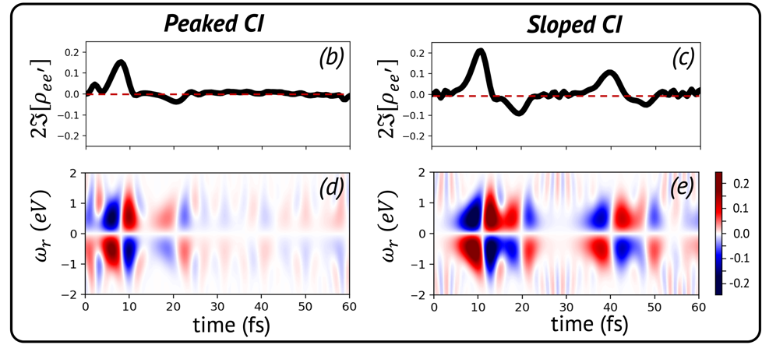
The TRUECARS technique
TRUECARS provides an unambiguous direct probe of conical intersections and delivers information about their topology, allowing one to distinguish between peaked and sloped CI topologies.
TRUECARS has never been experimentally implemented and requires the generation of phase-locked XUV pulse pairs.
Notes:
40

Slide 41
Phase-locked XUV pulse pairs from FERMI
A. Wituscheck et al., Nat. Comm 11, 883 (2020)
Notes:
41

Slide 42
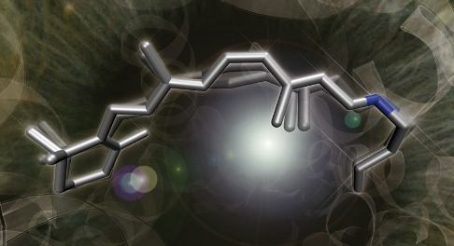

Conclusions
Conical intersections preside over excited state processes in biomolecules which lead to efficient energy storage/dissipation
Isomerization of rhodopsin in the primary event of vision
Ultrafast photoprotection mechanisms in DNA
Plenty of opportunities to visualize the dynamics of conical intersections with XFELs
TRUECARS allows direct visualization of the quantum nature and the topology of conical intersections
Giulio Cerullo
Notes:
42

