Slide 1
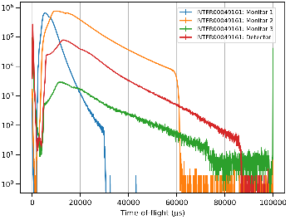
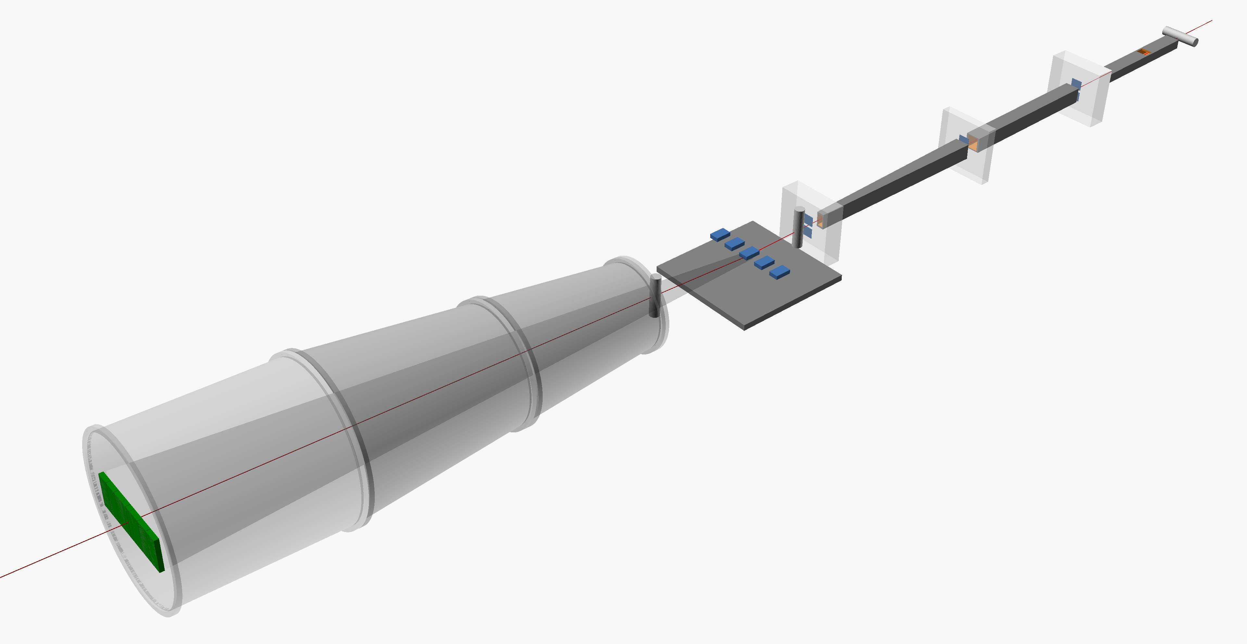
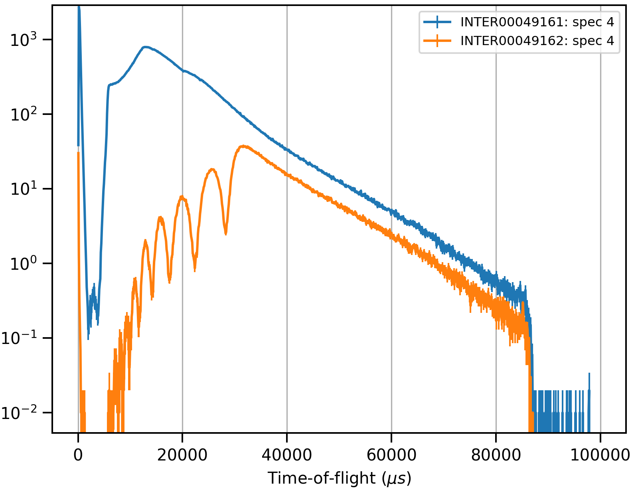

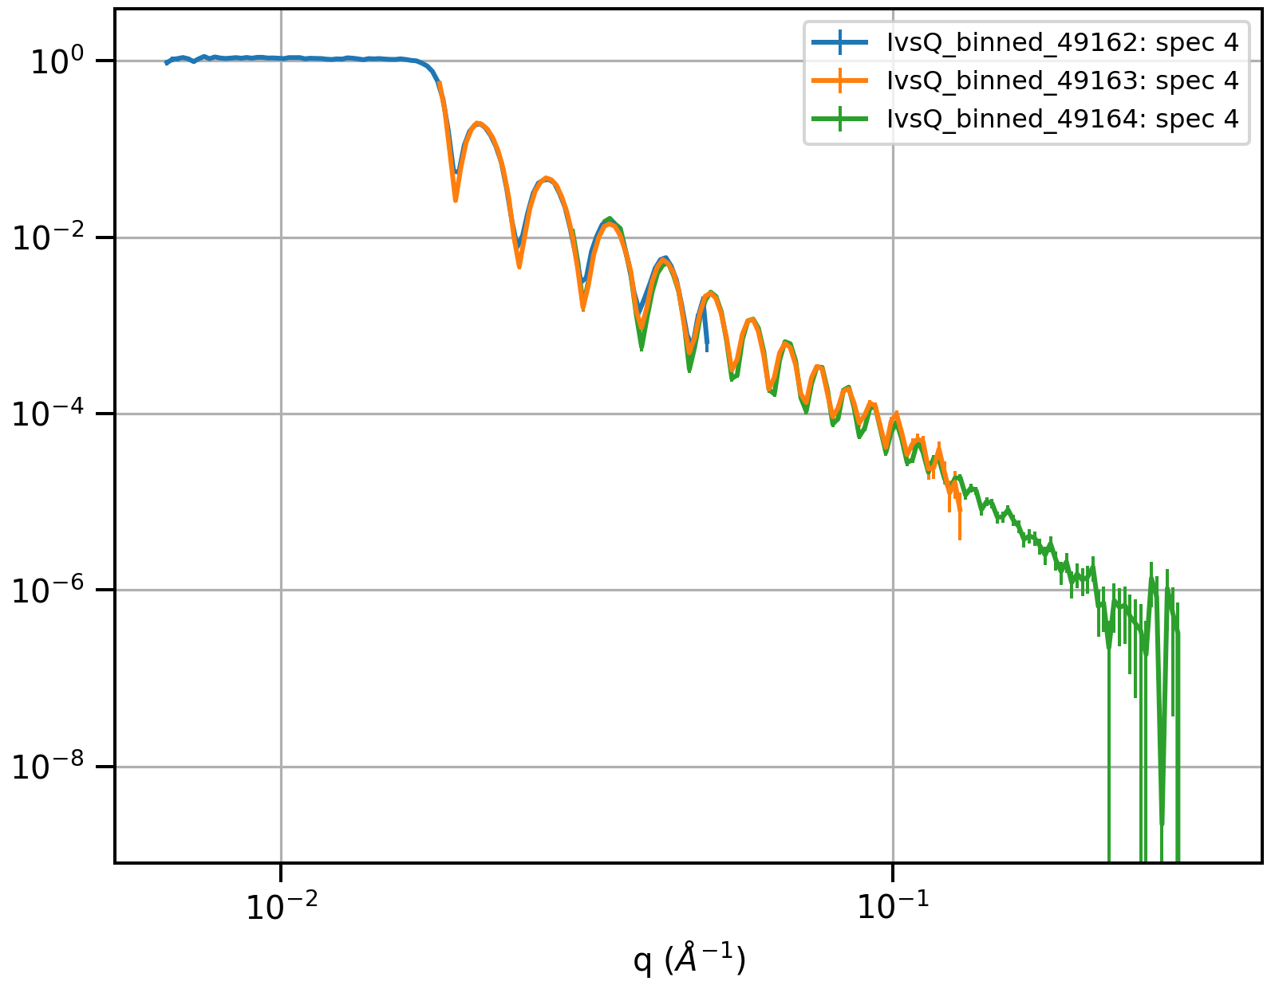
Time-Of-Flight
Data Reduction
M. Skoda
Notes:
The abstract pattern can be removed or repositioned if required. Be careful to ‘Send to Back’ so that it does not obscure any important information.

Slide 2
INTER Reflectometer
neutron guides
supermirrors
beam monitor
beam monitors
slits
vacuum vessel
sample area
area detector

Slide 3
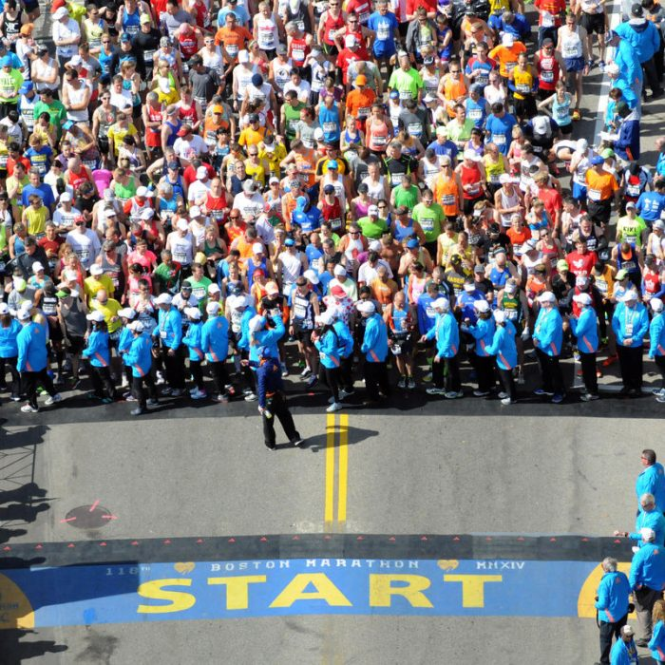
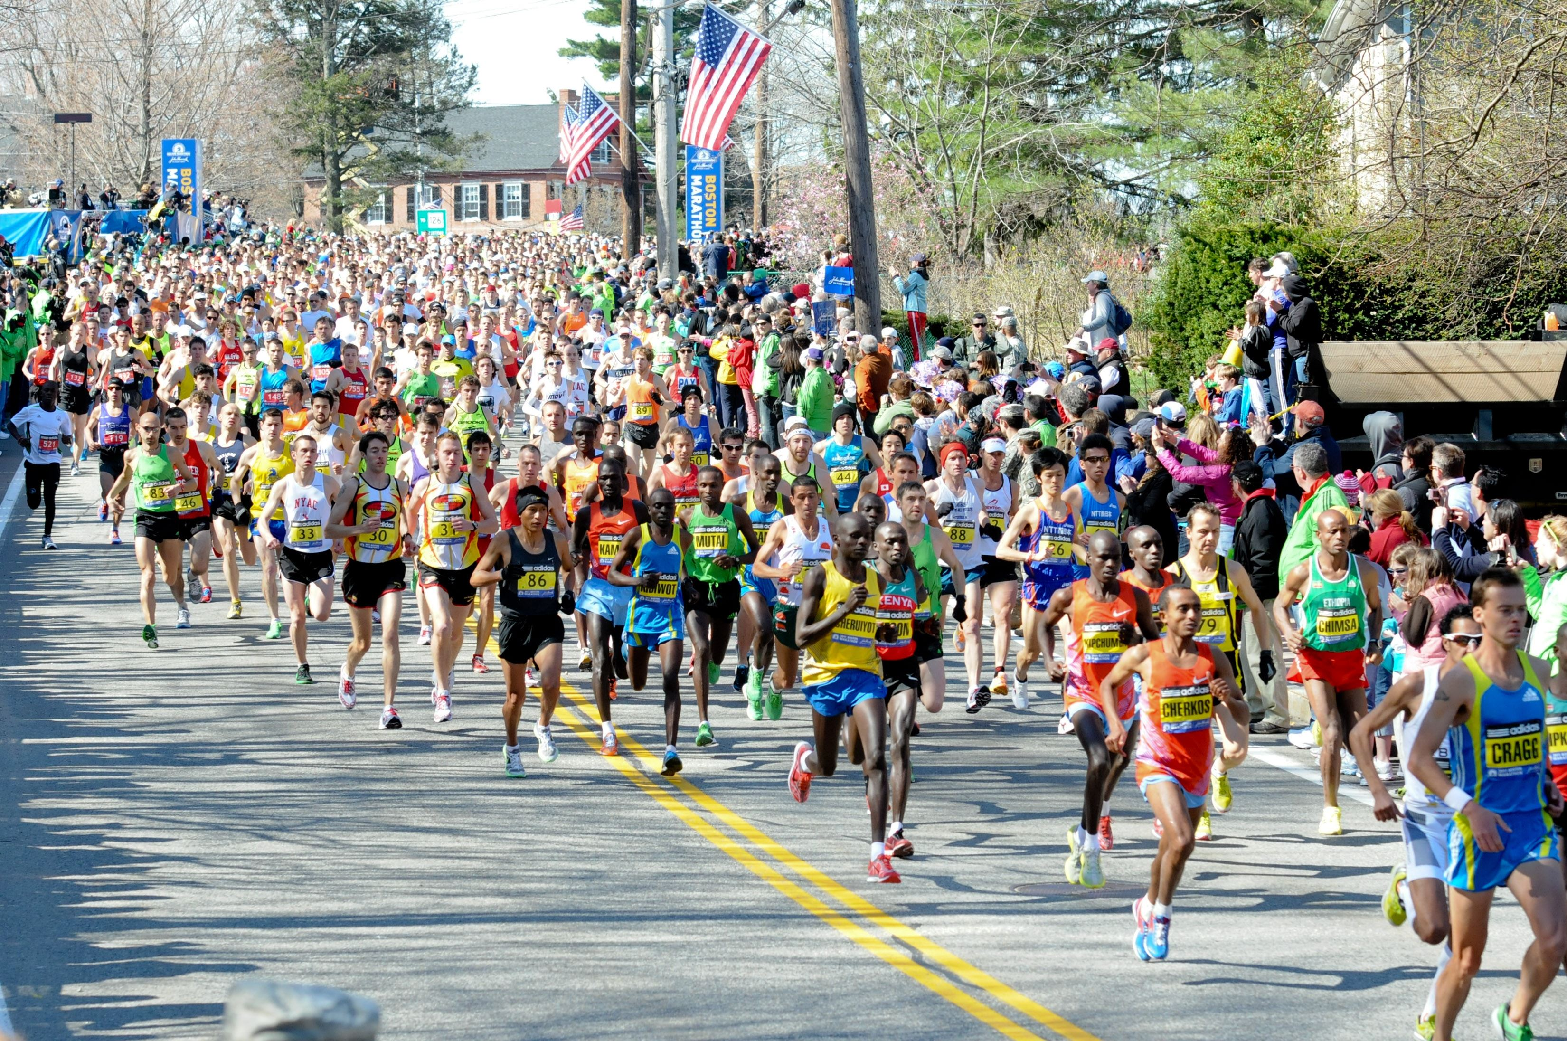
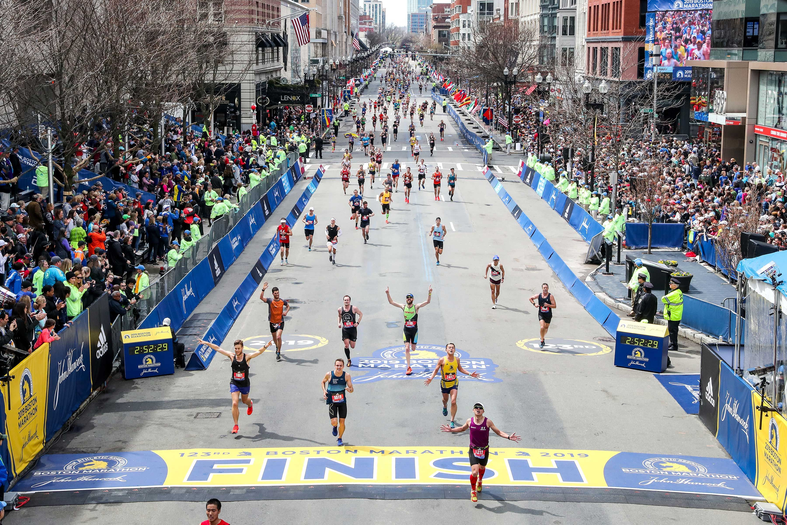
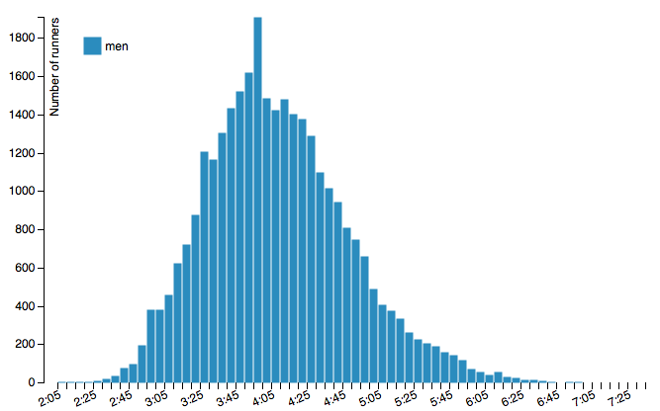

Time-Of-Flight Reflectometry
Paris marathon 2014
$$I(TOF)$$

Slide 4
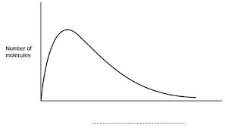
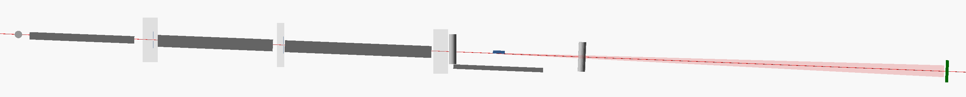
Time-Of-Flight Reflectometry
Paris marathon 2014
Monitor 1
Monitor 2
Monitor 3
Detector
Source
15 m
17 m
20 m

Slide 5
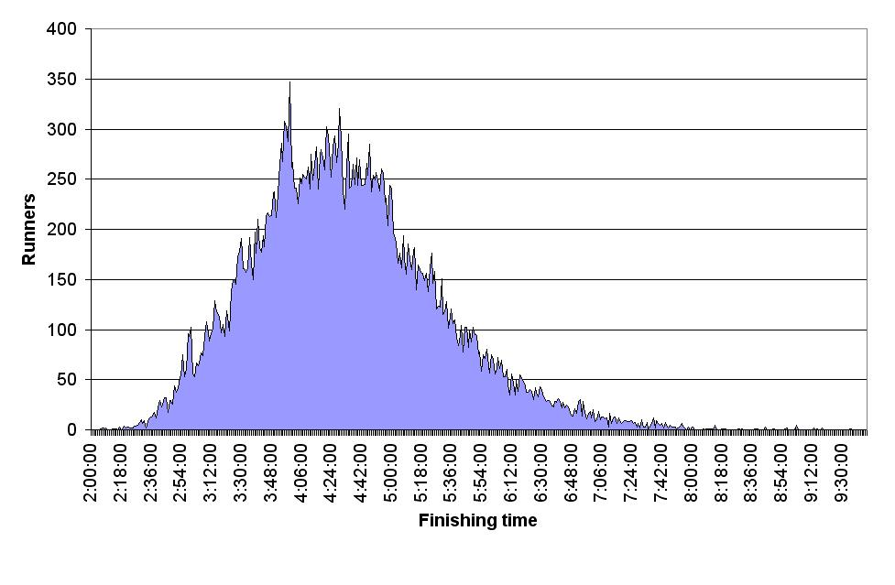
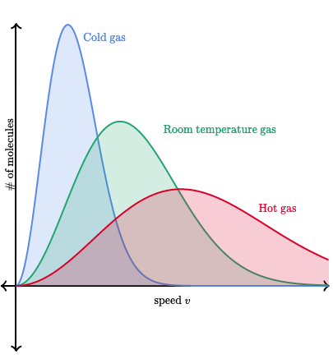
Time-Of-Flight Reflectometry
Paris marathon 2014
London marathon 2010
Thermalised neutrons have which energy/velocity distribution?
Gaussian
Maxwell-Boltzmann
Poisson
1
2
Maxwell-Boltzmann
2
3
Maxwell-Boltzmann Distribution

Slide 6
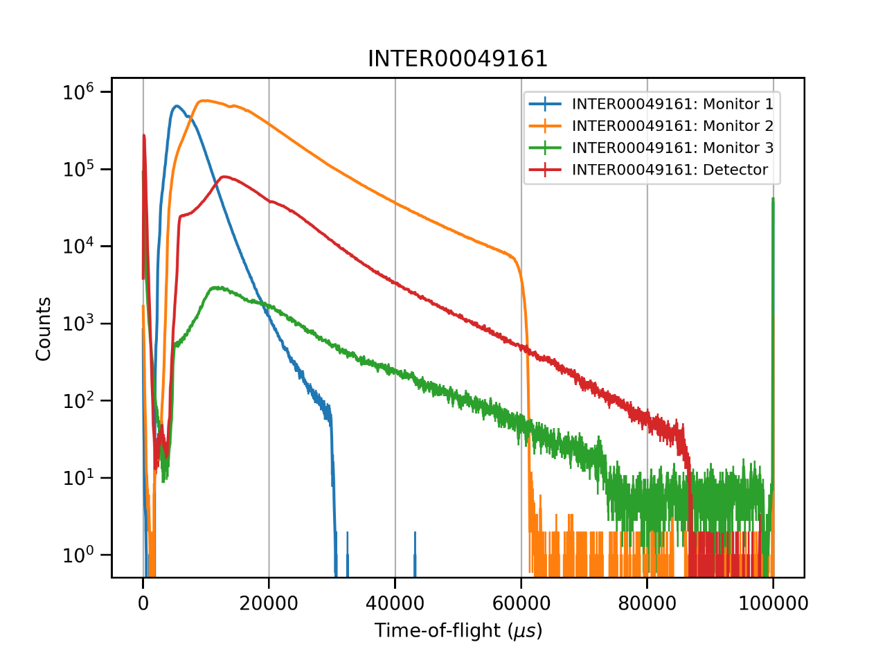
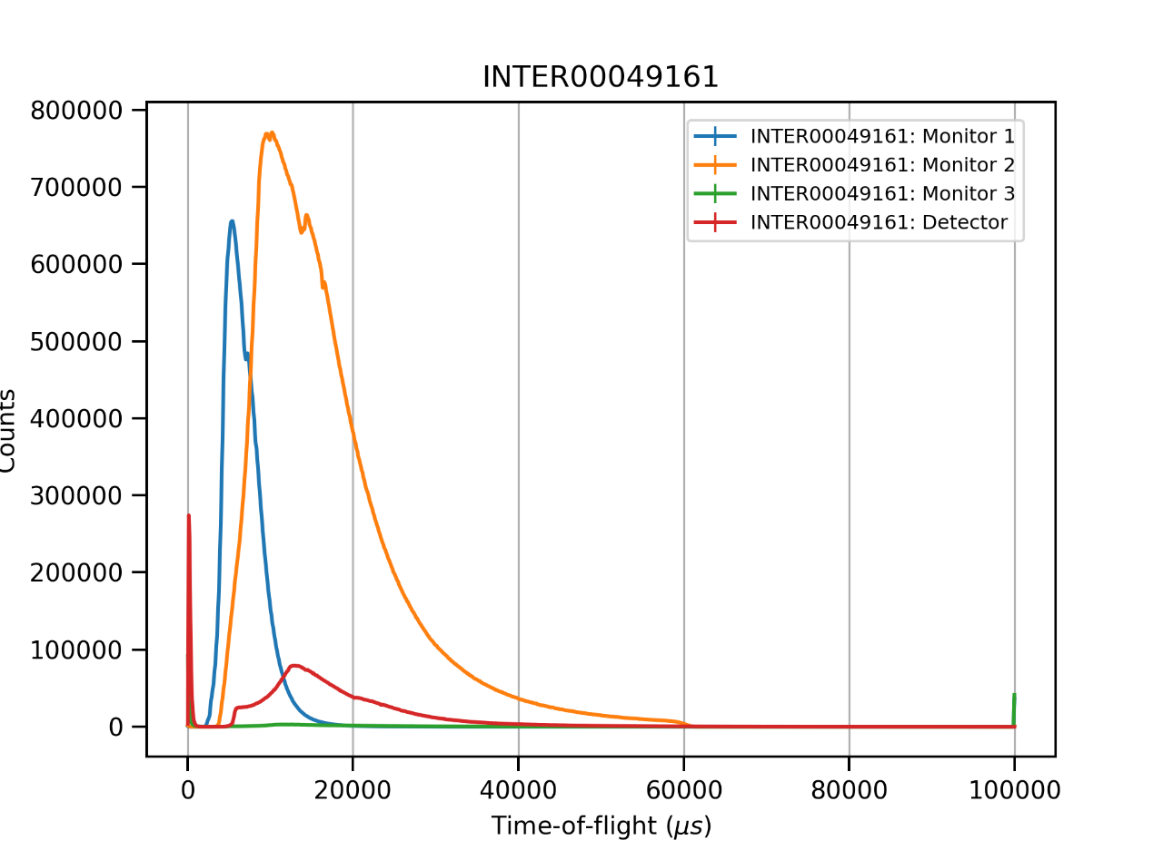
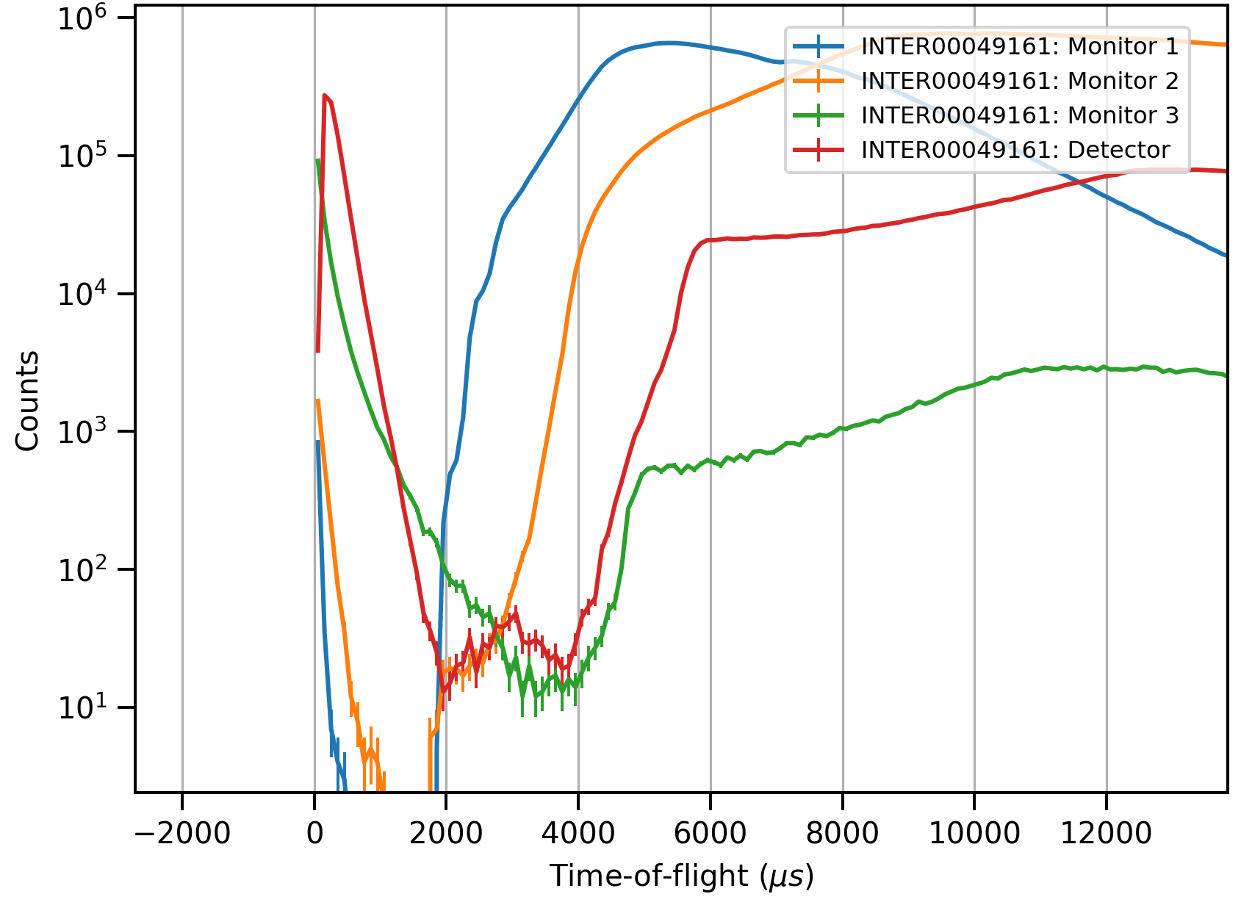
Time-Of-Flight Reflectometry
Monitor 1
Monitor 2
Monitor 3
Detector

Slide 7




Time-Of-Flight Reflectometry
Reflectivity measured from a surface is defined as the ratio of reflected intensity to incident intensity:
?
$$R=\frac{I}{I_{0}}$$
$$R(Q)=\frac{I}{I_{0}}$$
$$Q_{z}=\frac{4π}{λ}\sin{θ}$$
$$Q_{z}=\frac{2d}{λ}\sin{θ}$$
1
2
What we measure:
$$I(TOF)$$
To obtain fittable data
Corrections (eg. I₀)
Unit conversion (to Q_{z})
(a)
(b)

Slide 8
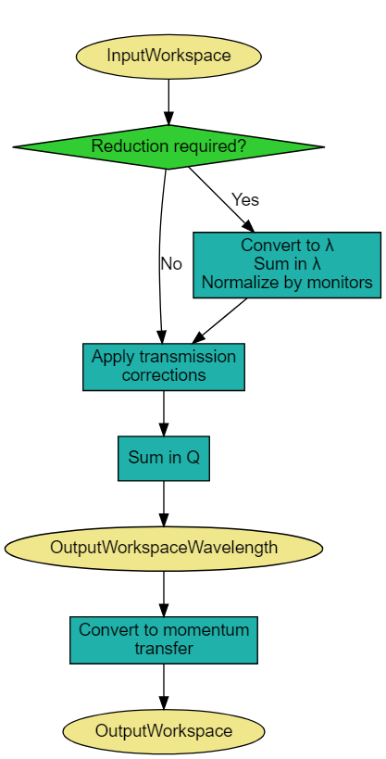
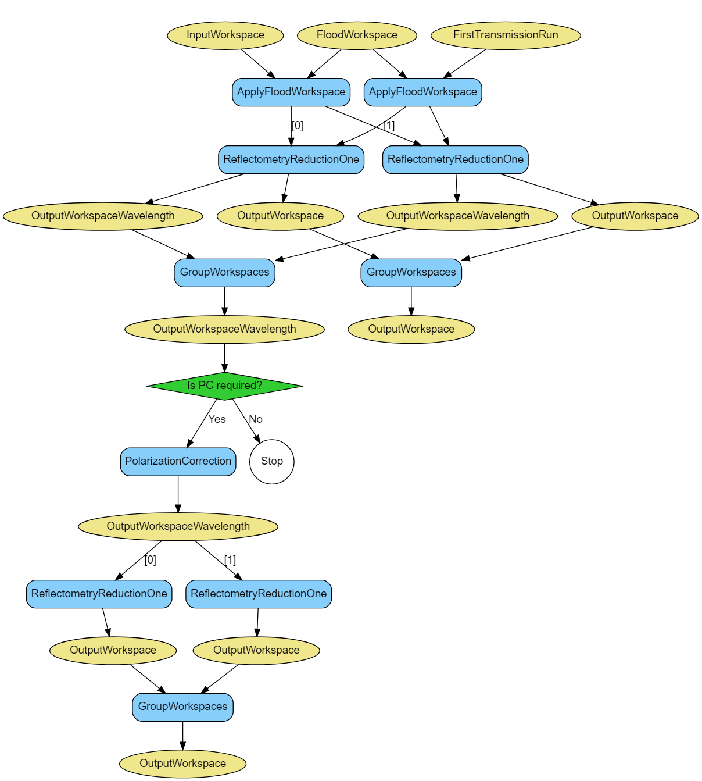



Data reduction steps
$$R(Q)=\frac{I}{I_{0}}$$
$$I$$
$$I_{0}$$
direct beam or transmission through air, sample cell or substrate.
InputWorkspace
Transmission Workspace
Convert to λ
Convert to λ
Normalisation
Normalisation
Transmission Correction
Convert to Q

Slide 9
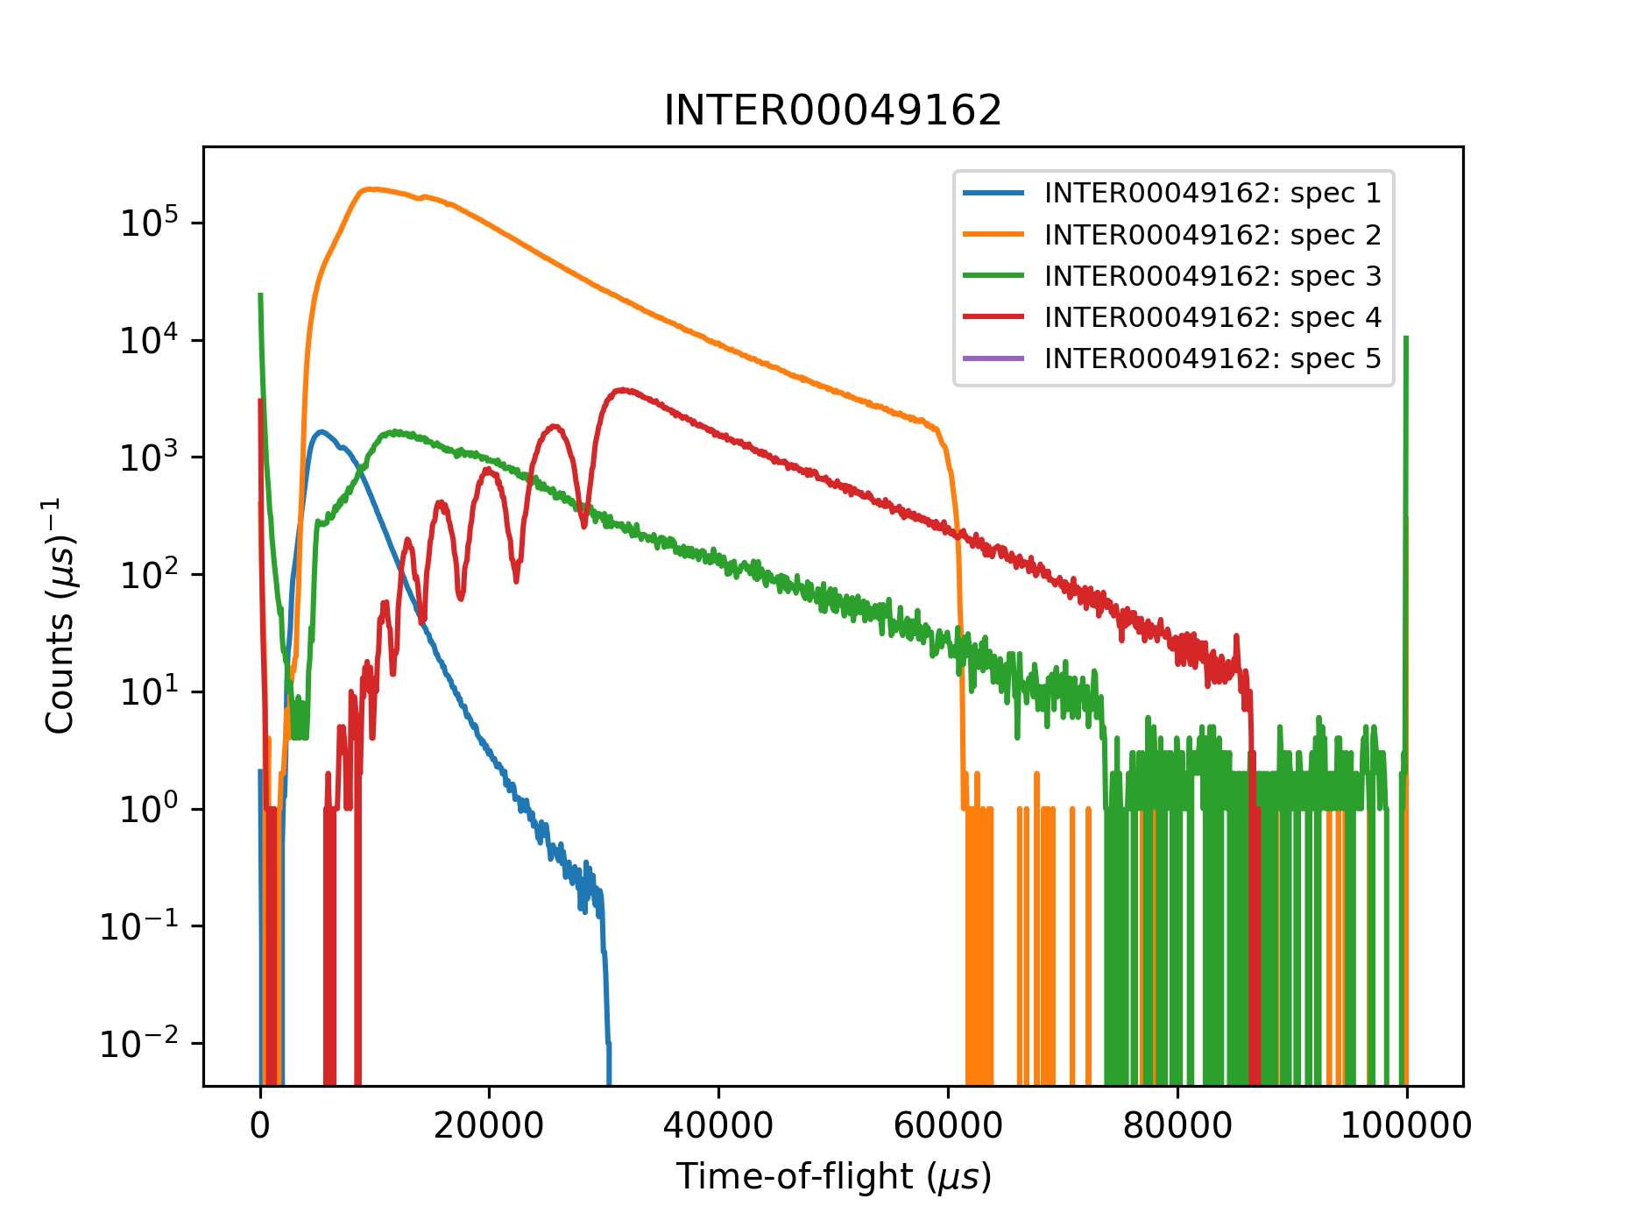
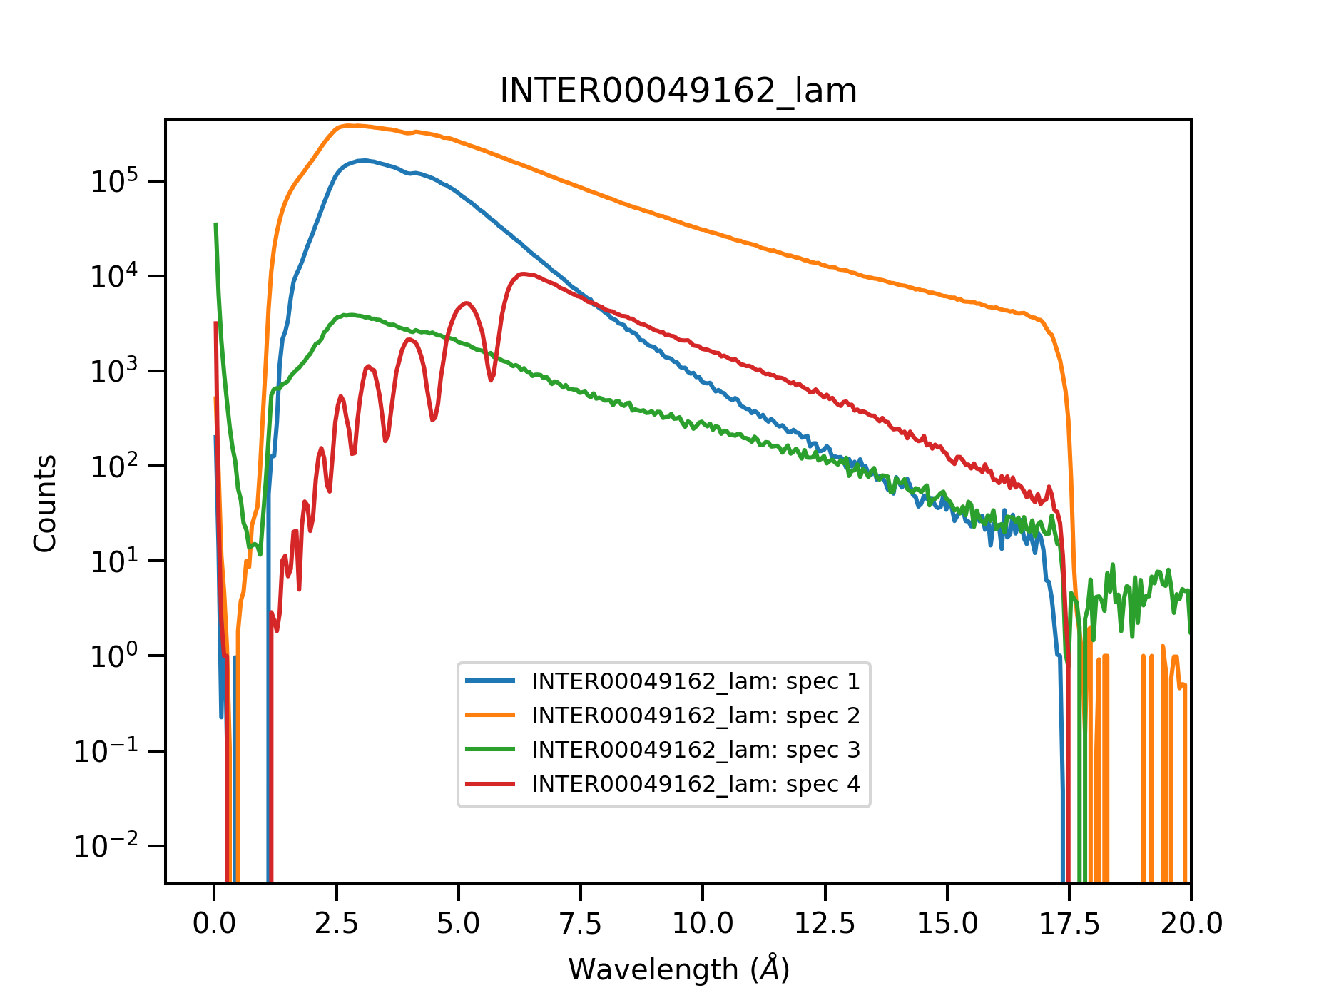



Data reduction steps – Unit conversion to wavelength
$$I$$
$$I_{0}$$
InputWorkspace
Transmission Workspace
Convert to λ
Convert to λ
Normalisation
Normalisation
de Broglie wavelength
Transmission Correction
1
λ$=\frac{hc}{E}$
λ$=\frac{h}{p}$
2
λ$=\frac{h}{p}=\frac{h}{m_{n}v}=\frac{h}{m_{n}\frac{d}{TOF}}$
Convert to Q
15 m
17 m
20 m

Slide 10
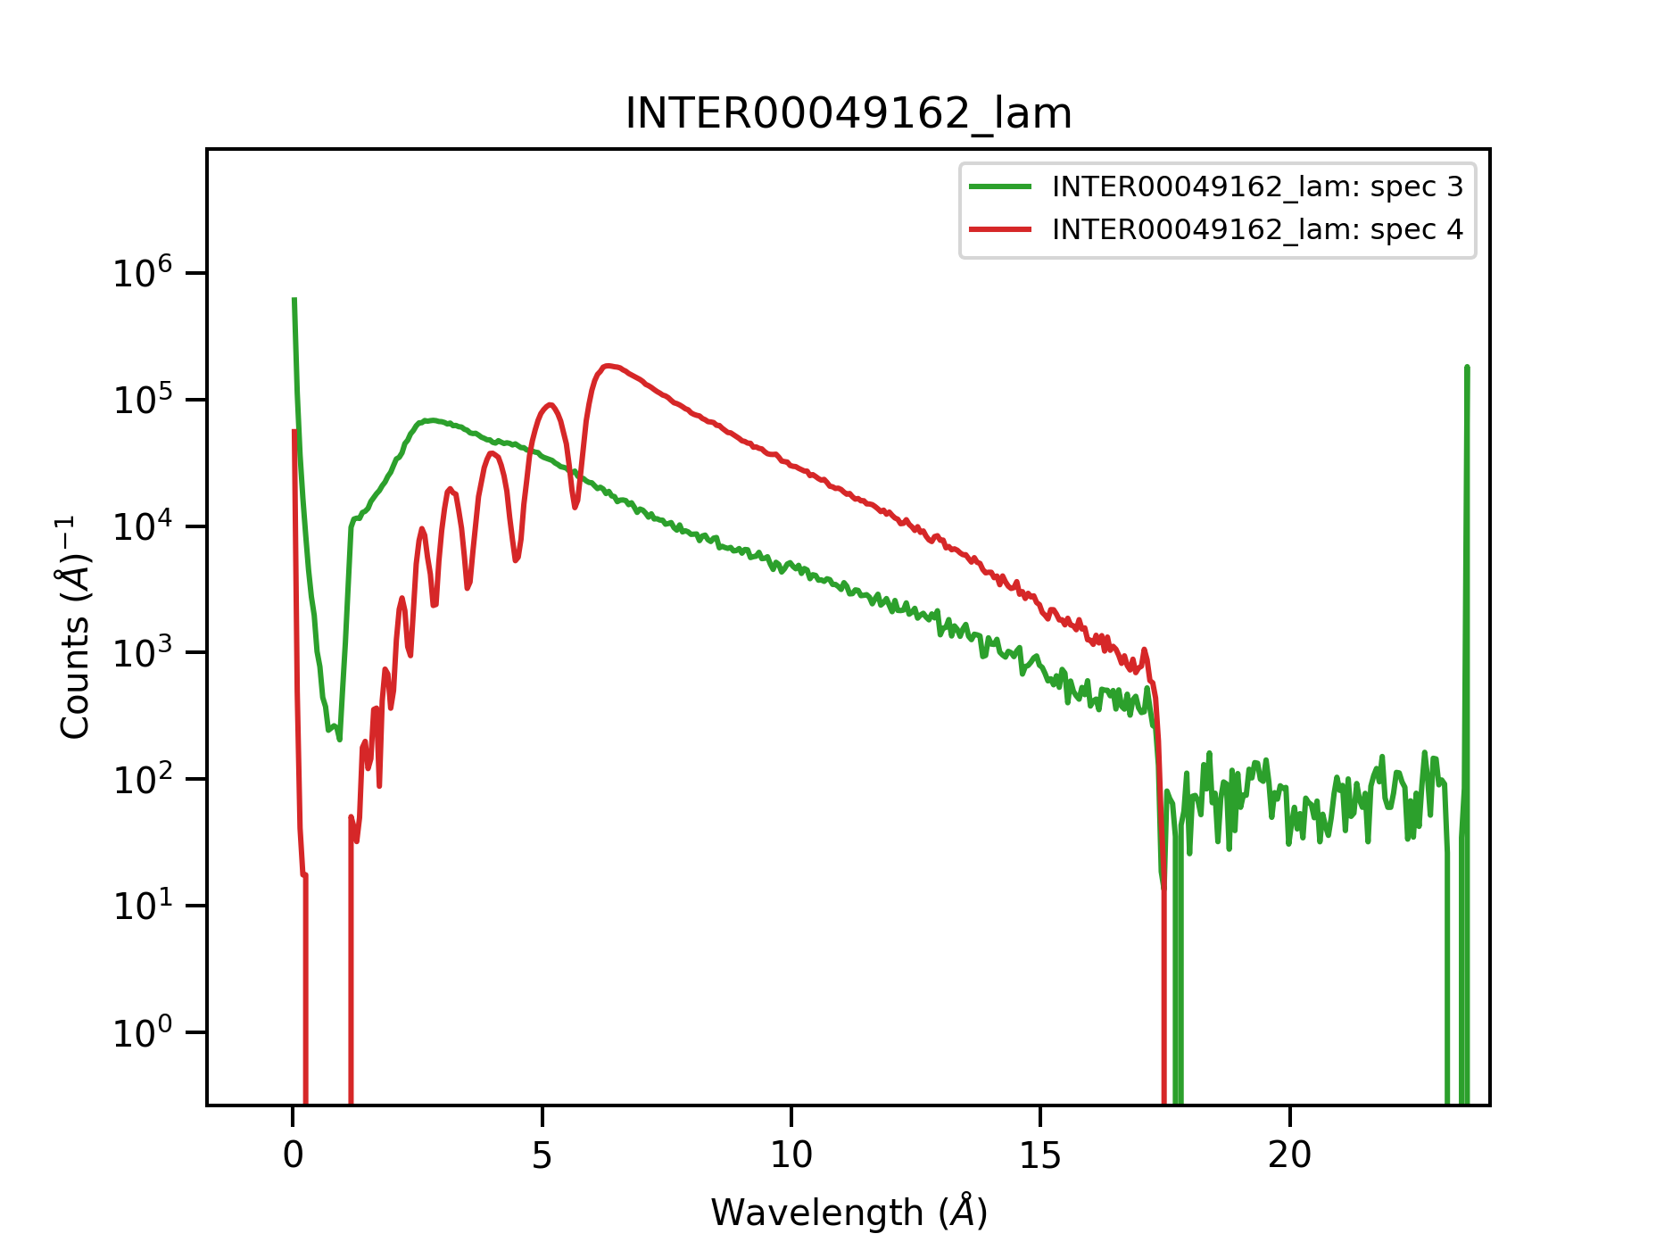
Data reduction steps – Normalisation
$$I$$
$$I_{0}$$
InputWorkspace
Transmission Workspace
Convert to λ
Convert to λ
Normalisation
Normalisation
integrate monitor spectrum and divide detector by integral
Transmission Correction
Convert to Q
15 m
17 m
20 m

Slide 11
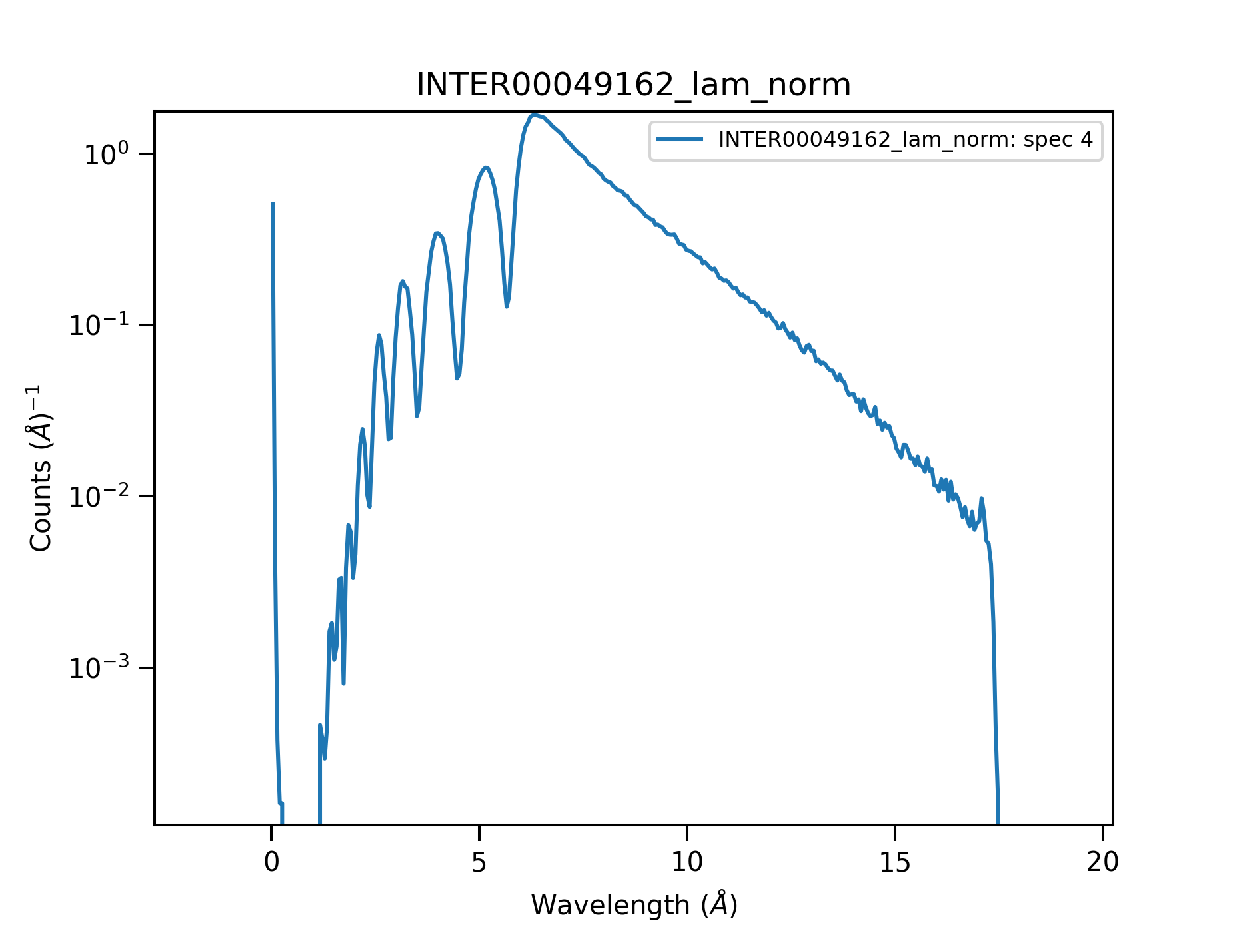
Data reduction steps – Normalisation
$$I$$
$$I_{0}$$
InputWorkspace
Transmission Workspace
Convert to λ
Convert to λ
Normalisation
Normalisation
Transmission Correction
Convert to Q

Slide 12
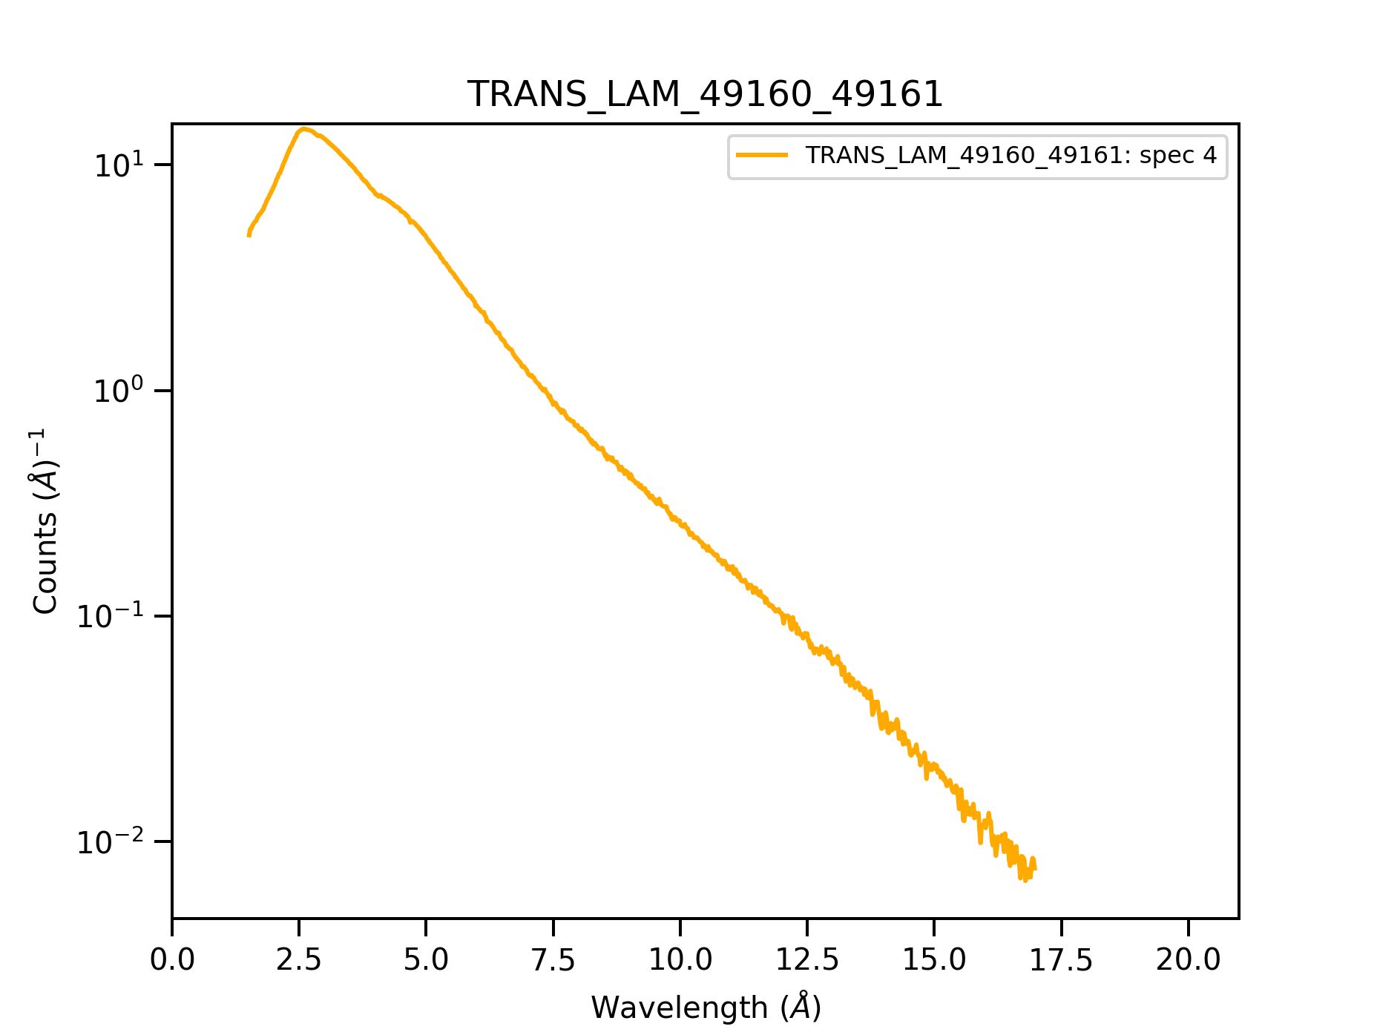
Data reduction steps – Normalisation
$$I$$
$$I_{0}$$
InputWorkspace
Transmission Workspace
Convert to λ
Convert to λ
Normalisation
Normalisation
Transmission Correction
Convert to Q

Slide 13
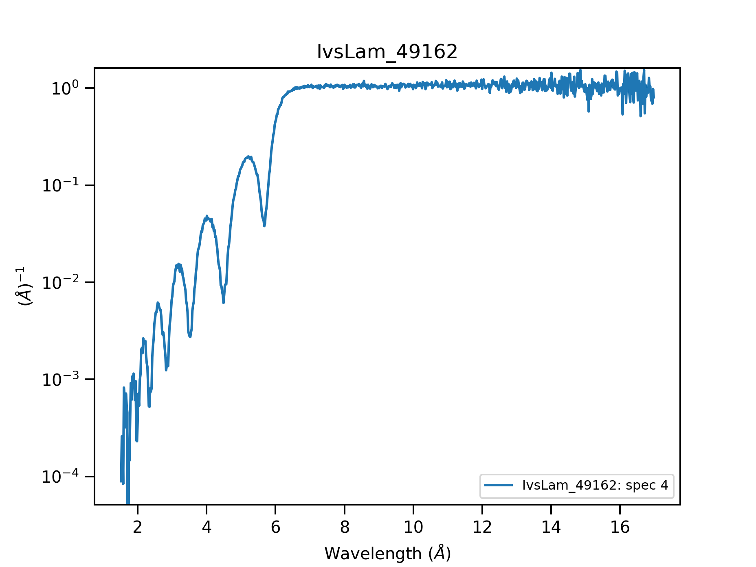
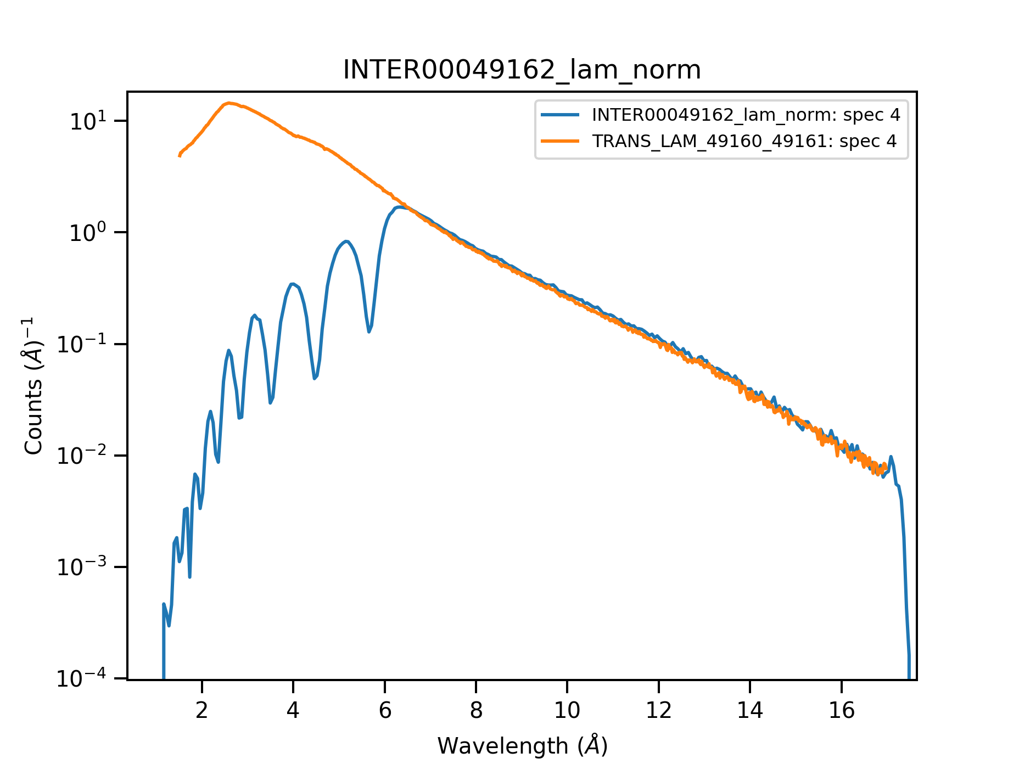
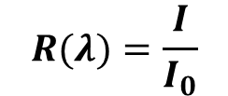
Data reduction steps – Transmission correction
$$I$$
$$I_{0}$$
InputWorkspace
Transmission Workspace
Convert to λ
Convert to λ
Normalisation
Normalisation
Transmission Correction
divide sample data by transmission data:
$$R(λ)=\frac{I}{I_{0}}$$
Convert to Q

Slide 14
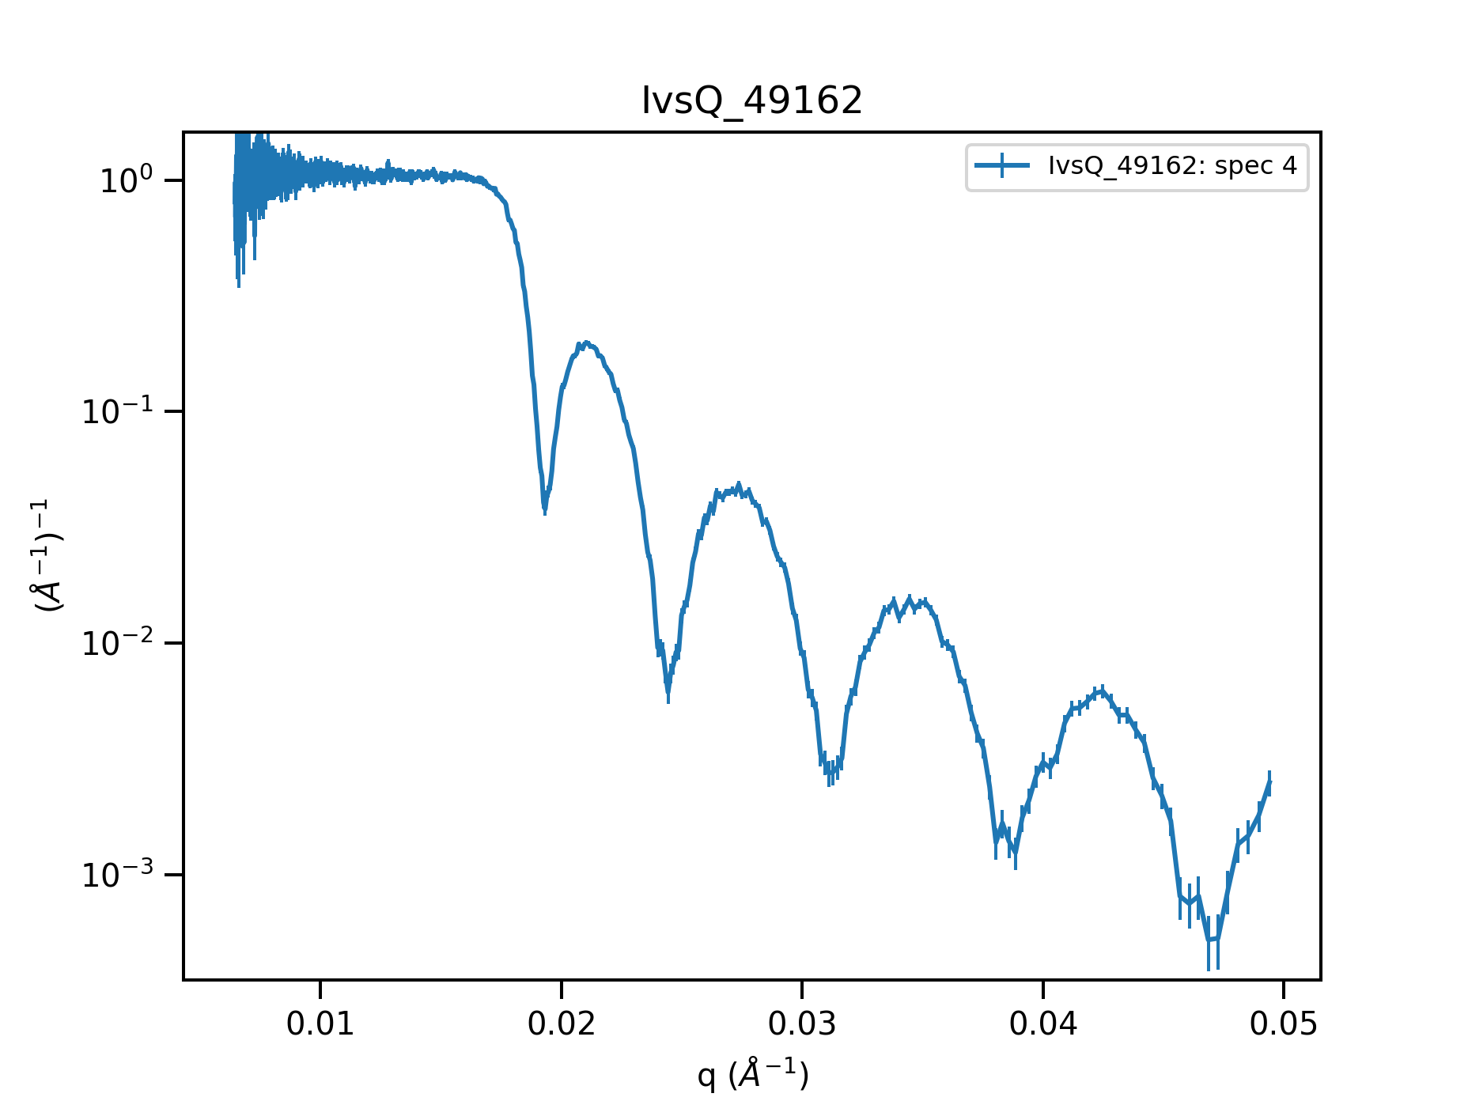

Data reduction steps – Q conversion
$$I$$
$$I_{0}$$
InputWorkspace
Transmission Workspace
Convert to λ
Convert to λ
Normalisation
Normalisation
Transmission Correction
$$Q_{z}=\frac{4π}{λ}\sin{θ}$$
Convert to Q

Slide 15
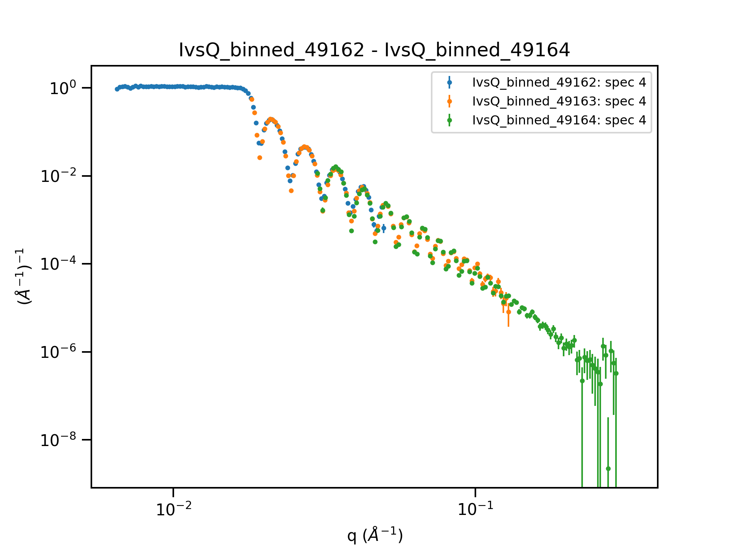
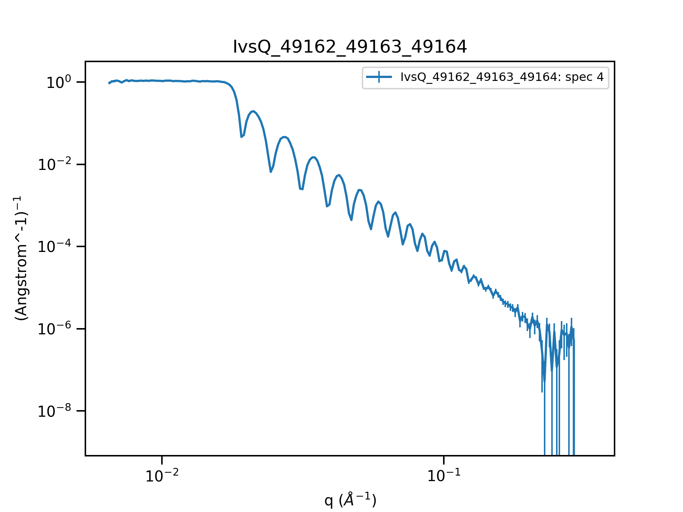
Data reduction steps – Stitching
$$I$$
$$I_{0}$$
InputWorkspace
Transmission Workspace
θ1
Convert to λ
Convert to λ
θ2
θ3
Normalisation
Normalisation
Transmission Correction
Convert to Q

Slide 16
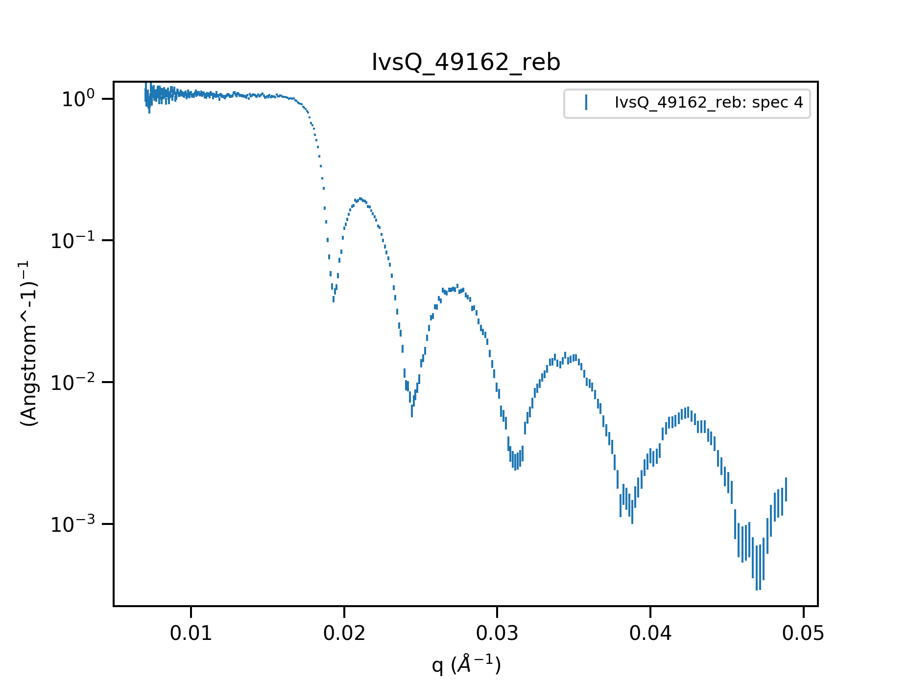
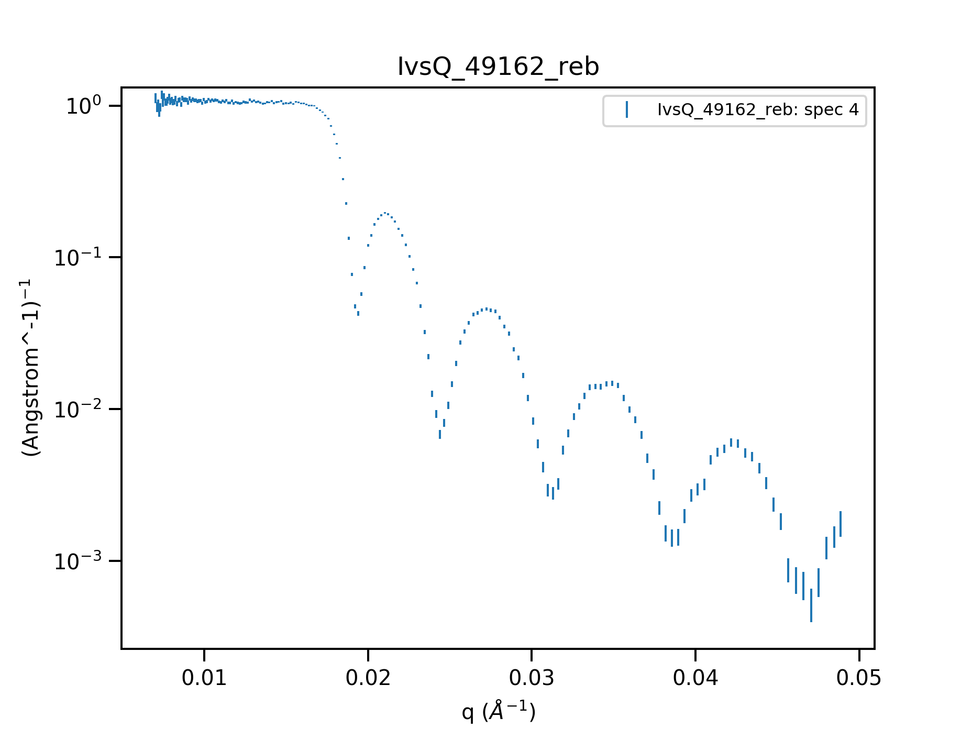
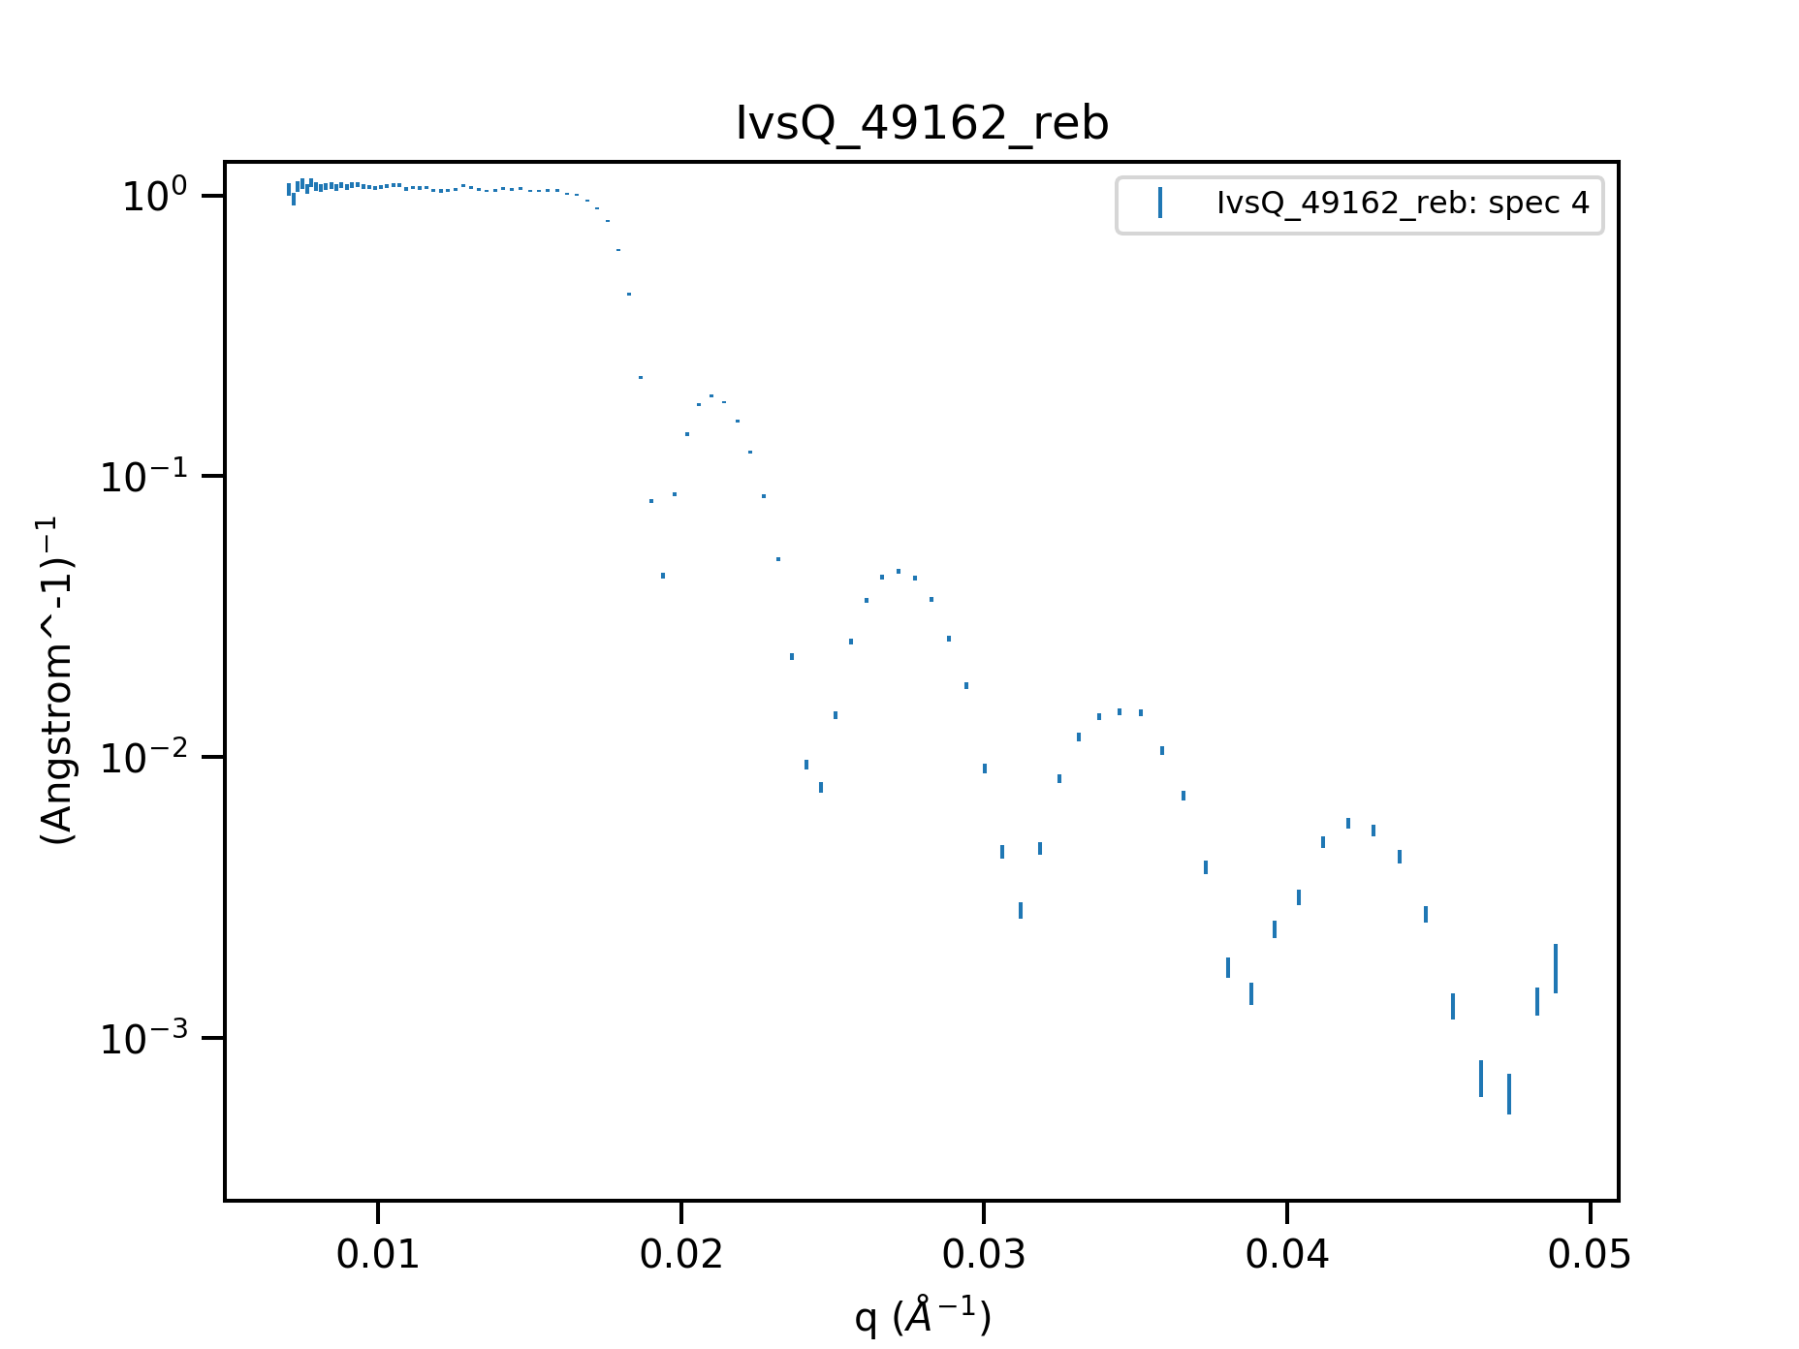
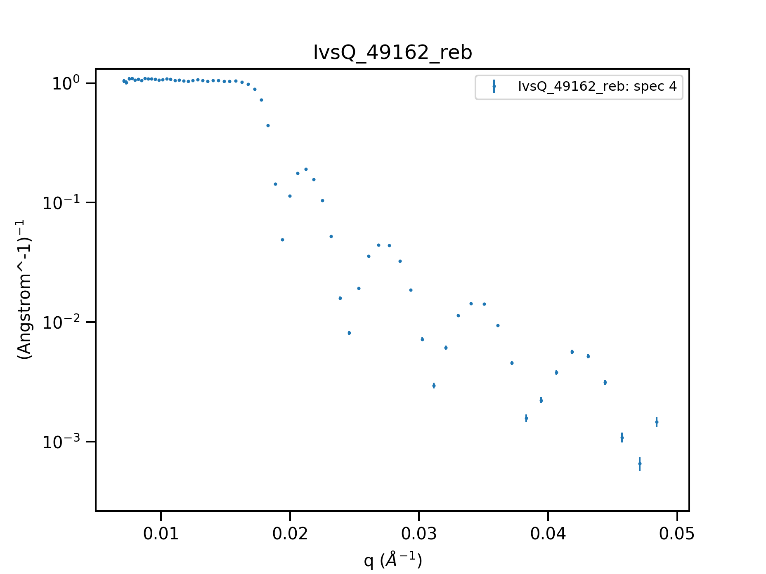
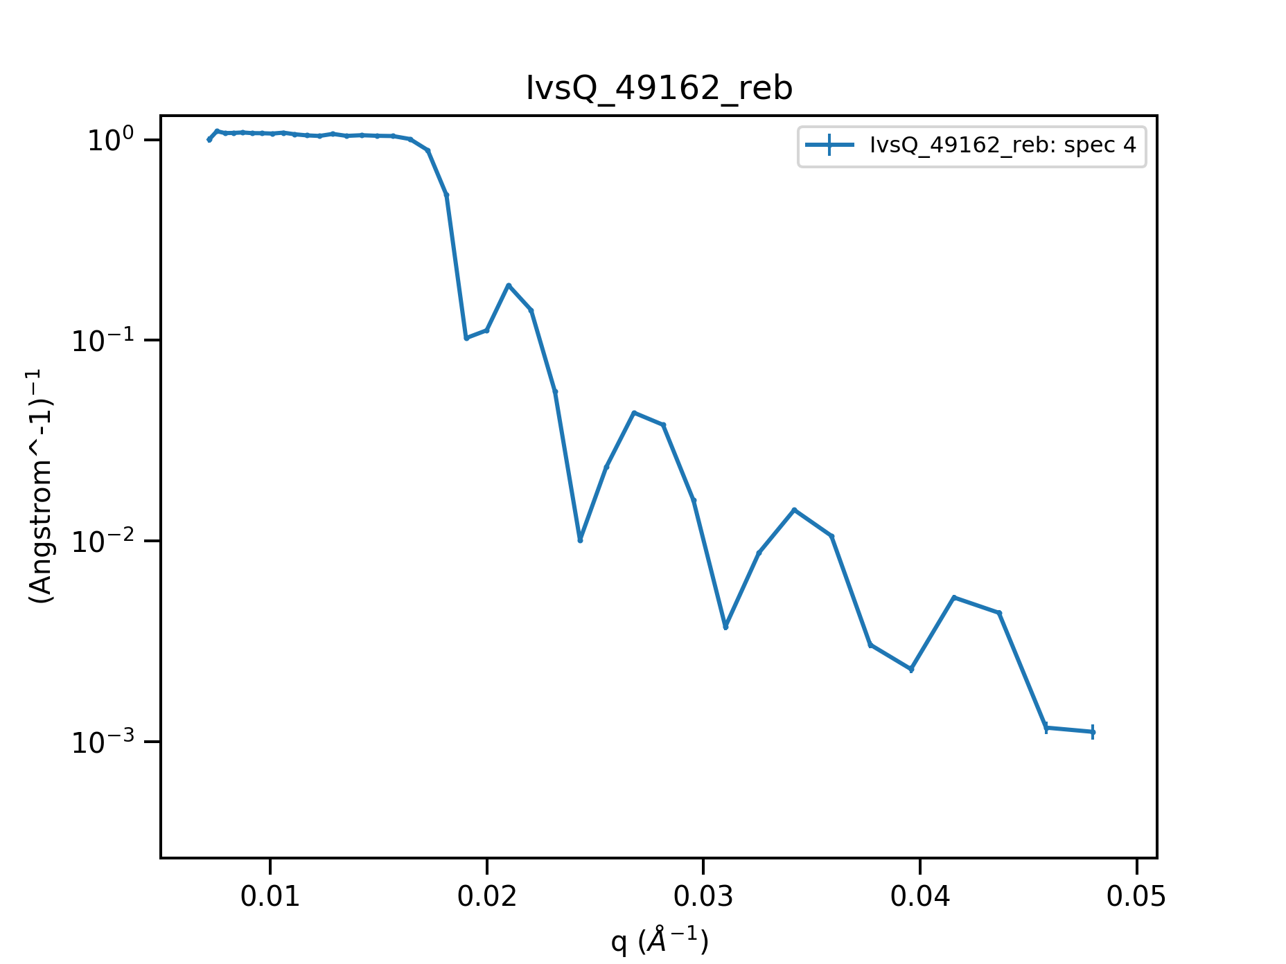
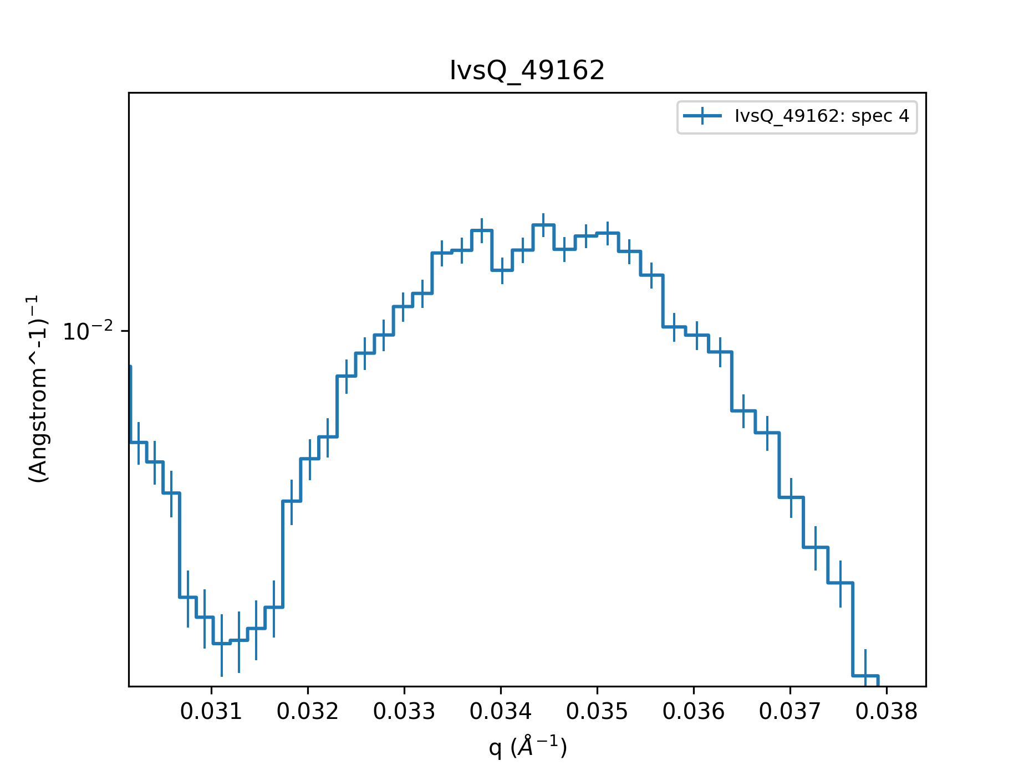
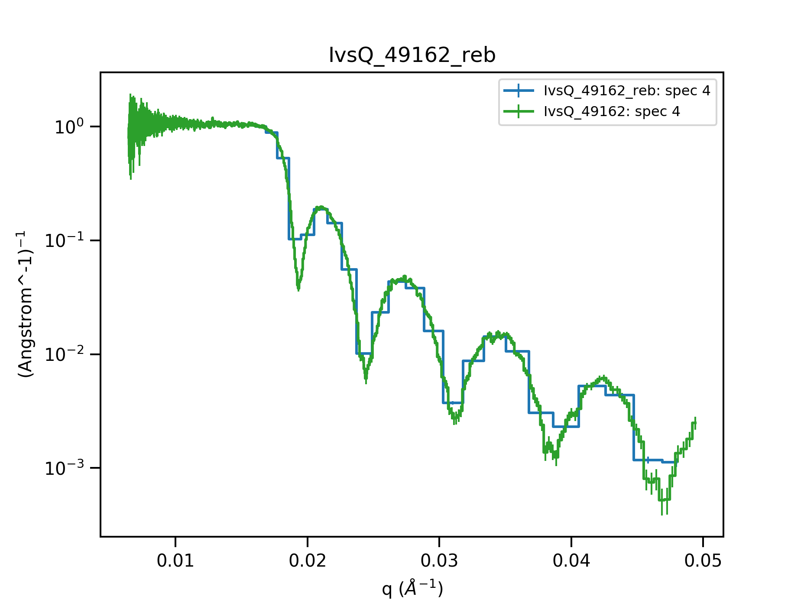
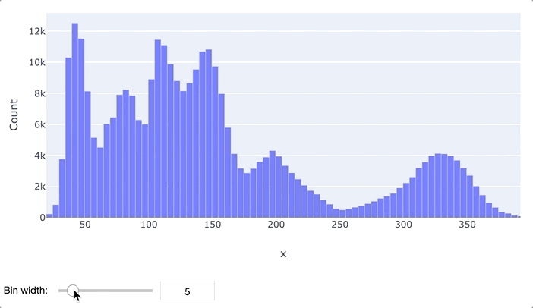
Further steps and comments
Rebinning
Should match experimental resolution
Error bars
Kinetic data
Export/save as ASCII
Δq/q=0.05
Δq/q=0.01
Δq/q=0.02
Δq/q=0.03
Δq/q=0.005
Δq/q=0.005

Slide 17
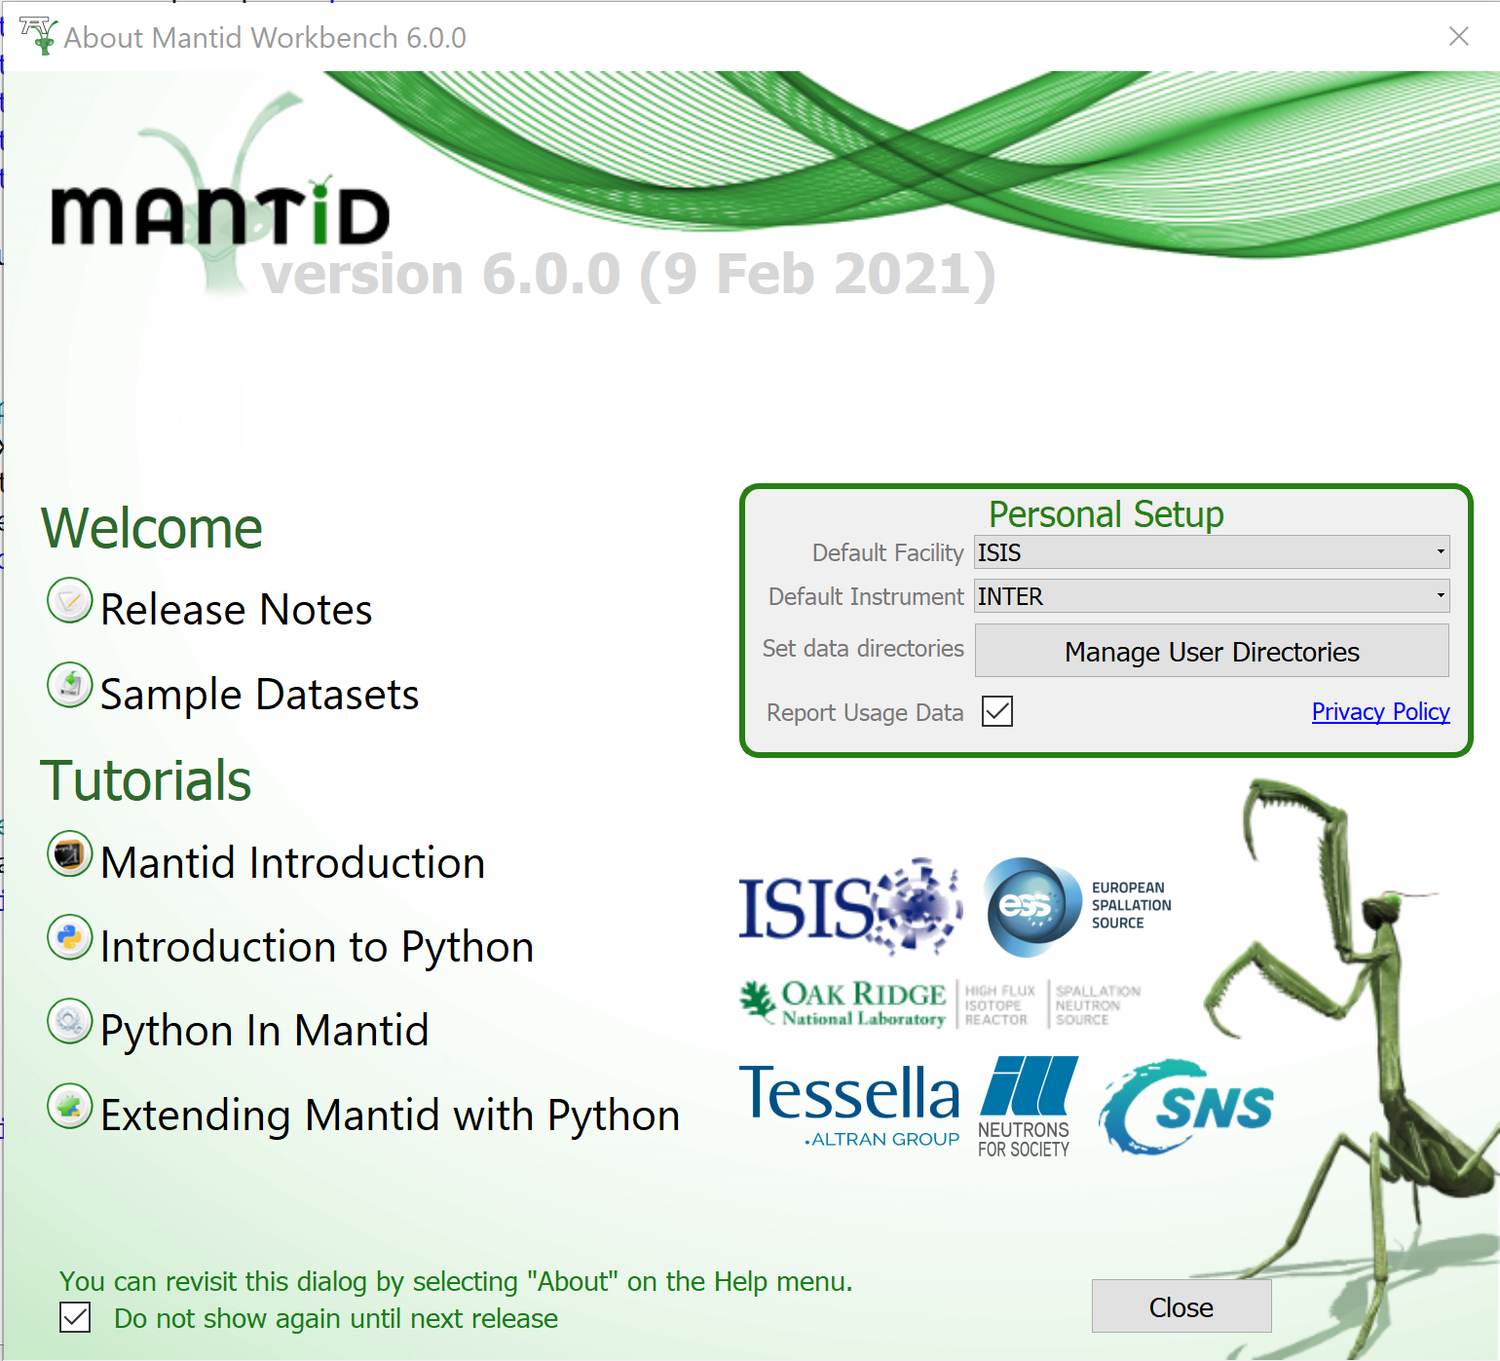
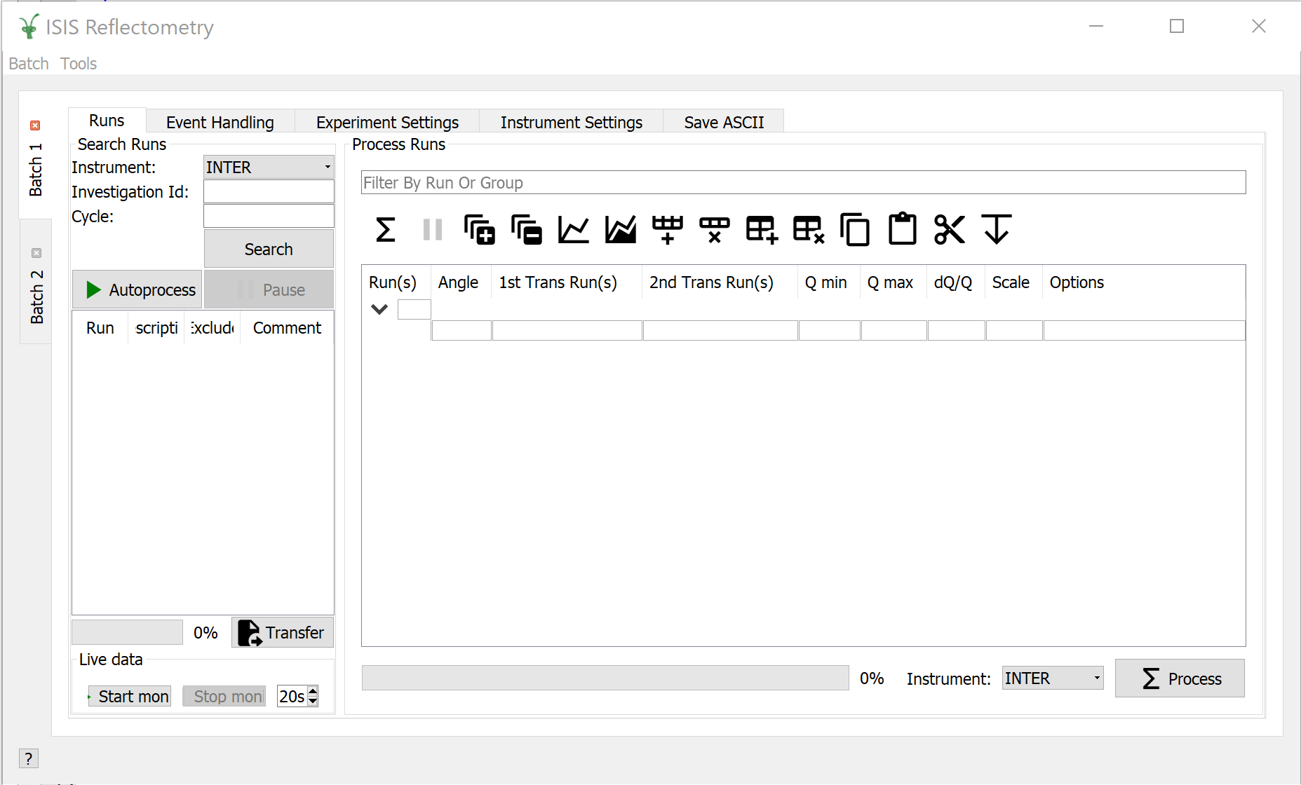
Data Reduction in Mantid Workbench

Slide 18
Questions?

