Slide 1

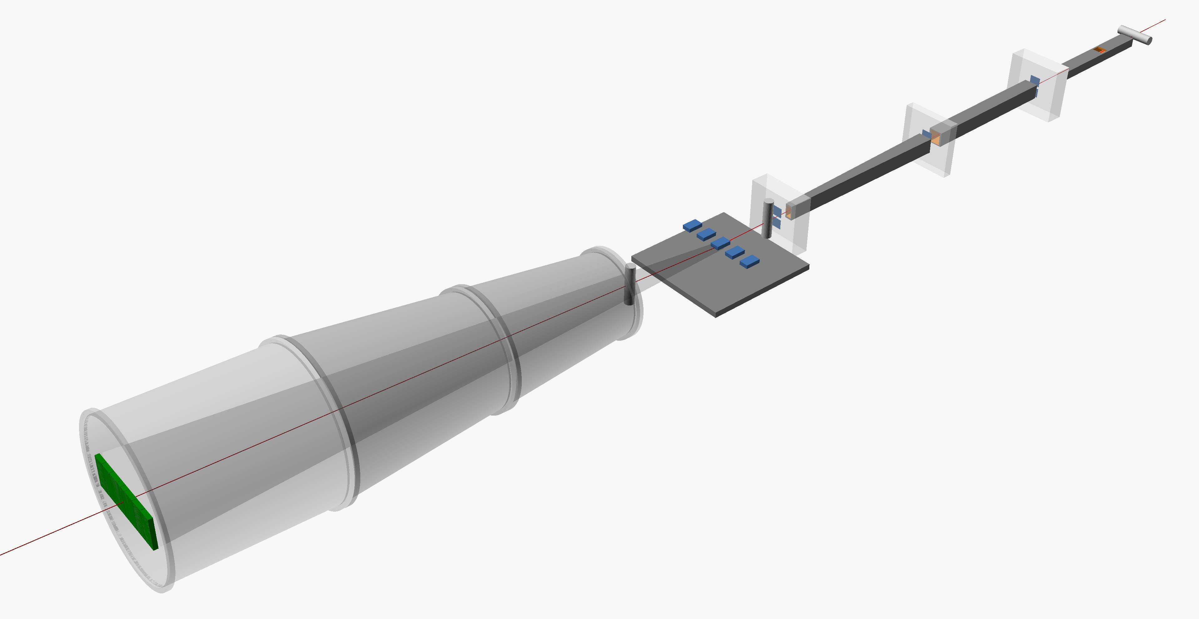
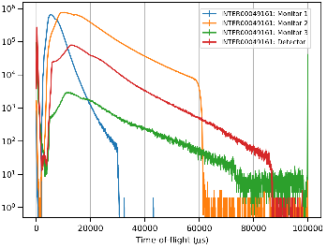
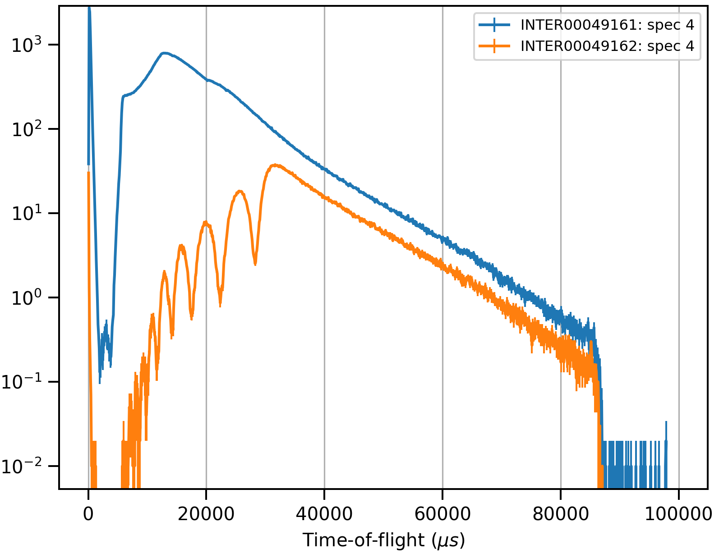
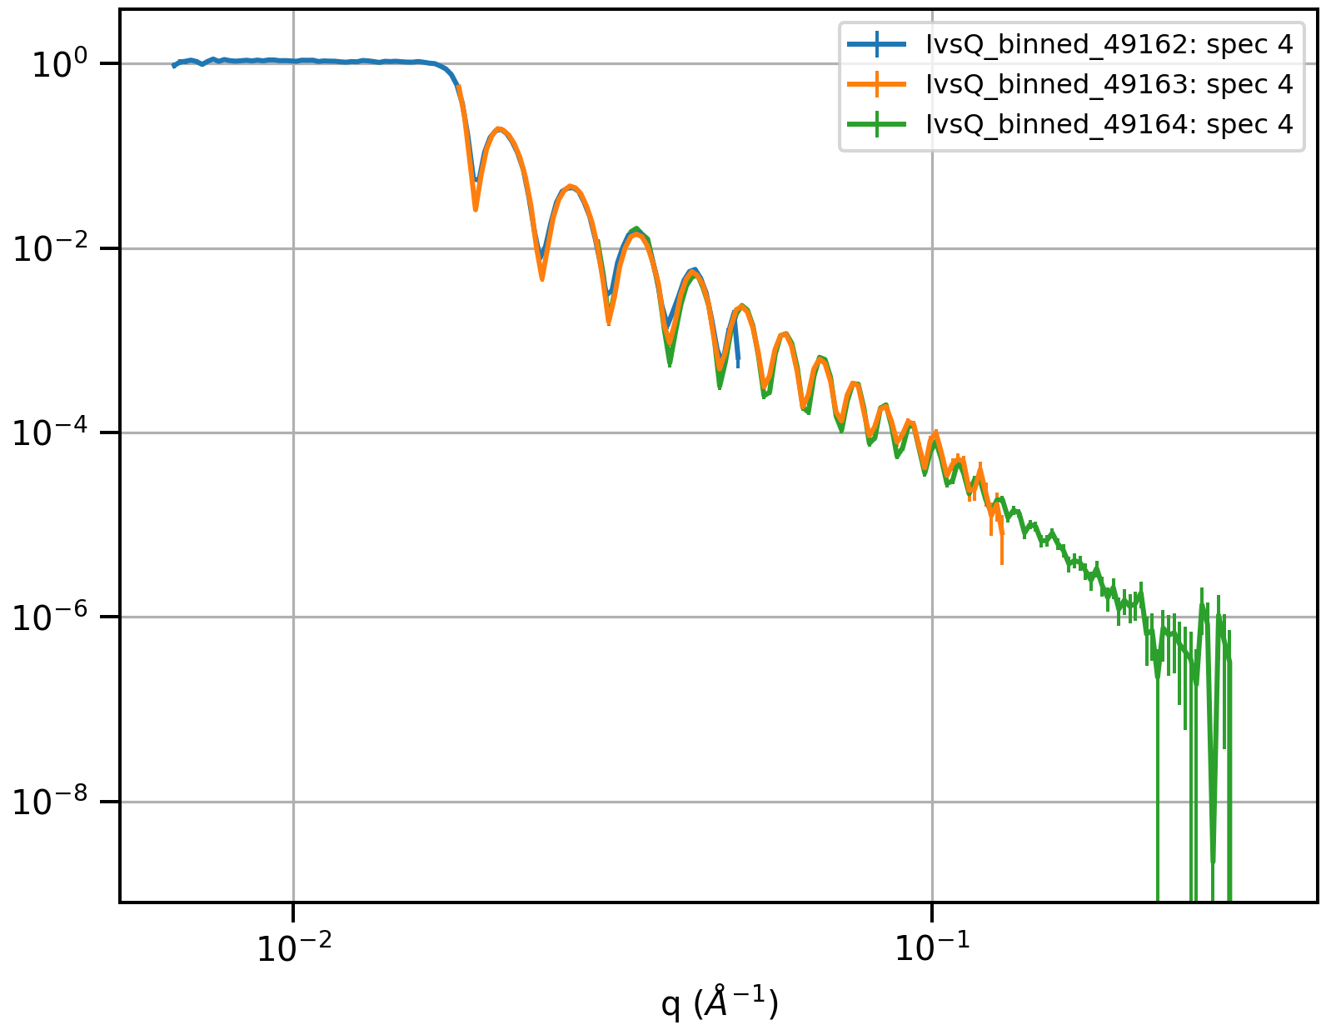
Time-Of-Flight
Data Reduction
M. Skoda

Slide 2
INTER Reflectometer
neutron guides
supermirrors
beam monitors
beam monitor
slits
vacuum vessel
sample area
area detector

Slide 3
FILM

Slide 4



Time-Of-Flight Reflectometry
Reflectivity measured from a surface is defined as the ratio of
reflected intensity to incident intensity:
$$R=\frac{I}{I_{0}}$$
$$R(Q)=\frac{I}{I_{0}}$$
What we measure:
$$I(TOF)$$
To obtain fittable data
Corrections (eg. I₀)
Unit conversion (to Q_{z})
(a)
(b)

Slide 5
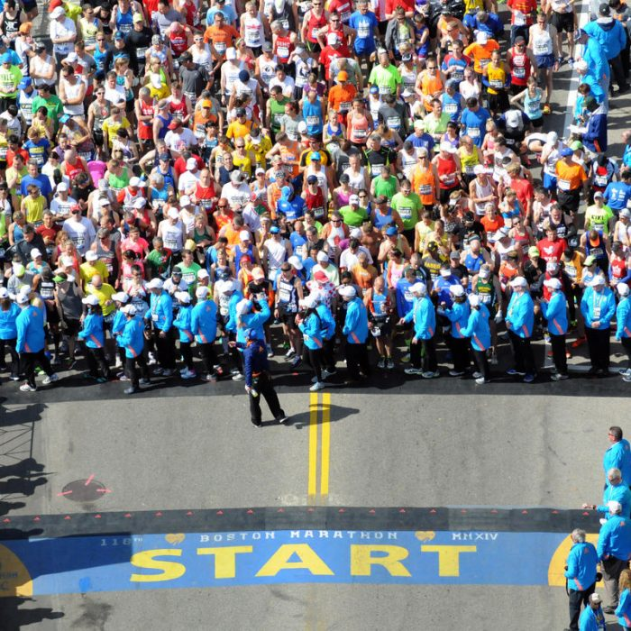
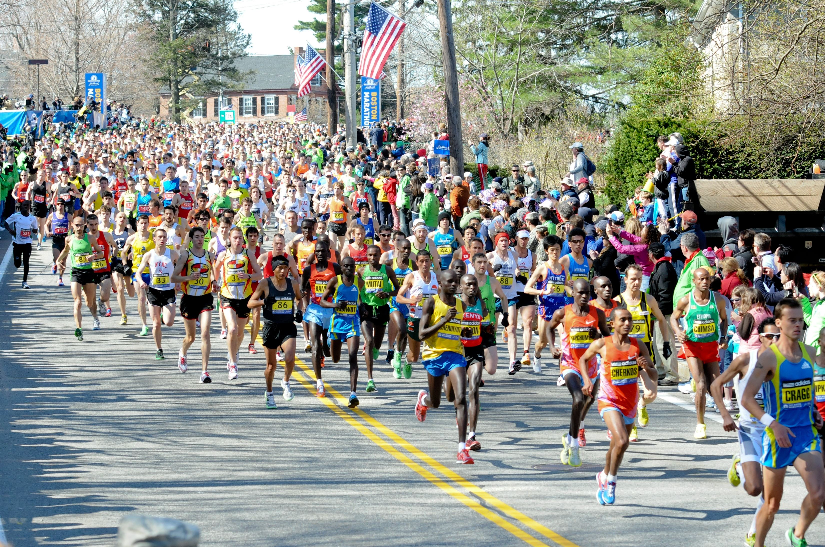
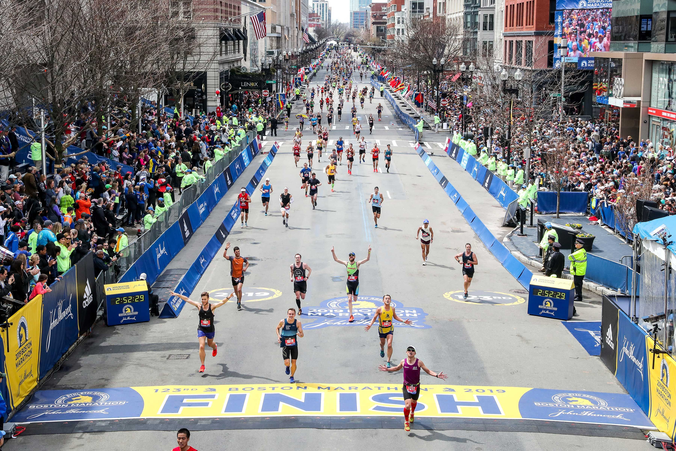
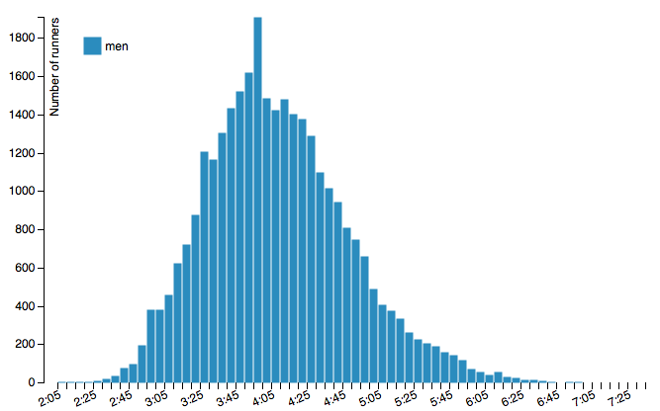
Time-Of-Flight Reflectometry
Paris marathon 2014
$$I(TOF)$$

Slide 6
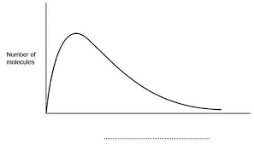
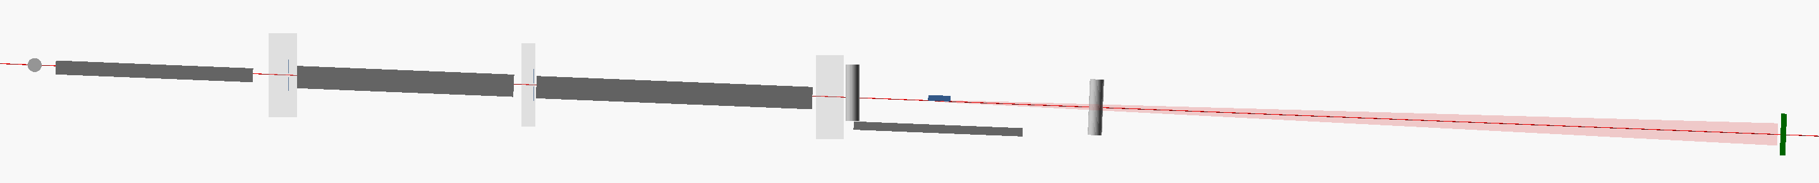
Time-Of-Flight Reflectometry
Paris marathon 2014
Monitor 1
Monitor 2
Monitor 3
Detector
Source
15 m
17 m
20 m

Slide 7
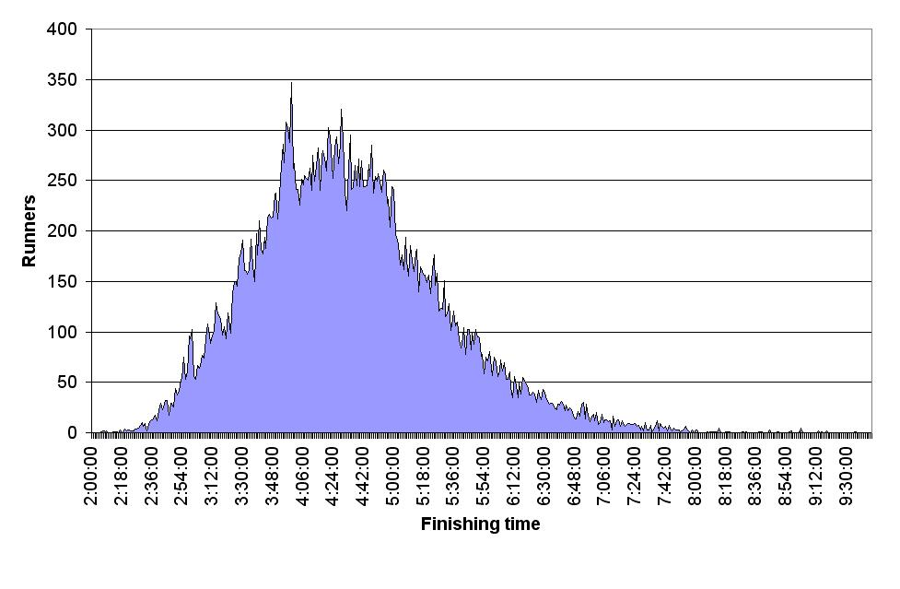
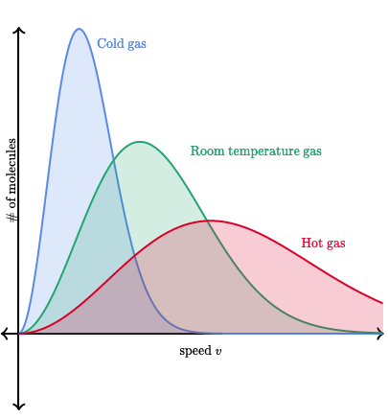
Time-Of-Flight Reflectometry
Paris marathon 2014
London marathon 2010

Slide 8
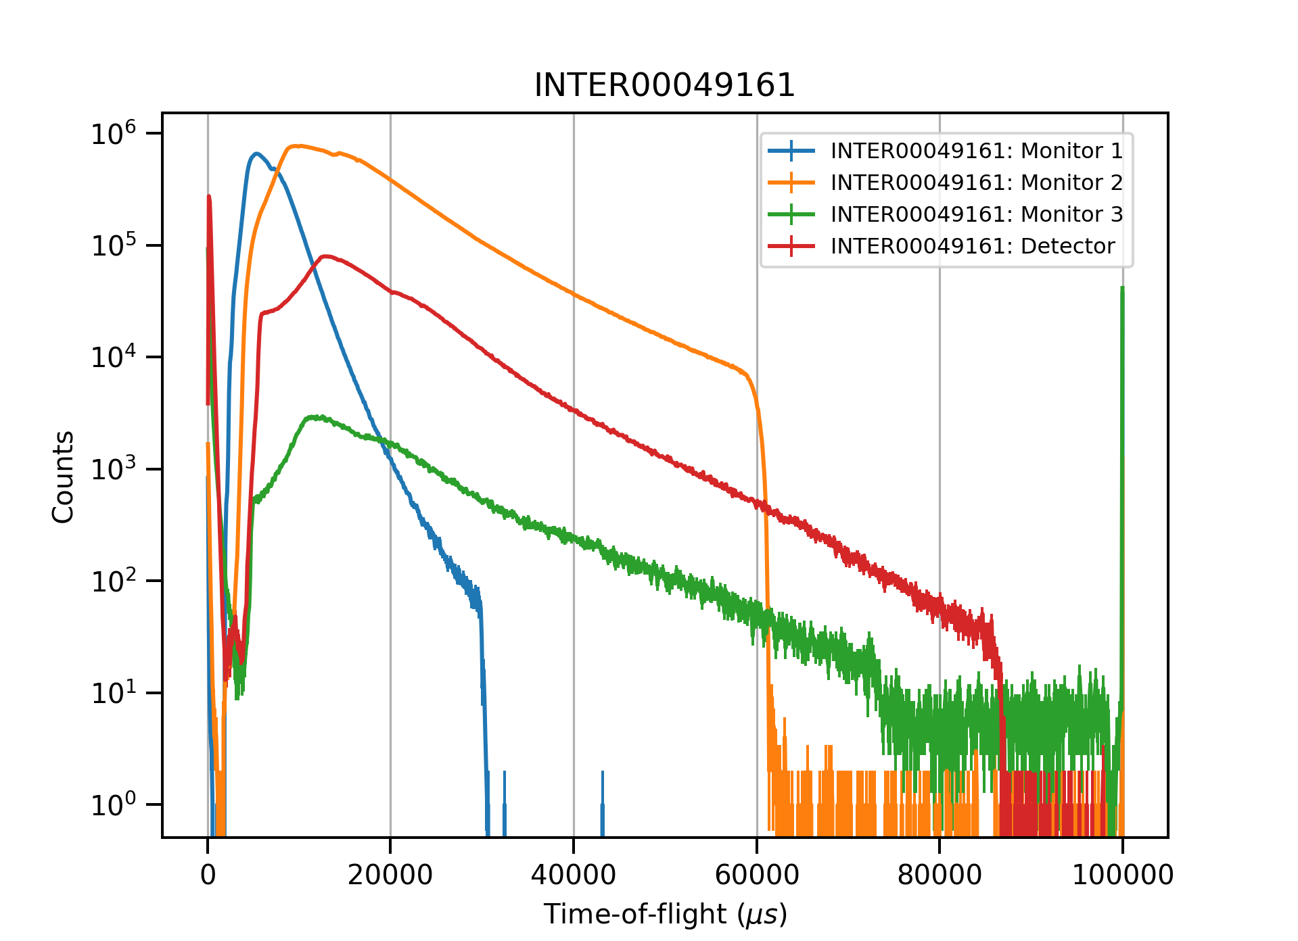
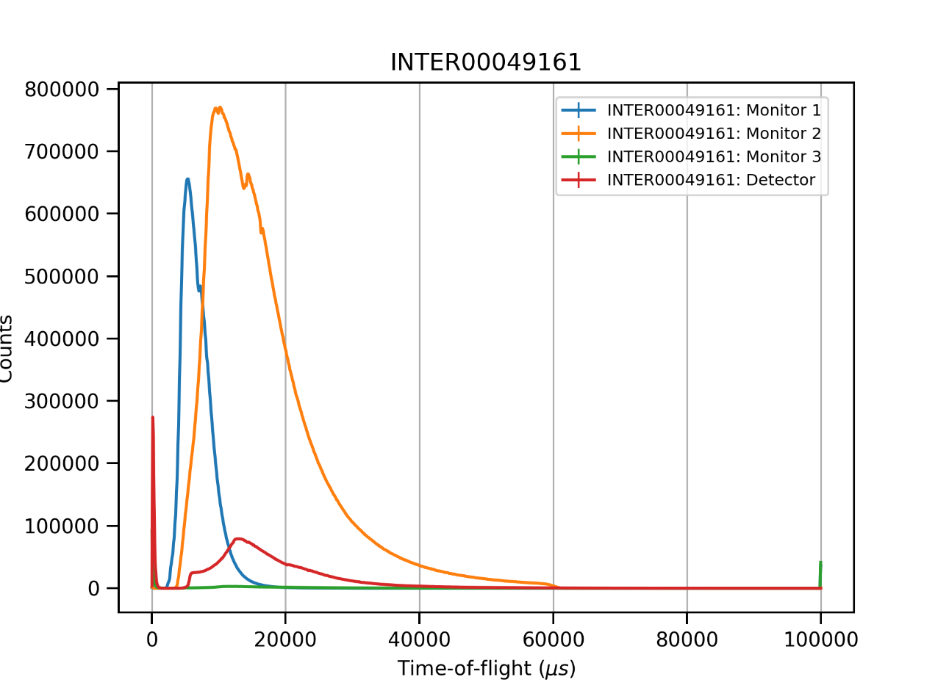
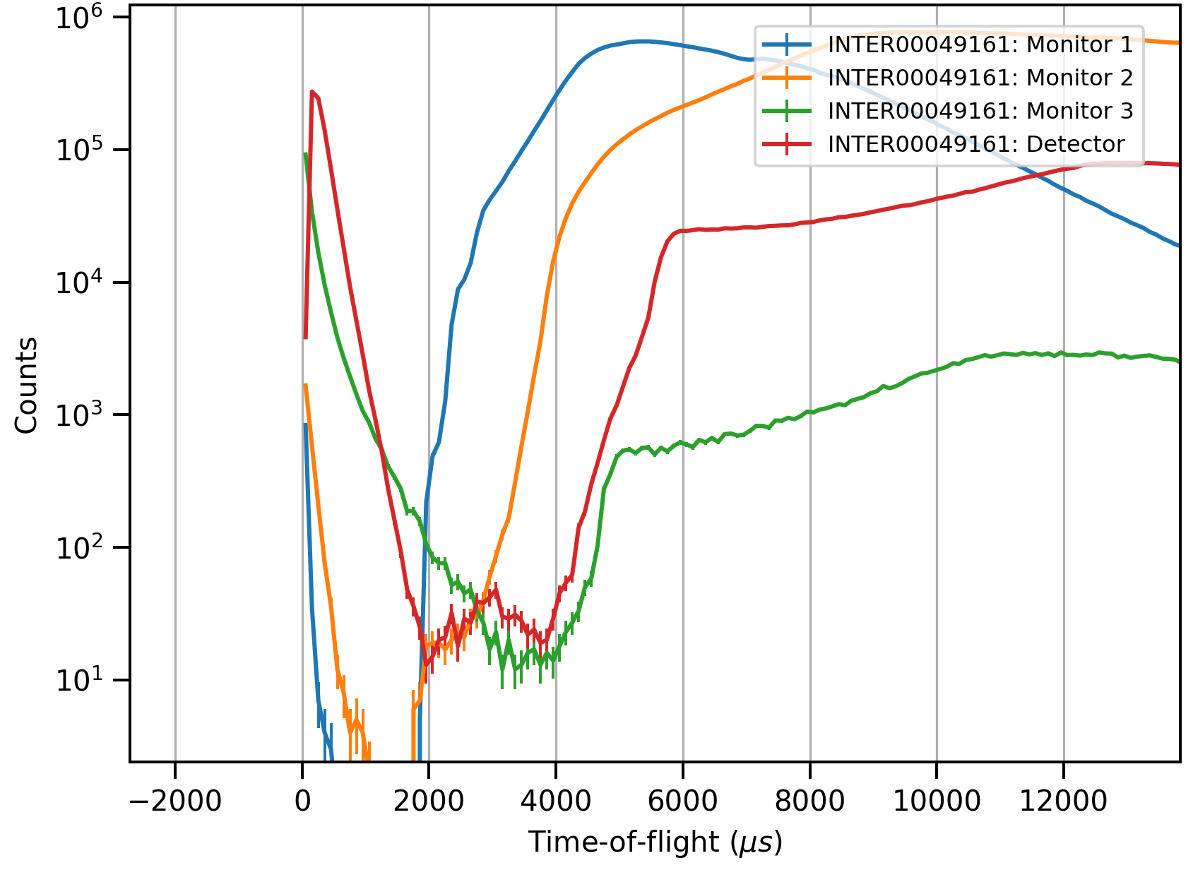
Time-Of-Flight Reflectometry
Monitor 1
Monitor 2
Monitor 3
Detector

Slide 9
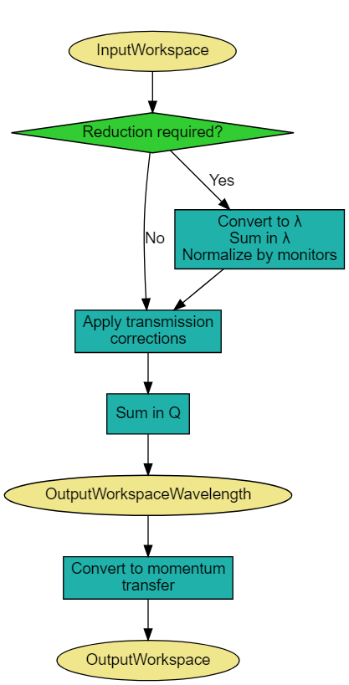
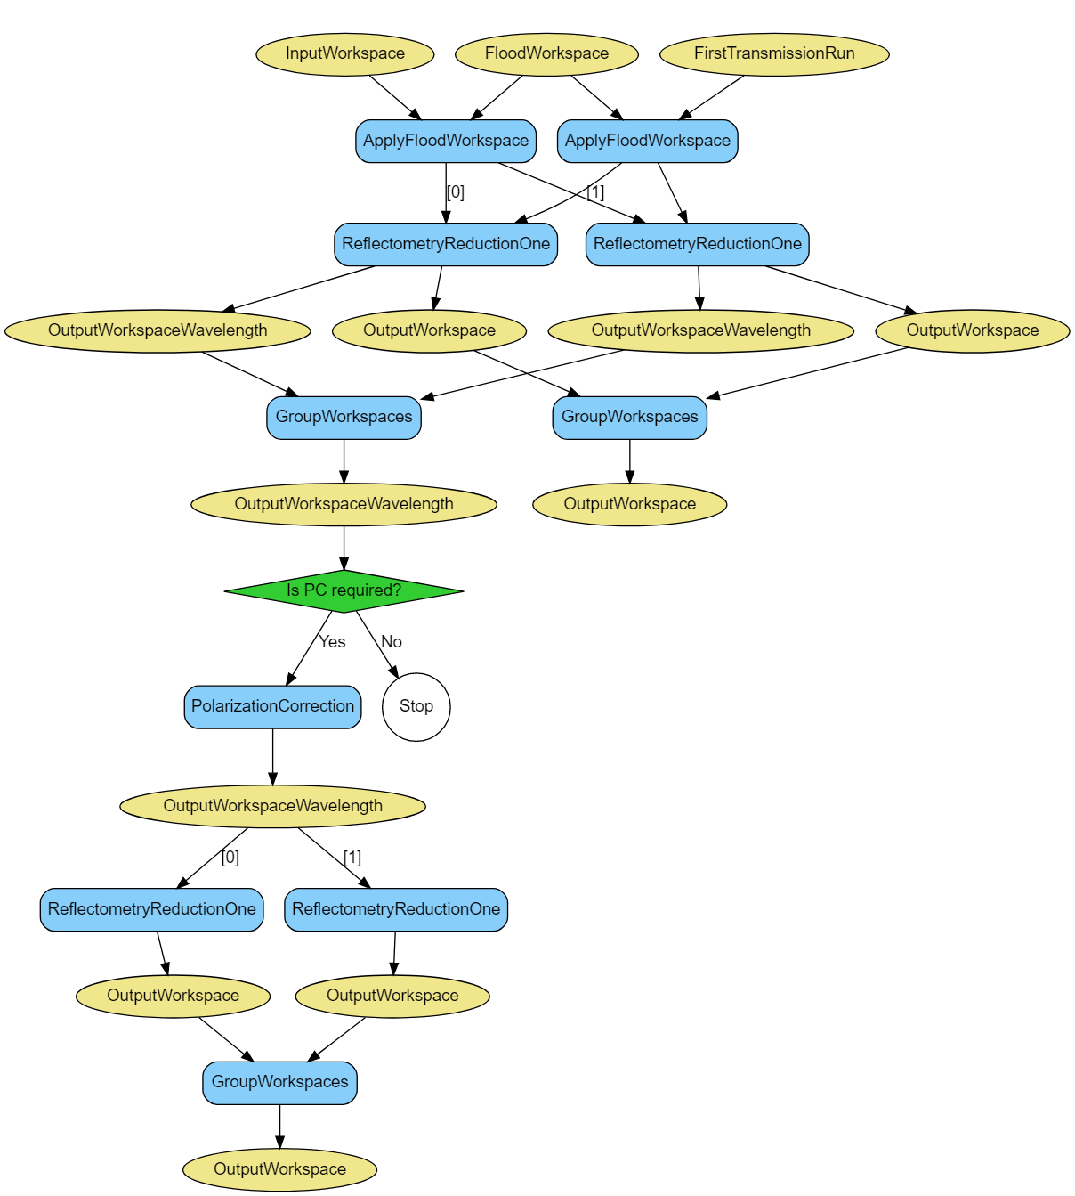



Data reduction steps
$$R(Q)=\frac{I}{I_{0}}$$
$$I$$
$$I_{0}$$
direct beam or transmission through air, sample cell or substrate.
InputWorkspace
Transmission
Workspace
Convert to λ
Convert to λ
Normalisation
Normalisation
Transmission Correction
Convert to Q

Slide 10
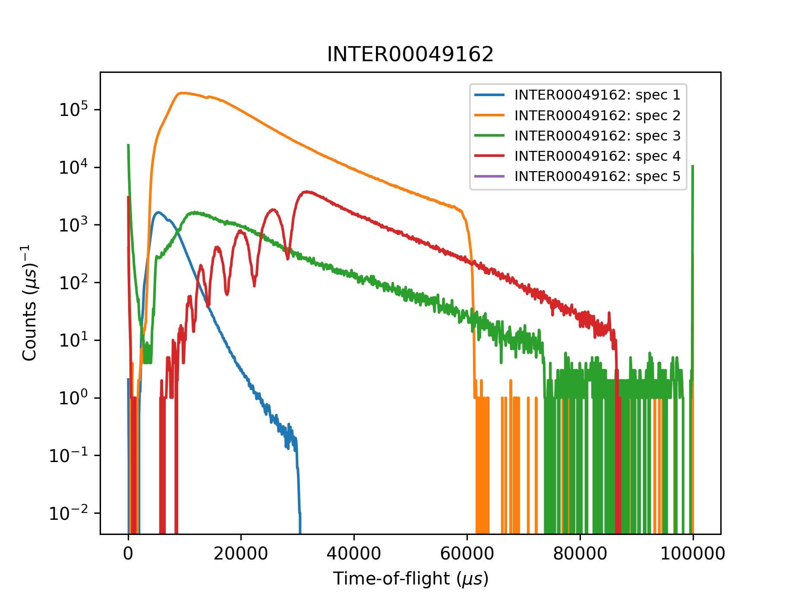
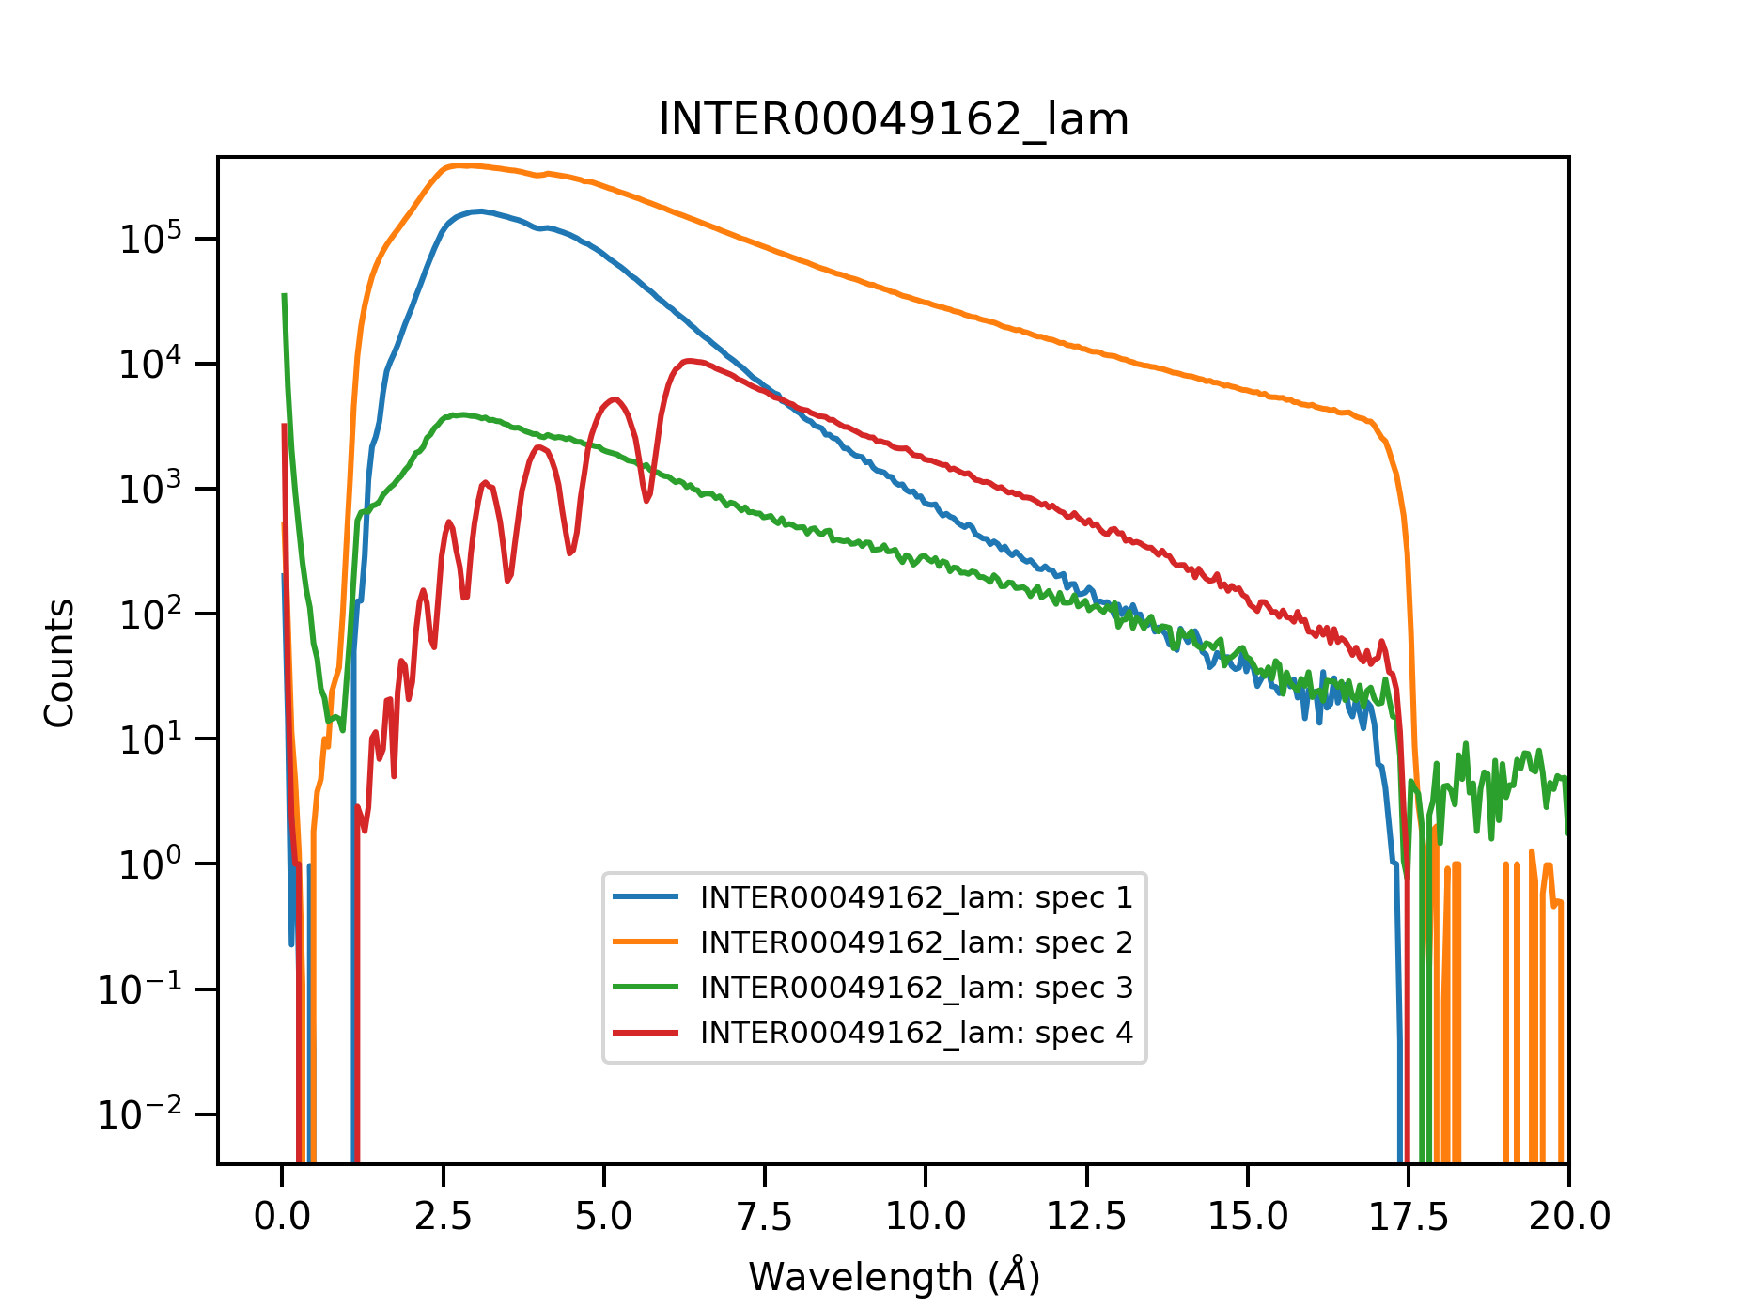
Data reduction steps – Unit conversion to wavelength
$$I$$
$$I_{0}$$
InputWorkspace
Transmission
Workspace
Convert to λ
Convert to λ
Normalisation
Normalisation
Transmission Correction
Convert to Q
15 m
17 m
20 m

Slide 11
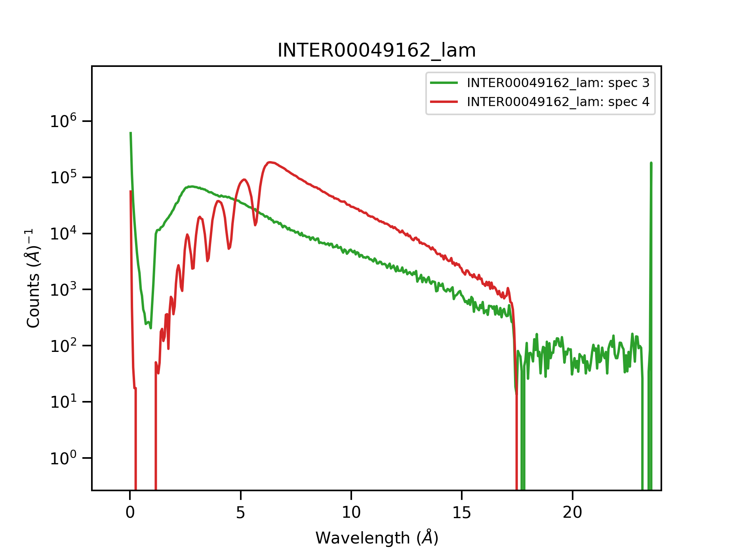
Data reduction steps – Normalisation
$$I$$
$$I_{0}$$
InputWorkspace
Transmission
Workspace
Convert to λ
Convert to λ
Normalisation
Normalisation
integrate monitor spectrum and divide detector by integral
Transmission Correction
Convert to Q
15 m
17 m
20 m

Slide 12
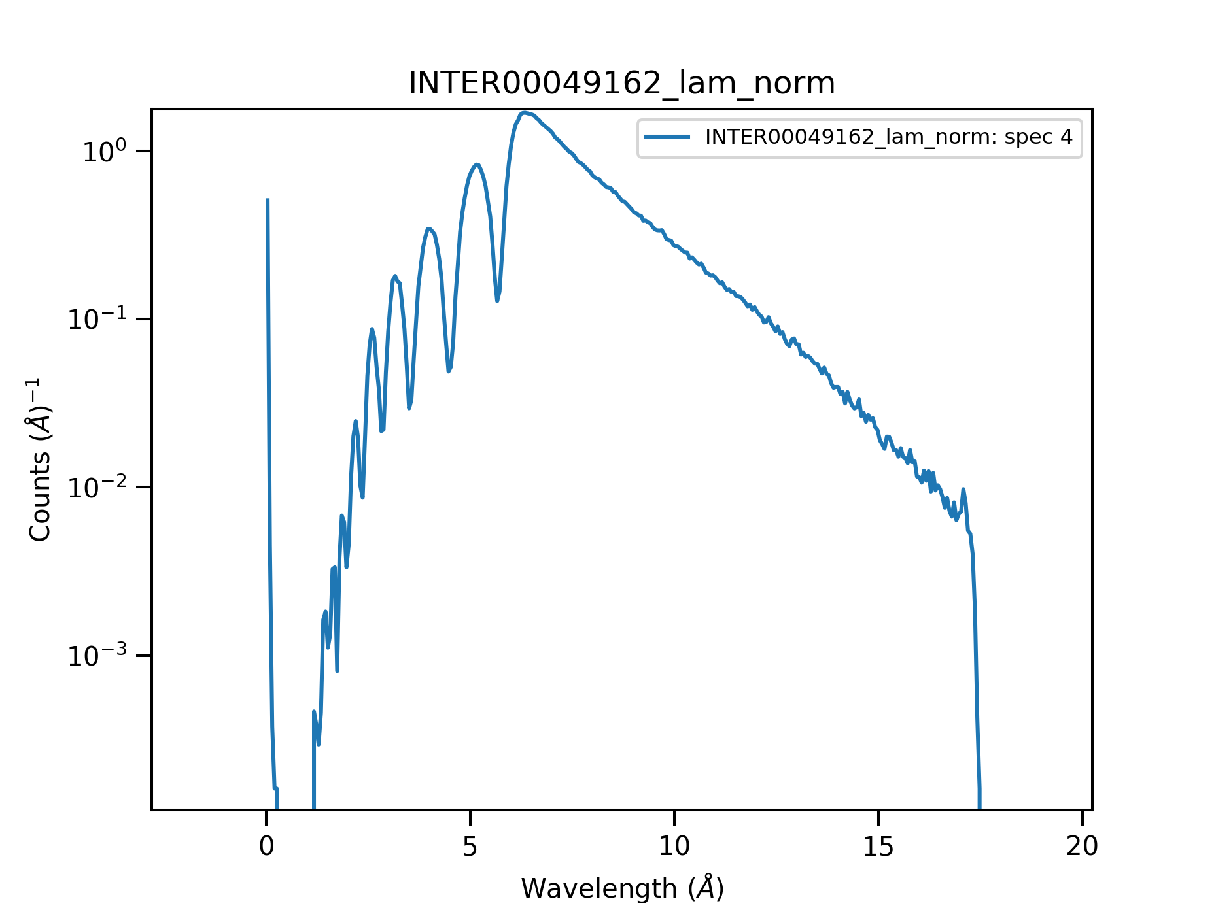
Data reduction steps – Normalisation
$$I$$
$$I_{0}$$
InputWorkspace
Transmission
Workspace
Convert to λ
Convert to λ
Normalisation
Normalisation
Transmission Correction
Convert to Q

Slide 13
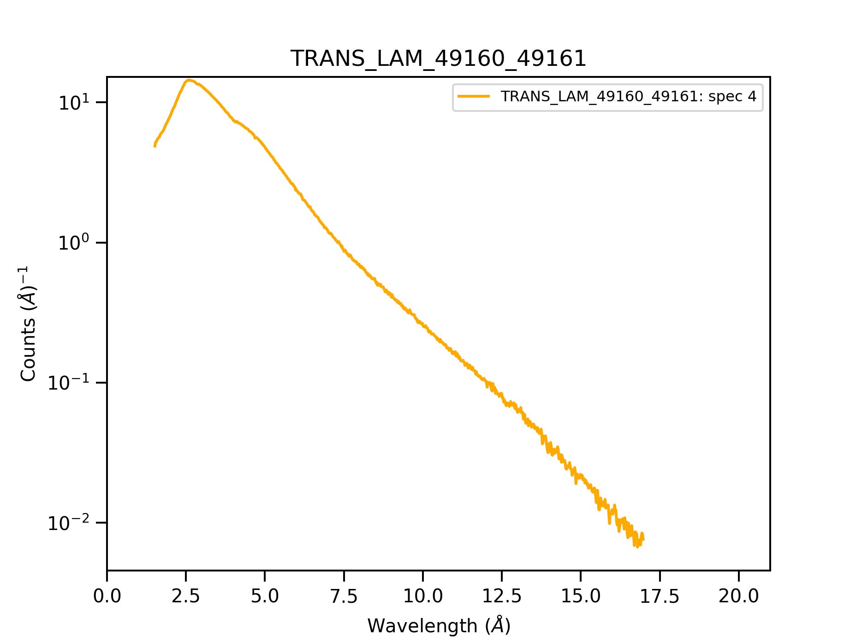
Data reduction steps – Normalisation
$$I$$
$$I_{0}$$
InputWorkspace
Transmission
Workspace
Convert to λ
Convert to λ
Normalisation
Normalisation
Transmission Correction
Convert to Q

Slide 14
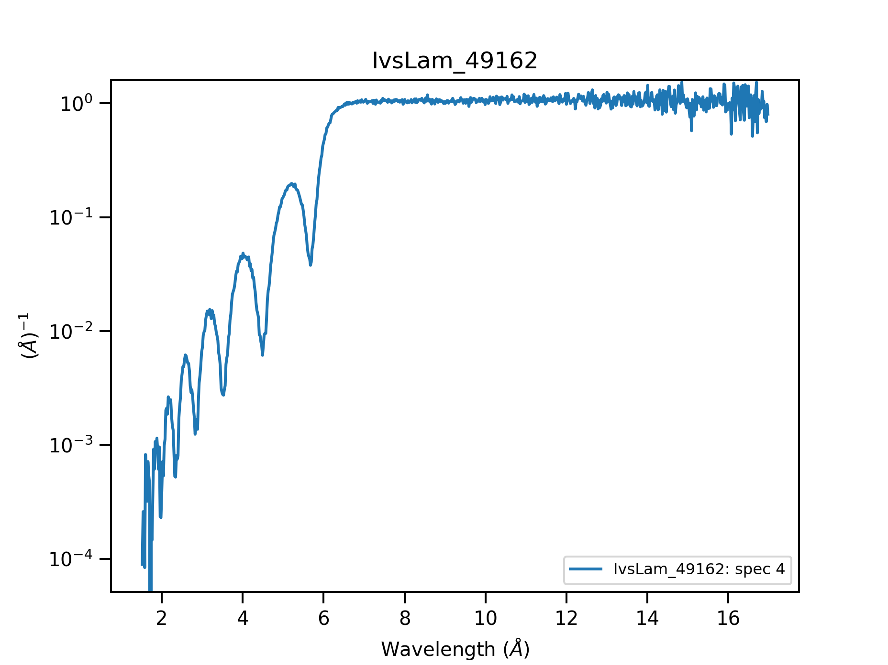
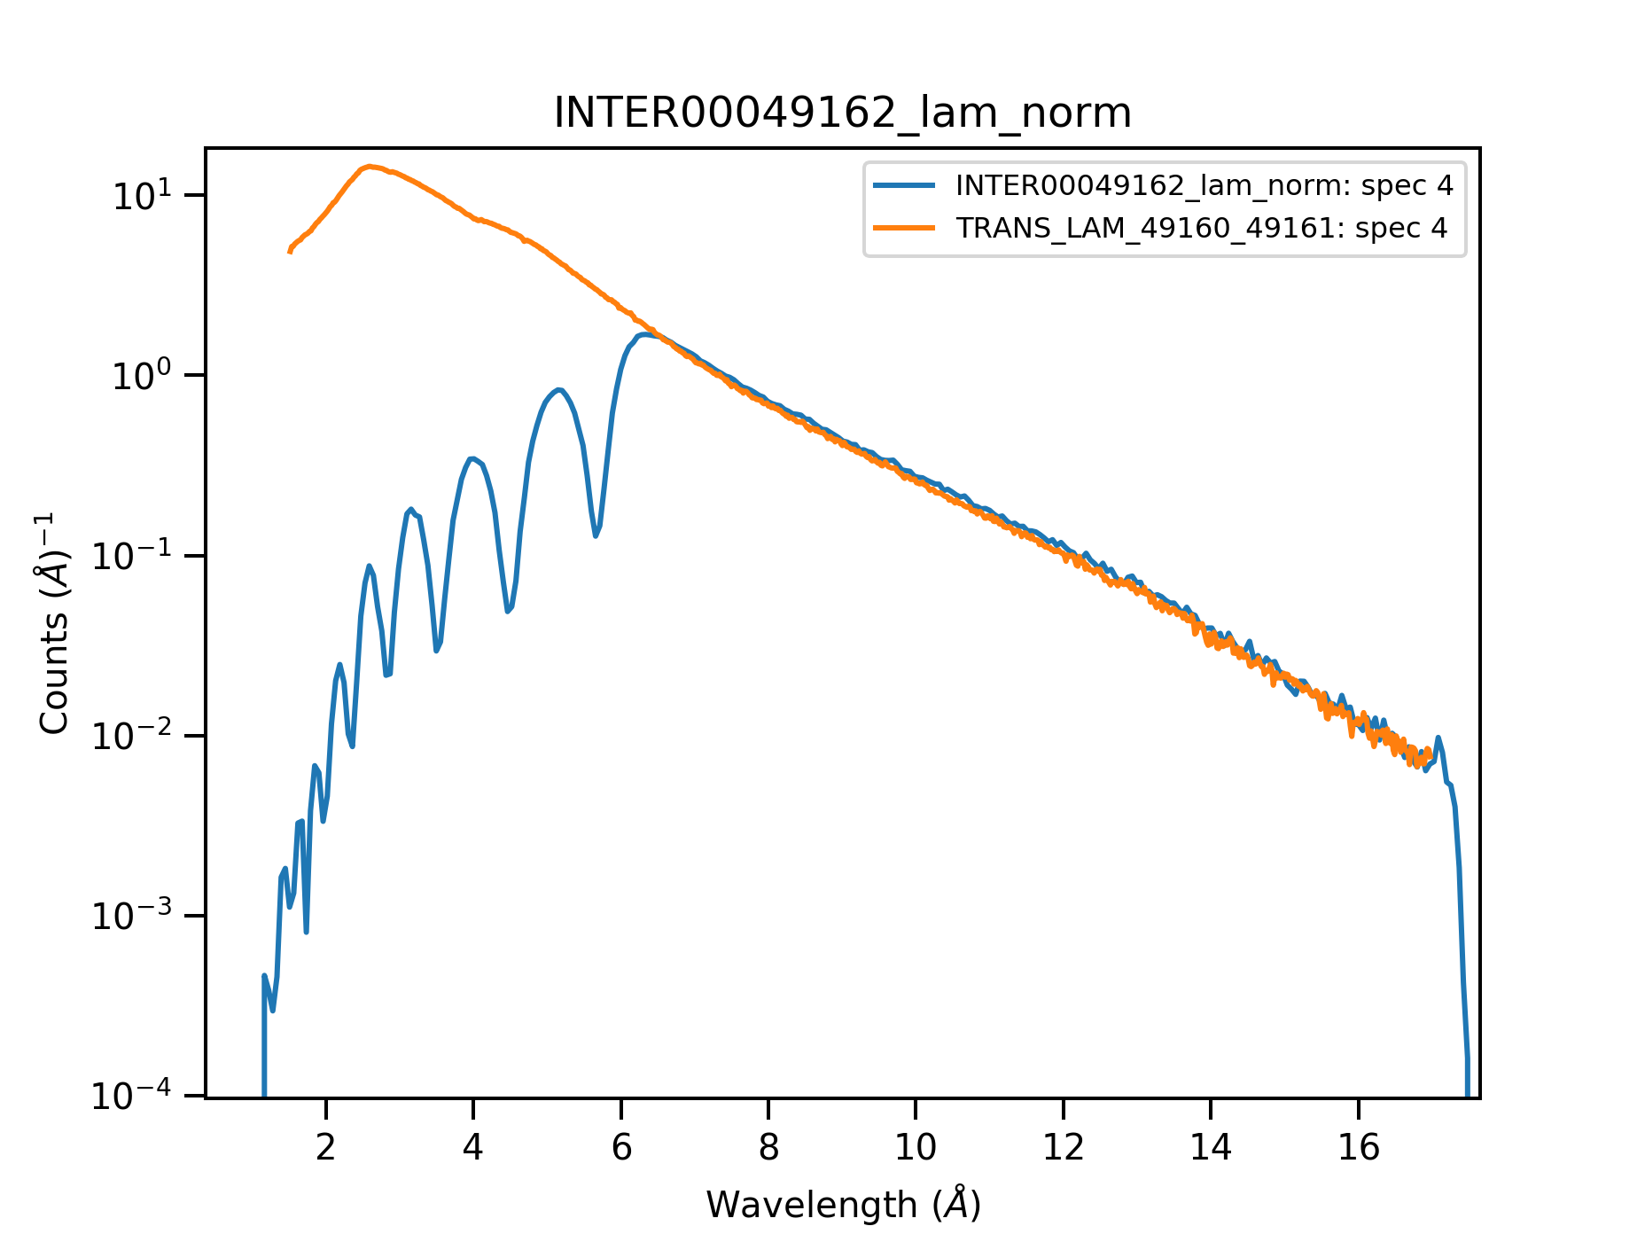
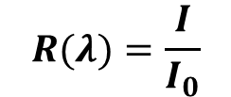
Data reduction steps – Transmission correction
$$I$$
$$I_{0}$$
InputWorkspace
Transmission
Workspace
Convert to λ
Convert to λ
Normalisation
Normalisation
Transmission Correction
divide sample data by transmission data:
$$R(λ)=\frac{I}{I_{0}}$$
Convert to Q

Slide 15
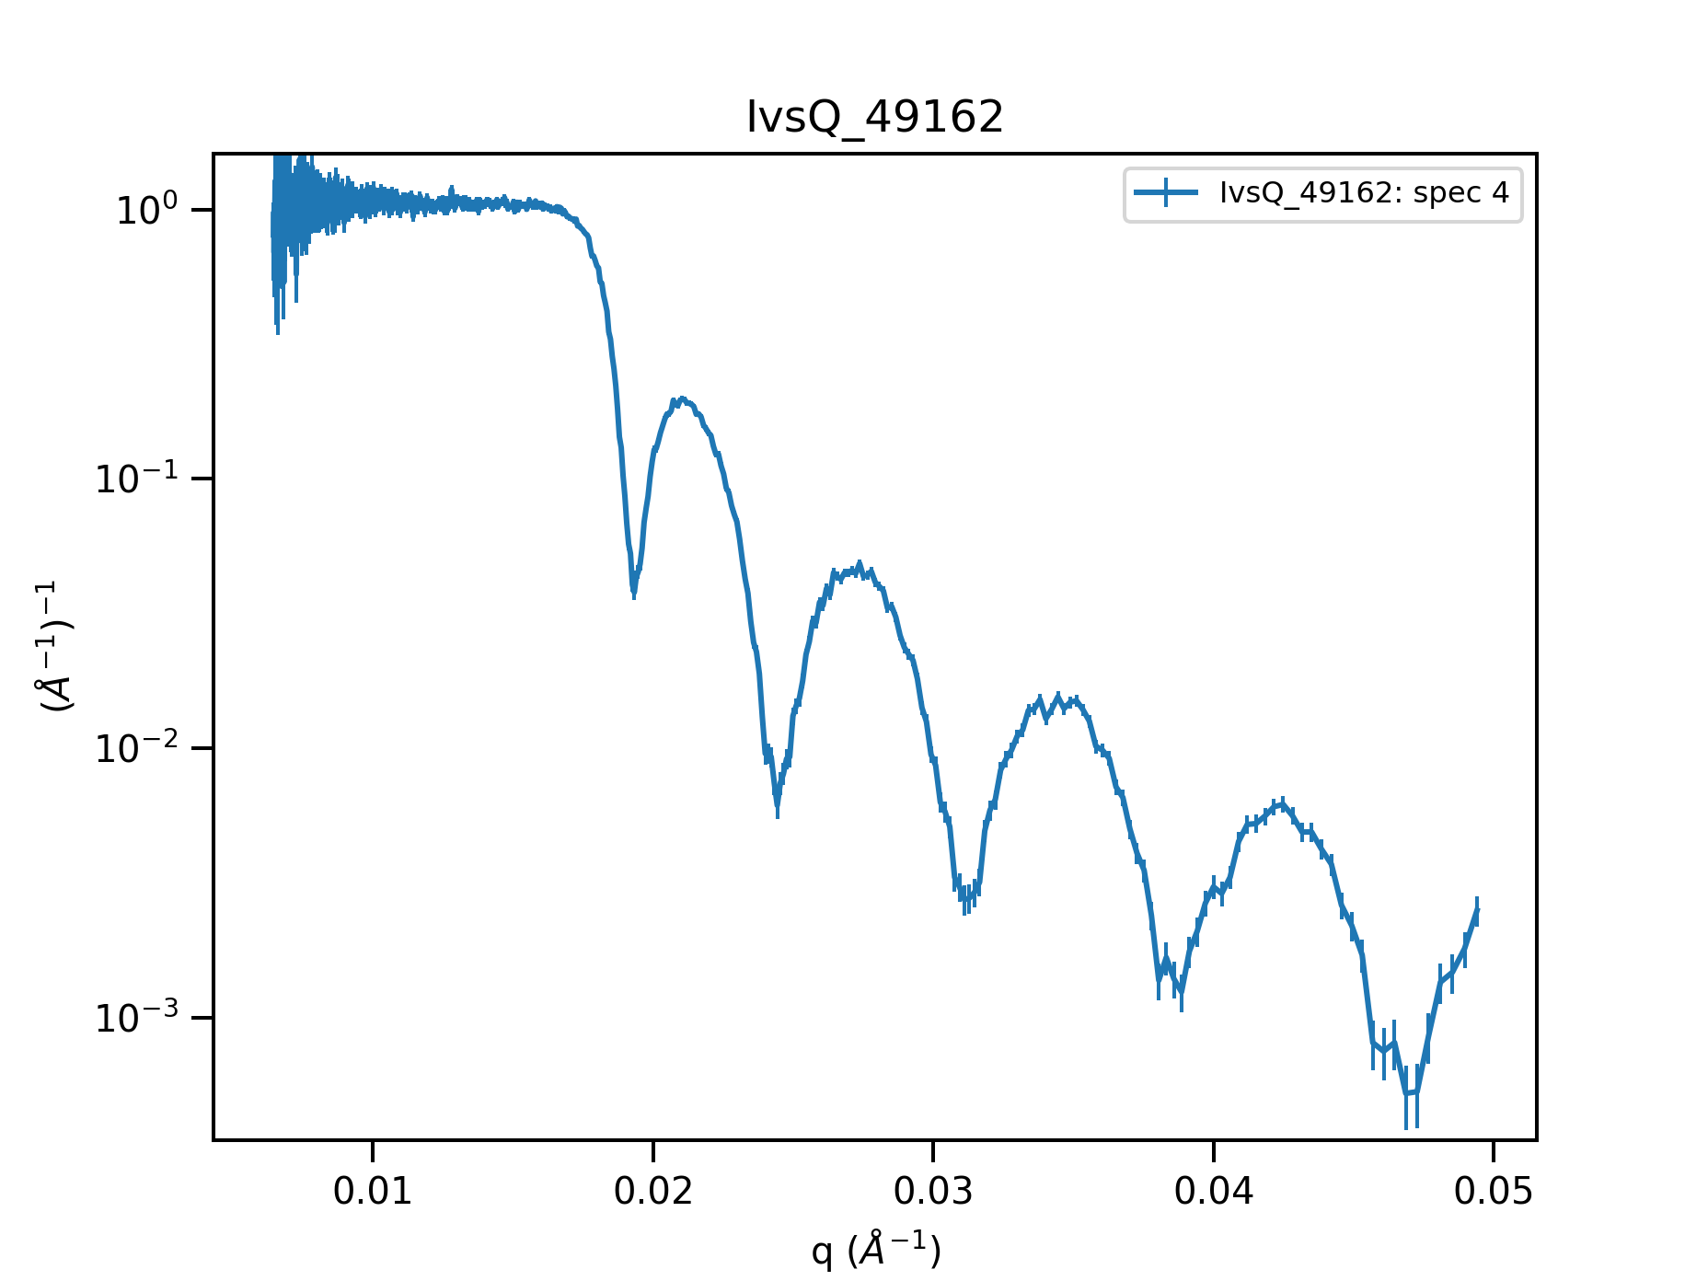

Data reduction steps – Q conversion
$$I$$
$$I_{0}$$
InputWorkspace
Transmission
Workspace
Convert to λ
Convert to λ
Normalisation
Normalisation
Transmission Correction
$$Q_{z}=\frac{4π}{λ}\sin{θ}$$
Convert to Q

Slide 16
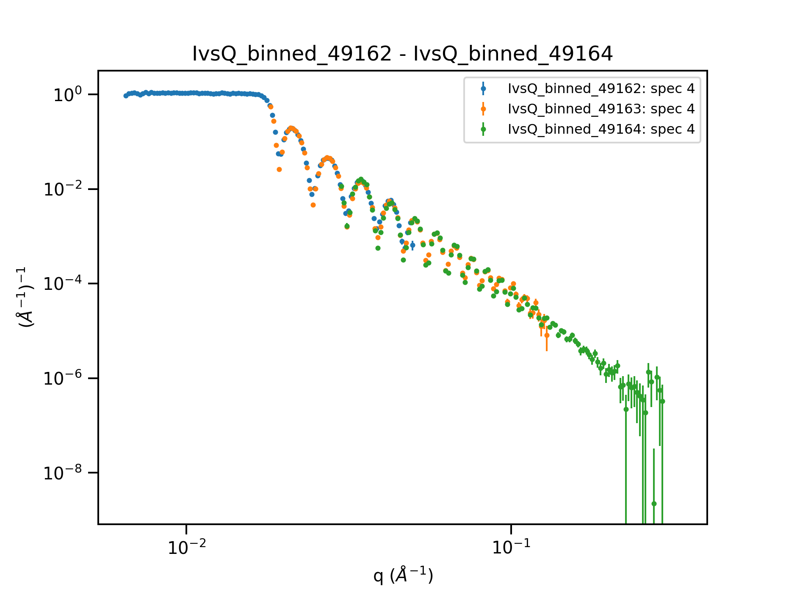
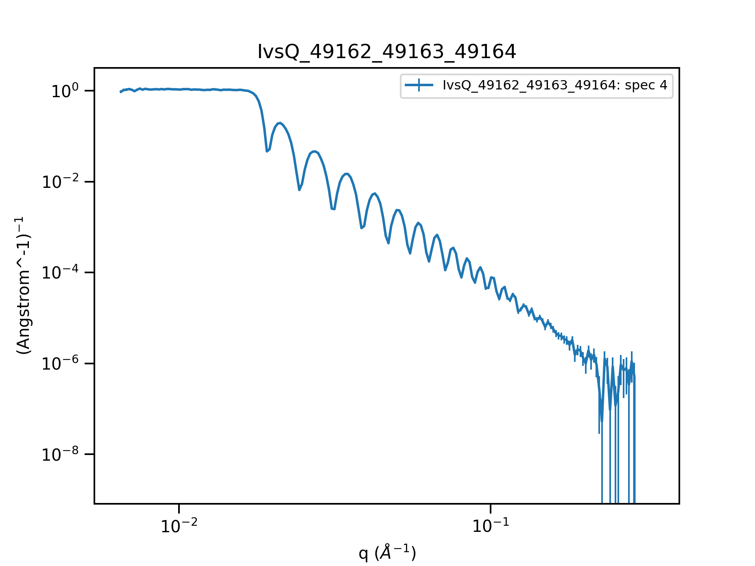
Data reduction steps – Stitching
$$I$$
$$I_{0}$$
InputWorkspace
Transmission
Workspace
θ1
Convert to λ
Convert to λ
θ2
θ3
Normalisation
Normalisation
Transmission Correction
Convert to Q

Slide 17
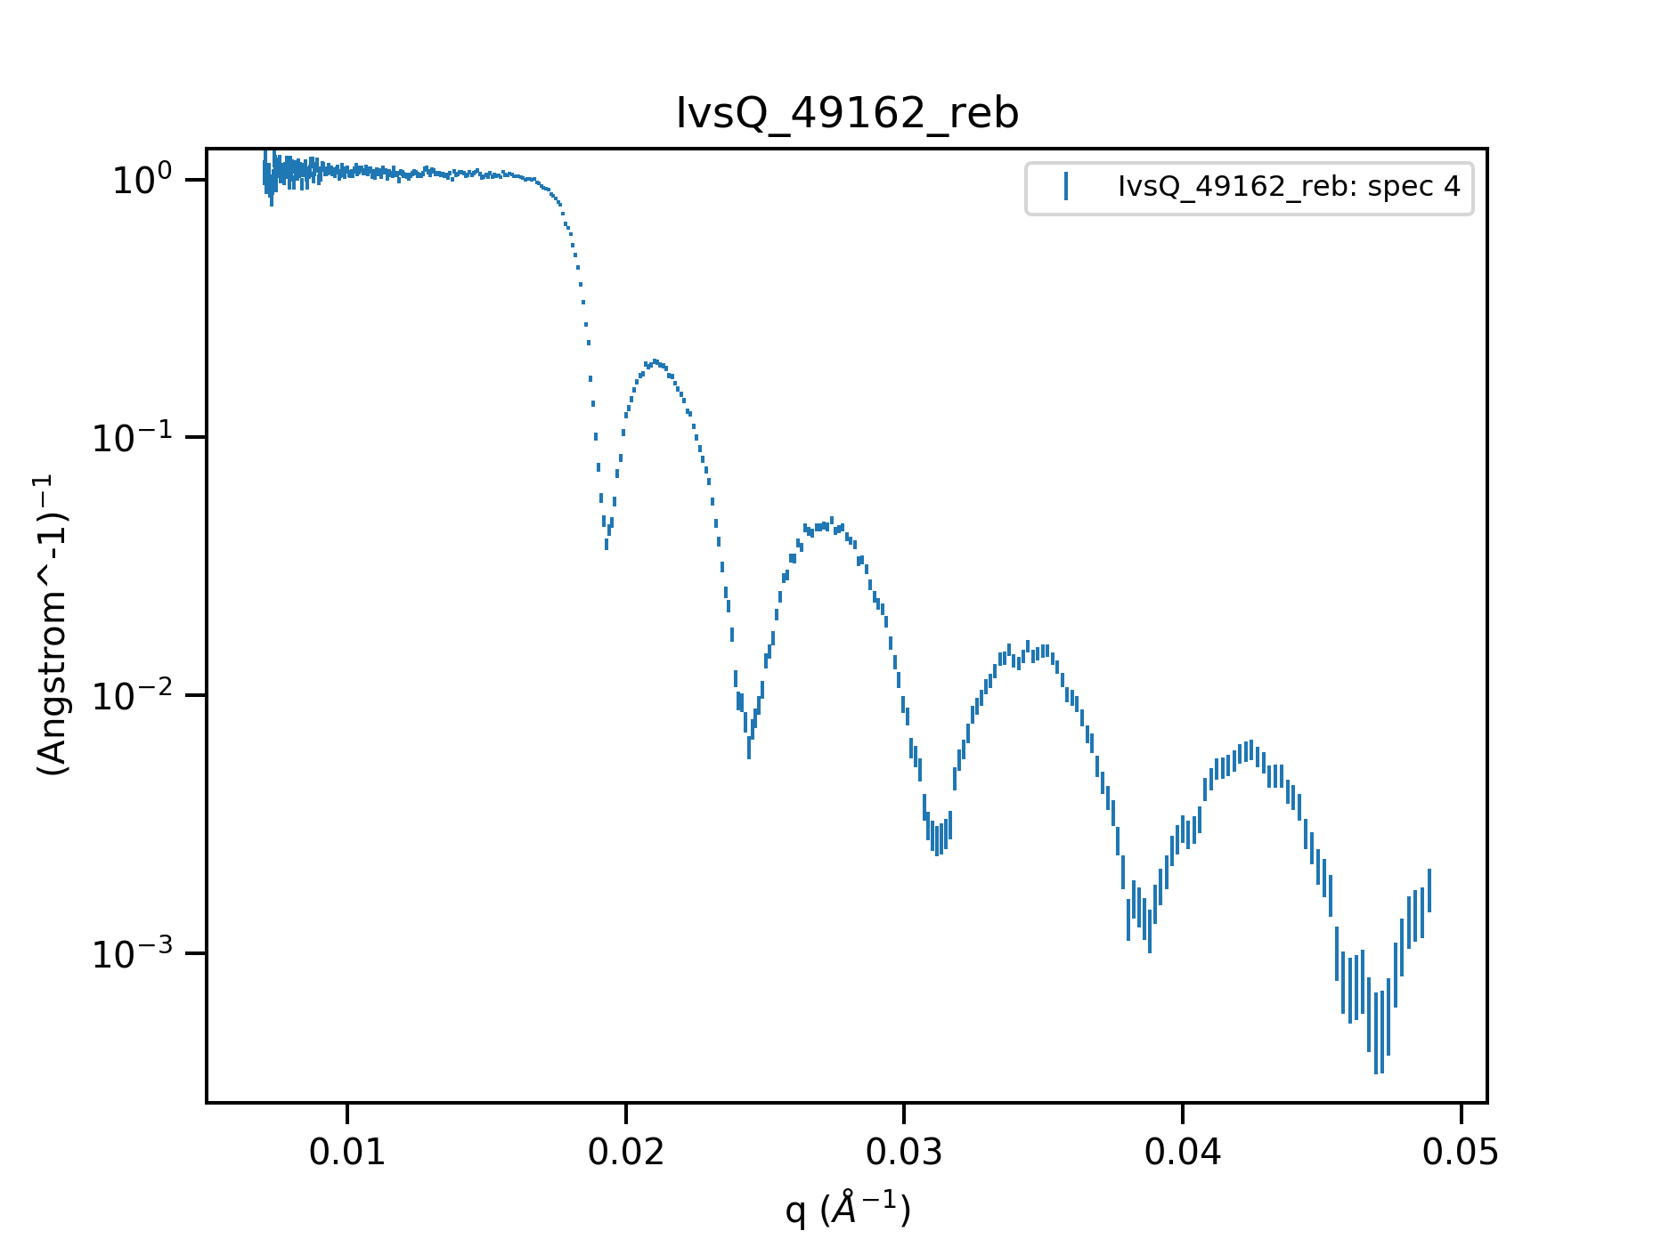
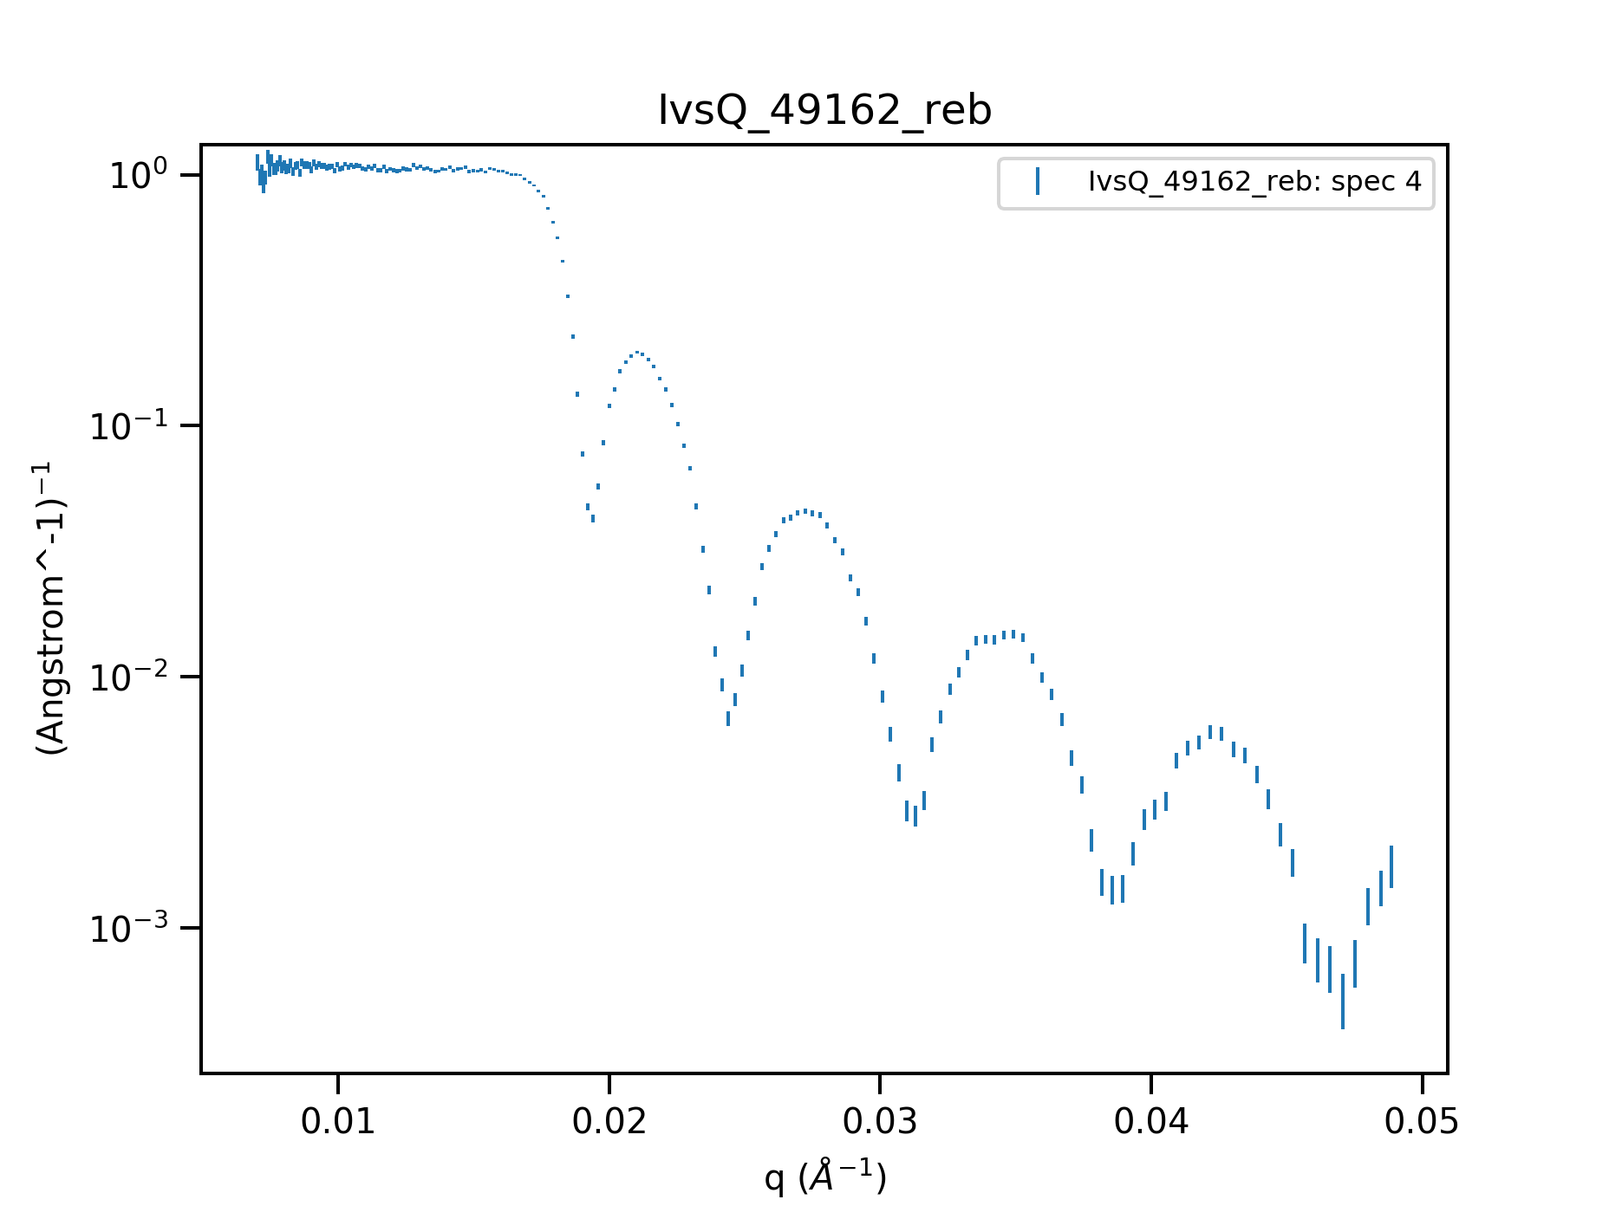
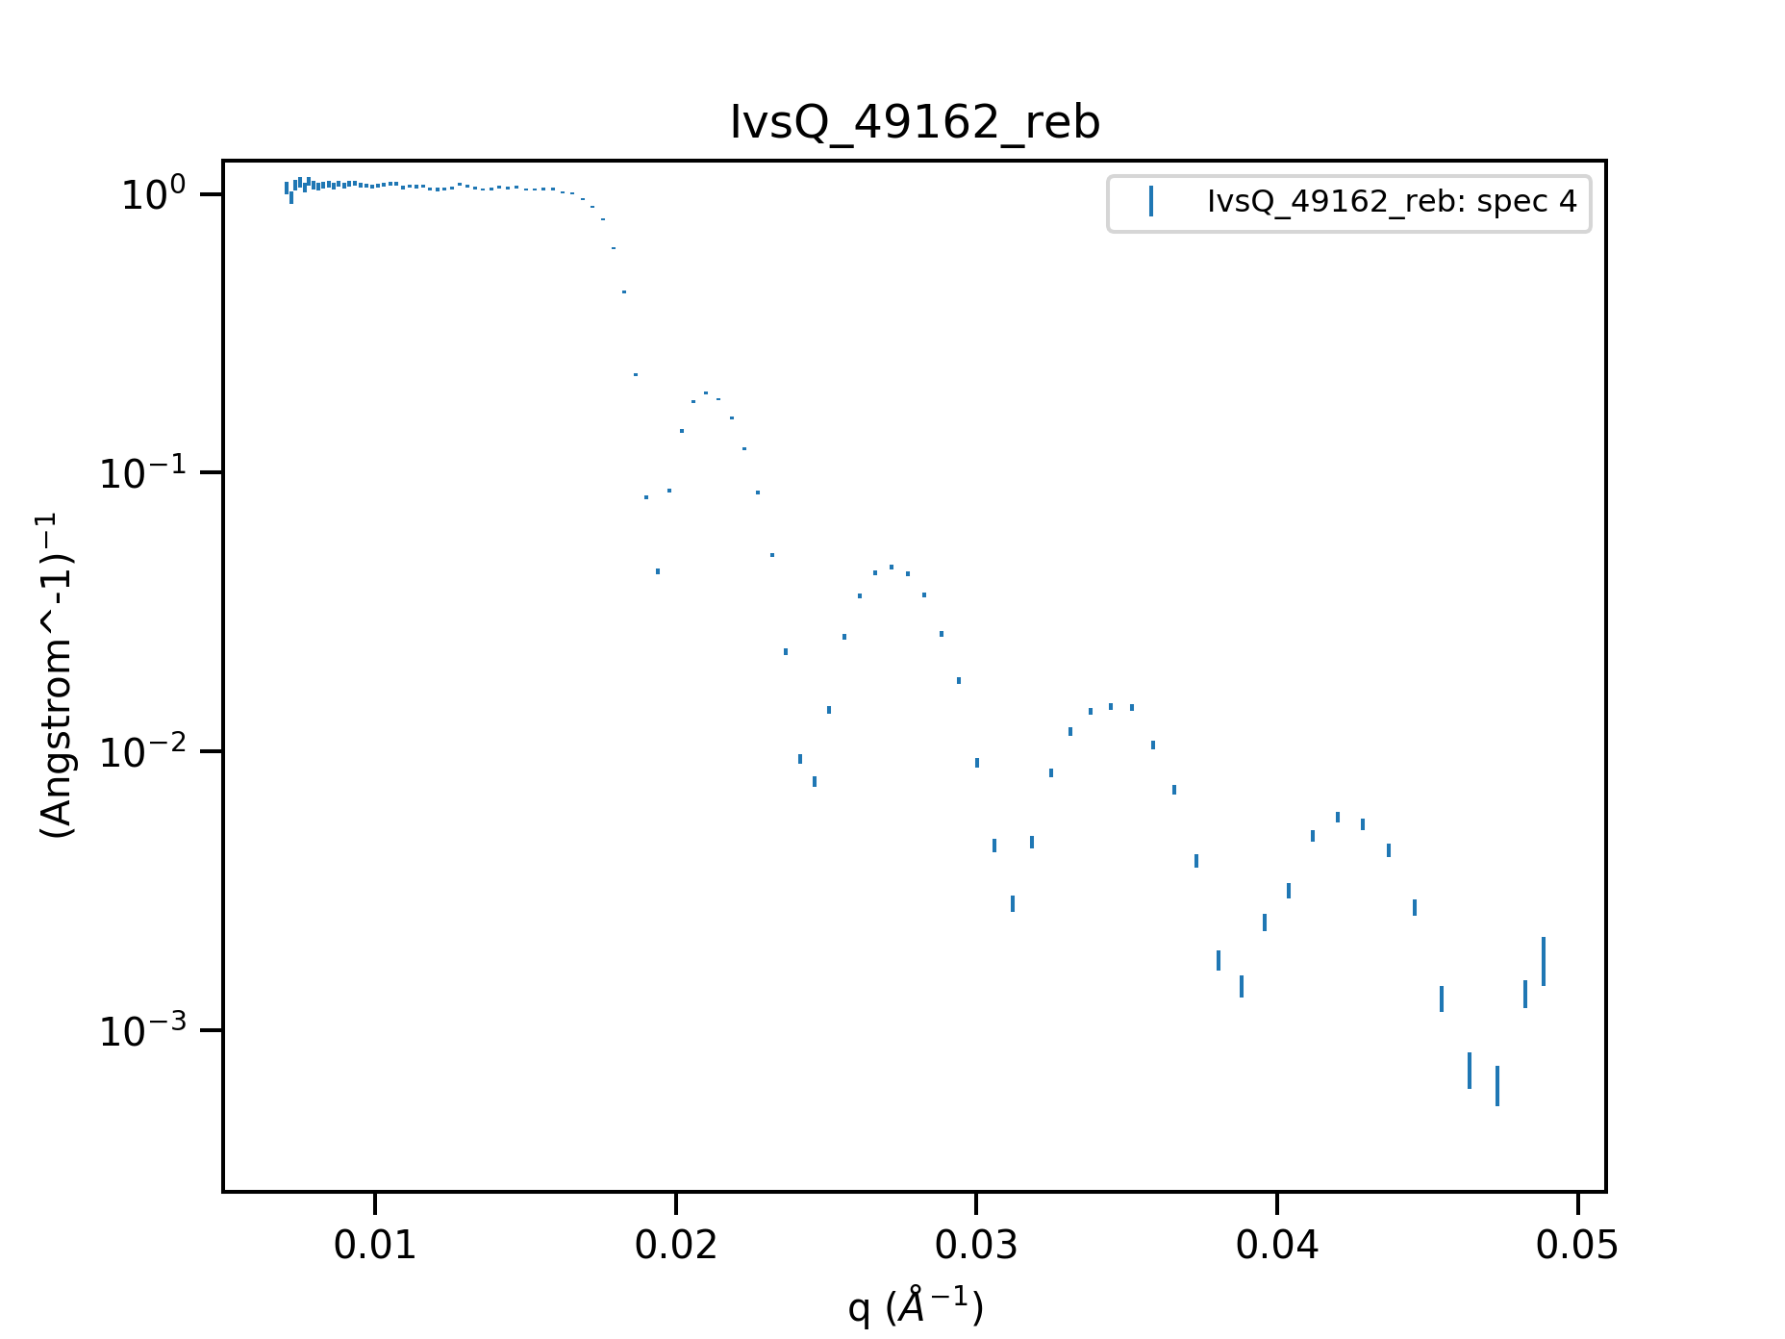
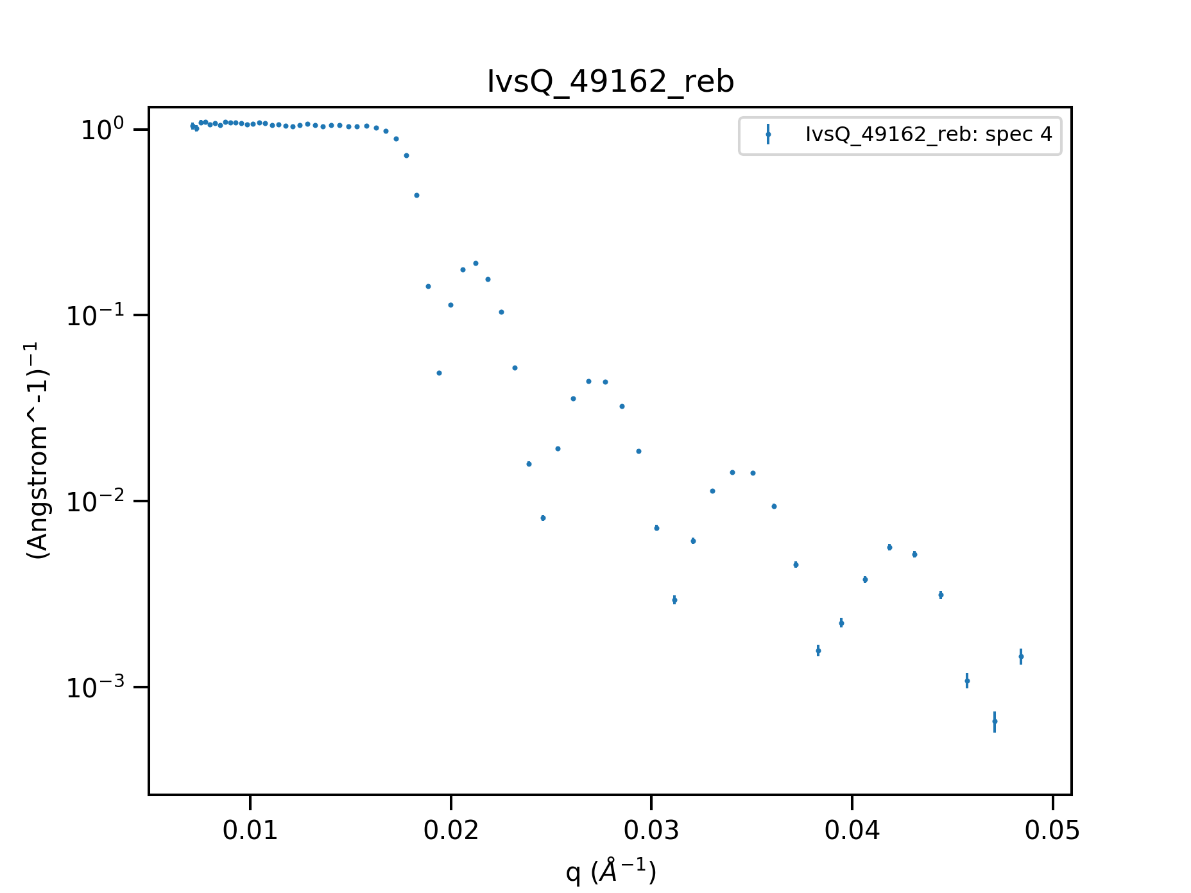
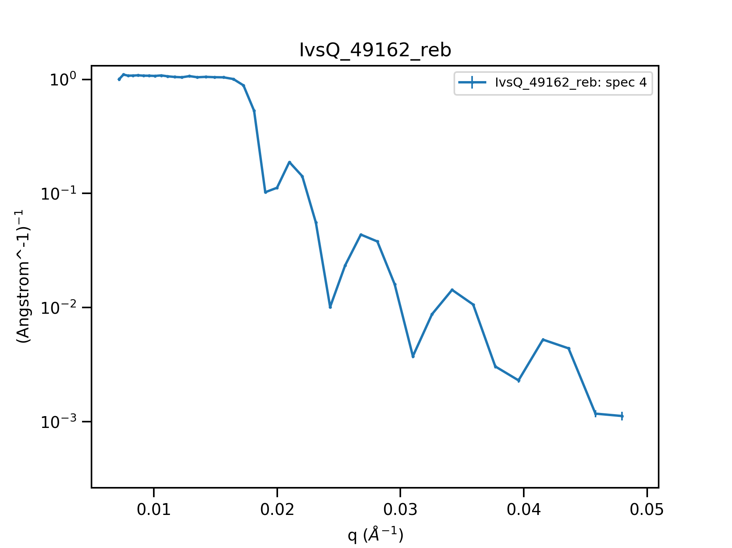
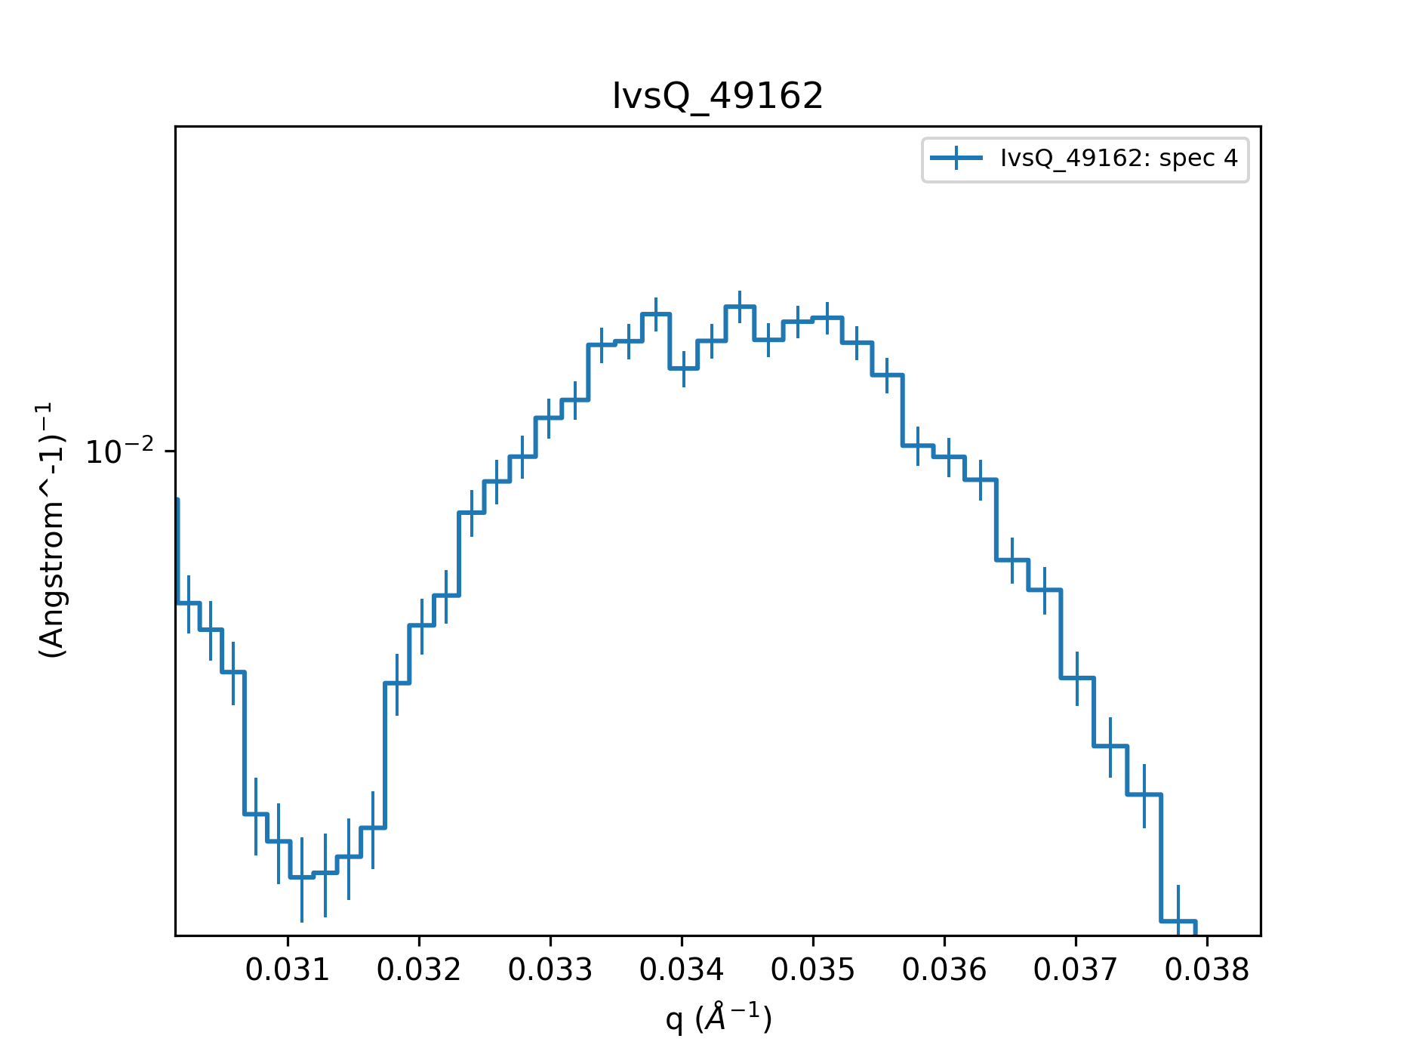
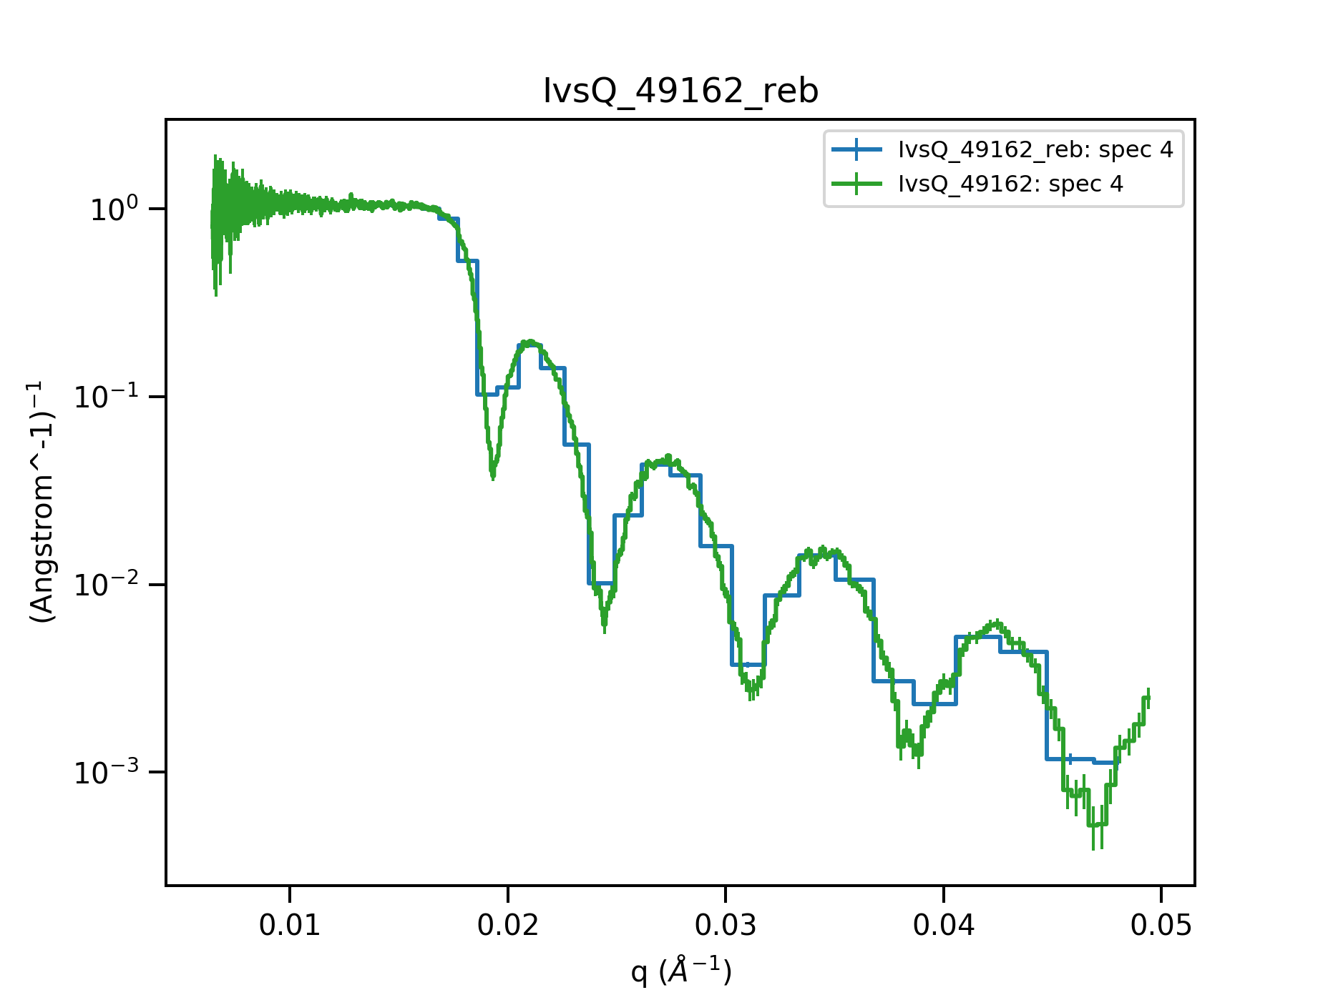
Further steps and comments
Rebinning
  Should match experimental resolution
Error bars
Kinetic data
Export/save as ASCII
Δq/q=0.05
Δq/q=0.01
Δq/q=0.02
Δq/q=0.03
Δq/q=0.005
Δq/q=0.005

Slide 18
Time-Of-Flight Reflectometry

