Slide 1

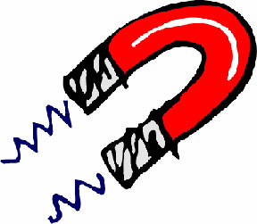
A Brief Introduction to
Neutron Reflectivity
Christy Kinane, Andrew Caruana, Goran Nilsen, Max Skoda and Luke Clifton – ISIS
Alex Grutter, Patrick Quarterman, Brian Kirby, Brian Maranville – NCNR NIST
(basically, all the people I have politely stolen stuff from)
With almost constant reference to the published works of F. Ott, S. Sinha, R. Pynn, C. Majkrzak and D. Sivia
Christy.kinane@stfc.ac.uk
1

Slide 2
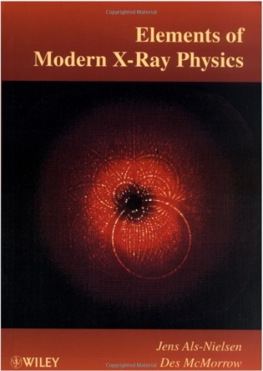
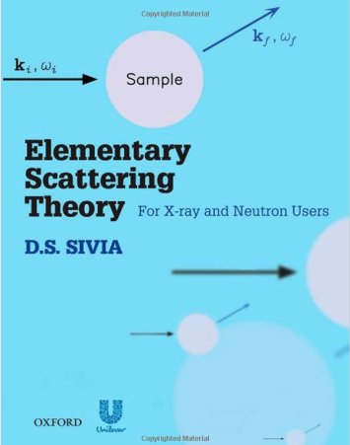


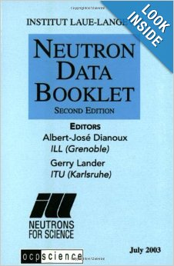

Useful books: These are actually helpful when doing experiments!
Free on web
http://xdb.lbl.gov/
Excellent for x-ray magnetic scattering.
Deals with all theory that’s is needed for doing scattering experiments.
Deals with all stats needed for dealing with SANS/NR data.
Deals with a lot of basic optics theory.
These are the books I learned from but there are many out there.
Thank you for listening

Slide 3
Outline: 60 minutes to describe a very versatile technique.
What is reflectivity?
  Basic defintions
  Snell's Law
  Fresnel's Laws
  Interference
  Braggs Law
  Offspecular reflections
Why bother? What does it tell you?
  General overview
  NR
Next lecture @ 13:30
  PNR
  PA

Slide 4
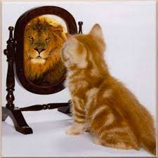
Neutron Reflectometry (NR):
NR measures the nuclear scattering length density profile.
Some basic principles, but by no way exhaustive!

Slide 5
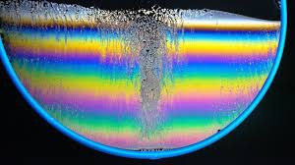
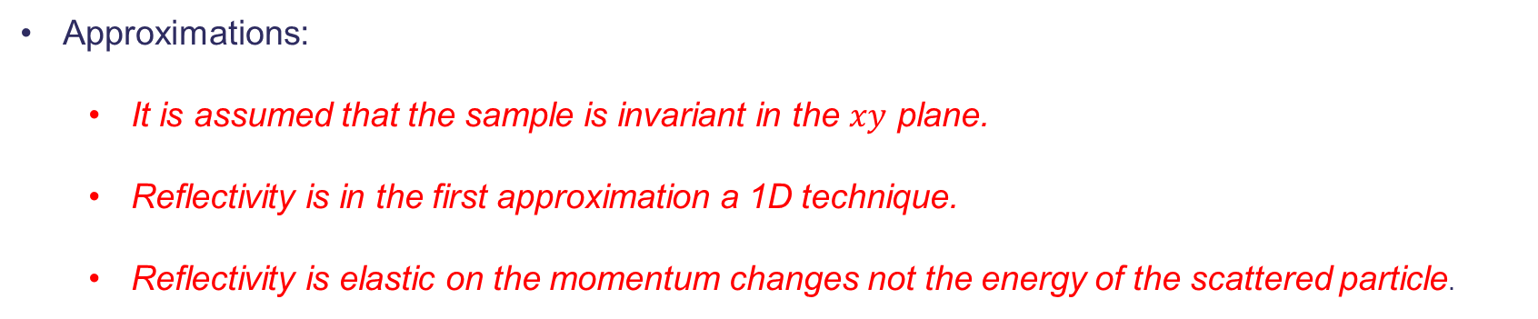
What is Reflectivity?
Reflectivity is the study of surfaces and layered materials, particular buried interfaces.
Reflectivity primarily gives information in the z direction perpendicular to the plane via constructive and destructive interference effects in the measured reflectivity.
Approximations:
  It is assumed that the sample is invariant in the $xy$ plane.
  Reflectivity is in the first approximation a 1D technique.
  Reflectivity is elastic on the momentum changes not the energy of the scattered particle.
Interference fringes in a thin soap film.
Hecht: Optics

Slide 6





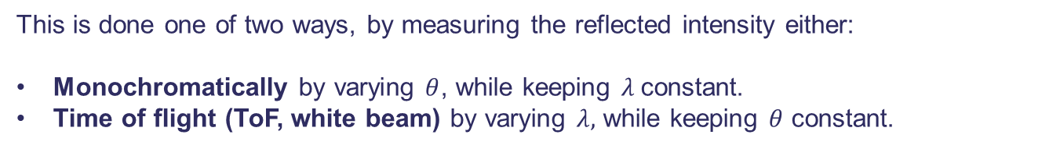
What is Reflectivity?
$$z$$
Basic geometry of reflection.
Reflectivity: A beam (can be anything) of particles of wavelength $λ$ impinges at a grazing angle $θ$ on a planar sample, and the fraction that bounces back is ascertained.
$$y$$
$$λ$$
$$λ$$
$$θ$$
$$θ$$
$$x$$
This is done one of two ways, by measuring the reflected intensity either:
Monochromatically by varying $θ$, while keeping $λ$constant.
Time of flight (ToF, white beam) by varying $λ,$ while keeping $θ$ constant.
Sivia: Elementary scattering theory Chapter 4

Slide 7
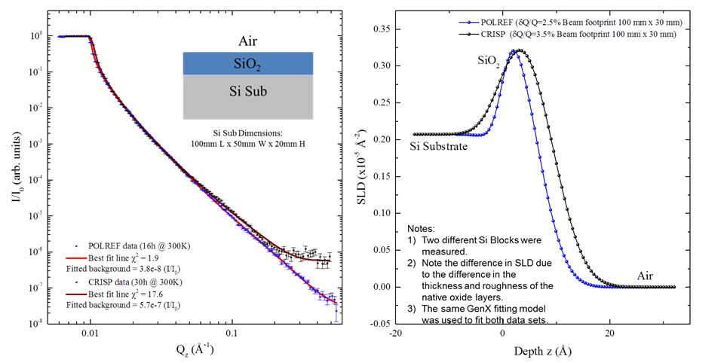
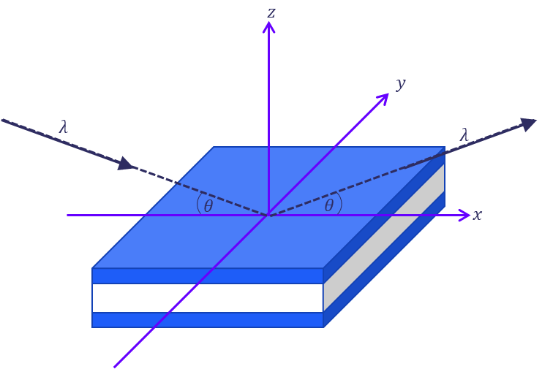
What is the Goal of Neutron Reflectivity (NR)?
The Scattering Length Density (SLD) Profile
This is the density profile, providing information on how the density of the sample various normal to the surface of the sample.
This is over a length scale of 0.5 nm – 300nm

Slide 8
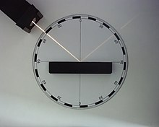
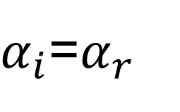
What is Reflectivity? The Specular Condition
As a function of angle:
Perpendicular normal
I
R
α_{i}
α_{r}
surface
T
First part of the law of reflection:
The angle of incidence (α_{i}) equals the angle of reflection (α_{r}).
$α_{i}$=$α_{r}$
Equ: 1
Second part of the law of reflection:
The incident ray, the perpendicular normal and the reflected ray all lie in a plane, called the plane of incidence.
This is often called the θ/2θ, Omega/Theta or specular condition
Hecht: Optics

Slide 9
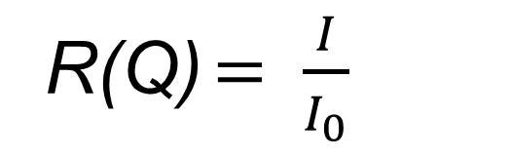
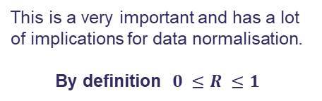
What is Reflectivity? Reflectivity itself (The thing on the y axis)
As a function of intensity:
Perpendicular normal
I
R
α_{i}
α_{r}
Surface
T
$$Reflectivity \left(R\right)= \frac{Rate of Specular reflective scattering (I)}{Rate of incidence (I_{0})}$$
Equ: 2
So simply,
This is a very important and has a lot of implications for data normalisation.
By definition $0 ≤R ≤1$
Equ: 3
R(Q) $= \frac{I}{I_{0}}$
Note this is a dimensionless quantity
By definition total External reflection R = 1
Hecht: Optics

Slide 10

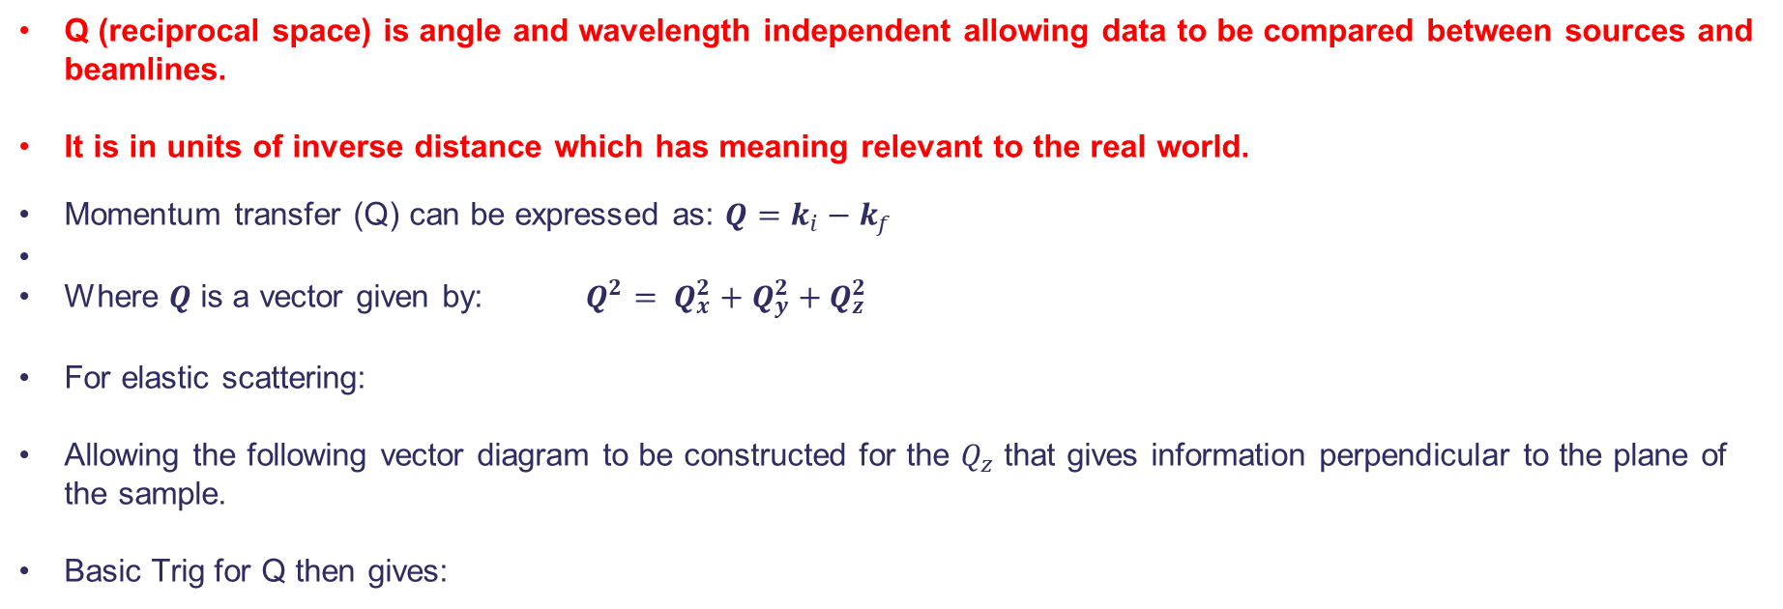

Q_{z} and why its important (The thing on the x axis)
Q (reciprocal space) is angle and wavelength independent allowing data to be compared between sources and beamlines.
It is in units of inverse distance which has meaning relevant to the real world.
Momentum transfer (Q) can be expressed as: $Q=k_{i}−k_{f}$
Where $Q$ is a vector given by: $Q^{2}= Q_{x}^{2}+Q_{y}^{2}+Q_{z}^{2}$
For elastic scattering:
Allowing the following vector diagram to be constructed for the $Q_{z}$ that gives information perpendicular to the plane of the sample.
Basic Trig for Q then gives:
$\left|k_{i}\right|=\left|k_{f}\right|=\frac{2π}{λ}$
k_{f}
k_{i}
$$Q_{z}=\frac{4π}{λ}\sin{θ }$$
2θ
θ
θ
_{Q}
-k_{f}
Q in reflectometry is normally expressed in units of Å⁻¹ or nm⁻¹
Sivia: Chapter 3

Slide 11
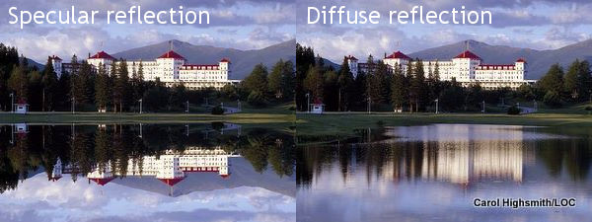
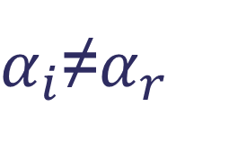
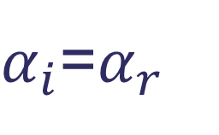
What is Reflectivity? The Non-Specular
Specular reflection:
Off-Specular or diffuse reflection:
$α_{i}$=$α_{r}$
$α_{i}$≠$α_{r}$
Most reflectivity is some combination of these two extremes.
Reflectivity is normally measure in what's called the specular condition.
Hecht: Optics

Slide 12
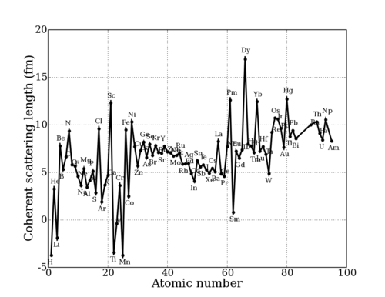
Scattering length
Scattering power of an atom in the sample expressed as a scattering length b:
X-rays
H
D
C
O
Si
Al
Fe
Figure adapted from NIST
Neutrons
For neutrons, b varies randomly through the periodic table - light atoms more visible, larger contrast between adjacent elements.
Isotopes of the same element scatter differently unlike x-rays.
X-rays scattering factor f scales as Z⁴
12

Slide 13
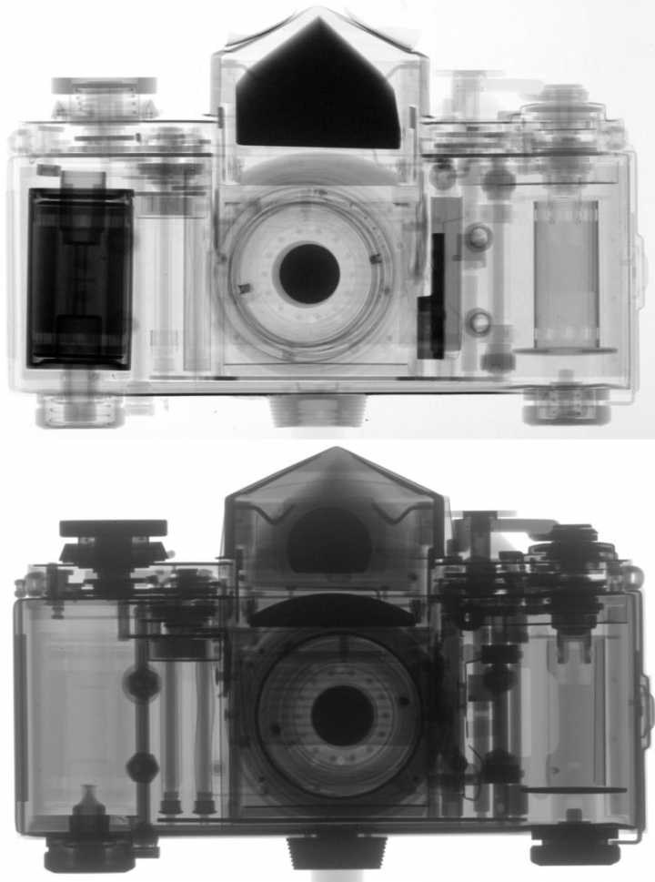
Neutron imaging and radiography
Neutron
Scattering power varies randomly over periodic table:
Neutrons
X-ray
H
Al
X-rays
Strong contrast for H-containing components (e.g. plastics)
Image: Paul Scherrer Institute
Magnetic imaging by polarised neutrons is a growth area.

Slide 14
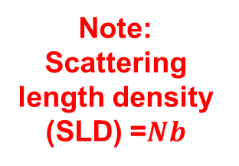






The fundamental differences
Quick aside: Neutrons and X-rays scatter analogously after the refractive index has been defined. It is defined differently for different particles:
Neutrons
X-Rays
$$n=1−λ^{2}A−iλB$$
$$n=1−λ^{2}α−iλβ$$
where,
where,
Note: Scattering length density (SLD) =$Nb$
$$A=\frac{Nb}{2π}$$
$$α=\frac{Nr_{e}}{2π}$$
Dispersion term
Dispersion term
and
and
$$B= \frac{N\left(σ_{a}+σ_{i}\right)}{4π}$$
Absorption term
$$β= \frac{μ}{4π}$$
Absorption term
Where N is the number density of Atoms per unit volume in the material (Atoms/Å³).
b is the scattering length of the material in fm (10⁻¹⁵m).
σ_{a and} σ_{i} are the neutron absorption and incoherent cross sections respectively in units of barns (10⁻²⁸m² )

Slide 15
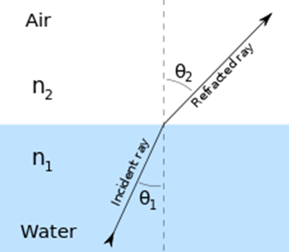
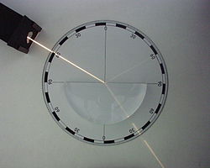
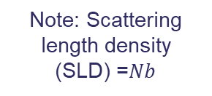
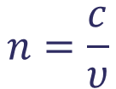
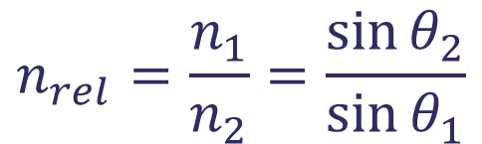
What is Reflectivity?
Snell’s Law (The Law of Refraction)
Note: n varies with wavelength (λ): This is called dispersion.
$$n=\frac{c}{υ}$$
Absolute refractive index: The ratio of the speed of light in a vacuum to that in matter.
Note: Scattering length density (SLD) =$Nb$
$$n_{rel}=\frac{n_{1}}{n_{2}}=\frac{\sin{θ_{2}}}{\sin{θ_{1}}}$$
The relative reflective index
Refraction is the consequence of a density change when moving from one medium to another.
Hecht: Optics

Slide 16
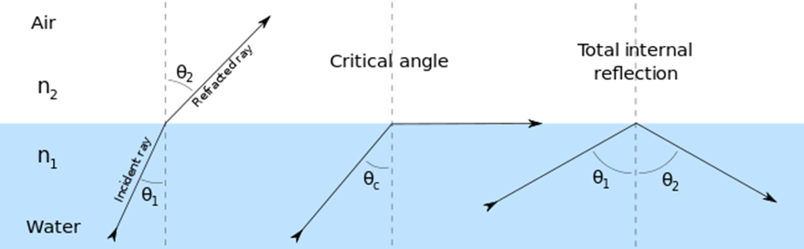



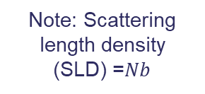


What is Reflectivity?
Critical reflection: Internal and most importantly external reflection.
Note: Scattering length density (SLD) =$Nb$
$$\frac{cosθ_{c}}{\cos{0}}=n$$
At the critical angle $θ_{2}$=0
$$\cos{θ_{c}=n}$$
Then taking the neutron definition for $n$ and neglecting absorption from earlier
$$n=1−\frac{λ^{2}Nb}{2π}=\cos{θ_{c}}$$
Taylor expand $\cos{θ }$to 1st degree $\cos{θ_{c}}=1−\frac{θ_{c}^{2}}{2}$
$$θ_{c}=\sqrt{\frac{λ^{2}Nb}{π}}$$
Remember this for the next slide!
Hecht: Optics and Sivia Chapter 3

Slide 17


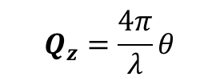

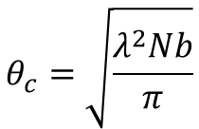

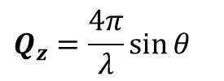
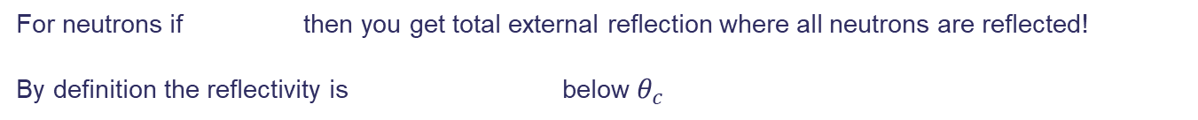
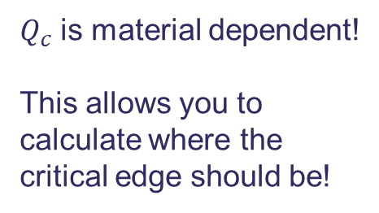
What is Reflectivity?
Critical reflection: Internal and most importantly external reflection.
Via Small Angle
Approximation
$$Q_{z}=\frac{4π}{λ}θ$$
$$θ_{c}=\sqrt{\frac{λ^{2}Nb}{π}}$$
$$Q_{z}=\frac{4π}{λ}\sin{θ }$$
Then combine with the result
This result assumes the top layer is vacuum or air.
$$Q_{c}=\sqrt{16πNb}$$
$$Q_{c}=\sqrt{16π(Nb_{1}−Nb_{2})}$$
$Q_{c}$ is material dependent!
This allows you to calculate where the critical edge should be!
For neutrons if then you get total external reflection where all neutrons are reflected!
By definition the reflectivity is below $θ_{c}$
$$θ≤θ_{c}$$
R $= \frac{I}{I_{0}}=1$
Hecht: Optics and Sivia

Slide 18








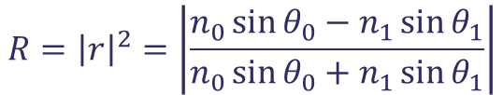





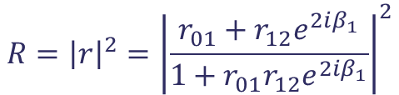

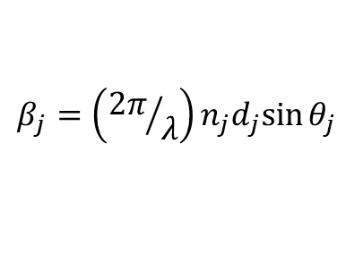


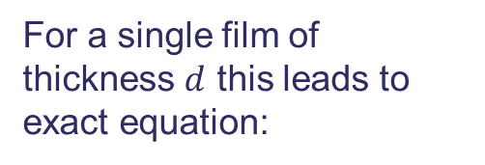
Fresnel's Equations for Reflection and Transmission
Fresnel’s laws for light apply to neutrons, if you take the case for an electromagnetic wave with its electric field vector perpendicular to the plane of incidence (plane of the screen)
$$k_{0}$$
$$R={\left|r\right|}^{2}=\left|\frac{n_{0}\sin{θ_{0}−n_{1}\sin{θ_{1}}}}{n_{0}\sin{θ_{0}+n_{1}\sin{θ_{1}}}}\right|$$
Single interface
$$k_{0}$$
$$θ_{0}$$
$$θ_{0}$$
$$n_{0}$$
$$z$$
$$θ_{1}$$
$$k_{1}$$
$$n_{1}$$
$$d$$
For single interface it can be shown that:
$$x$$
$$θ_{1}$$
For a single film of thickness $d$ this leads to exact equation:
$$θ_{2}$$
$$n_{2}$$
$$R\left(Q\right)=\frac{16π^{2}}{Q^{4}}Δ{\left(Nb\right)}^{2}$$
$$R={\left|r\right|}^{2}={\left|\frac{r_{01}+r_{12}e^{2iβ_{1}}}{1+r_{01}r_{12}e^{2iβ_{1}}}\right|}^{2}$$
Where $r_{ij}$ is
$$r_{ij}=\frac{ρ_{i}−ρ_{j}}{ρ_{i}+ρ_{j}}$$
(Δ just means the difference fo the things proceeding it)
Hence Δ(Nb) means (Nb₁-Nb₂)
with
$$p_{j}=n_{j}\sin{θ_{j}}$$
and
$$β_{j}=\left({2π}/λ\right)n_{j}d_{j}sin{θ_{j}}$$
$β_{j}$ is the optical path length in the film
This can be made to work for a few thin layers but becomes unwieldy very quickly.
So what does this look like in a simple case.
Hecht: Optics
https://www.ncnr.nist.gov/summerschool/ss10/pdf/SANS_NR_Intro.pdf

Slide 19

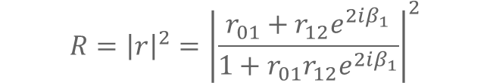


Single film at an interface
$$ΔQ$$
SiO₂ (500Å)
Si (substrate)
n
n+1
n+2
This is for a perfectly flat substrate and SiO₂
Note this only approximates the thickness as it does not take account of the order (n) of the fringes. It works as a good rule of thumb, for checking data is correct.
$$R={\left|r\right|}^{2}={\left|\frac{r_{01}+r_{12}e^{2iβ_{1}}}{1+r_{01}r_{12}e^{2iβ_{1}}}\right|}^{2}$$
$$ΔQ=\frac{2π}{d}$$
$$2d\left(\sin{θ_{n+1}−\sin{θ_{n}}}\right)=λ$$
Where $d$ is equal to the thickness of the layer of SiO₂
H. Kiessig Ann Phys 1931, 10, 769-788 P. Poulopoulos, et al, Journal of Surfaces and Interfaces of Materials, 2015, 3, 52-59
P. Poulopoulos, et al, J. Appl. Phys. 94, 7662–7669 (2003)

Slide 20
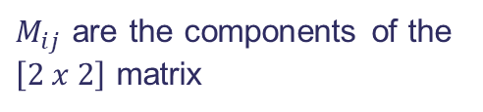
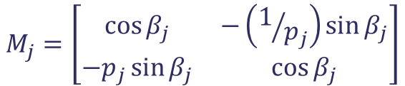
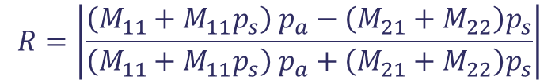
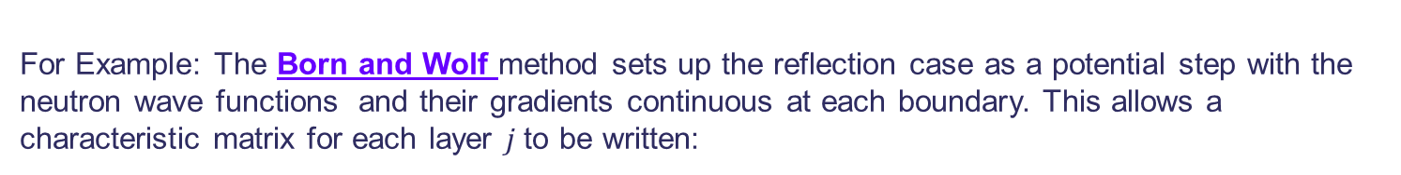
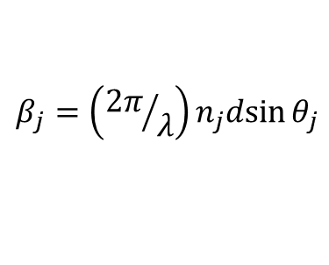

Generalised solutions to Reflectivity?
Parratt recursive formalism: L. G. Parratt, Physical review 1954, 95, 359-369
Abeles matrix formalism: F. Abeles, Le Journal de Physique et le Radium, "La théorie générale des couches minces", 11, 307–310, 1950)
Born and Wolf formalism: Principles of optics: electromagnetic theory of propagation, interference and diffraction of light. Oxford, Pergamon
Press, 1964
For Example: The Born and Wolf method sets up the reflection case as a potential step with the neutron wave functions and their gradients continuous at each boundary. This allows a characteristic matrix for each layer $j$to be written:
Remember
$$M_{j}=\left[\begin{matrix}\cos{β_{j}} & −\left(1/{p_{j}}\right)sin{β_{j}} \\ −p_{j}\sin{β_{j}} & \cos{β_{j}}\end{matrix}\right]$$
$$p_{j}=n_{j}\sin{θ_{j}}$$
$$β_{j}=\left({2π}/λ\right)n_{j}dsin{θ_{j}}$$
So for $n$ layers the reflectivity $M_{R}=\left[M_{1}\right]\left[M_{2}\right]$….. $\left[M_{n}\right]$ (note $M_{R}$ is a $\left[2 x 2\right]$ matrix)
$$R=\left|\frac{{\left(M_{11}+M_{11}p_{s}\right) p}_{a}−\left(M_{21}+M_{22}\right)p_{s}}{{\left(M_{11}+M_{11}p_{s}\right) p}_{a}+\left(M_{21}+M_{22}\right)p_{s}}\right|$$
$M_{ij}$ are the components of the $\left[2 x 2\right]$ matrix
Hecht: Optics
https://www.ncnr.nist.gov/summerschool/ss10/pdf/SANS_NR_Intro.pdf

Slide 21
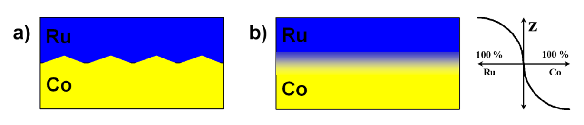




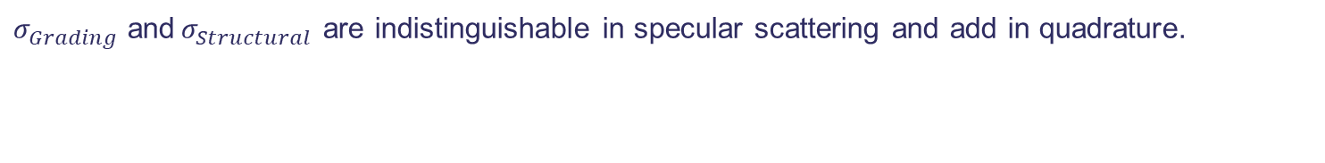
Rough interfaces
All of what has come before assumes “perfectly flat” interfaces.
Nature just does not like that idea, so we have to introduce rough interfaces.
A Debye-Waller like factor can be used to modify the reflected intensity:
$R$ and $R_{0}$ are the reflectivity with and without roughness and $σ$ is the root mean square (RMS) roughness.
Two basic types:
Structural $σ_{Structural}$
Grading $σ_{Grading}$
$$R\left(Q\right)=R_{0}(Q)e^{−Q_{0}Q_{1}σ^{2}}$$
Where $Q_{i}=2k\sin{θ_{i} }$and $k=\frac{2π}{λ}$
$σ_{Grading}$ and${ σ}_{Structural}$ are indistinguishable in specular scattering and add in quadrature.
$$σ_{Total}^{2}=σ_{Structural}^{2}+σ_{Grading}^{2}$$
This can also be applied to the generalised matrix solution.
Sinha et al, Phys Rev B, 1988, 38, 2297 Wormington et al, Phil Mag Lett 1996, 74, 211-216

Slide 22
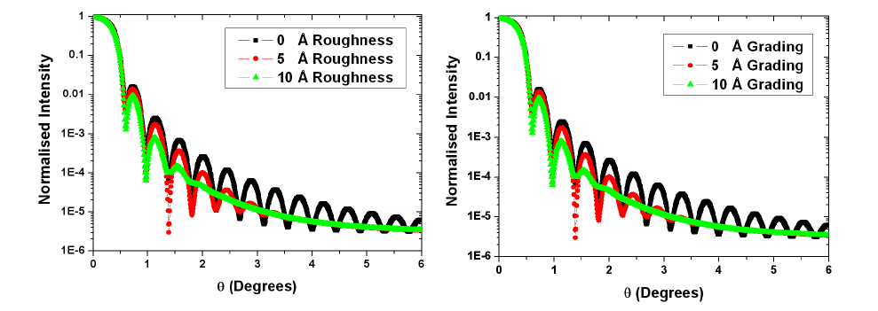


Rough interfaces
$σ_{Grading}$ has no effect on off-specular scattering!
$σ_{Structural}$ is solely responsible for the off-specular reflectivity.
Hence it is possible to use a combination of specular and offspecular scattering to split the two components to first approximation.
D. E. Savage et al, J. Appl. Phys, 1991, 69, 1411
Nevot, Croce, Rev. Phys. Appl, 1980, 15, 761-779
Sinha et al, Phys Rev B, 1988, 38, 2297

Slide 23

Correlated interface roughness
Be aware roughness has many guises, for example
Perfectly flat and perfectly correlated interfaces
Correlated interfaces
Uncorrelated interfaces
The degree of correlation is often defined by a correlation length.
The degree of correlation between interfaces results in a change in the width of the Bragg peaks and fringes in the specular data. It can also lead to features and scatter in the offspecular.
D. E. Savage et al, J Appl Phys 1992, 71, 3282 , I. Pape, et al, Physica B 253, 278 (1998). , V. Holy, et al , Phys. Rev. B 47, 15896 (1993).

Slide 24







Offspecular (diffuse) reflectivity
Offspecular scattering probes information form the pane of the sample $Q_{x}$ on the length scale of approximately 0.5 $μm$ to 50 $μm$.)
Spin-echo reflectometry gives information on the length scales of 10 $nm$ to 10 $μm$.
This is beyond the scope of this lecture.
$$Q_{z}$$
$$Q_{x}$$
$Q_{x}=\frac{2π}{λ}(\sin\left(2θ−θ\right)+\sin{θ}$)
Magnus et al POLREF Offspecular PA data
Ott et al, Journal of Applied crystallography, 2011, 44, 359-369)
Majkrzak et al, Physical Review A, 89, 033851 (2014)
24

Slide 25



The Phase Problem
Reflectivity suffers from the phase problem as a scattering experiment measures the intensity $I\left(q\right).$
The Intensity $I\left(q\right)$ is effectivity the modulus squared (by taking the complex conjugate) of the complex scattering function $ψ\left(q\right)$. Hence all complex components that represent the phase information are lost.
What is left is the modulus squared of the amplitude, ie the real components. This is what is measured via counting.
This is called a loss of uniqueness as the amplitude is insensitive to translation.
Here the amplitude information is swapped between the figures but because the phase information is still there the basic picture is recovered though distorted as is amplitudes are all off!
Note! Without the phase information you can get multiple solutions when fitting a reflectivity data set.
$I\left(q\right)= {\left|ψ\left(q\right)\right|}^{2}=ψ\left(q\right)ψ{\left(q\right)}^{∗}$
PHASE tells us where the different parts of the object are located!
Taken from Chapter 2.6 of Sivia

Slide 26
What kind of scientific information can be obtained from Neutron Reflectivity (NR)?
Specular Reflectivity (non-polarised) provides the chemical (isotopic) scattering length density (SLD) depth profile along the surface normal with a spatial resolution approaching half a nanometer (nm).
From basic theory of reflectivity, a simple box model then requires 3 parameters:
=> essentially thickness, roughness, density (SLD).
2. Scientific meanings of the parameters:
Thickness: thermal expansion/Contraction, glass transitions, surface adsorption/desorption, kinetics, etc.
Roughness: polymer reptation, interdiffusion, diffusion coefficients, surface tension, strain, etc.
Density: Density variation, surface enrichment, surface segregation, Level of hydration, etc.
Density (SLD)
Roughness at top surface
A Box layer
Thickness

Slide 27






Neutron Reflectivity - an interference phenomenon
detector
soap film
Compact Disc
neutron ‘wave’
δ
oil film
SLD
Si
θ
θ
SLD1
Bilayer
Oxide
D₂O/H2O or protein solution
SLD2 > SLD1
~density difference
z
interfacial roughness
Q spacing of fringes
=>
SLD: Scattering Length Density
(neutron refractive index)
layer thicknesses
Q
Logarithmic X axes should for a smooth sample give a linear die off for the intensity. This should match a 1/Q⁴

Slide 28
Thickness (t or d)
Air
x Å Layer of Pt
Where x = 0, 200 and 1000 Å.
Resolution is infinitely good in these simulations.
Think layers will appear at high Q.
Thick layers will appear at low Q.
This can greatly effect your count times!
Si substrate
For a smooth sample with a linear X axis, the die off of intensity should scale as Q⁻⁴ or θ⁻⁴.
If there is no roughness applied this will be a straight line on a log/log plot.
H. Kiessig Ann Phys 1931, 10, 769-788

Slide 29
Roughness (σ_{r})
Air
Roughness modelled as a smoothing of the SLD profile.
Grading/interdiffusion also produces the same effect on the SLD as roughness. It requires off-specular scattering to differentiate between them.
Note a small amount of roughness 60A almost wipes out the reflectivity completely.
600Å Layer of Pt
Si substrate

Slide 30


Contrast Part 1: Substrate/Air Interface
$$Q_{c}=\sqrt{16πNb}$$
or more generally,
$$Q_{c}=\sqrt{16π({Nb}_{1}−{Nb}_{2})}$$
Where:
Q_{c}= Critical Q
N = number density (atoms/Å³)
b = Scattering Length (fm 10⁻¹⁵m)
Nb = Scattering Length Density (SLD in Å⁻²)
Note the shift to higher Q as the SLD increases.
Ti has a negative SLD, hence no critical edge.
The critical edge position is normally given by the system components with the biggest relative SLD difference. Normally the substrate (subphase) vs the air (superphase).
Air (superphase), Nb₂
Substrate X
(Subphase), Nb₁
Where X can be any of Ti, Si, Bi, Pt or Ni.

Slide 31
Contrast Part 2: Si(sub)/Layer(200Å)/Air
Air
Where X can be any of Ti, Bi, Pt or Ni.
The height of the fringes is informative on the relative contrast of the layer to the substrate.
The roughness is set to zero ion all these cases.
200Å Layer of X
Si substrate

Slide 32
Contrast Part 3: Si(sub)/Layer(200Å)/Air
Air
200 Å Layer of X
Where X is either Bi or Pt.
The substrate reflectivity should mark the bottom of the fringes
Si substrate

Slide 33
‘Good’ Contrast

Slide 34
‘Poor’ Contrast

Slide 35


Contrast Part 4: The order can be important!!!!!!!
Si crystal
Neutrons
LC pump
Peek trough
Waste
$$Q_{c}=\sqrt{16π({Nb}_{1}−{Nb}_{2})}$$
Air is not the only medium through which the beam can be passed.
The order is important!
Similar to refractive index.
Contrast must be considered.
Absorption must also be corrected for and incoherent background considered, when running and designing experiments.
Notes:
Deposited at 27 mN m⁻¹ monolayer pressure.

Slide 36
Contrast/Roughness and the perils of resolution
Resolution issues can look like contrast and Roughness!
Resolution damps interference fringes and rounds off critical edges (as does absorption).
Make an effort to know what the resolution is in your experiment.
Keep in mind that Time of Flight measurements have constant dQ/Q this is not the case for fixed slit monochromatic beamlines. Note. some Monochromatic beamlines dynamically open the slits to maintain a constant dQ/Q.
If you are over illuminating your sample the resolution will be better than you think it is! The sample can act as a slit!
This is not so critical for thin layers.

Slide 37
Useful books: These are actually helpful when doing experiments!
Free on web
http://xdb.lbl.gov/
Excellent for x-ray magnetic scattering.
Deals with all theory that’s is needed for doing scattering experiments.
Deals with all stats needed for dealing with SANS/NR data.
Deals with a lot of basic optics theory.
These are the books I learned from but there are many out there.
Thank you for listening

Slide 38
Polarised Neutron Reflectometry (PNR)
NR measures the nuclear scattering length density profile.
PNR measures the magnetic scattering lengthy density profile.

Slide 39
What kind of scientific information can be obtained PNR:
Magnetometry (SQUID, VSM, MOKE):
  Measure the bulk magnetic response of a sample
  No spatial information
PNR:
  Highly penetrating so can probe large volume. Can probe buried interfaces.
  Spin Neutron interaction direct. Results easy to interpret.
  Strong magnetic scattering
  Contrast variation across the periodic table means light element easily measurable.
  Isotope contrast variations available
  Depth dependent magnetometer
  Absolute moment
  Vector magnetometer (in the plane of the sample)
  Long coherence length
Electrical Transport:
  Measures the conductive layers preferentially
  Also no spatial information so very hard to interpret results beyond bulk response
Magnetic X-ray techniques (XMCD, XAS, XMLD):
  Element specific, very high sensitivity.
  Results hard to interpret! (Spin-Photon interaction indirect).
  Light elements are difficult to measure.
  Soft x-rays highly absorbing.
Microscopy (Electron, MOKE based, X-rays based):
  Surface sensitive only.
  Sample environment limited.
Low Energy Muons:
  Poor depth sensitivity.
  Difficulties large internal magnetic fields.
  Fantastic sensitivity to very small magnetic moments.
PNR is an excellent tool to connect all these together!

Slide 40
What kind of PRACTICAL scientific information can be obtained PNR:
Polarised Specular Reflectivity provides both the chemical/nuclear (isotopic) and the Magnetic scattering length density depth profile along the surface normal with a spatial resolution approaching half a nanometer (nm).
1. In NR you get three basic parameters assuming a box model is used to construct the SLD profile:
=> essentially thickness, roughness, density (nSLD).
2. In PNR these are joined by three more magnetic parameters:
=> essentially magnetic thickness, magnetic roughness and magentic density (mSLD).
  Magnetic thickness: Magnetic dead layers, magnetic proximity effects, topological insulators.
  Magnetic roughness: Canting, spirals, coupling, superconducting vortices.
  Magnetic Scattering Length Density: Total moment, interlayer coupling (RKKY AF coupled layers), inhomogeneities, magnetic transitions (AF/FM/P).
Note: PNR is NOT sensitive to inter-atomic magnetic order like antiferromagnetism!

Slide 41





Properties of Hysteresis loops (Terminology)
Field (H) and Moment (M)
  SQUID, VSM (PNR/PA!)
Relative response to Field (H) only
  MOKE, XMCD
Magnetisation vs Temperature - (MvsT)
Magnetisation vs Applied Field - (MvsH)
The applied field and thermal histories are very important in magnetic materials.
C. J . Kinane et al. New Journal of Physics 16 (2014) 113073
O Inyang et al, PRB 100, 174418 (2019)

Slide 42
Properties of Hysteresis loops (Terminology): Magnetic Hysteresis
H_{c} = Coercivity or coercive field
H_{Sat} = Saturation or saturation field
M_{Rem} = Remnant magnetisation or retentivity.
M_{sat} = Saturation magnetisation
M_{+ve}
+H_{sat}
+M_{sat}
+M_{rem}
virgin curve
-H_{c}
+H_{c}
H_{-ve}
H_{+ve}
+M_{rem}
-M_{sat}
-H_{sat}
M_{-ve}
The properties of a magnetic hysteresis loop are often thought of as scaler in nature (directionless) but in fact are vectorial. They apply to the direction the H field is applied in the sample.
Hysteresis means the magnetic history of the sample is VERY important!

Slide 43
Properties of Hysteresis loops (Terminology):
M
M
(0,1)
(1,1)
H field applied in the (0,1) direction
H
H
(0,0)
(1,0)
Hard Magnet
Easy Axis (EA)
M
M
(0,1)
(1,1)
H field applied in the (1,0) direction
H
H
(0,0)
(1,0)
Soft Magnet
Hard Axis (HA)
Anisotropy has many forms – Magnetocrystalline, shape etc
The direction that the H field is applied affects the values of H_{c}, H_{sat}, M_{rem}, M_{sat}
Its very important to know the sample orientation vs the magnetic field!

Slide 44


Neutron-electron interaction
The neutron has magnetic moment which can interact with sample moments:
Sample
Nuclear spin I
−
Nuclear
Magnetic
Interaction is between dipolar fields of neutron and unpaired electron(s) → directional dependence.
Neutrons scatter magnetically for the B field of the magnetic material!
Strength of magnetic interaction similar to that neutron and nucleus (unlike X-rays).
A neutron is a spin ½ particle with a magnetic dipole moment, effectively it’s a little bar magnet. (like a fridge magnet only smaller)
Thanks to G Nilsen for this slide

Slide 45


Polarised neutrons PNR or Half Polarised:
Now measure two reflectivity curves:
Spin up
Spin down.
Experiments now takes 4 times as long to get similar statistics!
Guide Field
Unpolarised neutrons have no orientation
There several ways of polarising and flipping neutrons, but that is beyond scope of this talk.
It is the difference between the reflectivity curves of the two spin states that allow the magnetism to be probed.
W. Gavin Williams Polarized neutrons Oxford Science
A.-J. Dianoux et al, Neutron Data Booklet (Institut Laue-Langevin, 2002), 1st ed.

Slide 46
PNR Terminology:
In PNR we refer to measuring the spin states.
These are referred to by a multitude of names but ultimately all the names are labels referring to the spin of the neutron being aligned “Parallel” or “Antiparallel” to the guide field. Labels include:
  Parallel => Up, U, I⁺ , ↑, or just +
  Antiparallel => Down, D, I⁻ , ↓, or just -
It is important to note that in PNR the “Up” and “Down” states contain the Spin flip components as well. E.g. Up = UU + UD and Down = DD +DU but more on this later.
Maintaining the guide field on a PNR beamline is VERY VERY important!
U
D

Slide 47




Polarised Neutron Reflectivity (PNR):
It is assumed that the polarisation vector and magnetisation are parallel (We set the beamline up so this is as true as possible)
where $V_{n}=\frac{2πℏ^{2}}{m}Nb$ and $V_{m}=\frac{2πℏ^{2}}{m}Np=±μ_{n}B$
$$V=V_{n}±V_{m}$$
With $p=\left({2.695×{10}^{−4}}/{μ_{B}}\right)\left|μ_{i}\right|$
$V=\frac{ℏ}{2πm}N(b_{N}±b_{m}$)
For a single magnetic layer
This essential means you get two reflectivity curves as the magnetic layer has two different values for its SLD depending it M is parallel or anti-parallel to the polarisation P direction established by the guide field.
For example A 500 Å Ni layer on Si substrate
Bland et al, Phys Rev B, 46, 3391 (1992)
Zabel et al Physica B 276-278, 17 (2000)
R. M. Moon et al Phys Rev, 1969, 181, 920-931
S. Blundell et al, JMMM, 1993, 121, 185-188
Bland et al, Phys Rev B, 46, 3391 (1992)
G. L. Squires introduction to the Theory of
Thermal neutron scattering
Modern Techniques for Characterizing Magnetic Materials Edited by Yimei Zhu, Springer
Neutron Scattering form Magnetic Materials, editor Tapan Chatterji, Elsevier

Slide 48

PNR: An example of PNR from a simple Ni film.
PNR provides both the Nuclear (structural) and the magnetic SLD depth profile.
Effectively functions as a depth dependent magnetometer
But takes longer than NR by a factor 4 for similar statistics

Slide 49

PNR: Spin Asymmetry
This magnetization-induced splitting between the Up-Up and Down-Down reflectivity's contains information regarding the magnetic depth profile of the thin film structure.
Although not universally true, it is often the case that a larger splitting between the two cross sections indicates a larger magnetization of the film.
Although we will always fit the reflectivity data itself, it is often helpful to plot the spin asymmetry (SA) of the reflectivity, defined as (U-D)/(U+D), to better emphasize the magnetic features in the scattering, as shown below:
$$Spin Asymmetry= \frac{U−D}{U+D}$$
This makes small magnetic changes a lot easier to see
WARNING!!! Never fit the Spin Asymmetry exclusively on its own!!!!!

Slide 50
PNR Magnetic SLD: Magnetic saturation to Negative Magnetic Saturation
Air
Magnetic Ni
Si substrate
The Ni layer is 500 Å thick with the Silicon substrate and top Ni interface roughness's set to 5Å rms (σ=5 Å).
The edges of the magnetism are commensurate with the Ni nuclear structure, i.e. matching the thickness and roughness exactly.
Note the spin states have switched position for the negative magnetic moment -0.6μ_{b}/atom

Slide 51
PNR Magnetic SLD: Magnetic saturation to Negative Magnetic Saturation
Air
Magnetic Ni
Si substrate
The Ni layer is 500 Å thick with the silicon and top interface roughness set to 5Å rms (σ=5 Å).
It is much easier to see changes in the SA plot.
The -0.6μ_{b}/atom SLD and SA are both flipped. This is the reverse saturated case the magnetisation of the sample is now antiparallel to the polarisation of the beamline.

Slide 52

PNR :Magnetic Thickness: Commensurate Ni
Air
Magnetic Ni
Si substrate
The Ni layer is 500 Å thick with the silicon and top interface roughness set to 5Å rms (σ=5 Å).
The magnetism in the Ni is set to 0.6 $μ$_{b}/atom, the saturated case.
The edges of the magnetism are commensurate with the Ni nuclear structure, matching the thickness.

Slide 53
PNR Magnetic Thickness: Bottom magnetic dead-layer
Air
Magnetic Ni
Non- magnetic Ni
Si substrate
The Ni layer is 500 Å thick with the silicon and top interface roughness set to 5Å rms (σ=5 Å).
50 Å magnetic dead-layer at the bottom interface with the silicon substrate.
The splitting in the PNR is modulated by a long range envelope function from the thinner dead-layer.

Slide 54
PNR Magnetic Thickness: Top magnetic dead-layer
Air
Non- magnetic Ni
Magnetic Ni
Si substrate
The Ni layer is 500 Å thick with the silicon and top interface roughness set to 5Å rms (σ=5 Å).
50 Å magnetic dead-layer at the top interface with the air.
Easy to see using the SA that the envelope function shifts its modulation.

Slide 55
PNR Magnetic Thickness: Top and bottom dead-layers
Air
Non- magnetic Ni
Magnetic Ni
Non- magnetic Ni
Si substrate
The Ni layer is 500 Å thick with Silicon and top interface roughness of 5Å (σ=5 Å).
50 Å magnetic dead-layer at the top and bottom interfaces with the silicon substrate and air respectively.
Easy to see using the SA that two envelope functions combine to change the modulation. Effectively now have three magnetic layers living in the same nuclear layer.
NOTE: Dead-layers can be inverted, where the bulk becomes non magnetic and the interfaces remain magnetic.

Slide 56
PNR example: MgO(sub)/FeRh(50nm)/MgO(5nm)
400K Magnetic
Structural
300K magnetic
FeRh has a AF/FM/P set of transitions with temperature. The T_{c} for the FM is 400K (100C).
Magnetic SLD depth profile, shows how influence of substrate and surface effect magnetism in AF phase. FM persists at in the interface regions to low temperatures.
R. Fan et. al. Phys. Rev. B 82, 184418 (2010)

Slide 57
PNR Magnetic roughness:
Magnetic roughness treated the same as structural roughness. Applied to the mSLD only.
Modelled as a gaussian interface.
Not the only functional form for a magnetic interface.
Effects are much more subtle in the reflectivity curves and harder to spot.
Air
Non Magnetic Ni
Ni
Magnetic Ni
Si substrate

Slide 58
PNR Magnetic roughness:
Air
Non Magnetic Ni
Ni
Magnetic Ni
Si substrate
The Ni layer is 500 Å thick with the silicon and top interface roughness set to 5Å rms (σ=5 Å).
250 Å magnetic dead-layer starting in the middle of the layer which is magnetically roughened via a Gaussian profile.
Effects are more subtle but easily seen at High Q in the SA

Slide 59

PNR examples CFTB/Pt proximity effects
CoFeTaB – amorphous FM, low magnetisation and tuneable T_{C} with tantalum concentration
Polarised neutron reflectivity (PNR) using Polref instrument @ ISIS, data fitted using GenX
Scattering sensitive to structure and magnetism
Magnetic signal here only from CoFeTaB layer: moment on Pt is below sensitivity limit.
Authors use XRMS scattering to probe the Pt. This is a good example of the complementary use of different scattering techniques.
The effects are a combination of density changes and magnetic roughness.
O. Inyang et. al. Phys. Rev. B 100, 174418

Slide 60




PNR Examples: Spin Helix in FeGe thin films and FeGe/Fe multilayers (DMI)
Example of the combination of PNR with Transport/Magentometry and XRD/XRR
N.A. Porter et al PRB 92, 144402 (2015)
C. S. Spenser et al PRB 97, 214406, (2018)
Notes:
PNR provides the same information as XRR and NR but now with magnetic sensitivity. Two curves are recorded – one for each spin state. The critical edges are now dependent on not only the structural scattering length density but also + and – the magnetic component of the SLD. This means the difference between the two curves give information about the magnetism as a function of depth. Looking at my somewhat non-realistic simulation, you can see the NR i.e. structural SLD might be simple but due to local changes within the material you may have a complicated magnetic SLD which gives rise to a complicated PNR curve set.

Slide 61


PNR example: Er Spin Spiral
Er based Spin spiral in a think magnetic layer.
Good example of the use of a Null hypothesis to indicate the presence of a magnetic structure.
N Satchell et. al. Journal of Physics: Condensed Matter, Volume 29, Number 5 2016

Slide 62

Polarisation analysis (PA)
NR measures the Nuclear scattering length density profile.
PNR measures the Magnetic scattering length density profile.
PA measures the Magnetic scattering length density profile and Magnetic vector in the $xy$plane of the sample as a function of depth!

Slide 63


Polarisation analysis (PA):
Guide Field
M
Unpolarised neutrons have no orientation
Second flipper and Analyser added to the system. Experiments now takes a factor 8 to 16 times longer!
Now measure 4 spin states with 50% of the initial flux! PA experiments very tough!
  UU and DD – Non Spin flip channels
  UD and DU – Spin flip channels
W. Gavin Williams Polarized neutrons Oxford Science
A.-J. Dianoux et al, Neutron Data Booklet (Institut Laue-Langevin, 2002), 1st ed.

Slide 64






Polarisation analysis (PA):
Only magnetic scattering can cause spin flip scattering.
y
Non Spin Flip scattering (NSF)
NSF
M
SF
H
x
$$φ$$
$$θ_{i}$$
$$θ_{f}$$
P
z
Spin Flip scattering (NSF)
By measuring the 4 spins states uu, dd, ud and du, the in-plane orientation of the magnetism M is obtainable.
The ratio of Non Spin flip to Spin flip scattering scales with the angle of M in the plane of the sample.
$$b=b+p\sin{φ}$$
$$p_{m}\cos{φ}=p_{x}$$
Bland et al, Phys Rev B, 46, 3391 (1992)
Zabel et al Physica B 276-278, 17 (2000)
R. M. Moon et al Phys Rev, 1969, 181, 920-931
S. Blundell et al, JMMM, 1993, 121, 185-188
Bland et al, Phys Rev B, 46, 3391 (1992)
G. L. Squires introduction to the Theory of Thermal neutron scattering
Modern Techniques for Characterizing Magnetic Materials Edited by Yimei Zhu, Springer
Neutron Scattering form Magnetic Materials, editor Tapan Chatterji, Elsevier

Slide 65
Polarisation Analysis (PA): Test system
Test Case: proto exchange bias (EB) sample
EB happens when and antiferromagnet is put next to a FM.
The effect is to pin the FM in one direction that can be set by the growth or a thermal anneal above Tc and cooling in a guide field.
If a small guide field approx. 10 Oe (0.001T) is used at the sample point then the sample can be rotated without M rotating to follow the guide field.
Normally sputtered Co is very soft and amorphous/polycrystalline so has very low anisotropy, so no preferred direction and will roated to follow any applied magnetic field.
Co 25Å
IrMn₃ 175Å
SiO₂ native approx. 15Å
Si Substrate

Slide 66
Polarisation Analysis Example 1: 0 Deg rotated M
Guide H field (50 to 250 Oe approx. The bigger the better
Guide field magnets
M
P Pol direction
Beam
Non spin flip case, only UU, DD states will can scatter.
Zero spin flip

Slide 67
Polarisation Analysis Example 2: 45 Deg rotated M
Guide H field (50 to 250 Oe approx. The bigger the better
Guide field magnets
M
P Pol direction
Beam
Non spin flip UU, DD splitting reduced.
Spin flip UD, DU is increased. In the specular case they should be the same.

Slide 68
Polarisation Analysis Example 3: 90 Deg rotated M
Guide H field (50 to 250 Oe approx. The bigger the better
Guide field magnets
M
P Pol direction
Beam
Non spin flip scattering now purely non-magnetic and UU and DD show no spin splitting nuclear scattering only.
Spin flip UD, DU scatter is maximised

Slide 69

Polarisation Analysis (PA): Summary
Polarisation analysis tells you the angle of the Magnetisation in the plane of your sample as a function of depth.
It also provides the nuclear (structural) and magnetic density depth profile.
But it takes longer than PNR taking a factor 8-16 longer than NR for equivalent statistics.
Warning PA experiments are tough going! You really need to have to do the measurement and really need to know at what fields and temperatures to measure at!

Slide 70
Magnetic Scattering Rule:
The non-spin-flip scattering is sensitive only to those components of the magnetisation parallel to the neutron spin
The spin-flip scattering is sensitive only to those components of the magnetisation perpendicular to the neutron spin.
The ratio of non spin-flip to spin-flip scattering give the angle in the plane of the sample.
NB This is one of those points that you should take away with you. It is
the basis of all magnetic polarization analysis techniques.
Courtesy of Ross Stewart, ISIS

Slide 71

PNR/PA Practical points for experiments: Soft matter Magnetic contrast.
Reflectivity is basically a battle for contrast!
In NR for Chemistry and Biology isotopic contrast is a real boon. Can mix H₂O and D₂O to contrast to match out layers and beat the inverse phase problem. Makes fitting a lot easier!
Deuteration not possible for some systems. To expensive or too difficult.
Magnetic contrast can then be used. Magnetic reference layer is used like Py or Fe. This gives two contrast via that magnetic layer.
The technique can be used with isotopic contrast as well to reduce the ambiguity of analysis further.
Warning PNR takes longer to measure (x4) it might be worth measuring more isotopic contrasts rather than one magnetic contrast.
Why reference layers and Isotopic/magnetic contrast variation works:
A. Koutsioubas, J. Appl. Cryst. (2019). 52, 538–547
C.F. Majkrzak et. al., Langmuir 2003, 19, 7796-7810
S.C. Hall et. al.,Surface-Tethered Planar Membranes Containing the β-Barrel Assembly Machinery: a platform for Investigating Bacterial Outer Membrane Protein Folding
Biophysical Journal, 2021

Slide 72
PNR/PA Practical points for experiments:
Plotting PNR SLD profiles for Hard Condensed Matter (HCM) and Soft Matter (SM) experiments is different as they have different aims.
In SM the mSLD is added to the nSLD as the magnetic profile is effectively irrelevant its just there to add another contrast. This is what the spin up and down neutrons actually interact with in reality.
In HCM the magnetic mSLD profile is the thing that is actually wanted so it is best to deconvolve the two into separate mSLD and nSLD curves.

Slide 73
PNR/PA Practical points for experiments:
Experimental planning: Count times and picking measurements!
Technique:
  NR is quick
  PNR is x4 time slower than NR
  PA is x8 -x16 times slower than NR (is it really needed? Pick your measurements very carefully, beamtime is limited and precious, its your Thesis!
Sample area: Count time scales linearly with area
  SM samples sizes tend to by 80mm x 50 mm in area or bigger.
  PNR/PA samples tend to be 20 x 20 mm 10 x 10 mm or even 5 x 5 mm in area!
  A 20 x 20 mm sample will require a factor 10 in count time to get the same level of statistics as an 80mm x 50mm SM Si block!
  Point to take home for PNR/PA the larger the surface area the better!
Sample area: Other effects of small surface areas on data quality
  Smaller Q range – its not possible to count out to high Q usually within the time allowed for an experiment.
  Can you redesign your sample, not affecting the physics/chemistry/biology, to push the measurable effects to lower Q.
  Small sample often replace slit 2 as the final resolution optic! Think carefully about what resolution you need! This can have dramatic effects on resolution and count times!
  Tricks include:
    Resonance effects
    Bilayer/multilayering of the system to boost the signal into a Bragg peak.
    Thick buffer/capping layers to shift the signal to lower Q in a radio carrier wave analogy.
    Thickness variation of the various layers to make sure features of interest are not in intensity minima.
  When designing the experiment simulating the sample and what you what to see is KEY to a successful experiment!

Slide 74

PNR/PA Practical points for experiments:
Contrast is key for HCM
  Like in SM, HCM experiments need to think about contrasts.
  Trying to fit one PNR data set in isolation is very difficult as can get multiple solutions.
  If possible measure at H_{sat} and H_{rem} or at any other magnetic fields of interest and simultaneously fit the data.
  This also works if there is a variation of M in the sample with temperature.
  Measuring multiple fields or temperatures and fitting simultaneously is analogous to solving a simultaneous equations. This can vastly reduce ambiguity! (more in the lectures to come on this)
W. Griggs, et. al., Depth selective magnetic phase coexistence in FeRh thin films, APL Materials, 2020, 8, 121103

Slide 75

PNR/PA Practical points for experiments:
Null Experiments:
  Often results are not clear, so think carefully about the null measurements you need to make to demonstrate an effect is present or not!
    E.g. saturate the sample
    E.g. change the temperature to be above or below a transition temperature.
  Experiment time is limited so pick carefully!
  Same idea applies to analysis of the data!
Setup time and correction/calibration measurements:
  Remember to factor in any transmission measurements. This is very important for SM experiments as not all Si blocks, etc are the same and may have different transmissions!
  Remember to factor in sample environment changes like sample changes, sample alignment warm up and cool down times for cryostats
  TALK TO THE LOCAL CONTACT ABOUT THE ABOVE!!!!!!!
N Satchell et. al. Journal of Physics: Condensed Matter, Volume 29, Number 5 2016

Slide 76
PNR/PA Practical points for experiments:
Pre characterise samples:
  Please Please pre characterise your samples if at all possible! We have the R53 facility to help with this!
    XRR at a bar minimum SQUID (HvsT or MvsT)
    XRD/Transport/AFM/MOKE/TEM if you have time.
Why? PNR/PA takes a long time to count out so you have to count in the right place on the right sample!
  Does the sample display the effect/phenomena?
  It is the worst idea in the world to use a PNR beamline like a SQUID because you don’t know where the transition is. You could have just used a squid and be counting out the magnetic depth profile or vector profile which is what PNR/PA does best!
The Mark 1 Eyeball is a good technique to use to check a sample is optically flat. I.e. if the sample is rough visibly! Its unlikely to work on a reflectometer!
Pre characterise samples:
  Anisotropies! Do you know the sample anisotropies, easy and hard axes?
    SQUID/MOKE/crystallography
    This is so the sample can be mounted in the right direction in the beamline.
  Silicon block roughness/substrate roughness! THIS IS VERY IMPORTANT FOR SM experiments! A quick XRR scan can show if you have a smooth block or not! If its too rough it will not work.
In science fortune favours the prepared!

Slide 77


Thank you
Christy.kinane@stfc.ac.uk
isis.stfc.ac.uk
@ISISNeutronMuon
STFC

Slide 78
Useful books: These are actually helpful when doing experiments!
Free on web
http://xdb.lbl.gov/
Excellent for x-ray magnetic scattering.
Deals with all theory that’s is needed for doing scattering experiments.
Deals with all stats needed for dealing with SANS/NR data.
Deals with a lot of basic optics theory.
These are the books I learned from but there are many out there.
Thank you for listening

Slide 83
Appendices

Slide 84
Software
There are lots of different packages out there, we recommend the following because they are supported to some greater or lesser extent
GenX: Can fit Soft X-rays, Cu K alpha X-rays, NR, PNR and PA using a very efficient genetic algorithm for both magnetic and biological systems. I recommend starting here. http://genx.sourceforge.net/
RasCAL: Optimised for biological data sets. Now has bootstrapping and Bayesian data analysis and fitting routines. Requires Matlab. http://sourceforge.net/projects/rscl/
Ref1D and BUMPS: (NR/PNR/PA) for when layer models simply won’t do and you need Bayesian fitting and analysis. (Warning can be very difficult to get working.) http://www.reflectometry.org/
Motofit/ref_nx: A package that aids the simultaneous least squares fitting of multiple-contrast specular X-ray and neutron reflectivity data – needs IGOR but that’s free. http://motofit.sourceforge.net/wiki/index.php/Main_Page
Older Software includes things like XPOLLY, MULF and Parratt32 however they are not supported and tend to not work well on modern operating systems.

Slide 85


Useful Websites:
Need to calculate SLD’s these will help:
NIST SLD calculator: http://www.ncnr.nist.gov/resources/activation/ (Neutron and x-ray scattering lengths)
NIST Table of scattering lengths and Cross sections: http://www.ncnr.nist.gov/resources/n-lengths/
ISIS Biomolecular Scattering Length Density Calculator: http://psldc.isis.rl.ac.uk/Psldc/ For all your protein and peptide SLD needs. Also has a manual explaining how this is done!
NIST Resources including SANS and NR calculators: http://www.ncnr.nist.gov/resources/
WebElements: http://www.webelements.com/ (Probably one of the most useful website on the web in my opinion)
X-ray interactions with Matter CXRO : http://henke.lbl.gov/optical_constants/

Slide 86

How to Calculate a Nuclear Scattering Length Density (nSLD)
How do we calculate the SLD?
  Easiest method: go to www.ncnr.nist.gov/resources/sldcalc.html
By hand: let us calculate the scattering length density for quartz – SiO₂
  Density ($ρ$) of SiO₂ is 2.66 gm.cm⁻³; Molecular weight (M) is 60.08 gm. mole⁻¹
  Number of molecules per Å³ = N is given by:
  $N={10}^{−24}\left(\frac{ρ}{M}\right)∗N_{avagadro}$
  $N$= 10⁻²⁴(2.66/60.08)*N_{avagadro} = 0.0267 molecules per Å³
  $SLD=Nb =N\sum{b}=\frac{\sum{b}}{Volume}=N\left(b_{Si}+{2b}_{O}\right)$
  SLD=Σb/volume = N(b_{Si} + 2b_{O}) = 0.0267(4.15 + 11.6) 10⁻⁵ Å⁻²
  = 4.21 x10⁻⁶ Å⁻²
N_{avagadro}=6.022x10²³
Example taken form Roger Pynn online lecture slides: https://neutrons.ornl.gov/sites/default/files/intro_to_neutron_scattering.pdf

Slide 87

How to Calculate a Magnetic Scattering Length Density (mSLD)
How do we calculate the SLD?
  Easiest method: go to www.ncnr.nist.gov/resources/sldcalc.html
By hand: first calculate the Nuclear scattering length density for saturated Ni -
  Density ($ρ$) of Ni is 8.908 gm.cm⁻³; Molecular weight (M) is 58.69 gm. mole⁻¹
  Number of molecules per Å³ = N is given by:
  $N={10}^{−24}\left(\frac{ρ}{M}\right)∗N_{avagadro}$
  $N$= 10⁻²⁴(8.908/58.6934)*N_{avagadro} = 0.0914 Ni atoms per Å³
  $SLD=Nb =N\sum{b}=\frac{\sum{b}}{Volume}=N\left(b_{Ni}\right)$ b_{Ni}=10.3 fm
  SLD=Σb/volume = N(b_{Ni}) = 0.0914*(10.3) *10⁻⁵ Å⁻² (the *10⁻⁵ converts fm to Å)
  SLD_{Ni} = 9.41 x10⁻⁶ Å⁻²
N_{avagadro}=6.022x10²³
Example taken form Roger Pynn online lecture slides: https://neutrons.ornl.gov/sites/default/files/intro_to_neutron_scattering.pdf

Slide 88

How to Calculate a Magnetic Scattering Length Density (mSLD)
The saturated total magnetic moment of Ni is 0.6 μ_{b}/atom which is equivalent to approximately 508 emu/cm³ as would be measured from a magnetometer.
The magnetic component of the SLD is given by:
$${SLD}_{M}=\sum_{i}^{J}{N_{i}b_{mi}}=C\sum_{i}^{J}{N_{i}μ_{i}=} Cm$$
The units of the magnetic scattering length, b_{m}, are Å. This is the magnetic equivalent to the nuclear scattering length b here denoted b_{N.}
The magnetic moment per formula unit, μ, is in units of Bohr magnetons μ_{B}
  In this case the constant is C= 2.645 x 10⁻⁵Åμ_{B}⁻¹
More usefully we normally measure the magnetisation M in a magnetometer and convert it to magnetic moment m by dividing it by the sample volume.
  If m is in units of Tesla, then C = 2.645x10⁻⁵ /4π Å⁻²T⁻¹
  If m is in units of emu/cm³, then C = 2.853 x 10⁻⁹ Å⁻² cm³ emu⁻¹
  This is taken form “Application of polarized neutron reflectometry to studies of
  artificially structured magnetic materials “ by M. R. Fitzsimmons
  and C. F. Majkzak

Slide 89
How to Calculate a Magnetic Scattering Length Density (mSLD)
SLD_{m}= ± CN_{i} μ_{i} = ± 2.645 x 10⁻⁵ x 0.0914 x 0.6 = ± 1.451x 10⁻⁶ Å⁻²
The following from what we know about the SLD’s:
SLD_{Ni} = SLD_{Ni (Nuclear)} ± SLD_{Ni (Magnetic)}
SLD_{Ni+}= (9.41+1.451) x 10⁻⁶ Å⁻² = 10.861 x 10⁻⁶ Å⁻²
SLD_{Ni-} = (9.41-1.451) x 10⁻⁶ Å⁻² = 7.959 x 10⁻⁶ Å⁻²
This results in two very independent reflectivity curves each with there own critical edge
This is what is measured by the Up and Down spin state reflectivity curves.
  This is taken form “Application of polarized neutron reflectometry to studies of
  artificially structured magnetic materials “ by M. R. Fitzsimmons
  and C. F. Majkzak

Slide 90
Data fitting?
Neutron reflectivity only measures the intensity so we have lost all phase information!
Hence we cannot do a direct inversion from reciprocal space to real space, in order to obtain the Scattering Length Density (SLD) profile.
  This is commonly obtained by iteratively fitting a model to the data
  Iterative fitting attempts to minimize the chi-square error between the data set and the model-generated reflectivity .
  The model encompasses the SLD profile and mathematical formalism (Parratt/Abeles) employed to calculate the reflectivity.
When fitting reflectivity data, it is assumed that when the difference between the data and the model approaches zero, the scattering length profile accurately represents the distribution of material inside the sample region (within the limits of non-uniqueness due to lack of phase information).
Taken from “How bad is Good” online Slides from Charlie Laub and Tonya L. Kuhl, Department of Chemical Engineering and Materials Science University of California, Davis
http://neutrons2.ornl.gov/workshops/sns_hfir_users/posters/Laub_Chi-Square_Data_Fitting.pdf

Slide 100


$${Reduced χ}^{2}$$
$χ_{v}^{2}=\frac{χ_{min}^{2}}{v}$
Where $v=N−p$-1 with N=number of data points and p the number of parameters in the model.
The Reduced chi Squared is simply the best $χ^{2}$ or more clearly put the minimum $χ_{min}^{2}$ value divided by the number of degrees of freedom.
Hence a $χ_{v}^{2}=1$is a good fit
Measures of goodness of fit typically summarize the discrepancy between observed values and the values expected under the model in question.
This is often referred to as the Goodness of Fit (GOF) of Figure of Merit (FOM).
There are lots of other FOMS, GOF’s out there !
This does not tell you that you have the correct model only how well the model you are using matches the data!
See: See chapters 5 and 6 of Hughes and Hase

Slide 101
Fitting Algorithms
These are a science in and of themselves, so I will not spend long on them just let you know they exist.
Often referred to as energy minimisation routines.
Lots of different types approaches:
  Genetic Algorithms
  Simulated annealing
  Particle Swarm
  Steepest descent
  To name a few
We need one that is good at searching FOM space and not at getting stuck in local minima.
GenX uses a differential evolution genetic algorithm + Simplex
Rascal has Simplex, Differential evolution and Bayesian routines
Fitting with differential evolution: an introduction and Evaluation Matts Bjorck J. Appl. Cryst. (2011). 44, 1198–1204

Slide 102
Model fitting: How do you know you have a good fit and the right model
Sadly this is really hard and there is no correct answer.
In general fit results are not unique, but independent knowledge of the system often makes them very reliable.
By independent knowledge, we mean real world constraints, things you can measure with other techniques such as:
  Top surface roughness/Coverage (AFM/BAM), local probes
  Total magnetic moment (SQUID/VSM), average probes
  TEM (allows you to see the layer profile directly but with different electron contrasts, local probe)
But you can also constrain models via contrast matching, of which there are three main forms:
  Deuteration
  Magnetic contrast
  Lab based X-Ray reflectivity (Cu K_{a} etc)
By doing simultaneous fits to the same model with data which has regions of different contrast, you can greatly improve the uniqueness of your fit.
This is analogous to solving a
simultaneous equation!

Slide 103

DPPC : Lipid A outer bilayer
D₂O
SMW
H₂O

Slide 104

DPPC : Rc-LPS outer bilayer
D₂O
SMW
H₂O

Slide 105

DPPC : Ra-LPS outer bilayer
D₂O
SMW
H₂O
J. R. Soc. Interface 2013, 10, 20130810.

Slide 106
Model fitting: How do you know you have a good fit and the right model
(Know Thy Data!)
Make sure you measure and normalise your data correctly:
  Measure the critical edge, crucial for sorting substrate density and scaling data sets.
  Measure the background,
  Scale the critical edge to 1 or get the correct scale factor from a reference.
These can then be locked down and constrained with upper an lower bounds in a fit.
You are not starting with zero knowledge of what should be there!
You know the nominal structure so you can:
  Simulate the reflectivity you expect, this should be your starting point for any fitting and usually in the proposal?
  Calculate the critical edge position, as shown earlier this should be given mainly by the substrate, does your data agree?
  You can calculate total film thickness from Kessig fringes and bilayer thicknesses from Bragg peaks in multilayers by hand rom your data and see if your fit agrees. This only works for simple systems. Usually more than 3 layers and it is impossible to do.

Slide 107
Is a surface really a surface or a layer a layer?
Question everything! Do not trust sample growers even if that is you!
(YES YOU!)
Surface region?
Dose of Reality
Ni Layer
Ni Layer
Oxidation, growth issues, surface contamination, magnetic dead layers, layer interdiffusion etc, etc.
Substrate region?
Si (Sub)
Si (Sub)
What you think you have….
Reality???
Taken from ECNS’2003 Introductory Course
By F. Ott

Slide 108

Dealing with Complex Density Profiles
Beware of being a slave to box models! The SLD is really what matters and the box model is what you are using to construct it.
There are other ways to construct an SLD profile, however it is acknowledged that box models make it easy to interpret an SLD profile.
Any SLD depth profile can be “chopped” into slices essentially lots of box’s.
The Parratt formalism allows the reflectivity to be calculated.
A thickness resolution of 1 Å is adequate – this corresponds to a value of Q_{z} where the reflectivity has dropped below what neutrons can normally measure.
Computationally intensive!!
Image from M. Tolan and R Pynn

Slide 109


Things to be scared of:
Beware of Chi^2 FOM’s they often lock into the section of your reflectivity with the best error bars. This depends on how the FOM was implemented in your software.
Beware of Coupled parameters!!!! They can produce a good SLD profile but as numbers from a box model be fairly meaningless. The SDS practical is a good example of this!!!
Beware of parameters that are unphysical eg negative thickness’s or roughness's that are bigger than layer thicknesses etc.
Beware of fitting 2$θ$ offsets!!! This can screw things up both massively and/or subtly!!! Either make the measurement properly in the first place, or make sure you account for angle offsets in the data reduction.
Beware of adding to many parameters. With enough you could fit anything. Occam's Razor (the simplest model is most likely correct) is the only really useful measure, but still might not be correct. You must therefor justify every parameter in a fit.
Always remember a small${ χ}^{2}$or FOM does not tell you that you have the correct model only how well the model you are using matches the data!
Ask yourself would you publish the fit, is it unique/physical?
If the model is highly constrained, with independently measured parameters then you can have real confidence your are close
to the true answer.

Slide 110
Things to add later
Linearize your data by dividing out the substrate reflectivity or Q-4 die off can often help.
Break the system down into lots of simpler systems, for instance measure the substrate to correctly fit its density etc?
Add effects of absorption demo
Add effects of top and bottom roughness (correlated interfaces) demo
Add a grading demo and explain sharp but graded interfaces etc
Add section on setting upper and lower limits. Set them by eye using a simulation or via independent variables. Be wary of leaving to small limits or too big. Rule of thumb is +/- 10% then check parameters to see if things max out.
Mention oscillating between FOMS to jump models out of local minimum Ie switching form Ch^2 to Log FOMs a good way of doing this.
Mention designing experiment and sample cleverly to aid in fitting
Adda defintion of ordinary chi^2 page 67 hase
Add maxs Hamilton Test nsigma test to check the numbe rof paraterms actually improves the quality
Don’t fit the substrate Know what it is!!! Often best done by measuring just a substrate and fitting it.
Don’t fit Q or twotheta offsets!

Slide 111


Basic Definitions
$$R=\frac{I}{I_{0}}$$
Reflectivity defined as:
Where $I$ is the measure intensity and${ I}_{0}$ is the direct beam or monitor measurement.
So critical edge is by definition at 1 and is dimensionless.
Once the division by the direct beam or monitor has been performed this is often not the case!
A scale factor needs to be applied, hence careful measurements of references D₂O/Air etc are needed to obtain the scale factor. This can then be used to correctly scale the reflectivity.
However if the critical edge is measured then you can scale everything to it and set it at 1.
Beware of absorption! This can round off the critical edge.
Note there is no footprint correction required for TOF reflectivity data as compared to monochromatic data as the illuminated length is always kept constant.
Before fitting data it should be properly scaled and corrected along with
the correct error bars, in XYE format or equivalent X,Xe,Y,Ye. etc

Slide 112

Measurement geometry

Slide 113





TOF resolution
For a white (TOF) beam, the resolution is:
Where $δθ$ is the geometrical resolution, (slits and angle stages), $δt$_{ch} is the time-of-flight channel window (typically µs with ns precision), $δt$_{m} is the moderator pulse width (the moderator is a physical thing with a certain size and it is known only statistically, where a neutron will moderate in it. Hence the time of flight distance is slightly fuzzy. $t$ is the time of flight.
In general the $\frac{δt}{t}$ contribution is very small and can be neglected,
For most reflectometers $\frac{δQ}{Q}$ is dominated by $\frac{δθ}{θ}$ and so $\frac{δQ}{Q}$ is constant over the whole Q range of a measurement.
In most fitting packages constant resolution is achieved by using a
Gaussian smoothing function of width $\frac{δQ}{Q}$, that is convoluted
with the reflectivity profile.
$$\frac{δ^{2}Q}{Q^{2}}=\frac{δ^{2}t_{ch}+δ^{2}t_{m}}{t^{2}}+\frac{δ^{2}θ}{θ^{2}}$$
$$θ=\frac{S1+S2}{L}$$
Collimation Equation
S2 width
$δ$θ
S1 width
$$δθ=\tan^{−1}\left(\frac{S1+S2}{2L}\right)$$
L= Distance between slits

Slide 114


Poisson or Gaussian?
The Poisson distribution is the distribution function appropriate for modelling discrete events such as Neutron and X-ray counting.
Something obeys Poisson's distribution if:
  Counts are of rare events.
  All events are independent.
  The average rate does not change over the period of interest.
Poisson statistics display a an asymmetric distribution for a low mean. However as the mean value of a Poisson distribution gets bigger then it eventually starts to closely resemble the Gaussian distribution.
As a rule of thumb once the mean of a Poisson distribution $\overline{N}≥35$ then the asymmetry in the Poisson distribution is said to be negligible and Gaussian stats can be used.
If an experiment yields a mean count of $N$ the best estimate of the error in this quantity is $\sqrt{N}$. We therefore report each measurement as $N±\sqrt{N}.$
This is useful to know as it is a ready way to calculate error bars for both X-rays and neutron data.
It also provides an effect method of knowing when to stop counting e.g. At high Q counting can be very time consuming.
$$Percentage error= \frac{\sqrt{N}}{N}≤1\%= \frac{100}{10000}$$
See: See chapter 3 of Hughes and Hase
Measurement and their uncertainties A practical guide to Modern Error Analysis - Ifan Hughes and Thomas P.A. Hase.
A practical guide to Data analysis for physical Science Students – Louis Lyons

