Slide 1
An Introduction to NR Data Fitting
Dr Stephen Hall
ISIS Virtual Reflectometry Training Course
April 2026
stephen.hall@stfc.ac.uk

Slide 2
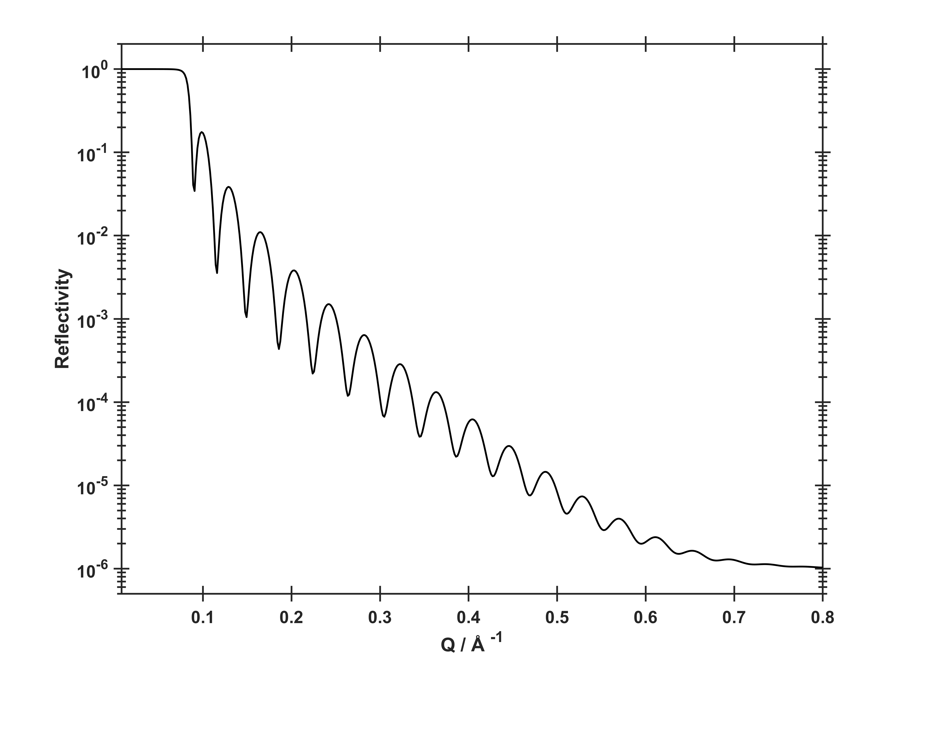




What information can we tell directly from the data?
$$Q_{c}=\sqrt{16πΔρ}$$
$Qz=\frac{4π sinθ}{λ}$
Surface Roughness
$$θ$$
$$θ$$
Contrast / Roughness
Layer Thicknesses
$$d=\frac{2π}{ΔQ}$$

Slide 3
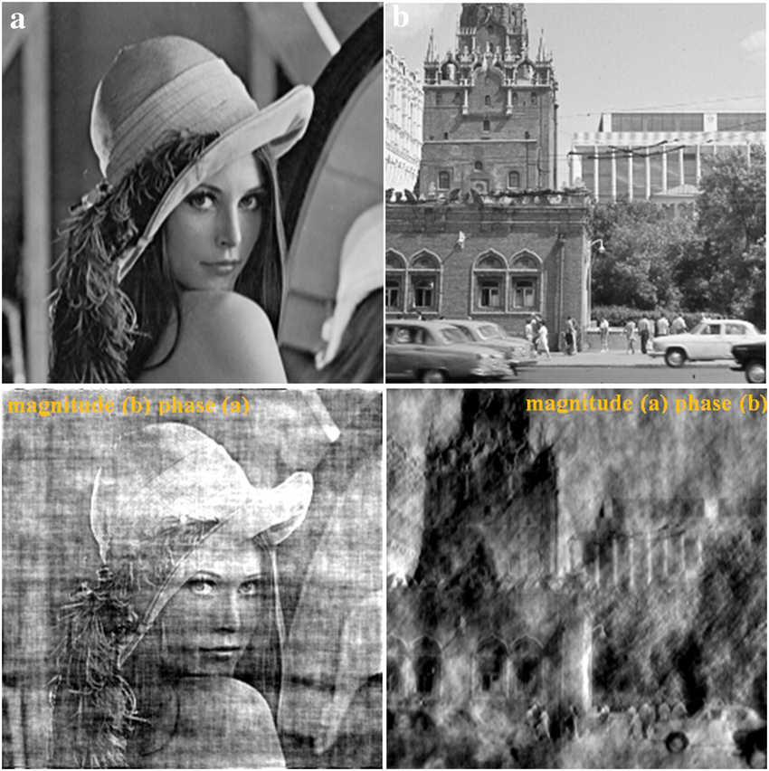
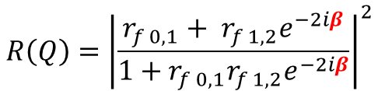

Then why do we need to fit data?
n₀
Measuring Reflectivity loses the phase information: The Phase Problem!
θ₁
Without phase information, direct Fourier inversion of the data is not possible.
n₁
θ₂
n₂
From the Fresnel equations:
$$R\left(Q\right)={\left|\frac{r_{f 0,1}+ r_{f 1, 2}e^{−2iβ}}{1+r_{f 0,1}r_{f 1,2}e^{−2iβ}}\right|}^{2}$$
$β$ is the phase term:
$$β= \frac{2π}{λ}n_{i}d_{i}\sin{θ_{i}}$$
DOI: 10.1186/1687-5281-2014-41

Slide 4
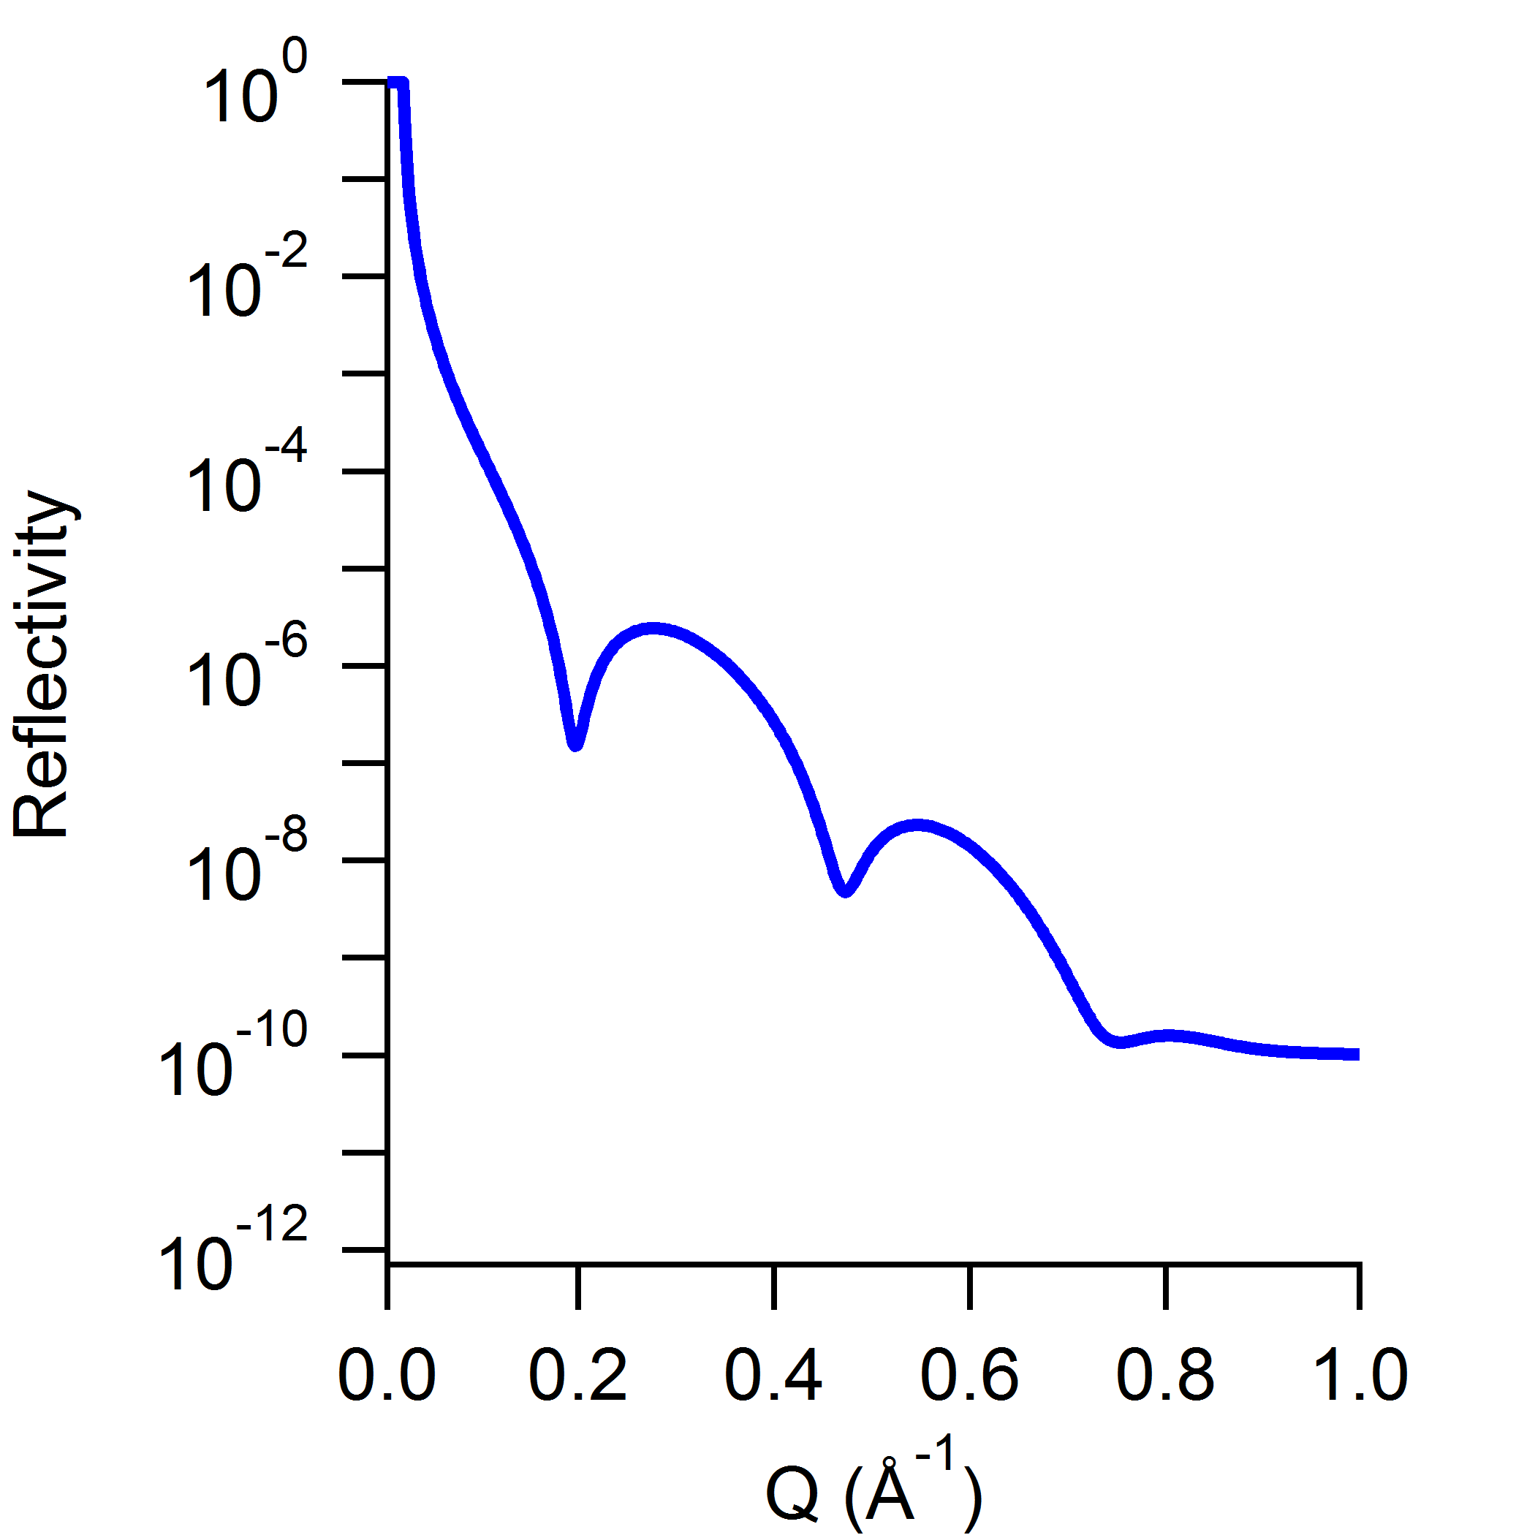




Model-dependent fitting of reflectometry data
$$Q_{z}=\frac{4π sinθ}{λ}$$
$$k_{i}$$
$$k_{r}$$
Detector
Si
$$θ$$
SiO₂
Phospholipid Bilayer
Bulk Solvent
Measured neutron intensity profile
Scattering Length Density profile
Abeles Optical Matrix
SLD
R
Distance from interface
See Christy’s lecture from yesterday
Q_{z}

Slide 5
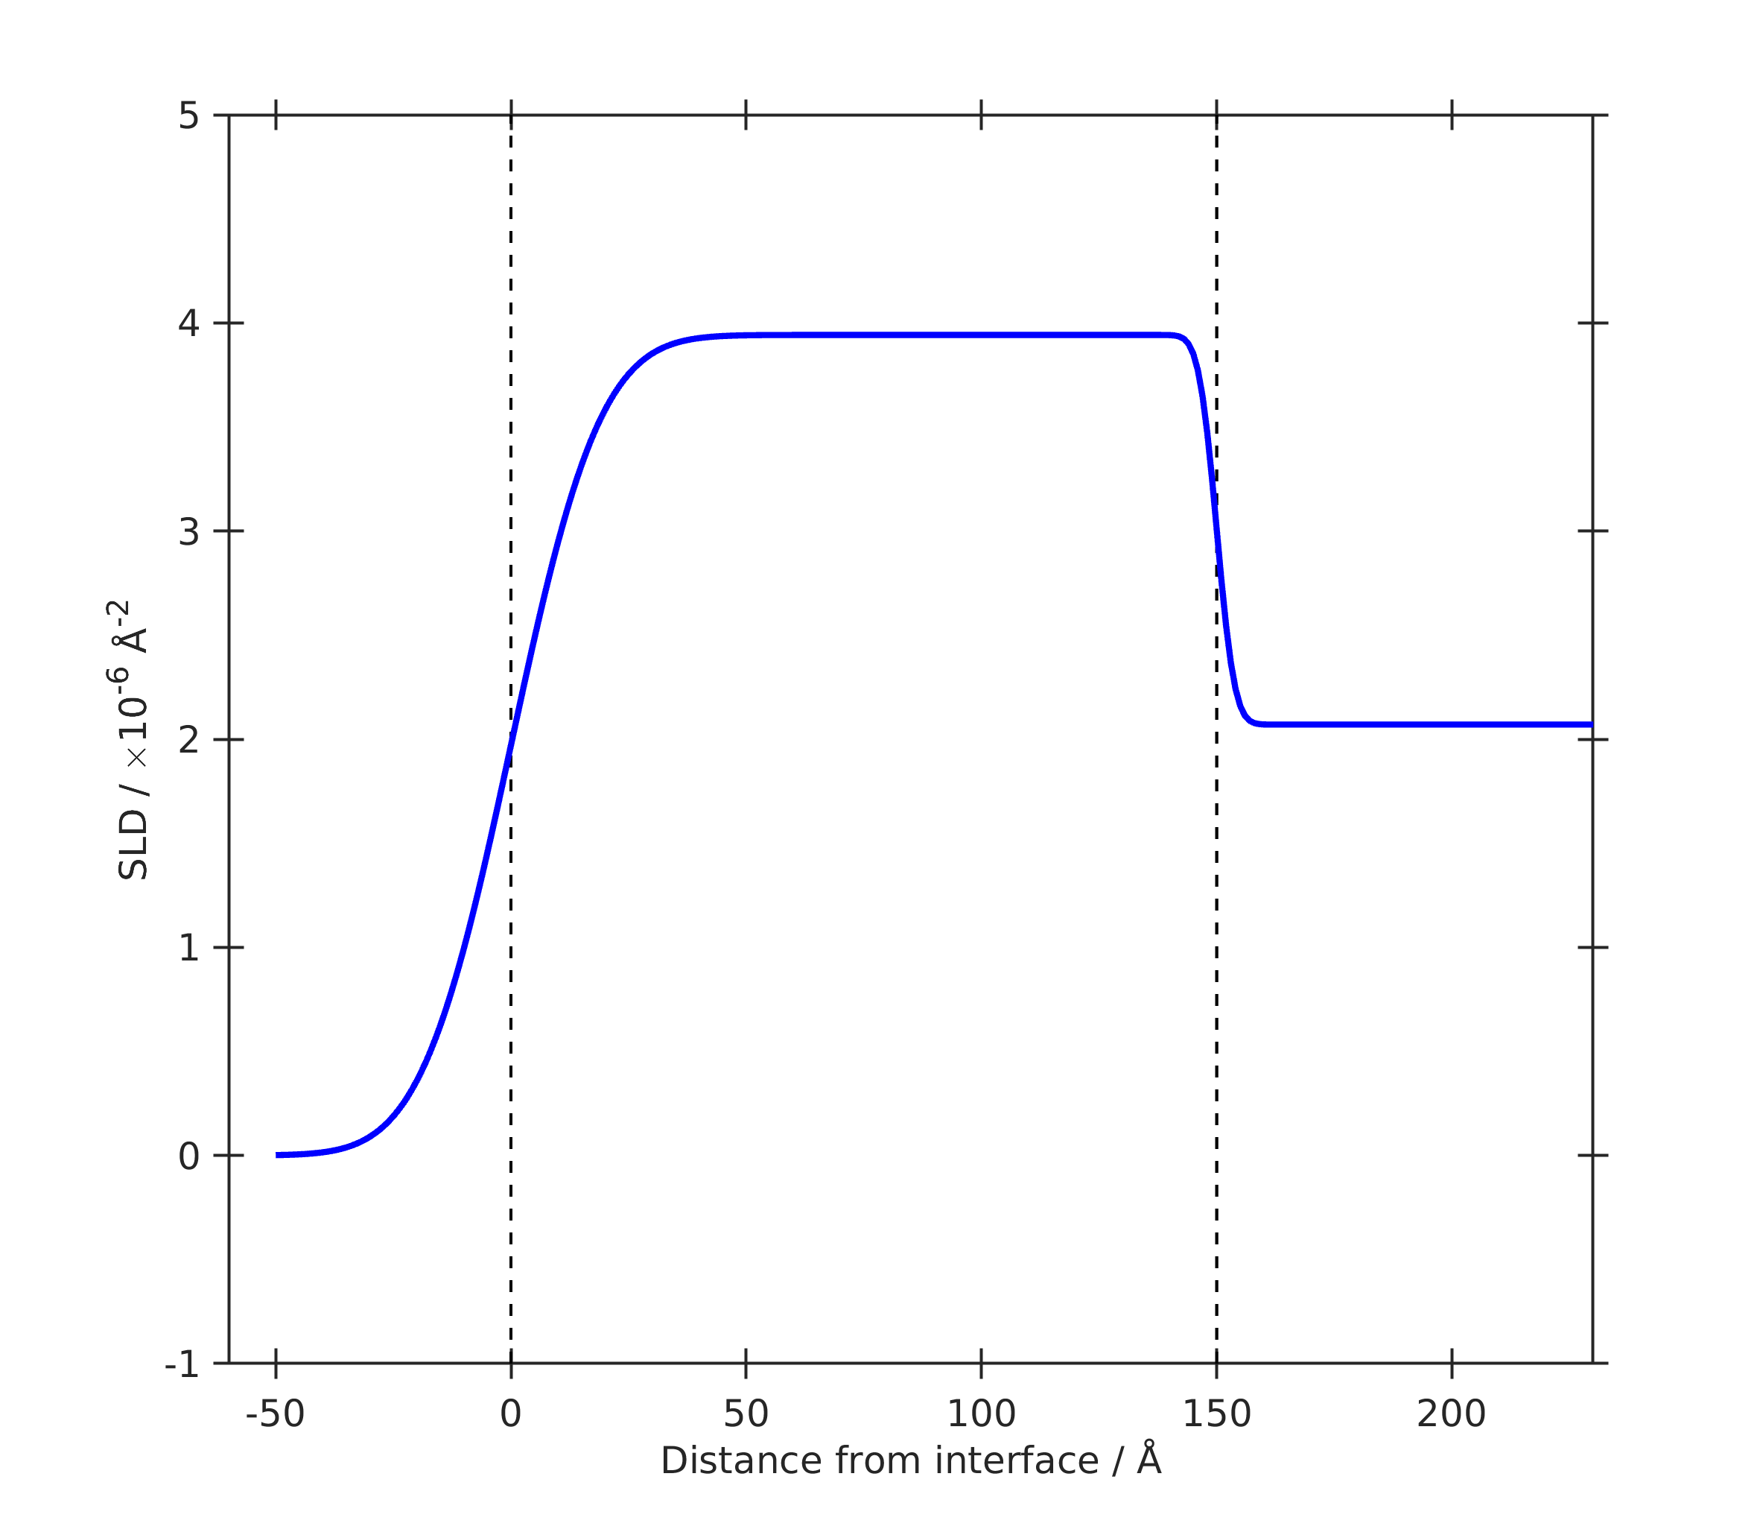
Slab Models (a.k.a. Box models)
Interfacial Structures are averaged in the Z direction and modelled as a series of laterally homogeneous slabs. These are assembled to produce an SLD profile.
Interfacial Slab
Infinite Superphase (e.g. air)
‘Substrate’
roughness
Si
Slab representing interfacial material
Substrate
Slab
Roughness
Infinite Subphase (e.g. Si)
Air
Slab Parameters:
Thickness
SLD
Roughness

Slide 6
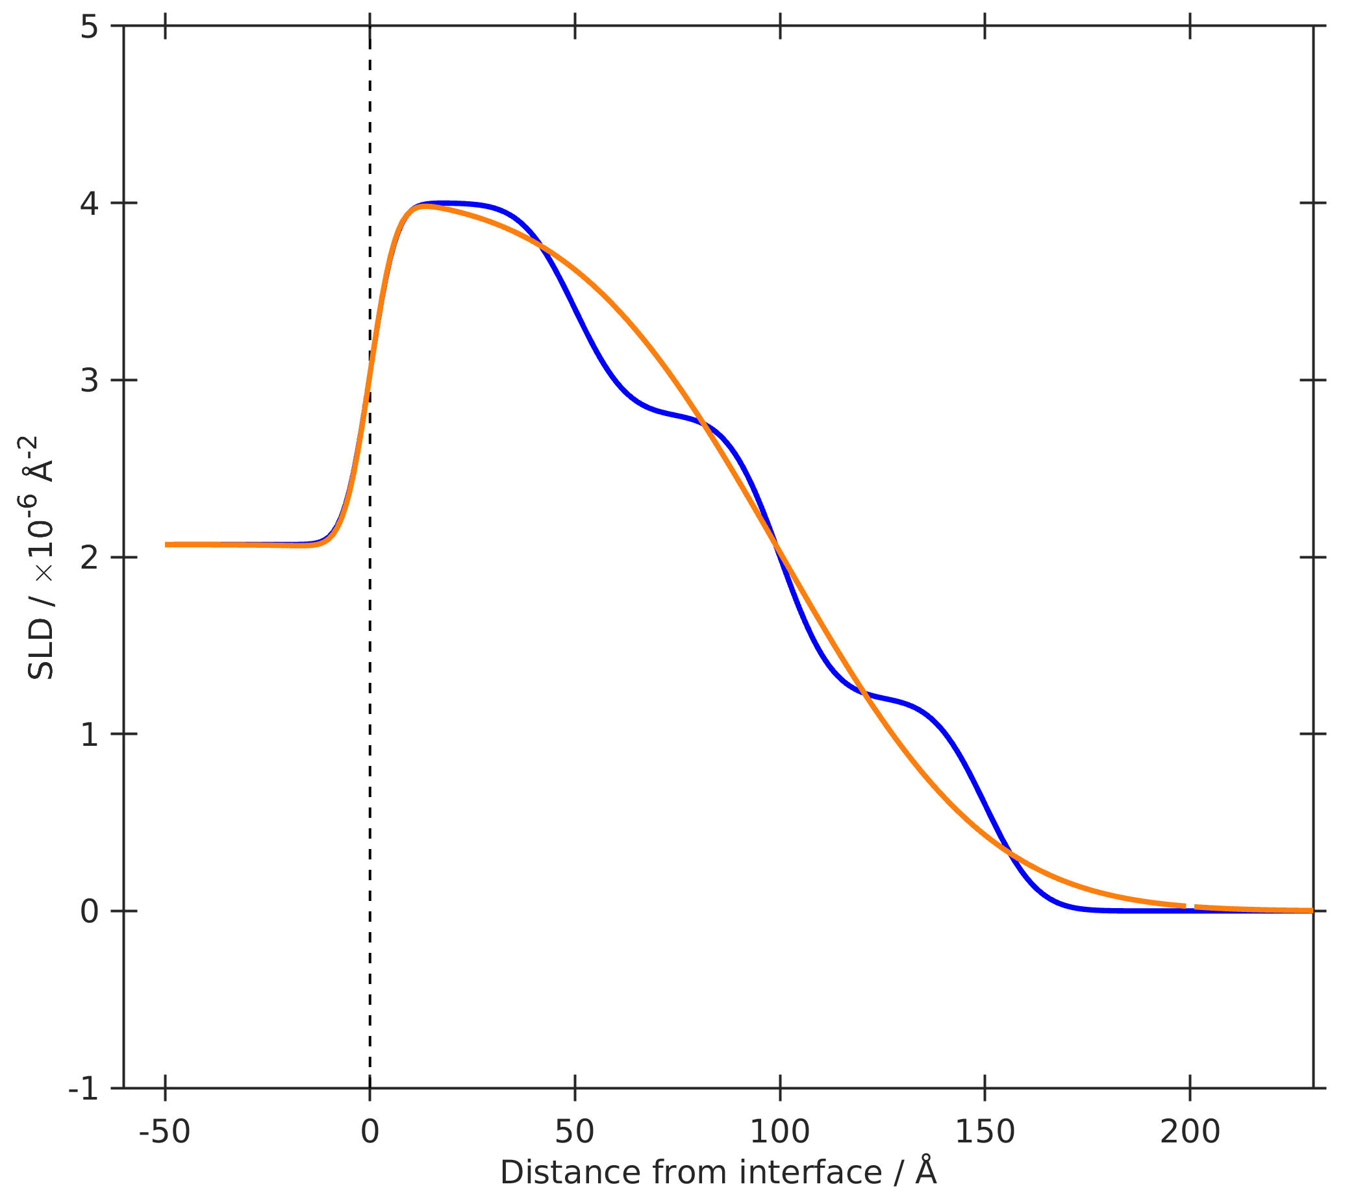
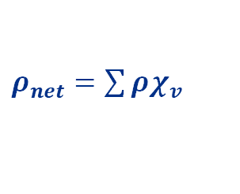
Versatility of Slab Models
Each slab assumes lateral homogeneity, but doesn’t have to contain just one chemical moiety.
$ρ_{net}=\sum{ρχ_{v}}$
The overall SLD of each layer is the volume fraction weighted average SLD:
Eg: Adsorbed mixed nanoparticles
Model 1:
Model 2:
— Model 1
— Model 2
$$ρ_{net}=ρ_{blue}χ_{v_{blue}}+ρ_{red}χ_{v_{red}}$$
Infinite Superphase
Infinite Superphase
Slab 3
Si
Single Slab
(High Roughness)
Slab 2
Slab 1
Substrate
Infinite Subphase
Infinite Subphase
Air
Different models can produce similar SLD profiles.
Regardless of the model used, the SLD profile is what you want!
How do I get an SLD profile that makes physical sense, fits the data and is as simple as possible?

Slide 7
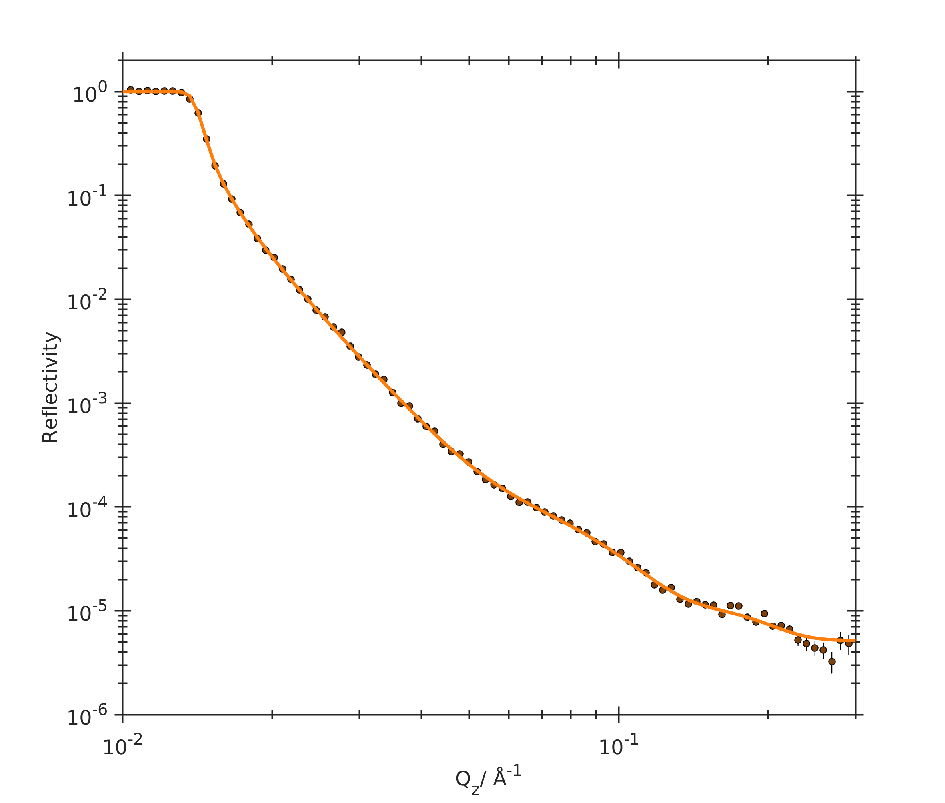
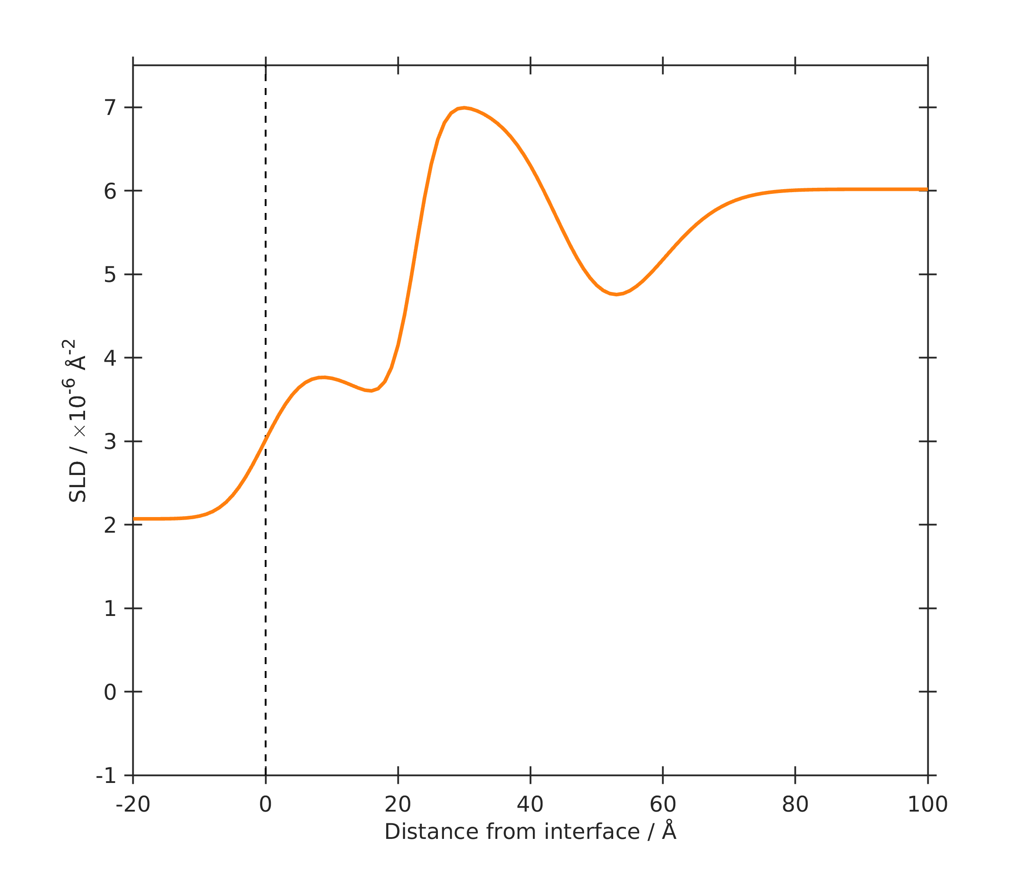






Versatility of Slab Models
Warning: For a slab of mixed composition (e.g. molecule + solvent) it is challenging to determine both the volume fraction and sld.
Eg: Lipid Bilayer
Infinite Subphase
$$ρ_{solvent}$$
Headgroup Slab
$${χ_{v_{head}}ρ}_{head}+{χ_{v_{solvent}}ρ}_{solvent}$$
Tails Slab
$$ρ_{tails}$$
Headgroup Slab
$${χ_{v_{head}}ρ}_{head}+{χ_{v_{solvent}}ρ}_{solvent}$$
SiO₂
SiO₂ Slab
$$ρ_{{SiO}_{2}}$$
Si
Infinite Superphase
$$ρ_{Si}$$
N.B.:
$$χ_{v_{solvent}}=1−χ_{v_{head}}$$
— D₂O
D₂O
The Solution?
Isotopic Contrast Variation!
Si

Slide 8
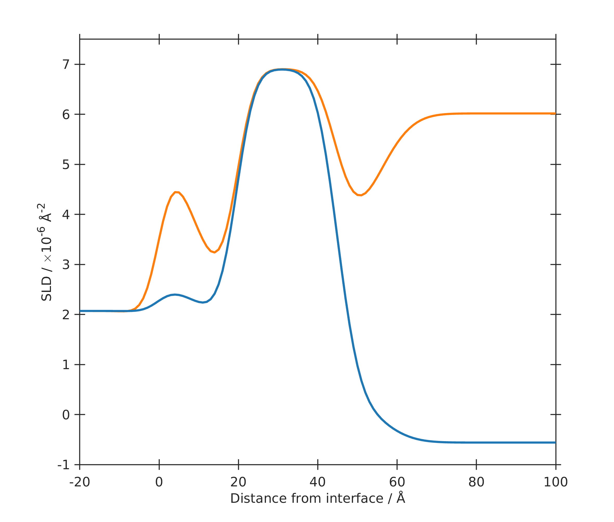
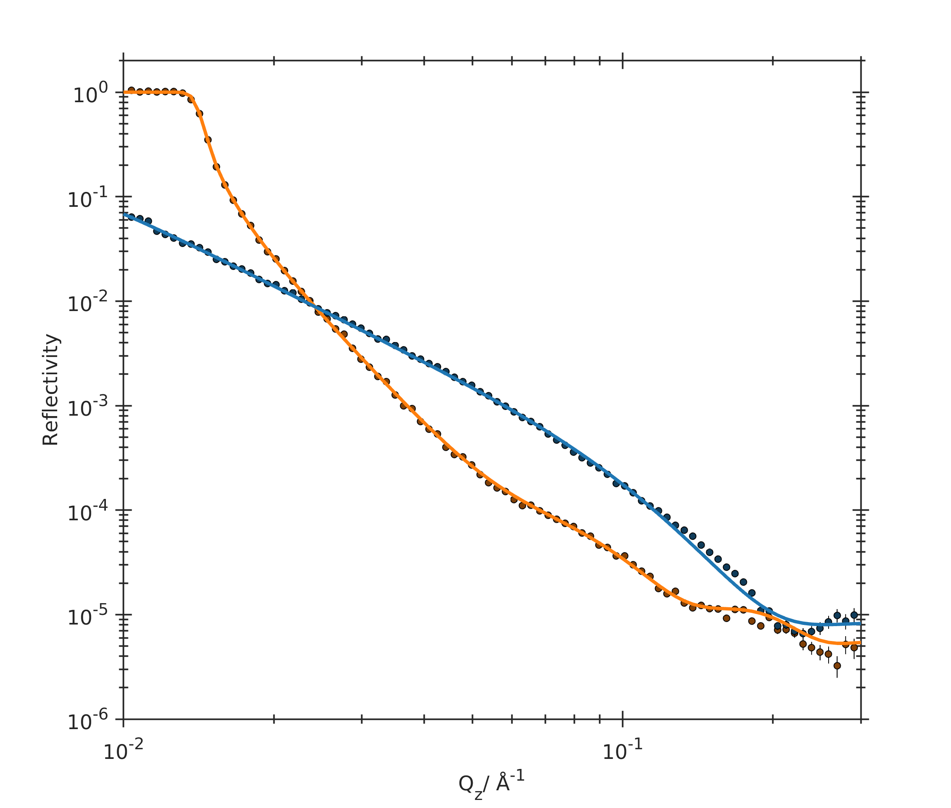
Versatility of Slab Models
Warning: For a slab of mixed composition (e.g. molecule + solvent) it is challenging to determine both the volume fraction and sld.
Eg: Lipid Bilayer
Infinite Subphase
$$ρ_{solvent}$$
Headgroup Slab
$${χ_{v_{head}}ρ}_{head}+{χ_{v_{solvent}}ρ}_{solvent}$$
Tails Slab
$$ρ_{tails}$$
Headgroup Slab
$${χ_{v_{head}}ρ}_{head}+{χ_{v_{solvent}}ρ}_{solvent}$$
SiO₂
SiO₂ Slab
$$ρ_{{SiO}_{2}}$$
Si
Infinite Superphase
$$ρ_{Si}$$
N.B.:
$$χ_{v_{solvent}}=1−χ_{v_{head}}$$
— D₂O
— H₂O
D₂O
The Solution?
Isotopic Contrast Variation!
Si
H₂O

Slide 9
Slab Parameters – Fix or Fit?
SLD
Do you know the composition of the slab? If so, FIX
If a mixture, FIT, but set the limits equal to the lowest and highest SLD component
Constrained based on Mass Spec/NMR for (partial) deuteration
Be cautious – does the density in a thin film match that measured in the bulk?
Thickness
This is usually what you want to find out – Normally FIT
BUT – Ensure limits are physically feasible (i.e. d_{max} ≤ Tanford Length)
Roughness
Hard to pre-characterise or know in advance, so generally FIT
BUT – Ensure limits are sensible (more on this shortly)
Can be constrained. E.g. are different slabs coupled, could they share a single parameter?
Hydration/Coverage
Normally FIT
Constrain where possible
Be aware of the correlation between SLD and Hydration (previous slide).
Can surface coverage be pre-characterised?

Slide 10
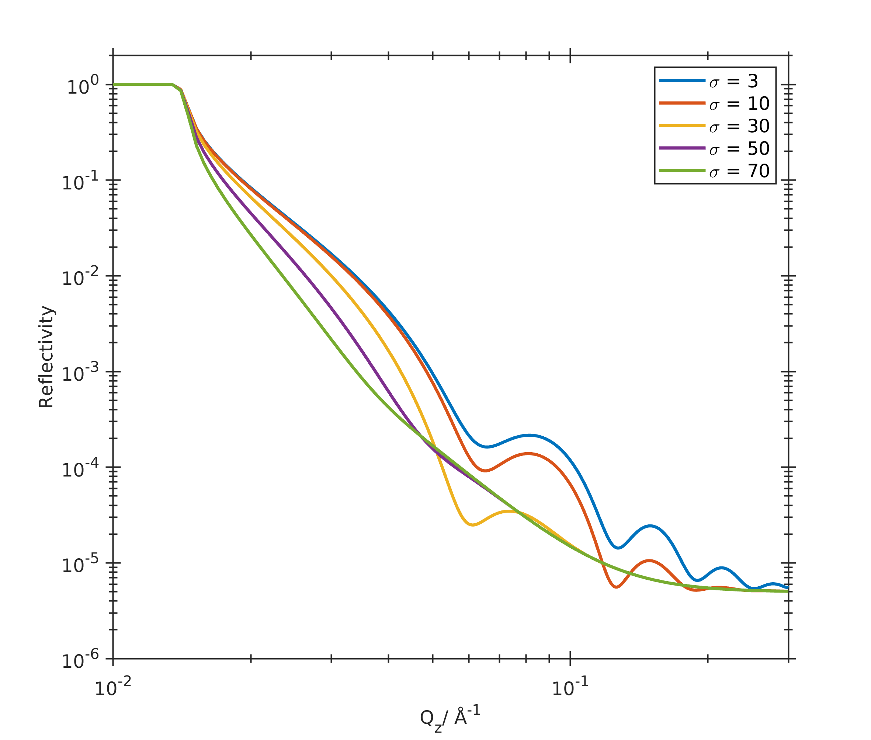
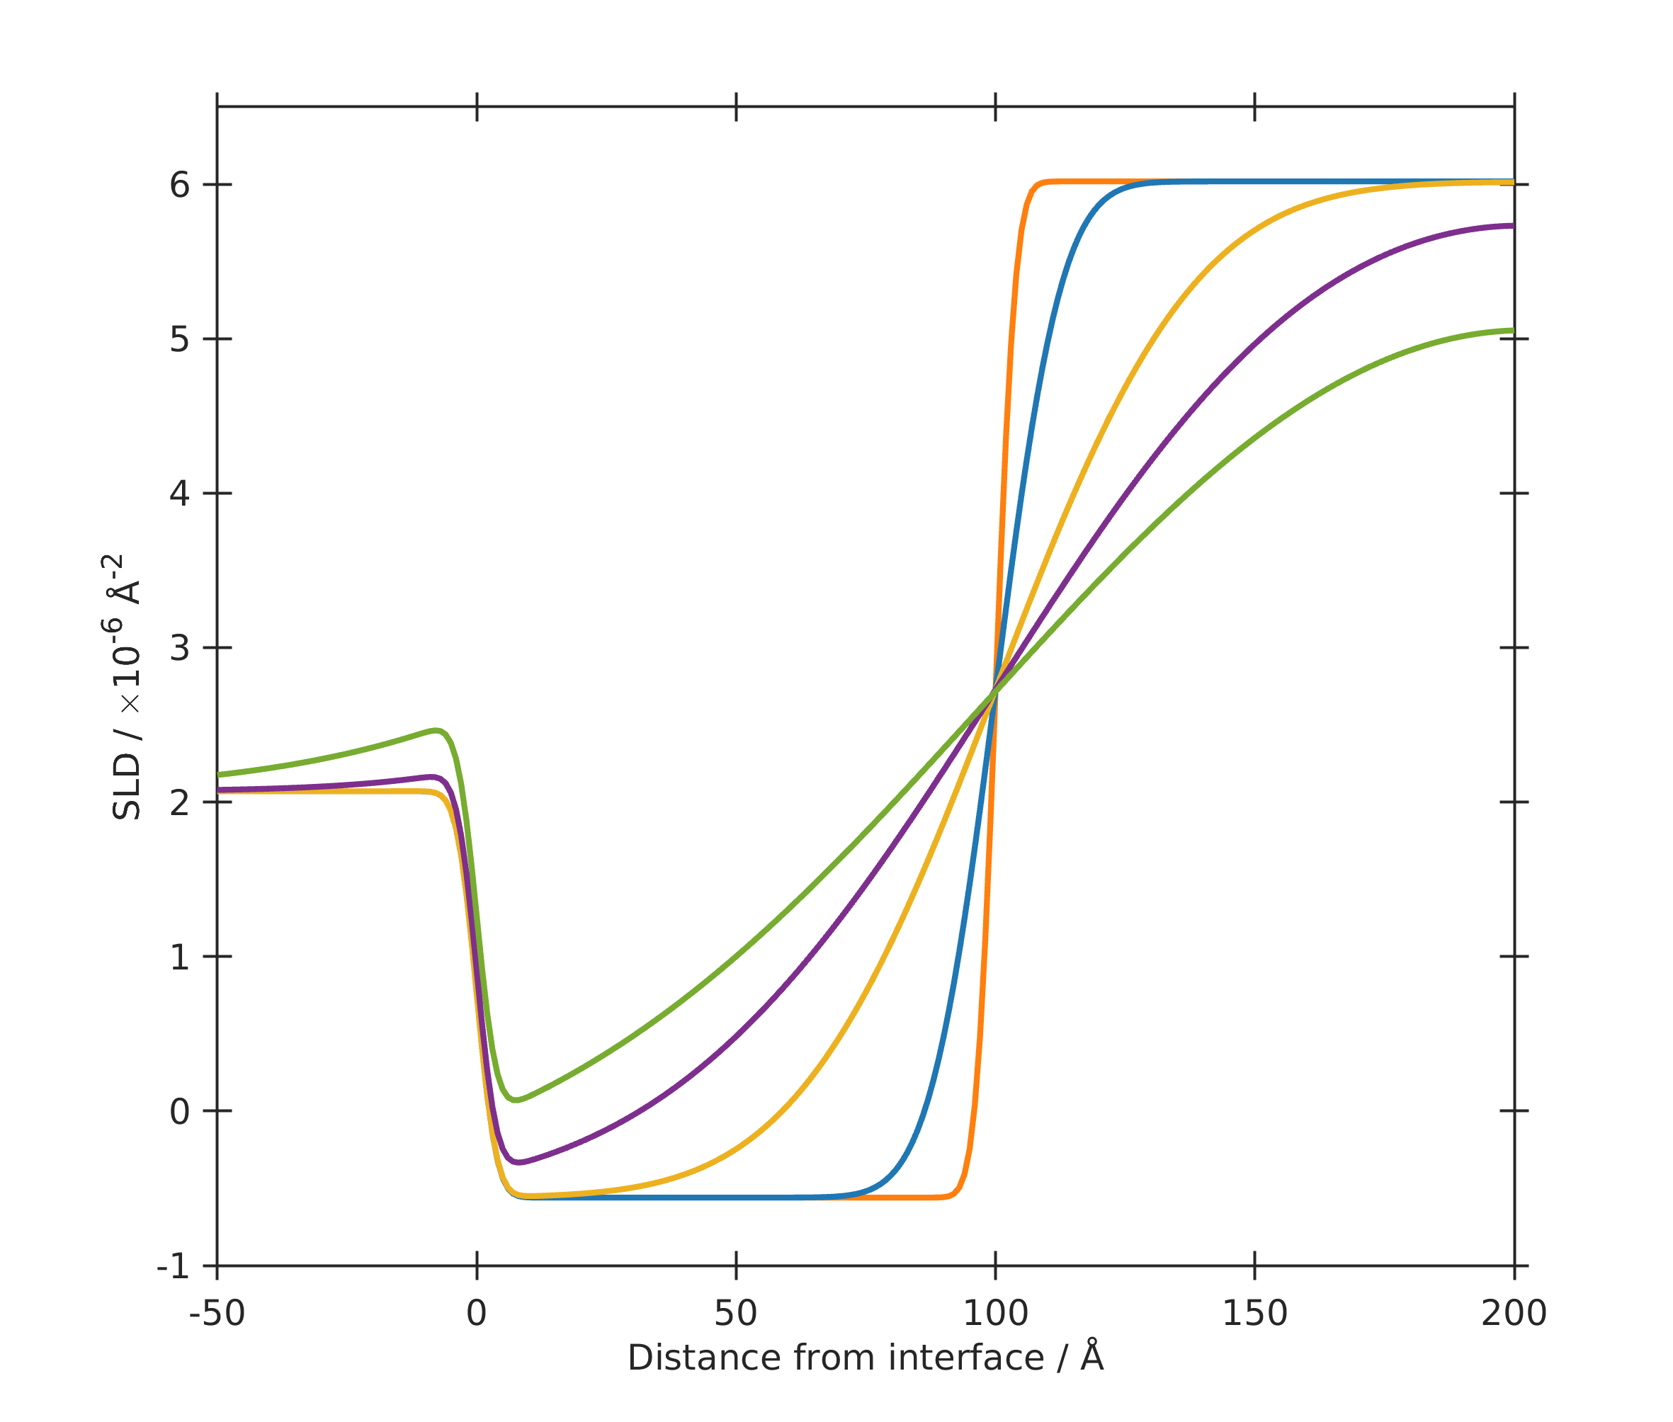
Roughness
Roughness is usually defined as an error function (Névot-Croce Roughness).
If this is too high, it can ‘bleed through’ into different slabs.
Layer thickness = 100 Å
This presents several problems:
Non-physical SLD profile
The ‘leaking’ roughness is not taken into account in the Fresnel coefficients used in the Abeles Obtical Matrix Reflectivity Calculation
Rule of thumb: Slab Roughness should ideally not exceed ~50% of the slab thickness!

Slide 11
Instrumental Parameters – Fix or Fit?
— D₂O
— H₂O
Scale Factor
If you have a critical edge, then FIT within tight limits to find optimum position
If there is no critical edge, constrain this to be equal to that determined for the last dataset measured with a critical edge IN THE SAME MEASUREMENT.
Bulk SLDs
If you have a critical edge, then FIT solvent SLD within tight limits to find optimum position
No Critical Edge? Is it a pure Solvent? Do you know the density? If so FIX
FIX the substrate SLD.
Resolution
SM: FIX – resolution is set by the instrument settings (slits at ISIS, slits/choppers at ILL)
HCM: FIT with maximum limit set as the slit resolution or small samples. Big convex samples, fit it – who knows (in other words, don’t bring bent samples!)
Backgrounds
Fit, but very carefully within tight limits.
Don’t allow the background to goo too low/high as a ‘fudge’ to fit a feature at lower Q.
Q-shifts/2θ offset
FIX to 0!

Slide 12

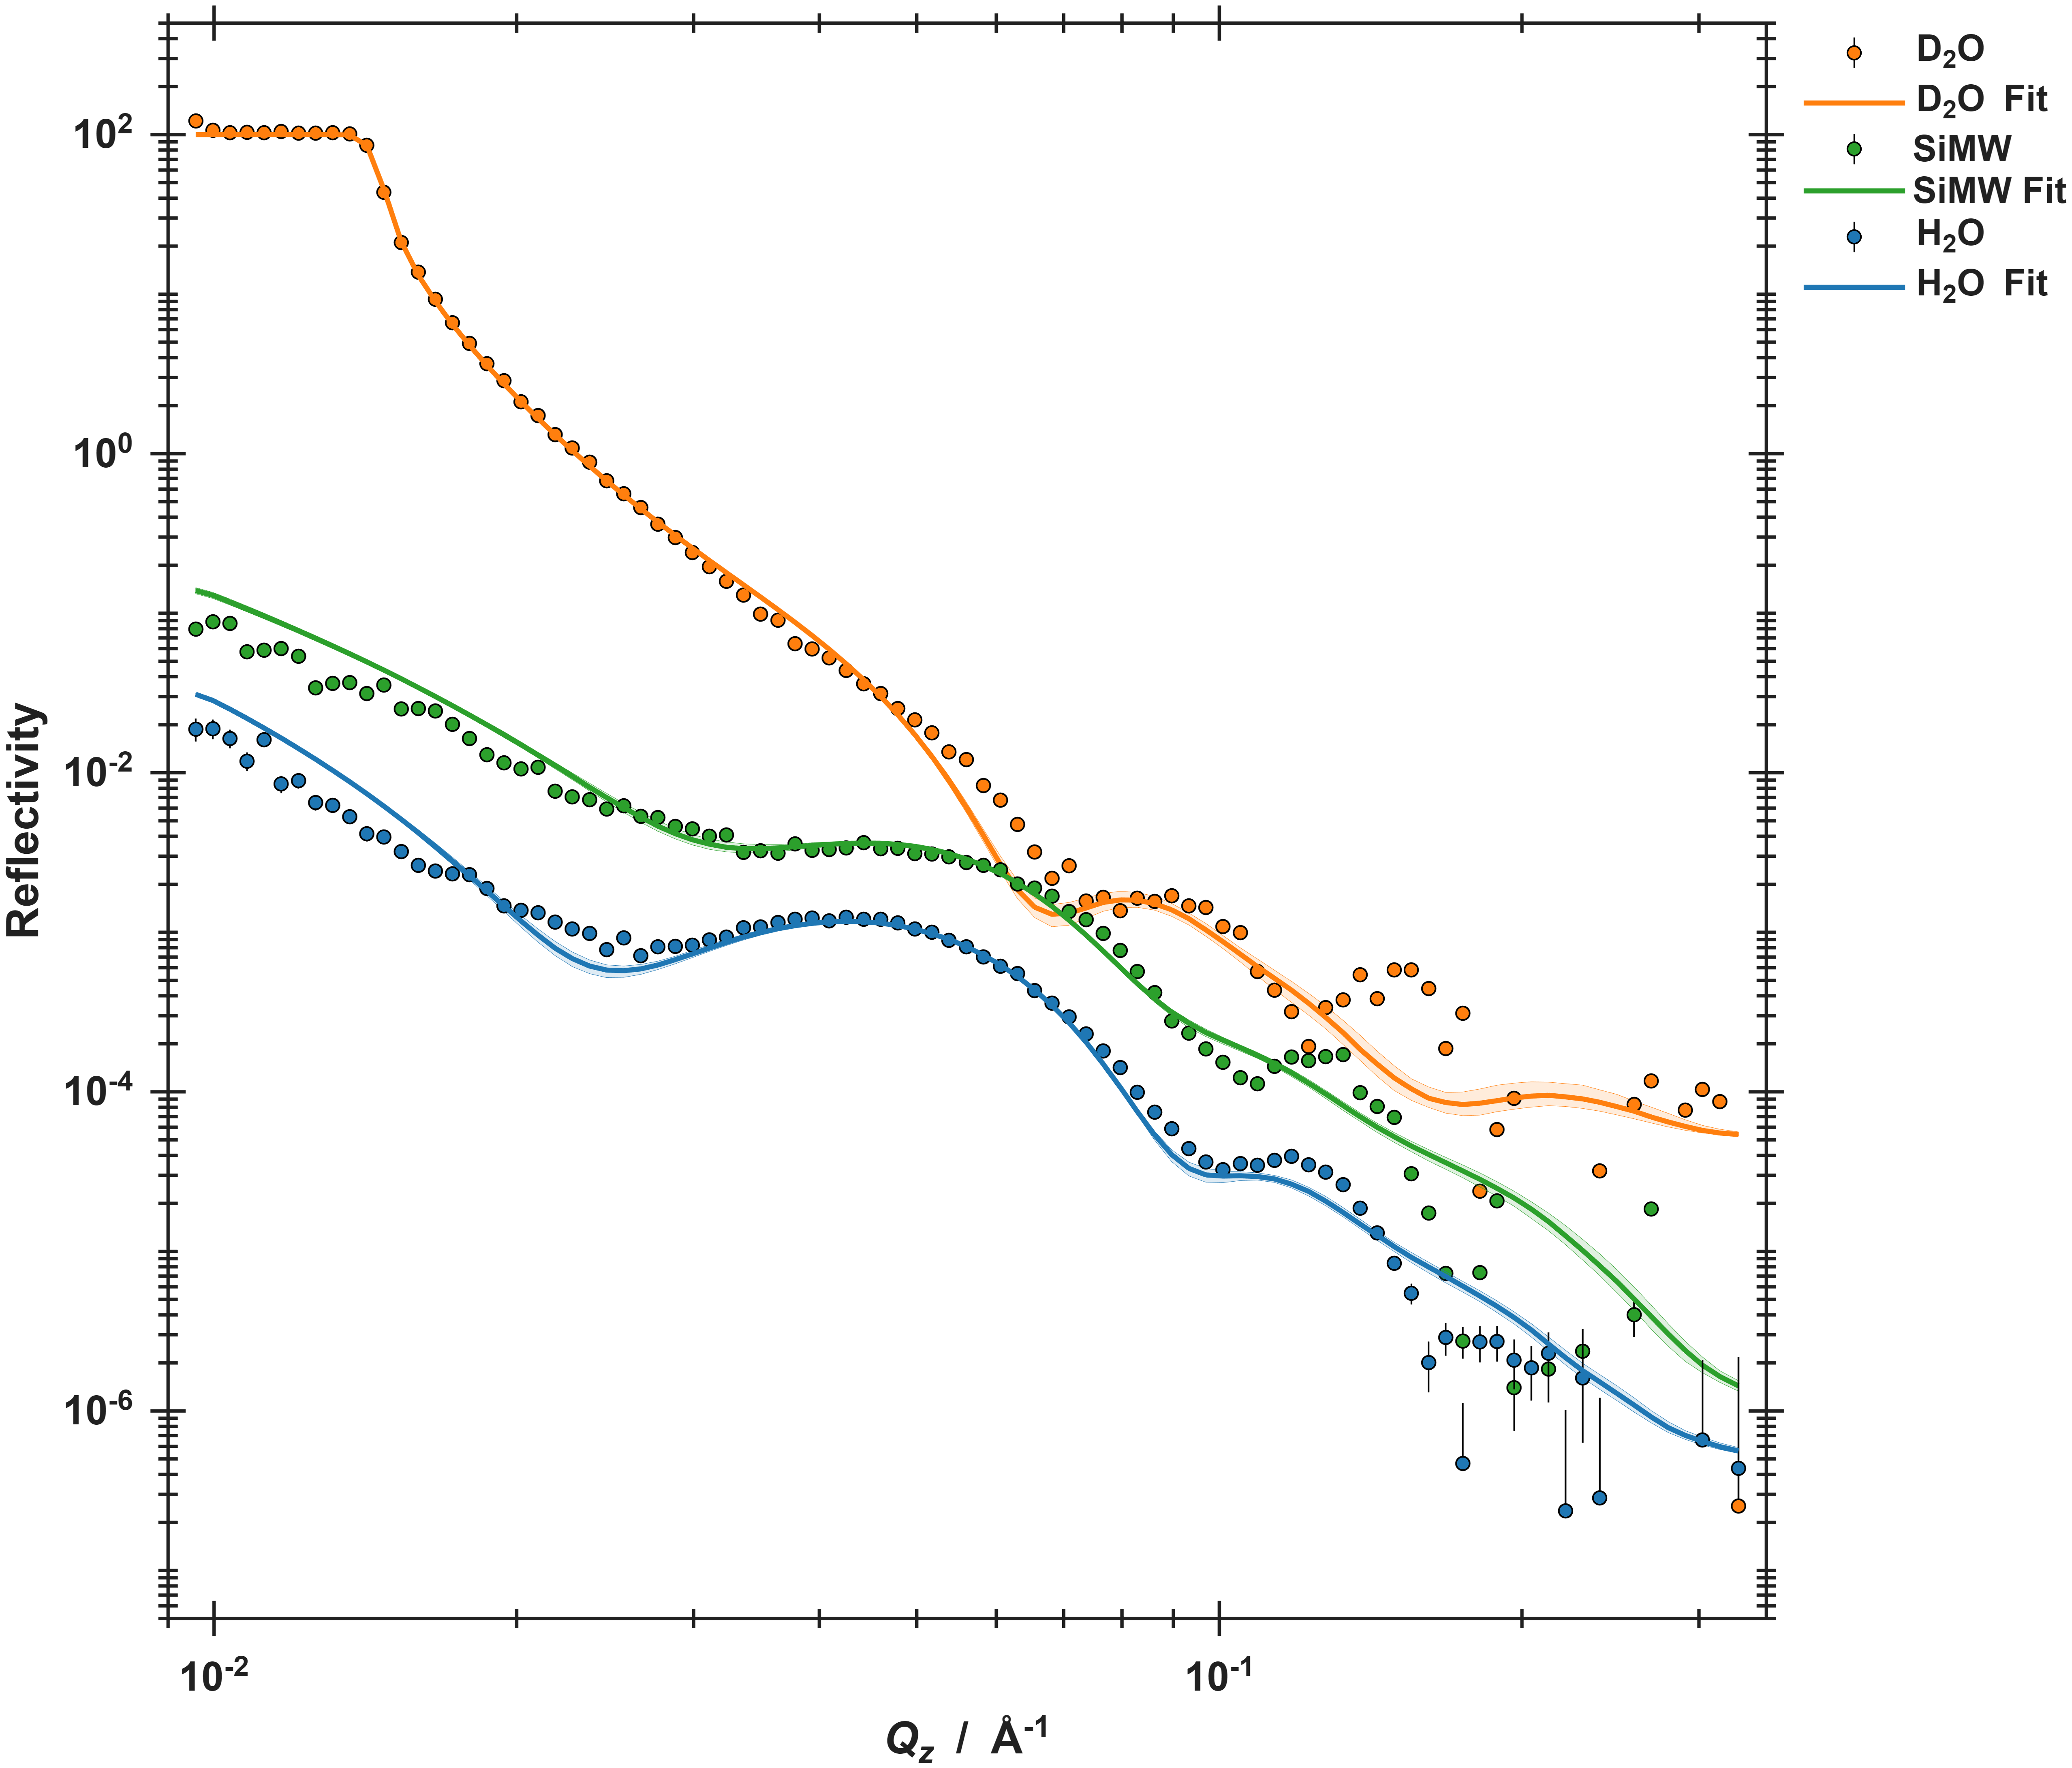
Why won’t my model fit my data?
What do we mean by ‘it doesn’t fit’?
The calculated reflectivity does not reproduce key features of the data (e.g. fringes, critical edge, decay, intensity)
Possible Causes:
The fit is ‘stuck’ in a local minimum in the wrong part of parameter space
The model does not adequately describe the sample
Could be as simple as a wrong limit or incorrect constraint
Or could require different/more layers
There is a problem with my data

Slide 13
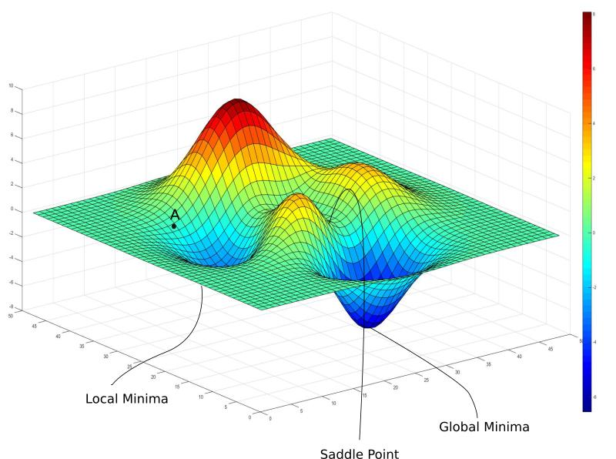
Navigating the χ² landscape
Gradient Descent Algorithms
Starting from an initial guess, looks at the local gradient of the cost function (usually χ² ) and moves ‘downhill’
Fast, local optimisation.
BUT, gets easily stuck in local minima.
Genetic Algorithms (e.g. Differential Evolution)
Starts from a population of random solutions across the whole parameter space and evaluates the χ² for each.
Iteratively combines the good solutions, whilst adding some random variation (mutations), and keeps the best solution.
Can be more successful in finding the global minimum
BUT, is slower and can struggle to converge
The χ² landscape for a typical reflectivity fit is highly dimensional and not smooth.
Easy to get stuck in a local minimum!
If struggling, start with Genetic then use Gradient Descent algorithms to converge

Slide 14
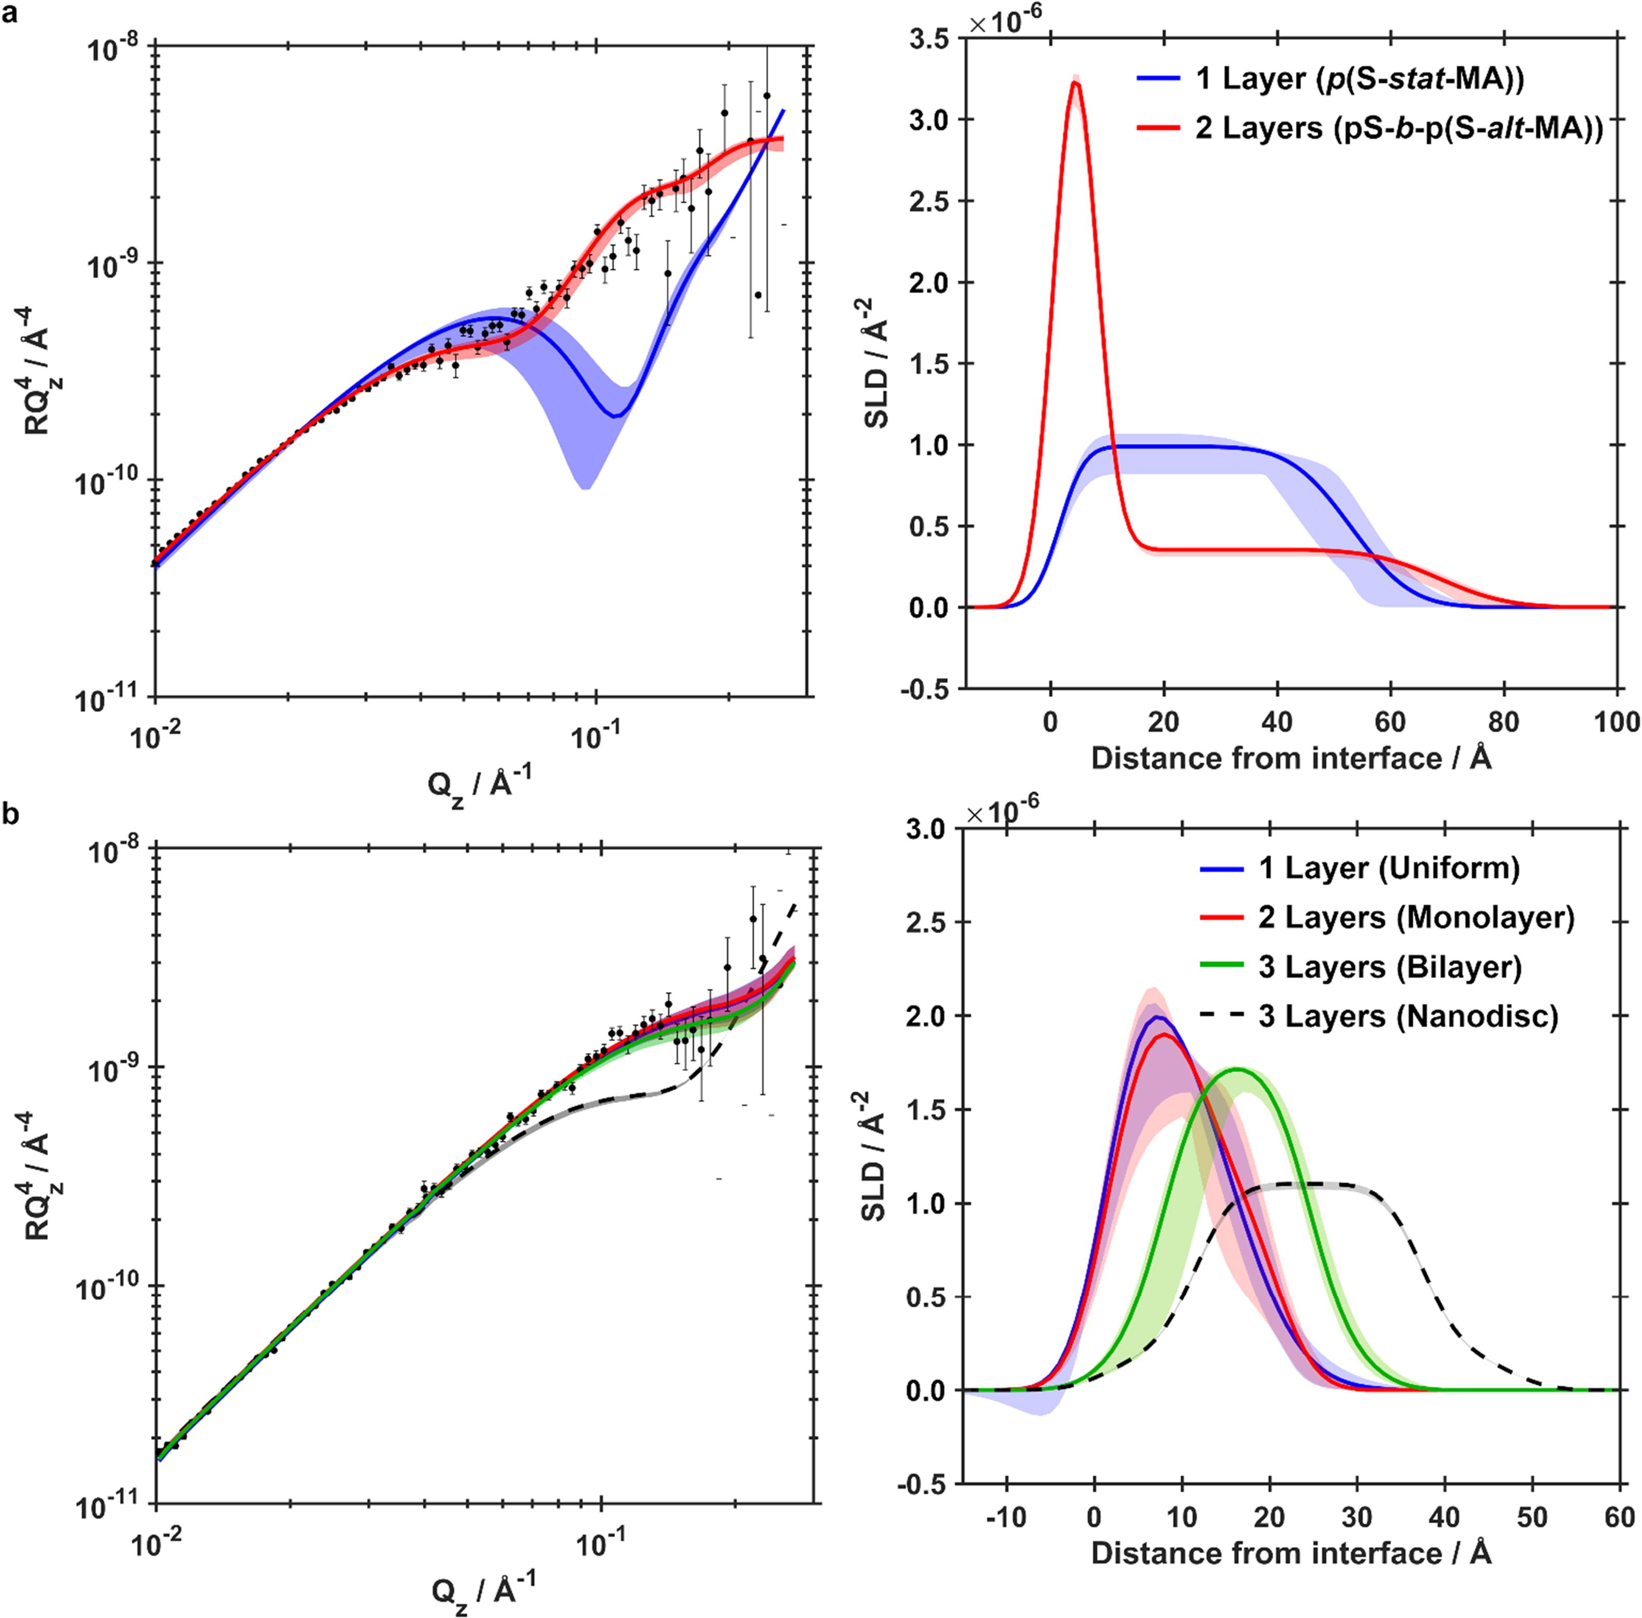
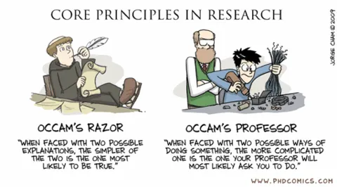
Slab Model Parameterisation
How Many Layers?
Smallest number of layers required to fit the data
Start simple!
Utilise prior knowledge of the system
Different models can produce similar SLD profiles and similar fits
If a model needs to be complex, consider constraints
Shared parameters between slabs (minimise number of parameters)
Fix known parameters
Constrain based on physical knowledge
https://doi.org/10.1016/j.jcis.2022.03.102
Regardless of parameterisation, it is the shape of the SLD profile which is important!

Slide 15
Model Re-parameterisation
Here, we still use slabs, but those slabs are parameterised using physically meaningful parameters
Chain Tilt Angles
Molecular Volumes
Packing Density (e.g. taking into account intrinsic hydration
Protein Orientation
Area per Molecule
Many benefits:
Reduced number of parameters
Reduced parameter uncertainty (see Andrew’s lecture next)
Reduced Correlations between parameters
Simplified parameter space – often easier to converge
Enforces physical constraints (e.g. stoichometric consistency)
θ

Slide 16
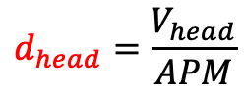





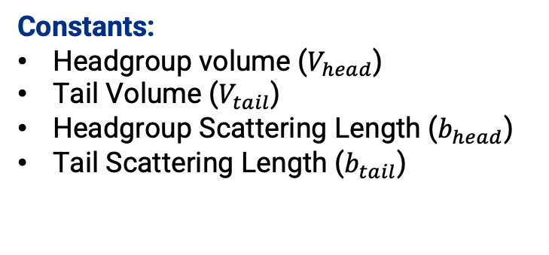
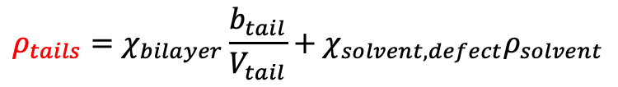




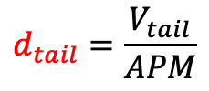

Lipid Bilayer Example – Area Per Molecule Constraints
$$χ_{total solvent,head}$$
Exploiting known molecular architecture and self assembly of lipids to use physical parameters to construct slabs rather than slab parameters
$$χ_{Solvent,head}$$
$$χ_{v, head}$$
Constants:
Headgroup volume ($V_{head}$)
Tail Volume ($V_{tail}$)
Headgroup Scattering Length ($b_{head}$)
Tail Scattering Length ($b_{tail}$)
Fitting Parameters:
Area Per Molecule ($APM$)
Headgroup hydration ($χ_{solvent,head}$)
Bilayer Coverage ($χ_{bilayer}$)
Bilayer Roughness ($σ_{bilayer}$)
$$d_{tail}=\frac{V_{tail}}{APM}$$
$$d_{head}=\frac{V_{head}}{APM}$$
$$χ_{solvent,defect}=1 −χ_{bilayer}$$
$$χ_{head}=1 −χ_{solvent,head}$$
$$ρ_{tails}=χ_{bilayer}\frac{b_{tail}}{V_{tail}}+χ_{solvent,defect}ρ_{solvent}$$
$$χ_{total solvent,head}=1 −χ_{v,head}χ_{solvent,defect}$$
$$χ_{v,head}=1 −χ_{total solvent,head}$$
$$χ_{bilayer}$$
$$χ_{solvent, defect}$$
$$ρ_{heads}=χ_{v,head}\frac{b_{head}}{V_{head}}+χ_{total solvent,head}ρ_{solvent}$$
Red Parameters give us everything we need to assemble 4 slabs defining the bilayer

Slide 17
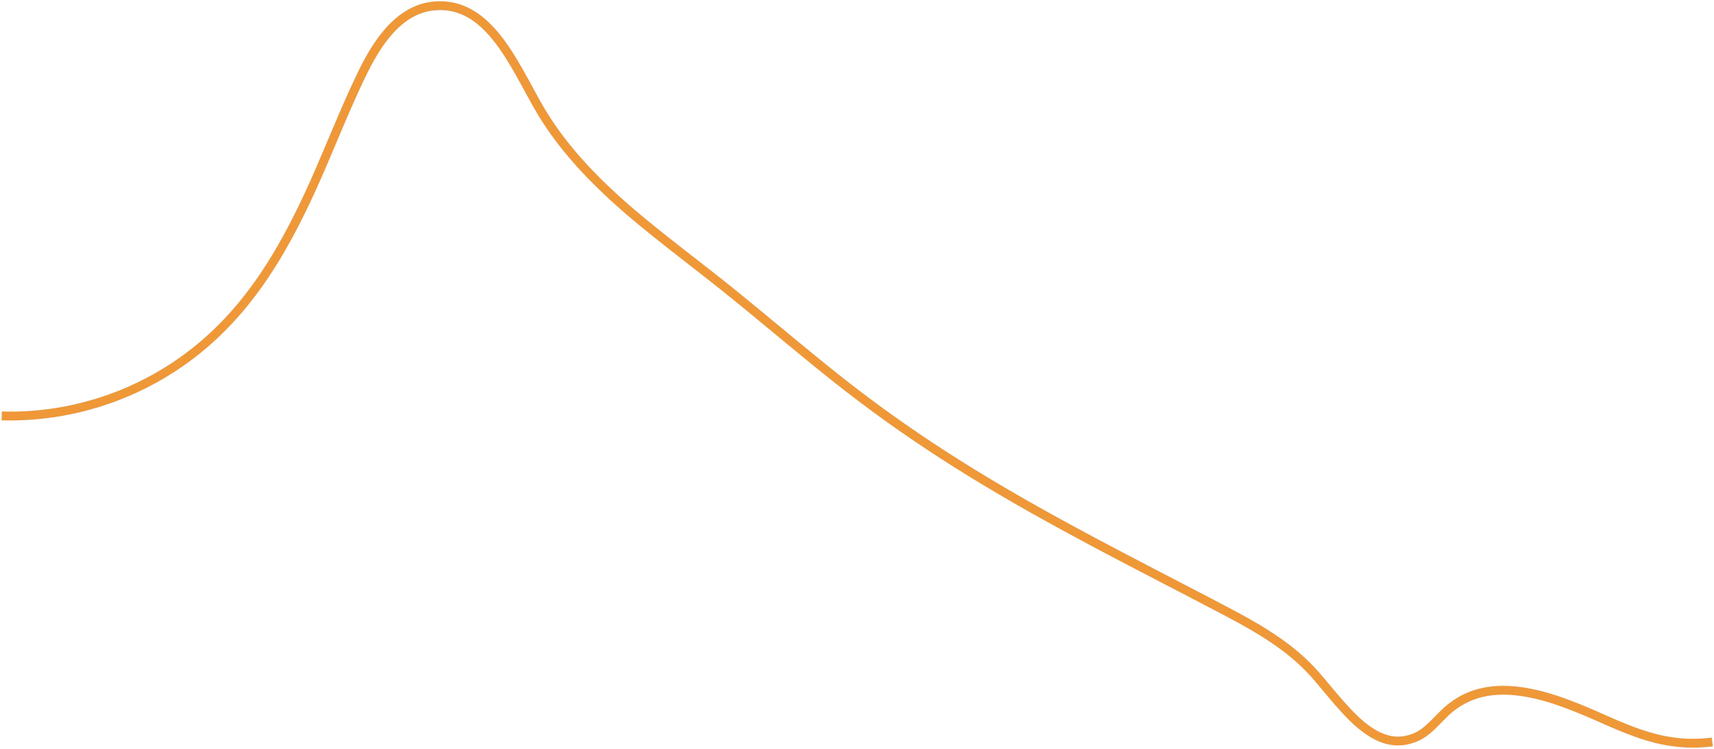



Non-Slab Models - Microslicing
Any functional form can be approximated by a series of mini-slabs
This allows us to model gradients and complex structures beyond simple slab models.
Highly Versatile
Can be very tightly constrained
$$ρ$$
$$ρ=f(z)$$
Computationally Intensive
Risk of over-fitting
Applications
Non error function roughnesses
Diffuse films (e.g. polymer brushes)
Continuous distributions
$$z$$
N.B. Can be used to accurately calculate the reflectivity from artefacts introduced by Névot-Croce Roughness (see earlier slides)

Slide 18
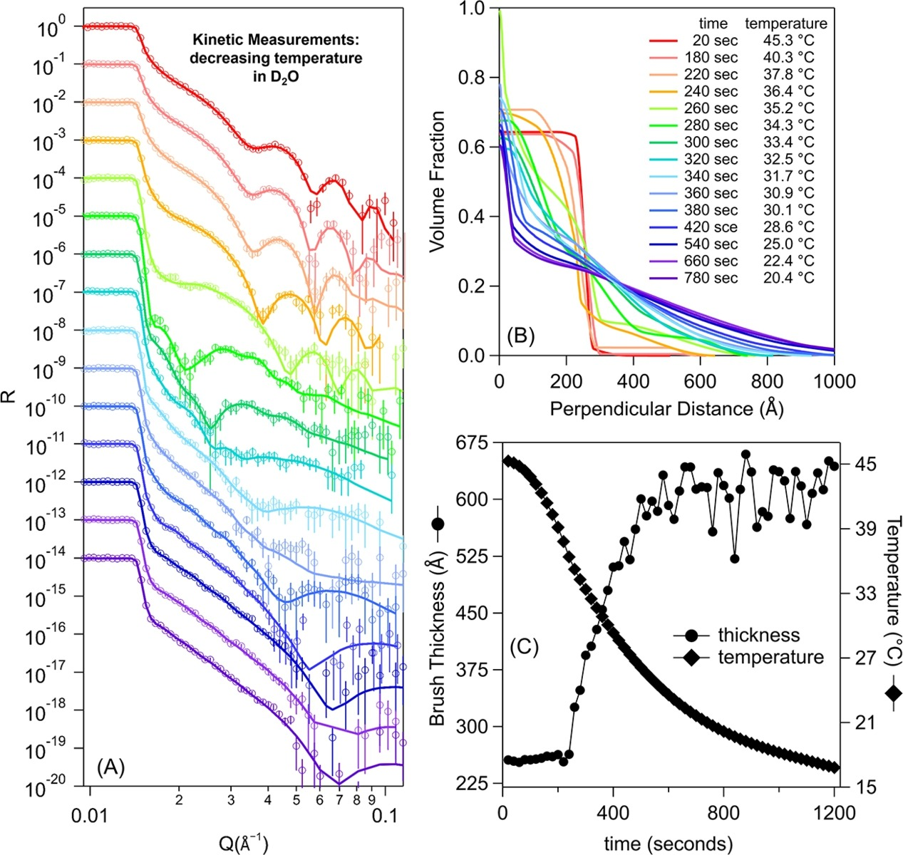
Microslicing Example – Polymer Brush Swelling
Polymer brushes form diffuse, extended disordered structures which cannot be modelled by simple slabs.
Splines used to model the brush volume fraction distribution.
WARNING: Splines have a potentially huge parameter space
Spline-based models need tight constraints
In this case, the collapsed, dry brush was modelled as a single slab.
Spline constrained such that it’s integral equals the integral of the slab.
Same surface excess, different structure
https://doi.org/10.1016/j.jcis.2025.138248

Slide 19
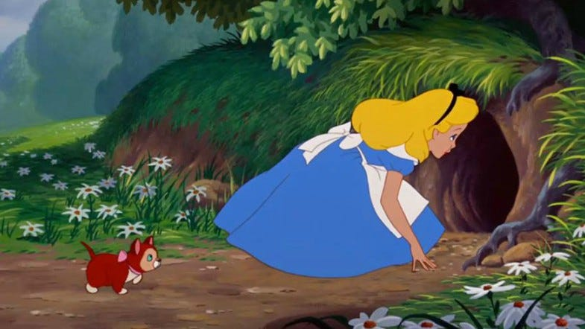
Common Reflectometry Fitting Packages: Pick Your Poison
The choice of software matters less than the model and assumptions.
RasCAL2
https://github.com/RascalSoftware/RasCAL-2/releases
Refnx (Motofit)
https://doi.org/10.1107/S1600576718017296
Anaklasis
https://doi.org/10.1107/S1600576721009262
Refl1D
https://github.com/reflectometry/refl1d/releases/tag/v1.0.1
GenX
https://aglavic.github.io/genx/
And Many More… https://www.reflectometry.org/learn_about_reflectometry/analysis_software
All these packages are effectively calculating the same thing, and have been validated against one another.

Slide 20
Summary
Reflectometry is an inverse problem
Many models can fit the same data
Use the simplest physically meaningful model
Constrain parameters wherever possible
The SLD profile, not the model, is what matters

