Slide 1

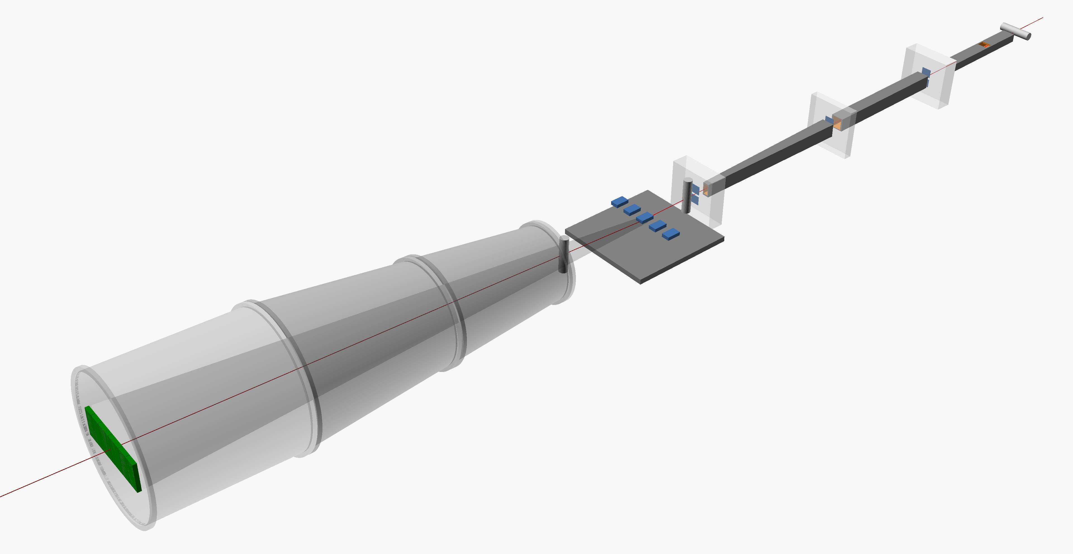
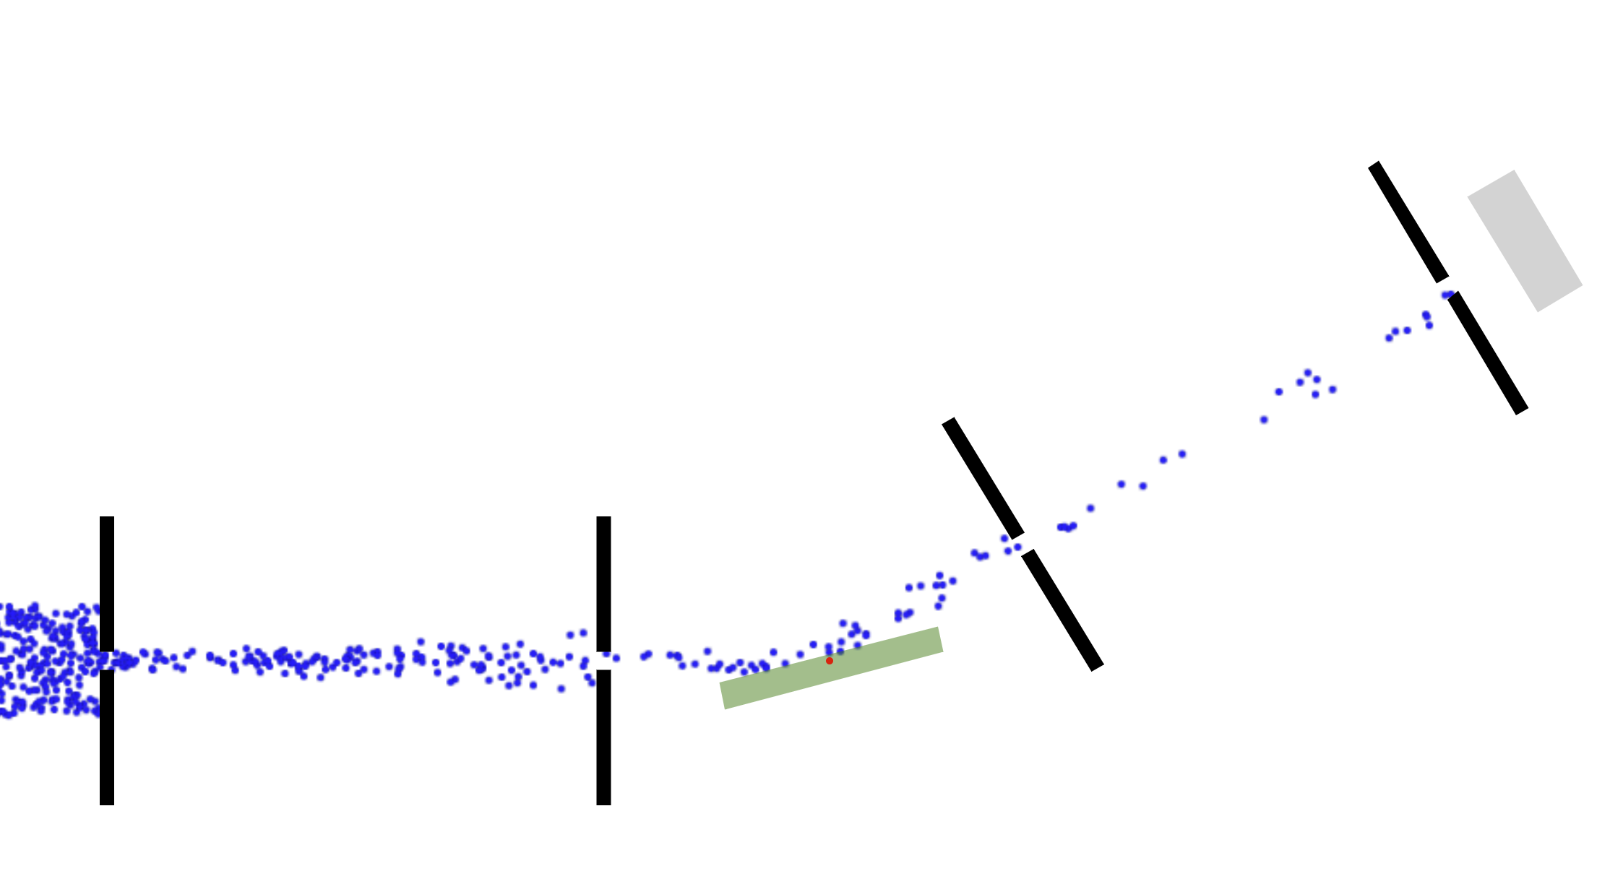
Sample Alignment
M. Skoda

Slide 2

Aligned Sample
θ
2θ
angle
height

Slide 3
Aligned Sample
θ
2θ
angle
height

Slide 4
Misaligned Sample
θ
2θ
angle
height

Slide 5
Misaligned Sample
θ
2θ
angle
height

Slide 6
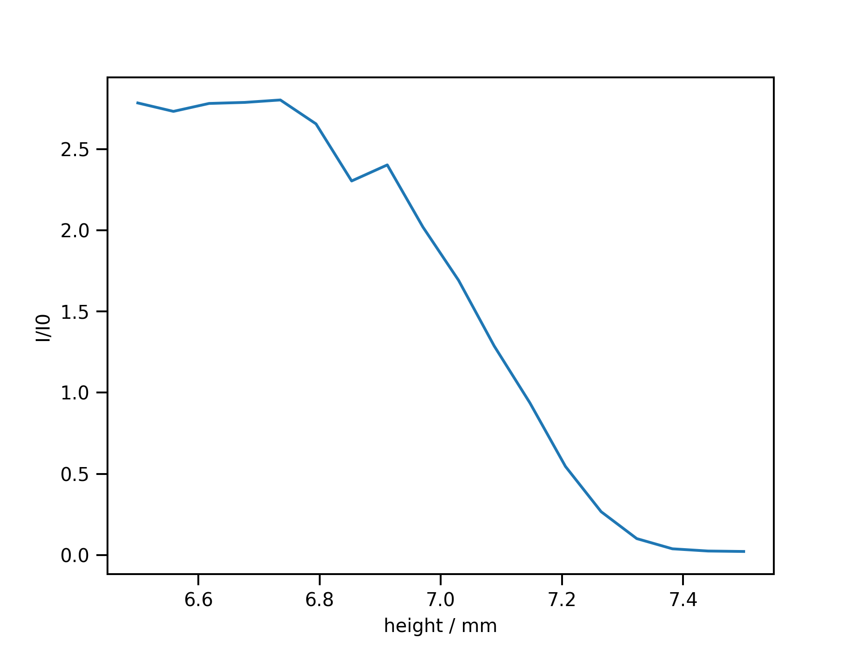
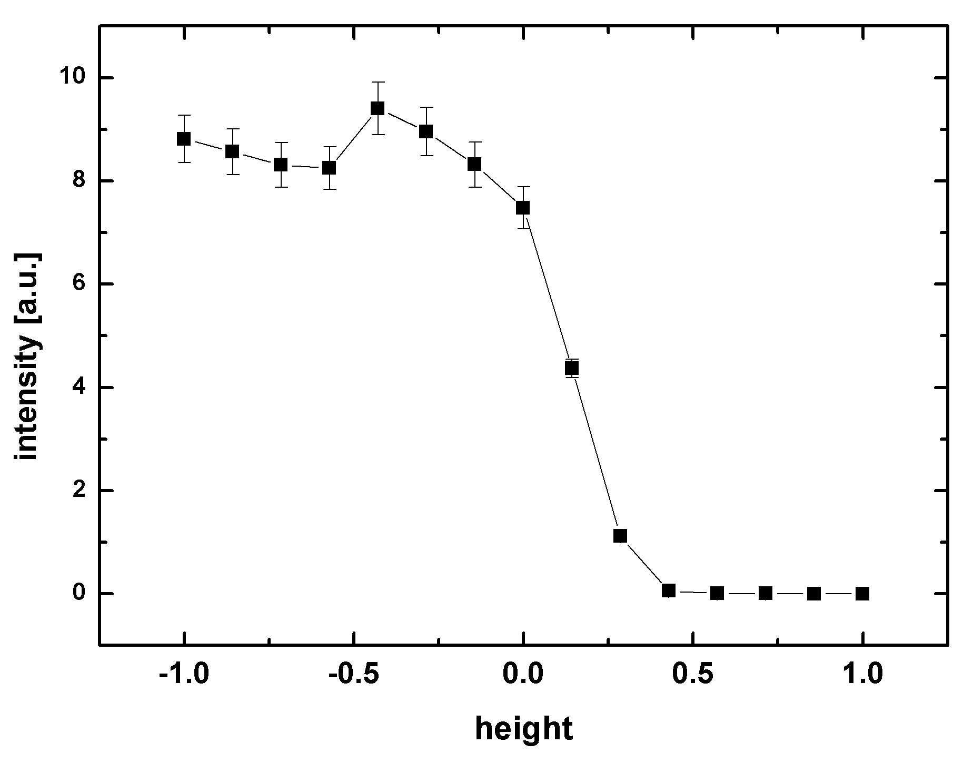
height scan I
initial height scan to find half-beam
> scan height -1 1 16 10
> scan height 6.5 7.5 11 10
+
sample
S2
S1
detector
→ Set height to 7.08

Slide 7
phi “shadow” scan
symmetric phi scan around phi=0° (theta=0)
> scan phi -0.25 0.25 16 100
sample
S2
S1
detector

Slide 8
phi “shadow” scan
symmetric phi scan around phi=0° (theta=0)
> scan phi -0.25 0.25 16 100
sample
S2
S1
detector

Slide 9
phi “shadow” scan
symmetric phi scan around phi=0° (theta=0)
> scan phi -0.25 0.25 16 100
sample
S2
S1
detector

Slide 10
phi “shadow” scan
symmetric phi scan around phi=0° (theta=0)
> scan phi -0.25 0.25 16 100
sample
S2
S1
detector

Slide 11
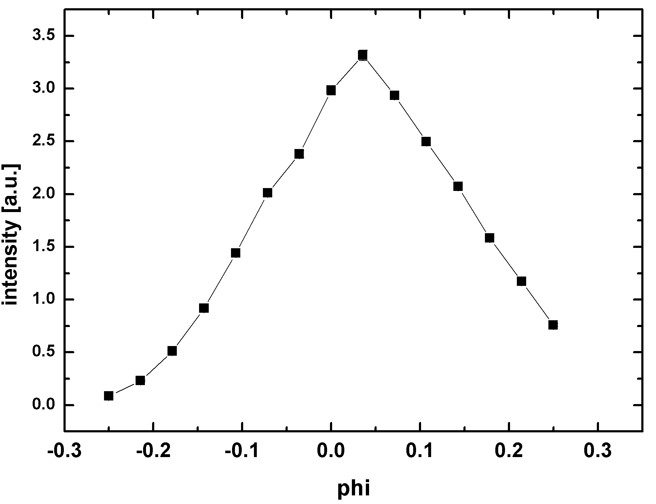
phi “shadow” scan
symmetric phi scan around phi=0° (theta=0)
> scan phi -0.25 0.25 16 100
phi offset
sample
S2
S1
detector
→ phi = theta+ phi offset (e.g. 0.04)

Slide 12
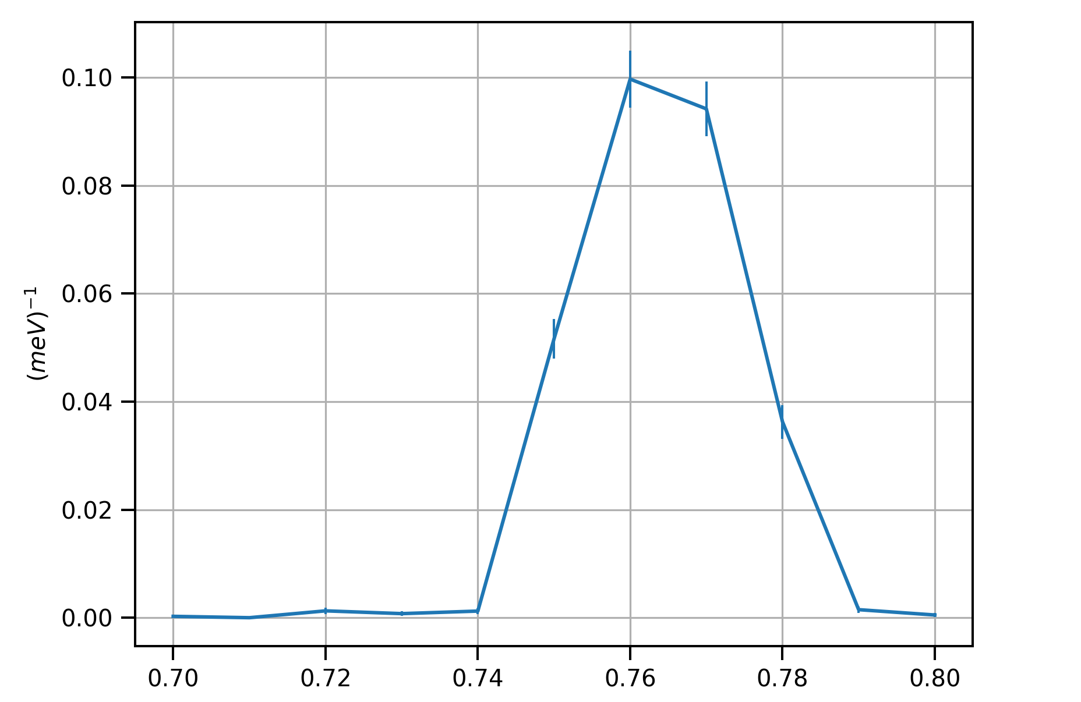

phi (rocking) scan
symmetric phi scan around phi=0.7° + 0.04 (theta=0.7°)
> scan phi 0.7 0.8 11 40
phi offset
detector
sample
S2
S1
→ Set phi to 0.762

Slide 13
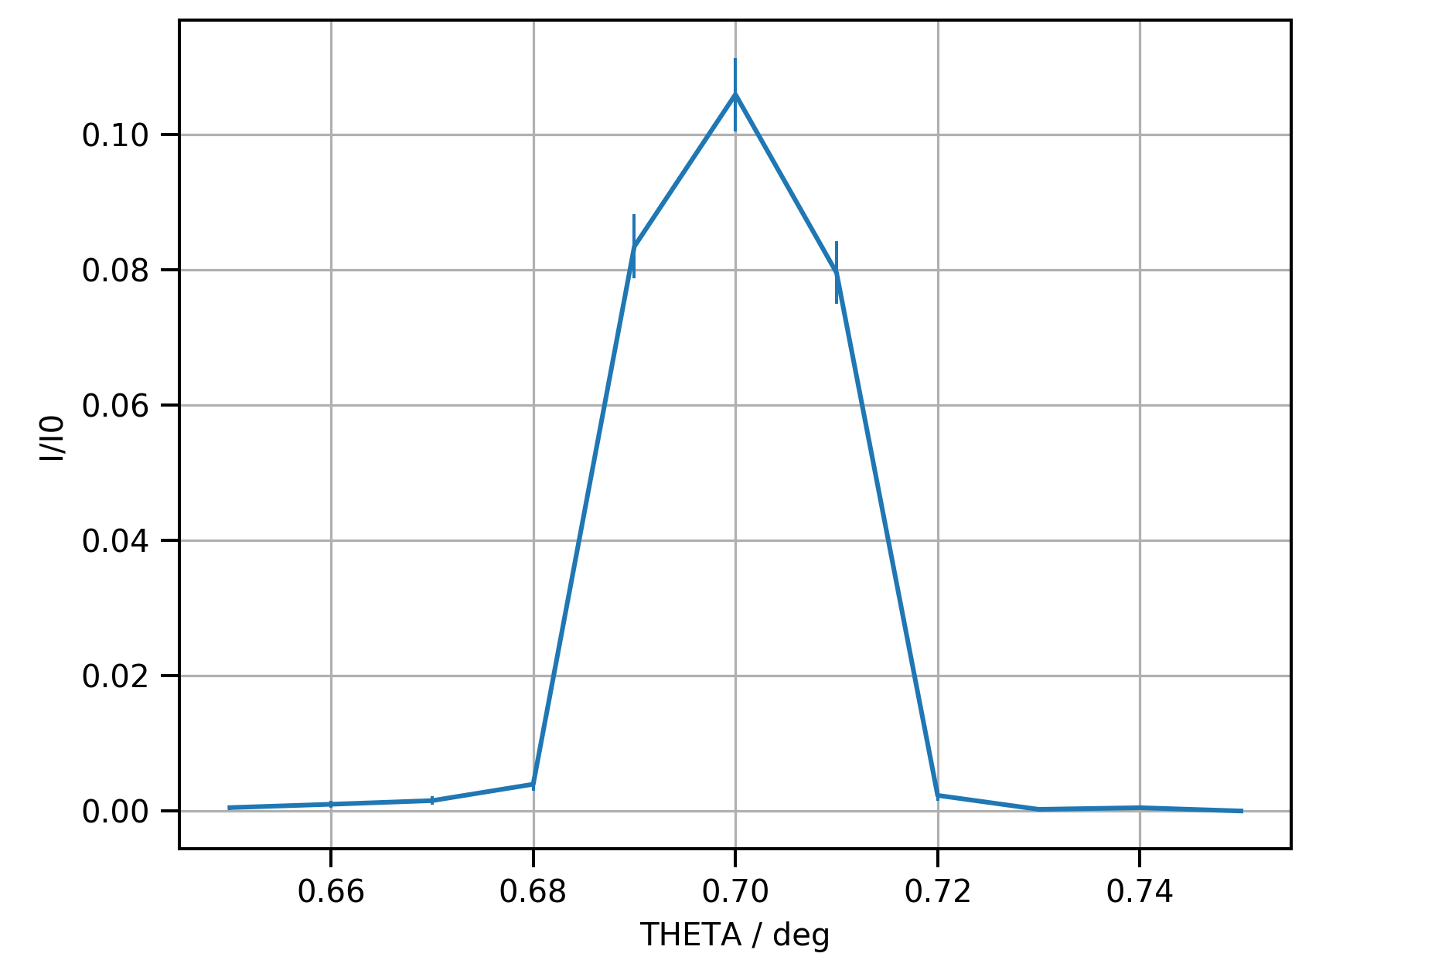
theta (detector) scan
symmetric theta scan around theta=0.7° (phi=0.762°)
> scan theta 0.65 0.75 10 40
detector
sample
S2
S1

Slide 14
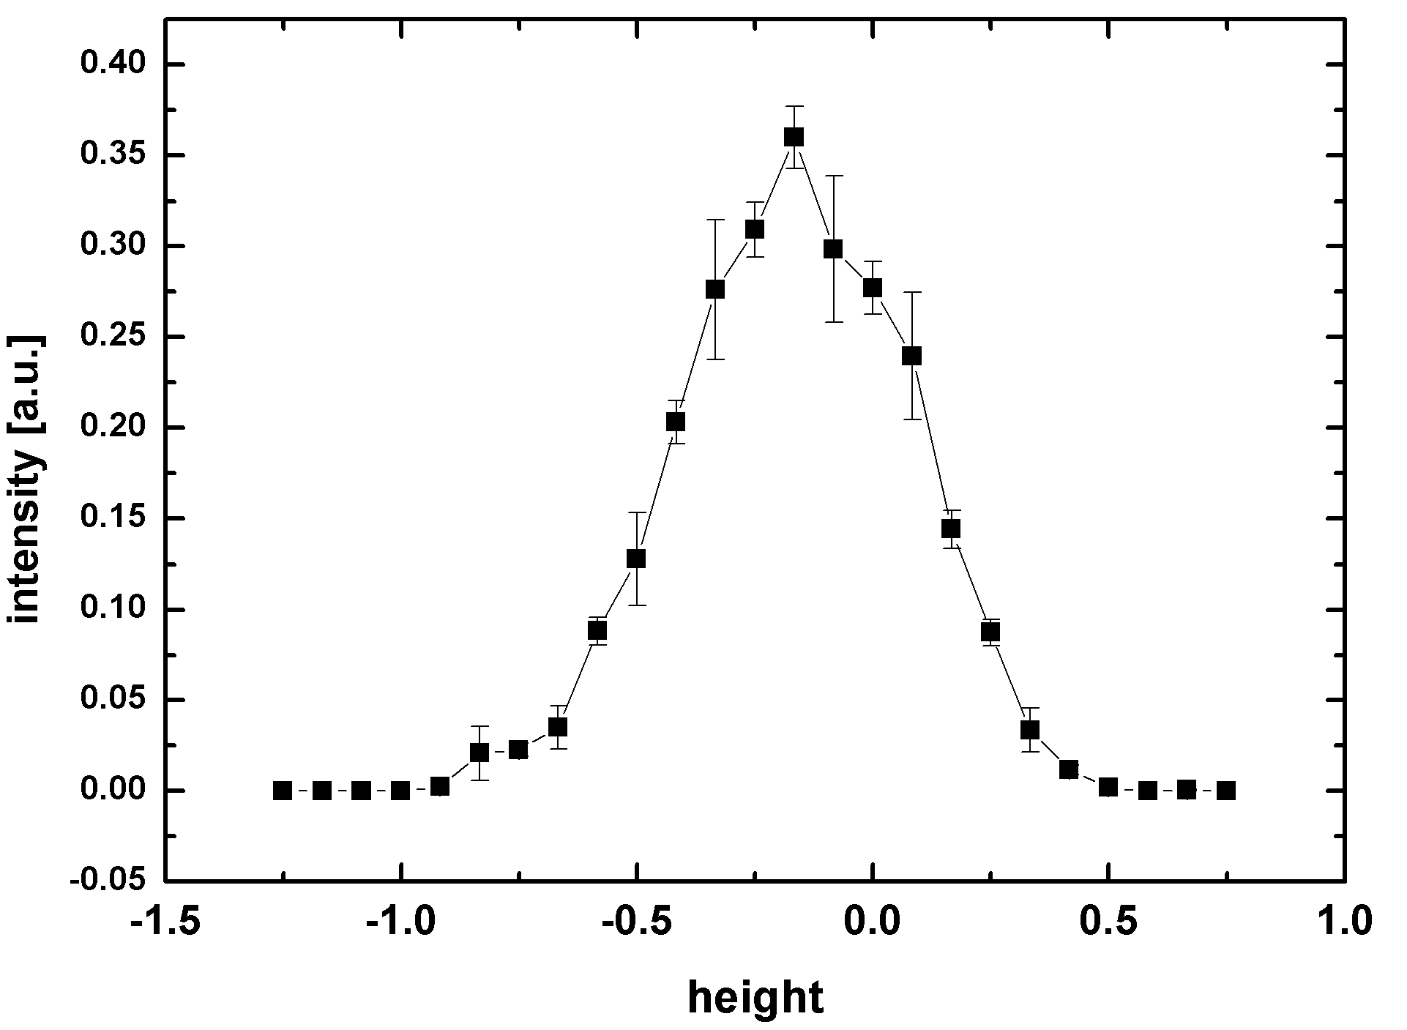
height scan II
height scan with theta=0.7° and phi=0.762°)
> scan height -1.25 0.75 25 200
detector
sample
S2
S1

Slide 15
Questions?

Slide 16

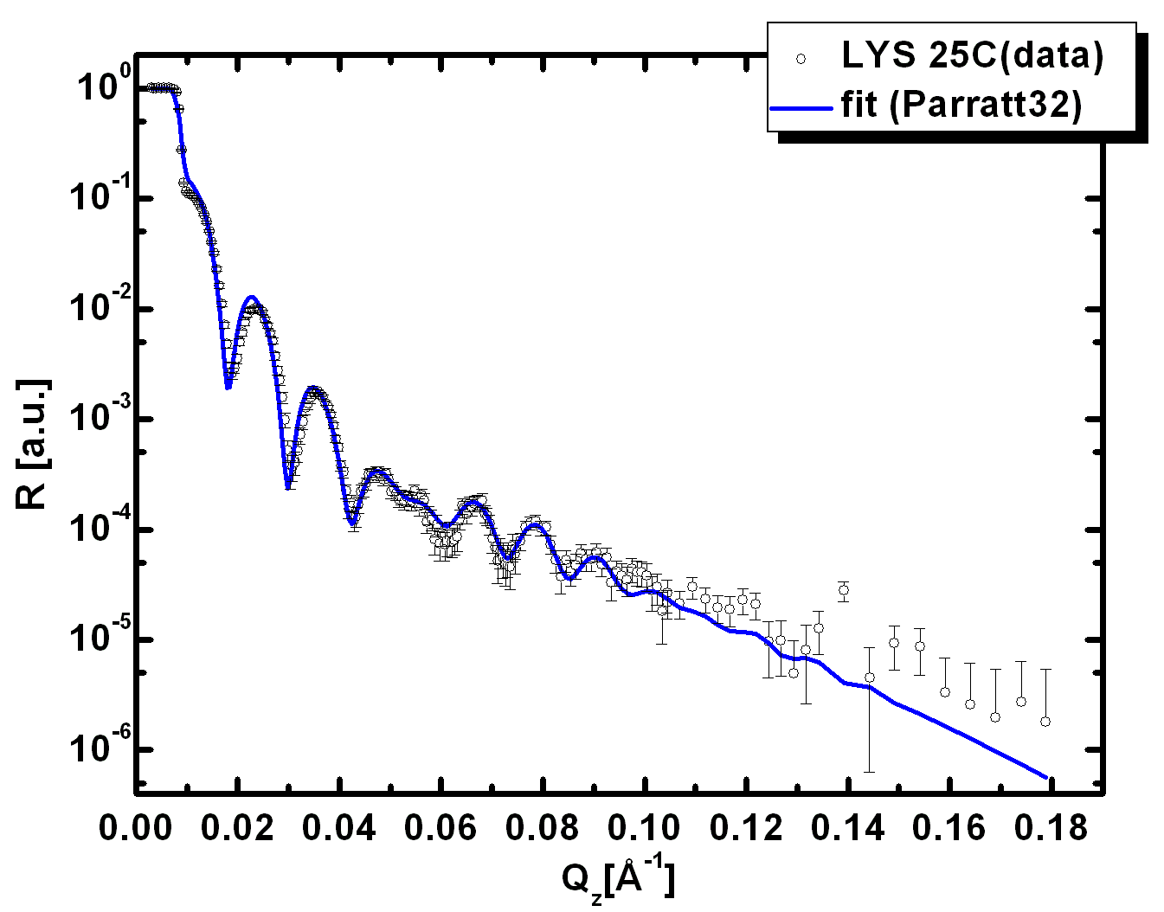
Detection Principle
layers of different scattering length densities (SLD),
i.e. different ‘refractive index’ for neutrons
SLD
courtesy of www.ill.fr
He detector
sample parameters:
contrast adjustment
by deuteration
neutron ‘wave’
δ
interfacial roughness
SLD
quartz
θ
θ
SLD1
Cr
Au
Q spacing of fringes
=>
layer thicknesses
SAM
D₂O/protein solution
SLD2 > SLD1
z

