Slide 1
X-ray Reflectometry - all you need to know
(at least for now)
Philip Mousley
Data analysis scientist: surfaces and structures beamlines
(I05, I07, B07, I09)

Slide 2
Outline
Similarities to neutrons
Differences to neutrons
Details on I07
Case studies x-ray reflectometry

Slide 3

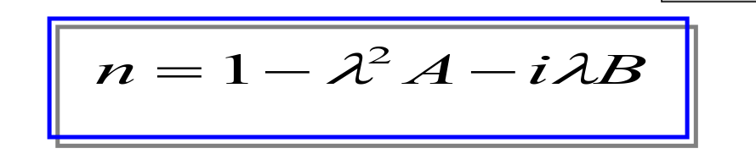
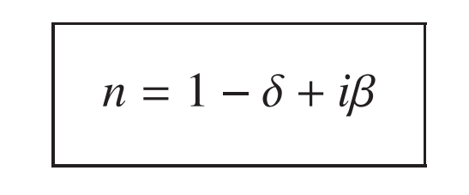
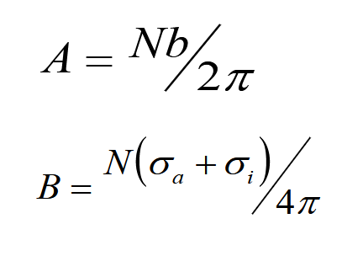
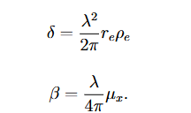
Similarities to neutrons
density
Refractive index
absorption
neutrons
X-rays

Slide 4
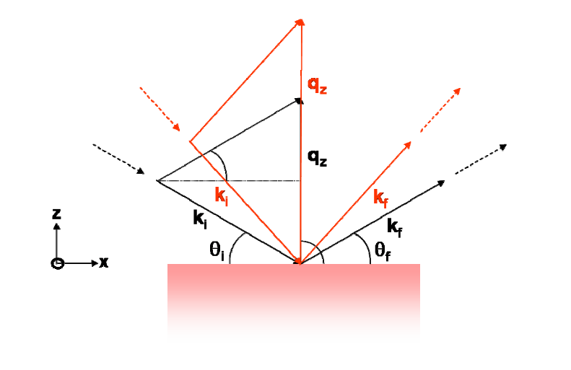

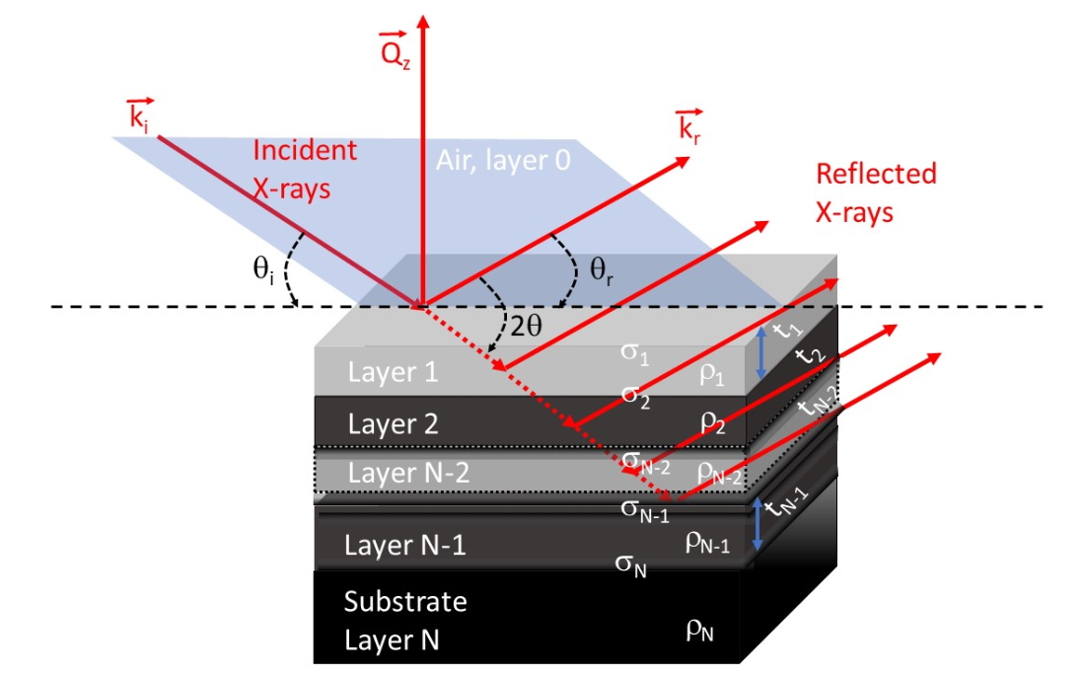
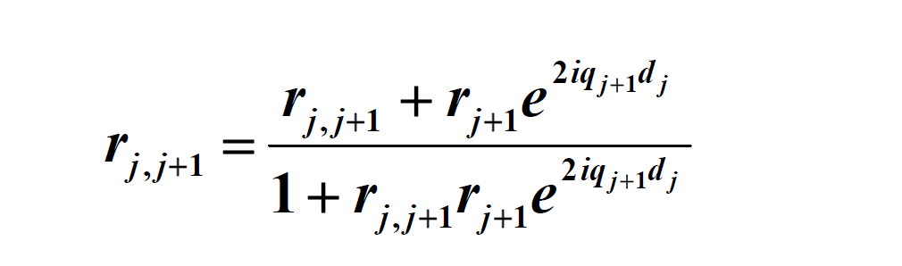
Similarities to neutrons
Q vector calculation
Multi-layer formalisms (Parrat , Abeles)

Slide 5
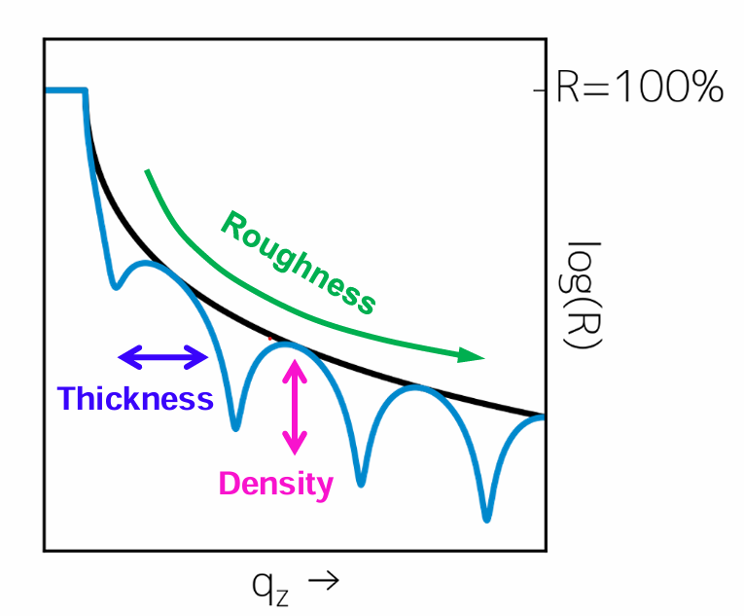
Differences to neutrons
Neutrons: interact with atomic nuclei, probing effectively the average mass density profile
X-rays: interact with electronic charge, probing effectively the total electron density profile
Interacts more with sample
  Penetrates less into surface, better suited to thinner samples
  Possible beam damage
Mostly coherent elastic scattering – much lower incoherent background, increased signal-to-noise ratio
X-rays have higher flux
  Smaller samples can be used
  Quicker measurements - growth dynamic measurements
  Larger Q range – drop off proportional to Q^4, – improved accuracy for thickness and roughness

Slide 6
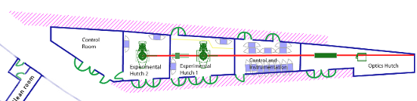
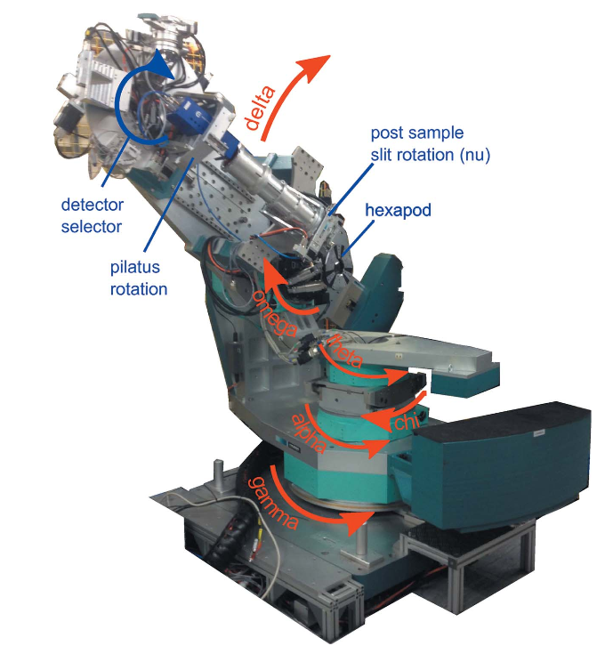
Diamond I07 beamline
EH2
EH1
X-ray beam
https://journals.iucr.org/s/issues/2016/05/00/vv5140/index.html
Hard x-ray (8-30 keV)
Diffractometer allows both horizontal and vertical geometry
Reflection geometry allows study of thin films and surfaces.
Small sample volume requires intense synchrotron x-rays
Diamond only facility in UK
Range of sample environments possible – UHV, liquids, high gas pressures or buried solid–solid interfaces

Slide 7
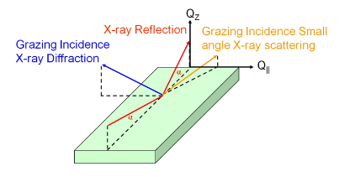
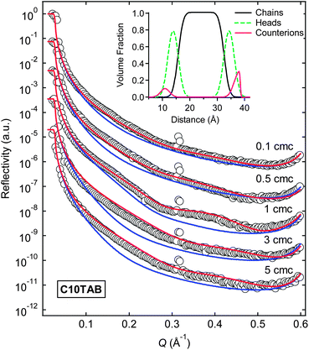
Diamond I07 beamline
Soft Matter, 2013,9, 7028-7041
DOI - 10.1039/C3SM50336D
X-ray Reflectivity – symmetrical diffraction:
  Layer thickness
  Scattering length density distribution
  Interface and surface roughness

Slide 8
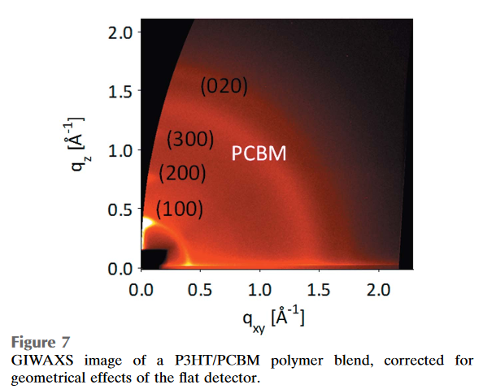
Diamond I07 beamline
Agostinelli et al (2011). Adv. Funct. Mater. 21, 1701–1708
DOI - 10.1002/adfm.201002076
Grazing incidence small angle x-ray scattering
  Measure shape and size distributions of nanostructures (surfaces and in thin films)
  Interparticle correlations of nanostructures

Slide 9
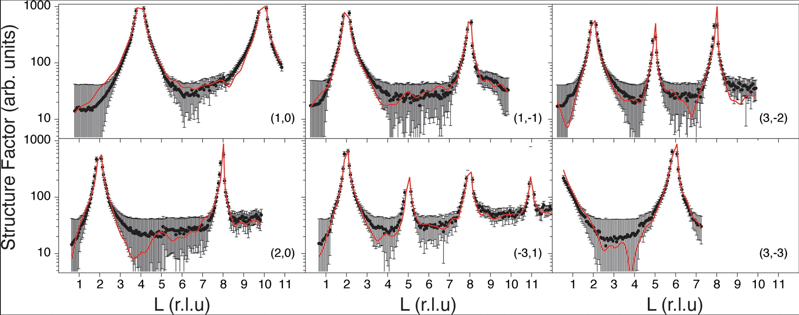
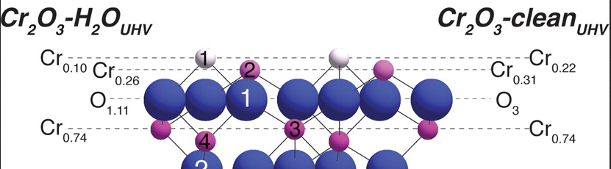
Diamond I07 beamline
J. Phys. Chem. C, 2015, 119 (37), pp 21426–21433
DOI: 10.1021/acs.jpcc.5b04607
Grazing incidence x-ray diffraction
  Measure layer strain and spacings of both in-plane and out-of-plane directions
  Adsorbate sites on surfaces
  Can penetrate sample to investigate solid/liquid interface or buried solid/solid interfaces

Slide 10
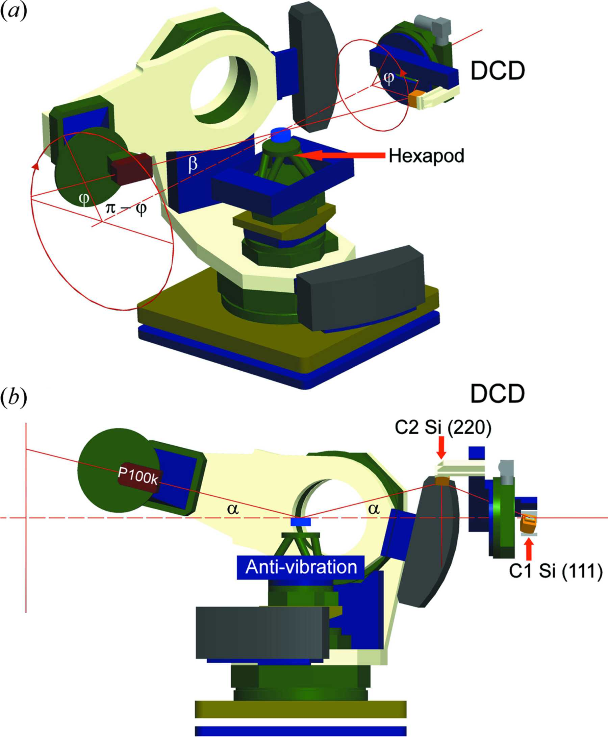
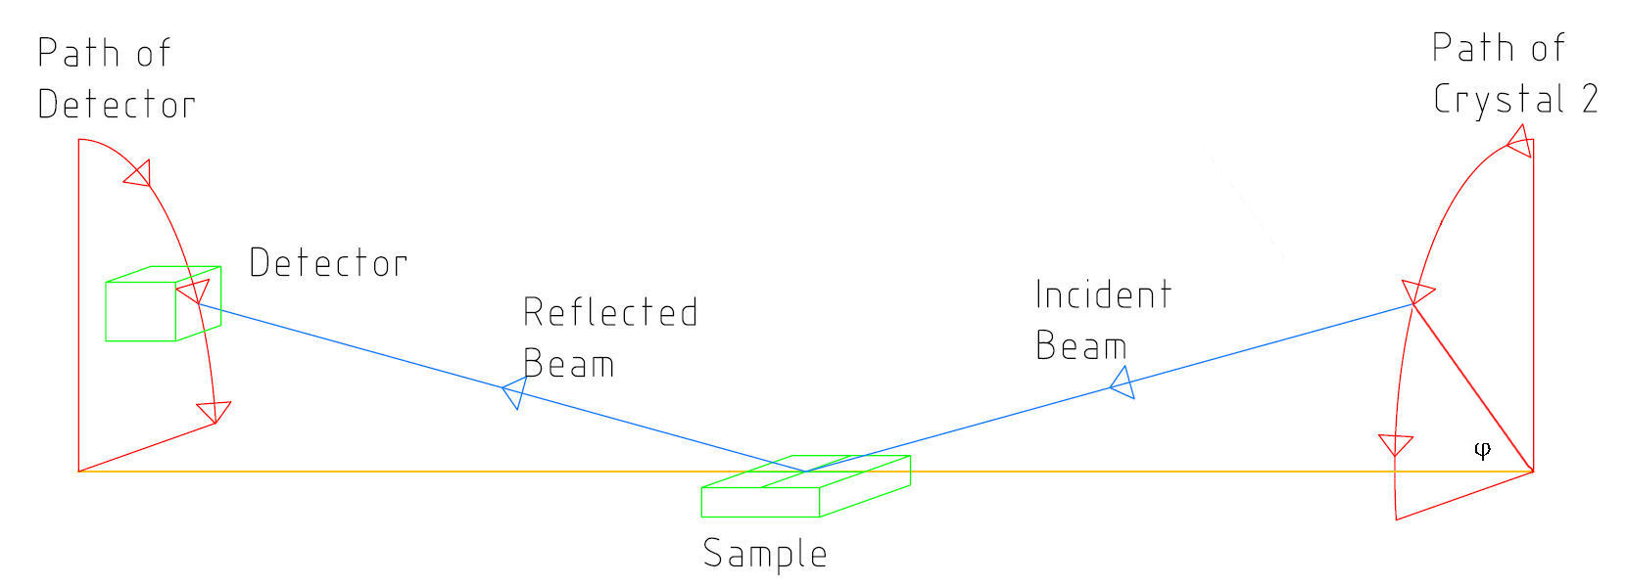
Diamond I07 beamline
Double crystal deflector (DCD)
https://journals.iucr.org/s/issues/2012/03/00/vv5036/index.html
solid
liquid
Detector
X-ray

Slide 11
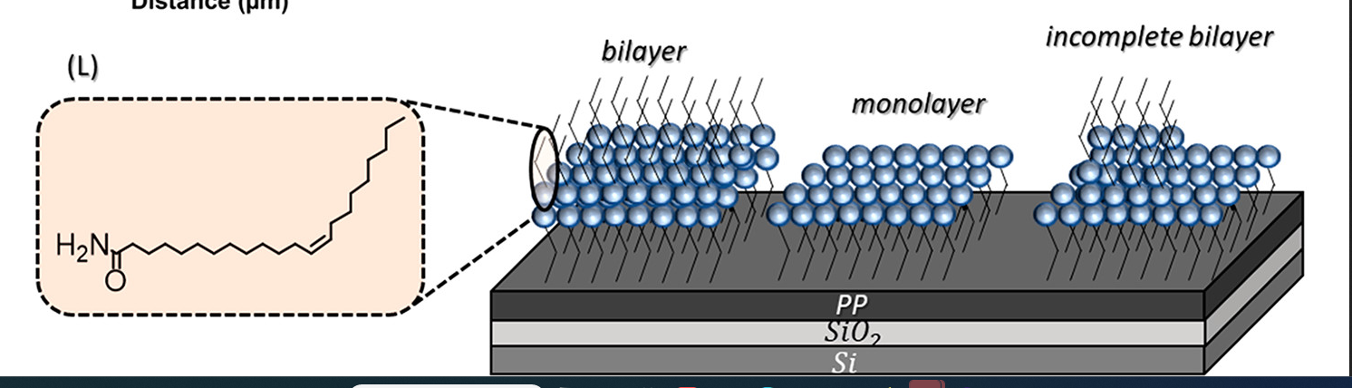
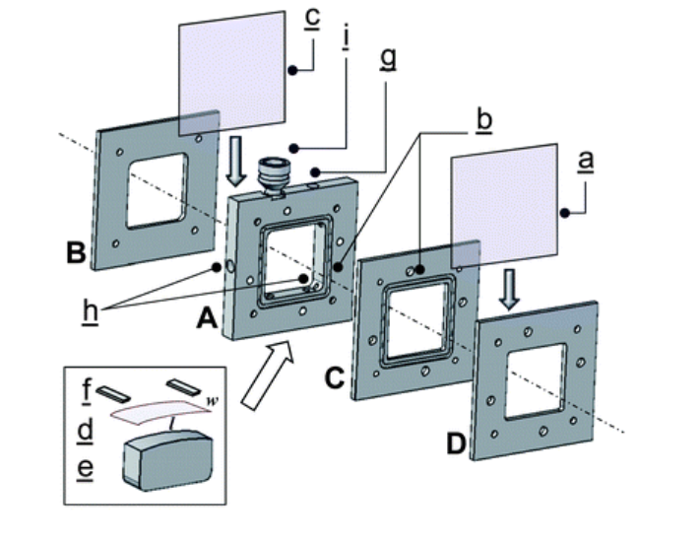
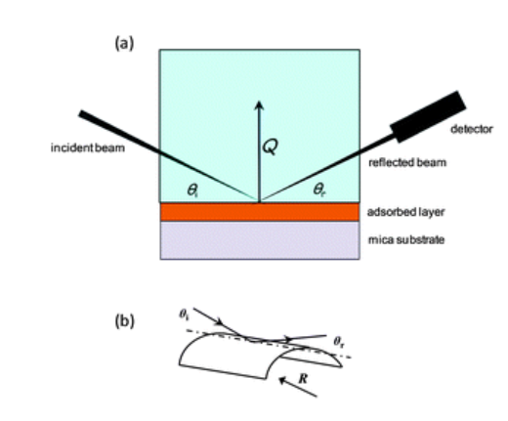
2021 - Gubala et al
Structure, Nanomechanical Properties, and Wettability of Organized Erucamide Layers on a Polypropylene Surface
https://pubs.acs.org/doi/10.1021/acs.langmuir.1c00686
Used a special made XRR cell
https://pubs.rsc.org/en/content/articlelanding/2012/sm/c2sm07179g
Aim: investigate erucamide thin films prepared via spin casting from its nonaqueous solution on more hydrophobic polypropylene-coated silica
Interested in the structure, molecular orientation, and nanomechanical properties of the erucamide multilayers
Techniques: AFM,
quantitative nanomechanical mapping AFM , XRR

Slide 12
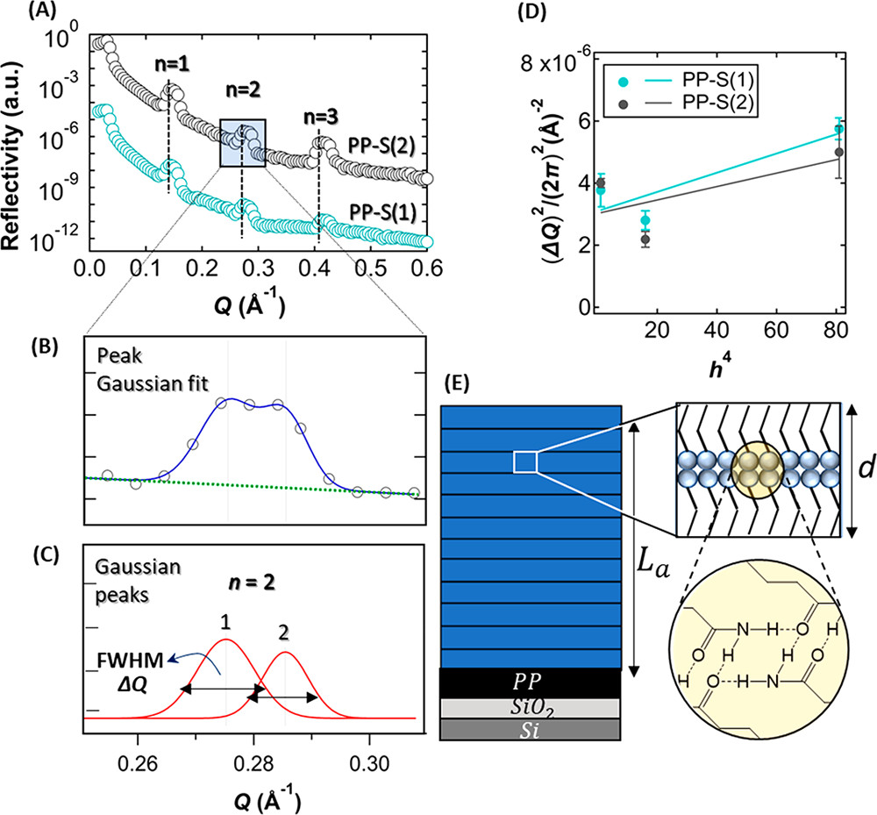
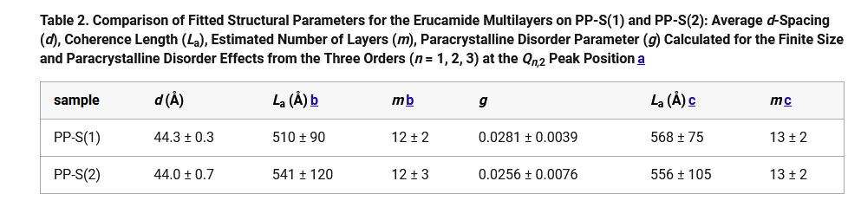
2021 - Gubala et al
Structure, Nanomechanical Properties, and Wettability of Organized Erucamide Layers on a Polypropylene Surface
https://pubs.acs.org/doi/10.1021/acs.langmuir.1c00686

Slide 13
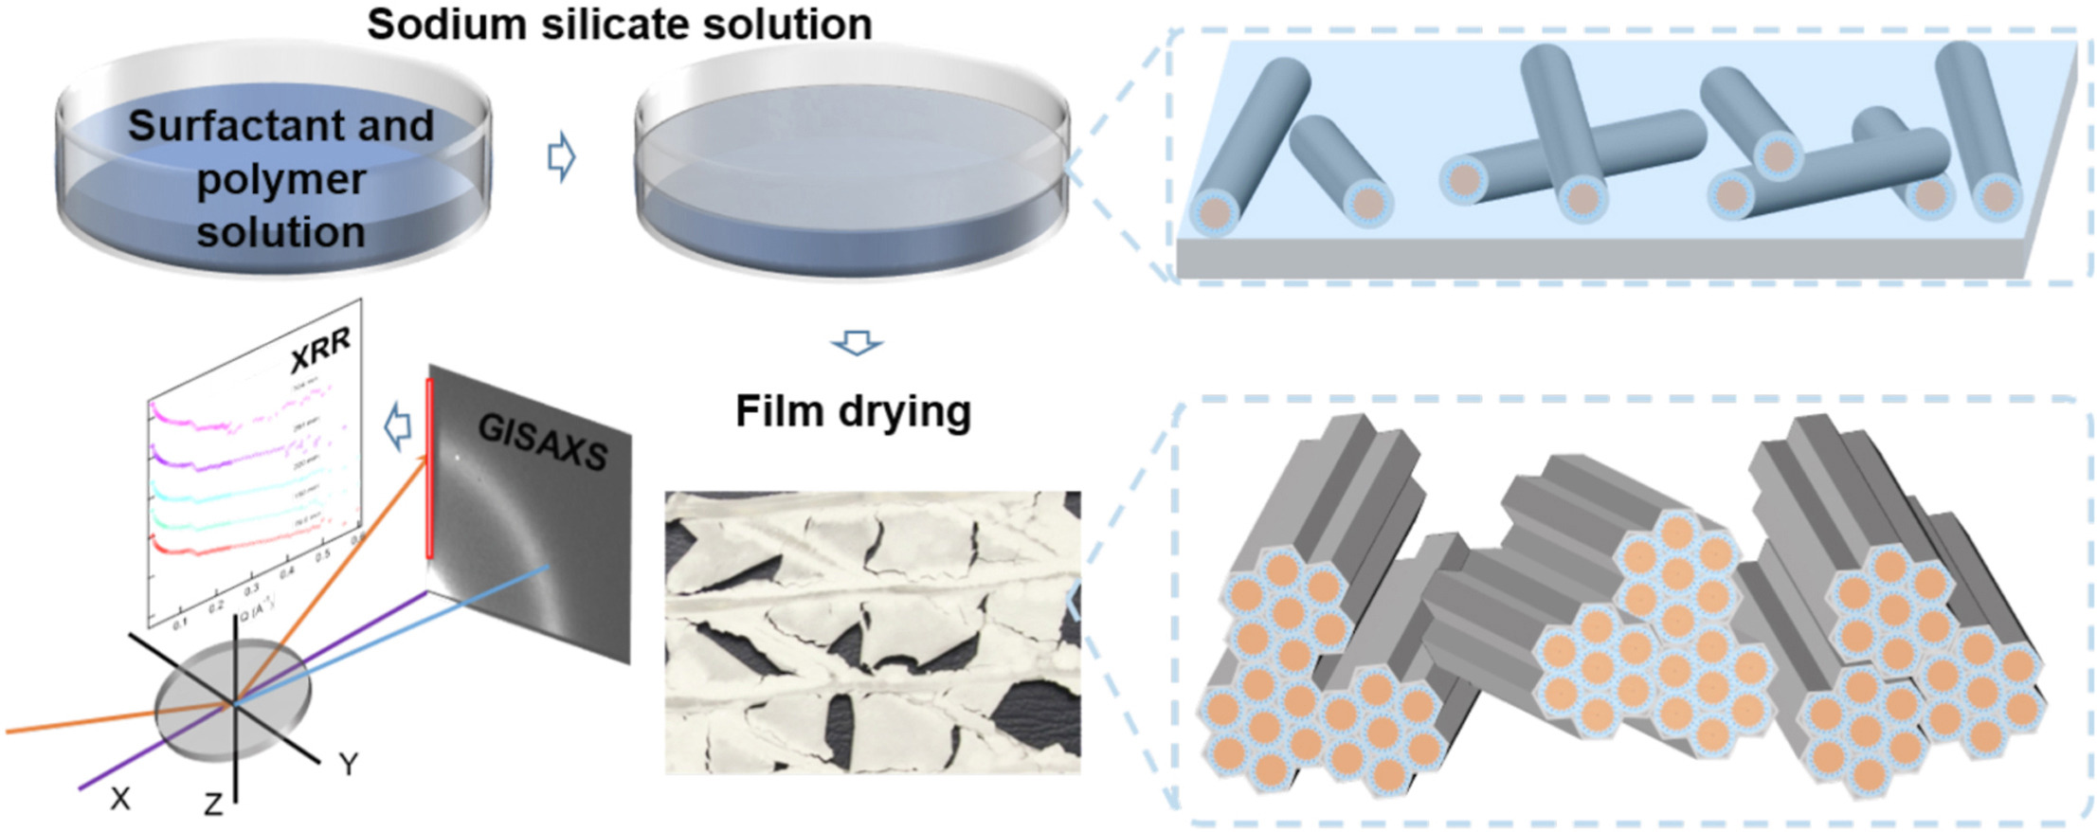
2022 - Di et al
In situ X-ray reflectivity and GISAXS study of mesoporous silica films grown from sodium silicate solution precursors
https://doi.org/10.1016/j.micromeso.2022.112018
Aim: investigate the synthesis of mesoporous silica films using an aqueous Na-silicate as the silica source
Monitoring the evolution of the surface structure, making use of the large electron density contrast between the CTAB-LPEI template and the silica matrix
Techniques: GISAXS, XRR

Slide 14
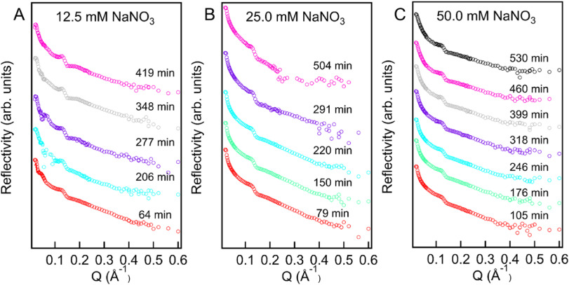
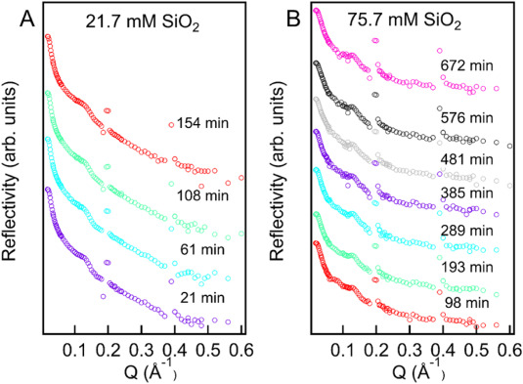
2022 - Di et al
In situ X-ray reflectivity and GISAXS study of mesoporous silica films grown from sodium silicate solution precursors
https://doi.org/10.1016/j.micromeso.2022.112018
X-ray (Diamond I07 , DCD, 12.5 keV)
“A broad secondary reflected peak… (ca. 0.190 Å⁻¹)…evidence of the formation of a wormlike disordered structure along the perpendicular direction to the surface”
No significant variation time period
Lack of (110) peak seen in dry silica

Slide 15
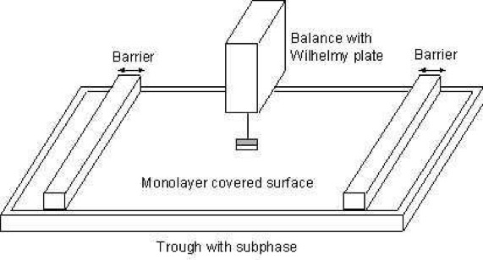
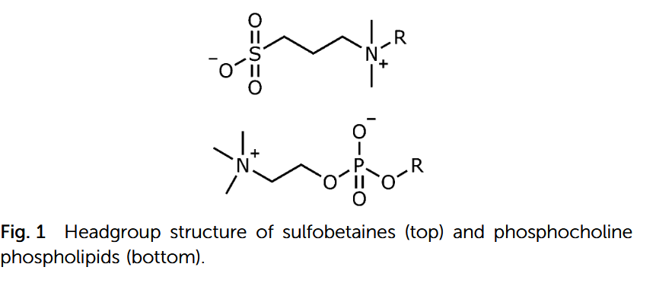
2022 - Elstone et al
Structural investigation of sulfobetaines and phospholipid monolayers at the air–water interface
https://doi.org/10.1039/d2cp02695c
Pressure-area isotherms
Aim: investigate the structure of monolayers at the air–water inter-
face
https://www.nanoscience.com/techniques/langmuir-films/
Techniques: NR,XRR, pressure-area isotherms
“The position of the trough was also shifted horizontally between each measurement to minimise beam damage to the monolayer.”

Slide 16
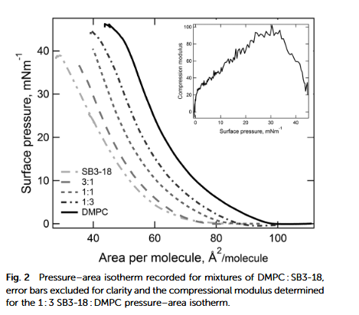
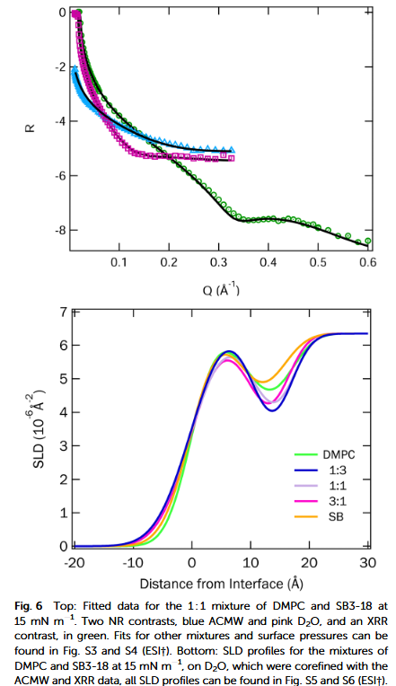
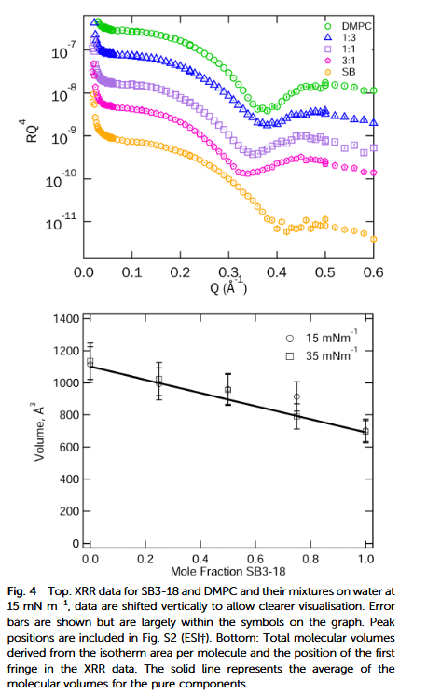
2022 - Elstone et al
Structural investigation of sulfobetaines and phospholipid monolayers at the air–water interface
https://doi.org/10.1039/d2cp02695c
Pressure-area isotherms
Neutron- INTER beamline on Target Station 2, ISIS
X-ray (I07 Diamond,
DCD + Langmuir trough)

Slide 17
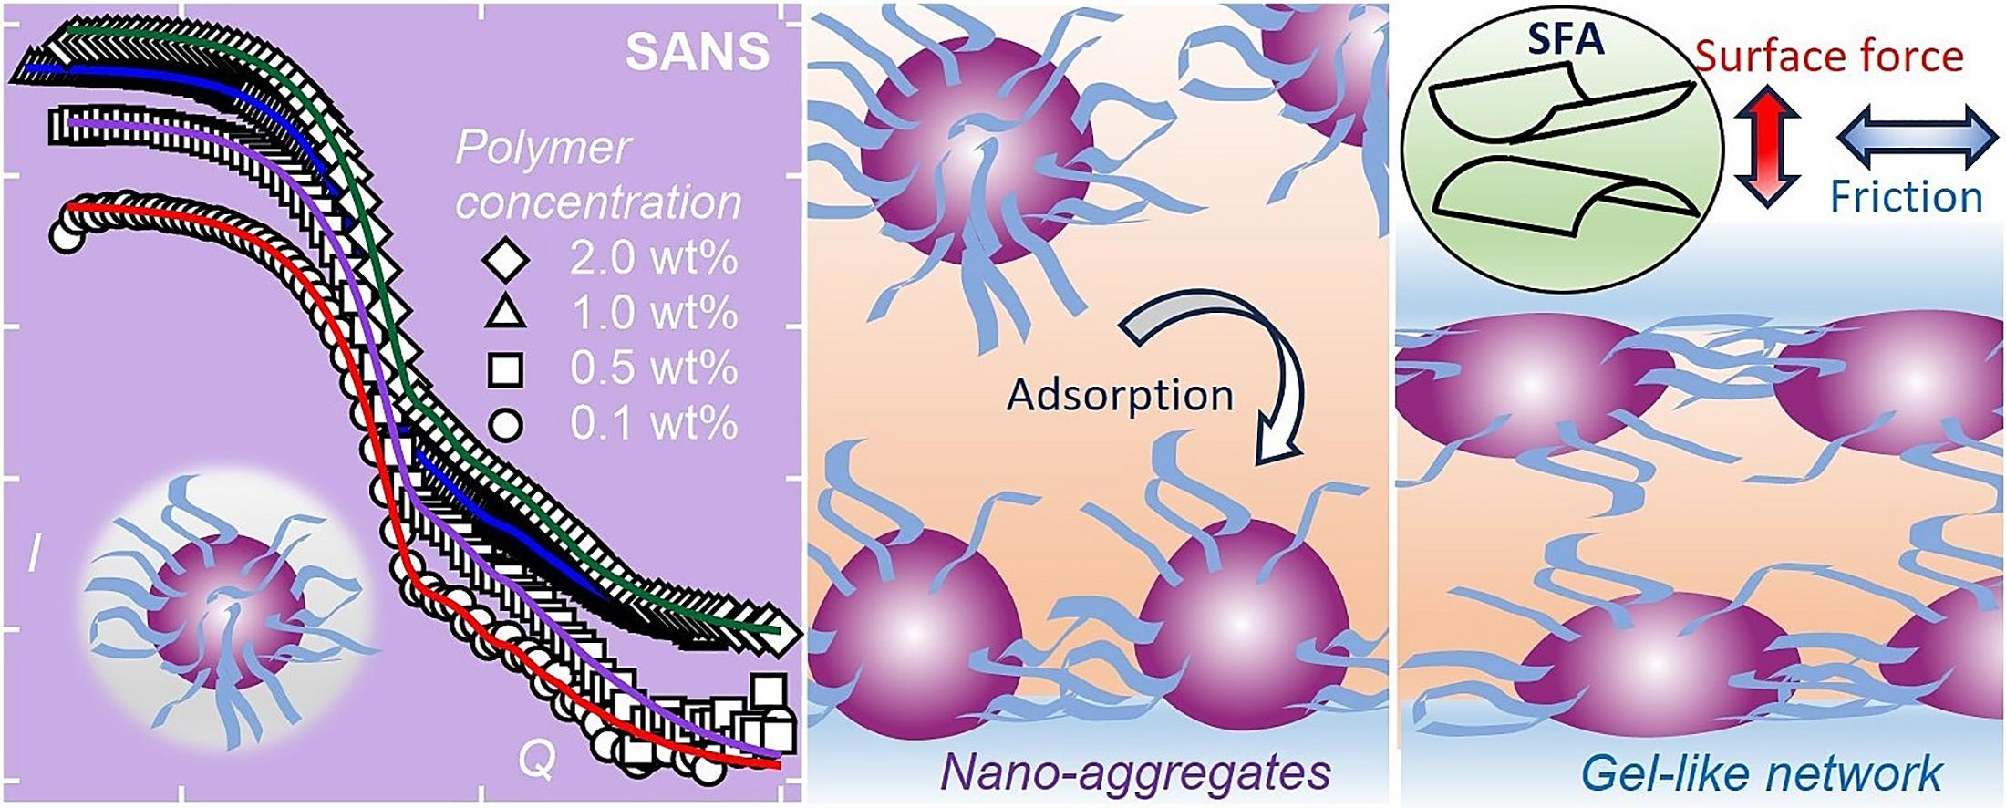
2023 - Stevens et al
Diblock bottlebrush polymer in a non-polar medium: Self-assembly, surface forces, and superlubricity
https://doi.org/10.1016/j.jcis.2023.12.056
Aim: investigate polymer characteristics and friction qualities for lubrication applications
Techniques: SANS, XRR, surface force aparatus

Slide 18
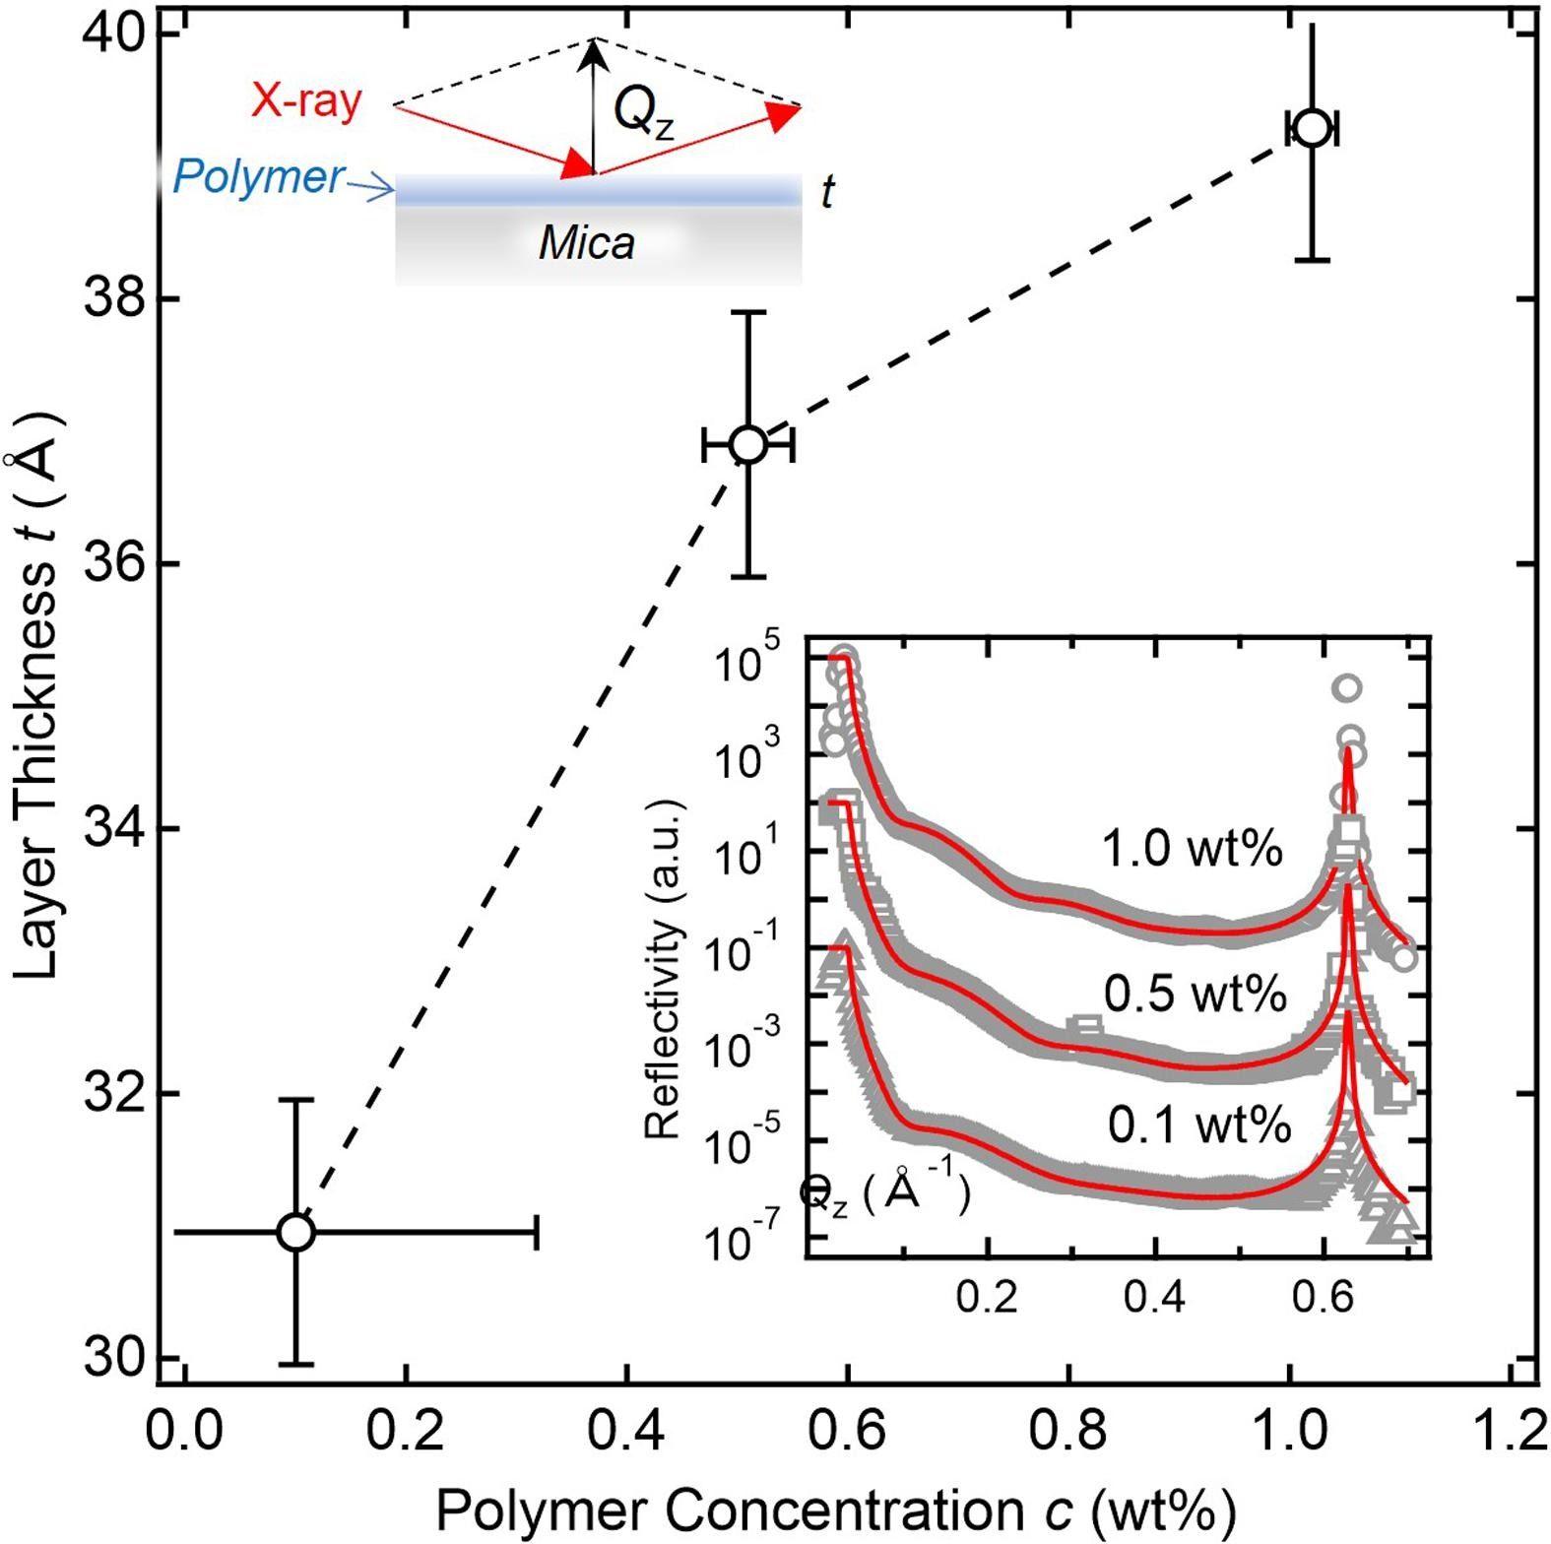
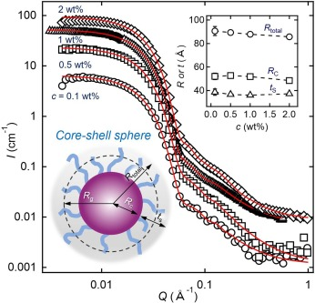
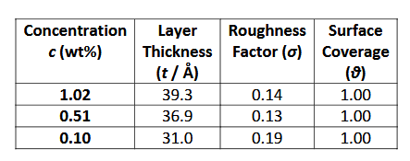
2023 - Stevens et al
Diblock bottlebrush polymer in a non-polar medium: Self-assembly, surface forces, and superlubricity
https://doi.org/10.1016/j.jcis.2023.12.056
X-ray (Diamond I07, 15keV)
polymer layer thickness
Small angle neutron scattering
(SANS2D beamline, ISIS)
- Guinier analysis – self-assembly shape/process
supplementary
“the XRR results, … clearly indicate that polymers adsorbed to mica and
the polymer layer thickness depended on the bulk polymer concentration”

Slide 19
References
[1] BOOK - Elements of Modern X-ray Physics - Jens Als-Nielsen, Des McMorrow
[2] https://www-ssrl.slac.stanford.edu/conferences/workshops/xrs2016/documents/hgs_sxr2016_sxrd.pdf
[3] https://www.psi.ch/sites/default/files/import/sinq/amor/ManualsEN/Zuoz2006.pdf
[4] https://neutrons.ornl.gov/sites/default/files/beamline_04A_xray_neutron_reflectivity_tutorial.pdf
[5] https://www.reflectometry.org/
https://www.diamond.ac.uk/Instruments/Structures-and-Surfaces/I07.html

