Slide 1
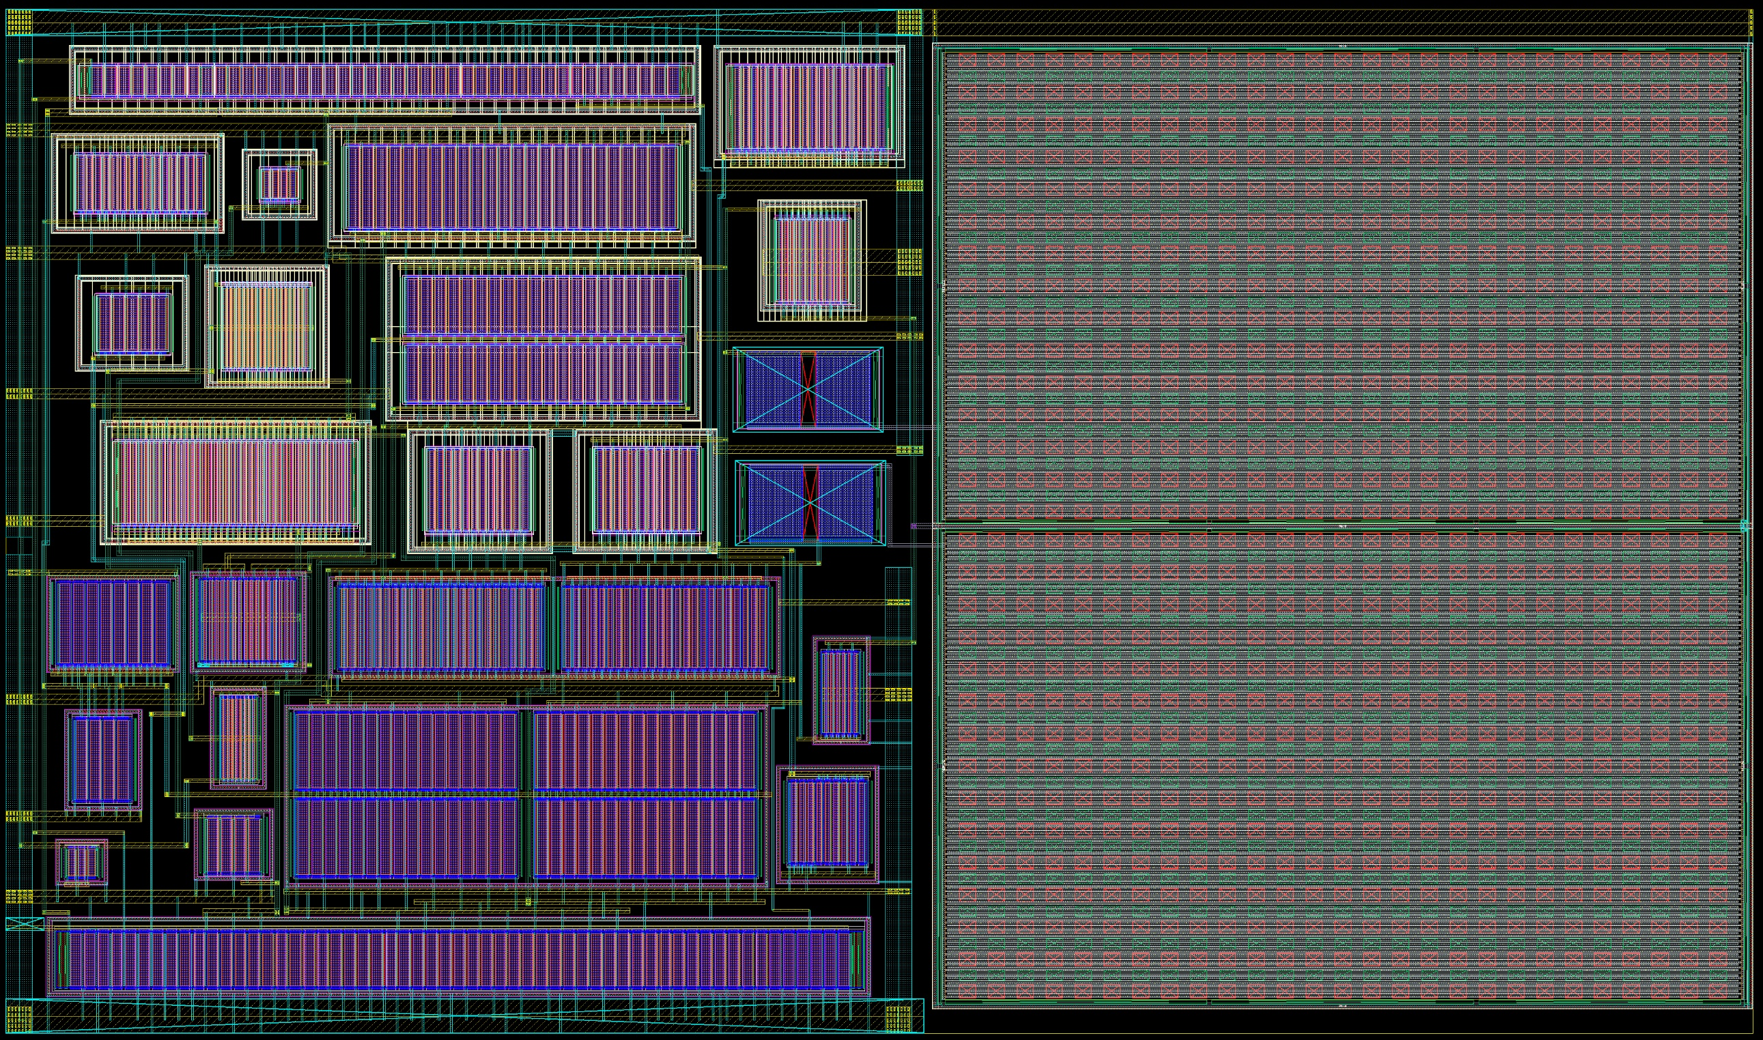
28nm IP Development
WP3 DAQ and services
Mark Prydderch
RAL ASIC Design Group

Slide 2
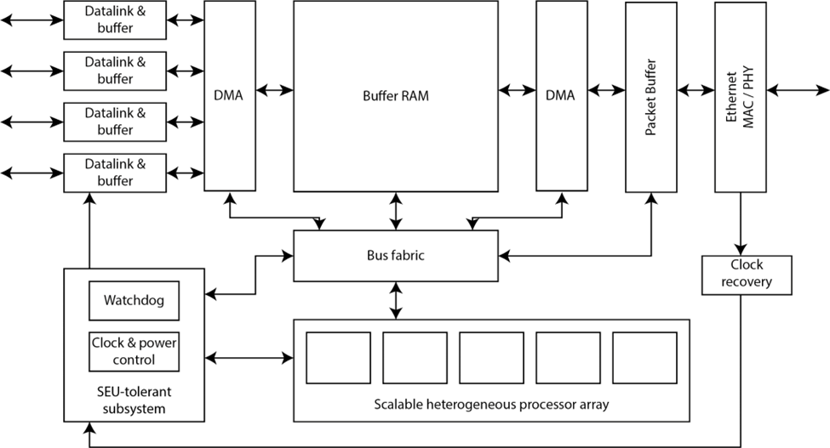
EoI to DRD7: Common interface ASIC for detector readout, timing, and control

Slide 3
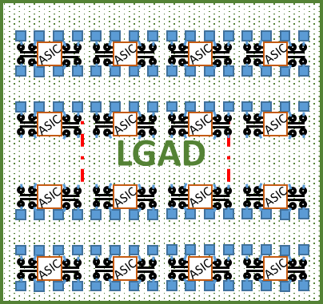
EoI Work Packages:
Definition of requirements
Emulation and architectural studies
Datalinks & Ethernet ← Area for IP development with links to other DRD7 activities
Clock recovery and timing distribution ← Area for IP development with links to other DRD7 activities
Processor cores and Memory ← Area for IP development with links to other DRD7 activities
ASIC Assembly and Configurability
Software tool chain for cores
Back-end software libraries and test software
ASIC SoC Verification
Hardware Testing
Total effort estimate for whole project: 50-75 staff-years or between 10 and 15 people active over 5 years.
28nm for LGAD:
Currently exploring benefits of 28nm for LGADs and timing
FE for large pixel (>1mm) LGADs
Targeting 20ps resolution or better
Continue development and possibly scale up or target different pixel sizes

