Slide 1
DRD7
Marcus French
Detector & Electronics Division
UKRI STFC, RAL

Slide 2
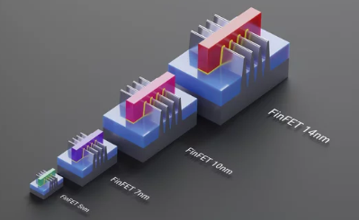
DRD7 – Purpose and activities
Purpose
Advance the state-of-the-art in performance and deliverability of detector electronics and data processing
Build expertise, improve and develop further common standards, methodologies, and IP for implementation of electronic and data processing systems
Increase efficiency and decrease duplication of effort in detector electronics development
Provide facilities and tools for R&D in the community, with long-term continuity.
Activities
Oversee, drive and coordinate strategic R&D in electronics for particle physics
Support and maintain an active and well connected R&D community
Promote and maintain a connection between the developers and users of future electronic systems
Coordinate cross-European access to technologies, tools, and knowledge
Interface with other DRDs in areas of common interest, undertaking joint projects

Slide 3
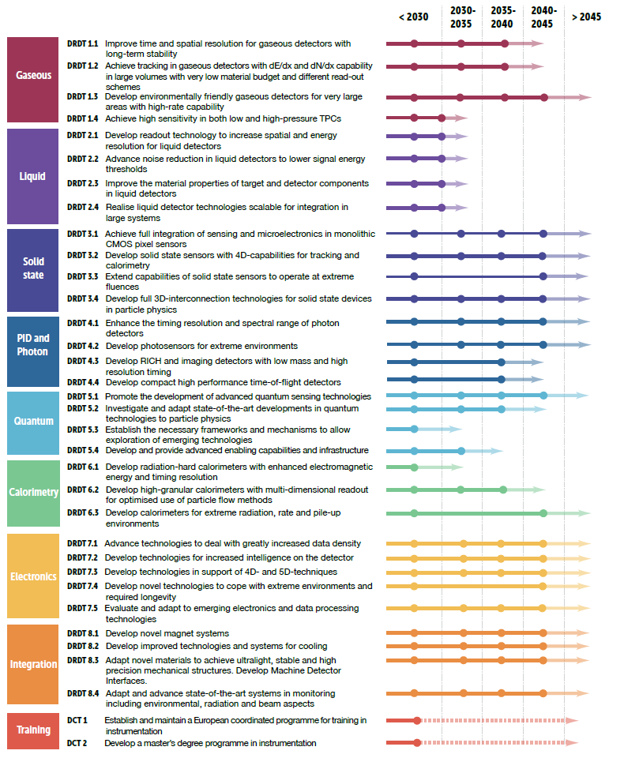
DRD7 – Wide engagement – Responsibility Sharing
WG 7.1: Data density and power efficiency
Szymon Kulis (CERN), Jeffrey Prinzie (KU Leuven), Jan Troska (CERN)
High data-rate ASICs and systems
New link technologies, including silicon photonics technology
Power conversion and efficiency optimisation
WG 7.2: Intelligence on the detector
Davide Ceresa (CERN), Francesco Crescioli (IN2P3-LPNHE), Frédéric Magniette (IN2P3-LLR)
Front-end programmability and modular design
Intelligent power management
Advanced data reduction techniques
WG 7.3: 4D and 5D techniques
Sophie Baron (CERN), Marek Idzik (AGH-Kracow), Adriano Lai (INFN-Cagliari)
High-performance sampling
High-precision timing distribution
Novel on-chip architectures
WG 7.4: Extreme environments
Giulio Borghello (CERN), Oscar Francisco (Uni-Manchester), Manuel Rolo (INFN-Torino)
Cryogenic technology and operation
Thermal management of ASICs
Radiation hardness
WG 7.5: Backend systems and COTS
Conor Fitzpatrick (Uni Manchester), Niko Neufeld (CERN), NN
Use and adaptation of advanced COTS technologies
Real-time software and firmware development
System-level control and readout
WG 7.6: Complex imaging ASICs and technologies
Marlon Barbero (IN2P3-CPPM), Michele Caselle (KIT), Iain Sedgwick (RAL), Walter Snoeys (CERN)
Common access framework to selected imaging technologies
Common IP for imaging ASICs
3D integration and interconnects
WG 7.7: Tools and technologies
Kostas Kloukinas (CERN), Xavi Llopart (CERN), Mark Willoughby (RAL)
Access and support to qualified technologies and tools
Investigation of emerging microelectronics technologies
Support and training for device and systems development and verification
Common IP and design reuse
DRD7: A broad range of topics in electronics

Slide 4
DRD7 – Key Dates
Step 1a (Mar – Jun 2023): convenors
Step 1b (Mar – Jul 2023): technical committee
Step 2 (July – Aug 2023): Letter of Intent
Step 3 (Sep – Oct 2023): second DRD7 workshop
Step 4a (Sep – Nov 2023): initial set of projects
Step 4b (Sep – Nov 2023): national communities
Step 5 (Dec 2023): DRD7 Collaboration Proposal
Step 6 (2024 on): Projects start in national communities
seeks expressions of interest in specific projects
defines few initial priority projects with relevant institutes and substantial community interest
defines common plans & interfaces with other DRDs
avoids duplication or omission of work
set DRD7 work plan responding to other DRDs plans
submit to the DRDC
with scope of DRD7 + internal organisation + list of researchers and institutes
to hear detailed proposals for the initial projects
to discuss areas of common interest.
open to both LoI signatories and other institutes seeking to join the effort
take account of feedback from the DRDC
planned and costed in detail
discuss with national funding agencies
define likely participation and resource envelope for the initial projects
submit to the DRDC
includes resource-loaded plans for the initial projects
take into account feedback from the DRDC,
make proposals to their funding agencies
start projects as resources are allocated
=> from 2024 onwards: annual DRD7 workshops

Slide 5
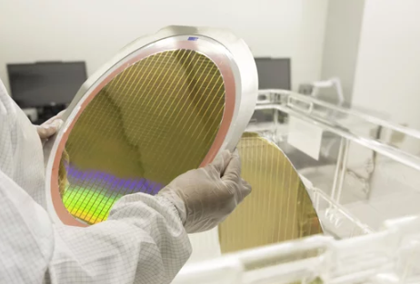
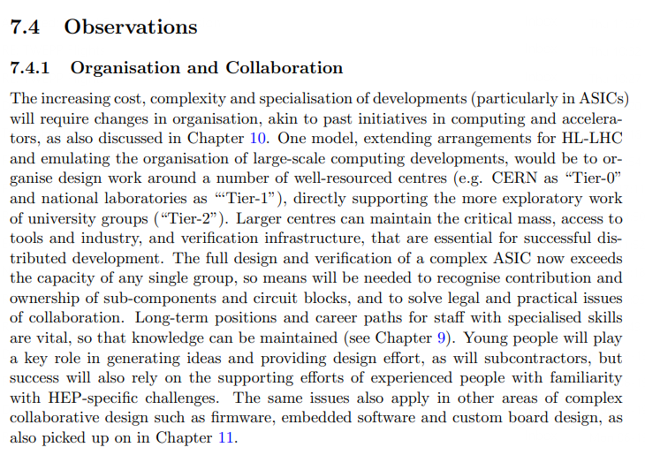
Enabling Technology Access – National strategy
Issues
Wafer runs are now major investments in time and money
Securing access to the technologies we need in an affordable way
Many legal and practical issues with deign sharing and team working
Verification infrastructure, protocol testing, design reviewing, learning from mistakes
Library management, distribution and maintenance
Funding agency assurance
….
We have to have to find ways to combine the strengths of all parties. The tierd structure proposed needs to be fleshed out
– that process is ongoing, please input!

