Slide 1



Radiobiological opportunities with ITRF and LhARA
Professor Jason Parsons
Institute of Cancer and Genomic Sciences
School of Physics and Astronomy

Slide 2
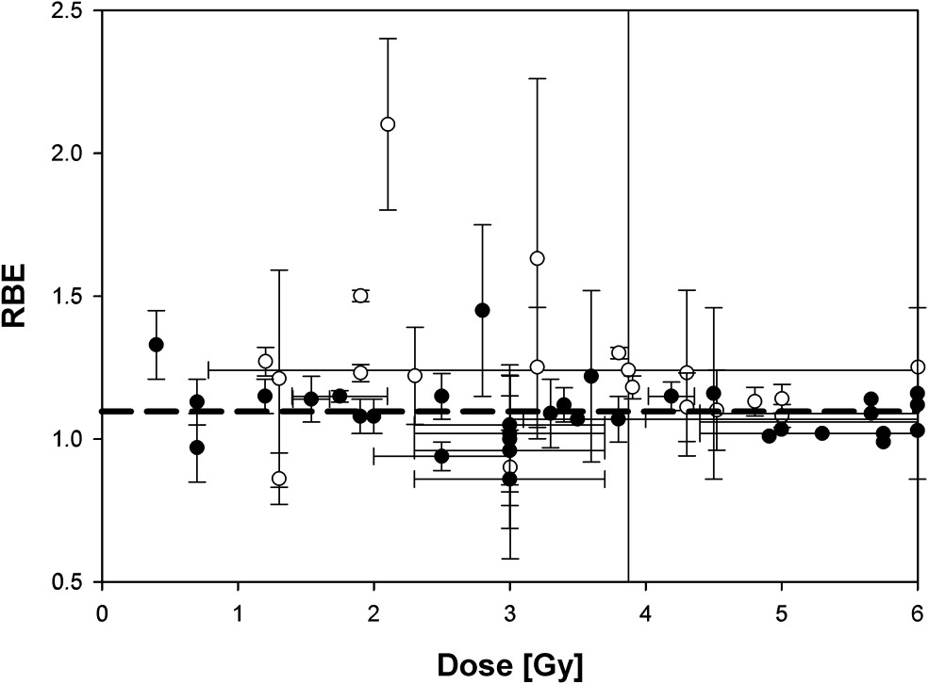
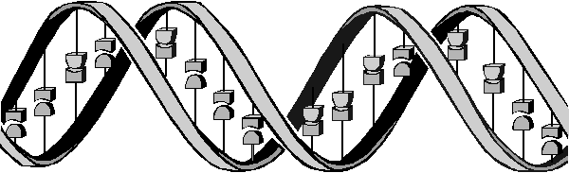
The biological uncertainties following proton beam therapy
Tumour
Bragg peak
-in vitro
-in vivo
X-rays
Distal fall-off
Low-LET radiation tracks
Relative dose
Protons
High-LET radiation tracks
LET (protons)
Depth in tissue
Taken from Paganetti and van Luijk (2013) Sem Rad Oncol
  As the proton energy decreases, the linear energy transfer (LET or ionisation density) increases leading to biological and clinical uncertainty.
  Further research exploiting the biological impact of PBT is vital for establishing biological effectiveness (RBE) and optimal clinical treatment for tumours.
Vitti and Parsons (2019) Cancers

Slide 3
Major research questions/aims
Do photons, protons and other particle ions (with increasing LET), lead to changes in the molecular (DNA) and cellular (survival) profiles, and how do cells respond to this.
Can the effectiveness of photons/protons/particle ions in tumour cell killing be exacerbated using drugs/inhibitors.
What biological factors (e.g. reduced oxygen, hypoxia) influence the radiobiological response.
How do physical factors (e.g. dose rate, FLASH) effect radiotherapy efficacy.

Slide 4
  “Relatively” high-LET protons cause a decrease in HNSCC cell survival due to CDD formation compared to low-LET protons
  UMSCC74A
160
  UMSCC74A
140
*
120
*
100
***
80
Enzyme-modified (DSB+CDD)
60
**
40
****
20
0
CDD
*
  SF2, p<0.02; RBE=1.7
  *p<0.005, **p<0.002, ***p<0.001
***
**
  UMSCC6
120
100
80
60
40
20
0
  *p<0.02, **p<0.01, ***p<0.005, ****p<0.001
  SF2, p<0.01; RBE=1.9
  58 MeV (1 keV/μm); 11 MeV (12 keV/μm)
  Carter et al., (2018) Int J Rad Oncol Biol Phys
  Fabbrizi et al., (2021) Methods Protoc

Slide 5
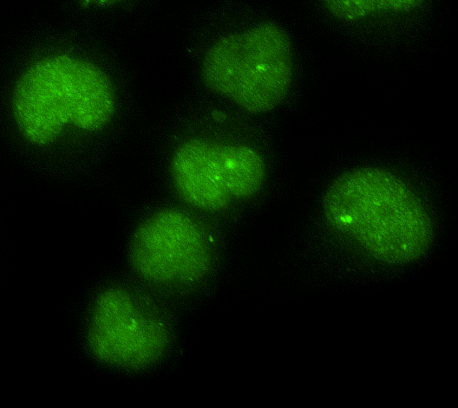
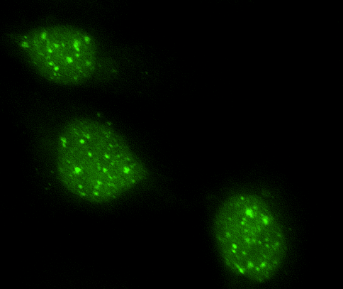
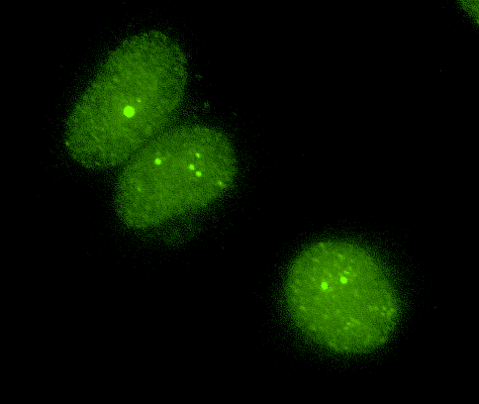
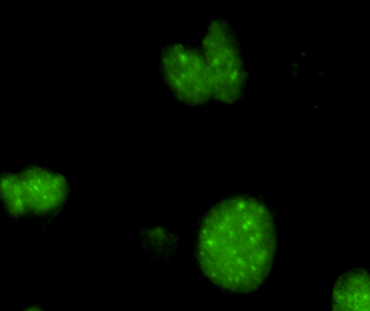
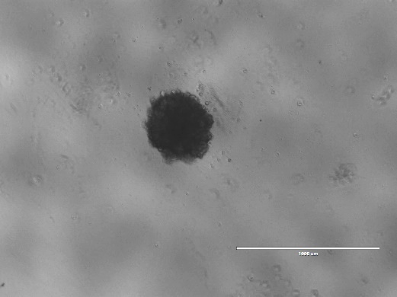
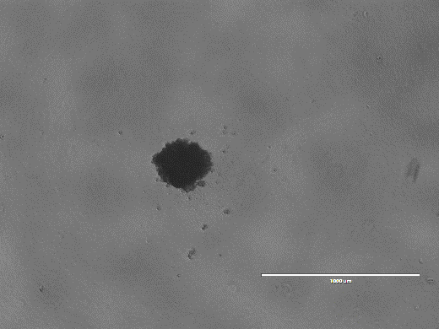
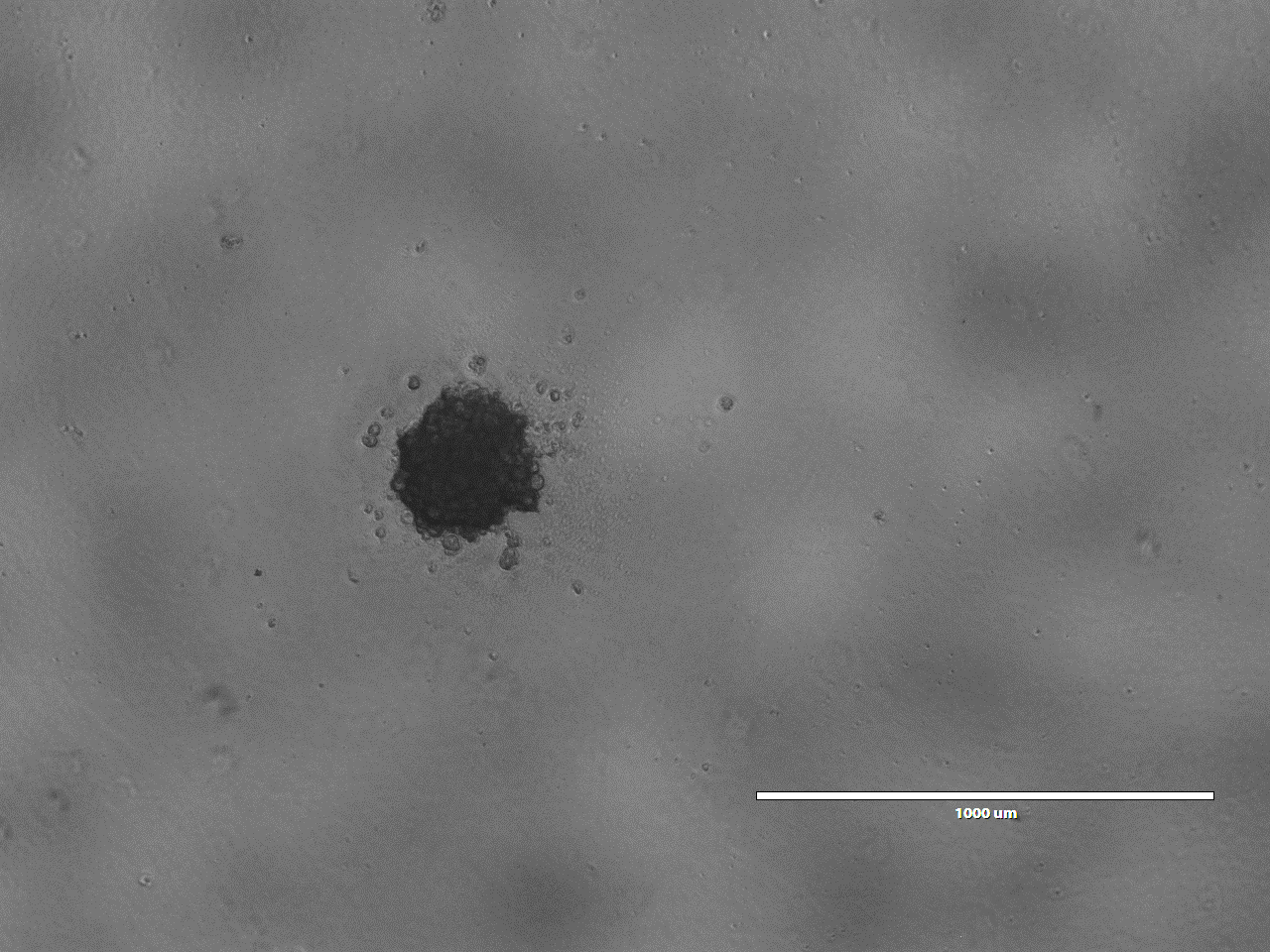
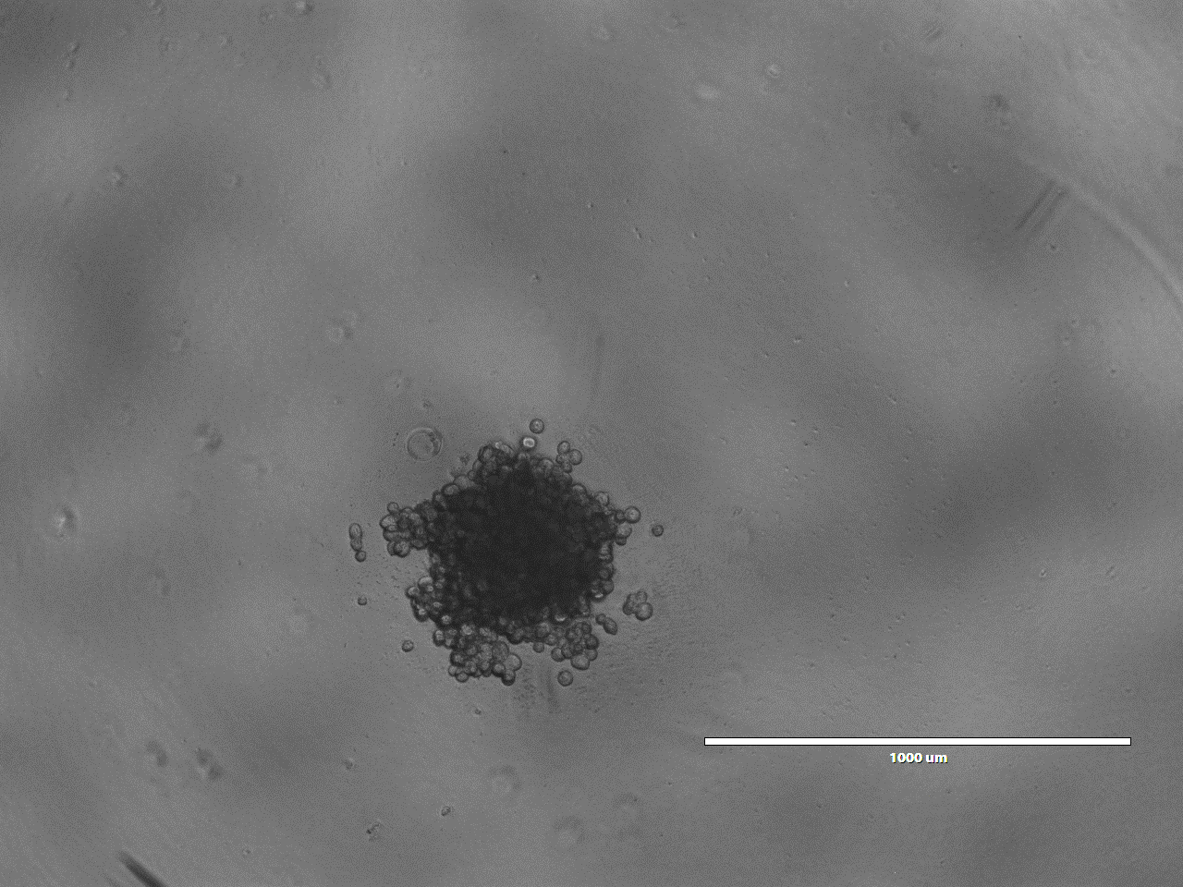
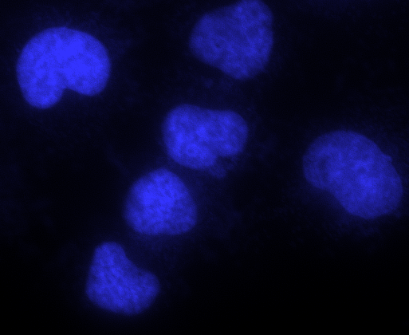
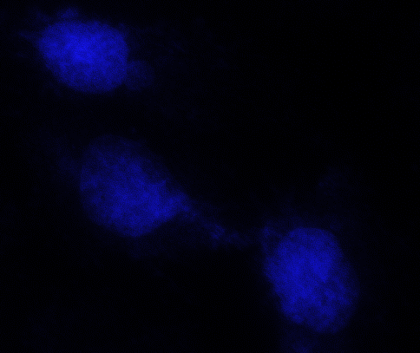
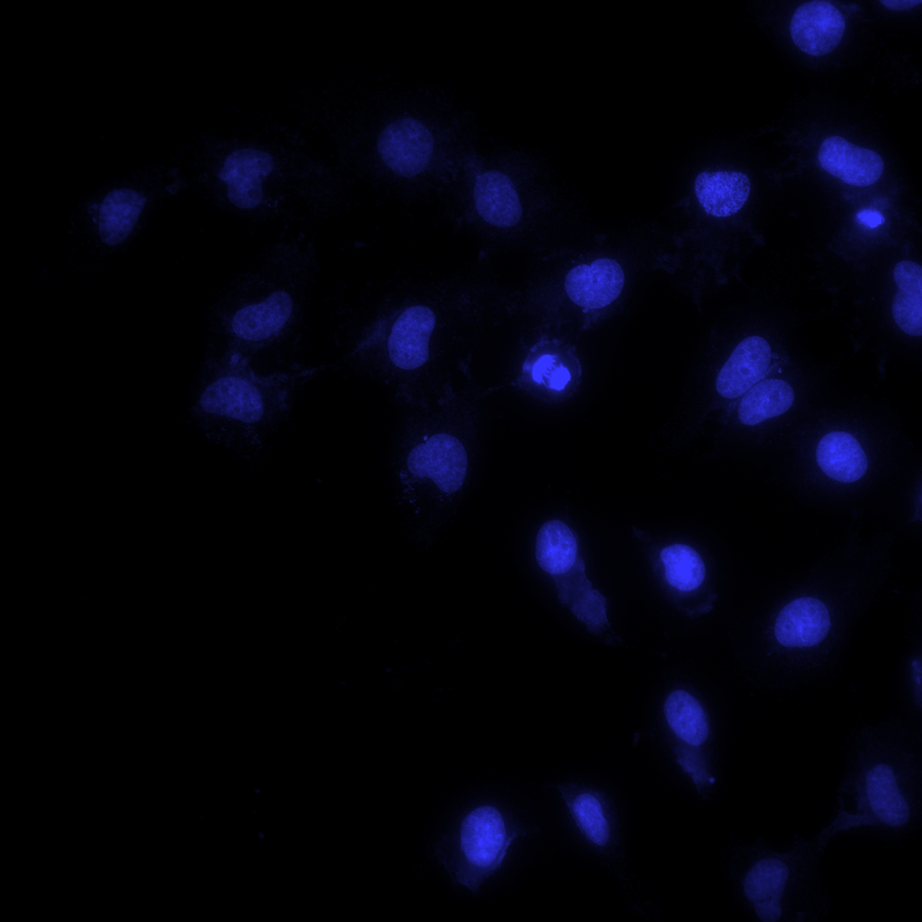
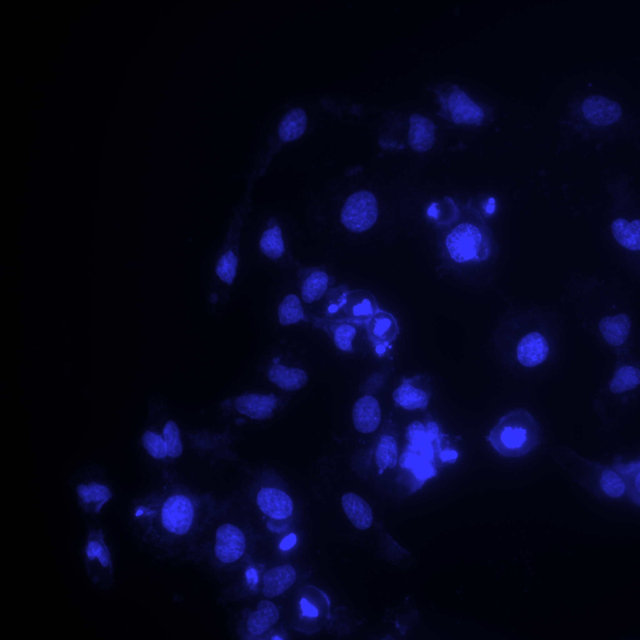
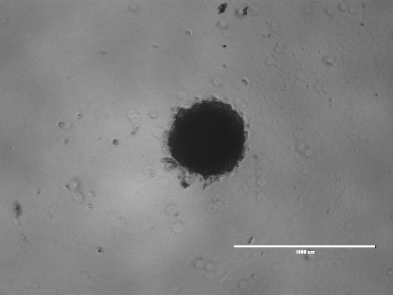
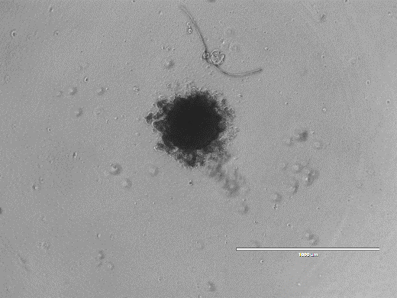
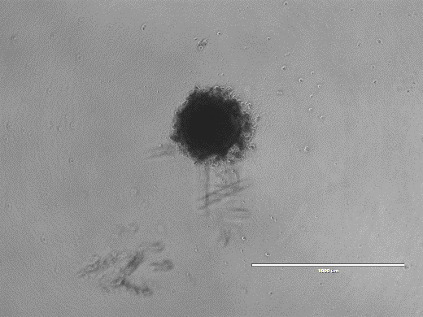
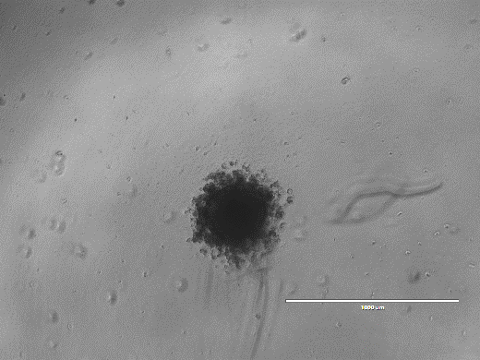
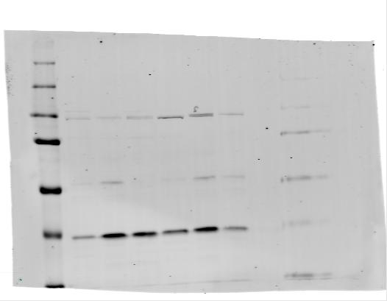
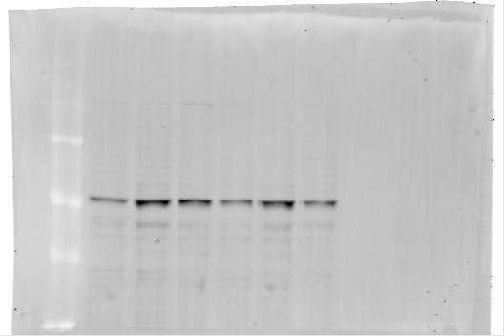
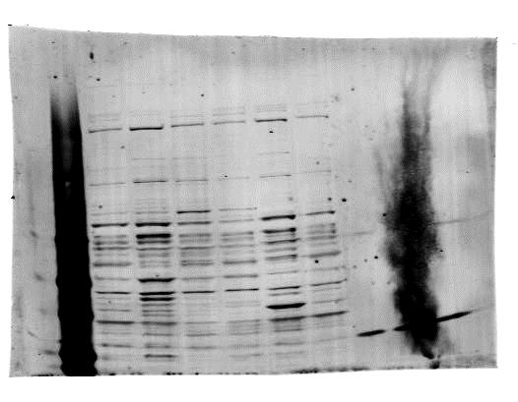

  Identifying cellular targets for radiosensitisation
58 MeV
11 MeV
58 MeV
Day 10 + X-rays
Control
24 h
Control
24 h
DMSO
ATMi
ATRi
DNA-PKi
OGG1
UMSCC74A
11 MeV
DAPI
UMSCC6
58 MeV
Detroit
11 MeV
58 MeV
  UMSCC74A
  Detroit 562
  UMSCC11B
  FaDu
  UMSCC6
  A253
RAD51
CHK1
  Carter et al., (2019) Int J Rad Oncol Biol Phys
  Nickson, Fabbrizi et al., (2021) Front Oncol
ATR
  Vitti, Kacperek and Parsons (2020) Cancers
  Zhou et al., (2022) Front Oncol
Actin

Slide 6
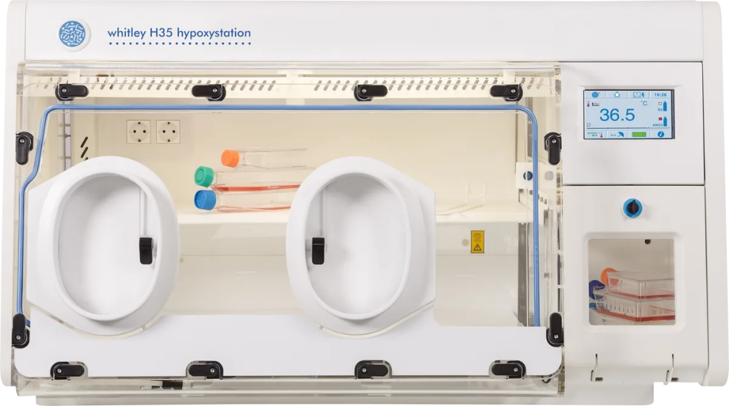
  DDR inhibitors can sensitise hypoxic GBM, but not HNSCC, cells to photon irradiation
AZD1390 (ATMi)
AZD6738 (ATRi)
AZD7648 (DNA-Pkcsi)
Detroit
E2
Normoxia
E2
Hypoxia (1 %)
Detroit
  Aiyappa-Maudsley, Zhou, Chalmers et al., (Unpublished)

Slide 7
The radiobiology of ultra-high dose rates (FLASH)
Using ultra high-dose rates (>40 Gy/s; versus ~2-5 Gy/min).
The “FLASH effect” leads to significant normal tissue sparing.
  Favaudon et al (2014) Sci Trans Med
  Bourhis et al (2019) Radiother Oncol
  Vozenin et al (2018) Clin Cancer Res

Slide 8
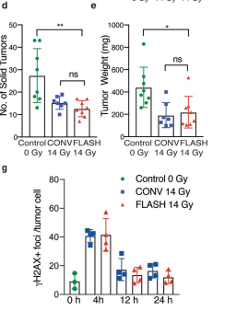
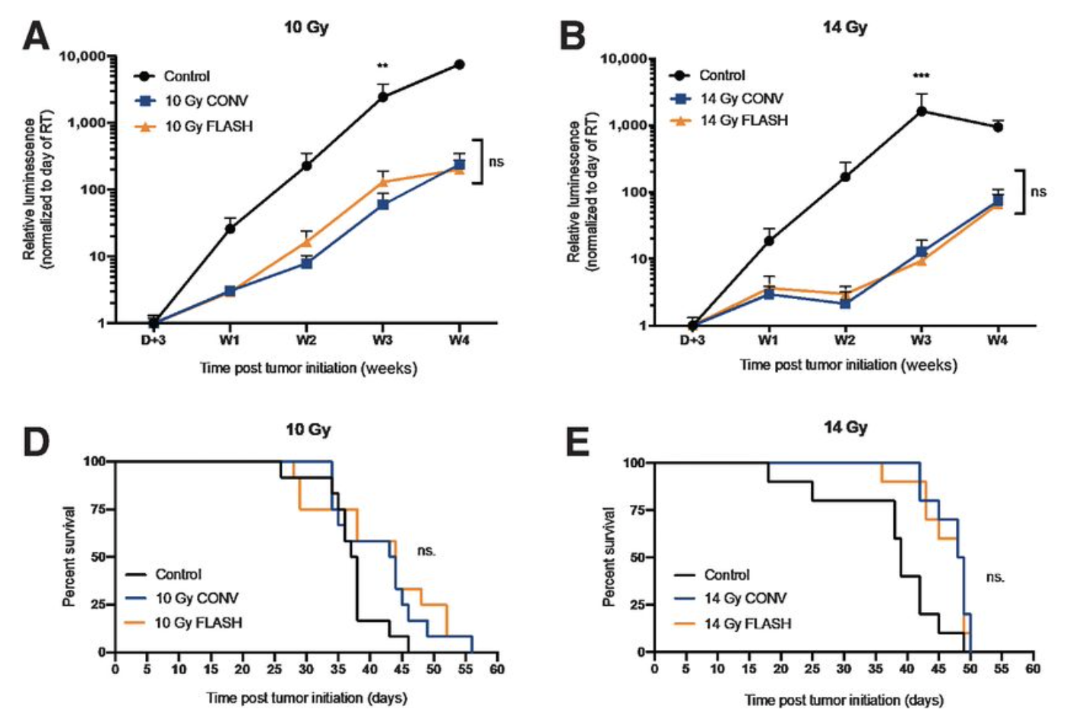
The radiobiology of ultra-high dose rates (FLASH)
Some evidence that FLASH delivery maintains tumour control.
Can increase dose delivered to the tumour to enhance efficacy.
Ovarian cancer
Glioblastoma
  Montay-Gruel et al (2021) Clin Cancer Res
  Levy et al (2020) Scientific Reports

Slide 9
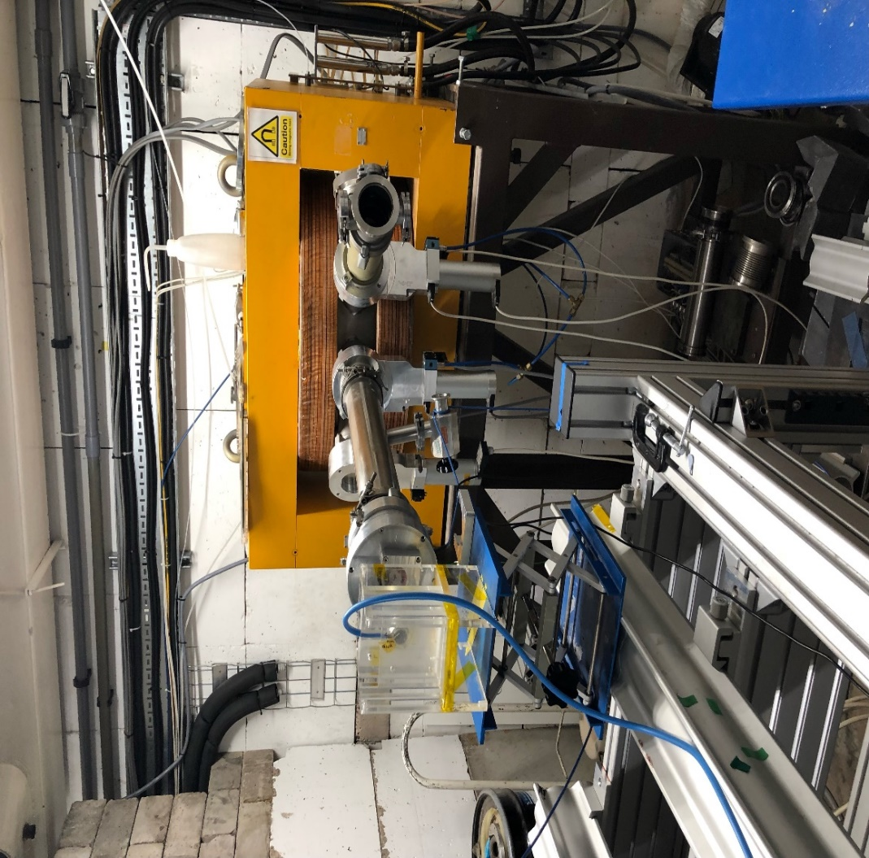
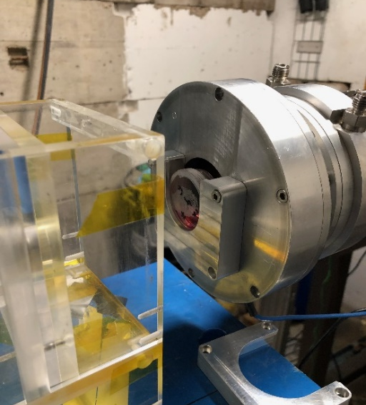
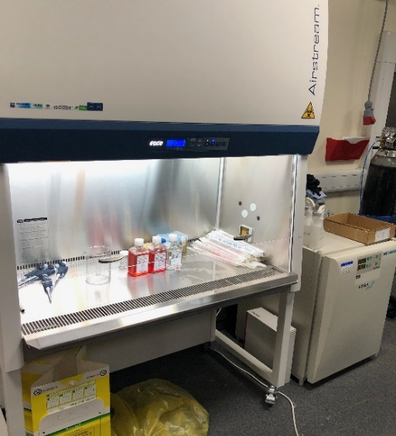
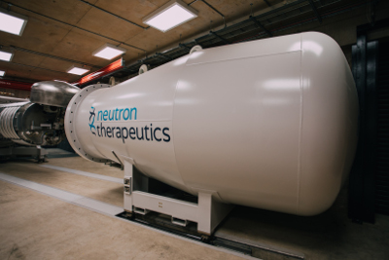
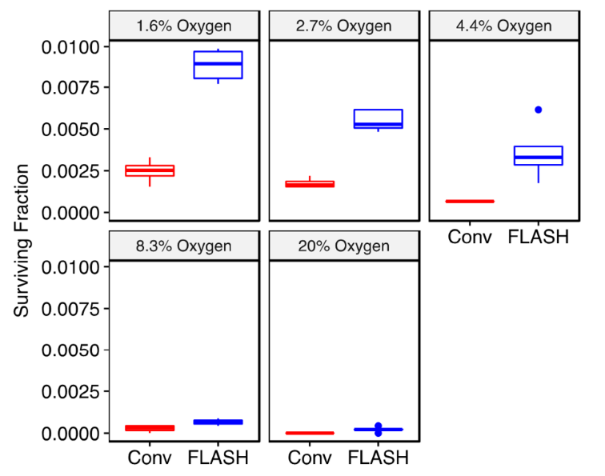
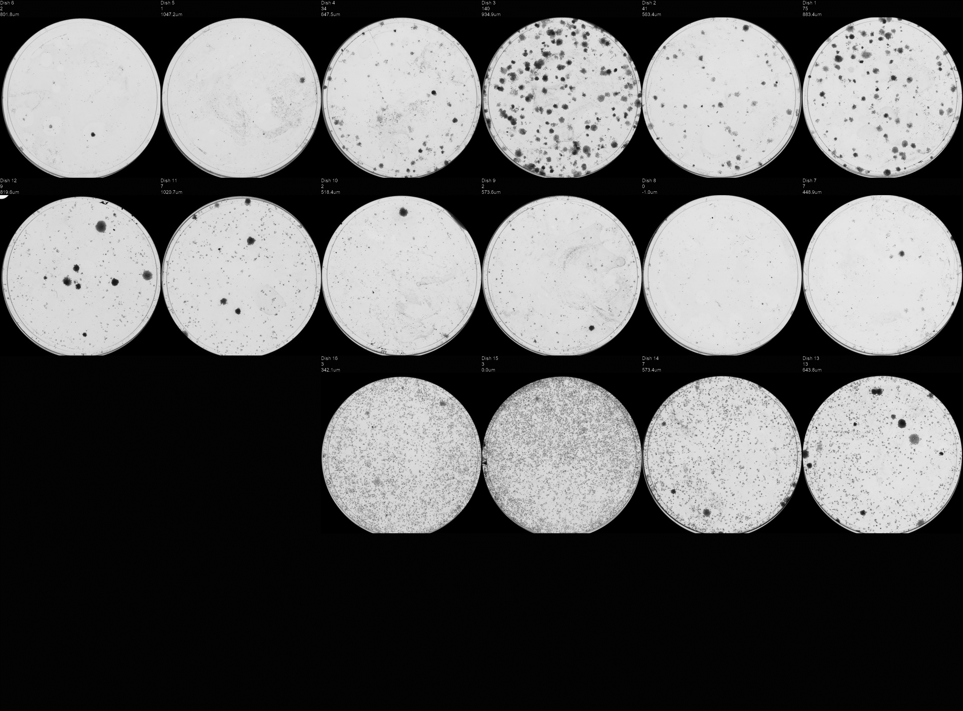
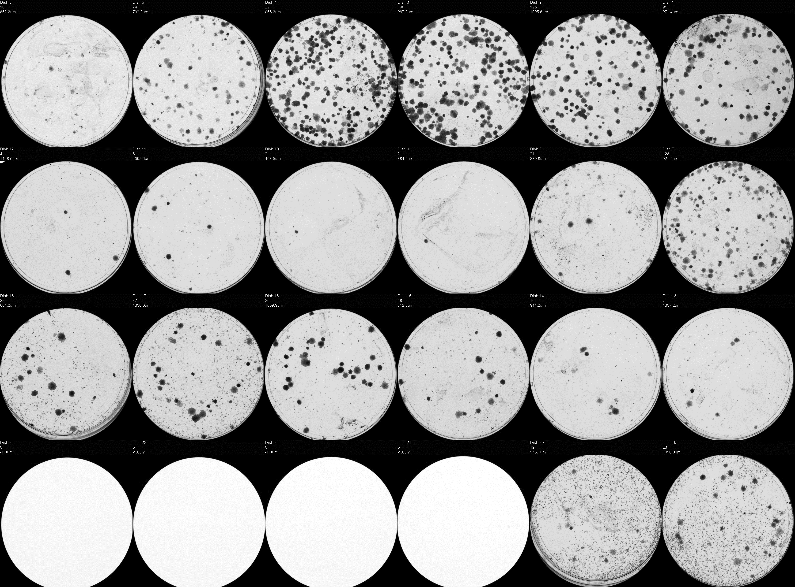
Examining the radiobiology of FLASH high-LET radiation
High flux accelerator neutron source for BNCT
DU145 prostate cancer cells (18 Gy electrons)
5 Gy
22 Gy
HeLa cells (protons)
CONV
  Collaborations with Stuart Green, Tzany Wheldon, Tony Price, Ben Phoenix and Kristoffer Petersson
FLASH
Courtesy of Kristoffer Petersson

Slide 10
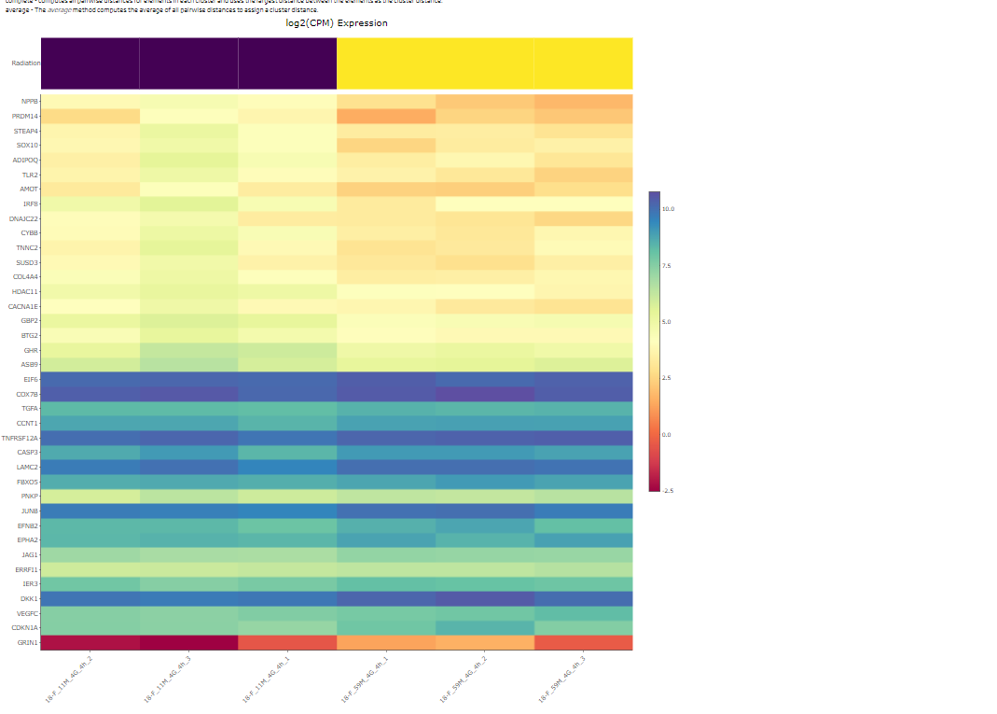
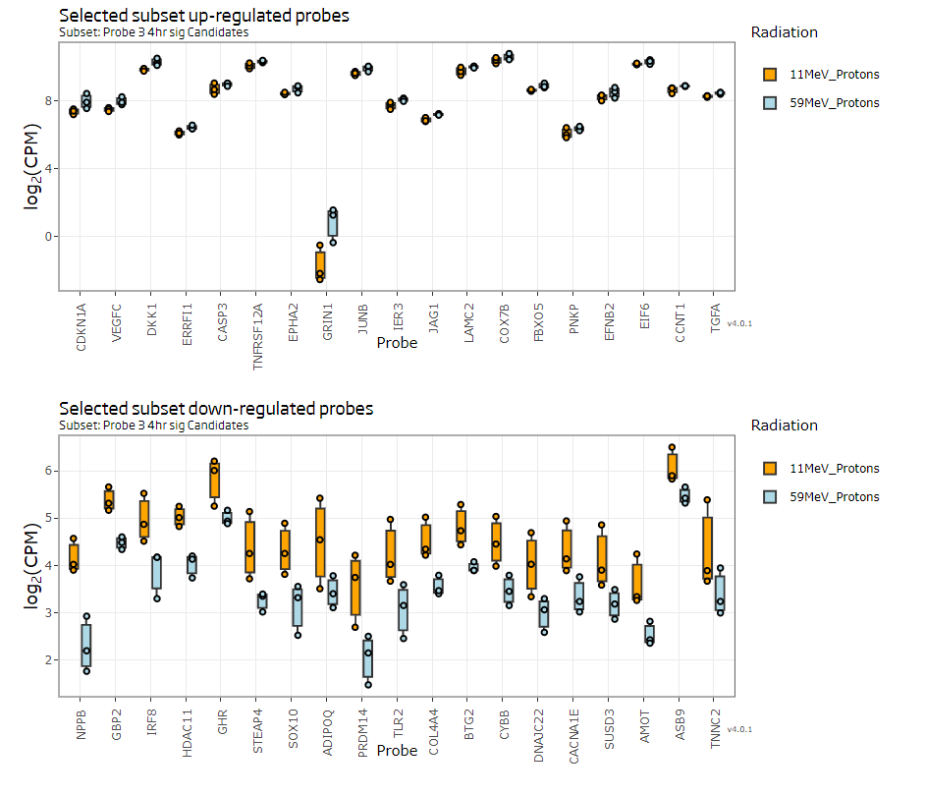
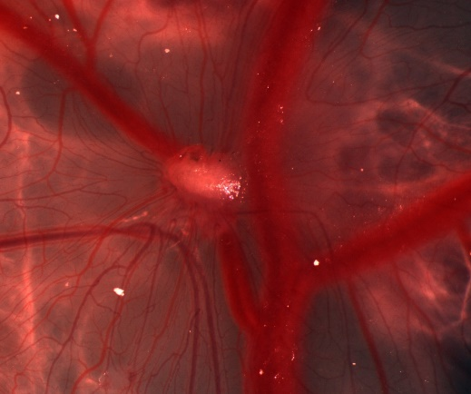
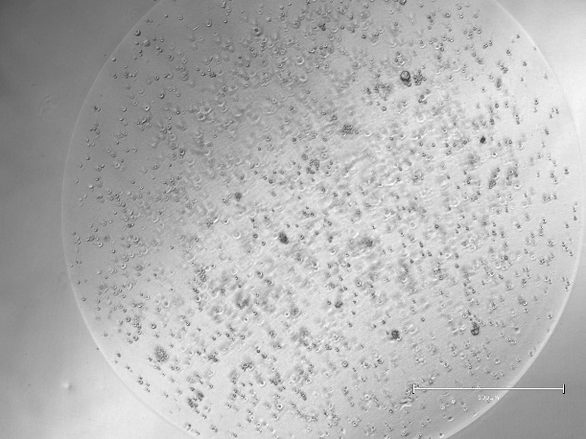
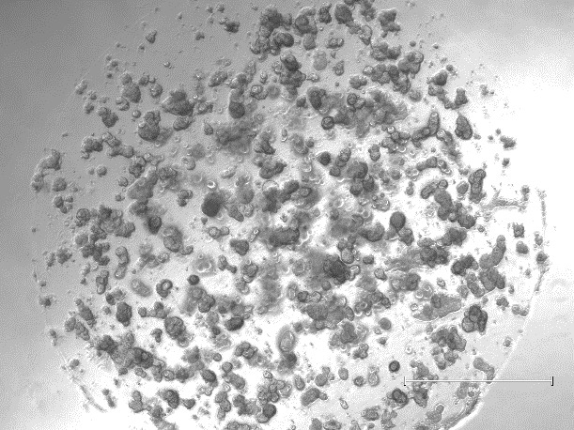
Current radiobiology research focus
11 MeV
59 MeV
11 MeV
59 MeV
Transcriptomic and proteomic analysis post-irradiation
Day 1
Day 7
Development of patient-derived organoids (Hisham Mehanna/Colin Watts)
Development of chick embryo model

Slide 11
Summary
Technical advantages of the LhARA facility
Provides a reproducible, stable and reliable beam critical for acquiring accurate radiobiological data, and for performing systematic evaluations of the biological response.
Beam which is flexible, easily accessible, and potentially high throughput (unlike clinical facilities).
Ions can be delivered in very short pulses (10-40 ns) and high repetition rates.
Ability to deliver particle ions at different energies/LET (protons at 15 and 125 MeV; carbon ions at 30 MeV) and at different dose rates (e.g. FLASH).
In vitro and in vivo end-stations both for routine cell culture experiments (with automated handling in controlled environments), but also animal irradiations.
Stimulate the analysis of more complex biological end-points.
Potential for live cell imaging, rather than single end-point measurements.

Slide 12
Summary
Biological questions to be addressed
More substantial investigations into the radiobiology of particle ions with increasing LET in defined 2D/3D preclinical normal/tumour model systems.
Uniquely positioned to investigate novel beam delivery (e.g. FLASH and minibeams) and to define the biology behind these phenomenon.
Enable clinically-relevant dose fractionation experiments in relevant in vitro and in vivo preclinical models.
Examine role and impact of the tumour microenvironment in response to particle ions in defined models systems.
Investigate combinatorial treatments (e.g. targeted DDR/IO drugs and inhibitors, stimulate high-throughput screening experiments) for tumour radiosensitisation and normal tissue radioprotection.
More effective and efficient translation of radiobiology research into particle ions from the lab and into the clinic for patient benefit.

