Slide 1
WP5: Novel end station development Report from 1st peer-group consultation meeting – 14 Dec 2022
Dr Ruth McLauchlan Imperial College Healthcare NHS Trust
Dr Tony Price University of Birmingham
Dr Carsten Welsch University of Liverpool

Slide 2
WP5: Objectives
Through peer-group consultation, produce detailed specifications and designs for the in-vitro and in-vivo end stations, the associated dosimetry and the beam diagnostics necessary to characterise the beam delivered to the end stations.

Slide 3
WP5: Tasks and Milestones
Design LhARA automated cell dish handling and environmental system via user-community consultation
De-risk key end station components though experimental measurements at Birmingham
Assessment of current beam monitoring technology and identification of the R&D required to deliver the diagnostic systems for LhARA
Development of the design of a test facility at Birmingham capable of delivering kGy/s for use to prove instrumentation and diagnostics developed for LhARA in the Preconstruction Phase
M5.1 Initial report on the user requirements for the in-vitro and in-vivo end stations
An initial parameter list and end-station specification will be given
M5.2 Report on the beam-monitoring technology for LhARA.
Will include an options analysis and discussion of cost and R&D requirements
M5.3 Report on the user requirements for the in-vitro and in-vivo end stations.
Will contain detailed specifications, analysis of layout options, and initial designs for key components

Slide 4
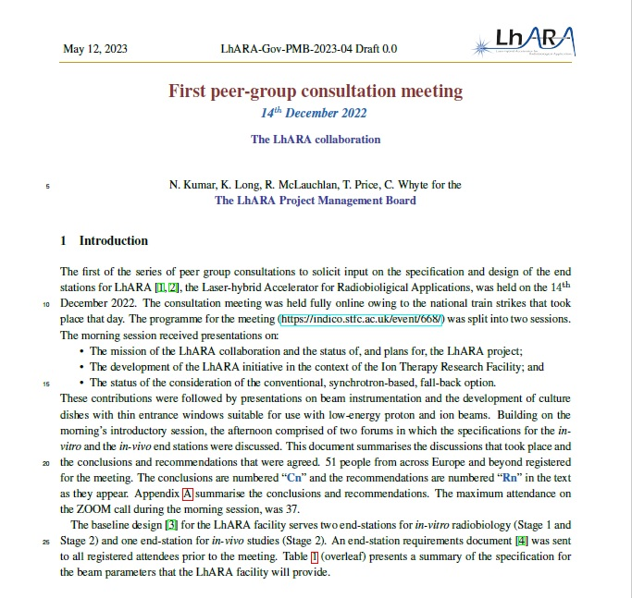
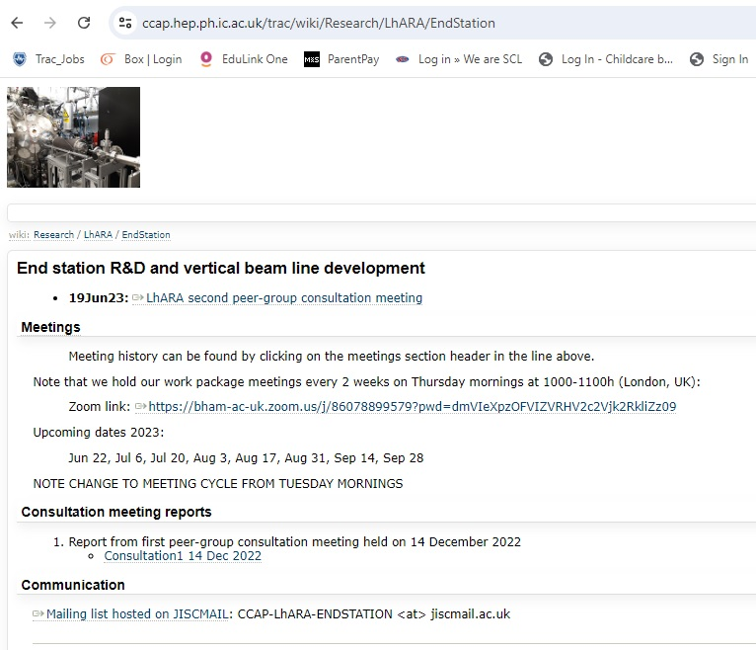
WP5: Report from first peer-group consultation

Slide 5
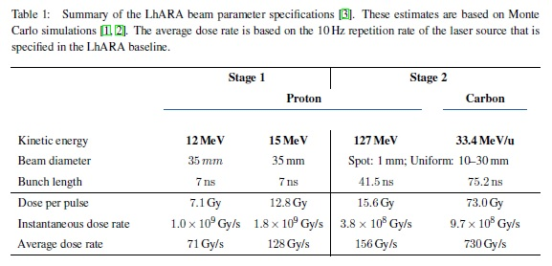
WP5: Report from first peer-group consultation
Conclusions
Recommendations
Baseline to be retained
Upper limit on accuracy and repeatability of dosimetry = 5%
Investigate radiobiological opportunities arising from unique time-structure offered by LhARA
Consider experimental complications arising from low-energy proton beam (Stage 1)
Carefully plan workflow and cell-culturing facilities to support multi-user, quasi-continuous irradiation facility
Evaluate impact of scattered radiation on neighbouring samples
Consider required ranges and stability of temperature and oxygen-levels
Careful consideration required for in-vitro end-station regarding all aspects of animal-handling (Stage 2)
Consideration of location of LhARA relative to animal house

Slide 6
WP5: Report from first peer-group consultation

