Slide 1
FFA studies at high intensity
Carl Jolly – ISIS accelerator physics group
Notes:
The abstract pattern can be removed or repositioned if required. Be careful to ‘Send to Back’ so that it does not obscure any important information.

Slide 2
Contents
1 The effects of space charge in FETS FFA
2 FFAs in OPAL
3 Simulating space charge in OPAL
4 Current progress and next steps
Notes:
To replace photo with one of your own. 1) Send the geometric shape overlay to the back – Right-Click > Send to Back > Send to Back. 2) Replace image – use the guides provided to correctly position it. 3) Send your image to the back so that the geometric overlay re-appears over the image. Please remove or amend the image credit if you are using a different image to the one provided.

Slide 3
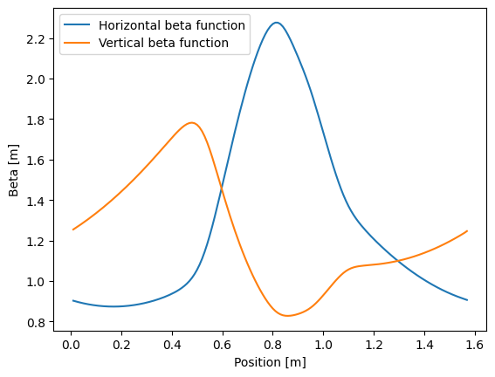
How will space charge affect the dynamics
Beta functions over a single cell
With no space charge the tune is determined by the beta functions.
With no space charge the tune is determined by the beta functions.
Horizontal tune = 3.41 and Vertical tune = 3.39

Slide 4
How will space charge affect the dynamics
This term gives the tune shift due to space charge (KV distribution).
With $4×{10}^{11}$ particle per bunch, we expect a tune shift of around -0.3

Slide 5
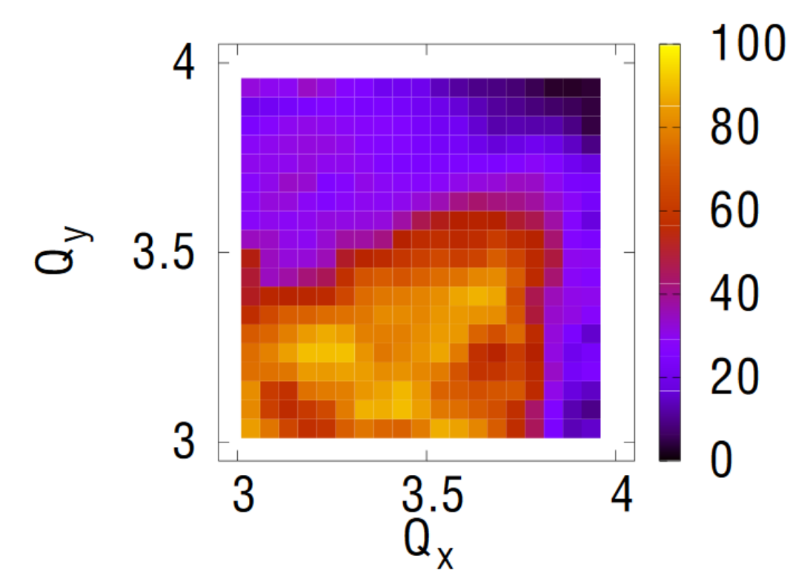
Effect on dynamic aperture

Slide 6
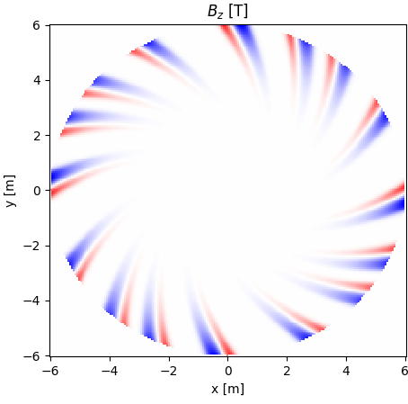
FFA simulations in OPAL
Originally a cyclotron simulation code
OPAL now has been extended to horizontal and vertical FFAs with the Enge fringe field model
Placeholder for plot of FFA field map
Notes:
Also tanh
Enge up to arbitrary order
Sprial magnets
Python interface

Slide 7
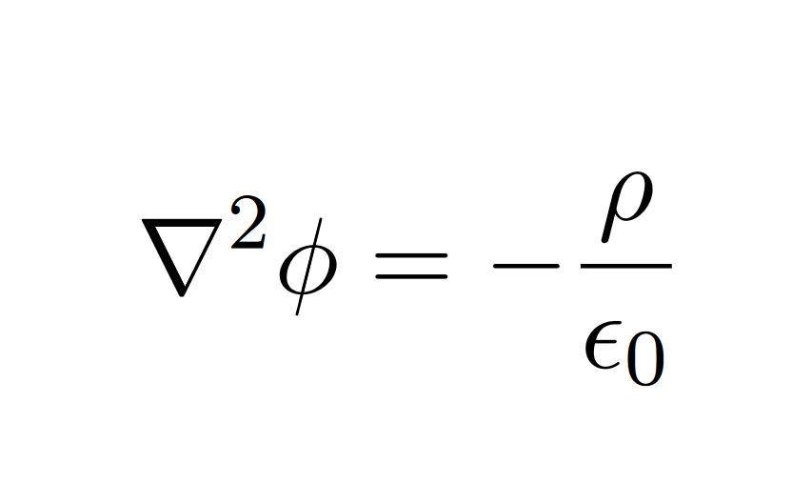
Space charge in OPAL
Goal is to solve for the scalar potential,
Notes:
Set up transition to revel equations
Grids up the charge
Solves for the scalar potential
Full 3D
A few different types of solvers

Slide 8
Space charge in OPAL
Goal is to solve for the scalar potential,
The solution is written in terms of the Green’s function for this problem:
More details in the OPAL manual: http://amas.web.psi.ch/opal/Documentation/master/#chp.fieldsolvers
Notes:
Set up transition to revel equations
Grids up the charge
Solves for the scalar potential
Full 3D
A few different types of solvers

Slide 9
FFT solver
How is the solver actually implemented in OPAL?
The convolution for the scalar potential can be rewritten in terms of FFTs for faster computation:

Slide 10
Current progress
The OPAL space charge routine is relatively untested with FFA simulations.
Currently running 2D simulations to check it works as expected.
Potentially discovered some issues with OPAL… work in progress.

Slide 11
Next steps
Understand and fix the existing issues with the OPAL solver.
Implement a more realistic 3D bunch.
Include the energy loss from the stripping foil.

