Slide 1
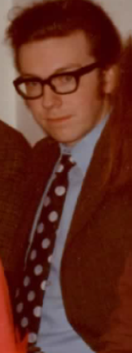

NINA at DNPL and John (Terry Sloan 7 July 2023)
John in Daresbury days (1973)
Modern John

Slide 2
Brief History
1940s Hot topic = nuclear physics. Chadwick brings cyclotron to Liverpool.
1947 π meson discovered. Pion source needed Chadwick gets a synchrocyclotron in Liverpool.
1950s Scattering theory and scattering amplitudes were hot topics to explain particle interactions. We were
trying to understand the forces between particles.
Nimrod built at Rutherford Lab. As a complement Jim Cassels et al proposed an electron machine for
North of England. This became NINA (Northern Institute Nuclear Accelerator) 5 GeV electron synchrotron.
1965 NINA comes on air at DNPL (Daresbury Nuclear Physics Lab).
Meanwhile Physics moved on –
1959 Tulio Regge developed Regge theory of scattering amplitudes.
1964 Gellman and Zweig propose quark model of the hadrons.
1966 NINA came on air and was used to study both these topics
– the quark model through the excited states of the nucleon (nucleon resonances)
- Regge theory through the production of mesons.
However, the energy was too low to study the quark structure directly which needed deep inelastic scattering
discovered at SLAC (20 GeV Linac) in 1969.

Slide 3
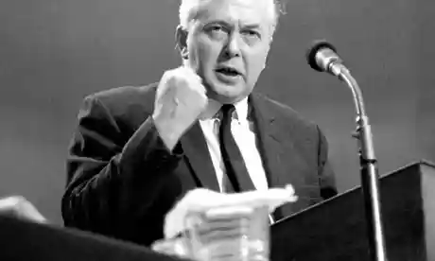
NINA = Northern Institute Nuclear Accelerator
@
DNPL = Daresbury Nuclear Physics Laboratory
Even though our work had little to do with
nuclear physics. (60s politics Nuclear seen as
part of the “White heat of modern
Technology” - Harold Wilson).

Slide 4
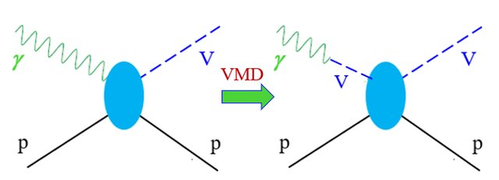
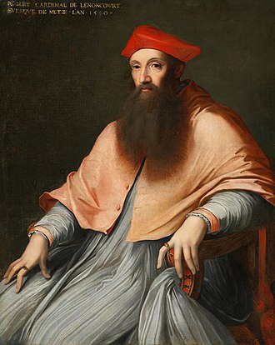
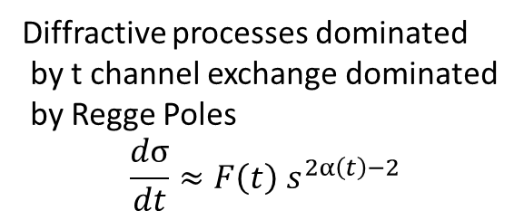
General photon Interactions.
S channel processes
study of N* production
Diffractive processes dominated
by t channel exchange dominated
by Regge Poles
$$\frac{dσ}{dt}≈F\left(t\right) s^{2α\left(t\right)−2}$$
Reginald Pole

Slide 5
Phase 1 1969
Experimental Hall 1969

Slide 7
World data on total cross sections.
NB Daresbury results.

Slide 8

Typical Results on s channel resonances.
GLS photoproduction data
Mancaster $π0$ electroproduction

Slide 9
Results from pre-1969 experiments
Orsay Group
WAPP Group

Slide 10
NINA – Resonance work
With a few exceptions most of the work during this first phase involved a study of the nucleon resonances.
- using tools such as angular distributions, polarised photons and protons.
Before NINA only known excited nucleon states were P33(1236), D13(1518), F15(1688), S11(1550), D15(1680).
At NINA further states discovered and photoproduction amplitudes of all states measured precisely –
S11(1700), D13(1700), S31(1650), D33(1685), P13(1770), F15(1690), P31(1910), P33(1900), F35(1890), f37(1920)
Modellers used these amplitudes to determine the properties of the resonances which began to
interpreted by models (including the quark model).
Work done by Glasgow, Liverpool and Sheffield groups plus Orsay group (backward pion).
Electroproduction studied by Manchester –Lancaster (Mancaster) and PEP (DNPL – Pisa groups) gave further
information on nucleon excited states.

Slide 11
Phase 2 1972
John joins LAMP

Slide 12
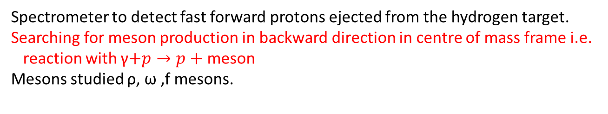
1972 Large Angle Meson Production
(LAMP Phase 1)
Spectrometer to detect fast forward protons ejected from the hydrogen target.
Searching for meson production in backward direction in centre of mass frame i.e.
reaction with γ$+p→p+$ meson
Mesons studied ρ, ω ,f mesons.

Slide 13
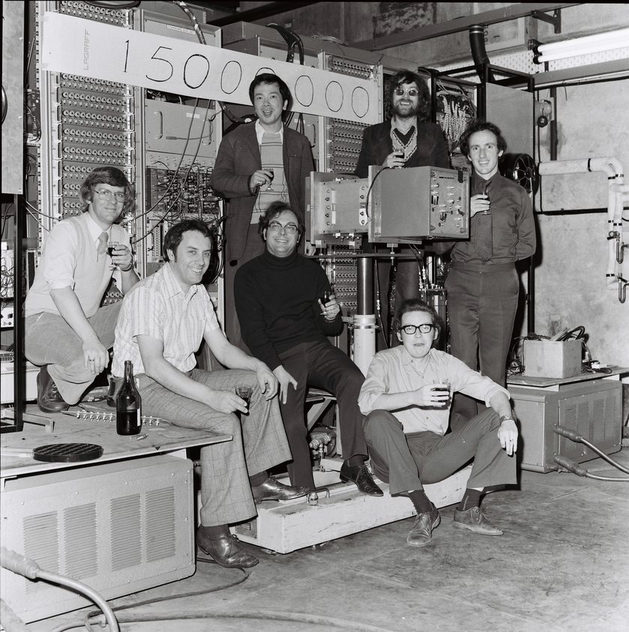

Slide 14
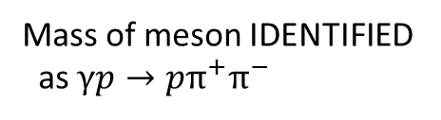
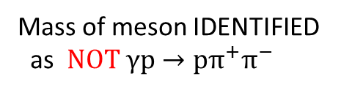
Mass of meson IDENTIFIED
as $NOT γp→pπ^{+}π^{−}$
Mass of meson IDENTIFIED
as $γp→pπ^{+}π^{−}$

Slide 15




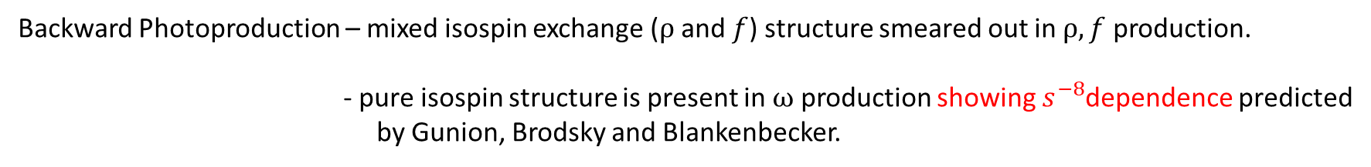
$$γp→pρ$$
$$γp→pω$$
$$γp→Δ^{++}π^{−}$$
$$γp→pf$$
Backward Photoproduction – mixed isospin exchange ($ρ$ and $f$) structure smeared out in $ρ, f$ production.
- pure isospin structure is present in $ω$ production showing $s^{−8}$dependence predicted
by Gunion, Brodsky and Blankenbecker.

Slide 16
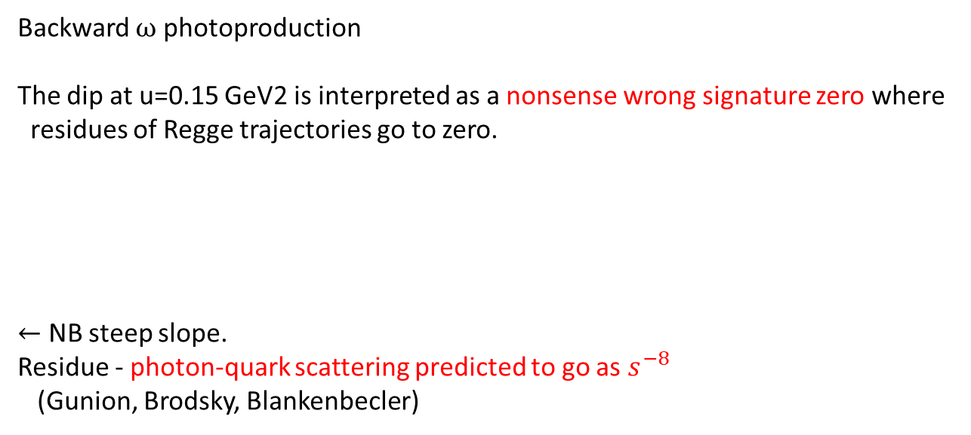
Backward $ω$ photoproduction
The dip at u=0.15 GeV2 is interpreted as a nonsense wrong signature zero where
residues of Regge trajectories go to zero.
$←$ NB steep slope.
Residue - photon-quark scattering predicted to go as $s^{−8}$
(Gunion, Brodsky, Blankenbecler)

Slide 17

CLAS data on $γp→ωp$from Jefferson Lab
Model by Laget et al
LAMP
Model is based on exchanges of quarks
and gluons and Reggeons.
No mention of nonsense wrong signature zeros.

Slide 18
LAMP Phase 2 (Large Aperture Magnet Project)
Large Aperture allows forward produced particles to be measured precisely.

Slide 20
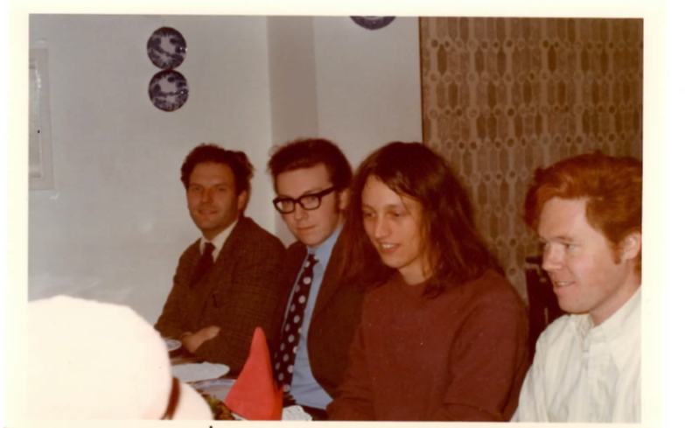
Lunch on Erwin at Old Vic in December 1973.

Slide 21
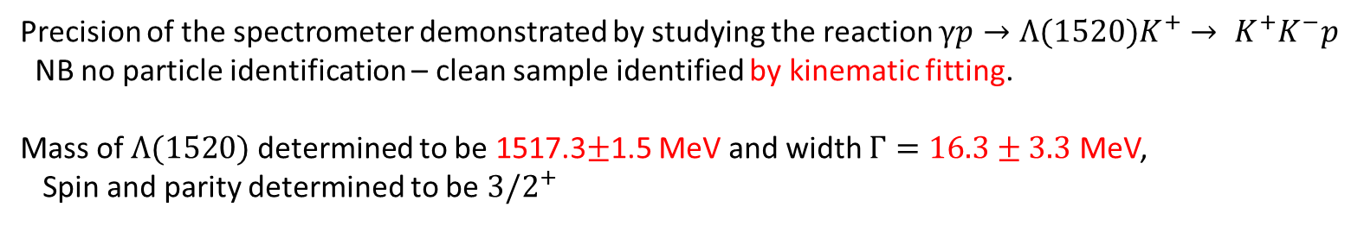
Precision of the spectrometer demonstrated by studying the reaction $γp→Λ(1520)K^{+}→ K^{+}K^{−}p$
NB no particle identification – clean sample identified by kinematic fitting.
Mass of $Λ(1520)$ determined to be 1517.3$±$1.5 MeV and width $Γ=16.3±3.3$ MeV,
Spin and parity determined to be ${3/2}^{+}$

Slide 22
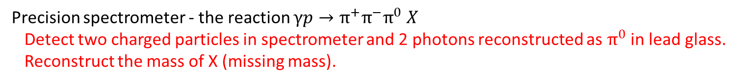
Precision spectrometer - the reaction $γp→π^{+}π^{−}π^{0} X$
Detect two charged particles in spectrometer and 2 photons reconstructed as $π^{0}$ in lead glass.
Reconstruct the mass of X (missing mass).

Slide 23
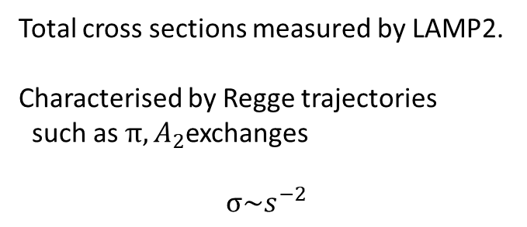
Total cross sections measured by LAMP2.
Characterised by Regge trajectories
such as $π,A_{2}$exchanges
$$σ\sim s^{−2}$$

Slide 24
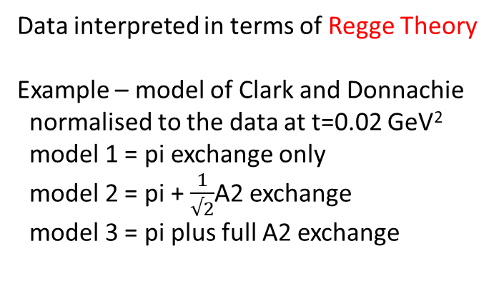
Data interpreted in terms of Regge Theory
Example – model of Clark and Donnachie
normalised to the data at t=0.02 GeV²
model 1 = pi exchange only
model 2 = pi + $\frac{1}{√2}$A2 exchange
model 3 = pi plus full A2 exchange

Slide 26
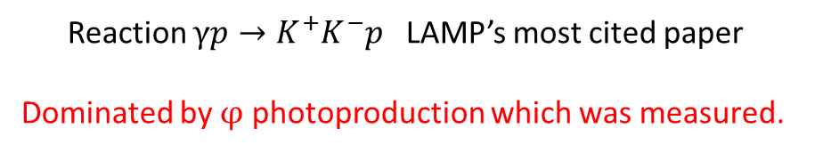
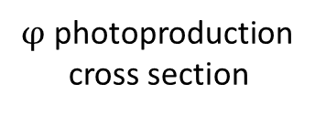
Reaction $γp→K^{+}K^{−}p$ LAMP’s most cited paper
Dominated by $φ$ photoproduction which was measured.
$φ$ photoproduction
cross section
Pomeron exchange is dominant –
but measured Regge trajectory seems to be
different from that seen in pp scattering.
Density matrix elements show deviations from
helicity conservation away from forward direction.

Slide 27
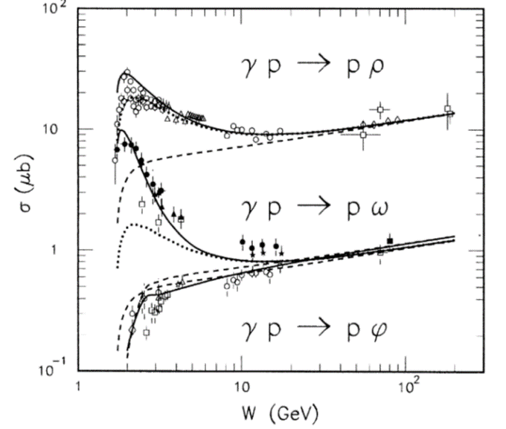
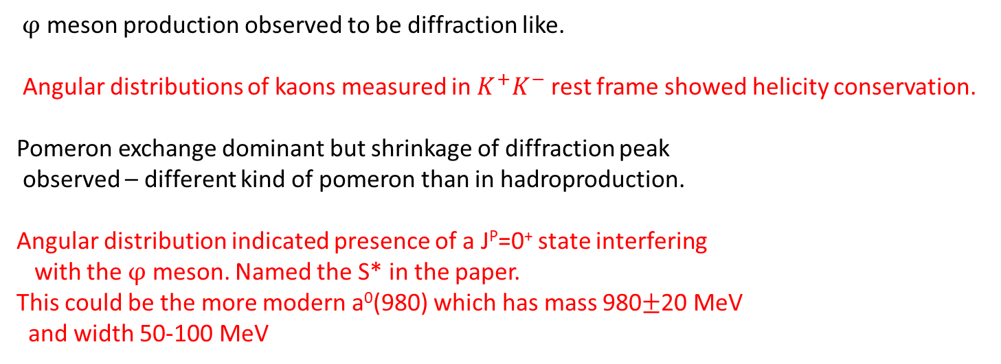
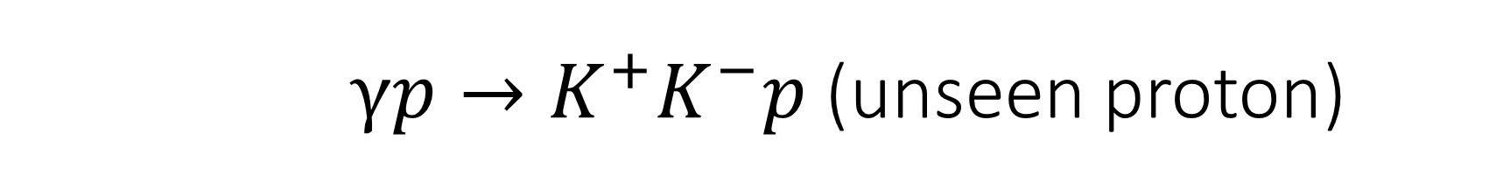
$γp→K^{+}K^{−}p$ (unseen proton)
$φ$ meson production observed to be diffraction like.
Angular distributions of kaons measured in $K^{+}K^{−}$ rest frame showed helicity conservation.
Pomeron exchange dominant but shrinkage of diffraction peak
observed – different kind of pomeron than in hadroproduction.
Angular distribution indicated presence of a J^{P}=0⁺ state interfering
with the $φ$ meson. Named the S* in the paper.
This could be the more modern a⁰(980) which has mass 980$±$20 MeV
and width 50-100 MeV
From J-M Laget

Slide 28
Conclusions
A snapshot of the work at DL in the late 60s and early 70s.
John and I started to work together 50 years ago on the LAMP2 experiment.
I look back on those years with fondness and pleasure. We were a very productive group
producing results which are still being cited.
From the start John’s enthusiasm and common sense were an influence on us all.
I learned a lot from him.

Slide 31
σT Experiment to measure total photoproduction cross sections to hadrons Phys. Rev. D5 (1972) 1640

Slide 32
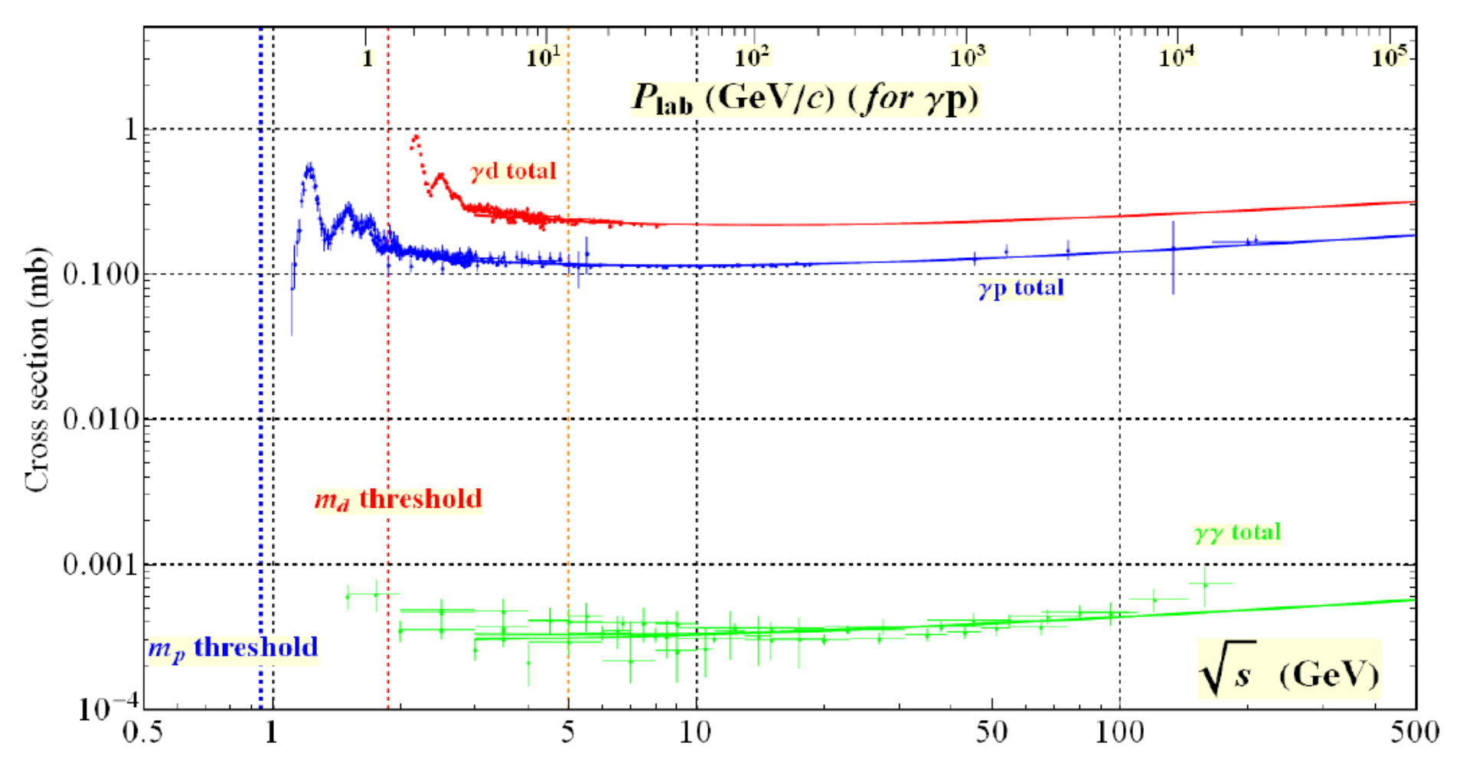
σT Experiment to measure total photoproduction cross sections to hadrons
T.A. Armstrong et al
Phys. Rev. D5 (1972) 1640

Slide 33
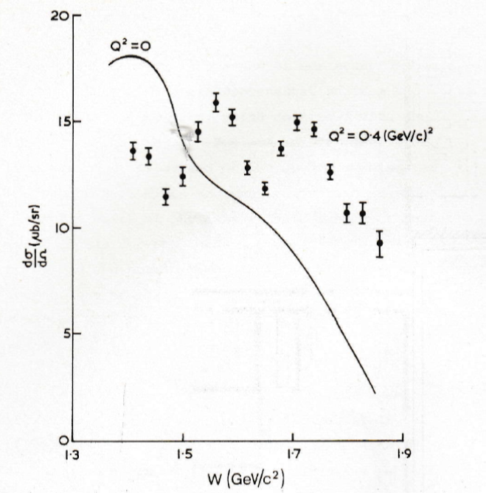
Electroproduction – adds in –Q2 taking the
photon away from the vector meson mass
Photon becomes a pure electromagnetic probe.
π+production
Curve = photoproduction
Points = electroproduction.
Decays
p

