Slide 1
PLUTO at PETRA
Notes:
…not content with smashing photons into stationary targets…

Slide 2
INTRODUCTION
PLUTO - General purpose detector that operated between 1974-1982 at the DESY lab in Hamburg
It had several incarnations and I’ll mostly talk about its final version when it was installed in the PETRA e⁺ e⁻ storage ring.
But PLUTO was already a venerable detector by then and it’s worth describing a little ‘pre-history’

Slide 3
A reminder of context:
Mid ’70’s were an exciting time:
The contents of the standard model (J/Psi 1974, tau 1976, upsilon 1977…) were being discovered one-by-one in quick succession at SLAC, Brookhaven, Fermilab etc.
Quarks were real, hadronization into jets established ‘statistically’ in ’75 (SPEAR, SLAC)
e⁺ e⁻ storage rings at height of fashion.
In 1969, D.E.S.Y lab decided to build its own:
DORIS Doppel-Ring-Speicher
came online in 1974. (~3–5 GeV) in 1974–1976
PLUTO began as a general-purpose detector at one of the two interaction regions in DORIS.
Note, double-ring: beams separated except at interaction regions.

Slide 4
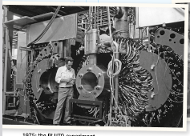
The PLUTO detector
Already a Pioneering detector…
The first detector to make use of a large Superconducting 1.65T solenoid.
Big enough to contain tracking and shower counters…
1977 version

Slide 5
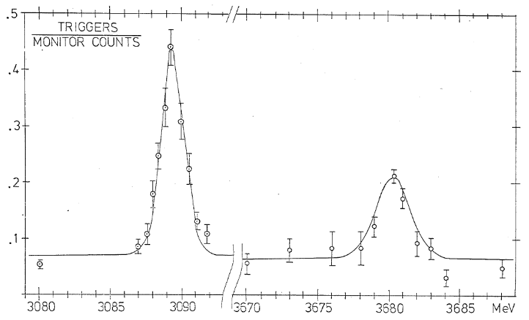
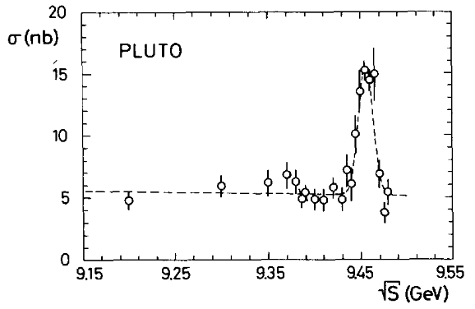
DORIS DAY(s)
1st Publication
Confirmation of the new 3700-MeV narrow resonance in e+e−e+e− - collisions
DORIS underwent several upgrades in response to developments:
DORIS II (~7–10 Gev) in 1978
1977 PLUTO proposal to up energy to 8.6 GeV cm for tau, excited charm studies.
Accepted by Forschungskollegium 30/06/77
  Same day as Upsilon announced!
Just a week later PLUTO proposed upgrade to 10GeV by switching to single ring (at lower luminosity) and using PETRA cavities.
Upgrade approved end of 77 even though Petra due to start in 78!
Started running just two months later!
PLUTO and DASP confirm FNAL evidence of Upsilon April 78.
Phys.Lett.B 53 (1975) 489-490
Width (brought down to DORIS resolution 8MeV) and electronic width determination confirming interpretation as narrow quark-antiquark bound state of charged -1/3 quarks,
Observation of a Narrow Resonance Formed in e+ e- Annihilation at 9.46-GeV Phys.Lett.B 76 (1978), 243-245

Slide 6
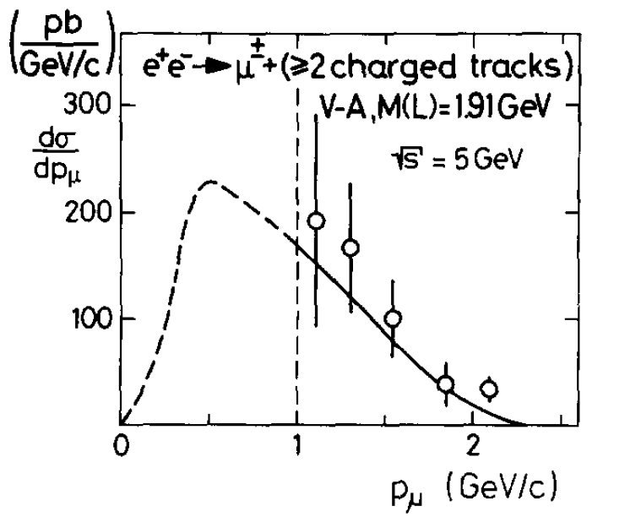
DORIS DAY(s)
Published data on total hadronic cross-sections, K₀ production, J/Ψ decays, Ψ’, various papers confirming τ.
Observation of Associated K0(s) electron Production in e+ e- Annihilation
Phys.Lett.B 64 (1976), 369-372
The Total Hadronic Cross-Section for e+ e- Annihilation Between 3.1-GeV and 4.8-GeV Center-Of-Mass Energy
Phys.Lett.B 66 (1977), 395-400
Inclusive K0(s) Production in e+ e- Annihilation at Energies of 3.6-GeV to 5.0-GeV
Phys.Lett.B 67 (1977), 367-370
Inclusive J/psi Production in e+ e- Annihilation in the Energy Range from 4.0-GeV to 5.0-GeV
Phys.Lett.B 68 (1977), 283, Physics Letters B68 (1977) 283-286 Evidence for Heavy Leptons from Anomalous mu e Production in e+ e- Annihilation
Phys.Lett.B 68 (1977), 301-304
Anomalous Muon Production in e+ e- Annihilation as Evidence for Heavy Leptons
Phys.Lett.B 68 (1977), 297, Physics Letters B68 (1977) 297-300
Measurement of the Branching Ratios for the Decays J/psi (3.1) --> f omega and J/psi (3.1) --> B pi
Phys.Lett.B 72 (1977), 135, Physics Letters B72 (1977) 135-138
Measurement of the J/psi Radiative Decay Into F0 (1270) gamma
Phys.Lett.B 72 (1978), 493, Physics Letters B72 (1978) 493-496
Evidence for the tau --> Neutrino rho pi Decay Mode
Phys.Lett.B 73 (1978), 99-104

Slide 7
Comment: Far from ‘mere’ follow ups. Early discoveries by no means certain. e,g. Tau:
Charm ‘expected’ but what was 3rd lepton thing?
“Our first publication was followed by several years of confusion and uncertainty about
the validity of our data and its interpretation [ …]There were several reasons for the uncertainties of that period. It was hard to believe that both a new quark, charm, and a new lepton, tau, would be found in the same narrow range of energies. And, while the existence of a fourth quark was required by theory, there was no such requirement for a third charged lepton. So there were claims that the eμ events were the complicated result of the decays of charm quarks. There were claims that the other predicted decay modes of tau pairs such as e-hadron and μ-hadron events could not be found. Indeed finding such events was just at the limit of the particle identification capability of the detectors of the mid-1970’s. It was a difficult time. Rumors kept arriving of definitive evidence against the τ: eμ events not seen, the τ → πμ decay not seen, theoretical problems with momentum spectra or angular distribution. With colleagues such as G. Feldman I kept going over our data again and again. Had we gone wrong somewhere in our data analysis?” […]
“The most welcomed confirmation, because it came from an experiment at the DORIS e+e- storage ring, was from the PLUTO experiment. In 1977 the PLUTO Collaboration published (Burmester et al. 1977) A paper entitled “Anomalous Muon Production in e+e- Annihilation as Evidence for Heavy Leptons”. PLUTO was also a large-solid-angle detector and so for the first time we could fully discuss the art and technology of τ research with an independent set of experimenters, with our friends Hinrich Meyer and Eric Lohrman of the PLUTO Collaboration.” Martin Perl reflecting in 1992

Slide 8
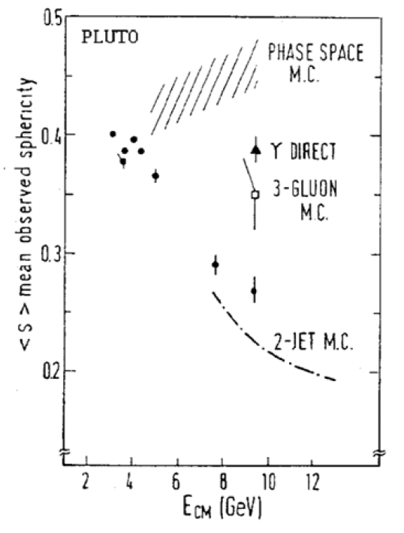
PLUTO and the GLUON
In contrast to the discoveries of the narrow resonances, evidence for the existence of gluons, made by the DESY-based experiments was an extended process that accumulated evidence from DORIS and PETRA detectors.
Controversial and intriguing story!
See e.g.
The Hunting of the Quark: A True Story of Modern Physics . Michael Riordan,. First published 1987
P. Söding Eur. Phys. J. H 35, 3–28 (2010)
Stella and Meyer Eur. Phys. J. H 36, 203–243 (2011)
Not enough time here…
But already at DORIS…
Event topology (thrust, sphericity changes at resonance. Consistent with 3gluon decay
Jet Analysis of the $\Upsilon$ (9.46) Decay Into Charged Hadrons Phys.Lett.B 82 (1979), 449-455
A Study of Jets in electron Positron Annihilation Into Hadrons in the Energy Range 3.1-GeV to 9.5-GeV Phys.Lett.B 78 (1978), 176-182

Slide 9
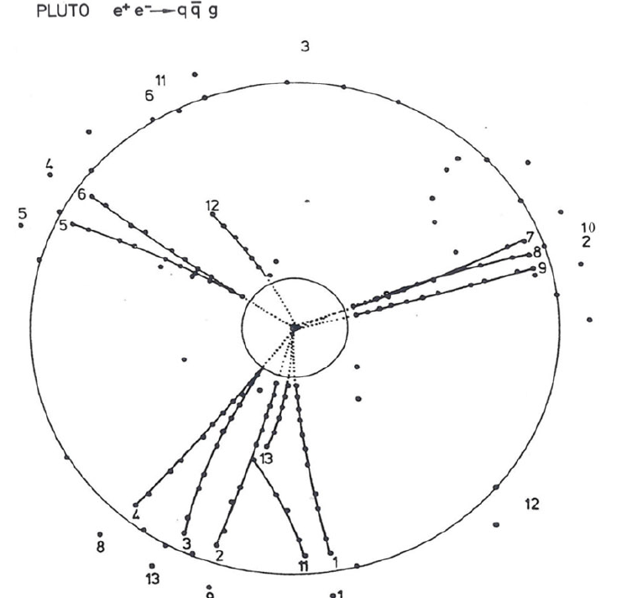
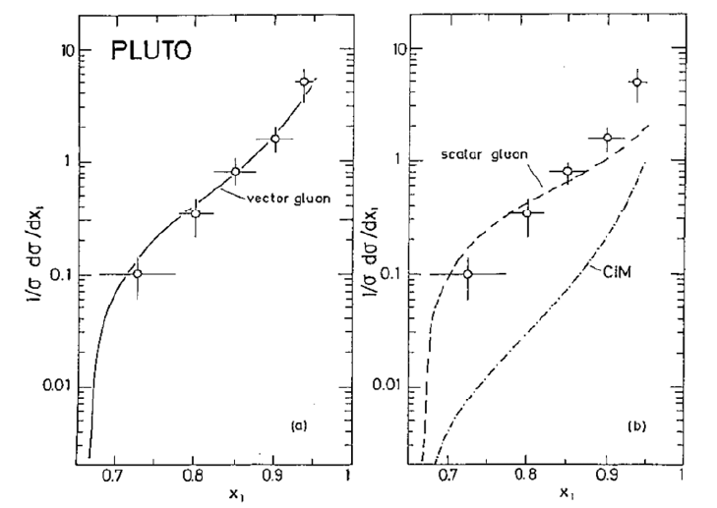
Confirmation at PETRA from gluon bremsstrahlung.
Enough energy to see 3 jets. (first by TASSO – see refs last page(!))
Some of PLUTO’s contributions to the story. Clear 3-jet topology and spin-1
July 1995, EPS, Prize for High Energy and Particle Physics to TASSO Collaboration: (Paul Söding, Bjørn Wiik, Günter Wolf and Sau Lan Wu) .
Complementary prize to four collaborations in recognition of their combined work “definite existence (of the gluon) emerged gradually from the results of the TASSO Collaboration and the other experiments working at PETRA, JADE, MARK J and PLUTO”.

Slide 10
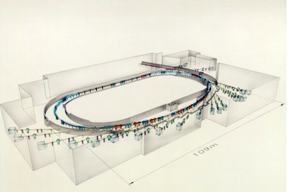
(DORIS DAY(s)
DORIS continued to run in parallel with PETRA and HERA
and DORIS III
By 1993, running as a dedicated synchrotron radiation source,
DORIS III.
Continued until 2012
)
…but PLUTO was set to move…

Slide 11
PART II

Slide 12
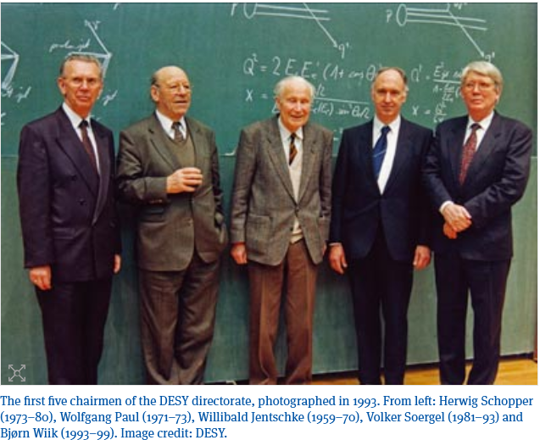
PLUTO moves to PETRA Positron Elektron Tandem Ring Anlage
Designed 1974 (note before charm¹) for 15GeV beam energy to exceed energies of SPEAR, DORIS
2.3 km circumference largest that would fit within DESY site
Authorised and financed in 1975.
Amazingly, took < 3 years to be ready: luminosity runs began Nov 1978…ahead of schedule and in under budget†!
Ran for eight years as highest energy e⁺ e⁻ collider in the world.
Started at 17 GeV, and raised to
31.6 GeV in 1979, 36.6 GeV in 1980and ended up with 23GeV beams in 1982(?)
Luminosities ~ 10³¹ cm⁻² s⁻¹
¹existence of quarks in general not regarded as fully confirmed: hadronic cross sections not guaranteed to stay high at these energies!
† Kudos to Schopper, Soergel, Paul and Voss and many others

Slide 13
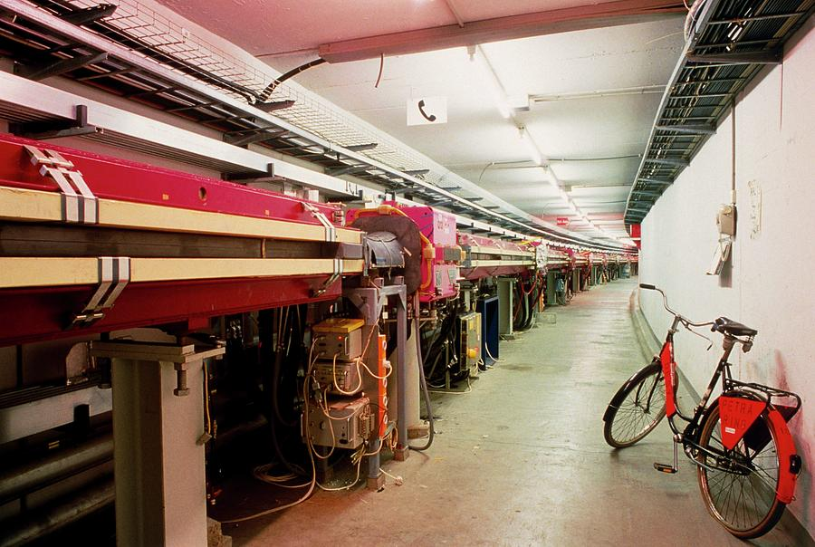
PLUTO moves… Five into Four Doesn’t go
The new PETRA collider had four interaction regions.
Three of these were occupied by TASSO, MARK J and JADE.
The NE Halle was to be shared by two detectors in a roll-in roll-out arrangement: CELLO and PLUTO
(In fact it was a requirement on all the PETRA detectors that they could be rolled in and out of the beamline for maintenance, repair etc. so that data-taking could continue with the other detectors)
The first NE occupant was supposed to be CELLO but they weren’t ready so PLUTO got the first shot at PETRA data.
PLUTO got More upgrades for its PETRA incarnation…
Upgrade
PLUTO vs. CELLO
1978–79 PLUTO
1979 1981 CELLO
1981- 1982 PLUTO
1986 end PETRA CELLO
Upgrade

Slide 14
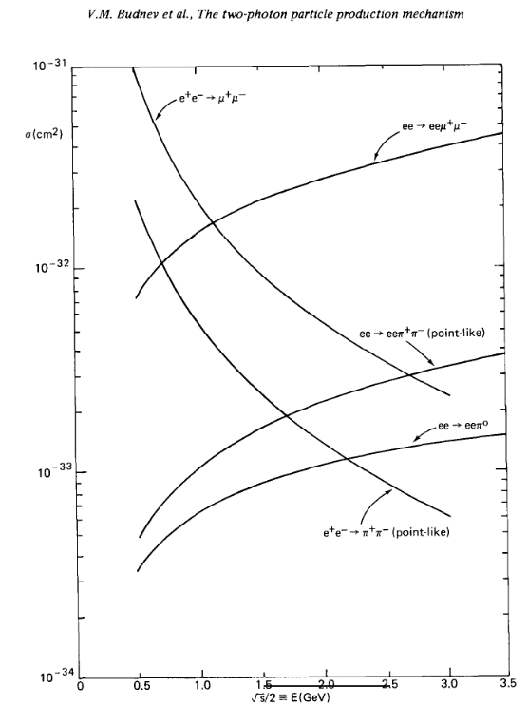
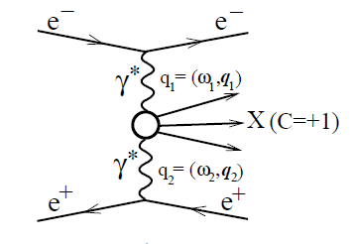
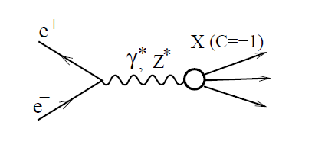
Major aim of upgrade was to improve the ability to measure Two-photon Processes
As well as annihilation processes, e⁺ e⁻ colliders can produce final states
via so-called two-photon interactions:
Long-understood† that 2γ processes would come to dominate at high energies in colliders.
Renewed interest with new generation of machines.
†L.D. Landau, E.M. Lifshitz, Sov. Phys. 6, 244 (1934).

Slide 15
Motivations for γγ physics
Importance for production of hadrons and leptons storage rings recognised ~1970†
…but only a few experimental results
e.g. 1970 Novosibirsk
seen as interesting fundamental process in its own right
  QED lepton pair production
  inclusive particle production
  C=+1 resonances
  total crossection
  high-p_{T} jet production
  tool for investigation of QCD
  (recall gluons still in process of being confirmed, QCD little-tested)
†Arteage-Romero, Jaccarini, Kessler and Parisi (1970), Balakin, Budnev and Ginzburg(1971), Brodsky,Kinoshita and Terazawa (1971).

Slide 16
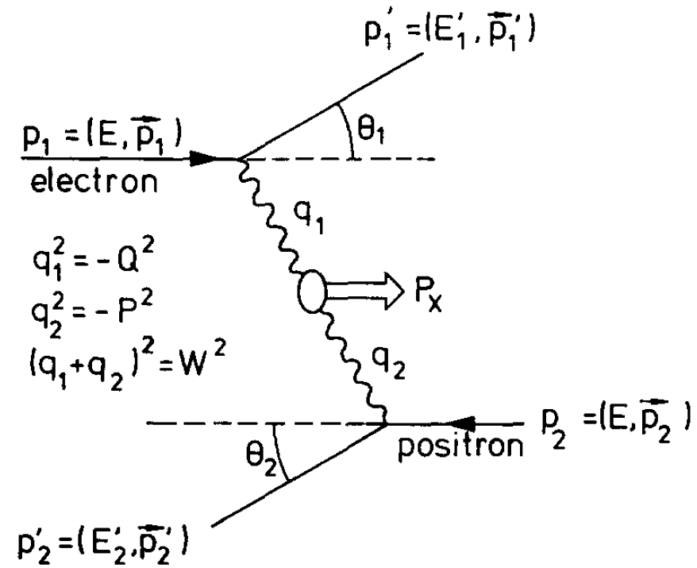
Can measure without detecting outgoing e⁺ e⁻ (lower than cms energy in final state)
collision of nearly real photons
But interest in processes where one or both photons off-shell.
Detecting (or ‘tagging’) scattered e⁺ e⁻ enables full control over virtuality of the photons
Needed good detector coverage in forward regions

Slide 17
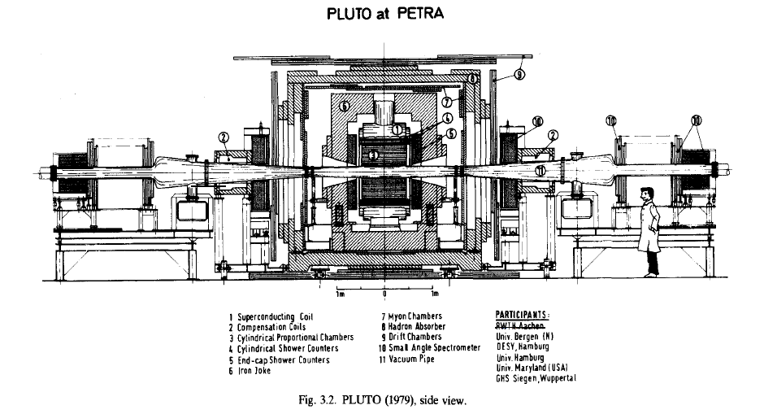
Upgrade 1. First PETRA data
Addition of forward spectrometers to facilitate γγ physics
Forward spectrometer
compensating coil
Note: no momentum measurement in forward spectrometers

Slide 18
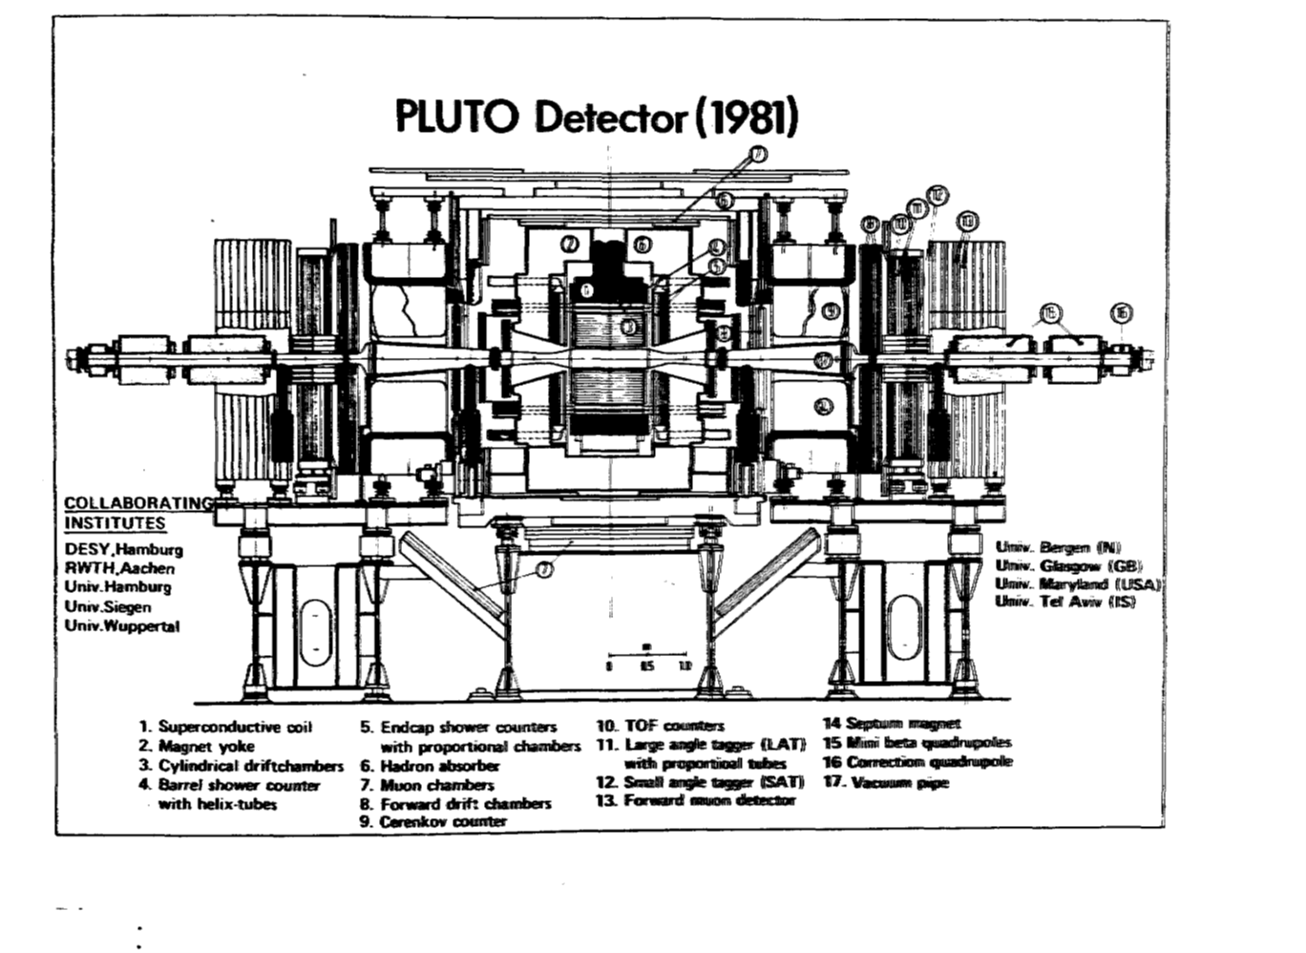
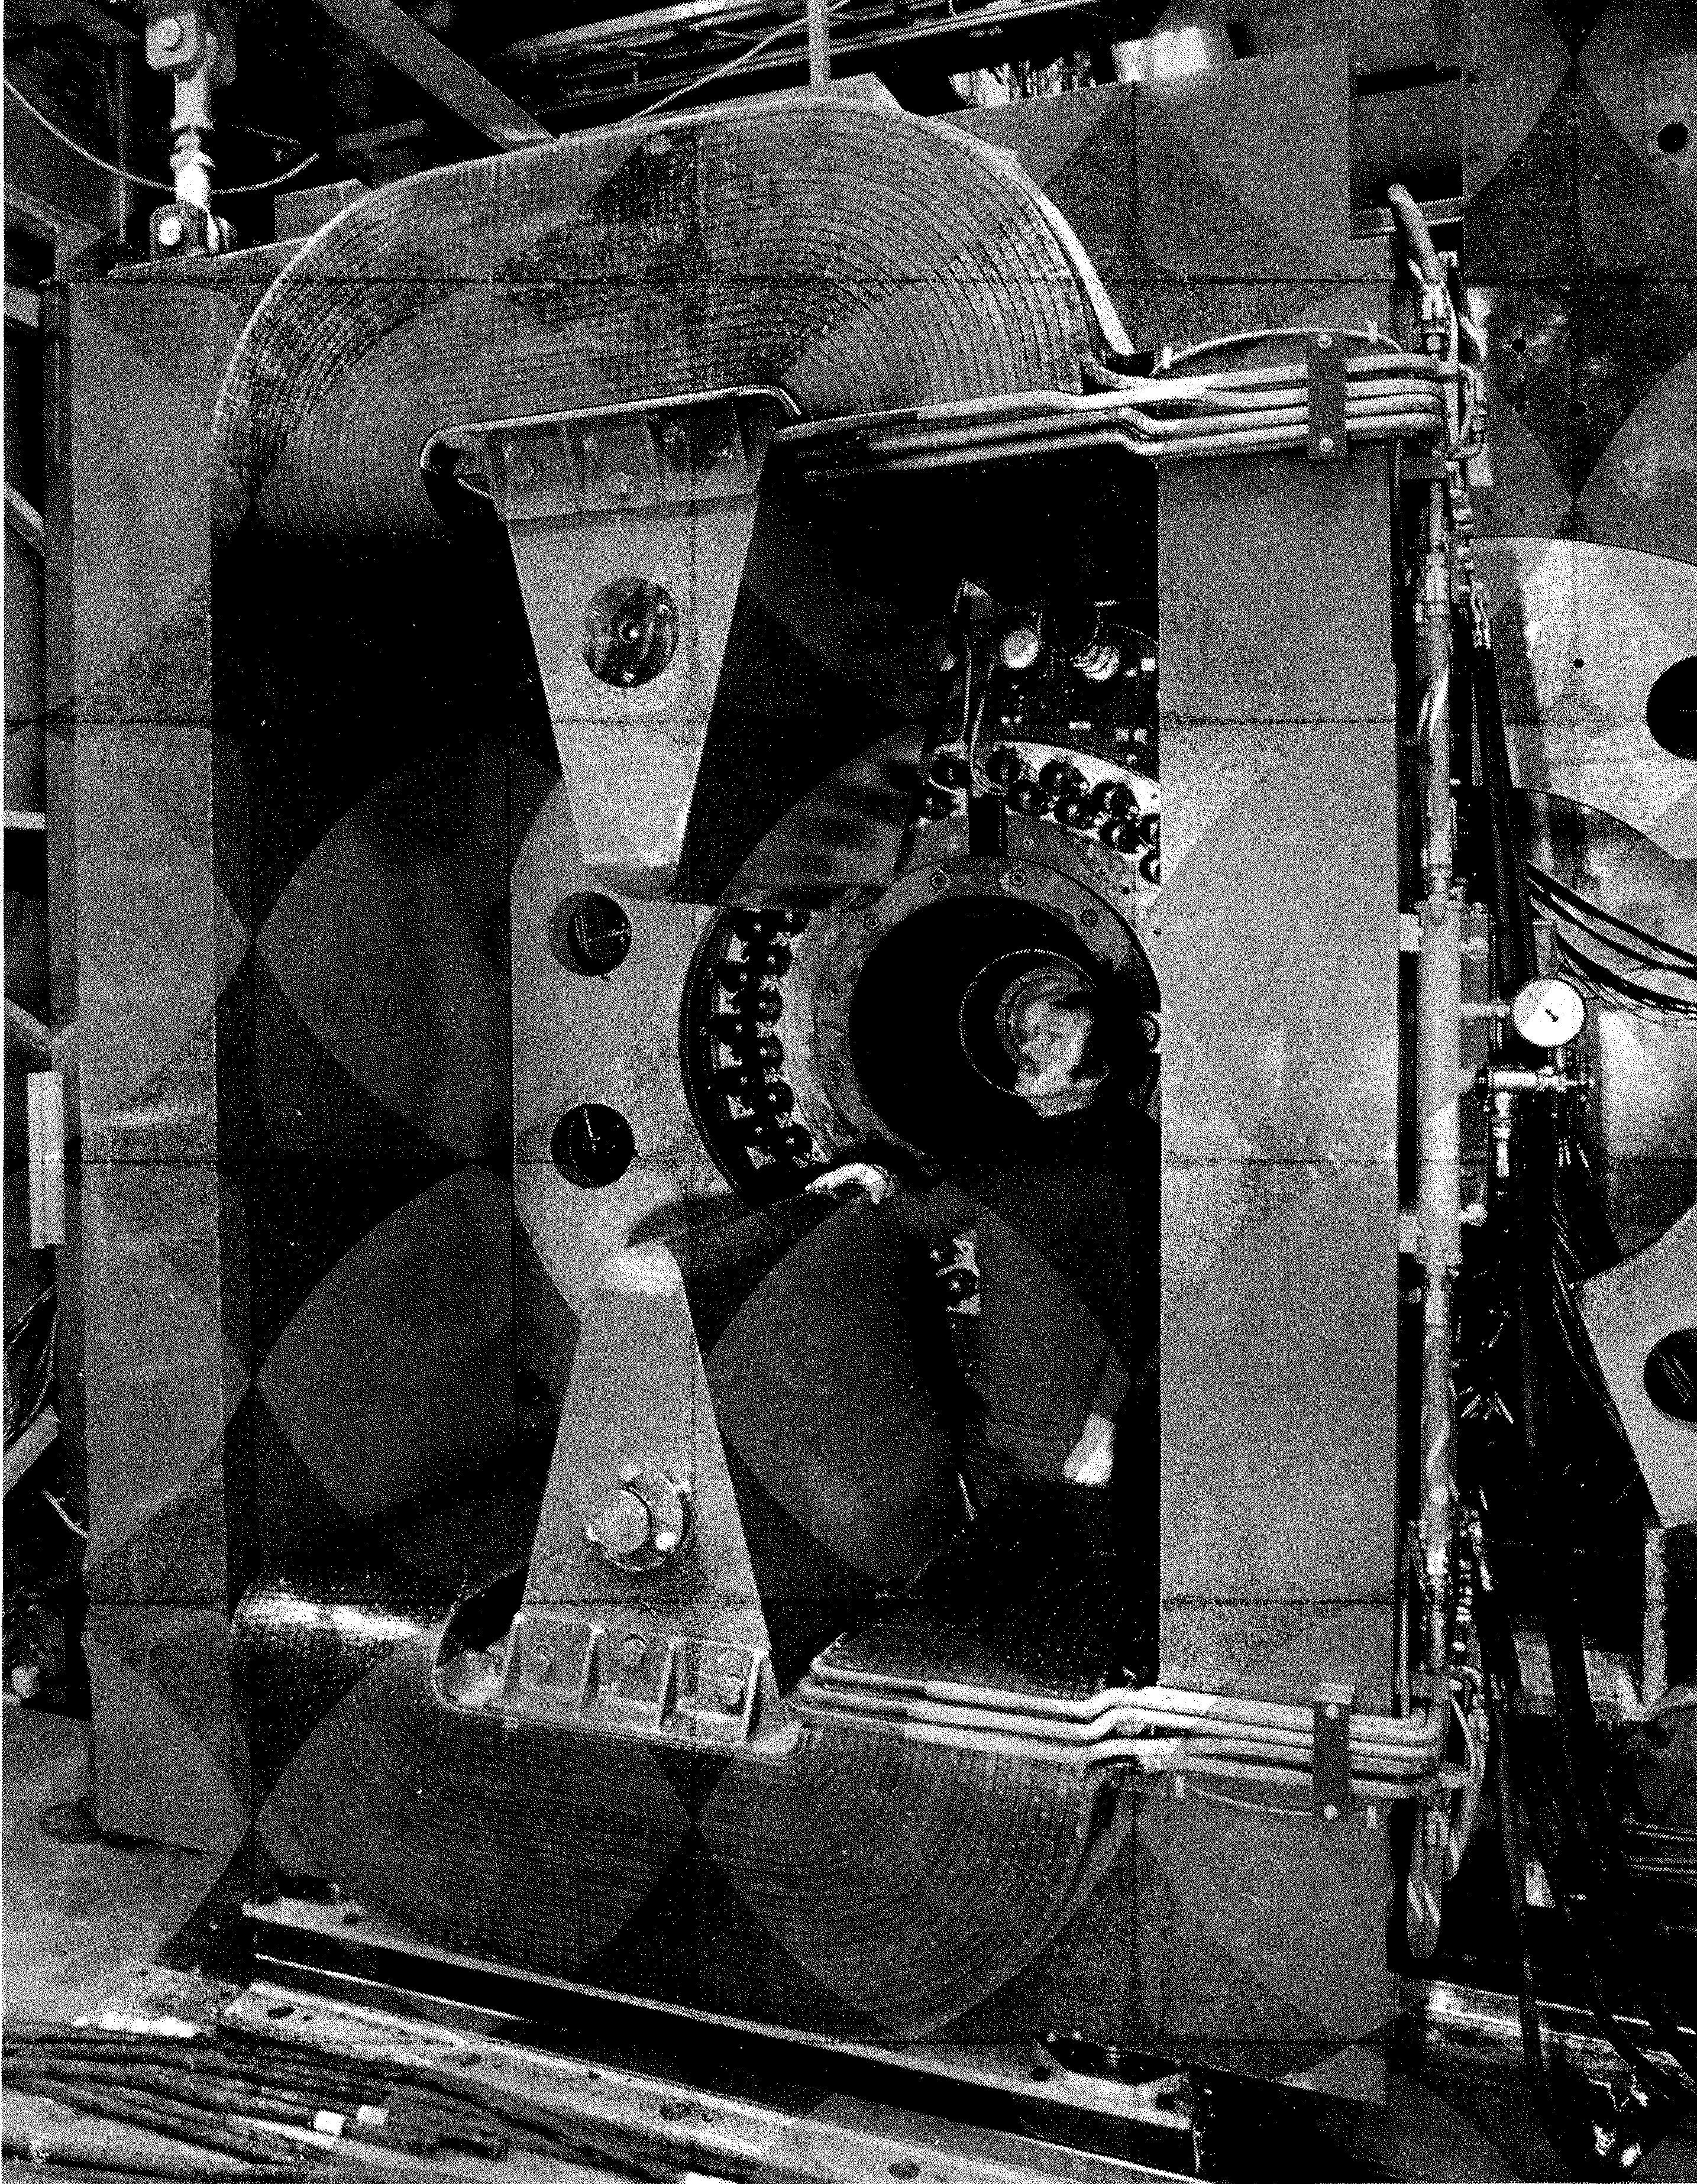
Upgrade 2. 1980: introduction of Mini-β optics Interaction region shrunk from 15m to 9m.
Further Improvement of forward spectrometers to facilitate γγ physics
New
TOF
Septum magnets
Cerenkovs
DC’s
LAT and SAT
forward muons
…

Slide 19
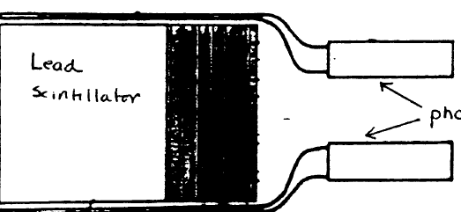
Needed a new SAT. Old one (lead glass blocks)wouldn’t work in fringe field of the septum magnets†:
[The calorimeter part of the new SAT was designed and built by Maryland. The prop tubes were designed built and installed by Bergen: In a single weekend! (aided by much cold beer). They worked immediately and flawlessly.
†This was discerned experimentally by waving around a crystal/pm as the field was wound up eventually killing the signal. It also very nearly killed people:
Unfortunately, the LAT(?) which was on rails had been unlocked somehow and (spotted by JBD!) started to tip. Test abandoned.

Slide 20
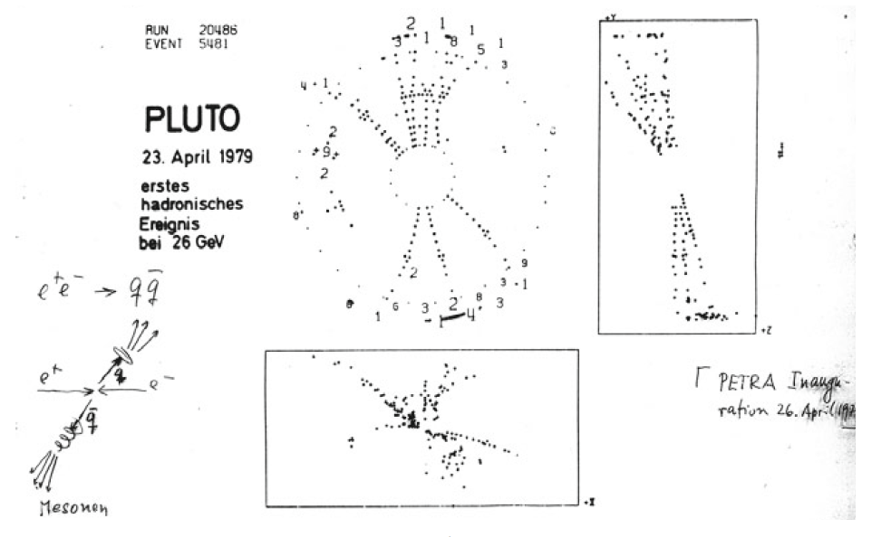
PLUTO’s First (PETRA-driven) hadronic event:
manifest Jets!
Some early publications:
Evidence for Gluon Bremsstrahlung in e+ e- Annihilations at High-Energies Phys.Lett.B 86 (1979), 418-42
Hadron Production From Photon - Photon Interactions in the Center-of-mass Energy Range From 1-{GeV} to 5-{GeV} Phys.Lett.B 89 (1979), 120-124
Search for a 'Top' Threshold in Hadronic $e^+ e^-$ Annihilation at Energies Between 22-{GeV} and 31.6-{GeV} Phys.Lett.B 86 (1979), 413-417
…by now mandatory.

Slide 21
PLUTO@PETRA publications
Cross-Sections and Event Topologies in e+ e- Annihilation at 13-GeV and 17-GeV Observed with the PLUTO Detector Phys.Lett.B 81 (1979), 410-415
Search for a 'Top' Threshold in Hadronic $e^+ e^-$ Annihilation at Energies Between 22-{GeV} and 31.6-{GeV} Phys.Lett.B 86 (1979), 413-417
Evidence for Gluon Bremsstrahlung in e+ e- Annihilations at High-Energies Phys.Lett.B 86 (1979), 418-42
Hadron Production From Photon - Photon Interactions in the Center-of-mass Energy Range From 1-{GeV} to 5-{GeV} Phys.Lett.B 89 (1979), 120-124
Two Particle Correlations in $e^+ e^-$ Annihilation Phys.Lett.B 90 (1980), 312, Phys.Lett.B90 (1980) 312-316
Test of {QED} in the Reactions $e^+ e^- \to e^+ e^-$ and $e^+ e^- \to \mu^+ \mu^-$ at {CMS} Energies From 9.4-{GeV} to 31.6-{GeV} Z.Phys.C 4 (1980), 269
Search for Narrow Resonances in $e^+ e^-$ Annihilation at {PETRA} Phys.Lett.B 91 (1980), 148-151
Lepton and Hadron Pair Production in Two Photon Reactions Phys.Lett.B 94 (1980), 254-258
Measurement of the Reaction $e^+ e^- \to \gamma \gamma$ at {CMS} Energies From 9.4-{GeV} to 31.6-{GeV} Phys.Lett.B 94 (1980), 87-90
Multiplicity Distributions in e+ e- Annihilations at PETRA Energies Phys.Lett.B 95 (1980), 313-317
A Study of Multi-Jet Events in e+ e- Annihilation Phys.Lett.B 97 (1980), 459-464
INELASTIC ELECTRON PHOTON SCATTERING AT MODERATE FOUR MOMENTUM TRANSFERS Phys.Lett.B 99 (1981), 287-291
A Cluster Algorithm for Jet Studies Z.Phys.C 8 (1981), 167
Observation of {QCD} Effects in Transverse Momenta of $e^+ e^-$ Jets Phys.Lett.B 100 (1981), 351-356
Experimental Test of Electroweak Effects at {PETRA} Energies Z.Phys.C 7 (1981), 289
Energy-energy Correlations in $e^+ e^-$ Annihilation Into Hadrons Phys.Lett.B 99 (1981), 292
Lepton Pair Production and Search for a New Heavy Lepton in $e^+ e^-$ Annihilation Phys.Lett.B 99 (1981), 489-494
Inclusive $K^0$ Production in $e^+ e^-$ Annihilation for 9.3-{GeV} $<\sqrt{s}<$ 31.6-{GeV} Phys.Lett.B 104 (1981), 79-8
First Measurement of the Photon Structure Function F2 Phys.Lett.B 107 (1981), 168-172
Energy Dependence of Jet Measures in $e^+ e^-$ Annihilation Z.Phys.C 12 (1982), 297
A Study of Two Photon Production of Two-body Final States With Invariant Mass Greater Than 2.0-{GeV} Nucl.Phys.B 202 (1982), 189-200
A Measurement of Charge Properties of Quark Jets at {PETRA} Nucl.Phys.B 214 (1983), 189-200
ENERGY MOMENTS FOR QUARK JETS AT PETRA Z.Phys.C 19 (1983), 205,
Measurement of Transverse Momenta in $e^+ e^-$ Annihilation Jets at {PETRA} Z.Phys.C 22 (1984), 103,
Measurement of the Muon Pair Asymmetry in $e^+ e^-$ Annihilation at $\sqrt{s}=34$.7-{GeV} Z.Phys.C 21 (1983), 53
Exclusive Production of Hadron Pairs at Large Momentum Transfer in Photon-photon Interactions Phys.Lett.B 137 (1984), 267-271
Measurement of the Photon Structure Function F2 (x, Q**2) Phys.Lett.B 142 (1984), 111-118
Measurement of Deep Inelastic Electron Scattering Off Virtual Photons Phys.Lett.B 142 (1984), 119
Measurement of Exclusive $\eta^\prime$ Production in $\gamma \gamma$ Reactions Phys.Lett.B 142 (1984), 125-129
The $Q^2$ and Transverse Momentum Dependence of Jet Production in Photon-photon Interactions Z.Phys.C 26 (1984), 191
Pion Pair Production in Photon-photon Interactions Z.Phys.C 26 (1984), 199
Formation of the Tensor Mesons A2 (1320) in Photon-photon Interactions Phys.Lett.B 149 (1984), 427-432
STERMAN-WEINBERG JETS AND ENERGY FLOW IN e+ e- ANNIHILATION AT center-of-mass ENERGIES BETWEEN 9.4-GeV AND 35-GeV Z.Phys.C 27 (1985), 167
A Measurement of the $Q^2$ and $W$ Dependence of the $\gamma \gamma$ Total Cross-section for Hadron Production Z.Phys.C 26 (1984), 353
Measurement of the Total Photon-photon Cross-section for the Production of Hadrons at Small $Q^2$ Phys.Lett.B 149 (1984), 421-426
Tagged Two Photon Production of Muon Pairs Z.Phys.C 27 (1985), 249
Tests of the Standard Model With Lepton Pair Production in $e^+ e^-$ Reactions Z.Phys.C 27 (1985), 341
Measurements of Tau Lepton Production and Decay Z.Phys.C 28 (1985), 1
A Study of Energy-energy Correlations in $e^+ e^-$ Annihilations at $\sqrt{s}=34$.6-{GeV} Z.Phys.C 28 (1985), 365
Study of the Reaction $\gamma \gamma \to 2 \pi^+ 2 \pi^- \pi^0$ and Upper Limits on the Production of $\gamma \gamma \to \omega \omega$ and $\gamma \gamma \to \rho^0 \omega$ Z.Phys.C 29 (1985), 183, Z. Phys. C29 ( 1985) 183-187
Jet Production at High Transverse Momenta by Interactions of Two Quasireal Photons Z.Phys.C 29 (1985), 499, Hamburg Desy - DESY 85-100 (85,REC.OCT.) 12p
Evidence for Exclusive $\eta_c$ Production in $\gamma \gamma$ Interactions Phys.Lett.B 167 (1986), 120-126, Phys. Lett. B167 ( 1986) 120-126
Measurement and QCD Analysis of the Photon Structure Function F2 (x, Q**2) Nucl.Phys.B 281 (1987), 365,
Jet Production in Photon-photon Interactions Z.Phys.C 33 (1987), 351
Tensor Meson Excitation in the Reaction $\gamma \gamma \to K^0_S K^0_S$ Z.Phys.C 37 (1988), 329
∼ Half 2γ

Slide 22
γγ−physics
“…the condensation of light into matter…” B etal
JBD: Everything is in here somewhere
1975
Opens up possibility of measuring Photon Structure Function: DIS of electrons off photon target

Slide 23

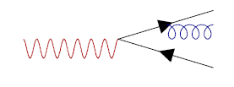
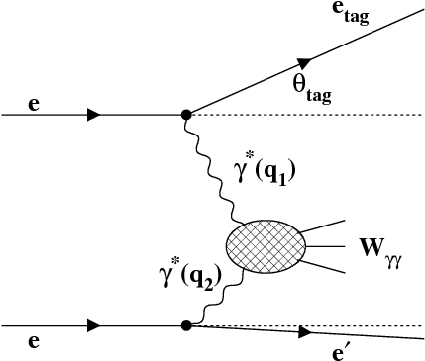
PHOTON STRUCTURE FUNCTION
Photon develops structure, including hadronic structure, through fluctuation into quark pairs and ‘subsequent’ gluon emissions in higher order.
VDM
point-like
QCD
Hadronic structure can be ‘probed’ as in DIS
‘Single tag’ mode: DIS off quasi-real photon
‘Probe’ Q²
‘Target’ P²

Slide 24
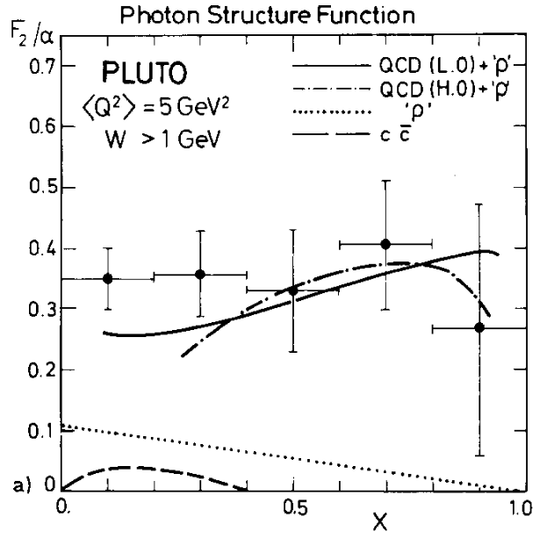
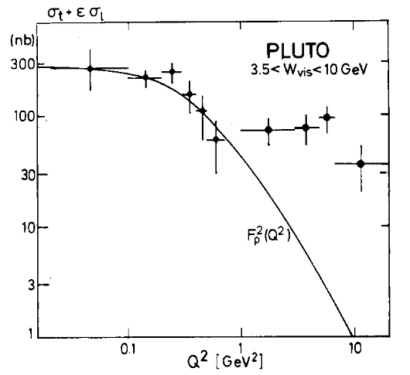
NLO Bardeen and Buras 1979, 1980 Duke and Owens
LO Witten 1977
1981: Point-like photon structure demonstrated
First Measurement of the Photon Structure Function F2
PLUTO Collaboration • Christoph Berger (Aachen, Tech. Hochsch.) et al.
DOI: 10.1016/0370-2693(81)91174-6
Published in: Phys.Lett.B 107 (1981), 168-172
Striking features:
rising x-shape in sharp contrast to (1-x)-ish hadrons
Proportional to 4th power of quark charges
Strong scaling violations.
Calculable in pQCD
Powerful test of QCD
Possibility of precision determination of α_{S}

Slide 25
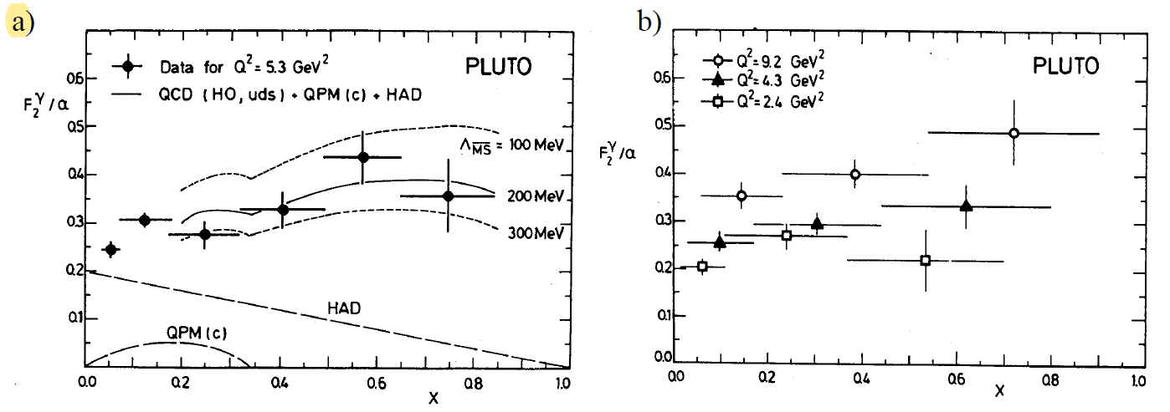
1984 With improved forward spectrometer
1417 hadronic events in ‘tag’+’antitag’ configuration integrated luminosity 34.2pb-1
Confirmed basic properties,
Measured QCD scale parameter of 65 < < 575 MeV

Slide 26
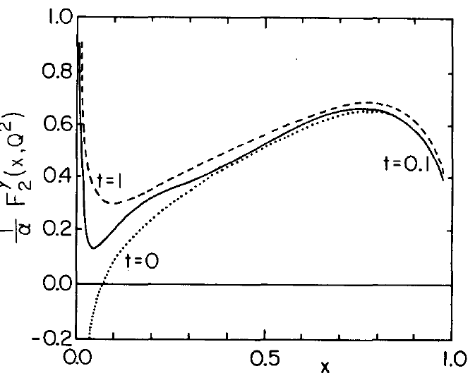
But…
All not quite as it seemed with HO QCD calculations.
Predicted negative F₂ at low x!
perturbatively incalculable ‘hadronic’ terms remain
Asymptotically dominant point-like term is calculable but separating this out from the full expression causes issues: splits previously well-behaved terms into parts that are individually singular (poles in the moments). Higher order, more poles
Leads to singular x behaviour:
Impact on higher x region depends on residuals. In principle calculable but had only been done to second order
Instead various regularisation schemes were tried.
e.g. Antoniadis and Grunberg. Additional parameter to be fitted.

Slide 27
Lessened interest somewhat and attention switched to Q² evolution of structure function à la conventional hadron structure with various pdf’s being measured etc.
There is another way…
Virtual Photon Structure
If target photon goes off-shell, its mass provides a lower cutoff, also expect suppression of ‘VDM’
for leading part of
Uematsu-Walsh (1981,1982)
Sacrifice sensitivity to QCD scale factor but fully calculable in pQCD.
Could this be measured by PLUTO? Rate for double-tagged events low. Not clear would be enough data. Also, with <Q² > ~ 5GeV² and <P² > ~ 0.35GeV² condition barely met.
Nevertheless, with strong encouragement from JBD…

Slide 28
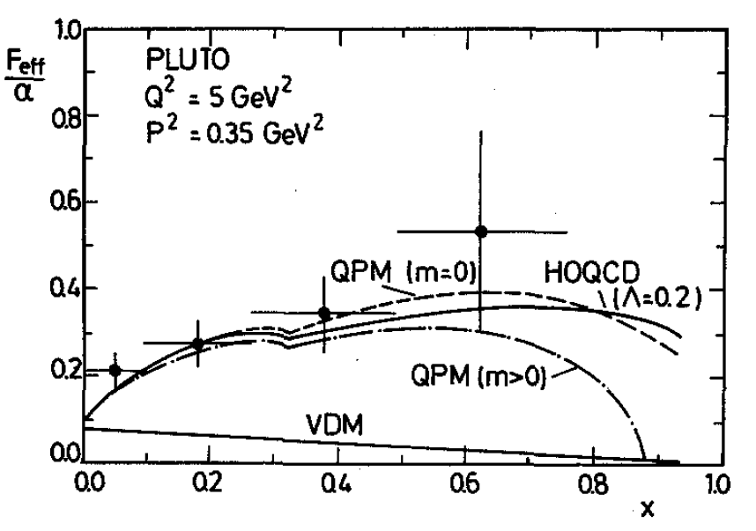
…Yes.
Only ~70 events after selection in LAT-SAT configuration.
‘Ambitious’ use of unfolding techniques needed:
needed unfolding in 3 variables x, Q² and P²
Testament to unfolding software (V. Blobel) that this actually worked!
First measurement of virtual photon structure function
Demonstration of principle
See evolution of photon from quasi-real photoproduction to virtual.
There might have been more but…
Measurement of Deep Inelastic Electron Scattering Off Virtual Photons
PLUTO Collaboration • Christoph Berger (Aachen, Tech. Hochsch.) et al.
Published in: Phys.Lett.B 142 (1984), 119

Slide 29
PLUTO , the end, Five into Four Doesn’t go
In August 1982, PLUTO gave way to CELLO and was taken out of the beam never to return.
This was disappointing for the PLUTO collaboration who decided to celebrate the event by conducting a funeral
with sombre eulogies and a procession from the NE Hall to the DESY directorates office carrying a coffin with a model of the PLUTO detector on top…
…there was also a Wake
…with lots of alcohol.
Much to celebrate:
PLUTO had taken data at three different storage rings at energies ranging 3 to 32 GeV over ~8 years
with multiple upgrades. Collaboration grew from 15 to ~80 members. Multi-national (Germany, UK, Israel, USA, Norway)
It was a pioneering detector, exploration of new resonances, QCD: gluons, jets, 2-gamma physics and photon structure function.
† PLUTO almost had yet another incarnation as a double β-decay expt. Would have involved replacing some wires in the drift chamber with Molybdenum(?) and removing background sources. Most significant was the lead in the barrel calorimeter. Physically v. difficult to pull out! Recall Dick Kellog phoning up the Hamburg water authorities enquiring about radioactivity of the water. He got instantaneous and detailed real-time information.
Notes:
† PLUTO almost had a reincarnation as a double β-decay expt. Would have involved replacing some wires in the drift chamber with Molybdenum(?) and removing background sources. Most significant was the lead in the barrel calorimeter. Physically v. difficult to pull out! but there were plenty of others. Recall Dick Kellog phoning up the Hamburg water authorities enquiring about radioactivity of the water. He got an instantaneous and detailed real-time account

Slide 30
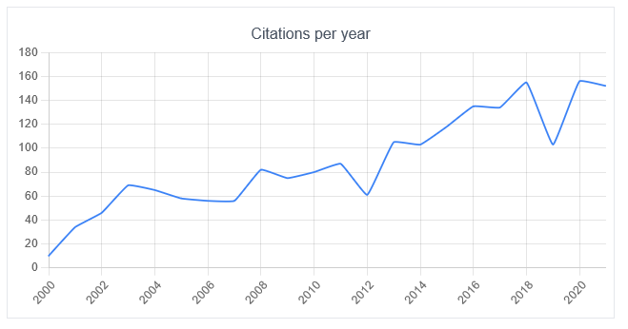
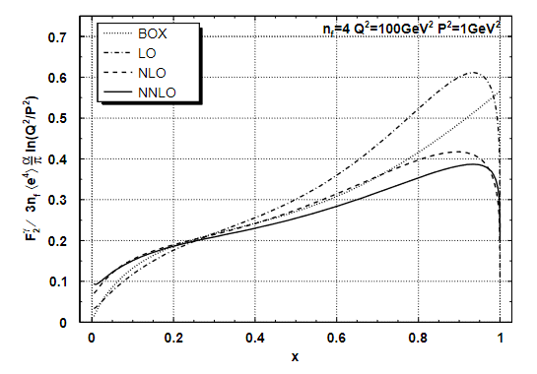
POST-SCRIPT on PHOTON STRUCTURE
2γ Physics continues into the 1990’s and early 2000’s at LEP, PEP and TRISTAN and at HERA, LHC. Even heavy ions – high Z compensates for mass
A respectable α_{S} was eventually extracted from combined F₂^{γ} data
Theoretical developments:
Clarification of point-like/hadronic contributions and NNLO calculations (Moch, Vermaseren, Vogt 2002, Ueda, Sasaki, Uematsu Phys. Rev. D 75, 114009 2007)
Strong resurgence of interest with prospect of FCC-ee and CEPC.

Slide 31

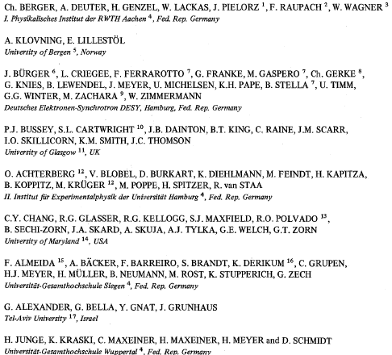
The PLUTO Collaboration:
1974: 15
Confirmation of
1984: 78

Slide 32
END

Slide 33
Personal Note:
Many thanks JBD for introducing me to the joy (curse?) of two-photon physics.
After that there was no escape:
My subsequent career :
PEP TPC/2-gamma more
HERA: H1 direct and resolved photons (losing one e-beam didn’t do it)
LHC ATLAS: Search for extra dimensions graviton at least they’d shifted sides
finally… FNAL g-2. At last!...nope - Light-by-light
…Nevertheless,
Thank you, John

Slide 34
NOTES

Slide 35
ChatGPT on PLUTO:
PLUTO stood for "PLUon TOdetector," and it was designed to study the properties of the subatomic particles known as hadrons. Hadrons are particles that are made up of quarks, which are the building blocks of matter. The PLUTO detector was specifically designed to study the production and decay of hadrons, with a particular focus on the properties of the so-called "strange" hadrons.
On two photon physics:
Two-photon physics was an important area of research at the PLUTO detector at PETRA. In this type of physics, two photons (particles of light) are used to create other particles through a process known as "photon-photon scattering."
At the PETRA accelerator, high-energy electron and positron beams were collided to produce a high-energy photon beam, which was then directed onto a target made of heavy elements. When the photon beam collided with the target, some of the photons interacted with the target's atomic nuclei, producing a second photon beam.
The two photon beams were then brought into collision with each other in the PLUTO detector, producing a range of particles, including electron-positron pairs, muon-antimuon pairs, and hadrons. The PLUTO detector was able to detect and measure the properties of these particles, allowing scientists to study the underlying physics of the process.

Slide 36
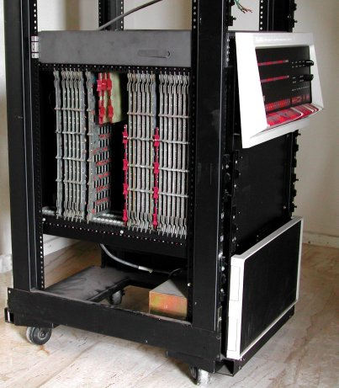
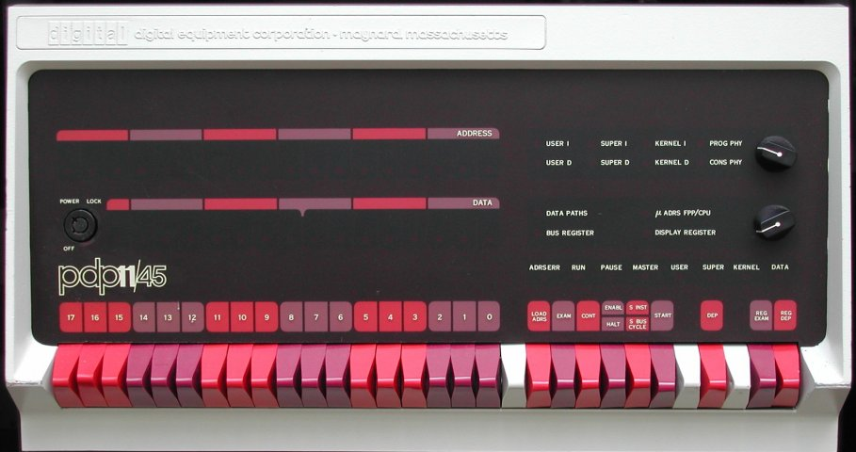
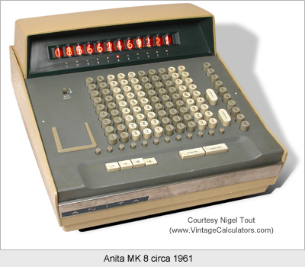
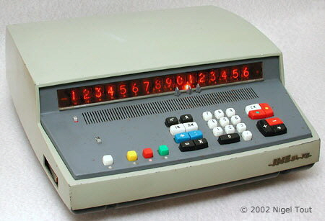
PLUTO data acquisition:
Controlled by PDP-11/45
data sent by fast link to DESY IBM for further processing and writing to tape.
128k memory
The PDP-11/45 was an excellent choice.
They were used by London Terminal Control Centre air-traffic control between 1980 and 2005. Never suffered a major failure.
Still in use today Nuclear Power Plants, US Navy…!
More importantly, it had a really, really cool looking console!
Also, I’m pretty sure there was one of these in the PLUTO control room

Slide 37
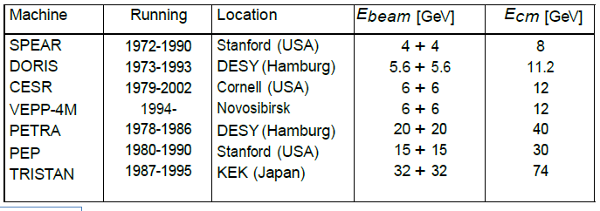
Two Photon Physics and the photon structure function
H.Kolanoski –Two-Photon Physics in the 1980ies
Photon'15 Novosibirsk 15-19-Jun-15

Slide 38
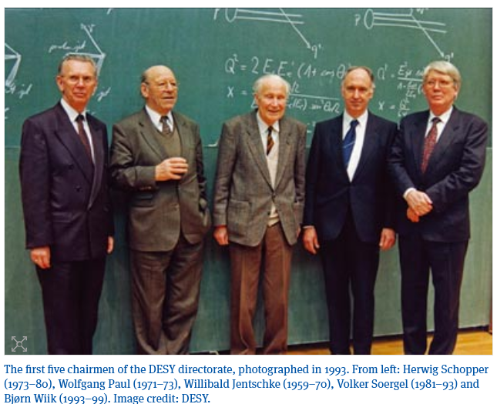
1981 Schopper Soergel
1973 to 1980: Herwig Schopper
1981 to 1993: Volker Soergel (1931 – 2022)

