Slide 1



Authentication and Authorisation for the WLCG
An introduction to the key concepts, and how they fit within the WLCG Space
Notes:
The abstract pattern can be removed or repositioned if required. Be careful to ‘Send to Back’ so that it does not obscure any important information.

Slide 2


Who am I?
I currently wear multiple Authentication and Authorisation hats…
Service Manager for the Identity and Access Management service for the U.K. IRIS Collaboration
Current Authorisation Working Group Chair for the WLCG
Scrum master for the SKA agile team working on Authentication and Authorisation Infrastructure (AAI)
Working to ensure that all these communities (and others!) can interoperate
Questions? Feel free to contact at:
thomas.dack@stfc.ac.uk
Notes:
Please replace photo of presenter with a portrait of your own. 1) Send the geometric shape overlay to the back – Right-Click > Send to Back > Send to Back. 2) Replace image – use the guides provided to correctly position it. 3) Send your portrait to the back so that the geometric overlay re-appears over the portrait.

Slide 3


Agenda
1 Introduction to AuthN & AuthZ
…and why does it matter anyway
2 AuthN & AuthZ For the WLCG
3 AuthN & AuthZ: Certificates & VOMS
4 AuthN & AuthZ: Tokens
Image © STFC Alan Ford
5 Towards Tokens for WLCG
Notes:
To replace photo with one of your own. 1) Send the geometric shape overlay to the back – Right-Click > Send to Back > Send to Back. 2) Replace image – use the guides provided to correctly position it. 3) Send your image to the back so that the geometric overlay re-appears over the image. Remember to delete the image credit if using your own image.

Slide 4
Take Aways
What is the difference between Authentication and Authorisation
An understanding of why this is important for research
A basic understanding of the existing Certificate and VOMs infrastructure
A more in-depth understanding of the OAuth and OIDC protocols
A brief overview of the planned token transition for WLCG

Slide 5


Introduction to
Authentication &
Authorisation
…and why does it matter anyway
Notes:
The abstract pattern can be removed or repositioned if required. Be careful to ‘Send to Back’ so that it does not obscure any important information.

Slide 6

Authentication and Authorisation
Or, Not letting everyone in
Letting everyone access everything is often a bad idea
Though this is not always true – the level of access control required involves considering the risks
In the contest of research, we probably don’t want anyone and everyone online being able to get in…

Slide 7


Authentication and Authorisation
Controlling access depends on:
Verifying a user’s access to an account or identity – authentication (AuthN)
Knowing that a user is allowed to do what they want to do – authorisation (AuthZ)
These processes are usually combined, as key processes in a community’s Authentication and Authorisation Infrastructure - AAI
SIDE NOTE:
AuthoriZation - 🇺🇸 & 🇨🇦
AuthoriSation - 🇬🇧 & the rest of the English-speaking world
I will have typed AuthoriSe, except in occurrences where it is a named term or attribute
… also I use the Americanised shorthand, AuthZ

Slide 8
Authentication and Authorisation - Then
Traditionally a user would need to Authenticate separately to every new service or account they wanted to use
Lots of accounts, scattered through every site a user has ever signed up for
This results in many username and password pairs, which in turn leads to bad security practices
  Credentials are reused for “simplicity”, or simply forgotten and lost

Slide 9
Authentication and Authorisation - Now
In more modern applications, the process is evolving
Increased importance of account credibility
  Processes and systems in place to show that an associated identity is verified
Increased adoption of single sign-on mechanisms, using a unified identity
  Log-in with Social IDs, such as Facebook, Google, ORCID
Can grant authorised access based on an identity’s attributes
  Home institute, email address, etc

Slide 10
What makes AAI important for research?
A couple of key concepts underpin the use of identity in research:
Confidentiality
Traceability
Suspension
Attribution

Slide 11

What makes this important for research?
A couple of key concepts underpin this:
Confidentiality
Traceability
Suspension
Attribution
Confidentiality
Whilst final research outputs are public, maintaining confidentiality before this point is important
Particularly important for fields handling personal and medical data

Slide 12

What makes this important for research?
A couple of key concepts underpin this:
Confidentiality
Traceability
Suspension
Attribution
Traceability
If something goes wrong – accidentally or maliciously – service owners need to be able to trace where this happened
Knowing which account caused an issues is important for both support or suspension

Slide 13

What makes this important for research?
A couple of key concepts underpin this:
Confidentiality
Traceability
Suspension
Attribution
Suspension
Processes to suspend an individual user account in case of compromise or malicious activity
Avoids downtime caused by stopping an entire service or resource, by isolating the problematic identity

Slide 14
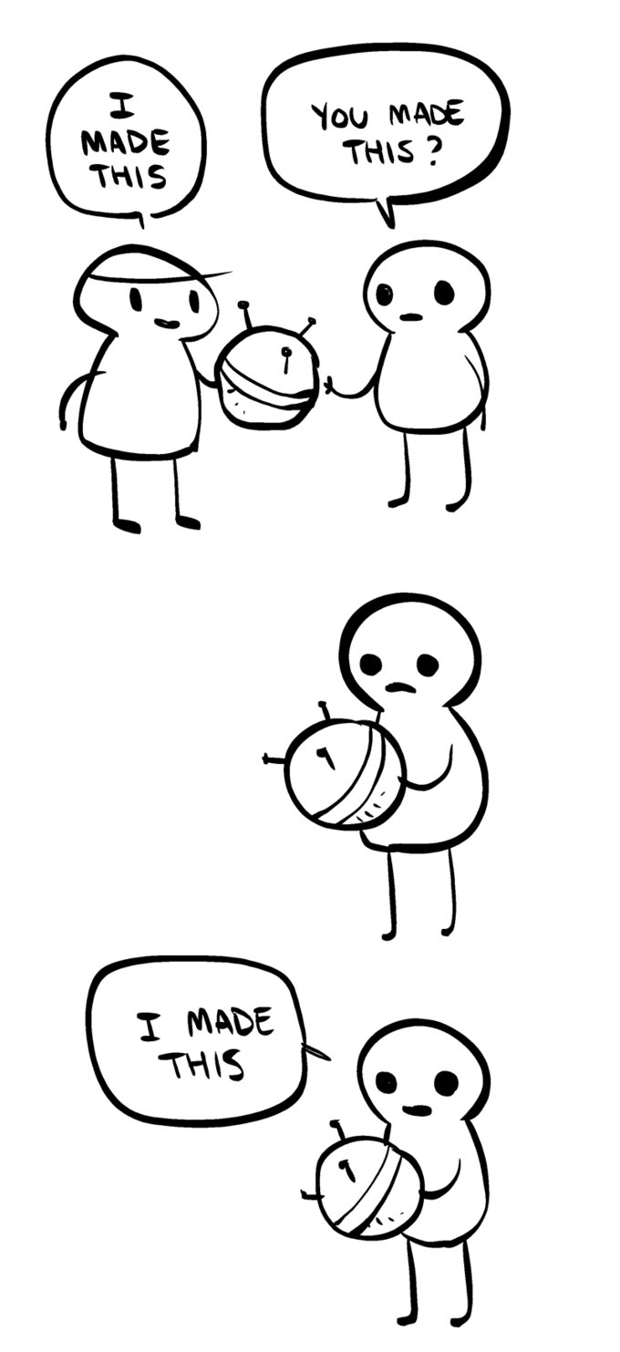
What makes this important for research?
A couple of key concepts underpin this:
Confidentiality
Traceability
Suspension
Attribution
Attribution
A single central identity provides a mechanism through which research can be attributed
ORCID is an example of this – life-long identifiers for researchers, which can be attached to publications, grant requests, etc
Identity changes can present problems – name changes from marriage, gender transition, etc
Tumblr – The Internet by Nedroid / January 30th, 2013

Slide 15
AuthN & AuthZ
For the WLCG
Notes:
The abstract pattern can be removed or repositioned if required. Be careful to ‘Send to Back’ so that it does not obscure any important information.

Slide 16
AuthN & AuthZ for the WLCG
Providing global access to computing resources – not easy!
Global user community, with many members
Distributed single infrastructure
Not guaranteed that users know each other
Not guaranteed that users will ever meet
Need a system for provisioning access, to be trusted across the grid

Slide 17
Not guaranteed that users know each other
Who can you trust to know the users, in order to authenticate them?
Many options, including:
The Infrastructure
The Experimental Group or Research Community
The Home Organisations
A trusted Third Party
In most cases, a user’s Home Organisation may have the most current information – especially if their access is a function of their affiliation.
Notes:
Or, potentially, a trusted 3rd party like a government, bank or organisation specialised in identity vetting

Slide 18
Not guaranteed that users will ever meet
But! A user’s Experimental Group or Research Community may be better placed to tell you…
Which group the user belongs to
What roles (permissions) they should have
  what are they authorised to do
  Are they a user, an admin, a super-user, etc?
The status of a user’s policy acceptance – e.g. whether they have accepted the latest acceptable usage policy
Notes:
Or, potentially, a trusted 3rd party like a government, bank or organisation specialised in identity vetting

Slide 19
AuthN & AuthZ for the WLCG
Need to bring these concepts together in order to control access to the grid
We’ll look at an overview of how this is done for the WLCG, looking at both the current system and the intended migration infrastructure:
Current: | Future:
Certificates & VOMS | Tokens & IAM

Slide 20
AuthN & AuthZ:
Certificates & VOMS
Notes:
The abstract pattern can be removed or repositioned if required. Be careful to ‘Send to Back’ so that it does not obscure any important information.

Slide 21
X.509 – a Recap
A Certificate is…
A digital identity, representing an entity
  could be a service/website, a machine, or a human individual
Signed by a Certificate Authority (CA)
  Self-signed certificates do exist but are not useful for authentication purposes!
  Signed by taking a hash of the certificate, which is then encrypted with the CA’s private key
Long lived – typically a grid certificate will last a year
User keeps an accompanying private key and password

Slide 22
VOMS - Virtual Organization Membership Service
VOMS is the certificate-based AAI for the WLCG
A central attribute authority, and central repository for VO user information
Enables sorting of users into group hierarchies, storing roles and other attributes
This is used to issue trusted attribute certificates which can then be used in the Grid environment for authorisation purposes.

Slide 23
VOMS - Virtual Organization Membership Service
The typical VOMS user flow is as follows
The user registers at the CERN User Office and with their experiment secretariat, and the user is entered into the CERN HR database.
The user gets a certificate from any eligible Certificate Authority
The user registers with VOMS Admin for their VO and presents their certificate to authenticate. Their email address is matched with their record in the CERN HR database to confirm that their identity has been verified. The VO manager approves the registration. From that time on, the HR ID is used as the unique ID in the VOMS DB, allowing the e-mail address to be changed independently at either end.
VOMS attributes, such as groups and roles, are maintained by VO Managers.
The user can submit jobs to the grid or access data on the grid by saving their User Certificate locally, running voms-proxy-init to generate the VOMS proxy, and running the relevant grid command; their proxy will get delegated to grid services as needed.
Notes:
The user registers at the CERN User Office and with their experiment secretariat, has their identity verified and proves their affiliation to an experiment. The user is entered into the CERN HR database.
The user gets a certificate from any eligible Certificate Authority
The user registers with VOMS Admin for their VO and presents their certificate to authenticate. Their email address is matched with their record in the CERN HR database to confirm that their identity has been verified. The VO manager approves the registration. From that time on, the HR ID is used as the unique ID in the VOMS DB, allowing the e-mail address to be changed independently at either end.
VOMS attributes, such as groups and roles, are maintained by VO Managers.
The user can submit jobs to the grid or access data on the grid by saving their User Certificate locally, running voms-proxy-init to generate the VOMS proxy, and running the relevant grid command; their proxy will get delegated to grid services as needed.

Slide 24
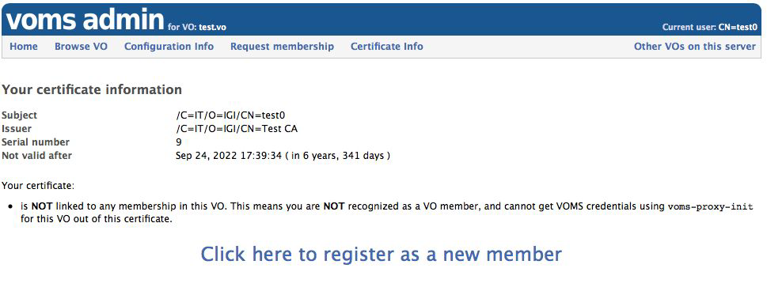
Proxy Certificates?
A Proxy Certificate is generated and signed using a user’s certificate
As it is signed by the user, the proxy certificate acts as a proof of identity – can be used for authentication
A VOMS Proxy adds extra, VO specific, information to the proxy – such as roles
This adds authorisation information to the proxy
Proxy certificates are short lived, and can be used to in turn sign further proxies – therefore allowing for delegated access on behalf of the user
Notes:
The user registers at the CERN User Office and with their experiment secretariat, has their identity verified and proves their affiliation to an experiment. The user is entered into the CERN HR database.
The user gets a certificate from any eligible Certificate Authority
The user registers with VOMS Admin for their VO and presents their certificate to authenticate. Their email address is matched with their record in the CERN HR database to confirm that their identity has been verified. The VO manager approves the registration. From that time on, the HR ID is used as the unique ID in the VOMS DB, allowing the e-mail address to be changed independently at either end.
VOMS attributes, such as groups and roles, are maintained by VO Managers.
The user can submit jobs to the grid or access data on the grid by saving their User Certificate locally, running voms-proxy-init to generate the VOMS proxy, and running the relevant grid command; their proxy will get delegated to grid services as needed.

Slide 25
AuthN & AuthZ:
Tokens
Notes:
The abstract pattern can be removed or repositioned if required. Be careful to ‘Send to Back’ so that it does not obscure any important information.

Slide 26
…Tokens?
There are a few components in a token flow. Key to this, a token is…
a JSON Web Token
  “JWTs are an open, industry standard RFC 7519 method for representing claims securely between two parties.” https://jwt.io/introduction/
  Tokens are encoded strings of data, issued by an issuer with which the client (receiver) has a trusted relationship.
In this context, JWTs are used to communicate authentication and authorization information using the OAuth 2.0 and OIDC protocols
OAuth 2.0 | OIDC
Open Authorization | Open ID Connect

Slide 27

Oauth 2.0 – the Access Token
An open standard for access delegation, and most often used for allowing users to grant a website access to their information on another website, without giving them their password
  Examples include signing into a third-party website using your Google, GitHub, or Orcid account
An access token is provided to the third party, from whichever service is acting as the Authorization Server, which it can then use to retrieve a protected resource
Want to know more about OAuth after the lecture?
https://oauth.net/

Slide 28






Oauth 2.0 – Terminology
Protected Resource
  The identity or data which is to be shared
  eg: your email address, or the ability to post to your Twitter
Resource Owner
  The user who owns the Protected Resource
  eg: you!
Client
  The application that wants access on behalf of the Resource Owner
  eg: the website you want to register with using your Google identity
Authorisation Server
  The application which knows the Resource Owner, and where the Resource Owner already has an account
  eg: The Google, Twitters, Orcids of the world
Resource Server
  Where the Protected Resource lives, and what the Client wants to use
  eg: the API from which the Client can access the Protected Resource
Owner
Client
AuthZ
Resc

Slide 29
Oauth 2.0 – Terminology
Protected Resource
  The identity or data which is to be shared
  eg: your email address, or the ability to post to your Twitter
Resource Owner
  The user who owns the Protected Resource
  eg: you!
Client
  The application that wants access on behalf of the Resource Owner
  eg: the website you want to register with using your Google identity
Authorisation Server
  The application which knows the Resource Owner, and where the Resource Owner already has an account
  eg: The Google, Twitters, Orcids of the world
Resource Server
  Where the Protected Resource lives, and what the Client wants to use
  eg: the API from which the Client can access the Protected Resource
A quick aside…
OAuth 2.0 defines two types of clients:
Confidential and Public Clients
Confidential applications can hold credentials with which they use to authenticate themselves to the AuthZ Server in a secure way. They require a trusted backend server to store the secret(s).
eg – a web application with a secure backend
Public clients cannot hold credentials securely.
eg – a native desktop or mobile application, or a JavaScript-based client-side web application (single-page app)
Owner
Client
AuthZ
Resc

Slide 30

OAuth 2.0 – How things work
Client
AuthZ
Server
Authorisation Request
Owner Authorisation
Client
Owner
Authorisation Grant
AuthZ
Access Token Request w AuthZ Grant
Owner
Access Token
Resource
Server
Resource Request with Access Token
Resc
Protected Resource

Slide 31
OAuth 2.0 – Authorisation Grants
The OAuth 2.0 framework specifies several different methods through which a Client can verify itself to the Authorisation Server - these are known as Authorisation Grants
  Authorisation Code
  PKCE
  Client Credentials
  Device Code
  Refresh Token
Key Authorisation Grant Concepts
Redirect URL – a URL at the client which the AuthZ server will deliver an issued token to
ClientID – the “username” of the client
ClientSecret – the “password” of the client

Slide 32
OAuth 2.0 – Authorisation Grants
The OAuth 2.0 framework specifies several different methods through which a Client can verify itself to the Authorisation Server - these are known as Authorisation Grants
  Authorisation Code
  PKCE
  Client Credentials
  Device Code
  Refresh Token
Authorisation Code
Used by both confidential and public clients
An authorisation code is exchanged for an access token
When the user returns to the client via the Redirect URL, the Authorisation Code is extracted from the URL and used to obtain the Access Token

Slide 33
OAuth 2.0 – Authorisation Grants
The OAuth 2.0 framework specifies several different methods through which a Client can verify itself to the Authorisation Server - these are known as Authorisation Grants
  Authorisation Code
  PKCE
  Client Credentials
  Device Code
  Refresh Token
https://example.com/oauth/auth?
response_type=code
&scope=EXAMPLE_REQUESTED_SCOPES
&client_id=EXAMPLE_CLIENTID
&redirect_uri=EXAMPLE_REDIRECT_URI
Authorisation Code
Used by both confidential and public clients
An authorisation code is exchanged for an access token
When the user returns to the client via the Redirect URL, the Authorisation Code is extracted from the URL and used to obtain the Access Token

Slide 34
OAuth 2.0 – Authorisation Grants
The OAuth 2.0 framework specifies several different methods through which a Client can verify itself to the Authorisation Server - these are known as Authorisation Grants
  Authorisation Code
  PKCE
  Client Credentials
  Device Code
  Refresh Token
curl --header "Authorization: Basic EXAMPLE_SECRET"
--data "grant_type=authorization_code&code=EXAMPLE_CODE"
--request POST https://example.com/oauth/token
Authorisation Code
Used by both confidential and public clients
An authorisation code is exchanged for an access token
When the user returns to the client via the Redirect URL, the Authorisation Code is extracted from the URL and used to obtain the Access Token

Slide 35
OAuth 2.0 – Authorisation Grants
The OAuth 2.0 framework specifies several different methods through which a Client can verify itself to the Authorisation Server - these are known as Authorisation Grants
  Authorisation Code
  PKCE
  Client Credentials
  Device Code
  Refresh Token
PKCE: Proof Key for Code Exchange
An extension to Authorisation Code, which aims to prevent Cross Site Request Forgery (CSRF) and authorisation code injection attacks
Not a replacement for a ClientSecret, and therefore does not enable treating a Public Client as Confidential
Notes:
Code challenge and method sent with AuthZ request
Code verifier sent with AuthZ Code to the Token endpoint

Slide 36
OAuth 2.0 – Authorisation Grants
The OAuth 2.0 framework specifies several different methods through which a Client can verify itself to the Authorisation Server - these are known as Authorisation Grants
  Authorisation Code
  PKCE
  Client Credentials
  Device Code
  Refresh Token
Client Credentials
Must ONLY be used by Confidential Clients
The Client authenticates itself directly with the Authorization Server, for example using it’s ClientID and ClientSecret pair or with an public/private key pair
As Client Authentication is used as the Authorisation grant, no further AuthZ is required
Often used for a client to obtain information about itself
Notes:
Code challenge and method sent with AuthZ request
Code verifier sent with AuthZ Code to the Token endpoint

Slide 37
OAuth 2.0 – Authorisation Grants
The OAuth 2.0 framework specifies several different methods through which a Client can verify itself to the Authorisation Server - these are known as Authorisation Grants
  Authorisation Code
  PKCE
  Client Credentials
  Device Code
  Refresh Token
curl --request POST \
--url 'https://EXAMPLE/oauth/token’ \
--header 'content-type: application/x-www-form-urlencoded’ \
--data grant_type=client_credentials \
--data client_id=EXAMPLE_CLIENT_ID \
--data client_secret=EXAMPLE_CLIENT_SECRET \
--data audience=EXAMPLE_AUDIENCE
Client Credentials
Must ONLY be used by Confidential Clients
The Client authenticates itself directly with the Authorization Server, for example using it’s ClientID and ClientSecret pair or with an public/private key pair
As Client Authentication is used as the Authorisation grant, no further AuthZ is required
Often used for a client to obtain information about itself
Notes:
Code challenge and method sent with AuthZ request
Code verifier sent with AuthZ Code to the Token endpoint

Slide 38
OAuth 2.0 – Authorisation Grants
The OAuth 2.0 framework specifies several different methods through which a Client can verify itself to the Authorisation Server - these are known as Authorisation Grants
  Authorisation Code
  PKCE
  Client Credentials
  Device Code
  Refresh Token
Device Code
This flow is intended for use by browserless or input constrained clients – such as command line
The user is directed to visit a URL at the AuthZ Server in a separate browser, along with a user code to identify the device
The original device continuously polls the AuthZ server with the generated device code until the user completes the interaction, the code expires, or another error occurs

Slide 39
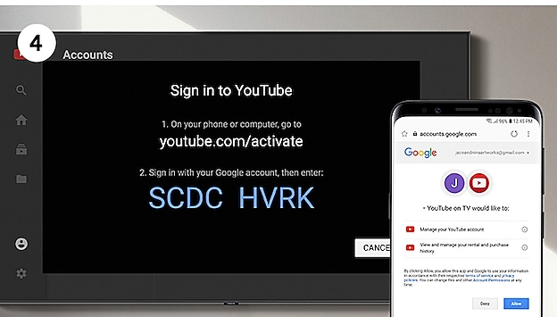
OAuth 2.0 – Authorisation Grants
The OAuth 2.0 framework specifies several different methods through which a Client can verify itself to the Authorisation Server - these are known as Authorisation Grants
  Authorisation Code
  PKCE
  Client Credentials
  Device Code
  Refresh Token
Device Code
This flow is intended for use by browserless or input constrained clients – such as command line
The user is directed to visit a URL at the AuthZ Server in a separate browser, along with a user code to identify the device
The original device continuously polls the AuthZ server with the generated device code until the user completes the interaction, the code expires, or another error occurs

Slide 40
OAuth 2.0 – Authorisation Grants
The OAuth 2.0 framework specifies several different methods through which a Client can verify itself to the Authorisation Server - these are known as Authorisation Grants
  Authorisation Code
  PKCE
  Client Credentials
  Device Code
  Refresh Token
Refresh Token
This is a mechanism for allowing a client to get a new Access Token after an initial one has expired, without further user interaction
Not a replacement for a ClientSecret, and therefore does not enable treating a Public Client as Confidential

Slide 41
OAuth 2.0 – Authorisation Grants
To get a Refresh token, the client needs to request the scope:
scope=offline_access&
curl --request POST \
--url 'https://{yourDomain}/oauth/token’ \
--header 'authorization: Basic {yourApplicationCredentials}’ \
--header 'content-type: application/x-www-form-urlencoded’ \
--data grant_type=refresh_token \
--data 'client_id={yourClientId}’ \
--data 'refresh_token={yourRefreshToken}
The OAuth 2.0 framework specifies several different methods through which a Client can verify itself to the Authorisation Server - these are known as Authorisation Grants
  Authorisation Code
  PKCE
  Client Credentials
  Device Code
  Refresh Token
Refresh Token
This is a mechanism for allowing a client to get a new Access Token after an initial one has expired, without further user interaction
Not a replacement for a ClientSecret, and therefore does not enable treating a Public Client as Confidential

Slide 42
Oauth 2.0 – the Access Token
OAuth is an Authorisation flow – does not have a method for user Authentication
Enter…
OpenID Connect: OIDC

Slide 43

OIDC: The ID Token
OpenID Connect (OIDC) is an identity layer on top of the base OAuth 2.0 protocol
OIDC provides the ability for app and web developers to authenticate users without the need to directly store credential sets
OIDC enables the Authorisation Server to act as an Identity Provider (IdP). An OAuth 2.0 Authorisation Server implementing OIDC is also referred to as an OpenID Provider (OPs).
A client which uses an OP for authentication is a Relying Party (RPs).
OIDC identifies a set of personal attributes that can be exchanged between Identity Providers and the apps that use them, and includes an approval step so that users can consent (or deny) the sharing of this information
Want to know more about OIDC after the lecture
https://openid.net/connect/

Slide 44
OIDC: The ID Token
In OAuth flows involving a user, the user will authenticate with the Authorisation Server before providing consent for the server to release information to the client. OpenID Connect utilises this process to authenticate to the client
The Token Endpoint will provide two separate tokens: a standard OAuth Access Token, and the OIDC ID Token.
The ID Token will contain information about the user pertaining to what the client has requested
When the client receives the ID Token, it may then read off requested claims

Slide 45
OIDC: Requesting Info with Scopes
When the client makes its token request, it must use Scopes to specify which privileges are being requested in the token
In OAuth 2.0, Scopes correspond to what resources are available when a protected resource is accessed
In OIDC, Scopes correspond to the specific sets of information to be made available as Claim Values
OIDC defines a set of standard Scopes, but does allow additional Scope values to be defined and used
https://example.com/oauth/auth?
response_type=code
&scope=openid%20profile%20email
&client_id=EXAMPLE_CLIENTID
&redirect_uri=EXAMPLE_REDIRECT_URI

Slide 46
OIDC: Default Scopes
as defined by OIDC Core
Claim | Summary
openid | REQUIRED. Informs the Authorization Server that the Client is making an OpenID Connect request. If the openid scope value is not present, the behaviour is entirely unspecified.
profile | OPTIONAL. This scope value requests access to the End-User's default profile Claims, which are: name, family_name, given_name, middle_name, nickname, preferred_username, profile, picture, website, gender, birthdate, zoneinfo, locale, and updated_at.
email | OPTIONAL. This scope value requests access to the email and email_verified Claims.
address | OPTIONAL. This scope value requests access to the address Claim
phone | OPTIONAL. This scope value requests access to the phone_number and phone_number_verified Claims.
offline_access | OPTIONAL. This scope value requests that an OAuth 2.0 Refresh Token be issued that can be used to obtain an Access Token that grants access to the End-User's UserInfo Endpoint even when the End-User is not present (not logged in).

Slide 47
OIDC: Default Token Required Claims
as defined by OIDC Core
Claim | Summary
iss | REQUIRED: Issuer identifier for who issued the response. This is a case sensitive URL
sub | REQUIRED: Subject identifier. A locally unique identifier which must never be reassigned, this identifies the user within the issuer. A case sensitive string ≤ 255 ASCII characters in length
aud | REQUIRED: Audiences that this token is intended for, using the Client ID as its identifying value.
exp | REQUIRED: Expiration time for the token, after which it MUST NOT be used for processing.
iat | REQUIRED: Time at which the JWT was issued
auth_time | Time when end-user authentication occurred. If a max_age request is made or auth_time is requested as an essential claim, this is REQUIRED – otherwise it is OPTIONAL
{ "iss":
"https://server.example.com",
"sub": ”24400320",
"aud": "s6BhdRkqt3”,
"exp": 1311281970,
"iat": 1311280970,
"auth_time": 1311280969”
}

Slide 48
OIDC: Standard Identity Claims
as defined by OIDC Core
Claim | Summary
name | The end-user’s full name, including all name parts. given_name, family_name, middle_name and nickname may also be used.
preferred_username | A shorthand name by which the user wishes to be referred to by at the RP. This MAY be any valid JSON string – including special characters such as @, /, or whitespace. The RP MUST NOT rely on this value being unique.
email | End-User's preferred e-mail address. Its value MUST conform to the RFC 5322 addr-spec syntax. The RP MUST NOT rely upon this value being unique.
phone_number | End-user’s preferred telephone number.
address | End-User's preferred postal address.
profile | URL of the End-User's profile page. The contents of this Web page SHOULD be about the End-User.
... And others | picture, website, email_verified, gender, birthdate, zoneinfo, locale, phone_number_verified, updated_at

Slide 49
OIDC: Additional Claims
The OpenID Connect Core specification only defines the previous small set of claims as standard
However, OP’s MAY provide additional claims about the End-User
A typical example includes groups, a list of groups the user is registered with at the OP
Any additional Claim will need to have a corresponding Scope, to allow it to be requested
  Alternatively, extra claims could be included within the profile scope – this is how the OP to be used within the exercises provides its groups claim

Slide 50
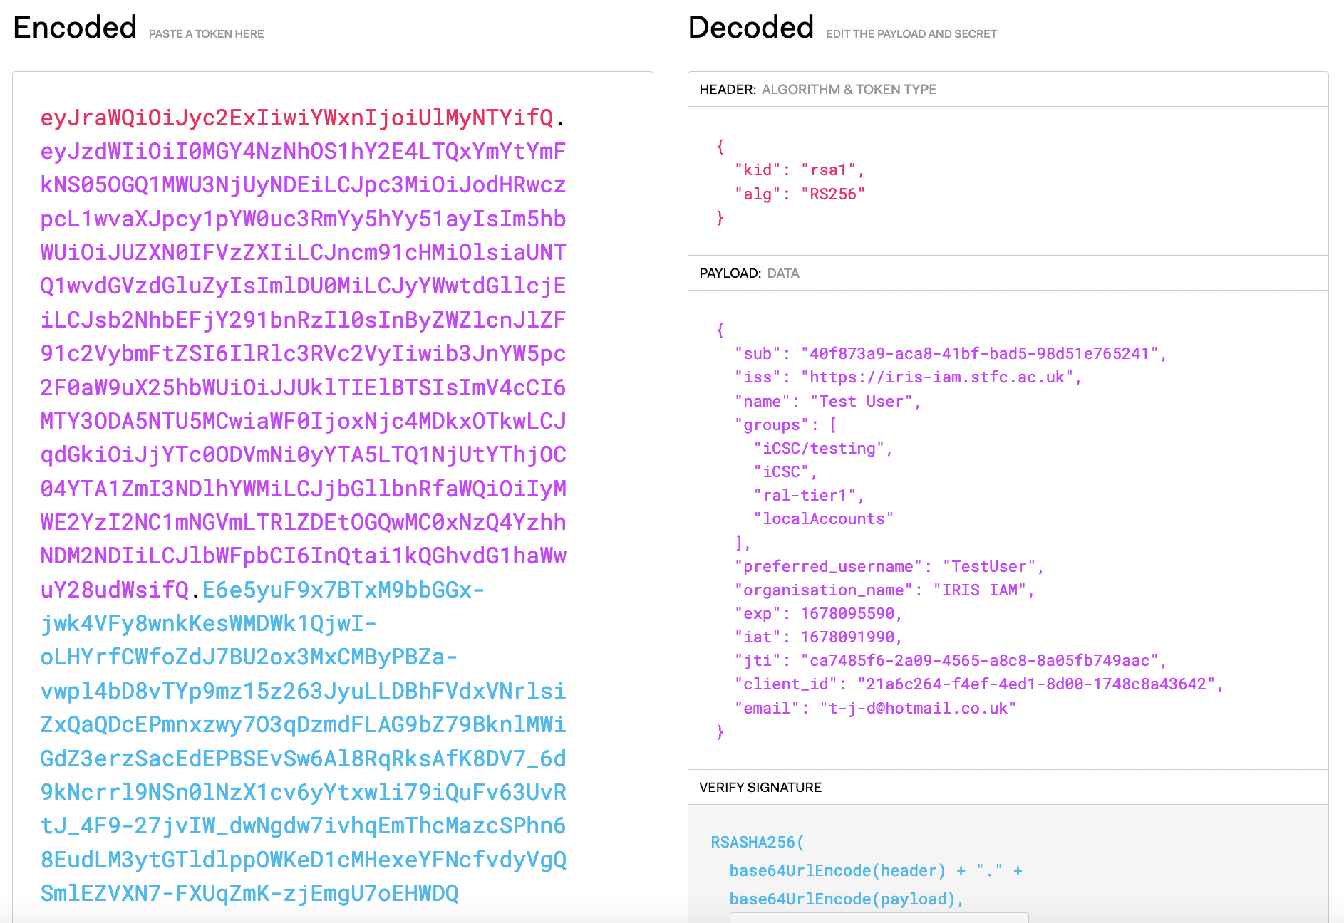
OIDC: Putting this together…
The token is three Base64-URL strings separated by dots that can be easily passed in HTML and HTTP environments
Handy token decoding taken from: https://jwt.io/
Check it out for more info on JWTs or when using them yourself!

Slide 51
OIDC: Putting this together…

Slide 52
OIDC: Putting this together…
🙂

Slide 53
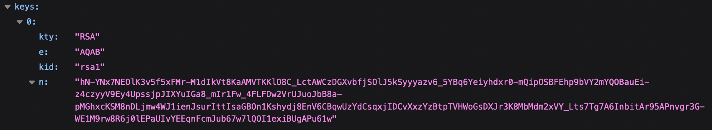
OIDC: Putting this together…
JWK signing key published at a URL at the OP, such as:
https://wlcg.cloud.cnaf.infn.it/jwk
The specific URL is detailed in the OP metadata, found at:
.well-known/openid-configuration
For Example:
https://wlcg.cloud.cnaf.infn.it/.well-known/openid-configuration

Slide 54
OIDC: UserInfo Endpoint
The ID token is not the only way for a RP to get information about a user – it can also make a request to the Ops UserInfo endpoint
A UserInfo Request is made by the client using either a HTTP GET or HTTP POST. The Access Token previously obtained from an OIDC Authentication request MUST be included as a Bearer Token
The OIDC Core recommendation is that the request uses the HTTP GET method, with the Access Token sent using the Authorization header field
A non-normative example of a UserInfo Request:
GET /userinfo HTTP/1.1
Host: server.example.com Authorization: Bearer SlAV32hkKG

Slide 55
Towards Tokens
for WLCG
Notes:
The abstract pattern can be removed or repositioned if required. Be careful to ‘Send to Back’ so that it does not obscure any important information.

Slide 56
Transition to Tokens - Motivations
OAuth and OIDC protocols have been adopted by a wide range of software and systems, thanks to their prevalence in industry – in particular within the social identity space
  This prevalence enables developers to utilise developed libraries, and facilitates integration and interoperability
Certificates, whilst established within WLCG, are not familiar outside this context - and are often viewed as unintuitive. Conversely, Token-based flows are becoming increasingly commonplace, and can lead to a better user experience as a result

Slide 57
Token Authentication and Authorisation Infrastructure
In the planned WLCG infrastructure, there will be an OP per VO, which users may access using their CERN Account
This model unifies the IdP and Research community, with both being represented by the Token Issuer
The Infrastructure design has been informed by the AARC Blueprint architecture - a set of software building blocks that can be used to implement federated access management solutions for international research collaborations

Slide 58
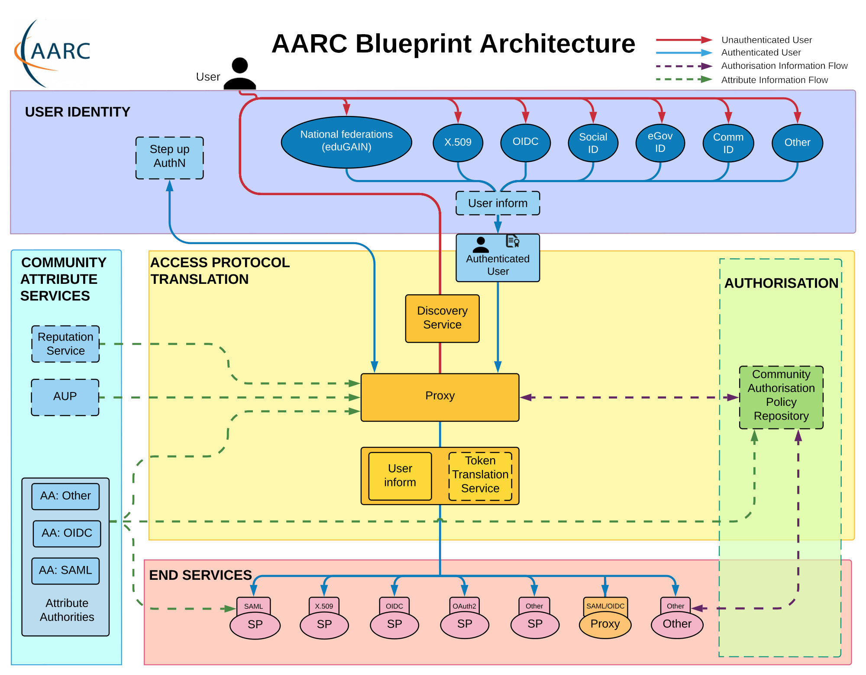
The AARC Blueprint

Slide 59
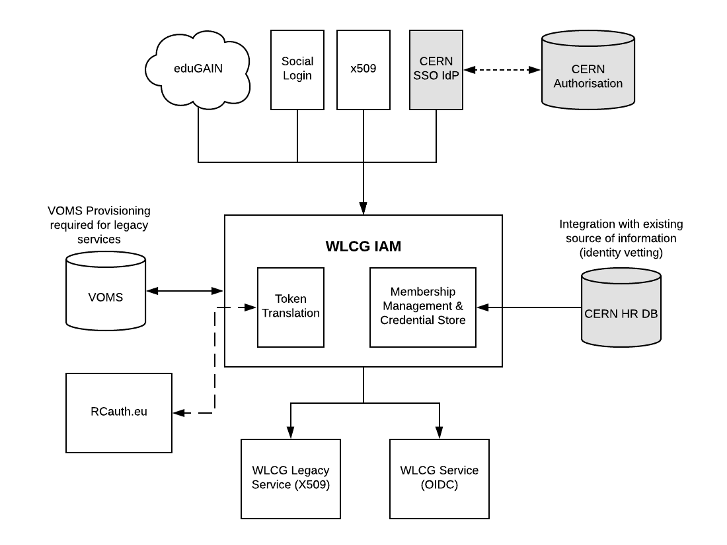
WLCG Token Infrastructure Design

Slide 60
WLCG Token Infrastructure Design

Slide 61
WLCG Token Infrastructure Design
CERN Person ID is checked against CERN HR DB. Affiliation with Virtual Organisation (experiment) is verified, as well as end dates.
If the check is OK, the membership
is approved.
CERN SSO releases:
● Name,
● Email,
● CERN Person ID (indicates
HR has performed ID check),
● CERN Kerberos Principal
● ...
Currently all researchers have
CERN accounts but aim is to work
towards removing this need in
future

Slide 62
WLCG Token Infrastructure Design
RCAuth integration possible
to generate short lived X.509 certs for backwards compatibility
Groups imported from VOMS

Slide 63
WLCG Token Schema
In order to serve authorisation information a VO, the WLCG token schema definies extra claims – wlcg.groups for Group-based authorisation and scopes for Capability-based authorisation
wlcg.groups semantics are equivalent to existing VOMS groups, and will be initially imported directly from VOMS
  Eg: /atlas/production
scopes is used to provide capability to a specific token, rather than permanent authorisation to a user
  Format $AUTHZ:$PATH where $PATH is mandatory (may be ‘/’ for *)
  Eg: storage.read:/atlas
For more details, you can see the published schema: https://zenodo.org/record/3460258#.Y-YqUxPMLVs

Slide 64



Notes:
The abstract pattern can be removed or repositioned if required. Be careful to ‘Send to Back’ so that it does not obscure any important information.

Slide 65






Science and Technology Facilities Council
@STFC_matters
Science and Technology Facilities Council
Notes:
The abstract pattern can be removed or repositioned if required. Be careful to ‘Send to Back’ so that it does not obscure any important information.

