Slide 1
CMOS Sensor Development for Particle Physics in TD
26/04/2023
Notes:
The abstract pattern can be removed or repositioned if required. Be careful to ‘Send to Back’ so that it does not obscure any important information.

Slide 2
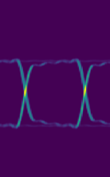
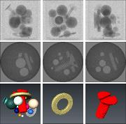
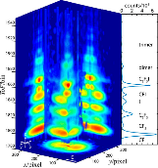
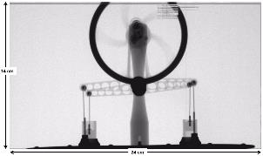
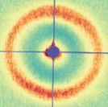
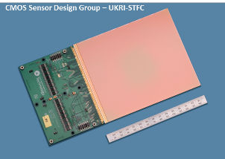
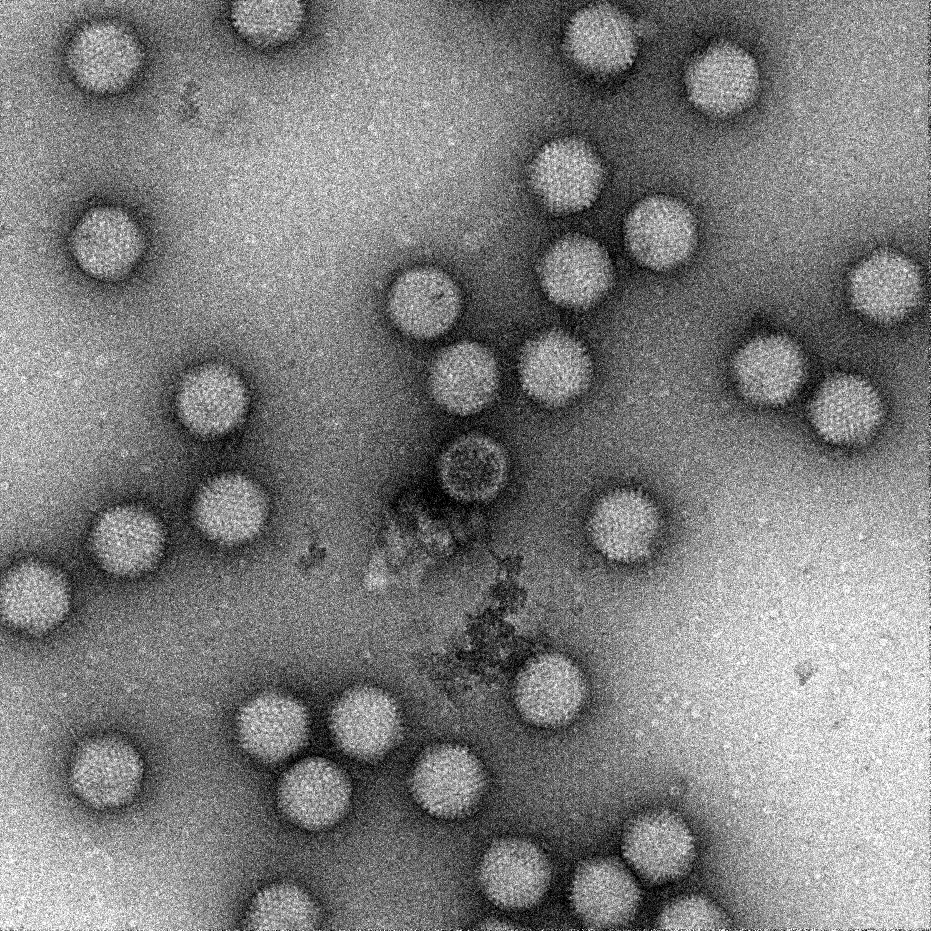
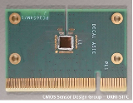
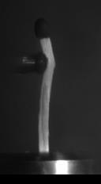
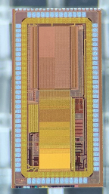
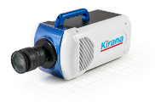
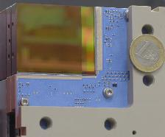
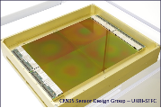
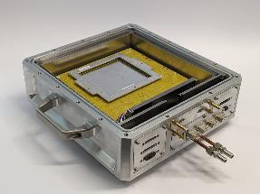
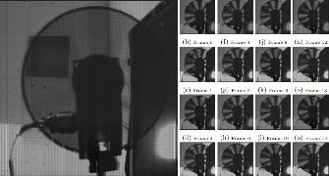
Agenda
1 CMOS Sensor Design Group
8 Designers, 1 Test Engineer
Group Leader: Nicola Guerrini
Share office with ASIC Design Group
2 Particle Physics Activities
Electron Ion Collider/ITS3
DECAL
DRD Programme
MALTA3
3 Other Activities
Electron Microscopy: TEMAPS, QEM, C100
Soft X-ray: PERCIVAL
Raman Spectrometry: IRIS
High Speed Imaging: KIRANA, TPM
Large Area X-ray: LASSENA
Notes:
Delete boxes as required

Slide 3
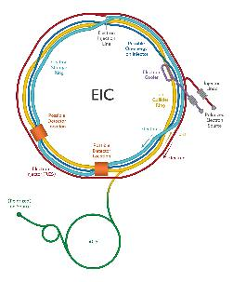
Electron Ion Collider/ALICE ITS3
What and Why?
The EIC will be built at BNL to study role of quarks and gluons in proton structure.
65nm chip envisioned for the ALICE ITS3 upgrade has very similar specifications, so the goal is to use the same chip.
Project is therefore also an opportunity to engage with CERN and work at a 65nm CIS node.
Other Personnel/Institutes Involved
PPD, Brunel, Birmingham, Lancaster, Daresbury, Liverpool, Oxford
Schedule and Funding
Machine operational ~2030
UKRI Infrastructure Fund
Preliminary Activity
Full Proposal

Slide 4
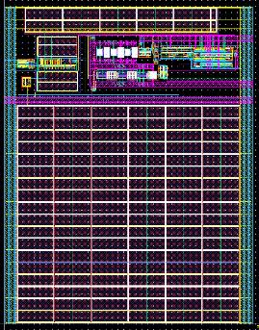
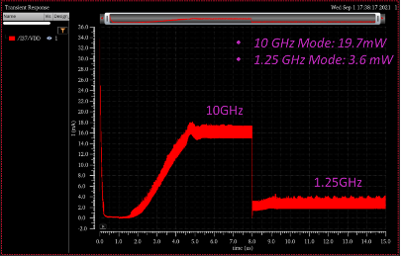
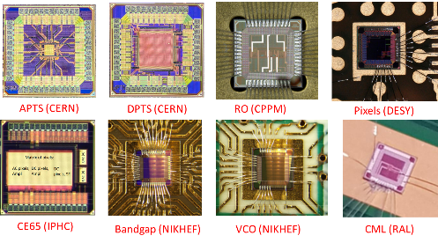
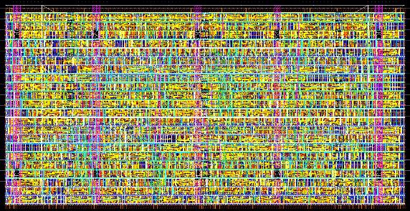
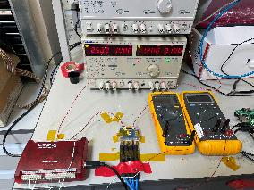
Electron Ion Collider/ALICE ITS3
Ongoing Work
Submitted various circuit blocks in 65nm
LVDS-CML drivers and receivers
I2C block
PLL
Support to development of high yield logic for MOSS
Currently working on SLDO for serial powering and other 65nm IPs

Slide 5
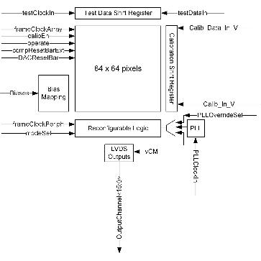
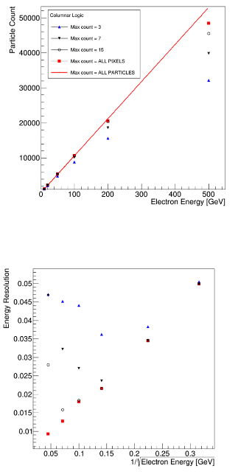
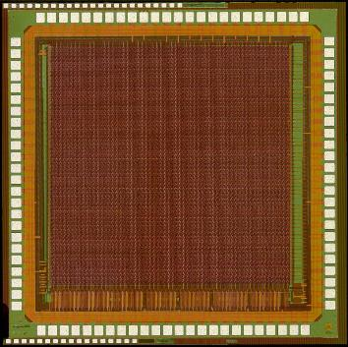
DECAL
What and Why?
Demonstrator chip for Digital Electromagnetic Calorimetry
Re-configurable to operate as strip tracker
Counts hits/chip (pad) or hits/column (strip)
Goal is to reduce costs with re-configurable chip
Other Personnel/Institutes Involved
PPD, Birmingham, DESY, UCL, Humboldt
Schedule and Funding
Currently none
Some idea to submit a proposal to DRD6

Slide 6
DRD Programme
What and Why?
CERN’s programme for Research and Development
Currently starting up
Aiming for Letter of Intent and collaboration forming later this year
Other Personnel/Institutes Involved
Very many…
In TD: Marcus French, Iain Sedgwick, Mark Willoughby (DRD7)…
Schedule and Funding
Idea is that DRD approval will help release money from funding agencies
DRD1: Gaseous Detectors
DRD2: Liquid Detectors
DRD3: Solid State Detectors
DRD4: Photon Detectors and PID
DRD5: Quantum and Emerging Technologies
DRD6: Calorimetry
DRD7: Electronics and On-detector processing
DRD8: Integration
DRD9: Training

Slide 7
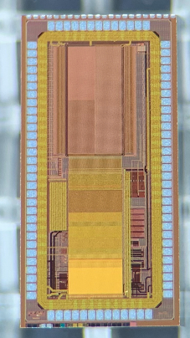
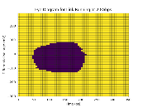
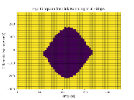
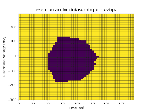
MALTA3
What and Why?
MALTA family is technology demonstrator for high granularity, high radiation hardness MAPS
Approached about providing previously developed high speed serialiser to be used in the design
Other Personnel/Institutes Involved
CERN
Schedule and Funding
Currently none
Some CfI last year, but difficult to respond rapidly to such requests

Slide 8
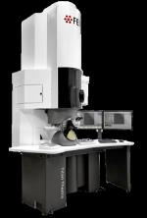
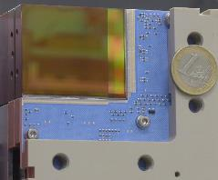
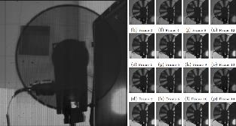
Other Activities
Also active in other fields
Electron Microscopy: TEMAPS, QEM, C100
Soft X-ray: PERCIVAL
Spectrometry: PImMS, IRIS
High Speed Imaging: KIRANA, TPM
Large Area X-ray: LASSENA

Slide 9
Thanks for your attention!
Questions?

Slide 10
Science and Technology Facilities Council
@STFC_matters
Science and Technology Facilities Council
Notes:
The abstract pattern can be removed or repositioned if required. Be careful to ‘Send to Back’ so that it does not obscure any important information.

