Slide 1
Detectors & Physics
Physics with Detectors
Detectors for Physics
Physics of Detectors

Slide 2
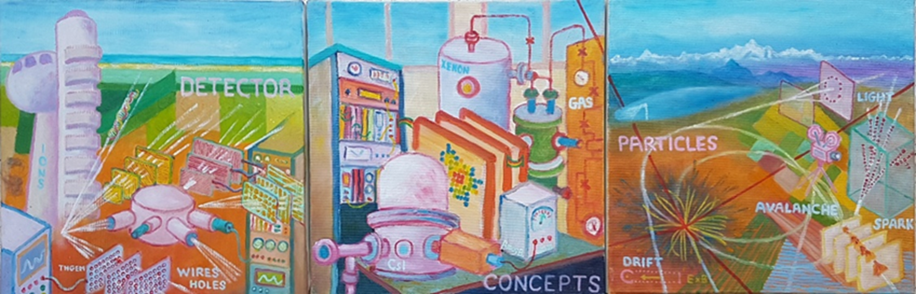
A disclaimer: Today’s talk:
Physics of Detectors ONLY
Detectors for Physics
Physics with Detectors
50 YEARS
Amos 2017

Slide 3
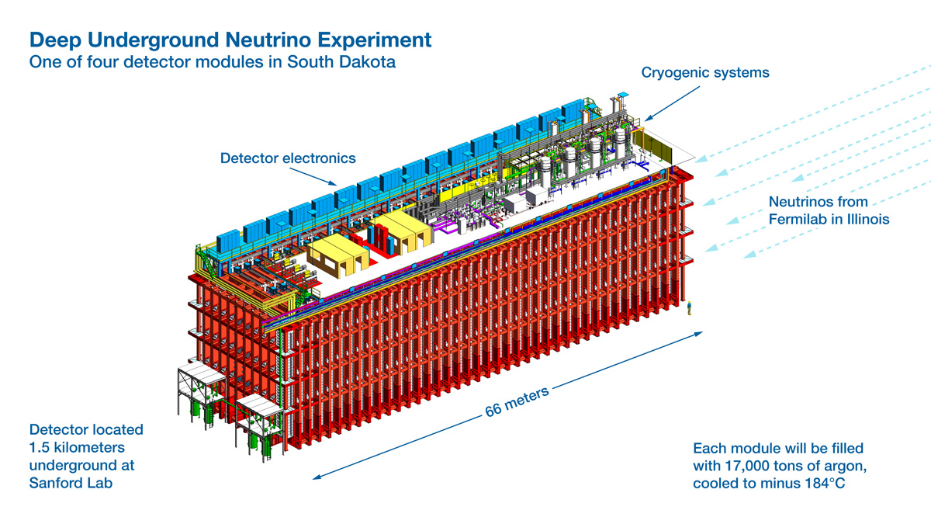
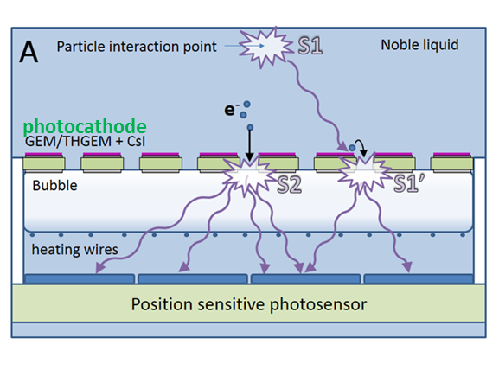
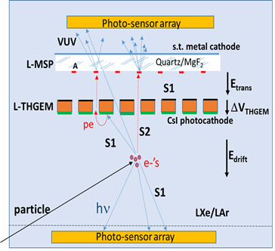
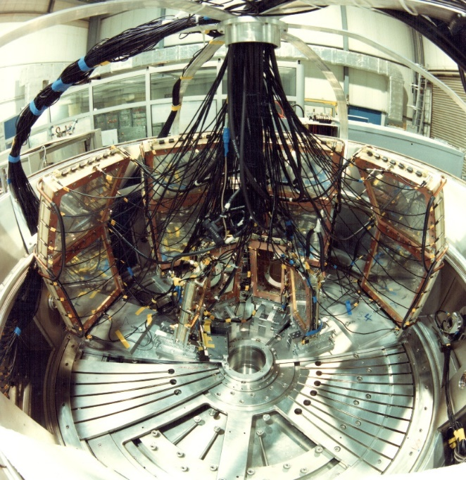
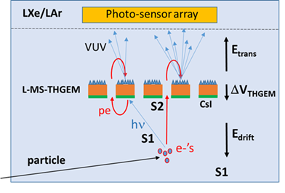
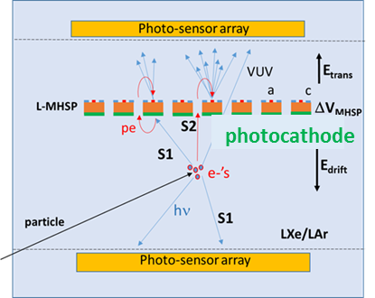
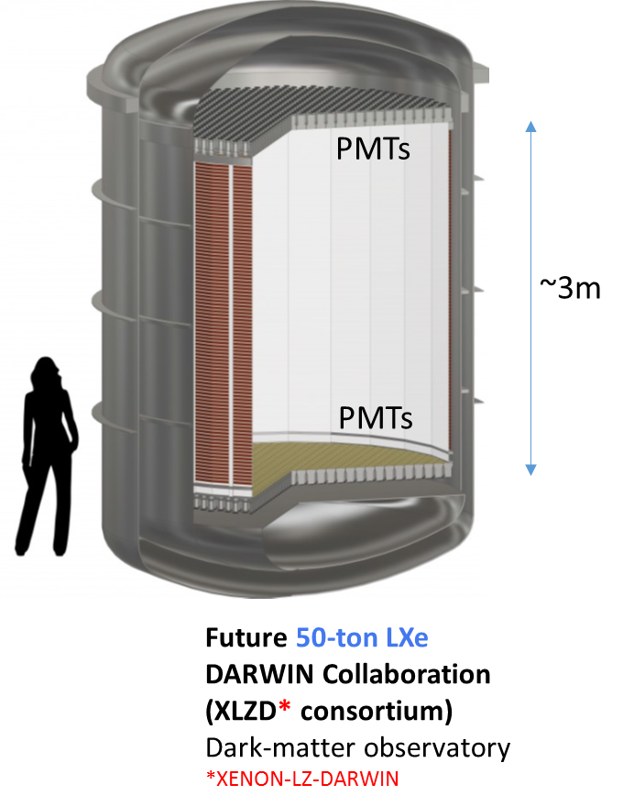
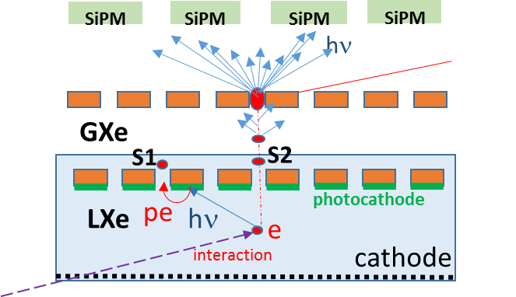
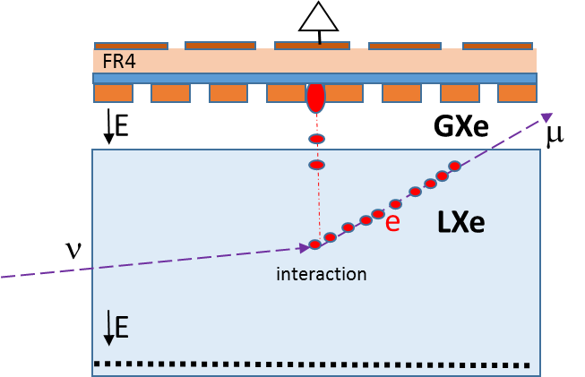
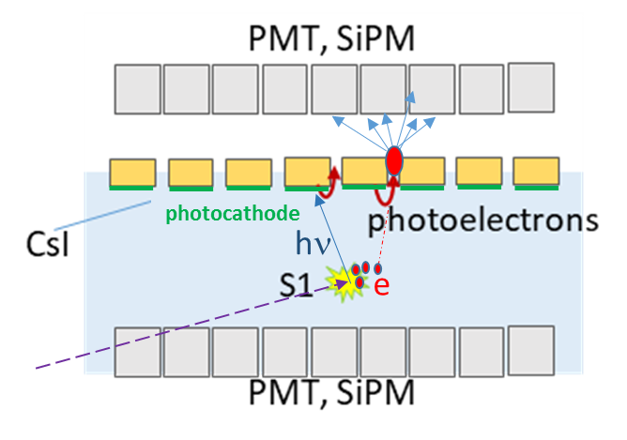
Radiation Detection Physics @ Weizmann
From mbar of gas – to – noble liquids
Single-phase noble-liquid detectors
ν physics
Very low pressure (mbar) ultra-fast MWPC Heavy-Ion imaging detectors
Dual-phase noble-liquid detectors
Brugger et al. Nature 1989
Search for Strange Matter
Dark Matter

Slide 4

Novel noble-liquid detector concepts
Amos Breskin
*
*
for more details:
http://arxiv.org/abs/2203.01774
https://doi.org/10.1088/1748-0221/17/08/P08002

Slide 5
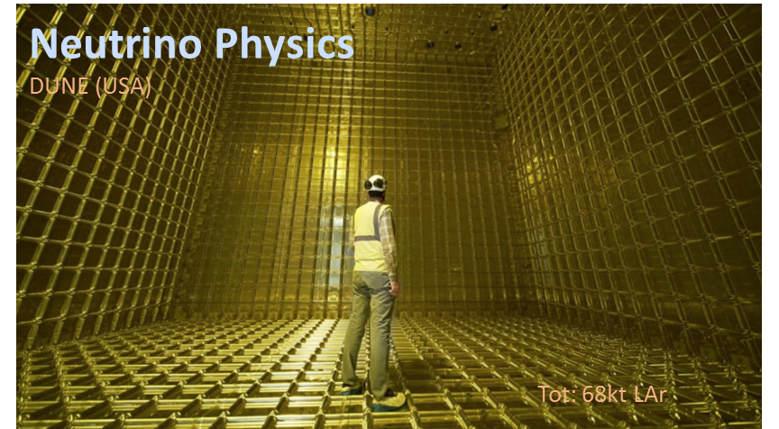
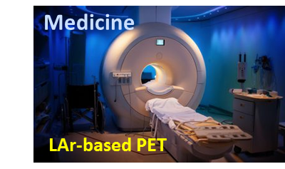
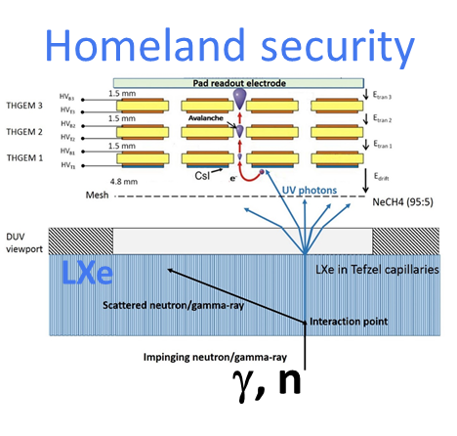

Why noble-liquid detectors?
Why noble-liquid detectors?
  High density ➔ higher interaction probability;
  High scintillation and ionization yields ➔ VUV photons & Ionization-electrons
  Scalability (Xe cost >>> Ar)
What are the challenges ?
  Rare events ➔ large volumes, high radiopurity & background discrimination, very high sensitivity
How?
  Charge readout (with/without multiplication)
  Light readout (primary scintillation & electroluminescence) with PMTs, SiPMs etc.
LXe
HEP
Calorimetry
Nucl Phys
LAr
LAr

Slide 6
DM & ν physics
DM:
low deposited energy (keV) by nuclear recoils ➔ low detection thresholds
➔ charge multiplication & efficient scintillation-photon recording
➔ background-radiation discrimination
Neutrino physics:
High μ charge deposits (few 10⁴ e/mm)
➔ Can operate without charge multiplication
multiplication would ease electronics & lower thresholds

Slide 7
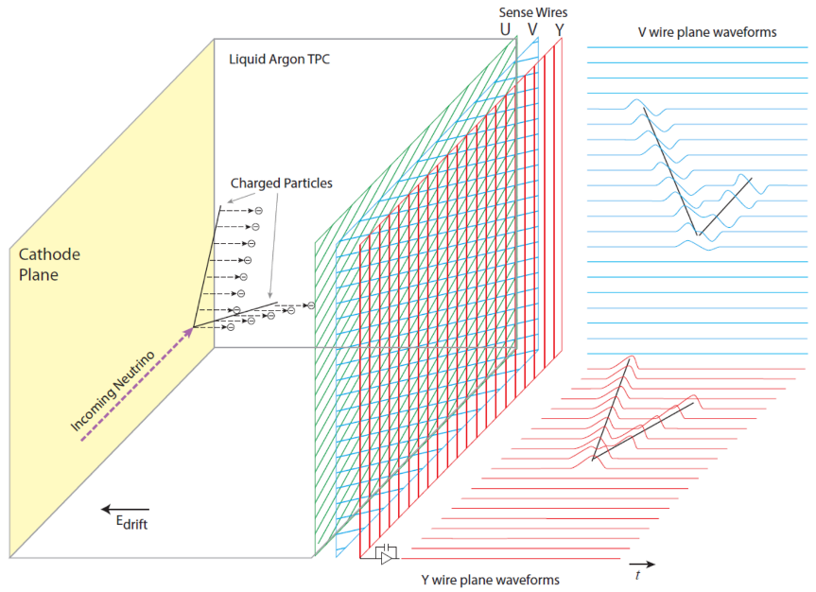
Single-phase TPC concept
Single-phase
Charge collection
Charged particles ionize the noble liquid;
~ few 10⁴ e⁻/mm in LAr
Electrons drift to, and induce charge on anode wires (2D);
Primary-scintillation light provides the e⁻ drift time
➔ third coordinate;
➔ 3D spatial reconstruction from wire planes;
Charge collection with no multiplication
➔ good only for large deposited charge
(e.g. neutrino physics)
Largest: ICARUS, DUNE...
(t₁ – t₀) v_{e}
3 wire planes or
Multilayer perforated PCB
PMTs ➔ t₀
t₁
(➔ In 2 DUNE modules)

Slide 8
170t
68,000t
270t
760t

Slide 9
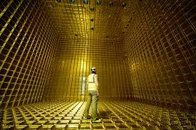
Single-phase: neutrino physics
Electro-magnetic shower
Hadronic shower
DUNE: Future 68-Kton LAr
Fermilab Long Baseline Neutrino Experiment
Photo: Inside a single module…

Slide 10
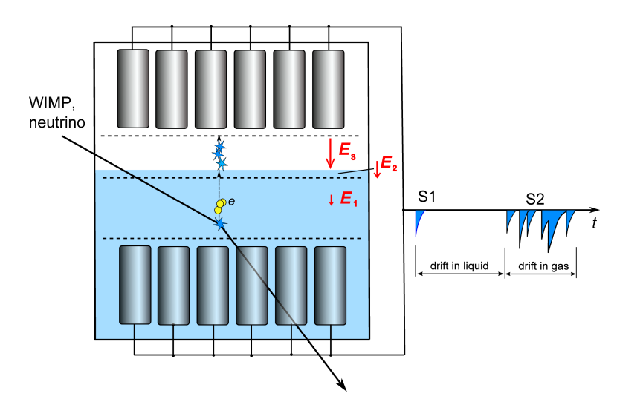
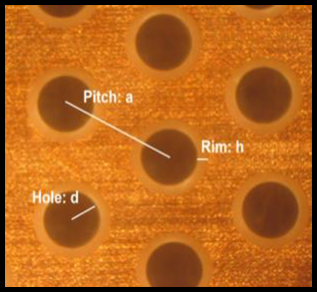
Dual-phase TPC concept - DM
EL-photon readout
PMTs
Vapor
Noble liquid
PMTs
The EL-photon readout can be substituted by charge readout: electron avalanche multiplication.
e.g. in: LEM (THGEM).
So far low gain.

Slide 11
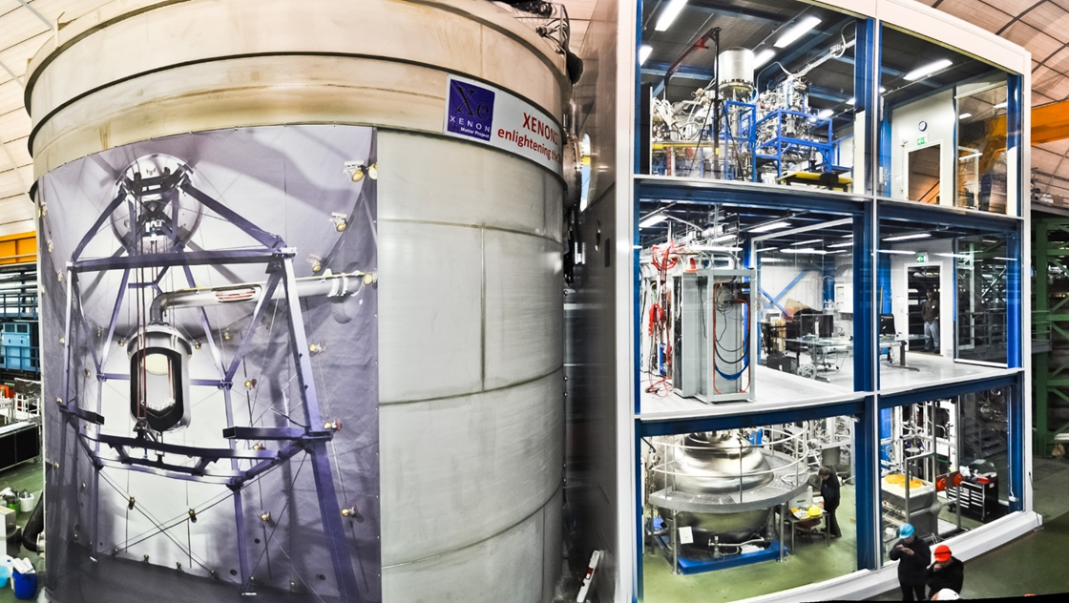
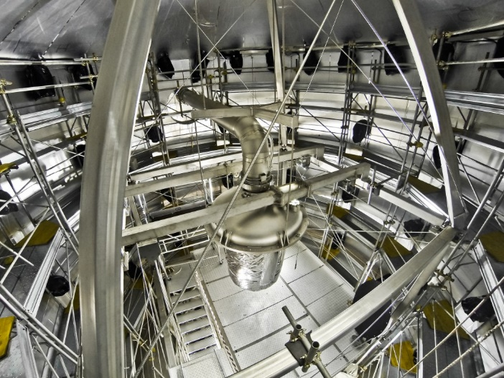
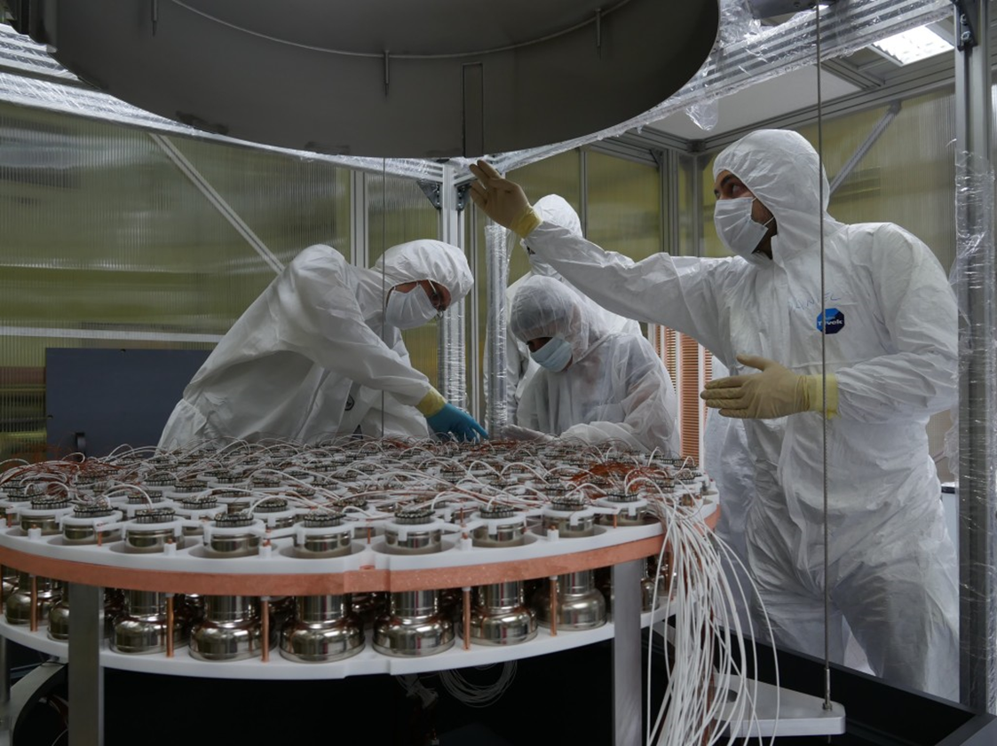
Dual-phase: Dark Matter searches
XENONnt, LUX-ZEPLIN (LZ), PNDA X, DARWIN/G3
8.5t 10t 4t 50t
PMTs
XENONnt
@ Grand Sasso
~3m
PMTs
Future 50-ton LXe
DARWIN/G3
Dark-matter observatory
XENON-LZ-DARWIN (XLZD consortium)

Slide 12
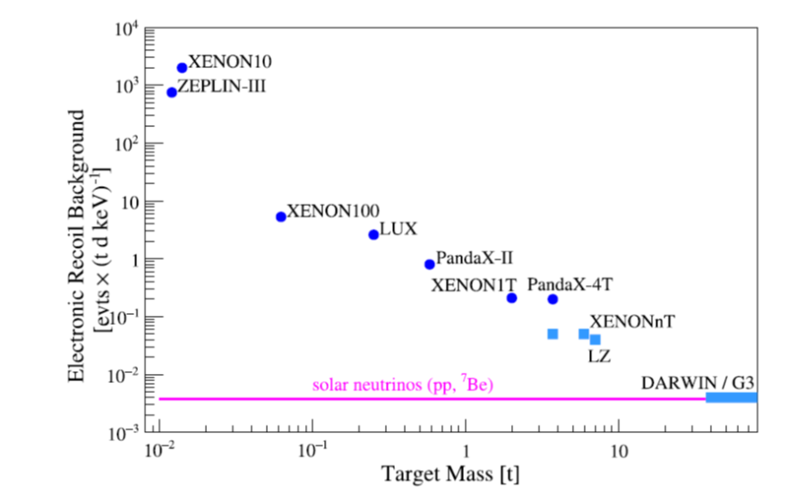
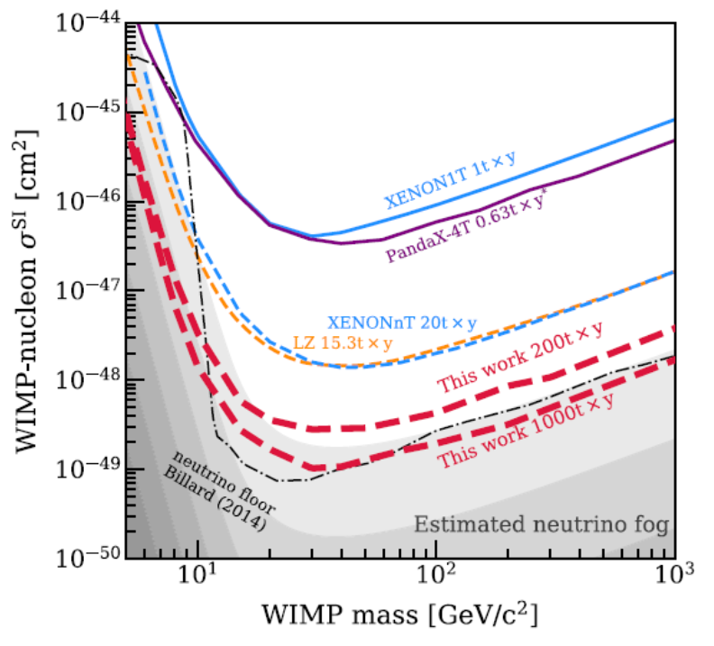
DARWIN/G3 50t LXe observatory for DM & neutrino physics
DARWIN/G3
Low background
current
⬅ 50t x 20Y
Aalbers et al 2023 J. Phys. G: Nucl. Part. Phys. 50 013001
DAWIN/G3

Slide 13
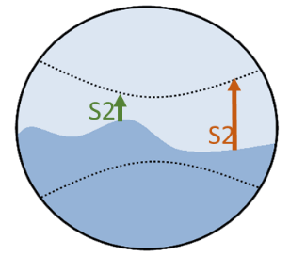
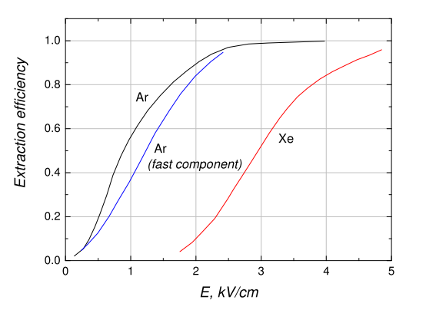
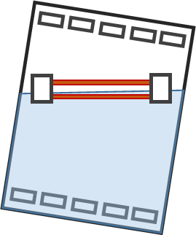




Why new concepts?
Dual-phase detectors: Problems
Current expected problems with large-volume detectors, affecting resolution & efficiency:
➔ liquid-gas interface instabilities - spontaneous electron emission, gas gap variations (tilt),
electron extraction efficiency into liquid.
Low energy deposits ➔ need multiplication
Limited avalanche gain in noble gases ➔ electroluminescence multiplication
Single-phase detectors:
Current limit: No multiplication in liquid.
➔ OK only for large energy deposits.
Stable primary-charges multiplication & efficient detection in both configurations
➔ lowering detection thresholds (& cost?)
G
e-
L
Electron emission efficiency vs $Eextr$
Extraction field E_{extr}
$$∼5 mm$$
$$∼4 kV/cm$$
e-
Drift field E_{D}
LXe
$$∼100 V/cm$$

Slide 14
Single-phase TPC: novel concepts

Slide 15
Why single phase?
To overcome liquid-gas interface problems in large dual-phase detectors:
Only single-phase can be “face-to-face” and “horizontal”:
➔ Half of HV for equal field; avoids effects of sporadic bubbles
“Radial geometry” possible
New concepts: potentially lower detection thresholds
sensors
sensors
E
E
E
NL
sensors
NL

Slide 16
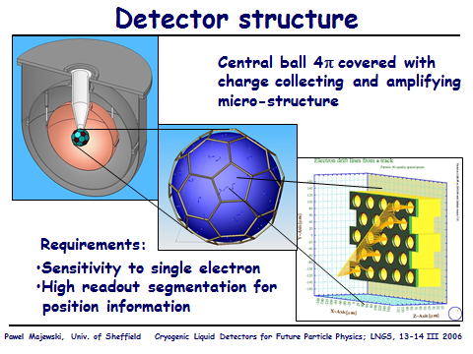
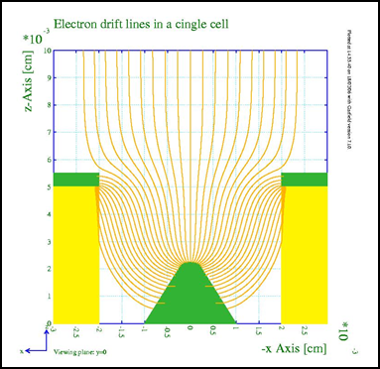
Idea: A spherical Single-Phase LXe DM detector
Pawel Majewski 2006
WIMP interaction➔ scintillation photons@ electrons;
Photons + CsI ➔ pe;
e + pe drift to & multiplied on sphere covered with micro-structure charge multipliers.
CsI
Multiplication in liquid difficult

Slide 17
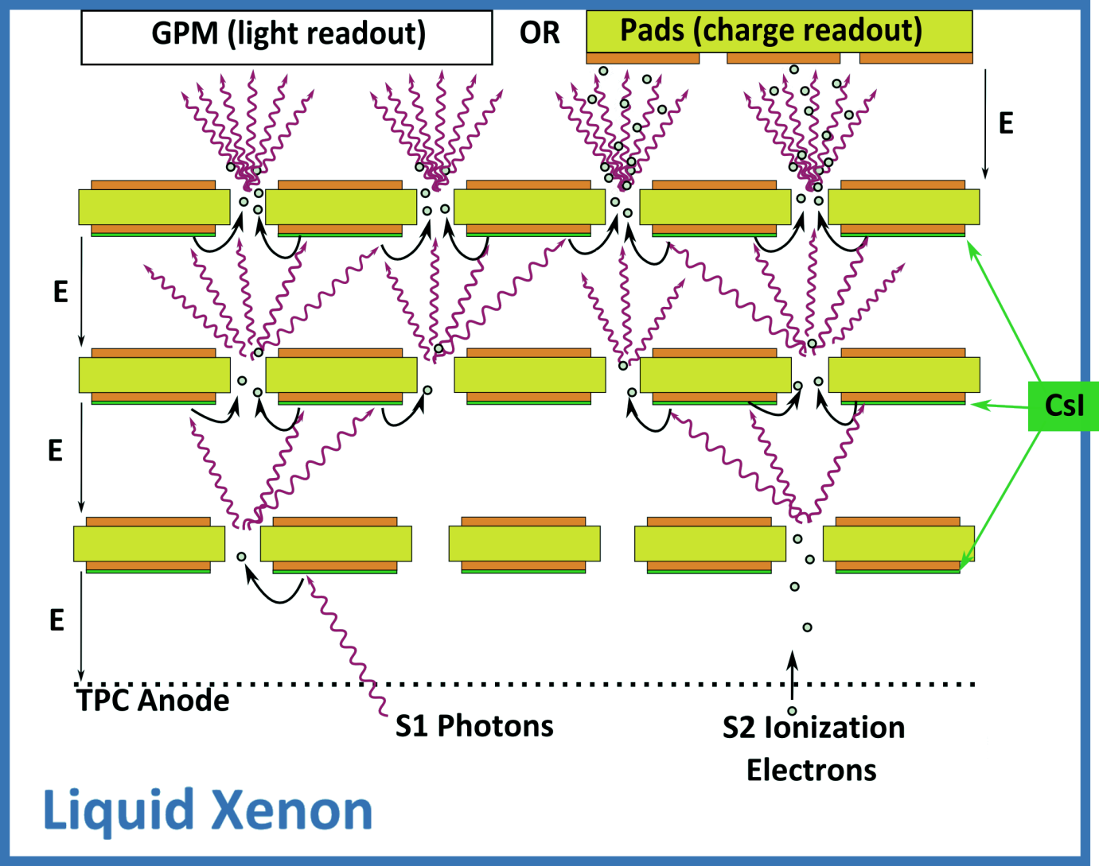
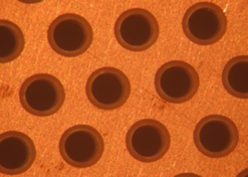
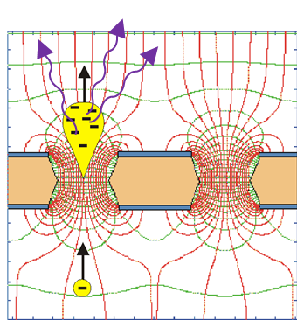
Originally proposed: Liquid Hole-Multipliers LHM in single-phase LXe
A.B. J. Phys. Conf. Ser. 460 (2013) 012020
Simultaneous detection of S1 scintillation UV-photons & S2 ionization electrons by a cascade of CsI-coated perforated electrodes.
Electron multiplication via electroluminescence, EL (+ maybe little charge gain) in the holes.
Optical readout (or maybe charge readout)
THGEM*
*Thick Gas
Electron Multiplier
CsI
Observed large signals!
Arazi 2013 JINST 8 C12004
But: LXe prior art:
Electroluminescence (EL) threshold:
~400 kV/cm - on wires
e-avalanche threshold :
~700 kV/cm on wires Aprile 2014
Conclusion:
EL in gas sporadic bubbles Arazi 2015 JINST 10 P08015
Similar conclusion by Lightfoot 2009
Electroluminescence from THGEM holes / SiPM in LAr

Slide 18

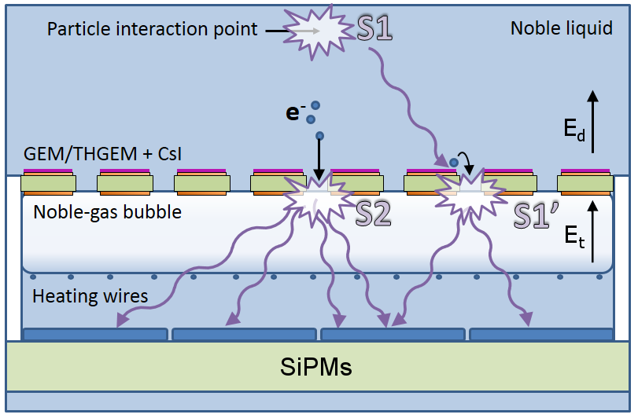
EXOTICS: A “local dual phase” TPC
The bubble-assisted Liquid Hole Multiplier (LHM)
EL
e- & scintillation-photon induced electroluminescence in a bubble, trapped in liquid under a photocathode-coated perforated electrode

Slide 19
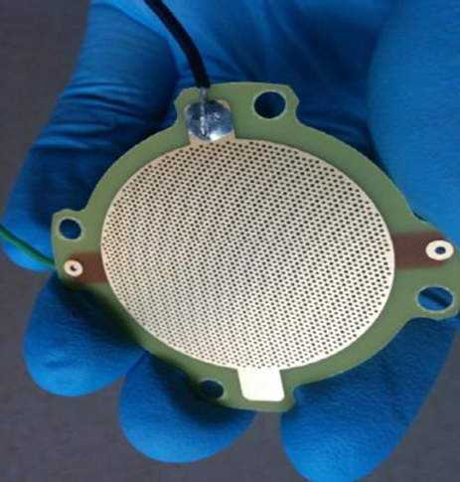
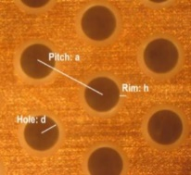
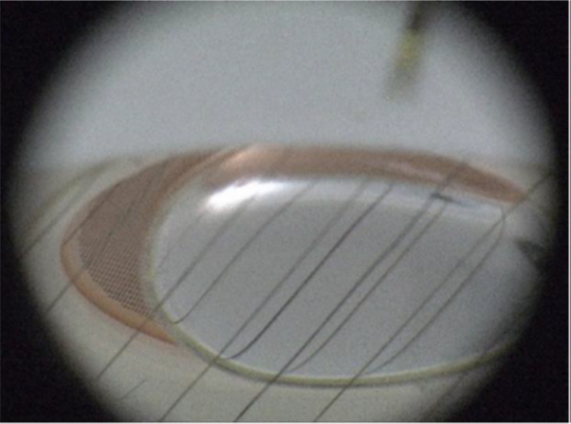
Bubble-assisted Liquid Hole Multiplier LHM
Principle: Radiation-induced electroluminescence from a bubble trapped in noble liquid
Creating a local “vapor bubble” underneath a “GEM-like” perforated electrode, immersed within a large noble-liquid volume.
The electrode is coated by CsI photocathode.
BOTH: S2 Electrons and S1-induced S1’ photoelectrons drift from the liquid into the bubble.
ELECTROLUMINESCENCE within the bubble ➔ Energy, 2D localization.
Demonstrated in both LXe & LAr.
CsI
Precise control of the liquid-gas interface, expected:
better S2 resolution
potentially better S2/S1-based background discrimination
Arazi et al., 2015_JINST 10 P08015
Arazi et al., NIM A 845 (2017) 218
Erdal et al., 2019 JINST 14, P01028
Erdal et al., 2018 JINST 13 P12008
Erdal et al., 2019 JINST 14 P11021

Slide 20
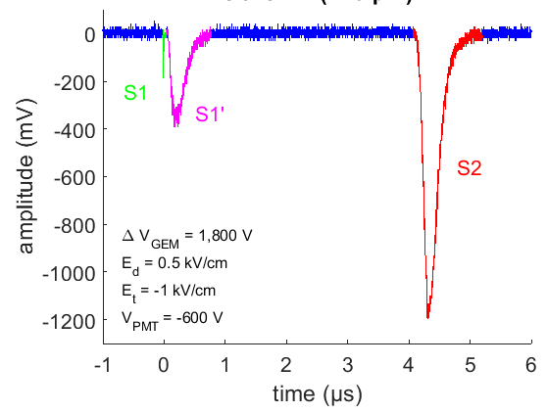
Waveform structure
PMT
Typical waveform of an alpha-particle event, recorded by a PMT below the bubble
S1: primary light passing through holes
S1’: EL light from bubble, by photoelectrons emitted from the CsI photocathode
S2: EL light from bubble, by ionization electrons from track
Light yield, resolution & PDE ➔ hole-electrode geometry
Best reached: ~400 photons /e-/4π
Erdal, NIMA 845 (2017) 218

Slide 21
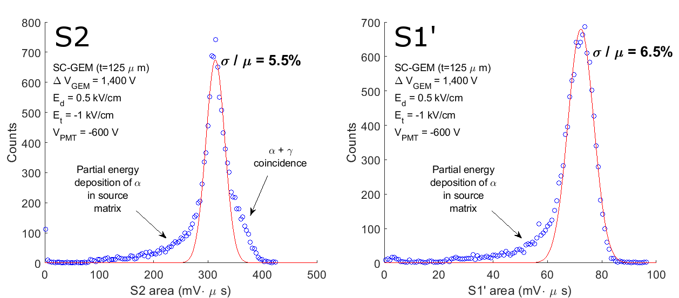
Energy resolution
Ionization electrons ➔ EL
Scintillation-induced photons
➔ CsI ➔ EL
R8520 PMT
Erdal, 2018 JINST 13 P12008
S2 ~7,000 ionization electrons/event
S1 ~1,700 photoelectrons/event
BUT: Better resolutions expected ➔ possible e- losses @ interface!
Preliminary studies with micro-CT ➔ interface shape varies with E

Slide 22
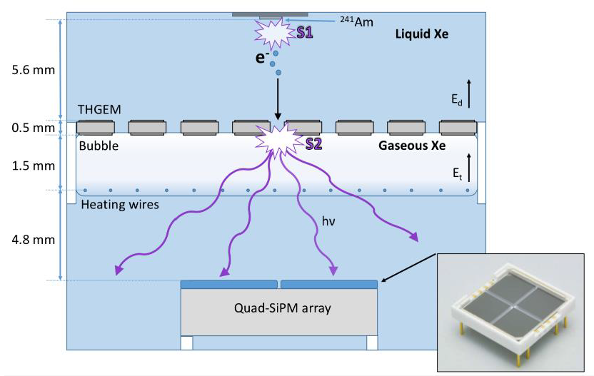
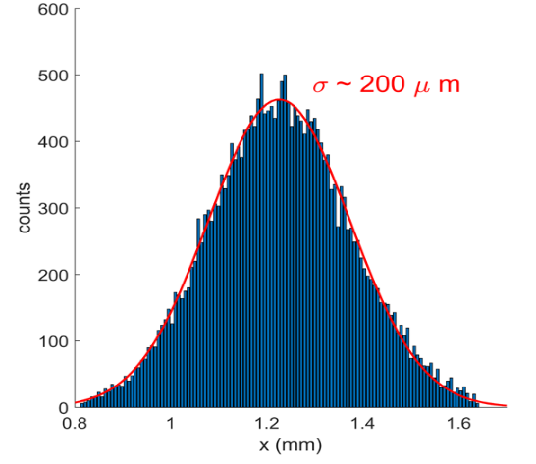
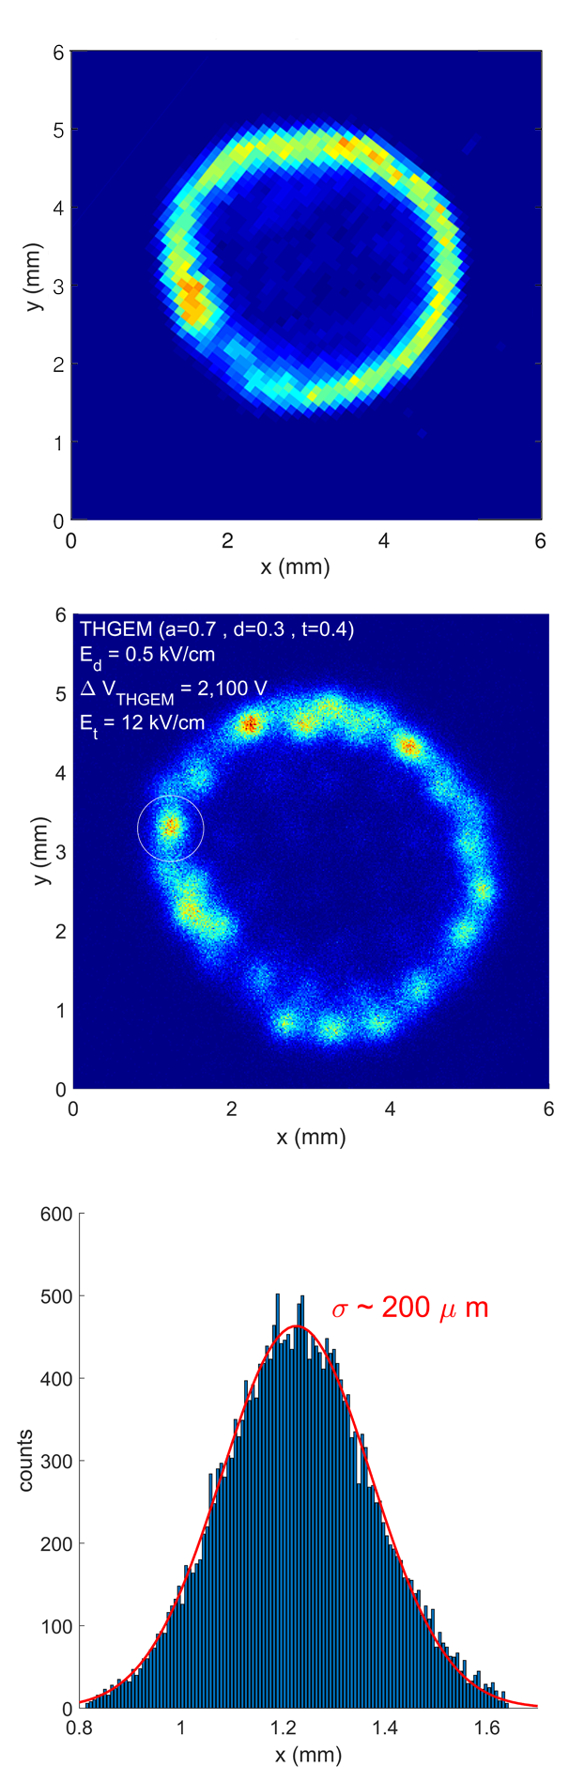
Image of α-particles of ring-shaped ²⁴¹Am source
~7000 electrons/event
Hamamatsu VUV4 quad-SiPM array
(4 6x6mm² elements); quartz window
Reconstruction resolution of THGEM holes: ~ 200μm RMS
THGEM holes:
Φ 0.3 holes, 0.7 spaced
LXe
~4mm
Erdal 2019 JINST 14 P01028
LHM reconstruction
Phosphor-imaging plate

Slide 23
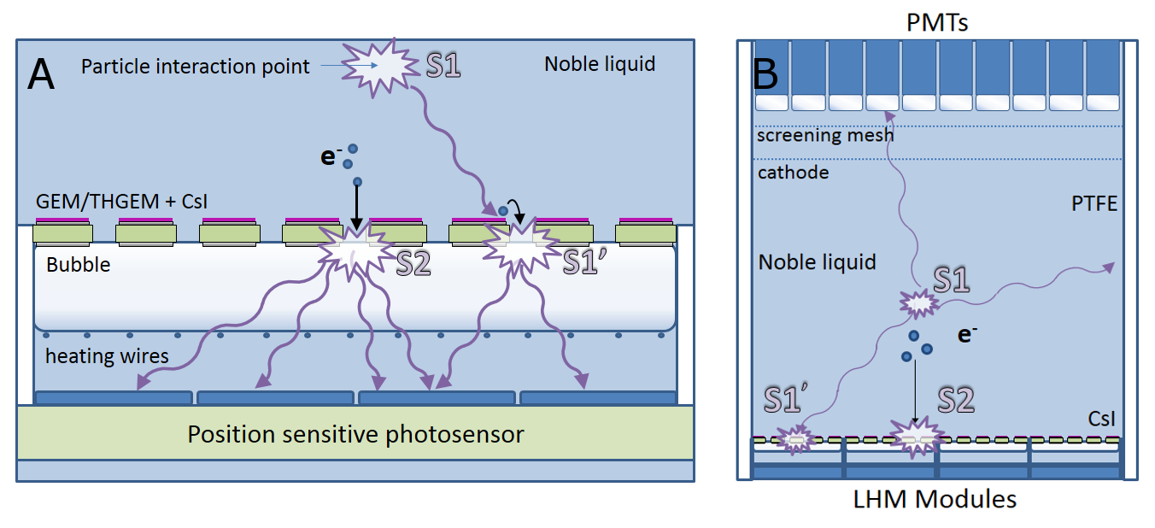
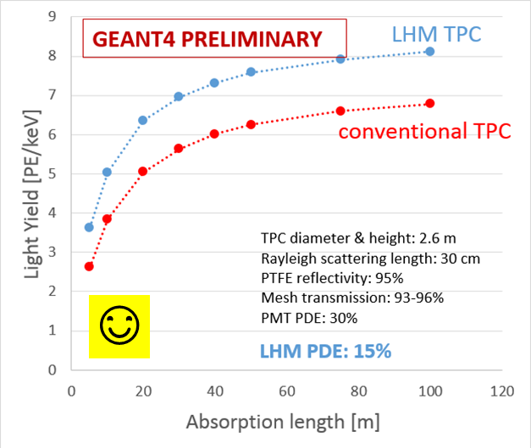
LHM highlights
RESULTS in LXe:
Controlled bubble formation & long-term stability S2 E-resolution: 6% RMS for ~3000 electrons
Light yield: ~400 photons /e-/4π
PDE: <5% ; expecting 15% ➔ potentially higher light yield in a DARWIN LHM-TPC
Localization resolution:
reconstruction: ~ 200μm RMS
Potential DARWIN LHM-TPC
CsI
GAS BUBBLE
LHM demonstrated also in LAr.
worse resolutions
(lower photon yields)
Light yield: DARWIN TPC
LHM/SiPM modules

Slide 24
NEW: Single-phase - from wires to microstructures
Examples: here multipliers sense S2-e⁻ ONLY
Scintillation S1-photons recorded by photosensors
~50 years of Wires in LXe:
Derenzo PRA 1974
Masuda NIM 1979
Aprile JINST 2014
Brown JINST 2022
Wires
Microstructures
PMT, SiPM, SPAD etc.
UV
S1
Robust
Modular
Micro Strip Plates
& more!
S1
UV
hν
S2
hν
wires
S2
UV transparent plate
EL
EL+CM
Printed anode strips
e
MSP LXe: gain 10
Policarpo et al. NIMA 1995
e
shadowing EL
Partial hν attenuation
hν
cathode
cathode
hν
- - -
e
Few μm wires or very high voltage ➔wires sagging, staggering
PMT, SiPM, SPAD etc.
or reflective cathode.
ST strips
e
Goals: Devise other robust high-gain solutions for detecting both S2-e⁻ & S1-photons

Slide 25
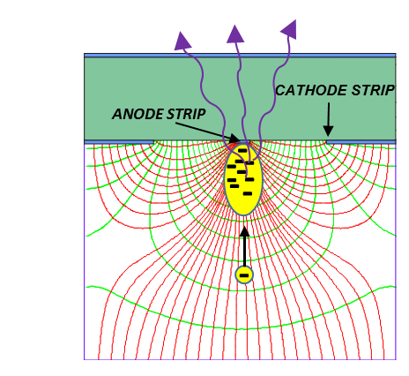
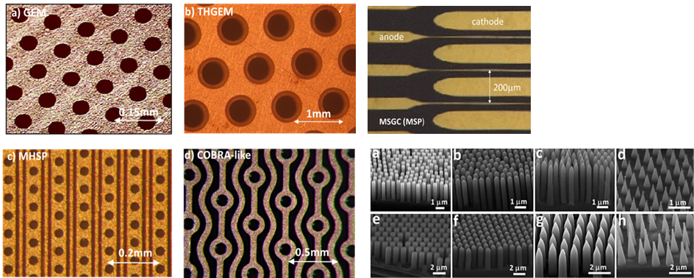
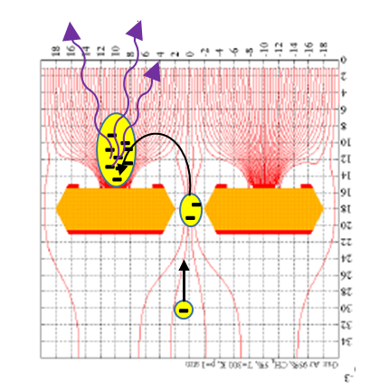
SINGLE-PHASE LIQUID-MPGD TPC CONCEPTS
Particle interaction in liquid ➔ ionizing electrons & single-photoelectrons (from a photocathode).
pe & e collected onto fine strip anodes (MSP, MHSP, COBRA...).
Charge multiplication (CM) and electroluminescence (EL), occur at high fields on the thin strips.
EL & CM photons detected by nearby photosensors.
Various configurations discussed for e & e + pe detection.
hν
hν
GEM
THGEM
MSP
hν
Building-blocks
MHSP
COBRA
microstructures

Slide 26
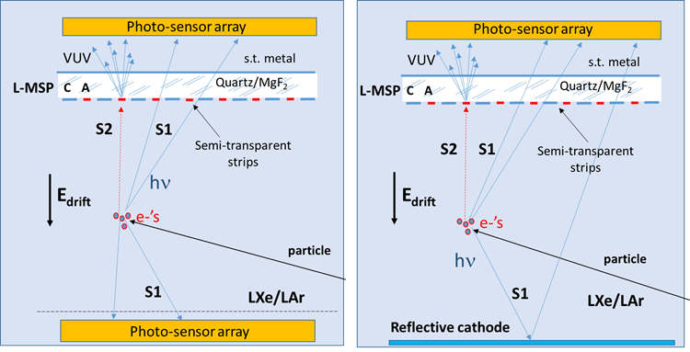
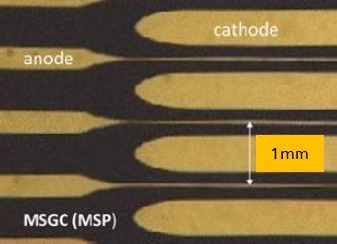
Single-phase with Micro Strip Plates (MSP): S2 e⁻ only
S2: EL+avalanche on strips. S2 Photons detected through VUV-transparent substrate
S1: photons detected (no amplification) by top and bottom photo-sensors (bottom can be replaced by a reflector)
MSP formed on VUV-transparent substrate, with few-nm thin Ni or Cr electrodes. (>50% transmission@175nm) ➔ small “shadowing”
L-MSP: MSGC, VCC …
Charges deposited in liquid, undergo EL & small avalanche multiplication at high field, near anode strips.
Photons recorded with nearby photo-sensors
The effective light-emission region depends on the MSP type, & potentials applied to the anode & cathode strips, cathode-backplane, and drift field.
MSGC
Policarpo, Chepel 1995
x10 electron multiplication in LXe with MSGC;
No EL photons recorded
Or a reflective cathode

Slide 27
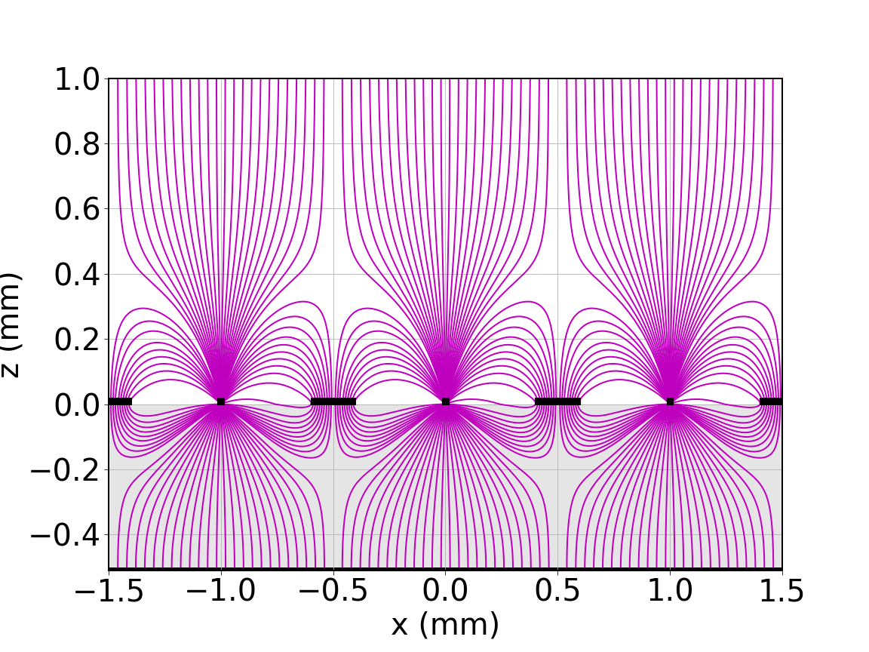
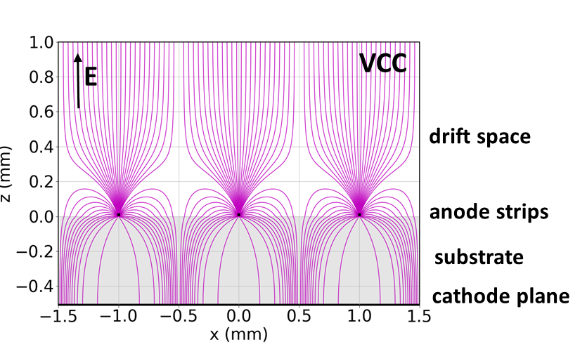
MSPs: MSGC & VCC – field simulations
Microstrip Gas Chamber
Oed 1988
Virtual Cathode Chamber
Capeans 1997
drift cathode
e⁻
MSGC
E
drift space
+
an. & cath.
strips
a
c
a
a
a
a
anode-strips 5μm
substrate
anode-strips 5μm
cathode plane
c
Weakness: discharges a-c limit HV
Benefit: discharge-less.
The substrate separates strips from cathode plane
Field-line simulations: substrate 0.5mm; anode-strips 5μm; cathode-strips 200μm; drift-gap=1.9mm; strip pitch=1mm. Potentials: V_{a}=5KV; V_{c}=0; backplane: V_{b}=0; drift: V_{d}=-300V.

Slide 28
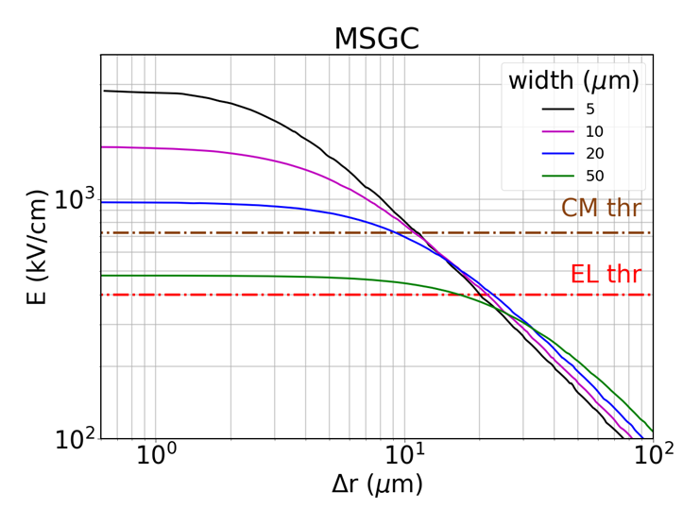

Simulated E vs distance from anode strip: MSGC vs VCC
Martinez Lema
Martinez Lema
2.5MV/cm
anode strip
CM: 10μm
hν
E vs Δr
Δr
EL: 20μm
Substrate 0.5mm; anode-strips 5-50μm; cathode-strips 200μm; drift-gap=1.9mm; strip pitch=1mm. Potentials: V_{a}=5KV; V_{c}=0; backplane: V_{b}=0; drift: V_{d}=-300V.
crossing EL threshold ~ 20μm from strip surface. Avalanche threshold ~10μm from surface. (thresholds: Aprile 2014)
MSGC & VCC: similar results @ V_{a}= 5kV But: in practice, not applicable to MSGC

Slide 29




Setup
Microstrip Plate - Preliminary results in LXe
Single event
S1
S2
Martinez Lema, Roy, Chepel, Breskin (2022)
V_{α} = 2.7 kV
V_{grid} = -1.7 kV
V_{cath} = ground
V_{back} = -2.0 kV
PMT
V_{α}
α
Mesh + α source
.
.
.
.
.
.
PRELIMINARY
V_{grid}
grid
LXe
MSGC
φ8μm
0.4mm
1mm
Microstrips plate
Ω ~ 6 %
T ~ 90%
QE ~ 40%
Q_{total} (α ) ~ 1 fC
Y ~ 10 photons/e @ 2.0 kV
(discharge limit)
Much higher gains/yields expected with VCC @ higher V_{anode}
Back plane
V_{back}
Charge gain ~ 4
V_{anode}
V_{cathode}
1mm
From: Bruno Guerard ILL
Amos Breskin - Noble-liquid detectors - RAL - April 5, 2023

Slide 30


Single-phase with cascaded THGEM + MSP ➔ S1 & S2
2-stage TPC with CsI-coated L-THEM + L-MSP;
(here L-VCC with S.T. Cr\Ni strips on VUV- substrate)
S2 e⁻ & S1 UV-pe⁻ collected into L-THGEM holes & efficiently* transferred to the L-VCC.
VUV photons emitted by EL + small avalanche near strips, detected through the substrate, by top photo-sensors.
A fraction of S1 photons – detected by bottom photo-sensors or reflected by a reflective-cathode to the CsI.
Option: top L-THGEM surface can be reflective or WLS-coated (➔ visible-range photo-sensors, glass substrate).
*
Experimental Transfer Efficiency of e⁻ and pe⁻ through THGEM holes in LXe.
Or a reflective cathode

Slide 31



Effective quantum efficiency Q_{eff} of CsI in LXe
GEM, SC-GEM, THGEM
Q_{eff}
Erdal 2021
https://jinst.sissa.it/jinst/theses/2021_JINST_TH_002.jsp
Expected average QE_{eff} in LXe across the entire surface of an electrode, as a function of voltage across the electrode. They were computed (using COMSOL®) for different perforated electrodes; electric field values: E_{d}=0.5 kV/cm and E_{t}=-1 kV/cm.

Slide 32



  Single-phase with single Micro Hole & Strip Plate (MHSP)
hν
avalanche
CsI
hν
e
MHSP: Veloso, Rev Sci. Instr. 71, 2371 (2000)
https://doi.org/10.1063/1.1150623
Current technologies➔ few-μm strips possible
A single-phase TPC with (here) a CsI-coated L-MHSP.
Both S2 e- & VUV photoelectrons are collected into the L-MHSP holes, drift to MHSP anode strips.
VUV photons by EL + small avalanche near strips, are detected by the top photo-sensors.
Other fraction of S1 photons - detected by bottom photo-sensors (or reflected.

Slide 33


  Single-phase with Micro-structured electrode
EL+CM
Hao Lin https://doi.org/10.1039/C3TA11889D
A single-phase TPC with a Liquid micro-structured THGEM multiplier (L-MS-THGEM) coated with CsI. Both S2 ionization electrons and S1 VUV photoelectrons are collected into the holes, drift through the THGEM, towards the micro-structured top surface.
VUV photons emitted by EL + small avalanche at the vicinity of the “anode tips”, are detected by the top photo-sensors.
Other fraction of S1 photons are detected by bottom photo-sensors (or reflected to CsI)

Slide 34

Can we form large-size patterned electrodes?
ARIADNE LAr TPC with optical readout. 50x50cm² glass THGEM (GTHGEM)
So far, borofloat 33 glass and fused silica glass electrodes (the latter of higher radio purity) produced by abrasive formation of sub-mm holes.
Electrode surfaces coated by resistive ITO film;
Can be patterned, by laser techniques – e.g. to form COBRA-like patterns.
Thin anode strips and other metallic patterns currently formed in industry: inkjet & photolithographic techniques. (few-micron thin strips on relatively large areas (up to 24”x 24”) already formed on a variety of substrate materials.
Lowe et al. Appl. Sci. 2021, 11(20), 9450;
https://doi.org/10.3390/app11209450
See refs in https://doi.org/10.1088/1748-0221/17/08/P08002

Slide 35
Novel Dual-Phase TPC Concepts
In case Single-Phase ones remain a dream…

Slide 36



Dual-Phase: Cascaded Liquid Hole Multiplier (LHM) – S1 & S2
Martinez Lema et al.
https://events.camk.edu.pl/event/47/contributions/377/attachments/126/281/LIDINE-2022%20The%20Bubble-Free%20Liquid%20Hole-Multiplier-v2.pdf
SiPM
SiPM
SiPM
SiPM
hν
EL
GEM/THGEM
G-THGEM
GXe
S1
S2
L-THGEM
photocathode
e- & pe- transfer efficiency through THGEM immersed in LXe
α-induced S1 energy resolution
pe
High QE in LXe
LXe
hν
e
interaction
cathode
PRELIMINARY:
~350 photons\e\4π
S2 electrons and fraction of S1-induced photoelectrons extracted efficiently in liquid through the holes of a CsI-coated immersed L-THGEM electrode. They traverse the interface inducing electroluminescence (EL) in gas phase, mostly in holes of a second perforated G-THGEM electrode. Readout by nearby photo-sensors. Bottom cathode: reflective, or photosensors underneath.
QE_{eff} in LXe
~30%@175nm
LXe: increased QE_{eff} by ~x3.5 compared to vacuum!
EL in holes does not depend on interface-gap variations

Slide 37
Dual-Phase: Cascaded Liquid Hole Multiplier (LHM) R&D - S1 & S2
The multiplier: Perforated electrode with thin strips
SiPM
SiPM
SiPM
SiPM
hν
High field on strip
➔EL + CM
COBRA
MHSP
e
MHSP
GXe
S1
S2
photocathode
pe
hν
High QE in LXe
LXe
e
Current technologies➔ few-μm strips possible
interaction
cathode
EXPECTED: higher field➔ larger photon yield & faster signals

Slide 38

A potential cascaded LHM DM TPC
High CsI QE
➔ expected high PDE
Unambiguous detection of amplified single photons
Above dark current
Possible to use SiPM, CMOS-SPAD etc.
➔Lower detection threshold
Transmitted charges detected in G-THGEM holes:
Interface fluctuations not critical
Faster EL signals
No PMTs
Economic
Radio-purity?
No wasted LXe in buffer region
G-THGEM
CsI L-THGEM
LXe
Reflective cathode

Slide 39




Dual-Phase: The Floating Hole Multiplier FHM
Better surface-effects control by separation of the two phases;
The liquid phase and the gas should be in thermal equilibrium (at the interface)
Use “rubust” interface: a perforated electrode FLOATING on the liquid surface ➔ e.g. GEM, THGEM, COBRA, etc
Must control the liquid level precisely to have liquid below and gas above.
Cu-clad FR4 PCB
Liq.-Gas interface
THGEM
LXe density 2.9 g/cm3
FR4 density 2.0$±$0.2 g/cm3
If copper cladding is not too heavy → THGEM should float on the surface of LXe
Idea V. Chepel
Let it float !

Slide 40




FHM – S2 e⁻ only
proof of FHM principle in LXe: Chepel et al. http://arxiv.org/abs/2301.12990
interface
S2 vs V_{extr}
GEM/THGEM
LXe
S2
α-induced S1 & S2
e
hν
PRELIMINARY:
Y~500 photons\e\4π
S2 electrons extracted efficiently through the interface within holes of a perforated electrode, floating on the liquid. They traverse the interface (under high fields) inducing EL in gas. Readout by nearby photo-sensors.
0.4mm thick
With 0.4mm thick electrode floating on LXe,
the holes are rather filled with the liquid.
R&D: Thicker electrode:
➔ expected higher photon yields.
Reduced interface effects and instabilities
α-induced S2
Energy resolution

Slide 41

FHM – S1 photons & S2 e⁻
Future R&D
S2
An optional CsI-coated perforated floating electrode allows for detecting both, a fraction of S1 photons (photoelectrons from CsI) and S2 electrons. Both are collected into the holes and traverse the interface (under high fields) inducing EL in gas. Readout by nearby photo-sensors. Under R&D.

Slide 42
FHM – potential benefits
Significantly smaller free liquid surface – reduced surface instabilities
High electron extraction probability thanks to high field at the interface
➔ Result – reduced single-electron noise
Parallelism between the gate and extraction electrodes
No sagging
No need for fine detector levelling and liquid level control
R&D:
Electrode optimization to maximize light emission from holes
Physics of interface
Photosensitive (CsI) FHM
FHM on LAr: need lower density PCB materials

Slide 43

Cryogenic charge multipliers with resistive electrodes
Motivation: Charge multiplication in noble gases limited by discharges due to secondary effects to <10 (DUNE)
Goal: Quench harmful discharges by deploying resistive materials in the gas-avalanche multiplier
THGEM electrode, coupled to readout anode via resistive electrode,
Deposited charges are collected into holes, undergoing avalanche multiplication under $∆$V_{RWELL}
Vapor phase
Resistive WELL (RWELL)
Resistive film, e.g. Diamond-Like-Carbon (DLC), on an insulator.
Charges evacuated sideways to ground via resistive layer
Signals are induced on readout anode by charges movement
Resistive-Plate WELL (RPWELL)
resistive plate, e.g. a ceramic material Yttria-Stabilized-Zirconia (YSZ) doped with ferrite oxide (Fe2O3), to readout anode.
Amplified charge travel through the resistive plate to the anode.
Vapor phase
challenges: find/develop resistive materials of the “right” surface/bulk resistivity at noble-liquid temperature

Slide 44


Cryogenic RWELL & RPWELL challenges
Discharge quenching:
An occasional gas breakdown ➔ very large charge accumulation within holes.
➔ reduction of the local electric field.
➔ quenching of discharge energy.
➔ Prevents damage to electrodes & electronics
A main challenge:
find/develop resistive materials of the “right” surface/bulk resistivity at noble-liquid temperatures (LAr ~87K; LXe ~ 165K).
Resistive FILM: ~ 20GΩ/□
Resistive PLATE: ~ 10⁹-10¹²Ω·cm
Tesi, MPGD2022
https://indico.cern.ch/event/1219224/contributions/5130754/attachments/2566756/4531430/Tesi_MPGD2022.pdf

Slide 45





Gain comparison: unquenched THGEM/WELL & RWELL
E_{d}=0.5kV/cm
E_{d}=0.5kV/cm
E_{i}=5kV/cm
RPWELL
G=30
Quenched
RWELL
RWELL
Quenched
RPWELL
Ar 90K
WELL
THGEM
RPWELL
So far, with experiments performed under equal conditions:
RWELL/DLC gain > THGEM (LEM) gain;
RWELL gain > RPWELL gain (but higher quenched-discharges rate
Near zero discharges @ gain < 17

Slide 46
Summary & Outlook
GENERIC R&D
Ideas & concepts for potential improvement of large-volume noble-liquid detectors: DM, neutrino…;
Goal: Effective detection of both, scintillation photons and/or ionization electrons;
Single-phase: various optically-recorded configurations incorporating micro-structured elements;
Dual-phase: Optically-recorded Cascaded (liquid/gas) multipliers, Floating Hole Multipliers, Bubble-assisted Liquid Hole Multipliers – and electrically-recorded Resistive Charge Multipliers;
So far:
Investigations in LXe (with only LHM investigated also in LAr);
Lower PDE and worse E-resolution than expected (electron losses at interface)
Single phase: - Charge & light amplification investigated on MSGC strips in LXe
Preliminary: low due to discharge limits. High amplification expected with VCC plates
Dual phase: - proof of principle for all; ~500 photons/e-/4π
⎝ potential to detect single photons above background with simpler photosensors
- Imaging investigated only in LHM (200μmRMS)
Potential applications: DM, ν physics, n/γ detection in Nucl. Physics,* Homeland security**…
*Cortesi 2017; **Israelashvili 2017
Many open questions requiring Simulations & exp. R&D (LAr, LXe); R&D on nanostructures, on stability of VUV-photocathodes in noble liquids & on technologies

Slide 47
Thank you

