Slide 1
In Memoriam: Pabi’s life and career
Adrian Hillier
The Queen’s College, Oxford
11 September 2023

Slide 2
Family
Science
Pabi

Slide 3
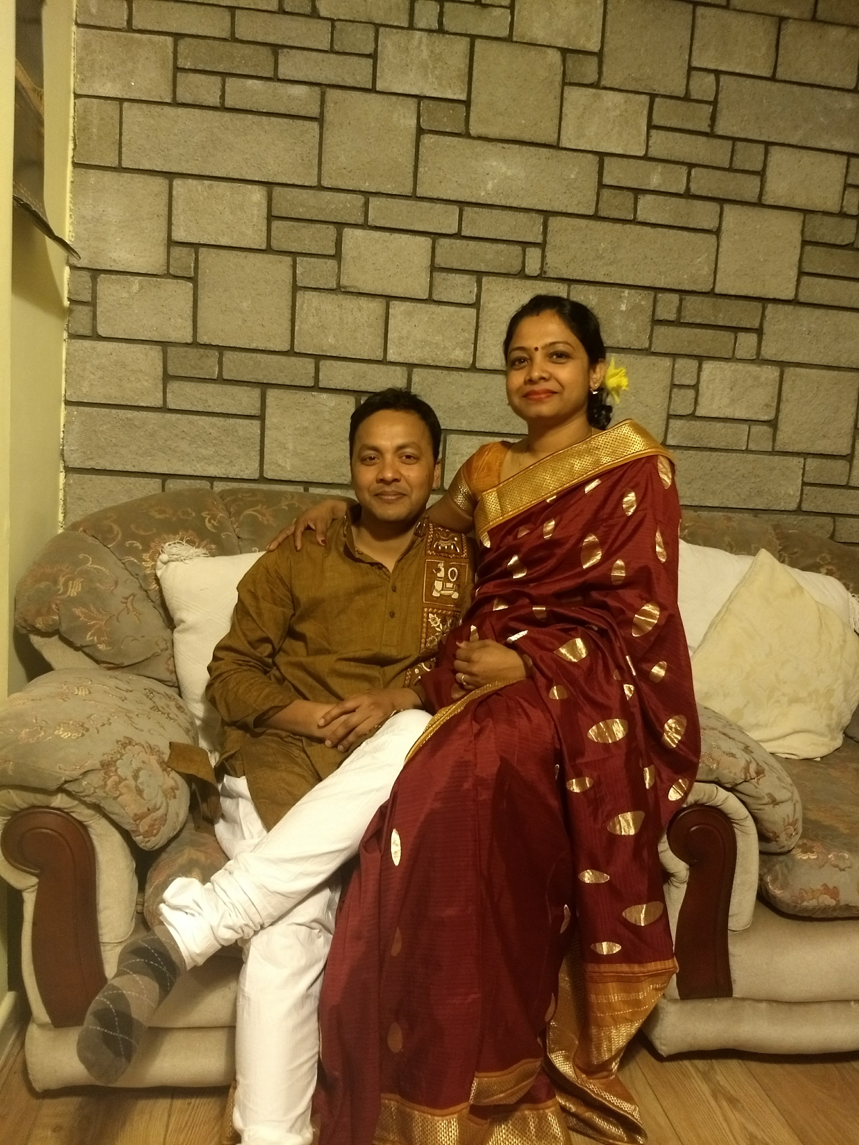
Pabi
Pabitra Kumar Biswas
Known to us as Pabi
With his wife Aparna

Slide 4
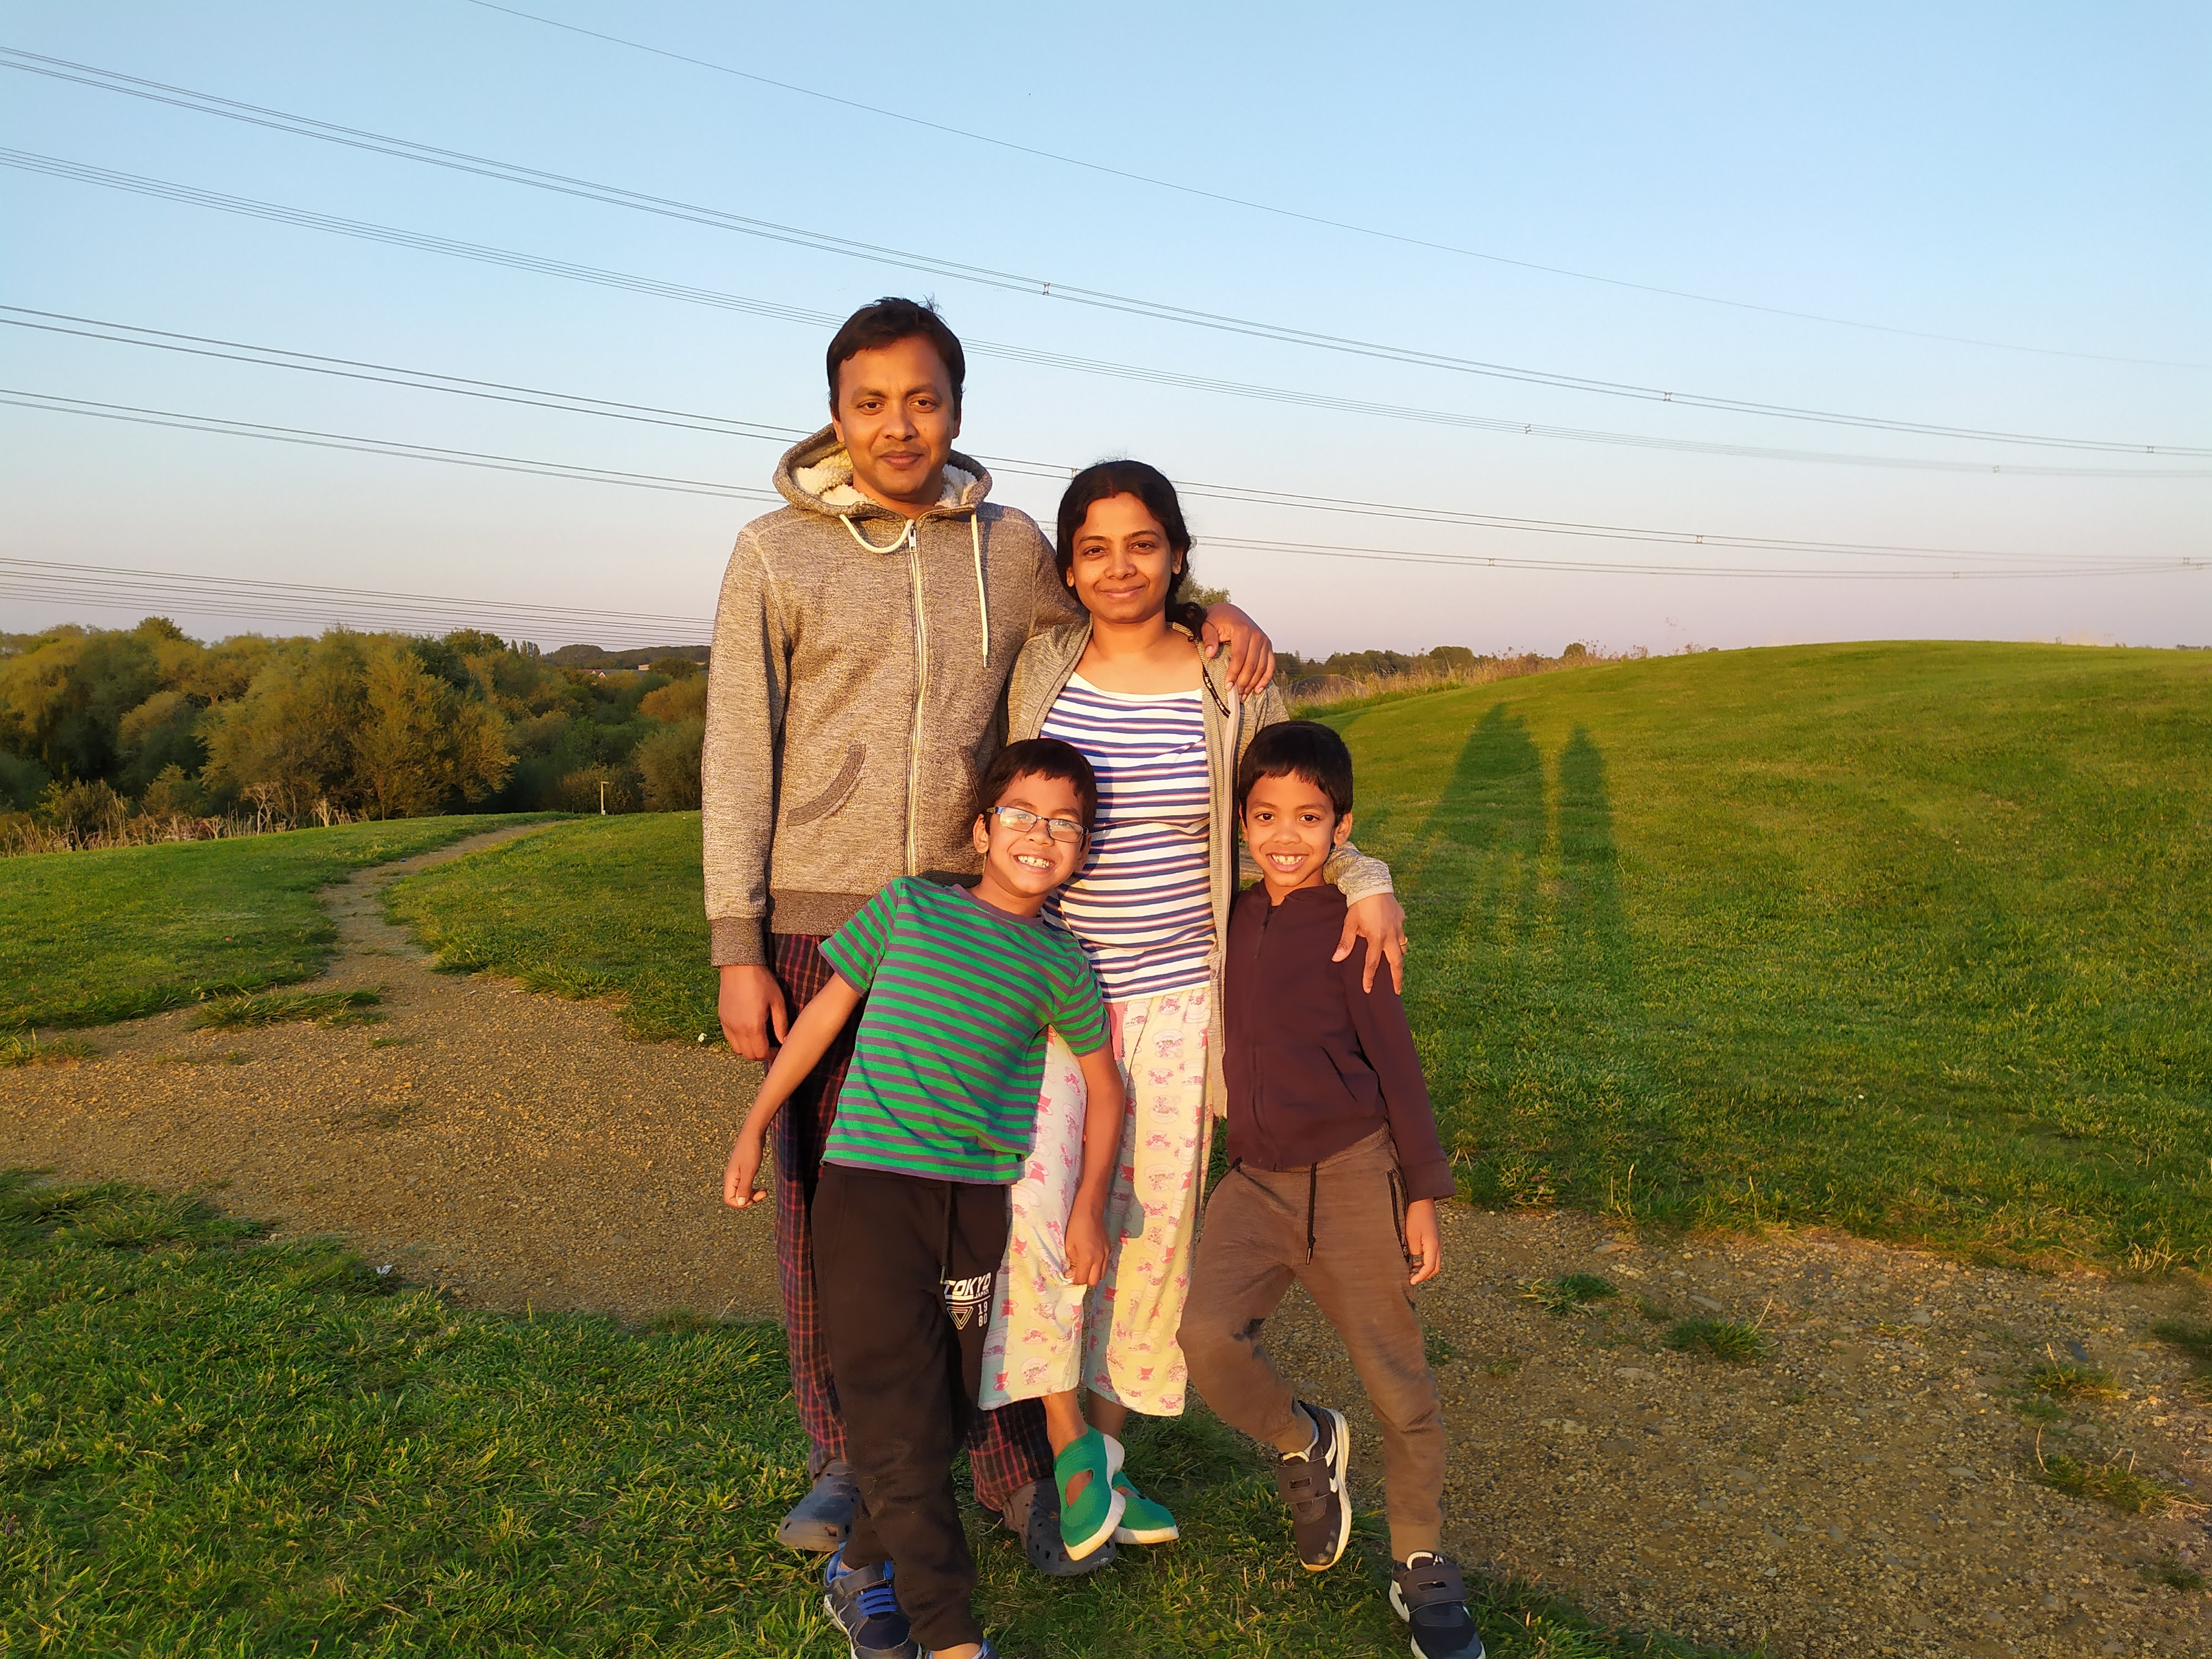
Pabi
Pabitra Kumar Biswas
Known to us as Pabi
With his wife Aparna and two boys - Ishaan and Srijan

Slide 5
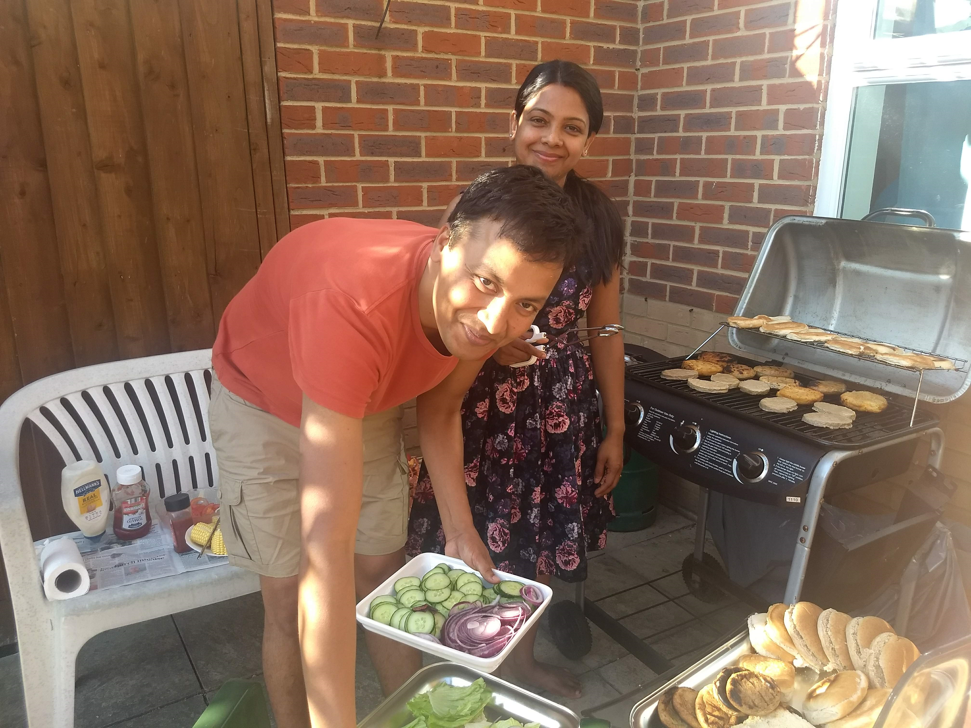
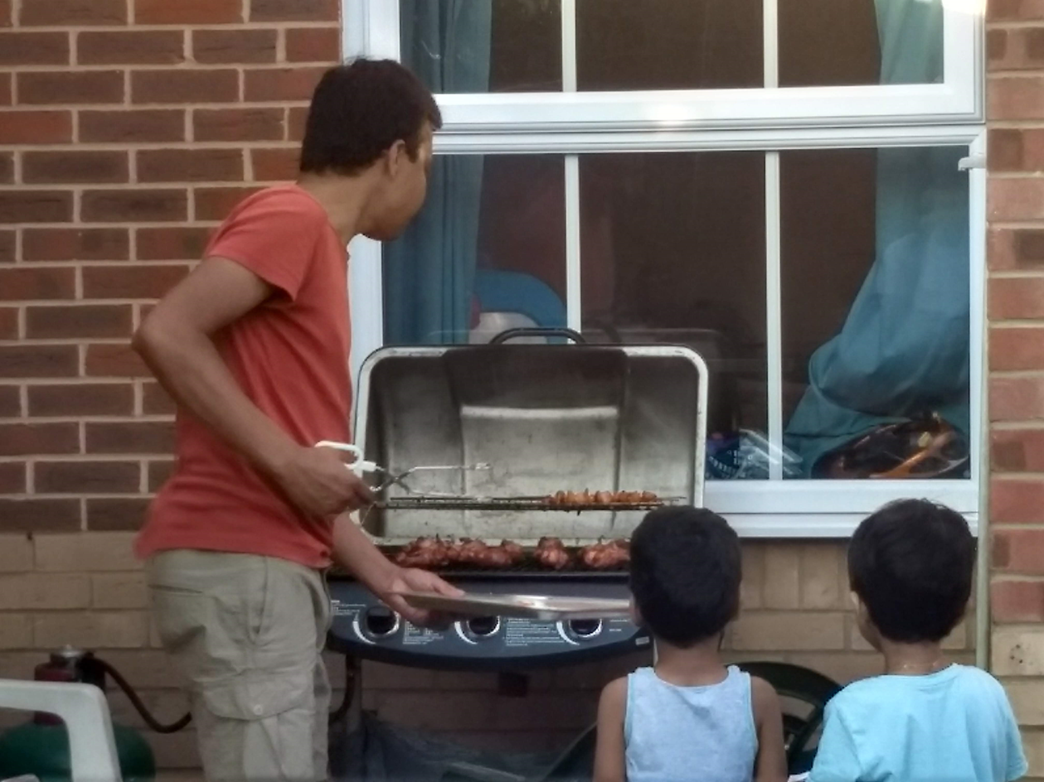
Pabi was saying that he could make the best burger in Oxfordshire. However, he bought the burger patties from Sainsbury.
He was teaching his sons (Ishaan and Srijan) how to prepare the best burger.

Slide 6
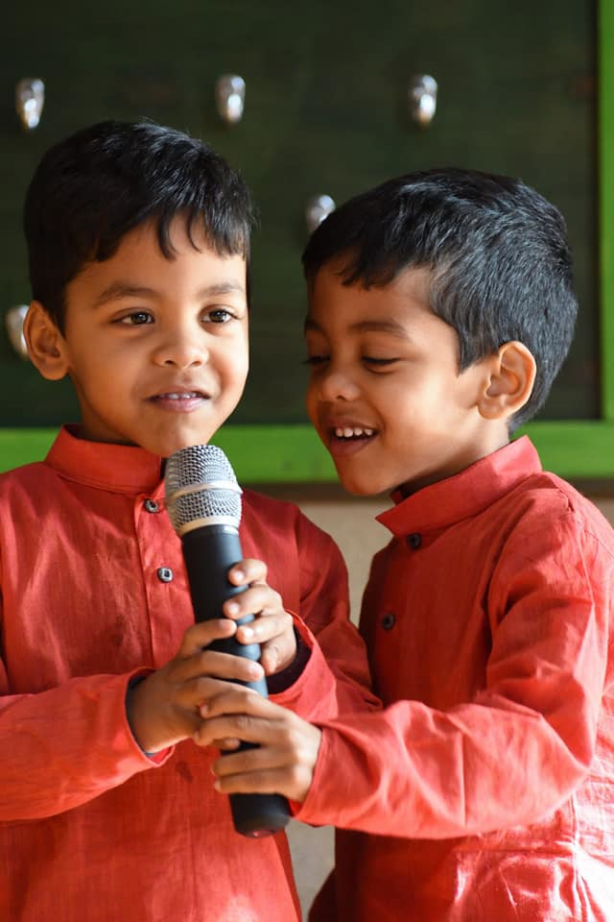
A Good Friend
From a friend, Aradhita:
My first meeting with Pabitra was him sitting on a couch after a 10-hour flight. And he had his two sons, Ishaan and Srijan, on both sides. Aparna had just dished out one of the mommy comfort foods and Pabitra was feeding the two kids. He was a doting father and supportive (read-loving) husband.
The friendship between the two families continued since my son was about the same age as his sons, and they trio played and talked about all the things under the sky. They shared their excitement about dinosaurs, spaceships, cars and of course what each other’s parents told them.
One day when I was reading a book on planets with my son and was telling him that there are 9 planets, he stopped me in a matter-of-fact manner and said, “mom, there are only 8 planets. Pluto is not a planet”. I was amazed as I didn’t expect the 4-year-old child to understand why Pluto is not a planet. On enquiring why, he told me “ You know mummy, Ishaan bhaiya’s papa is also a scientist like my papa. But he works in outer space, not in lab like Papa. And he has told Ishaan bhaiya that Pluto cannot be a planet because it is the name of a dog.”

Slide 7
A Good Friend
From a friend, Aradhita:
My first meeting with Pabitra was him sitting on a couch after a 10-hour flight. And he had his two sons, Ishaan and Srijan, on both sides. Aparna had just dished out one of the mommy comfort foods and Pabitra was feeding the two kids. He was a doting father and supportive (read-loving) husband.
The friendship between the two families continued since my son was about the same age as his sons, and they trio played and talked about all the things under the sky. They shared their excitement about dinosaurs, spaceships, cars and of course what each other’s parents told them.
One day when I was reading a book on planets with my son and was telling him that there are 9 planets, he stopped me in a matter-of-fact manner and said, “mom, there are only 8 planets. Pluto is not a planet”. I was amazed as I didn’t expect the 4-year-old child to understand why Pluto is not a planet. On enquiring why, he told me “ You know mummy, Ishaan bhaiya’s papa is also a scientist like my papa. But he works in outer space, not in lab like Papa. And he has told Ishaan bhaiya that Pluto cannot be a planet because it is the name of a dog.”
. He was a doting father and supportive (real-loving) husband

Slide 8
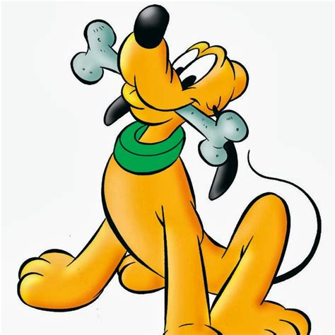
A Good Friend
From a friend, Aradhita:
My first meeting with Pabitra was him sitting on a couch after a 10-hour flight. And he had his two sons, Ishaan and Srijan, on both sides. Aparna had just dished out one of the mommy comfort foods and Pabitra was feeding the two kids. He was a doting father and supportive (read-loving) husband.
The friendship between the two families continued since my son was about the same age as his sons, and they trio played and talked about all the things under the sky. They shared their excitement about dinosaurs, spaceships, cars and of course what each other’s parents told them.
One day when I was reading a book on planets with my son and was telling him that there are 9 planets, he stopped me in a matter-of-fact manner and said, “mom, there are only 8 planets. Pluto is not a planet”. I was amazed as I didn’t expect the 4-year-old child to understand why Pluto is not a planet. On enquiring why, he told me “ You know mummy, Ishaan bhaiya’s papa is also a scientist like my papa. But he works in outer space, not in lab like Papa. And he has told Ishaan bhaiya that Pluto cannot be a planet because it is the name of a dog.”
was telling him that there are 9 planets, he stopped me in a matter-of-fact manner and said, “mom, there are only 8 planets. Pluto is not a planet”. I was amazed as I didn’t expect the 4-year-old child to understand why Pluto is not a planet. On enquiring why, he told me “ You know mummy, Ishaan bhaiya’s papa is also a scientist like my papa. But he works in outer space, not in lab like Papa. And he has told Ishaan bhaiya that Pluto cannot be a planet because it is the name of a dog.”

Slide 9
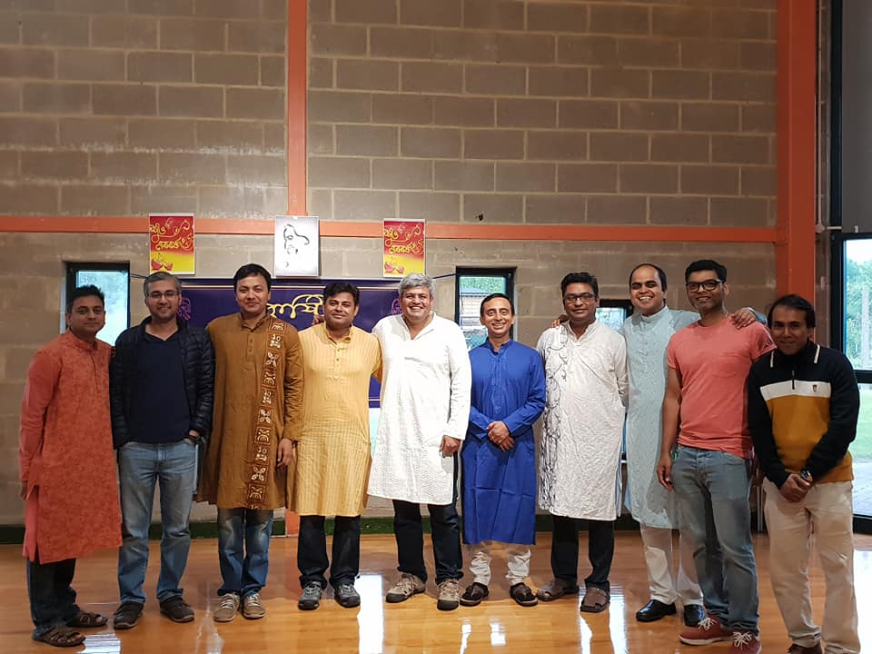
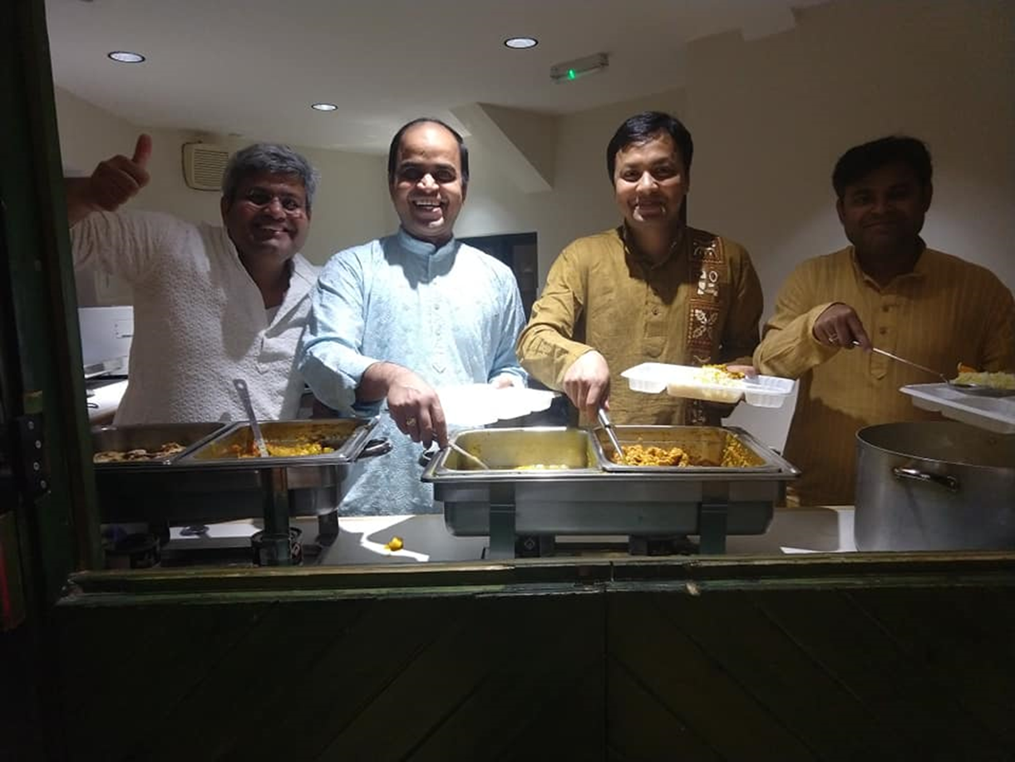
Pabi was the most active member in uniting a group of Bengali people in Didcot to celebrate some nostalgic Bengali festivals.

Slide 10
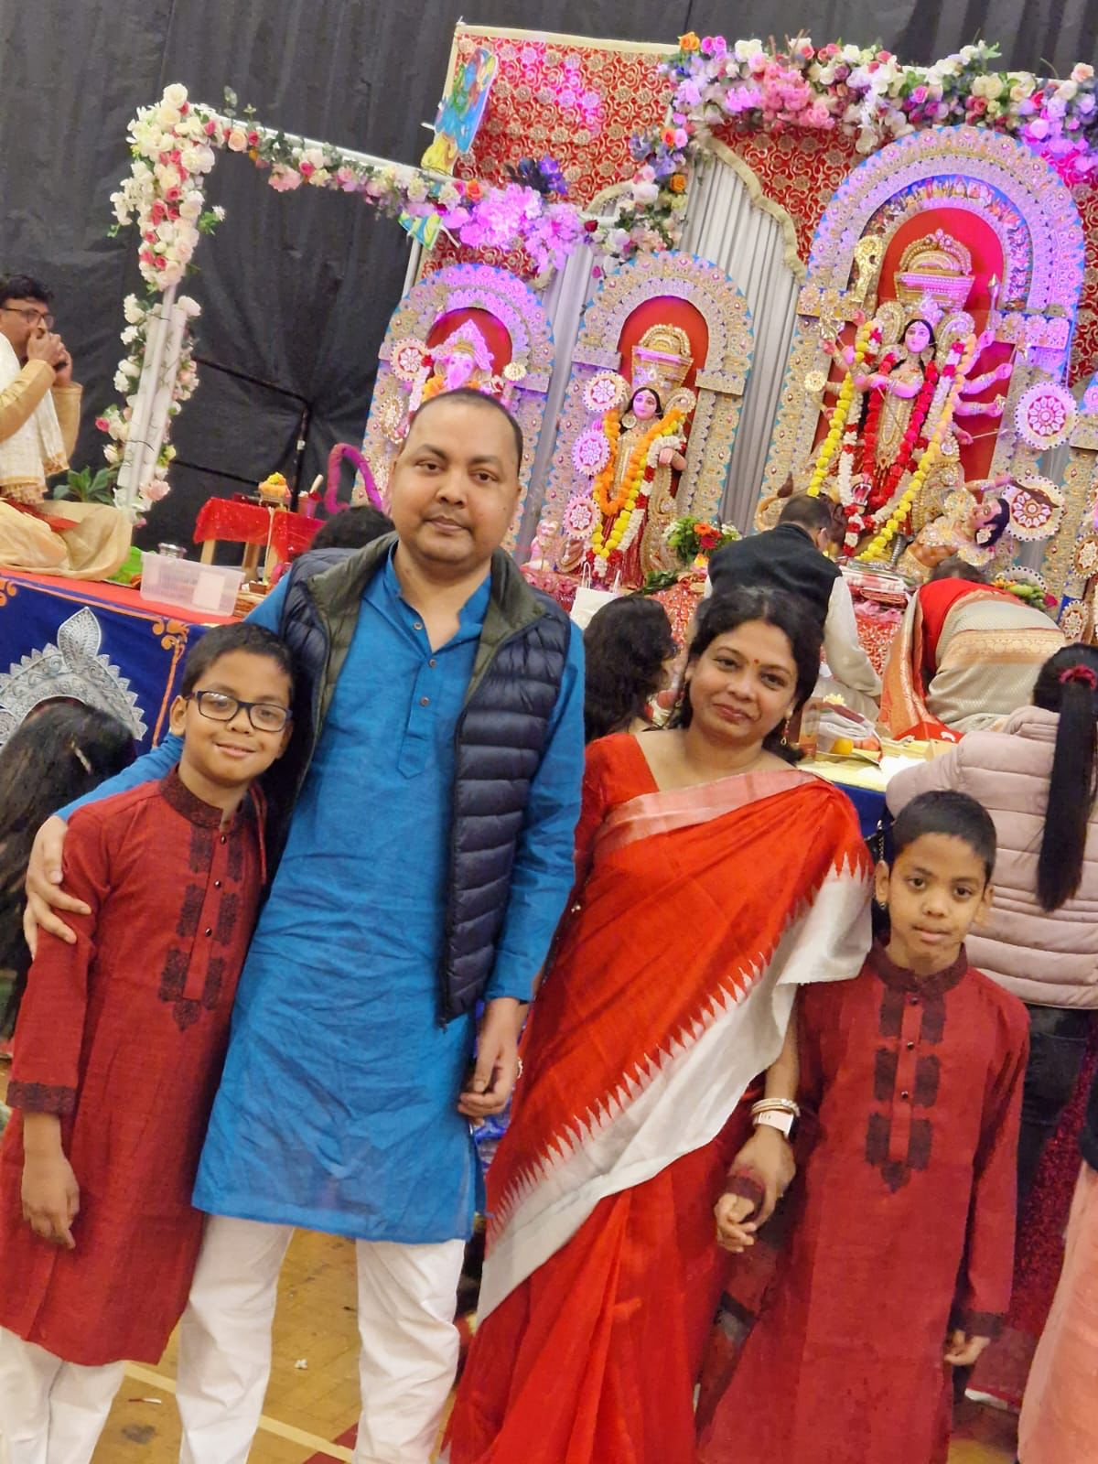
He joined the Durgapuja in Reading
after the pandemic.

Slide 11
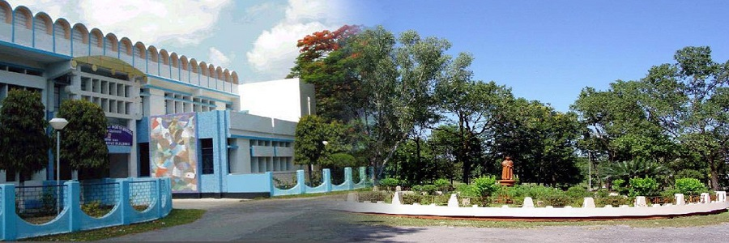
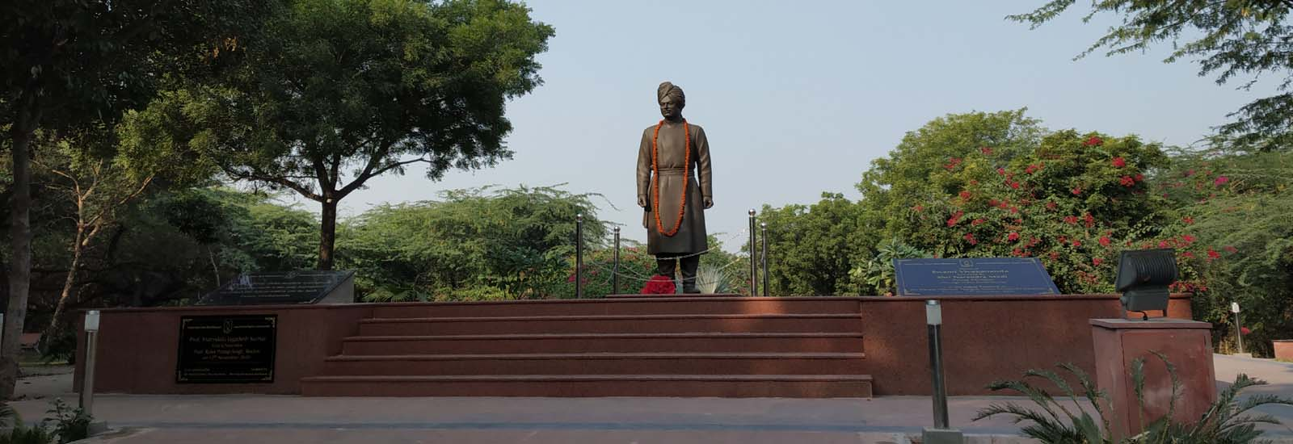
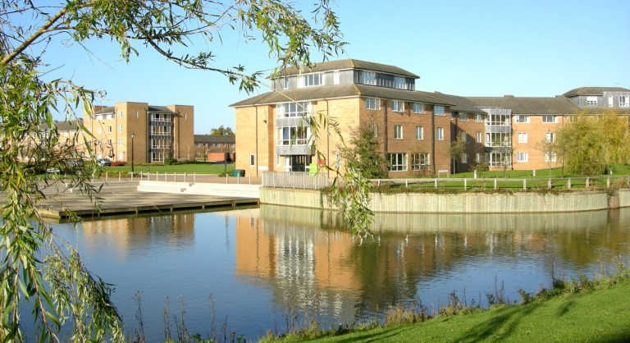
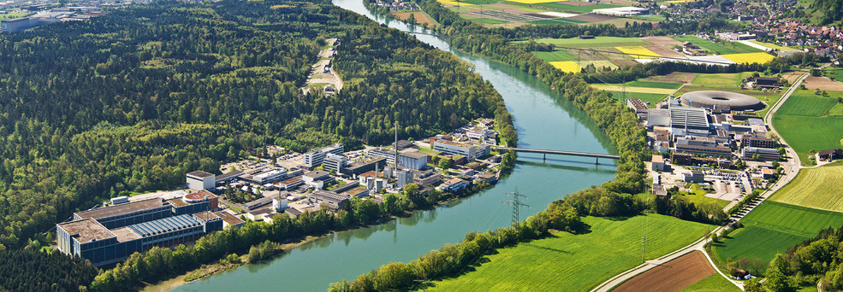
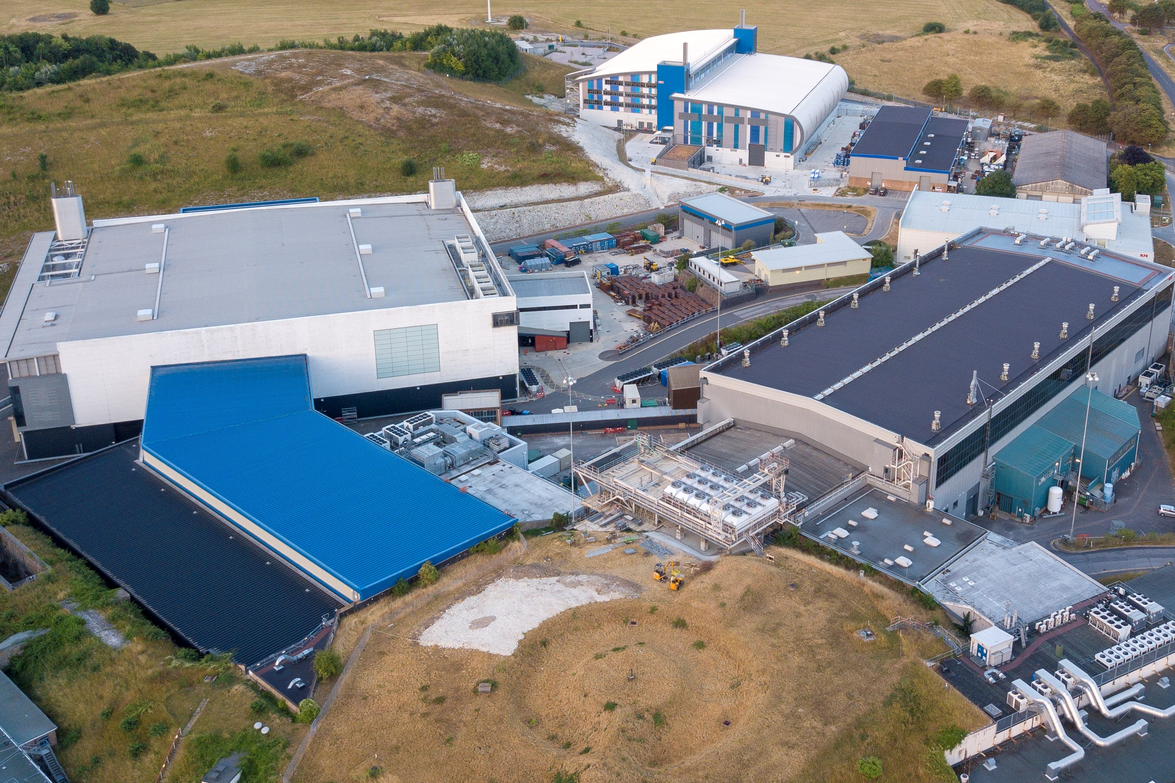
Career
BSc Physics, North Bengal University, West Bengal, India 2001-2005
MSc Physics, Jawaharlal Nehru University, New Delhi, India 2005-2007
PhD Physics, Warwick University, United Kingdom 2008-2012
Postdoctoral Researcher, Paul Scherrer Institut, Switzerland 2012-2015
ISIS Neutron and Muon Facility, UK, 2015-2021

Slide 12
Science and Community Impact

Slide 13
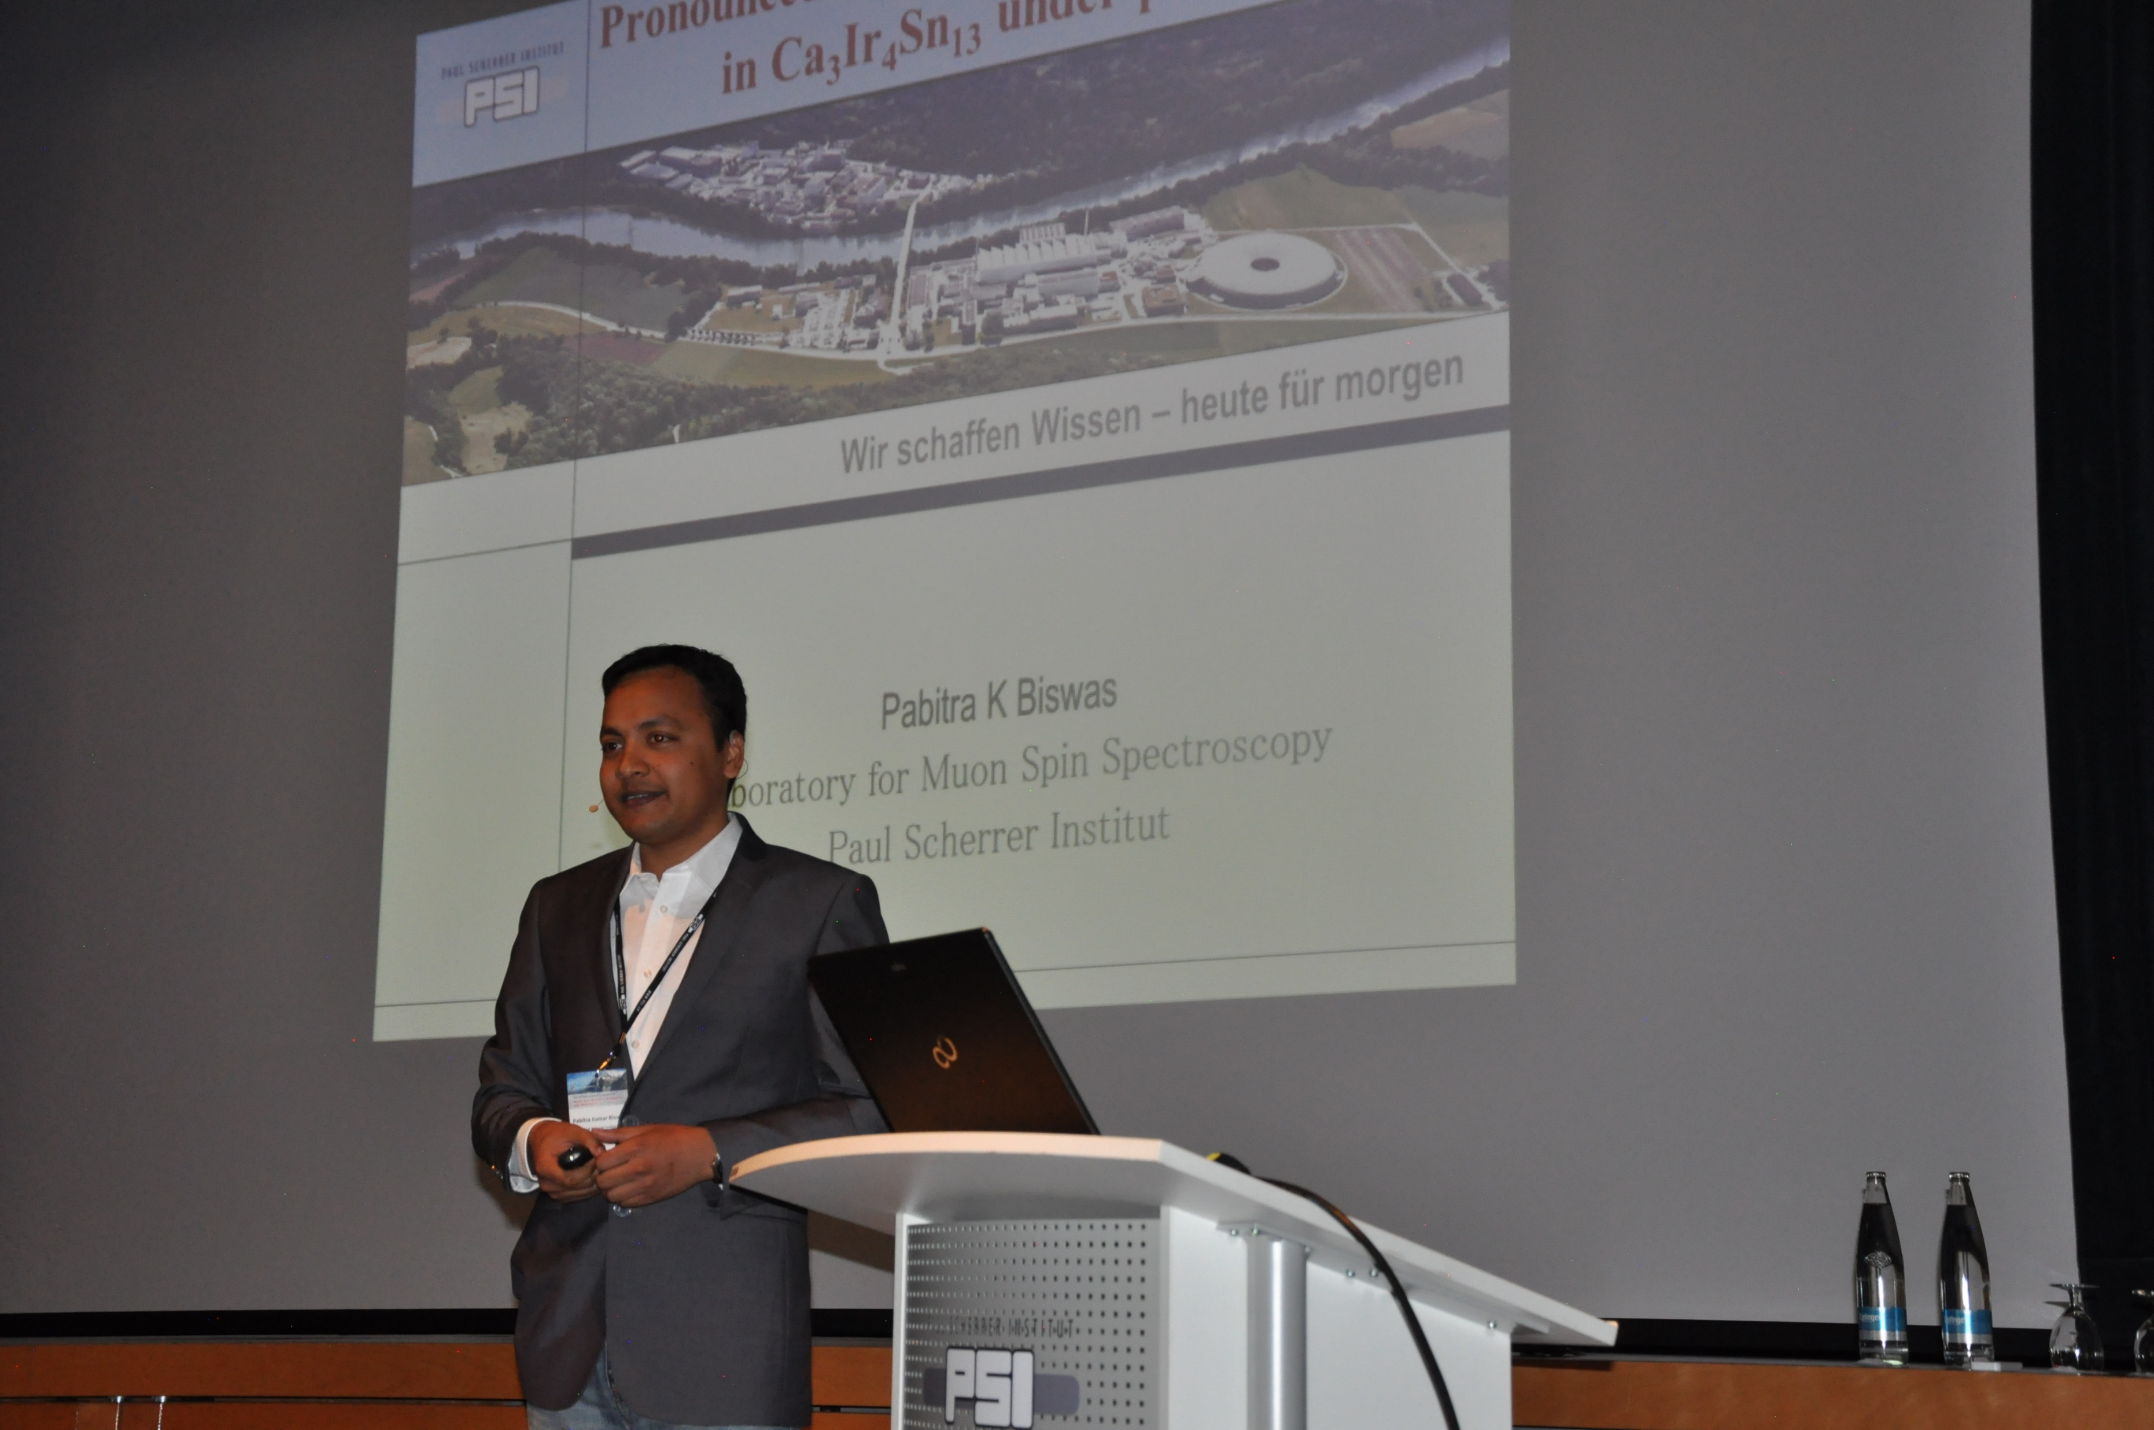
Topics

Slide 14
Topics
Meeting Topics
Unconventional Superconductivity
Quantum Materials under pressure
Quantum Magnetism
Non-centrosymmetric superconductors
Early Careers
and, of course, Facility developments

Slide 15
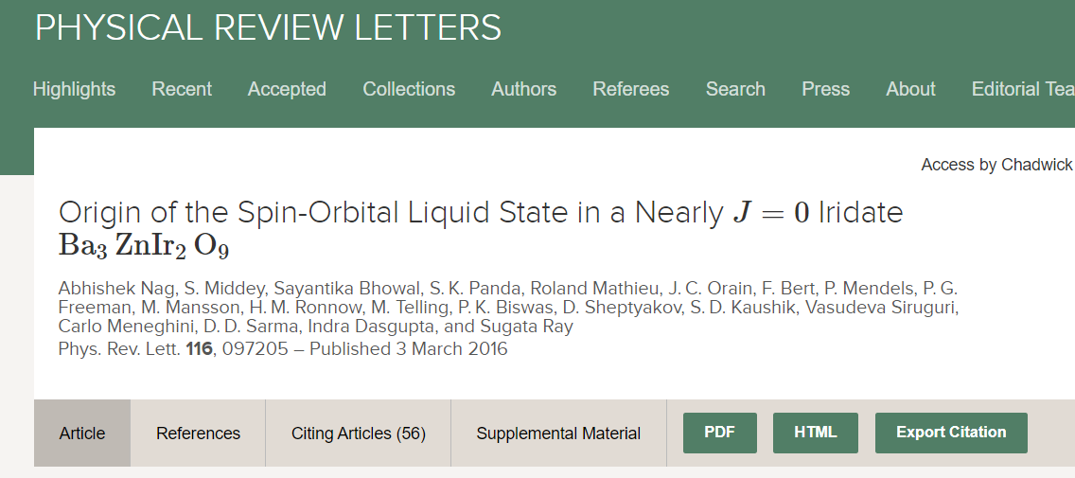
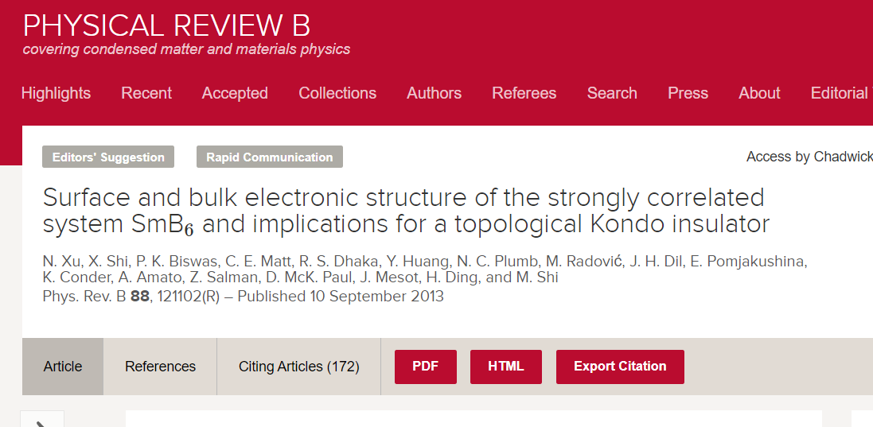
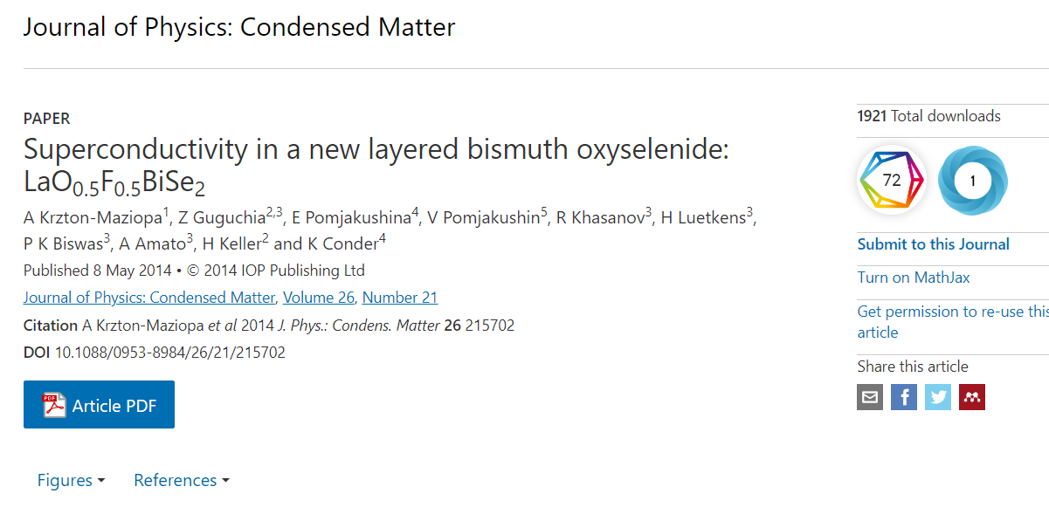
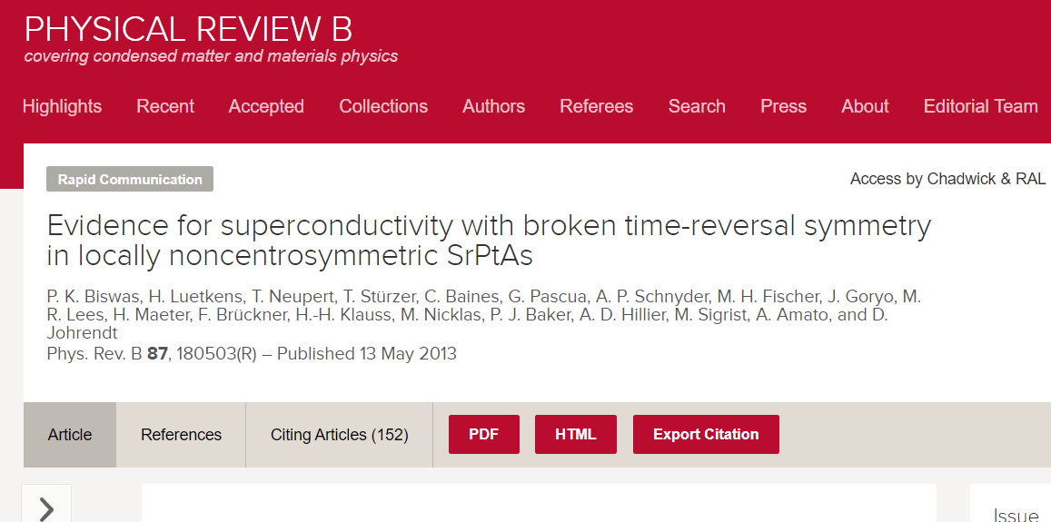
Science Impact
Citations 182
Citations 172
Citations 151

Slide 16
Pabications

Slide 17
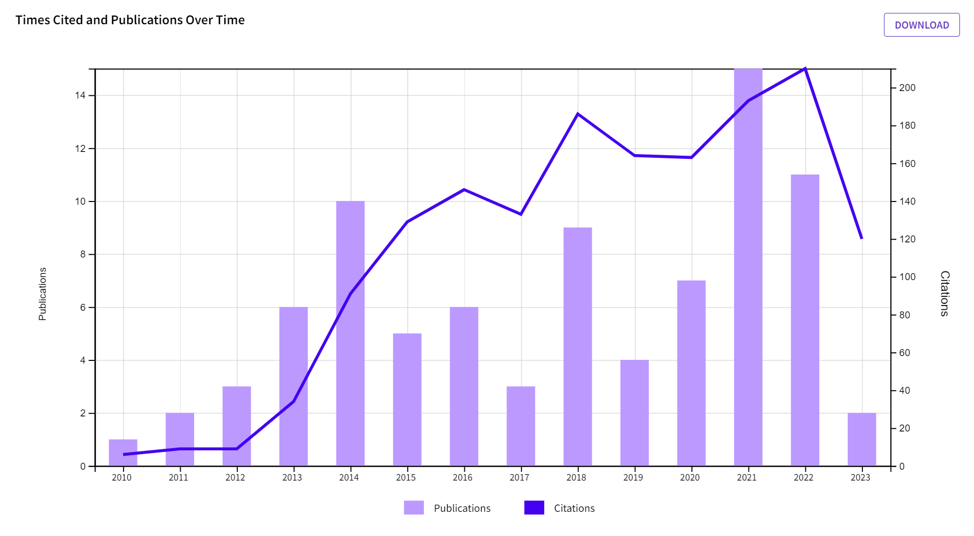
Pabications

Slide 18
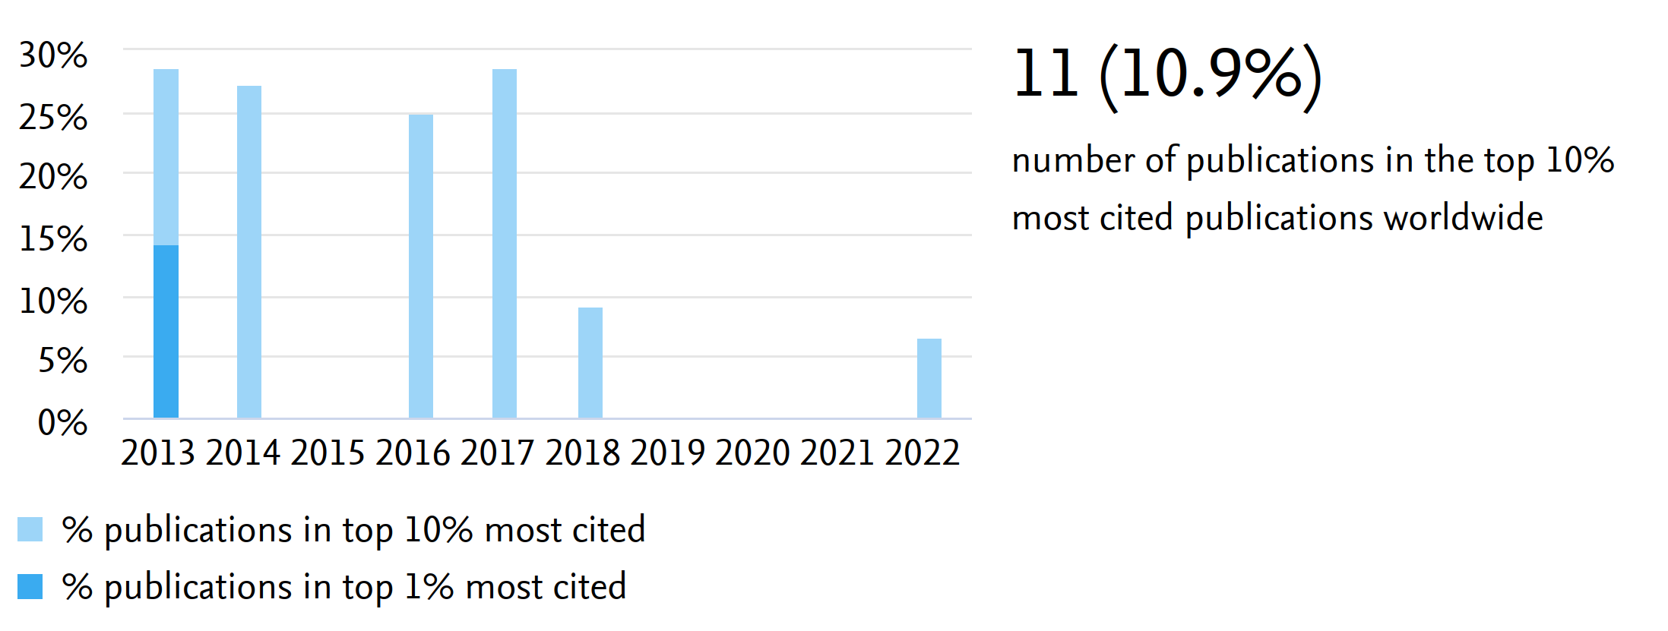
Pabications

Slide 19
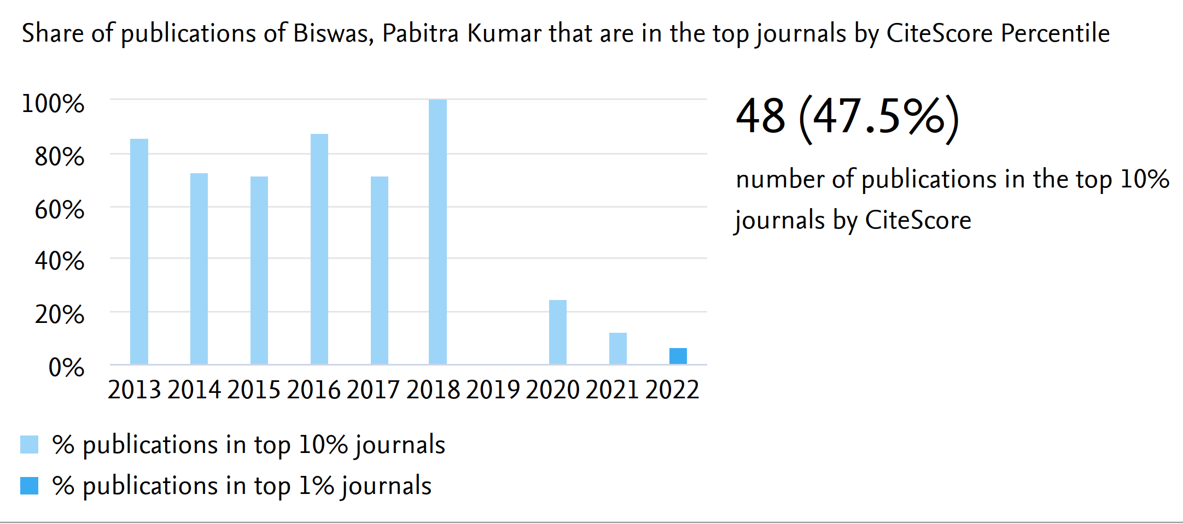
Pabications

Slide 20
Projects
Involved with rebuilding Dolly @ PSI
Detectors
Cryostats
Beam tuning
Data Acquisition

Slide 21
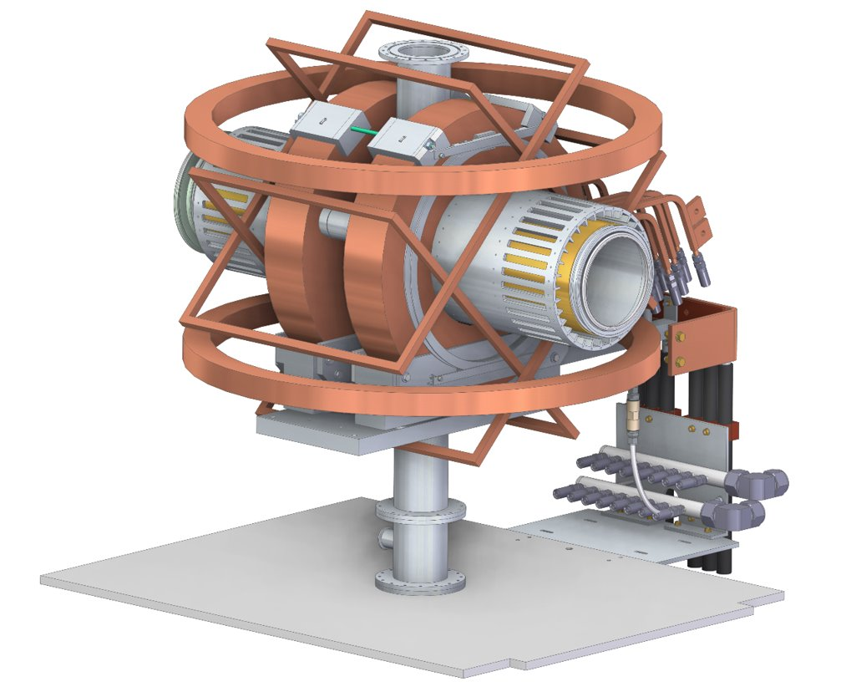
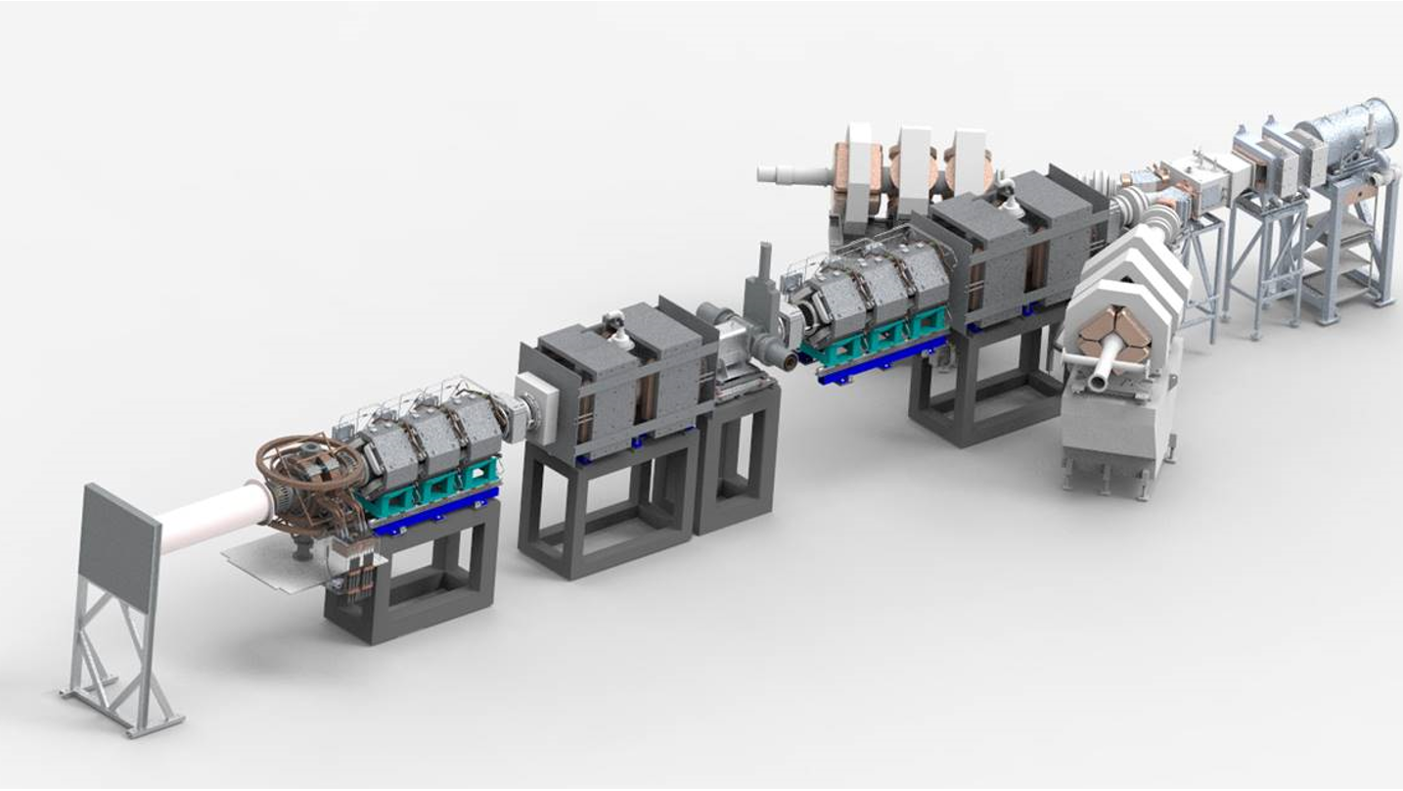
Projects
Involved with Super-MuSR
Science Case
Design
Detectors
Beam Optics
Data Acquisition

Slide 22
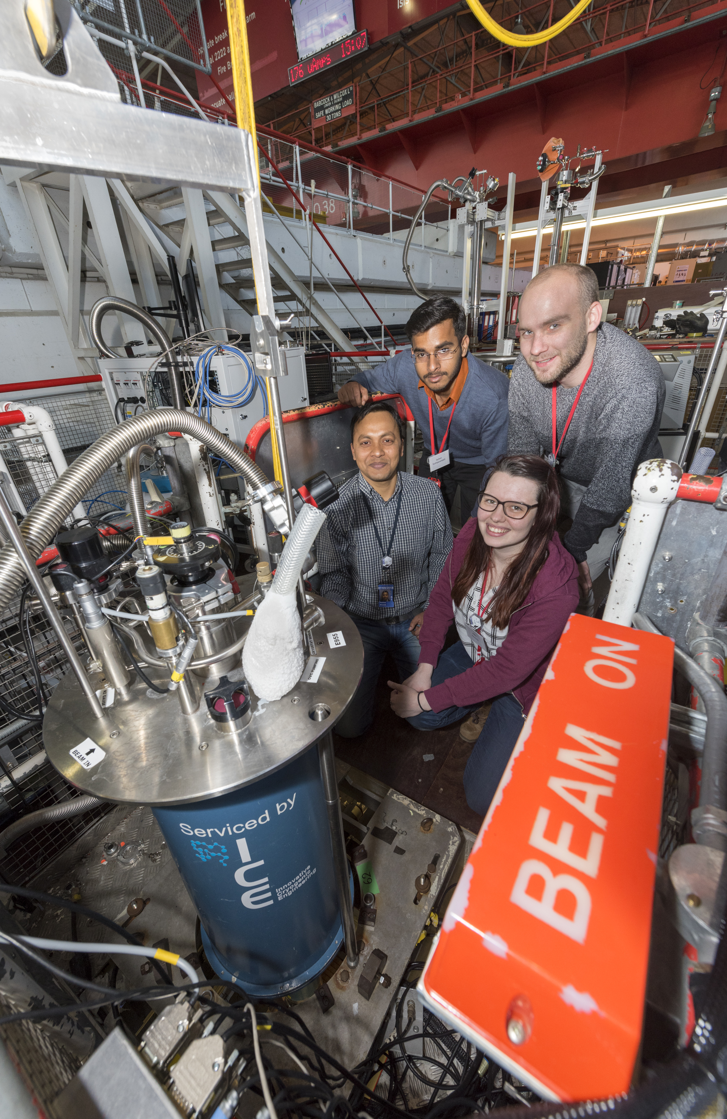
Muon School
Involved with Practical Muon School
Giving lectures
Running experiments
Co-organised the Advanced muon school
Gave lectures
Ran virtual practicals
Wrote a section on Experimental Techniques

Slide 23
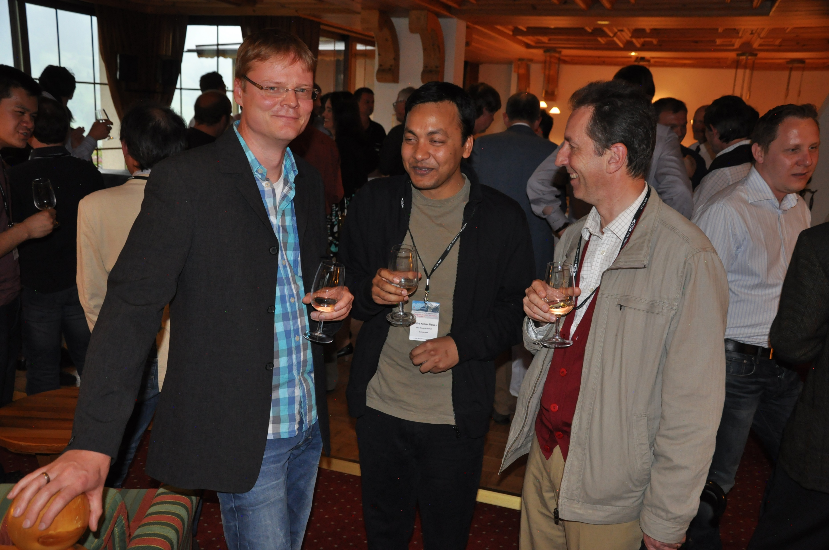
International Collaborations
Collaborations across Europe

Slide 24
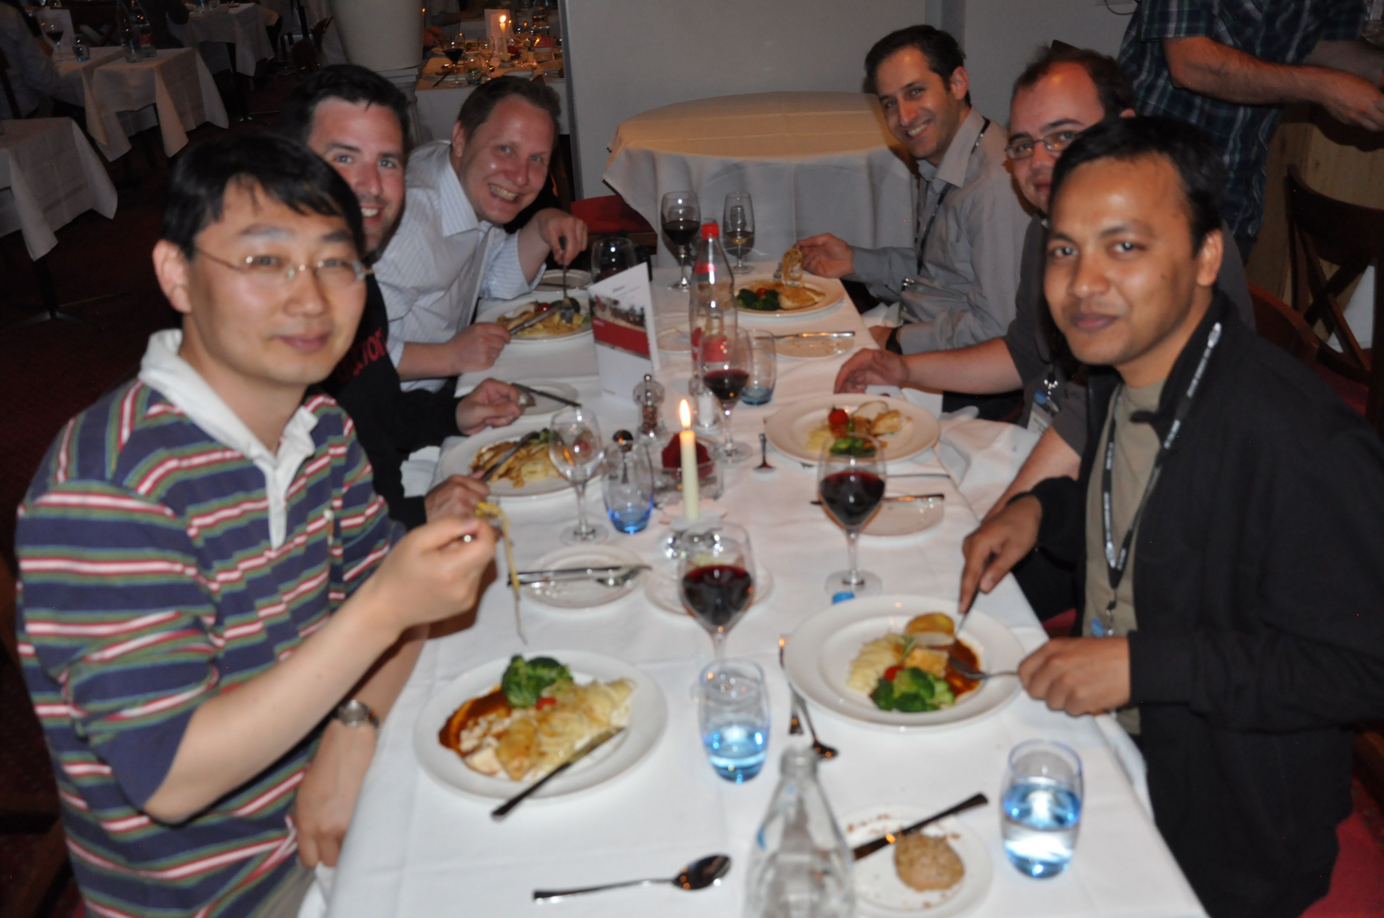
International Collaborations
Actually, collaborations across World
Significant growth of user community
In particular:
India
China

Slide 25
Pabi our friend and colleague
Please sign the paper for inclusion in a printed version of Pabi’s papers for his family.

