Slide 1
Superconducting RF Materials for Accelerators
Prof Graeme Burt
Lancaster University
CI Postgraduate Lectures May 2023

Slide 2
Q-slope
The main property of any RF system is gradient.
SRF cavities are often characterised by Q versus E curves.
As the gradient increases heating, field emission and vortex penetration all lead to an increased surface resistance.
If the Q drops too low it will increase the cryogenic load which will increase LHe boiling

Slide 3
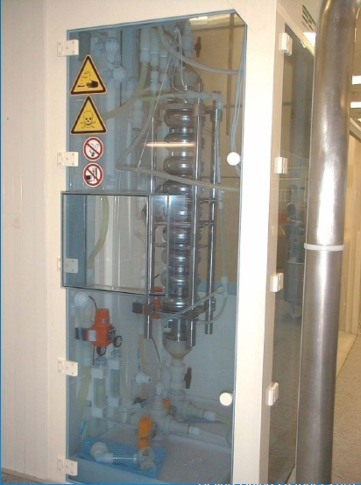
Buffered Chemical Polish
In order to remove any defects or damage to the surface, an light acid etch is applied to the cavities.
Hydrofluoric acid
Nitric Acid
Phosphoric Acid
In a 1:1:2 solution
Care must be taken to avoid hydrogen contamination, so the correct mixture should be used.
The cavity should be dunked in the acid at a low temperature (<18 degC).
Afterwards the cavity should be cleaned with ultrapure water.

Slide 4
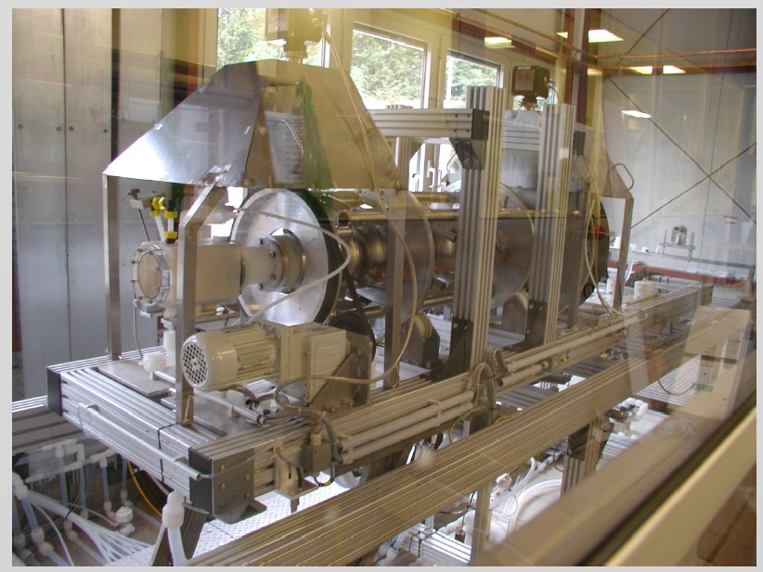
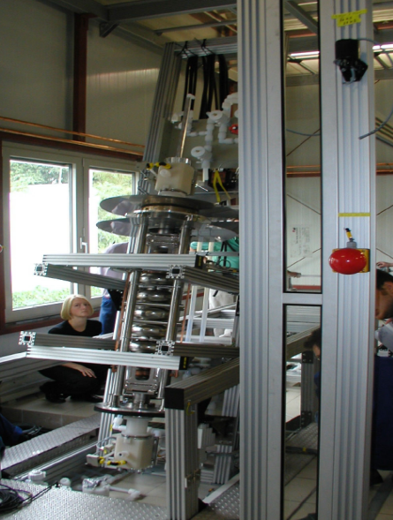
Electropolish (EP)
Some labs use an electropolish instead of a BCP to achieve a smoother finish.
This involves using the cavity as an anode and an aluminium cathode, while immersed in an electrolyte.
This method can produce more hydrogen so it is often necessary to heat the cavity in a vacuum furnace after electropolishing.

Slide 5
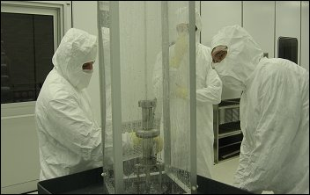
High Pressure Rinse
After etching it is necessary to clean the cavity using ultrapure water. For an aggressive removal of particulates, high pressure (~100 bar) rinsing is often performed in a clean room.
The rinsing facility uses small nozzles to direct the water. Care must be taken not to use metal parts as UPW is highly corrosive.

Slide 6
Q slope
At low field the injection of oxygen in the niobium after baking produces additional NbOx clusters that, at low field, are not in thermal equilibrium with the surrounding niobium and therefore cause additional losses. Above about Bp=12mT thermal equilibrium is achieved.
Above about 12mT peak magnetic field, the cavity quality factor is decreasing with higher fields, causing a medium field Q-slope that is temperature dependent. All the models that try to explain this effect involve heating of the inner surface of the cavity with respect to the helium bath due to low thermal conductivity and Kapitza resistance of niobium.
High field Q-drop Among the possible physical origins behind the Q drop mechanism, recent theoretical calculations and experimental results suggest the possibility of losses being generated by the motion of magnetic vortices, either pinned at the Nb surface or moving in and out of the surface in one rf period. Another explanation is electric losses at interfaces but T mapping shows losses in high B locations.

Slide 7
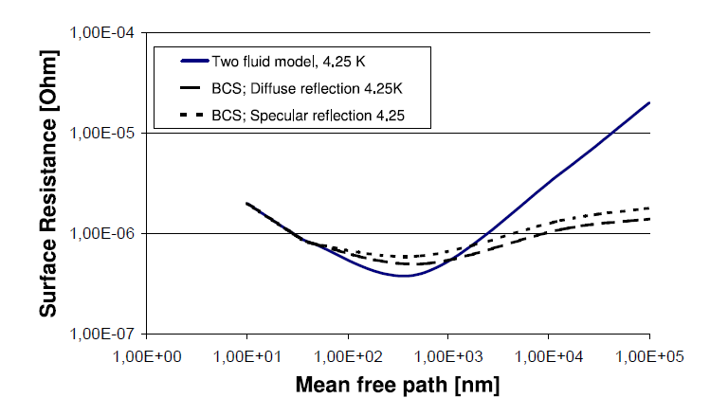

Mean Free Path
As a result the minimum BCS resistance occurs at a mean free path of around 200 nm for Nb.
High RRR Nb typically has a larger mean free path and is in the clean limit.
Baked cavities have a shorter mean free path (due to oxygen diffusion from the surface into the penetration depth) and are in the dirty limit.

Slide 8
120 deg Cavity Baking

Slide 9
120 deg Cavity Baking
The change in mean free path changes the BCS resistance. Ideally should be around 20-100 nm for Niobium.

Slide 10
120 deg Cavity baking
Baking at 120 deg reduces the high field slope. Not entirely sure why but measurements suggest it is due to Oxygen at the surface.
Cavities are also normally baked at 600-800 degrees as well to get rid of Hydrogen which can cause Q disease.
Hydrogen can get trapped at dislocations at the surface so a post bake BCP is often required.

Slide 11
Nitrogen Doping
Introducing interstitial Nitrogen into a Nb cavity has ben shown to increase Q0 at low-medium field, but it quenches at a lower field
More recently we have Nitrogen infusion which has lower concentrations which increases the quench field.

Slide 12
Thin Films
Since thermal breakdown is such a major problem, many have sought to grow a thin superconducting film on a copper cavity substrate.
This film has the SRF properties of the film but the thermal properties of the bulk hence avoids thermal breakdown.
However many impurities and dislocations are introduced when grown and there are compressive stresses from the substrate and this alters the properties of the film compared to the bulk SRF magterial.
For example Nb films have a large Ginzburg-Laundau parameter (3.5-12) and a higher Tc (up to 9.6 K).
In addition there was a high drop in Q with increasing field that could not be fully explained, this limited their operation to low fields. However in the past few years we understand the effect is related to the quality of welds on the copper cavity.
On the plus side their residual resistance is less sensitive to external magnetic fields than bulk Nb.

Slide 13
New Materials
In order to reach higher temperature operation and higher gradients new materials beyond Nb are required.
NbTi and Nb3Sn are already used in superconducting magnets.

Slide 14
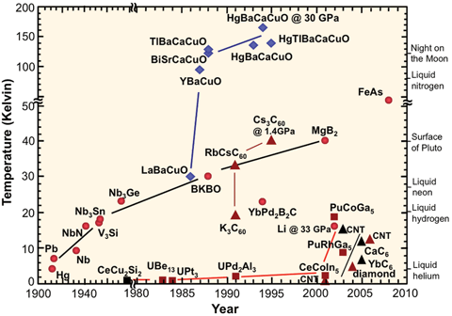
High Tc superconductors
There have been many superconductors found to have transition temperatures above the 23 K prediction for metallic BCS superconductors.
The three most common types are iron based, fullerites and copper oxide based.
These materials have very high transition temperatures up to 133 K for copper oxides (HgBa₂Ca₂Cu₃O_{x}).
This could allow accelerators with LN₂.

Slide 15
RF properties of High Tc SC
High Tc means high Hc
High Tc means low coherence length
High Tc means large penetration depth due to low numbers of charge carriers. This leads to a high GL parameter and hence low Hc1.
New non-metallic SC can mean low surface resistance

Slide 16
RF properties of High Tc SC
Obviously a high Tc is really good as this in turn leads to a large accelerating voltage possibly hundreds of MV/m. This means shorter accelerators.
However the higher surface resistance and shorter coherence length can be a major problem.
The grain boundaries tend to be on the order of a few nm so if the coherence length is less than this then RF losses grow substantially as the grains are weakly coupled and a supercurrent flows between grains by tunneling. Above a threshold surface field (related to the critical current) the grains are decoupled leading to additional losses. This is the current theory but might prove to be incorrect.
In addition most high Tc superconductors would have to be grown as a thin film on the cavity surface as they are not machinable or formable.
The films can crack or delaminate if the cavity is deformed for tuning or thermal cycles
Biggest issues are growing the correct phase and often orientation of the film with no impurities.

Slide 17
NbTi
A ductile material, good for making wires
Tc=10 K, Hc=15 T
Coherence length ~4 nm
λ_{L}=250 nm
Hence GL is ~60
High Hc2 but low Hc1

Slide 18
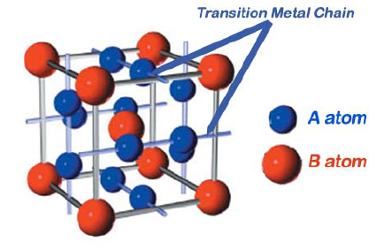
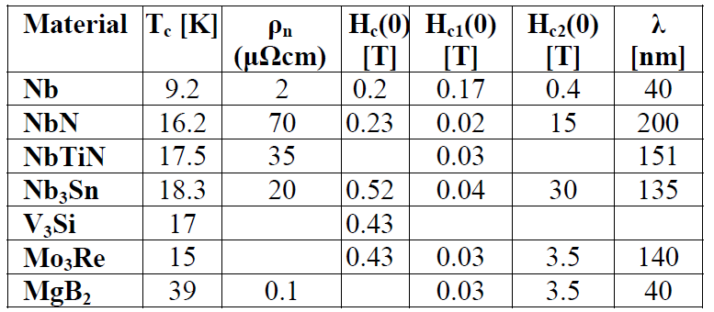
A15’s
The highest useful Tc for an SRF cavity is about 20 K where the coherence length is about 5 nm (for Nb₃Sn).
There are a number of alloys that are superconducting at Tc~20 K, these are known as the A15’s and they all have the form A₃B.
The most successful so far has been Nb₃Sn.
B1 compounds have lower Tc but are less sensitive to radiation damage and crystalline disorder
NbTiN is one such compound and has Tc=17.9 K
NbN and TiN are other examples but Tc is lower and they have a high resistivity.

Slide 19
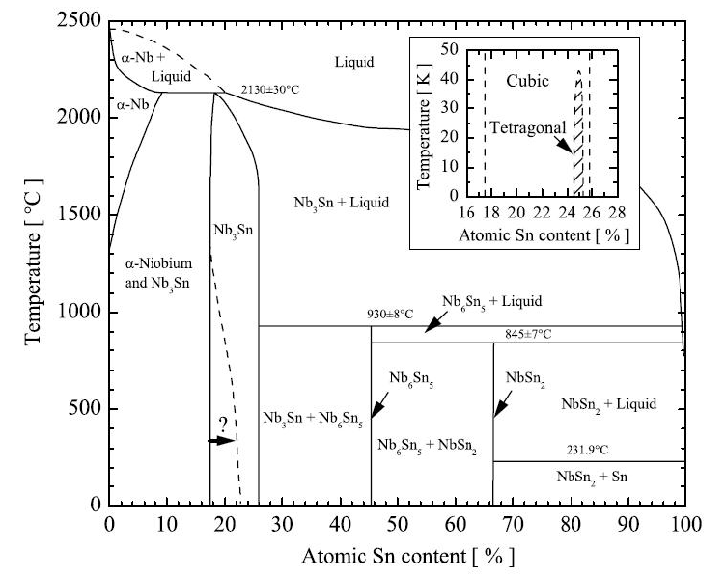
Nb₃Sn
T_{c} = 18.2 K
H_{sh} = 400 mT
Coherence length = 6 nm
London penetration depth = 120 nm
Kappa GL = 20
Nb₃Sn is a promising material as its higher Tc and Hsh than Nb would allow a high gradient (100 MV/m) linear collider at 4.2 K (as opposed to 1.8K)
The only fabrication technique explored has been vapour diffusion of tin into niobium at 900-1200 degC (this could allow upgrading of existing cavities). The difficulty is not to create other non-SC phases.
Results Wuppertal in the 70’s and 80’s have found a higher low field Q value than niobium (10¹¹) at 4.2 K and the highest gradients have been 16 MV/m. There is also a high increase in resistance at higher fields believed to be due to intergrain losses.

Slide 20
Cornell Nb₃Sn results
Cornell has done a more complete study of coating and treatment of Nb3Sn cavities and now have high Q0 at medium feld while operating at 4.2 K
This is one of the major breakthough’s of the past few years in SRF.

Slide 21
Nb₃Sn versus NbTi in magnets
Niobium tin Nb₃Sn has a much higher performance in terms of critical current field and temperature than NbTi
But it is brittle intermetallic compound with poor mechanical properties
10⁴
Nb₃Sn
Critical current density A.mm⁻²
10³
NbTi
10²
Conventional iron yoke electromagnets
10
Magnetic field (Tesla)

Slide 22
YBCO (REBCO)
REBCO is made in tapes rather than wires this can lead to some issues
Expensive to manufacture, and fat tapes have non-ideal current distributions
Difficult to detect quenches
Anisotropic (performs differently depending on field orientation)
Also need to consider effects of stress, temperature and radiation
But solenoids have been demonstrated up to 40 T fields

Slide 23
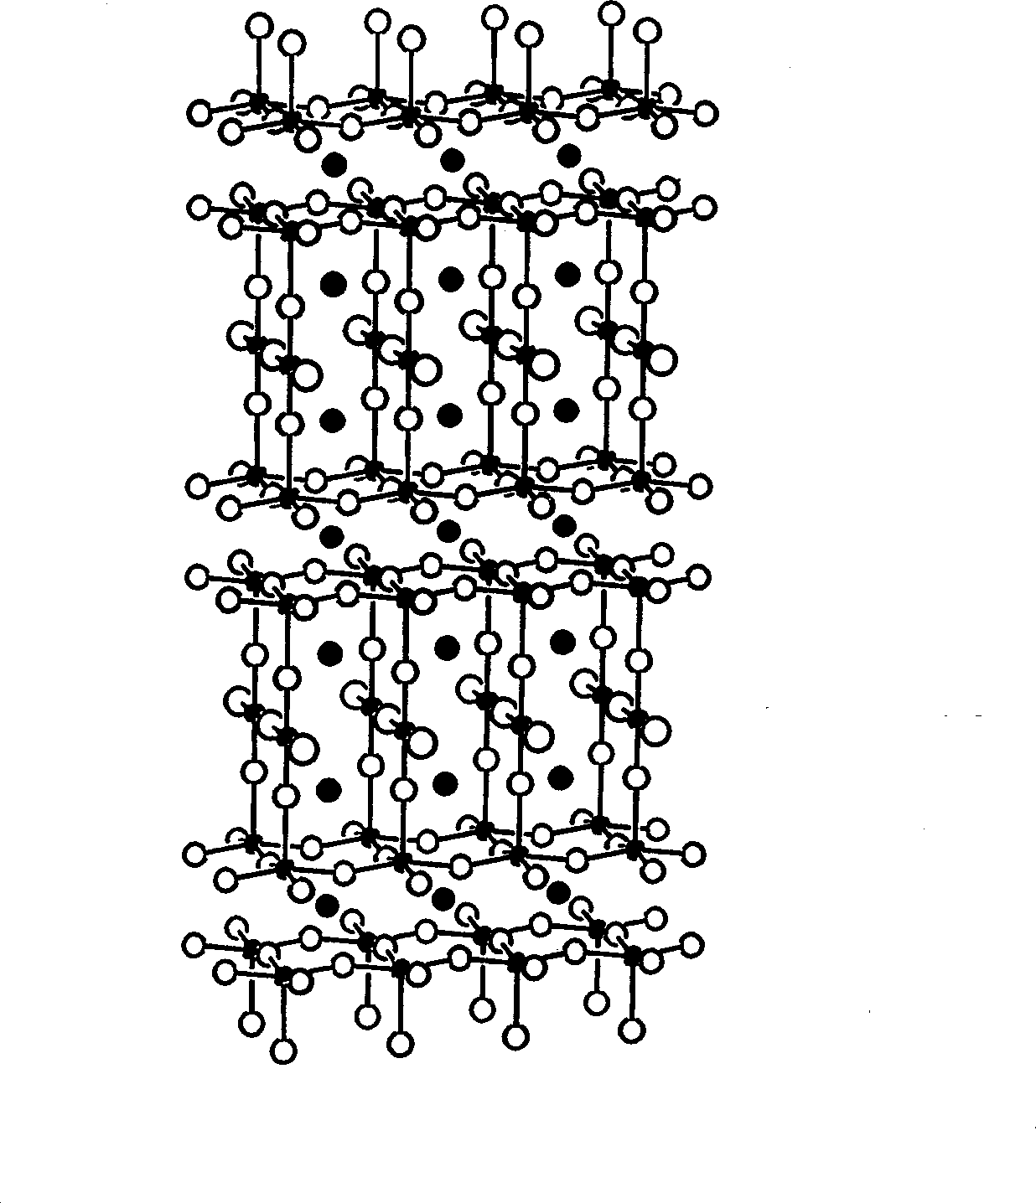
High temperature superconductors
High critical temperature also brings high critical field
Unlike the metallic superconductors, HTS do not have a sharply defined critical current.
Yttrium Barium Copper Oxide
YBa₂Cu₃O₇
Barium Strontium calcium Copper Oxide BSCCO
Magnesium Diboride MgB₂

Slide 24
Critical Currents & Fields

Slide 25
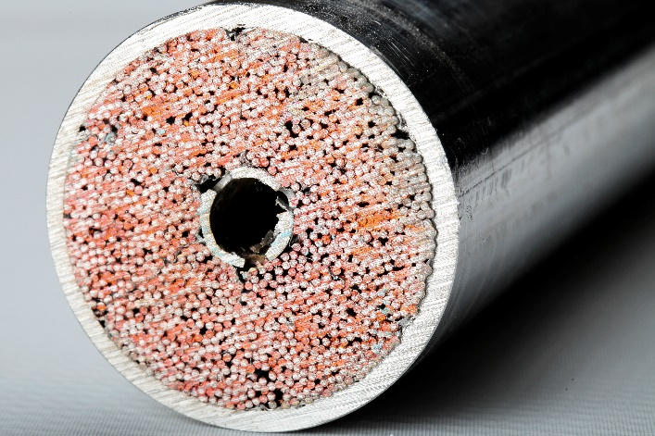
Cable types
Non-uniform current distributions are undesirable because these strands will reach their critical current I^{c} early and quench the whole cable at lower currents than it should be capable of. To promote a uniform current distribution the strands must be fully transposed, ie all strands must change places with each other along their length.

Slide 26
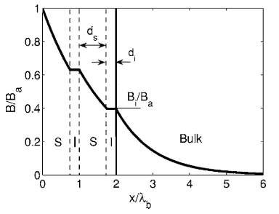
SIS
If a magnetic field is incident on a thin superconductor where thickness<<penetration depth the material can maintain superconductivity at a magnetic field much higher than Hc1.
However while this reduces the field penetration the field will go through the layer, so the field would see the substrate.
If we have a thin High-T superconductor separated from bulk Nb by an insulator then the thin layer can shield the bulk Nb from vortex penetration.
With the correct choice of superconductor such a material would sustain higher fields at lower losses.

