Slide 1
WP4: Ion-acoustic dose mapping
Maria Maxouti, Josie McGarrigle, Anthea MacIntosh-LaRocque, Vanya Lay, Yu Hu, Ben Cox, Ben Smart, Colin Whyte, Kenneth Long, Emma Harris, Jeff Bamber

Slide 2
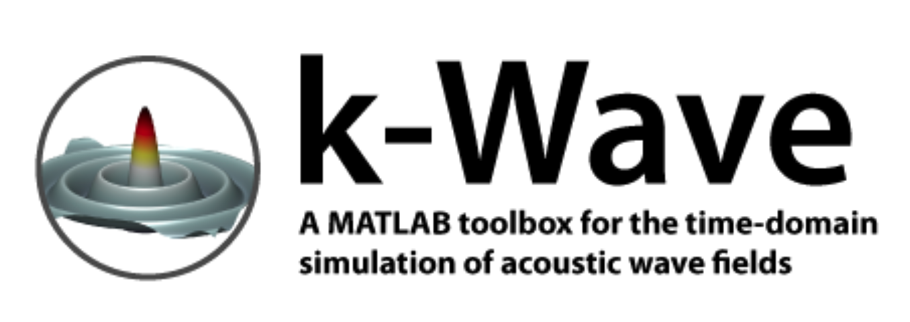
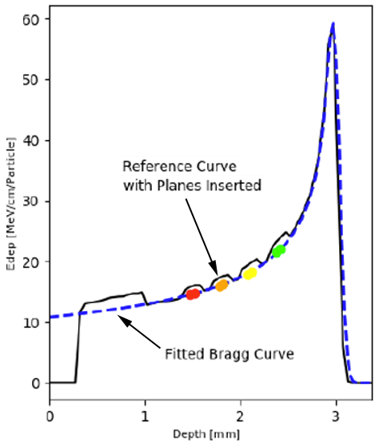
WP4: Ion-acoustic dose mapping
2 Years
5 years
Validated models for the simulation of dose and ion-acoustic signals
Multi-element part spherical array
Biological sample holder designed for high throughput
Dose map
Ioacoustic signal (Pa)
Scintillator signal (mV)
simulation
experiment
Lhara beams
Lhara beam
Dose (J/kg)
Ion-acoustic system for dose mapping on a pulse-by-pulse basis
Smart phantom system for cross-calibration of dose/range estimation
Signal (Pa)
Validated models for the simulation of dose and ion-acoustic signals for LhARA
Results from initial biology experiments
Angle from beam direction (deg)
Experimental testing/evaluation of initial components for ion-acoustic and scintillation systems.

Slide 3
2-year Objectives,Tasks, Milestones
Objectives:
The development of a Geant4 MC simulation of the forward model
The development of a k-wave acoustic forward model
Tasks:
The detailed design of a proof of principle experiment to be executed during the Preconstruction Phase of the project, identifying potential suppliers for components.
Reports on progress towards above objectives.
Milestones:
18-month report: forward simulation of energy deposited in a water phantom (SmartPhantom) and deposited energy resolved in 4D.
24-month report: results of forward simulation and its use to optimise SmartPhantom performance to provide the power density spectrum as input to the acoustic model.

Slide 4
Quick reminder of Maria’s and Josie’s presentations last month

Slide 5
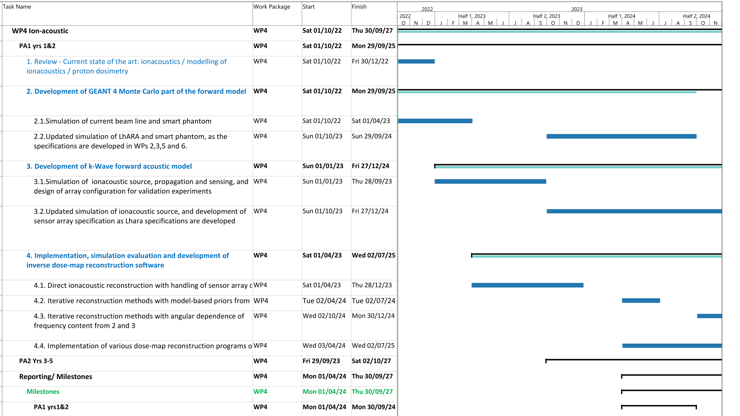

Slide 6
Additional preliminary thermoacoustic simulation-validation experiment – Yu Hu and Maria Maxouti
Monte Carlo simulation
3-D dose distribution
Threshold and tessellate 3-D surface
3-D printer to produce mould
Optically absorbing gel phantom in the shape of the deposited dose distribution
Image using the photoacoustic system (hemispherical and ring arrays) at ICR
Compare received acoustic frequencies, SNR and reconstructed images with k-Wave predictions for thresholded dose distributions and various proton-beam energies

Slide 7
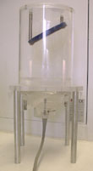
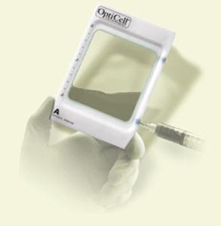
Example ultrasound-compatible cell culture chambers, used previously for ultrasound gene transfection studies
Sound absorber
Water in tank
Position of sample chamber
Ultrasound source
Maintains sterility during exposure
Membranes acoustically transparent
Used for investigating dose effect in ultrasound field
Complete submerging of sample for exposure
Reproducible sample and ultrasound source positioning
Insulation against standing waves

