Slide 1
Coincidence detection QKD protocol
Ayan Biswas, Anindya Banerjee, Rupesh Kumar,
Pooja Chandravanshi, M.V. Jabir, Ali Anwar, Sarika Mishra, G.K. Samanta, Shashi Prabhakar, R. P. Singh
Quantum Science & Technology Program
Atomic, Molecular and Optical Physics Division
Physical Research Laboratory (PRL), Ahmedabad
Quantum Technologies Laboratory
Photonic Sciences Laboratory
Attosecond Physics Laboratory
Crystal Defects and Luminescence Lab
Quantum Materials and Photonic Quantum Computing Lab
Atomic Physics: Theory

Slide 2
Coincidence Detection Protocol
After protocol run Bob keeps the record of all the measurements including 2-fold and 3-fold coincidences.
Sifting process is also similar to BB84 except for 2-fold and 3-fold Coincidences.
Bob matches coincidences corresponding to Alice's bases and keep those results where at least one photon hits the correct basis.
If the number of 2-fold and 3-fold coincidences fall below a threshold value they abort the protocol.
Bob
BS

Slide 3
For 2 photon pulse incident on BS the cases are
Possible Cases | (T) | (R) | Probability
1 | 2 | 0 | 1/4
2 | 0 | 2 | 1/4
3 | 1 | 1 | 1/2
BS
N
T
m
For 3 photon pulse incident on BS the cases are
D/A
Possible Cases | (T) | (R) | Probability
1 | 3 | 0 | 1/8
2 | 0 | 3 | 1/8
3 | 2 | 1 | 3/8
4 | 1 | 2 | 3/8
R
N-m
H/V

Slide 4
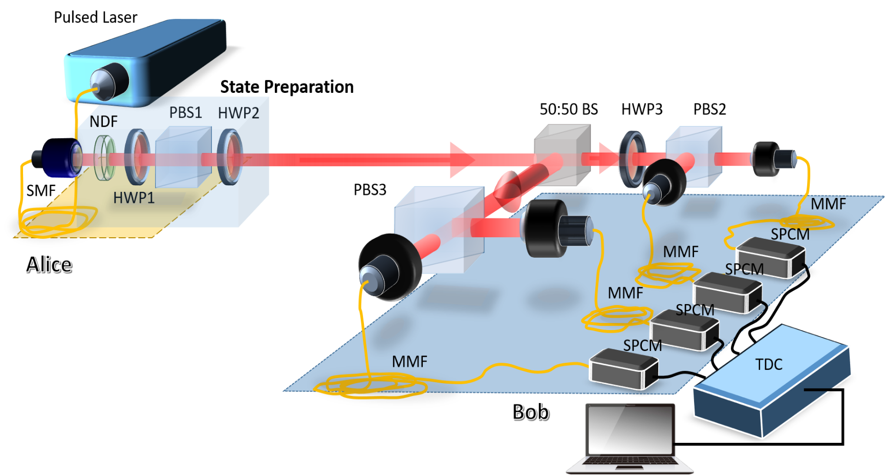
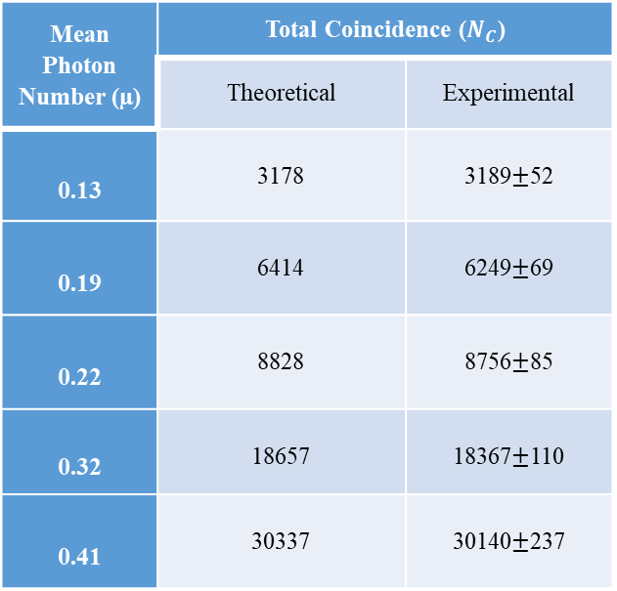
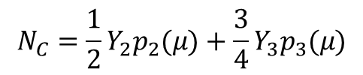
Optical Setup for CD Protocol
Coincidences at Bob
$$N_{C}=\frac{1}{2}Y_{2}p_{2}(μ)+\frac{3}{4}Y_{3}p_{3}(μ)$$
Mean Photon Number (µ) | Total Coincidence ($N_{C}$)
 | Theoretical | Experimental
0.13 | 3178 | 3189$±$52
0.19 | 6414 | 6249$±$69
0.22 | 8828 | 8756$±$85
0.32 | 18657 | 18367$±$110
0.41 | 30337 | 30140$±$237
A. Biswas, A. Banerji, N. Lal, P. Chandravanshi, R. Kumar, and R. Singh, Opt. Continuum 1, 68-79 (2022), doi: 10.1364/OPTCON.445727

Slide 5


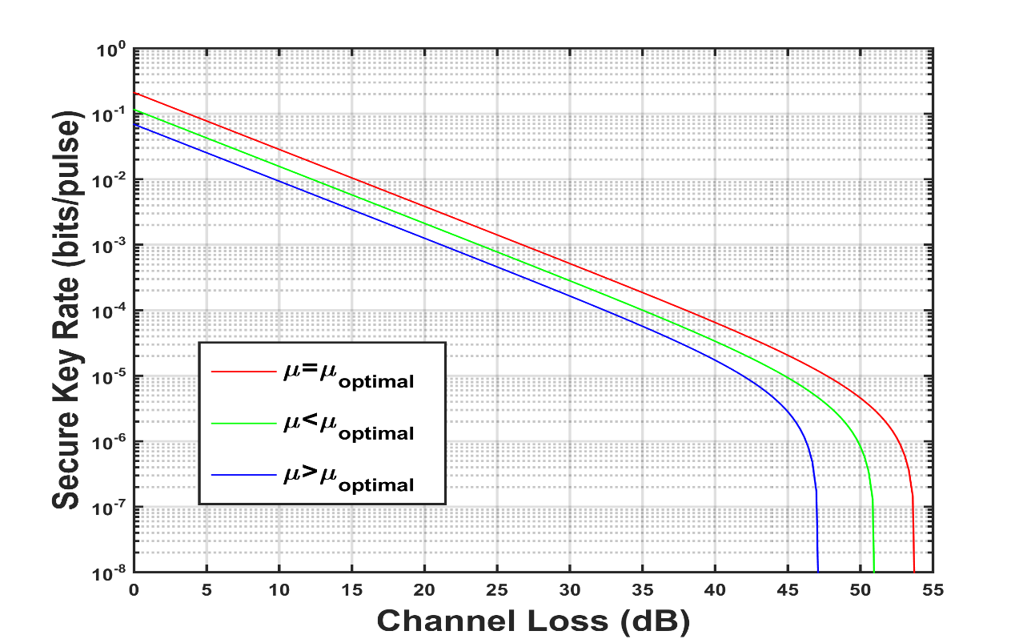
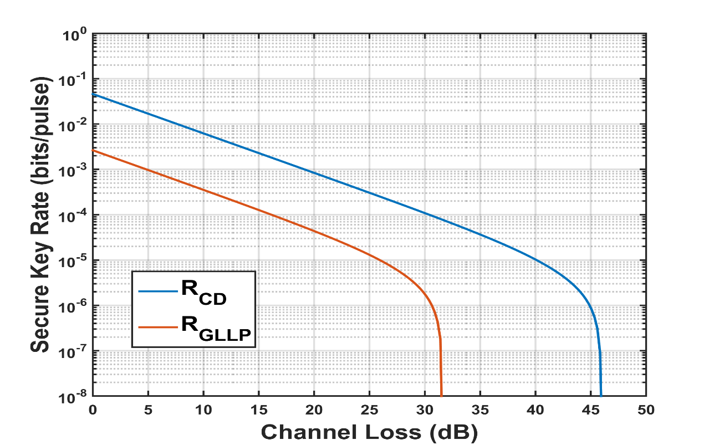

Key Rate for Coincidence Detection Protocol
$$R≥\left\{{\frac{1}{2}Q}_{1}\left[1−H_{2}\left(e_{1}\right)\right]+{\frac{3}{4}Q}_{2}\left[1−H_{2}\left(e_{2}\right)\right]+\frac{7}{8}Q_{3}\left[1−H_{2}\left(e_{3}\right)\right]−\frac{Q_{μ}}{2}f\left(E_{μ}\right)H_{2}\left(E_{μ}\right)\right\}$$
Security Parameter
Figure: Key rate of CD protocol for various $μ$
Figure: Comparison between GLLP protocol and CD Protocol

Slide 6
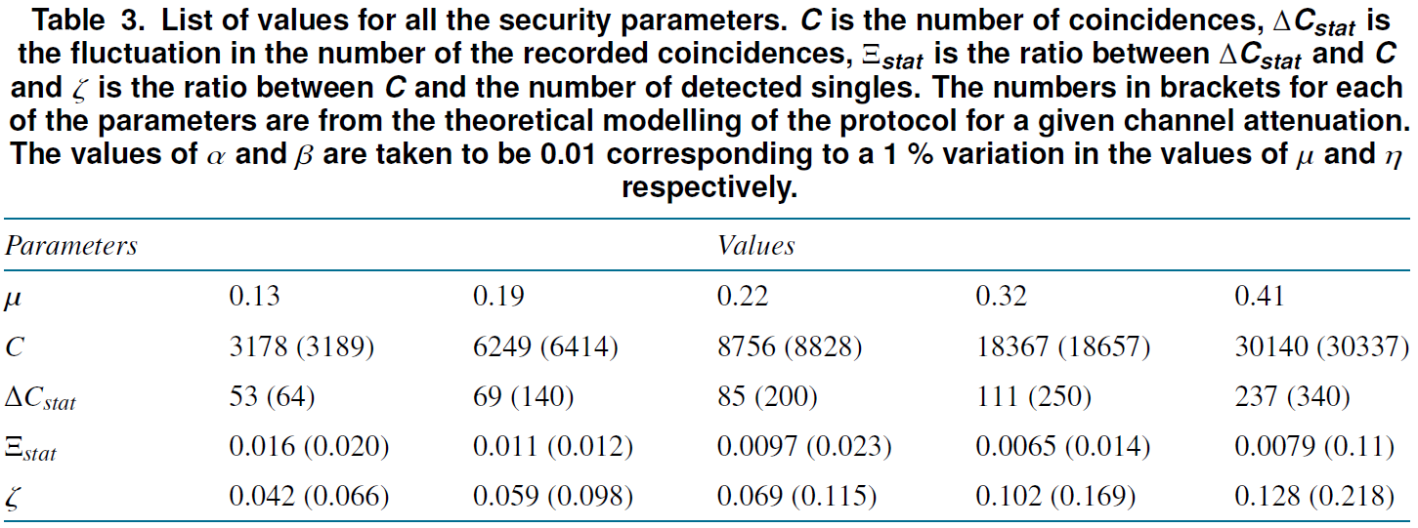
Security Parameters of CD Protocol
A. Biswas, A. Banerji, N. Lal, P. Chandravanshi, R. Kumar, and R. Singh, Opt. Continuum 1, 68-79 (2022), doi: 10.1364/OPTCON.445727

Slide 7
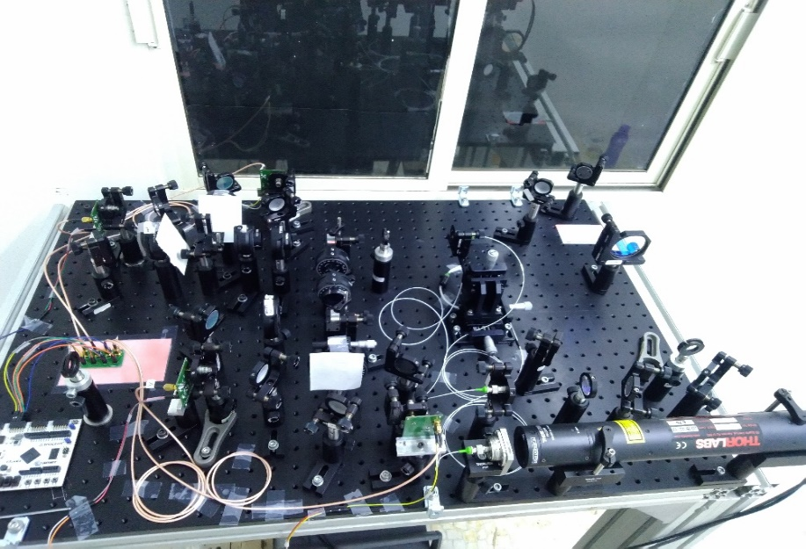
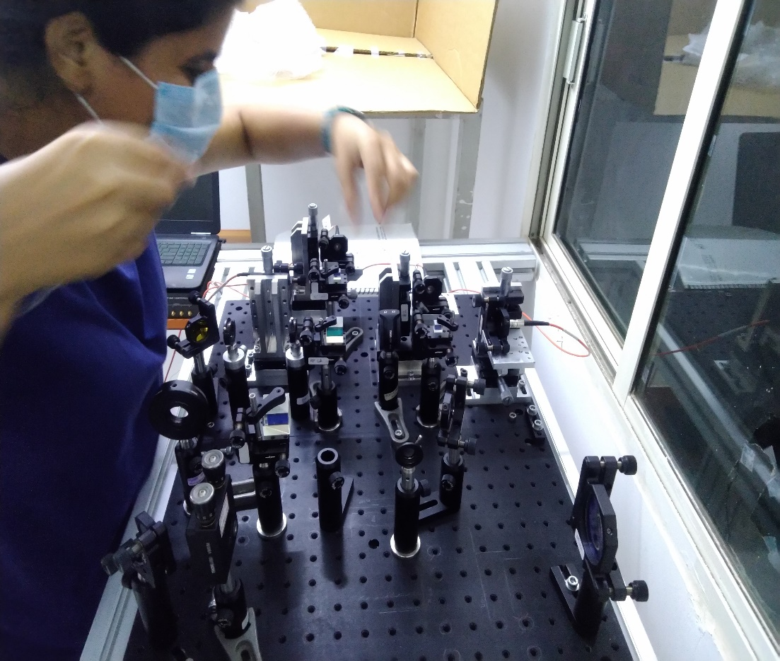
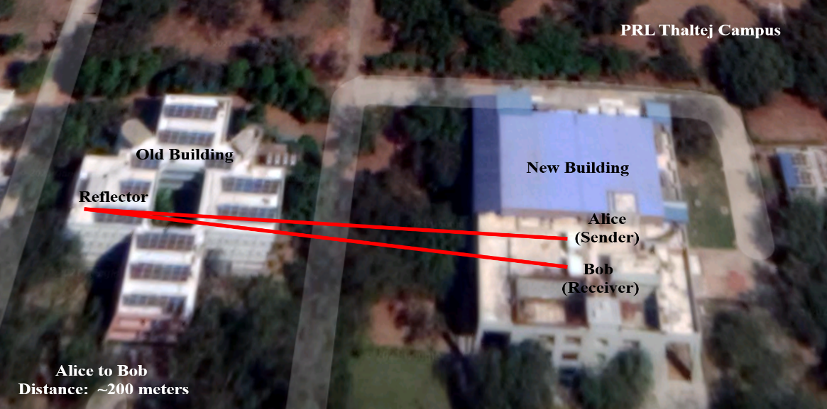
Demonstration of BB84 and BBM92 Protocol over 200 meters
Transmitter (Alice)
Receiver (Bob)

Slide 8
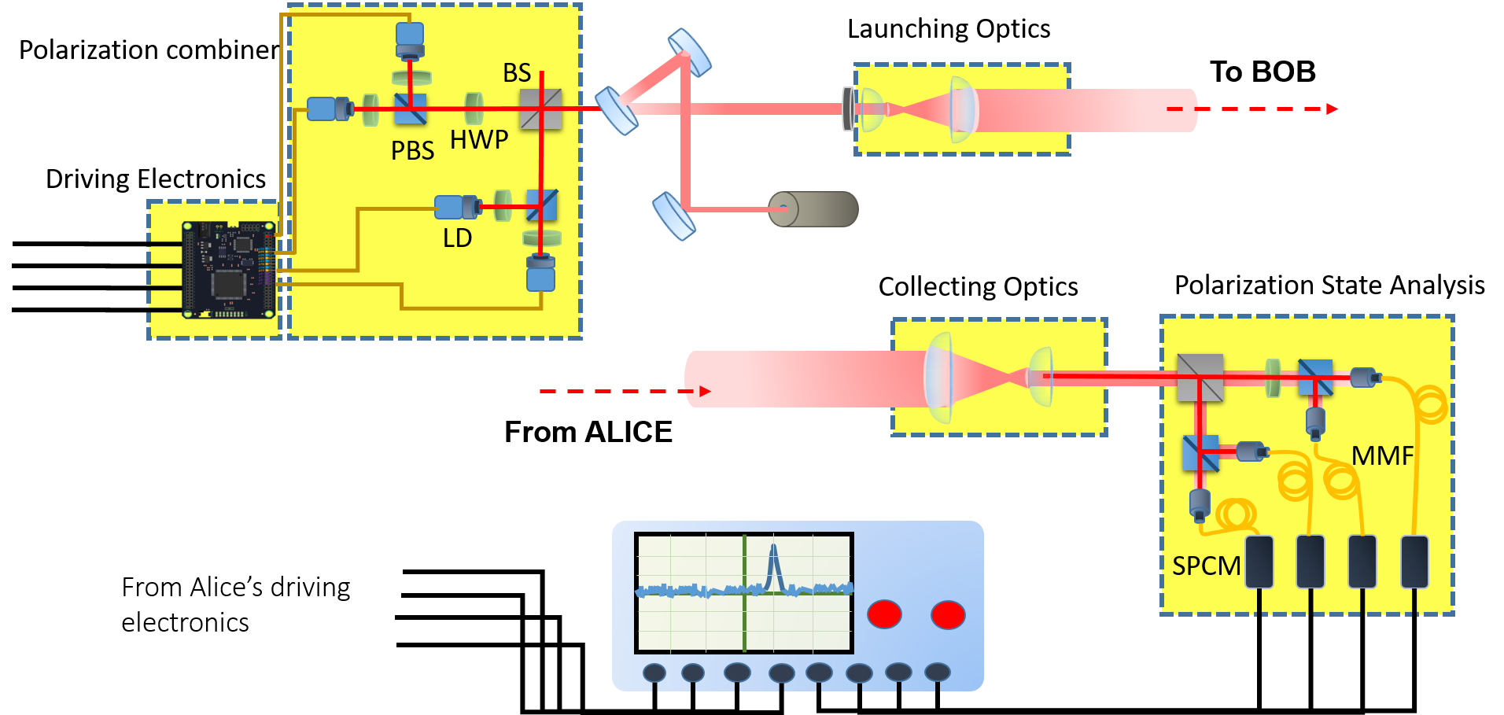
Optical Setup for BB84 Protocol

Slide 9
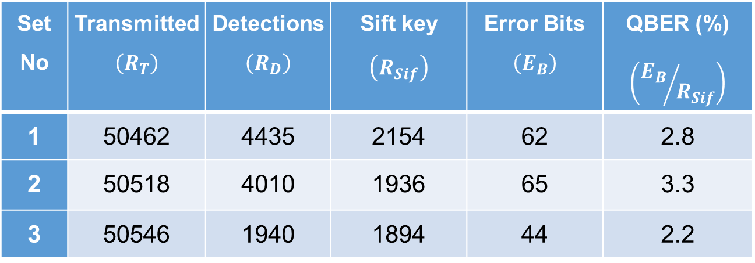
BB84 Protocol over 200 meters
Parameter Estimation
Channel Transmissivity $\left(η_{Ch}\right)$=0.70 Overall Detector Efficiency$\left(η_{det}\right)$=0.4
Mean Photon Number $\left(μ\right)$=0.3 Repetition Rate of Laser $\left(f_{rep}\right)$=5 MHz
TABLE: Showing QBER and Key Rate for some sets taken at random from detections
Set No | Transmitted$\left(R_{T}\right)$ | Detections$\left(R_{D}\right)$ | Sift key $$\left(R_{Sif}\right)$$ | Error Bits $$\left(E_{B}\right)$$ | QBER (%) $$\left({E_{B}}/{R_{Sif}}\right)$$
1 | 50462 | 4435 | 2154 | 62 | 2.8
2 | 50518 | 4010 | 1936 | 65 | 3.3
3 | 50546 | 1940 | 1894 | 44 | 2.2
Average Sift Key Rate$\left(K\right)$ ~ 200 Kbps
Secret Key Rate$\left(K_{s}\right)$ ~ 140 Kbps

Slide 10
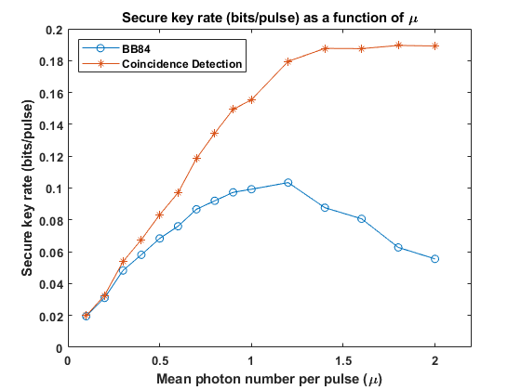
Results for 200 atmospheric channel

Slide 11
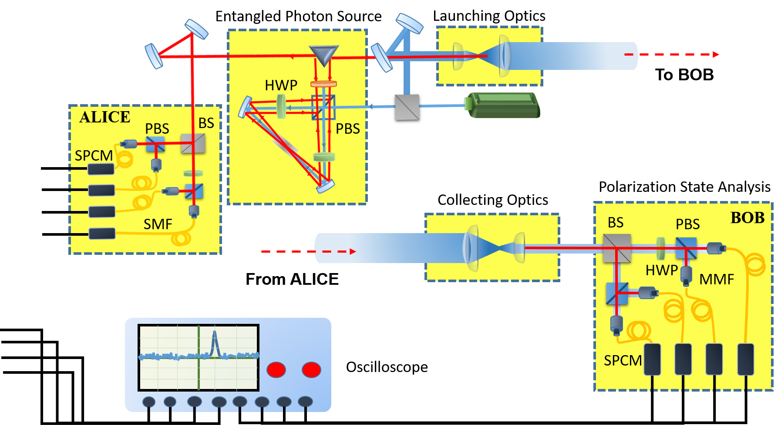
Optical Setup for BBM92 Protocol
S. Mishra, A. Biswas, S. Patil, P. Chandravanshi, V. Mongia, T. Sharma, A. Rani, S. Prabhakar, S. Ramachandran, R. P. Singh, 24 (2022) 074002.

Slide 13
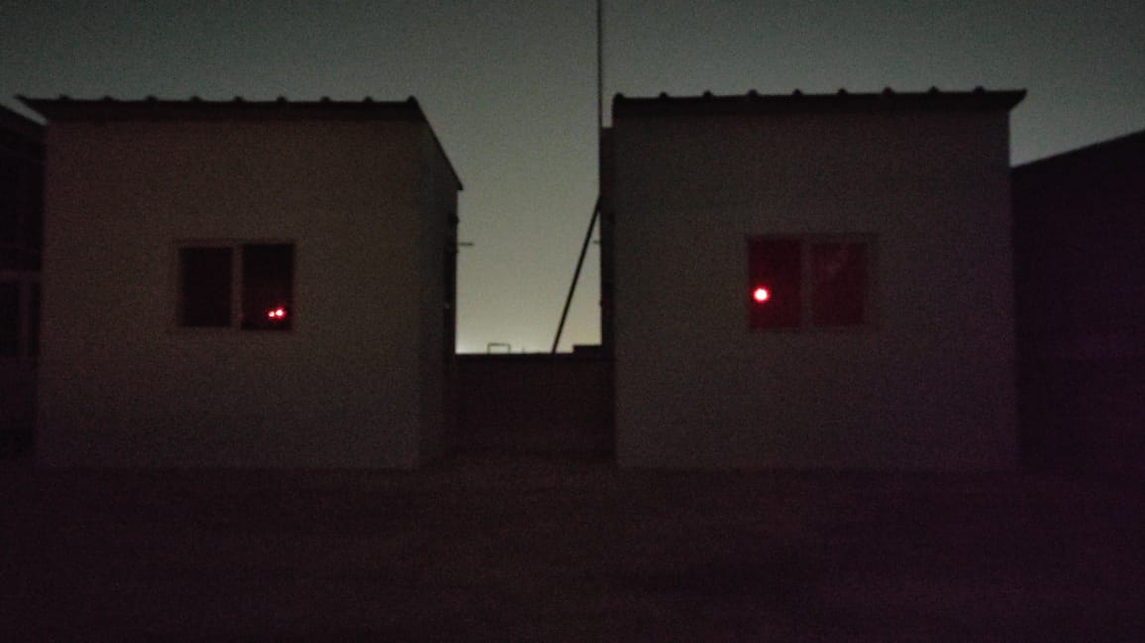
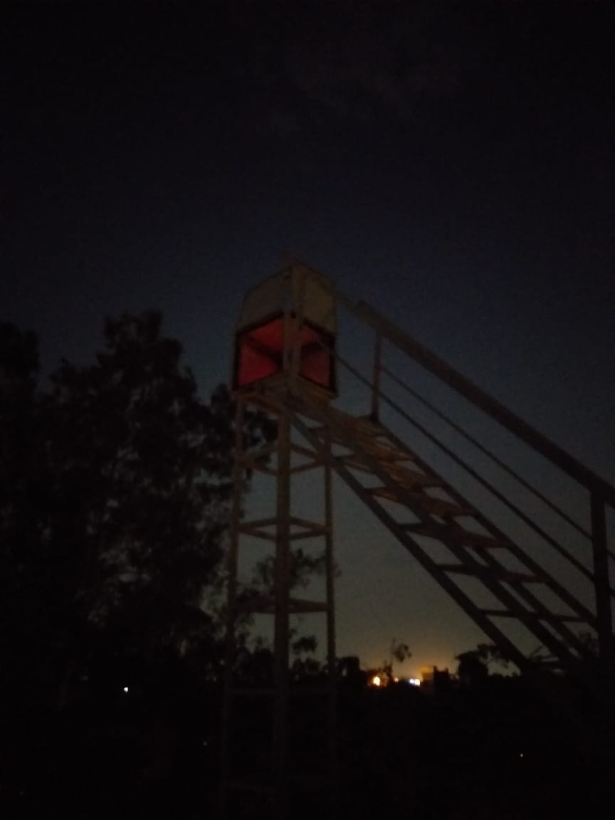
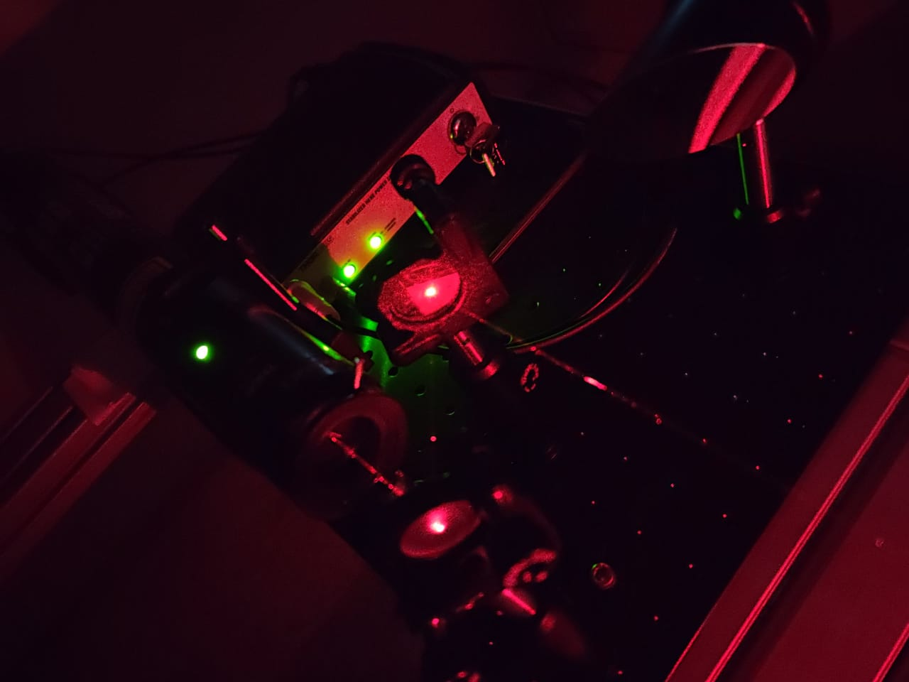
Free space BB84 Protocol in the field
Transmitter (Alice)
Receiver (Bob)
Reflector
~100 m
~100 m
This Photo by Unknown Author is licensed under CC BY-SA

Slide 14
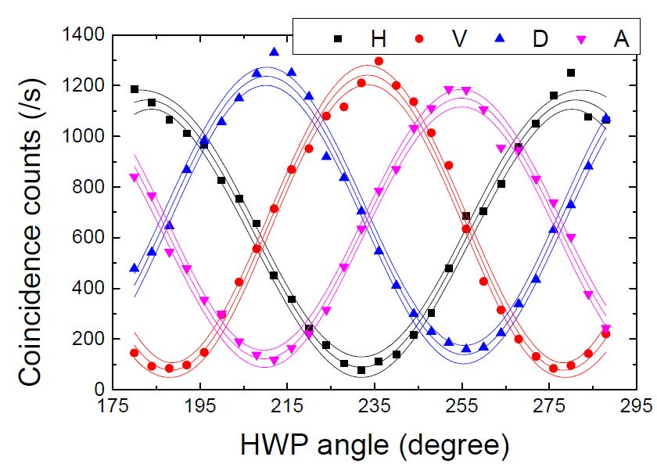
Entanglement Distribution over 200 meters
Correlation of polarization states between Alice and Bob
Coincidence window = 1 ns
Bell’s Parameter
S=2.54
Polarization Visibility
H | V | D | A
94.2% | 93.66% | 83.33% | 87.53%

Slide 15
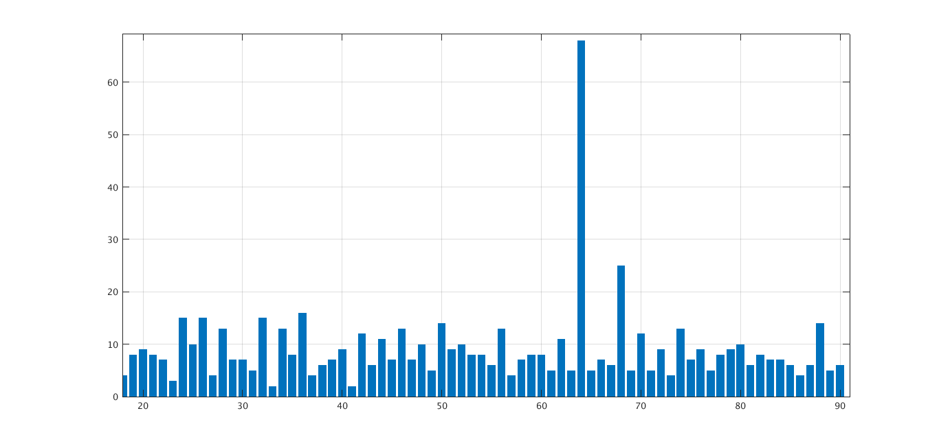
Temporal Filtering
C.C. Window = 1ns
Integration Time = 40ms
Counts
Delay x 10 ns
Delay from Alice’s H pol. state detector to Bob’s H pol. State detector = 648ns

Slide 16
BBM92 Protocol over 200 meters
Parameter Estimation
Channel Transmissivity $\left(η_{Ch}\right)$=0.70 Overall Detector Efficiency$\left(η_{det}\right)$=0.4 Background Coincidences=40
TABLE: Showing QBER and Key Rate for BBM92 Protocol
 | H | V | D | A
H | 1023 | 41 | 603 | 501
V | 36 | 1167 | 661 | 592
D | 408 | 671 | 1287 | 76
A | 644 | 591 | 117 | 1140
BOB
ALICE
Average Sift Key Rate$\left(K\right)$ = Total CC in correct basis detectors = 4.5 kbps
QBER= CC in wrong detectors/total CC= 4%
Secure key rate ~ 1.7 kbps

Slide 17
Atmospheric conditions, mean and variance from midnight to 6 AM (typical measurement time for our experiments)
Date | Extinction (Mm-1) | Scattering (Mm-1) | PM2.5 (µg/m3)
08/05/2021 | 76.41±7.78 | 62.73±5.82 | 2.87±0.26
10/05/2021 | 48.67±6.70 | 40.16±6.15 | 1.68±0.24

Slide 18
Summary
Proposed a new protocol to increase the secure key rate using the same resources as in BB84 protocol.
Demonstrated the feasibility of CD protocol for atmospheric channel of 200 meters.

Slide 19
Future plan of work at QST Program @ PRL
Effect of turbulence and how to mitigate it for terrestrial communication.
Simulating conditions for uplink and downlink to check the key rate for satellite based quantum communication.
Development of Device Independent QKD protocol.
Entanglement swapping and quantum teleportation in free space for 200 meters towards setting QC network
Using structured light such as - Vortex beam, Pencil beam, Gaussian Schell Model beam, Twisted Gaussian Schell Model beam - for robust and secure key distribution
Development of Photonic Quantum Computing since it is the best bet for quantum internet, the ultimate stage of quantum communication (China, Xanadu in Canada and Psi Quantum in USA, ORCA Computing in UK are making good progress)

Slide 20
Thank you

