Slide 1

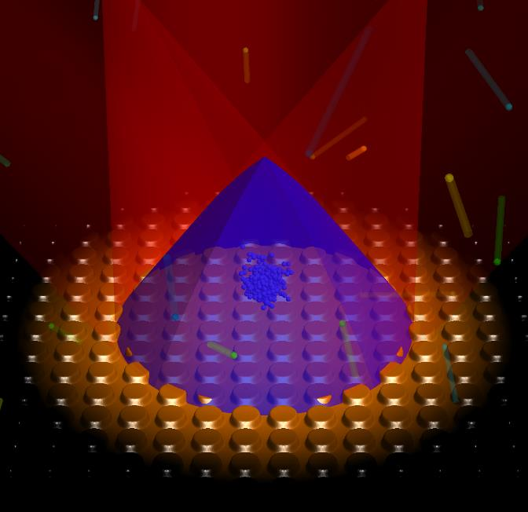
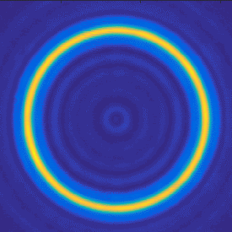
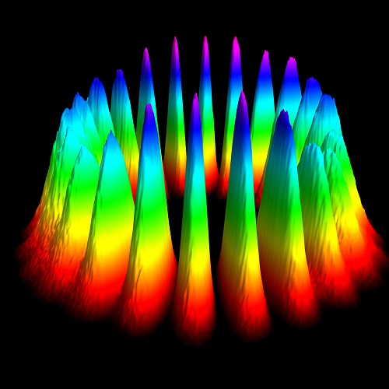
Enhanced optical geometries for atoms
Aidan Arnold + team
University of Strathclyde
photonics.phys.strath.ac.uk

Slide 2
It’s all about the (spatial) phase
Key areas of interest (for me):
1D/2D reflective/transmissive zone plates for MOTs/lattices/atomtronics
‘Grey’ zone plates formed by BEC interference or extra clean LG beams

Slide 3
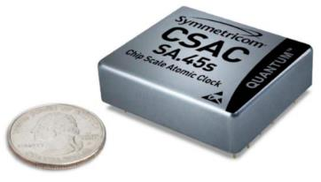
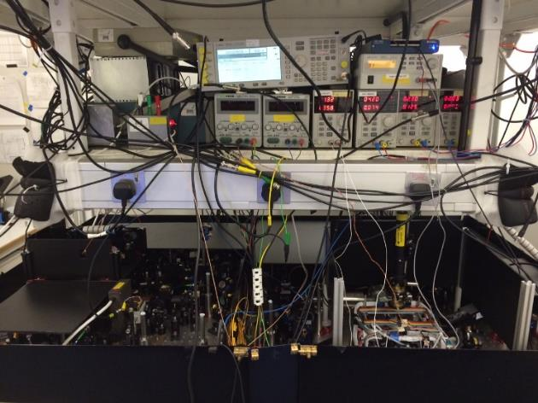
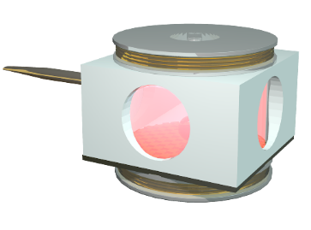
Why make atoms cold? Accuracy…
Miniaturisation has been a thing since… a while…
PhD aside…1997 table-top MOT for the Royal Society Soirée
Ultracold atom experiments, still complex – but getting smaller
Handheld? James’ RSI 93, 091101 (2022) review!
cf μQuans, ColdQuanta,…
Space atoms: ESA (Bruno), NASA, JPL (Makan),
RALspace, China, Russia, India,…
Notes:
Richtig und präzise = accurate and precision

Slide 4
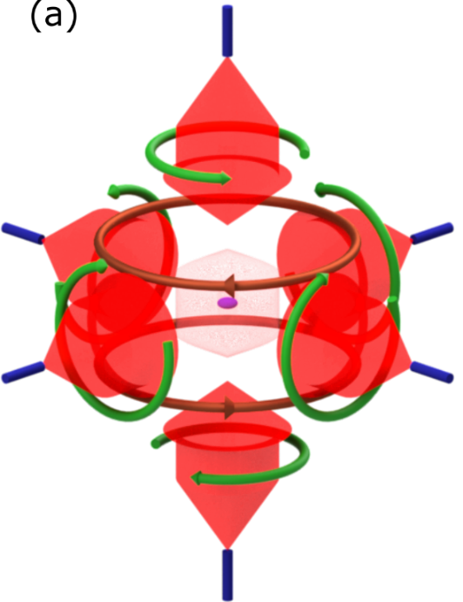
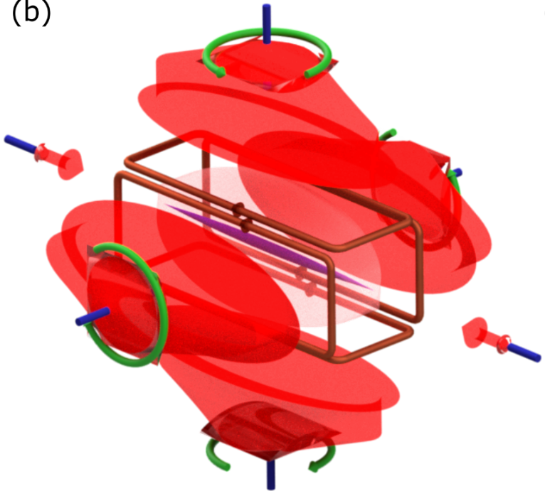
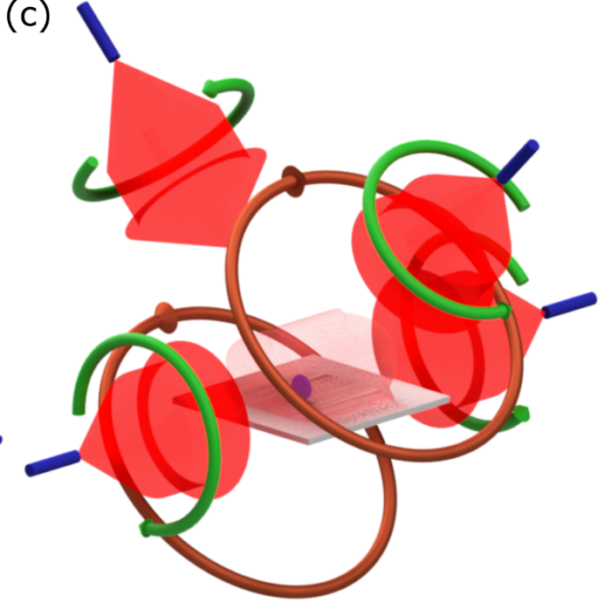
Multi-beam MOT geometries
First MOT: PRL 59, 2631 (1987).
2D(+) MOT, PRA 58, 3891 (1998).
Mirror MOT, (also on chip U-wire) PRL 83, 3398 (1999).

Slide 5
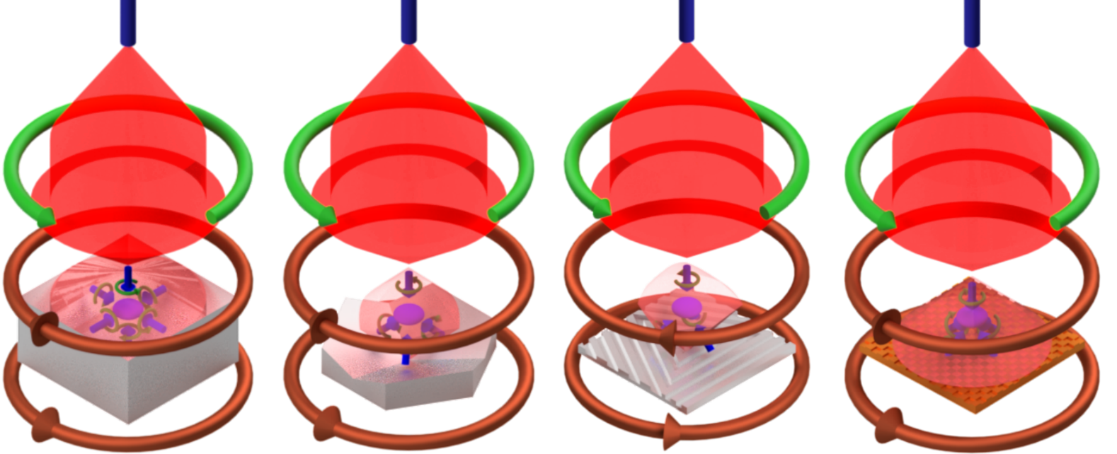
Single-beam MOT gallery
The following solve issues of regular pyramid MOT (left, OL 21, 1177 (1996))…
Matt. Tetra. mirror pyramid MOT: OE 17, 13601 (2009).
Matt. Tetra. grating MOT: OL 35, 3453 (2010). Oliver+PB+... Quantum AVS
Notes:
(CCOOL review TBA)

Slide 6
GMOT chip concept
No high orders (>1st) if: λ < d < 2λ (1D) λ < d < 2^{½}λ (2D)
No 0th order: chip λ/4 deep. For Rb d~1μm and depth~0.2μm
1D grating 2Dgrating

Slide 7
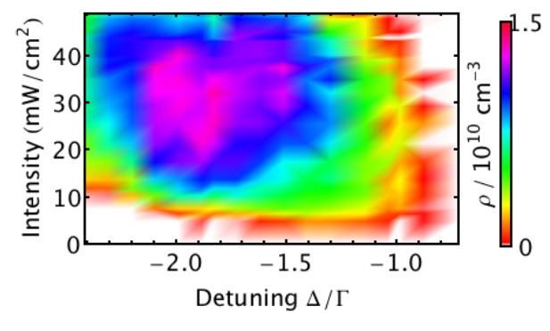
GMOT PSD studies
1st Chidi Nature Nano. 8, 321 (2013): 1cm³ overlap N~10⁸ @mK, or N~10⁶ @50uK
2nd James OE 23, 8948 (2015): full PSD expt.+model with N ~3x10⁷ and @50µK
3rd James Sci. Rep. 7, 384 (2017): N~3×10⁶ @3μK with careful B cancellation
Notes:
With this implemented and alignment taken care of by the grating, we studied the optimum characteristic of the MOT itself by varying two key parameters, the intensity and detuning of the incident beam.
(talk about number and density)
When we then introduce sub doppler cooling mechanisms and allow the atoms to ballistically expand, we can measure a consistent temperature of 15 micro K, Bringing this chip scale device in as a reasonable competator with many larger 6 beam mots for performance.
----- Meeting Notes (01/06/2015 16:00) -----
reduce words, just say description

Slide 8
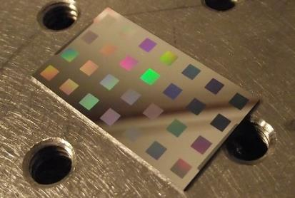
Grating characterisation
(>100 4mm² gratings): period d; duty cycle; 1D & 2D; coating material/thickness… James JOSAB 33, 1271 (2016).
Fab. details: Joe APB 122, 172 (2016).
Surprising
wavelength
versatility
η₁ = diffracted order
η₀ = reflected order
grating
Notes:
To make these diffraction gratings we use ebeam lithography upon a silicon wafer to a depth of …
We apply an adhesion layer and sputter coat our top layer.
There are a lot of free parameters in this design that we tested for optimum performance, with optimum performance being the production of a balanced radiation pressure.
A measurement of interest is the broadband nature of the diffraction efficiency, covering pm 100nm, opening exotic two wavelength cooling species such as Sr for GMOTS.
----- Meeting Notes (01/06/2015 15:25) -----
mention with a first slide why cold atoms are good for precision measurements
----- Meeting Notes (01/06/2015 15:55) -----
percentage on the side
comparison of different gratings first order and zero order
add a key to say what things are
just show molasses balance
mention this works for Rb, Cs, K
remove polarisation from graph, add middle marker to show direction of beam

Slide 9
Compact ‘head’ Raman-Ramsey clock
Rachel OE 27, 38359 (2019). ⁸⁷Rb D₁ CPT,… more to clock in Alan’s talk.
Umakanth’s new project…

Slide 10
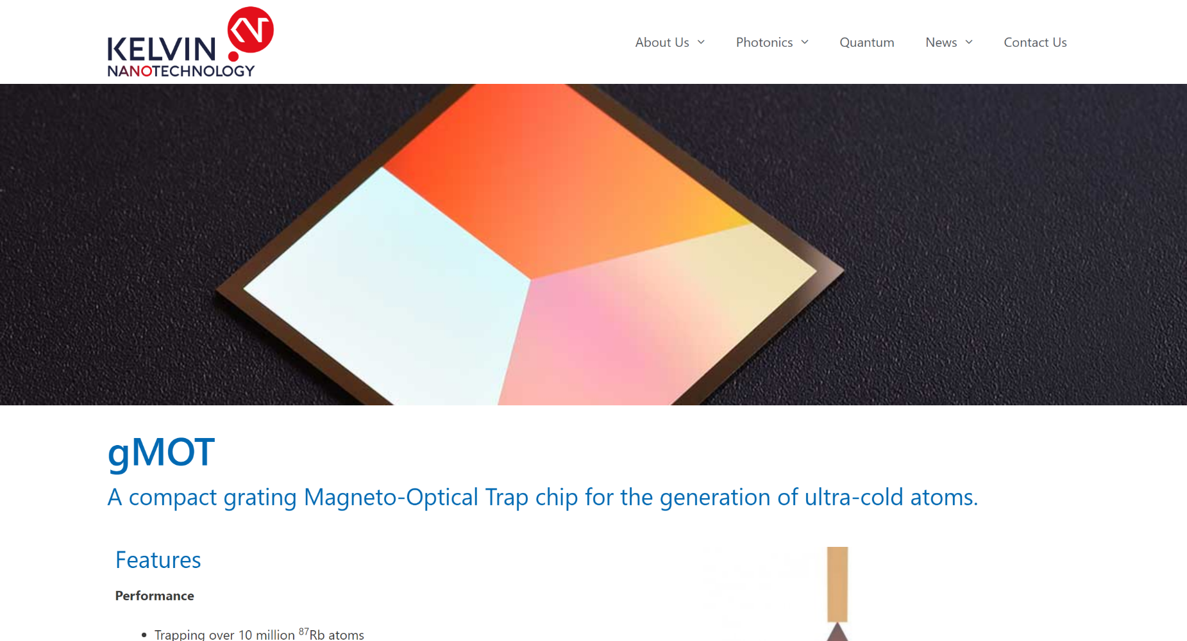
A commercial break…
https://www.kntnano.com/quantum/gmotgrating/

Slide 11
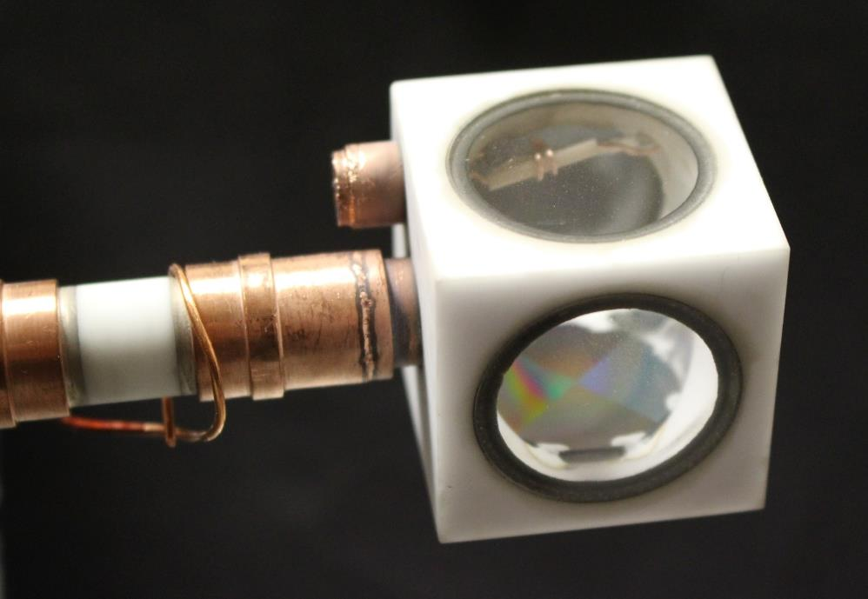


Compact vacuum system with GMOT
10⁷ cold ⁸⁷Rb atoms / second
Continuous Rb gas emission:
10⁻⁷ mbar (active pumping)
3x10⁻⁶ mbar (passive pumping)
No Rb dispensing (passive pumping):
similar pressure for >500 days.
Appears ok against He diffusion
Paper: Oliver APL 119, 124002 (2021)…. definitely cubesat size Craig?
[Enhanced model for pressure based on PRA 85, 033420 (2012).]

Slide 12
Simple imaging + microfab cells, with JK, NIST
Simple imaging solution: Alan APL 119, 184002 (2021).
Laser cooling in a chip-scale platform: James APL 117, 054001 (2020).

Slide 13
A ‘holy’ grating fountain
Two frequencies allow a moving-molasses launch, 100ms TOF so far.
See Ben (now @ Boulder) APL 121, 164001 (2022).

Slide 14
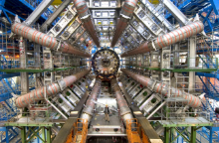
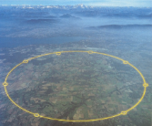
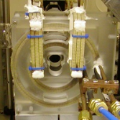
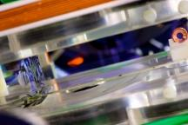
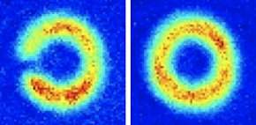
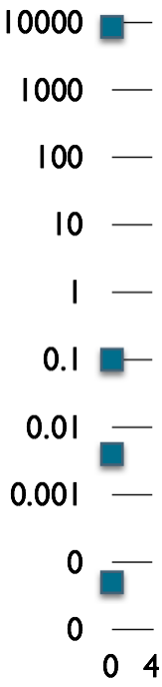
Ring traps
10⁴
Why?
- ‘infinite’ 1D system
- boundary conditions
- closed guiding potential
- reciprocal paths
- supercurrents
LHC
10³
10²
10¹
1
Diameter [m]
Strath #1
10⁻¹
10⁻²
Strath #2
10⁻³
0.0001
10⁻⁴
Superfluid
BEC expts
0.00001
10⁻⁵
Notes:
I don’t really need to tell this audience about why rings are good!
See also impressive interferometry experiments from Paul Griffin in BEC #2

Slide 15
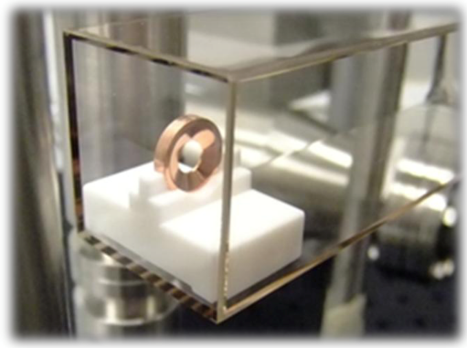
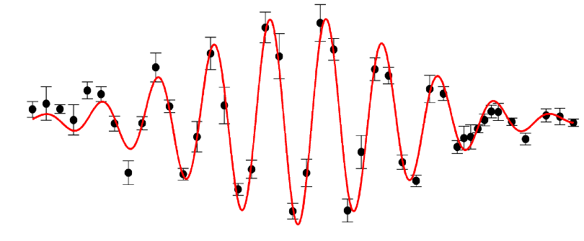
BEC rings/interferometers
Large DC ring trap/BEC1
JMO 49, 959 (2002)
PRA 73, 041606(R) (2006)
Mateusz PRA 81, 043608 (2010)
Yueyang Optica 5, 80-85 (2018).
AC/Inductive ring traps/BEC2
JPB 37, L29 (2004)
Griff PRA 77, 051402(R) (2008)
Jon NJP 14, 103047 (2012)
Matt JPB 47, 071001 (2014) (with BG, HP)
German NC 5, 5289 (2014) (with BG)
Billy PRA 96, 053622 (2017).
Notes:
Track record of ring traps and BEC interferometers at Strathclyde, new recent papers out.

Slide 16
Fresnel zone plates: rings, splitters….
Strathclyde reflective grating technology → transmission?
Vicki NJP 18 025007 (2016)… FZP theory

Slide 17
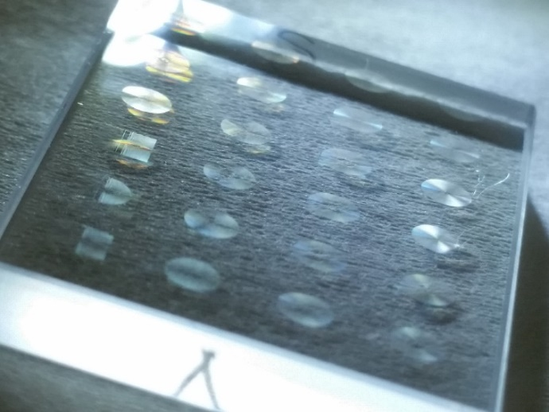
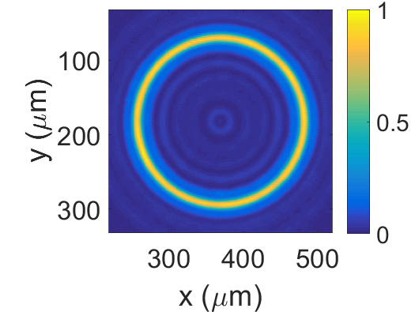
Fresnel zone plates: rings, splitters….
24 different 2×2mm² binary FZPs with 1μm resolution
Optical Expt: normalised intensity <3% rms ripple Vicki OE 28, 9072 (2020).
Experimental
beam data

Slide 18
Beam shaping/FWM with SLMs
With Prof. Sonja Franke-Arnold, Glasgow Uni
Highly efficient FWM in 120C Rb vapour
‘Trans-spectral’ images, QC applications
Clean OAM modes with SLMs:
Tom+Rachel, OE 24, 6249 (2016).
OAM in a FWM vapour:
Graeme PRL 108, 243601 (2012).
Rachel Comm. Phys. 1, 84 (2018).
Rachel+Andy PRA 103, L021502 (2021). Experimental beam data
See also: Andy+Rachel, A simple, powerful diode laser AO 60, 5832 (2021).

Slide 19

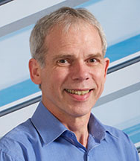
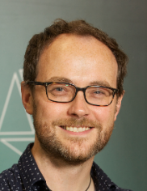
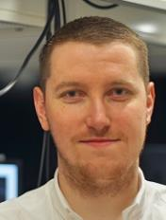


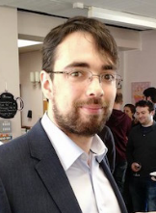

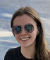
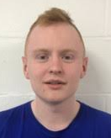
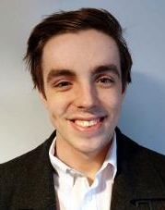
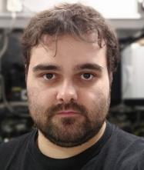
People+funds
Academic Collabs
Erling
Riis
Paul
Griffin
James
McGilligan
GMOT-related team (+lasers+cells)
FZP team
Oliver
Burrow
Umakanth
Dammalapati
Alan
Bregazzi
Rachel
Cannon
Sean
Dyer
Iain MacCuish
Anthony Pike
Rachel Elvin (FCAP), Michael Wright (Alter), Ben Lewis (LF), Matt Johnson (NPL), Vicki Henderson (HUB)

