Slide 1


Slide 2
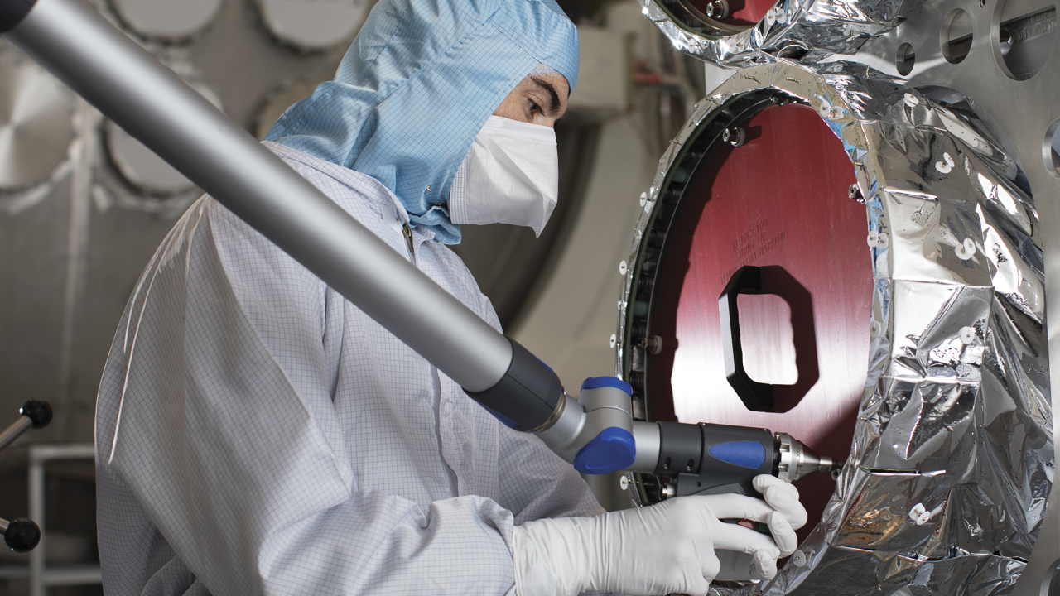
Image © STFC RAL Space
Notes:
To edit the background image, select ‘Format’ from the PowerPoint menu and ‘Slide Background’ from the drop-down menu. Within the new list of options that appears on the right of the screen, select the ‘File’ button under ‘Insert picture from’ and select your image from your file browser. Please remove or amend the image credit if you are using a different image to the one provided.

Slide 3
INSQT Workshop 2
Engineering Challenges in
Space Quantum Technologies

Slide 4
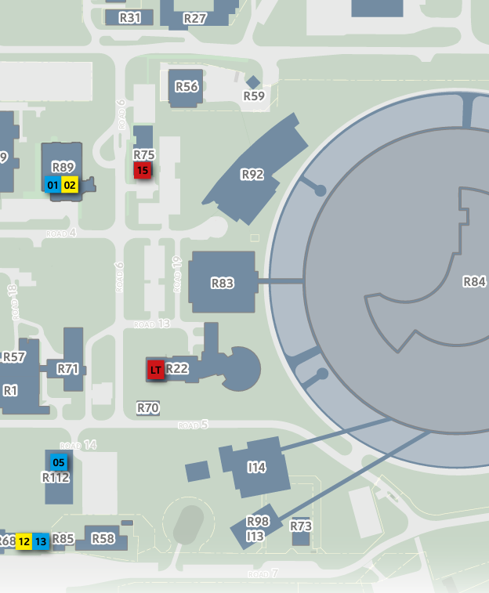

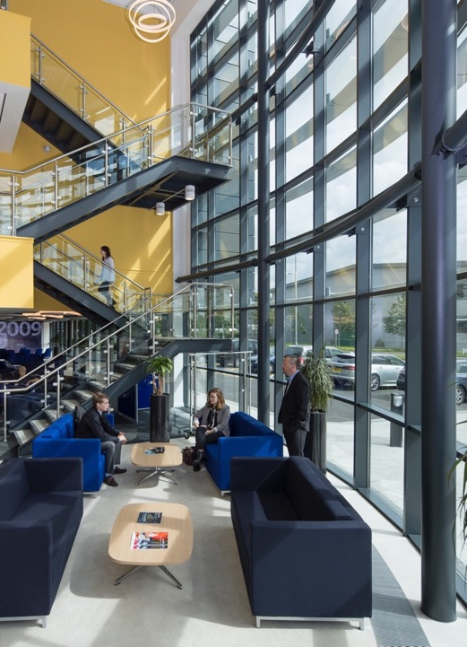
Agenda and Organisation
1 Where are we?
We are in the R22 building: Lectures and Coffee breaks
We have some events in R112: Lunches and Poster session
Image © STFC RAL Space - BuiltVision
Notes:
To replace photo with one of your own. 1) Send the geometric shape overlay to the back – Right-Click > Send to Back > Send to Back. 2) Replace image – use the guides provided to correctly position it. 3) Send your image to the back so that the geometric overlay re-appears over the image. Please remove or amend the image credit if you are using a different image to the one provided.

Slide 5

Agenda and Organisation
1 Where are we?
We are in the R22 building: Lectures and Coffee breaks
We have some events in R112: Lunches and Poster session
2 Programme
Up-to-date version in https://indico.stfc.ac.uk/e/INSQTws2
Image © STFC RAL Space - BuiltVision
Notes:
To replace photo with one of your own. 1) Send the geometric shape overlay to the back – Right-Click > Send to Back > Send to Back. 2) Replace image – use the guides provided to correctly position it. 3) Send your image to the back so that the geometric overlay re-appears over the image. Please remove or amend the image credit if you are using a different image to the one provided.

Slide 6
Agenda and Organisation
1 Where are we?
We are in the R22 building: Lectures and Coffee breaks
We have some events in R112: Lunches and Poster session
2 Programme
Up-to-date version in https://indico.stfc.ac.uk/e/INSQTws2
3 Dinner
At The Cosener’s House at 19:00
15 - 16 Abbey Close, Abingdon, OX14 3JD
Coach leaving here to hotel at: 17:30
Coach leaving hotel to dinner venue at: 18:30
Coach transfer back to hotel: 22:00
Optional: local bus X2 runs until late from Abingdon to near the hotel
Image © STFC RAL Space - BuiltVision
Notes:
To replace photo with one of your own. 1) Send the geometric shape overlay to the back – Right-Click > Send to Back > Send to Back. 2) Replace image – use the guides provided to correctly position it. 3) Send your image to the back so that the geometric overlay re-appears over the image. Please remove or amend the image credit if you are using a different image to the one provided.

Slide 7
Agenda and Organisation
1 Where are we?
We are in the R22 building: Lectures and Coffee breaks
We have some events in R112: Lunches and Poster session
2 Programme
Up-to-date version in https://indico.stfc.ac.uk/e/INSQTws2
3 Dinner
At The Cosener’s House at 19:00
15 - 16 Abbey Close, Abingdon, OX14 3JD
Coach leaving here to hotel at: 17:30
Coach leaving hotel to dinner venue at: 18:30
Coach transfer back to hotel: 22:00
Optional: local bus X2 runs until late from Abingdon to near the hotel
Image © STFC RAL Space - BuiltVision
4 Tomorrow
Coach transfer from hotel to RAL: 08:30
Notes:
To replace photo with one of your own. 1) Send the geometric shape overlay to the back – Right-Click > Send to Back > Send to Back. 2) Replace image – use the guides provided to correctly position it. 3) Send your image to the back so that the geometric overlay re-appears over the image. Please remove or amend the image credit if you are using a different image to the one provided.

Slide 8
Agenda and Organisation
1 Where are we?
We are in the R22 building: Lectures and Coffee breaks
We have some events in R112: Lunches and Poster session
2 Programme
Up-to-date version in https://indico.stfc.ac.uk/e/INSQTws2
Important
Please keep badge until end of workshop
If you have a parking permit also keep until the end
3 Dinner
At The Cosener’s House at 19:00
15 - 16 Abbey Close, Abingdon, OX14 3JD
Coach leaving here to hotel at: 17:30
Coach leaving hotel to dinner venue at: 18:30
Coach transfer back to hotel: 22:00
Optional: local bus X2 runs until late from Abingdon to near the hotel
Image © STFC RAL Space - BuiltVision
4 Tomorrow
Coach transfer from hotel to RAL: 08:30
Notes:
To replace photo with one of your own. 1) Send the geometric shape overlay to the back – Right-Click > Send to Back > Send to Back. 2) Replace image – use the guides provided to correctly position it. 3) Send your image to the back so that the geometric overlay re-appears over the image. Please remove or amend the image credit if you are using a different image to the one provided.

Slide 9
Welcome to STFC
Rutherford Appleton Laboratory

Slide 10
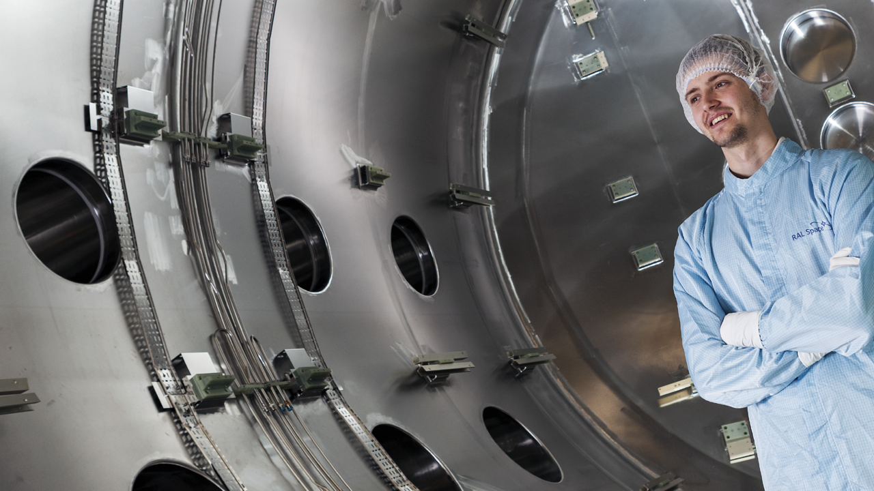
What is RAL Space
RAL Space is the UK's national laboratory advancing the understanding​ of space and our environment for the benefit of all.
Image © STFC RAL Space – Gatsby Foundation
Notes:
To edit the background image, select ‘Format’ from the PowerPoint menu and ‘Slide Background’ from the drop-down menu. Within the new list of options that appears on the right of the screen, select the ‘File’ button under ‘Insert picture from’ and select your image from your file browser. Please remove or amend the image credit if you are using a different image to the one provided.

Slide 11







UK Research and Innovation

Slide 12
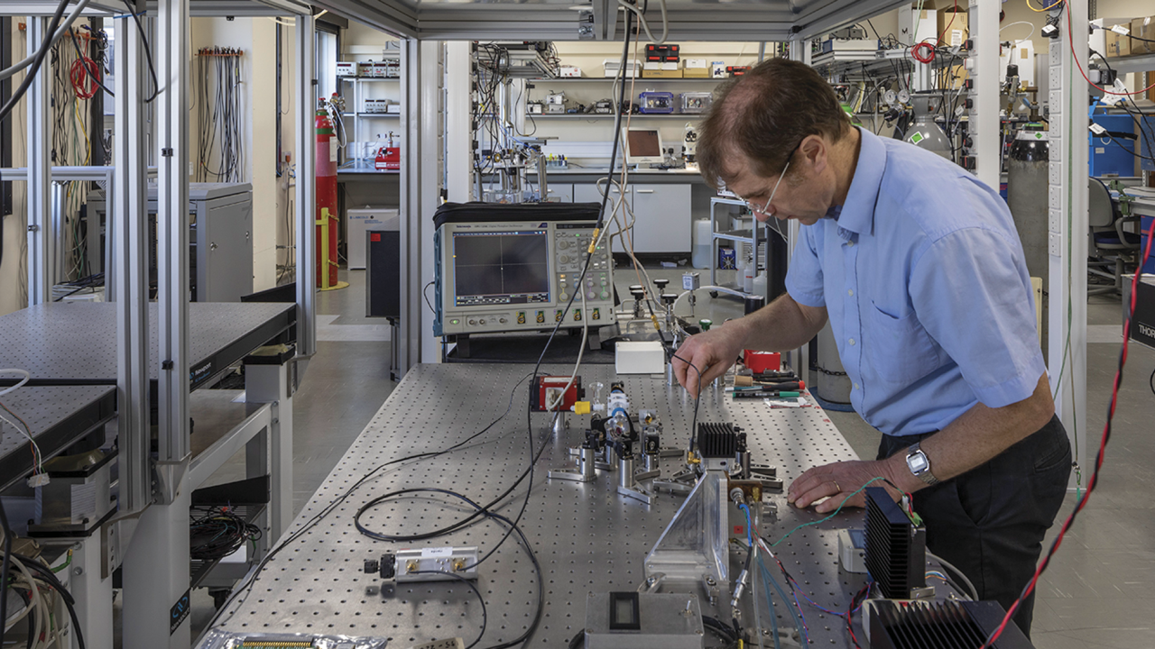
What we do
​We work with UK and overseas agencies, universities and industrial companies on space and ground based space projects. Our unique position between industry and academia enables us to strengthen the UK space community. We do this through:​
scientific research ​
technology development
providing cutting edge facilities​
strategic advice to external partners
Image © STFC RAL Space - BuiltVision
Notes:
To edit the background image, select ‘Format’ from the PowerPoint menu and ‘Slide Background’ from the drop-down menu. Within the new list of options that appears on the right of the screen, select the ‘File’ button under ‘Insert picture from’ and select your image from your file browserPlease remove or amend the image credit if you are using a different image to the one provided.

Slide 13
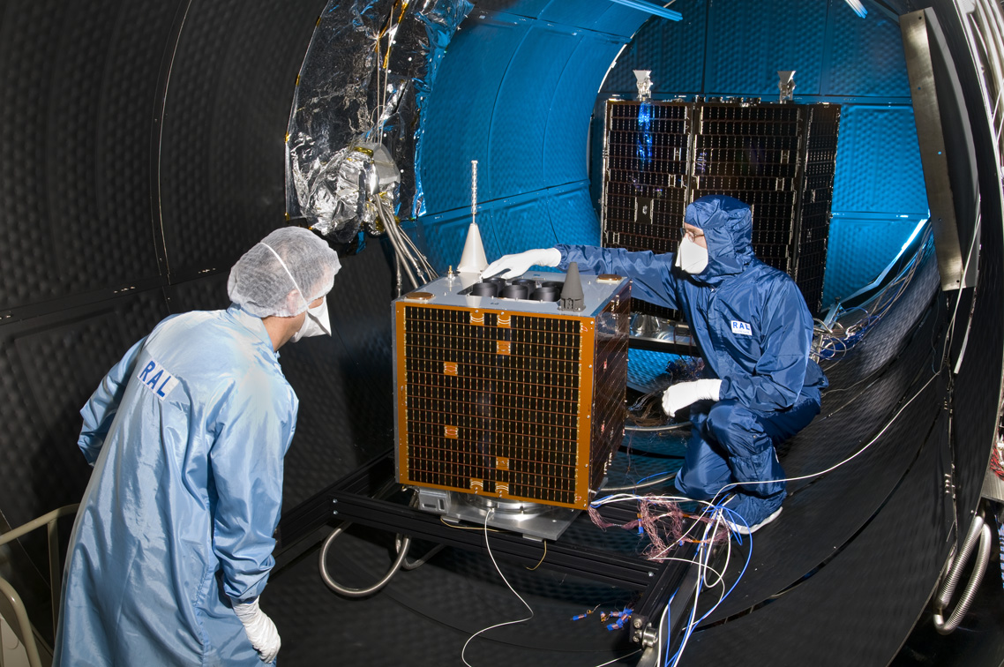
What we do
​Full life cycle
Engineering (Mech, Thermal, Optical, Electronic, and Q)
AIT/AIV
PA/QA
Ground Station (RF and Optical*)
Test Facilities
TVAC, Vib, Piro-shock
Large TVAC, L-Vib, EMC, Acoustic vib
Image © STFC RAL Space
Notes:
To edit the background image, select ‘Format’ from the PowerPoint menu and ‘Slide Background’ from the drop-down menu. Within the new list of options that appears on the right of the screen, select the ‘File’ button under ‘Insert picture from’ and select your image from your file browserPlease remove or amend the image credit if you are using a different image to the one provided.

Slide 14

ralspace.stfc.ac.uk
@RAL_Space_STFC
RAL Space
RAL Space

Slide 15
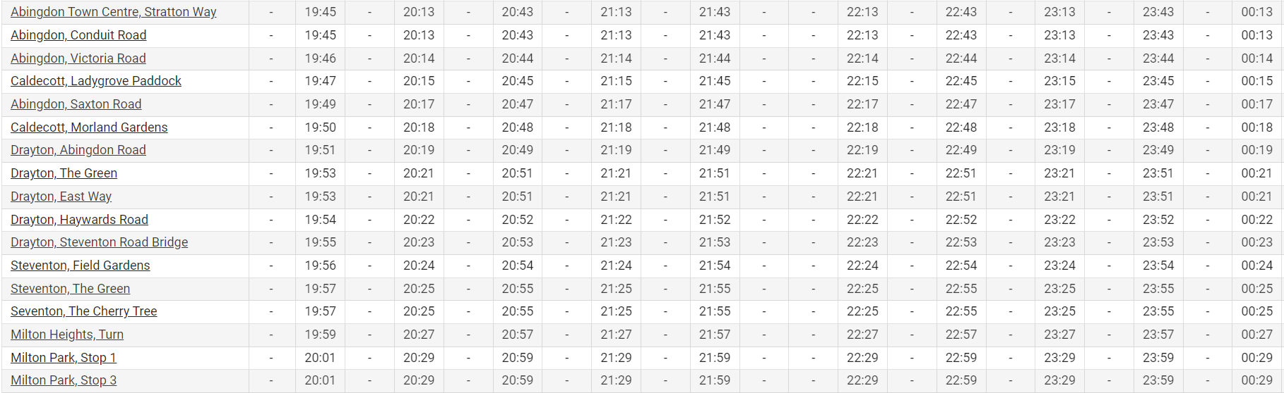
X2 Bus
https://www.oxfordbus.co.uk/services/OXBC/X3

Slide 16
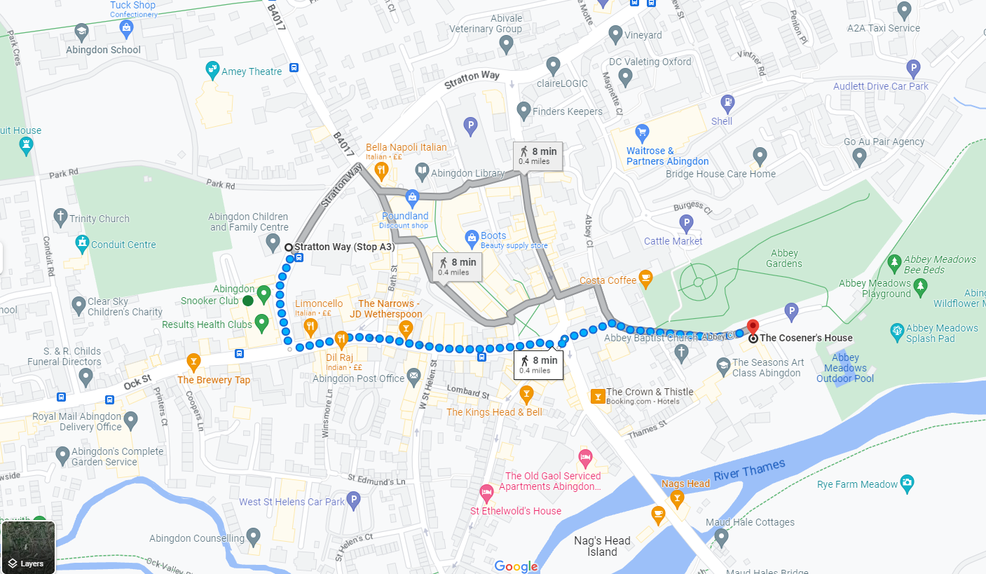

Slide 17
