Slide 1

How do you make electronics work in the space environment?
Mike Salter
Electronics Development Lead

Slide 2

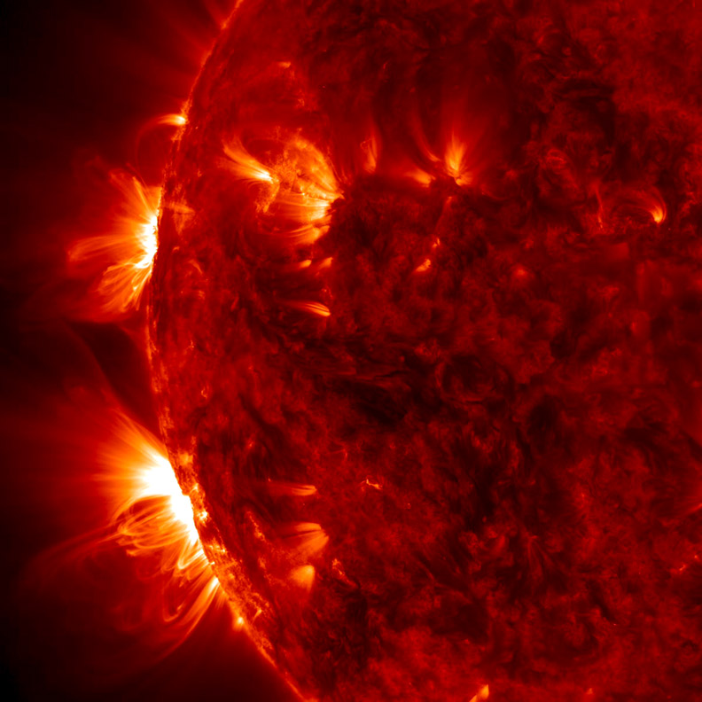
About Me
Electronic Engineering
Background in CCD imaging for high-reliability space applications, including:
GOES (NASA)
World Space Observatory (Roscosmos)
PUNCH (NASA)
Now focussed on bringing new Quantum technologies into orbit:
Electronic systems lead on SpeQtre, a QKD demonstration mission.
Electronic development lead for Cold Atom applications.
Image © NASA SDO

Slide 3
Two Big Questions
What is it about the space environment that limits us flying ground-based electronics?
What are our options for doing something about it?
Image © NASA SDO

Slide 4
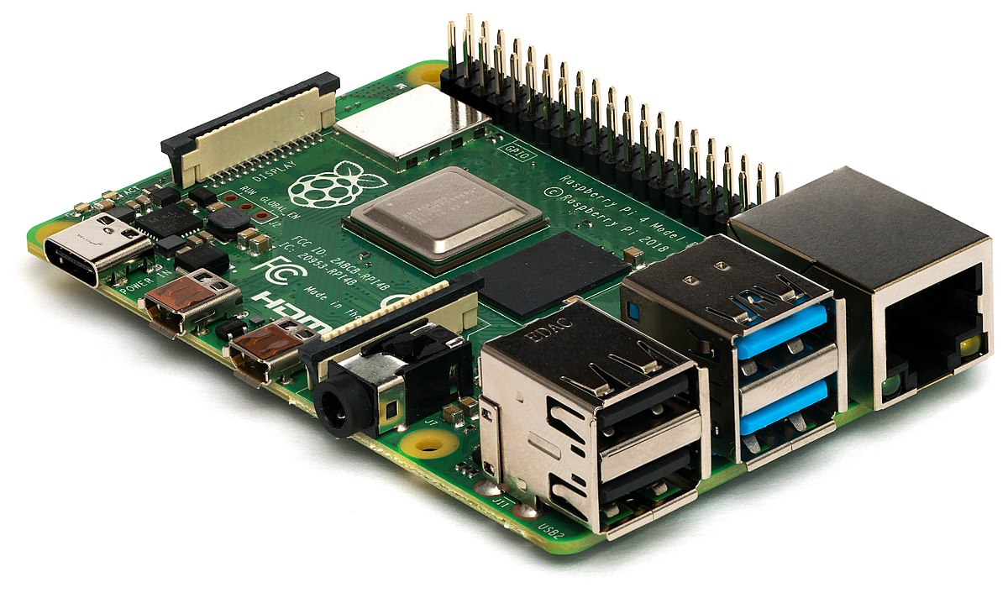
Typical Electronic System
Memory
Microprocessor and/or FPGA
Generic I/O, ADCs, Housekeeping
Power Management
Interfaces
Specialist Function ICs
Image © Raspberry Pi Foundation

Slide 5
Data Handling
Radiation
Reliability
Thermal
Spacecraft
Design
Considerations
Mass
Power
Vibration
Vacuum Compatibility

Slide 6
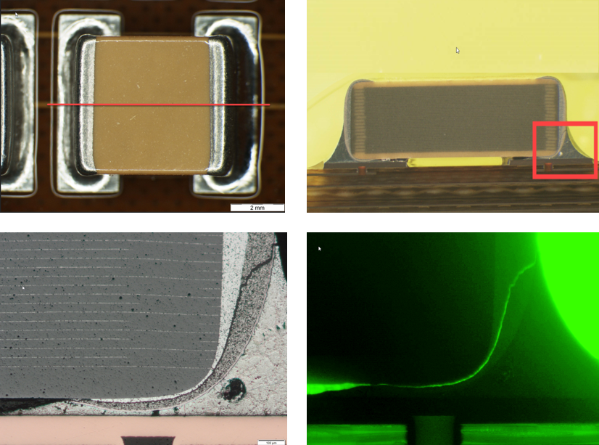
Thermal
Common component rated temperature ranges:
  Commercial 0°C to +70°C
  Industrial -40°C to +85°C
  Military -55°C to +125°C
Relates to junction temperature, therefore linked to power dissipation and operating environment. Typical spacecraft electronic subsystem temperature range: -20°C to +50°C
Thermal expansion and contraction of PCBs is a key design driver.
Image © Alter Technology

Slide 7
Data Handling
Radiation
Reliability
Thermal
Spacecraft
Design
Considerations
Mass
Power
Vibration
Vacuum Compatibility

Slide 8
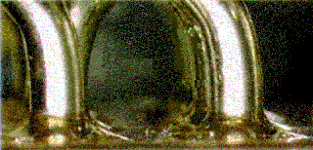
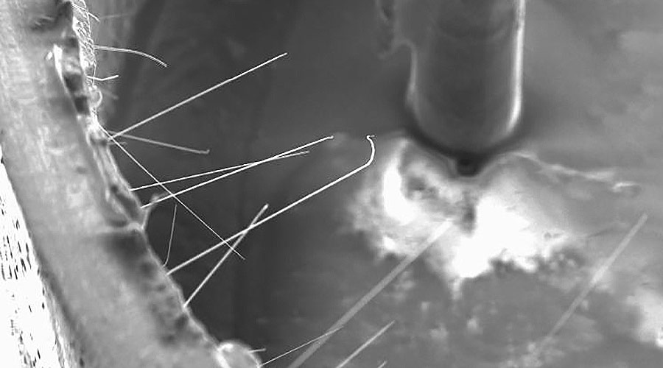
Vacuum Compatibility
Voids / Delamination
Tin Whiskers
Pure tin finishes common in COTS parts, risk of dendrite growth. Lead-alloy solders widely used in space industry.
Outgassing
Careful selection of materials to avoid outgassing effects, soldermask prohibited in some specifications.
Image © NASA, Pinksy/Hester - Raytheon

Slide 9
Data Handling
Radiation
Reliability
Thermal
Spacecraft
Design
Considerations
Mass
Power
Vibration
Vacuum Compatibility

Slide 10
Reliability by Design
Mitigation strategies against failures, resulting from FMEA / FMECA
Design for assembly:
  Component pad dimensions to provide optimal solder joint forming.
  Allowance for staking on higher mass components.
De-rating of components specifications, often in excess of 50%.
PCB trace thicknesses and separations increased.
Via annular rings increased.
ECSS specifications (e.g. ECSS-Q-ST-70-12C Design of Printed Circuit Boards) provide a detailed reference.

Slide 11
Data Handling
Radiation
Reliability
Thermal
Spacecraft
Design
Considerations
Mass
Power
Vibration
Vacuum Compatibility

Slide 12
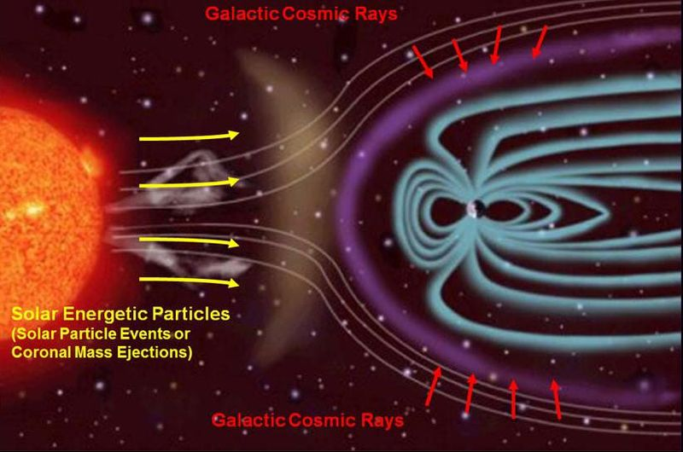
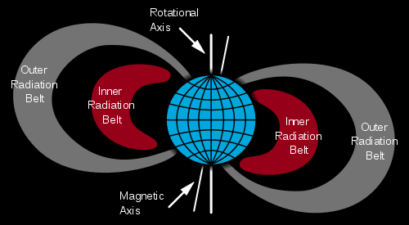
Radiation
Ionising radiation poses a big challenge for electronic systems.

Slide 13
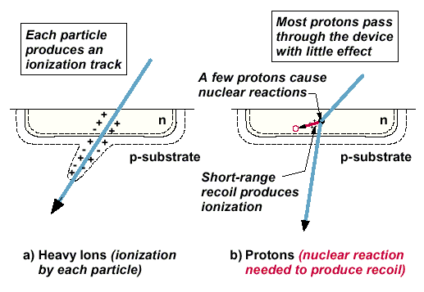
Radiation Effects
Single Event Upsets
Ionising radiation can cause “bit-flips” in logic and memory.
AND Gate
NOT Gate
D
Q
CLK
D-Type Flip Flop
(used as type memory storage)

Slide 14
Radiation Effects
Single Event Upset Mitigation – Triple Voting
Signal A
Signal B
Signal A
Majority Voter
Signal B
Signal A
Signal B
Preserving long-term memory storage, especially program configuration memories, is a significant challenge.

Slide 15
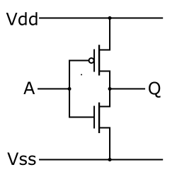
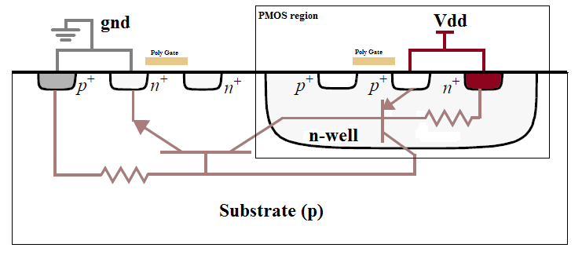
Radiation Effects
Single Event Latch-Up
  Ionising radiation causes a large current to flow between power rails.
  Can be recovered by turning the device off and on again
  Silicon process can be designed to remove latch-up susceptibility
NOT Gate

Slide 16
Two Big Questions
What is it about the space environment that limits us flying ground-based electronics?
What are our options for doing something about it?
Image © NASA SDO

Slide 17
What’s the mission context?
Flagship Science Mission
Educational CubeSat
New Space Constellation
Technology Demonstration
High Performance
Low Cost
Short Lead Time
Reliability Requirement
High
Low
Medium
Medium

Slide 18
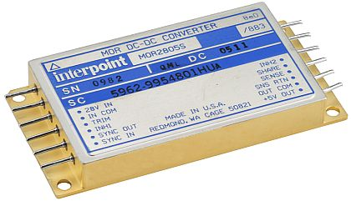
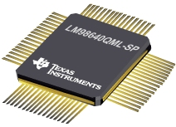
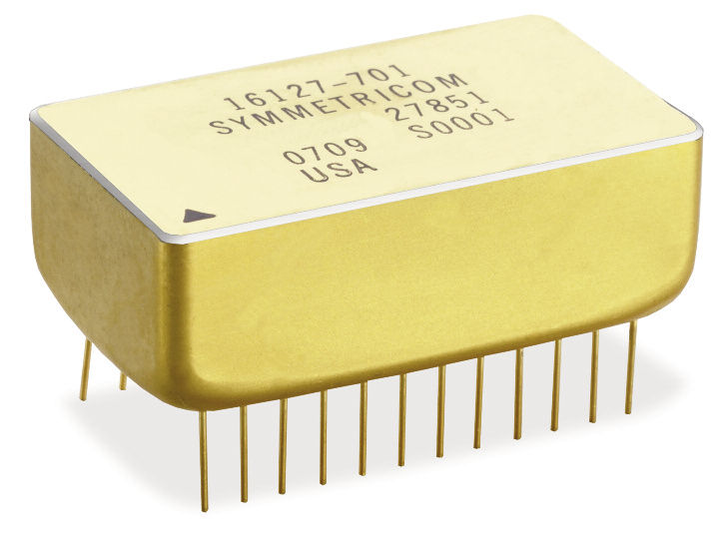
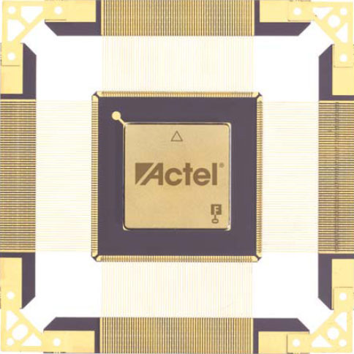
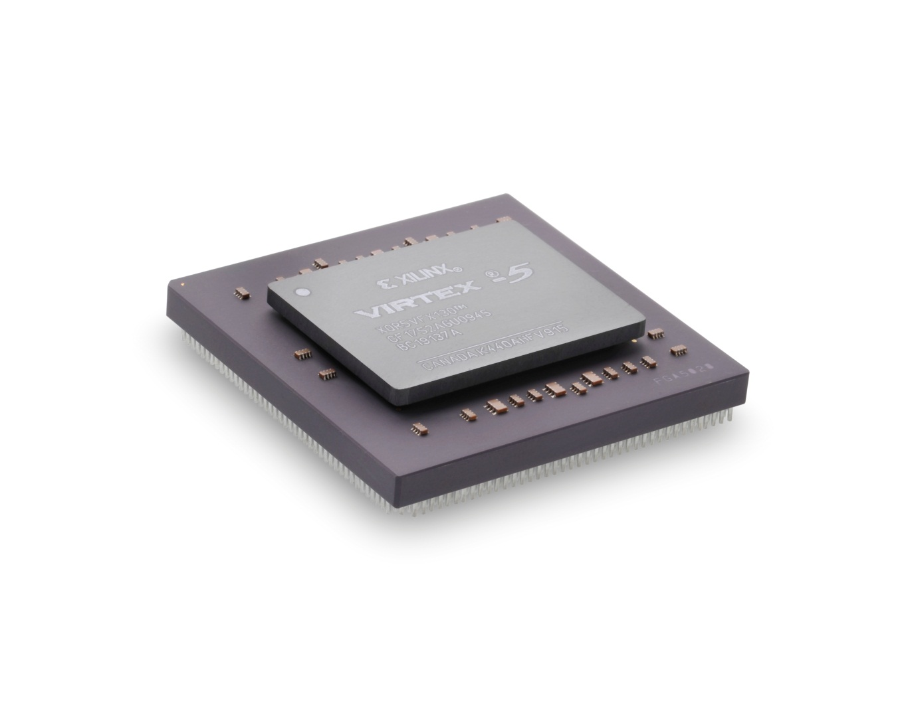
“Space-Qualified” Components
Radiation-hardened and with rated performance to a specified level.
e.g. Texas Instruments TPS7H4001-SP
      TID = 100-krad(Si) RHA
      SET/SEFI characterized to LET = 75 MeV-cm2/mg
      SEL/SEB/SEGR immune to LET = 75 MeV-cm2/mg
Wafer traceability, quality assurance
Lot acceptance testing to Military or Space Standard
Typically a large price tag, not insignificant minimum order quantity and long lead-time.
Look out for emerging “New Space” products.

Slide 19
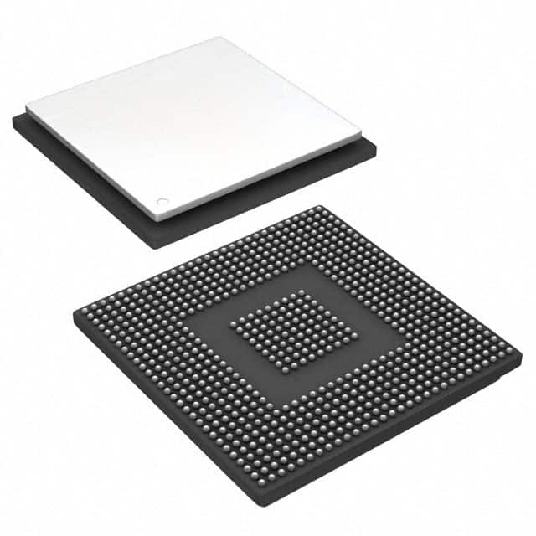
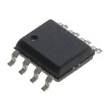
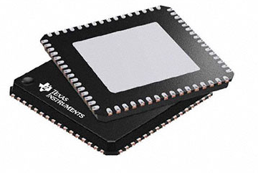
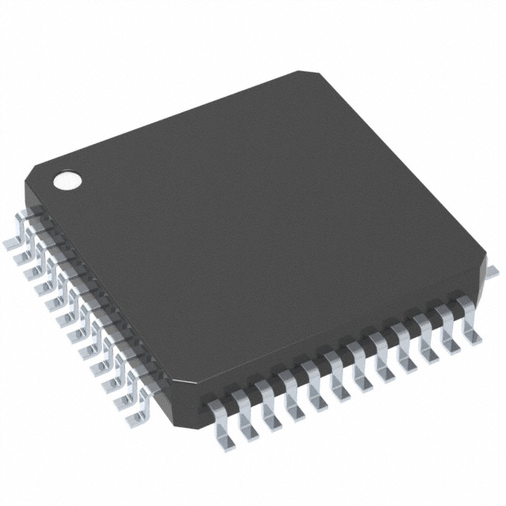
Up-screening COTS parts
Radiation Performance Testing
Vibration/Thermal performance with destructive physical analysis
Lead surface re-finish
Lot traceability
  Wafer inspections
  Anti-counterfeit measures
Lifetime Testing / Burn-in
“Cautious COTS” enables high-performance devices on high-reliability missions but…
NOT Cheaper, NOT Quicker
(for a single spacecraft!)

Slide 20
What’s the mission context?
Flagship Science Mission
Educational CubeSat
New Space Constellation
Technology Demonstration
High Performance
Low Cost
Short Lead Time
Reliability Requirement
High
Low
Medium
Medium

Slide 21
The High-Risk Approach
Orbit and lifetime has a big impact on radiation and reliability requirements.
At LEO, many groups have success with a buy-and-fly “Carefree COTS” approach.
iPhones, Raspberry Pi’s and many other ground-based systems have worked in-orbit.
Heritage, or use of known parts, can give some confidence but COTS process variation makes it impossible to quantify the risk.
CubeSat providers have a successfully and repeatedly flown a wide-range of COTS-based subsystems, typically developed incrementally over many years.

Slide 22
What’s the mission context?
Flagship Science Mission
Educational CubeSat
New Space Constellation
Technology Demonstration
High Performance
Low Cost
Short Lead Time
Reliability Requirement
High
Low
Medium
Medium

Slide 23
The Tricky Middle Road
“Clever COTS” - Can you get 80% of the risk reduction, for 20% of the cost?
Deep understanding exact susceptibilities in each part technology, likelihood of occurrence in planned orbit, and impact on instrument operation.
Careful parts selection helps you design out risk, and minimise it elsewhere.
Awareness of outstanding risks allows thorough hierarchy of mitigation strategies, focussed on preventing damage to instrument operation.
Targeted component-level up-screening and testing where needed, focussed on identified risks.
Subsystem / Instrument environmental testing (e.g. proton irradiation) can help gain confidence and verify top-level mitigation strategies, but may give limited insight on where issues occur.

Slide 24
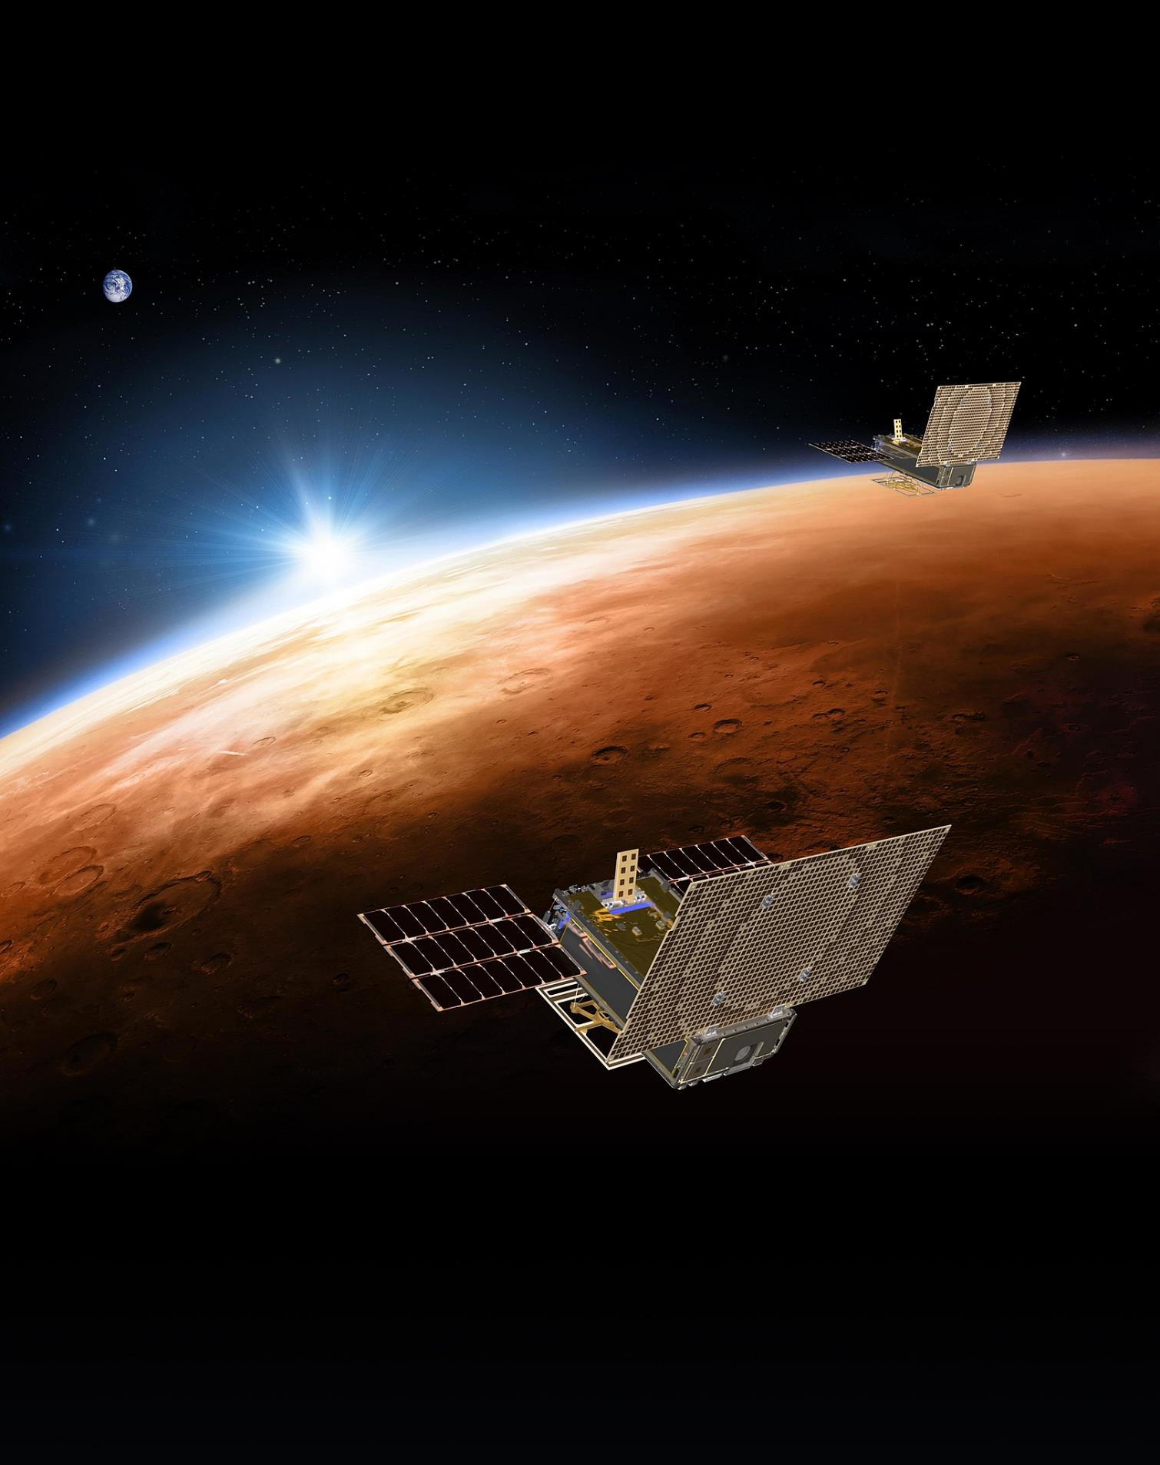
Final Thoughts
Capabilities of small-satellites have increased rapidly, with a huge potential for advanced technology demonstration payloads at a lower cost.
The industry is learning how to best to deliver these type of projects.
Design electronics with a route-to-space in mind.
Image © NASA JPL - MarCO

Slide 25




Thank you
ralspace.stfc.ac.uk
@RAL_Space_STFC
RAL Space
RAL Space

