Slide 1
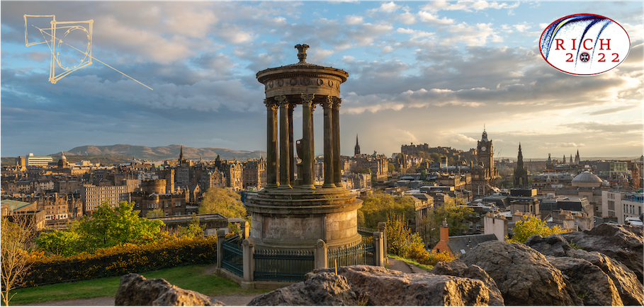
Highlights from the RICH 2022 Conference
Antonis Papanestis
STFC/RAL
RICH = Ring Imaging Cherenkov detector

Slide 2
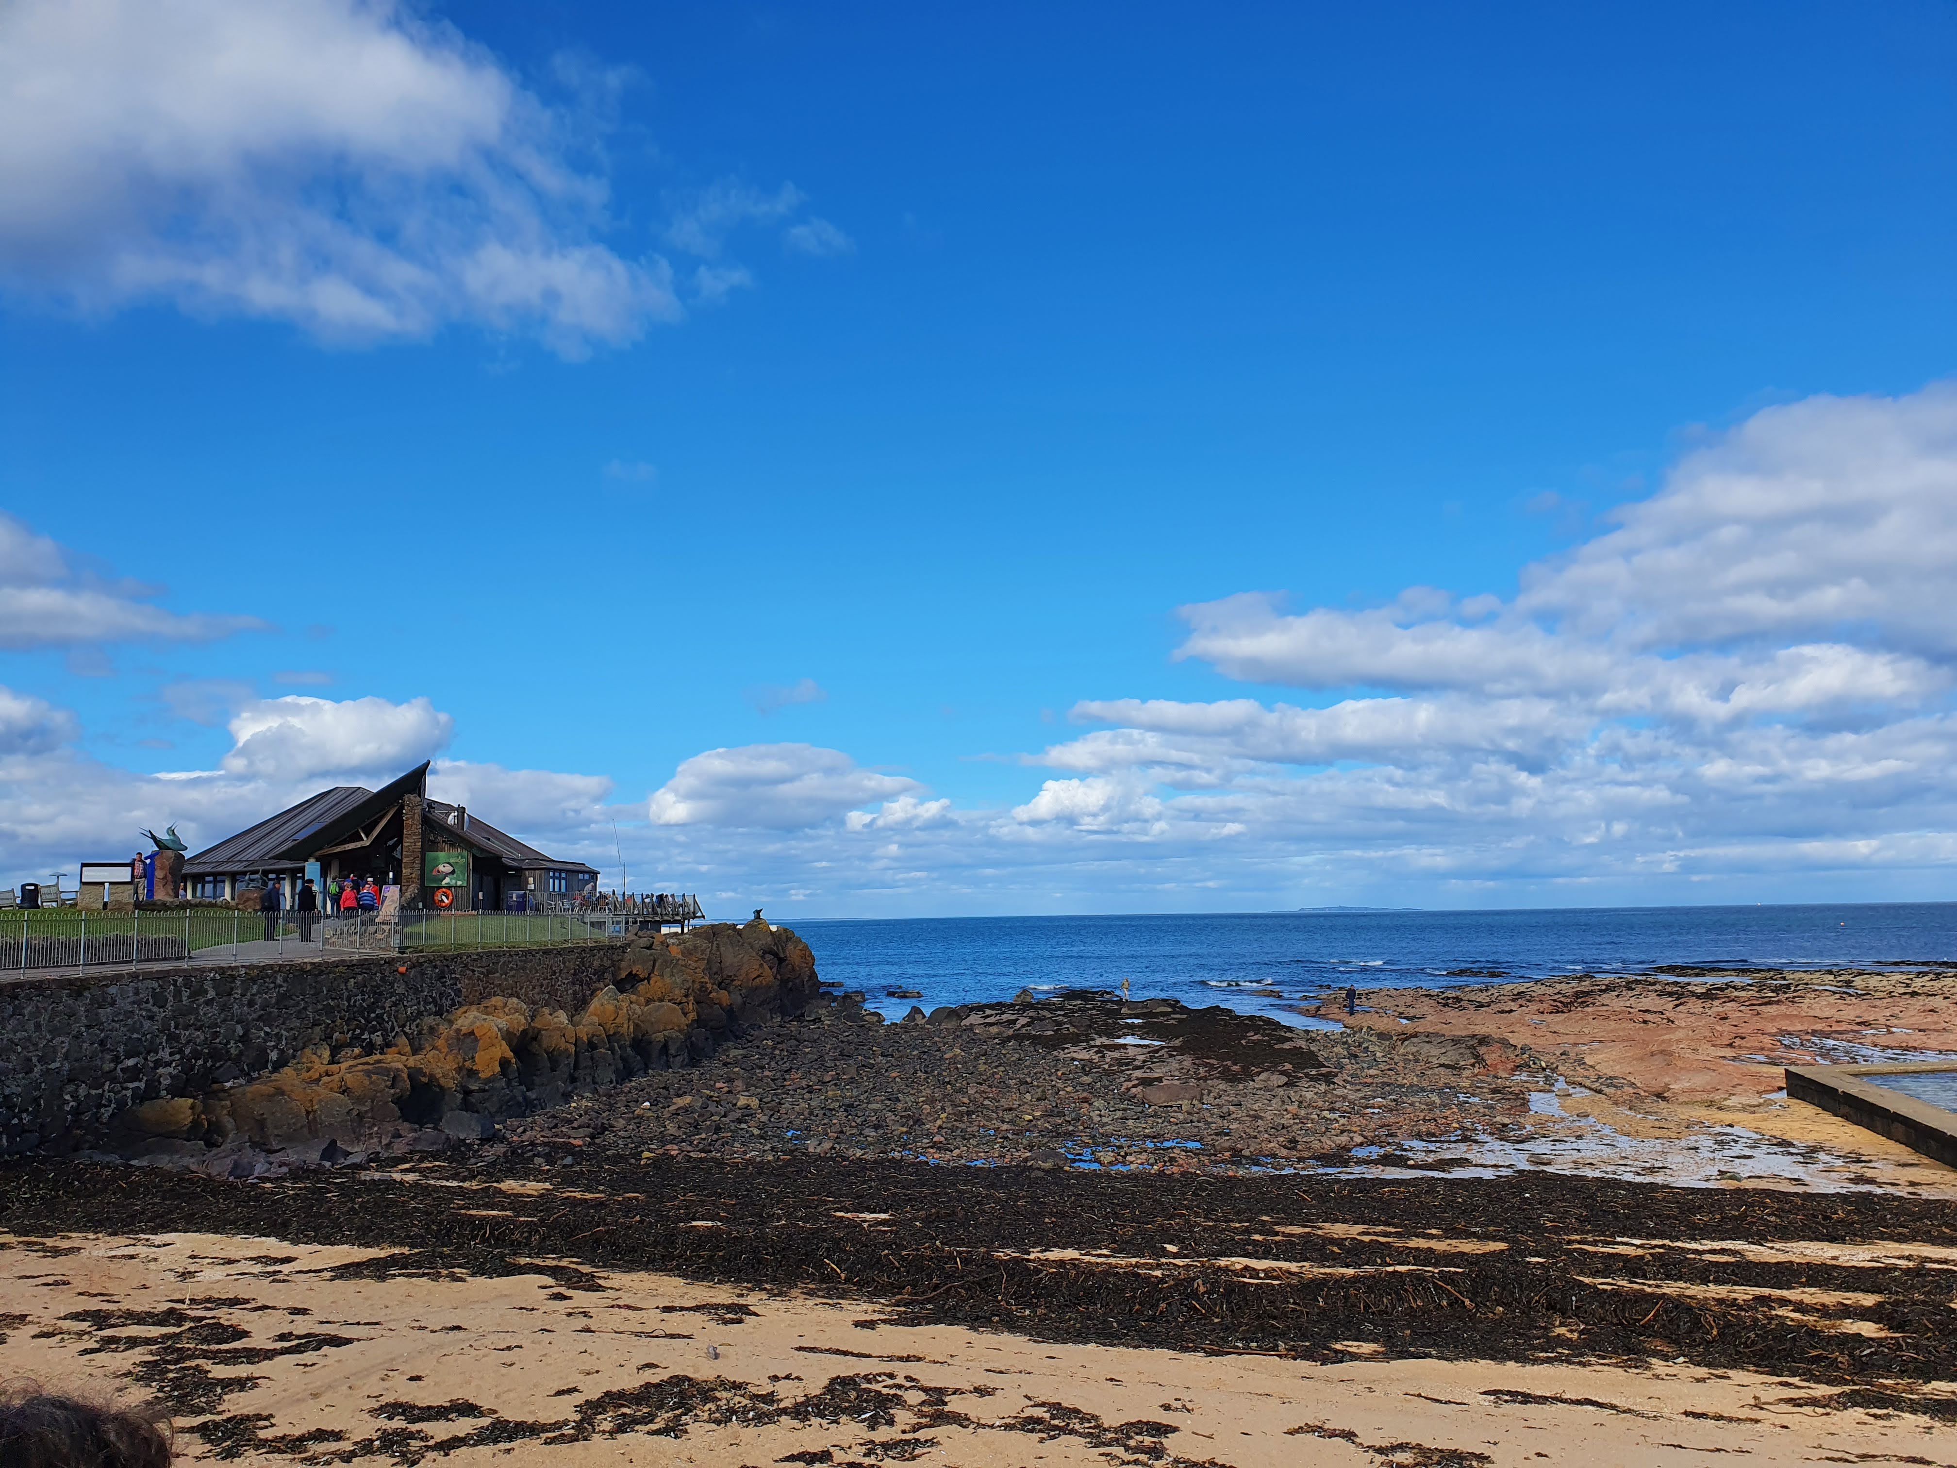
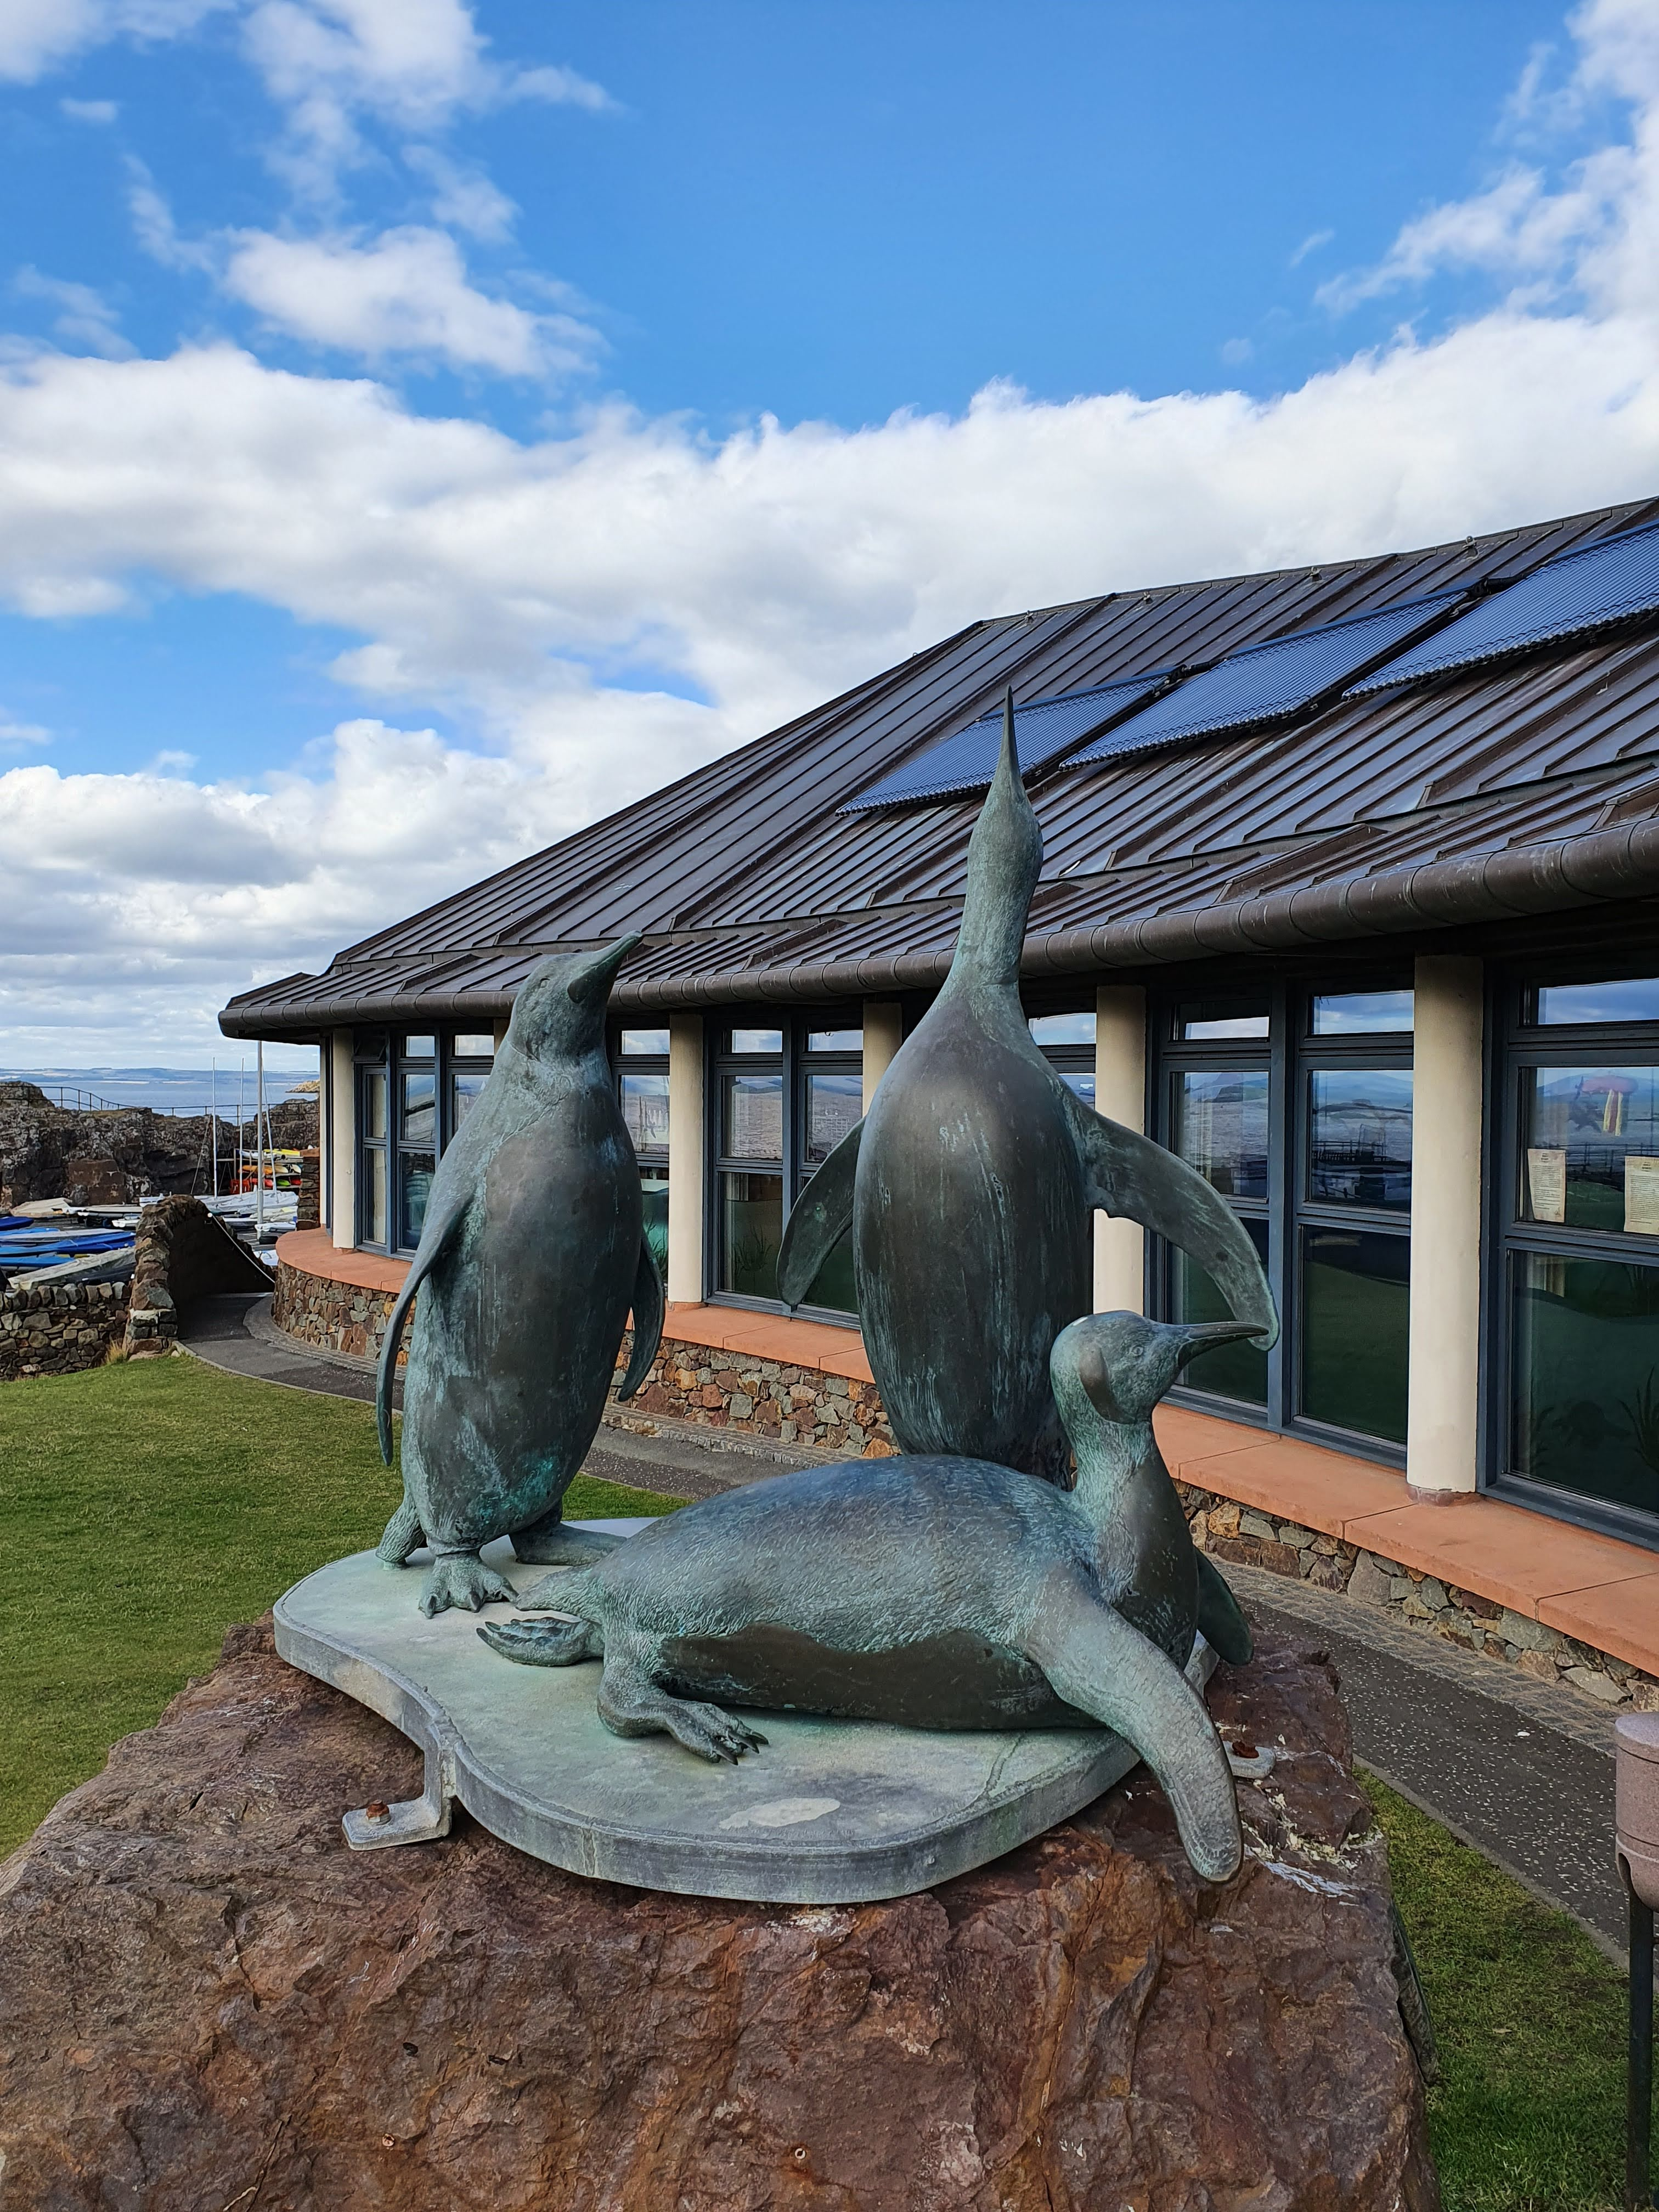
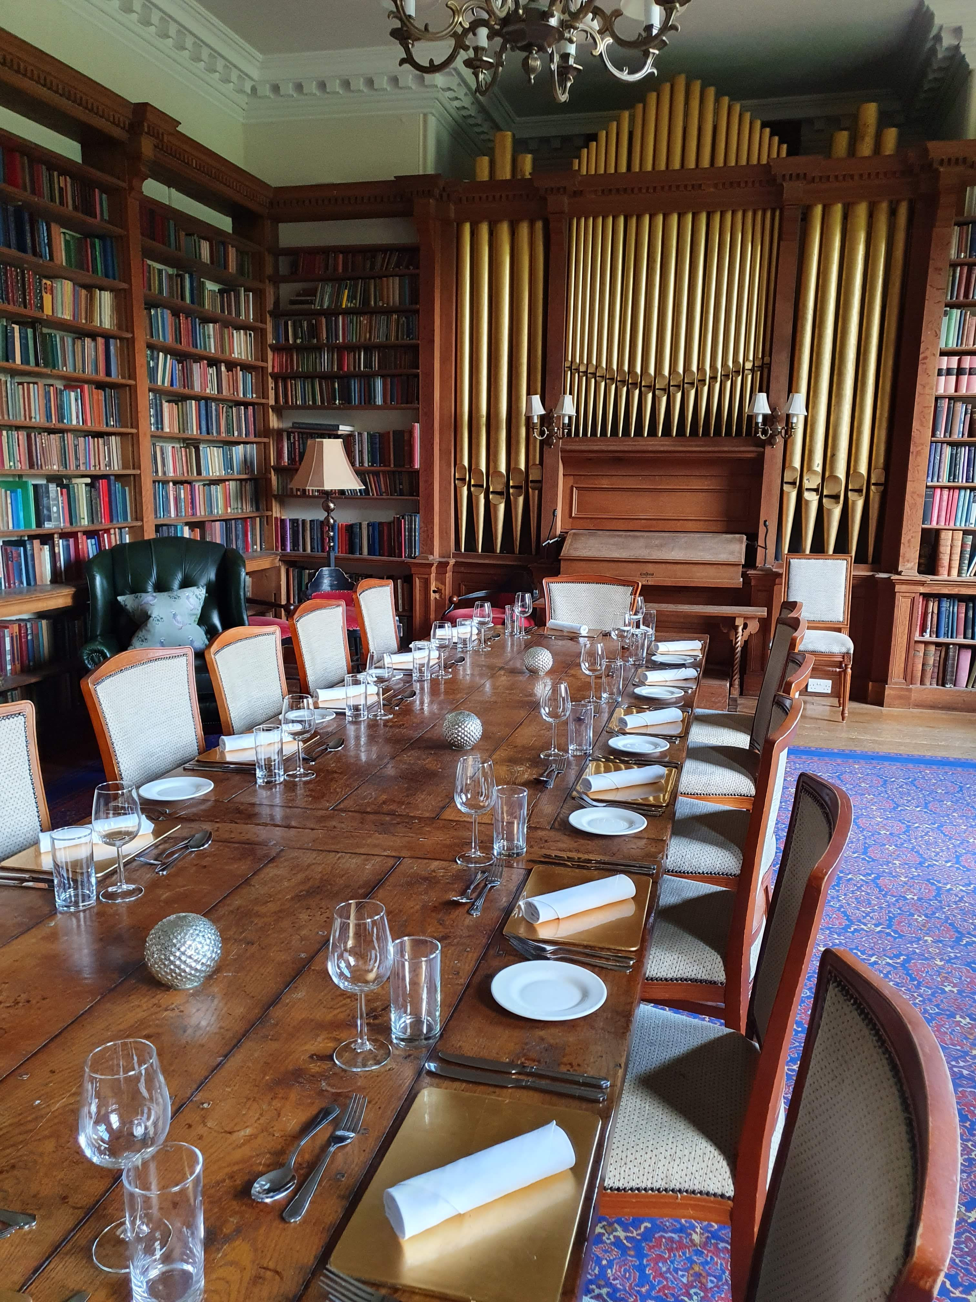
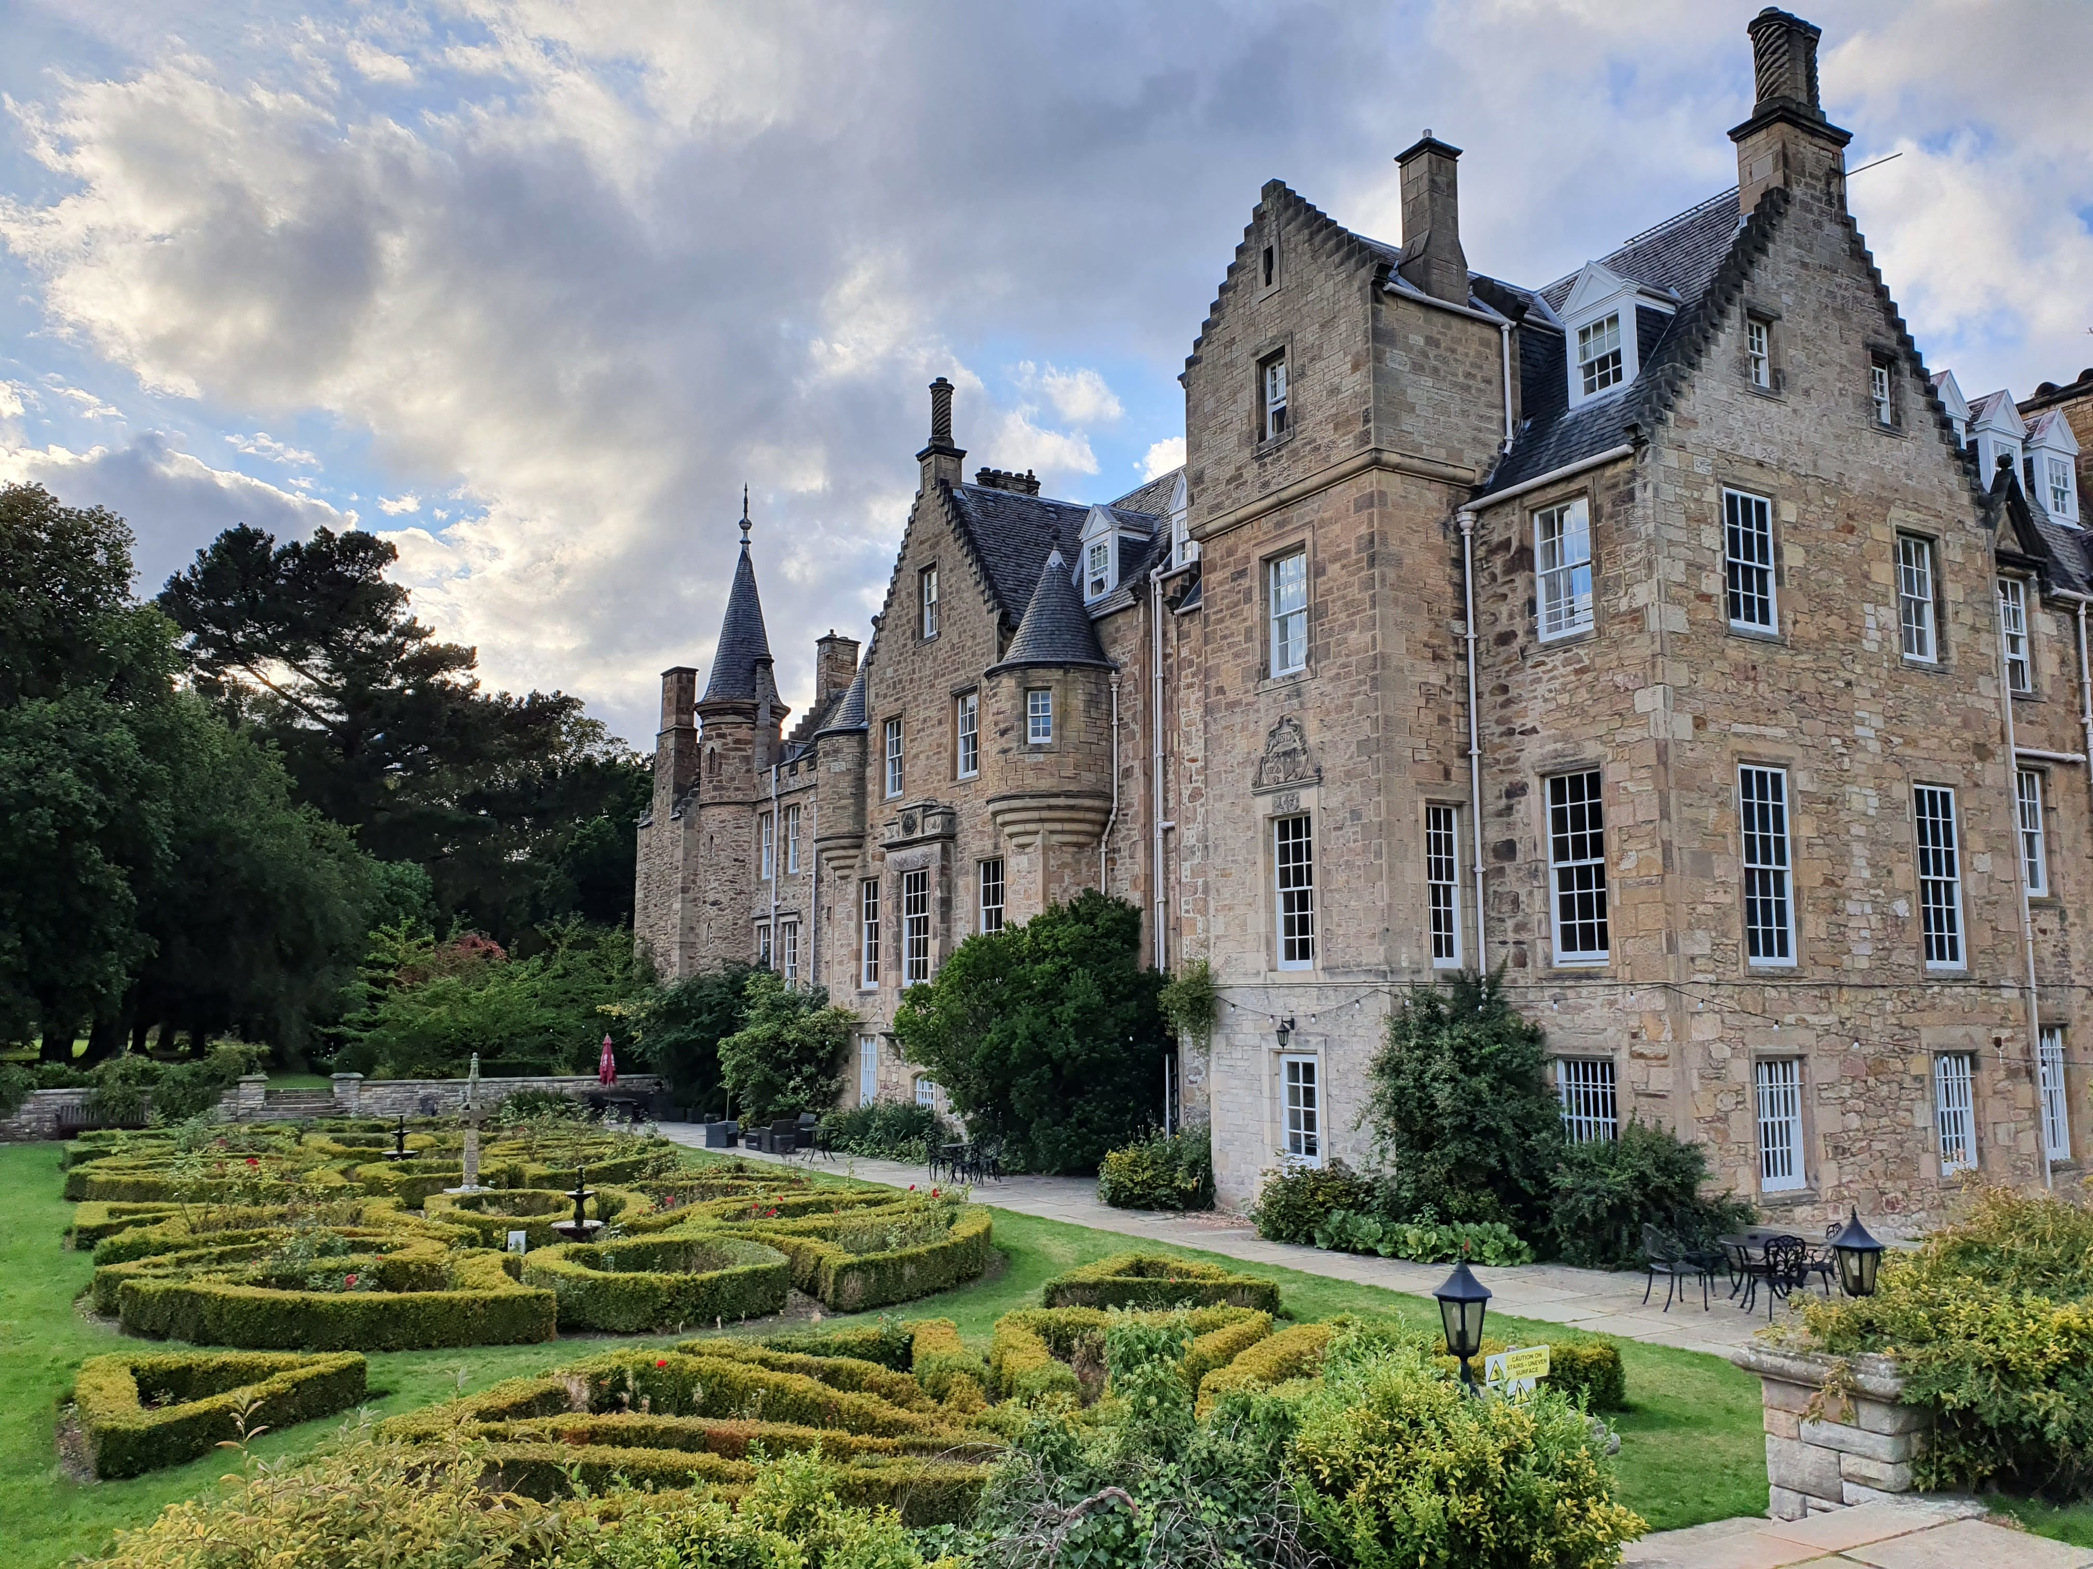
Edinburgh Sep 2022
CARBERRY TOWER

Slide 3
Looking back as well as forward
Homage to Jacques Seguinot
Homage to Sheldon Stone

Slide 4
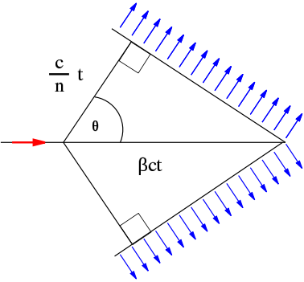
Cherenkov radiation
Lake Placid – LHCb Collaboration Week

Slide 5
Cherenkov principles
Threshold:
$$β_{th}=\frac{ν_{th}}{c}=\frac{1}{n\left(λ\right)}$$
Cherenkov angle:
$$\cos{θ_{c}=\frac{1}{βn(λ)}}$$
$$N_{photons}=L\frac{α}{ℏc}Z^{2}\int{\sin^{2}{θ_{c}\left(E\right)dE}}$$
Number of produced photons:

Slide 6
Refractive index range
1
1.5
~100 GeV/c
~1 GeV/c
Momentum

Slide 7
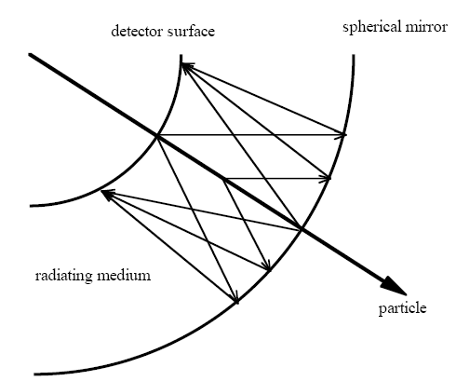
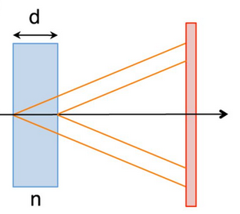
RICH Detectors
Proximity focusing geometry
Measures both the Cherenkov angle and the number of photoelectrons detected.
Can be used over particle identification over large surfaces.
Requires photodetectors with single photon identification capability.

Slide 8
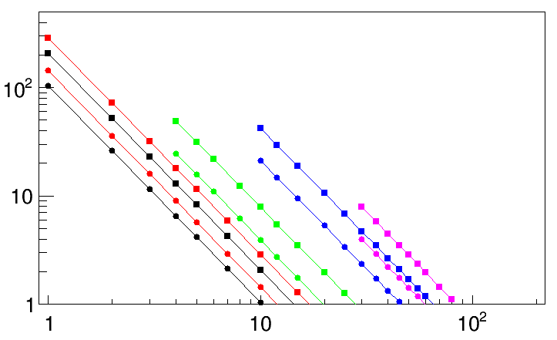
RICH performance
$$N_{σ}≈\frac{\left|m_{1}^{2}\right.−\left.m_{2}^{2}\right|}{2P^{2}σ\left[θ_{c}(tot)\right]\sqrt{n^{2}−1}}$$
For particles well above threshold
B. N. Ratcliff, NIMA 502 (2003) 211-221
0.5 mrad
Fused Silica
1 mrad
C₆F₁₄ (liquid)
$σ\left[θ_{c}(tot)\right]$ components:
Emission point error
Detection point error (pixel size)
Chromatic error
Aerogel (1.04)
Nσ π/K separation
C₄F₁₀
CF₄
3 σ
Particle momentum (GeV/c)

Slide 9
The performance of the LHCb RICH detectors during the runs 1 and 2 of the LHC
Antonis Papanestis
STFC – RAL
on behalf of the LHCb RICH Collaboration

Slide 10
Overview
The LHCb RICH detectors
Cherenkov angle resolution and alignment
Number of photons
Real-time Online calibration
PID performance
Physics impact
Performance of the LHCb RICH detectors during LHC Run 2
R. Calabrese et al 2022 JINST 17 P07013
Performance of the LHCb RICH detector at the LHC
Adinolfi, M. et al. Eur. Phys. J. C 73, 2431 (2013).

Slide 11
The LHCb experiment
RICH 1
RICH 2

Slide 12
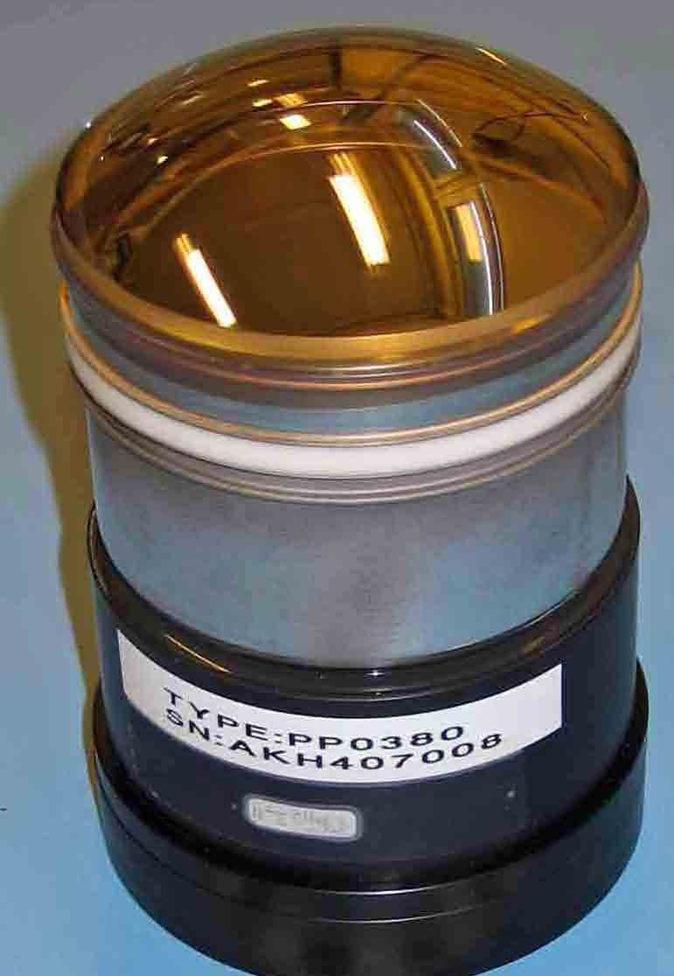
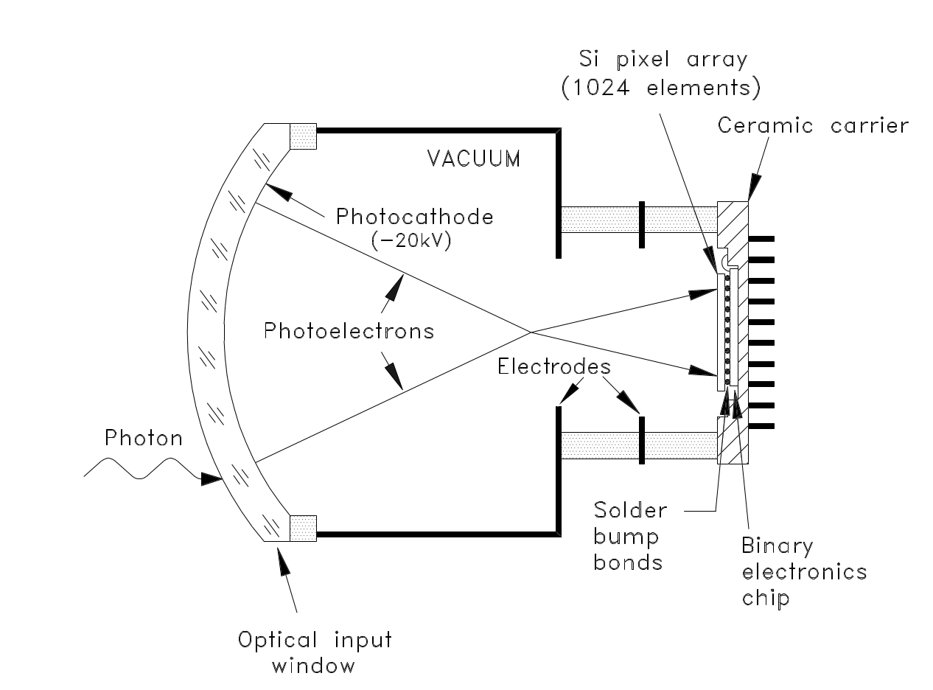
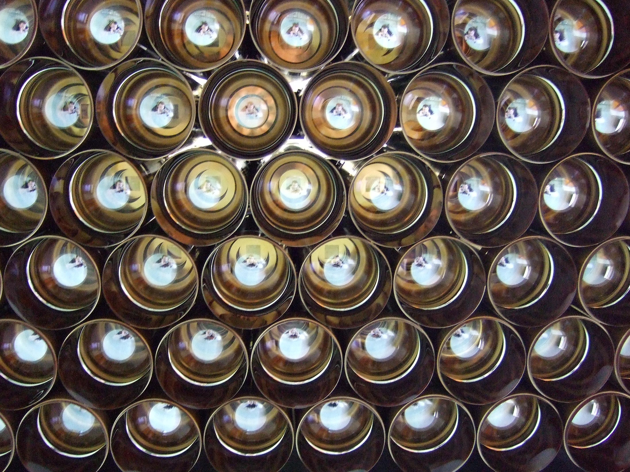
The Pixel Hybrid Photon Detectors
The encapsulated electronics operate at a maximum read-out rate of 1 MHz; not compatible with 40 MHz readout

Slide 13
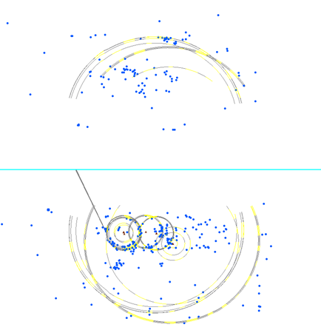
RICH 1: From 2 radiators to 1
Original design of RICH 1 was to accommodate 2 radiators to cover a wider momentum range:
C₄F₁₀
Aerogel
However:
Increased luminosity compared to original design and increased background (and underestimate of track multiplicity) made aerogel photons difficult to identify
The requirement for offline quality results from High-Level Trigger output put strict conditions for processing time
Online alignment and calibration before HLT
Removal of aerogel extended the length of the gas radiator

Slide 14
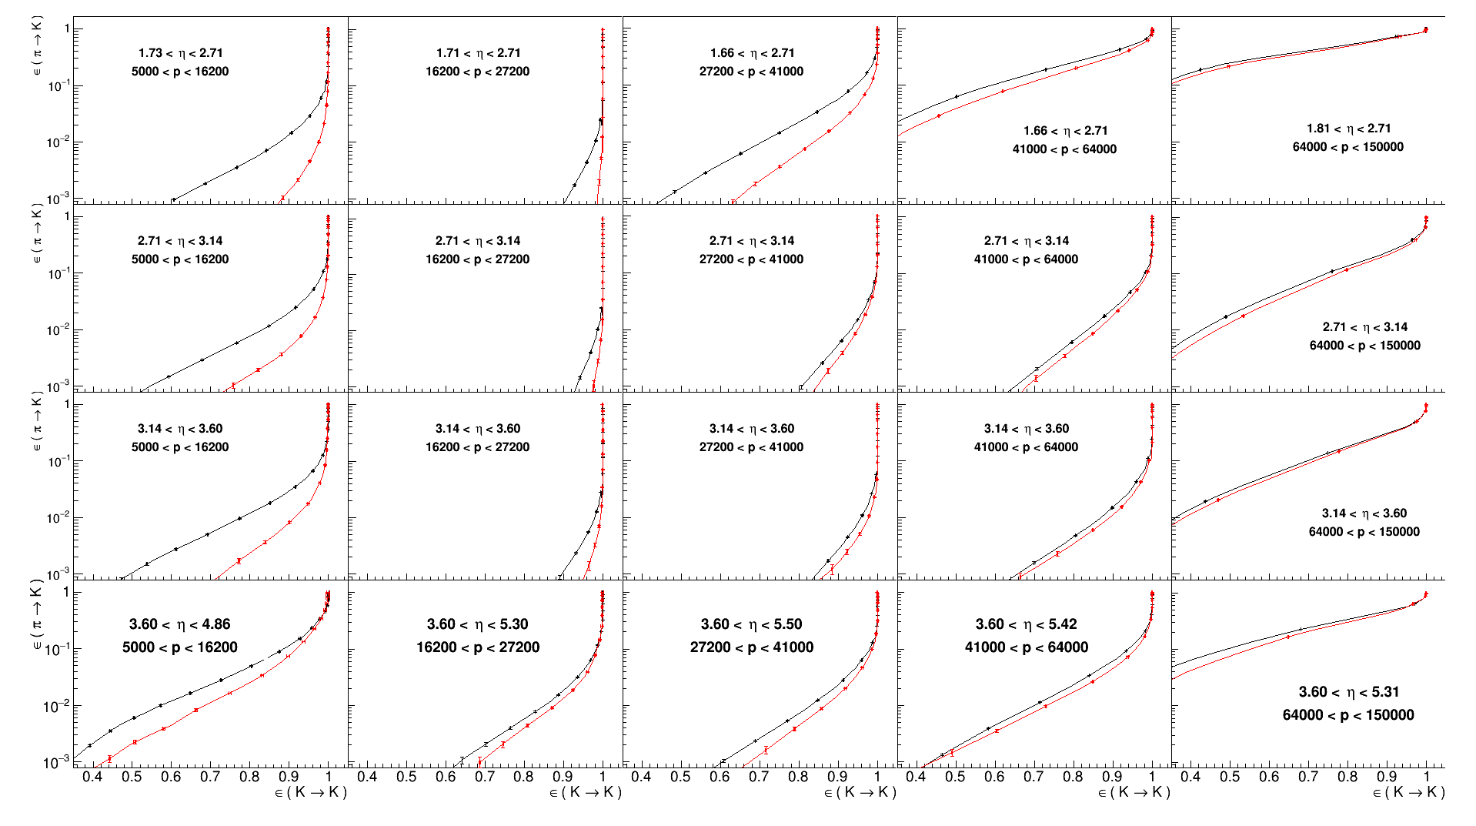
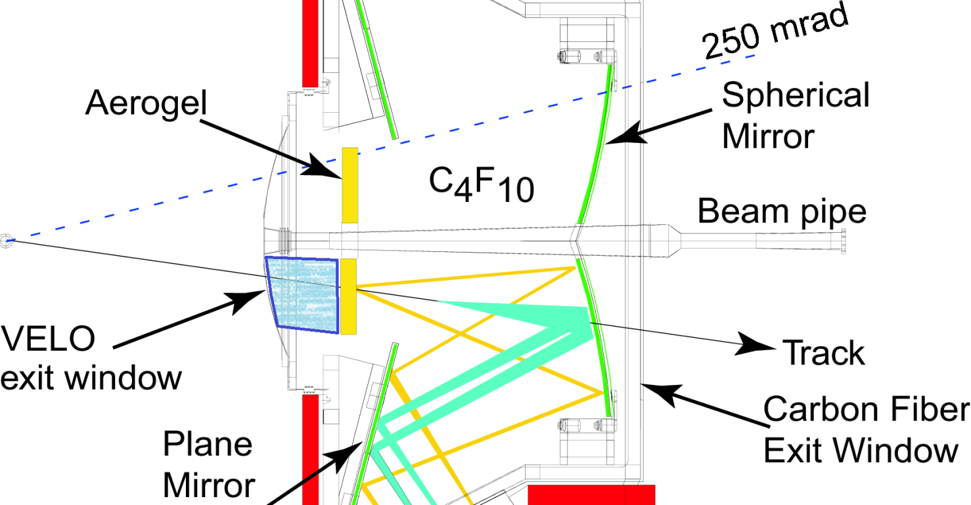
Aerogel removal
π/K PID 2012/2015
Mis-ID π→K
⇓ η
Efficiency K→K
Momentum →

Slide 15
Cherenkov angle reconstruction
Notes:
The abstract pattern can be removed or repositioned if required. Be careful to ‘Send to Back’ so that it does not obscure any important information.

Slide 16
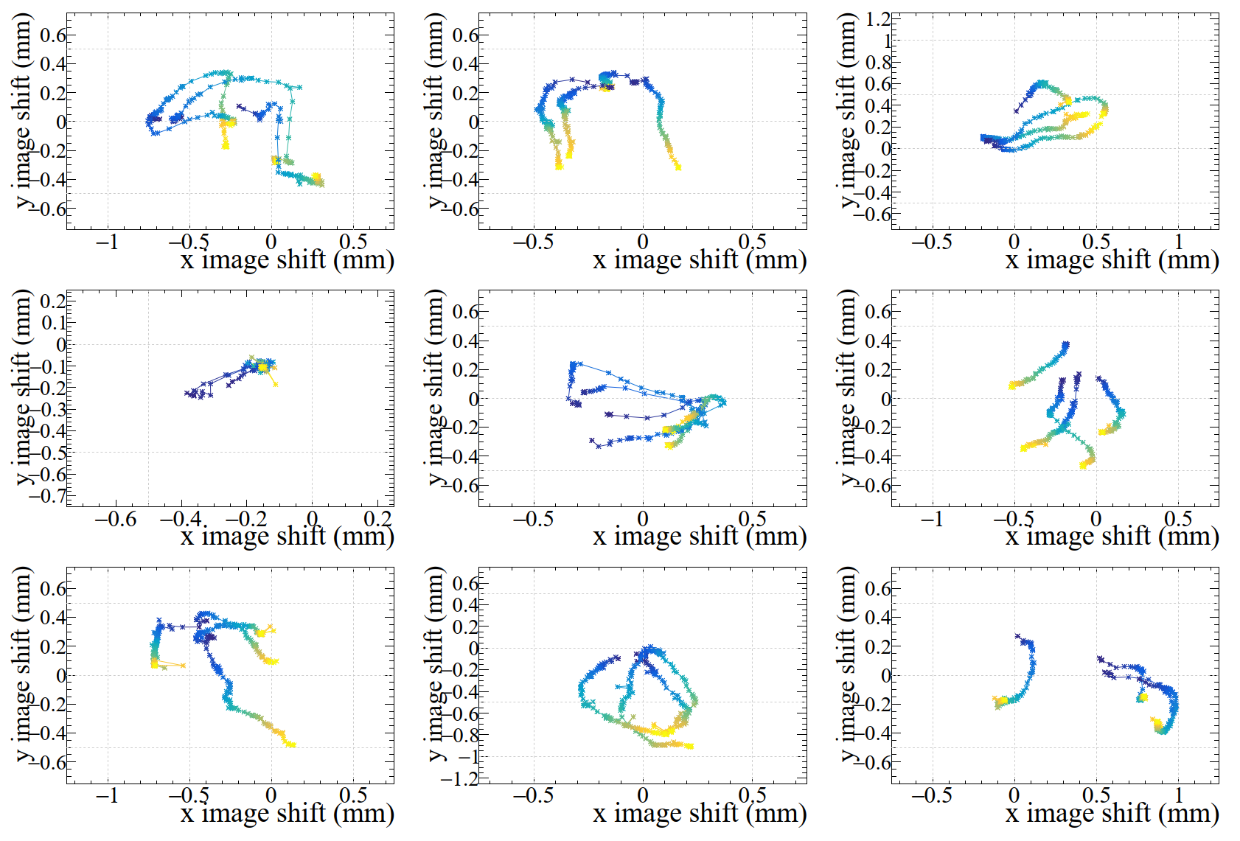
HPD photocathode position
One pixel
Automatic Online calibration for every run (max 1 hour)

Slide 17
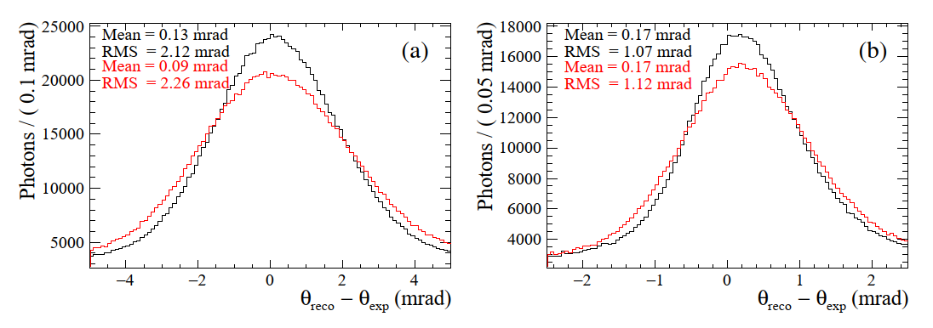
HPD Image centre effect
RICH 1
Before corrections
After corrections
RICH 2

Slide 18
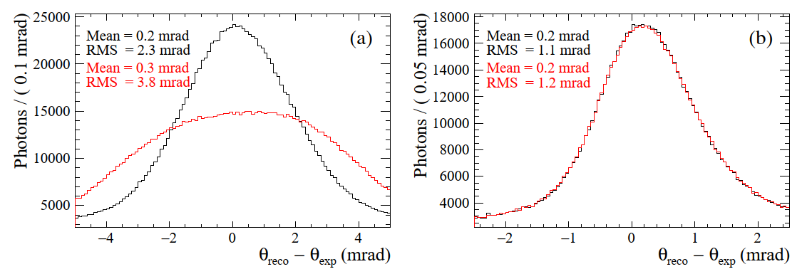
Magnetic field distortions
A Borgia et al, NIM A 735 (2014) 44-52
R Cardinale et al, 2011 JINST 6 P06010
RICH 1
Before corrections
After corrections
RICH 2

Slide 19
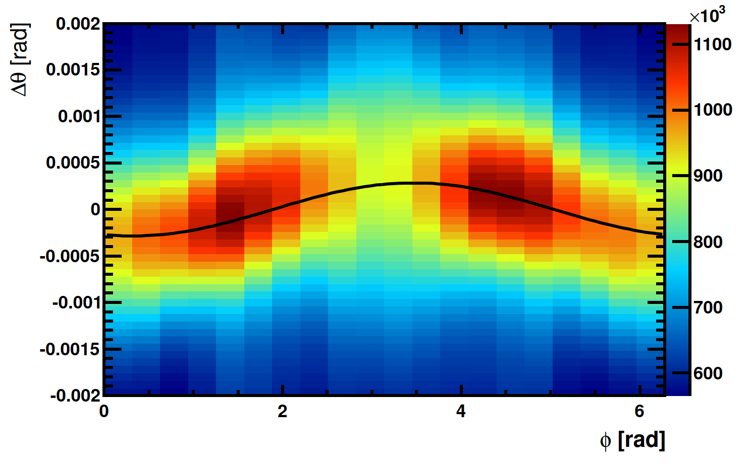
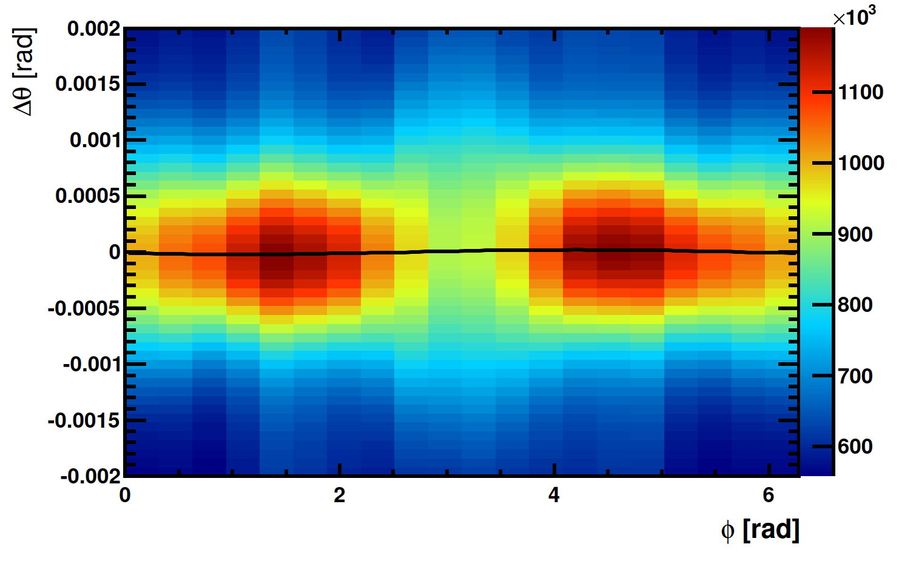
Mirror alignment
Primary (spherical) mirrors
0.1 mrad
Mirror
Rotation
-0.1 mrad
0.1 mrad
Mirror
Rotation
-0.1 mrad
Secondary (~planar) mirrors

Slide 20
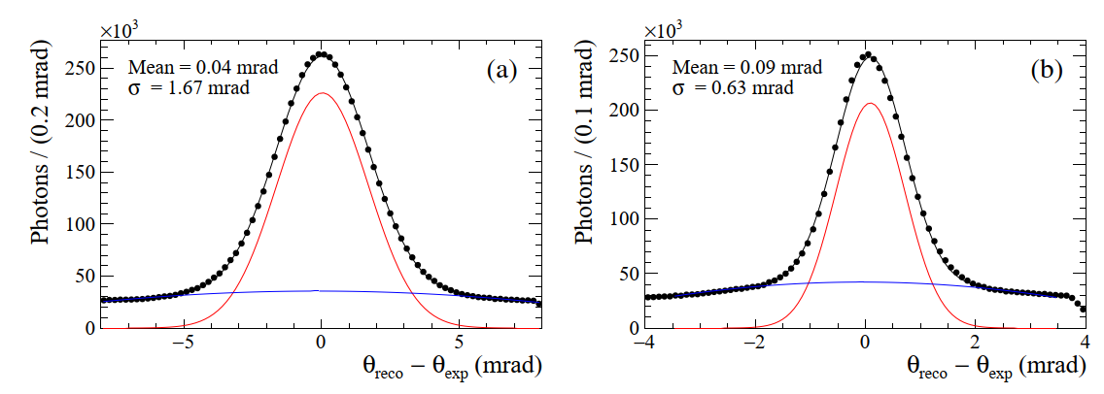
Cherenkov angle resolution
From low track multiplicity events
RICH 1
RICH 2

Slide 21
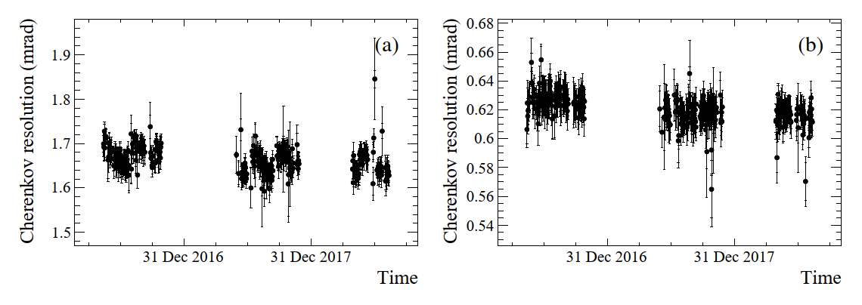
Cherenkov angle resolution stability
2018
2017
2016
2016
2017
2018
RICH 1
RICH 2

Slide 22
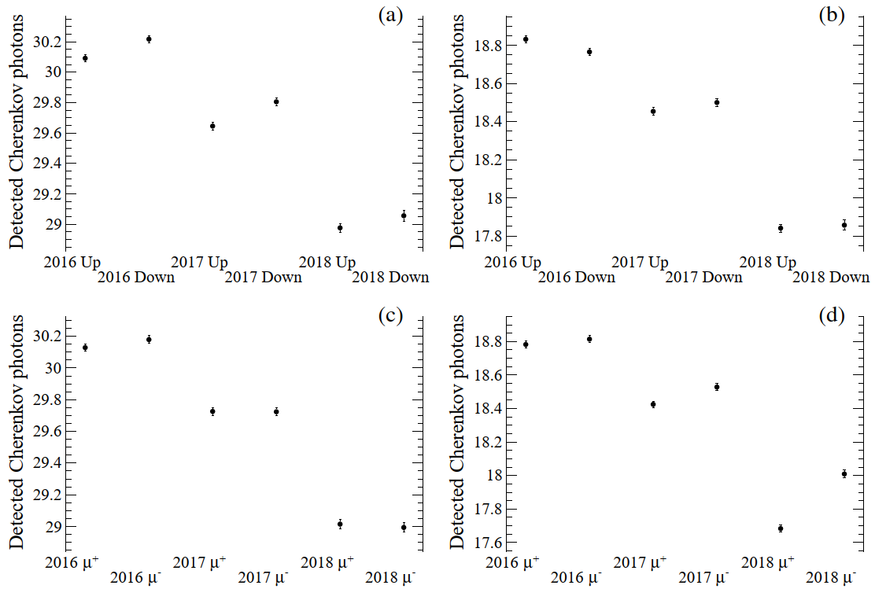
Number of detected photons
2017
Using low multiplicity events, identified as muons by the muon system
The number of photons is estimated per track from the resolution plot with the background subtracted
LHCb operates with two magnetic field polarities to avoid systematic errors:
Field UP
Filed DOWN
2018
2016
RICH 1
RICH 2

Slide 23
Calibration
Notes:
The abstract pattern can be removed or repositioned if required. Be careful to ‘Send to Back’ so that it does not obscure any important information.

Slide 24
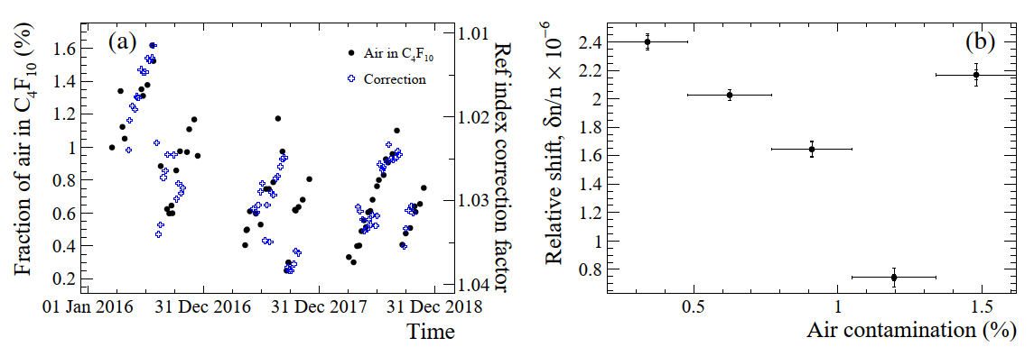
Refractive index calibration
Correction factor and air contamination
Residual refractive index bias after correction

Slide 25
Decays for PID calibration
Identified without RICH information
EPJ Techn Instrum 6, 1 (2019). https://doi.org/10.1140/epjti/s40485-019-0050-z

Slide 26
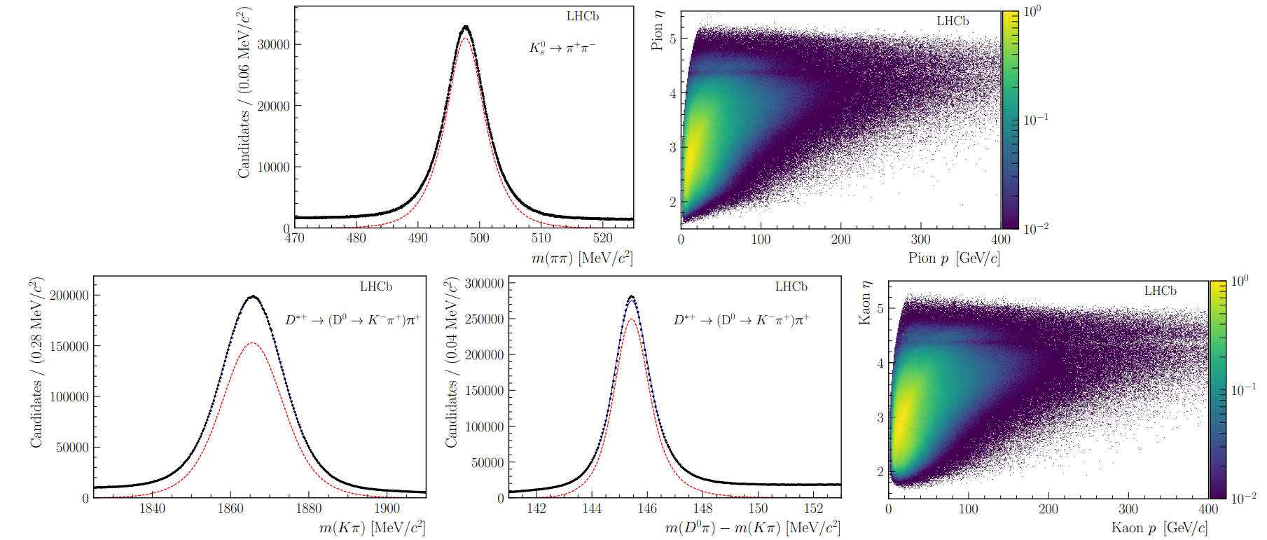
Kinematic range (K, π)

Slide 27
PID performance
Notes:
The abstract pattern can be removed or repositioned if required. Be careful to ‘Send to Back’ so that it does not obscure any important information.

Slide 28
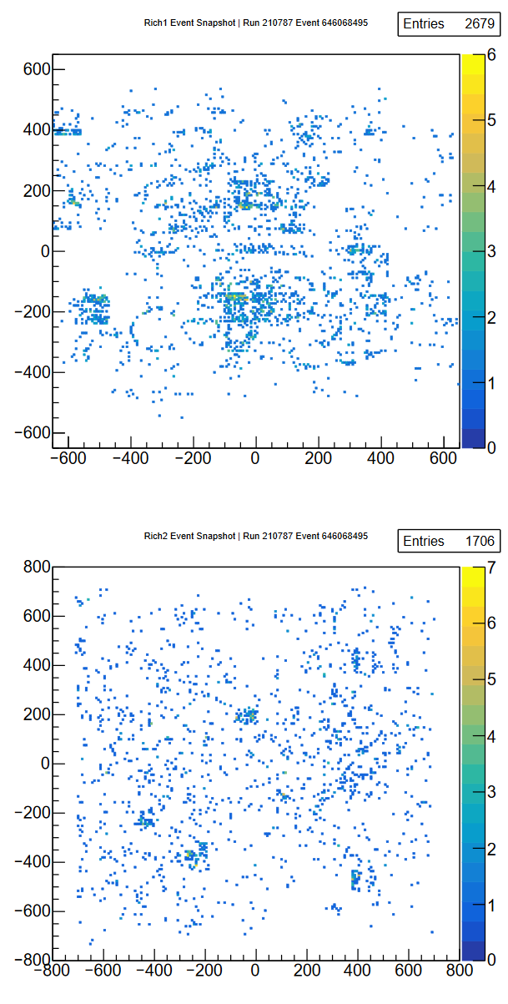
Global likelihood PID method
In the busy LHC environment, most of the “background” to the identification of a given track comes from signals of other tracks in the event
make a global optimisation of the mass hypotheses
For each track in the event, for a given mass hypothesis, determine the expected distribution of Cherenkov photons on the detector plane using the knowledge of the geometry of the detector and its optical properties
Repeat for all the tracks in the event
From the photon distribution on the detector plane calculate the probability that a signal would be seen in each pixel of the detector from all tracks
Compare this with the observed set of photoelectron signal on the pixels and calculate a likelihood
Repeat the above, changing the set of mass hypothesis of the tracks to find the set of mass hypotheses which maximize the likelihood

Slide 29
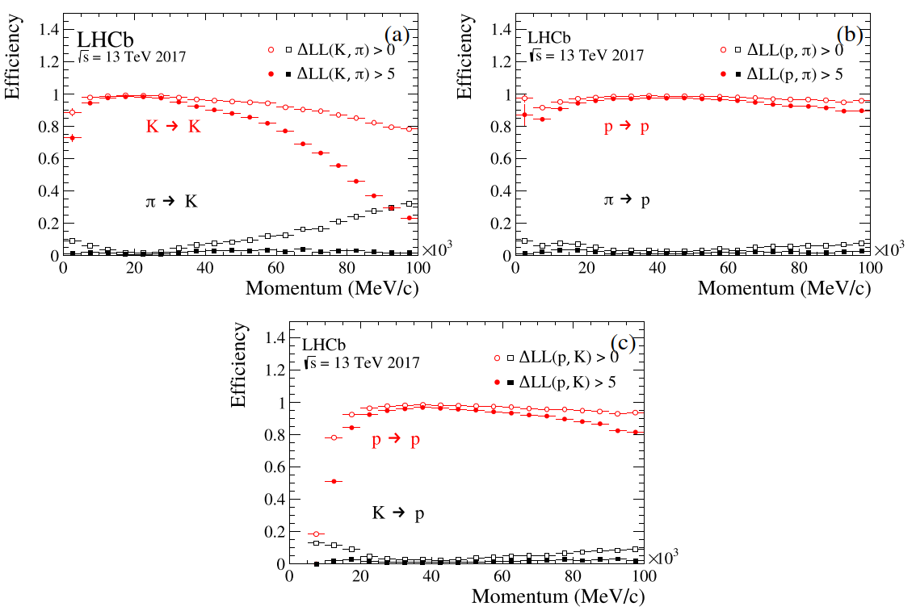
PID performance (2017)

Slide 30
PID stability

Slide 31
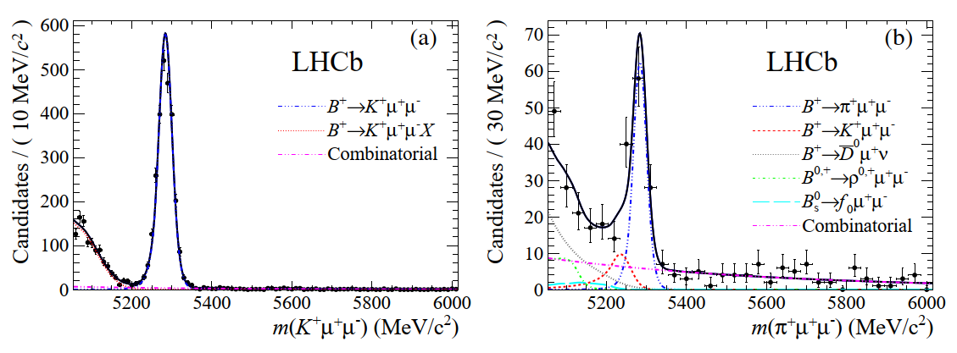
Physics impact of hadron PID
First measurement of the diﬀerential branching fraction and 𝐶𝑃 asymmetry of the
𝐵± → 𝜋± 𝜇+ 𝜇− decay, JHEP 10 (2015) 034 [arXiv:1509.00414]

Slide 32
Summary
The data from years 2016 to 2018 have been analysed leading to a better understanding of the detectors and knowledge towards future designs
The original LHCb RICH detectors have been replaced with the new upgraded versions
Brand new RICH 1, new photon detectors and new electronics everywhere
This is an opportunity to celebrate the success of the original design showing the exceptional performance and stability in a difficult hadron environment

Slide 38
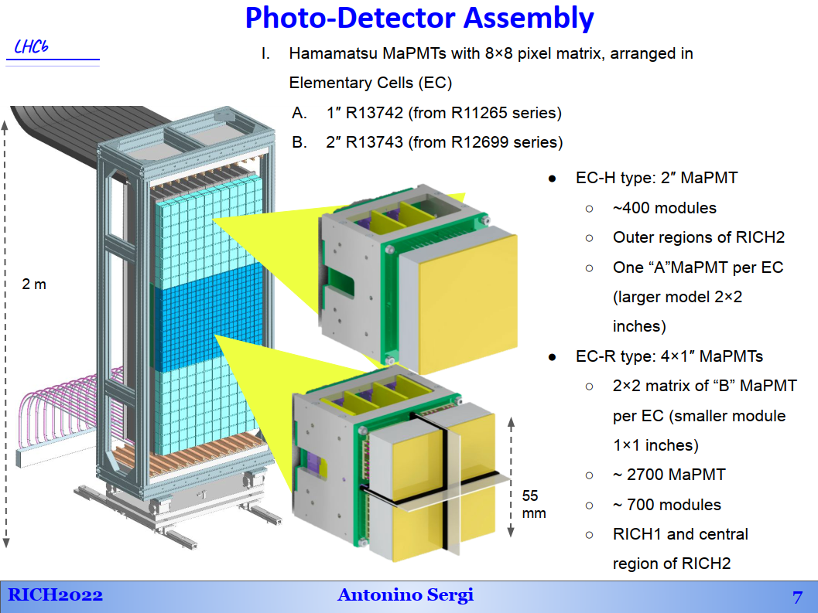

Slide 46
