Slide 1
CI-ACC-212 Beam Diagnostics #3:
Longitudinal Measurements
Thomas Pacey | CI Lecture Series
20/03/2023
Dr. Thomas Pacey| Senior Accelerator Physicist (ASTeC) STFC Daresbury Laboratory | Warrington WA4 4AD
thomas.pacey @stfc.ac.uk
Notes:
Any questions at this point?

Slide 2
Outline
Longitudinal profile measurements
Energy & Energy Spectrum measurements
Summary
Hands-on with some typical systems

Slide 3
Summary from Lecture #1
Recap
There are a lot of properties to measure!
Bunch is a 6D object, Beams are made of many different bunches
Somethings are measured - destructive or multi-shot
Others can be monitored - single-shot and/or non-invasive
There is a whole zoo of diagnostic systems and devices
Ask what a TLA is and what it does
You need a combination of systems to operate the accelerator
Even more systems needed to understand the beam!
All diagnostics have limits…

Slide 4
Summary From Lecture #2
Recap
There are many well established off the shelf systems for measuring bunch charge
Still have to be setup correctly and calibrated accurately
Imaging the beam profile is a important for doing accelerator physics
Scintillators are a powerful tool to view beam profiles
Consider the performance of the whole system for imaging
Chain of physical processes produces the profile and contribute to performance
Beam properties, crystal properties, optics properties, camera sensor properties, etc.
Emittance can be measured by imaging multiple beam(-let) profiles on a screen
Appreciate the limitations of the screen system when you measure emittance
Appreciate the whole system, make sensible choices for the beam you (expect to) have
Any questions from Lecture #2?

Slide 5
Measuring longitudinal profile
How long is the pulse? What does it look like?

Slide 6
Longitudinal Measurements
Overview
Aiming to measure either σ_{t} or complete ρ(t)
Making and measuring short pulses important for:
Wakefield accelerators
FELs
Electron diffraction (pump-probe generally)
(Another) large topic - could be multiple lectures on variety of techniques and their limitations
Focus on 3 techniques to provide an overview:
Using external field to manipulate particles: The TDC
Generating radiation from the bunch: CTR based BCM
Using beams own field to streak particles: Passive Wakefield Streaker
Detail is beyond scope of course, focus on key limitations

Slide 7
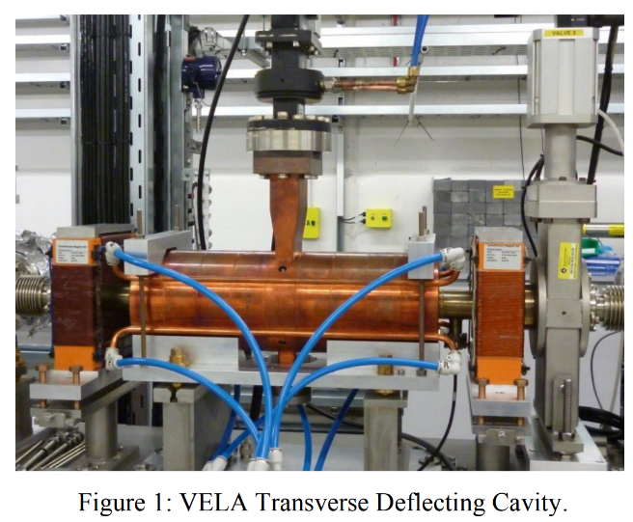
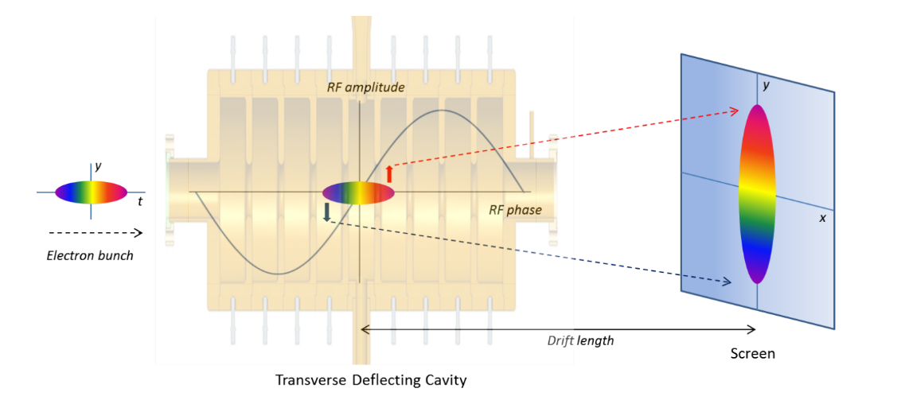
Transverse Deflecting Cavity
Overview
TDC = Transverse Deflecting Cavity
Single shot destructive measurement of longitudinal profile
RF cavity profiles a longitudinally varying streaking force to beam
Maps longitudinal profile onto spatial coordinate with appropriate beam optics
Can be used to measure longitudinal phase space and slice properties…
Wheelhouse, A. E., et al. "Commissioning of the Transverse Deflecting Cavity on VELA at Daresbury Laboratory." Proc. IPAC’15 (2015).
Image: J McKenzie Thesis

Slide 8
TDC Process Schematic
Simple case
RF System
y
z
Applying RF field to give a kick which varies in amplitude longitudinally within bunch.
Map kick onto transverse position within bunch.
Transversely image bunch, extract longitudinal information.
y
y
x
x

Slide 9
With beam divergence
With TDC off,
Beam size on screen is given by divergence and drift length
Just drift length
y
z
Drift, L
TDC On
Longitudinal slices separated on screen
Each slice has grown through divergence
y
y
x
x

Slide 10
With additional optics
With TDC off,
Beam is focussed onto screen 90°w/ phase advance
Some quads
Array of quadrupoles

Slide 11
Resolution of TDC measurements
What can you improve?
Define longitudinal shear parameter S such that
$$S=R_{3,4}\frac{2 π f e V_{0}}{c^{2} p}$$
f = frequency of TDC, V₀ = voltage ,p = momentum, $R_{3,4}$ = transfer matrix element
$R_{3,4}$ = length of drift (iff no quads)
Work through to find resolution ,r_{t} ,for initial (TDC off) beam size $σ_{y,0}$ with emittance $ε_{y}$:
$r_{t}=\frac{σ_{y,0}}{|S|}$ $∝\frac{\sqrt{ε_{y} }p}{f V_{0}}$
Want 90° betatron phase advance -> map angles to positions
Want either correctly tuned quads or suitably long drift
Adding ‘more drift’ (once 90° condition achieved) increases $σ_{y,0}$
Does not provide resolution increase
Meaningful resolution improvements: emittance, voltage
Typical fixed variables: momentum, frequency
Important note:
Imaging beam from a screen!
All resolution limits from Lecture #2 also apply!
More information and discussion in: Röhrs, Michael, et al. "Time-resolved electron beam phase space tomography at a soft x-ray free-electron laser.“ PRSTAB 12.5 (2009): 050704.

Slide 12
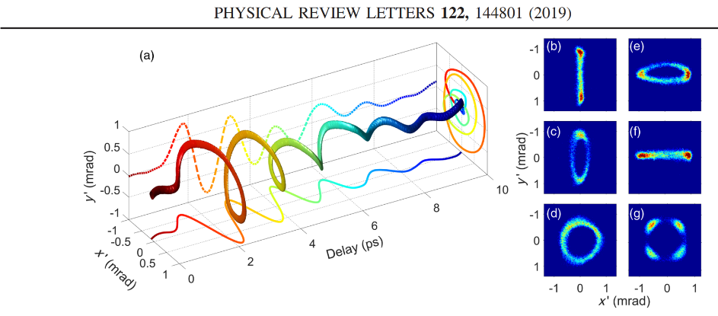
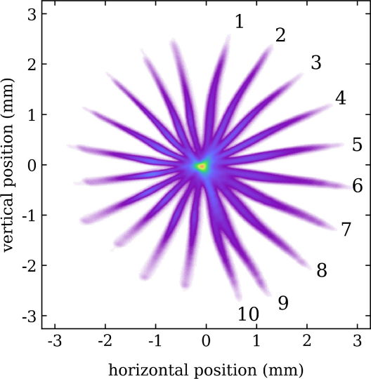
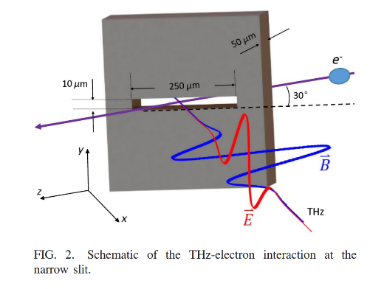
Advanced techniques
Cutting edge schemes
Zhao, Lingrong, et al. "Terahertz oscilloscope for recording time information of ultrashort electron beams." Physical review letters 122.14 (2019): 144801.
Shanghai University circularly polarised THz streaker:
Broadband bunch length and timing measurements for UED
Shanghai university THz slit system:
Ultrashort bunch length and timing measurements for UED
DESY variable polarisation X band TDC PolariX:
Produces ρ(x,y,t)
Zhao, Lingrong, et al. "Terahertz streaking of few-femtosecond relativistic electron beams." Physical Review X 8.2 (2018): 021061.
Marchetti, Barbara, et al. "Experimental demonstration of novel beam characterization using a polarizable X-band transverse deflection structure." Scientific reports 11.1 (2021): 3560.

Slide 13
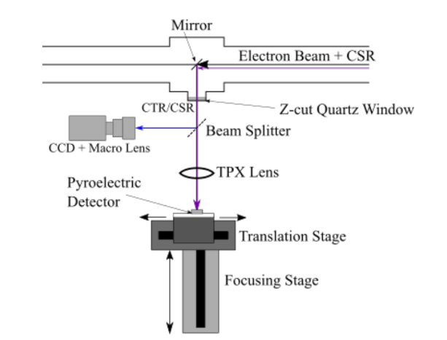
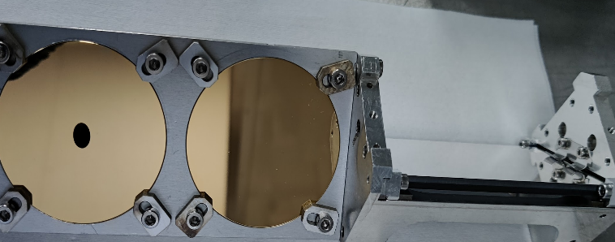
Coherent Transition Radiation BCM
Overview
BCM = Bunch Compression Monitor
Single-shot monitor for bunch length
Detects intensity of coherent radiation emitted by bunch
Shorter bunches -> higher intensity of radiation
CTR BCM = Coherent Transition Radiation BCM
Single-shot destructive monitor for bunch length
Detects coherent radiation emitted as beam goes through metal target

Slide 14
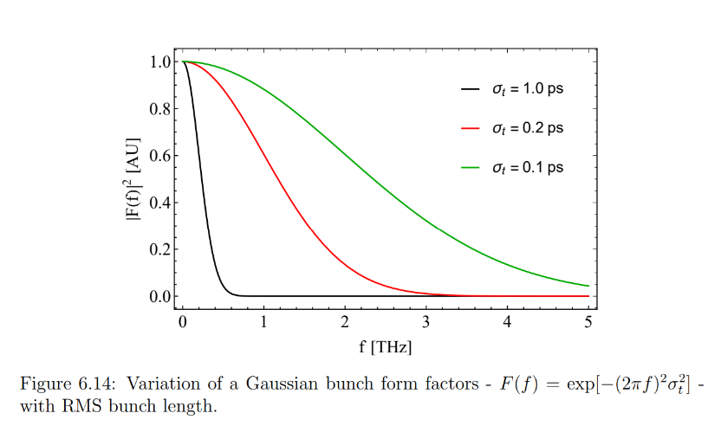
CTR Bunch length information
Subtitle
Coherent enhancement occurs when we have multiple emitters in phase
For a bunch with N particles:
Beam
Spectral intensity
Form factor:
Fourier transform of longitudinal profile
Single particle spectrum
(target properties, particle energy etc.)
Coherent enhancement with N²
Broadband TR lobes from a single electron
Bunch emits radiation with a spectrum depending on bunch profile. Transport the radiation, measure the spectrum, extract bunch profile.

Slide 15
CTR measurement schemes
Generally applicable to other ‘beam generating THz’ diagnostics
Highly compact (low footprint) longitudinal diagnostic
For picosecond and below electron beams: working in THz – far IR regime
Challenges: Optics, detectors, alignment, signal levels, vacuum windows…
Three potential options for measurement:
Capture intensity of CTR emitted -> single shot, more CTR, shorter bunches…
Pros: Straightforward, low cost, single shot
Cons: limited information, prone to errors
Use an interferometer to measure CTR spectrum
Pros: Off shelf optics, well developed in spectral range of interest, can maintain broadband response
Cons: Multi-shot limitation, time consuming, transport & alignment non-trivial
Directly measure spectrum of CTR in single shot spectrometer
Pros: High quality information, single shot
Cons: High cost, custom components needed, developing broadband difficult, fine spectral resolution difficult
Other techniques are possible, beyond scope here

Slide 16
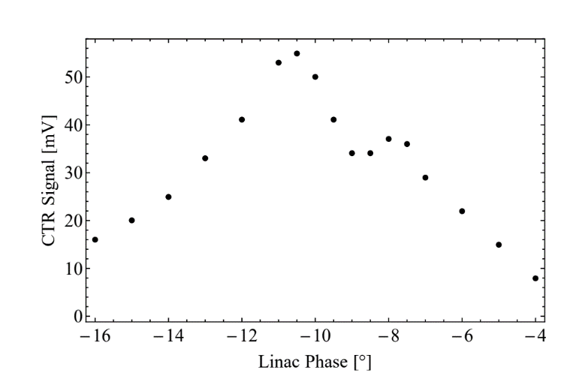
Real beams – Intensity Measurements
Limitations of simple techniques
Real beams aren’t Gaussian
Variation of Form Factor with ‘compression’ isn’t straightforward
Even in simulation can develop ‘high frequency’ features
Over-compression: Enhances high frequency features
High frequency features transported with reduced losses.
More CTR detected even though bunch is longer
Maximum compression
(Bunch length RMS & FWHM shortest)
CLARA BA1 2019

Slide 17
Passive Wakefield Streaking
Hybrid technique - beams own field kicks particles
Dielectric/corrugated structure
Beam generates a streaking wakefield.
Head of the beam kicks the tail.
Map kick onto transverse position within bunch.
Transversely image bunch, extract longitudinal information.

Slide 18
Passive Streaking
Pros and Cons
Pros
Single shot
Fully passive – no power needed
Self-Synchronised – timing jitter does not impact resolution
Generates high fields for short pulses
Cheap structures
Dielectric wakefields supported up to >MV/m level
Small total footprint, no RF, no lasers
Cons
Requires sufficient charge for a given momentum (to get kick angle high enough)
Non-linear wakefields have to be considered
Reconstruction of profile non-trivial
Requires on-shot charge measurement for accuracy
Resolution of measurement varies with bunch length
Resolution of measurement varies along bunch, poor at head
Relatively novel technique, still optimising schemes

Slide 19
Break
Questions?

Slide 20
Measuring Energy Spectrum
What is the beam energy? What is the spectrum?

Slide 21
Overview – Measuring Energy & Energy Spread
Aiming to measure <p_{z} > or complete ρ(p_{z})
Describing components needed and the beam dynamics process
Indicative/instructive example based on ‘imagined beamline’
Other experimental techniques possible
Identify error sources, add systems to correct what we can
Other equivalent lattices for measuring momentum
Procedure matters
All schematic/sketch diagrams, all first order considerations.

Slide 22
Bending with a EM dipole
Simplest case
EM Dipole: magnetic field B, powered by current I
Beam, momentum p
BPM: Measures Horizontal Positon
ρ
$$ρ≈\frac{p_{0}}{eB}$$
$Bρ \left[Tm\right]≈3.3356 p_{0}$[GeV/c]
ρ is a fixed property of lattice;
dipole bends so many degrees to get beam into centre of pipe
Zero position of BPM tells when on axis
Procedure to find p₀:
Find current I such that beam is central on BPM
Infer B from I, or have direct B measurement
Momentum is calculated directly

Slide 23
Bending with a EM dipole
Sources of errors #1
EM Dipole
Beam, momentum p
BPM: Measures Horizontal Positon
ρ
Miss-steer here
Input positon and angle wrong
Different bend angle achieved
Still set the aligned positon on BPM by increasing I
No longer know ρ
Inaccurately measure momentum!

Slide 24
Aligning into spectrometer
Fixing steering & offset errors
2 small horizontal correctors
Screen: 1
EM Dipole
SCR 2
BPM
ρ
SCR 3
Procedure:
Set dipole off
Using correctors, align beam onto SC1 and SC2
Set dipole on, repeat p₀ procedure:
Find current I such that beam is central on BPM & on SCR3 (cross check)
Infer B from I, or have direct B measurement
Momentum is calculated directly

Slide 25
Bending with EM Dipole
More important error sources
Procedure requires switching dipole ‘On’ and ‘Off’
If just controlling coil current I -> will create remnant field in poles
Setting current to 0 and beam still bends!
For a given current, no longer know the true B field
Produces inaccurate momentum measurement
Must degauss dipoles (requires polarity reverse of power supply)
Also note:
BPM & dipole power supply sets precision of measurement
BPM ‘zero position’ calibration contributes to accuracy
How well the BPM system ‘knows its centre’
Survey tolerances - mechanical accuracy of beamline – contributes to accuracy
How well the BPM centre is positioned in the beamline
How well the screen centres are aligned, SCR1 and SCR2

Slide 26
Measuring energy spectrum #1
Separating the energies
H Corrs.
SCR 1
EM Dipole
SCR 2
ρ
Understand your screen coordinates.
Lower energy particles are bent more by dipoles.
SCR 3
$$ρ≈\frac{p}{eB}$$
$Bρ \left[Tm\right]≈3.3356 p$[GeV/c]
Dipole generates dispersion, D_{x}
$${Δx= D}_{x }\frac{Δp }{p_{0}}$$
Procedure:
Setup as in momentum measurement to evaluate p₀
Measure distribution of particles on screen
Find D_{x} at screen (measured or inferred)
With a calibrated screen image map positions to momentum variation
Dx can be found through variation of <x> with B

Slide 27
Measuring energy spectrum #2
Vital transverse dynamics
Dipole off
In the absence of the dipole, the beam size changes
Can diverge or converge. Will be different in both planes
Size depends on emittance and beta function
Obvious statements -> impacts the spectrum measurement!

Slide 28
Measuring energy spectrum #2
Vital transverse dynamics
With the dipole on, particle location at screen depends on both Dispersion and Beta function
$$σ_{x}=D_{x}\frac{σ_{p}}{p_{0}}+\sqrt{ε_{x}β_{x}}$$
To get a momentum spectrum must minimise β_{x} so that dispersion dominates the image

Slide 29
Measuring energy spectrum #2
Vital transverse dynamics
Can switch off EM dipole and focus onto SCR2 as a starting point
Requires matching s position in lattice
Some (sector) dipoles will also focus
H Corrs.
SCR 1
EM Dipole
SCR 2
Quadrupoles
Q-1,2,3
ρ
SCR 3
Procedure:
Setup as in momentum measurement to evaluate p₀
Use quads Q-1,2,3 to reduce horizontal beam size on SCR3
Finding minimal beam size sets small β_{x}
Be mindful of introducing offsets, may need to iterate p₀ procedure
Maintain control of vertical beamsize
Now record measurements of momentum spectrum

Slide 30
Measuring energy spectrum #3
Dealing with large energy spread
H Corrs.
SCR 1
EM Dipole
SCR 2
Q1,2,3
ρ
SCR 3
Dipole generates dispersion, D_{x}
$${Δx= D}_{x }\frac{Δp }{p_{0}}$$
For large momentum spread, particles may not make it to screen.
Screen is at a fixed location and with a fixed size!

Slide 31
Measuring energy spectrum #3
Dealing with large energy spread
H Corrs.
SCR 1
EM Dipole
SCR 2
Q4 also changes β_{x} !!
If you touch it: repeat procedure.
If you change dipole: repeat procedure.
Be careful, keep track of procedures, iterate as needed.
Q1,2,3
Q4
ρ
SCR 3
Dipole generates dispersion, D_{x}
$${Δx= D}_{x }\frac{Δp }{p_{0}}$$
Quad Q4 modifies D_{x} at SCR3 so that
Whole spectrum $Δp$fits within screen $Δx$
Procedure:
Setup as in momentum measurement to evaluate p₀
Use quads Q4 to fit spectrum onto SCR3
Measure D_{x}
Repeat β_{x} minimisation procedure
Collect energy spectra
Dx can be found through variation of <x> with B

Slide 32
Measuring energy spectrum #3
Dealing with large energy spread
H Corrs.
Do not forget you are measuring a beam on a screen!
You are also limited by:
Scintillator properties
Imaging resolution
Camera properties
And the rest…
SCR 1
EM Dipole
SCR 2
Q4 also changes β_{x} !!
If you touch it: repeat procedure.
If you change dipole: repeat procedure.
Be careful, keep track of procedures, iterate as needed.
Q1,2,3
Q4
ρ
SCR 3
Dipole generates dispersion, D_{x}
$${Δx= D}_{x }\frac{Δp }{p_{0}}$$
Quad Q4 modifies D_{x} at SCR3 so that
Whole spectrum $Δp$fits within screen $Δx$
Procedure:
Setup as in momentum measurement to evaluate p₀
Use quads Q4 to fit spectrum onto SCR3
Measure D_{x}
Repeat β_{x} minimisation procedure
Collect energy spectra
Dx can be found through variation of <x> with B

Slide 33
Summary
Take homes
Longitudinal profiles can be measured by
Kicking the particles with a TDC
Measuring spectrum of coherent radiation produced from the beam
Generating a wakefield to passively streak the beam
Resolution of each method is affected by different bunch and diagnostic parameters
Appropriate technique for each machine is a function of:
Control/flexibility of beam parameters, available space in lattice, money, and expertise
Measuring momentum of particles requires several diagnostics to produce accurate results
Measuring energy spectrum of particles requires a detailed procedure for precise and accurate results

Slide 34
Resources
References & links for images and further reading
DESY TDC measurements, longitudinal & LPS
https://journals.aps.org/prab/pdf/10.1103/PhysRevSTAB.12.050704
Theory of TR and CTR
https://journals.aps.org/prab/abstract/10.1103/PhysRevSTAB.11.012801
Variable Polarisation TDC
https://www.nature.com/articles/s41598-021-82687-2#article-info
CLARA Front End Review (BCM measurements)
https://journals.aps.org/prab/pdf/10.1103/PhysRevAccelBeams.23.044801
J McKenzie thesis - VELA TDC measurements:
https://livrepository.liverpool.ac.uk/3031981/
VELA TDC Commissioning – IPAC15
https://accelconf.web.cern.ch/ipac2015/papers/wepha054.pdf
THz Slit streaker
https://journals.aps.org/prx/pdf/10.1103/PhysRevX.8.021061
THz oscilloscope
https://journals.aps.org/prl/abstract/10.1103/PhysRevLett.122.144801

