Slide 1

CI-ACC-212
Beam Diagnostics #2:
Measuring charge and transverse properties
Thomas Pacey | CI Lecture Series
13/03/2023
Dr. Thomas Pacey| Senior Accelerator Physicist (ASTeC)
STFC Daresbury Laboratory | Warrington WA4 4AD
thomas.pacey @stfc.ac.uk
Notes:
Any questions at this point?

Slide 2
Outline
Measuring bunch charge
Transverse profile measurements and limitations
Emittance measurement techniques
Summary

Slide 3
Summary from Lecture #1
Some take homes
There are a lot of properties to measure!
Bunch is a 6D object, Beams are made of many different bunches
Somethings are measured - destructive or multi-shot
Others can be monitored - single-shot and/or non-invasive
There is a whole zoo of diagnostic systems and devices
Ask what a TLA is and what it does
You need a combination of systems to operate the accelerator
Even more systems needed to understand the beam!
All diagnostics have limits…
Any questions from Lecture #1?

Slide 4
Measuring bunch charge
How much beam have I got?

Slide 5
Measuring charge
Counting up all the particles
Measuring bunch charge/beam current is important.
Having a precise and accurate understanding of shot-by-shot charge variation is vital for example:
Beam dynamics (can be) charge sensitive – e.g. collective effects impact beam jitter
Some experiments are charge sensitive (signals go with Q² ) – e.g. development of novel diagnostics
Dosimetery experiments for (medical) research – absolute charge measurement is vital for meaningful science
The precision and accuracy of a charge measurement system is a function of
Physical device/pick-up
Read-out front end electronics
Digitising back end (feeds into control system)

Slide 6
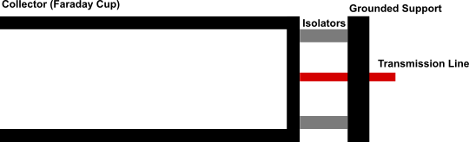
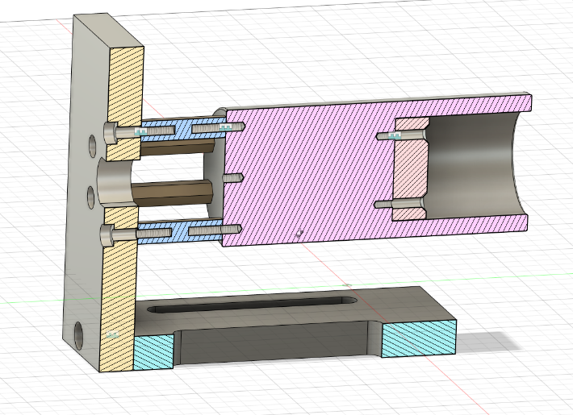
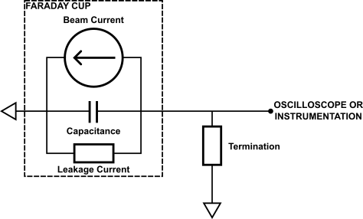
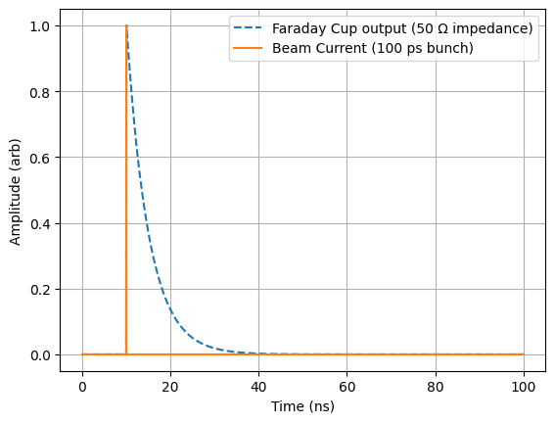
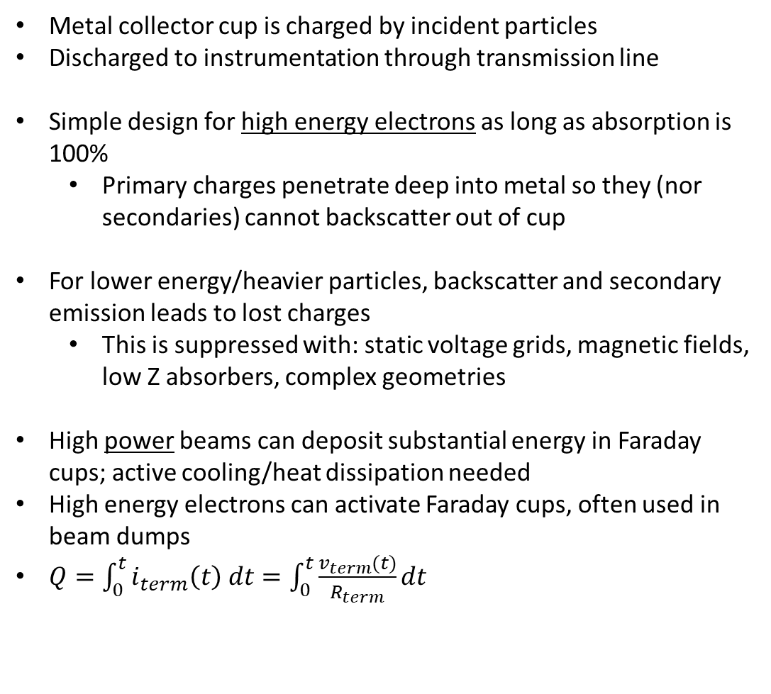
Faraday Cups
Courtesy of Storm Mathisen, ASTeC ADI
Beam in
Metal collector cup is charged by incident particles
Discharged to instrumentation through transmission line
Simple design for high energy electrons as long as absorption is 100%
  Primary charges penetrate deep into metal so they (nor secondaries) cannot backscatter out of cup
For lower energy/heavier particles, backscatter and secondary emission leads to lost charges
  This is suppressed with: static voltage grids, magnetic fields, low Z absorbers, complex geometries
High power beams can deposit substantial energy in Faraday cups; active cooling/heat dissipation needed
High energy electrons can activate Faraday cups, often used in beam dumps
$Q=\int_{0}^{t}{i_{term}\left(t\right) dt}=\int_{0}^{t}{\frac{v_{term}(t)}{R_{term}}dt}$

Slide 7
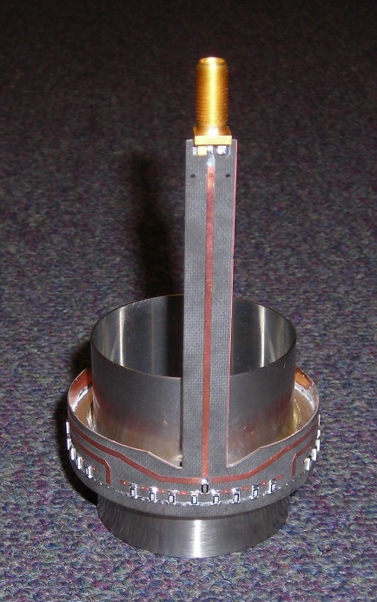
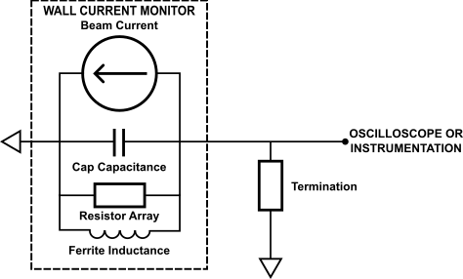
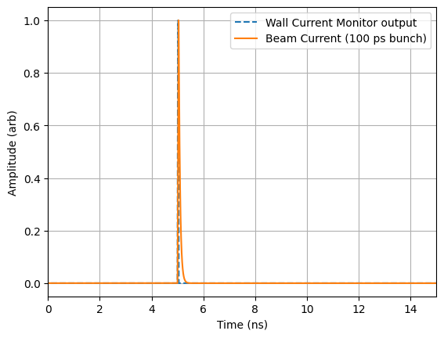
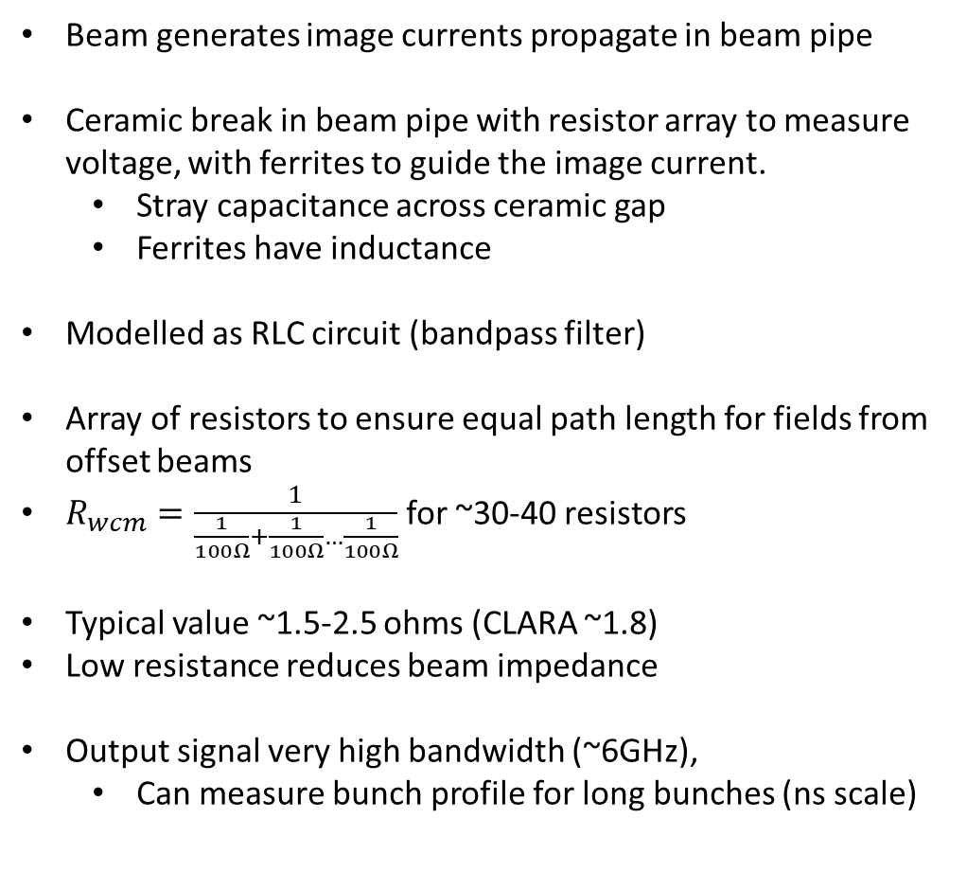
Wall Current Monitor
Courtesy of Storm Mathisen, ASTeC ADI
Beam generates image currents propagate in beam pipe
Ceramic break in beam pipe with resistor array to measure voltage, with ferrites to guide the image current.
  Stray capacitance across ceramic gap
  Ferrites have inductance
Modelled as RLC circuit (bandpass filter)
Array of resistors to ensure equal path length for fields from offset beams
$R_{wcm}=\frac{1}{\frac{1}{100Ω}+\frac{1}{100Ω}…\frac{1}{100Ω}}$ for ~30-40 resistors
Typical value ~1.5-2.5 ohms (CLARA ~1.8)
Low resistance reduces beam impedance
Output signal very high bandwidth (~6GHz),
  Can measure bunch profile for long bunches (ns scale)
Beam current (100 ps bunch)
Wall Current Monitor output

Slide 8
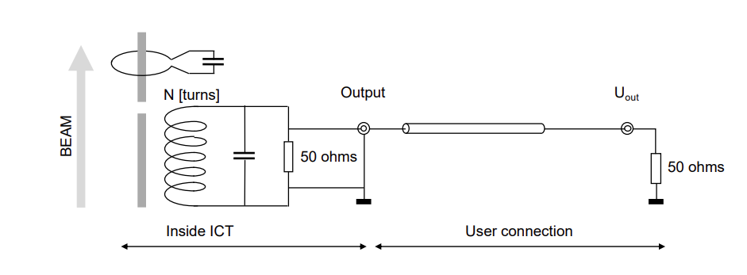
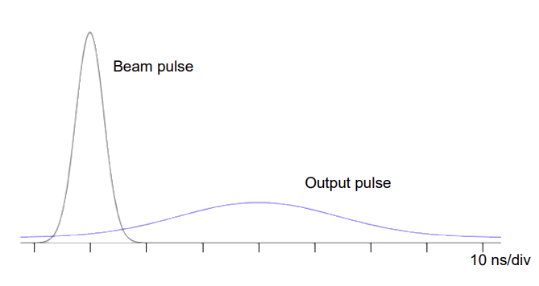
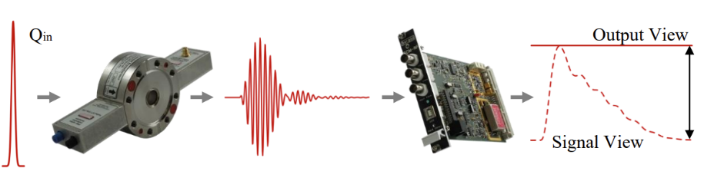
Integrating Current Transformer
Courtesy of Storm Mathisen, ASTeC ADI
Passive current transformer, coils in ceramic coupled to beam fields.
Integrates very fast pulses,
  Output bandwidth independent of bunch length.
Turbo-ICT applies narrowband processing to an ICT, with front-end amplification, to improve sensitivity and dynamic range
  Capable of 10 fC - > 300 pC
Pictures from Bergoz manuals:
https://www.bergoz.com/wp-content/uploads/ICT-manual-4-2.pdf
https://www.bergoz.com/wp-content/uploads/Turbo-ICT-manual-3-1-1.pdf

Slide 9
Transverse profile measurements
What does the beam look like? How is the shape changing?

Slide 10
Transverse profile measurements
What does a beam look like?
Many techniques for measuring or monitoring transverse profile: defined as ρ(x,y)
Following focuses on imaging the radiation released from bunch at a screen
Common operational process provides precise and (typically) accurate ρ(x,y)
In medium energy linac test facilities (CLARA) screens are the work horse for beam physics!
Screens also provide measurement of:
  Beam optics (Twiss values; beam waist size and location)
  Emittance
  Bunch length (with a TDC)
  Energy spectra (with a dipole + optics)
  Longitudinal Phase Space (with a TDC + dipole)
2 common processes:
  Optical Transition Radiation (OTR)
  Scintillation (YAG, GAGG,LYSO etc.)

Slide 11
Imaging Radiation from a Screen
System Analysis
Physical processes converts beam field into light – scintillation, transition
  Process can depend on beam energy as well as transverse size
  Can be a combination of processes,
  Can be broadband or narrowband light
Transport of light to window
  Including observation angles, reflection from other optics, apertures
Transmission of light through vacuum window
  Is an aperture, can be an absorber
Imaging optics (chromaticity) and associated PSF of imaging system
Sensor pixel pitch, array size, quantum efficiency (wavelength dependent), dark noise
Readout electronics speed, global vs rolling shutters, shutter stability
Bit depth and dynamic range
Beam
Light
Window
Turning electrons into photons, transporting those photons, then turning them back into electrons, then counting those electrons
Optics
Sensor
Camera

Slide 12
Optical Transition Radiation
Physical process
Forward TR
Relativistic charged particle transitions between 2 different electro-magnetic media (e.g. vacuum – metal or metal-vacuum)
Fields ‘attached’ to particle must transition from one steady state to another
Releases pulse of broadband transition radiation
  This is not Cherenkov Radiation
Can have components THz – IR – Optical – UV
  Cut offs at high/low frequency depend on target/pipe geometries and (non vacuum) medium properties
Field can be coherently enhanced by transverse or longitudinal bunch properties
  Coupling of longitudinal – transverse not good for measuring transverse profile!
Energy lost by beam is minimal
Beam
Backward TR
Opening angles of TR goes ~ 1/γ
TR is radially polarised
Far field (angular) distribution has characteristic ‘donut’ shape

Slide 13
Optical Transition Radiation
Pros, Cons, and Uses
Pros
Linear with charge, no saturation of emission process
High spatial resolution achieved straightforwardly:
  Needs a mirror-like target and suitable imaging
Can be used to measure beam profile & divergence
  Imaging near-field or far-field respectively
Very fast process that can produce timing signals
Target can be very thin (foil); for high energy beams target is minimally invasive
Cons
No light multiplication process, can be limited by SNR
  Might require be multi-shot integration
Broadband emission, best resolutions found by bandpass filtering, reduces intensity further
If coherent emission happens at optical wavelength (COTR) any useful transverse signal is lost
Sufficient average power or instantaneous intensity beam/bunch will destroy target…
OTR is useful for measuring small beam sizes (<20um) of relativistic high intensity bunches.
Under right conditions will provide most accurate beam size measurements.
Encoding of beam divergence gives access to emittance information.

Slide 14
Scintillators for beam imaging
A simple model
Many forms of scintillator (solid, liquid, gas) and material types (inorganic crystals, plastics, powders)
Focus on the inorganic crystals used in electron machines
Scintillators also used in particle and nuclear physics – calorimetry, photon energy (gamma ray) measurements
  Application is different, some of features that matter are different
Physical process:
  Charged particle (e-, p+, ion) deposits energy to atom in crystal lattice
    Assume enough momentum so beam particle then continues though material
  Promotes atomic electron to very high energy state (hot electron) and a creates a resulting hole
  Hot electrons scatter, cascading to create further ‘hot electrons’ (lower energies) – multiplying the potential emitters
  Eventually excited electrons either:
    Captured by a crystal lattice hole and emits photon
      Photon can be reabsorbed by crystal lattice
    Captured by dopant atom, relaxes and emits photon
      Photon emitted will leave material – light is observed!
Charged particle
Scintillator material
Column of light produced by scintillation
How scintillator screens affect beam measurement depends on:
Input beam properties
  (momentum, charge density)
How these properties interact with of the crystal lattice:
  its energy states, dopant atoms and mobility of hot electrons
Imaging of the resulting scintillation column

Slide 15
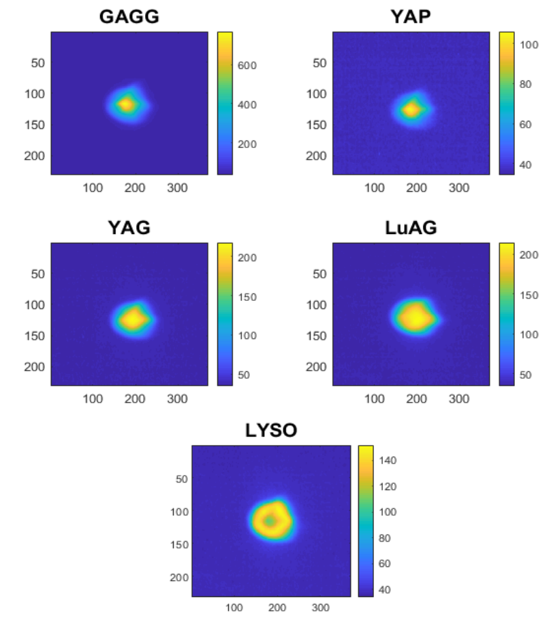
Issues with scintillators: Saturating & quenching
Material considerations: ‘Solid state’ physics
Width of the scintillating column is a property of the material
  How far hot electrons travel before they are captured by dopants
If have enough incoming charges we can liberate enough hot electrons to saturate all the emitting dopants
  Increasing charge density does not produce more light!
  Once material saturates, nothing you can do
There are additional processes by which the captured electrons and dopants can be recombined without emission.
  If enough overlapping scintillating columns then the process quenches and light output is reduced
    Produces a characteristic smoke-ring effect, seen at EuXFEL 2018/19 with LYSO screens
Performing well
Saturating
Quenching
Images from Pitz, 22 MeV, 6nC bunches, ~ 100 RMS size – IBIC ‘22 SCINTILLATOR NON-PROPORTIONALITY STUDIES AT PITZ doi:10.18429/JACoW-IBIC2022-TUP21

Slide 16
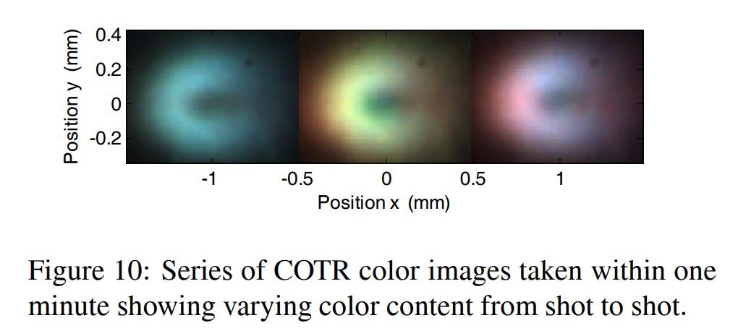
Issues with scintillators: COTR
Beam collective effects spoiling the image
Scintillator light can be >100x brighter than OTR from a mirror
However transition radiation will be released at vacuum-scintillator boundary
If the bunch is very short and/or has micro-bunching instabilities (e.g from CSR)
longitudinal profile can have ‘features’ at optical wavelength
Then COTR will be released with narrow opening angle at the vacuum boundaries
Effectively a donut shaped laser pulse fires from screen into imaging optics – forward and backward.
Observed at SLAC LCLS in 2008/9
OTR images cannot be saved. Scintillator images can be saved with appropriate geometry so that COTR pulse misses optics.
Image from:
Loos, H., et al. "Observation of coherent optical transition radiation in the LCLS linac." Proceedings of the 2008 Free-Electron Laser Conference (Gyeongju, Korea). 2008.

Slide 17
Imaging geometries
Potential COTR lobes
A few standard methods
3. Observing obliquely and with Scheimpflug imaging
2. Crystal normal & 45° mirror
1. Crystal @ 45°
Mirror
Beam
Beam
Beam
Very simple to implement
Poor optical resolution (depth of field)
Resolution limited by scintillator thickness
COTR can spoil image
High resolution
Compact design in vacuum, compact imaging
Mirror subject to radiation damage over time
COTR + upstream sources can spoil image
COTR not transported to optics
With correct angles (respecting refraction) will provide high resolution
Less trivial imaging
Non-compact design
More detail can be found in: Ischebeck, Rasmus, et al. "Transverse profile imager for ultrabright electron beams." PRSTAB 18.8 (2015): 082802.

Slide 18
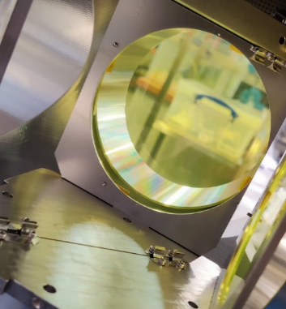


Issues with scintillators: Resolution & Imaging
Geometric considerations – ‘optical’ physics & mechanics
Out of focus
Thickness of scintillator impacts resolution
Reasonable thinnest free standing crystal can be 200um thick
  Remember a human being needs to handle it and assemble it!
  Largest we buy is 100mm dia.
Thinner scintillators can be made on a substrate, down to 5um thick
  Substrate intercepting the beam can charge up…
Imperfections (or dust) on surface will harm measurements
In focus
Beam
Out of Focus
Balancing Field of View , Magnification and Depth of Field can be a challenge
Common problem in close up photography…
Scheimpflug imaging is the solution for angled subjects – Google to learn more!

Slide 19
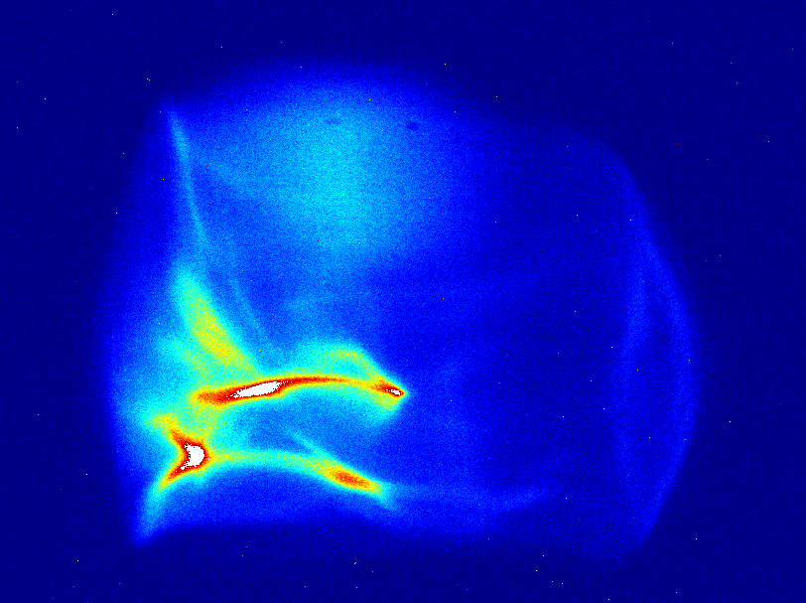
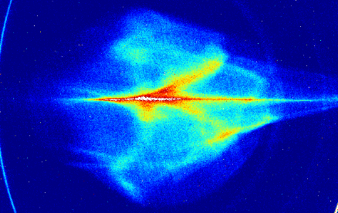
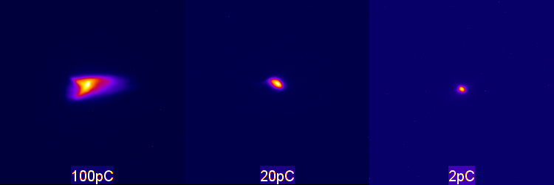
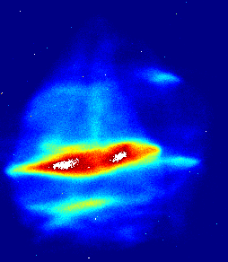
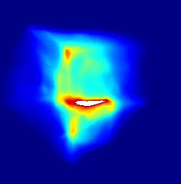
Real beam images
Holiday snaps from CLARA BA1
1.5mm
σ_{x} = 90 um
σ_{x} = 35 um
σ_{x} = 20 um
Images can reveal lots of interesting features…
Work of diagnostics research and engineering is to make sure it’s a feature of beam and not feature of the diagnostic
Only x-y projection of 6D charge density.
One piece of a puzzle
Takes a lot more work to produce useful physics from ‘feature full’ beam images

Slide 20
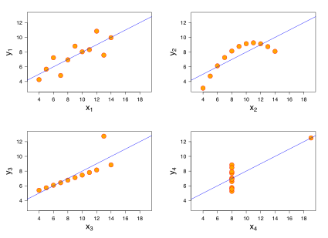
A warning: Statistical parameters & Data analysis
The RMS beam size is…
Accelerator physics often use 2nd moment of distribution – see Gaussian beams & Twiss parameters ☺
Anscombe’s quartet must be remembered:
4 (x,y) distributions with values:
  <x> = 9
  <y> = 7.5
  σ_{y} ² = 4.125
  σ_{x} ² = 11
  Linear regression (fit): y = 0.5x + 3
Warning applies when:
  Using a beam image to make a beam size measurement
  Using a set of beam sizes to calculate another parameter (e.g. emittance!)
  Whenever you use scripts to analyse large volumes of data
Anscombe, Francis J. "Graphs in statistical analysis." The american statistician 27.1 (1973): 17-21.
Image: https://en.wikipedia.org/wiki/Anscombe%27s_quartet
Beams can be messy.
Sense checks matter.

Slide 21
Break
Questions?

Slide 22
Measuring emittance
What is the transverse beam quality?

Slide 23
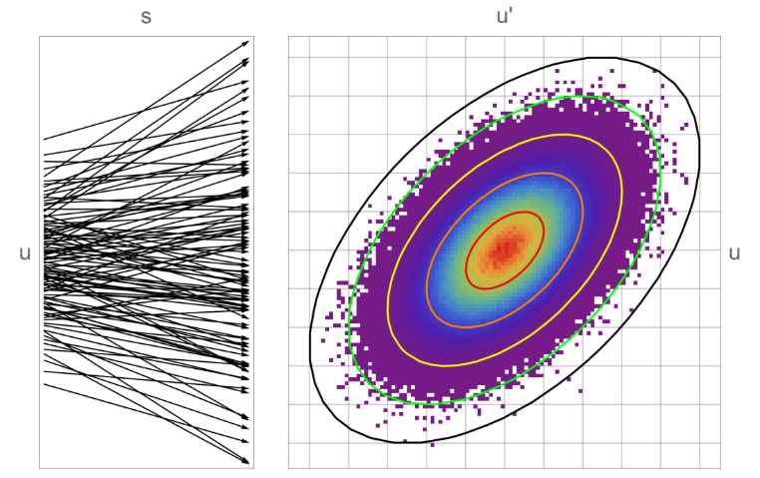
Emittance as a statistical value
Remembering Anscombe’s Quartet
2 common equivalent definitions of ‘emittance’:
  Area (of an ellipse) in transverse phase space the beam occupies
  Measure of the non-laminarity of the particle propagation within the beam
Many flavours of emittance
  RMS, 90% ,Full distribution
Understanding emittance can be complex
Measuring emittance could be several lectures!
Non-laminarity of particle trajectories with s
Area(s) of an ellipse in u-u’ space
Image: J K Jones Thesis: DESIGN OF A NOVEL STACKED STORAGE RING FOR LOW EMITTANCE LIGHT SOURCES, UoM 2015
Often measure and use RMS emittance
Derived from measuring RMS beam sizes
Many potential diagnostic issues!

Slide 24
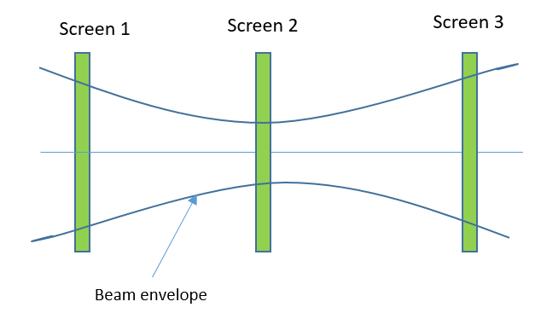
Multiscreen methods
3-Screen method
The variation of beam size across (at least) 3 screens of known separation can be used to calculate the emittance.
Typically need some optics (quads) to have enough beam size variation (phase advance) between the screens
For an ideal Gaussian beam 3 screens is enough and emittance can be calculated directly from beam sizes.
With additional ‘beam features’ 4-5 screens and a fit will provide a more reasonable estimate of emittance
Considerable space and equipment required for multiple screens across a drift
More info can be found in SY Lee Accelerator Physics, 3rd pg 58

Slide 25
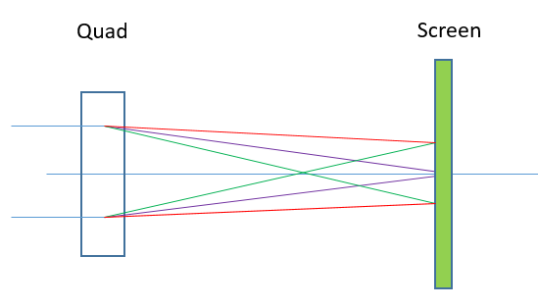
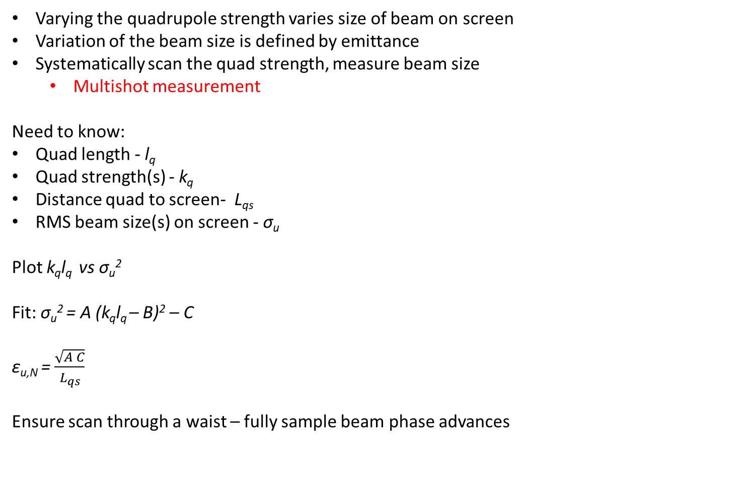
Quadrupole scans
Simple version
Varying the quadrupole strength varies size of beam on screen
Variation of the beam size is defined by emittance
Systematically scan the quad strength, measure beam size
  Multishot measurement
Need to know:
Quad length - l_{q}
Quad strength(s) - k_{q}
Distance quad to screen- L_{qs}
RMS beam size(s) on screen - σ_{u}
Plot k_{q}l_{q} vs σ_{u}²
Fit: σ_{u}² = A (k_{q}l_{q} – B)² – C
ε_{u,N} = $\frac{\sqrt{A C}}{L_{qs}}$
Ensure scan through a waist – fully sample beam phase advances
Schematic:
Initial beam
Increased focussing
Over focusing

Slide 26
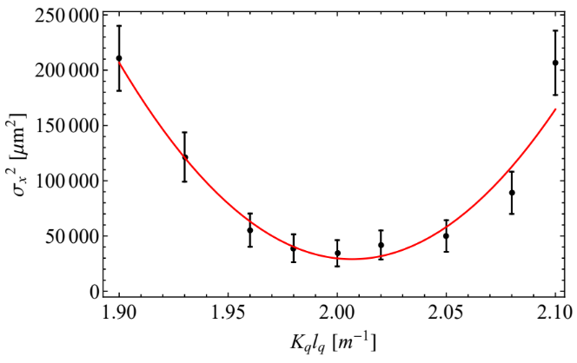
Limitations of quadrupole scans
Sometimes too good to be true
Watch out for:
1. Focussed beam size (e.g. x) becoming too small to accurately measure
2. Defocussed beam size ( e.g. y) becoming so large it is lost from screen edges
3. Not having the available quad strength to find a waist at the screen
Means carefully setting upstream quads (non-scanned) to ensure 1 & 2 hold for entire range of scanned values
Assumes the measurement process doesn’t change emittance
Tightly focusing a beam and transporting over a drift can cause space charge to increase the emittance
Problem for high charge densities or low energies, and/or long drift lengths
Real example of a poor quad scan measurement
(Pacey, BA1 2018)
Did all beam optics and data analysis correctly…
Did not have the imaging resolution on the scintillator!

Slide 27
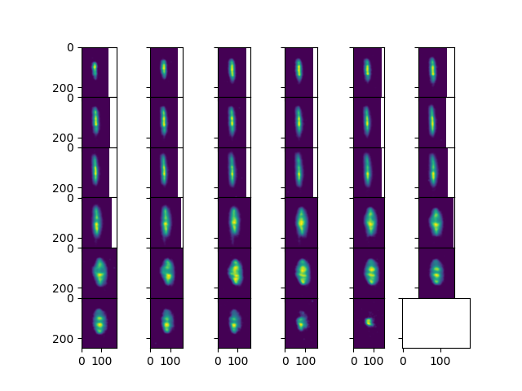
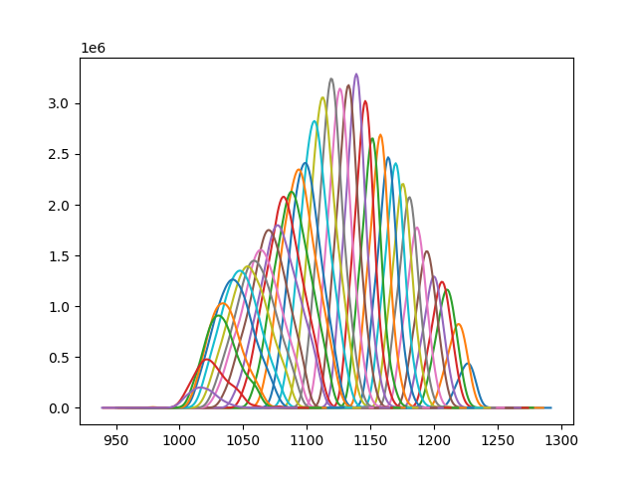
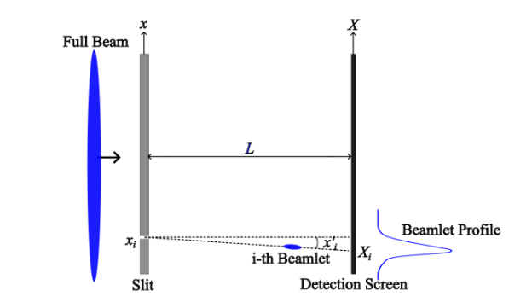
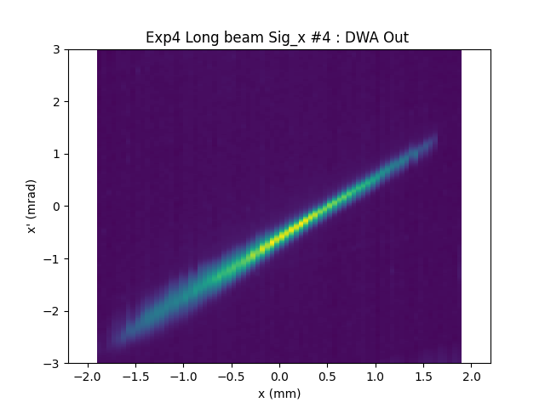
Pacey, BA1 (2021)
Slit scans
Simple masking method
Move a metallic slit across beam, forming a series of beamlets
  Multishot measurment
Drift beamlet to screen and measure their size, location, and intensity
Creating discrete samples of x and then measuring x’ profile
Series of formula to return RMS emittance (see last slide)
  Or can reconstruct full phase space
Need to have beam size at slit >> slit width and understand if beam is diverging/converging
Repeatable slit motion at <1um level is possible
Capture images
Plot profiles
Produce phase space
Image Courtesy T. Overton Thesis

Slide 28
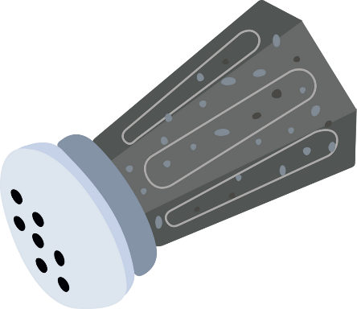

Combs and Pepperpots
More complex masking
Instead of moving a slit to generate samples, have a static mask with many slits or holes
Comb – array of slits – single shot monitor for 1D
Pepperpot – array of holes – multishot monitor for 2D
Must avoid overlap of beamlets after slit
No variability in sampling -> need either several masks with different size holes or ability to tune beam optics
Fast, single shot emittance monitoring is powerful tool for machine optimisation
d
d
Machine learning optimisation requires good diagnostics.
This result uses slit comb!
Roussel, Ryan, et al. "Turn-key constrained parameter space exploration for particle accelerators using Bayesian active learning." Nature communications 12.1 (2021): 5612.

Slide 29
Limitations of masking methods
More things to watch out for
Mask must be thick enough to scatter beam. Strong scaling with energy.
  2mm Tungsten -> 1 GeV electrons scatter 17mrad ☺
  5 Gev <1 mrad ☹
Slit size must be smaller than beam
  Easy to set with a movable slit + feeler gauge, hard to machine smaller holes a (thick) pepperpot
Need sufficient samples across beam size
  Easy to tune slit scan with a stage, slits/combs are fixed
Need sufficient drift lengths for beam divergence to dominate beamlet size
Beamlet size and location needs to be resolvable by imaging system
  Low geometric emittance beams have small beamlets
Intensity of beamlets will be low at beam edges
  Need high dynamic range on camera and good SNR
Difficult to perform masking for low absolute charges
  Can combine with high-resolution Fcups to get accuracy and precision…
Jackson, Classical Electrodynamics,1975
Detail on designing pepperpot here:
Apsimon, Oznur, Barney Williamson, and Guoxing Xia. "A numerical approach to designing a versatile pepper-pot mask for emittance measurement." NIMA (2019): 162485.

Slide 30

Summary
Take homes
There are many well established off the shelf systems for measuring bunch charge
  Still have to be setup correctly and calibrated accurately
Imaging the beam profile is a important for doing accelerator physics
  Scintillators are a powerful tool to view beam profiles
Consider the performance of the whole system for imaging
Chain of physical processes produces the profile and contribute to performance
  Beam properties, crystal properties, optics properties, camera sensor properties, etc.
Emittance can be measured by imaging multiple beam(-let) profiles on a screen
  Appreciate the limitations of the screen system when you measure emittance
Appreicate the whole system, make sensible choices for the beam you (expect to) have

Slide 31
Resources
References & links for images and further reading
Ischebeck, Rasmus, et al. "Transverse profile imager for ultrabright electron beams." Physical Review Special Topics-Accelerators and Beams 18.8 (2015): 082802.
  https://journals.aps.org/prab/pdf/10.1103/PhysRevSTAB.18.082802
Crytur webpage for scintillation crystals
  https://www.crytur.cz/products/scintillation-screens/
Wikipedia: Scheimpflug principle
  https://en.wikipedia.org/wiki/Scheimpflug_principle
Loos, H., et al. "Observation of coherent optical transition radiation in the LCLS linac." Proceedings of the 2008 Free-Electron Laser Conference (Gyeongju, Korea). 2008.
  https://accelconf.web.cern.ch/fel2008/papers/thbau01.pdf
IBIC22 – Scintillator Non-proportionality Studies
  https://ibic2022.vrws.de/papers/tup21.pdf
Indentification of ‘Smoke-ring’ effects in LYSO screens at EU XFEL
  https://accelconf.web.cern.ch/fel2019/papers/web01.pdf
Berghoz ICT Manuals:
  https://www.bergoz.com/wp-content/uploads/ICT-manual-4-2.pdf
  https://www.bergoz.com/wp-content/uploads/Turbo-ICT-manual-3-1-1.pdf
‘Smoke rings’ in scintillators @ EuXFEL
  https://accelconf.web.cern.ch/fel2019/papers/web01.pdf
Wikipedia Anscombes Quartet:
  https://en.wikipedia.org/wiki/Anscombe%27s_quartet
  Anscombe, Francis J. "Graphs in statistical analysis." The american statistician 27.1 (1973): 17-21.
Using a slit comb and Ml to optimise machine
  Roussel, Ryan, et al. "Turn-key constrained parameter space exploration for particle accelerators using Bayesian active learning." Nature communications 12.1 (2021): 5612.
  https://www.nature.com/articles/s41467-021-25757-3
Detailed discussion of slit comb technique
  https://accelconf.web.cern.ch/PAC2013/papers/thpac13.pdf
Best recipe for slit scan emittance calculation
  Emittance Formula for Slits and Pepperpot measurement, M Zhang, FNAL
  https://inis.iaea.org/collection/NCLCollectionStore/_Public/28/018/28018451.pdf?r=1&r=1
  O Mete-Apsimon: A Numerical Approach to Designing a Versatile Pepper-pot Mask for Emittance Measurement
  https://arxiv.org/abs/1907.13515

