Slide 1
CI-ACC-212 Beam Diagnostics #1:
Introduction to measuring beams
Thomas Pacey | CI Lecture Series
06/03/2023
Dr. Thomas Pacey| Senior Accelerator Physicist (ASTeC) STFC Daresbury Laboratory | Warrington WA4 4AD
thomas.pacey @stfc.ac.uk

Slide 2
Introductions & Course Structure

Slide 3
Housekeeping & Zoom
I will do my best to lecture hybrid, expect some teething problems
Please use raise hand and/or chat function to get my attention on zoom!
(Shout if I miss you out)
Find me in person or by email for questions after ☺
3 lectures, Monday 6th , 13th , 20th March ‘23, 2pm.
Slides on Indico.
Aiming 50mins/lecture. Short break at 25min mark.
There are no assessments/homeworks/exercises for this course ☺
Please ask questions, there are no silly questions!

Slide 4
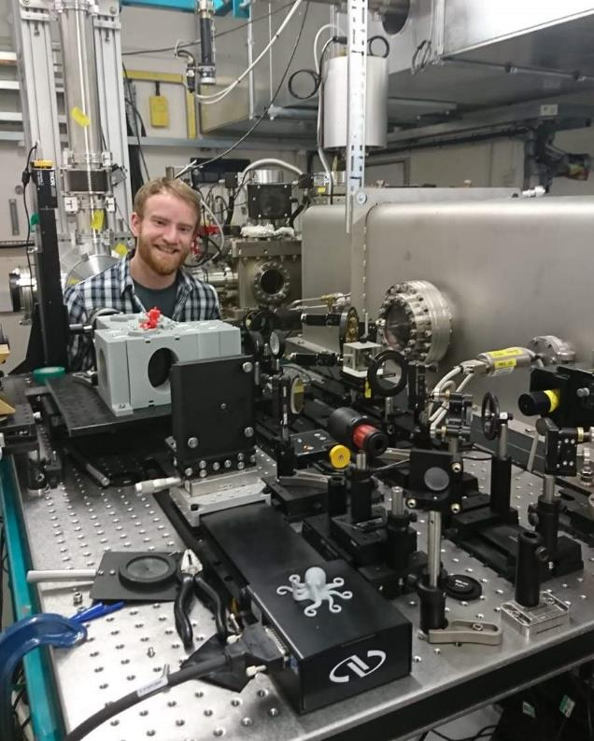
Who Am I?
CLARA BA1
Me
Background
2015 – Completed MPhys, University Manchester
Started at CI, PhD on ‘Novel Acceleration’ (DWA)
2019 – Finished my PhD in Accelerator Physics
Supervised by Yuri Saveliev (ADI group leader)
Performed 2 experiments at CLARA in 2018
Generating THz, measuring beam energy modulation
Jan 2019 – Joined STFC in ASTeC’s ADI group
I work on CLARA, BA1, FEBE instrumentation
Making novel transverse and longitudinal measurements
Supporting user experiments 2019-2023
Novel acceleration experiments require novel diagnostics!
Martin-Puplett
Interferometer
Measures <1ps bunch lengths using THz radiation…

Slide 5
Who are you?
What projects are being done?
Who is working on…
Beam dynamics?
Storage rings?
FELs?
Ion beams?
Novel acceleration?
Vacuum systems?
RF systems?
Magnet systems?
Diagnostics?
Anything else?

Slide 6
Course Structure
Aim to give an overview of the complex topic of beam diagnostics and instrumentation
Focus on linear, relativistic, electron beam machines
(based off my experience on CLARA)
Focus on practical aspects of making measurements
First run of this version, feedback welcomed!
Future versions may include ion beams and storage rings…
Lecture #1 : Introduction to measuring beams
What am I trying to measure? How can I measure it?
Lecture #2 : Measuring bunch charge and transverse properties
How much beam do I have? Where is it going? How is the shape changing?
Lecture #3 : Longitudinal beam measurements
What is the beam energy? How short is the pulse?
Notes:
Future examples – instrumenting a beam line?

Slide 7
CI-ACC-212 Beam Diagnostics #1:
Introduction to measuring beams
Thomas Pacey | CI Lecture Series
06/03/2023
Dr. Thomas Pacey| Senior Accelerator Physicist (ASTeC) STFC Daresbury Laboratory | Warrington WA4 4AD
thomas.pacey @stfc.ac.uk
Notes:
Any questions at this point?

Slide 8
Outline
Properties of beams we want to measure
Destructive vs Non-invasive and Measuring vs monitoring
Common diagnostic systems and their acronyms
Summary

Slide 9
Properties of beams we want to measure
This may seem abstract, but we will refer back in later lectures

Slide 10
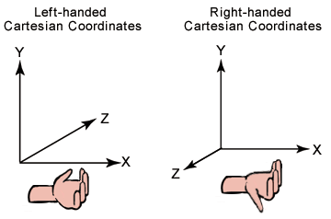
A beam & A coordinate system
Our ‘operational’ or ‘natural’ coordinate system
Fun fact
This means formally our natural operational coordinate system is left handed
z
y
x
Beam into page
Not very important
Unless comparing some simulations with measurements
Or drawing a diagram
Always know how you expect diagnostics to perform.
Which way have I bent the beam? Where should it go on a screen?

Slide 11
Particle properties
Particle
6D Object
Our ‘particle’ has a charge q & 6 degrees of freedom
Horizontal position - x
Horizontal divergence - x’ (/momentum - p_{x})
Vertical position - y
Vertical divergence – y’ (/momentum - p_{y})
Longitudinal momentum - p_{z} ( / energy E)
Longitudinal position - z (/ timing t)
Approx. for divergences:
Relativistic approx. for timings vs z
$$z= βct$$
$$β≈1$$
$$z= ct$$
$$p_{z}≫p_{y}$$
$$y^{′}= \frac{p_{y}}{p_{z}}$$
y
y’
Useful for comparing particles within a ‘bunch’
Often see liberal switching between bunch lengths in z or t
When working with simulations
Be wary of switching and keep track of head and tail of bunch
z

Slide 12
Bunch properties
Bunch is a population of particles
Our bunch has a 6D phase space made up of N particles.
There are many interesting projections and correlations
These are common properties we want to measure
Horizontal position - <x>
Horizontal propagation angle - <x’>
Vertical position - <y>
Vertical propagation angle - <y’>
Horizontal beam size - σ_{x}
Horizontal beam divergence – σ_{x’}
Vertical beam size - σ_{y}
Vertical beam divergence – σ_{y’}
Horizontal RMS emittance – ε_{x}
Vertical RMS emittance – ε_{y}
Momentum/Energy - <p_{z}>
RMS Energy spread - σ_{pz}
Bunch length - σ_{t}
Charge - Nq
Where is the beam?
Where is it going?
What is the beam size?
How is it changing?
What is the transverse beam quality?
What is the bunch energy?
How long is the pulse?
How much have I got?

Slide 13
Aside on bunch properties & statistics
We could go on and on
There are many ways to describe a statistical distribution of points in 1D, 2D…etc.
For example ‘beam size’:
Standard Deviation is common in acceleration physics: see Gaussian beams and Twiss parameters ☺
but see also FWHM, 1/e², D4σ … etc. (e.g. laser physics)
Know what you have measured and communicate this clearly!
Use appropriate metrics for your data – more in Lecture #2
$$<u> =\frac{1}{N} \sum_{i}^{N}{u_{i}}$$
$$σ_{u}^{2}=\frac{1}{N} \sum_{i}^{N}{{{(u}_{i}− <u>)}^{2}}$$
Sometimes we divide our beam down into sub-samples
Longitudinally typically we call this ‘slices’ - > Slice energy spread, slice emittances, slice Twiss values
Transversely we typically call this core and halo -> ‘core beam size’, ‘core charge’
Sub-samples typically have different properties to the whole beam
A lot of applications (e.g. FEL) care about properties of the sub-samples (e.g. slices)
Important to be able to measure sub-samples, but also difficult!

Slide 14
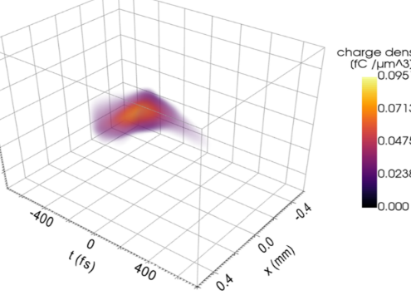
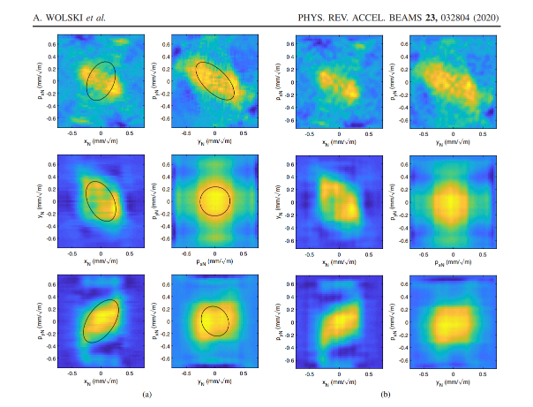
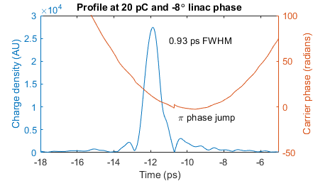
Multi-shot tomographic techniques
Aside on measuring a ‘profile’
Going on a little more
1D Profile: measuring u as a function of charge density ρ
e.g Longitudinal profile = ρ(t)
2D profile: measuring u₁ , u₂ as a function of ρ
e.g. Transverse profile = ρ(x,y)
3D profile: u₁ , u_{2 ,} u₃ as a function of ρ
e.g. 3D spatial profile = ρ(x,y,t)
4D profile: u₁ , u_{2 ,} u_{3 ,} u₄ as a function of ρ
e.g. 4D transverse phase space ρ(x,x’,y,y’)
3D spatial profile from FlashForward variable Polarisation TDC
Fig 5 in Marchetti, Barbara, et al. Scientific reports 11.1 (2021): 3560.
https://www.nature.com/articles/s41598-021-82687-2
1D Longitudinal profile of CLARA BA1 beam
From electro-optical sampling
2D transverse profile of CLARA BA1 beam
From YAG screen
2D projections of 4D CLARA beam phase space
Fig 7 in Wolski, A., et al. Physical Review Accelerators and Beams 23.3 (2020): 032804.https://journals.aps.org/prab/abstract/10.1103/PhysRevAccelBeams.23.032804
Single-shot techniques
Notes:
From a profile you can measure the statistical values
But you can measure a statistical value without a profile – e.g. beam position or beam size!

Slide 15
Beam properties
Beams are made of bunches
Bunches can be separated uniformly or with a sub-structure(‘train’/pulse)
z
z
Uniformly separated bunches
Uniformly separated bunch ‘trains’
Beam properties are time averaged properties of bunches or
Shot to shot variation in bunch properties
Beam properties we could measure include:
Beam current
Average energy
Energy instability
Charge instability
Pointing instability
To diagnose a bunch we must be able to pick it out from the beam
To fully diagnose a beam instability
We must be able to measure the bunches at their rep. rate…

Slide 16
Diagnostic modes
Some useful definitions

Slide 17
Single vs Multi-shot
Further definitions…
Diagnostics operate in either single shot or multi-shot modes:
Single shot = One bunch is captured to make a measurement
(This can be done at the beam rep. rate, but not necessarily)
Instabilities can be seen, fast feedback can be provided
Multi-shot = many bunches needed to make a measurement
Time averages bunch behaviour over many shots
Will smear out fast instabilities, may smear out slower drifts
Can provide slow feedback
Single shot is always better, but for some systems means compromising on precision, accuracy
How much precision or accuracy you need depends on what you want to do with the system…
e.g. Beam Position Monitor
e.g. Emittance Quad Scan

Slide 18
Destructive Vs Non-Invasive
Obvious statements & Buzzwords
Making a measurement of a bunch typically affects the bunch in some way…
If the bunch is lost or cannot be ‘used’ afterwards this is DESTRUCTIVE
If it isn’t useful, it may as well be lost
If no measureable change is made to the bunch this is NON-INVASIVE
If you can’t measure it, did it even happen?
If there is a measurable change but the beam can still be ‘used’ this is MINIMALLY INVASIVE
This is highly dependent on beam parameters & application
Typically we have destructive & non-invasive diagnostics

Slide 19
Measuring vs Monitoring
My view/definitions
When we operate an accelerator we either want to:
Monitor the beam (and do something else up/downstream)
Or
Measure the beam (to find out its properties in detail and do nothing else)
A monitoring system is single-shot and/or non-invasive
The best monitors are both!
A measuring system is either destructive or multi-shot
Diagnostics impact how an accelerator is operated
Without diagnostics, you can’t operate.
How you operate is defined by what diagnostics you have!

Slide 20
Break
Questions?

Slide 21
Common diagnostic systems
Know your BPMs from your TDCs and your OTR from your CSR

Slide 22
A zoo of systems
Always a new species to discover
The following is a set of common systems and their acronyms
Also included alternative acronyms that other labs use
Non-exhaustive list. There are many systems out there
Beware: some of the acronyms are the same, but mean different systems to different people/labs
There is no agreed ‘dictionary’!
Brief description of what that system is for
Detail will come in later lectures/slides for most systems (but not all!)
This is an introductory overview!
We love TLAs, do you?
Make sure you know someone actually means!

Slide 23
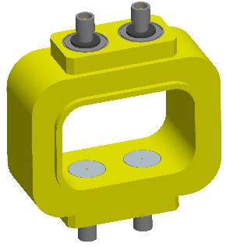
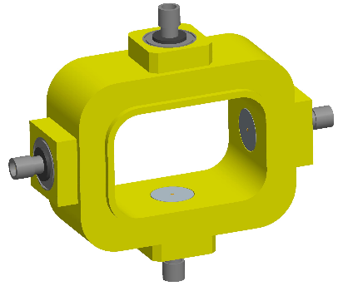
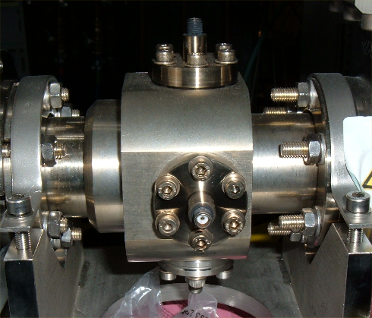
Common systems
Transverse #1
BPM = Beam Position Monitor
Non-invasive single shot monitor for <x> and <y>
Uses 4 pick-ups to measure proximity of electric field within the beam-pipe
Can be calibrated to estimate charge
Example pick-up types: buttons, striplines
cBPM = Cavity BPM
Uses a cavity to create a wakefield
Typically higher resolution than standard BPM
More info in Lecture #2 on how this works

Slide 24
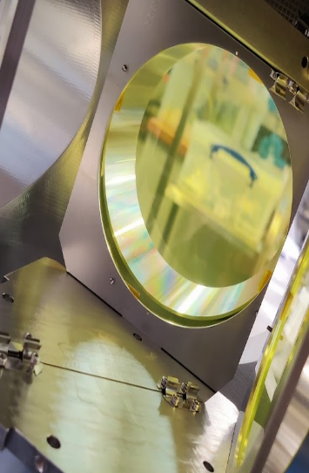
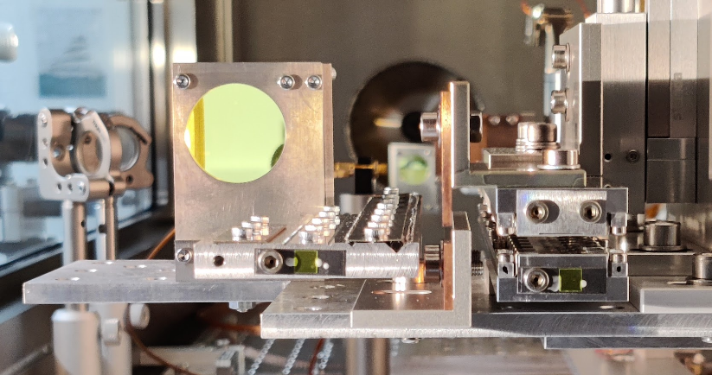
Common systems
Transverse #2
SCR = Scintillator Screen
Single-shot destructive measurement of x-y profile of beam
With additional beam optics/systems can measure other profiles, e.g. energy spectrum
Very bright, has fundamental resolution limits
Synonym: OPT = Optical screen
Variants:
YAG = Yttrium Aluminium Garnet scintillator screen
Very common material in electron machines for scintillator screen
LYSO = Lu_{1.8}Y_{0.2}SiO₅:Ce
(crystal formula for Cerium-doped Lutetium Yttrium Orthosilicate)
Another bright scintillator for electron beams with a fun name
Has issues with saturation/quenching at high charge density
GAGG = Gadolinium Aluminium Gallium Garnet
Very bright scintillator with high saturation point
Gaining in popularity!
LANEX = Trade name for kodax scintillator sheets
Cheap, large, can be cut to shapes
Poor transverse resolution & Finite lifetime!
More info in Lecture #2 on how this works

Slide 25
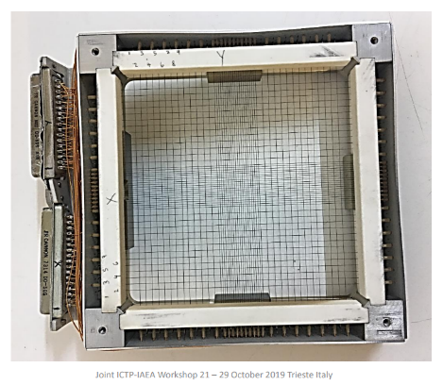
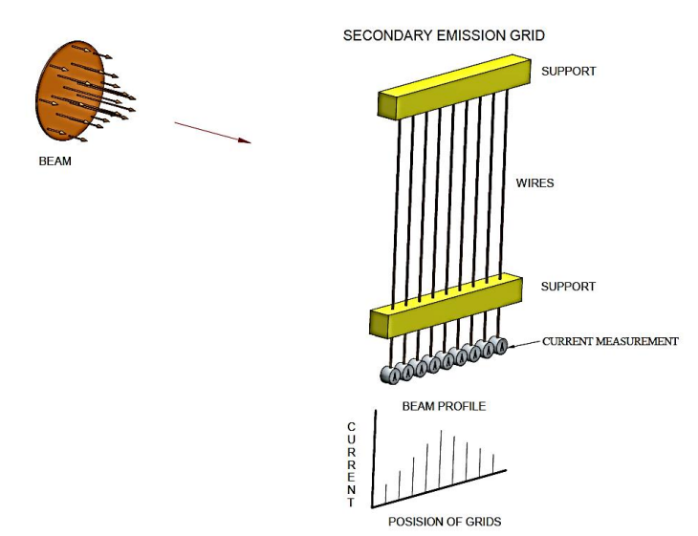
Common systems
Transverse #3
WS = Wire Scanner
Multi-shot minimally invasive measurement of x or y profile
Uses wire to intercept beam and scatter a transverse slice. Scan wire across beam
Either:
Additional detector to pick-up intensity scattered Or
secondary electrons liberated from wire, current measured by electrode
High resolution technique
SEM = Secondary Emission Grid
Single shot minimally invasive measurement of x or y profile
Uses a grid of wires to intercept beam and secondary electrons liberated from each wire and measure current on electrode
Images: Joint ICTP-IAEA Workshop on Accelerator Technologies, Basic Instruments and Analytical Technique
Lowry Conradie https://indico.ictp.it/event/8728/session/8/contribution/32/material/slides/0.pdf

Slide 26
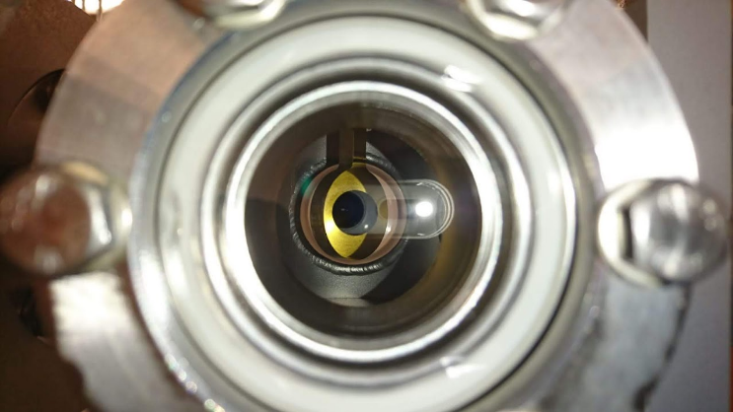
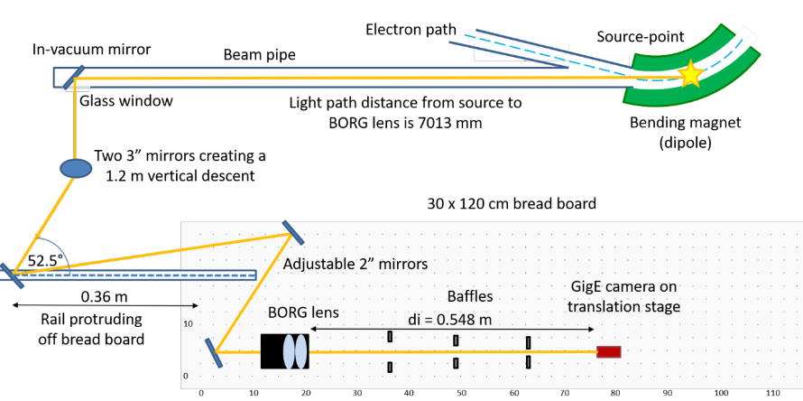
Common Systems
Transverse #4
OTR = Optical Transition Radiation
Single-shot destructive transverse profile measurement
Bunch passes through thin foil or metallic target
Releases radiation as the electric field transitions vacuum - > metal
Not very bright, but high resolution measurement
Resolution limited by imaging system
SRM = Synchrotron Radiation Monitor
Single shot non-invasive transverse profile measurement
Detect radiation (Optical/UV/X-ray) as beam passes round dipole (or undulator)
Use this to infer electron beam profile
More info in Lecture #2 on how this works
Image: Howling, E., and L. Bobb. "Development of a Beam Halo Monitor Using Visible Synchrotron Radiation at Diamond Light Source." IBIC21 (2021).

Slide 27
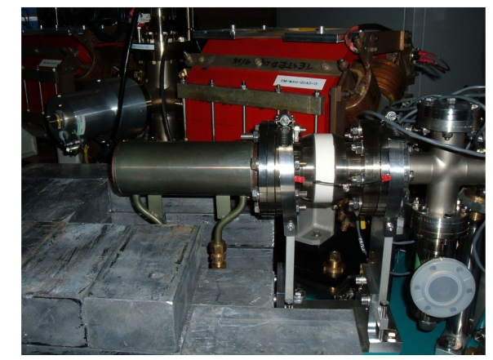
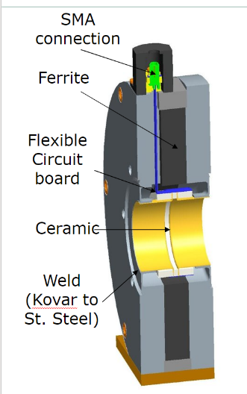
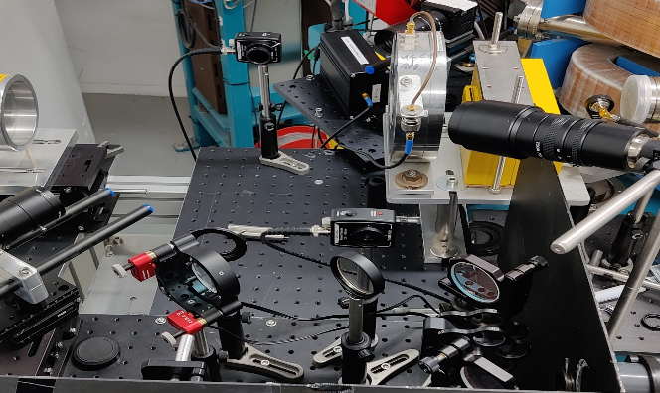
Common systems
Charge #1
FCUP = Faraday Cup
Destructive single-shot measurement of bunch charge
Metal cup which captures and stops beam charge
Discharge of cup can be measured and absolute charge can be measured
Synonyms: FC
WCM = Wall Current Monitor
Non-invasive single-shot measurement of bunch charge
Measures image current following through beam pipe
Requires calibration
More info in Lecture #2 on how this works

Slide 28
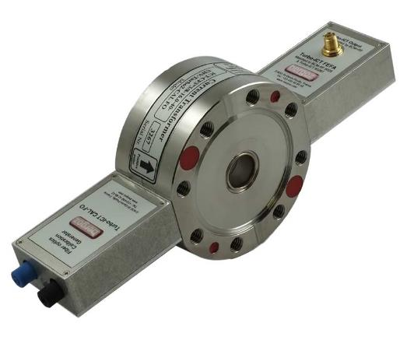
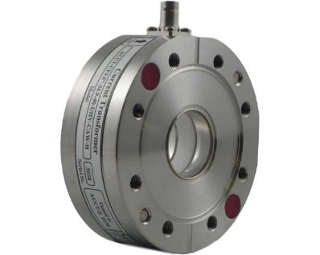
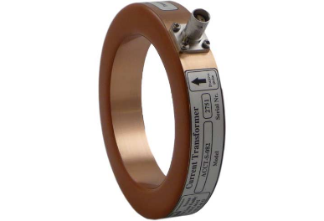
Common Systems
Charge #2
ICT = Integrating Current Transformer
Single-shot non-invasive bunch charge measurement
Limited by bunch pulse length and beam repetition rate
Can be in-flange or ‘in air’ or in vacuum
Variants:
Turbo-ICT: Filtered version, works with shorter pulses (<1ns) and higher resolution
Synonyms: BCM = Bunch Charge Monitor
ACCT = AC Current Transformer
Non-invasive beam current monitor for macropulse beams / quasi CW beams
Images:
https://www.bergoz.com/products/

Slide 29
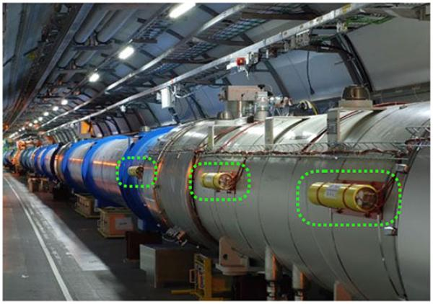
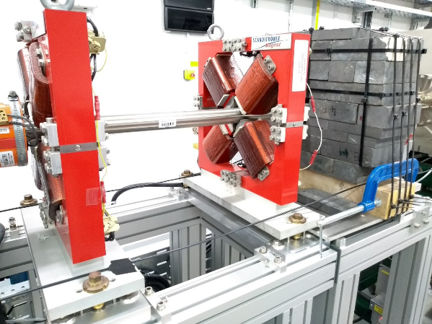
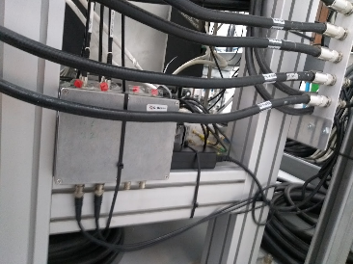
Common Systems
Charge #3 / Losses
BLM = Beam Loss Monitor
Non-invasive monitor of beam charge loss
Discrete gas or solid sample outside beam pipe to detect ‘escaped’ particles or
Secondary radiation
Used for machine protection
Variants
oBLM = Optical BLM
Continuous Optical Fibres which run alongside beam pipe
Secondary emission from beam loss creates Cherenkov radiation
Can be detected at either end of figure.
Time of arrival of detection gives loss position information
https://www.liverpool.ac.uk/quasar/research/beam-instrumentation/beam-loss-monitoring/

Slide 30
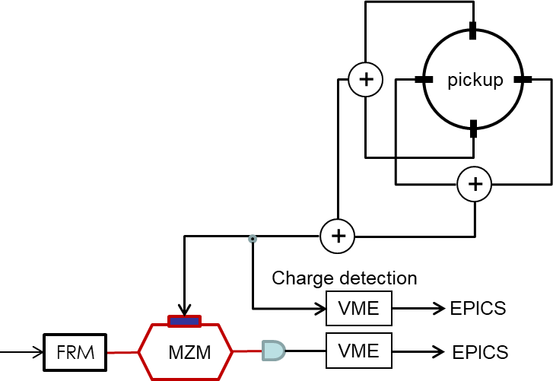
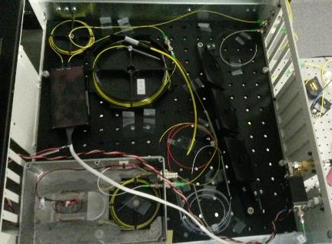
Common systems
Longitudinal #1
BAM = Beam Arrival Monitor
Non-invasive single shot measurement of time of arrival wrt global clock
High frequency cavity/pickups which detect bunch arrival
Signal needs to be converted to comparator to get TOA wrt global clock
Resolution limited by beam charge
TOF = Time of Flight system
Non-invasive single shot measurement of bunch energy
(at least) two pickups at different positions measure beam time of arrival
For known species, flight time between two points gives longitudinal momentum
Works for low energy, non-relativistic systems

Slide 31
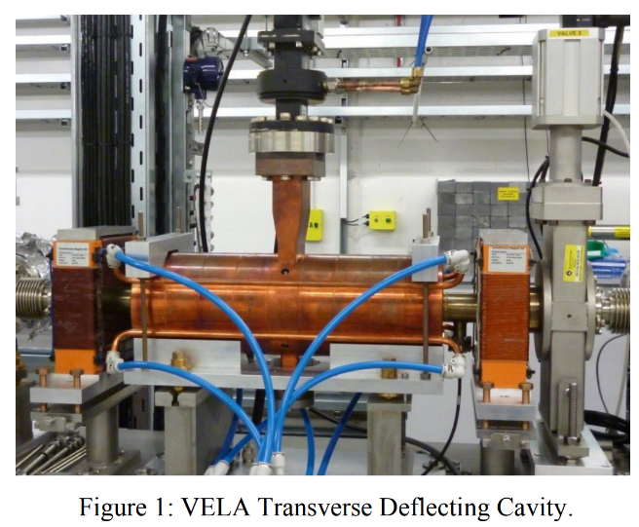
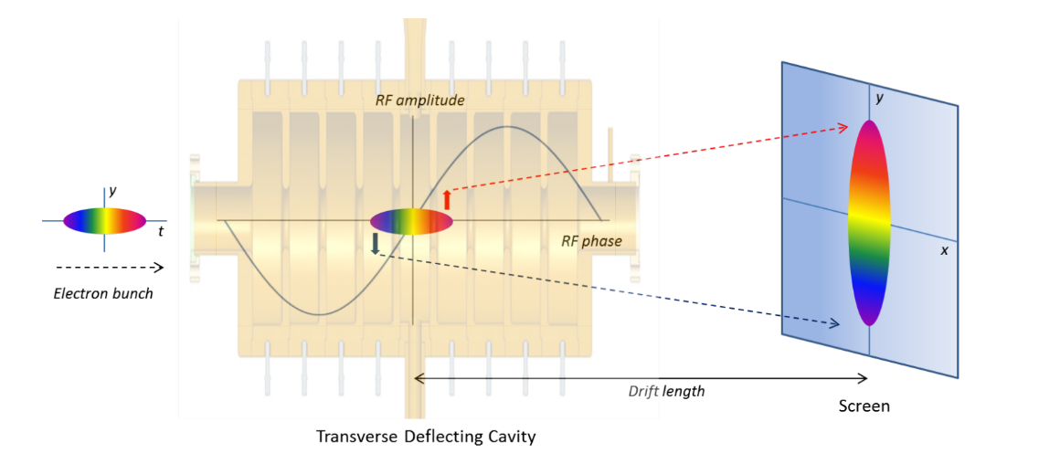
Common Systems
Longitudinal #2
TDC = Transverse Deflecting Cavity
Single shot destructive measurement of longitudinal profile
RF cavity profiles a longitudinally varying streaking force to beam
Maps longitudinal profile onto spatial coordinate with appropriate beam optics
Can be used to measure longitudinal phase space and slice properties…
Synonyms:
TDS = Transverse Deflecting Structure
RFD = Radio Frequency Deflector
More info in Lecture #3 on how this works
Image: J McKenzie Thesis

Slide 32
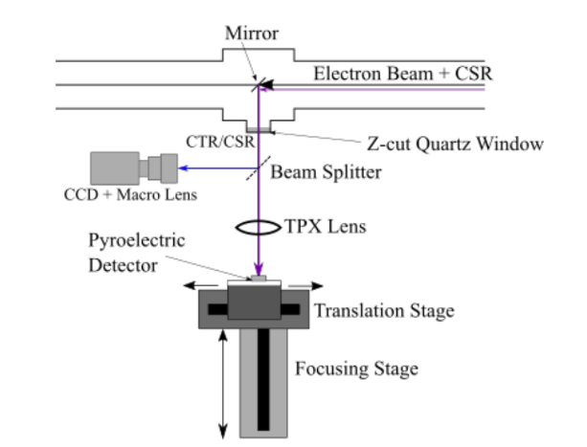
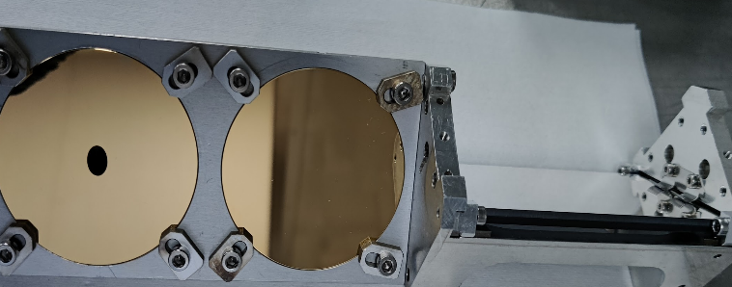
Common systems
Longitudinal #3
BCM = Bunch Compression Monitor
Single-shot monitor for bunch length
Detects intensity of coherent radiation emitted by bunch
Shorter bunches -> higher intensity of radiation
Whether destructive or non-invasive depends on source of radiation…
Variants =
CSR BCM = Coherent Synchrotron Radiation BCM
Single-shot non-invasive monitor for bunch length
Detects coherent radiation emitted as beam goes around dipole
CTR BCM = Coherent Transition Radiation BCM
Single-shot destructive monitor for bunch length
Detects coherent radiation emitted as beam goes through metal target
CDR BCM = Coherent Diffraction Radiation BCM
Single-shot non-invasive monitor for bunch length
Detects coherent radiation as beam goes through hole in metal target
More info in Lecture #3 on how this works

Slide 33
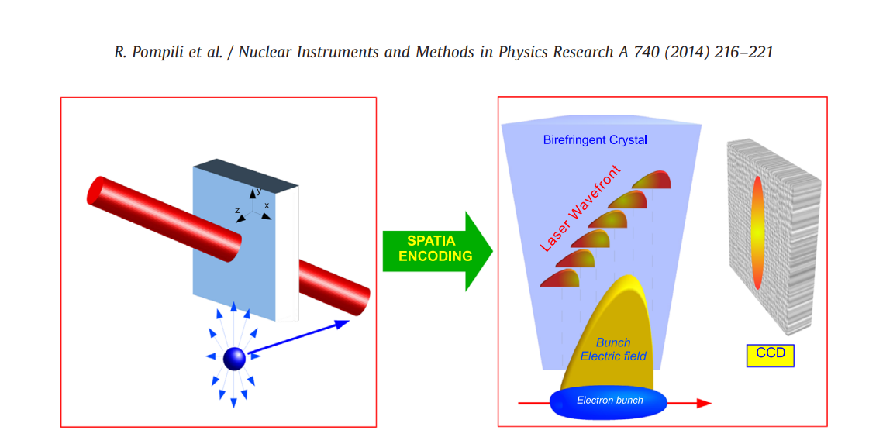
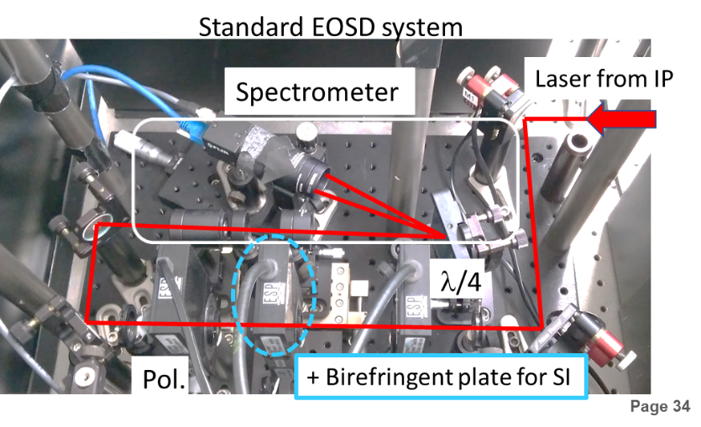
Common systems
Longitudinal #4
EOS = Electro-Optic Sampling
Single-shot non-invasive bunch profile monitor
Electric field of bunch interacts with non-linear crystal
Field changes polarisation properties of crystal
Simultaneously a laser pulse propagates in crystal
Changes in polarisation mapped onto laser
Measure change in polarisation as function of time/space in laser pulse
Synonyms: EO
Variants :
EOSD = Electro-Optic Spectral Decoding
Chirped laser pulse means spectrum maps to time
Variation in polarisation of spectrum -> electron bunch length
EOSI = Electro-Optic Spectral Interferometry
As EOSD but with higher resolution
and less ambiguous spectral interference for reconstruction
More info in Lecture #3 on how this works

Slide 34
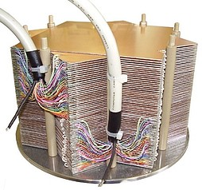
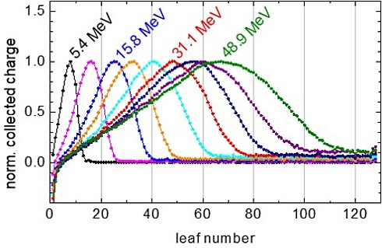
Common systems
Longitudinal #5
MLFC = Multi-leaf Faraday Cup
Single shot destructive measurement of energy spectrum
Multiple isolated faraday cup layers which stop beam and charge up
Depth of penetration gives particle energy
Coarse measurement, stochastic in nature (best for high charge bunches)
Images: https://www.ptb.de/cms/en/service-seiten/news/scientific-news.html?cHash=afc8730e344bcebbe77f3d3f8057e948&tx_news_pi1%5Baction%5D=detail&tx_news_pi1%5Bcontroller%5D=News&tx_news_pi1%5Bday%5D=20&tx_news_pi1%5Bmonth%5D=12&tx_news_pi1%5Bnews%5D=10186&tx_news_pi1%5Byear%5D=2019

Slide 35
Summary
Some take homes
There are a lot of properties to measure!
Bunch is a 6D object, Beams are made of many different bunches
Somethings are measured - destructive or multi-shot
Others can be monitored - single-shot and/or non-invasive
There is a whole zoo of diagnostic systems and devices
Ask what a TLA is and what it does
You need a combination of systems to operate the accelerator
Even more systems needed to understand the beam!
All diagnostics have limits…

Slide 36
Resources
References & links for images and further reading
CAS notes on beam diagnostics
https://cds.cern.ch/record/499098/files/p154.pdf
Berghoz product catalogue (ICTs etc.)
https://www.bergoz.com/products/
SwissFEL SRM & BCM compressor measurements
https://arxiv.org/pdf/1905.08081.pdf
FlashForward Variable Polarisation TDC
https://www.nature.com/articles/s41598-021-82687-2
VELA TDC commissioning
https://accelconf.web.cern.ch/ipac2015/papers/wepha054.pdf
UoL Quasar Article on BLMs
https://www.liverpool.ac.uk/quasar/research/beam-instrumentation/beam-loss-monitoring/
https://livrepository.liverpool.ac.uk/3031981/1/200845969_Aug2018.pdf
Overview of oBLMs
https://www.mdpi.com/1424-8220/23/4/2248
DLS SR based halo monitor
https://accelconf.web.cern.ch/ibic2021/papers/tupp10.pdf
Lowry Conradie notes on diagnsotics (see wire scanners and girds)
https://indico.ictp.it/event/8728/session/8/contribution/32/material/slides/0.pdf
SPARCLab EOS results
https://www.sciencedirect.com/science/article/abs/pii/S0168900213013776

