Slide 1
Surface Characterization
Dr R Valizadeh
ASTeC Vacuum Solution Group, STFC, Daresbury Laboratory, UK

Slide 2
Outline
Surface Characterization techniques
X-ray Photoelectron Spectroscopy (XPS)
Rutherford Backscattering (RBS)

Slide 3
Surfaces
What is surface in vacuum?
A special interface between solid and vacuum Interface: a small number of atomic
layers that interact with residual gas and charged particle in the vacuum.
Why surface is important?
Many properties determined by the surface/interface
  SEY and PEY,
  ESD and PSD
Many processes happens mainly at surface
  Chemical reaction
  Gettering,
  Field emission
  Corrosion
  Adhesion
Surface/interface may differ significantly from the bulk
  Phase Density,
  Composition,
  Mechanical,
Electronic

Slide 4
How to achieve desired surface
Surface preparation:
  Using solvent to wash away any organic contaminants
  Polishing
  Chemical etching
  Plasma cleaning
  Surface coating
  Nanotechnology structuring
  Surface passivation
Determining the surface properties:
  Composition
  Chemical states
  Surface roughness
  Surface morphology
  Surface electronic properties
  Surface area

Slide 5
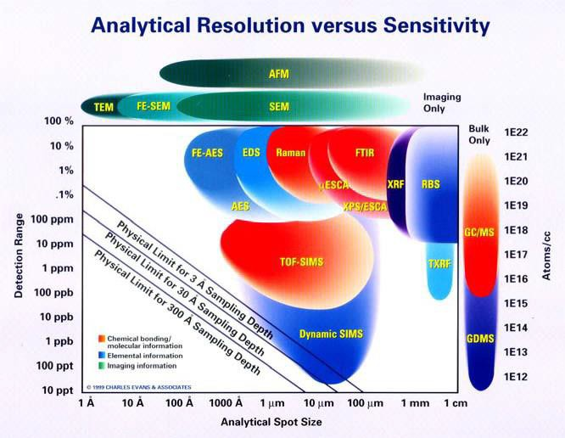
Surface Characterisation
What surface characterisation is available?

Slide 6
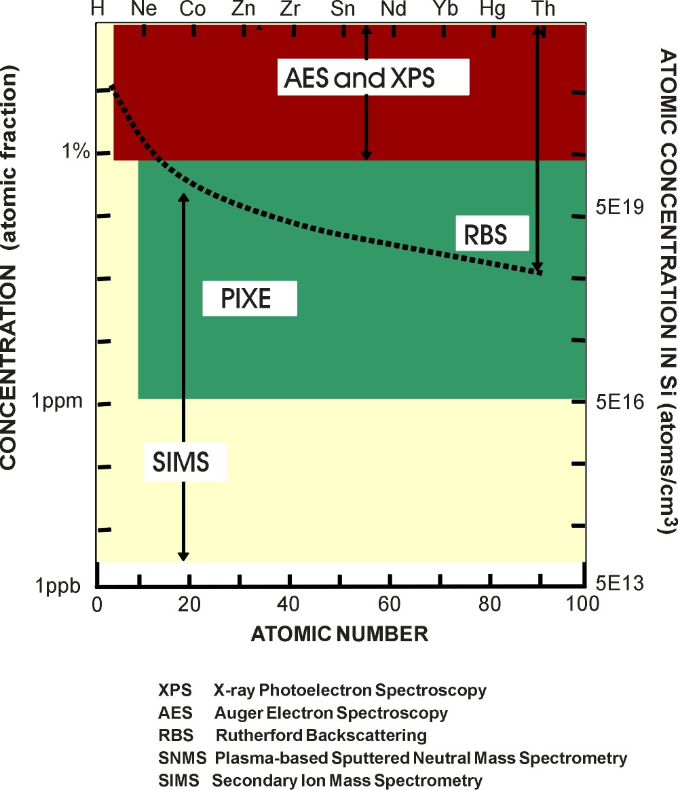
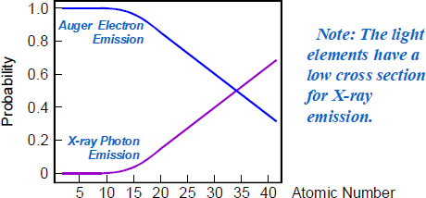
Comparison of Sensitivities.

Slide 7
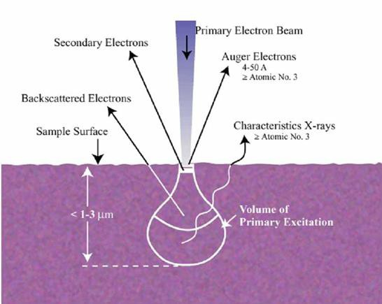
Electron solid interaction
Secondary electrons (SEs): are produced by the interactions between energetic e’s and weakly bonded valence e’s of the sample
Auger electron: incident e- kicks out an inner shell e-, a vacant e- state is formed; this
inner shell vacant state is then filled by another e- from a higher shell, and simultaneously the energy is transferred to another e- that leaves the sample
Characteristic X-rays: emitted when a hole is created in the inner shell of an atom in the specimen due to inelastic e- scattering, as it can recombine with an outer shell e- (EDX)
Cathodoluminescene (CL): light emission arising from the recombination of e-h pairs induced by excitation of e’s in the valence band during inelastic scattering in a semiconducting sample
Backscattered electrons (BSEs): are primary e’s leaving the specimen after a few large angle elastic scattering events

Slide 8
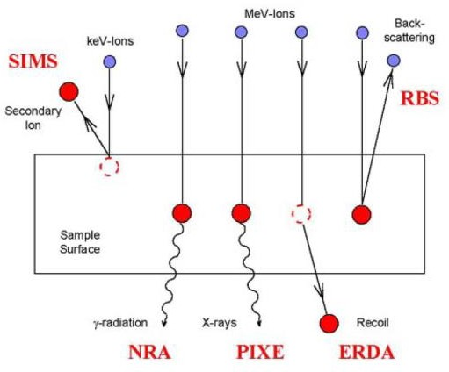
Ion-solid interaction
elastic scattering
fast recoils arising from elastic scattering
steering effects due to the crystalline structure of target atoms
inelastic processes: energy loss as a
function of depth
nuclear reactions
X-Ray production

Slide 9
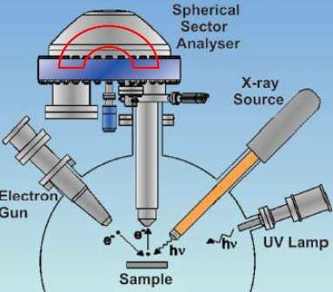
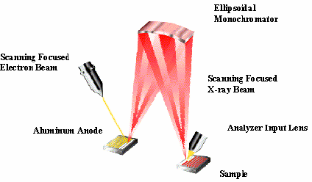
XPS , Auger and UPS Instrumentation
Essential components:
Sample: usually 1 cm2
X-ray source:
Al 1486.6 eV;
Mg 1256.6 eV
Electron Energy Analyzer:
100 mm radius concentric hemispherical analyzer (CHA); vary voltages to vary pass energy.
Detector: electron multiplier (channeltron)
Electronics, Computer
Note: All in ultrahigh vacuum (<10-8 Torr) (<10-11 atm)
State-of-the-art small spot ESCA: 5 µm spot size Sputtering gun for profiling
9

Slide 10
Strength and limitation of XPS
Strength:
Surface sensitive technique (top 10 nm)
Identifies the surface chemical states
Identifies the surface composition
Quantitative analysis, including chemical differences
A wide variety of material can be analysed, including non conducting samples
Oxide thickness measurements
Depth profiling
Limitations:
Detection limit typically 0.1%
Limited organic information,
Long acquisition time
Samples must be in XHV vacuum

Slide 11
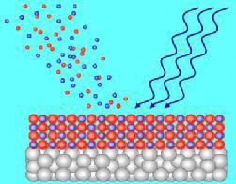


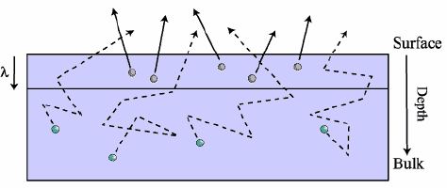
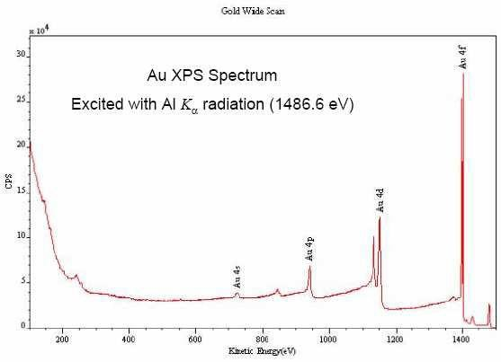
X-ray Photoelectron spectroscopy
Ejected Photoelectron
Incident X-ray
Free electron level
ɸ
Conduction band
Fermi l
Valence band
evel
2p
L2,L3
L1
2s
1s
K

Slide 12
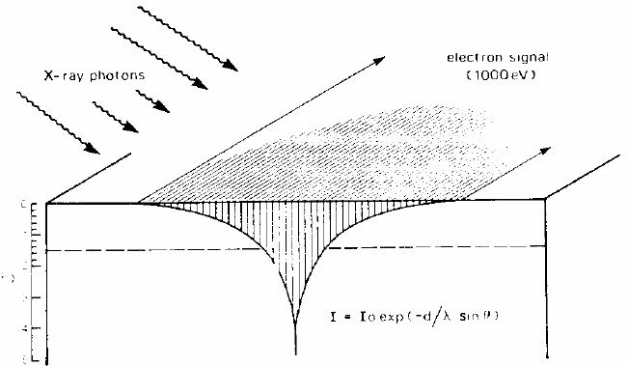
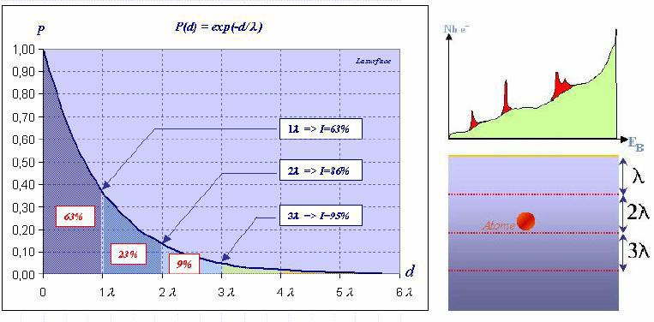
Sampling depth
Beer-Lambert relationship
Where
I =I exp (-d/ʎsinɵ) d 0
I_{d}= intensity of emitted photoelectron as a function of depth (d)
I₀ = intensity of emitted photoelectron from an infinity thick substrate
ʎ = inelastic mean free path of electron (1-3.5 nm)
ɵ = electron take-off angle relative to the surface
P = probability of emitted electron reaches the surface and being analysed.
If θ = 90º
P = Id/I0 = exp(-d/λ)
Sampling Depth is defined as the depth from
which 95% of all photoelectrons are scattered
by the time they reach the surface (3λ)
for XPS this is (1-10nm)

Slide 13
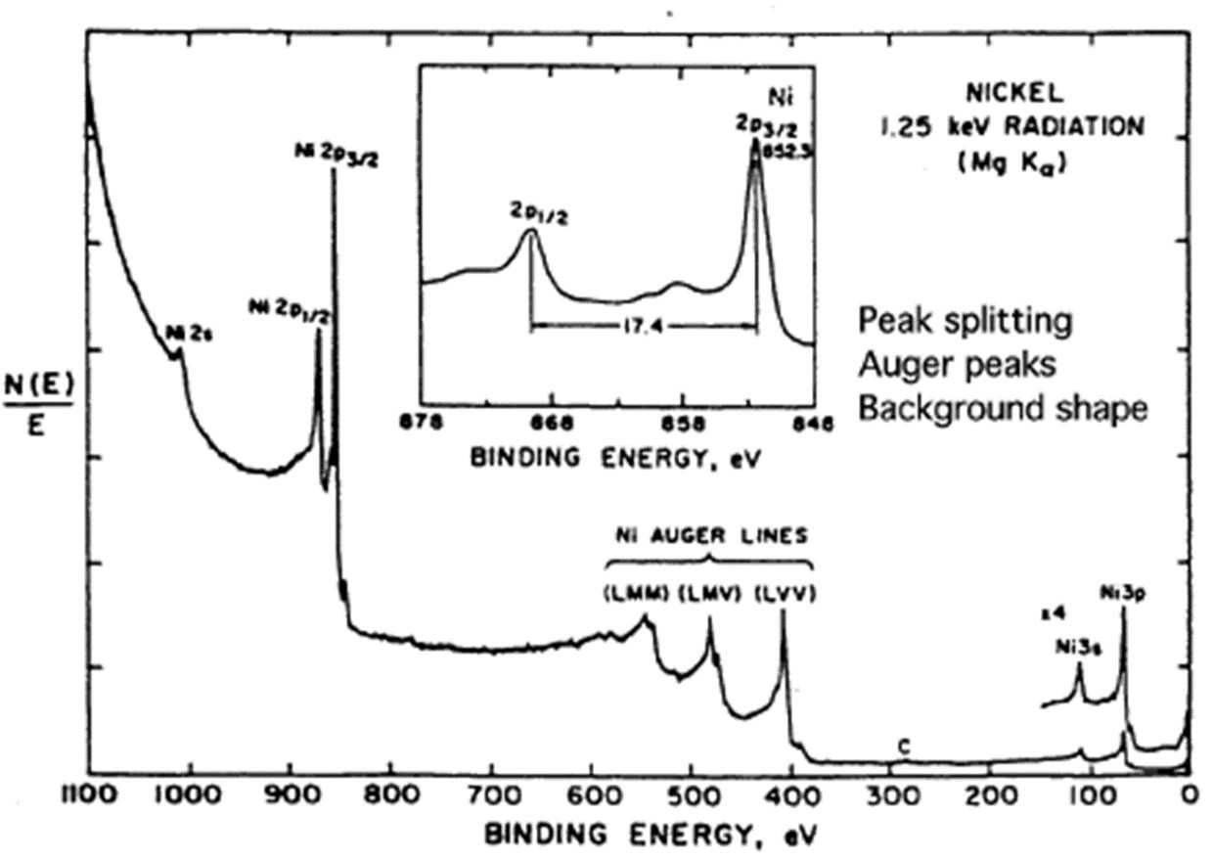
Main features of XPS wide spectra
Photoelectron lines:
  Core-levels
  Valence bands
  Spin-orbit splitting
Auger lines
Chemical shifts
X-ray satellites
X-ray “Ghost”
Shake-up satellite
Multiplet satellite
Energy loss lines
Atoms have valence and core electrons: Core-level Binding energies provide unique signature of
elements.

Slide 14
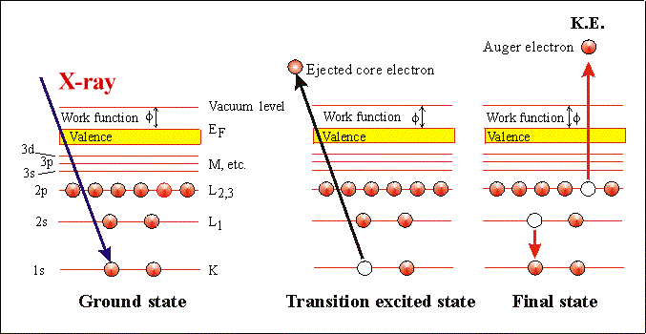
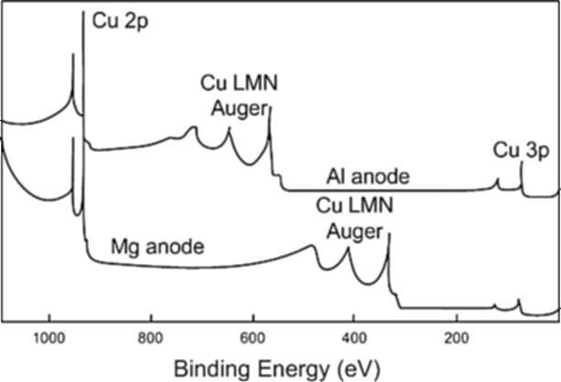
X-ray induced Auger electron
Cu XP spectra illustrating the shift in Auger peak positions with change from Mg to Al anodes in the x-ray source ( Auger is dependent on the photon energy)

Slide 15
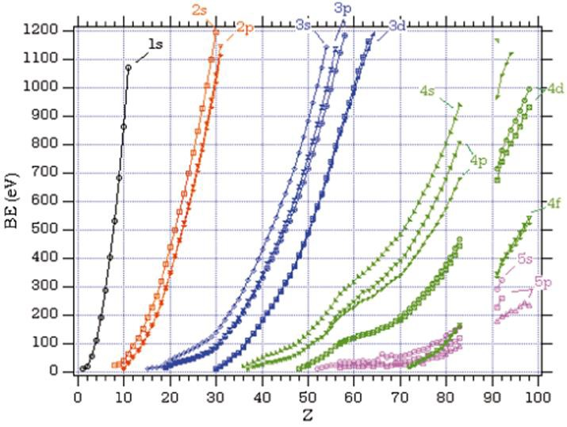
Z dependence of BE(eV)
BE follows the energy levels: BE(1s)>BE(2s)>BE(2p)
BE with same orbital increase with Z: BE(Mg1s)>BE(Na1s)

Slide 16
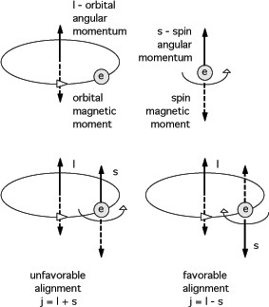
Spin-orbit splitting
Spin-orbit splitting is an initial state effect.
For any electron in orbital angular momentum, coupling between magnetic fields of spin (s) and angular momentum (l) occurs
(Higher binding energy)
Lower binding energy

Slide 17
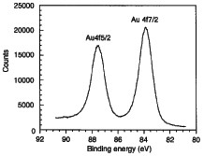
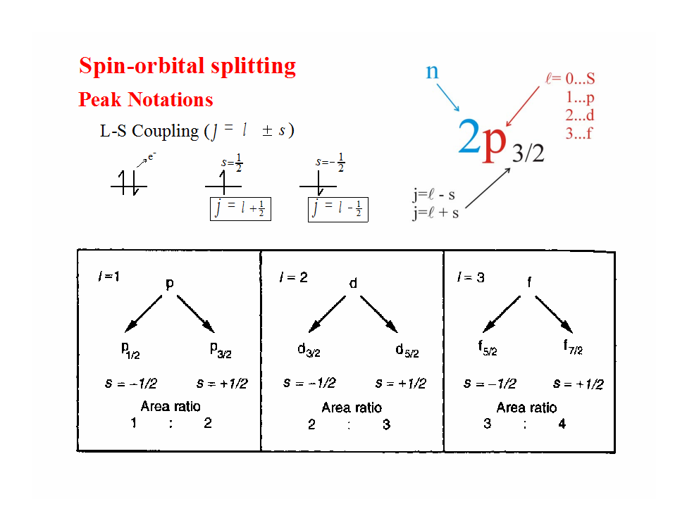
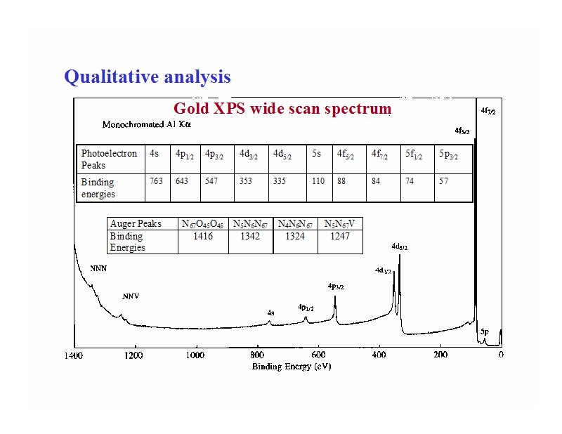
Spin-orbit splitting
S orbitals are not spin-orbit split – singlet in XPS
P, d, f, … orbitals are spin-orbit split – doublets in XPS
BE of lower j value in doublet is higher (BE2p1/2>BE2p3/2)
Magnitude of spin-orbit splitting increases with Z

Slide 18
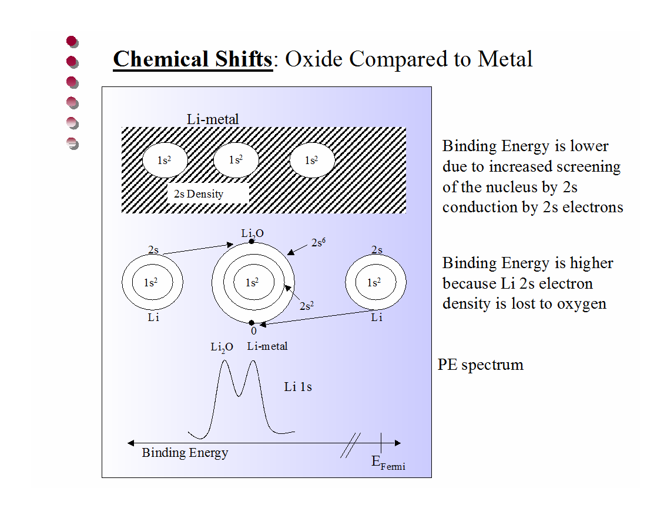
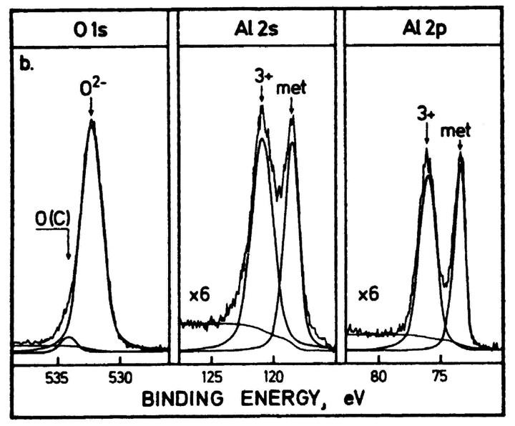







Core level chemical shift
Note : the binding energy of Al2s and Al2p in metallic state is at lower energy than the AL³⁺, while the biding energy of the O atoms (more positive charge) is higher than the O^{2-.}

Slide 19
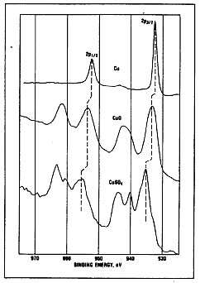
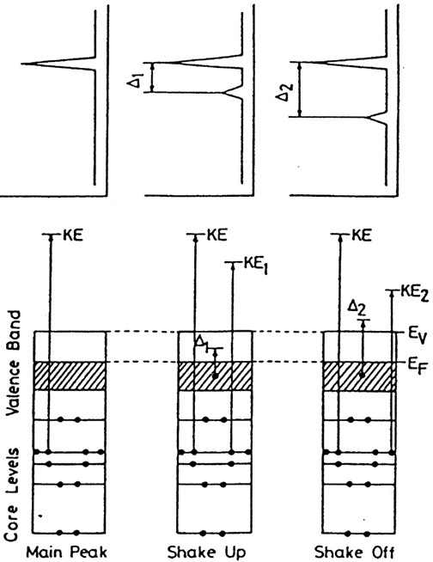
Satellites
Arises when a core electron is removed by photoionization. There is a sudden change in the effective charge due to loss of shielding electrons.
The perturbation induces a transition in which an electron from a bonding orbital can be transferred to an anti-bonding orbital simultaneously with core ionisation.
Shake-up: the outgoing electron interact with the valence electron and excites it (shakes it up) to a higher energy level. Therefore the energy core electron is reduced and a satellite structure appears a few EV below (KE scale)the core level position
Shake-off: the valence electron is ejected from the ion completely (to the continuum). Appears a broadening of the core level or contribute to the inelastic background.

Slide 20
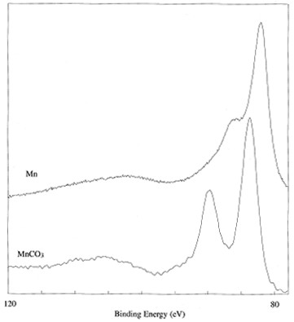
Mutiplet satellite
After photoelectron emission, the remaining unpaired electrons may couple with other unpaired electrons with several possible final state configuration with as many different.
This produces a line which is split asymmetrically into several component.
For S-type orbital with other unpaired electrons in the atoms there are split lines like in the shown figures.
For P-type is more complex and subtle.
Multiplet splitting of Mn 3s

Slide 21
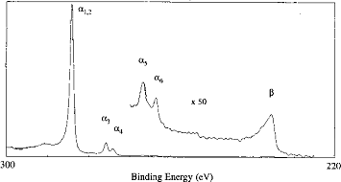
X-Ray Satellite
 | ^{α}1,2 | α₃ | α₄ | α₅ | α₆ | β
Mg displacement eV | 0 | 8.4 | 10.1 | 17.6 | 20.6 | 48.7
Relative Height | 100 | 8.0 | 4.1 | 0.6 | 0.5 | 0.5
Al displacement eV | 0 | 9.8 | 11.8 | 20.1 | 23.4 | 69.7
Relative height | 100 | 6.4 | 3.2 | 0.4 | 0.3 | 0.6
Emission from non
monochromatic x-ray sources produces satellite peaks in XPS spectrum at lower BE
Mg x-ray satellites observed in the C1s spectrum of graphite

Slide 22
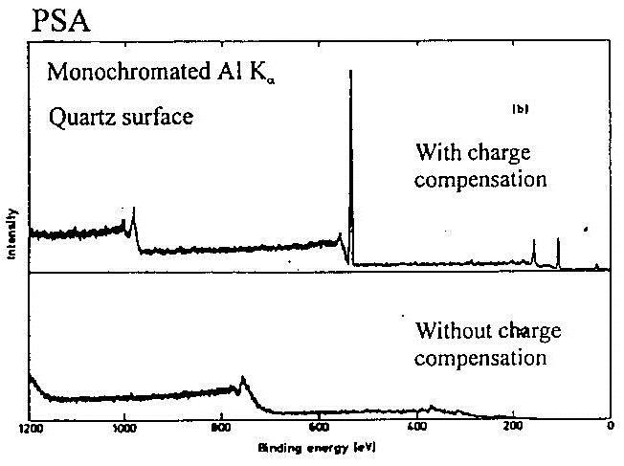
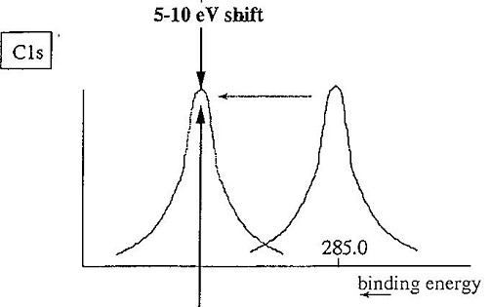
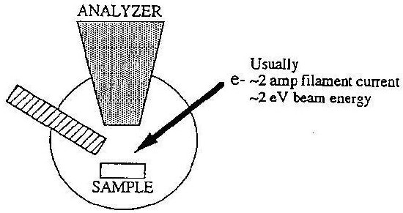
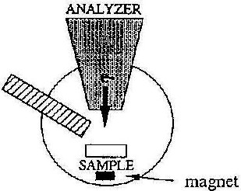
Sample Charging effects
Charging can even change the line shape due to Inhomogeneous Surface Charging, which have different positive voltage on the surface
In a lot of cases, there is only spectral shift due to charging, which can be determined by comparison
C 1s shifts due to the charging
XPS always
charges
surface
with known elemental XPS lines, for example C 1s.
positively (shifting of spectrum to higher binding energy) and leads to general instability (spectral noise). For the metal sample, which can be grounded and the charges can be quickly gone. However, for insulator, this effects are serious and need to be treated.
Electron flood gun mounted line of sight with sample or in analyser axis + electromagnet

Slide 23
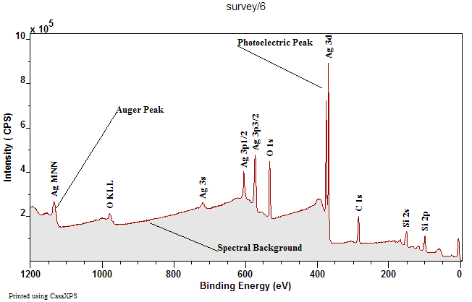
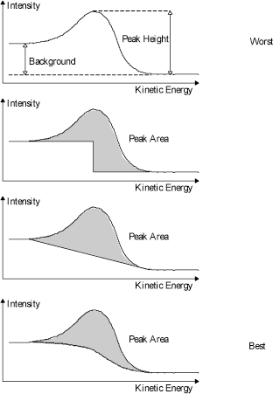
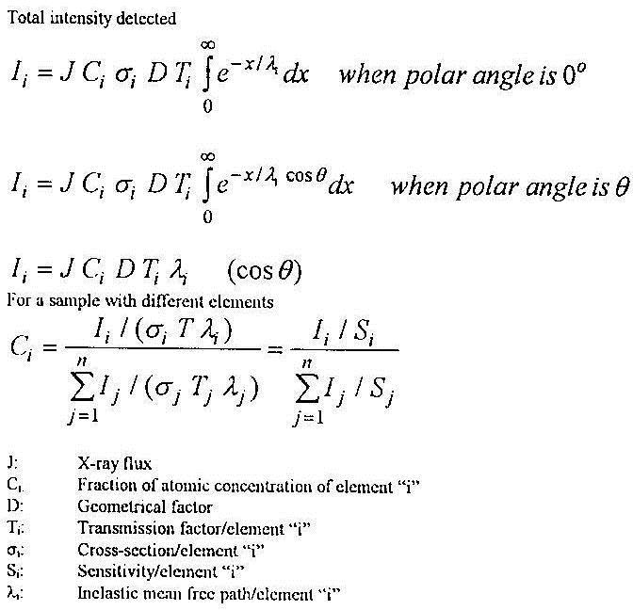
Quantitative analysis
Identify the peak position and relative peak intensity of 2 or more peaks (photoemission lines and Auger) of an elements.
Check for any charging effect
Check for any chemical shift
Check spin orbital splitting and area, ratio of the p, d, f peaks
Subtract the back ground and find the area under the curve.
Value from the handbook

Slide 24
Depth profiling using XPS analysis
If sputter rate is known, thickness of the surface layers can be calculated.
Si = 99.3 eV
SiO2 = 103.3 eV
Wide scan –
quantitative analysis

Slide 25
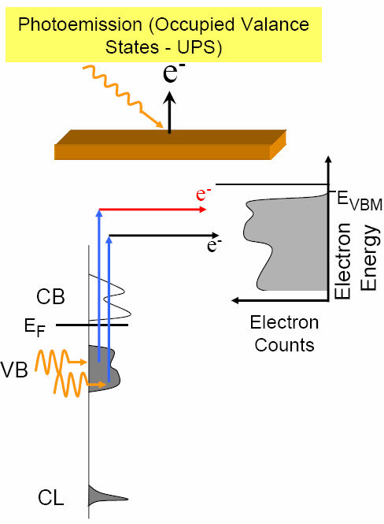
UV photo electron spectroscopy
XPS:
photon energy hѵ=200-4000 eV to probe core-levels (to identify elements and their chemical states).
UPS:
photon energy hѵ=10-45 eV to probe filled electron states in valence band or adsorbed molecules on metal.
UPS source of irradiation:
He discharging lamp (two strong lines at
21.2 eV and 42.4 eV, termed He I and He II) with narrow line width and high flux
Synchrotron radiation source: continuously variable photon energy, can be made very narrow, very intense, now widely available, require a mono- chromator

Slide 26
Work function determination using UPS
UPS spectrum of a gold sample.
The spectrum consist of three feature of interest:
  The fermi level at 0 eV binding energy
  The valence bands corresponding to the D bands of Au.
  High binding energy cut off
Au work function = Energy of the UV source – the width of spectra
Φ = hν - ΔE
ΦAu = 21.21 eV – 15.9 eV=5.3 eV

Slide 27
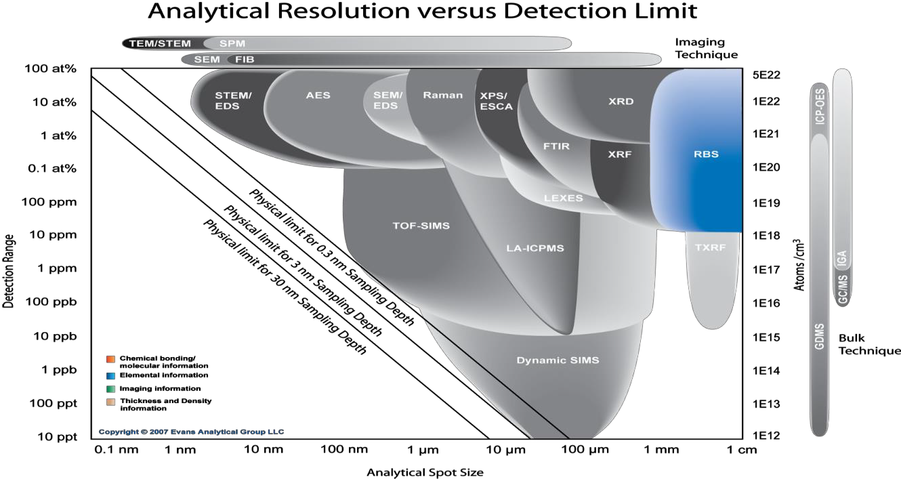
RBS: Rutherford Backscattering Spectroscopy
RBS accurately measures the composition and depth profile of thin films.
Quantitative? | Yes | Destructive? | No
Detection limits? | 0.001 – 100 at% | Lateral resolution (Probe size)? | ≥ 1 mm
Chemical bonding? | No | Depth resolution? | 5– 20 nm

Slide 28
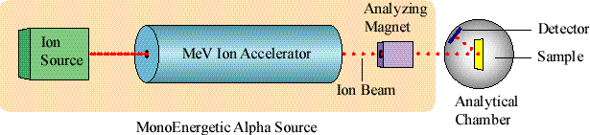
Application and Instrumentation
Determine thickness and composition of thin films
Determine film density from a film of known thickness
Assess damage to crystal structure as a result of processing
Quantification of films on whole wafers (up to 300 mm)
Qualify & monitor deposition systems (also fab-to-fab comparisons)
MeV ions from an electrostatic accelerator are focused on a sample
in a vacuum chamber for analysis.
Typically, 2 MeV He⁺⁺ ions are used.

Slide 29
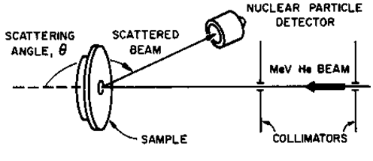
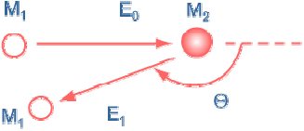
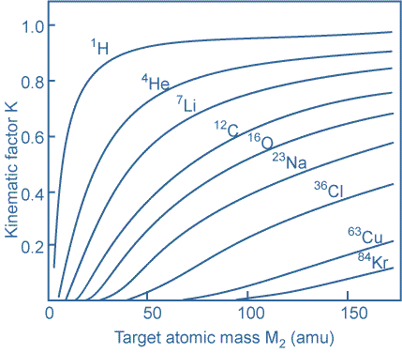
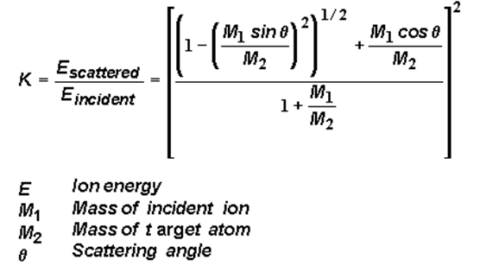
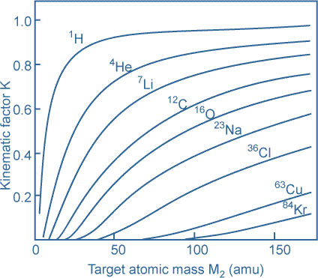
Kinematic factor
E1=KE0

Slide 30
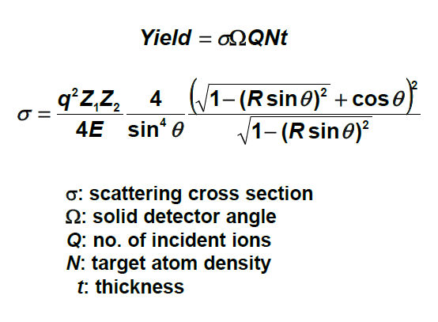
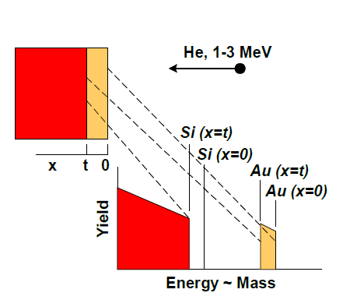
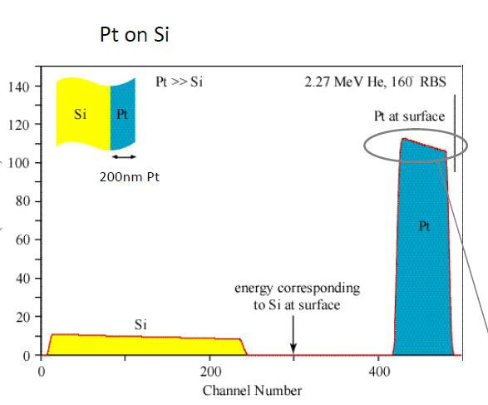
Thin film deposited on substrate
Channel number = Backscattering energy
Surface is on the right (high energy) greater depths to the left (lower energy)
Heavier elements produce higher energy backscattering.
Heavier elements produce larger peaks
per unit concentration.

Slide 31
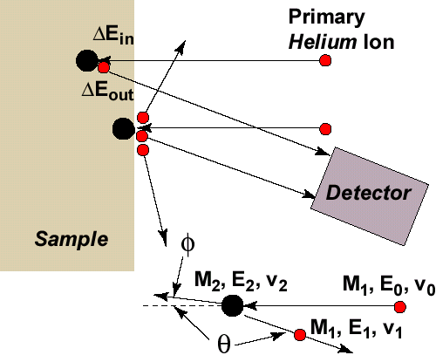
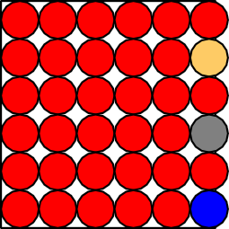
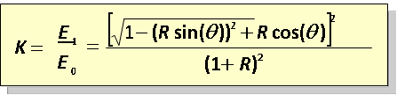

Surface doping
Works best for heavy elements on light substrates
He, 1-3 MeV
R = M₁/M₂
100 nm TiN on Si
Yield
Yield
Si Substrate
Ti
N
Si
Ag
Au
N
Energy (MeV)

Slide 32
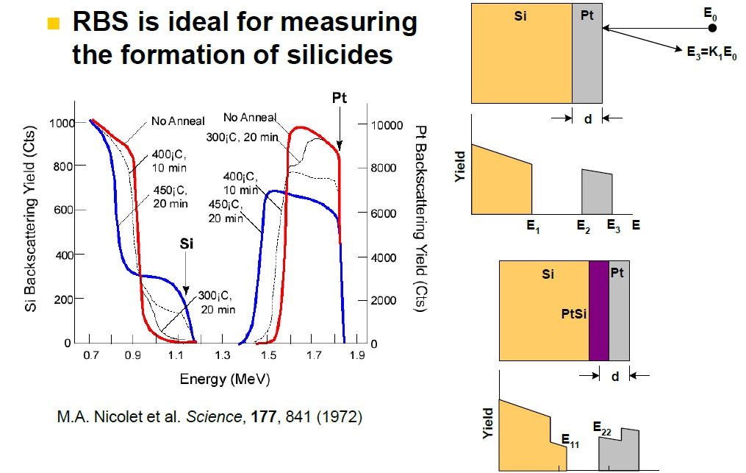
Interface mixing
E1

Slide 33
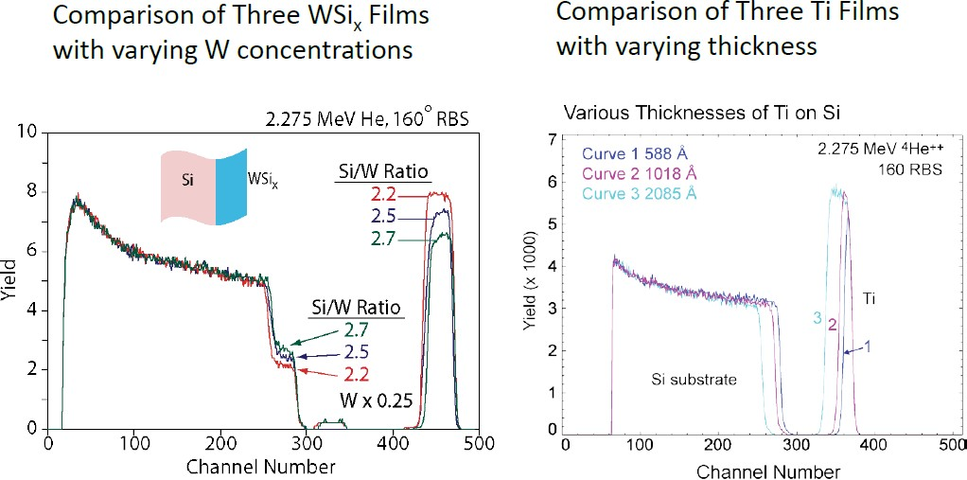
Measuring Concentration and thickness

Slide 34
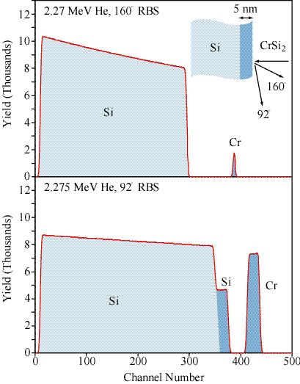

Scattering geometry affects depth resolution
Grazing angle detector improves depth resolution for thin film layer

Slide 35

Effect of film density on thickness
Fundamental unit of measurement for RBS is atoms/cm2
Density × thickness = atoms/cm2
To calculate a film thickness using RBS alone one must assume a film density
If the film thickness is known (by TEM, SEM, profilometry, etc.), then the film density can be calculated

Slide 36


Hydrogen forward scattering
spectroscopy
Also called Forward Recoil Spectrometry
He is heavier than H, so no He backscatters from H (or D)
He does forward scatter H at significant energy
Energy of recoiling H is measured
RBS spectrum
HFS spectrum
Notes:
Hydrogen can not be detected by RBS
So for that reason another technique such as forward recoil scattering where the sample is bombarded with He or heavier ions at an glacing incident which the the recoiled hydrogen will be detected with silicon surface barrier detector.

Slide 37




Nb3Sn multilayer on Sapphire
Layer t (1e15at/cm2) t (nm) r(1e22at/cm3) Nb Sn Al N O
1 245.384 48.060 5.106 75.0000 25.0000 0.0000 0.0000 0.0000
2 252.853 26.394 9.580 0.0000 0.0000 50.0000 50.0000 0.0000
3 321.916 63.050 5.106 75.0000 25.0000 0.0000 0.0000 0.0000
4 132.522 13.833 9.580 0.0000 0.0000 50.0000 50.0000 0.0000
5 11761.658 2109.336 5.576 100.0000 0.0000 0.0000 0.0000 0.0000
6 1143361.875 96895.070 11.800 0.0000 0.0000 40.0000 0.0000 60.0000
Notes:
The importance of using several different characterisation techniques is shown in this example.
The cross section SEM which was prepared by mechanical polishing followed by ion beam milling shows distortion of the Nb₃Sn / AlN bilayer.
On the other hand The RBS analysis predicts stoichiometric layers with the second AlN layer almost being double the thickness of the first AlN layer. Similarly the first Nb₃Sn layer is 25% thicker than the second Nb₃Sn layer.
It is therefore safe to conclude that the distortion observed in SEM is most probably due to mechanical polishing prior to ion beam milling, since such distortion is not present in the RBS spectra

Slide 38

Channeling
He Ions are scattered more when they are not channeled

Slide 39

Channeling: Crystal damage
Quantitative crystal damage profiling
  Ion Implants
  Regrowth of damaged crystals
  Polishing damage
  Ion etching
  Epitaxial layers
  Thickness of amorphous layers
Damage detection limit:
1 x 1015 to 1 x 1017 displaced at/cm2
Substitutionality of dopants / impurities

Slide 40
Strength and weaknesses
Strengths
  Non-destructive depth profiling
  Quantitative without standards
  Analysis of whole wafers (150, 200, 300 mm), irregular and large samples
  Can analyse conductors and insulators
  Can measure hydrogen
Weaknesses
  Large analysis area (1 mm)
  Poor sensitivity for low Z elements
  In many cases, useful information limited to thin films (<0.5 μm)
  Generally not good for bulk samples

Slide 41
Computer simulation code
Computer simulation code developed of RBS spectra evaluation are:
• RUMP by M. Thompson, Cornell University, USA, developed since
1983 [42].
• RBX by E. K´otai, Research Institute for Particle and Nuclear Physics,
Hungary, developed since 1985 [43].
• SIMNRA by M. Mayer, Max-Planck-Institute for Plasma Physics, Germany, developed since 1996 [15].
These codes are spectrum simulators, i.e. they calculate a spectrum for a
given target structure and allow fitting of target compositions to measured
spectra. Other useful programs for designing experimental setups and RBS
data analysis are:
• DEPTH by E. Szil´agyi allows to calculate the depth resolution of a
given experimental setup [44]. This is useful for designing new experiments.
• WiNDF by N. Barradas and C. Jeynes calculates the depth profiles
of different elements from a given RBS spectrum [45]. This is useful
if one or several elements have a non-uniform depth distribution, for
example due to diffusion.

