Slide 1
Vacuum Science and Technology in Accelerators
Stuart Wilde
Vacuum Solutions Group
ASTeC
stuart.wilde@stfc.ac.uk
Components and Construction Techniques

Slide 2

Familiarisation with Vacuum Components & their Construction
Consider Material/Component Selection
A quick look at some Construction Techniques of particular relevance to vacuum performance.

Slide 3
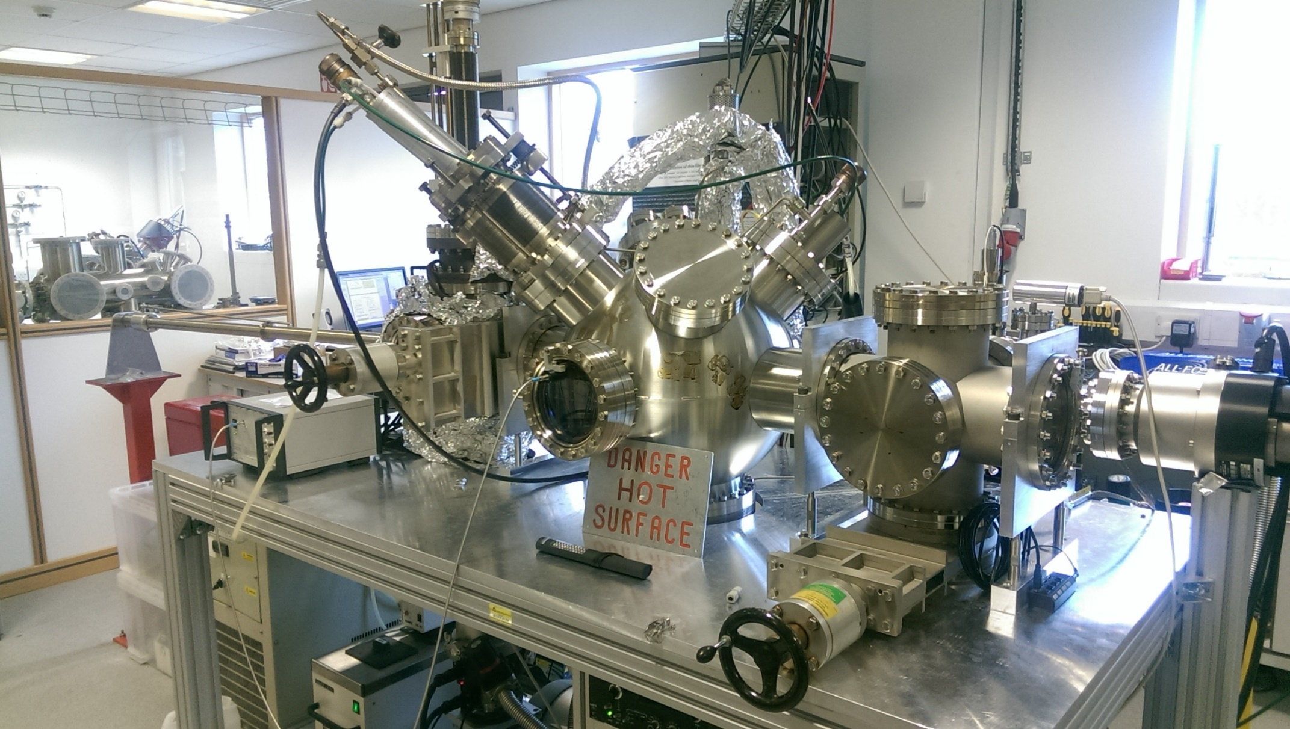
Typical UHV Vacuum System
Notes:
Simple, two chambers with gate valve
Thin film deposition system
Typically used with base pressure of 1e-9 mbar
Needs to be prepared to reach that
Cleaned and baked to remove grease and water vapour

Slide 4
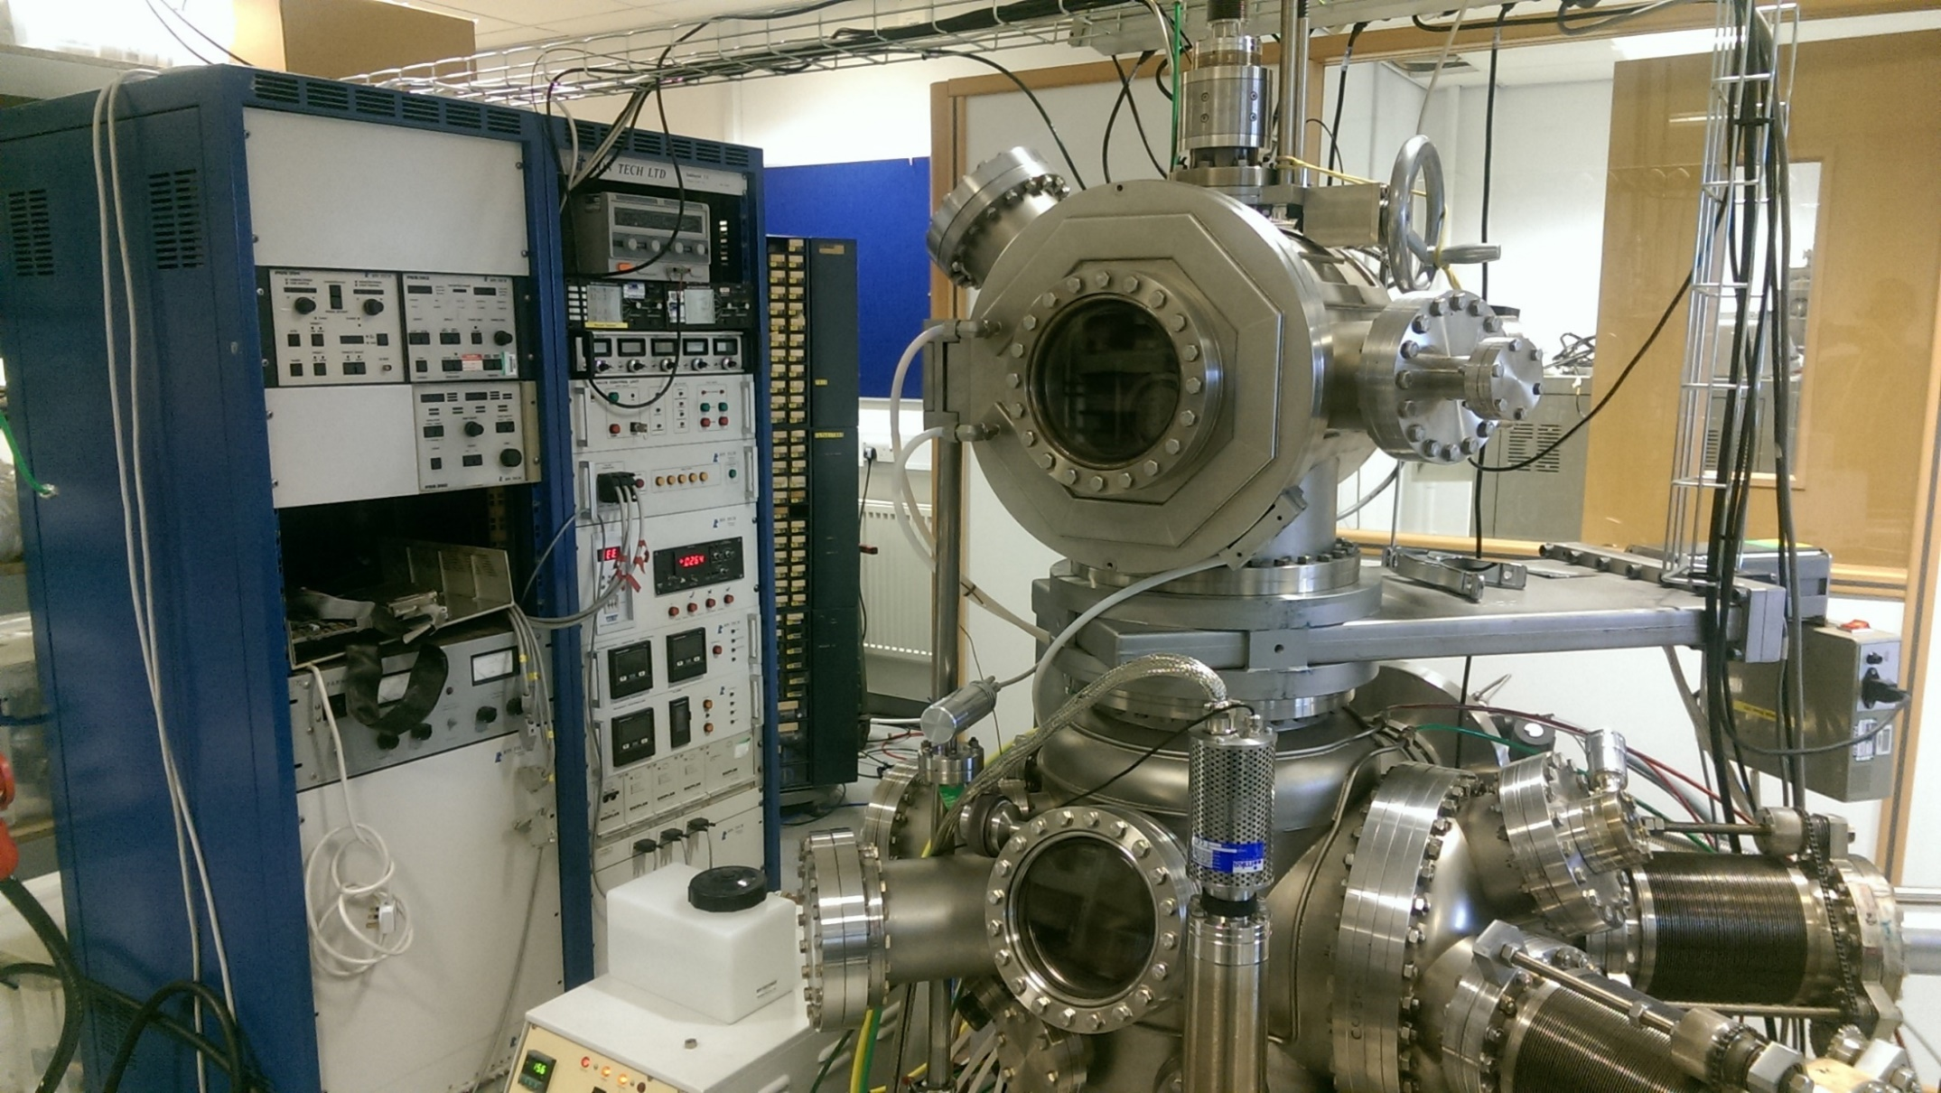
Typical UHV Vacuum System
Notes:
Another thin film deposition system
Typically was not baked
Only reached base pressure 1e-7 mbar
Higher partial pressures, therefore more contamination within thin films

Slide 5
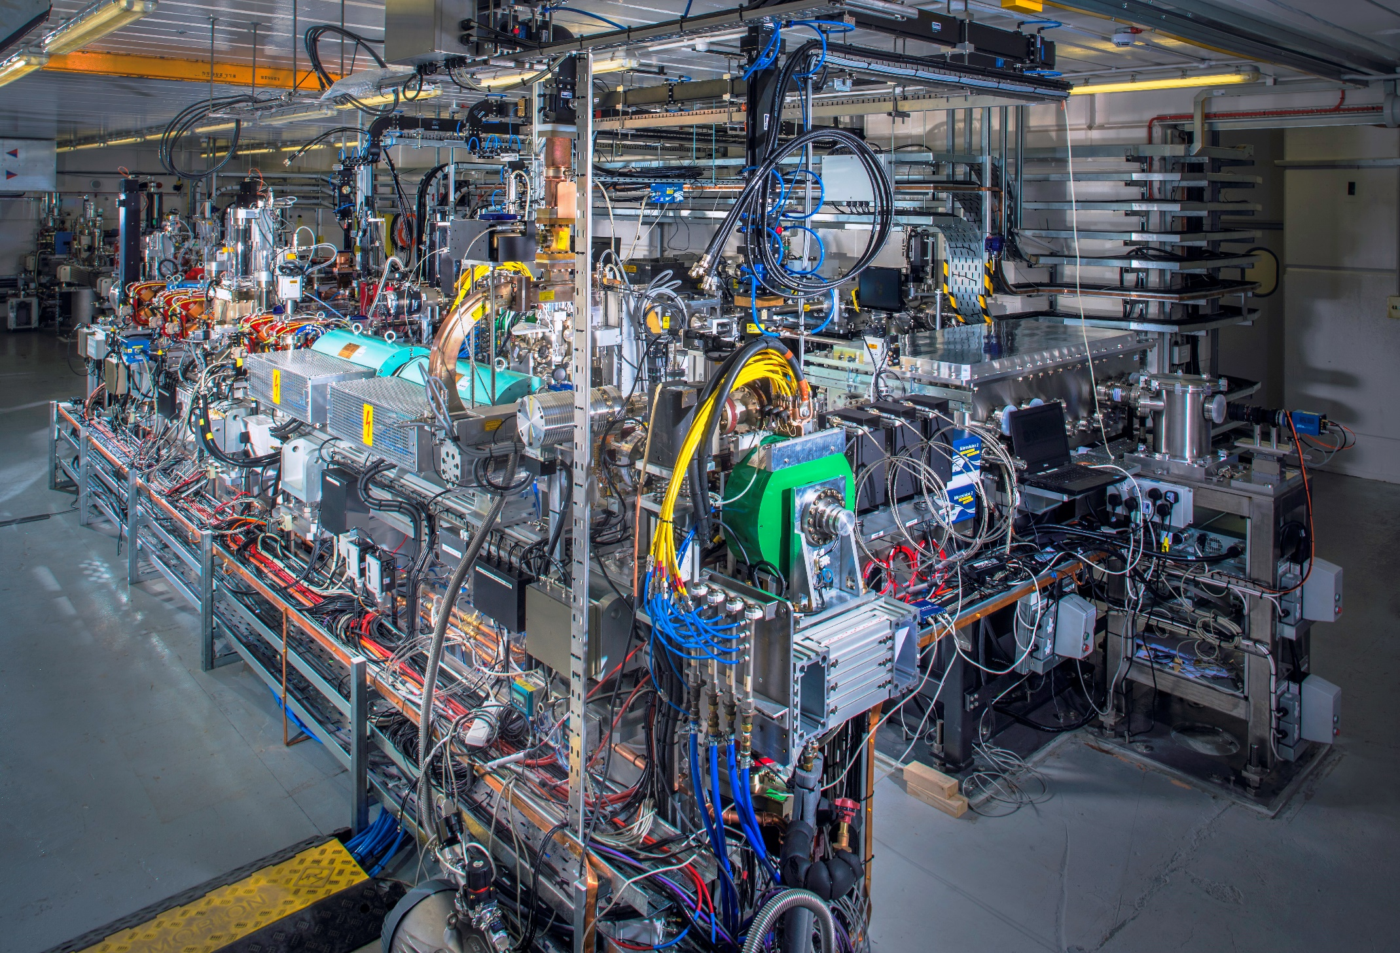
CLARA
Notes:
- Complex
Many chambers and isolation valves
Differential pumping sections

Slide 6
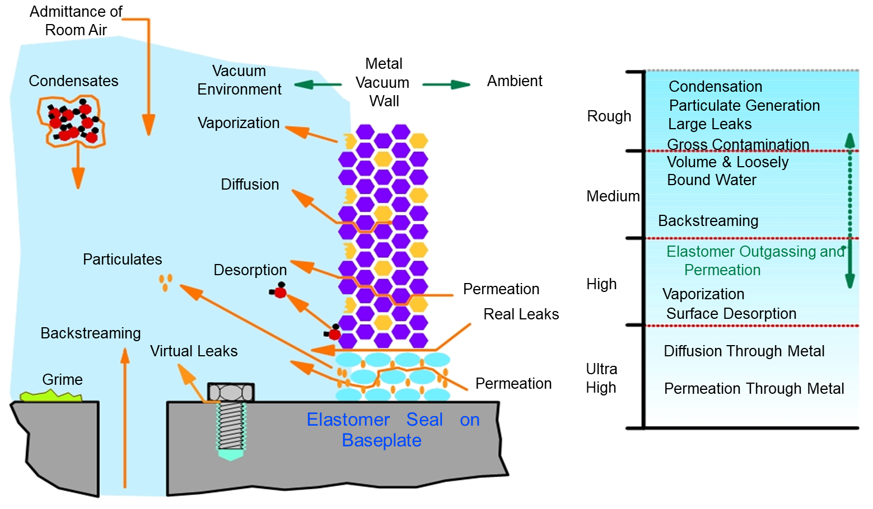
What limits the achievable vacuum and levels of contaminants?
Process Gas
1000 – 1 mbar
1 mbar – 10⁻³ mbar
10⁻³ – 10⁻⁶ mbar
≤ 10⁻⁷ mbar
Notes:
There are different vaccum regimes, rough, medium, high and ultra high
Consideration for which regime you require for your experiment
Different preparation for each regime
Typically, always remove grime by cleaning
Avoid leaks and trapped volumes
De-grease for High and ultra high
Consider outgassing rates of materials for UHV
Bake the system to remove water vapour if required

Slide 7
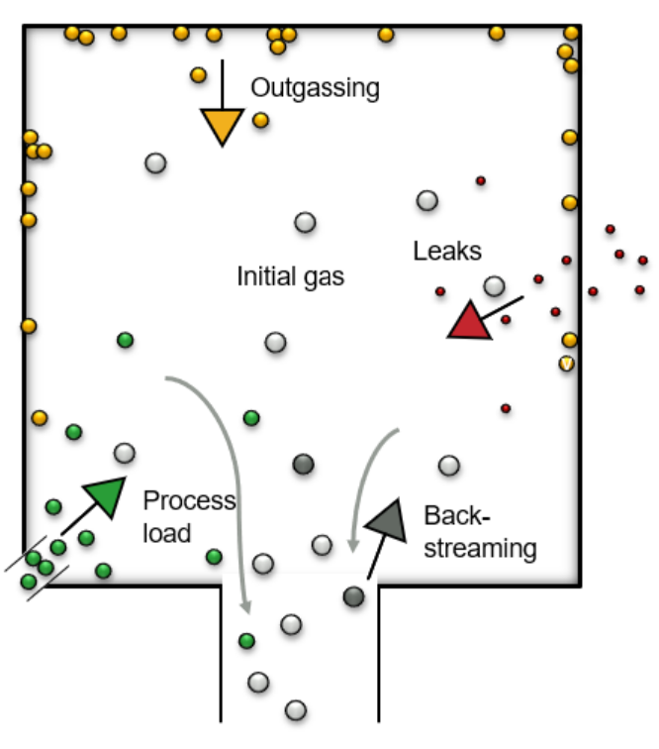
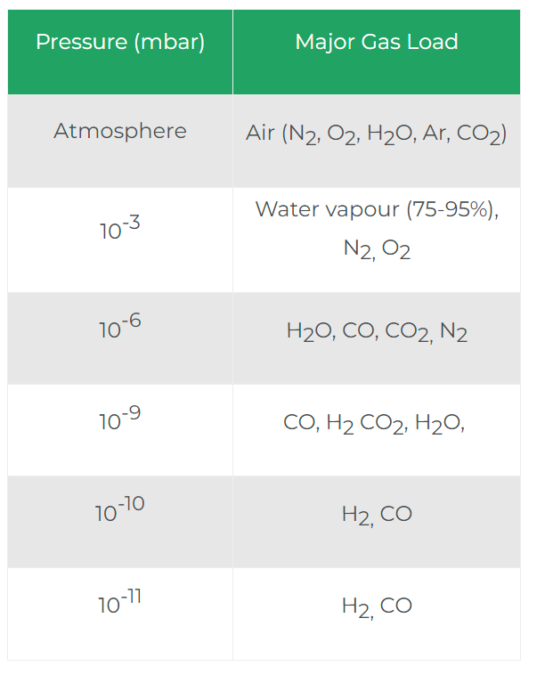
What limits the achievable vacuum and levels of contaminants?
Gas load is typically total of, leaks, back streaming from pumps, process gas and outgassing
Avoid leaks
Choose correct pump for process and gas load
Clean to remove grease and grime
Bake above 120 C to remove water vapour
Notes:
There are different vaccum regimes, rough, medium, high and ultra high
Consideration for which regime you require for your experiment
Different preparation for each regime
Typically, always remove grime by cleaning
Avoid leaks and trapped volumes
De-grease for High and ultra high
Consider outgassing rates of materials for UHV
Bake the system to remove water vapour if required

Slide 8
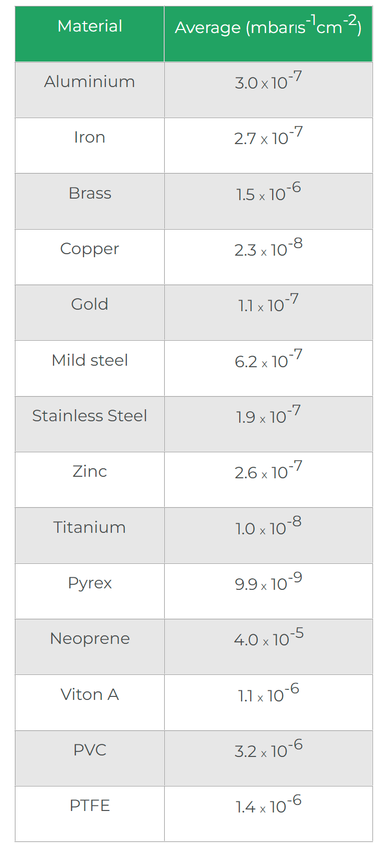
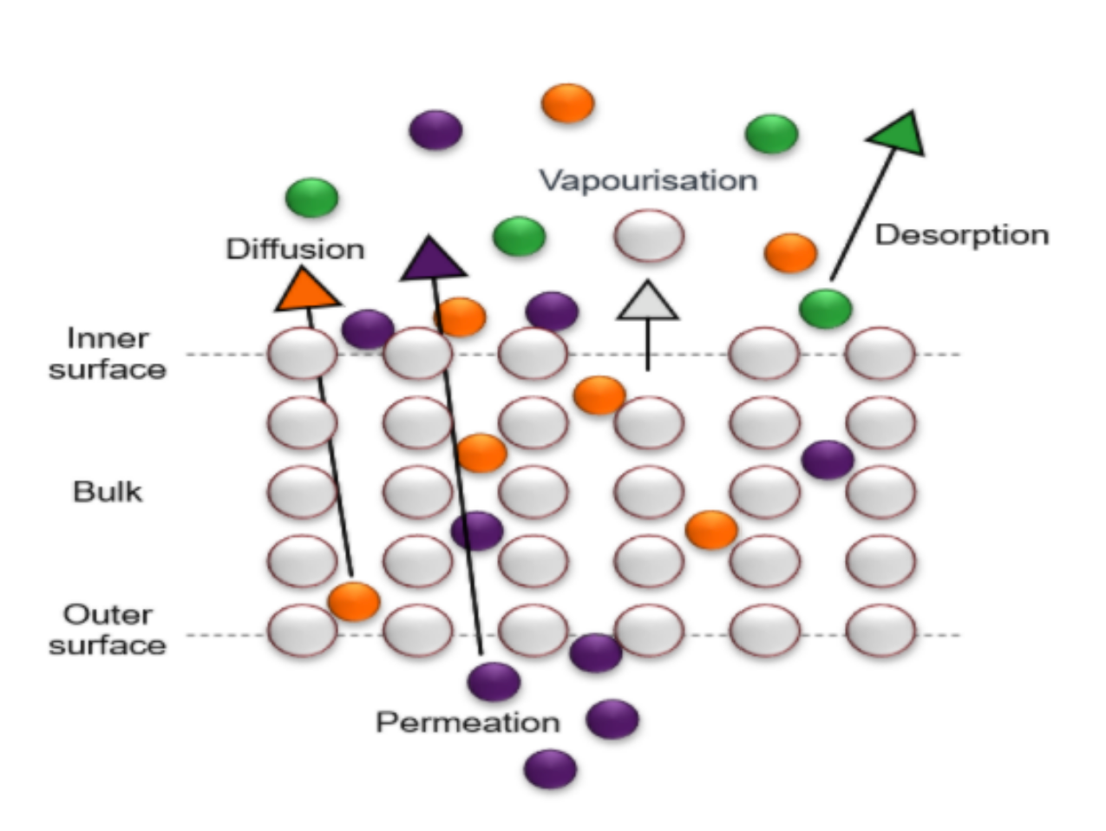
Choose material outgassing rate to match your pressure regime
Typically for UHV – stainless steel, copper and pyrex
High vacuum gives more choice in materials as higher outgassing rates can be used
Notes:
There are different vaccum regimes, rough, medium, high and ultra high
Consideration for which regime you require for your experiment
Different preparation for each regime
Typically, always remove grime by cleaning
Avoid leaks and trapped volumes
De-grease for High and ultra high
Consider outgassing rates of materials for UHV
Bake the system to remove water vapour if required

Slide 9
General Material Requirements for Vacuum Use
Low permeation (no leaks to atmosphere)
Low Partial Pressure
  Low content of gases, no significant material outgassing.
Mechanical Stability at Operational Temperature.
Weight
Ease of Fabrication: Turning, Milling, Welding, Cleaning etc..
Availability and Costs.
Notes:
-Typical materials are stainless steel, copper and

Slide 10
Specialist Material Requirements
Thermal Conductivity
Electrical Conductivity
Corrosion Resistance
Radiation Resistance
Magnetic Permeability

Slide 11
Vacuum Seals
Every accelerator incorporates many demountable vacuum joints. Clearly these have to be reliable.
The seal is the most unreliable part of such joints.
Seals are made of elastomers or metals.
The requirements are that the seal is deformable, elastic and stable (over time and over a range of temperatures).
In accelerators, radiation resistance of seal materials can be of importance.

Slide 12
Elastomer Seals
Definition:- Polymers. “Rubber-like” material with elastic properties.
Suitable elastomers include
  Buna N
  Neoprene
  Fluoroelastomer (VitonTM)
  Silicone
  PTFE
  Polyimide (VespelTM, KalrezTM)

Slide 13
Elastomer Seals
Limited temperature range
  Buna N, Neoprene ~ 85ºC
  Viton ~ 150ºC
  Polyimide, PTFE ~ 275ºC
  Kalrez ~327ºC
Limited radiation resistance
  PTFE – poor (for accelerator applications)
  Viton – moderate
  Polyimide – moderate
  Kalrez - Good

Slide 14
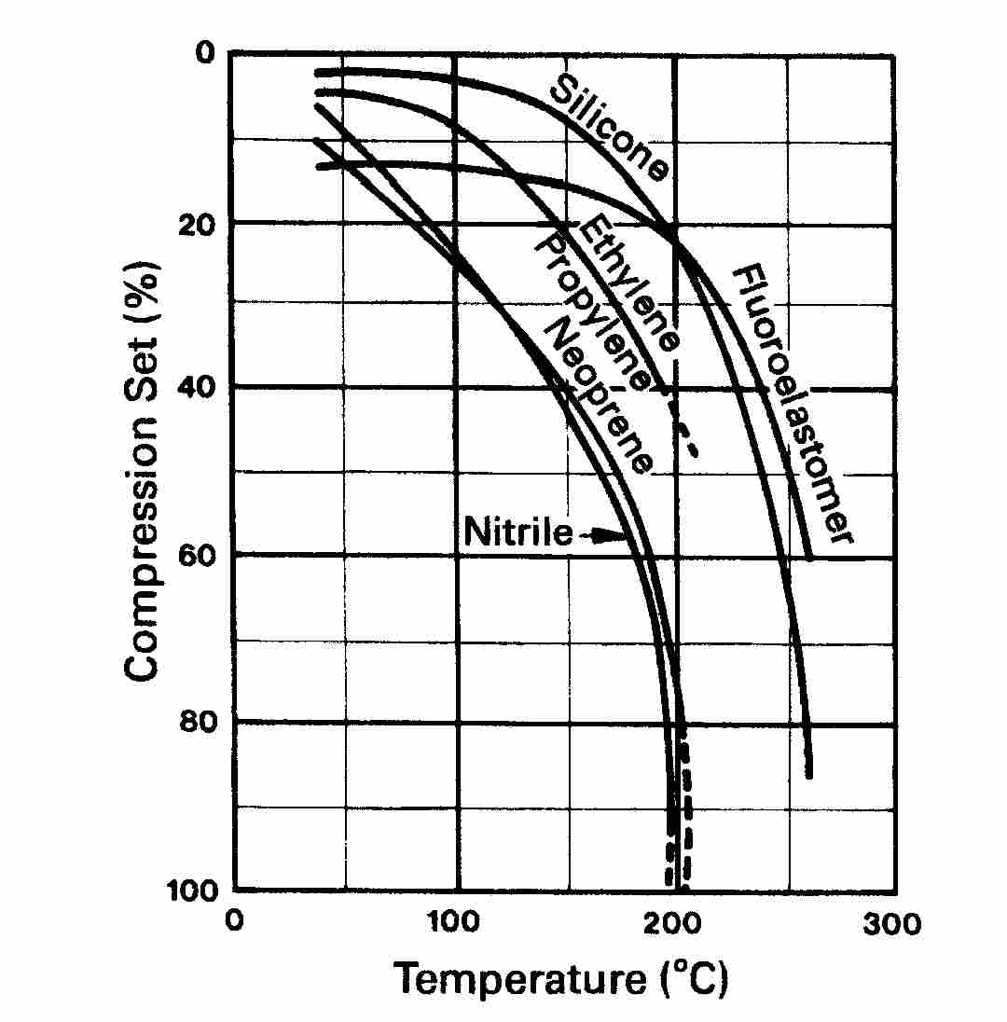
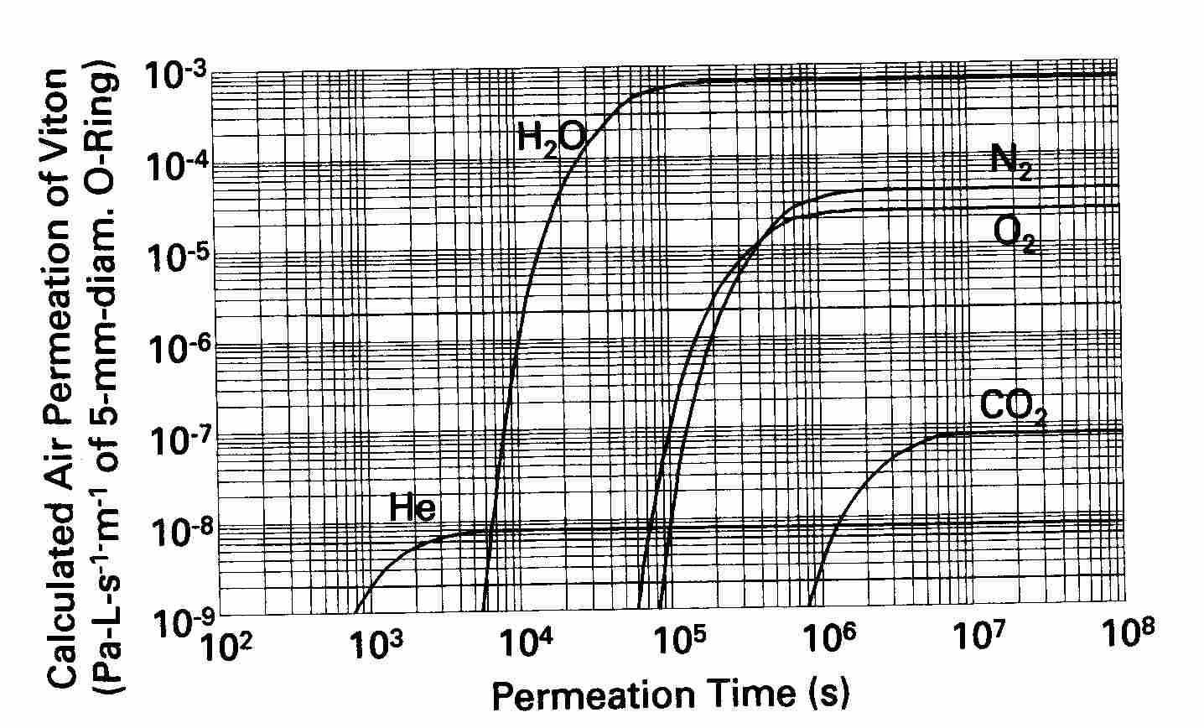
Elastomers - Properties
Compression Set
Permeation
Compression set is the permanent deformation remaining after removal of a force
Can not bake elastomers to high temperatures
He Permeation ~10-15min

Slide 15
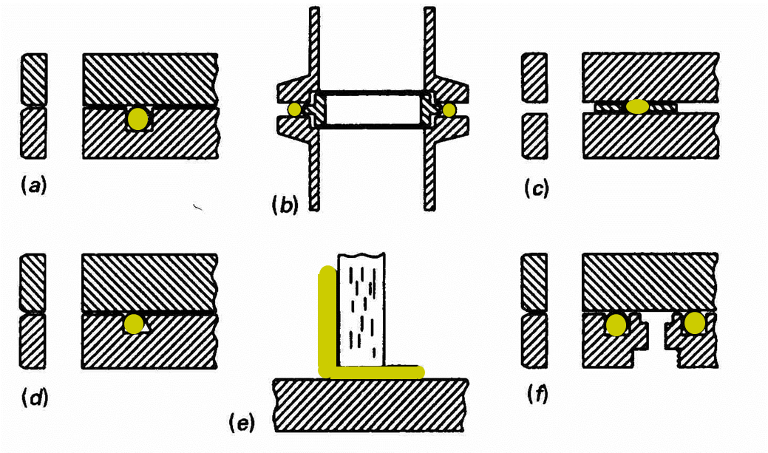
Elastomer seal configurations
Notes:
Examples of elastomer positions
Typically in the form of o-rings
Sealing occurs where a force is exerted by a flat surface onto the face of the elastomer
Sometime a double o-ring is used with the interspace evacuated and makes a better seal

Slide 16
Metal Seals
Copper
Aluminium
Aluminium alloys
Gold
Indium
Tin

Slide 17
Metal Seals
Metal O-rings (usually called wire seals) can be used in the same configurations as elastomer seals (except “L” seals) when higher temperatures are required, higher radiation resistance and generally for lower pressure applications.
Metal Seals are generally more expensive than elastomer seals and require more care to achieve a leak-tight seal.
There are 2 other common types of metal seal used in accelerator vacuum systems:-
  Knife-edge
  HelicoflexTM

Slide 18
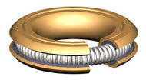
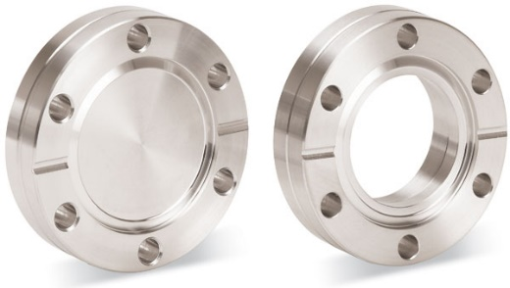
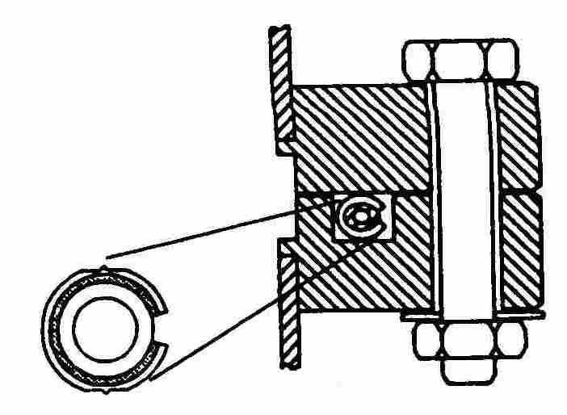
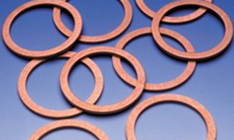
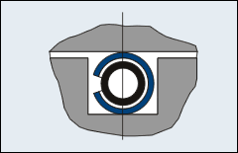
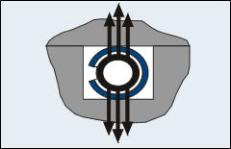
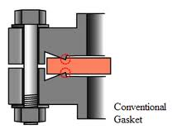
Metal Seals
HelicoflexTM
Knife edge - ConflatTM
Notes:
Helicoflex uses a spring to push sealing face onto a flat surface
Helicoflex is good for complicated shapes
Helicoflex is expensive
Knife edge and metal gasket is used more frequently and is cheaper

Slide 19

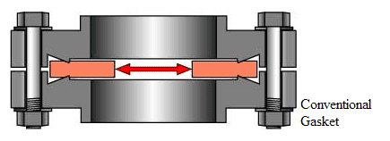
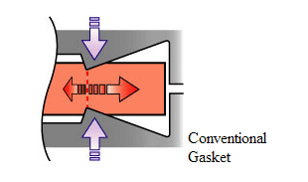
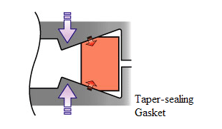
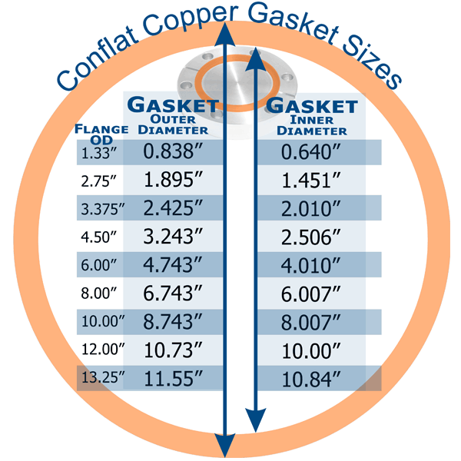
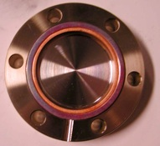
Knife edge seals
Notes:
- Knife edge forces the material in the direction of the arrows
Force is exerted onto the long edge of the knife edge and is therefore the sealing face
Taper seals work similarly and are an alternative

Slide 20
Metal Gasket Material
“Copper”
  OFHC (Oxygen free high conductivity)
  OFS (0.1% Silver) – Increased reliability
  Silver plated – Avoids cold welding and Oxidation
    Stamped - cheaper
    Machined - more reliable but expensive
Helicoflex
  Many different metal sealing jackets available
  Very expensive!

Slide 21
Flanges
Material usually similar to that of the vessel construction
  Harder than seal
  For wire seals, the ‘roughness’ of the sealing face should be ~ 1μ or less
  Lap finish should be parallel to the seal run
Knife edge (“ConflatTM”) flanges
  N hardened aluminium
  304 or 316 Stainless steel
  For highest reliability, 316LN should be used

Slide 22
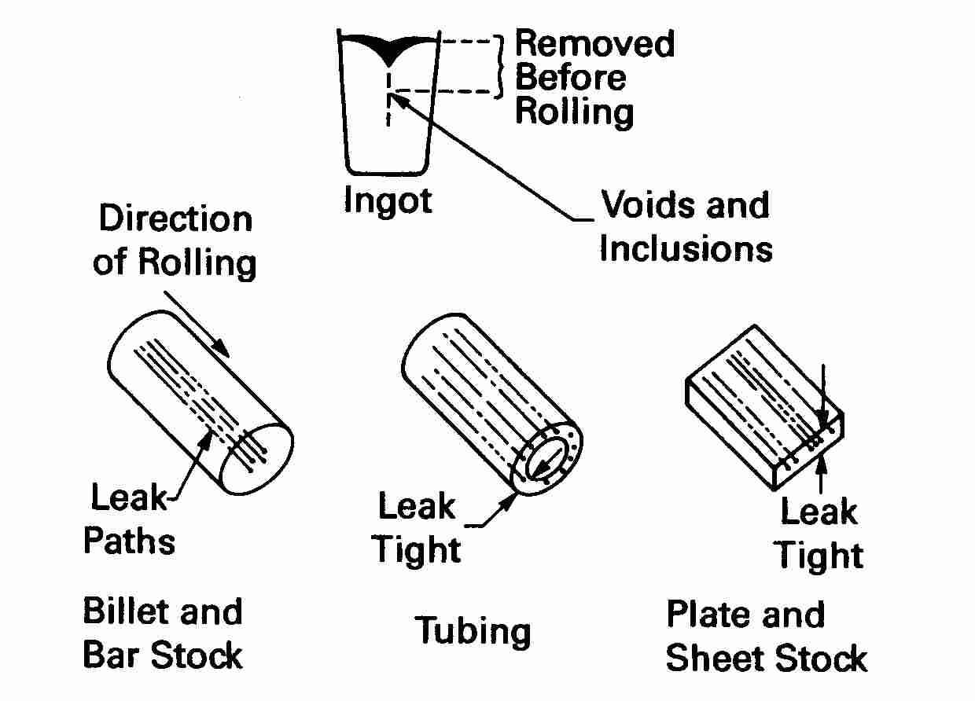
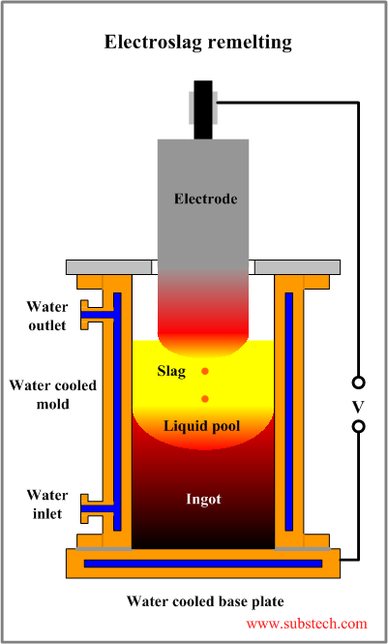
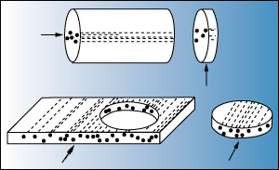
Sheets metal is usually rolled
Vacuum vessel manufacture usually rolls metal in many directions to ensure defects do not produce leak path

Slide 23
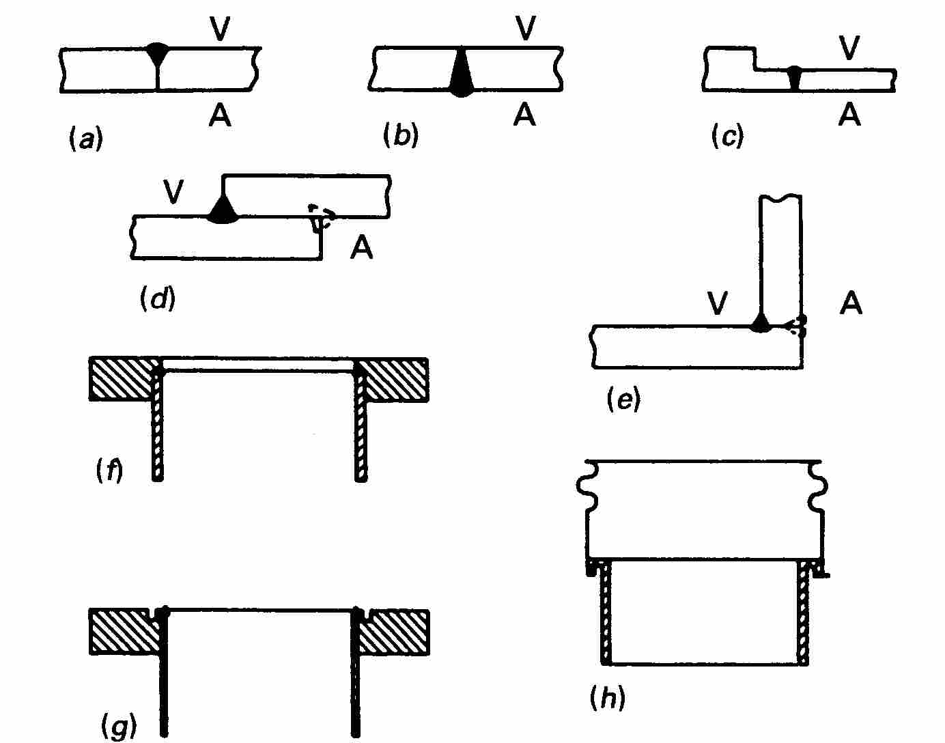
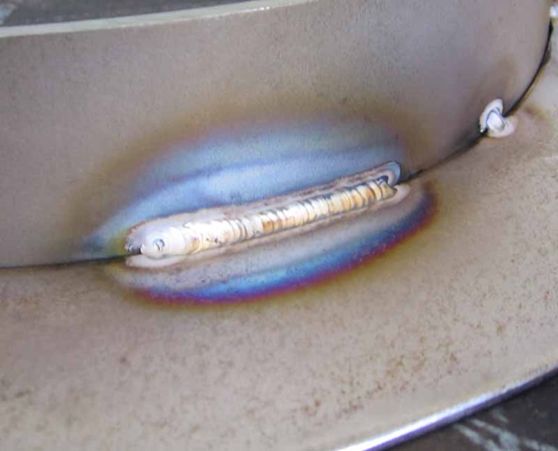
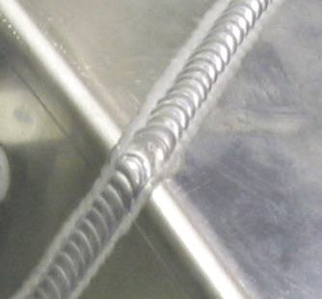
Construction Techniques
Welds
b and c show good full penetration welds
a, d and e are only welded on one side and can lead to possible weak points or trapped volumes
f displays where the correct weld should be for a flange fitting on internal surface – not always possible to perform full penetration weld

Slide 24
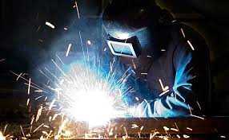
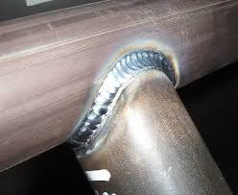
Welding Methods (STST & Al)
  TIG/MIG/MAG
  Laser Welding
  Orbital Welding
  Microplasma
  Electron Beam
NOTE – For vacuum-welds the key is leak tightness, not strength. BUT the Mechanical Engineer may require ‘Strength’ so the Vacuum Engineer & Mechanical Engineer have to work closely together!

Slide 25
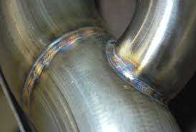
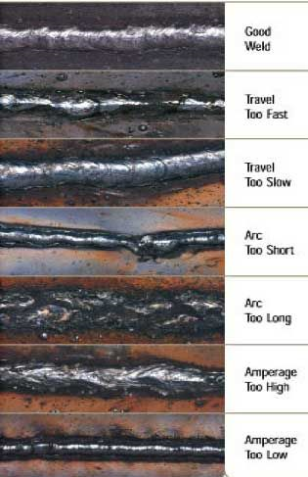
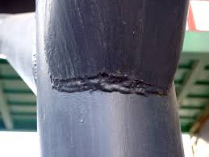

Slide 26
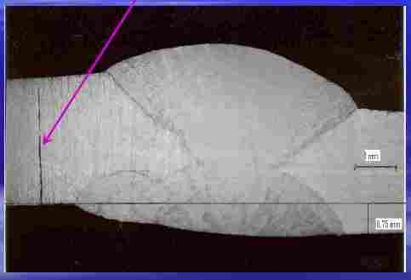
Shows a thick metal plate
Required 4 passes during welding
Inputted large amount of heat
What happened under the yellow box?
Thick plate – multi-pass weld

Slide 27
X-Ray Reveals Fracture due to
Poor Heat Distribution!

Slide 28
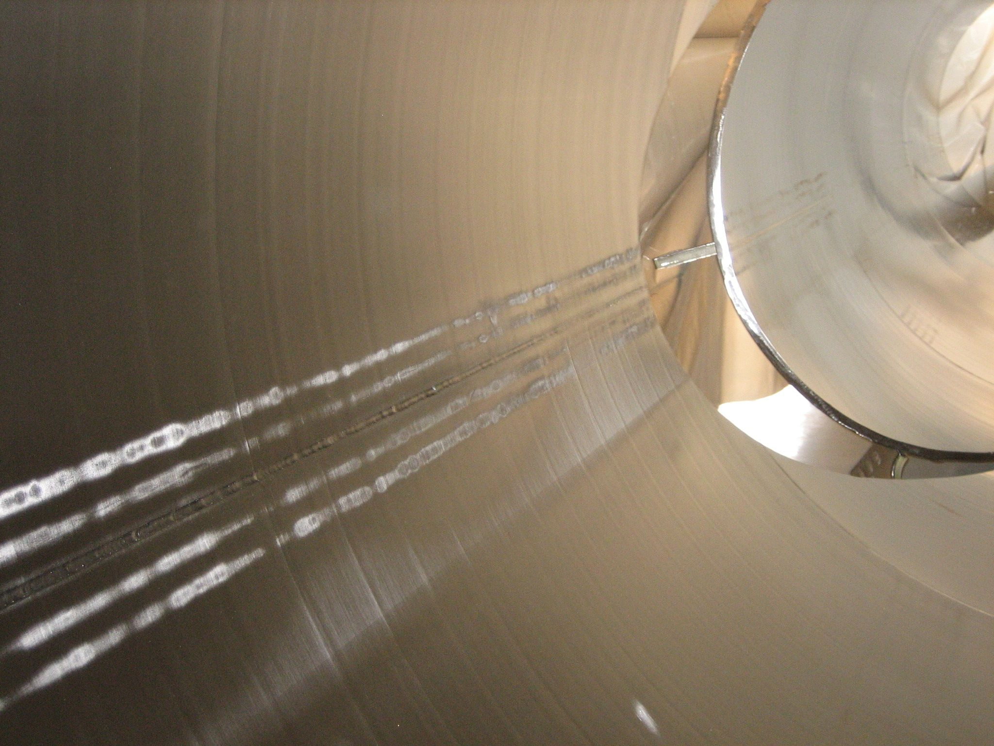
Heat runs can be used to avoid excessive heat stress
Heating a larger area of the material helps to distribute the heat
Heat runs to minimise stress & reduce distortion

Slide 29
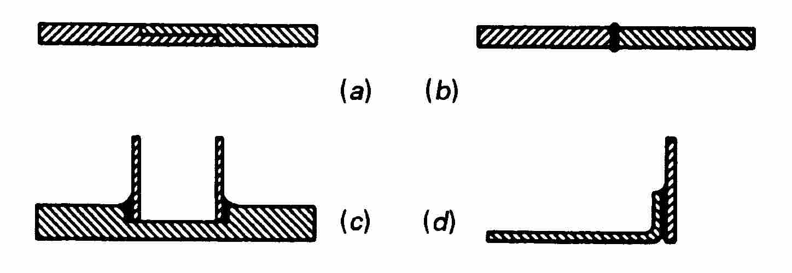
Construction Techniques
Brazing
‘Filler’ material (braze) drawn in by capillary attraction.
Typically for joining two different metals together
Typically >500ºC

Slide 30
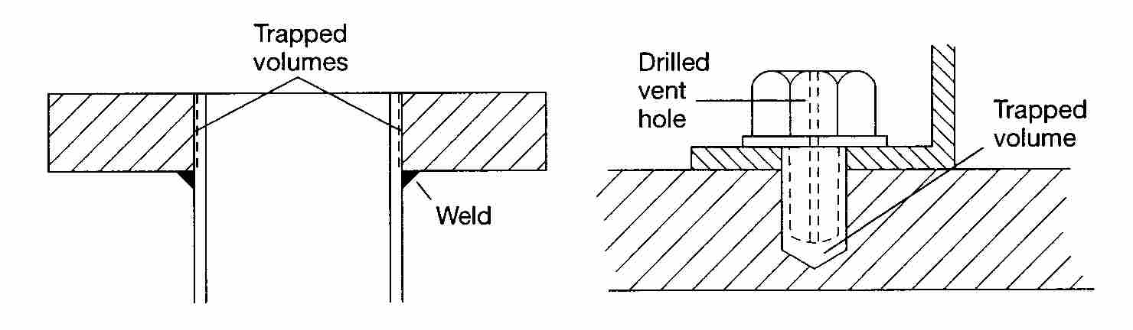
Construction Techniques
Trapped Volume OR the Blind Hole
Weld should be on the internal surface of the tube to avoid trapped volume
Holes can be drilled or slots cut into the fastener so that trapped volume can escape

Slide 31
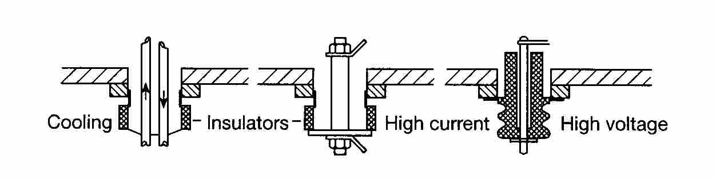
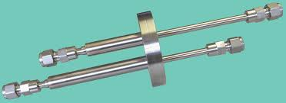
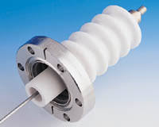
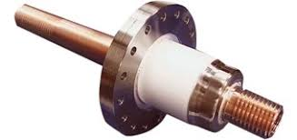
Feedthroughs
Feedthroughs are typically electrically isolated from the vacuum vessel
Cooling allows fluid to be passed though pipes
High current uses large cross-sectional area to dissipate heat
High voltage uses thicker insulator

Slide 32
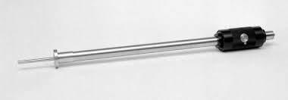
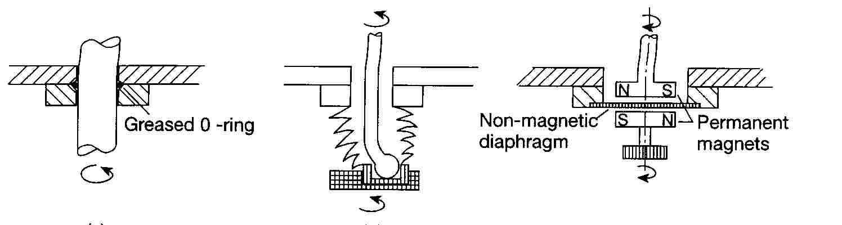
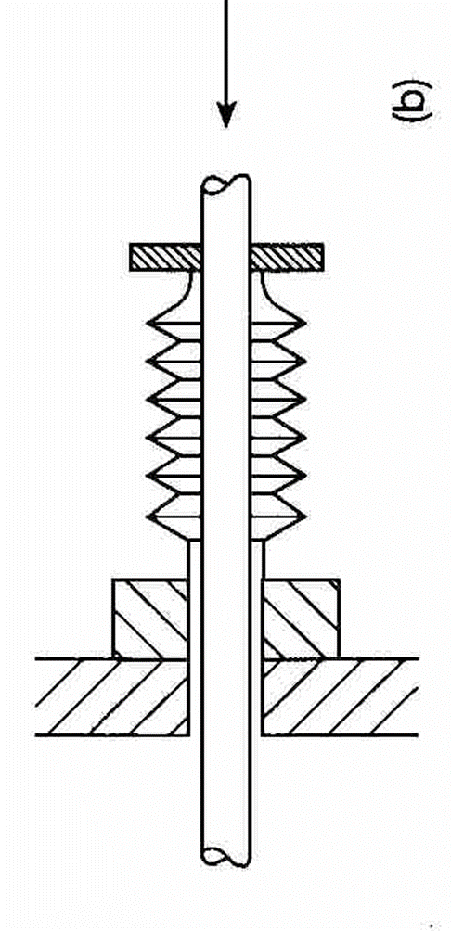
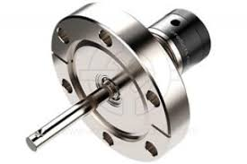
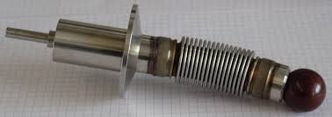
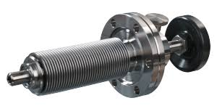
Motions (linear & Rotary)

Slide 33
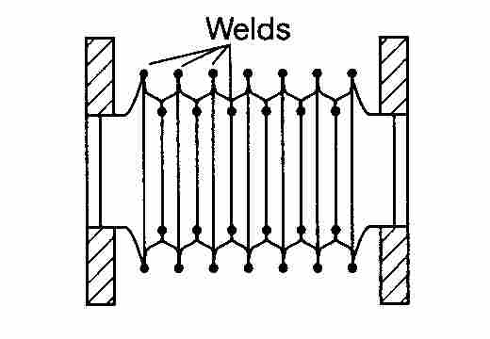
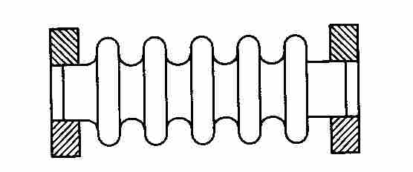

Bellows – Flexible Hose
Consider length – longer bellows are more difficult to clean
Formed are usually cheaper and have shorter lead times
Edge welded are more flexible
Edge welded can are more difficult to prepare for low particulate environments
(2) Edge welded
(1) Formed

Slide 34
Why do we need Bellows?
  Large Facility Construction Flexibility (None-Rigid)
  To Provide Component/Instrument Movement (e.g. Gate Valve)
  To damp unwanted vibration (e.g. Mechanical Pump)
  Ease of connection of mobile pump/diagnostic vacuum equipment.

Slide 35






Bellows sealed to maintain vacuum
Seal can either be all metal with knife edge or elastomer o-rings
All metal options allow baking to high temp
All metal soft close options are best for low particulate generation
Ideal for processes with many actuations
Right Angle Valve

Slide 36






Gate valve
Allow for maximum conductance
Very narrow installation depth
Space required for the travel space of the gate
Ideal for isolation from chamber to chamber of vacuum system

Slide 37

Dimensions
Imperial vs Metric – Why it matters
Critical if converting a Mechanical Drawing from one to the other. Dimensions often don’t convert accurately or ‘standard’ Imperial Sizes don’t match with the ‘standard’ metric sizes.
Example – Flange/gasket dimensions are critical
(2.3/4 inch = 69.85mm but metric size is DN70 – 70mm)

Slide 38
Manufacturing Technology
Five-axis Milling
Lathe and Milling
CNC drilling technology
Surface Finishing
  Fine-blasting with glass beads
  Grinding
  Passivation (chemical)
  Electropolishing

Slide 39
Lubrication
Lubricants may be required for bearing surfaces, especially in UHV where cold welding can occur.
Moving surfaces in contact should be designed so that the possibility of galling or scraping is minimised.
Lubricants should be chosen so that the vapour pressure is sufficiently low e.g. PTFE greases, FomblinTM oil or solid lubricants should be used.
Solid lubricants are always the preferred option for use in UHV environments

Slide 40
Lubrication
Solid lubricants
  PTFE
  Graphite
  MoS₂ (Molybdenum disulphide)
  Implanted Lead
  WS₂ (Tungsten disulphide)

Slide 41

Particulates
In an accelerator there can be many moving components – valves, shutters, beam stops, scrapers, beam monitors.
Care has to be taken regarding the generation of particulates. This can only be done by good design and the correct preparation techniques.
Components are typically cleaned and then processed with filtered nitrogen gas within a cleanroom so as to remove as much particulate contamination as possible.

Slide 42

Questions?

