Slide 1
Overview
Current and future activities in HEP detectors at RAL PPD
03/07/19
E. Giulio Villani, RAL
1

Slide 2
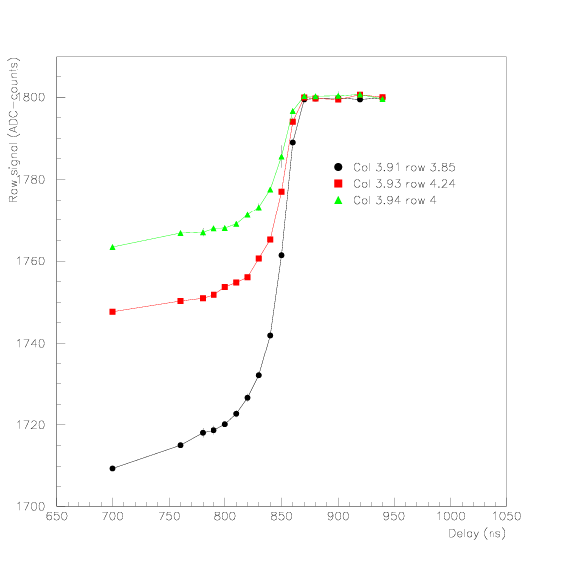
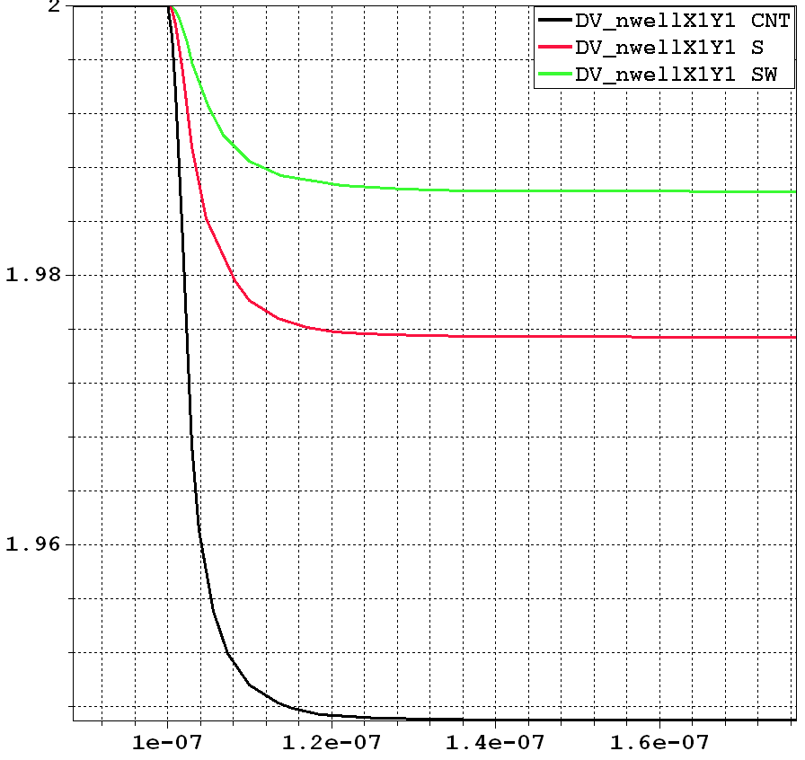
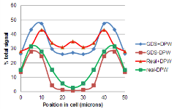
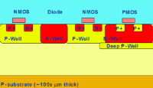

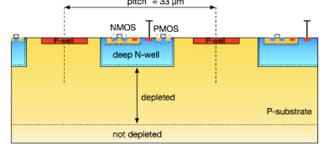
PPD past Silicon Projects
HEPAPS CMOS MAPS sensor
  0.25um CIS TSMC/IBM
  Developed ‘ad hoc’ radiation models
DNW CMOS MAPS
  Patented Triple Well for Charge collection
MI³
  Intelligent imaging
TPAC for CALICE
  50x50 um pixels tracking ECAL for ILC
  0.18um MAPS based Si-W ‘TeraPixel’ system
  Deep PW for improved CCE
  Extensive beam and laser test
Cherwell MAPS sensor (25x25um)
  0.18um CMOS Not rad hard
  Prototype for tracking and digital calorimetry
  Charge collection by diffusion
  Tested and Paper out soon
CHESS-2
  Testing rad hard HV-CMOS sensors
AIDA 2020
  TCAD simulations for the development of CMOS detector models
Most (all) current HVCMOS structures share the same topology initially proposed by us

Slide 3
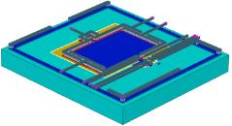
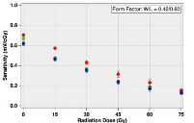
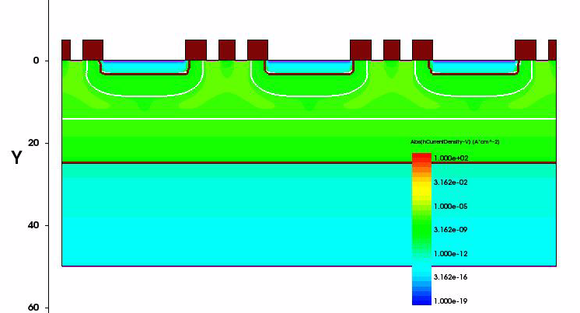
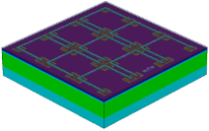

PPD current Silicon Projects
OverMOS 1, 1.1, 2.0 MAPS prototype sensor
  Rad Hard Pixel Monolithic HR-CMOS
  Multiple structures and substrates
  Neutron irradiation
  3D TCAD modelling
DECAL MAPS sensor (50x50um)
  0.18um Rad Hard Pixel Monolithic HR-CMOS
  40MHz global shutter
  Charge Collection by drift
  Configurable with in-pixel electronics
  For digital calorimetry and outer tracking at FCC
  In publishing stage
CMOS dosimetry
  0.18um SL CMOS FG based dosimeter
  Aimed at biomedical applications
  Sensitivity to 1 rad gamma doses
STI
M1

Slide 4
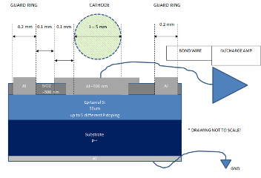
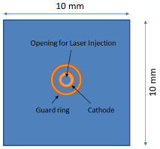
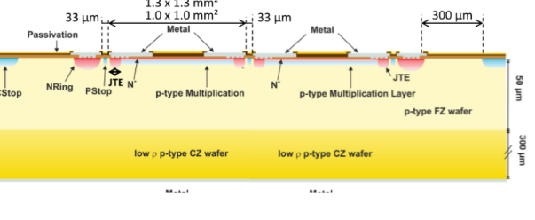
PPD future Silicon Projects
RD50 Schottky for radiation damage investigation
  RD50 proposal for epi Schottky fabrication
  Aimed at radiation damage investigation of P epi
  for CMOS TCAD modeling
  Design, fabrication, testing, analysis at RAL
Low Gain Avalanche Detectors (LGAD)
  Investigation of LGAD for Phase II ATLAS/CMS Upgrade
  Candidates for LHC-b Upgrade
  General applications as Ultra Fast Detectors (UFDs) in future HEP experiments
  Joint collaboration with Te2V, Oxford, Birmingham

Slide 5
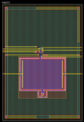
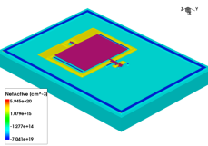
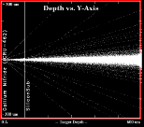
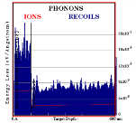
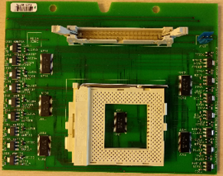
SW Tools
Synopsys TCAD simulations
We routinely use 4 – 5 machines simultaneously
Process fabrication simulations
Opto-electrical-thermal devices 3D simulations
Radiation damage modelling
SRIM simulations
Ions transport in matter
Radiation damage
Orcad – PCB design and SPICE simulation
Electronics and PCB layout
Maple for math modelling
Radiation damage modelling
Impact ionization studies
Physics of detectors
MoBo

Slide 6
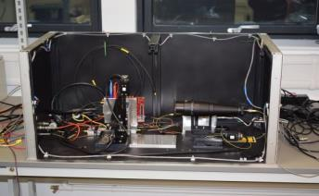
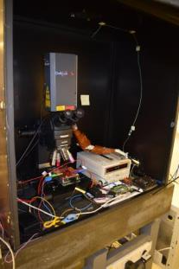
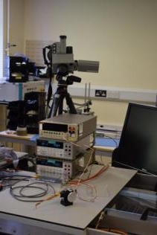
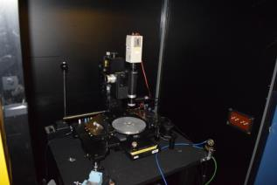
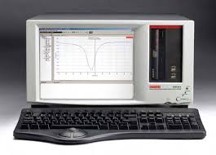
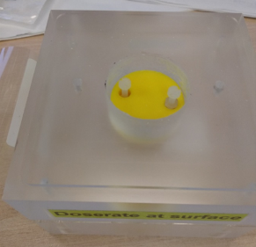
Lab equipment
TCT
Trilite
Pulsed 3 wavelength (‘Trilite’) laser with 1um minimum beam spot accuracy and <1um XYZ motorized stage for sensor testing
TCT laser
Radioactive sources (⁹⁰Sr, ⁵⁵Fe, ⁶⁰Co)
Peltier cooled CAs
Keithley Semi-Conductor analyzer CS4200 with HV – CV - PG units
Thermal camera
Environmental chambers
N2 cooling system for live sample testing
3-D printers
Laser Cutting facility
Impedance analyzer
DAQ facilities (ATCA, HSIO, ATLYS, ITS-DAQ, NI DAQ)
Excellent working relationships with international facilities
⁹⁰Sr

Slide 7
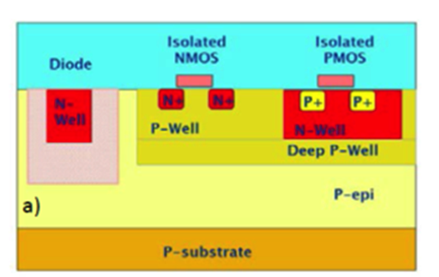
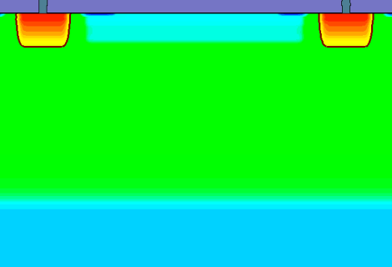
  OVERMOS description
Particle track
N⁺⁺
SiO₂
DPW
18 μm
P-Epi
P⁺⁺-Sub
OVERMOS is a CMOS MAPS project demonstrator fabricated using:
TJ 180 nm Hi-res 18 um thick epitaxial layer 1kOhm –cm
Small ( 3.5x3.5 um2) n-collecting nodes
Multi diode arrangements within pixel
CMOS DPW ∼ originally proposed for DECAL of ILC
03/07/19
E. Giulio Villani, RAL

Slide 8
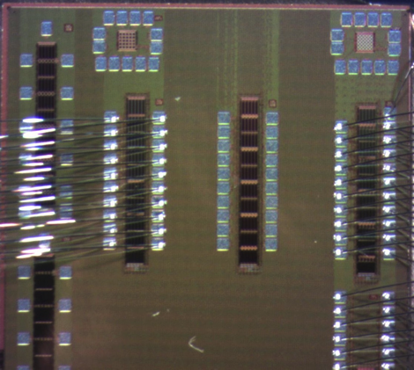
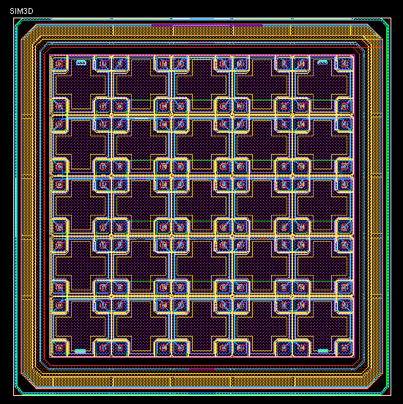
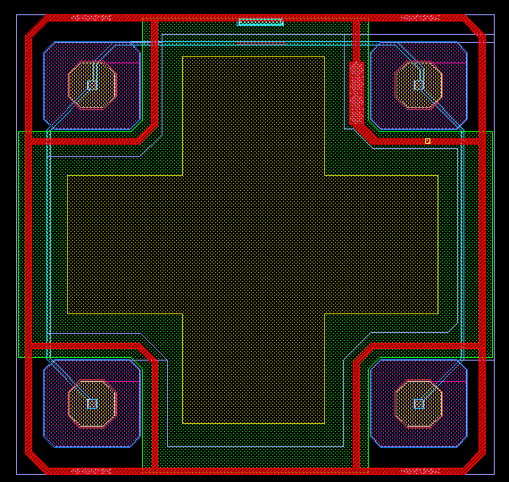
  OVERMOS description
40um
40um
Pixel 4
N++
P++
A TCAD modelling of fabrication process of OVERMOS has been developed to investigate and predict its performances
OVERMOS devices have been n-irradiated to Φ [1e13,5e13,1e14,5e14,1e15]
03/07/19
E. Giulio Villani, RAL

Slide 9
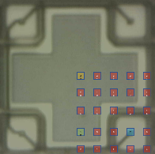
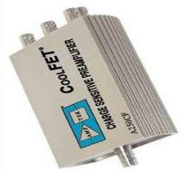
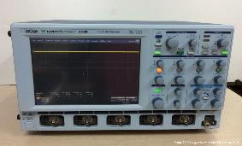
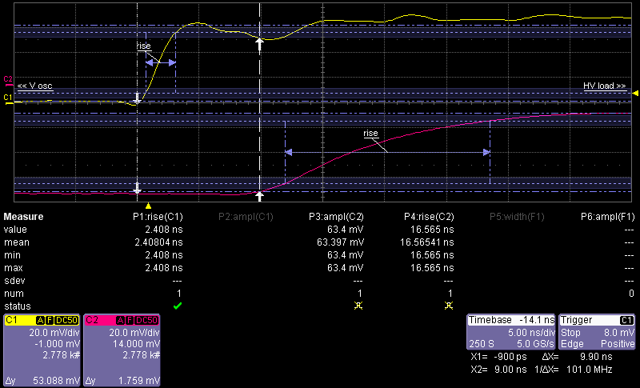
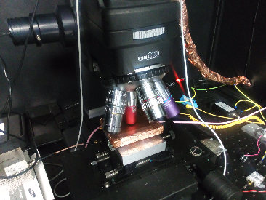
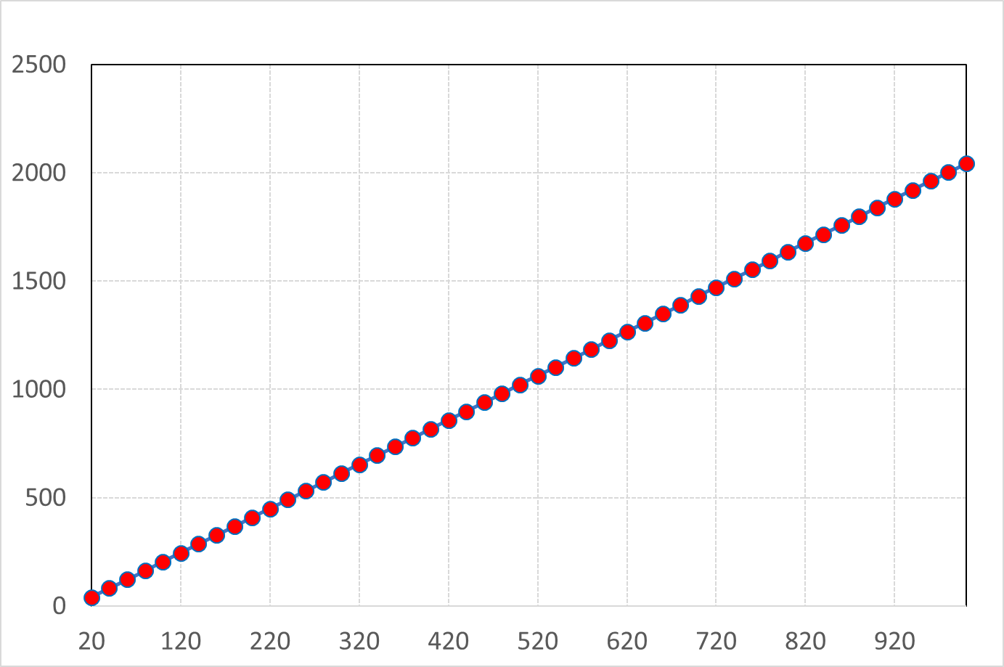
  OVERMOS Laser Test
Trigger (Q-sw)
DUT
XY stage 1um accuracy
T = 21°C
AMPTEK A250CF
LeCROY WR
  mV
  2.04 ± 0.17 mV/fC
  fC
Nd:YAG Trilite Laser
E. Giulio Villani, RAL
03/07/19

Slide 10
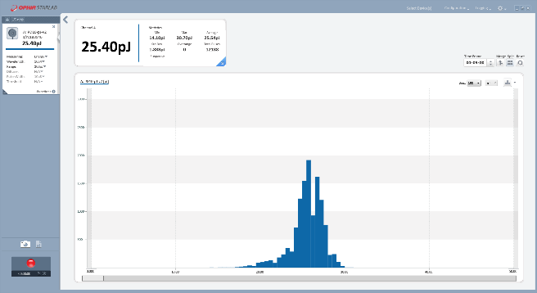
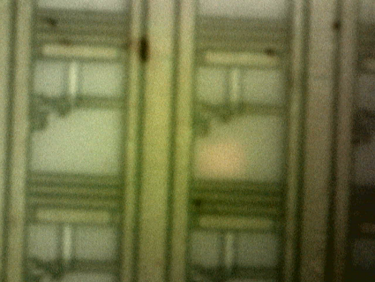
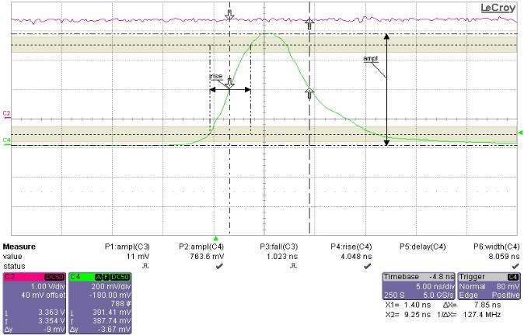
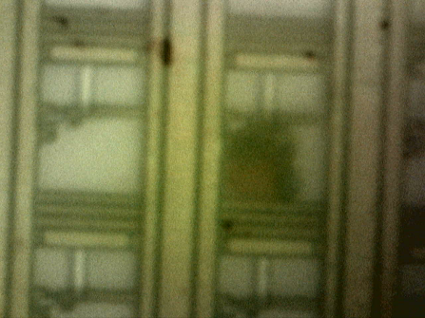
  OVERMOS Laser Test
  Beam size ‘destructive’ test
15 μm
  Laser energy settings, measured with Pd10-pJ:
  ~ 25 ± 1.8 pJ @ 1064 nm
  50Hz rate
  Shutter size set to 5 x 5 um2
  ~ 7.8 ns Laser pulse width,
03/07/19
E. Giulio Villani, RAL

Slide 11
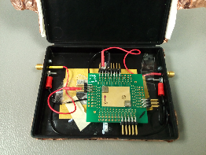
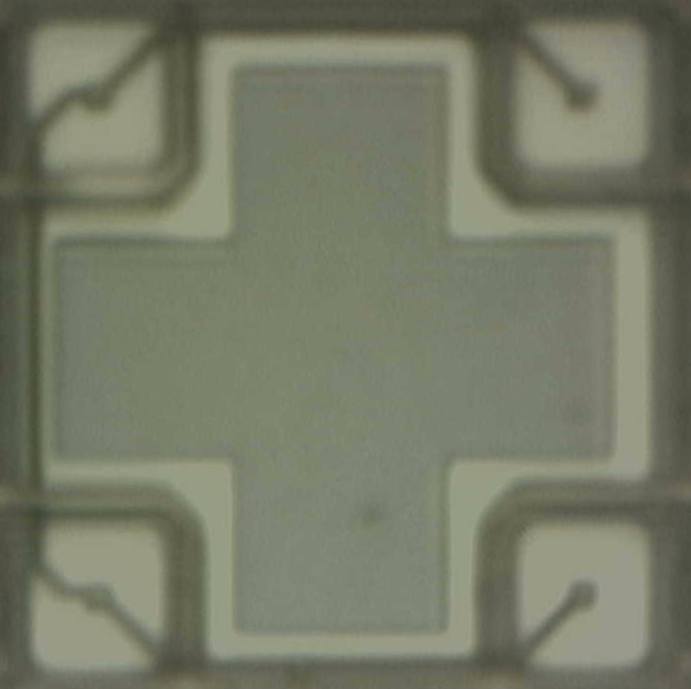
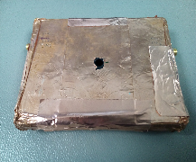
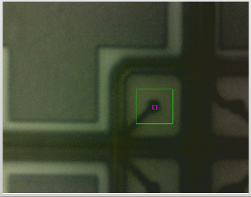
  OVERMOS Laser Test
40 μm
OVERMOS
Vbias = 10V
Cu shielded OVERMOS
40 μm
25
24
23
22
21
20
19
18
17
16
15
14
13
12
11
10
9
8
7
6
5
4
3
2
1
OVERMOS Laser scan 5 x 5 um2 beam size
25 points, repeated over entire pixel area to give map of collected charge
The dynamics of charge collection of three points (7,10,25) is compared with TCAD simulations for non-irradiated and irradiated devices
03/07/19
E. Giulio Villani, RAL

Slide 12
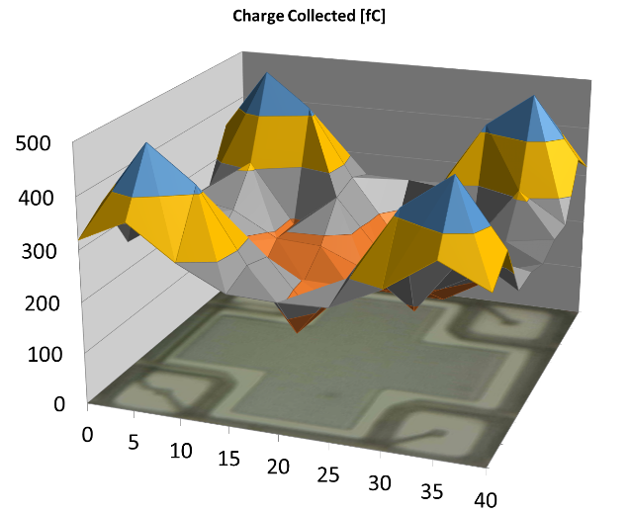
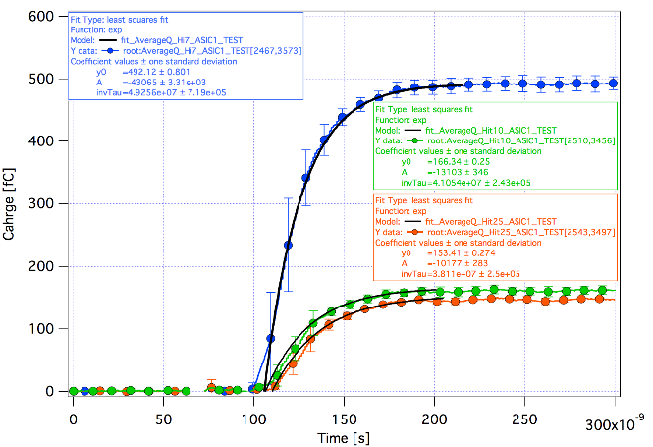
  OVERMOS Laser Test
Φ=0
<Q_{c}>=267
Hit 7
Hit 10
Hit 25
<Q> = 492.1 [fC] Collection time: 44.6±0.36 ns
OVERMOS Laser scan 5 x 5 um2 beam size
10 non – irradiated pixels Laser Test results
<Q>= 166.34 [fC] Collection time: 53.5±0.31 ns
<Q>= 153.4 [fC] Collection time: 57.6±0.52 ns
03/07/19
E. Giulio Villani, RAL

Slide 13
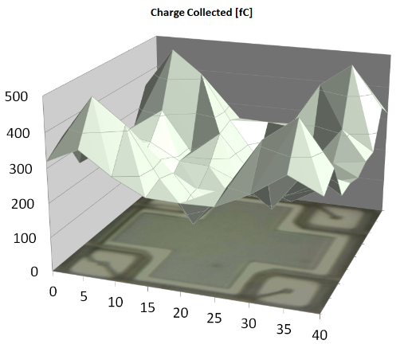
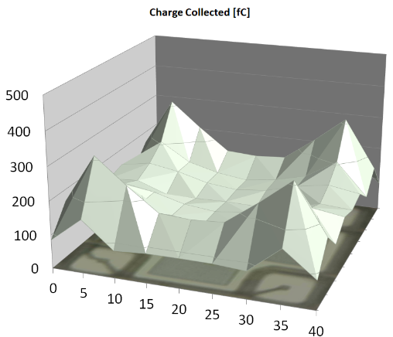
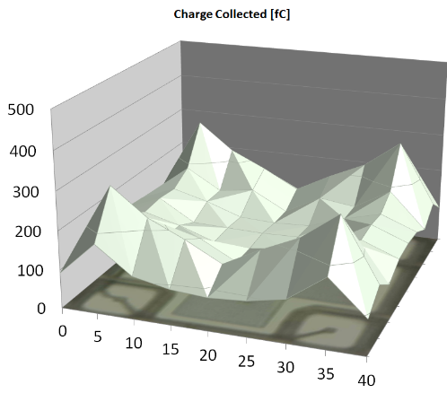
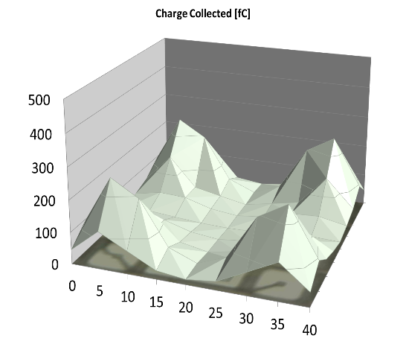
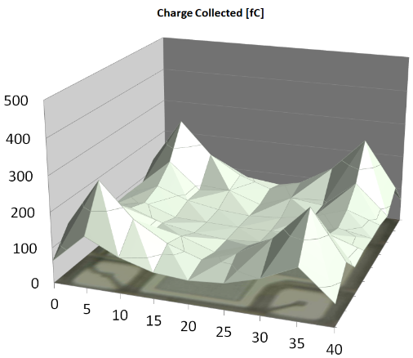
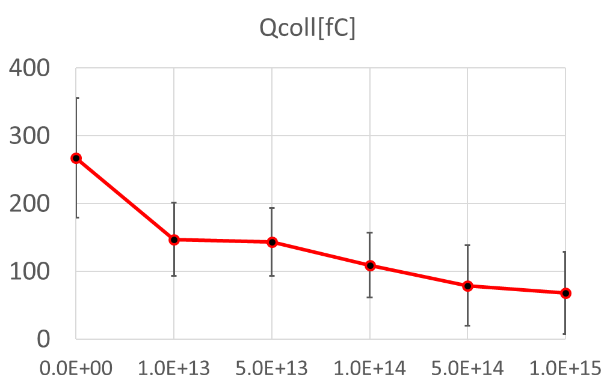
  OVERMOS Laser Test
Φ=1e13
Φ=5e13
Q_{c} [fC]
<Q_{c}>=147
Q_{c} [fC]
<Q_{c}>=143
Q_{c} [fC]
Φ=1e14
<Q_{c}>=109
μm
μm
μm
Q_{c} [fC]
Φ=5e14
Q_{c} [fC]
Φ=1e15
<Q_{c}>=79
<Q_{c}>=68
μm
μm
03/07/19
E. Giulio Villani, RAL

Slide 14







  OVERMOS Laser Test
Φ=0
Φ=1e13
Φ=5e13
Laser TRG
Φ=1e14
Φ=5e14
Φ=1e15
Kinematics of charge collection - fC
03/07/19
E. Giulio Villani, RAL

Slide 15







  TCAD simulation
Simulations workflow
Layout editing
Process simulation
∼5500 secs
Process simulation –
SDEVICE
∼4000 secs
DC/CC/OPT simulation
>200k secs
Running on WS Intel Xeon Gold 5122 4 Core Processor, 3.6GHz, 16GB 2.4GHz RAM, 240GB SSD 6Gb/s
03/07/19
E. Giulio Villani, RAL

Slide 16

  TCAD simulation
Si bulk
Epitaxial growth
SiO2 thermal growth
Mask layout 1
P implants
Strip resist
Mask layout 2
N implants
Strip resist
Mask layout 3
XP implants
Strip resist
Pixel .gds
SiO2 etching
Al patterning
dep
contacts
A simplified TJ CMOS fabrication process of OVERMOS has been implemented in SPROCESS
Around 15 simulated steps, which include epitaxial growth on Si bulk, SiO2 thermal growth, N/P implant, etching, thermal annealing, metal deposition, contacts placement
03/07/19
E. Giulio Villani, RAL

Slide 17



  TCAD simulation
SiO2
PolySi
For DC studies only ¼ pixel is simulated
For CC studies using Laser light, an extra PolySi box surrounds the pixel, with high SRV to simulate non-reflecting boundaries (added as an SDE directive within SPROCESS)
Thermally grown 8.1 nm SiO2 for interface traps effects
Thick deposited SiO2 for better Delaunay meshing/optical attenuation/reflection (will implement STI next)
Emulation of CoSi2 silicide for optical attenuation in non-NS regions (will implement silicide growth next)
03/07/19
E. Giulio Villani, RAL

Slide 18

  TCAD simulation
  HPTM
A factor 1.66 has been applied to g_{int} to account for n irradiation
03/07/19
E. Giulio Villani, RAL

Slide 19






  TCAD simulation
DLN=30
CB
1.2e11 Oxch
[0.007,10,10 ]
SiO₂
hN eN eN
SiO₂
VB
Fixed oxide-charge (Oxch) density and interface traps (Oxint) included
Interface traps distributed among 3 energy levels, Gaussian , σ = 70meV
Ratio Oxint/Oxch ~ 0.9
Simulations 1.2e11 Oxch
Xsection 1E-15 cm^-2
* Effects of Interface Donor Trap States on Isolation Properties of Detectors Operating at High-Luminosity LHC, DOI: 10.1109/TNS.2017.2709815
03/07/19
E. Giulio Villani, RAL

Slide 20

  TCAD simulation IV
DC IV plots up to BV
<IV>[10] measured OVERMOS + σ
IV TCAD Oxch 1.2e11, OxINT 1.1e11
TCAD
Φ | I_{leak_μ}[A] @10V | I_{leak_TCAD}[A] @10V | Δ% | ªBV_{μ}[V] | BV_{TCAD}[V]
0 | 1.0e-12 | 0.85e-12 | 15 | 50.8 | 54.79
1e13 | 7.5e-12 | 1e-11 | -33.3 | 52 | 54.6
5e13 | 6.72e-11 | 7.47e-11 | -11.1 | 51.2 | 54.7
1e14 | 2.1e-10 | 2.06e-10 | 1.9 | 52.4 | 54.7
5e14 | 6.21e-10 | 1.18e-9 | -90 | 53.6 | 54.8
1e15 | 1.43e-9 | 1.83e-9 | -28 | 54.4 | 54.8
TEST
1e15 Φ
5e14 Φ
1e14 Φ
5e13 Φ
1e13 Φ
0 Φ
^{Vbias for CCE}
ªBV defined as V: (ΔI/ΔV)_{max}
03/07/19
E. Giulio Villani, RAL

Slide 21

  TCAD simulation CC
Q_{coll} | Test | TCAD | Δ%
<Qh7> | 492 | 556 | -13
<Qh10> | 166 | 131 | 21
<Qh25> | 153 | 166 | -8.4
TCAD
TEST₁₀
T_{coll10-90} | Test | TCAD | Δ%
<t_{coll}h7> | 44.6 | 45.2 | 1.3ª
<t_{coll}10> | 53.5 | 59.9 | 12^{b}
<t_{coll}25> | 57.6 | 68 | 18^{c}
ªhit7 with CA delay subs: 9.1%
^{b}hit10 with CA delay subs: 17.7%
^{c}hit25 with CA delay subs: 23.3%
Laser Hit
03/07/19
E. Giulio Villani, RAL

Slide 22


  TCAD simulation
Q [fC]
1e13
Q_{coll} | Test | TCAD | Δ%
<Qh7> | 309 | 529 | -71
<Qh10> | 165 | 113 | 31
<Qh25> | 110 | 143 | -30
Q [fC]
t [ns]
5e13
Q_{coll} | Test | TCAD | Δ%
<Qh7> | 282 | 437 | -54
<Qh10> | 132 | 75 | 43
<Qh25> | 106 | 82 | 22
t [ns]
Laser Hit
03/07/19
E. Giulio Villani, RAL

Slide 23


  TCAD simulation
Q [fC]
1e14
Q_{coll} | Test | TCAD | Δ%
<Qh7> | 265 | 373 | -40
<Qh10> | 82 | 51 | 37
<Qh25> | 65 | 53 | 18
Q [fC]
t [ns]
5e14
Q_{coll} | Test | TCAD | Δ%
<Qh7> | 263 | 301 | -14
<Qh10> | 38 | 24 | -36
<Qh25> | 27 | 23 | -14
t [ns]
Laser Hit
03/07/19
E. Giulio Villani, RAL

Slide 24

  TCAD simulation
Q [fC]
1e15
Q_{coll} | Test | TCAD | Δ%
<Qh7> | 246 | 257 | -4
<Qh10> | 21 | 24 | -14
<Qh25> | 10 | 17 | 70
Laser Hit
t [ns]
03/07/19
E. Giulio Villani, RAL

Slide 25

RD50- Radiation Hard Semiconductor devices for very high luminosity colliders
PPD joined RD50 in Dec 2016
03/07/19
E. Giulio Villani, RAL

Slide 26

03/07/19
E. Giulio Villani, RAL

Slide 27

PPD contribution
03/07/19
E. Giulio Villani, RAL

Slide 28
  RD50 funding request
We propose to fabricate a number of Schottky and n+p diodes on p-type epitaxial (50um thick) silicon wafers, of doping concentration as they are normally used in CMOS MAPS devices, to investigate radiation bulk damage in CMOS sensors
1. RAL PPD, UK 3. JSI, Slovenia
2. IHEP, China 4. University of Birmingham, UK
The purpose is to gain a deep understanding of radiation damage in such structures with a view to develop reliable damage models that can be implemented in TCAD device simulators (Synopsys or Silvaco).
We will purchase 6 inch wafers, 25 x 5 doping levels (1e13, 1e14, 1e15, 1e16 and 1e17 cm⁻³ ), total 125 wafers.
The remaining wafers, upon agreement, could be distributed among other groups and/or RD50 institutes interested in participating in this project, whether at device design and/or at device test level

Slide 29


  RD50 funding request
Wafers purchase through IHEP
Schottky devices fabrication and modelling will take place at RAL, UK
N+P junctions fabrication at Carleton University, Canada
Neutron irradiation and tests at JSI
‘Unofficially’ told that the submission has been successful – waiting from confirmation from CERN

Slide 30

  LGAD
New end-cap timing detector: HGTD
LGAD could be used for PID using TOF in nuclear physics
They are potentially useful in pCT, for hadron therapy

Slide 31

  LGAD
Few vendors can produce LGAD with throughput needed for large area detector
Proposal with T2EV (UK based company with long history of space science imaging devices) for production of epi-based LGAD on low resistivity substrate

Slide 32
Conclusions
RAL PPD has many years of experience in CMOS HEP detectors development
Tangible international impact on CMOS HEP community
Very well positioned to continue and contribute even more to such activities
New projects include additional RD50 contribution and LGAD developments

Slide 33
CMOS neutron imaging
Neutron detectors using semiconductors usually rely on secondary radiation emitted from neutron interaction.
This is normally achieved by coating a charged particle sensitive device with a film converting neutrons to secondary charged particles, either via nuclear reactions (A) or as energetic recoils from elastic scattering (B).
n
n
Converter
Converter
-
-
α
-
n
-
α
Li
-
-
Si detector
Si detector
-
-
-
-
-
-
-
-
p
Li
A: α and Li produced by neutron capture in ¹⁰B-converter
Due to kinematic constraints, only one of the ions
might reach the detector
B: p produced by neutron elastic scattering in CH₂ converter

Slide 34



+
CMOS neutron imaging
h⁺
e⁻
FG
-
F [V/cm]
Φ [V]
STI
FG
Programming (i.e. e⁻ / h⁺ injection) is achieved via FN tunneling
The stored charge affects the conductivity of the N/P MOS

Slide 35

CMOS neutron imaging
-
-
-
-
-
-
-
-
-
-
-
-
FG
The process of n detection is then performed via ¹⁰B neutron capture in the CFLASH/NVM dielectric and subsequent discharge of the FG
Sensitive layer coincides with conversion layer

Slide 36




CMOS neutron imaging
In-beam sensors
N-beam path
off-beam sensors
A number of CFLASH sensors were tested in February, 2018, for sensitivity to slow neutrons. The facility used was the Vesuvio spectrometer, at ISIS (RAL).
5 sensors were placed inside the tank in the beam, while additional 3 were left outside, exposed to the gamma background.
The output of the sensors was monitored in real time while they were being exposed to the neutron flux.

Slide 37


CMOS neutron imaging
In-beam sensors output Average slope ≈ 1.7 μV/s +/- 1σ
Off-beam sensors output remained practically
unchanged over 12 hrs
Average dose received during the n test: 2.12E-3 cGy/s
Expected results: 4.7*K*1E-5 cGy/s
A value of K = 50, corresponding to a B doping level of around 5E18 – 1E19 would give expected results comparable to measured ones.

Slide 38

CMOS neutron imaging
In-beam sensors output
Comparison with ISIS current log file shows flattening of the cells output coincide
with beam off condition

