Slide 1
Parts Bin Engineering
Camera CCD Cooling on a low Budget

Slide 2
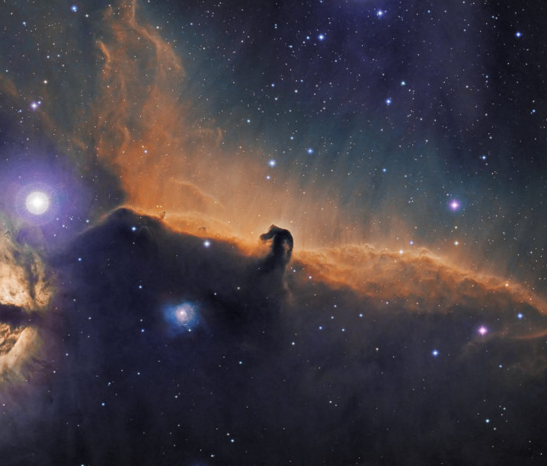
https://www.globaljetwatch.net/
Atik 490EX
Used by Global Jet watch to identify black hole candidates. A high end amateur grade camera used for making nice images.
CCD has a Small Peltier device suitable for making nice pictures can cool to -6C…..ish.
No good for do science. Requirement to achieve a CCD temperature of -20c.

Slide 3
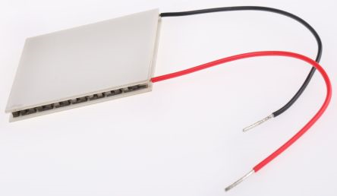
Peltier Modules
They are a HEAT PUMPS. Move heat form one place to another.
There is a cold side
and a Hot side. When current is
Applied heat is moved from
One side to the other. One side cools and the other gets hot.

Slide 4
How to use a Peltier device.
As the temperature between the hot side and the cold side diverges, the cooling efficiency drops. It is therefore in our interests to stop the hot side from getting too hot. We need to attach some mechanism to remove the heat from the hot side.
We must be mindful of where we intend to deploy this system and understand how the environment will affect the equipment we use to remove the heat. Given the location of these telescopes it is entirely feasible that condensation will occur at what we perceive as being reasonably warm temperatures.
Our heat removal mechanism needs to be either passive or forced radiation, a heatsink with a fan.

Slide 5
Heatsink Maths.
We would ideally like the CCD to run at -20 C, we will also assign an ambient temperature for running conditions at 32 Celsius a difference in temperature of 50 Celsius.
Referring to the previous plot and assuming we will drive at 2 A, this gives us a cooling capacity of about 8 W.
We already have an 8 Watt load from the target and we have thermal losses from the Peltier action itself. Assume 2 A at 12 V, an additional 24 Watts, 32 W in total.
We are going to maintain a hot side temperature 32 Celsius and dissipate 32 W of heat to a 30 Celsius ambient background.
Step 1, determine the hot side running temperature for our Peltier cooler.
Step 2, determine the heat load presented by the hot side of the Peltier.
Step 3, calculate thermal resistance of required heatsink.

Slide 6
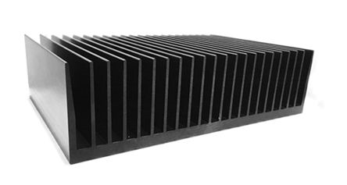
Heatsink maths
∆𝑇=𝑄 ×𝑅𝜃
Where T is temperature, Q is heat flow and R is thermal resistance.
Substituting and rearranging for thermal resistance.
$\frac{32 −30}{(8+24)}=0.0625 k/w$
0.06 k/w
0.07 k/w

Slide 7
Typical Physicist Requirements
Cost nothing
Extremely lightweight
100% reliable
Available with next day delivery
Can be installed by a post-doc
Be the thing I’ve already got in my head.
There is an additional requirement for particle physicists which is to have zero cross-sectional area.

Slide 8
Typical Physicist Requirements
Cost nothing
Extremely lightweight
100% reliable
Available with next day delivery
Can be installed by a post-doc
Be the thing I’ve already got in my head.
There is an additional requirement for particle physicists which is to have zero cross-sectional area.

Slide 9
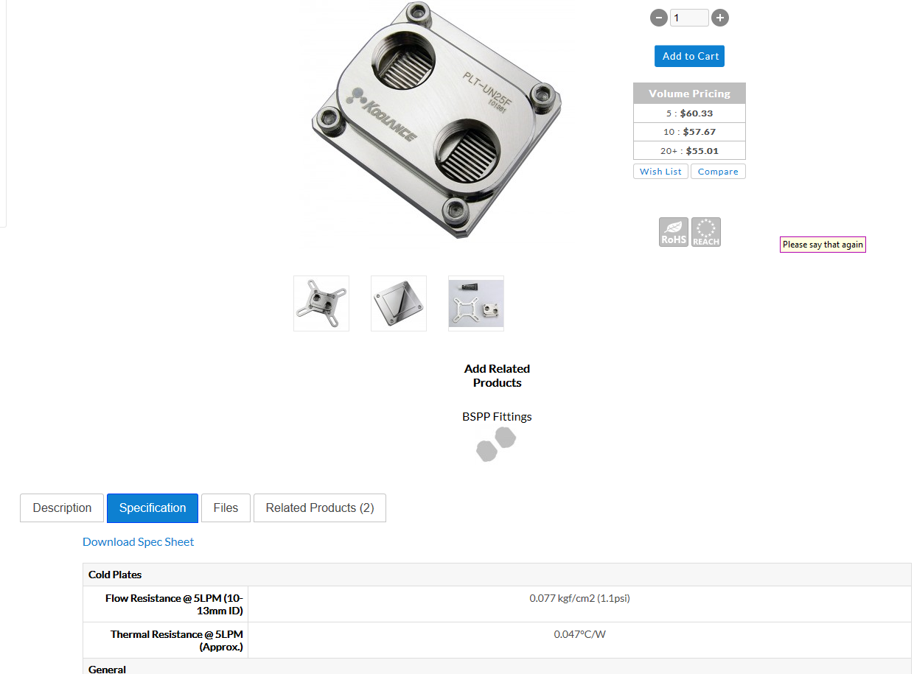
Water Cooling

Slide 10
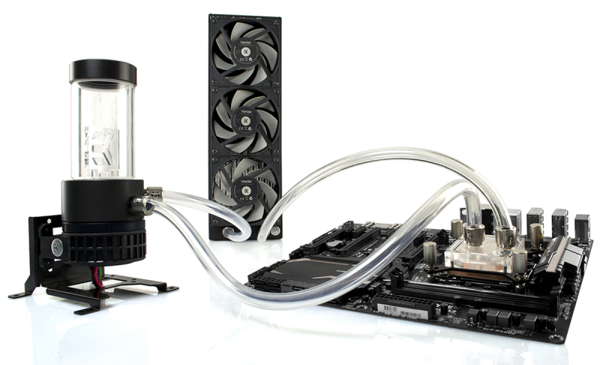
Time to Combine
Cost nothing
Extremely lightweight
Also need a source of cooled water.

Slide 11
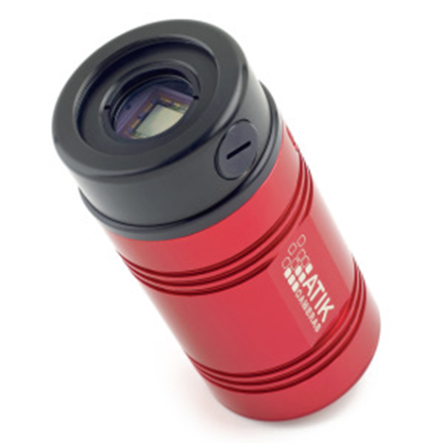

Slide 13
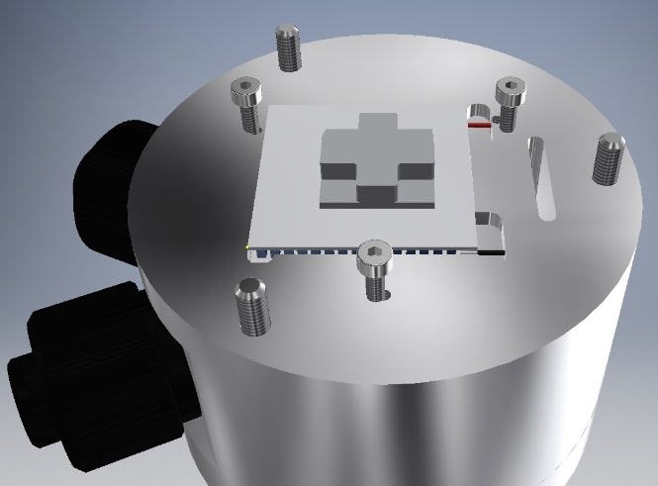

Slide 14
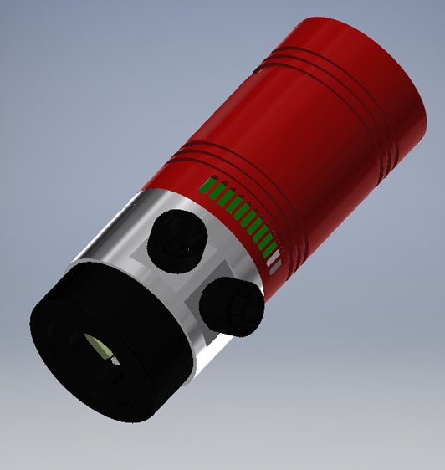

Slide 15
Lunch

